Slide 1
Construct 2 Game Development
Shahed Chowdhuri
Sr. Technical Evangelist
shchowd@microsoft.com

Slide 2
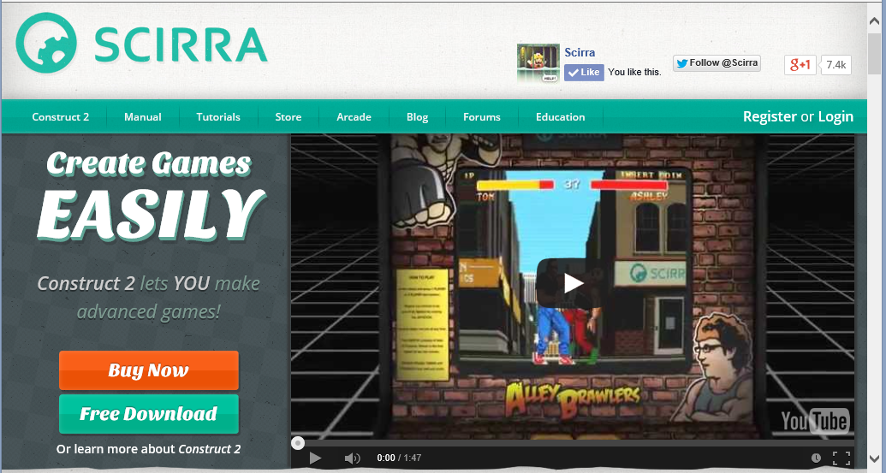
Construct 2 from Scirra
Download Now!
→ scirra.com

Slide 3
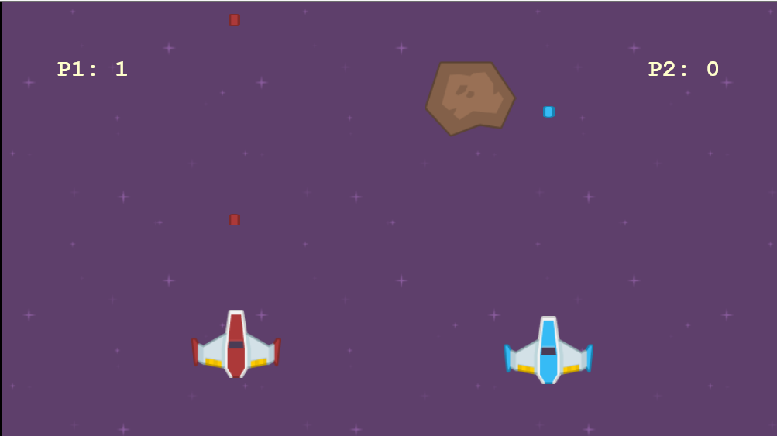
Space Shooter Tutorial

Slide 4
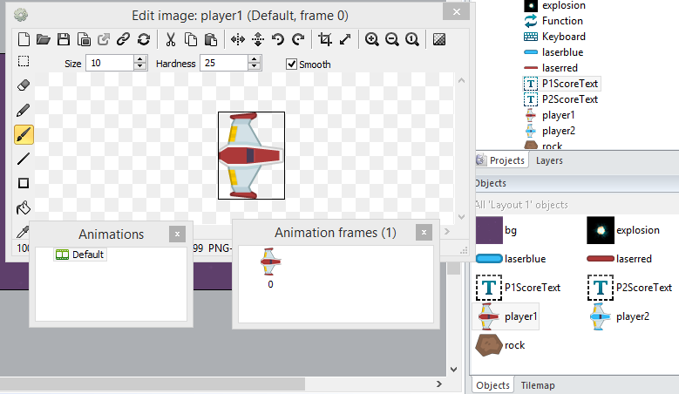
Insert New Objects
Our Objects
Background
Explosion
Lasers
Score Text
Spaceships
Rock
Keyboard
Function

Slide 5
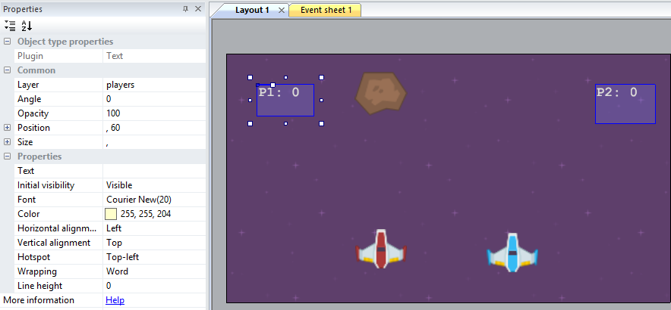
Add Text Boxes for Scores
Note:
Properties panel shows text font, color and size.

Slide 6
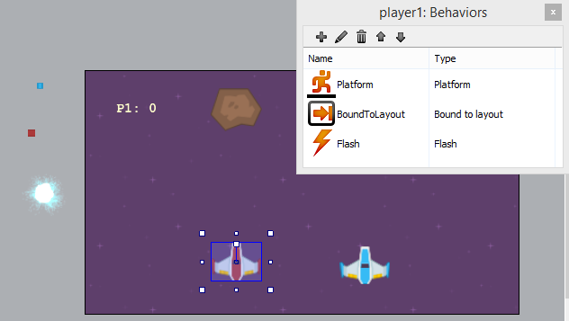
Add Behaviors
Some Behaviors:
Platform
BoundToLayout
Flash
Physics
Fade
Bullet
DestroyOutsideLayout

Slide 7
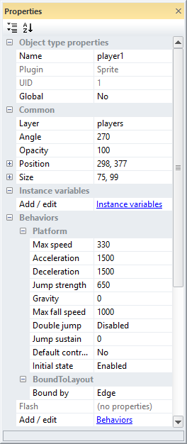
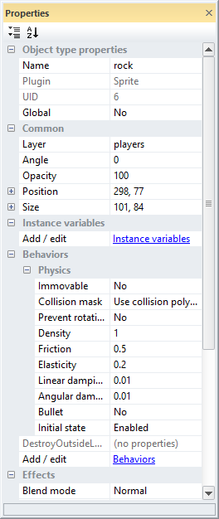
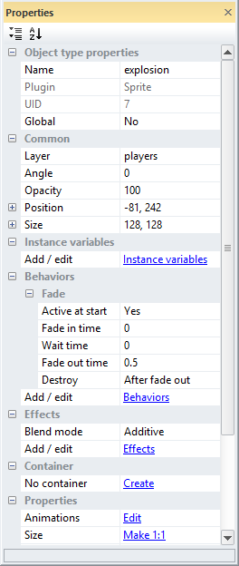
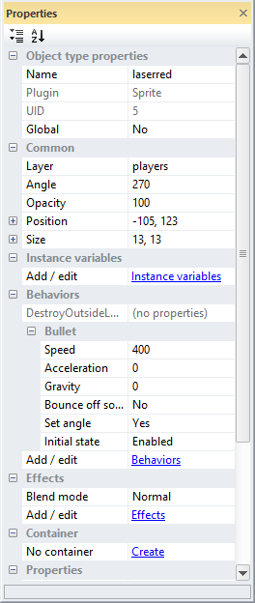
Properties & Behaviors
Players (1,2)
Rock
Explosion
Lasers (blue/red)

Slide 8
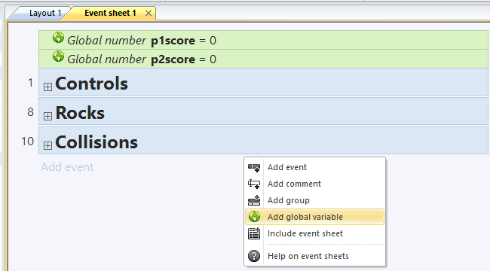
Add Global Variables
Note: In your Event Sheet, right-click blank area to
“Add global variable”

Slide 9
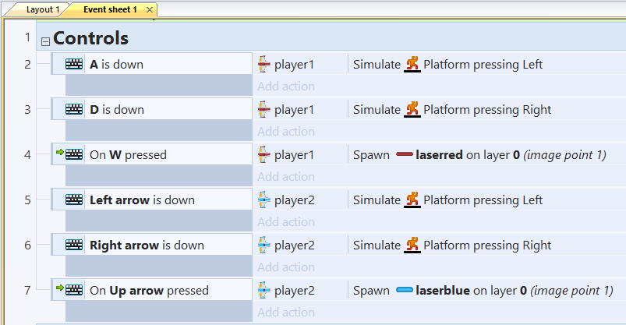
Add Controls to Event Sheet
Notes:
Player 1 uses W-A-D keys
Player 2 uses arrow keys

Slide 10
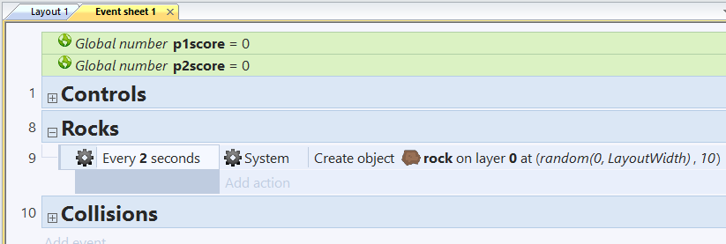
Create Rock Objects

Slide 11
Add Function to Destroy Rock
Note: First, add Function object.

Slide 12
Handle Rock Collisions with Players
Note: Flash player upon collision.

Slide 13
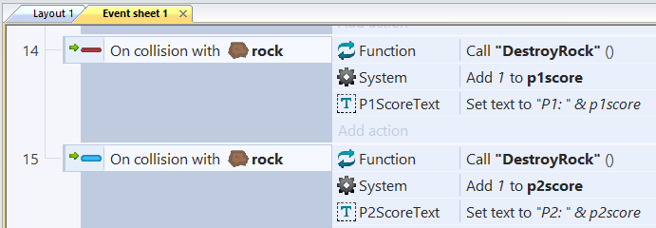
Handle Laser Collisions with Rocks
Note: Call DestroyRock() function, then update score.

Slide 14
Play Your Game!
Notes:
Player 1 uses W-A-D keys
Player 2 uses arrow keys

Slide 15
Resources & Communities
Construct 2 Index Page, on my website:
http://WakeUpAndCode.com/construct2
Construct 2 Indie Game Developers, on Facebook
http://facebook.com/groups/Construct2Devs
Construct 2 Brasil, on Facebook
https://www.facebook.com/groups/Construct2BR
Video Tutorials, on Microsoft Virtual Academy
http://aka.ms/mva-construct2

