Slide 1
Publish a Windows 10 Game with Construct 2
Export & Publish a Universal Windows Platform App
By Shahed Chowdhuri
Sr. Technical Evangelist
WakeUpAndCode.com
@shahedC
Notes:
Title Page: ASP .NET 5 (aka vNext) The Future of Web Apps
By Shahed Chowdhuri
Senior Technical Evangelist @ Microsoft
Blog: WakeUpAndCode.com
Twitter: @shahedC

Slide 2
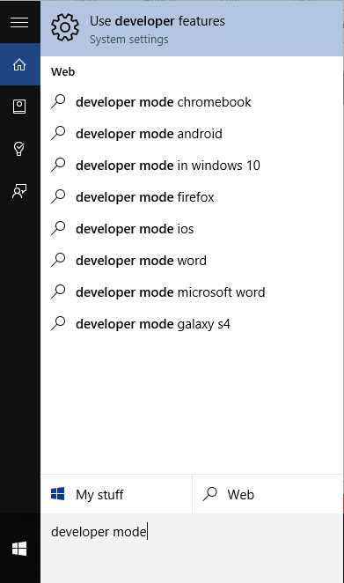
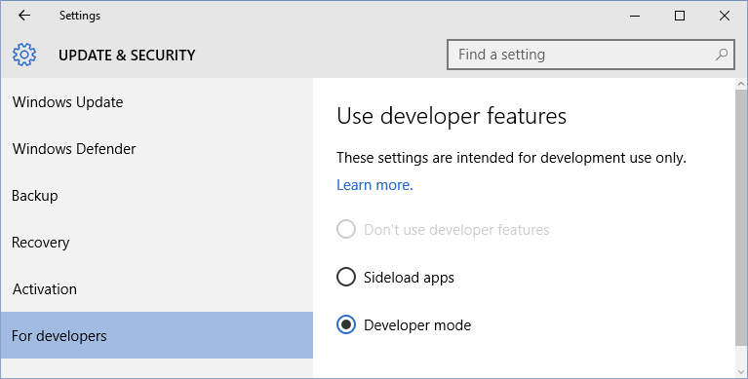
1. Enable Developer Mode
Search for “developer mode” or “developer features”
Enable “Developer mode” option

Slide 3
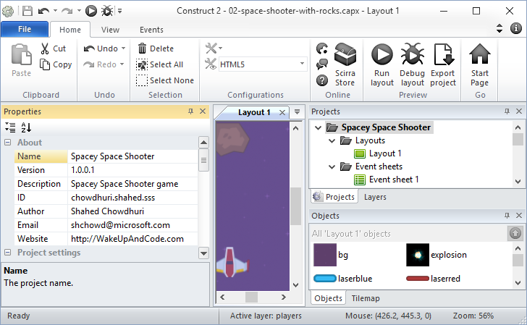
2. Enter Game Details

Slide 4
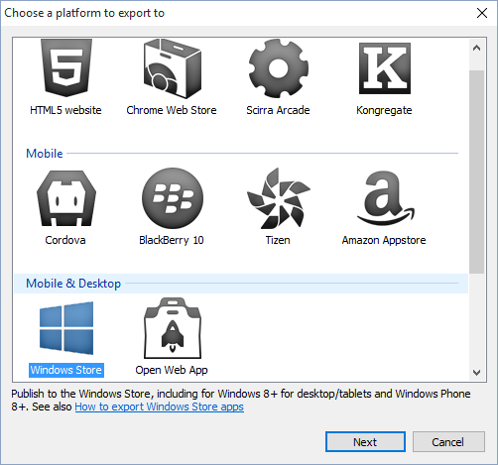
3. Export to Windows 10 Universal
Click “Export Project”
Select “Windows Store”

Slide 5
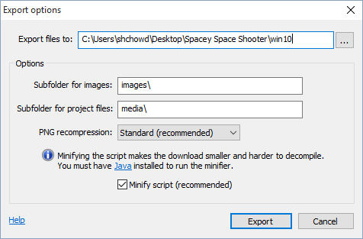
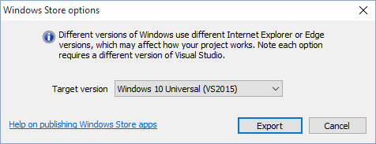
3. Export (continued)
Enter (or browse to) a location…
Click Export
Select Windows 10 Universal as Target…
Click Export

Slide 6
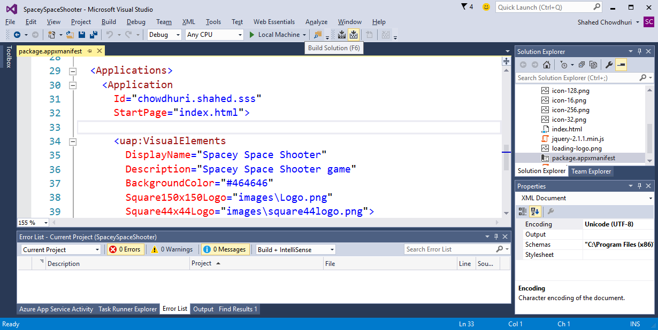
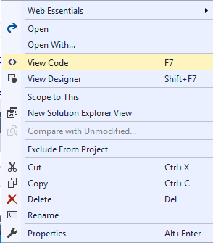
4. Fix manifest file, if necessary
Right-click to
View Code (F7)

Slide 7
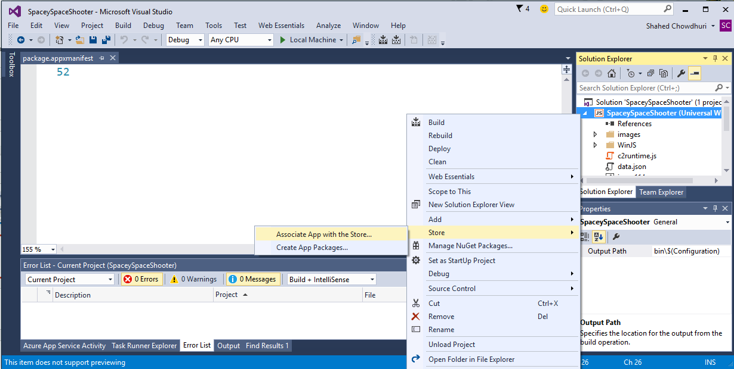
5. Associate with Store App
Right-click project in Solution Explorer
then click
Store → Associate App with the Store
in popup menu

Slide 8
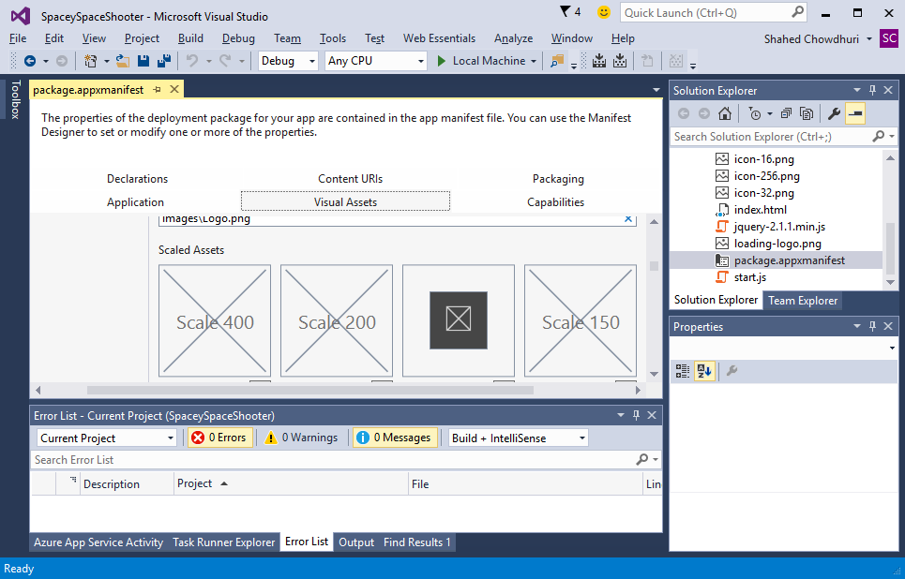
6. Add Required Images
Identify placeholder
images to replace

Slide 9
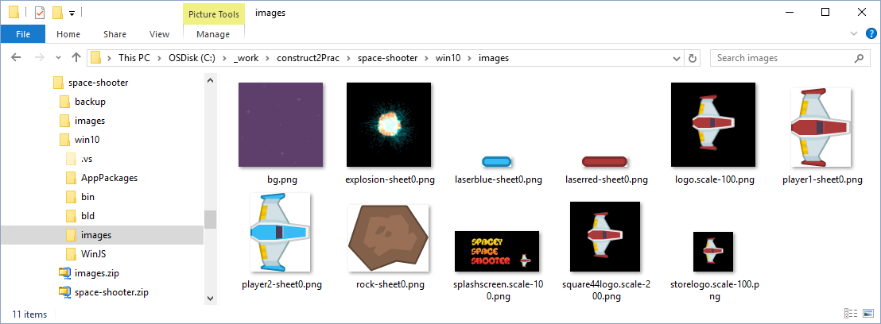
6. Add Required Images (continued)

Slide 10
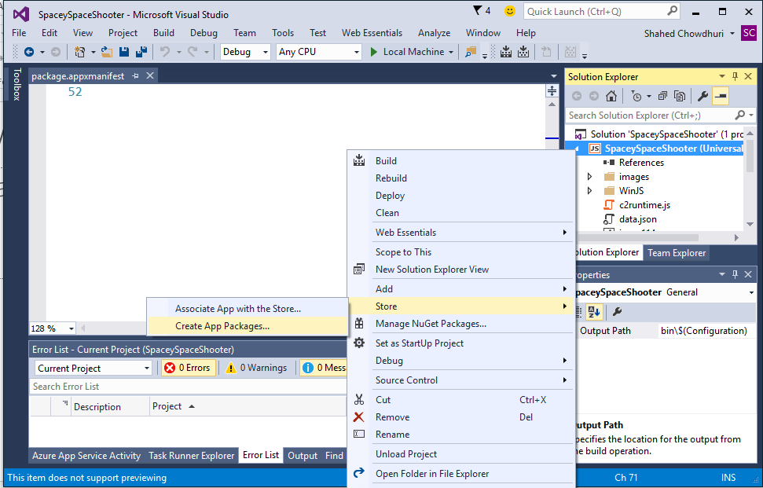
7. Run WACK!
Right-click project in Solution Explorer
then click
Store → Create App
Packages…
in popup menu

Slide 11
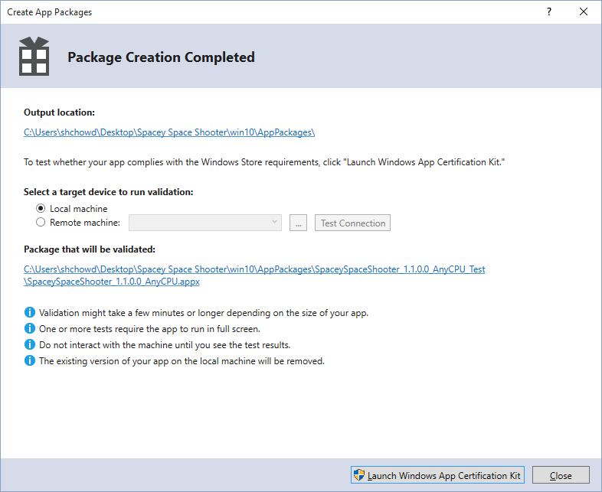
7. Run WACK (continued)
Step through dialogs,
then launch WACK
If FAILED, fix issues and repeat.
If PASSED, proceed to next step.

Slide 12
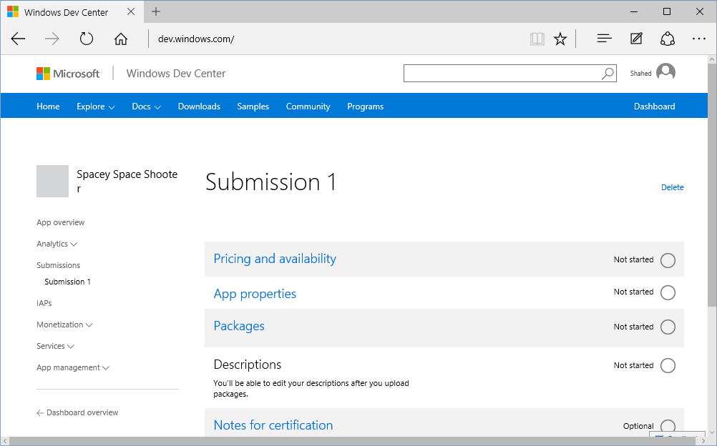
8. Publish to Windows Store
Go to
Dashboard
dev.windows.com

Slide 13
Summary
Enable developer mode in Windows 10
Enter game details in Construct 2
Export to Windows 10 Universal format
Fix manifest file in Visual Studio, if necessary
Associate your app with Store App
Add required images, e.g. logo, icon, splash
Run WACK (Windows App Certification Kit)
Publish to Windows Store!

