Slide 1


Entity Framework Code First Migrations
Don’t drown in database design during development
By Shahed Chowdhuri
WakeUpAndCode.com
@shahedC
Notes:
Entity Framework Code First Migrations (title page)
Don’t drown in database design during development

Slide 2









Thanks to our Sponsors
Notes:
Sponsors

Slide 3
Tech Check
Are you familiar with…?
EF
Code-First Migrations
Entity
Framework
EF
Code-First Development
ASP
.NET
MVC
Notes:
Are you familiar with:
ASP.NET MVC?
Entity Framework?
Code First development?
Code First Migrations?
(slow-reveal diagram + ask the audience)

Slide 4

Introduction
Enterprise
Web
Application
ASP.NET
MVC
web app
DB
Notes:
Introduction
We are building an enterprise web application with ASP.NET MVC, with a SQL Server back end?
But how exactly will we do it?

Slide 5
Options and Alternatives
A. Database-First
(EDMX)
B. Model-First
(Visual Designer)
C. Code-First (automatic migrations)
D. Code-First (manual migrations)
Notes:
Options and Alternatives
Database-First (EDMX)
Model-First (visual designer)
Code-First with automatic migrations
Code-First with manual migrations

Slide 6
A. Database-First (EDMX)
ASP.NET
MVC
app code
DB updates
EDMX Model
DB
ADO.NET Entity Data Model (EDMX)
Code
uses EDMX
Notes:
A. Options and Alternatives
Database-First (EDMX)

Slide 7
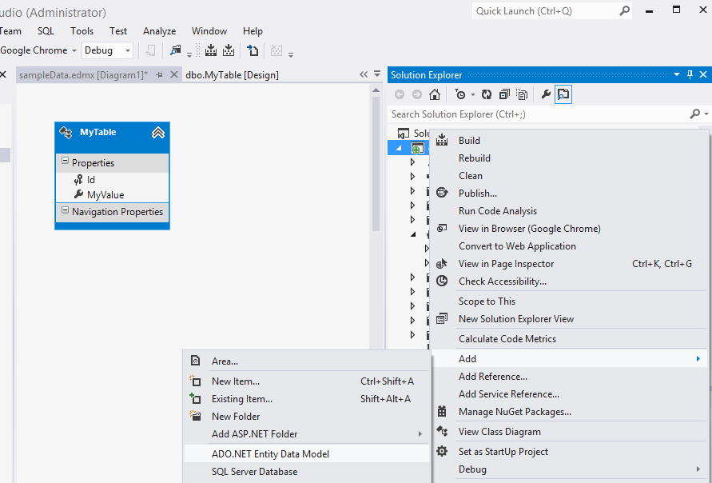

A1. Generate EDMX
Notes:
A1. Options and Alternatives: Database-First (EDMX)
Right-click project, click Add -> ADO.NET Entity Data Model, then select existing DB.

Slide 8
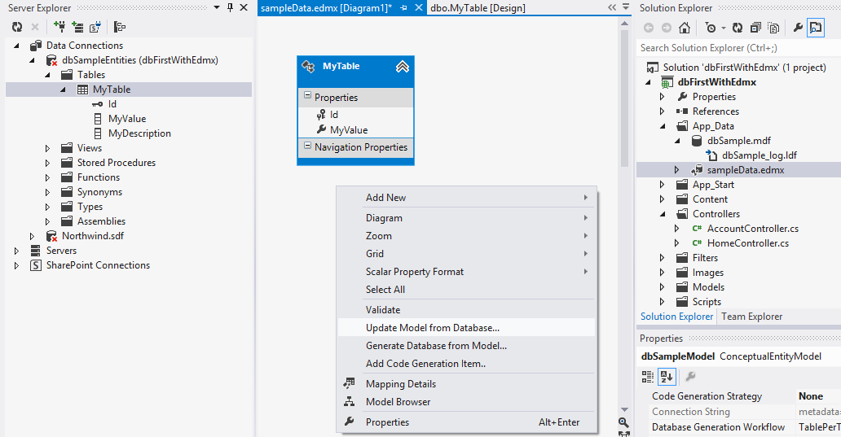
A2. Update Model From Database
Notes:
A2. Options and Alternatives: Database-First (EDMX)
Update your database table(s).
Open the EDMX designer, right-click within it, select Update Model from Database.

Slide 9
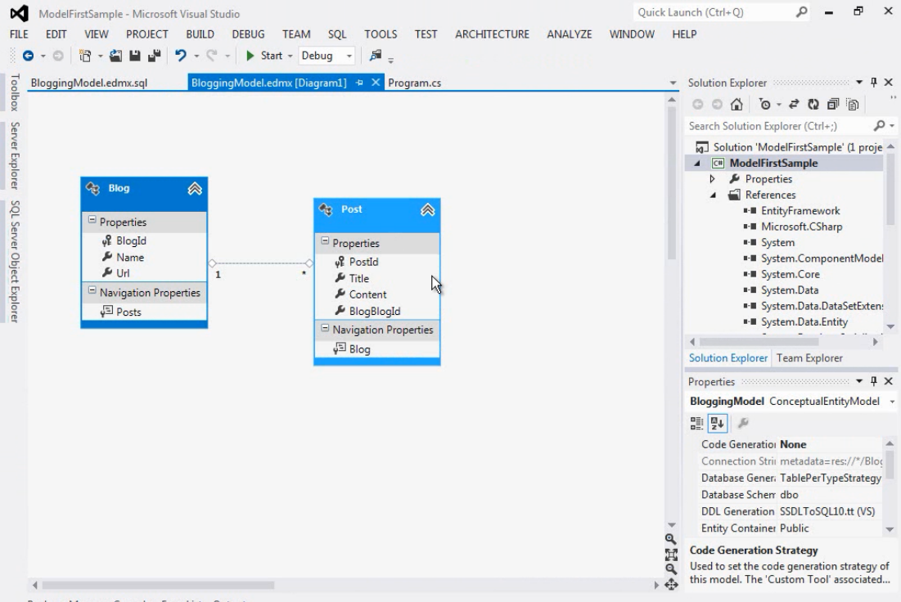
B. Model-First (Visual Designer)
Source: MSDN
Notes:
B. Options and Alternatives
Model-First (visual designer)

Slide 10
C.Code-First (automatic migrations)
ASP.NET
MVC
app code
uses
.NET models
(hand-coded)
generates
auto-
updates
Migration code
(auto-generated)
DB
Notes:
C. Options and Alternatives
Code-First with automatic migrations

Slide 11
D. Code-First (manual migrations)
ASP.NET
MVC
app code
uses
.NET models
(hand-coded)
generates
manually
updates
Migration code
(auto-generated)
DB
Notes:
D. Options and Alternatives
Code-First with manual migrations

Slide 12

What are we trying to solve?
Notes:
Avoid tug-of-war between :
Developers on your team
Developers on other teams
Database Architects
Database Administrators

Slide 13
Conflicts Within Organization
DB Architects
Dev Team X
Your Dev
Team
Dev Team Y
DB Admins
Notes:
Avoid tug-of-war between :
Developers on your team
Developers on other teams
Database Architects
Database Administrators

Slide 14
Main Agenda
1. Models & Mapping
2. Connection Strings
3. Enable Migrations
4. Update Database
5. Push Code + Migrate Server DB
6. Process Workflow
Notes:
Agenda
Add models and mapping in code
Connection String
Enable Migrations
Update Database
Push code + Migrate server DB
Process Workflow

Slide 15
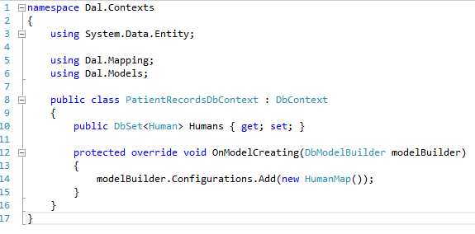
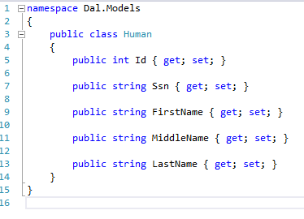
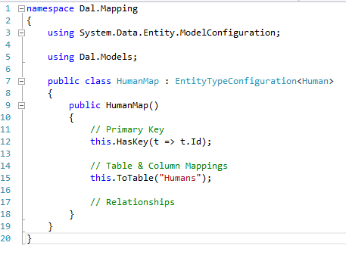
1. Models & Mapping
Notes:
1. Models & Mapping

Slide 16

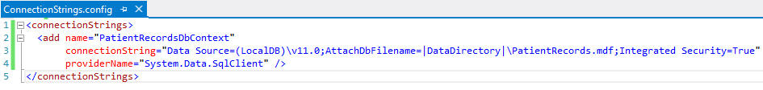
2. Connection Strings
For more info:
http://wakeupandcode.com/all-your-database-are-belong-to-us/
Notes:
2. Connection Strings
Connection String
Web.config
configSource
Machine config

Slide 17

2a. Connection Strings (explained)
How can I point to my own DB?
  Each dev has own ConnectionStrings.config
How do I avoid checking in to Source Control?
  Remove file from .csproj, keep it local
How will server deployments work?
  Use XML Transforms, i.e. Web.Prod.Config
Do I have to include credentials in .config?
  No, use machine access to SQL server instead
For more info:
http://wakeupandcode.com/all-your-database-are-belong-to-us/
Notes:
2. Connection Strings (explained)
How can I point to my own DB?
How do I avoid checking in to Source Control?
How will server deployments work?
Do I have to include credentials in .config?

Slide 18

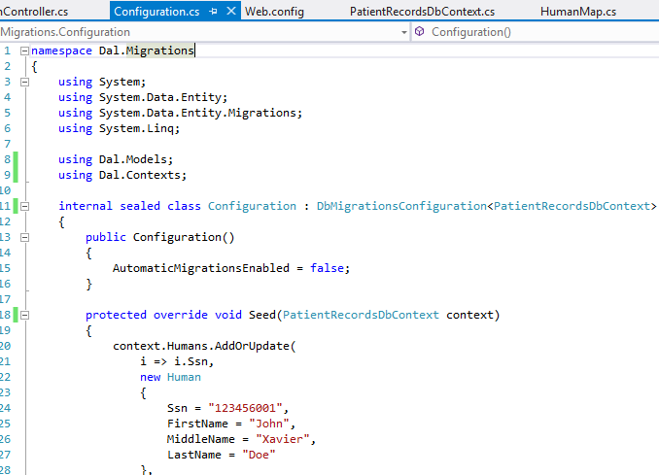
3. Enable Migrations
Notes:
3. Enable Migrations
Enable Migrations
Configuration.cs
Add Seed data

Slide 19
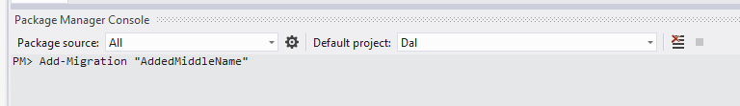

4. Update Database
model code
migration
code
migration code
+ seed
(sql)
dev
DB
Notes:
4. Update Database
Update Database
Run Seed Data
Verify SQL
Verify DB

Slide 20


5. Push Code + Migrate Server DB
code
push code
code
pull code
CI
Server
DB
migrate.exe
Notes:
5. Push Code + Migrate Server DB
Push code to source control
Other developers pull and Update Database
Migrate server DB via migrate.exe
Use TeamCity to automate this

Slide 21

6. Process Workflow
communication
DB
dev teams
DB architects
Notes:
6. Process Workflow
Process Workflow
Handle existing database
Comply with enterprise requirements

Slide 22
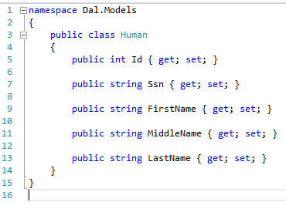
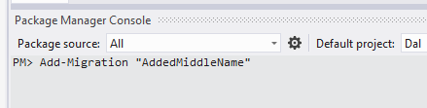
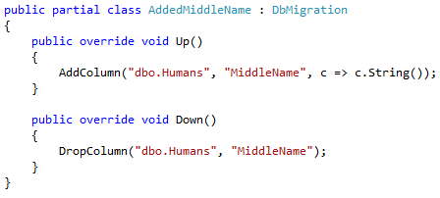
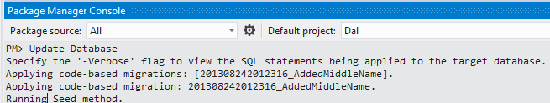
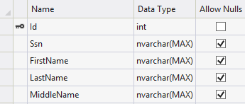
Code Walkthrough
Notes:
Code Walkthrough
(First, Enable-Migrations)
Update Model with new field
Add-Migration
Update-Database
Verify in DB

Slide 23


Making Migrations Work
1. Discuss upcoming changes with teams.
2. Inspect/Update migration code
3. Update your DB before check-in.
(use -script flag to inspect SQL first)
4. Run migrate.exe after deployments.
(see \packages\EntityFramework.5.0.0\tools\)
DB
Notes:
Making Migrations Work
1. Discuss upcoming changes with teams.
2. Inspect/Update migration code
3. Update your DB before check-in.
(use -script flag to inspect SQL first)
4. Run migrate.exe after deployments.
(see \packages\EntityFramework.5.0.0\tools\)

Slide 24



Upgrade or Downgrade
Rollback to a specific migration
Rollback all migrations (version 0)
Rollback all migrations ($InitialDatabase)
Notes:
Upgrade or downgrade
* Rollback to a specific migration
* Rollback all migrations (version 0)
* Rollback all migrations ($InitialDatabase)

Slide 25

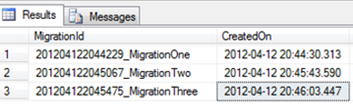
Migration History
Stored in table __MigrationHistory
Metadata for your EF Migrations
1 new record for every migration
Automatically generated
Used for upgrades & downgrades
Notes:
Upgrade or downgrade
* Rollback to a specific migration
* Rollback all migrations (version 0)
* Rollback all migrations ($InitialDatabase)

Slide 26

Common Issues
Pushing model changes without adding a migration.
  Others will see a Pending Migration!
Using an existing database
  Use empty Migration if Model added after Table
Customizing constraint names
  Manually edit your Migration code
DB
Notes:
Common Issues
1. Pushing model changes without adding a migration.
- Others will see a Pending Migration!
2. Using an existing database
- Use an Empty Migration!
3. Customizing constraint names
- Manually edit your Migration code

Slide 27
Additional Topics
Relationships
Attributes
Notes:
Additional Topics
Relationships
Attributes (Data-Annotation Attributes)

Slide 28
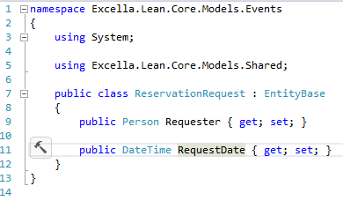

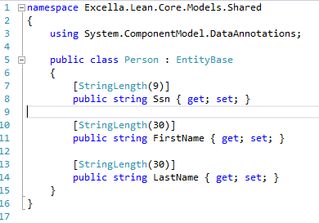

Relationships
DBContext
.OnModelCreating()
Source: Excella Lean presentation
https://github.com/excellaco/ExcellaLean
Notes:
Relationships
Related objects
Customizing constraint names

Slide 29
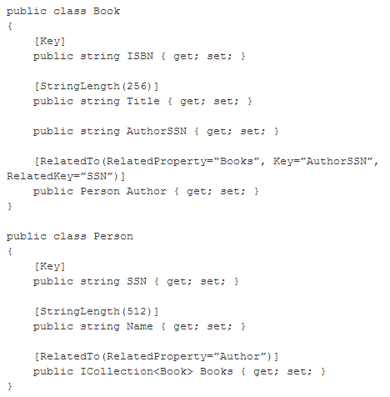
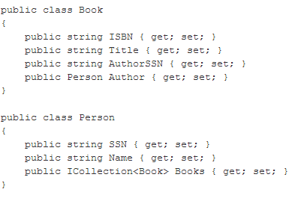
Data-Annotation Attributes
Source: MSDN
Notes:
Data-Annotation Attributes
Source: http://blogs.msdn.com/b/efdesign/archive/2010/03/30/data-annotations-in-the-entity-framework-and-code-first.aspx

Slide 30
Conclusion
Code-First Migrations
Dev Team Synchronized
Server Deployment
Database Versioning
Continuous Development
Notes:
Code First Migrations allows:
Continuous development
Synchronization among team members
Database versioning
Server deployment
(diagram with star pattern)

Slide 31
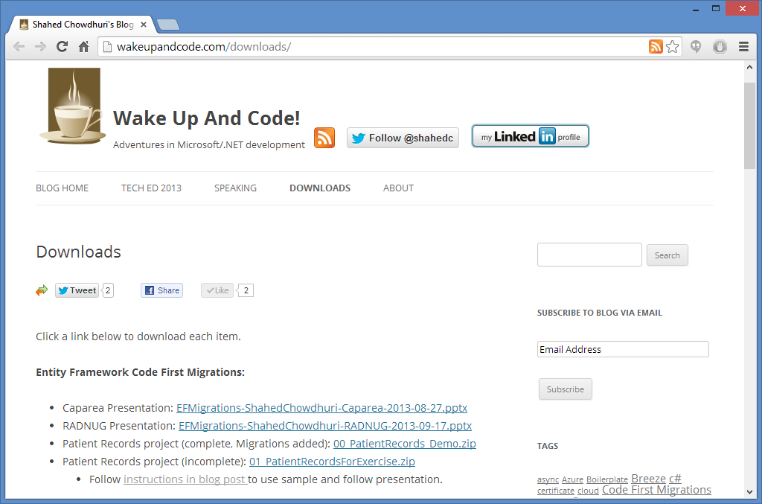
Downloads
http://wakeupandcode.com/downloads/
Notes:
Downloads
http://wakeupandcode.com/downloads/

Slide 32

Troubleshooting the Sample
Trouble with Package Manager commands?
Try the following:
  Delete your Packages folder first
  Open .sln in VS2012
  Restore NuGet Packages when prompted
  Clean Solution
  Uninstall EF via NuGet
  Reinstall EF via NuGet
  Rebuild your solution
Notes:
Troubleshooting the Sample
Clean Solution
Remove/Restore Packages
Uninstall/Reinstall EF via NuGet

Slide 33

Online Resources
EF Code First Migrations on MSDN:
  http://msdn.microsoft.com/en-US/data/jj591621
Web.config & configSource:
  http://wakeupandcode.com/all-your-database-are-belong-to-us/
PluralSight EF Migrations video tutorial:
  http://pluralsight.com/training/Courses/TableOfContents/efmigrations
My blog post on EF Code First Migrations:
  http://wakeupandcode.com/entity-framework-code-first-migrations/
Code First Data Annotations (Julie Lerman)
  http://msdn.microsoft.com/en-us/data/jj591583.aspx
Data Annotations in the Entity Framework (MSDN)
  http://blogs.msdn.com/b/efdesign/archive/2010/03/30/data-annotations-in-the-entity-framework-and-code-first.aspx
Troubleshooting
  http://stackoverflow.com/questions/10999561/exception-raised-when-im-trying-enable-migrations-in-ef-4-3-1
Notes:
Online Resources

Slide 34
Questions?
http://WakeUpAndCode.com
@shahedC
Notes:
Questions?

