Slide 1
Intro to Entity Framework
Don’t drown in database design during development
By Shahed Chowdhuri
WakeUpAndCode.com
@shahedC
Notes:
Entity Framework Code First Migrations (title page)
Don’t drown in database design during development

Slide 2
Welcome, GWU GCC Students!
Notes:
Sponsors

Slide 3
Tech Check
Are you familiar with…?
Entity
Framework
(ORM from Microsoft)
Object Relational Mapping (ORM)
Web Application Development
e.g. ASP.NET MVC
Notes:
Are you familiar with:
ASP.NET MVC?
Entity Framework?
Code First development?
Code First Migrations?
(slow-reveal diagram + ask the audience)

Slide 4
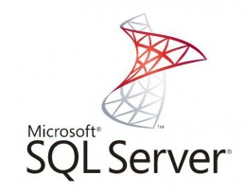
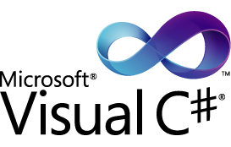
You Should Know…
Object-Oriented Programming (e.g. C#)
Visual IDE (e.g. Visual Studio)
Software Frameworks (e.g. Microsoft .NET)
Relational Databases (e.g. SQL Server)
Notes:
Things to Know
Object-Oriented Programming (e.g. C#)
Visual IDE (e.g. Visual Studio)
Software Frameworks (e.g. Microsoft .NET)
Relational Databases (e.g. SQL Server)

Slide 5
Object-Relational Mapping
Web App
ORM
DB
Notes:
Object-Relational Mapping
Web App – ORM -- DB

Slide 6
Top Choices
NHibernate
Mature, popular
Entity Framework
Now mature, integrated
Good Comparison: http://www.dennisdoomen.net/2013/03/entity-framework-56-vs-nhibernate-3.html
Notes:
Object-Relational Mapping
Web App – ORM -- DB

Slide 7
Working with EF
A. Database-First
(EDMX)
B. Model-First
(Visual Designer)
C. Code-First (automatic migrations)
D. Code-First (manual migrations)
Notes:
Working with EF
Database-First (EDMX)
Model-First (visual designer)
Code-First with automatic migrations
Code-First with manual migrations

Slide 8
A. Database-First (EDMX)
ASP.NET
MVC
app code
DB updates
EDMX Model
DB
ADO.NET Entity Data Model (EDMX)
Code
uses EDMX
Notes:
A. Options and Alternatives
Database-First (EDMX)

Slide 9
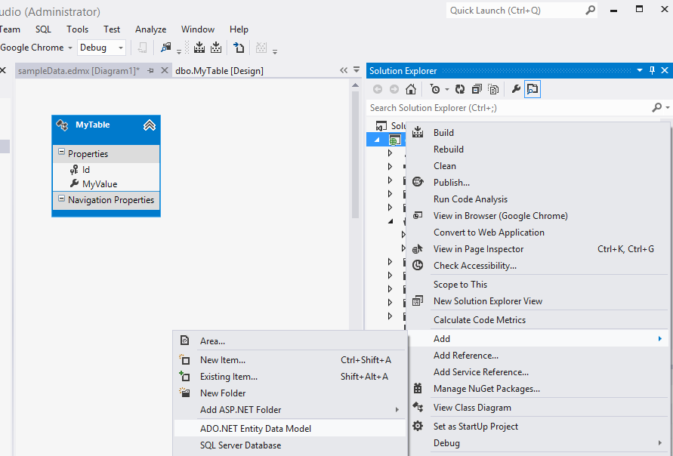
A1. Generate EDMX
Notes:
A1. Options and Alternatives: Database-First (EDMX)
Right-click project, click Add -> ADO.NET Entity Data Model, then select existing DB.

Slide 10
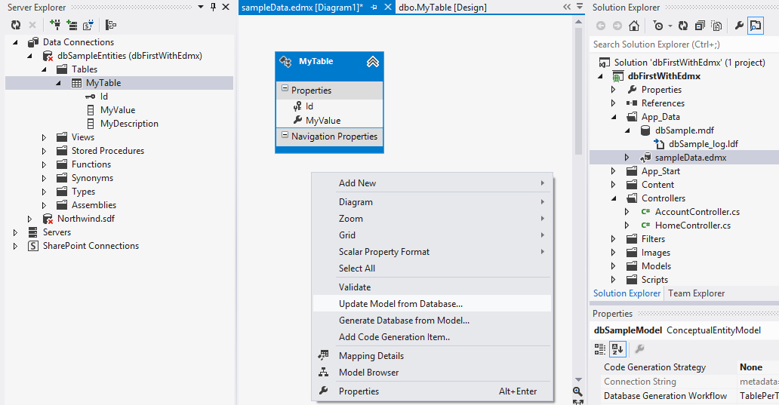
A2. Update Model From Database
Notes:
A2. Options and Alternatives: Database-First (EDMX)
Update your database table(s).
Open the EDMX designer, right-click within it, select Update Model from Database.

Slide 11
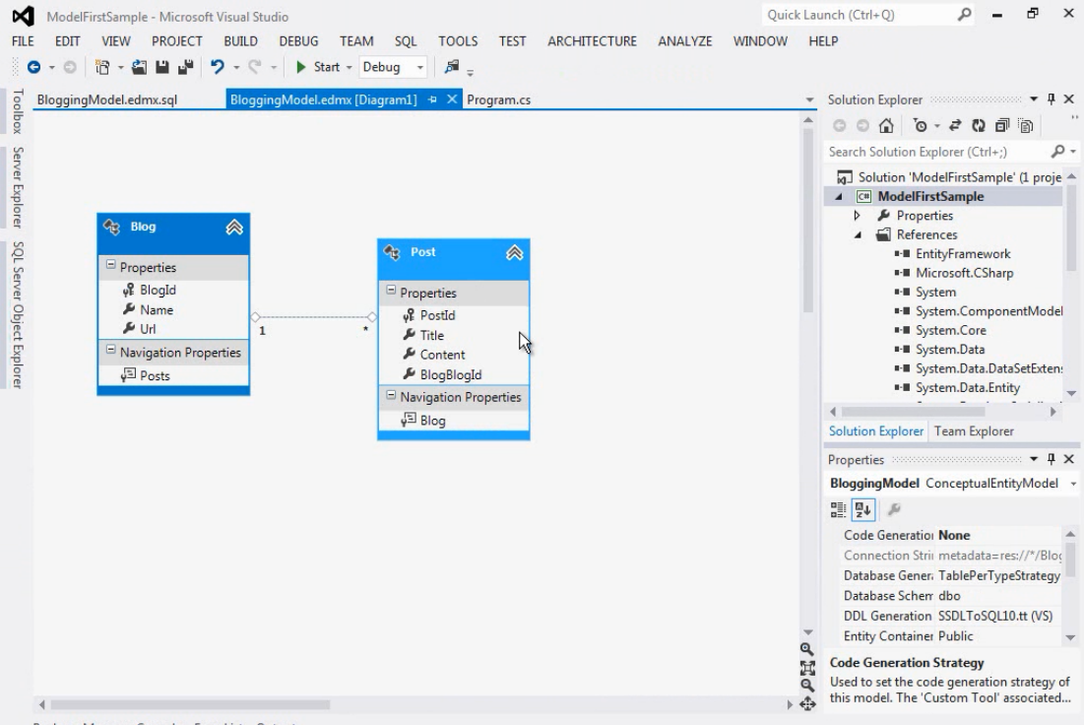
B. Model-First (Visual Designer)
Source: MSDN
Notes:
B. Options and Alternatives
Model-First (visual designer)

Slide 12
C.Code-First (automatic migrations)
ASP.NET
MVC
app code
uses
.NET models
(hand-coded)
generates
auto-
updates
Migration code
(auto-generated)
DB
Notes:
C. Options and Alternatives
Code-First with automatic migrations

Slide 13
D. Code-First (manual migrations)
ASP.NET
MVC
app code
uses
.NET models
(hand-coded)
generates
manually
updates
Migration code
(auto-generated)
DB
Notes:
D. Options and Alternatives
Code-First with manual migrations

Slide 14
What are we trying to solve?
Notes:
Avoid tug-of-war between :
Developers on your team
Developers on other teams
Database Architects
Database Administrators

Slide 15
Conflicts Within Organization
DB Architects
Dev Team X
Your Dev
Team
Dev Team Y
DB Admins
Notes:
Avoid tug-of-war between :
Developers on your team
Developers on other teams
Database Architects
Database Administrators

Slide 16
Main Agenda
1. NuGet
2. Entity Framework
3. Models & Mapping
4. Connection Strings
5. EF Migrations
6. Process Workflow
Notes:
Agenda
Add models and mapping in code
Connection String
Enable Migrations
Update Database
Push code + Migrate server DB
Process Workflow

Slide 17
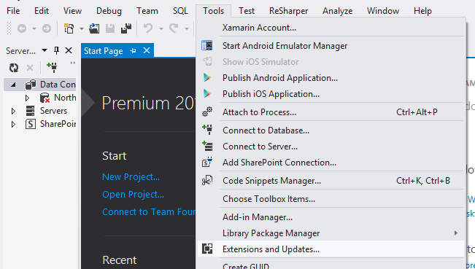
1. NuGet Package Manager
Notes:
NuGet Package Manager
In Visual Studio, click Tools -> Extension and Updates…
Search for “nuget“ to download or update NuGet Package Manager

Slide 18
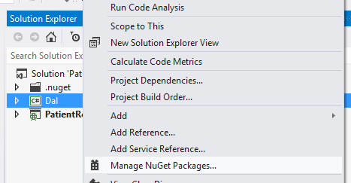
2. Entity Framework
Notes:
3. Entity Framework
In Visual Studio, right-click a project (e.g. Dal project)
Click “Manage NuGet Packages…”
Search for “entityframework”
Add EF to your project (or remove it, if already installed)

Slide 19
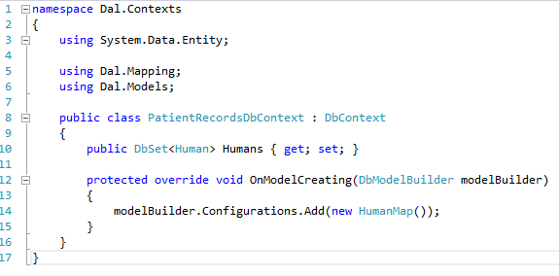
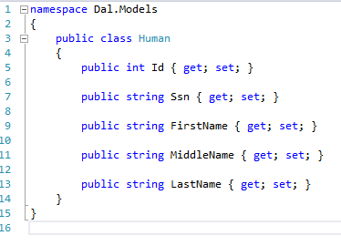
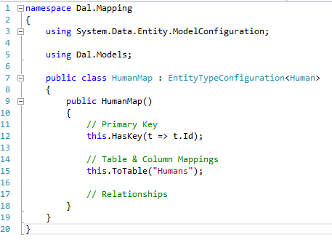
3. Models & Mapping
Notes:
3. Models & Mapping
Create a custom DbContext, with a DBSet for each entity
Create a model class for each entity
Create a mapping file for each entity

Slide 20
4a. Connection Strings
For more info:
http://wakeupandcode.com/all-your-database-are-belong-to-us/
Notes:
4a.. Connection Strings
Connection String
Web.config
configSource
For more info: http://wakeupandcode.com/all-your-database-are-belong-to-us/

Slide 21
4b. Connection Strings (explained)
How can I point to my own DB?
Each dev has own ConnectionStrings.config
How do I avoid checking in to Source Control?
Remove file from .csproj, keep it local
How will server deployments work?
Use XML Transforms, i.e. Web.Prod.Config
Do I have to include credentials in .config?
No, use machine access to SQL server instead
For more info:
http://wakeupandcode.com/all-your-database-are-belong-to-us/
Notes:
4b. Connection Strings (explained)
How can I point to my own DB?
How do I avoid checking in to Source Control?
How will server deployments work?
Do I have to include credentials in .config?

Slide 22
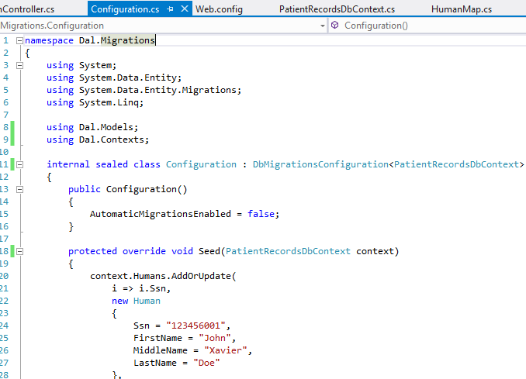
5a. Enable Migrations
Notes:
5a Enable Migrations
Enable Migrations
Configuration.cs
Add Seed data

Slide 23
5b. Update Database
model code
migration
code
migration code
+ seed
(sql)
dev
DB
Notes:
5b. Update Database
Update Database
Run Seed Data
Verify SQL
Verify DB

Slide 24
5c. Push Code + Migrate Server DB
code
push code
code
pull code
CI
Server
DB
migrate.exe
Notes:
5c. Push Code + Migrate Server DB
Push code to source control
Other developers pull and Update Database
Migrate server DB via migrate.exe
Use TeamCity to automate this

Slide 25
6. Process Workflow
communication
DB
dev teams
DB architects
Notes:
6. Process Workflow
Process Workflow
Handle existing database
Comply with enterprise requirements

Slide 26
Additional Topics
Relationships
Attributes
Notes:
Additional Topics
Relationships
Attributes (Data-Annotation Attributes)

Slide 27
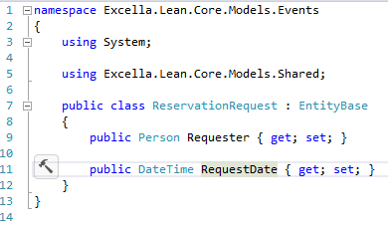
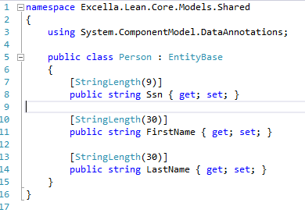
Relationships
DBContext
.OnModelCreating()
Source: Excella Lean presentation
https://github.com/excellaco/ExcellaLean
Notes:
Relationships
Related objects
Customizing constraint names

Slide 28
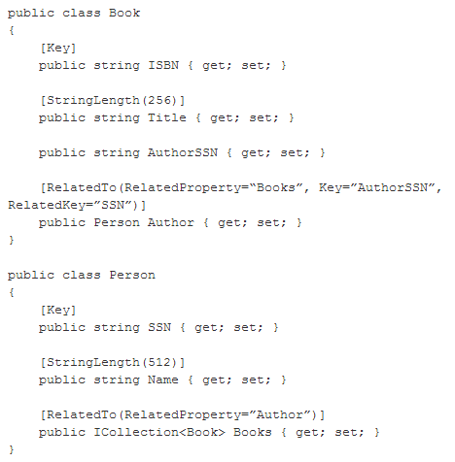
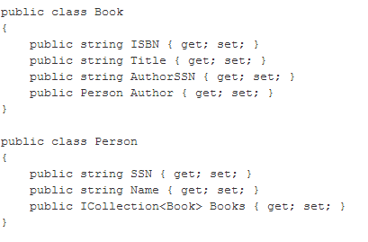
Data-Annotation Attributes
Source: MSDN
Notes:
Data-Annotation Attributes
Source: http://blogs.msdn.com/b/efdesign/archive/2010/03/30/data-annotations-in-the-entity-framework-and-code-first.aspx

Slide 29
Conclusion
Entity Framework & Code-First Migrations
Dev Team Synchronized
Server Deployment
Database Versioning
Continuous Development
Notes:
Code First Migrations allows:
Continuous development
Synchronization among team members
Database versioning
Server deployment
(diagram with star pattern)

Slide 30
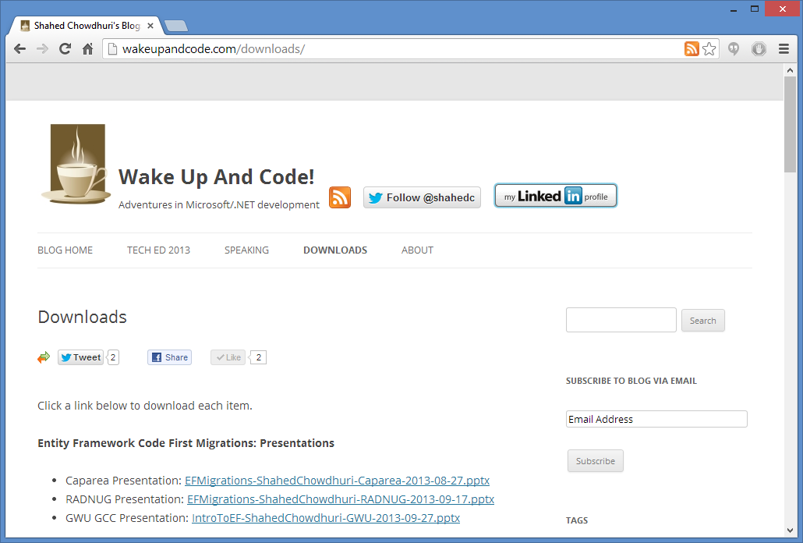
Downloads
http://wakeupandcode.com/downloads/
Notes:
Downloads
http://wakeupandcode.com/downloads/

Slide 31
Online Resources
Entity Framework on MSDN
http://msdn.microsoft.com/en-us/data/ef.aspx
EF Code First Migrations on MSDN:
http://msdn.microsoft.com/en-US/data/jj591621
Web.config & configSource:
http://wakeupandcode.com/all-your-database-are-belong-to-us/
Nhibernate vs Entity Framwork:
http://www.dennisdoomen.net/2013/03/entity-framework-56-vs-nhibernate-3.html
My blog post on EF Code First Migrations:
http://wakeupandcode.com/entity-framework-code-first-migrations/
Code First Data Annotations (Julie Lerman)
http://msdn.microsoft.com/en-us/data/jj591583.aspx
Data Annotations in the Entity Framework (MSDN)
http://blogs.msdn.com/b/efdesign/archive/2010/03/30/data-annotations-in-the-entity-framework-and-code-first.aspx
Notes:
Online Resources

Slide 32
Questions?
http://WakeUpAndCode.com
@shahedC
Notes:
Questions?

