Slide 1
Publish a Windows 10 Game with Unity 5
Export & Publish a Universal Windows Platform App
By Shahed Chowdhuri
Sr. Technical Evangelist
WakeUpAndCode.com
@shahedC
Notes:
Title Page: Publish a Windows 10 Game with Unity 5 Export & Publish a Universal Windows Platform App
By Shahed Chowdhuri
Senior Technical Evangelist @ Microsoft
Blog: WakeUpAndCode.com
Twitter: @shahedC

Slide 2
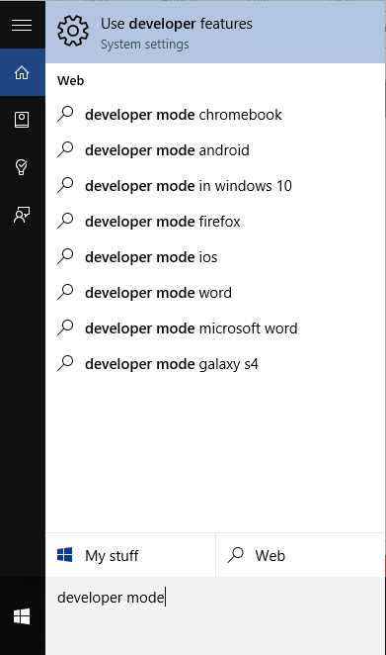
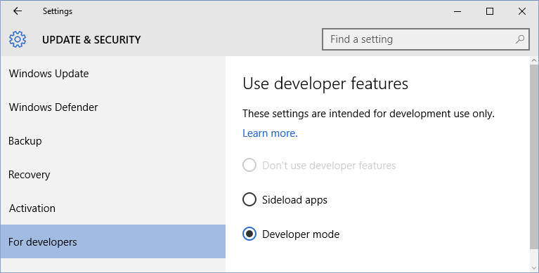
1. Enable Developer Mode
a. Search for “developer mode” or “developer features”
b. Enable “Developer mode” option

Slide 3
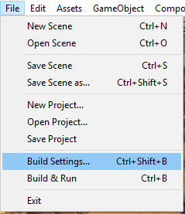
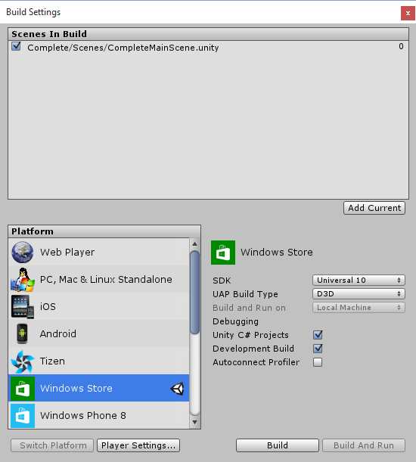
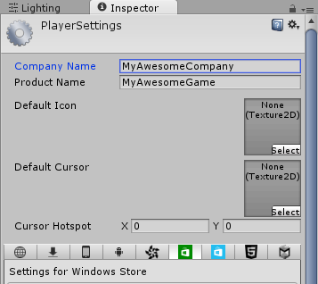
2. Enter Game Details
a. Click File, then
Build Settings…
b. Next, click
Player Settings…
c. Enter game details

Slide 4
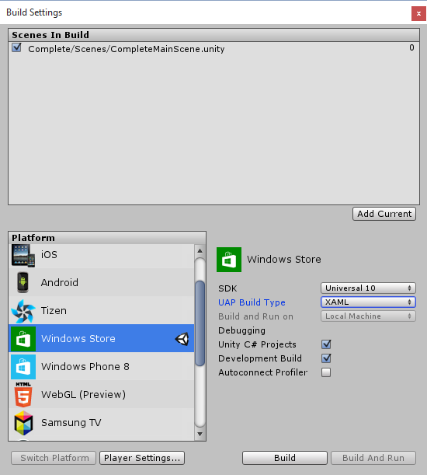
3. Export to Windows 10 Universal
c. Select:
SDK: Universal 10
UAP Build type: XAML
D3D optional
d. Optional:
Unity C# Projects
Development Build
Autoconnect Profilder
a. Click File, then
Build Settings…
b. Select
Windows Store

Slide 5
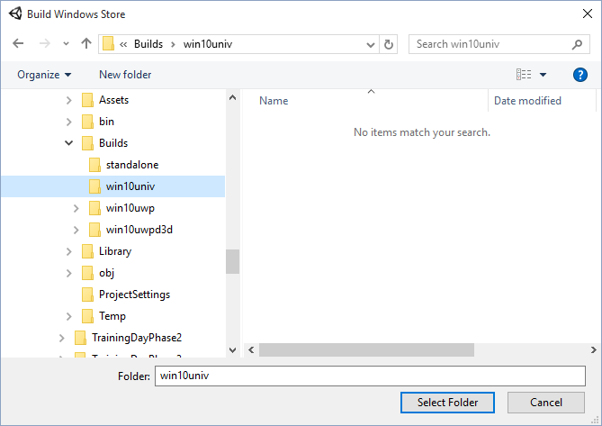
3. Export (continued)
Create new folder for build and select it

Slide 6
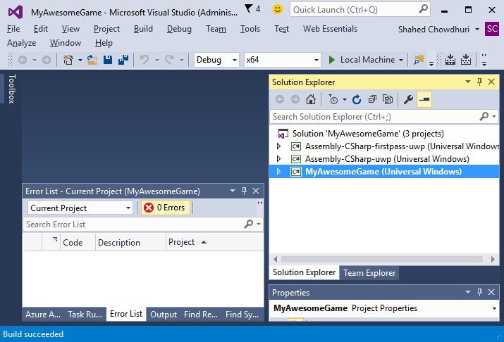
4. Build Solution in VS2015 w/ Win10 SDK
a. Change platform to x86 or x64
b. Click Build Solution (F6)
c. Allow package restore…
d. Run it!
e. Verify “Build Succeeded”

Slide 7
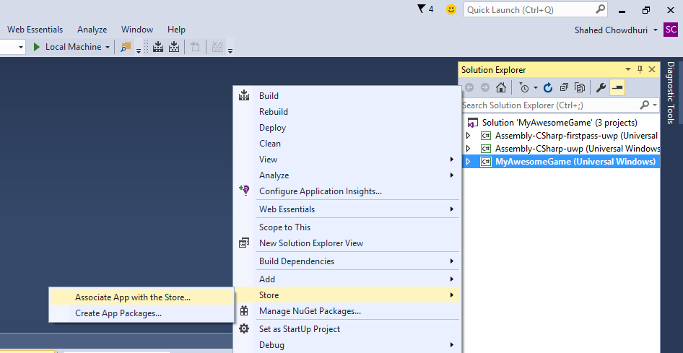
5. Associate with Store App
a. Right-click project
in Solution Explorer
b. Then click
Store → “Associate
App with the Store”
in popup menu

Slide 8
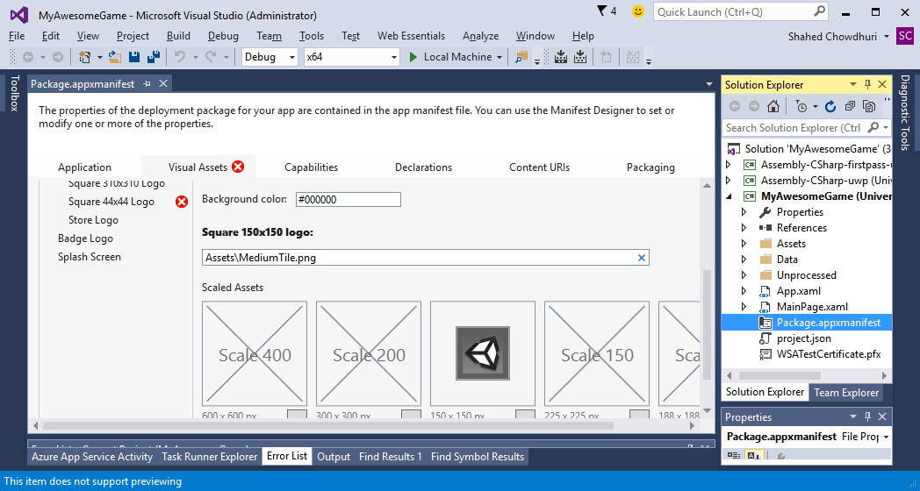
6. Add Required Images
Identify placeholder
images to replace

Slide 9
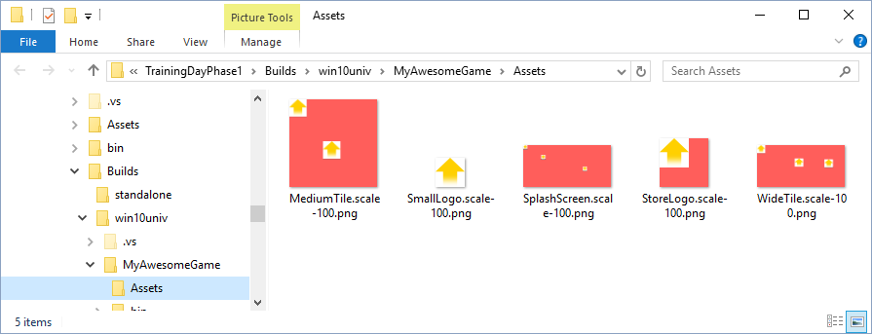
6. Add Required Images (continued)

Slide 10
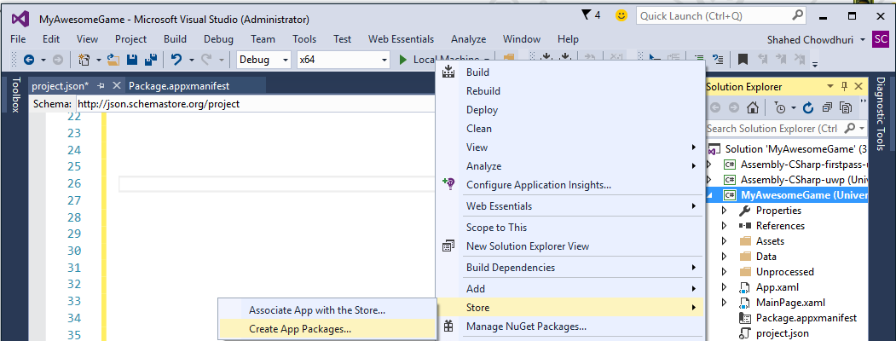
7. Run WACK!
a. Right-click project in
Solution Explorer
b. Then click Store →
Create App Packages…
in popup menu

Slide 11
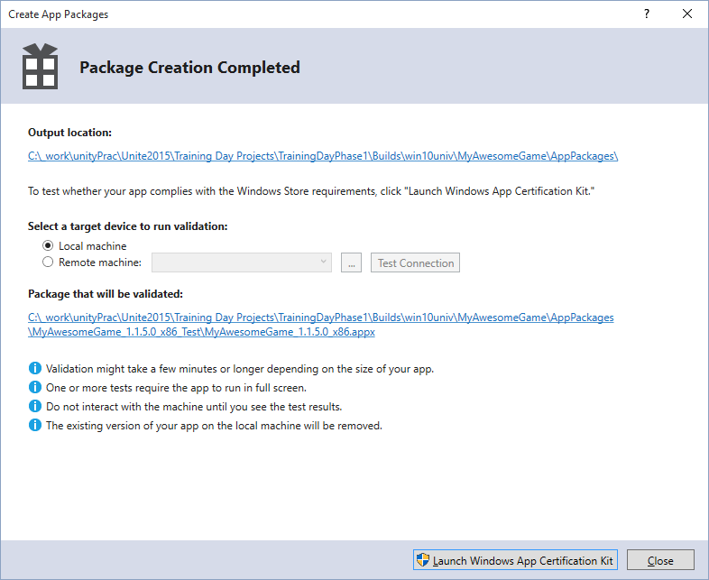
7. Run WACK (continued)
Step through dialogs,
then launch WACK
If FAILED, fix issues and repeat.
If PASSED, proceed to next step.

Slide 12
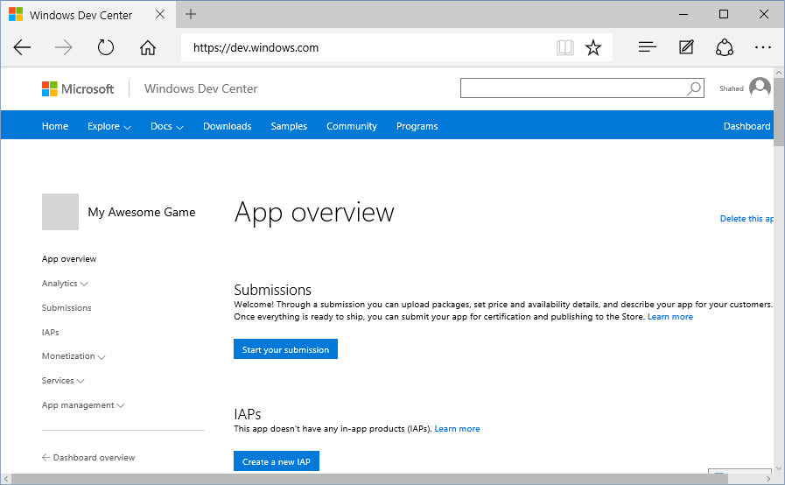
8. Publish to Windows Store
Go to:
dev.windows.com
b. Click on
Dashboard
c. Start your submission

Slide 13
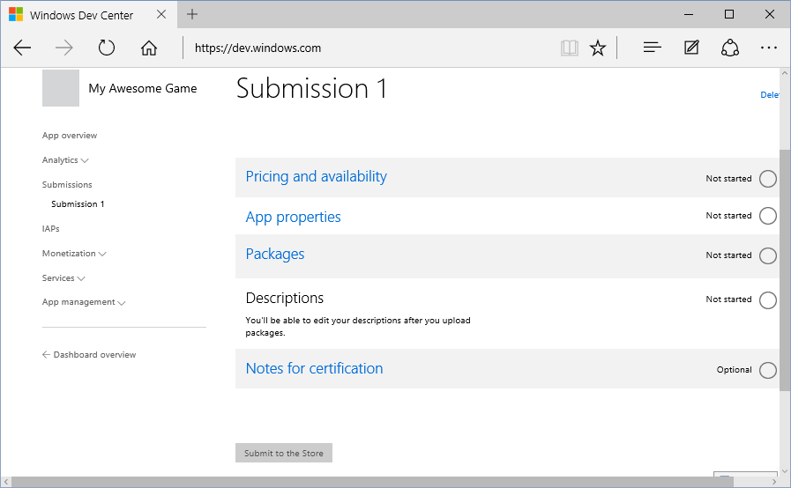
8. Publish to Windows Store (continued)
a. Edit game info
b. Upload packages here
c. Submit to the Store!

Slide 14
Summary
Enable developer mode in Windows 10
Enter game details in Unity
Export to Windows 10 Universal format
Build Solution in VS2015 w/ Win10 SDK
Associate your app with Store App
Add required images, e.g. logo, icon, splash
Run WACK (Windows App Certification Kit)
Publish to Windows Store!

