Slide 1
Game Development with Unity and C#
Windows  Web  Xbox  Mobile
By Shahed Chowdhuri
Senior Technical Evangelist
WakeUpAndCode.com
@shahedC
Notes:
Title Page: Game Development with Unity and C# Windows  Web  Xbox  Mobile
By Shahed Chowdhuri
Technical Evangelist
Blog: WakeUpAndCode.com
Twitter: @shahedC

Slide 2
Agenda
Background + Intro
> UI Basics & Assets
> Moving Around
> Scripts & Animations
> Transitions, Colliders & Triggers
Graphics & Audio, Wrap-Up
Notes:
Agenda
Intro + XNA/XBLIG
> Construct2
> C++ and DirectX
> Unity with C#
Being an Indie in the Real World
* Learn about how you can build games for Windows, Web and Xbox platforms.
* Visual tools like Construct 2, programming with C++ and DirectX, and using your C# experience with Unity.
* Not a deep dive into each topic, but enough info for you to get started and pick a direction.

Slide 3
My Background
Period | Background/Experience
1997 – present | Microsoft web/software development
2011 | XNA games on XBLIG for Xbox 360 2D Math Panic Angry Zombie Ninja Cats
2012 | Tools for XNA developers XBLIG Sales Data Analyzer (OnekSoftLabs.com) XNA Basic Starter Kit (CodePlex)
Online: http://facebook.com/OnekSoftGames
Notes:
My Background
1997 – present: Microsoft web/software development
2011: XNA games on XBLIG for Xbox 360
2D Math Panic
Angry Zombie Ninja Cats
2012: Tools for XNA developers
XBLIG Sales Data Analyzer (OnekSoftLabs.com)
XNA Basic Starter Kit (CodePlex)
Online: http://facebook.com/OnekSoftGames

Slide 4
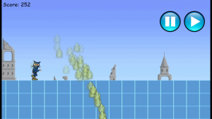
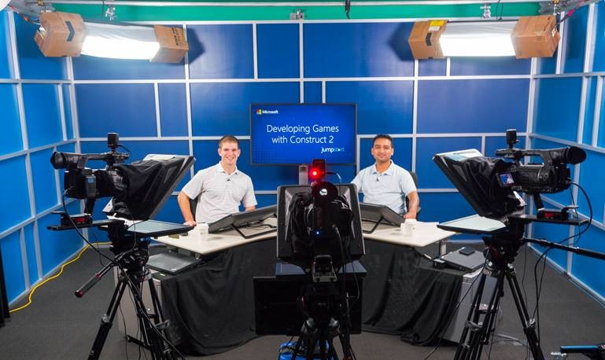
My Background (continued)
Period | Background/Experience
2013 | Ninja Cat Runner on Win8, WP8, Web (Construct 2) Video Q&A with MS Tech Evangelist Frank La Vigne Founder/Admin of FB groups: Construct2, Xbox One & Unity Indie Devs Started Public Speaking in DC area and East Coast
2014 | Public Speaking on Indie Game Development Joined Microsoft as a Sr. Technical Evangelist Gallant Glider on Win8, WP8, Web (Construct 2 → Universal App)
Video Q&A: http://youtu.be/lRjrQPvVOpo
MVA: http://aka.ms/DevGames-Const2
Notes:
My Background (continued) 2013
Ninja Cat Runner on Win8, WP8, Web (Construct 2)
Video Q&A with MS Tech Evangelist Frank La Vigne
Founder/Admin of FB groups: Construct2, Xbox One & Unity Indie Devs
Started Public Speaking in DC area and East Coast
2014
Public Speaking on Indie Game Development
Joined Microsoft as a Sr. Technical Evangelist
Gallant Glider on Win8, WP8, Web (Construct 2 → Universal App)
Video Q&A: http://youtu.be/lRjrQPvVOpo
MVA: http://aka.ms/DevGames-Const2

Slide 5
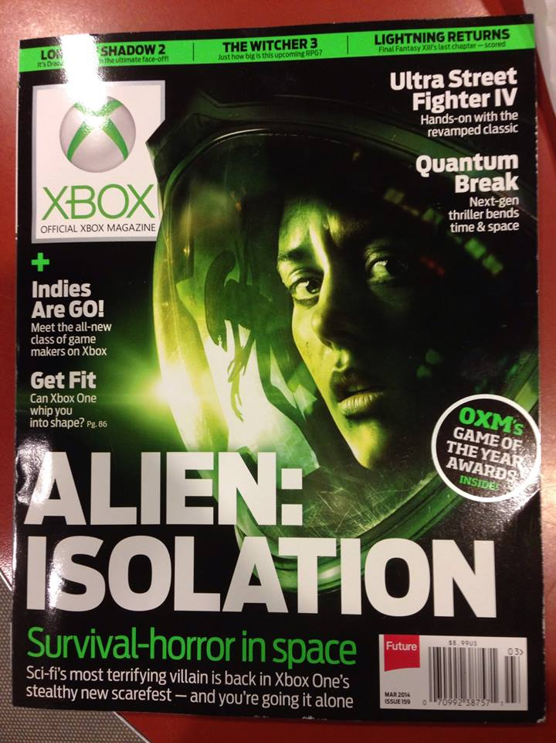
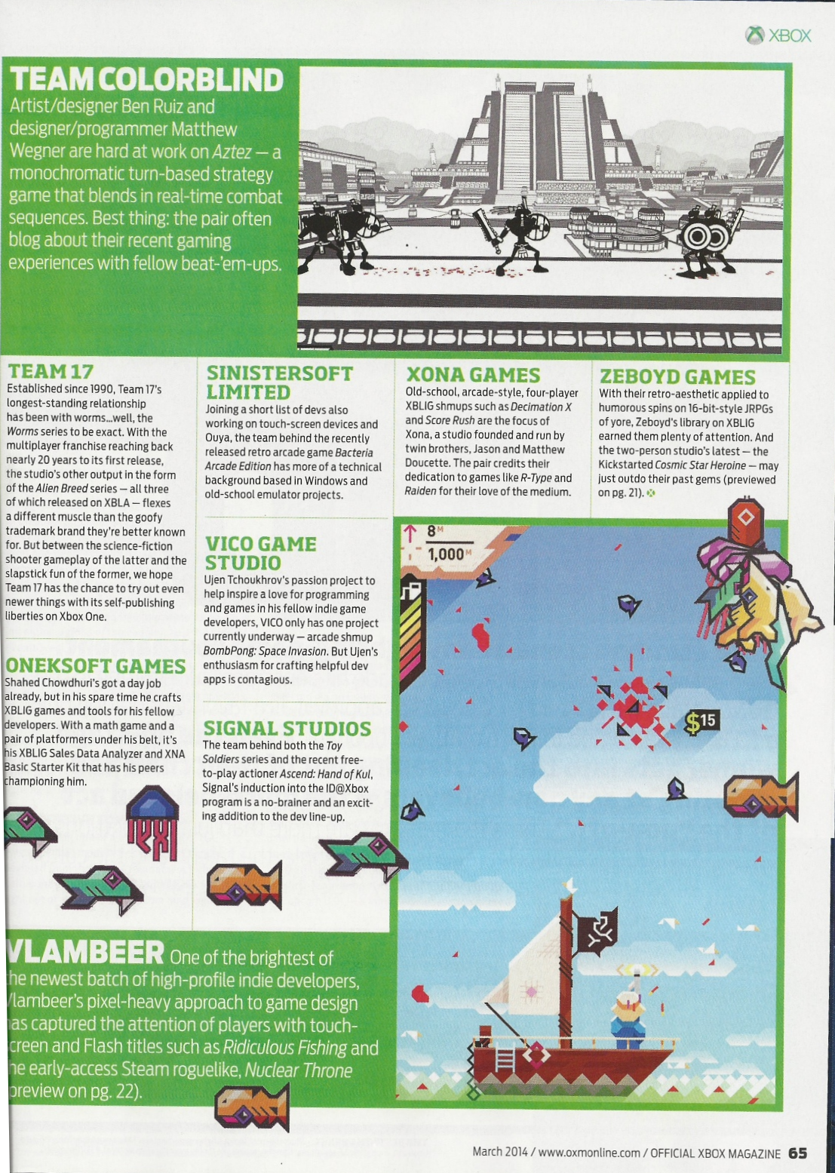
Official Xbox Magazine
`
Source: Official Xbox Magazine, March 2014, Page 65
Notes:
Official Xbox Magazine, March 2014, Page 65
"Shahed Chowdhuri's got a day job already,
but in his spare time he crafts XBLIG games and tools for his fellow developers.”
“With a math game and a pair of platformers under his belt,
it's his XBLIG Sales Data Analyzer and XNA Basic Starter Kit that has his peers championing him."

Slide 6
Tools & Technologies
Notes:
Tools & Technologies
Visual Studio 2013
Windows 8
Microsoft .NET and Visual C#
Xbox One
Construct2
C++ and DirectX 11.1+
HTML5/CSS/JS
Unity
Paint.net
Blender

Slide 7
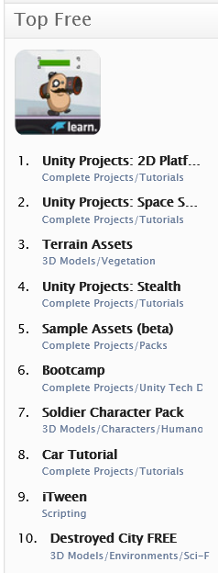
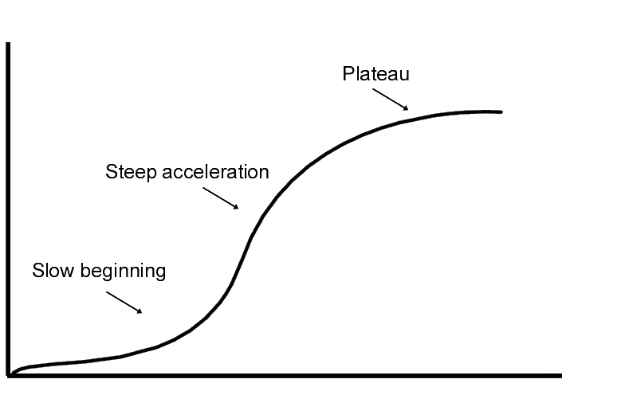
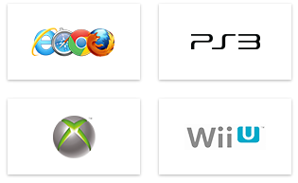
Unity: Things to Know
Learning curve
Create/Import models
Download/purchase models
Asset Store
Publish virtually anywhere!
Notes:
Unity: Things to Know
Learning curve for beginners
Need to create your own models
Or download/purchase pre-built models
Publish to Web, mobile, desktop, consoles

Slide 8
Agenda
Background + Intro
> UI Basics & Assets
> Moving Around
> Scripts & Animations
> Transitions, Colliders & Triggers
Graphics & Audio, Wrap-Up
Notes:
Agenda
Intro + XNA/XBLIG
> Construct2
> C++ and DirectX
> Unity with C#
Being an Indie in the Real World
* Learn about how you can build games for Windows, Web and Xbox platforms.
* Visual tools like Construct 2, programming with C++ and DirectX, and using your C# experience with Unity.
* Not a deep dive into each topic, but enough info for you to get started and pick a direction.

Slide 9
UI Basics & Assets

Slide 10
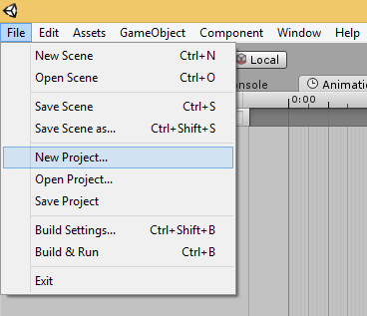
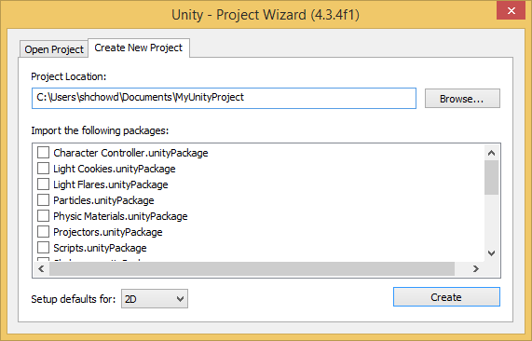
Creating a New 2D Project
Select an empty folder
Click File → New Project
Select 2D in the dropdown
Click the Create button

Slide 11
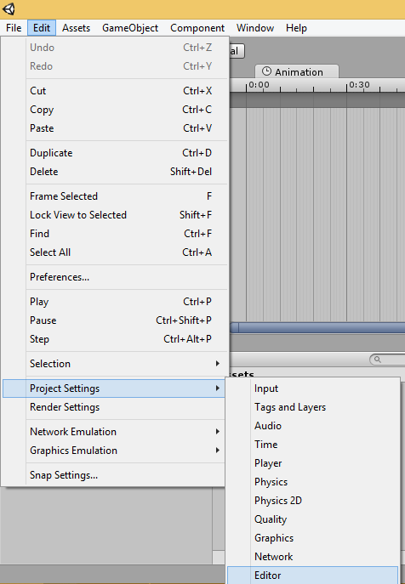
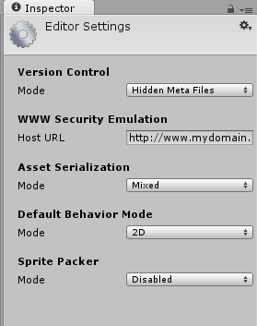
Editor Settings for 2D
Click Edit → Project Settings → Editor
Verify 2D Mode is the default

Slide 12
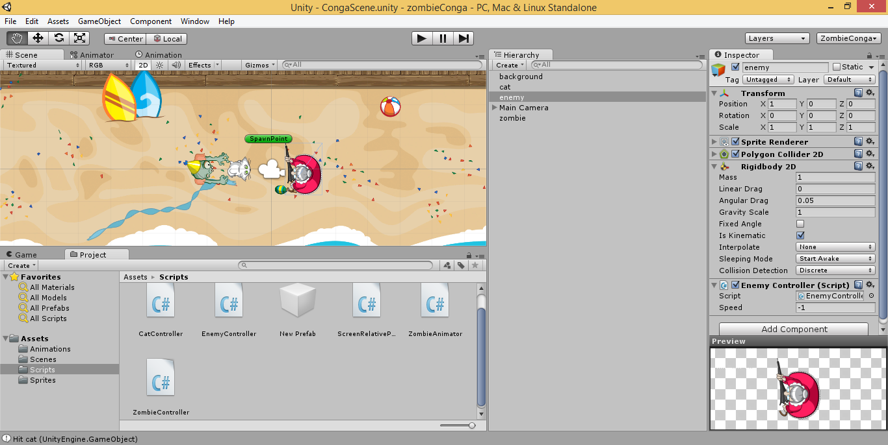
Unity UI: Scene, Hierarchy & Project Assets

Slide 13
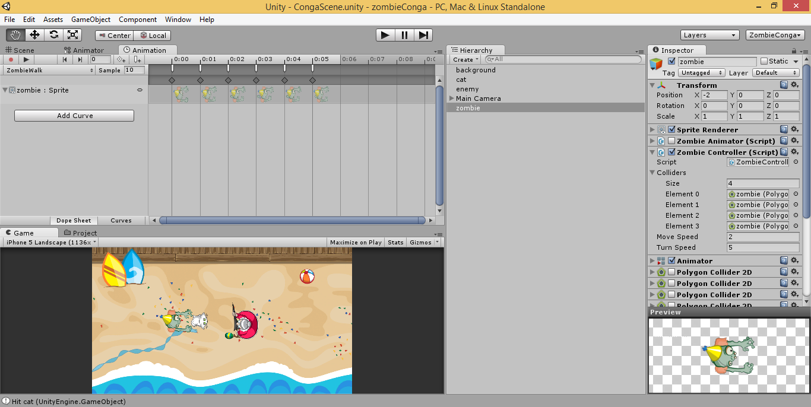
Unity UI: Animation and Game Panels

Slide 14
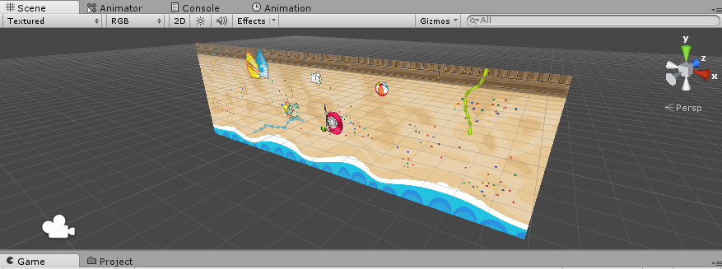
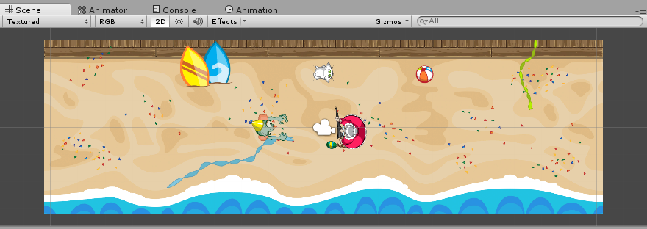
2D Overview
2D is just 3D in orthographic view
Collider 2D & Physics 2D (instead of Collider & Physics)
Sprite Renderer, Sorting Layers
Game Objects and Scripting!
Mecanim for sprite sheets

Slide 15
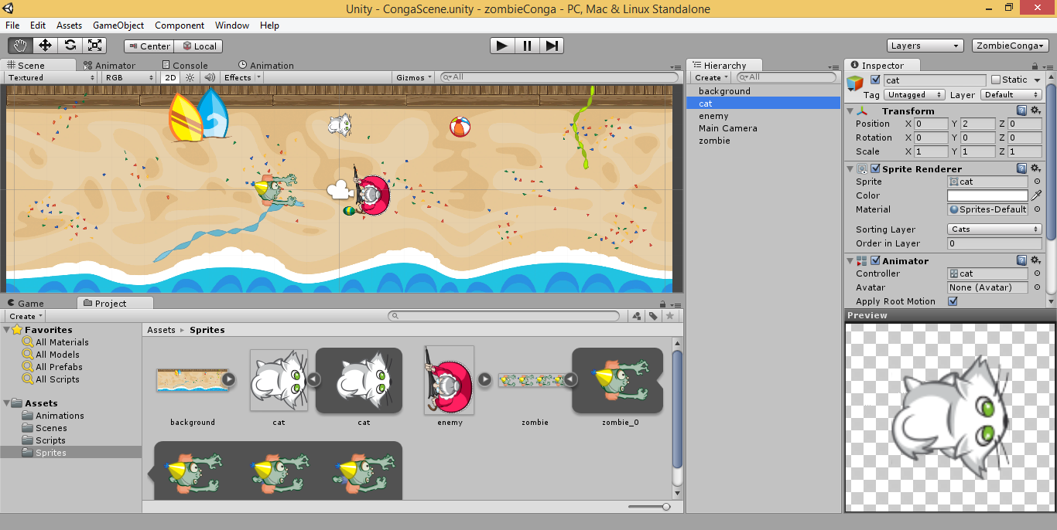
Customizing Your Editor UI
Hierarchy
Project
Scene View
Game View
Console
Animator
Animation
Inspector
Layers

Slide 16
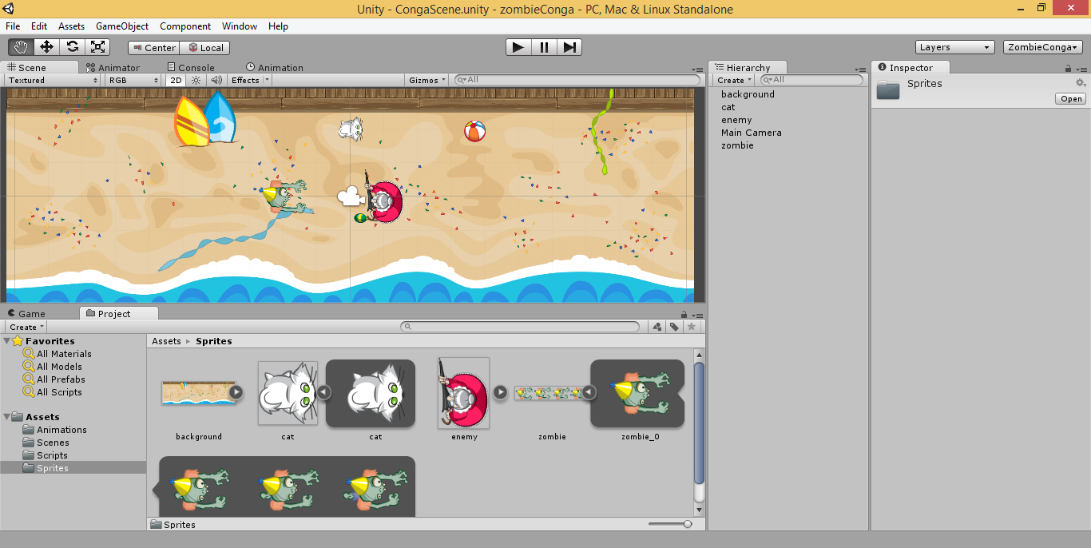
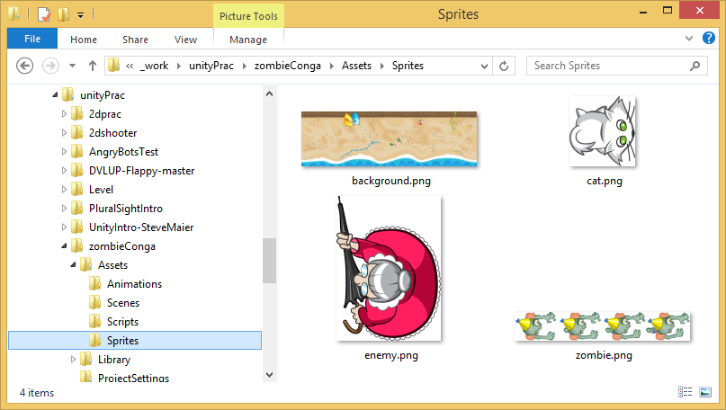
Importing a Sprite
Drag into
the scene
Note: Create Prefabs to reuse instances of an object in your scene.
http://docs.unity3d.com/Manual/Prefabs.html

Slide 17
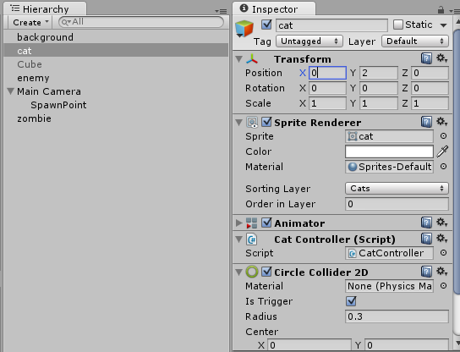
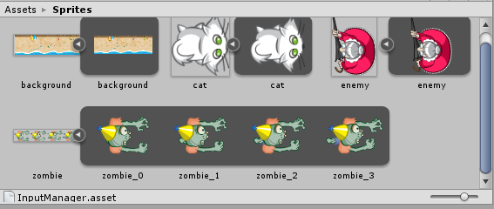
Textures and Sprites
Each texture can have sprites
Set the position/rotation/scale in the Inspector

Slide 18
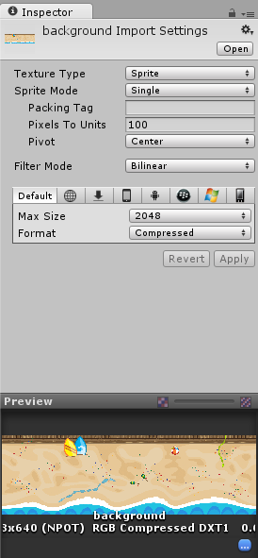
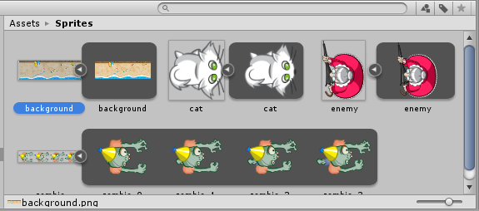
Background Import Settings

Slide 19
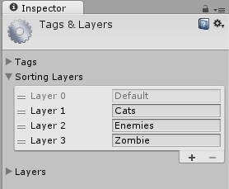
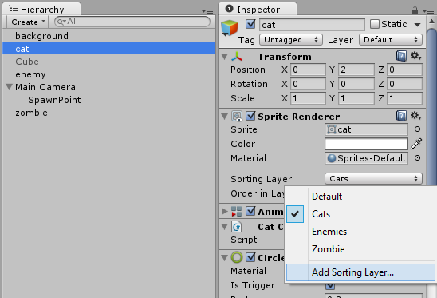
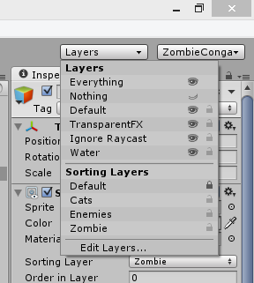
Sorting Layers
Add Layers via Sprite Renderer
Lock Layers

Slide 20
Moving Around

Slide 21
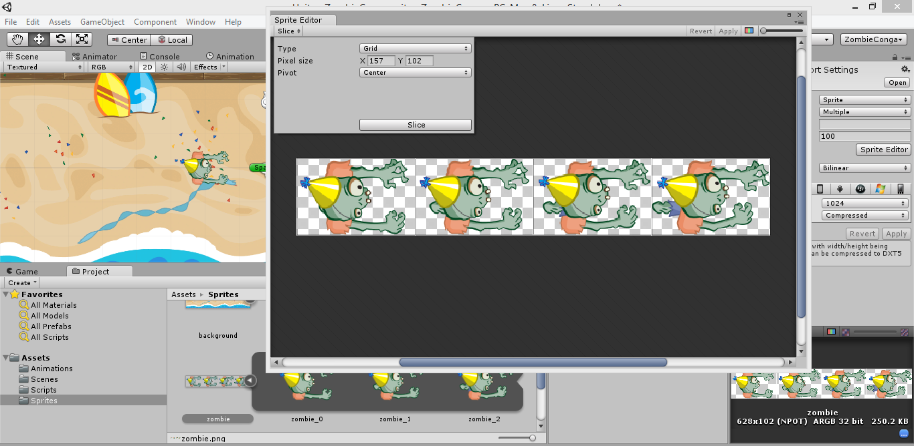
Sprite Editor

Slide 22
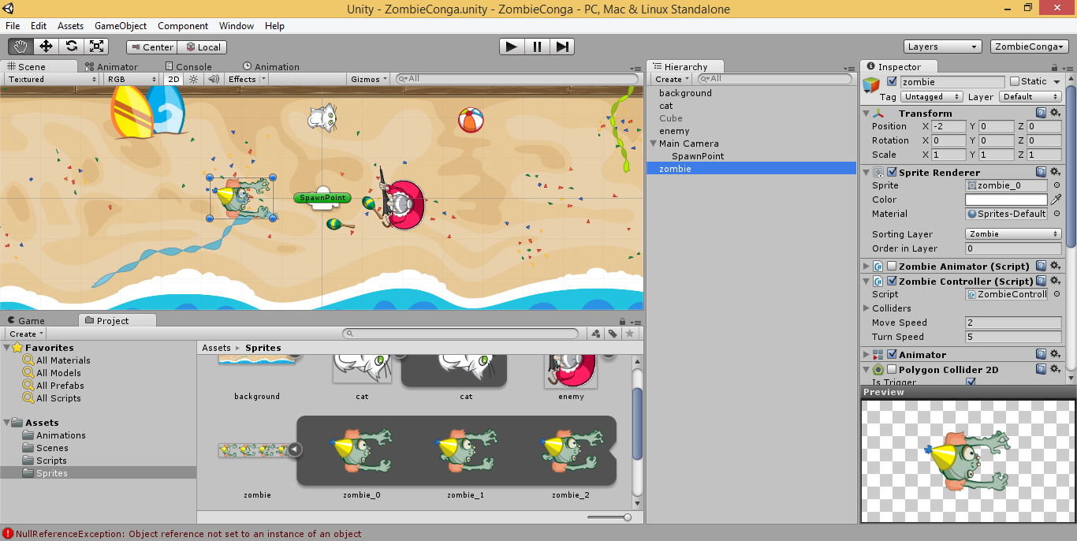
Adding Components

Slide 23
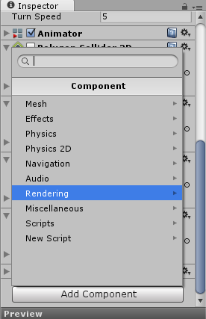
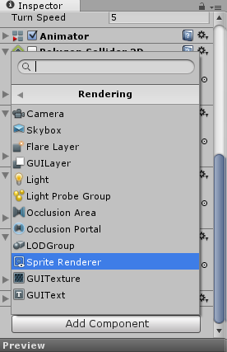
Adding a Sprite Renderer

Slide 24
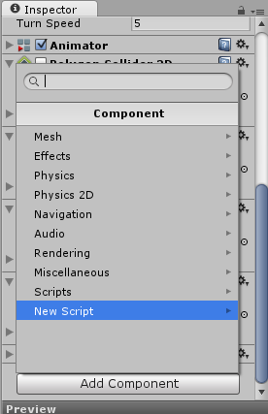
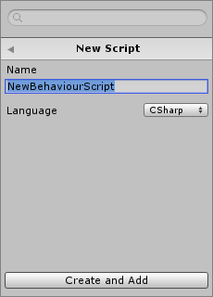
Adding a New Script (C#/JS/Boo)

Slide 25
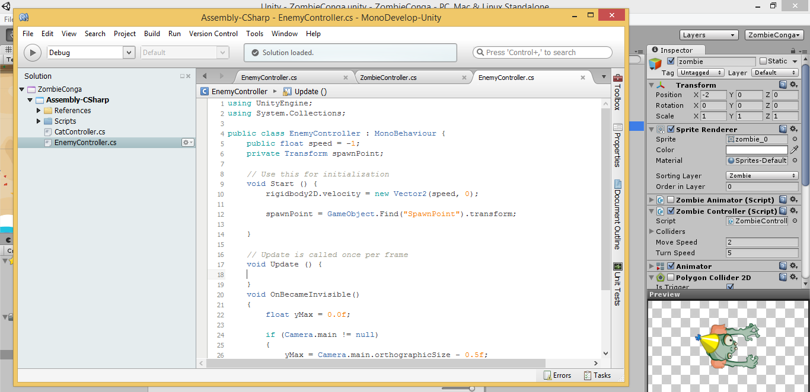
Start() and Update() in your Script

Slide 26
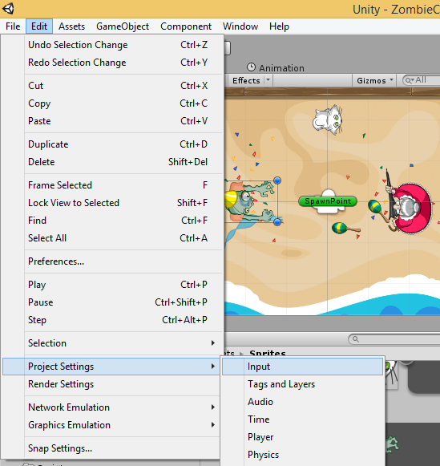
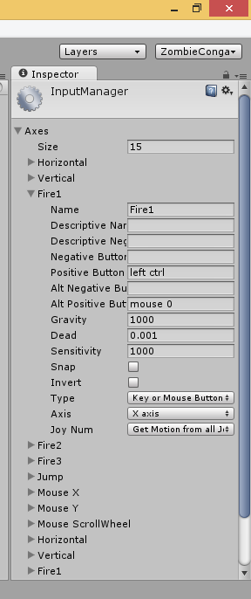
Built-in Input Controls

Slide 27
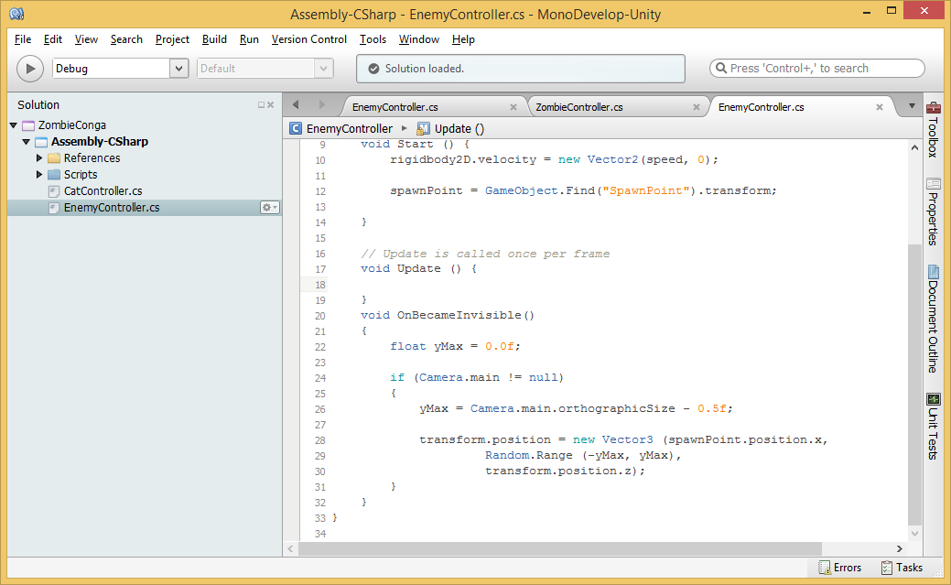
Updating Objects via transform.position

Slide 28
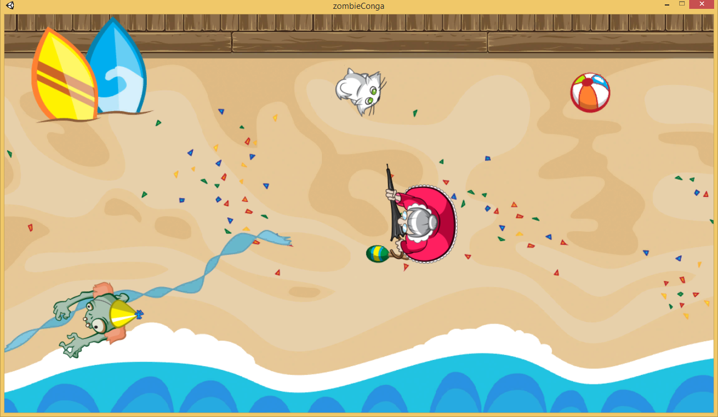
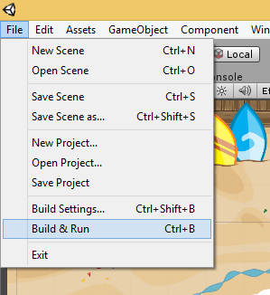
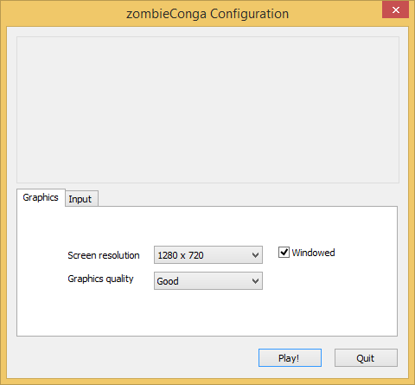
Running Your Game

Slide 29
Scripts & Animations

Slide 30
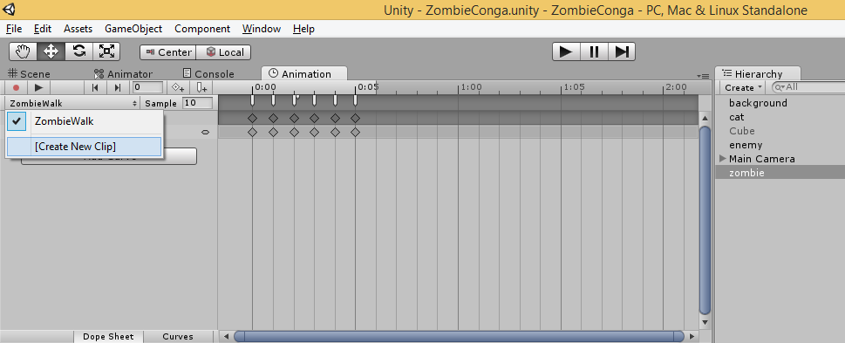
Animation Clips
Create New Clip, Curves, Keyframes

Slide 31
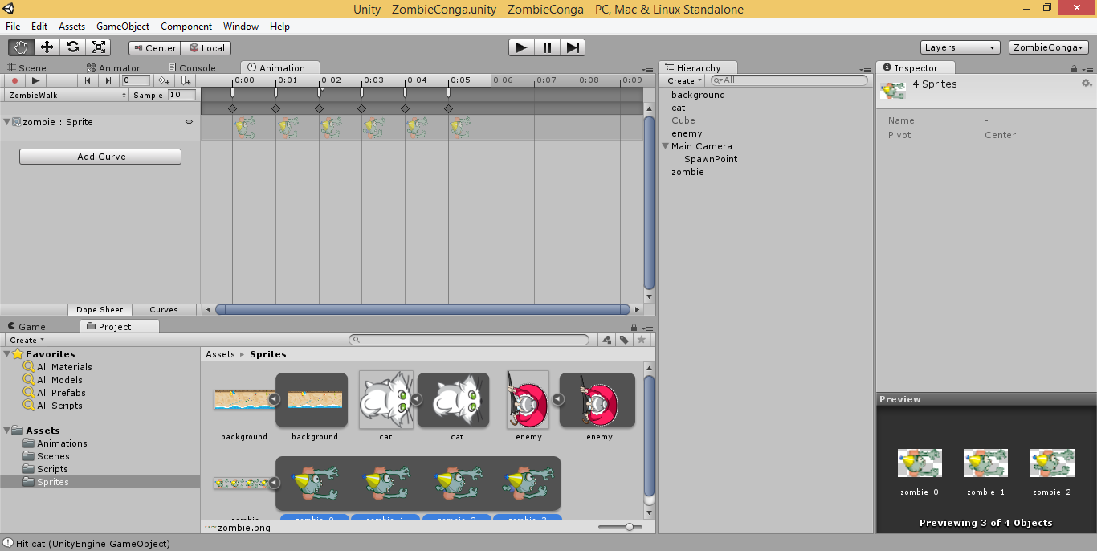
Adding Sprites From a Sprite Sheet
Drag sprites as a group or individually

Slide 32
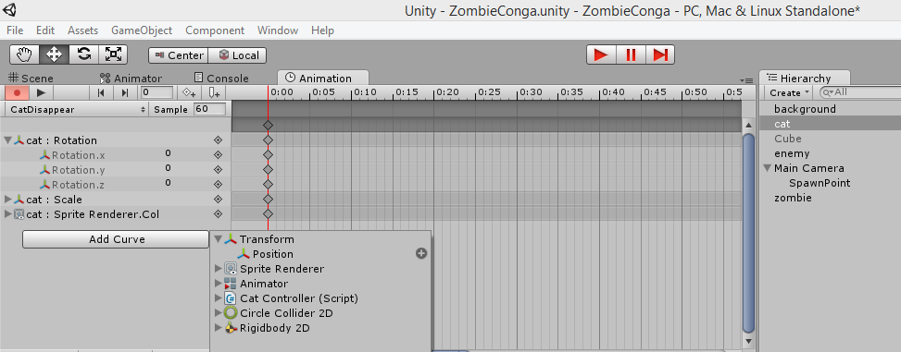
Adding Curves Manually
Change values manually for each keyframe
Create multiple animations, view one at a time

Slide 33
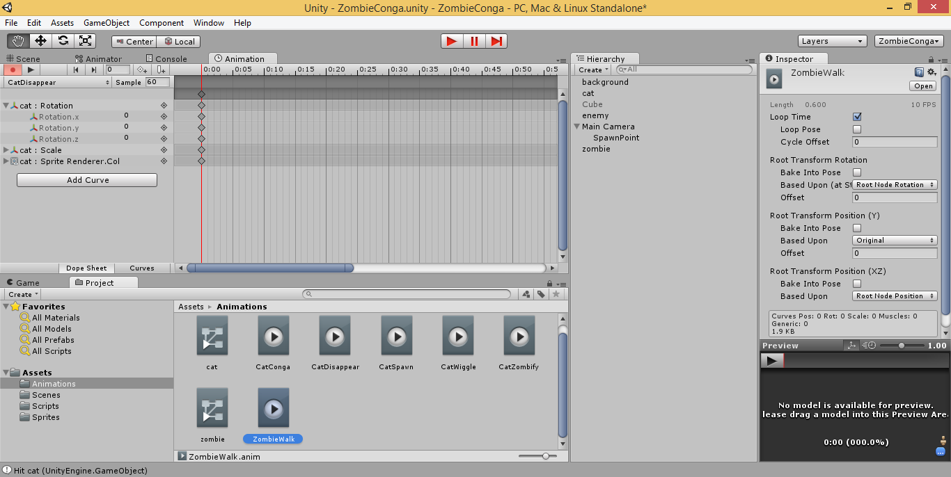
Loop Time for Animations

Slide 34
Transitions, Colliders & Triggers

Slide 35
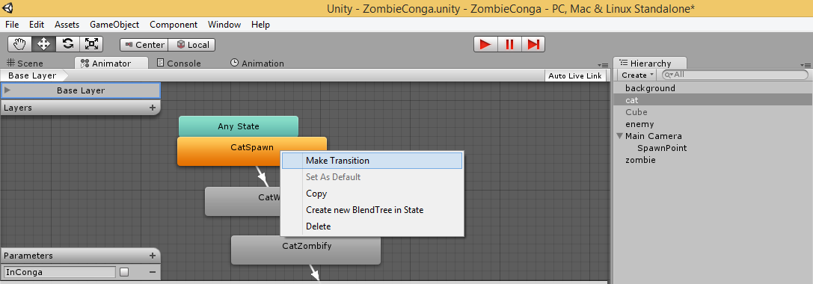
Animator Tab
Create transition from between animations
Right-click a state to Make Transition
Add parameters and set values

Slide 36
Conditions
Click a transition to edit in Inspector
Set Conditions for selected Transition

Slide 37
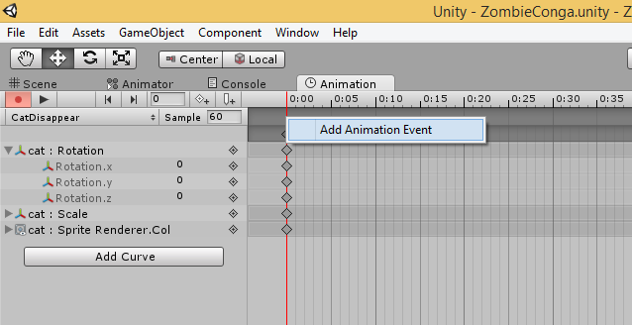
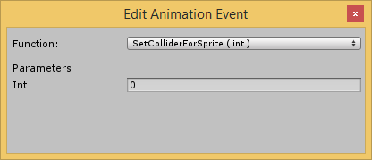
Linking Events to Keyframes
Right-click a keyframe to add animation event
Or select keyframe, and click []+ icon
`
Select function from your code, set parameters

Slide 38
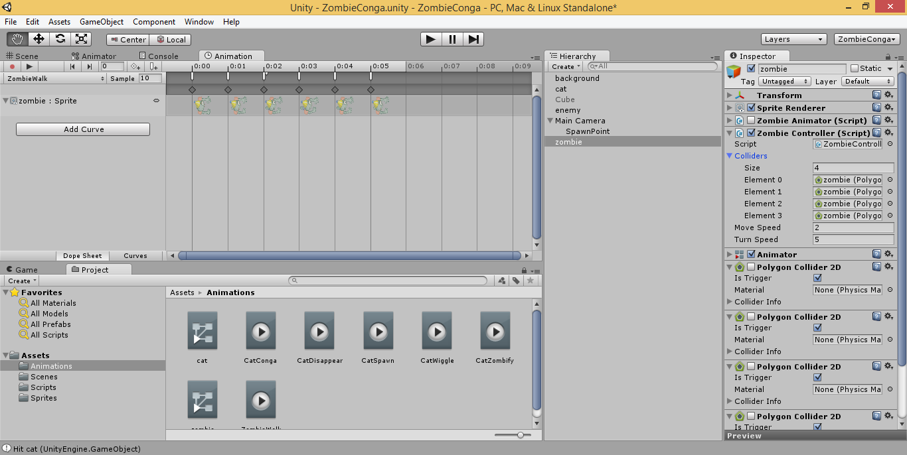
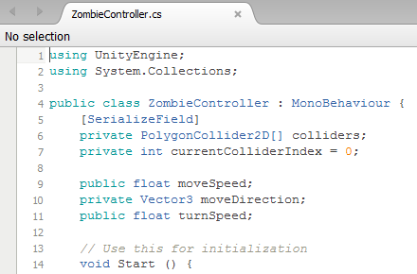
Custom Colliders

Slide 39
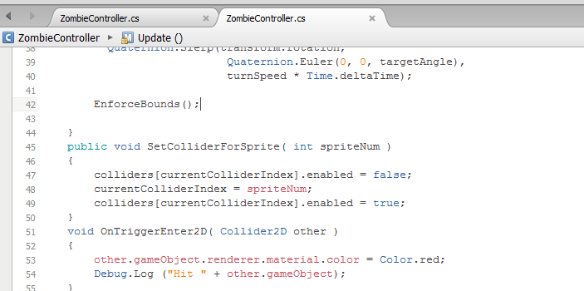
Enabling Triggers in 2D Colliders
Use OnTriggerEnter2D and OnTriggerExit2D in code

Slide 40
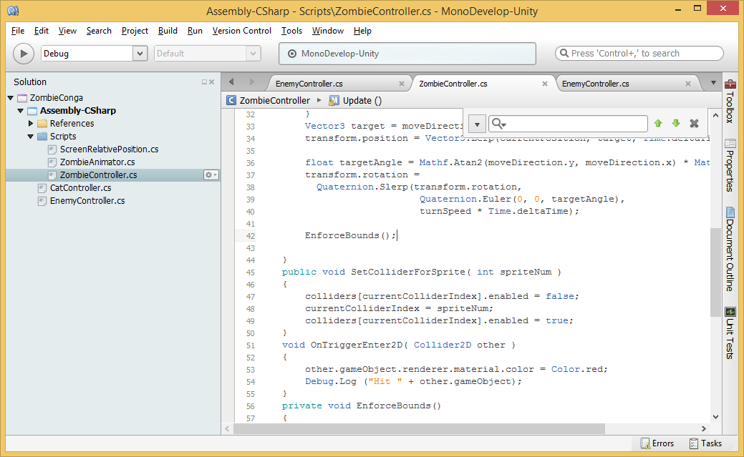
Swapping Colliders at Runtime
Called from
Keyframe
events

Slide 41
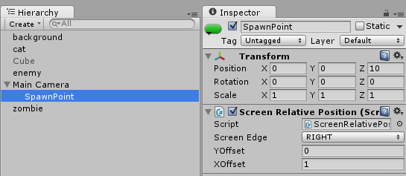
Using Empty Objects as Spawn Points
Use a script to control positioning behavior

Slide 42
Updating Gravity Settings
Set Y to 0 (zero) for top-down 2D games

Slide 43
Agenda
Background + Intro
> UI Basics & Assets
> Moving Around
> Scripts & Animations
> Transitions, Colliders & Triggers
Graphics & Audio, Wrap-Up
Notes:
Agenda
Intro + XNA/XBLIG
> Construct2
> C++ and DirectX
> Unity with C#
Being an Indie in the Real World
* Learn about how you can build games for Windows, Web and Xbox platforms.
* Visual tools like Construct 2, programming with C++ and DirectX, and using your C# experience with Unity.
* Not a deep dive into each topic, but enough info for you to get started and pick a direction.

Slide 44
Graphics For Your Game
FREE!
Gimp
Paint.net
Commercial
Adobe Illustrator
Adobe Photoshop

Slide 45
Audio Tools
FL Studio: http://www.image-line.com/flstudio/
Free demo, buy to access all features
Audacity: http://audacity.sourceforge.net/
Free, open-source

Slide 46
Useful Links
This presentation
http://WakeUpAndCode.com/downloads
Zombie Conga Tutorial, by Chris LaPollo
http://www.raywenderlich.com/61532/unity-2d-tutorial-getting-started
Unity Tutorials: http://unity3d.com/learn
Free Assets: http://codefoster.com/media

Slide 47
For More Info:
Xbox One Indie Devs:
http://facebook.com/groups/XboxOneIndieDevs
http://WakeUpAndCode.com/xb1
Unity Indie Devs:
http://facebook.com/groups/UnityIndieDevs
http://WakeUpAndCode.com/unity
Notes:
For more info:
Xbox One Indie Devs:
http://facebook.com/groups/XboxOneIndieDevs
http://WakeUpAndCode.com/xb1
Unity Indie Devs:
http://facebook.com/groups/UnityIndieDevs
http://WakeUpAndCode.com/unity
Construct2 Devs:
https://www.facebook.com/groups/construct2devs

Slide 48
Mecanim for 2D Sprite Animations
https://github.com/Banbury/UnitySpritesAndBones/wiki/Tutorial%3A-Using-Sprites-And-Bones-and-Mecanim-to-animate-a-bird

Slide 49
2D Platformer Overview
http://blogs.unity3d.com/2013/11/12/unity-4-3-2d-game-development-overview/
https://www.youtube.com/watch?v=4qE8cuHI93c

Slide 50
Unity 5 Preview
Official Unity 5 Feature Preview Trailer (jump to 2:10 for 2D)
https://www.youtube.com/watch?v=dk8gpz0o5TU

Slide 51
Agenda
Background + Intro
> UI Basics & Assets
> Moving Around
> Scripts & Animations
> Transitions, Colliders & Triggers
Graphics & Audio, Wrap-Up
Notes:
Agenda
Intro + XNA/XBLIG
> Construct2
> C++ and DirectX
> Unity with C#
Being an Indie in the Real World
* Learn about how you can build games for Windows, Web and Xbox platforms.
* Visual tools like Construct 2, programming with C++ and DirectX, and using your C# experience with Unity.
* Not a deep dive into each topic, but enough info for you to get started and pick a direction.

Slide 52
Contact
Email: shchowd@microsoft.com  Twitter: @shahedC
Notes:
Contact
Web: OnekSoft.com
Email: games@OnekSoft.com
Twitter: @OnekSoftGames
Microsoft email: shchowd@microsoft.com
Personal Twitter: @shahedC
R&D: OnekSoftLabs.com
Dev Blog: WakeUpAndCode.com
FB: http://facebook.com/groups/XboxOneIndieDevs

