Slide 1
App Studio
Windows 8.1  Windows Phone 8.1  Windows 10  … and more!
By Shahed Chowdhuri
Sr. Technical Evangelist
WakeUpAndCode.com
@shahedC
Notes:
Title Page: App Studio Windows 8.1  Windows Phone 8.1  Windows 10  … and more!
By Shahed Chowdhuri
Sr. Technical Evangelist
Blog: WakeUpAndCode.com
Twitter: @shahedC

Slide 2
Agenda
Introduction
> Getting Started
> New Features
> Demo
Q&A
Notes:
Agenda
Introduction
> Visual Studio
> Alternative Tools
Publishing
* Learn about how you can build Universal Apps for Windows.
* Use Visual Studio or alternatives like App Studio, Construct 2, Unity.
* Not a deep dive into each topic, but enough info for you to get started and pick a direction.

Slide 3
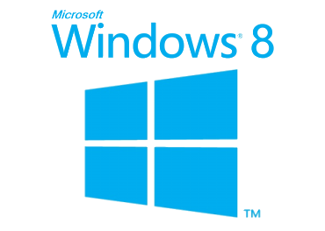
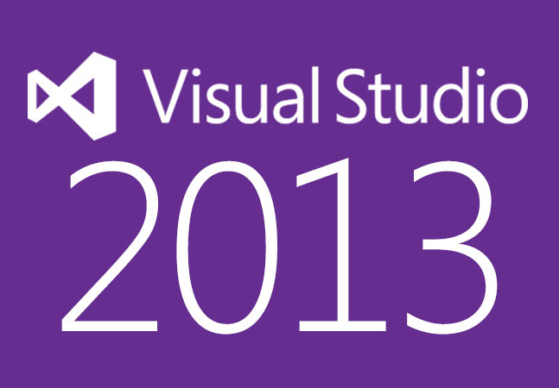
Tools & Technologies
Notes:
Tools & Technologies
Visual Studio 2013
Windows 8
Microsoft .NET and Visual C#
Windows Phone
HTML5/CSS/JS
Xbox One
Unity
C++ and DirectX 11.1+
XAML
Construct 2

Slide 4
Introduction
Notes:
Introduction

Slide 5
What is a Universal App?
"Apps that are tailored to people with disabilities"
"Apps that are automatically multi-lingual and culture adherent"
"Apps that can run on all platforms (iOS, Android, Windows)"
"A single app package that will work across Microsoft devices“
None of the Above?
Notes:
What is a Universal App?
"Apps that are tailored to people with disabilities"
"Apps that are automatically multi-lingual and culture adherent"
"Apps that can run on all platforms (iOS, Android, Windows)"
"A single app package that will work across Microsoft devices“
None of the Above?

Slide 6
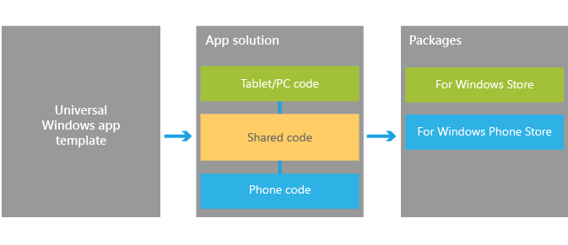
Universal Apps for Windows
Universal Apps for Windows
1 solution
1 shared project (no binary output)
1 project per platform (separate binary output per platform)
Windows, Windows Phone, Xbox One (coming soon!)
Ref: http://dev.windows.com/en-us/develop/Building-universal-Windows-apps
Notes:
Universal Apps for Windows
Universal Apps for Windows
1 solution
1 shared project (no binary output)
1 project per platform (separate binary output per platform)
Windows, Windows Phone, Xbox One (coming soon!)
Ref: http://dev.windows.com/en-us/develop/Building-universal-Windows-apps

Slide 7
Benefits of Universal Apps
Pricing structure – Match Windows Phone pricing on Windows 8
Shared in-app purchases – Buy IAPs only once, on either platform.
Install across devices – Buy app only once, own across platforms
Shared revenue model – Keep 70% of revenue
Unified ad-units for Windows Phone and Windows apps
Ref: http://www.wpcentral.com/what-is-a-universal-windows-app
Notes:
Benefits of Universal Apps
Pricing structure – Match Windows Phone pricing on Windows 8
Shared in-app purchases – Buy IAPs only once, on either platform.
Install across devices – Buy app only once, own across platforms
Shared revenue model – Keep 70% of revenue
Unified ad-units for Windows Phone and Windows apps
Ref: http://www.wpcentral.com/what-is-a-universal-windows-app

Slide 8
Streamlined Development
Notes:
Streamlined Development
(graphic)
UI → App Model → APIs → Tools → Store

Slide 9
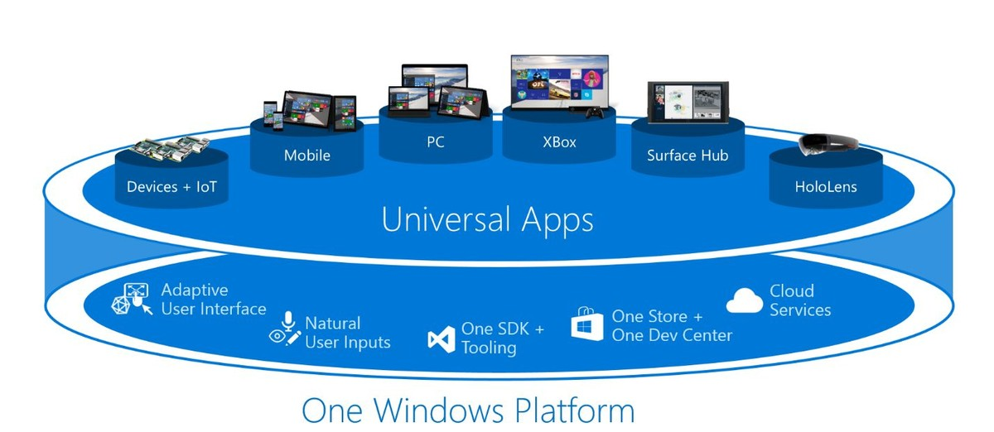
Universal Apps in Windows 10
“The platform enables a new class of Windows universal apps – apps that are truly written once, with one set of business logic and one UI. Apps that are delivered to one Store within one package.”
More Info: http://www.windowscentral.com/microsoft-reveals-its-windows-10-universal-apps-plans-developers-mwc-2015

Slide 10
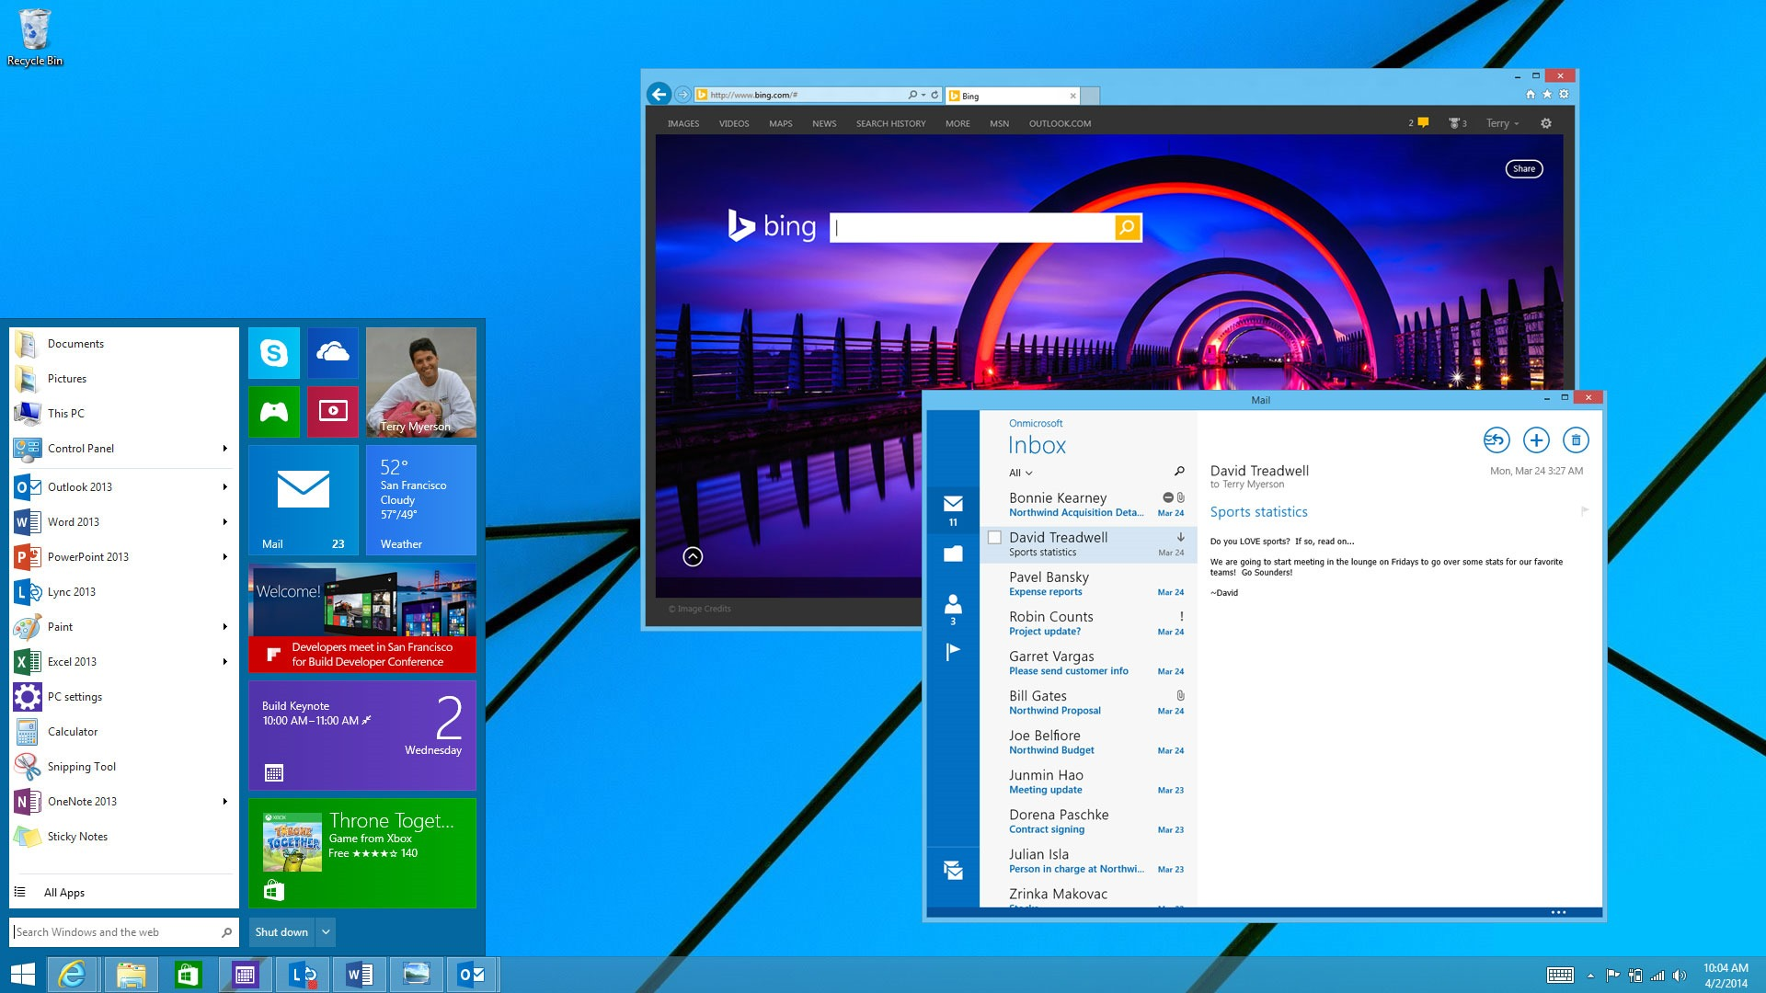
Why Windows 10?
Overlapping Windows!
Desktop + Store apps
New
Start
Screen
Un-max!
Start
Menu!
Notifications

Slide 11
App Studio
Notes:
Alternative Tools

Slide 12
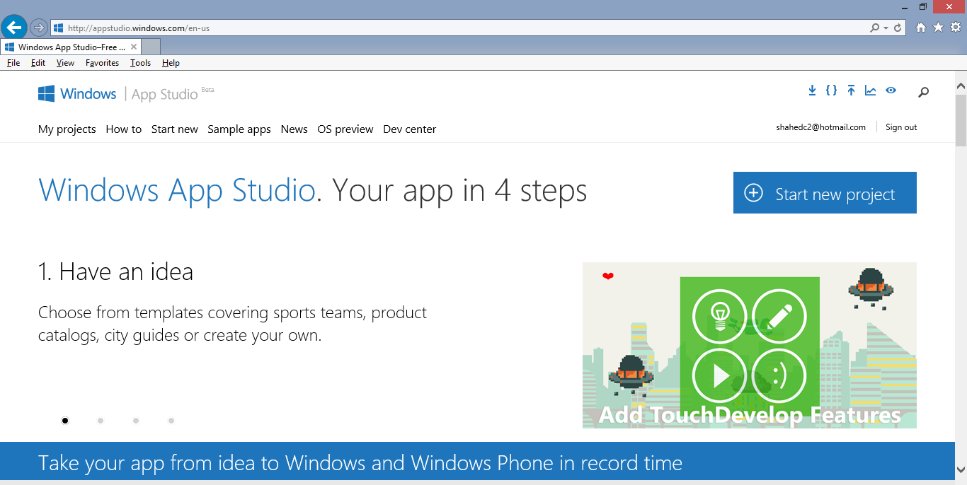
App Studio
Start here: http://appstudio.windows.com

Slide 13
App Studio in 4 Steps (from App Studio website)
App Studio Tutorial
Link: http://social.technet.microsoft.com/wiki/contents/articles/24933.create-a-universal-application-with-windows-app-studio.aspx
Notes:
App Studio in 4 Steps (from App Studio website)
Have an idea
Add content
Choose style
Use It!
App Studio Tutorial
Link: http://social.technet.microsoft.com/wiki/contents/articles/24933.create-a-universal-application-with-windows-app-studio.aspx

Slide 14
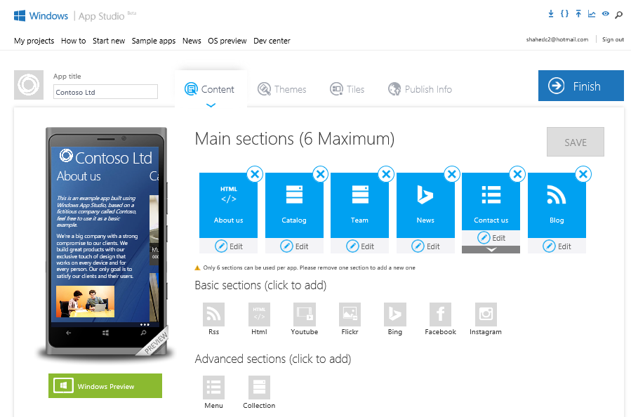
Build Your App in Your Browser
Click Finish
When Done
Notes:
Build Your App in Your Browser
(screenshot of App Studio UI)
Click Finish When Done

Slide 15
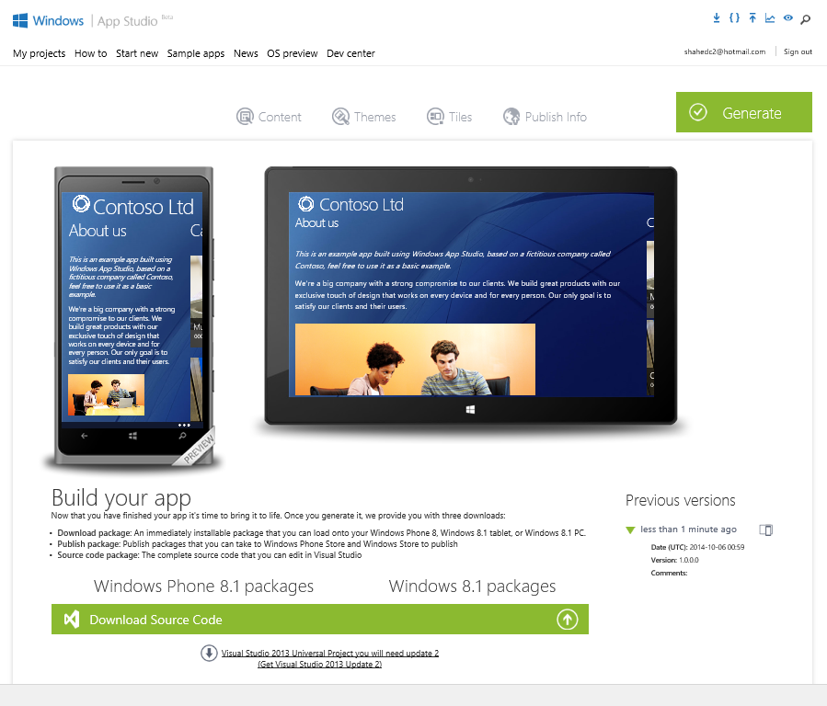
Generate & Download
Download Source Code
Notes:
Generate & Download
(screenshot of App Studio UI)
Download Source Code

Slide 16
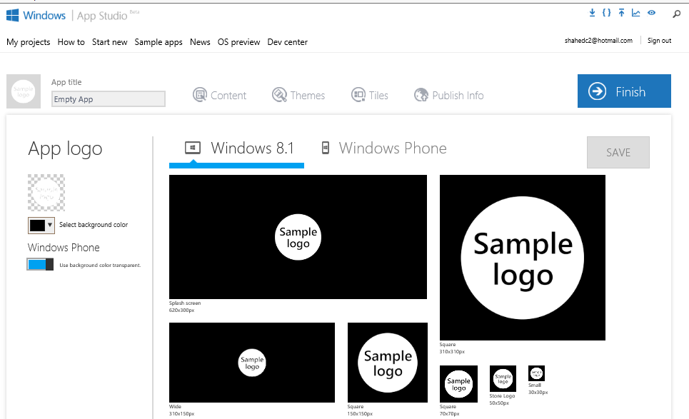
New Logo/Image Wizard

Slide 17
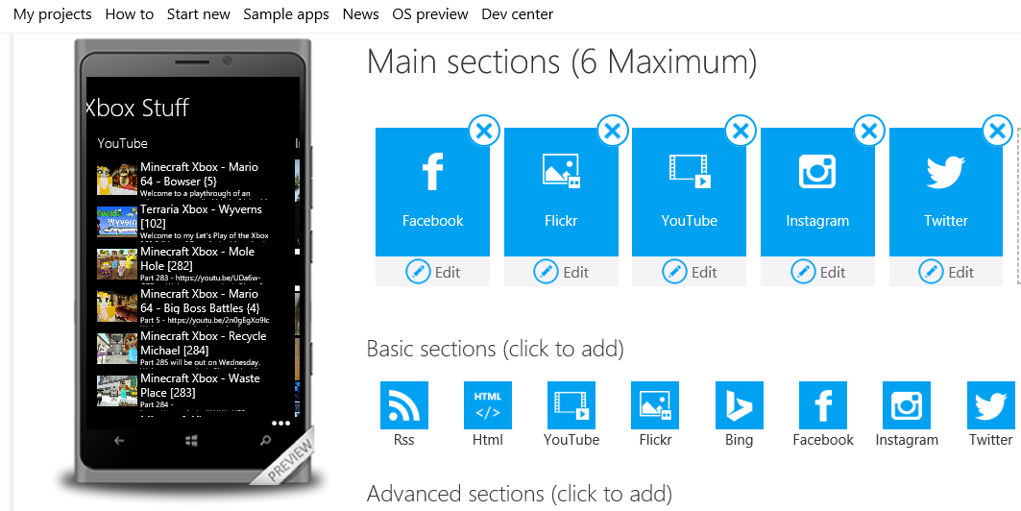
Facebook & YouTube Integration*
* Similar to recently-added Instagram and Twitter integration

Slide 18
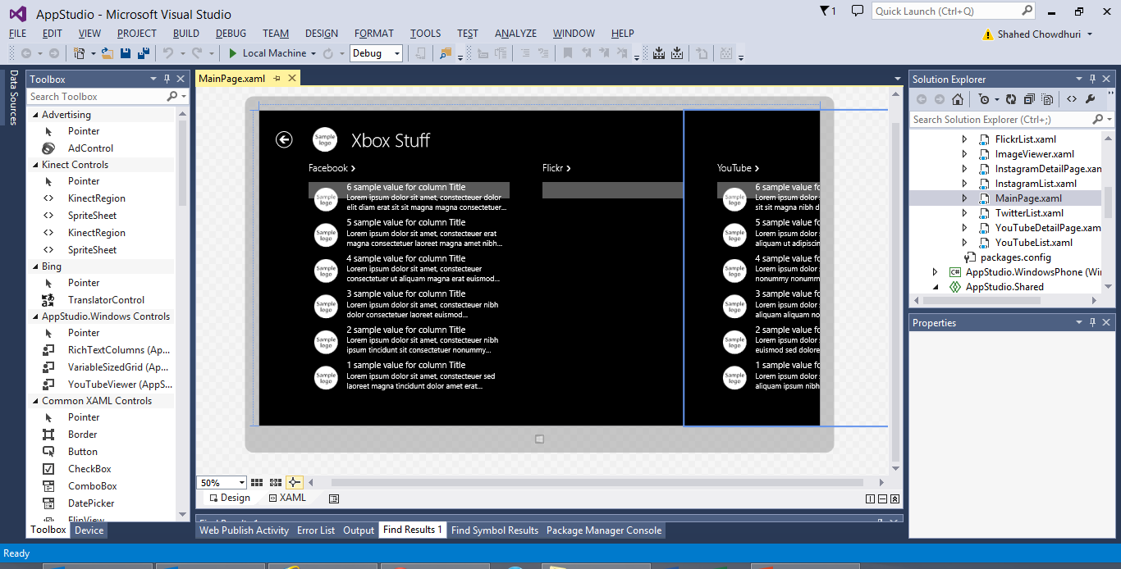
Demo
Notes:
Demo

Slide 19
Questions?
Notes:
Questions?

Slide 20
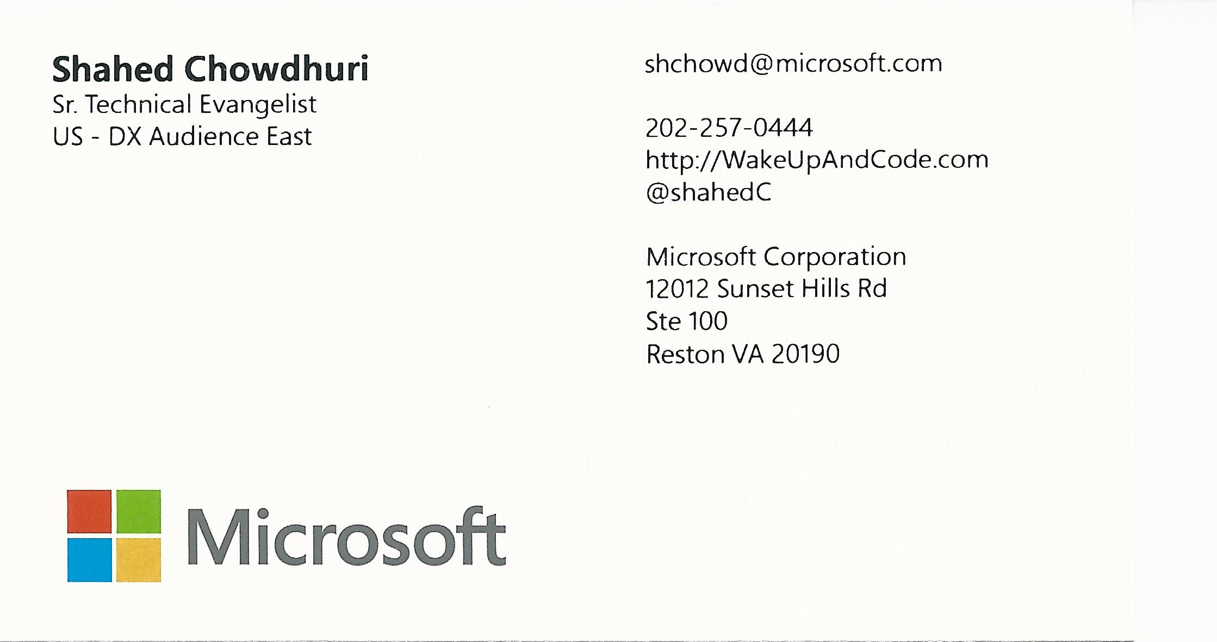
Contact
Email: shchowd@microsoft.com  Twitter: @shahedC
Notes:
Contact
Microsoft email: shchowd@microsoft.com
Personal Twitter: @shahedC
Dev Blog: WakeUpAndCode.com

