Slide 1
Cross-Platform Apps/Games with Azure
Windows  iOS  Android  … and more!
By Shahed Chowdhuri
Sr. Technical Evangelist
WakeUpAndCode.com
@shahedC
Notes:
Title Page: Cross-Platform Apps/Games with Azure Windows  Windows Phone  Azure  … and more!
By Shahed Chowdhuri
Sr. Technical Evangelist
Blog: WakeUpAndCode.com
Twitter: @shahedC

Slide 2
Agenda
Introduction
> Mobile Apps & Services
> Construct 2 Games
> Unity Games
Q&A
Notes:
Agenda

Slide 3
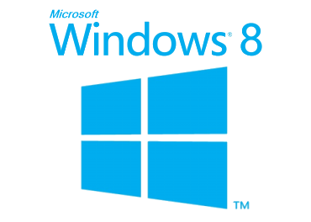
Tools & Technologies
Windows 10
Notes:
Tools & Technologies
Visual Studio
Windows 8 & Windows 10
Microsoft .NET and Visual C#
Windows Phone
JavaScript
Microsoft Azure

Slide 4
Introduction: The Cloud
Notes:
Introduction

Slide 5
Cloud Services: IaaS, PaaS and SaaS
 |  | Host | Build | Consume
 | Packaged Software | IaaS: infrastructure as a service | PaaS: Platform as a service | Saas: software as a service
Applications | Self- Managed | Self- Managed | Self- Managed | Managed By Vendor
Data
Runtime |  |  | Managed By Vendor
Middleware
O/S
Virtualization |  | Managed By Vendor
Servers
Storage
Networking
Notes:
Cloud Services: IaaS, PaaS and SaaS

Slide 6
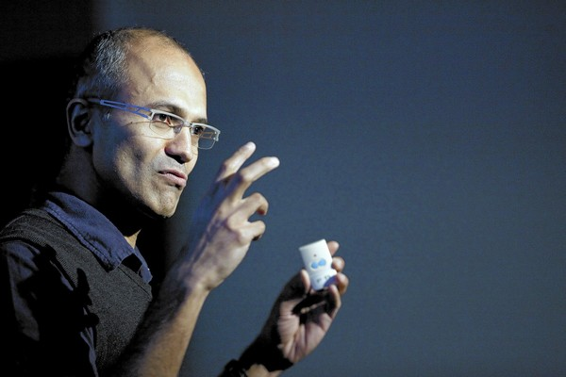
In Line with Microsoft’s Vision
“… mobile first, cloud first… ”
Microsoft CEO Satya Nadella
Notes:
In Line with Microsoft’s Vision
“… mobile first, cloud first… ”
Microsoft CEO Satya Nadella

Slide 7
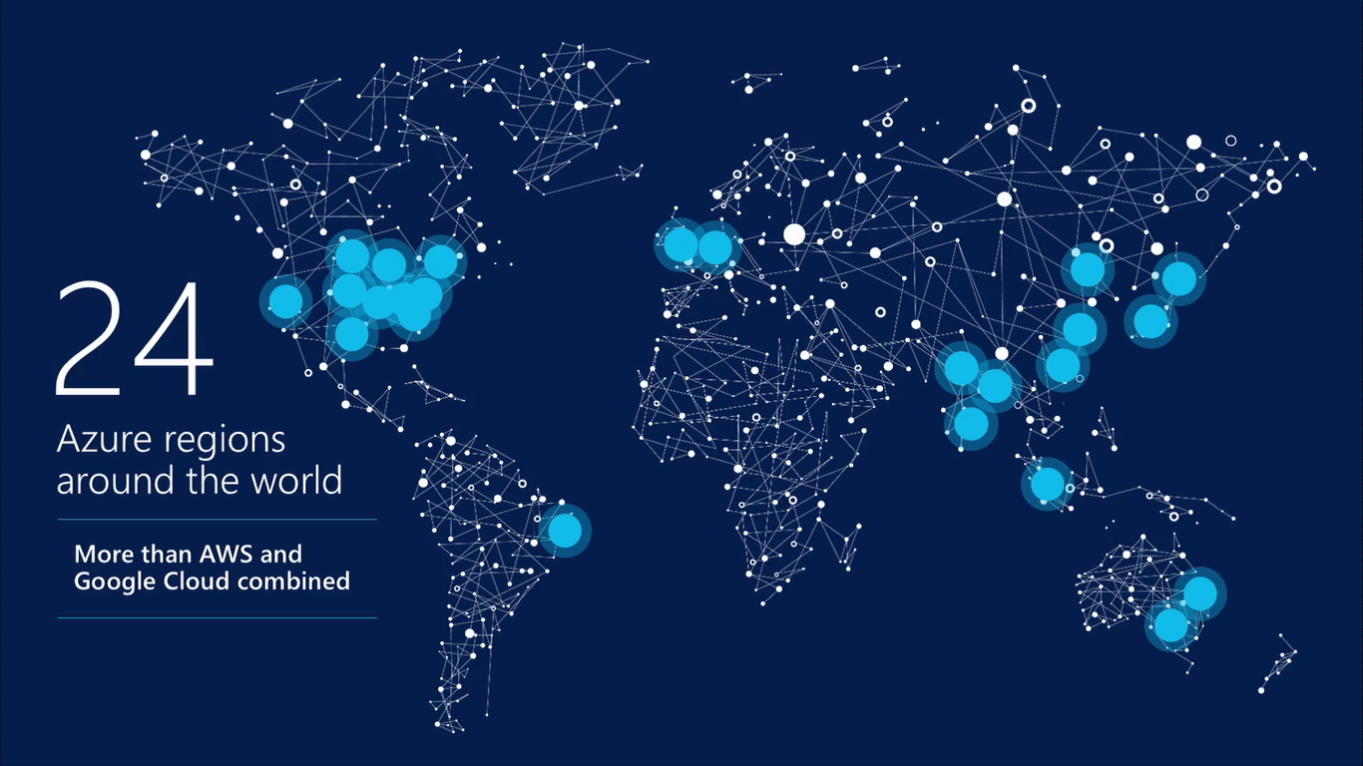
17 regions worldwide in 2015
Azure footprint
Data Centers
Regional Partners

Slide 8
Agenda
Introduction
> Mobile Apps & Services
> Construct 2 Games
> Unity Games
Q&A
Notes:
Agenda

Slide 9
Mobile Services

Slide 10
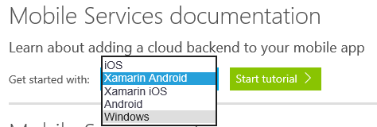
Getting Started
Link: https://azure.microsoft.com/en-us/documentation/services/mobile-services/
Notes:
Getting Started
Link: http://azure.microsoft.com/en-us/documentation/articles/mobile-services-dotnet-backend-windows-store-dotnet-get-started/

Slide 11
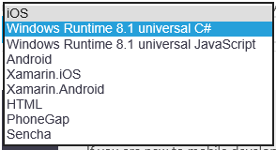
Getting Started (continued)
Notes:
Getting Started
Link: http://azure.microsoft.com/en-us/documentation/articles/mobile-services-dotnet-backend-windows-store-dotnet-get-started/

Slide 12
Create a Mobile Service
Notes:
Create a Mobile Service

Slide 13
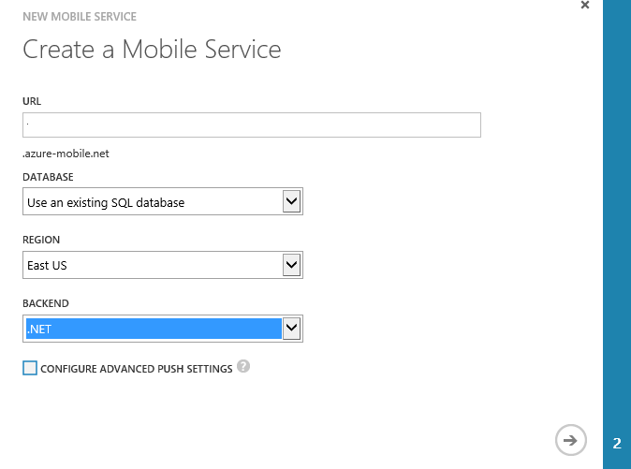
Specify Mobile Service Details
Name for the URL
(not the full URL)
Notes:
Specify Mobile Service Details

Slide 14
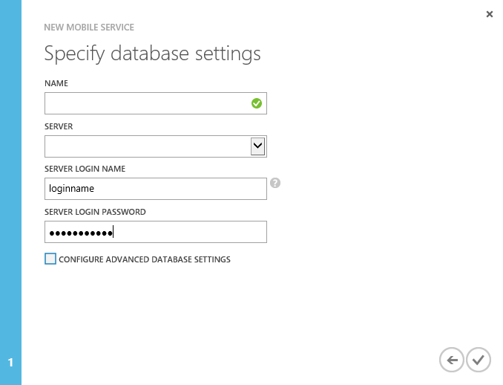
Specify Database Settings
Notes:
Specify Database Settings

Slide 15
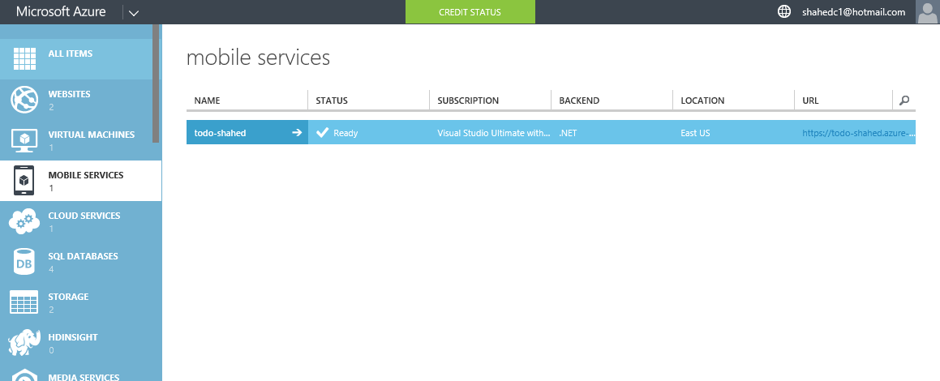
Verify Status of Mobile Service
Notes:
Verify Status of Mobile Service

Slide 16
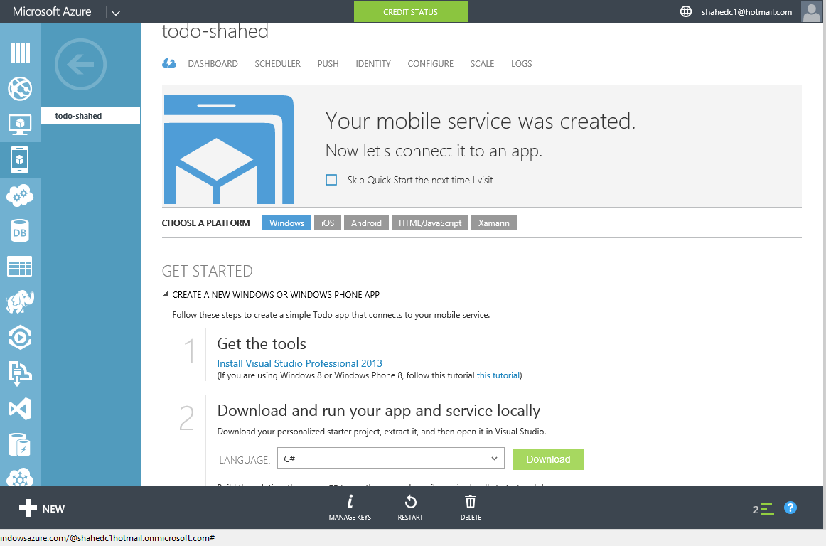
Get Tools & Download Your Solution
Notes:
Get Tools & Download Your Solution

Slide 17
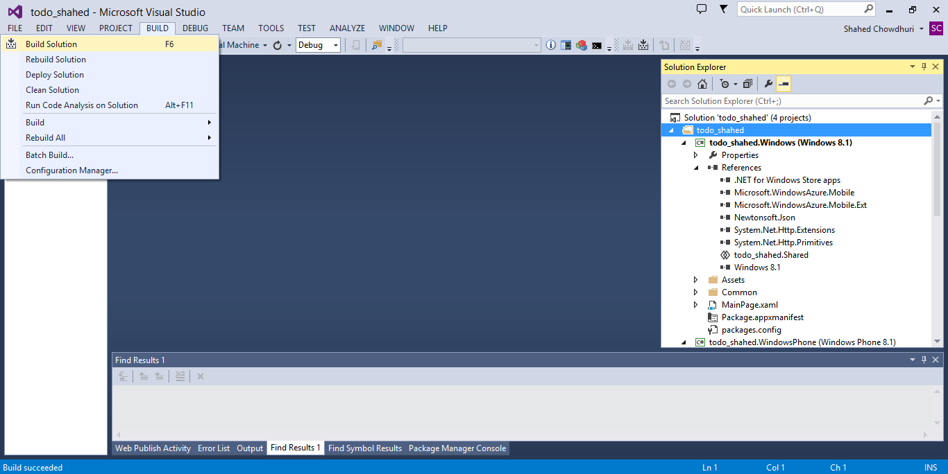
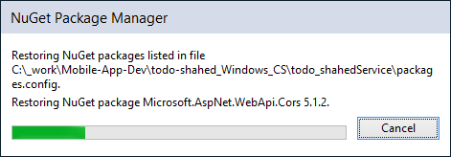
Build Your Solution (update NuGet packages)
. . .
Notes:
Build Your Solution (update NuGet packages)

Slide 18
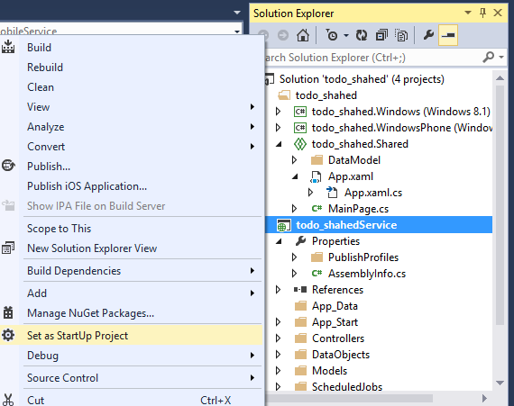
Run the Service Locally
Notes:
Run the Service Locally

Slide 19
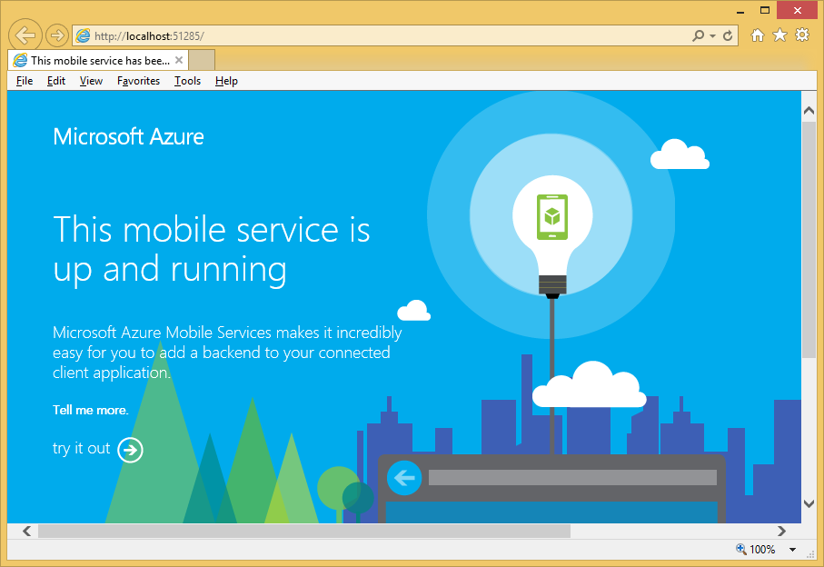
Verify the Service Locally
Notes:
Verify the Service Locally

Slide 20
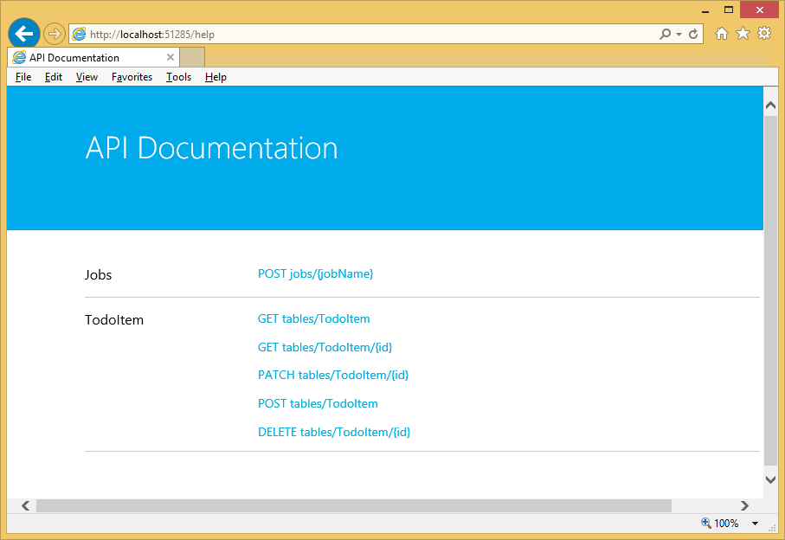
Try it out…
Notes:
Try it out…

Slide 21
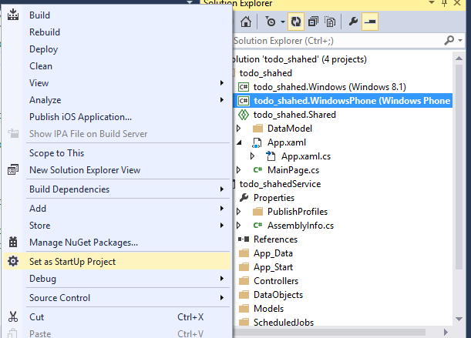
Run Windows Phone App Locally
Notes:
Run Windows Phone App Locally

Slide 22
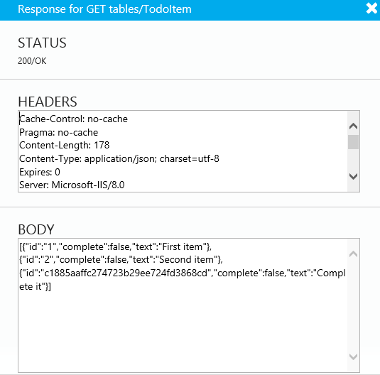
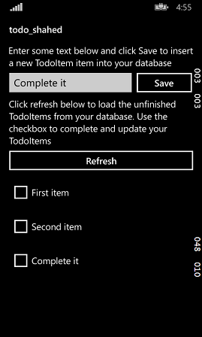
Verify Windows Phone App
Notes:
Verify Windows Phone App

Slide 23
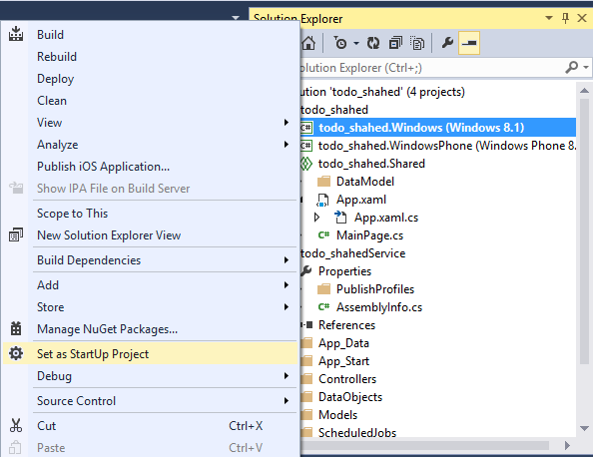
Run Windows App Locally
Notes:
Run Windows App Locally

Slide 24
Verify Windows App Locally
Notes:
Verify Windows App Locally

Slide 25
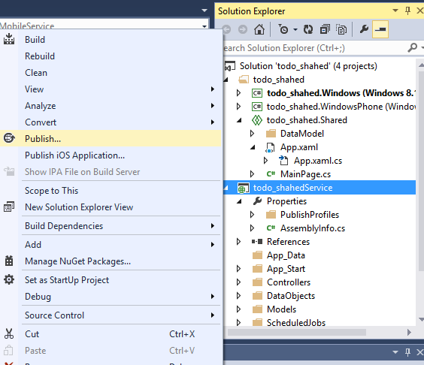
Publish Your Mobile Service
Notes:
Publish Your Mobile Service

Slide 26
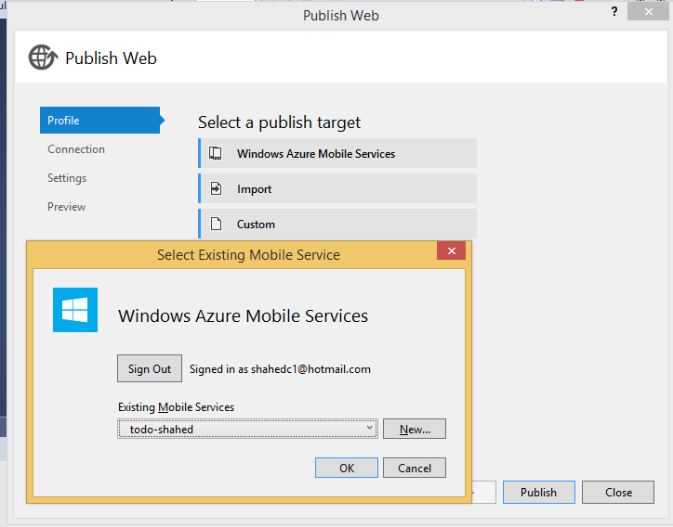
Sign In and Select Existing Service
Notes:
Sign In and Select Existing Service

Slide 27
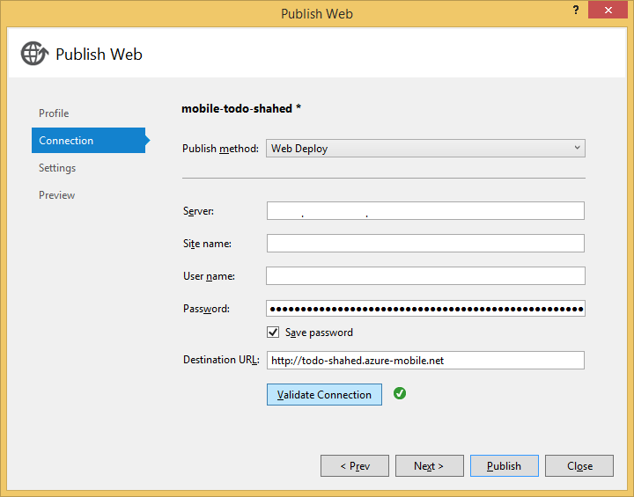
Complete the Publishing Process
Notes:
Complete the Publishing Process

Slide 28
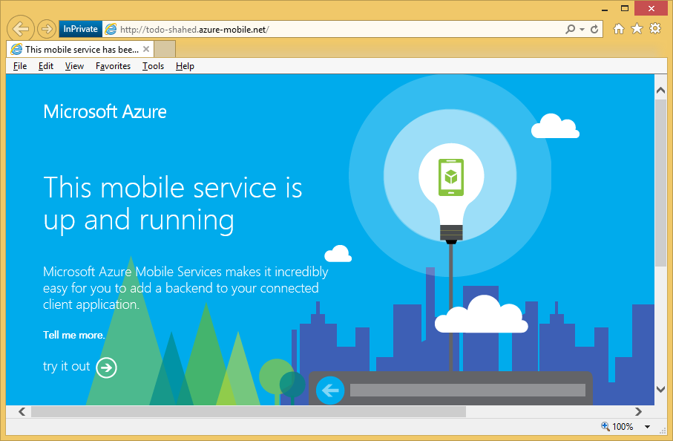
Verify the Service is Running
Notes:
Verify the Service is Running

Slide 29
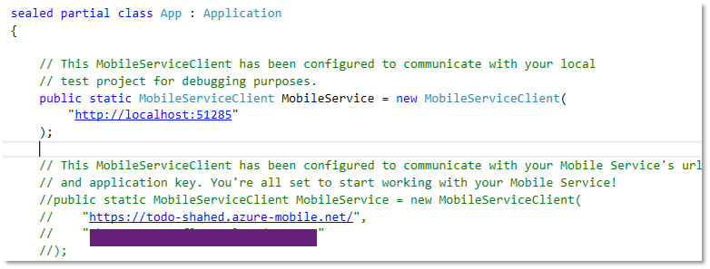
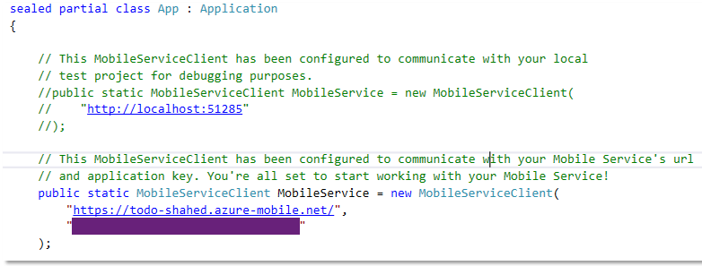
Update App.Xaml.cs (Shared project)
BEFORE:
AFTER:
Comment out local settings
Uncomment server settings, including key
Notes:
Update App.Xaml.cs (Shared project)
Comment out local settings
Uncomment server settings, including key

Slide 30
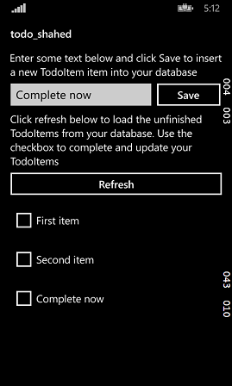
Run Windows Phone Project
Enter a value to test it
Notes:
Run Windows Phone Project

Slide 31
Run Windows project
Enter a value to test it
Notes:
Run Windows project

Slide 32
App Service → Mobile App (NEW!)
Notes:
Mobile Apps & Services

Slide 33
Getting Started
Link: https://azure.microsoft.com/en-us/documentation/services/app-service/
Notes:
Getting Started
Link: http://azure.microsoft.com/en-us/documentation/articles/mobile-services-dotnet-backend-windows-store-dotnet-get-started/

Slide 34
Getting Started (continued)
Notes:
Getting Started

Slide 35
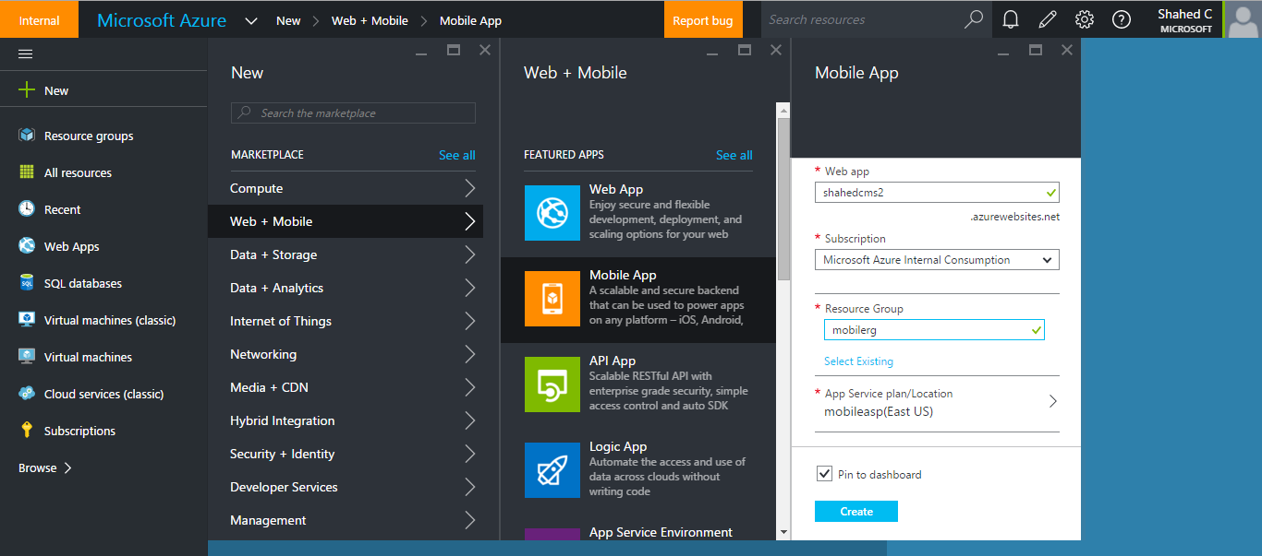
Create a Mobile Service
Notes:
Create a Mobile Service

Slide 36
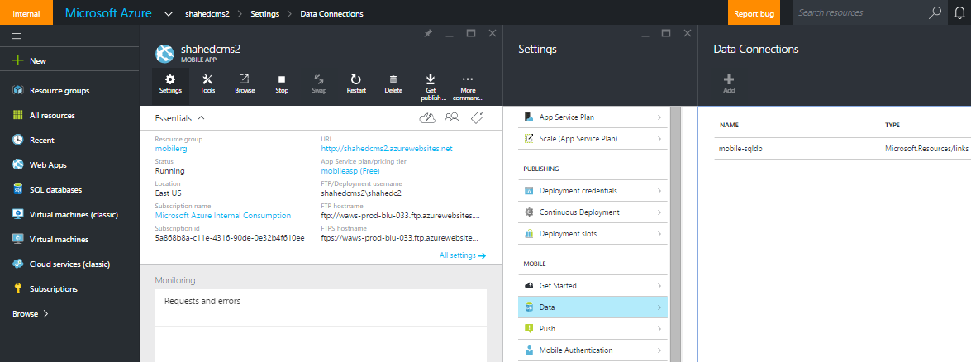
Add a Data Connection

Slide 37
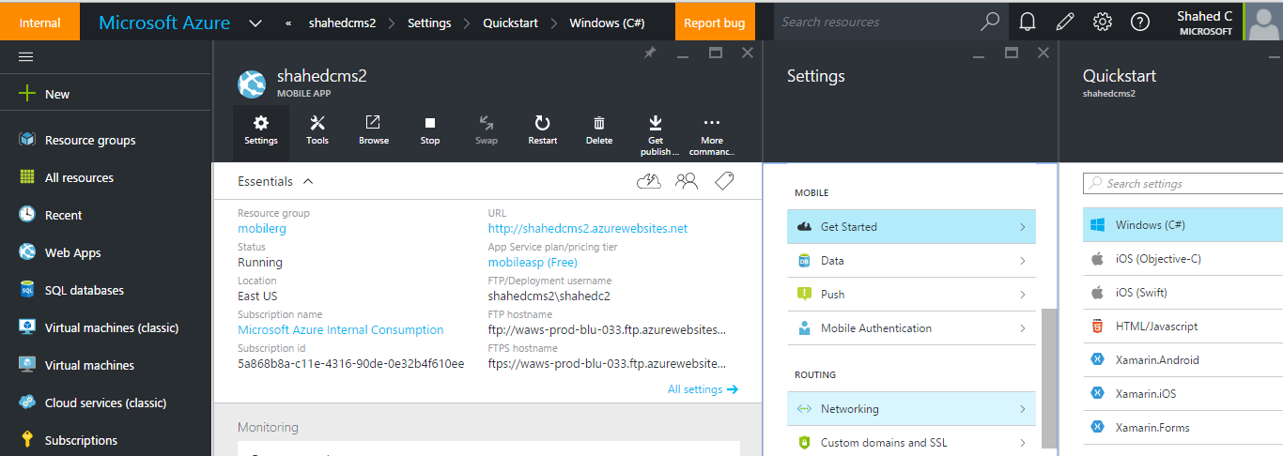
Generate Mobile App

Slide 38
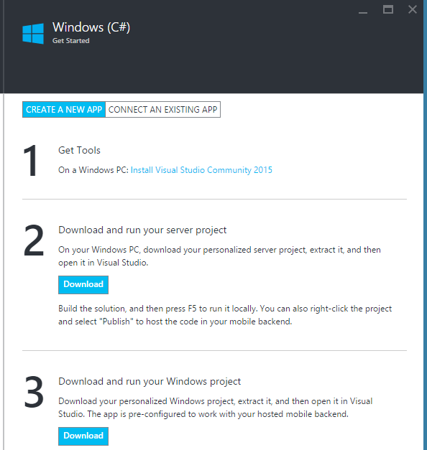
Create New or Connect Existing App

Slide 39
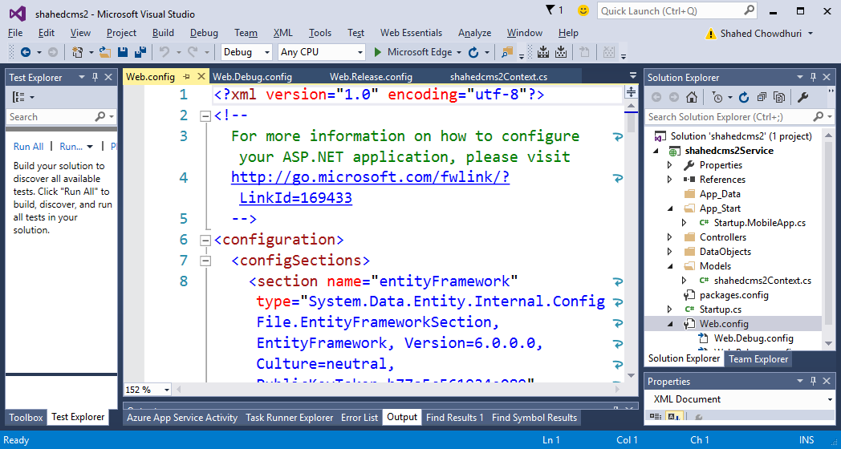
Build & Run Service/App Projects
NOTE: Mobile client app and service app are in separate projects now.

Slide 40
Construct 2 Games

Slide 41
Setting up Azure Mobile Services for C2
Create
Config
Get Auth Data
Tutorial: http://blogs.msdn.com/b/quick_thoughts/archive/2015/03/10/construct-2-global-high-scores-for-windows-8-1-with-windows-azure-plugin.aspx

Slide 42
1. Create Mobile Service

Slide 43
2. Configure Mobile Service

Slide 44
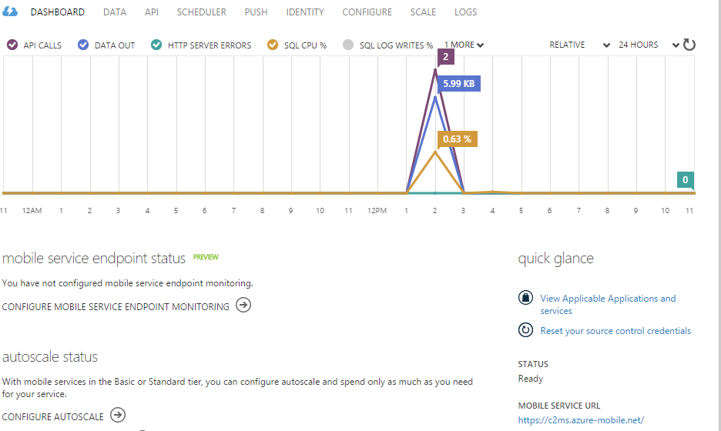
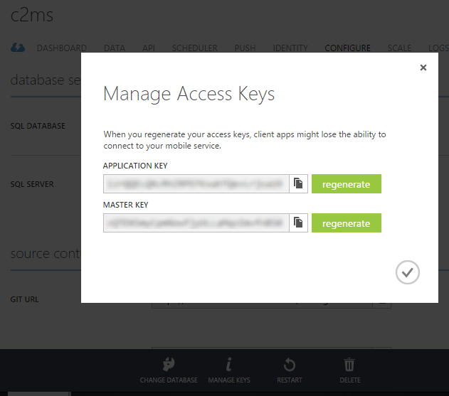
3. Get Authentication Data

Slide 45
Connecting Construct 2 to Azure
Export Game
Add Refs
Update Code
Tutorial: http://blogs.msdn.com/b/quick_thoughts/archive/2015/03/10/construct-2-global-high-scores-for-windows-8-1-with-windows-azure-plugin.aspx

Slide 46
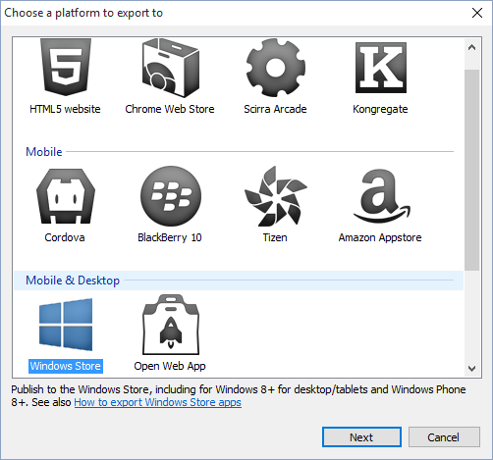
1. Export Game Project
Click “Export Project”
Select “Windows Store”

Slide 47
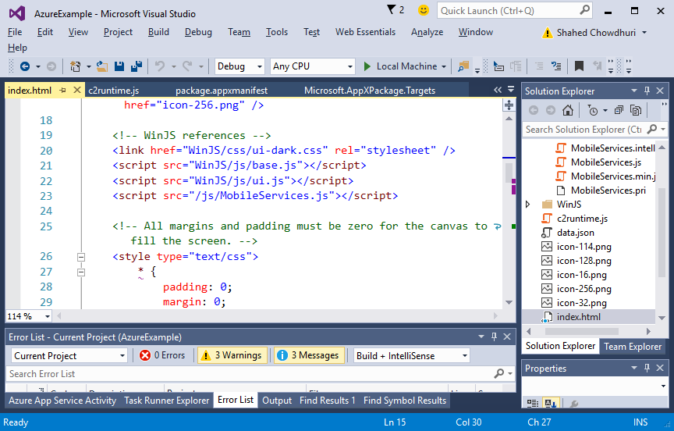
2. Add References

Slide 48
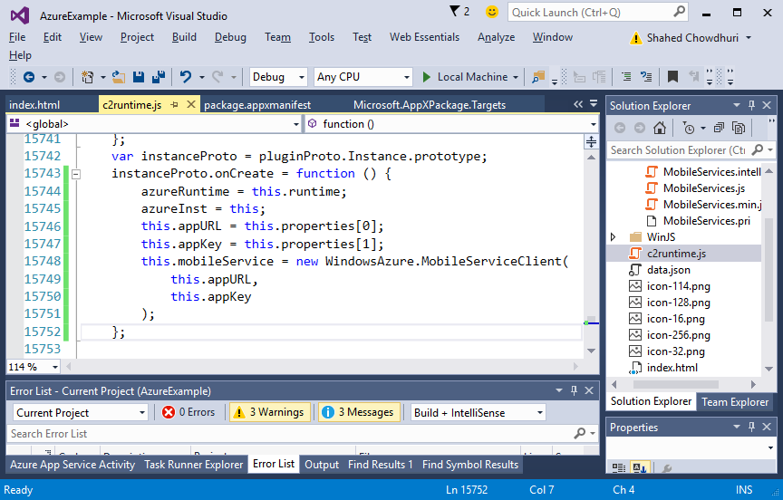
3. Update Code

Slide 49
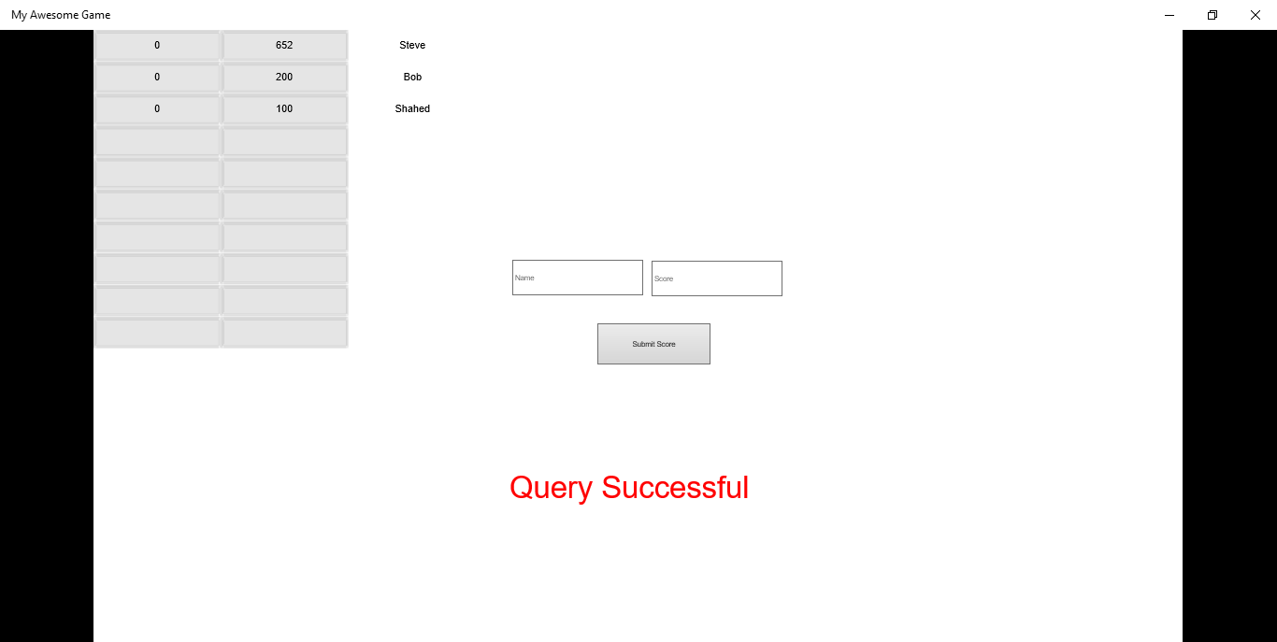
Demo: Construct 2 with Azure

Slide 50
Unity Games

Slide 51
Setting up Azure Mobile Services for Unity
Create
Config
Get Auth Data
Tutorial: http://www.deadlyfingers.net/azure/unity3d-game-dev-with-azure-mobile-services-using-bitrave-plugin/

Slide 52
1. Create Mobile Service

Slide 53
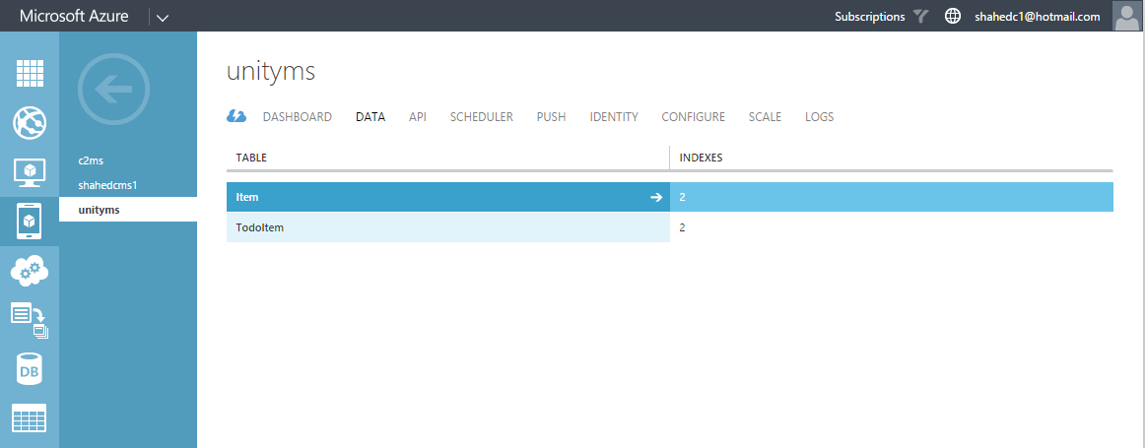
2. Configure Mobile Service

Slide 54
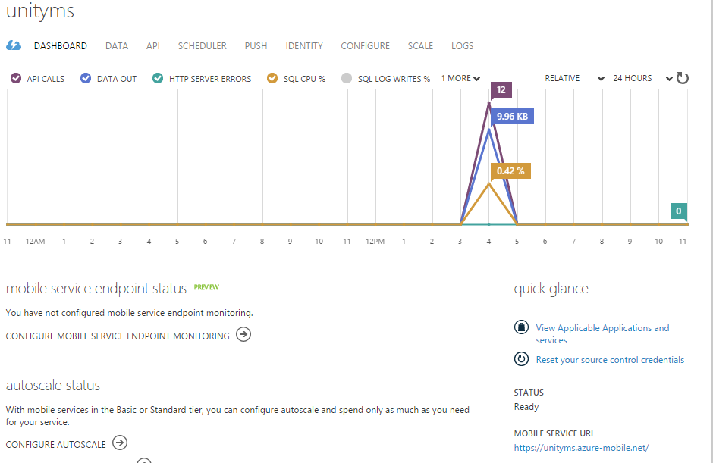
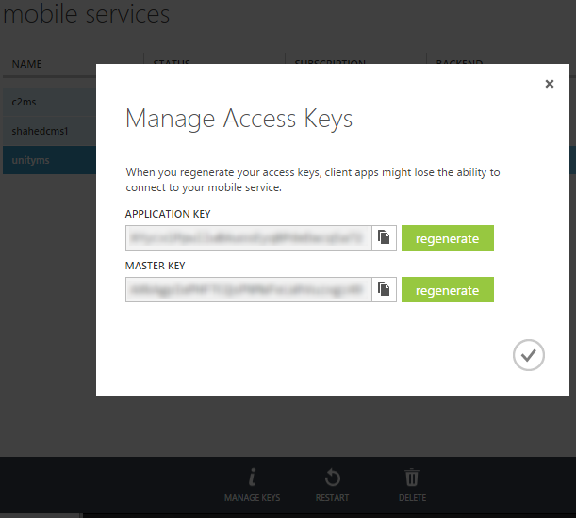
3. Get Authentication Data

Slide 55
Connecting Unity to Azure
Get plugins
Config auth
Update Code
Tutorial: http://www.deadlyfingers.net/azure/unity3d-game-dev-with-azure-mobile-services-using-bitrave-plugin/

Slide 56
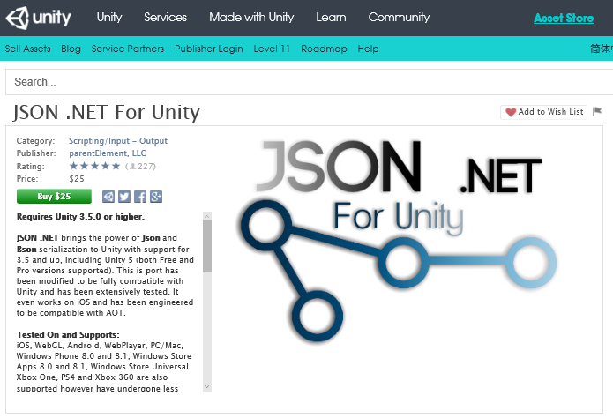
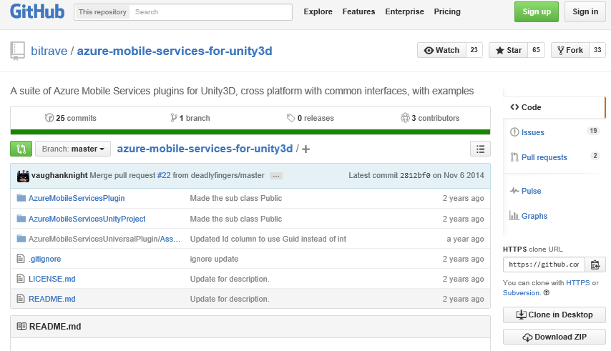
1. Get BitRave Plugin, JSON.NET Asset

Slide 57
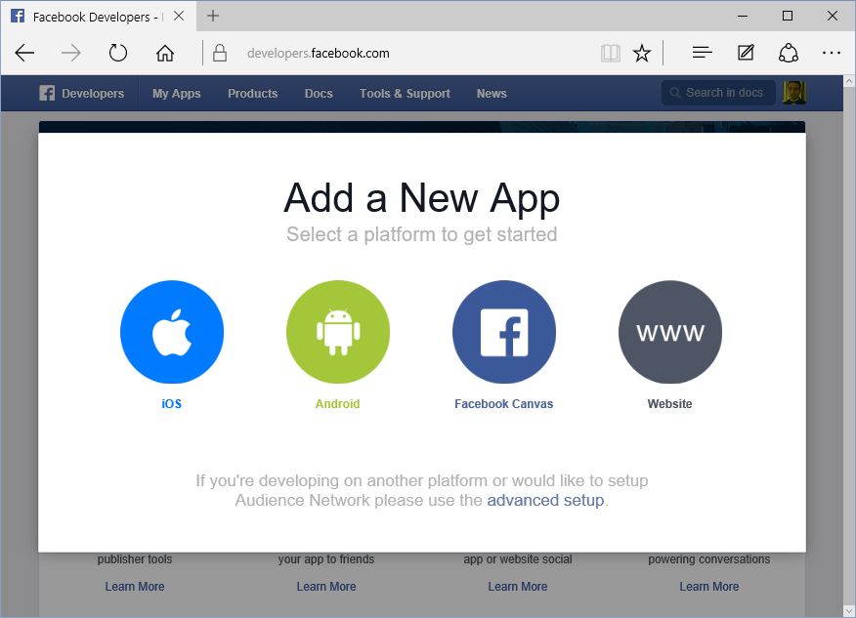
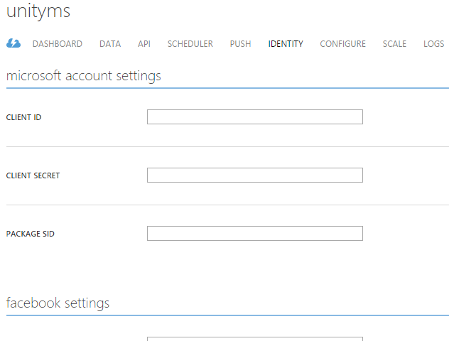
2. Configure Authentication

Slide 58
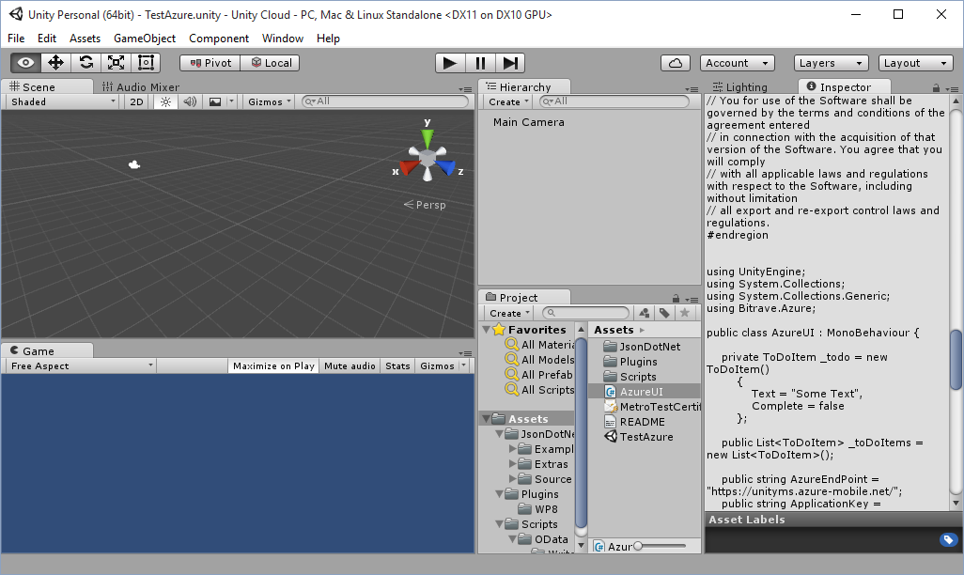
3. Update Code, Add URL and Keys

Slide 59
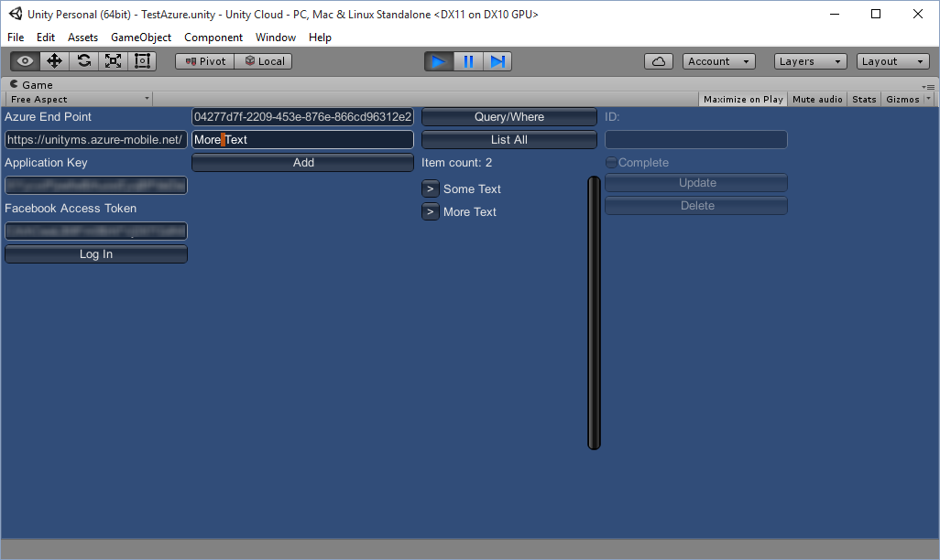
Demo: Unity with Azure

Slide 60
Agenda
Introduction
> Mobile Apps & Services
> Construct 2 Games
> Unity Games
Q&A
Notes:
Agenda

Slide 61
Questions?
Notes:
Questions?

Slide 62
Agenda
Introduction
> Mobile Apps & Services
> Construct 2 Games
> Unity Games
Q&A
Notes:
Agenda

Slide 63
Contact
Email: shchowd@microsoft.com  Twitter: @shahedC
Notes:
Contact
Microsoft email: shchowd@microsoft.com
Personal Twitter: @shahedC
Dev Blog: WakeUpAndCode.com

