Slide 1
Azure Mobile Services (+ Universal Apps)
Windows  Windows Phone  Azure  … and more!
By Shahed Chowdhuri
Sr. Technical Evangelist
WakeUpAndCode.com
@shahedC
Notes:
Title Page: Azure Mobile Services (+ Universal Apps) Windows  Windows Phone  Azure  … and more!
By Shahed Chowdhuri
Sr. Technical Evangelist
Blog: WakeUpAndCode.com
Twitter: @shahedC

Slide 2
Agenda
Intro: Cloud + Universal Apps
> Creating a Mobile Service
> Consuming the Service
> Publishing the Service
Q&A
Notes:
Agenda
Intro: Cloud + Universal Apps
> Creating a Mobile Service
> Consuming the Service
> Publishing the Service
Q&A
* Learn about how you can build a mobile service in Azure and consume it with a mobile app.

Slide 3
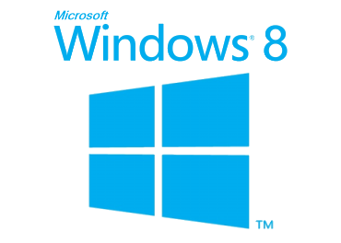
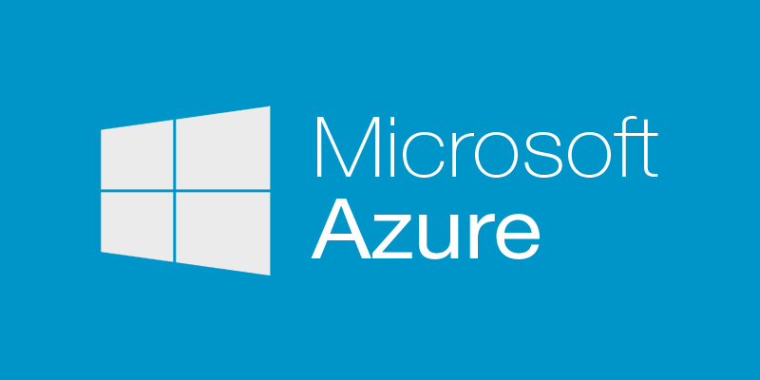
Tools & Technologies
Notes:
Tools & Technologies
Visual Studio 2013
Windows 8
Microsoft .NET and Visual C#
Windows Phone
JavaScript
Microsoft Azure

Slide 4
Introduction: The Cloud
Notes:
Introduction

Slide 5
What is the Cloud?
“No one understands
the Cloud!!!”
Notes:
What is the Cloud?
Screen Capture: “No one understands the Cloud!!!”

Slide 6
Cloud Services: IaaS, PaaS and SaaS
 |  | Host | Build | Consume
 | Packaged Software | IaaS: infrastructure as a service | PaaS: Platform as a service | Saas: software as a service
Applications | Self- Managed | Self- Managed | Self- Managed | Managed By Vendor
Data
Runtime |  |  | Managed By Vendor
Middleware
O/S
Virtualization |  | Managed By Vendor
Servers
Storage
Networking
Source: Bret Stateham, Windows Azure evangelist
Notes:
Cloud Services: IaaS, PaaS and SaaS

Slide 7
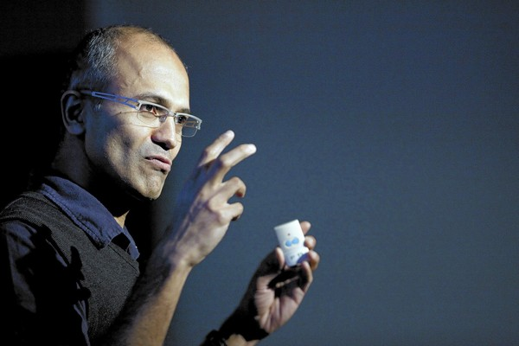
In Line with Microsoft’s Vision
“… mobile first, cloud first… ”
Microsoft CEO Satya Nadella
Notes:
In Line with Microsoft’s Vision
“… mobile first, cloud first… ”
Microsoft CEO Satya Nadella

Slide 8
Universal Apps
Notes:
Introduction

Slide 9
What is a Universal App?
"Apps that are tailored to people with disabilities"
"Apps that are automatically multi-lingual and culture adherent"
"Apps that can run on all platforms (iOS, Android, Windows)"
"A single app package that will work across Microsoft devices“
None of the Above?
Notes:
What is a Universal App?
"Apps that are tailored to people with disabilities"
"Apps that are automatically multi-lingual and culture adherent"
"Apps that can run on all platforms (iOS, Android, Windows)"
"A single app package that will work across Microsoft devices“
None of the Above?

Slide 10
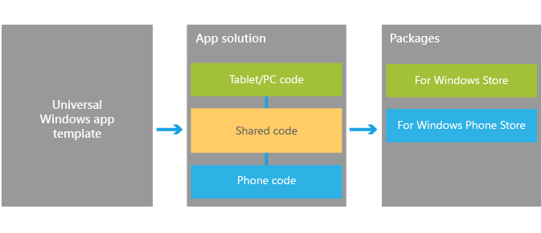
Universal Apps for Windows
Universal Apps for Windows
1 solution
1 shared project (no binary output)
1 project per platform (separate binary output per platform)
Windows, Windows Phone, Xbox One (coming soon!)
Ref: http://dev.windows.com/en-us/develop/Building-universal-Windows-apps
Notes:
Universal Apps for Windows
Universal Apps for Windows
1 solution
1 shared project (no binary output)
1 project per platform (separate binary output per platform)
Windows, Windows Phone, Xbox One (coming soon!)
Ref: http://dev.windows.com/en-us/develop/Building-universal-Windows-apps

Slide 11
Benefits of Universal Apps
Pricing structure – Match Windows Phone pricing on Windows 8
Shared in-app purchases – Buy IAPs only once, on either platform.
Install across devices – Buy app only once, own across platforms
Shared revenue model – Keep 70% of revenue
Unified ad-units for Windows Phone and Windows apps
Ref: http://www.wpcentral.com/what-is-a-universal-windows-app
Notes:
Benefits of Universal Apps
Pricing structure – Match Windows Phone pricing on Windows 8
Shared in-app purchases – Buy IAPs only once, on either platform.
Install across devices – Buy app only once, own across platforms
Shared revenue model – Keep 70% of revenue
Unified ad-units for Windows Phone and Windows apps
Ref: http://www.wpcentral.com/what-is-a-universal-windows-app

Slide 12
Streamlined Development
Notes:
Streamlined Development
(graphic)
UI → App Model → APIs → Tools → Store

Slide 13
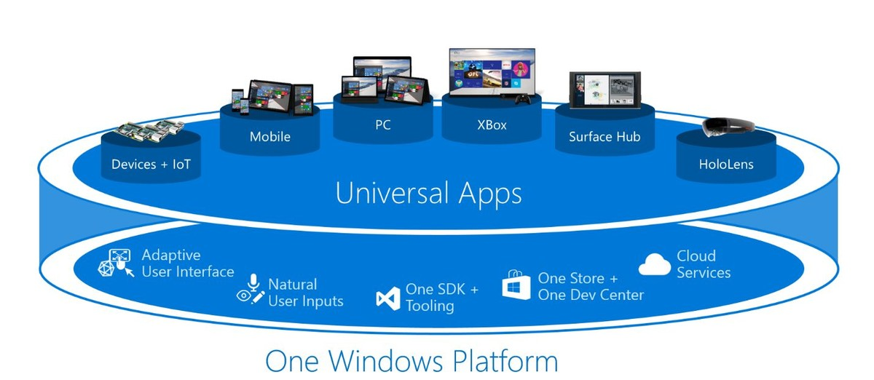
Universal Apps in Windows 10
“The platform enables a new class of Windows universal apps – apps that are truly written once, with one set of business logic and one UI. Apps that are delivered to one Store within one package.”
More Info: http://www.windowscentral.com/microsoft-reveals-its-windows-10-universal-apps-plans-developers-mwc-2015

Slide 14
Visual Studio
Notes:
Visual Studio

Slide 15
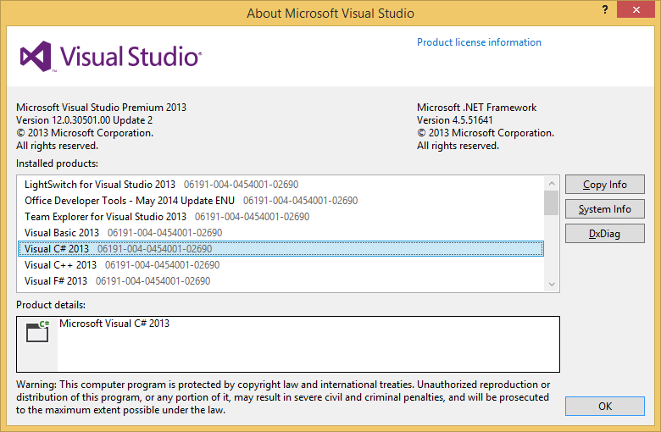
VS 2013 Update 2+
C# and XAML
HTML5 & JavaScript
C++ and DirectX
Notes:
VS 2013 Update 2+
C# and XAML
HTML5 & JavaScript
C++ and DirectX

Slide 16
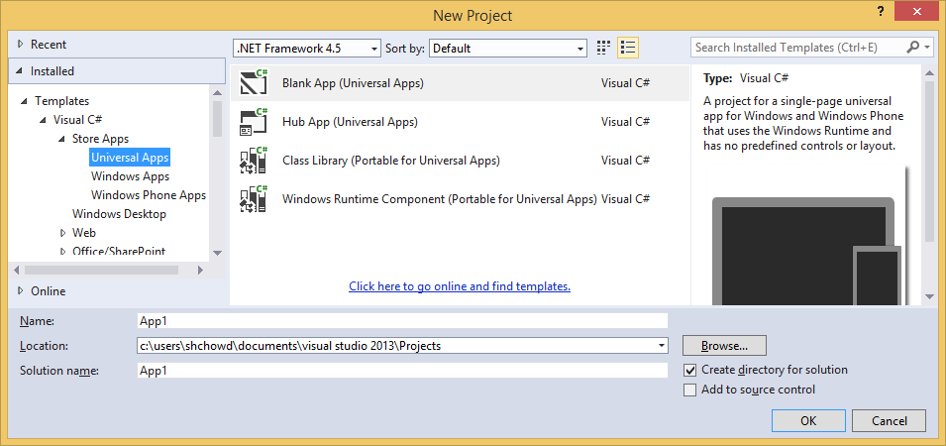
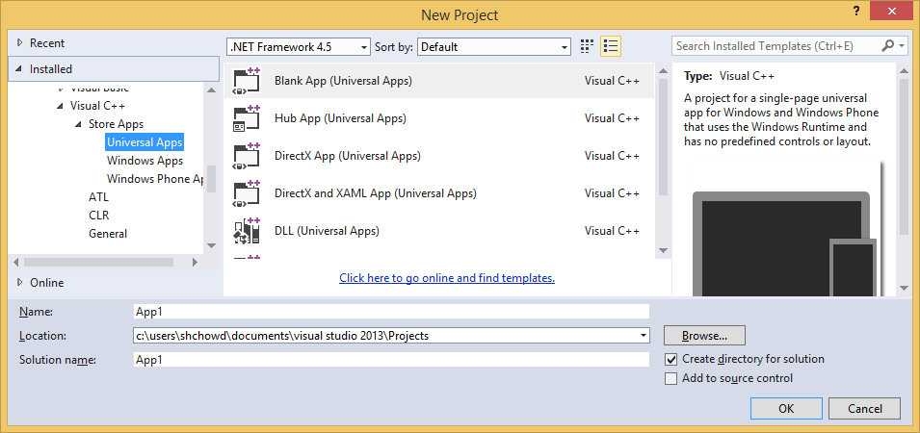
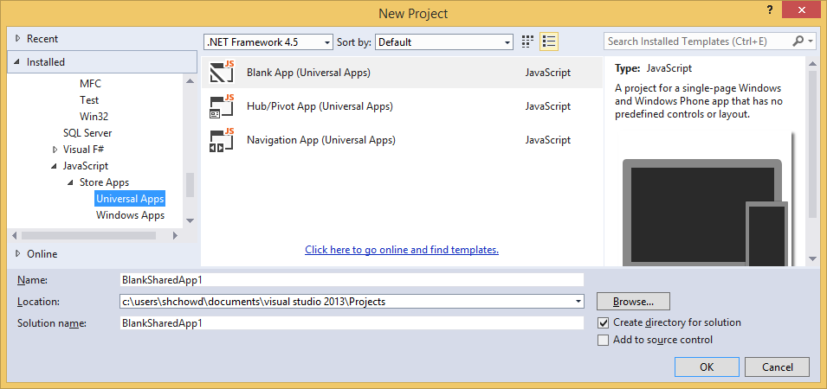
Creating a Universal Project
Notes:
Creating a Universal Project
Look under Store Apps for specific language
C++, C#, JavaScript

Slide 17
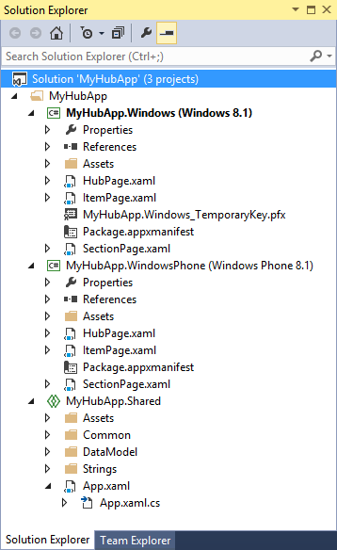
New Project
Windows 8.1 project
Windows Phone 8.1 project
Shared project
Notes:
New Project
Solution Explorer
Windows 8.1 project
Windows Phone 8.1 project
Shared project

Slide 18
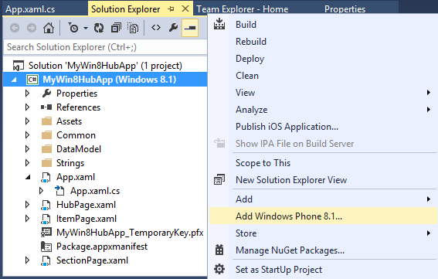
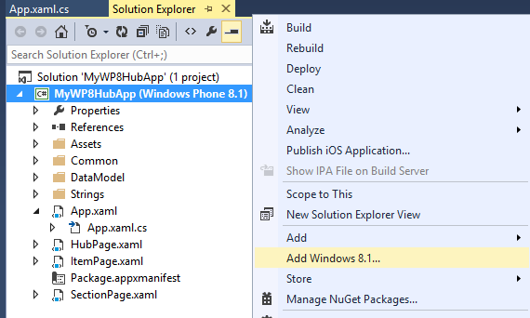
Existing Project
Windows 8.1 project?
Right-click → Add Windows Phone 8.1…
Windows Phone 8.1 project?
Right-click → Add Windows 8.1…
Notes:
Existing Project
Windows 8.1 project?
Right-click → Add Windows Phone 8.1…
Windows Phone 8.1 project?
Right-click → Add Windows 8.1…

Slide 19
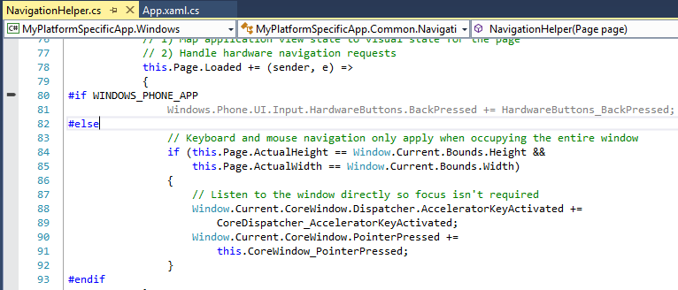
Platform-Specific Code (with conditional compilation)
Reference:
http://blogs.msdn.com/b/visualstudio/archive/2014/04/14/using-visual-studio-to-build-universal-xaml-apps.aspx
Notes:
Platform-Specific Code (with conditional compilation)
C#
WINDOWS_APP
WINDOWS_PHONE_APP
C++
WINAPI_FAMILY_PC_APP
WINAPI_FAMILY_PHONE_APP
Reference:
http://blogs.msdn.com/b/visualstudio/archive/2014/04/14/using-visual-studio-to-build-universal-xaml-apps.aspx

Slide 20
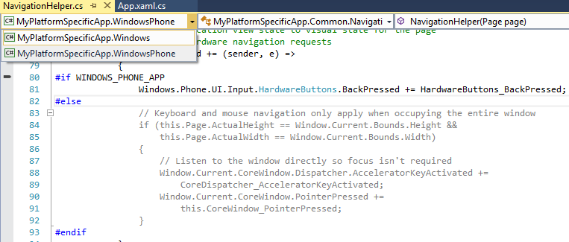
Context Chooser
Reference:
http://msdn.microsoft.com/en-us/library/windows/apps/dn609832.aspx
Notes:
Context Chooser
(top-left dropdown to choose Windows or Windows Phone)
Reference:
http://msdn.microsoft.com/en-us/library/windows/apps/dn609832.aspx

Slide 21
Sharing Code Across Universal Apps
How about using a Portable Class Library (PCL)?
“This type of project has been improved in Visual Studio 2013 Update 2 and now, if we target Windows 8.1 and Windows Phone 8.1, we’ll be able to use all the common APIs.
However, PCL produces a single binary that works as is in all the supported projects. Handling divergent APIs requires using higher-level abstractions, such as dependency injection or IoC containers. We can’t simply use conditional if to define platform specific code.”
Reference:
http://marcominerva.wordpress.com/2014/04/22/how-to-share-code-among-different-universal-windows-apps/
Notes:
Sharing Code Across Universal Apps
How about using a Portable Class Library (PCL)?
“This type of project has been improved in Visual Studio 2013 Update 2 and now, if we target Windows 8.1 and Windows Phone 8.1, we’ll be able to use all the common APIs.
However, PCL produces a single binary that works as is in all the supported projects. Handling divergent APIs requires using higher-level abstractions, such as dependency injection or IoC containers. We can’t simply use conditional if to define platform specific code.”
Reference:
http://marcominerva.wordpress.com/2014/04/22/how-to-share-code-among-different-universal-windows-apps/

Slide 22
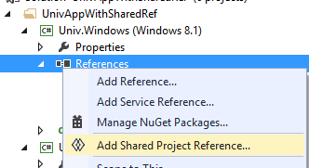
Shared Reference Project
Download & Install “Shared Project Reference Manager” from MSDN:
http://visualstudiogallery.msdn.microsoft.com/315c13a7-2787-4f57-bdf7-adae6ed54450
Add Project to Solution:
Add Class Library for each platform (Win 8.1 & WP 8.1)
Add Shared Project Reference to each Class Library.
Ref: http://marcominerva.wordpress.com/2014/04/22/how-to-share-code-among-different-universal-windows-apps/
Notes:
Shared Reference Project
Download & Install “Shared Project Reference Manager” from MSDN:
http://visualstudiogallery.msdn.microsoft.com/315c13a7-2787-4f57-bdf7-adae6ed54450
Add Project to Solution:
Add Class Library for each platform (Win 8.1 & WP 8.1)
Add Shared Project Reference to each Class Library.

Slide 23
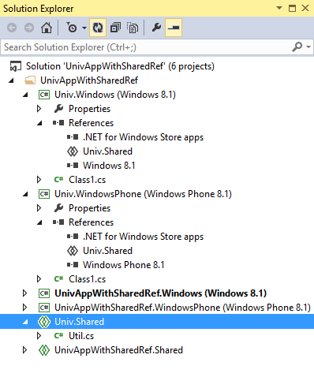
Shared References in Solution Explorer
Class Library for Windows 8.1
with reference to Shared project
Class Library for Windows Phone 8.1
with reference to Shared project
Shared project for Class Libraries
Notes:
Shared References in Solution Explorer
Class Library for Windows 8.1 with reference to Shared project
Class Library for Windows Phone 8.1 with reference to Shared project
Shared project for Class Libraries

Slide 24
For more info:
Samples on MSDN:
http://code.msdn.microsoft.com/windowsapps/Universal-Windows-app-cb3248c3
MVA:
http://www.microsoftvirtualacademy.com/training-courses/developing-universal-windows-apps-with-c-and-xaml
Wintellect
Blog Post: http://www.wintellect.com/blogs/jprosise/building-universal-apps-with-visual-studio-2013-update-2
Notes:
For more info:
Samples on MSDN:
http://code.msdn.microsoft.com/windowsapps/Universal-Windows-app-cb3248c3
MVA:
http://www.microsoftvirtualacademy.com/training-courses/developing-universal-windows-apps-with-c-and-xaml
Wintellect
Blog Post: http://www.wintellect.com/blogs/jprosise/building-universal-apps-with-visual-studio-2013-update-2

Slide 25
Agenda
Intro: Cloud + Universal Apps
> Creating a Mobile Service
> Consuming the Service
> Publishing the Service
Q&A
Notes:
Agenda
Intro: Cloud + Universal Apps
> Creating a Mobile Service
> Consuming the Service
> Publishing the Service
Q&A
* Learn about how you can build a mobile service in Azure and consume it with a mobile app.

Slide 26
Creating a Mobile Service
Notes:
Creating a Mobile Service

Slide 27
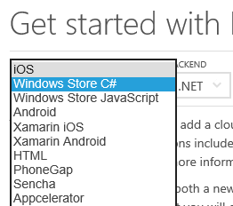
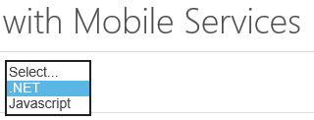
Getting Started
Link: http://azure.microsoft.com/en-us/documentation/articles/mobile-services-dotnet-backend-windows-store-dotnet-get-started/
Notes:
Getting Started
Link: http://azure.microsoft.com/en-us/documentation/articles/mobile-services-dotnet-backend-windows-store-dotnet-get-started/

Slide 28
Create a Mobile Service
Notes:
Create a Mobile Service

Slide 29
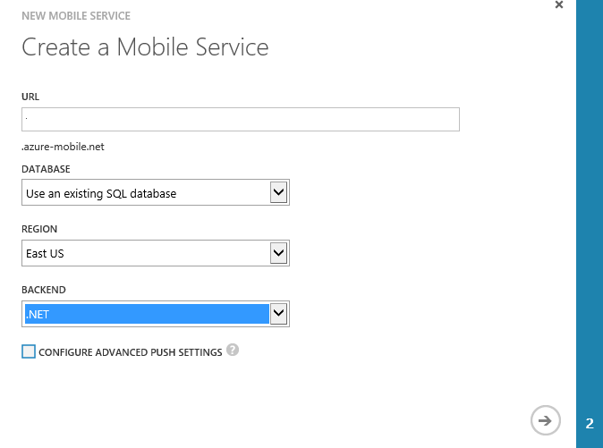
Specify Mobile Service Details
Name for the URL
(not the full URL)
Notes:
Specify Mobile Service Details

Slide 30
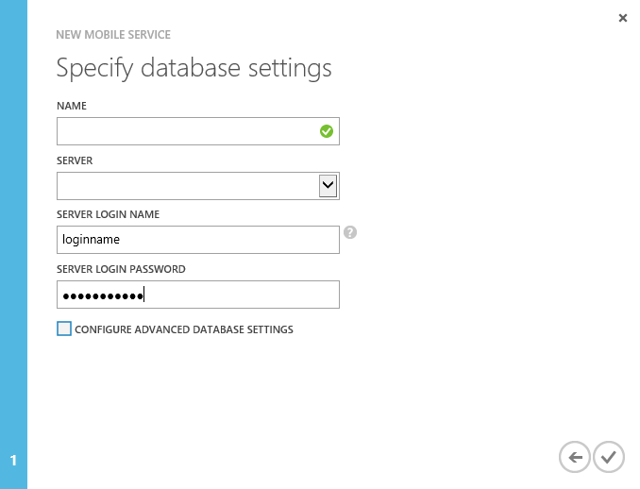
Specify Database Settings
Notes:
Specify Database Settings

Slide 31
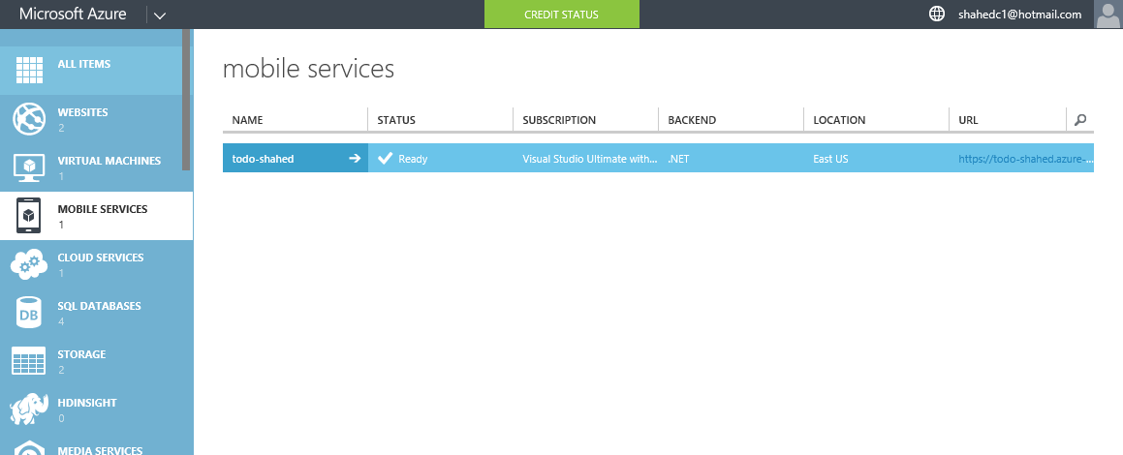
Verify Status of Mobile Service
Notes:
Verify Status of Mobile Service

Slide 32
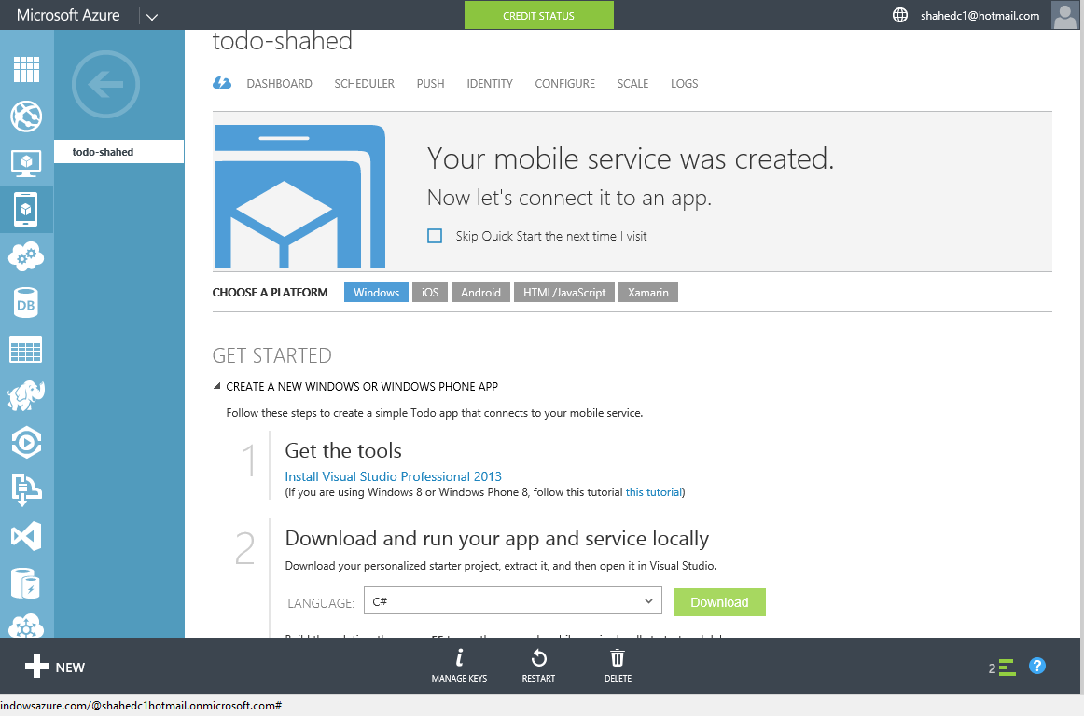
Get Tools & Download Your Solution
Notes:
Get Tools & Download Your Solution

Slide 33
Consuming the Service
Notes:
Consuming the Service

Slide 34
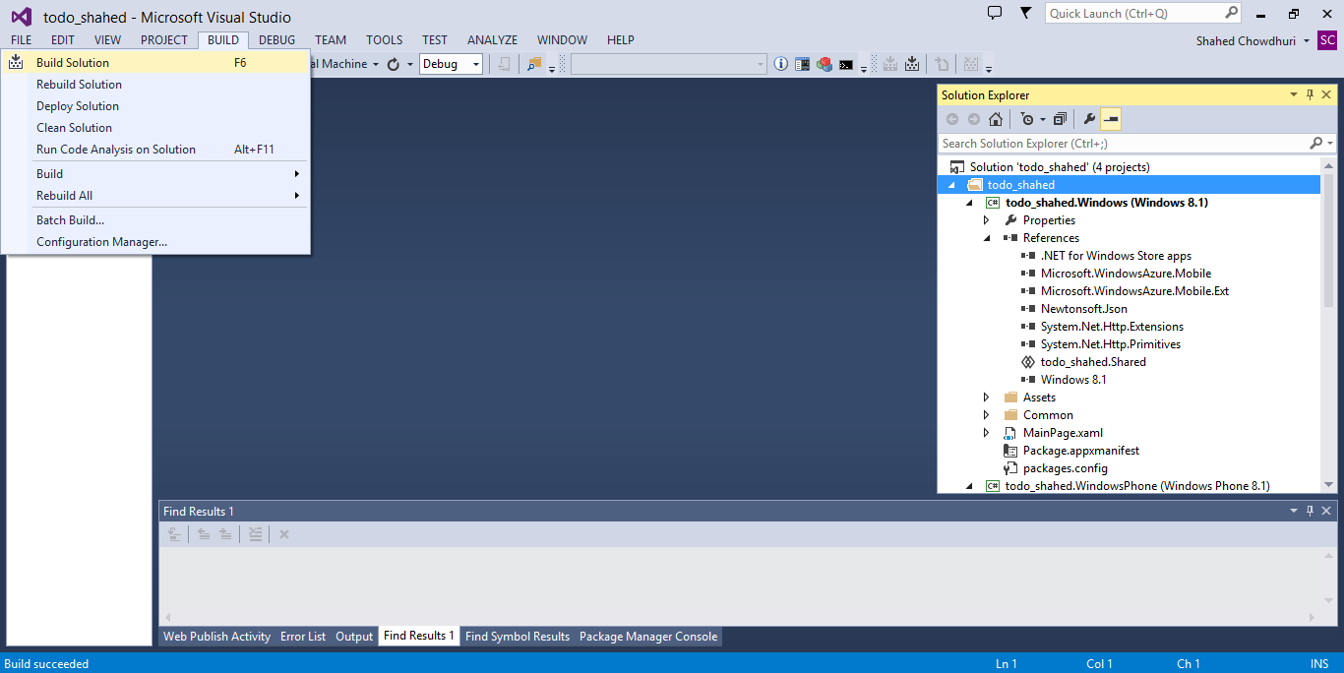
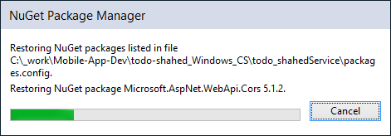
Build Your Solution (update NuGet packages)
. . .
Notes:
Build Your Solution (update NuGet packages)

Slide 35
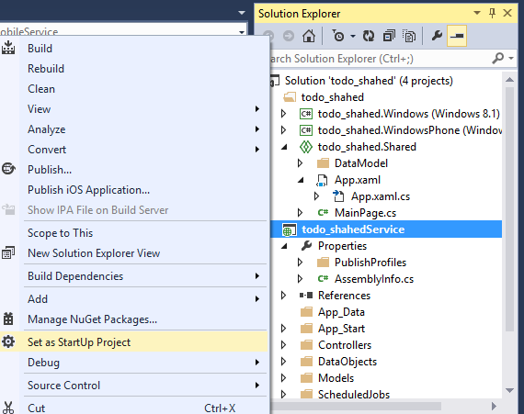
Run the Service Locally
Notes:
Run the Service Locally

Slide 36
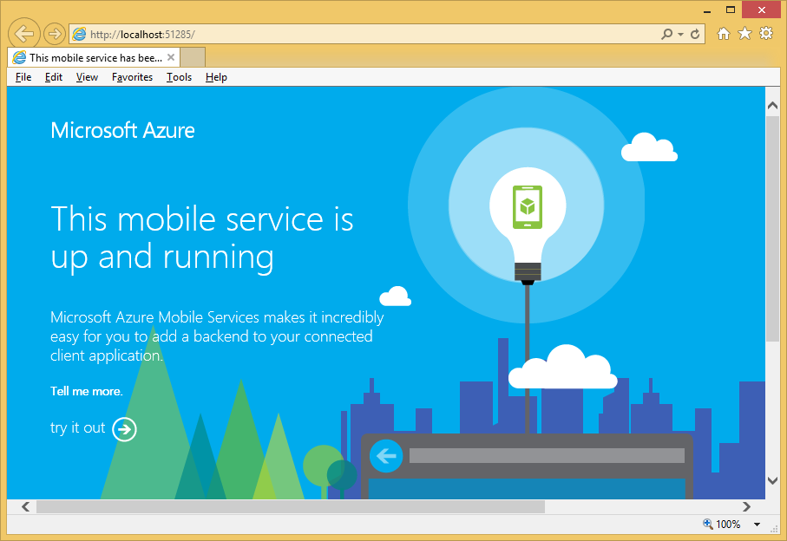
Verify the Service Locally
Notes:
Verify the Service Locally

Slide 37
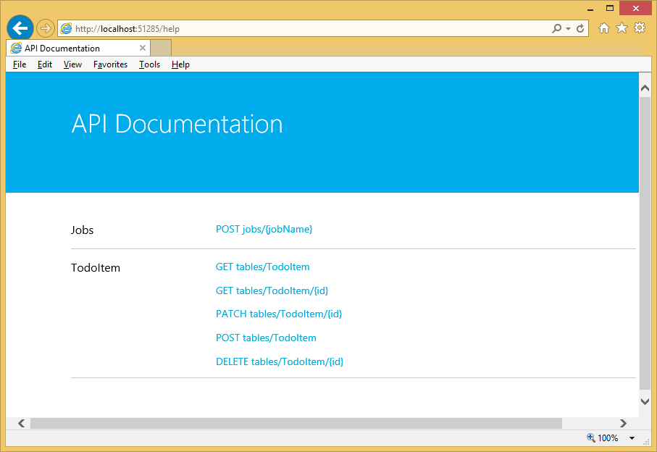
Try it out…
Notes:
Try it out…

Slide 38
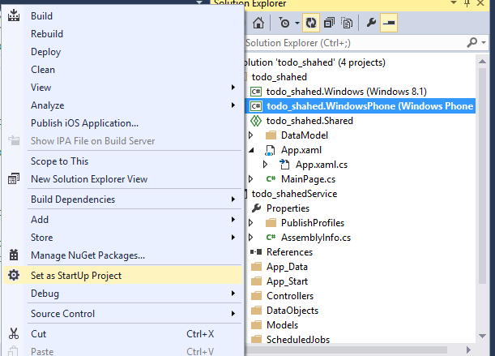
Run Windows Phone App Locally
Notes:
Run Windows Phone App Locally

Slide 39
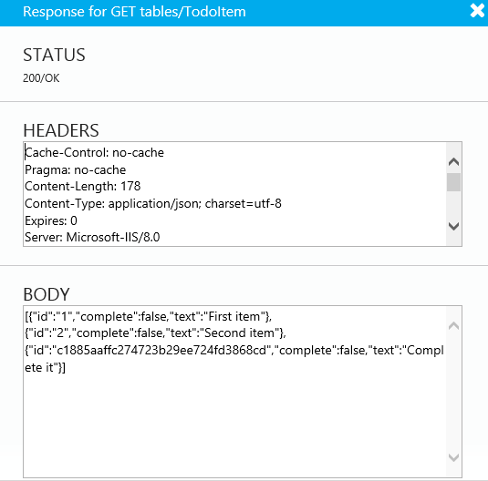
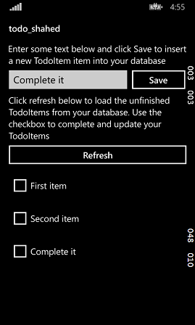
Verify Windows Phone App
Notes:
Verify Windows Phone App

Slide 40
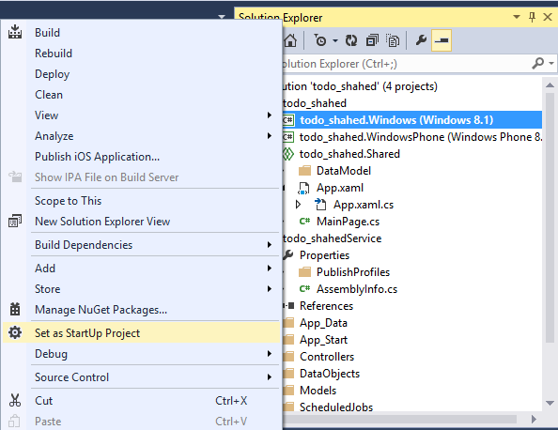
Run Windows App Locally
Notes:
Run Windows App Locally

Slide 41
Verify Windows App Locally
Notes:
Verify Windows App Locally

Slide 42
Publishing the Service
Notes:
Publishing the Service

Slide 43
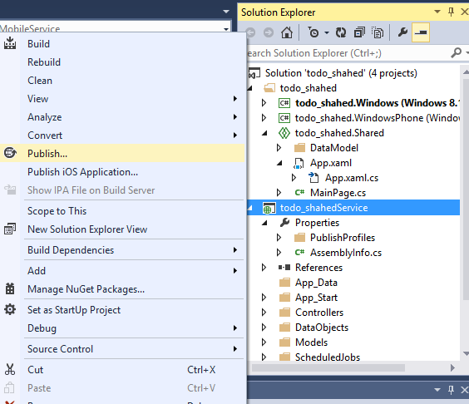
Publish Your Mobile Service
Notes:
Publish Your Mobile Service

Slide 44
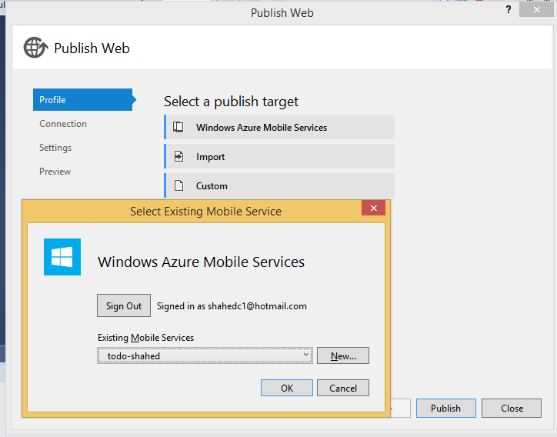
Sign In and Select Existing Service
Notes:
Sign In and Select Existing Service

Slide 45
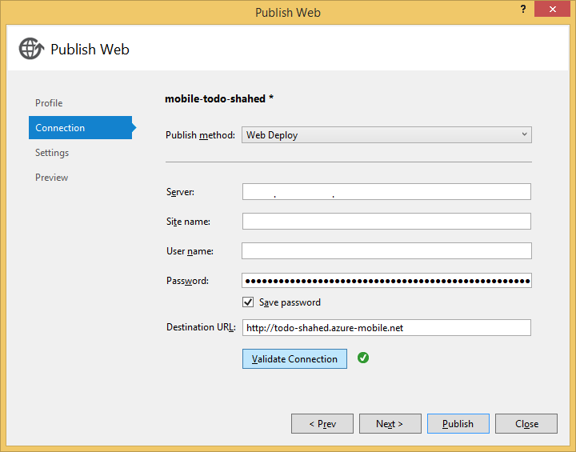
Complete the Publishing Process
Notes:
Complete the Publishing Process

Slide 46
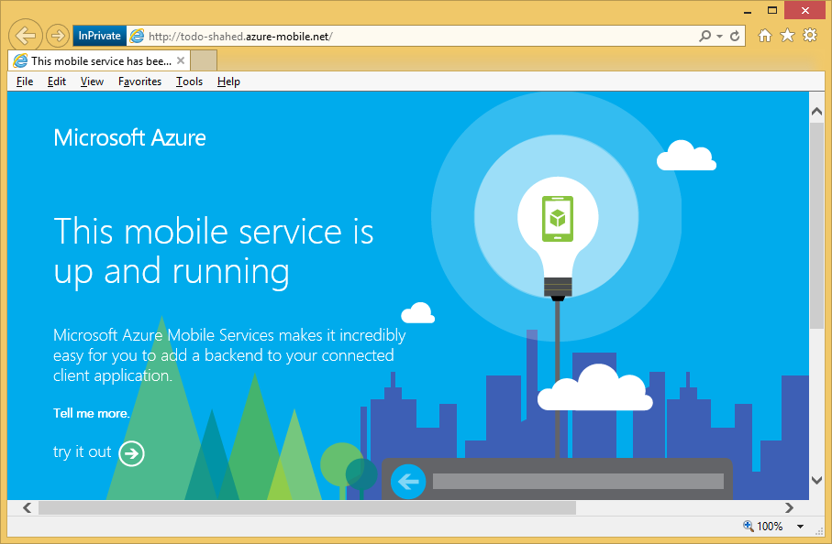
Verify the Service is Running
Notes:
Verify the Service is Running

Slide 47
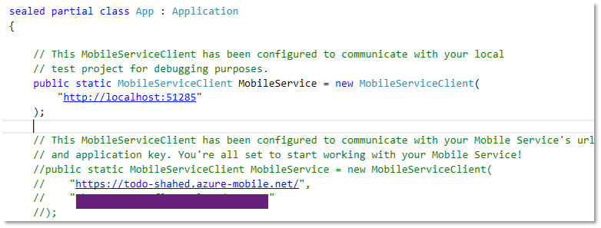
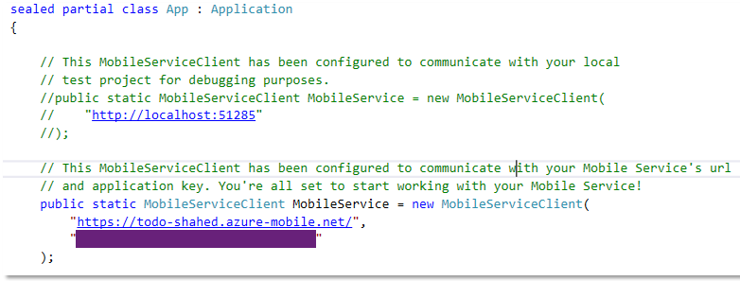
Update App.Xaml.cs (Shared project)
BEFORE:
AFTER:
Comment out local settings
Uncomment server settings, including key
Notes:
Update App.Xaml.cs (Shared project)
Comment out local settings
Uncomment server settings, including key

Slide 48
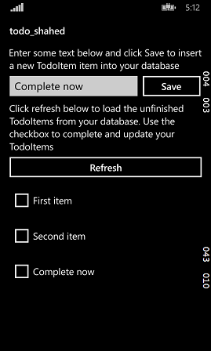
Run Windows Phone Project
Enter a value to test it
Notes:
Run Windows Phone Project

Slide 49
Run Windows project
Enter a value to test it
Notes:
Run Windows project

Slide 50
Agenda
Intro: Cloud + Universal Apps
> Creating a Mobile Service
> Consuming the Service
> Publishing the Service
Q&A
Notes:
Agenda
Intro: Cloud + Universal Apps
> Creating a Mobile Service
> Consuming the Service
> Publishing the Service
Q&A
* Learn about how you can build a mobile service in Azure and consume it with a mobile app.

Slide 51
Questions?
Notes:
Questions?

Slide 52
Agenda
Intro: Cloud + Universal Apps
> Creating a Mobile Service
> Consuming the Service
> Publishing the Service
Q&A
Notes:
Agenda
Intro: Cloud + Universal Apps
> Creating a Mobile Service
> Consuming the Service
> Publishing the Service
Q&A
* Learn about how you can build a mobile service in Azure and consume it with a mobile app.

Slide 53
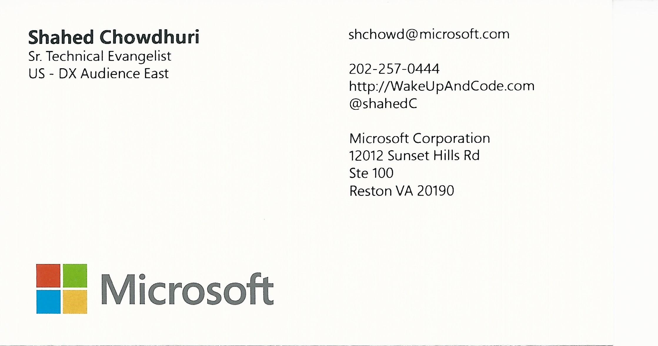
Contact
Email: shchowd@microsoft.com  Twitter: @shahedC
Notes:
Contact
Microsoft email: shchowd@microsoft.com
Personal Twitter: @shahedC
Dev Blog: WakeUpAndCode.com

