Slide 1
Construct 2: Flapping Bird Improvements
Windows 8  Windows Phone 8  Web  Mobile  … and more!
By Shahed Chowdhuri
Sr. Technical Evangelist
WakeUpAndCode.com
@shahedC
Notes:
Title Page: Intro to Indie Game Development Windows  Web  Xbox  Mobile
By Shahed Chowdhuri
Technical Evangelist
Blog: WakeUpAndCode.com
Twitter: @shahedC

Slide 2
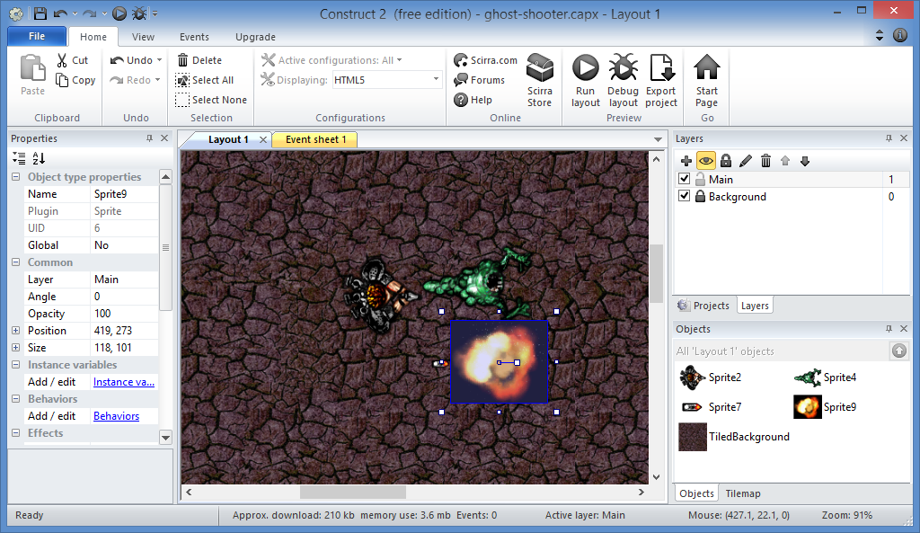
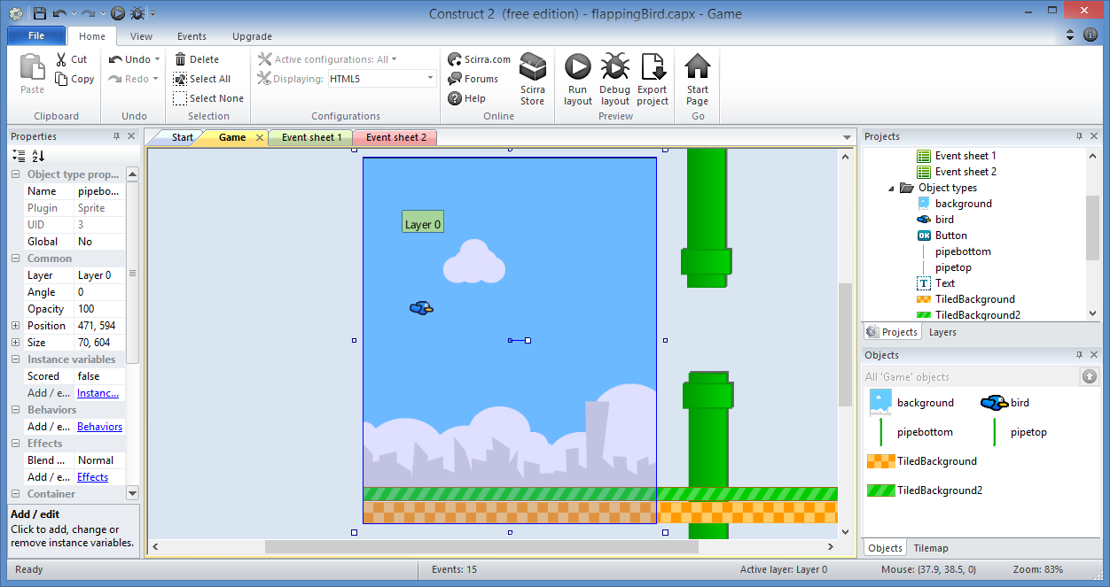
Prerequisites
Ghost Shooter Tutorial
Flapping Bird Tutorial
Both available at:
Construct 2 – Step by Step
http://wakeupandcode.com/construct-2-step-by-step/

Slide 3
High Scores

Slide 4
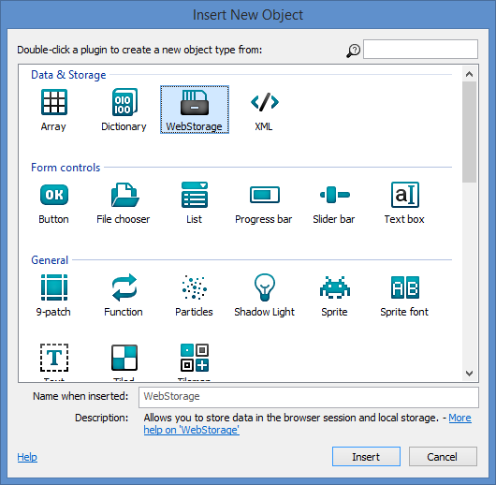
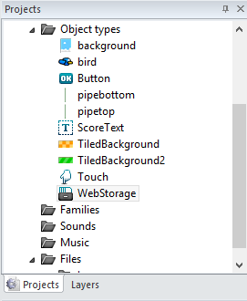
1. Insert New Object → WebStorage
Click “Insert”

Slide 5
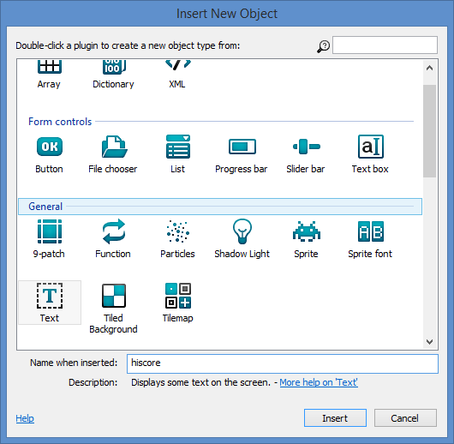
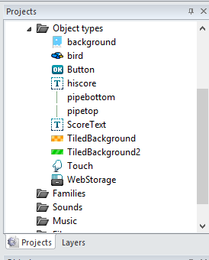
2. Insert New Object → Text on Start screen
Select “Text”
Rename “hiscore”
Click “Insert”

Slide 6
3. Add New Event for Start screen
Add Event: System → On start of layout
Add Sub-event: Webstorage → Local key exists: “hiscore”
Add Action: hiscore → Set text to “high score= “ & WebStorage.LocalValue(“hiscore”)
Add Else:
Add Action: WebStorage → Set local value:
Key = “hiscore”
Value = 0

Slide 7
Functions

Slide 8
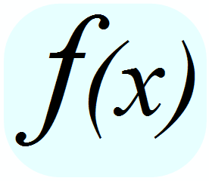
1. BUT FIRST… What is a Function?
Definition: series of instructions that can be called with a name instead of each individual instruction.
Example:
Function CleanYourRoom()
Pick up clothes.
Pick up papers.
Vacuum the floor.
Wipe off dust.

Slide 9
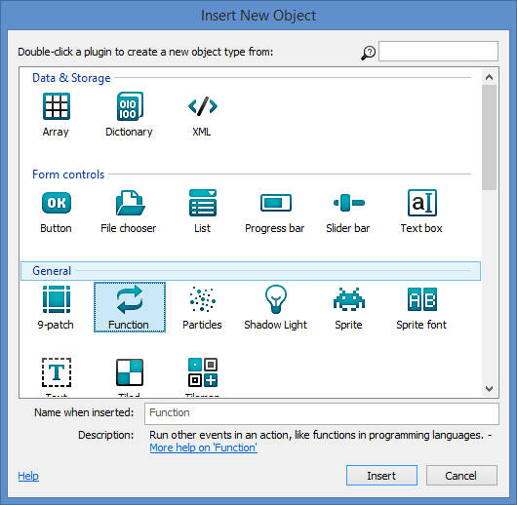
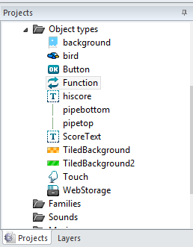
2. Insert New Object → Function
Click “Insert”

Slide 10
3. Add New Event for Game screen
Add Event: Function → On function → “endgame”
Add Sub-event: System → Compare variable → Score > WebStorage.LocalValue(“hiscore”)
Add Action: WebStorage → Set local key “hiscore” to Score
Add Action: System → Go to layout: “Start”
Add Else:
Add Action: System → Go to layout: “Start”

Slide 11
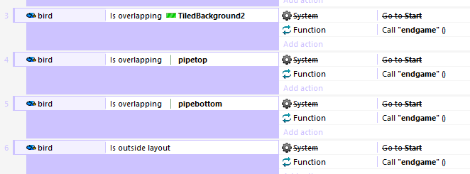
4. Call Function “endgame” instead of Go to Start
Add Action: Function → Call function “endgame”

Slide 12
Sounds

Slide 13
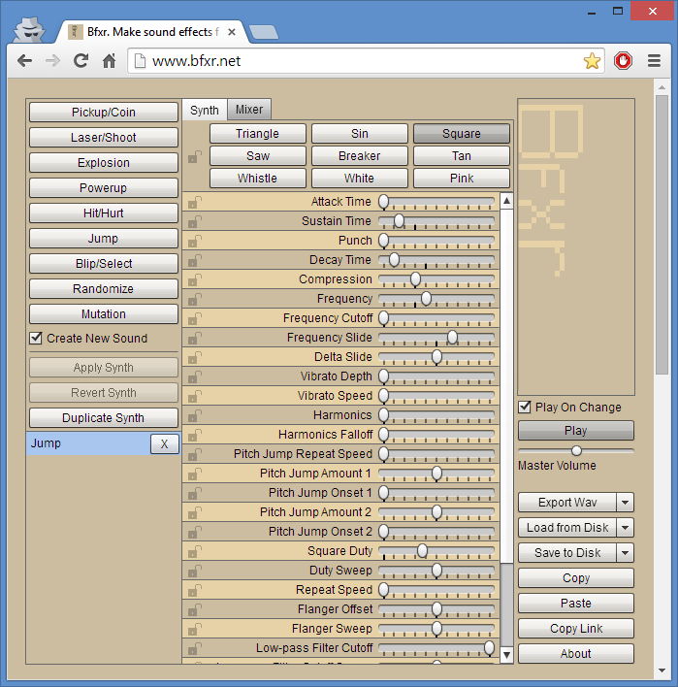
1. BUT FIRST… let’s make some sounds!
a
Go to www.bfxr.net
Verify “Jump” is selected, or click to add it.
Click “Play” on the right to hear it.
Click Export Wav to download the file.
b
c
d

Slide 14
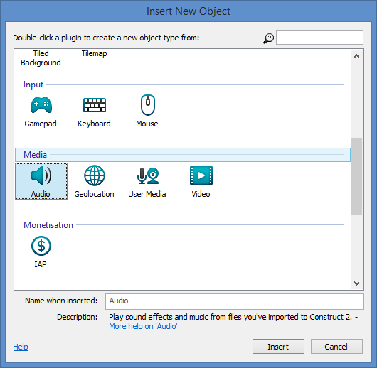
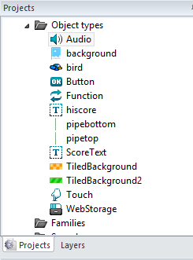
2. Insert New Object → Audio
Click “Insert”

Slide 15
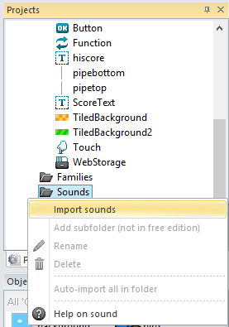
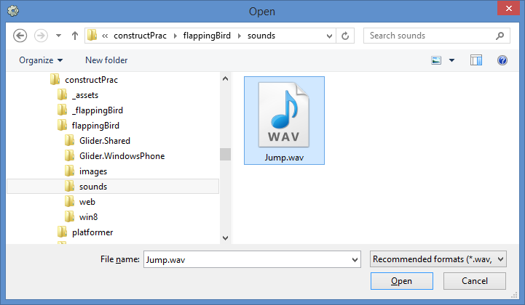
3. Import Sounds
Right-click Sounds folder
Click “Import sounds”
Select “Jump” sound you just downloaded, to Import it

Slide 16
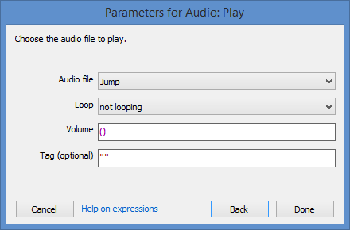
4. Play Sound on Touch Event
Add Action: Audio → Play “Jump”

Slide 17
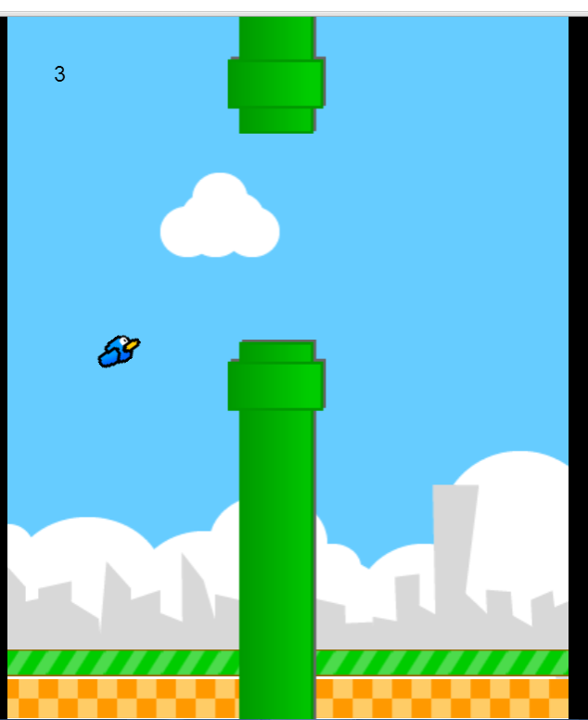
Play Your Game with Sounds and Hi-Scores!

Slide 18
(END of Part 1)
Derived from ‘Make your own "Flappy Bird" game in 10 minutes’ originally published by Tom
Updated with enhancements from Flappy Bird template
Additional improvements for more functionality

