Slide 1


C# Crash Course 101.5
Beginner - Intermediate
By Shahed Chowdhuri
Sr. Technical Evangelist
WakeUpAndCode.com
@shahedC
Notes:
Title Page: C# Crash Course 101.5
Beginner - Intermediate
By Shahed Chowdhuri
Senior Technical Evangelist
Blog: WakeUpAndCode.com
Twitter: @shahedC

Slide 2
Agenda
Introduction
> Variables, Operators & Loops
> Classes & Methods
> Files & Exceptions
Additional Topics
Enumerators
Extension Methods
Generics
Lists
Dictionaries
LINQ
BONUS: Unit Tests
Notes:
Agenda
Introduction
> Variables, Operators & Loops
> Classes & Methods
> Files & Exceptions
Additional Topics
Enumerators
Extension Methods
Generics
Lists
Dictionaries
LINQ
BONUS: Unit Tests

Slide 3



My Background
Period | Background/Experience
1997 – present | Microsoft web/software development
2011 | XNA games on XBLIG for Xbox 360 2D Math Panic Angry Zombie Ninja Cats
2012 | Tools for XNA developers XBLIG Sales Data Analyzer (OnekSoftLabs.com) XNA Basic Starter Kit (CodePlex)
Online: http://facebook.com/OnekSoftGames
Notes:
My Background
1997 – present: Microsoft web/software development
2011: XNA games on XBLIG for Xbox 360
2D Math Panic
Angry Zombie Ninja Cats
2012: Tools for XNA developers
XBLIG Sales Data Analyzer (OnekSoftLabs.com)
XNA Basic Starter Kit (CodePlex)
Online: http://facebook.com/OnekSoftGames

Slide 4
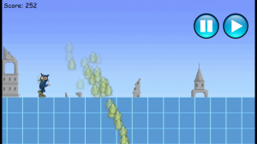
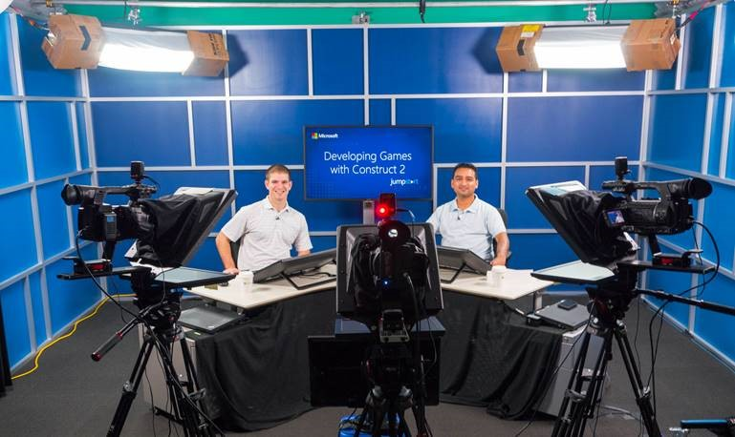
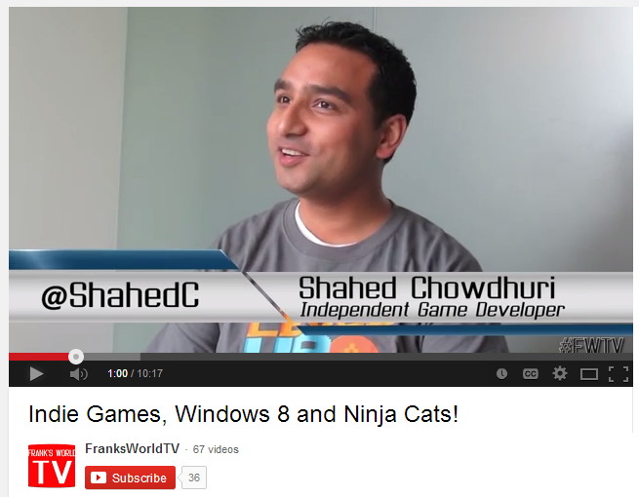
My Background (continued)
Period | Background/Experience
2013 | Ninja Cat Runner on Win8, WP8, Web (Construct 2) Video Q&A with MS Tech Evangelist Frank La Vigne Founder/Admin of FB groups: Construct2, Xbox One & Unity Indie Devs Started Public Speaking in DC area and East Coast
2014 | Public Speaking on Indie Game Development Joined Microsoft as a Sr. Technical Evangelist Gallant Glider on Win8, WP8, Web (Construct 2 → Universal App)
Video Q&A: http://youtu.be/lRjrQPvVOpo
MVA: http://aka.ms/DevGames-Const2
Notes:
My Background (continued)
2013
Ninja Cat Runner on Win8, WP8, Web (Construct 2)
Video Q&A with MS Tech Evangelist Frank La Vigne
Founder/Admin of FB groups: Construct2, Xbox One & Unity Indie Devs
Started Public Speaking in DC area and East Coast
2014
Public Speaking on Indie Game Development
Joined Microsoft as a Sr. Technical Evangelist
Gallant Glider on Win8, WP8, Web (Construct 2 → Universal App)
Video Q&A: http://youtu.be/lRjrQPvVOpo
MVA: http://aka.ms/DevGames-Const2

Slide 5
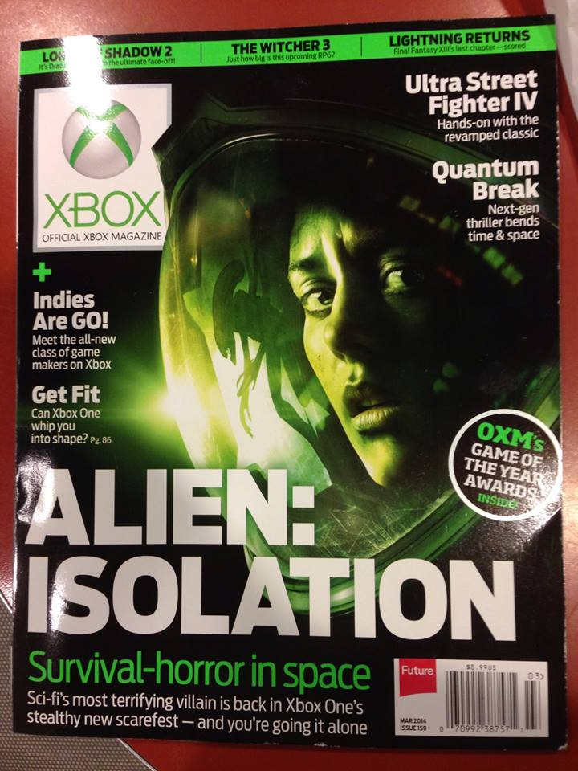
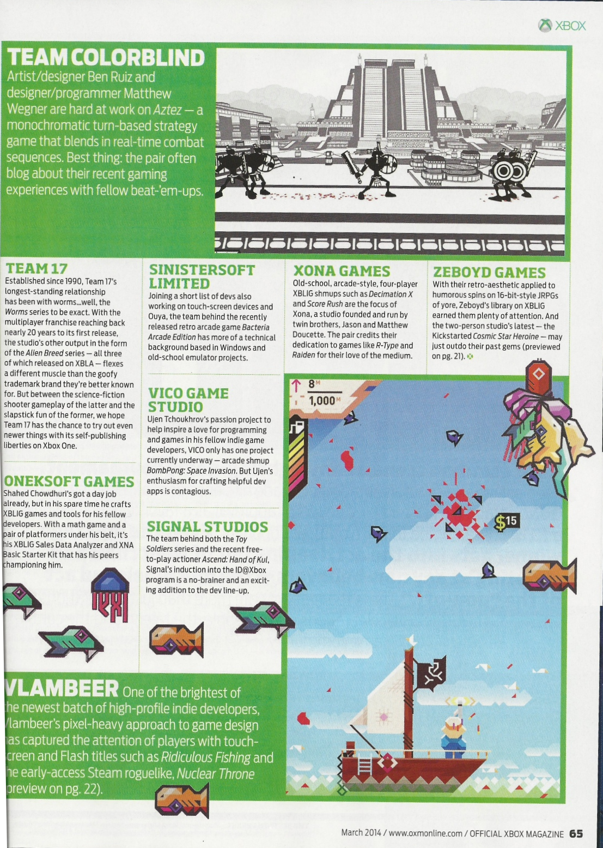
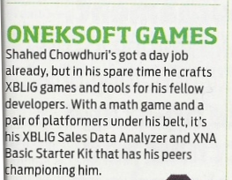
Official Xbox Magazine
`
Source: Official Xbox Magazine, March 2014, Page 65
Notes:
Official Xbox Magazine, March 2014, Page 65
"Shahed Chowdhuri's got a day job already,
but in his spare time he crafts XBLIG games and tools for his fellow developers.”
“With a math game and a pair of platformers under his belt,
it's his XBLIG Sales Data Analyzer and XNA Basic Starter Kit that has his peers championing him."

Slide 6

Introduction
Notes:
Intro to Visual Studio

Slide 7
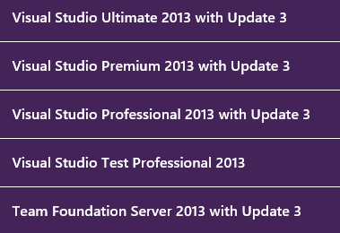



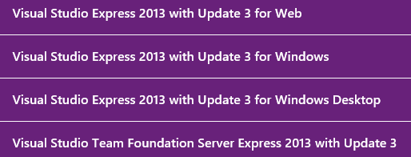
Download & Install Visual Studio
http://www.visualstudio.com/downloads
90-day Trial
Express (free)

Slide 8

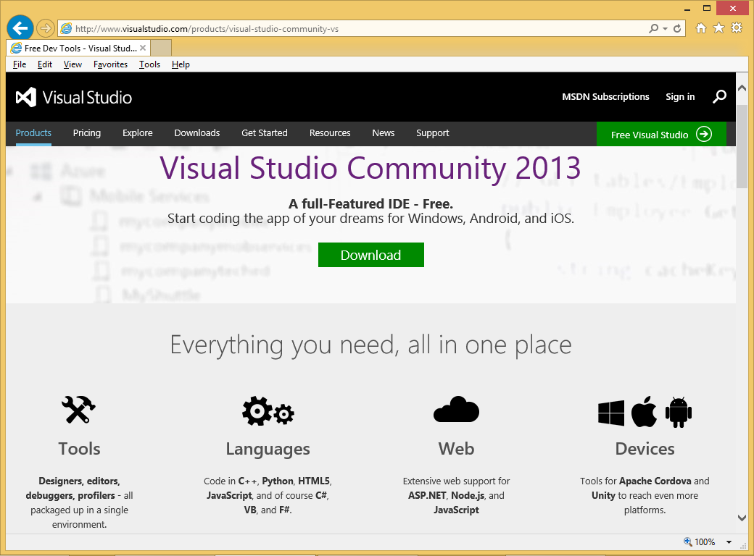
Visual Studio Community Edition
http://www.visualstudio.com/products/visual-studio-community-vs
Equivalent to Pro
Replaces Express
FREE!
Short URL:
http://aka.ms/vs2013ce

Slide 9
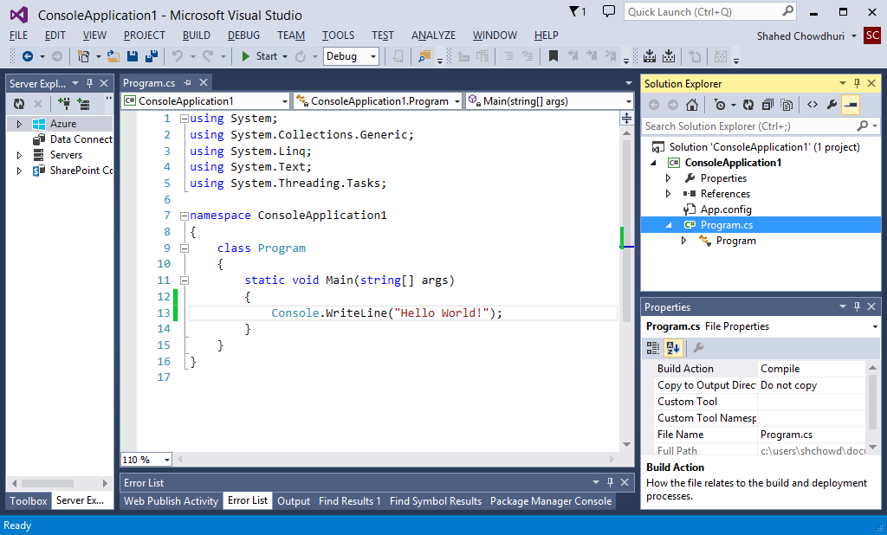
Visual Studio UI (User Interface)
Code Editor
Start (Run)
Solution
Explorer
Toolbar
References
Properties
Panel
Ouput

Slide 10
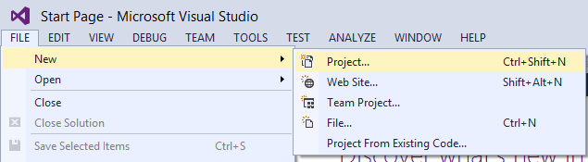
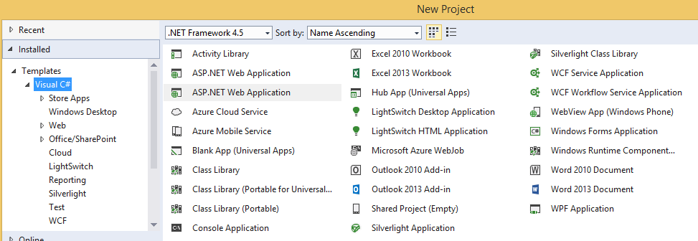
Why Learn C#?
Hint: In Visual Studio, click File → New → Project

Slide 11
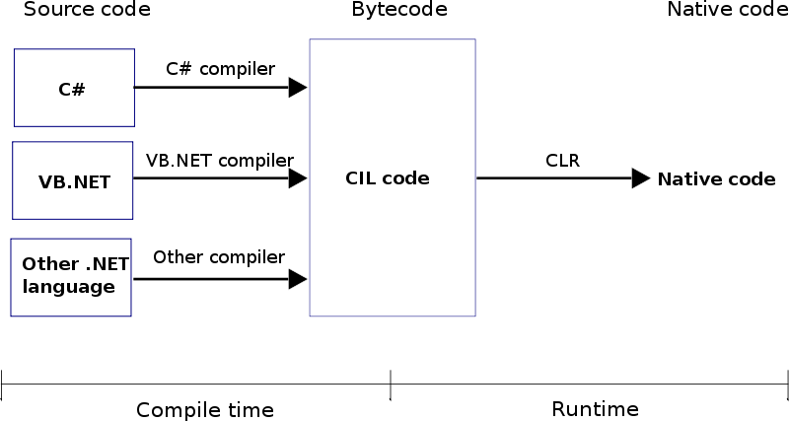
How Does It Work?
Source: http://www.dotnetspark.com/tutorialpic/clr.png

Slide 12
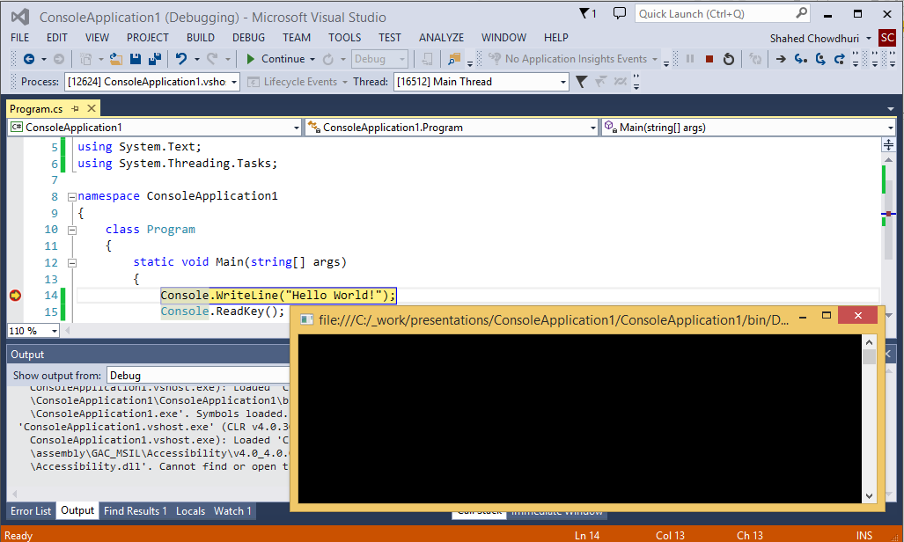
Demo (with debugging/breakpoints)
Start/Continue
Hint: Press F9 on any statement to toggle breakpoints

Slide 13

Agenda
Introduction
> Variables, Operators & Loops
> Classes & Methods
> Files & Exceptions
Additional Topics
Notes:
Agenda
Introduction
> Variables, Operators & Loops
> Classes & Methods
> Files & Exceptions
Additional Topics

Slide 14
Variables, Operators & Loops
Notes:
Variables, Operators & Loops

Slide 15
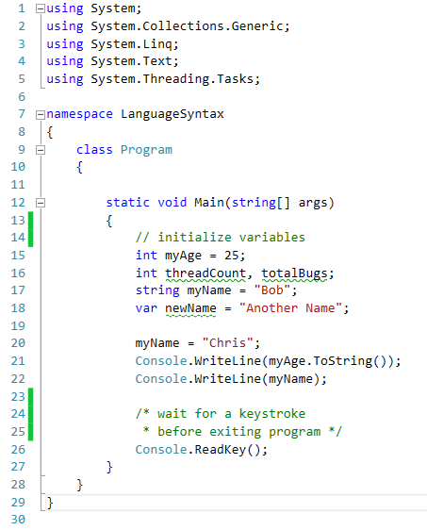
C# Language Syntax
using statements
namespace
Method ( )
class
Variables
// 1-line comment
Data Types
Integer
String
var?
Assignment
Output
/* multi-line
comments */

Slide 16
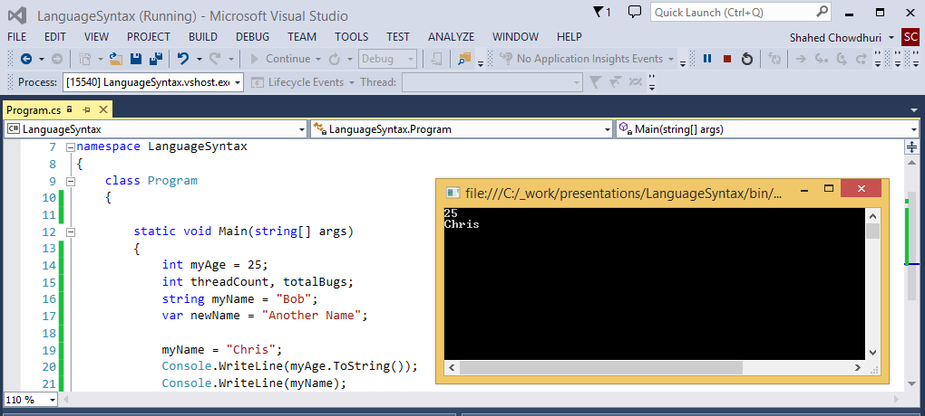
Demo (language syntax)

Slide 17
Operators (Math, Assignment)
Type | Operators
Unary Postfix Operators | ++ --
Unary Prefix Operators | ++ -- + -
Multiplicative Operators | * / % (modulus)
Additive Operators | + -
Assignment Operators | =
Precedence
higher
lower

Slide 18
Logical Operators
Type | Operators
Equality | == !=
Logical AND | &
Logical XOR | ^
Conditional AND | &&
Conditional OR | ||
Conditional Ternary Operator | ?:

Slide 19
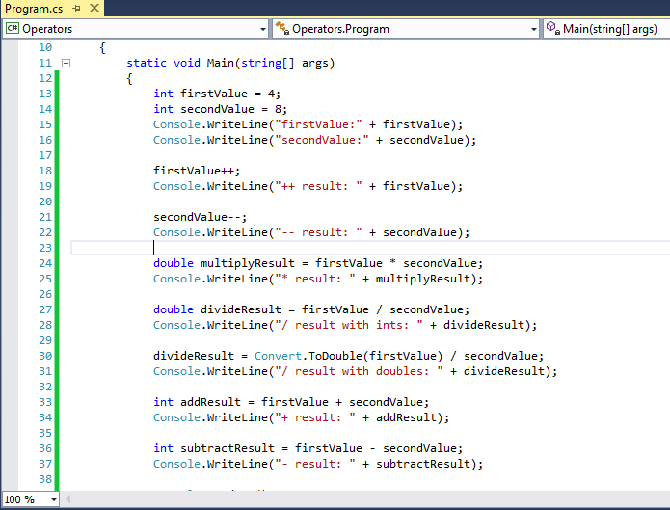
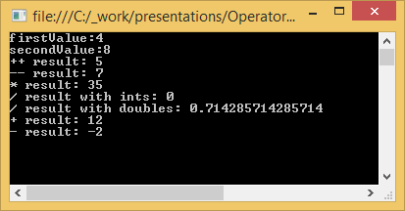
Demo (operators)

Slide 20
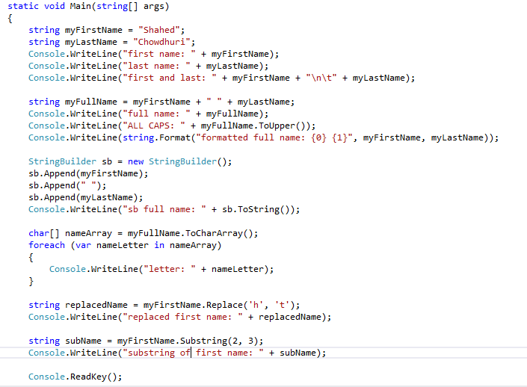
Strings
Literal
Concatenate
Special Characters
Declare
& Assign
StringBuilder
string.Format()
Char Array
String
Functions

Slide 21
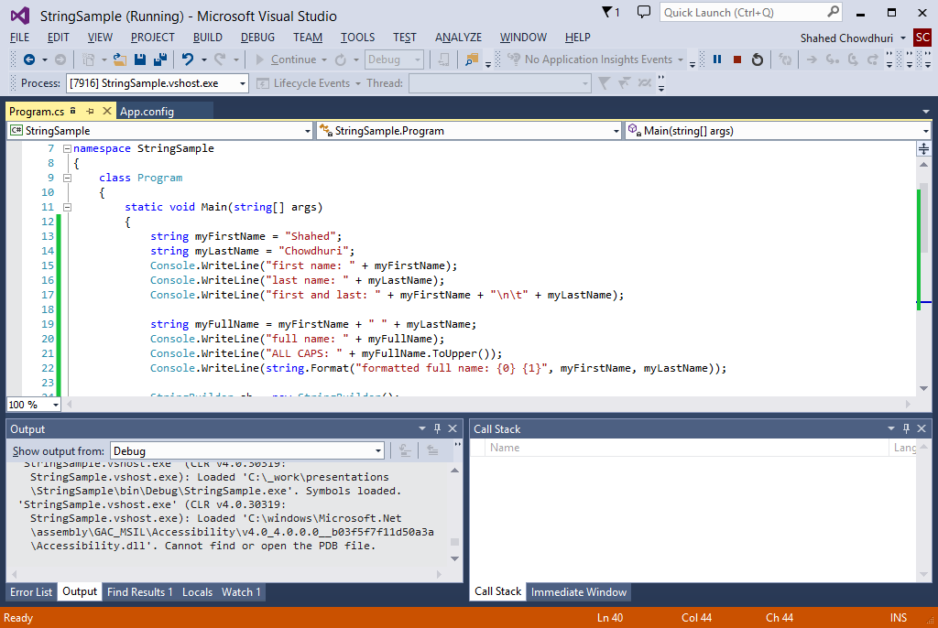
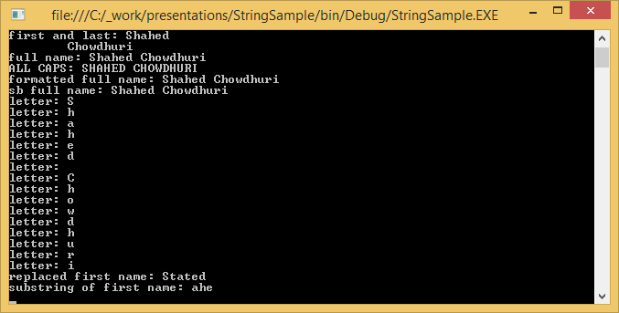
Demo (strings)

Slide 22
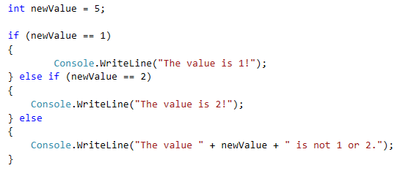
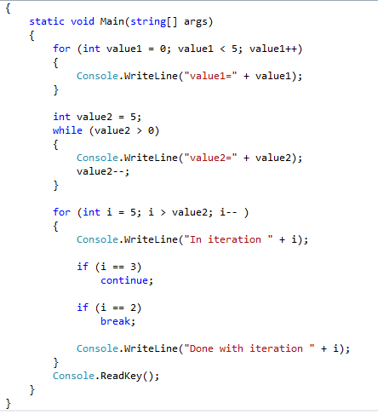
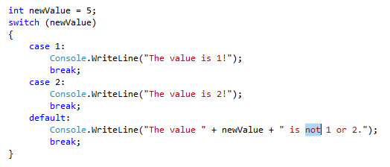
Loops, etc
if/else
blocks
for loop
switch-case statements
while loop
continue
break
default
break

Slide 23
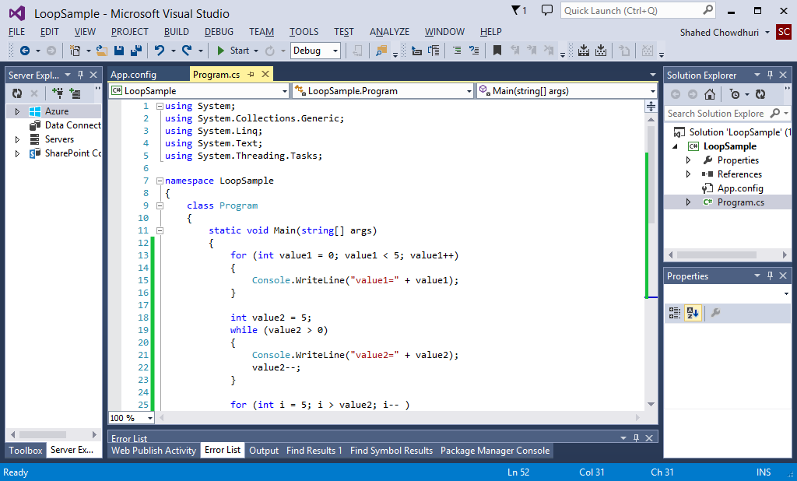
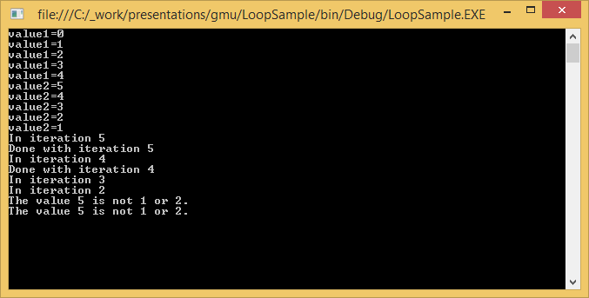
Demo (loops, etc)

Slide 24
Classes & Methods
Notes:
Classes & Methods

Slide 25
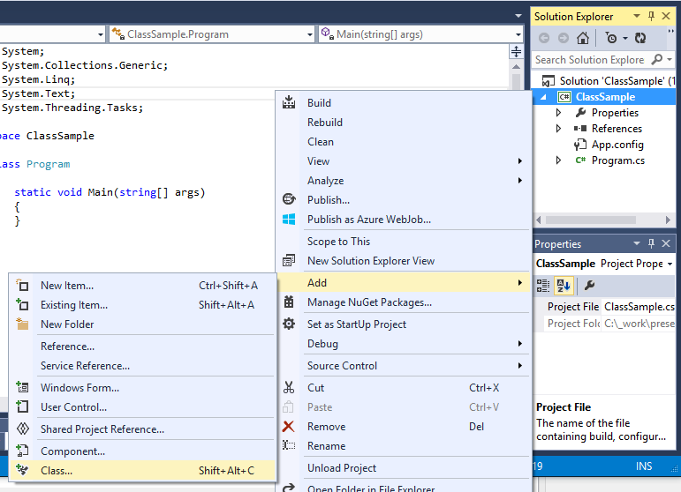
Creating a New Class
1
Right-click project
Click Add
Click Class…
3
2

Slide 26
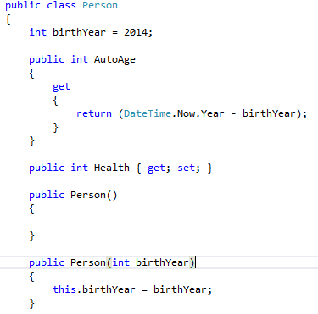
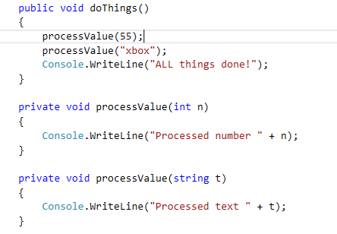
Parts of a Class
class declaration
Instance
variable
properties
public method
constructors
private
methods
(overloaded)
this keyword

Slide 27
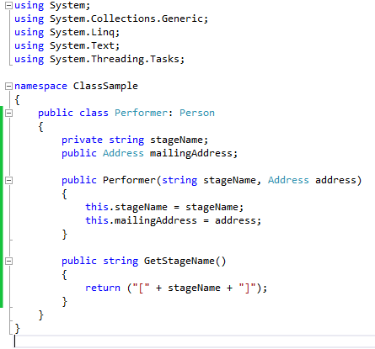
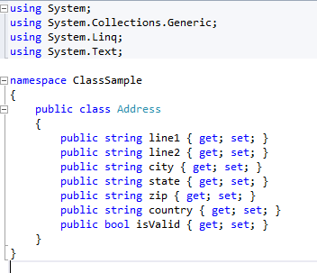
Inheritance & Complex Objects
private variable
parent class
complex
object
public
method

Slide 28
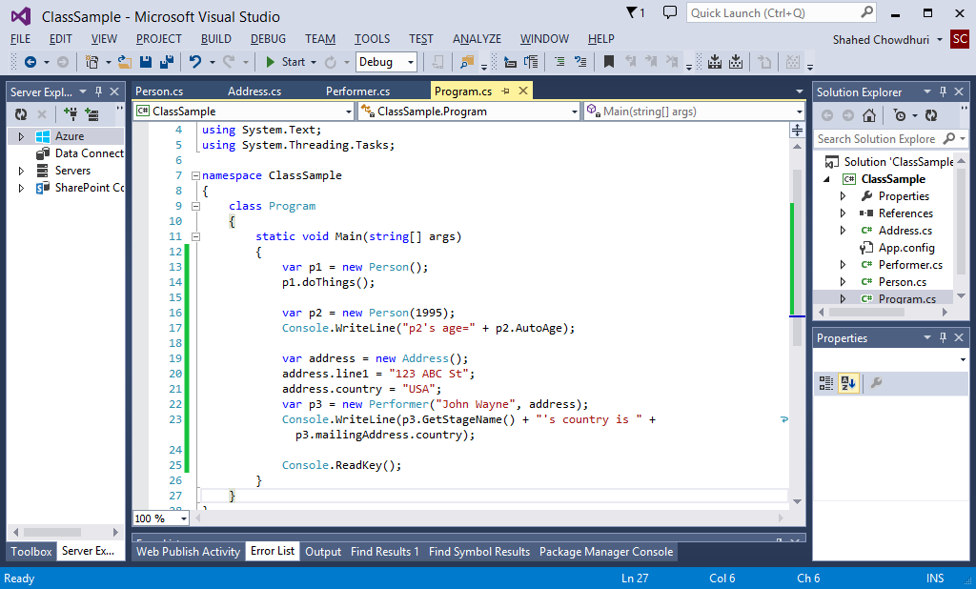
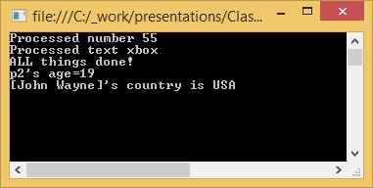
Demo (classes)

Slide 29
Files & Exceptions
Notes:
Namespaces, Files & Exceptions

Slide 30
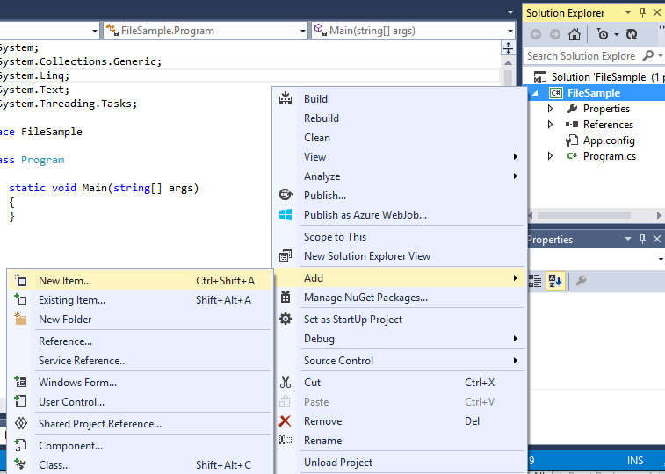
Add Text File
1
Right-click project
Click Add
Click New Item…
3
2

Slide 31
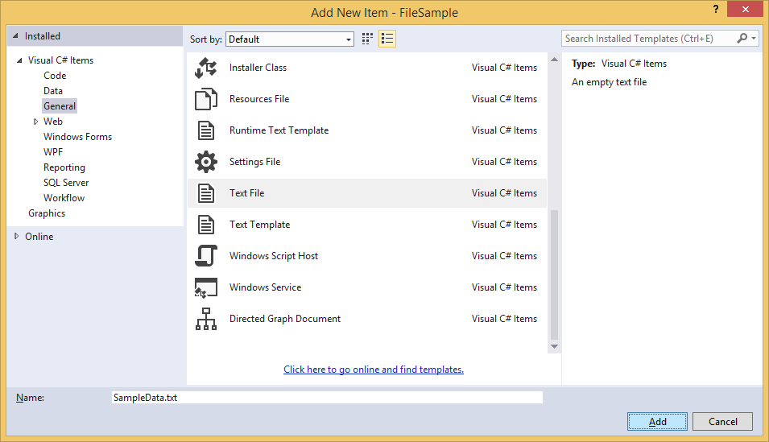
Name New Text File
1
Select “General”
Select “Text File”
Name it.
2
3

Slide 32
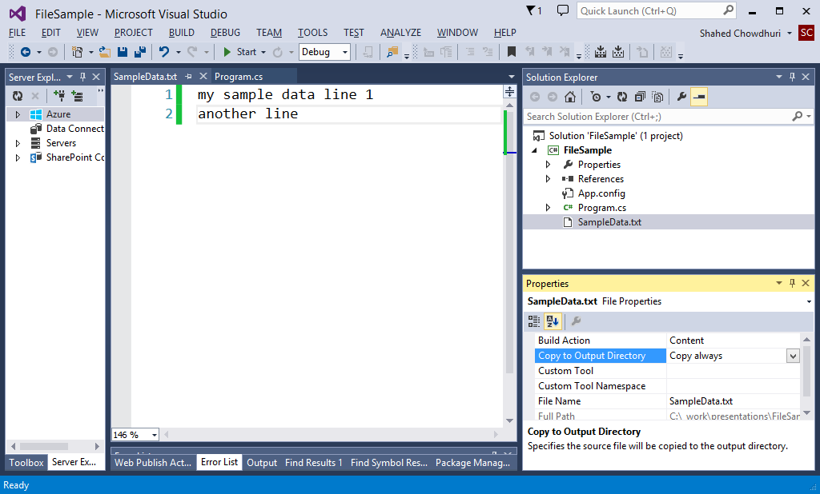
Update Text File And Properties
Set to
“Copy always”
enter sample data

Slide 33
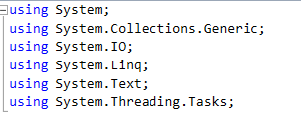
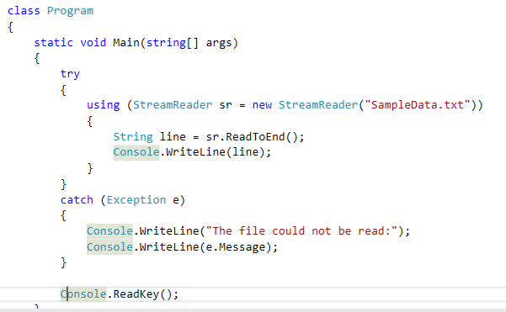
Read File, Handle Exceptions
Use System.IO namespace for
StreamReader
Handle possible
exceptions with
try-catch block

Slide 34
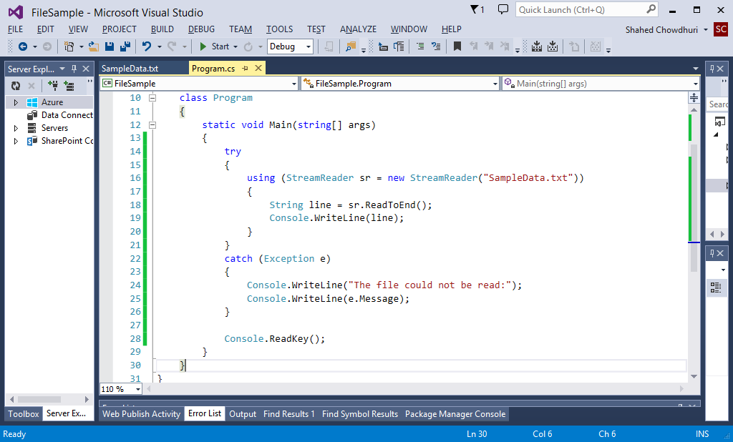
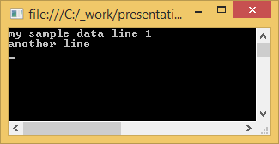
Demo (read text file)

Slide 35
Agenda
Introduction
> Variables, Operators & Loops
> Classes & Methods
> Files & Exceptions
Additional Topics
Notes:
Agenda
Introduction
> Variables, Operators & Loops
> Classes & Methods
> Files & Exceptions
Additional Topics

Slide 36
Additional Topics
Notes:
Additional Topics

Slide 37
Enumerators
Notes:
Enumerators

Slide 38
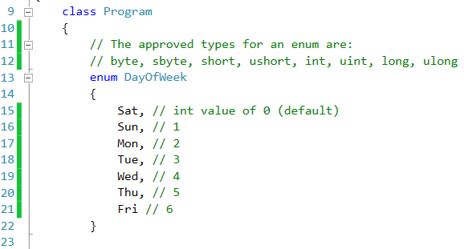
Enum declaration
enum keyword
name of enum
}
initialization
not required

Slide 39
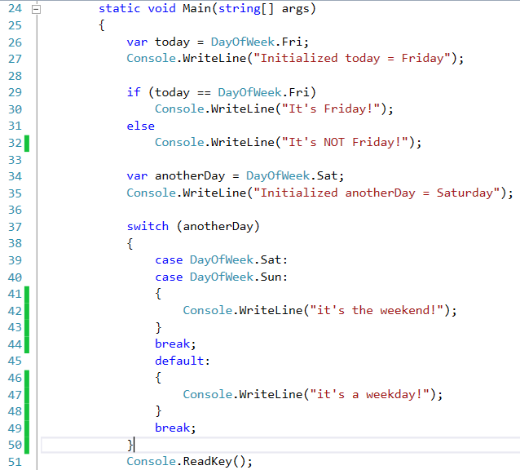
Enum usage
initialization
}
if-else check
initialization
}
switch-case check

Slide 40
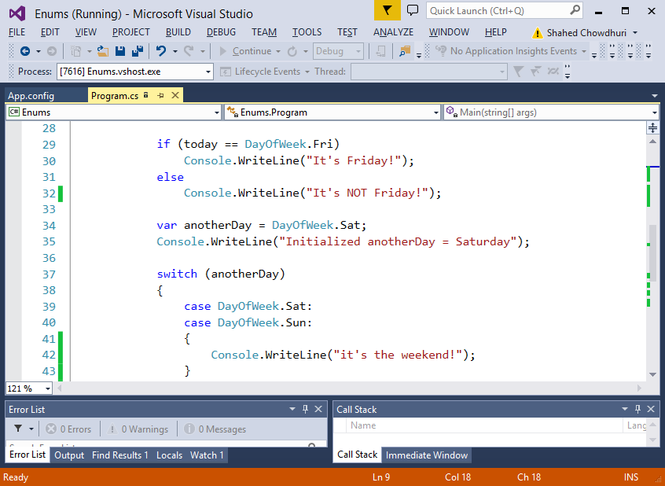
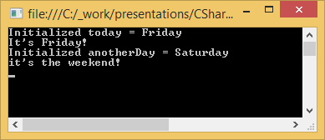
Demo (enumerator)

Slide 41
Extension Methods
Notes:
Extension Methods

Slide 42
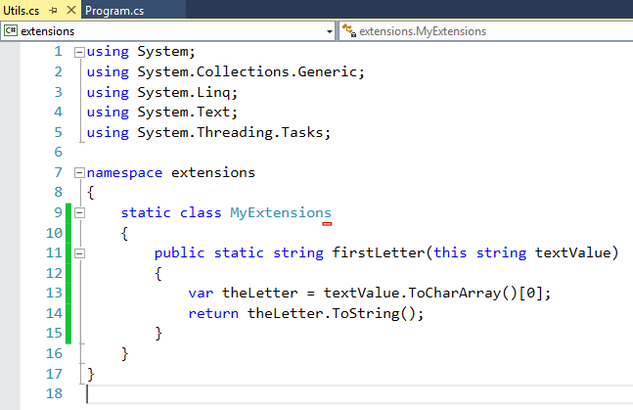
Extension Method Definition Example
static class
static method
data type matches
extended class
e.g. string
this keyword
before
first parameter

Slide 43
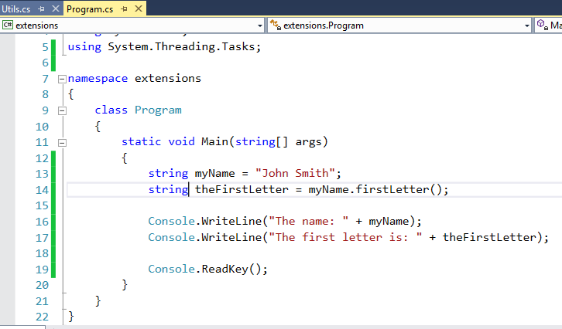
Extension Method Usage
data type to be extended
call extension
method just like
Instance method

Slide 44
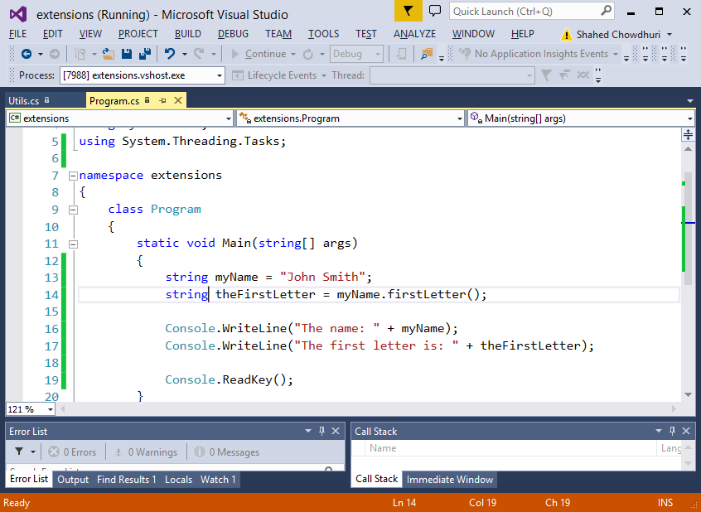
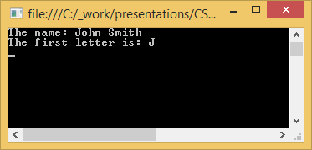
Demo (Extension Method)

Slide 45
Generics
Notes:
Generics

Slide 46
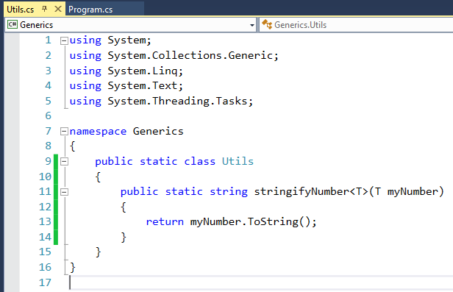
Placeholders for Generics
placeholder within
< angle brackets >
right after
method name
placeholder used
for one or more
parameters

Slide 47
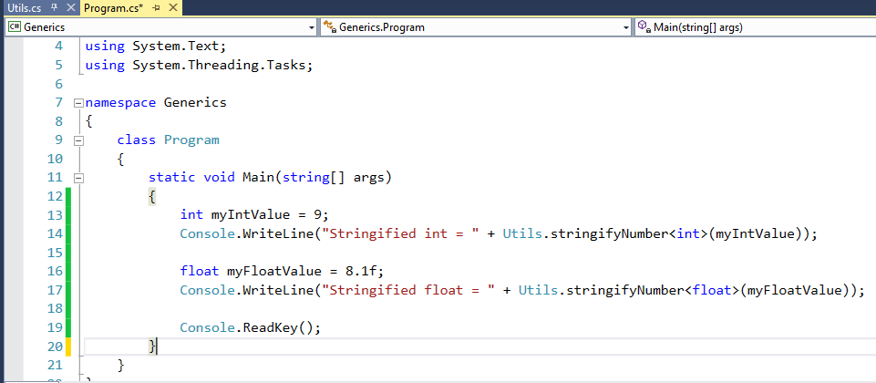
Generics Usage
actual data type, e.g. <int>
within < angle brackets >
in place of placeholder
a different data type!

Slide 48


Demo (Generics)

Slide 49
Lists
Notes:
Lists & Dictionaries

Slide 50

Defining Lists, Adding Values
Declare Lists of different types
e.g. <string> and <int>
}
add values individually
}
add multiple values at once
(separated by commas)

Slide 51

Using Lists
iterate through values
using foreach loops

Slide 52


Demo (Lists)

Slide 53
Dictionaries
Notes:
Dictionaries

Slide 54

Initializing a Dictionary
Two data types
<int, string> for
key-value pairs
Initialize multiple values
(separated by commas)
Initialize individually

Slide 55

Using a Dictionary
retrieve value,
using [key]
in square brackets

Slide 56


Demo (Dictionary)

Slide 57
LINQ
(Language-Integrated Query)
Notes:
Linq

Slide 58

LINQ: Setting Up…
initialize number array
retrieve contents

Slide 59

LINQ: Query vs Lambda Syntax
similar to SQL
dot-notation
e.g. myNums.Where()
=> “goes to” syntax
for input into expression

Slide 60


Demo (LINQ)

Slide 61

Videos on Microsoft Virtual Academy
C# Fundamentals for Absolute Beginners:
http://www.microsoftvirtualacademy.com/training-courses/c-fundamentals-for-absolute-beginners
Programming in C# Jump Start:
http://www.microsoftvirtualacademy.com/training-courses/developer-training-with-programming-in-c

Slide 62
BONUS
Unit Test Example
(using NUnit)
Notes:
Unit Test Example
(using NUnit)

Slide 63


New ASP.MVC Project
Click File → New Project
Select Web Application project
Select any template, then click OK

Slide 64


New Test Project
Right-click Solution
Click Add → New Project
Select “Class Library”
Name it, click OK.

Slide 65

Add References
Add References:
MyWebApp (web project)
nunit.framework (via NuGet)
System.Web.Mvc (browse)
NUnit Quick Start: http://nunit.org/index.php?p=quickStart&r=3.0

Slide 66

Write Application Code
note public method

Slide 67

Write Unit Test Code
pass in input parameters
and
expected
result
call public method
assert returned result

Slide 68


Run Unit Tests (via ReSharper)
Download ReSharper: https://www.jetbrains.com/resharper/download/

Slide 69

Contact
Email: shchowd@microsoft.com  Twitter: @shahedC
Notes:
Contact
Web: OnekSoft.com
Email: games@OnekSoft.com
Twitter: @OnekSoftGames
Microsoft email: shchowd@microsoft.com
Personal Twitter: @shahedC
R&D: OnekSoftLabs.com
Dev Blog: WakeUpAndCode.com

