Slide 1
Mobile Apps & the Cloud
Windows  Windows Phone  Azure  … and more!
By Shahed Chowdhuri
Sr. Technical Evangelist
WakeUpAndCode.com
@shahedC
Notes:
Title Page: Mobile Apps & the Cloud Windows  Windows Phone  Azure  … and more!
By Shahed Chowdhuri
Sr. Technical Evangelist
Blog: WakeUpAndCode.com
Twitter: @shahedC

Slide 2
Agenda
Introduction
> Creating a Mobile Service
> Consuming the Service
> Publishing the Service
Publishing
Notes:
Agenda
Introduction
> Creating a Mobile Service
> Consuming the Service
> Publishing the Service
Publishing
* Learn about how you can build a mobile service in Azure and consume it with a mobile app.

Slide 3
My Background
Period | Background/Experience
1997 – present | Microsoft web/software development
2011 | XNA games on XBLIG 2D Math Panic Angry Zombie Ninja Cats
2012 | Tools for XNA developers XBLIG Sales Data Analyzer (OnekSoftLabs.com) XNA Basic Starter Kit (CodePlex)
Online: http://facebook.com/OnekSoftGames
Notes:
My Background
1997 – present: Microsoft web/software development
2011: XNA games on XBLIG
2D Math Panic
Angry Zombie Ninja Cats
2012: Tools for XNA developers
XBLIG Sales Data Analyzer (OnekSoftLabs.com)
XNA Basic Starter Kit (CodePlex)
Online: http://facebook.com/OnekSoftGames

Slide 4
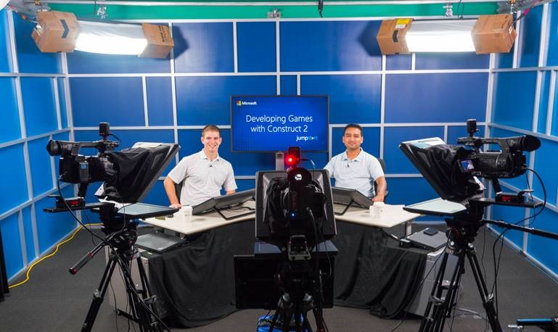
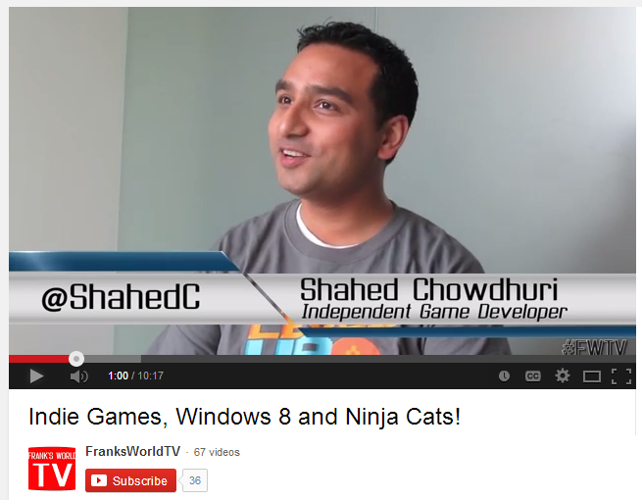
My Background (continued)
Period | Background/Experience
2013 | Ninja Cat Runner on Win8, WP8, Web (Construct 2) Video Q&A with MS Tech Evangelist Frank La Vigne Founder/Admin of FB groups: Construct2, Xbox One & Unity Indie Devs
2014 | Public Speaking on Indie Game Development Joined Microsoft as a Sr. Technical Evangelist Gallant Glider on Win8, WP8, Web (Construct 2 → Universal App) Cloud Camp presentations in DC Metro area
Video Q&A: http://youtu.be/lRjrQPvVOpo
MVA: http://aka.ms/DevGames-Const2
Notes:
My Background (continued) 2013
Ninja Cat Runner on Windows 8 (Construct2)
Video Q&A with MS Tech Evangelist Frank La Vigne
Founder/Admin of Xbox One Indie Devs Group (FB)
Attended ID@Seattle, Microsoft’s ID@Xbox summit
2014
Public Speaking on Indie Game Development
Joined Microsoft as a Technical Evangelist
Gallant Glider on Win8, WP8, Web (Construct 2 → Universal App)
Cloud Camp presentations in DC Metro area
Video Q&A: http://youtu.be/lRjrQPvVOpo
MVA: http://aka.ms/DevGames-Const2

Slide 5
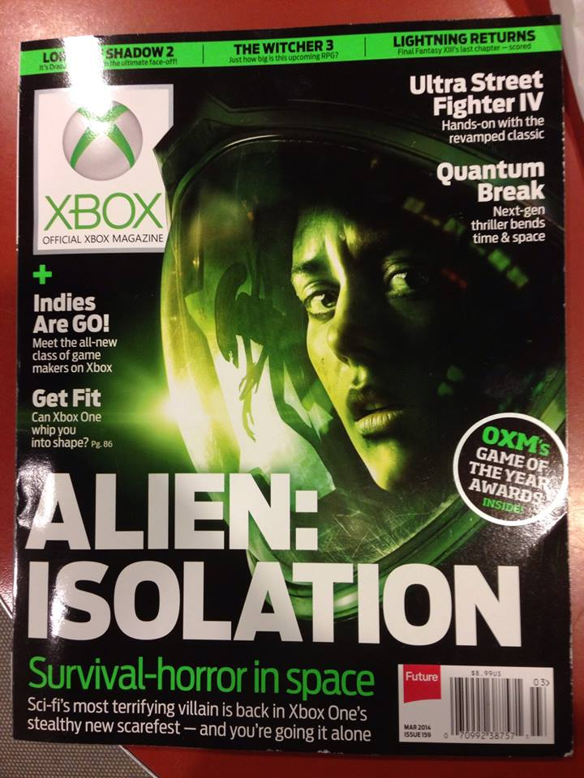
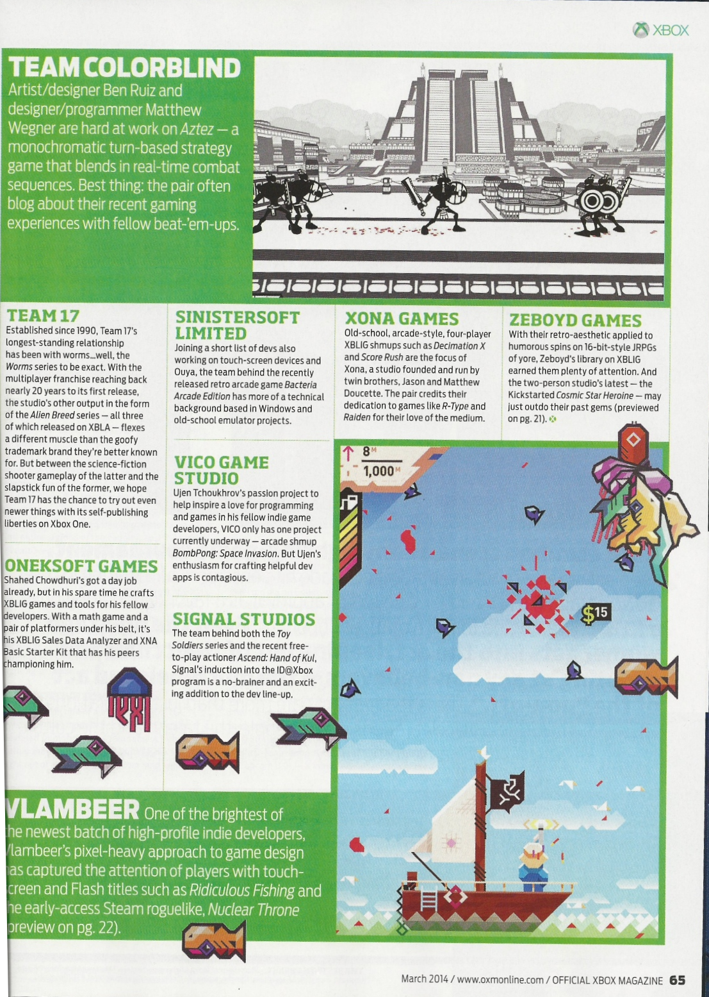
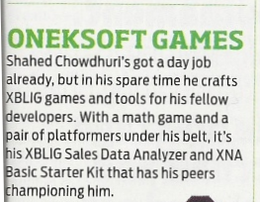
Official Xbox Magazine
`
Source: Official Xbox Magazine, March 2014, Page 65
Notes:
Official Xbox Magazine, March 2014, Page 65
"Shahed Chowdhuri's got a day job already,
but in his spare time he crafts XBLIG games and tools for his fellow developers.”
“With a math game and a pair of platformers under his belt,
it's his XBLIG Sales Data Analyzer and XNA Basic Starter Kit that has his peers championing him."

Slide 6
Tools & Technologies
Notes:
Tools & Technologies
Visual Studio 2013
Windows 8
Microsoft .NET and Visual C#
Windows Phone
JavaScript
Microsoft Azure

Slide 7
Introduction
Notes:
Introduction

Slide 8
What is a Mobile Device?
Smartphones
Tablets
Laptops
Netbooks and smaller laptops
Laptop/Tablet hybrids
Notes:
What is a Mobile Device?
Smartphones
Tablets
Laptops
Netbooks and smaller laptops
Laptop/Tablet hybrids

Slide 9
What is the Cloud?
“No one understands
the Cloud!!!”
Notes:
What is the Cloud?
Screen Capture: “No one understands the Cloud!!!”

Slide 10
Cloud Services: IaaS, PaaS and SaaS
 |  | Host | Build | Consume
 | Packaged Software | IaaS: infrastructure as a service | PaaS: Platform as a service | Saas: software as a service
Applications | Self- Managed | Self- Managed | Self- Managed | Managed By Vendor
Data
Runtime |  |  | Managed By Vendor
Middleware
O/S
Virtualization |  | Managed By Vendor
Servers
Storage
Networking
Source: Bret Stateham, Windows Azure evangelist
Notes:
Cloud Services: IaaS, PaaS and SaaS

Slide 11
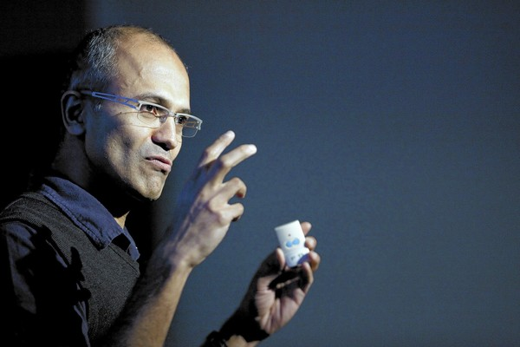
In Line with Microsoft’s Vision
“… mobile first, cloud first… ”
Microsoft CEO Satya Nadella
Notes:
In Line with Microsoft’s Vision
“… mobile first, cloud first… ”
Microsoft CEO Satya Nadella

Slide 12
Creating a Mobile Service
Notes:
Creating a Mobile Service

Slide 13
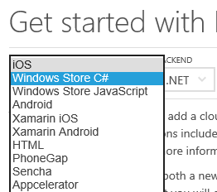
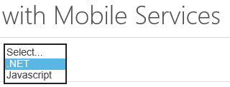
Getting Started
Link: http://azure.microsoft.com/en-us/documentation/articles/mobile-services-dotnet-backend-windows-store-dotnet-get-started/
Notes:
Getting Started
Link: http://azure.microsoft.com/en-us/documentation/articles/mobile-services-dotnet-backend-windows-store-dotnet-get-started/

Slide 14
Create a Mobile Service
Notes:
Create a Mobile Service

Slide 15
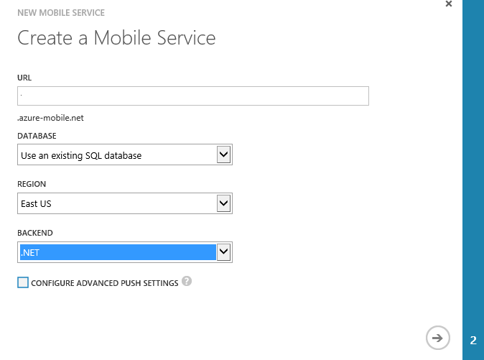
Specify Mobile Service Details
Name for the URL
(not the full URL)
Notes:
Specify Mobile Service Details

Slide 16
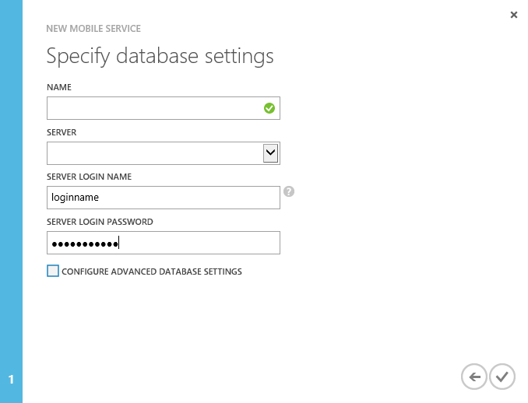
Specify Database Settings
Notes:
Specify Database Settings

Slide 17
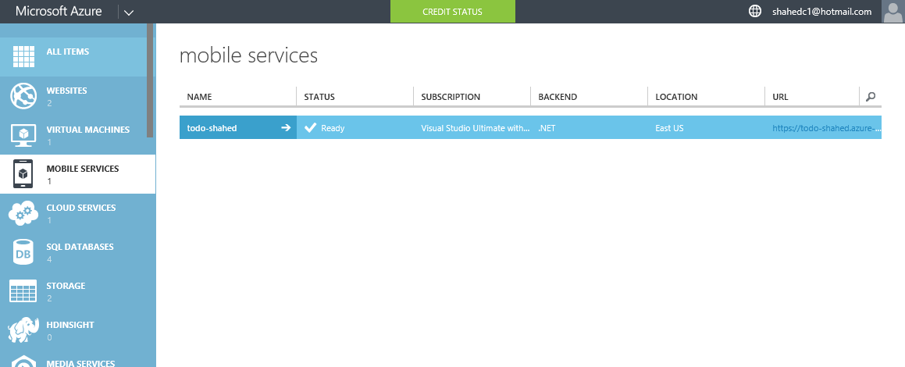
Verify Status of Mobile Service
Notes:
Verify Status of Mobile Service

Slide 18
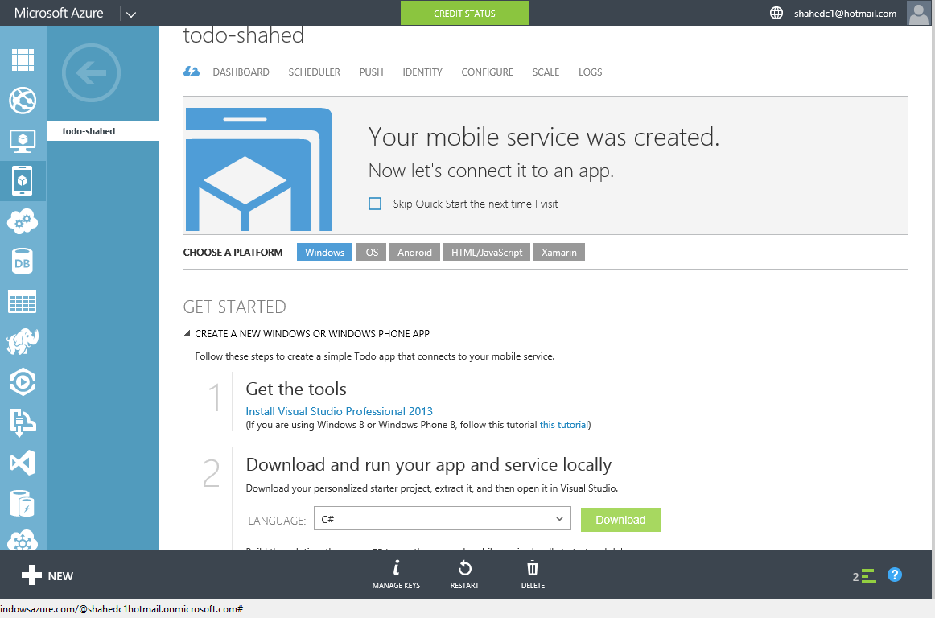
Get Tools & Download Your Solution
Notes:
Get Tools & Download Your Solution

Slide 19
Consuming the Service
Notes:
Consuming the Service

Slide 20
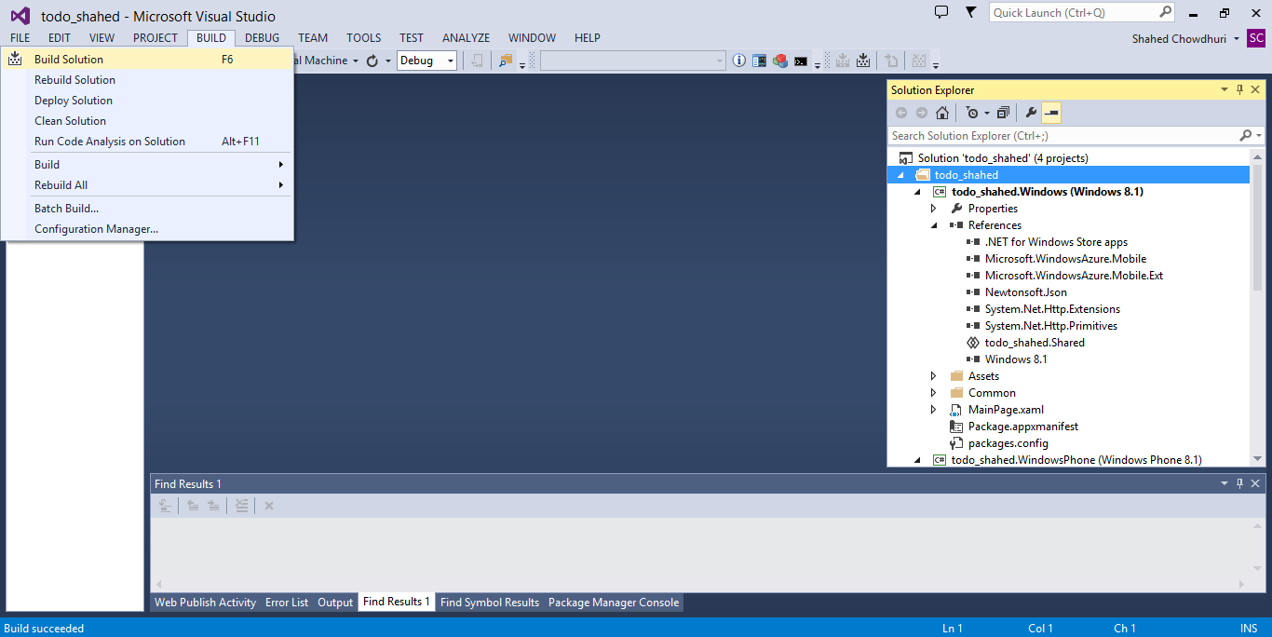
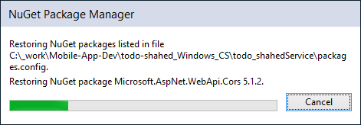
Build Your Solution (update NuGet packages)
. . .
Notes:
Build Your Solution (update NuGet packages)

Slide 21
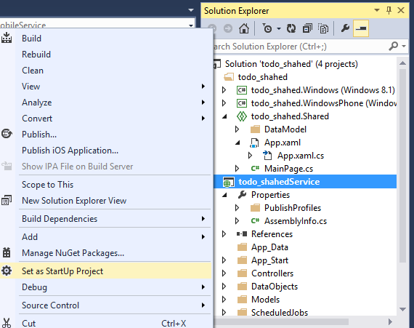
Run the Service Locally
Notes:
Run the Service Locally

Slide 22
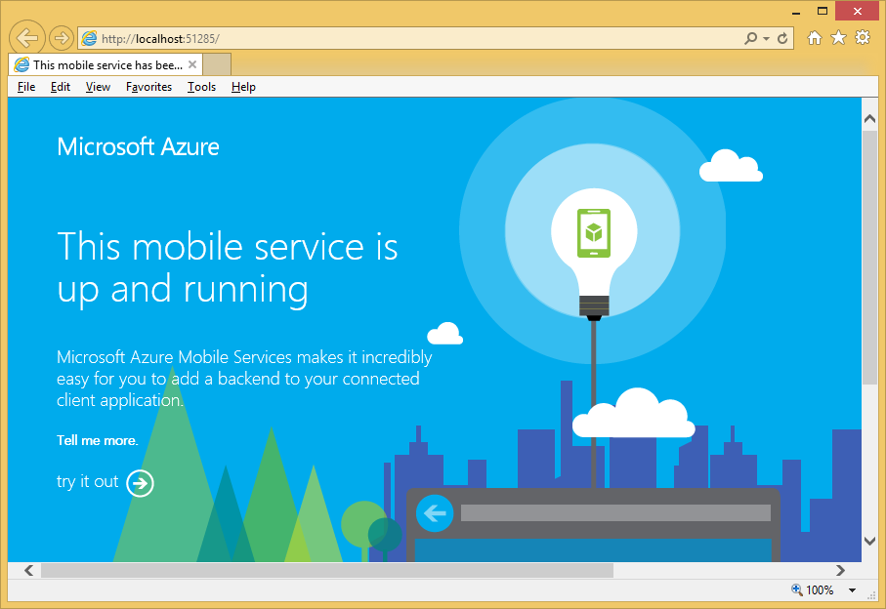
Verify the Service Locally
Notes:
Verify the Service Locally

Slide 23
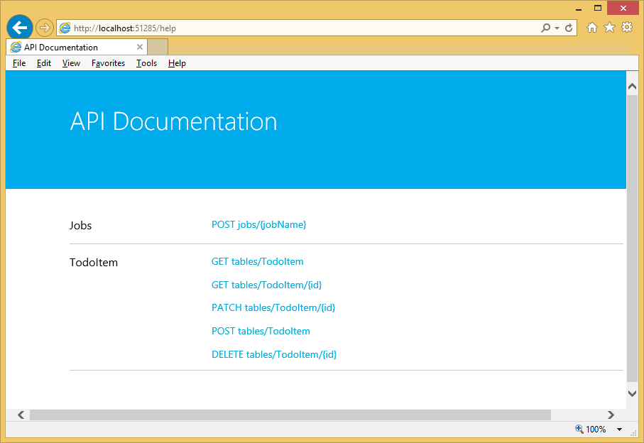
Try it out…
Notes:
Try it out…

Slide 24
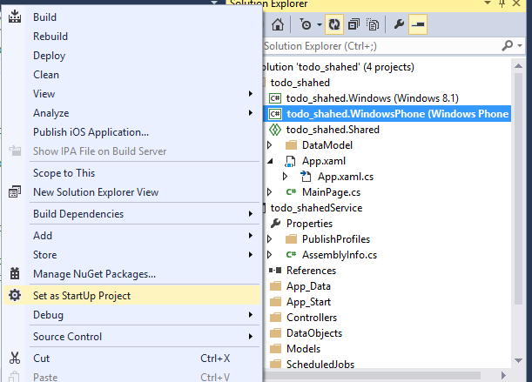
Run Windows Phone App Locally
Notes:
Run Windows Phone App Locally

Slide 25
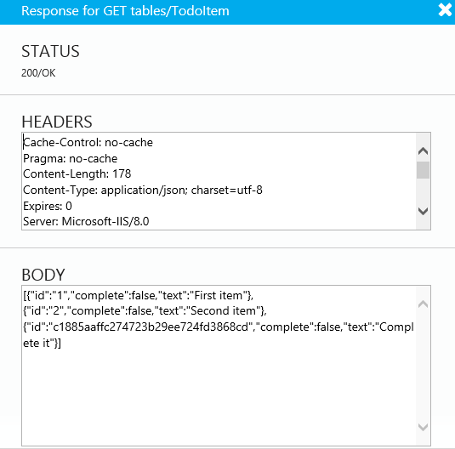
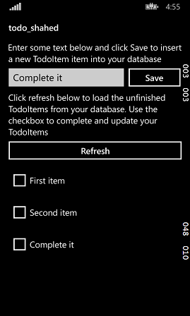
Verify Windows Phone App
Notes:
Verify Windows Phone App

Slide 26
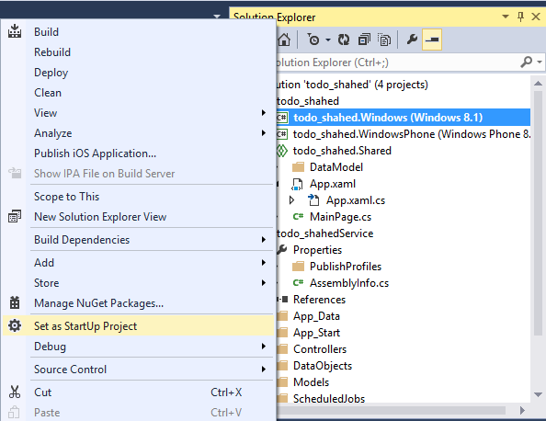
Run Windows App Locally
Notes:
Run Windows App Locally

Slide 27
Verify Windows App Locally
Notes:
Verify Windows App Locally

Slide 28
Publishing the Service
Notes:
Publishing the Service

Slide 29
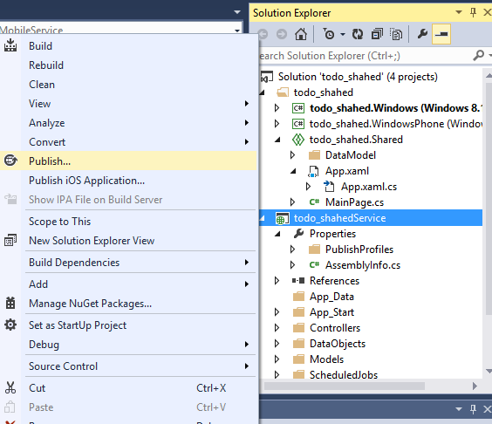
Publish Your Mobile Service
Notes:
Publish Your Mobile Service

Slide 30
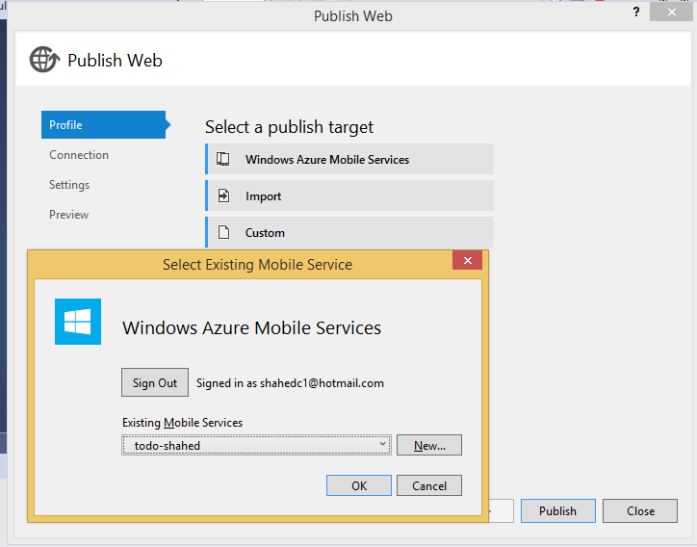
Sign In and Select Existing Service
Notes:
Sign In and Select Existing Service

Slide 31
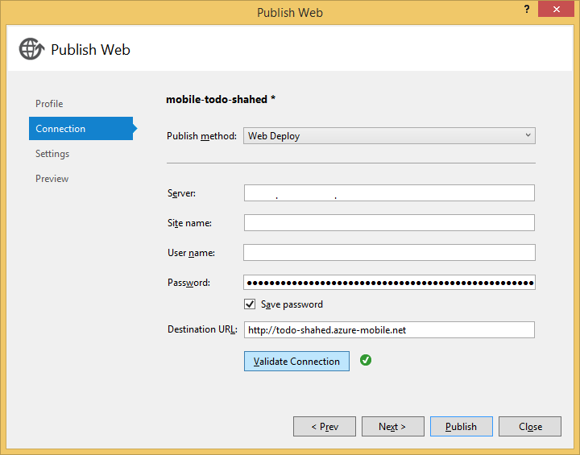
Complete the Publishing Process
Notes:
Complete the Publishing Process

Slide 32
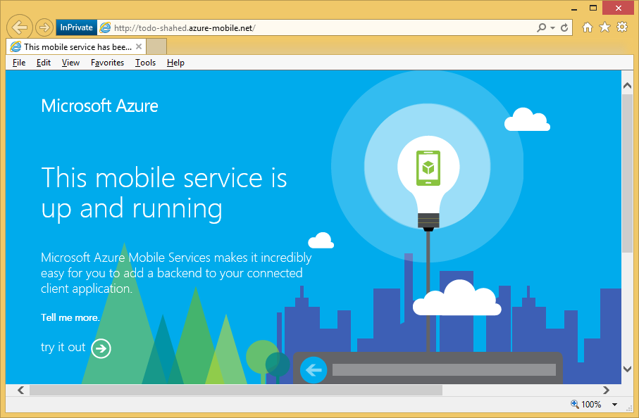
Verify the Service is Running
Notes:
Verify the Service is Running

Slide 33
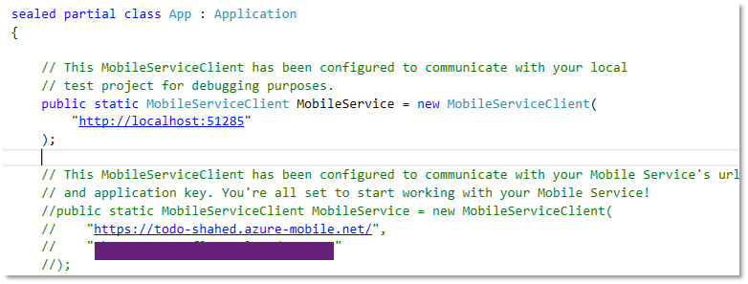
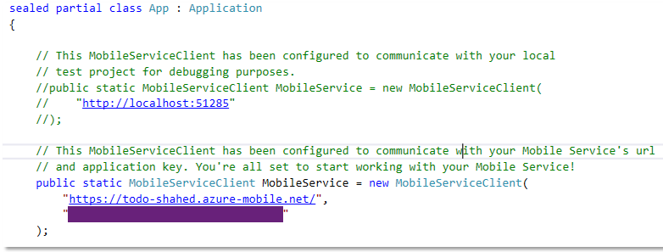
Update App.Xaml.cs (Shared project)
BEFORE:
AFTER:
Comment out local settings
Uncomment server settings, including key
Notes:
Update App.Xaml.cs (Shared project)
Comment out local settings
Uncomment server settings, including key

Slide 34
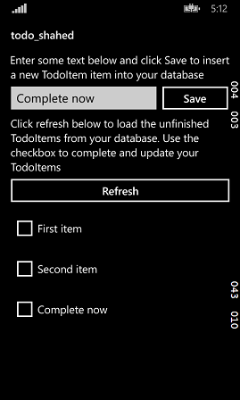
Run Windows Phone Project
Enter a value to test it
Notes:
Run Windows Phone Project

Slide 35
Run Windows project
Enter a value to test it
Notes:
Run Windows project

Slide 36
Questions?
Notes:
Questions?

Slide 37
Contact
Email: shchowd@microsoft.com  Twitter: @shahedC
Notes:
Contact
Microsoft email: shchowd@microsoft.com
Personal Twitter: @shahedC
Dev Blog: WakeUpAndCode.com

