Slide 1
Unity 5: Rollerball (Step by Step)
Based on Roll-a-ball video tutorial from Unity Technologies
Part 1
By Shahed Chowdhuri
Senior Technical Evangelist
WakeUpAndCode.com
@shahedC
Notes:
Title Page: Game Development with Unity 5 and C# Windows  Web  Xbox  Mobile  … and more!
By Shahed Chowdhuri
Technical Evangelist
Blog: WakeUpAndCode.com
Twitter: @shahedC

Slide 2
Agenda
Getting Started
> Creating the Ground
> Creating the Player
> Materials, Colors & Lighting
> 3D Physics & Movement
Controlling the Camera
Notes:
Agenda

Slide 3
Getting Started

Slide 4
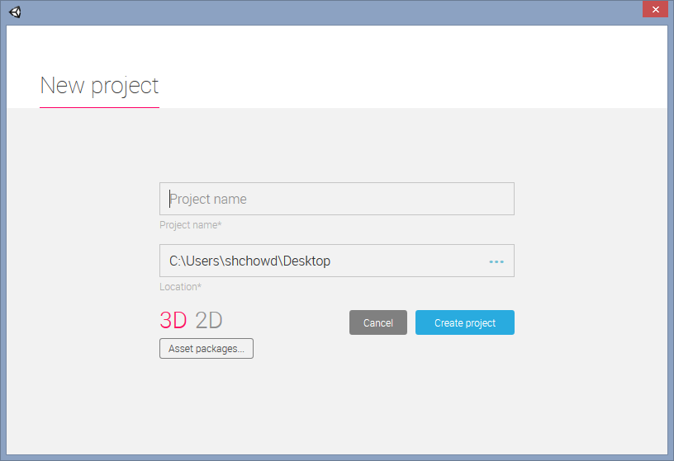
Create New Project
When you launch Unity 5…
… you should see a New Project window

Slide 5
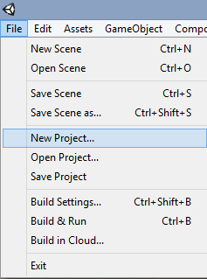
File → New Project…
If you don’t see a New Project window…
Click File → New Project

Slide 6
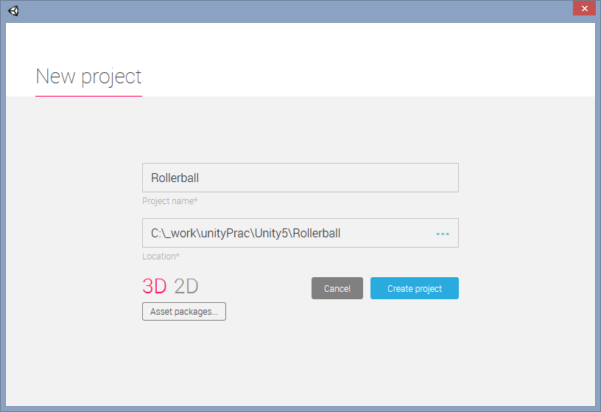
Create Project
Enter the following:
Project name: Rollerball
Location: (any new/empty folder)
Select 3D (not 2D)
Click [Create project]

Slide 7
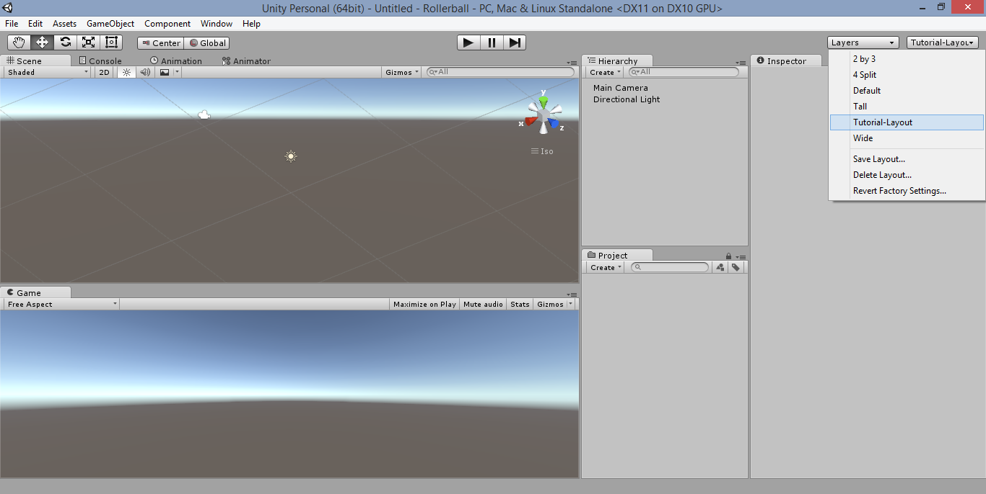
Choose a Layout
Click Layout
dropdown
to select
or save
Hint: You can drag the panels (Scene, Game, etc) to different locations.

Slide 8
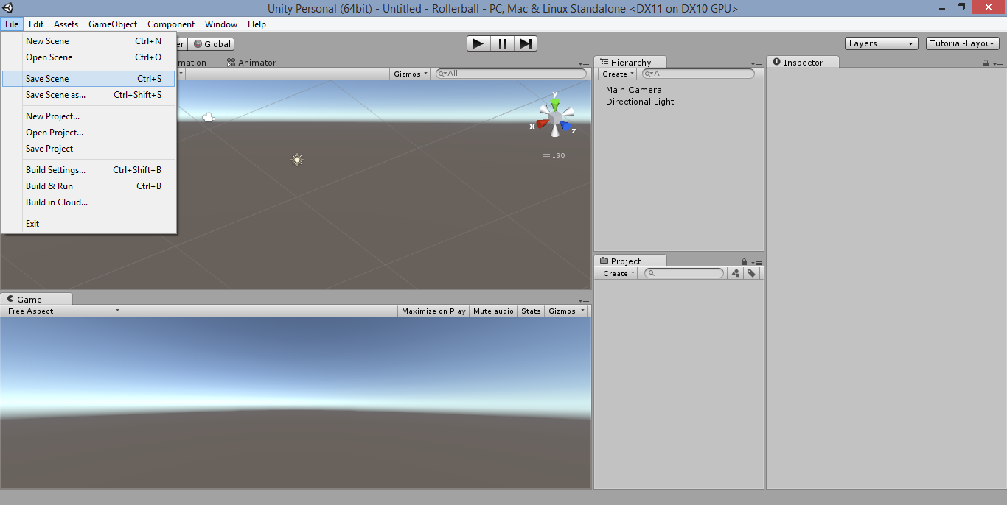
Save Your Scene
Click
File →
Save Scene
Hint: You can also click Ctrl-S on your keyboard.

Slide 9
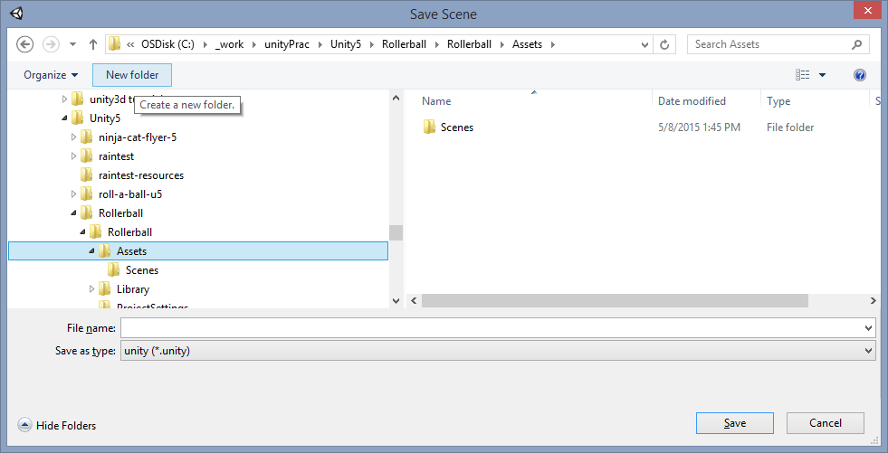
Create “Scenes” Subfolder
Create
New folder
below
Assets
folder
Name it
“Scenes”

Slide 10
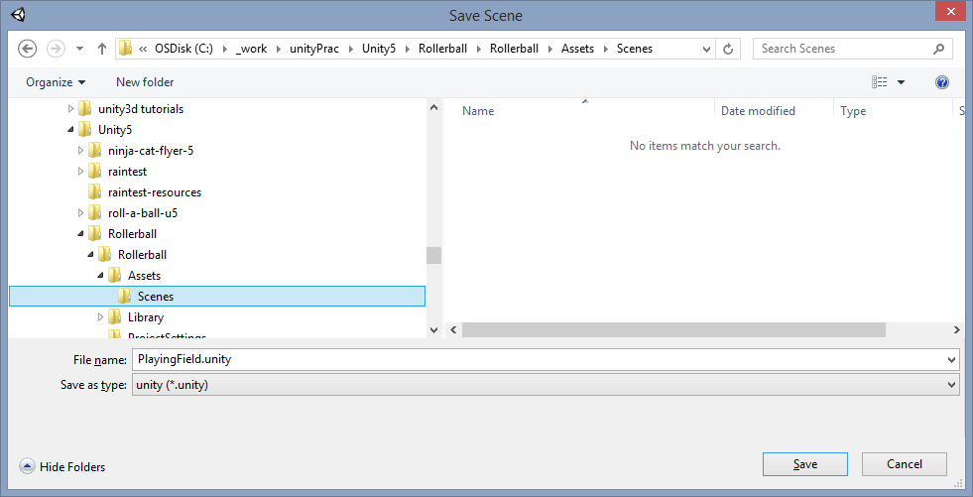
Name Your Scene
Inside
“Scenes”
Subfolder…
… Name your scene “PlayingField.unity”
, then click [Save]

Slide 11
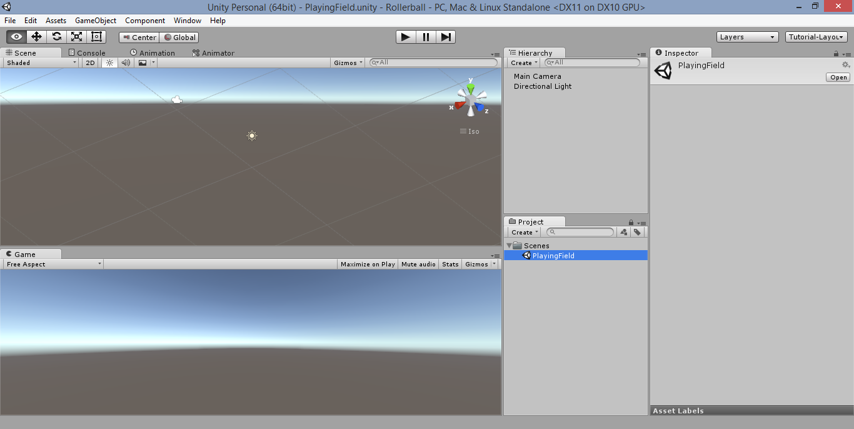
Verify Saved Scene
Verify Scene Name in Title Bar
Verify
Saved Scene
in
Project panel

Slide 12
Creating the Ground

Slide 13
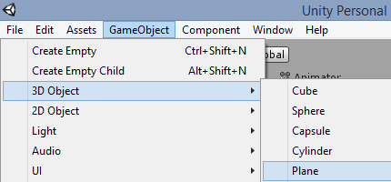
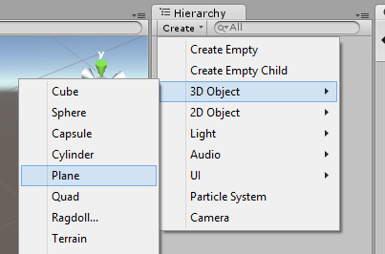
Create a Plane in 3D
In the top menu…
- OR -
In the Hierarchy panel…
Click GameObject → 3D Object → Plane
Click Create → 3D Object → Plane

Slide 14
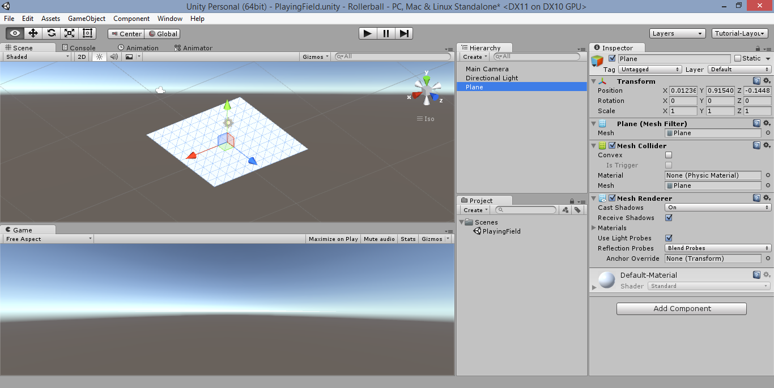
Verify Plane in Scene & Hierarchy

Slide 15
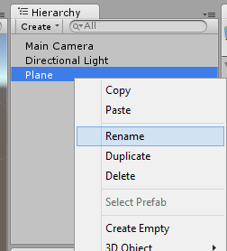
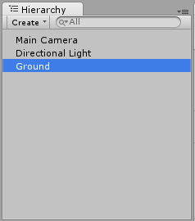
Rename Plane to “Ground”
Right-click to rename
Enter “Ground”

Slide 16
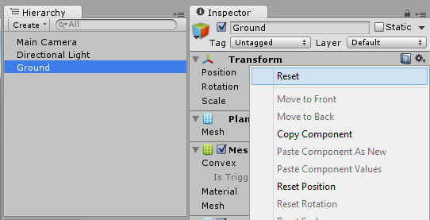
Rename Plane to “Ground”
Click gear icon
next to
Transform
then
click “Reset”
Select
“Ground”
in Hierarchy

Slide 17
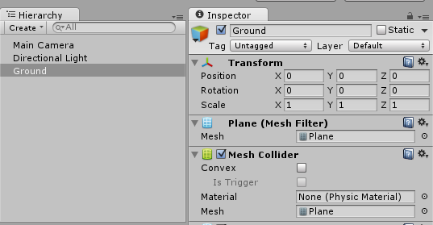
Verify Ground Position at Origin (0,0,0)

Slide 18
Focus on Ground in Scene
With “Ground” selected in hierarchy…
… move your cursor to the Scene
… press ‘F’ on your keyboard to focus on it

Slide 19
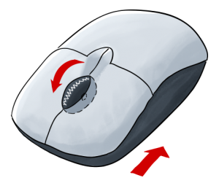
Zoom In/Out Within Your Scene
Scroll the mouse wheel over your scene to zoom in/out

Slide 20
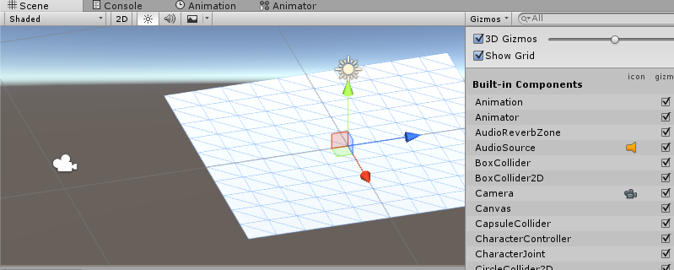
Show/Hide Grid in Scene View
In the Scene panel, click the Gizmos dropdown to toggle “Show Grid”

Slide 21
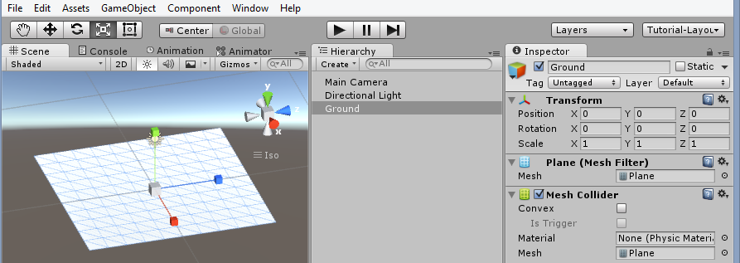
Resize the Ground
Click on the Scale tool, while the Ground is selected…
… then, drag the handles to resize the ground

Slide 22
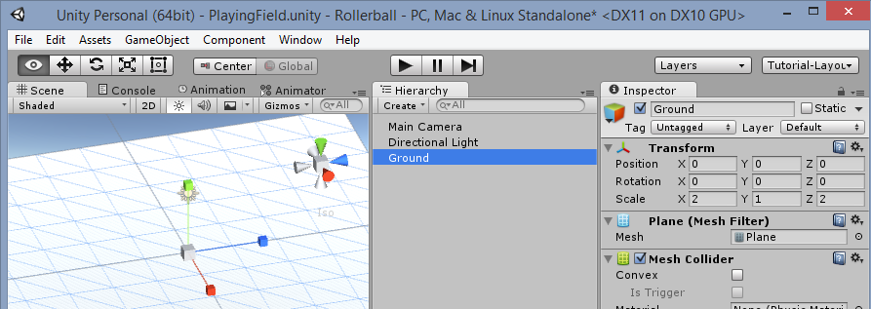
Enter Scale Values
Manually enter Scale values in the Ground’s Transform component
Scale: X = 2, Y = 1, Z = 2

Slide 23
Creating the Player

Slide 24
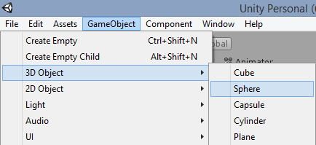
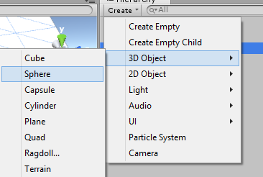
Create a Sphere in 3D
In the top menu…
- OR -
In the Hierarchy panel…
Click GameObject → 3D Object → Sphere
Click Create → 3D Object → Sphere

Slide 25
Position Sphere on Ground
Position Sphere at X = 0, Y = 0.5, Z = 0

Slide 26
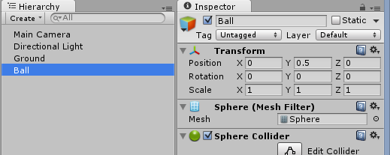
Rename Sphere to “Ball”

Slide 27
Materials, Colors & Lighting

Slide 28
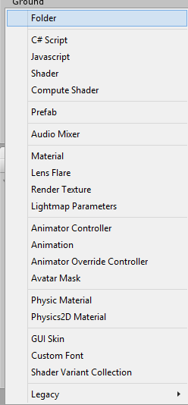
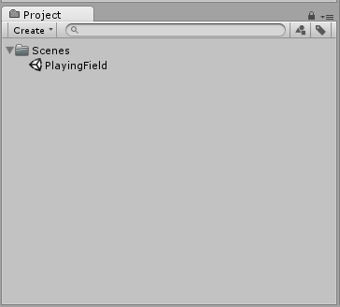
Create New Folder for “Materials”
In the Project panel,
click Create dropdown
then, select “Folder”

Slide 29
Create New Folder for “Materials”
In Project panel,
click Create
then, select “Folder”
Rename it “Materials”

Slide 30
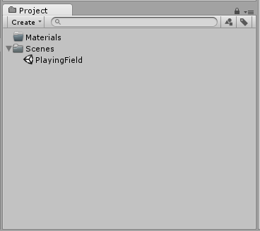
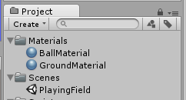
Create New Materials for Ground & Ball
In Project panel,
click Create
then, select
“Material”
Rename it “GroundMaterial”
Repeat for “BallMaterial”

Slide 31
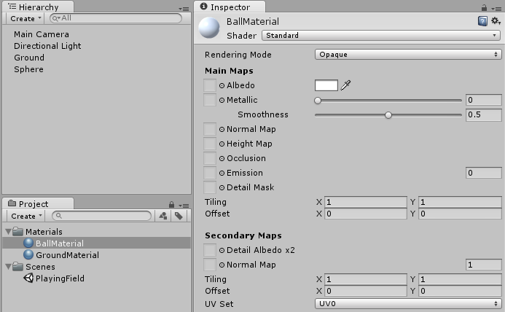
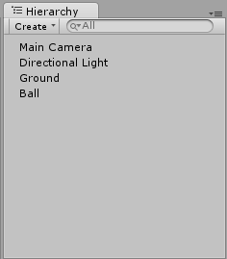
Update Material Colors
Update color
in Inspector
window
(click white
square)
For each
material...

Slide 32
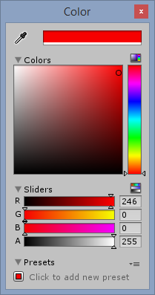
Choose Colors in the Popup
Red
Green
Blue
Alpha (Transparency)

Slide 33
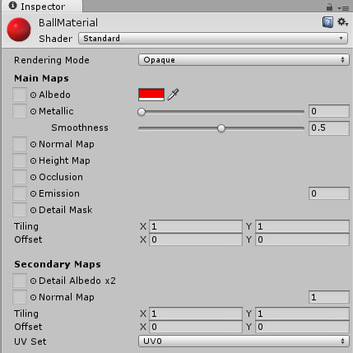
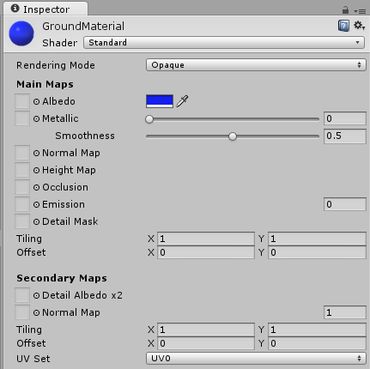
Verify Colors
Verify that GroundMaterial and BallMaterial have different colors.

Slide 34
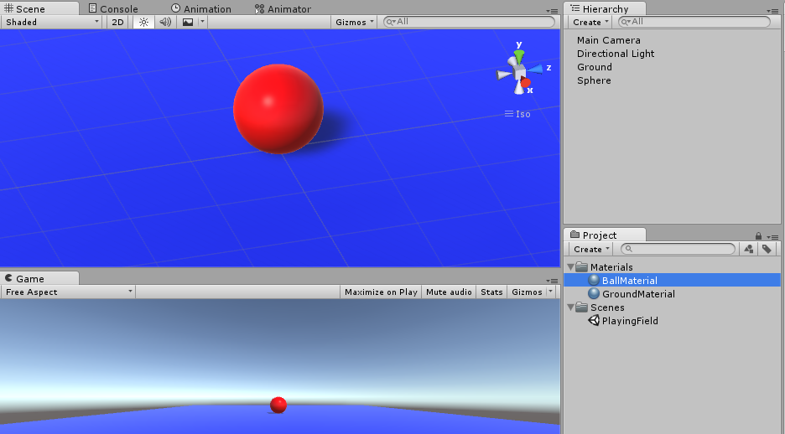
Assign Colors
Drag each material from Project panel to the Scene panel

Slide 35
Update Lighting Rotation
Update Direction Light in Inspector
Rotation: X = 50, Y = 60, Z = 0

Slide 36
3D Physics & Movement

Slide 37
Add RigidBody
With “Ball” selected in the Hierarchy panel…
Click Component → Physics → RigidBody

Slide 38
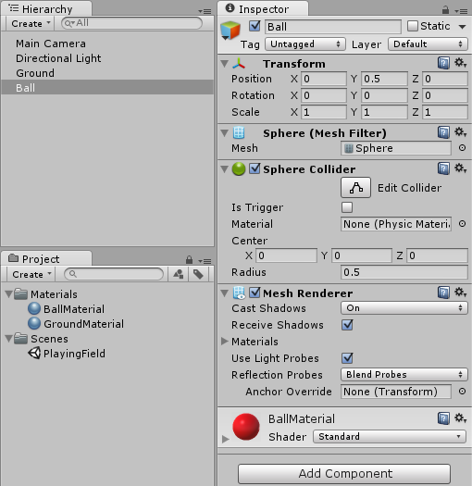
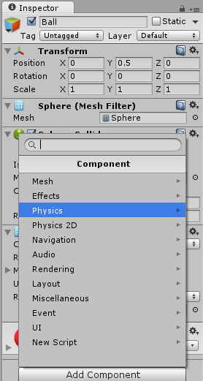
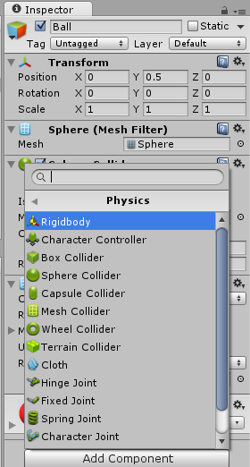
(Alternate Method) Add RigidBody
With “Ball” selected in the Hierarchy panel, click Add Component → Physics → Rigidbody

Slide 39
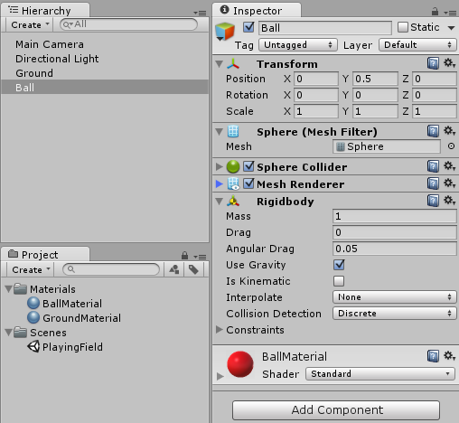
Verify RigidBody Component for Ball
Verify RigidBody Component

Slide 40
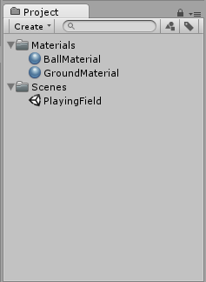
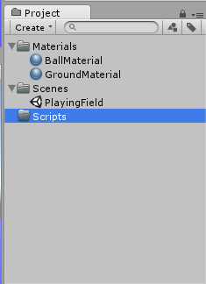
Create New Folder for “Scripts”
In the Project panel,
click Create dropdown
Then select “Folder”, name it “Scripts”

Slide 41
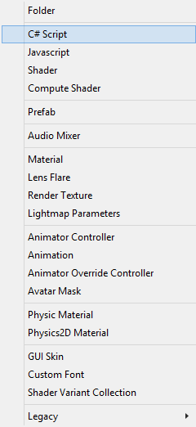
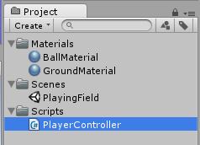
Create “PlayerController” Script
In the Project panel,
click Create dropdown
Then select “C# Script”, name it
PlayerController

Slide 42
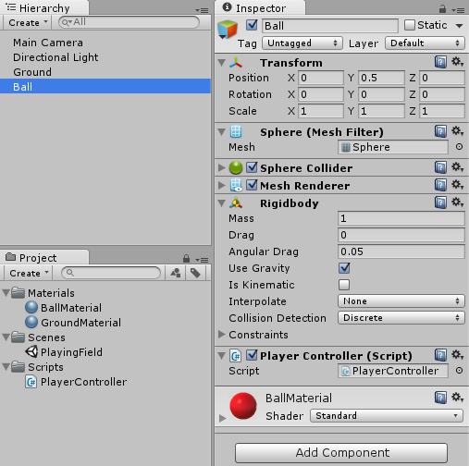
Assign “PlayerController” to Ball
With “Ball”
selected...
… Drag
script into
Ball
Verify Script
Component!

Slide 43
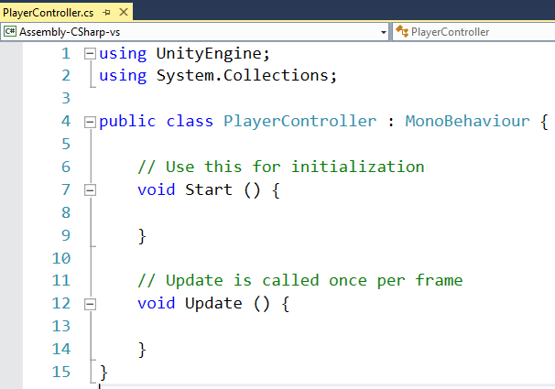
Launch “PlayerController” Script

Slide 44
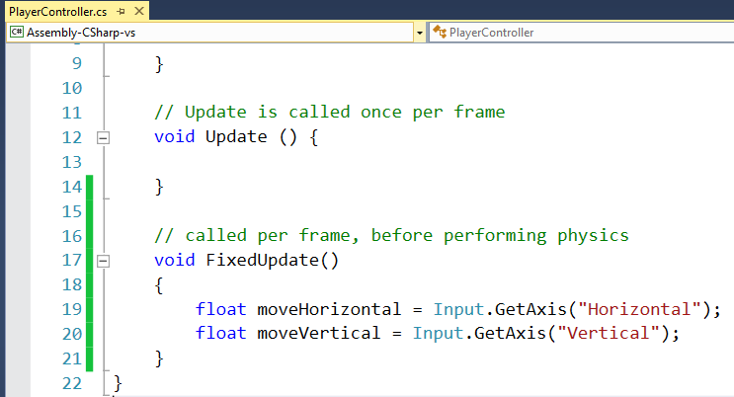
Get User Input
Add FixedUpdate() method
… just before last curly brace

Slide 45
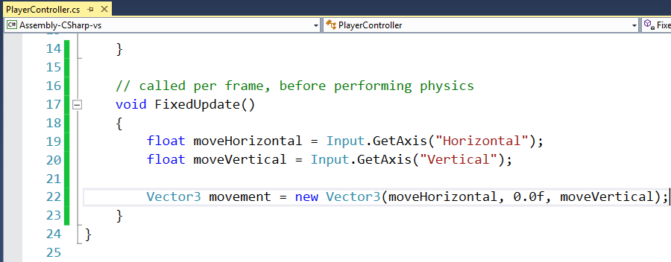
Calculate 3D Movement
Inside FixedUpdate() method…
Calculate 3D movement

Slide 46
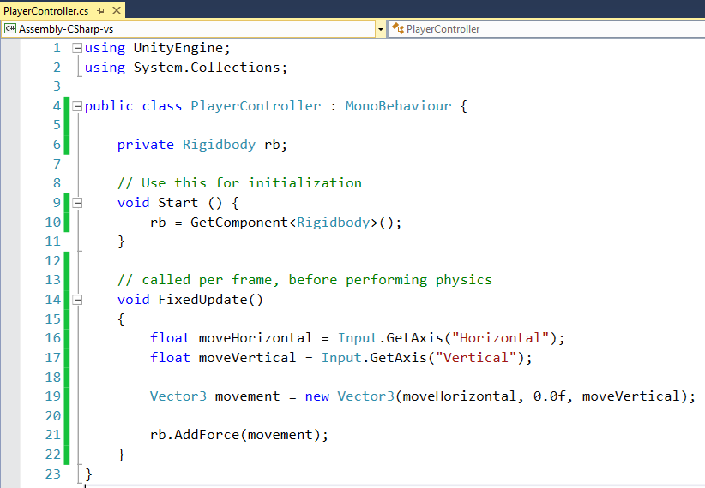
Add RigidBody Force
Define rb
just before Start()
Initialize inside
Start() method
Add Force inside
FixedUpdate()

Slide 47
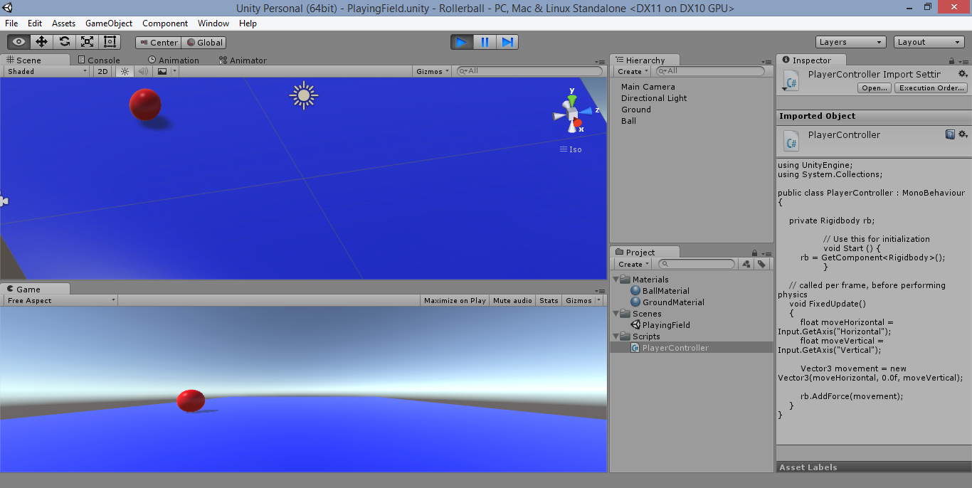
Run the Game… too slow?
Click Play button, move around with arrow keys!

Slide 48
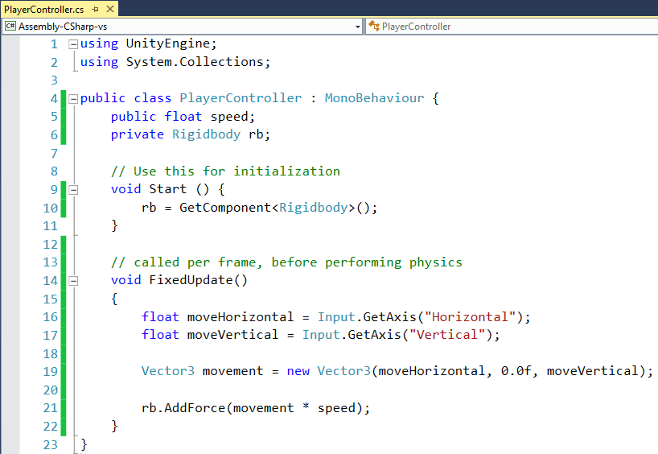
Add Variable for Speed
Define public
speed variable
Multiply speed
with movement

Slide 49
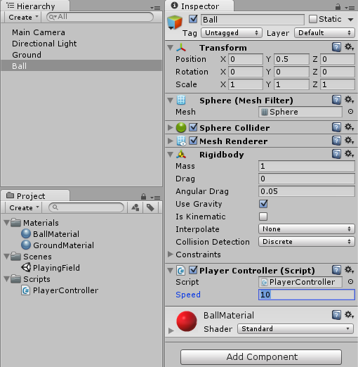
Assign Speed in Unity
With “Ball”
selected...
Set Speed = 10
What happens if
you set it to 100?

Slide 50
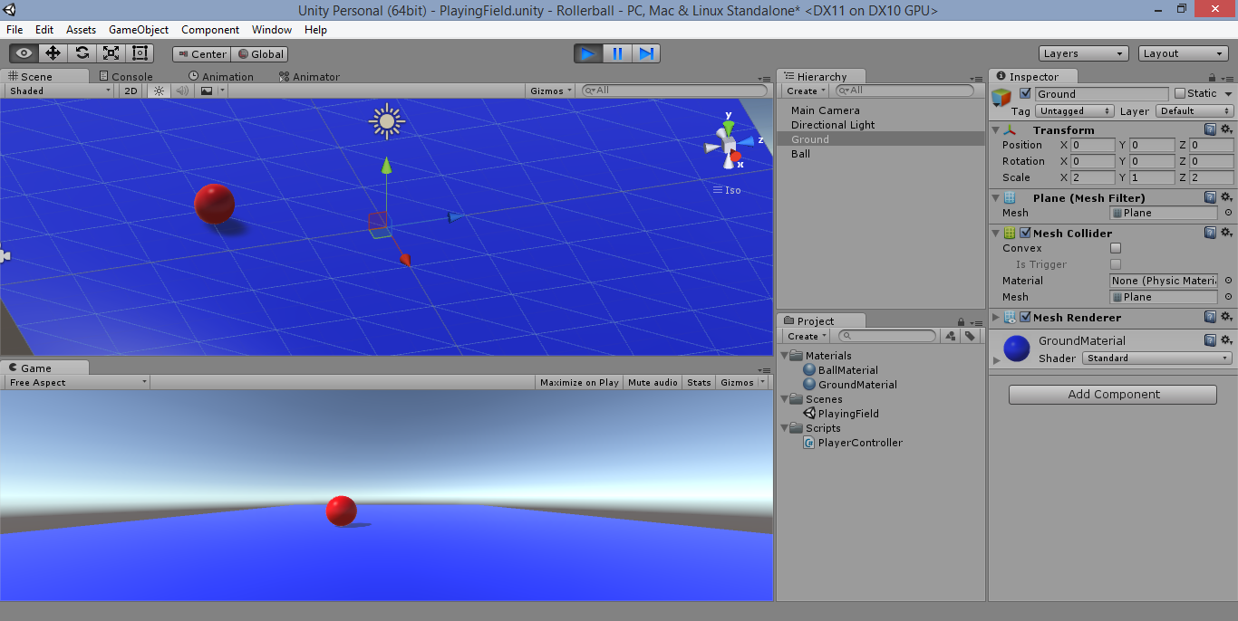
Run the Game… better now?
Click Play button, move around with arrow keys!

Slide 51
Controlling the Camera

Slide 52
Set Camera Position & Rotation
Set Camera Position and Rotation
Position: X = 0, Y = 10, Z = -10
Rotation: X = 45, Y = 0, Z = 0

Slide 53
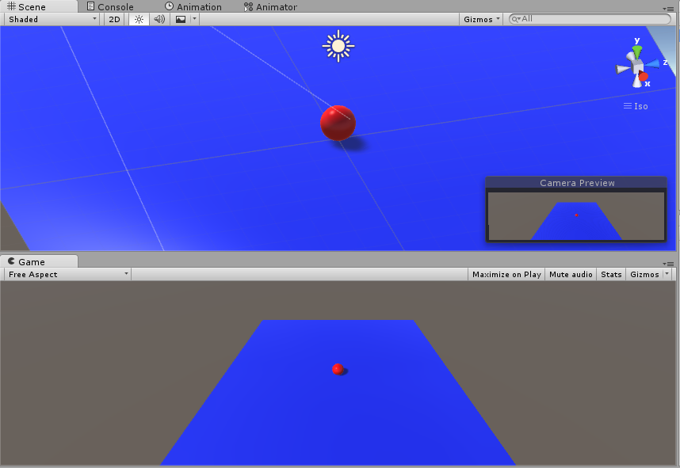
Verify Camera View in Game
Camera should
appear higher
with a better view

Slide 54
Create “CameraController” Script
In the Project panel,
click Create dropdown
Then select “C# Script”, name it
CameraController

Slide 55
Launch Script for “CameraController”

Slide 56
Define Instance Variables
Define instance
variables
just before Start()

Slide 57
Initialize Camera-Player Offset
Initialize offset
in Start() method

Slide 58
Set Camera Position in LateUpdate()
Add
LateUpdate()
method
Then, set
camera
position

Slide 59
Assign “CameraController” to Camera
With
“Main Camera”
selected...
Verify Script
Component!
… Drag
script into
camera

Slide 60
Assign “CameraController” to Camera
With
“Main
Camera”
selected...
… Drag Ball into Camera’s Player object

Slide 61
Run the Game!
Click Play, move around!

Slide 62
End of Part 1

