Slide 1
Unity 5: Rollerball (Step by Step)
Based on Roll-a-ball video tutorial from Unity Technologies
Part 2
By Shahed Chowdhuri
Senior Technical Evangelist
WakeUpAndCode.com
@shahedC
Notes:
Title Page: Game Development with Unity 5 and C# Windows  Web  Xbox  Mobile  … and more!
By Shahed Chowdhuri
Technical Evangelist
Blog: WakeUpAndCode.com
Twitter: @shahedC

Slide 2
Adding Borders

Slide 3
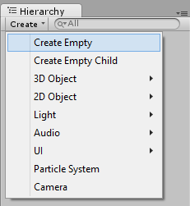
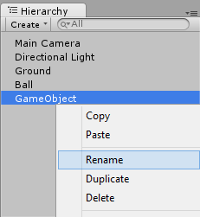
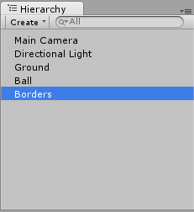
Create Empty Object for Borders
In Hierarchy panel, click Create → Create Empty
Rename empty “GameObject” to “Borders”

Slide 4
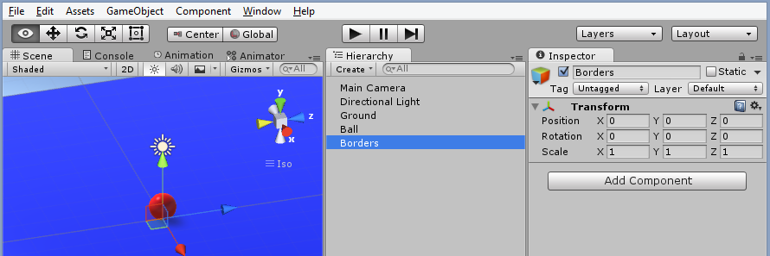
Reset to Origin
With “Border” selected in Hierarchy…
… Reset to origin in Inspector panel.

Slide 5
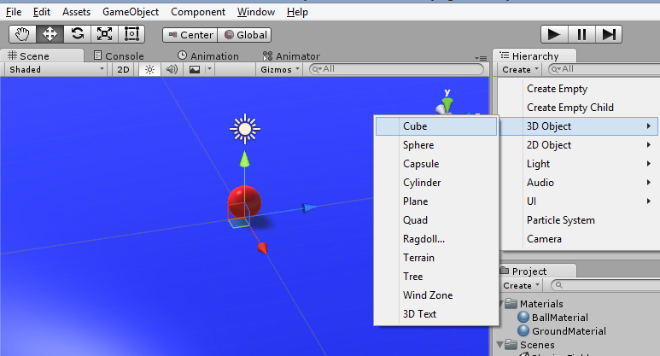
Create 3D Cube
In Hierarchy panel, click Create → 3D Object → Cube

Slide 6
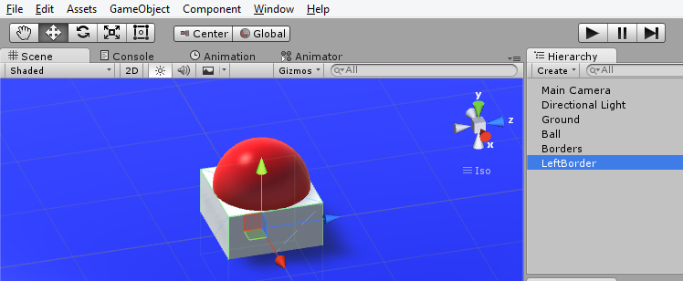
Rename Cube and Focus
Rename Cube to “LeftBorder” in the Hierarchy Panel
With the cube selected in Hierarchy, mouse over the Scene, press F key to focus on it

Slide 7
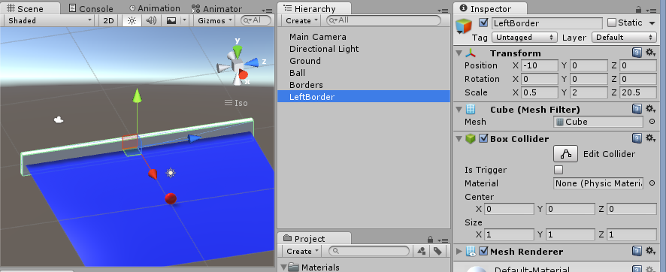
Set LeftBorder’s Position/Rotation/Scale
Transform
Position = -10, 0, 0
Rotation = 0, 0, 0
Scale = 0.5, 2, 20.5

Slide 8
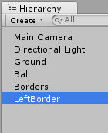
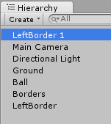
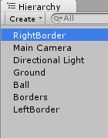
Duplicate and Rename to “RightBorder”
With “LeftBorder” selected in Hierarchy, press Ctrl-D to duplicate it
Rename the duplicate to “RightBorder”

Slide 9
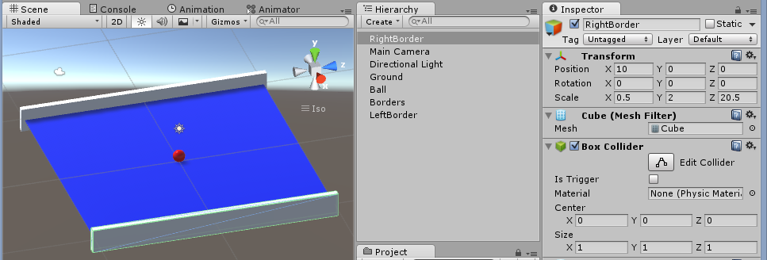
Set RightBorder’s Position/Rotation/Scale
Transform
Position = 10, 0, 0
Rotation = 0, 0, 0
Scale = 0.5, 2, 20.5

Slide 10
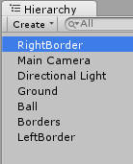
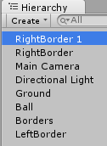
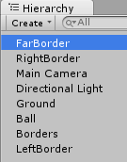
Duplicate and Rename to “FarBorder”
With “RightBorder” selected in Hierarchy, press Ctrl-D to duplicate it
Rename the duplicate to “FarBorder”

Slide 11
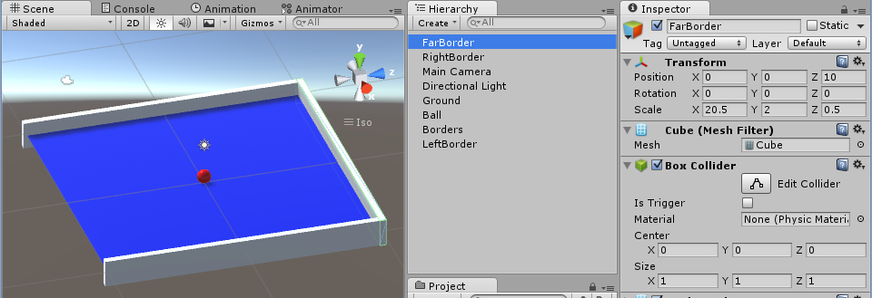
Set FarBorder’s Position/Rotation/Scale
Transform
Position = 0, 0, 10
Rotation = 0, 0, 0
Scale = 20.5, 2, 0.5

Slide 12
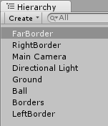
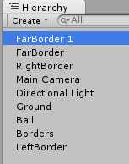
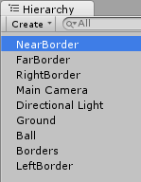
Duplicate and Rename to “NearBorder”
With “FarBorder” selected in Hierarchy, press Ctrl-D to duplicate it
Rename the duplicate to “NearBorder”

Slide 13
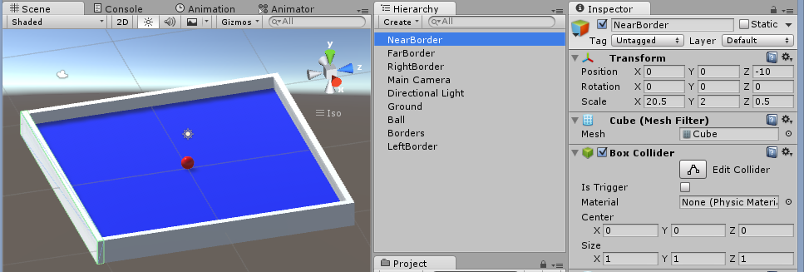
Set NearBorder’s Position/Rotation/Scale
Transform
Position = 0, 0, -10
Rotation = 0, 0, 0
Scale = 20.5, 2, 0.5

Slide 14
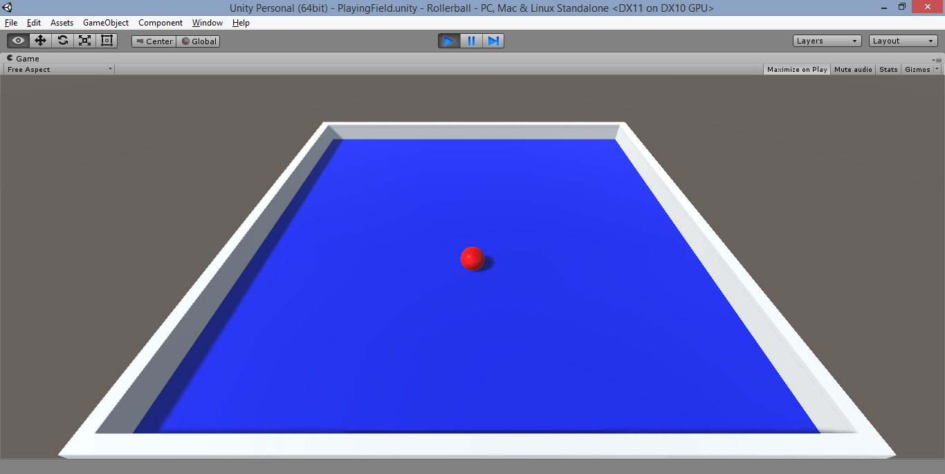
Run the Game!
Click Play button, move around with arrow keys!

Slide 15
Adding PowerUps

Slide 16
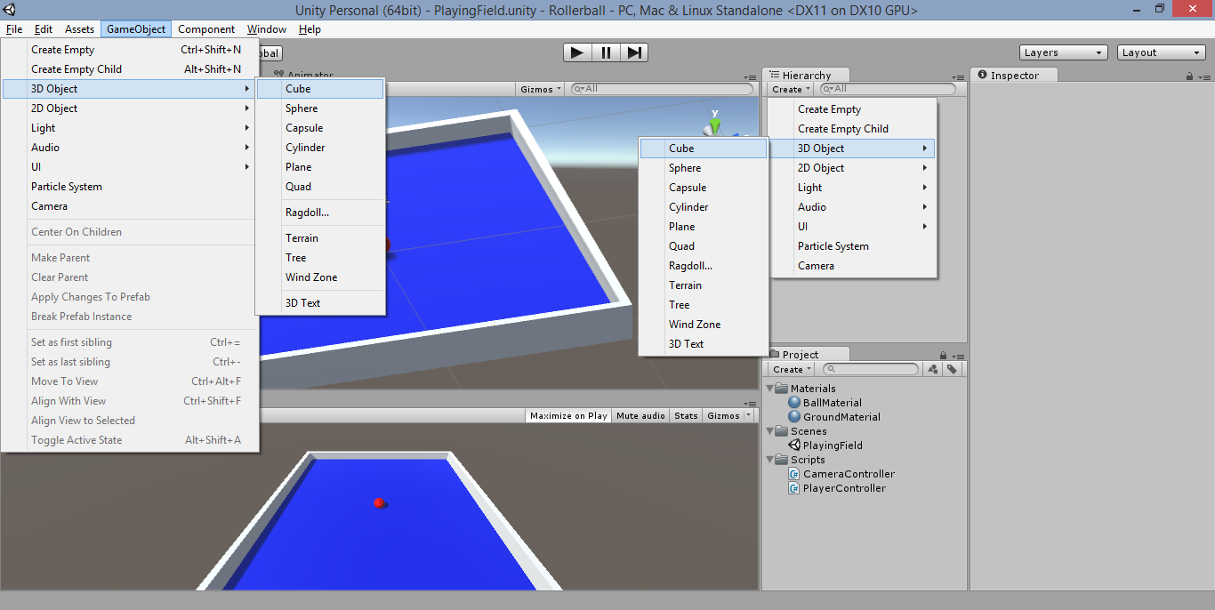
Create 3D Cube
Click GameObject → 3D Object → Cube
* OR *
Hierarchy
panel:
→ Create
→ 3D Object
→ Cube

Slide 17
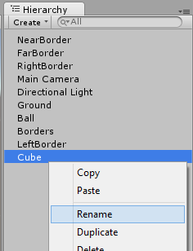
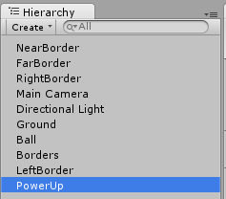
Rename Cube to “PowerUp”
Right-click Cube
in Hierarchy panel
Rename “Cube”
to “PowerUp”

Slide 18
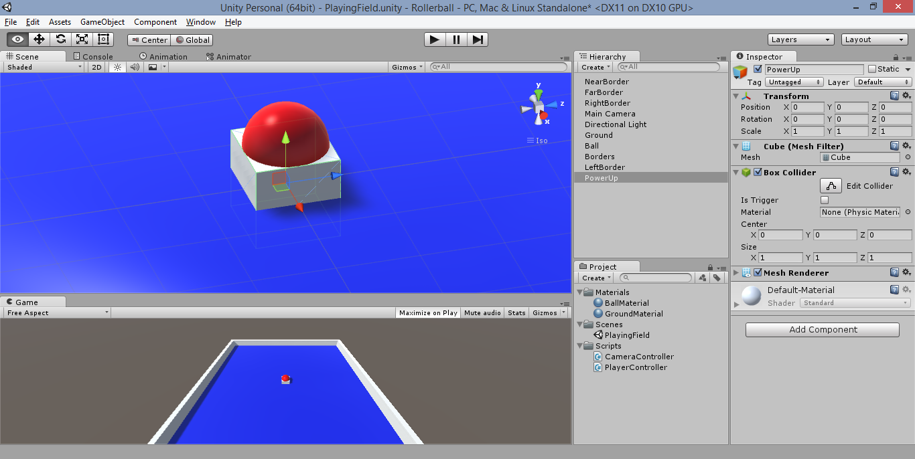
Center & Focus
Ensure PowerUp cube is at (0,0,0)
Mouse over Scene, then press “F” on keyboard to focus on selected PowerUp

Slide 19
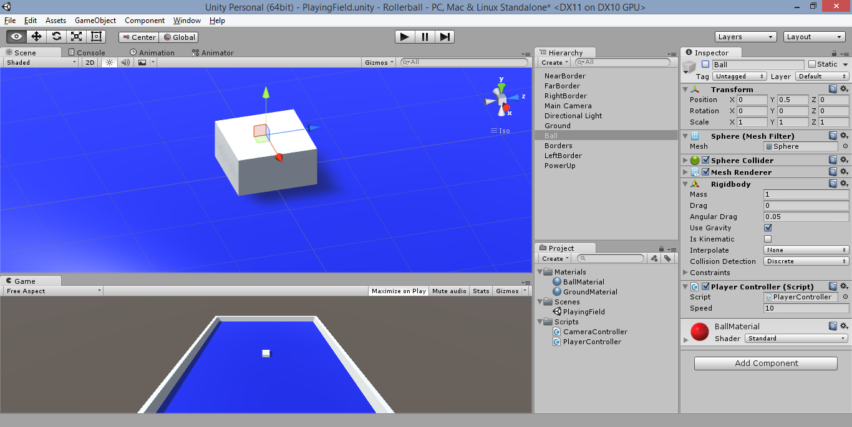
Deactivate Player Ball (temporarily)
Select Ball in Hierarchy, deselect active checkbox in Inspector panel
… the ball disappears from the Scene!

Slide 20
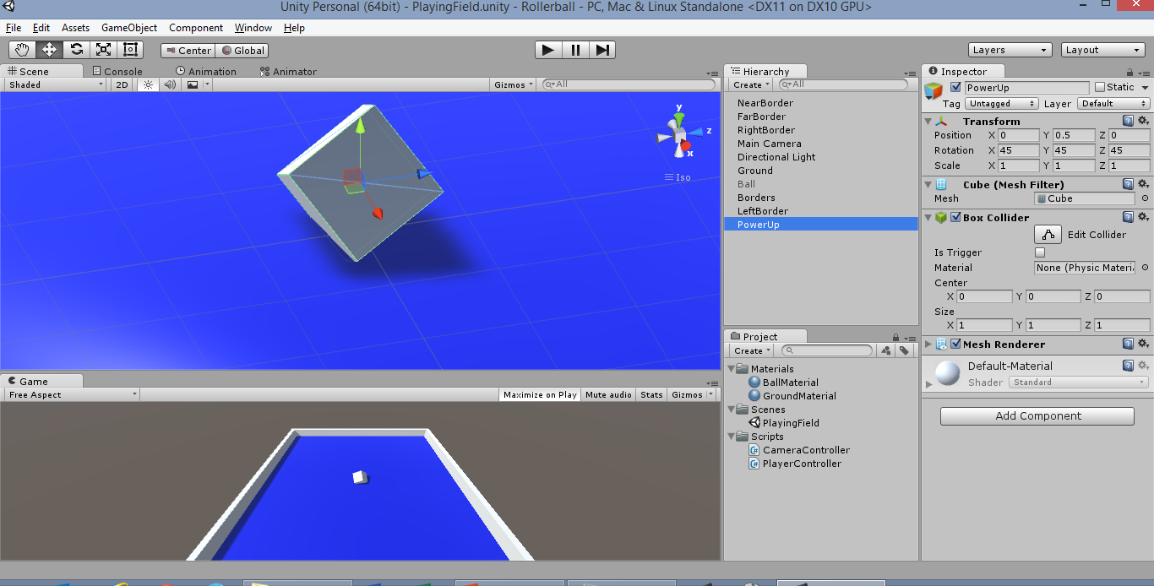
Reposition the PowerUp Cube
Position:
X = 0, 0.5, 0
Rotation = 45, 45, 45
Scale = 1, 1, 1
i.e. Lift up by 0.5, then rotate by (45, 45, 45)

Slide 21
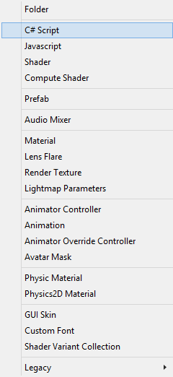
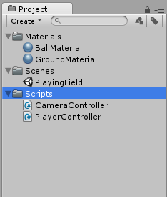
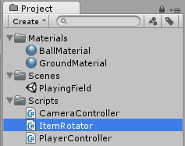
Create “ItemRotator” Script
In the Project panel,
click Create dropdown
Then select “C# Script”, name it
ItemRotator
… with Scripts folder
selected

Slide 22
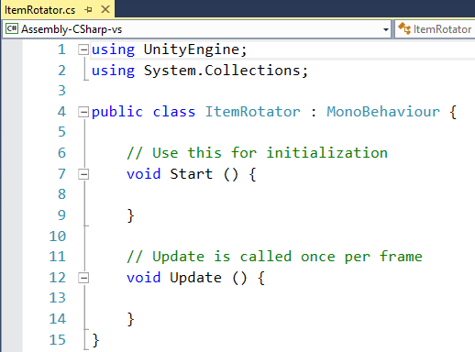
Launch “ItemRotator” Script

Slide 23
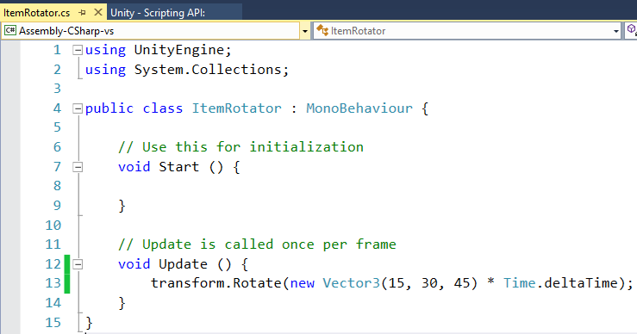
Edit Update() Method for Rotation

Slide 24
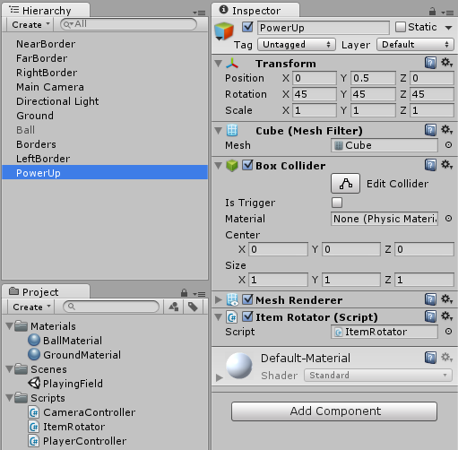
Assign ItemRotator Script to PowerUp
Drag to
PowerUp
Verify Script in Inspector panel

Slide 25
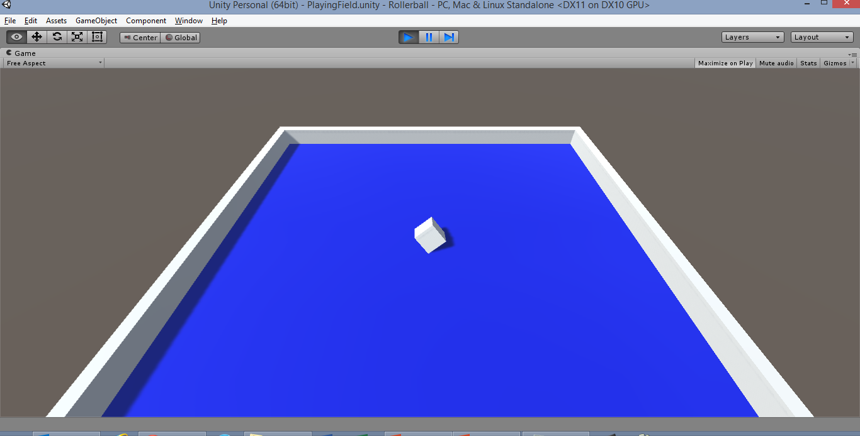
Run the Game!
Click Play button, see the rotation?

Slide 26
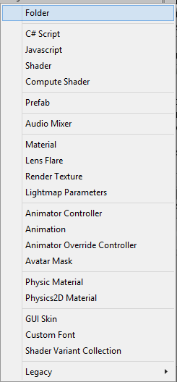
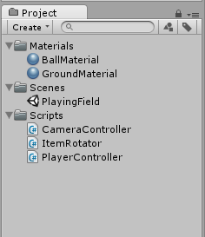
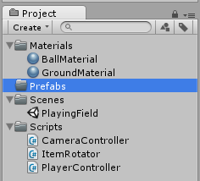
Create “Prefabs” Folder
In the Project panel,
click Create dropdown
Click “Folder”, then
Rename it “Prefabs"

Slide 27
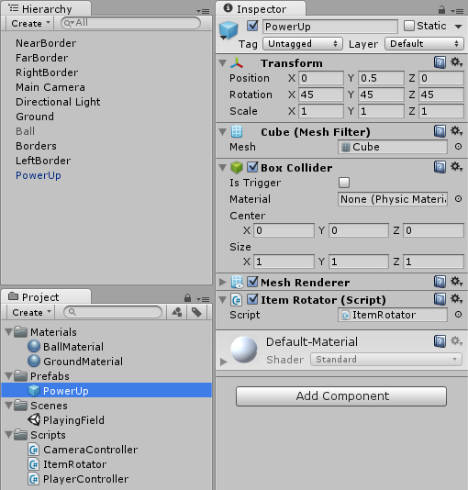
Drag PowerUp Into Prefabs Folder
Drag to
Prefabs
Verify that
PowerUp
is blue
In Hierarchy

Slide 28
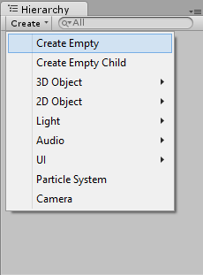
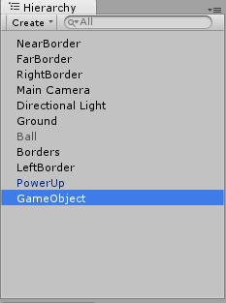
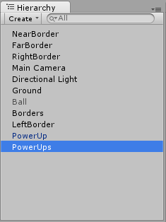
Create Empty GameObject for PowerUps
In the Hierarchy panel,
click Create → Create Empty
Rename GameObject to PowerUps (plural)

Slide 29
Reset to Origin
With “PowerUps” selected in Hierarchy…
… Reset to origin in Inspector panel.

Slide 30
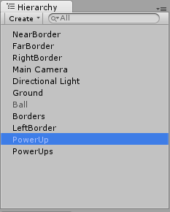
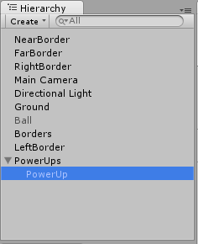
Drag PowerUp into PowerUps

Slide 31
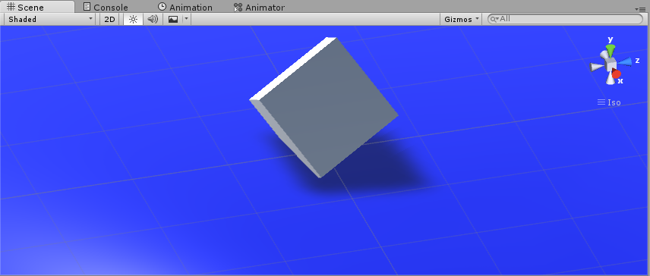
Switch to Top View
In the Scene panel, click the Y axis in the XYZ gizmo…
… top view!

Slide 32
Switch from Local to Global
Below the top menu, click the “Local” icon…
… it should switch to “Global”

Slide 33
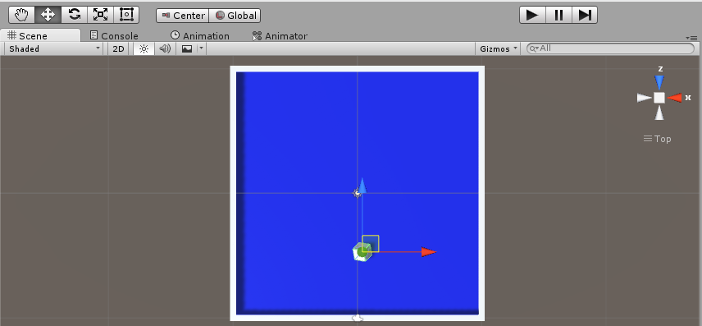
Move PowerUp Cube to Near Wall
Select the Move tool, then drag the PowerUp down to the Near Wall

Slide 34
Duplicate PowerUp and Rearrange
Press Ctrl-D to duplicate PowerUp, drag it to a new position…
… repeat this 11 times to create 12 PowerUps

Slide 35
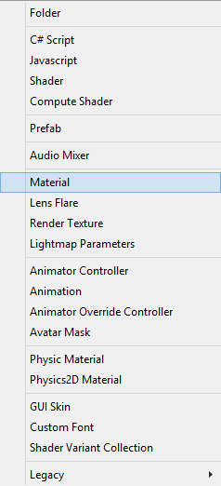
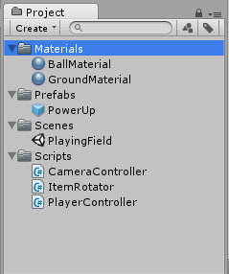
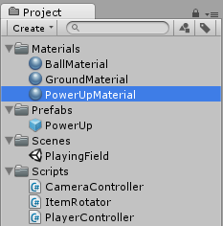
Create New Material for PowerUp
In the Project panel,
click Create dropdown…
Click “Material”, then
Rename it “PowerUpMaterial"
… with Materials
Folder selected

Slide 36
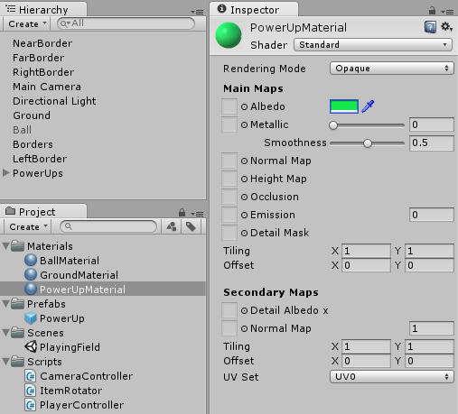
Change Color of PowerUpMaterial
Make sure color is
different from ball
and ground colors

Slide 37
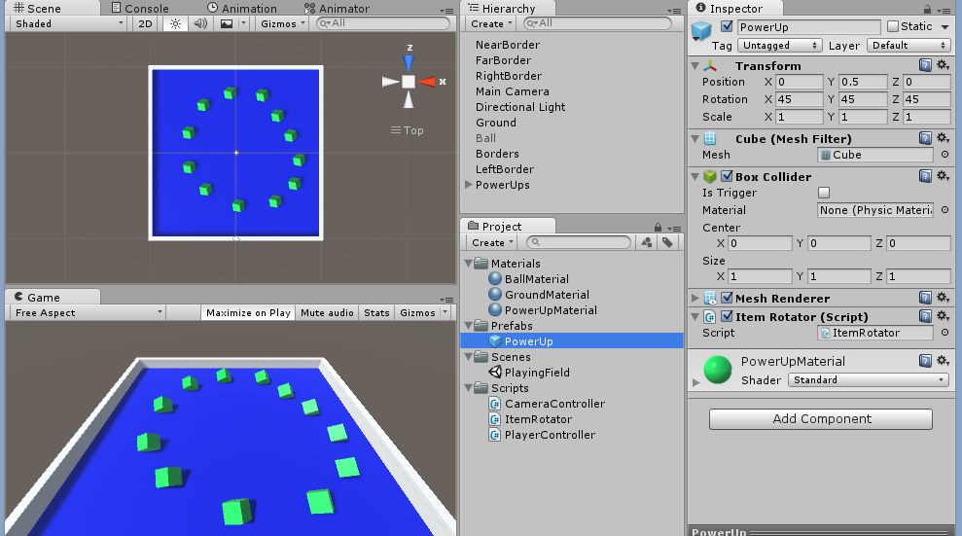
Apply PowerUp Material to Prefab
Drag to
Prefab
Verify Material

Slide 38
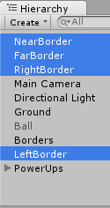
Clean Up: Borders
Drag
all 4
borders
into
“Borders”
Verify
Borders:
NearBorder
FarBorder
RightBorder
LeftBorder

Slide 39
Collision Detection

Slide 40
Re-Activate Player Ball
Activate “Ball”
by enabling
its checkbox
in Inspector
panel

Slide 41
Run the Game!
Click Play button, does the ball hit objects?

Slide 42
Launch “PlayerController” Script

Slide 43
Add OnTriggerEnter() Method
Add new method
OnTriggerEnter()
… just before class ends

Slide 44
Add Tag for PowerUp Prefab
In Inspector
window,
click Tag
dropdown
then click
“Add Tag…”
Select
PowerUp
Prefab
in
Project
window

Slide 45
Create New “PowerUp” Tag
Click + symbol
Rename New Tag
“PowerUp”

Slide 46
Assign Tag to PowerUp Prefab
In Inspector
window,
click Tag
dropdown
then select
“PowerUp” tag
Select
PowerUp
Prefab
in
Project
window

Slide 47
Run the Game!
Click Play button, ball still bounces back!

Slide 48
Enable Box Collider Trigger
Select
PowerUp
Prefab
in
Project
window
Enable
“Is Trigger”
Checkbox

Slide 49
Run the Game!
Click Play button, pick up PowerUps!

Slide 50
Add RigidBody to PowerUp Prefab
Select PowerUp
prefab in Project
Panel…
Then, Click Component → Physics → RigidBody

Slide 51
Enable IsKinematic
Select
PowerUp
Prefab
in
Project
window
Under RigidBody,
enable
“Is Kinematic”
checkbox
Notes:
*
need to optimize for static colliders
dynamic colliders are not cached
but static colliders are cached!
... collider + rigid body is dynamic
... collider but no rigid body is static
*
Solution?: If you add rigid body to pickups
they fall through the floor with gravity!
*
disable gravity? partial solution
but still respond to physics!
* keep gravity enabled, but select Is Kinematic
will not respond to physics forces!
objects with colliders or triggers
Suitable for: elevators, moving platforms, pickups

Slide 52
Scoring with Canvas

Slide 53
Launch “PlayerController” Script

Slide 54
Add and Increment Count Variable
Define a private integer
named “count”
Increment count by 1
inside OnTriggerEnter()
when player collides
with PowerUp

Slide 55
Add UI Text Element
In the Hierarchy panel, click Create → UI → Text

Slide 56
Verify New Objects in Hierachy
New Items in Hierarchy
Canvas
Text (child of Canvas)
Event System

Slide 57
Rename “Text” Object to “CountText”
In Hierarchy panel, right-click “Text” (below Canvas), rename to “CountText”

Slide 58
Update CountText Color and Text Value
Text: “count text”
Color: any light color

Slide 59
Update Rect Transform for CountText
Under “Rect Transform”, click on the square icon to see all Anchor Presets

Slide 60
Select an Anchor Preset
Hold down both Shift + Alt on keyboard
then click top-left square icon

Slide 61
Update Pox X and Y Offset
Pos X = 10
Pos Y = -10

Slide 62
Verify Count Text Position
Top
Left!

Slide 63
Launch “PlayerController” Script

Slide 64
Set Count Text in Code
First, add “using”
statement for
UnityEngine.UI
Add new public
variable for
countText object
In Start() method,
initialize count
and call
SetCountText()

Slide 65
Define SetCountText() Method
Add new method
SetCountText()
just before class ends

Slide 66
Update OnTriggerEnter() Method
Inside OnTriggerEnter()
call SetCountText()
on PowerUp collision

Slide 67
Assign CountText to Ball via Script Object
With
Ball
selected...
… drag to
CountText
Verify
CountText

Slide 68
Run the Game!
Click Play button, pick up PowerUps!
Count!

Slide 69
Add Another UI Text Element
In the Hierarchy panel, click Create → UI → Text

Slide 70
Rename New “Text” Object to “WinText”
In Hierarchy panel, right-click “Text” (below CountText), rename to “WinText”

Slide 71
Update Rect Transform for WinText
Under “Rect Transform”, click on the square icon to see all Anchor Presets

Slide 72
Select an Anchor Preset
Hold down both Shift + Alt on keyboard
then click middle-center square icon

Slide 73
Update Pox X and Y Offset
Pos X = 0
Pos Y = 75

Slide 74
Launch “PlayerController” Script

Slide 75
Set Win Text in Code
Add new public
variable for
winText object
In Start() method,
initialize
winText.Text

Slide 76
Update Win Text in SetCountText()
If all 12 PowerUps are collected…
… then, update winText.text

Slide 77
Assign WinText to Ball via Script Object
With
Ball
selected...
… drag to
WinText
Verify WinText

Slide 78
Run the Game!
Click Play, collect all PowerUps!

Slide 79
End of Part 2

