Slide 1
Your Host & Speaker
Shahed Chowdhuri
Sr. Technical Evangelist @ Microsoft
Technology Areas
Enterprise Web/Software Development
Game Development
Mobile Application Development
Cloud Solutions
Online
LinkedIn: http://linkedin.com/in/shahedc
Meetup: http://www.meetup.com/DC-MS-Devs/
Twitter: http://twitter.com/shahedC
Blog: http://WakeUpAndCode.com

Slide 2
Intro to Xamarin*
Cross-Platform Mobile App Development
Shahed Chowdhuri
Sr. Technical Evangelist @ Microsoft
@shahedC
WakeUpAndCode.com
* Now owned by Microsoft

Slide 3
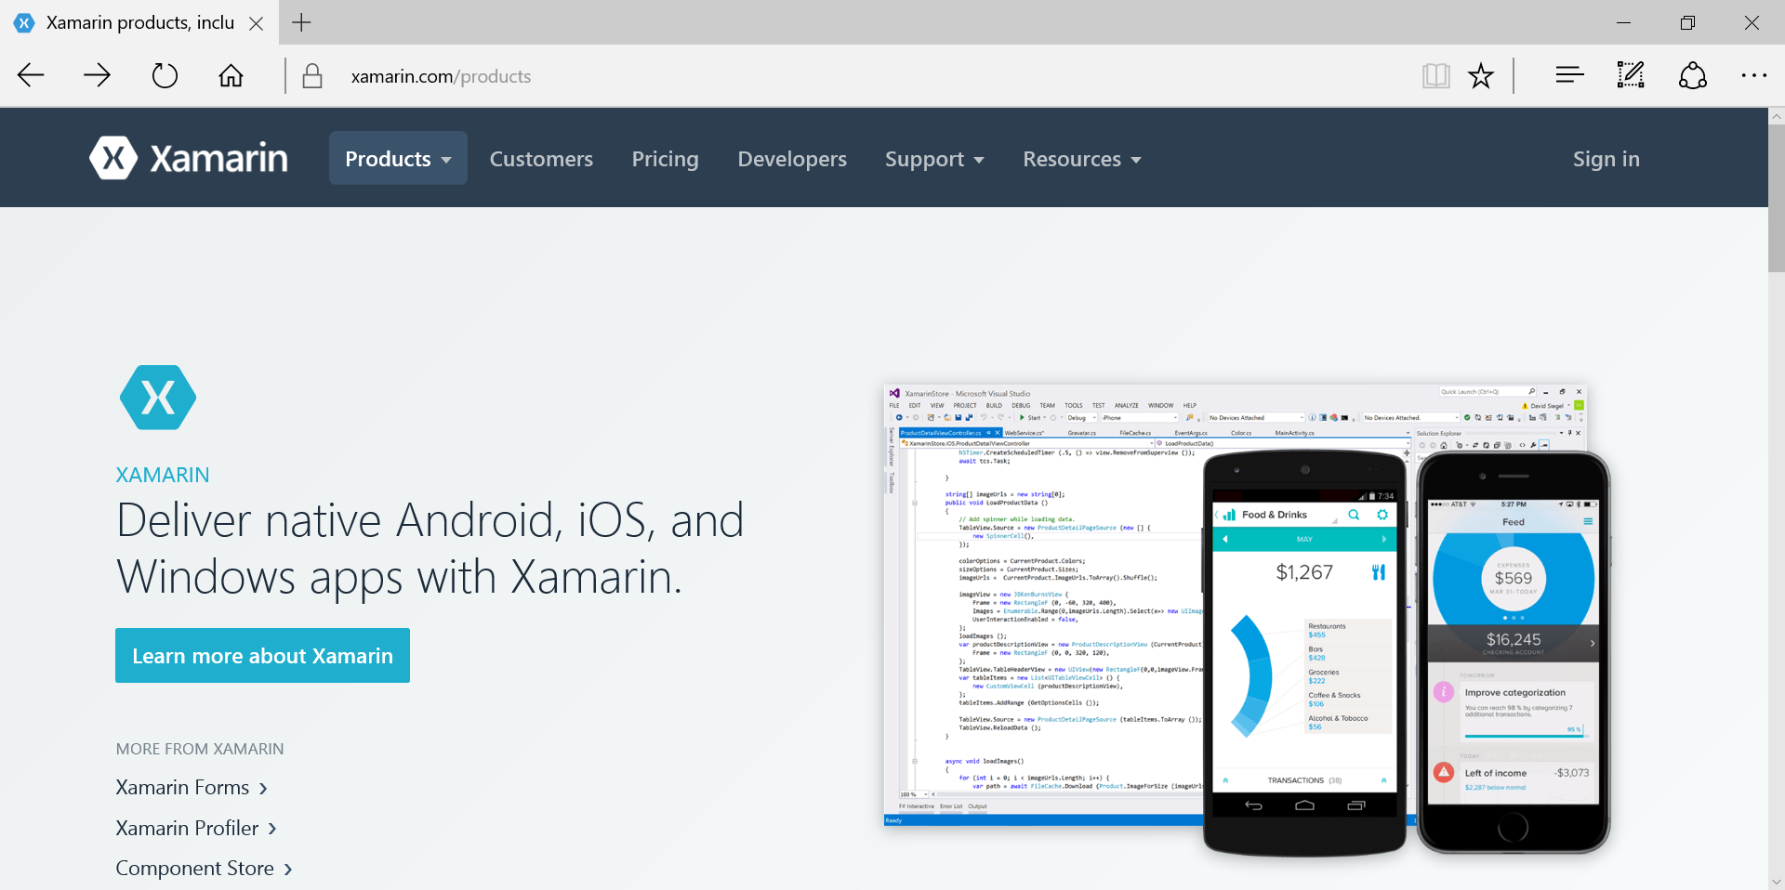
What is Xamarin?
https://www.xamarin.com/products

Slide 4
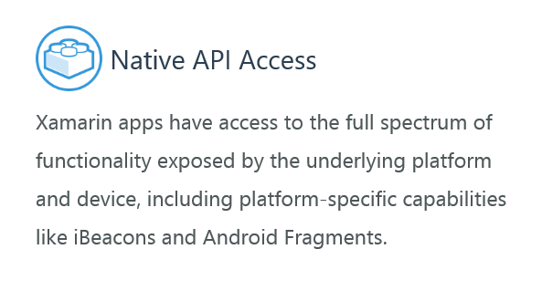
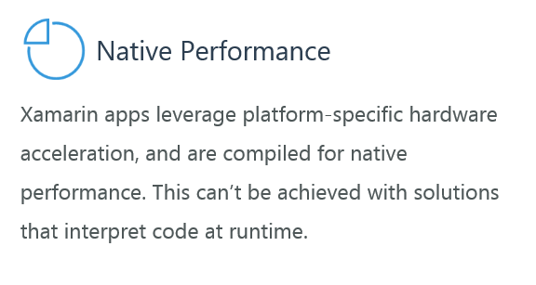
Native?
https://www.xamarin.com/products

Slide 5
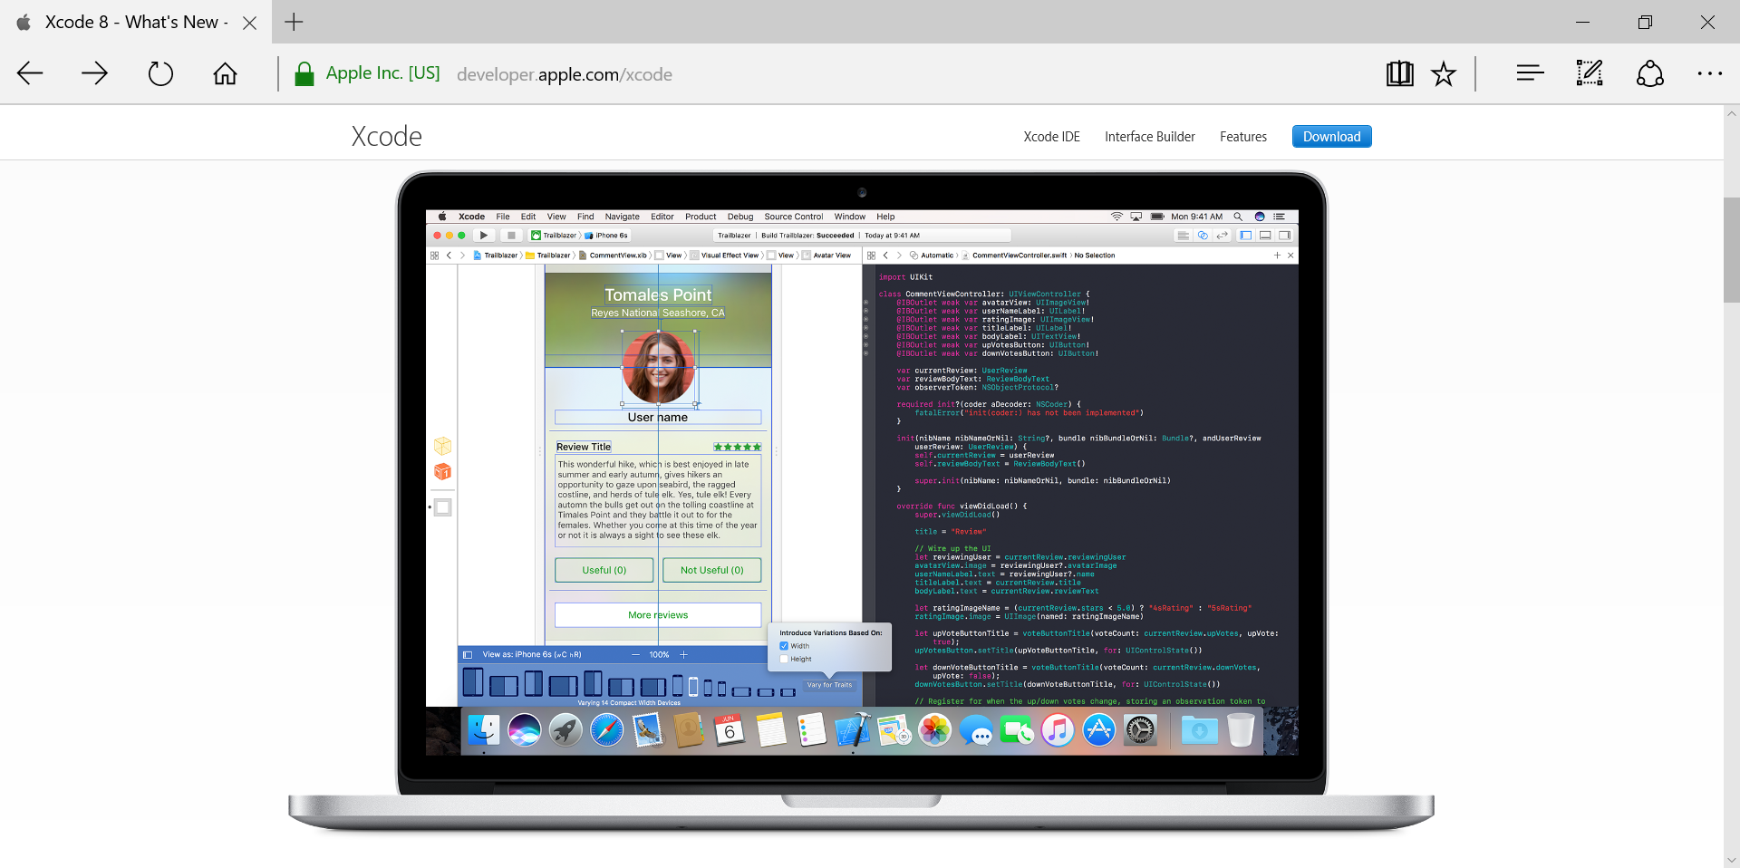
Dev Tools from Apple
https://developer.apple.com/xcode
OS:
Mac OS X
IDE:
Xcode
Languages:
Objective-C
Swift
Mobile Targets:
iOS

Slide 6
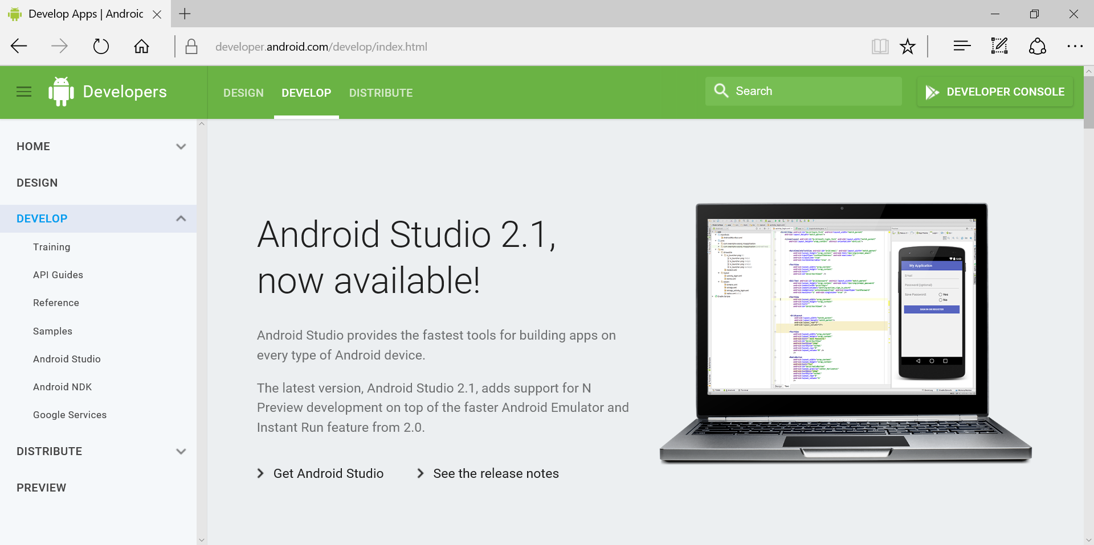
Dev Tools from Google
https://developer.android.com/studio
OS:
Windows
Mac OS X
Linux
IDE:
Android Studio
Language:
Java
Mobile Targets:
Android

Slide 7
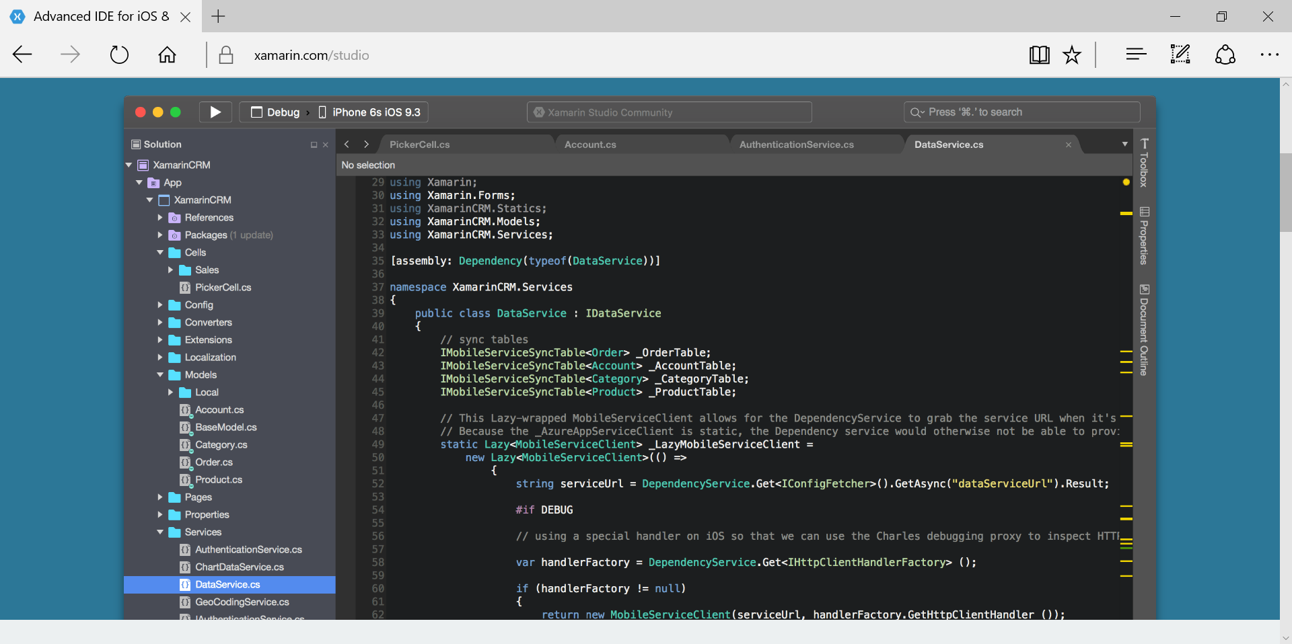
Dev Tools from Xamarin
https://www.xamarin.com/studio
OS:
Windows
Mac OS X
IDE:
Xamarin Studio
Language:
C#
Mobile Targets:
iOS
Android
Windows

Slide 8
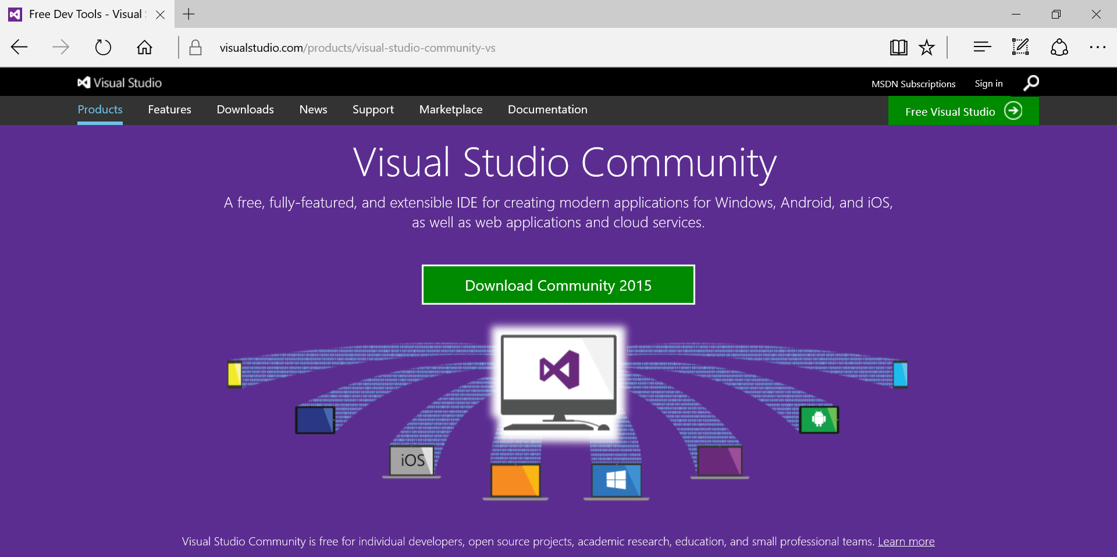
Dev Tools from Microsoft
https://www.xamarin.com/studio
OS:
Windows
IDE:
Visual Studio
Language:
C#
Mobile Targets:
iOS *
Android
Windows
* iOS development on Windows requires accessible Mac OS build host

Slide 9
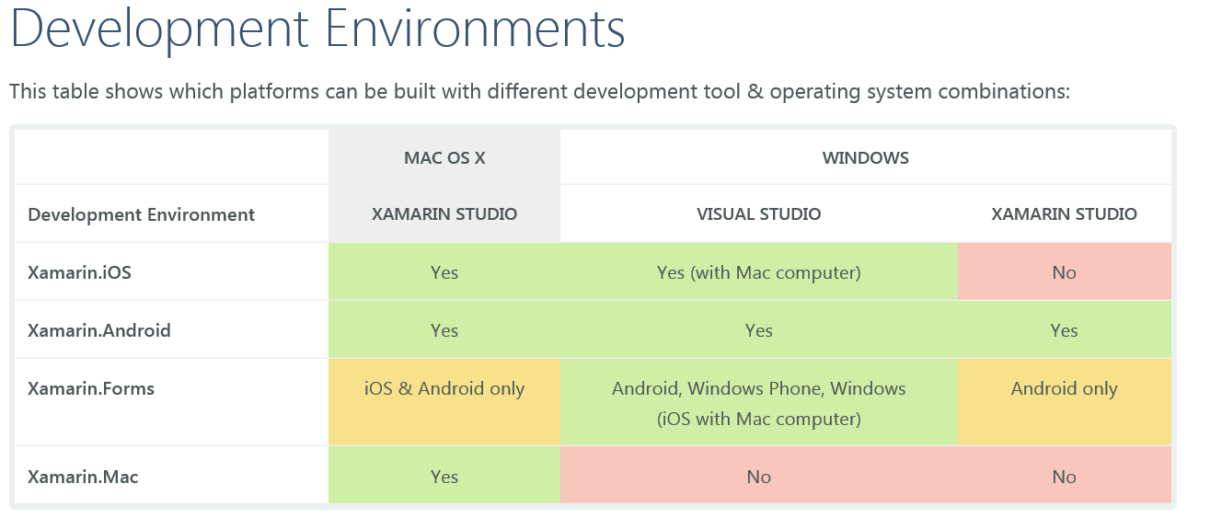
Xamarin Development Environments
https://developer.xamarin.com/guides/cross-platform/getting_started/requirements/

Slide 10
Why?

Slide 11
Option A: iOS Only with Apple Tools

Slide 12
Option B: Android Only with Google Tools

Slide 13
Option C: iOS + Android with both

Slide 14
Option D: PhoneGap / Cordova
Start with HTML5/CSS3/JavaScript → Use PhoneGap → Deploy to platforms
http://phonegap.com

Slide 15
Option E: Xamarin!
“Use the same language, APIs and data structures to share an average of 75% of app code across all mobile development platforms. Build user interfaces with Xamarin.Forms and share nearly 100%.”

Slide 16
C# Language Features: var keyword

Slide 17
C# Language Features: async + await

Slide 18
C# Language Features: Generics

Slide 19
C# Language Features: Lambda syntax

Slide 20
Demo
Notes:
Additional Topics

Slide 21
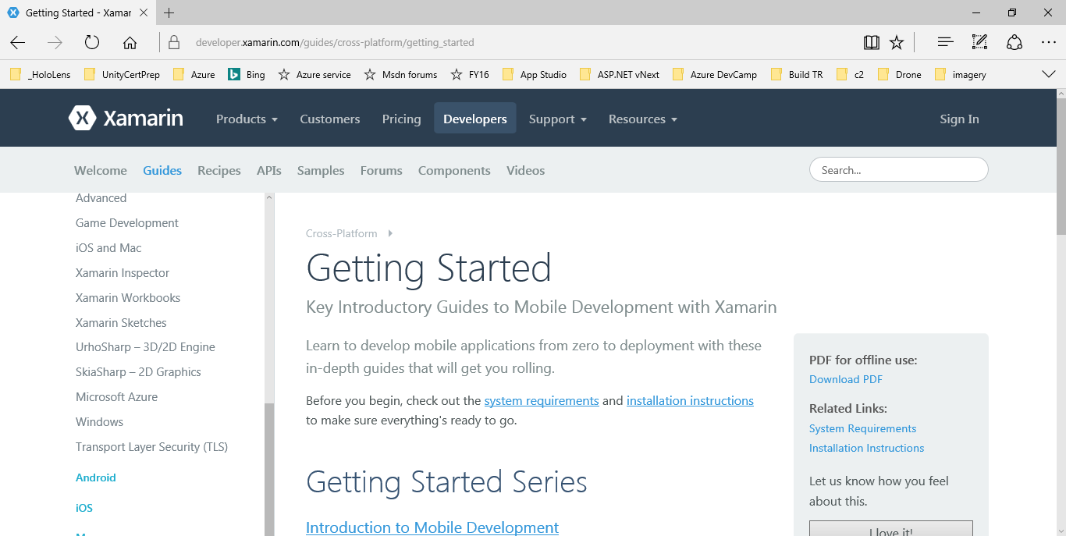
Next Steps
https://developer.xamarin.com/guides/cross-platform/getting_started/

Slide 22
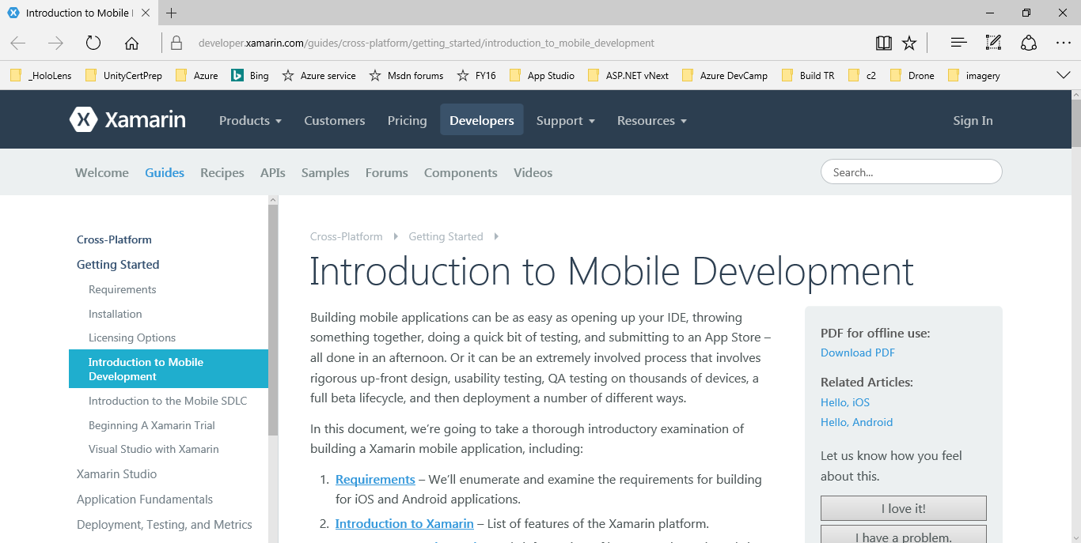
Intro to Mobile Development
https://developer.xamarin.com/guides/cross-platform/getting_started/introduction_to_mobile_development/

Slide 23
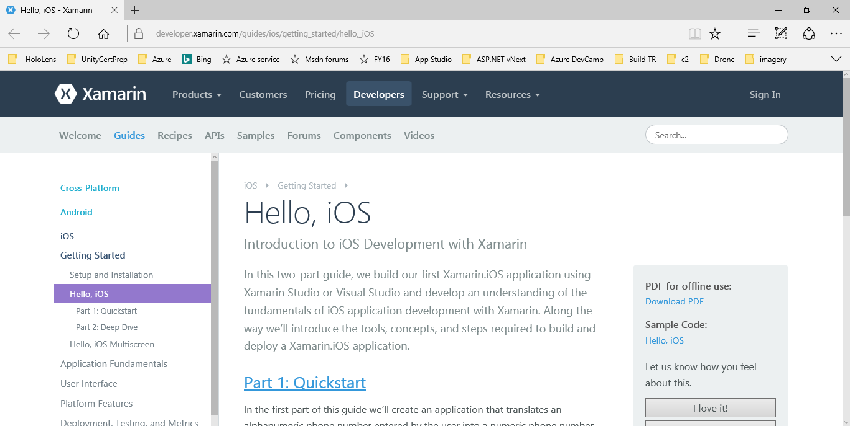
Hello, iOS
https://developer.xamarin.com/guides/ios/getting_started/hello,_iOS/

Slide 24
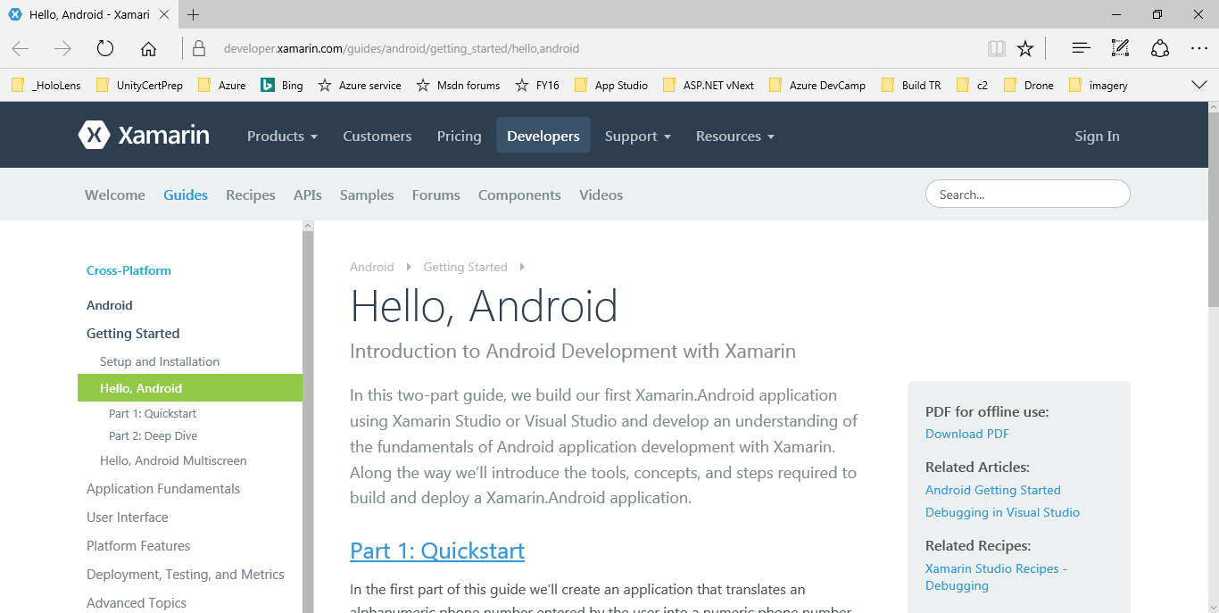
Hello, Android
https://developer.xamarin.com/guides/android/getting_started/hello,android/

Slide 25
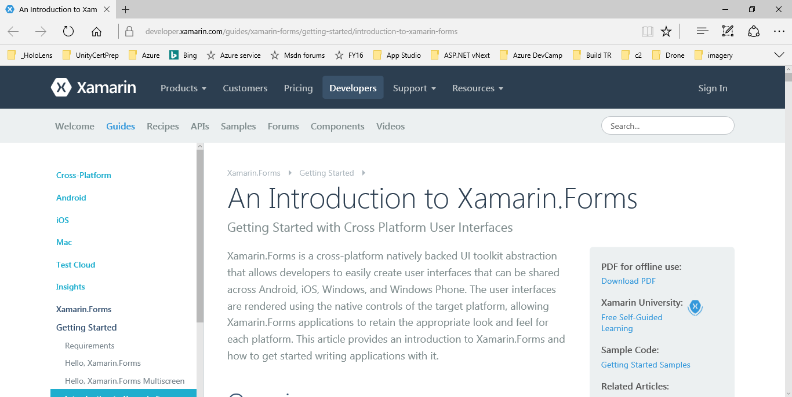
Intro to Xamarin.Forms
https://developer.xamarin.com/guides/xamarin-forms/getting-started/introduction-to-xamarin-forms/

Slide 26
Q & A
Notes:
Additional Topics

Slide 27
Email: shchowd@microsoft.com  Twitter: @shahedC
Notes:
Contact
Microsoft email: shchowd@microsoft.com
Personal Twitter: @shahedC
Dev Blog: WakeUpAndCode.com

