Slide 1
Your Host & Speaker
Shahed Chowdhuri
Sr. Technical Evangelist @ Microsoft
Technology Areas
Enterprise Web/Software Development
Game Development
Mobile Application Development
Cloud Solutions
Online
LinkedIn: http://linkedin.com/in/shahedc
Meetup: http://www.meetup.com/DC-MS-Devs/
Twitter: http://twitter.com/shahedC
Blog: http://WakeUpAndCode.com

Slide 2
Xbox One Dev Mode
Visual Studio, Unity, Construct 2, etc
Shahed Chowdhuri
Sr. Technical Evangelist @ Microsoft
@shahedC
WakeUpAndCode.com

Slide 3
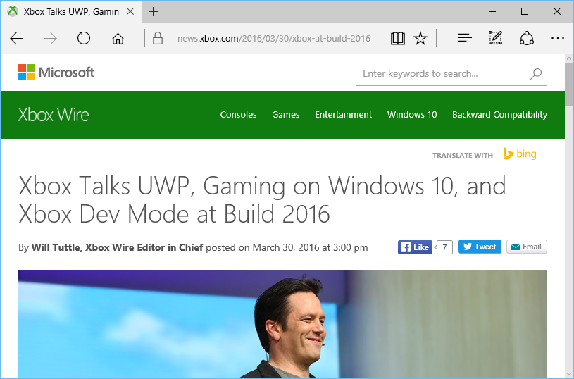
Things to Know
Xbox Dev Mode Activation
UWP on Xbox One
Visual Studio 2015 Update 2
Windows 10 Insider Program
Windows 10 Preview SDK
Windows Dev Center
3rd Party Tools
ID@Xbox
https://news.xbox.com/2016/03/30/xbox-at-build-2016/
Notes:
Speaker notes:
Deliver video content or stream video to audiences large or small to any device(Web or Mobile) anywhere reliably and in scale.
Helps you create versatile media workflows for ingesting, encoding, protecting and streaming content to audiences on-demand or broadcast live.
Powerful and extensible platform with broad set of first and third-party capabilities to support complete end-to-end media workflows.
Integration with Office 365 empowers organizations of all sizes helps to use videos to enhance sharing, collaboration and communication.
Azure Media Player, an automated online player solution, supports all the usual industry standards like HTML5 video, Media Source Extensions and rights management through Encrypted Media Extensions. The focus here is on open standards, but on older browsers, the player can fall back on Flash or Silverlight.

Slide 4
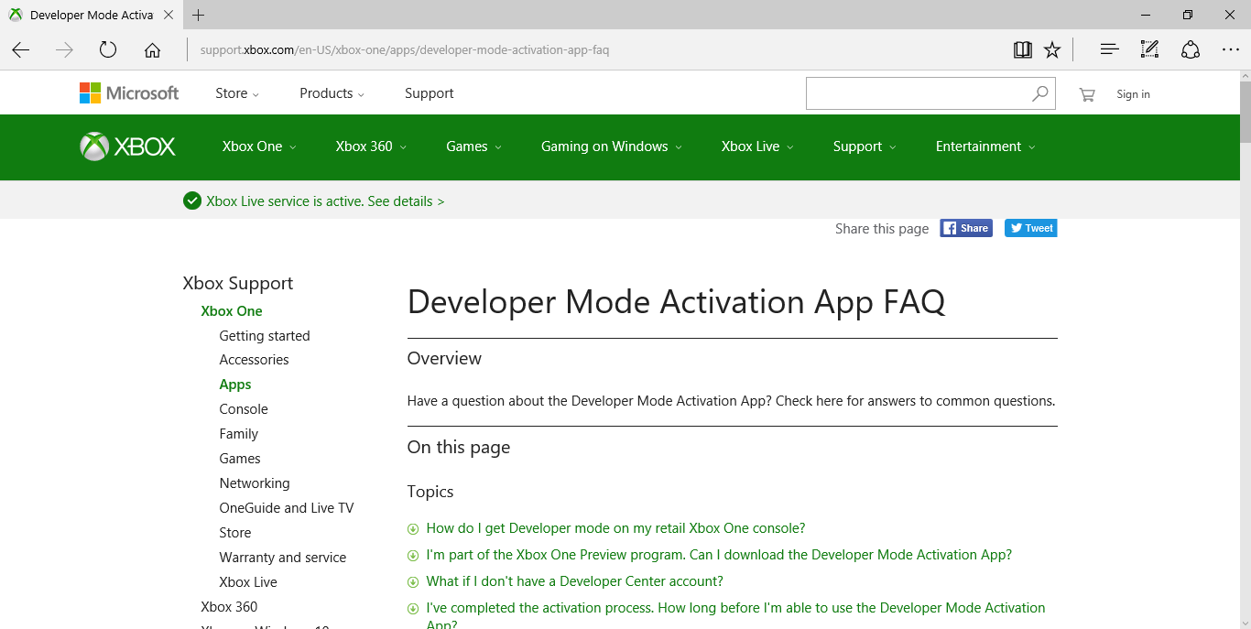
Xbox One Dev Mode Activation
http://support.xbox.com/en-US/xbox-one/apps/developer-mode-activation-app-faq
Notes:
Speaker notes:
Deliver video content or stream video to audiences large or small to any device(Web or Mobile) anywhere reliably and in scale.
Helps you create versatile media workflows for ingesting, encoding, protecting and streaming content to audiences on-demand or broadcast live.
Powerful and extensible platform with broad set of first and third-party capabilities to support complete end-to-end media workflows.
Integration with Office 365 empowers organizations of all sizes helps to use videos to enhance sharing, collaboration and communication.
Azure Media Player, an automated online player solution, supports all the usual industry standards like HTML5 video, Media Source Extensions and rights management through Encrypted Media Extensions. The focus here is on open standards, but on older browsers, the player can fall back on Flash or Silverlight.

Slide 5
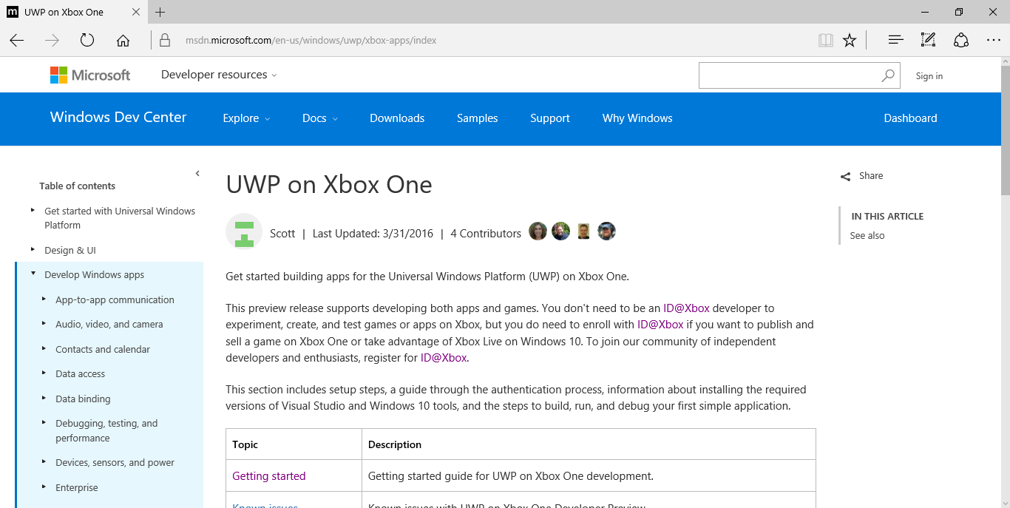
UWP on Xbox One
https://msdn.microsoft.com/en-us/windows/uwp/xbox-apps/index
Notes:
Speaker notes:
Deliver video content or stream video to audiences large or small to any device(Web or Mobile) anywhere reliably and in scale.
Helps you create versatile media workflows for ingesting, encoding, protecting and streaming content to audiences on-demand or broadcast live.
Powerful and extensible platform with broad set of first and third-party capabilities to support complete end-to-end media workflows.
Integration with Office 365 empowers organizations of all sizes helps to use videos to enhance sharing, collaboration and communication.
Azure Media Player, an automated online player solution, supports all the usual industry standards like HTML5 video, Media Source Extensions and rights management through Encrypted Media Extensions. The focus here is on open standards, but on older browsers, the player can fall back on Flash or Silverlight.

Slide 6
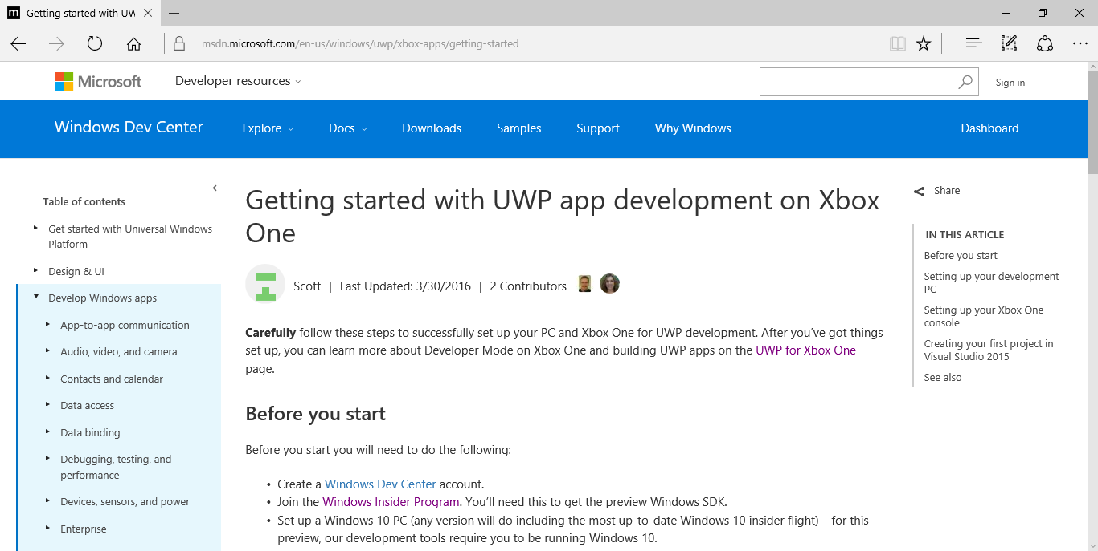
UWP on Xbox One: Getting Started
https://msdn.microsoft.com/en-us/windows/uwp/xbox-apps/getting-started
Notes:
Speaker notes:
Deliver video content or stream video to audiences large or small to any device(Web or Mobile) anywhere reliably and in scale.
Helps you create versatile media workflows for ingesting, encoding, protecting and streaming content to audiences on-demand or broadcast live.
Powerful and extensible platform with broad set of first and third-party capabilities to support complete end-to-end media workflows.
Integration with Office 365 empowers organizations of all sizes helps to use videos to enhance sharing, collaboration and communication.
Azure Media Player, an automated online player solution, supports all the usual industry standards like HTML5 video, Media Source Extensions and rights management through Encrypted Media Extensions. The focus here is on open standards, but on older browsers, the player can fall back on Flash or Silverlight.

Slide 7
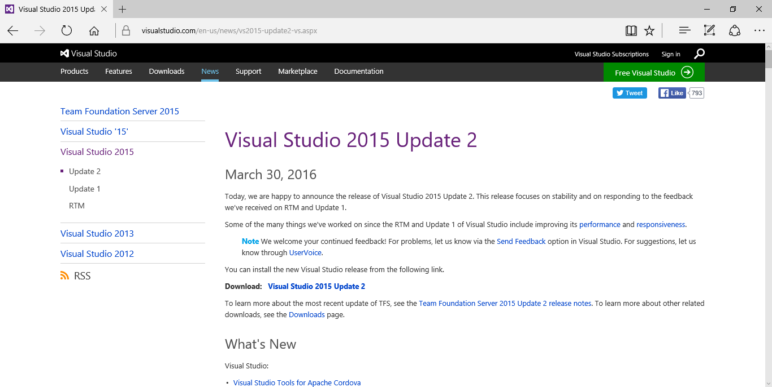
Visual Studio 2015 Update 2
https://www.visualstudio.com/en-us/news/vs2015-update2-vs.aspx
Notes:
Speaker notes:
Deliver video content or stream video to audiences large or small to any device(Web or Mobile) anywhere reliably and in scale.
Helps you create versatile media workflows for ingesting, encoding, protecting and streaming content to audiences on-demand or broadcast live.
Powerful and extensible platform with broad set of first and third-party capabilities to support complete end-to-end media workflows.
Integration with Office 365 empowers organizations of all sizes helps to use videos to enhance sharing, collaboration and communication.
Azure Media Player, an automated online player solution, supports all the usual industry standards like HTML5 video, Media Source Extensions and rights management through Encrypted Media Extensions. The focus here is on open standards, but on older browsers, the player can fall back on Flash or Silverlight.

Slide 8
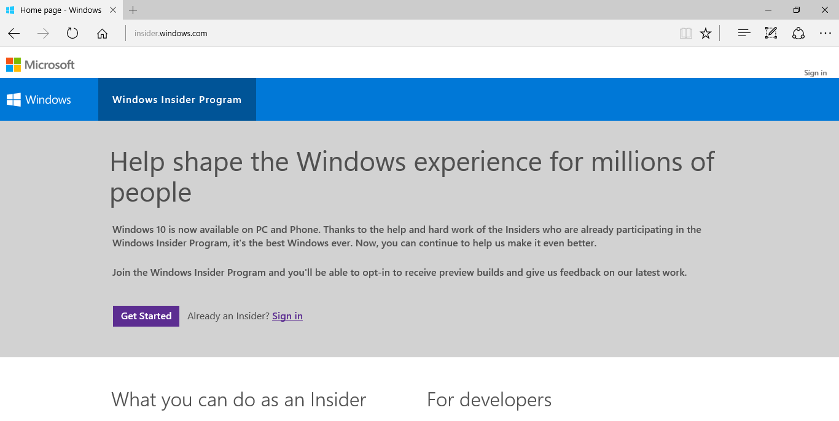
Windows 10 Insider Program
https://insider.windows.com/
Notes:
Speaker notes:
Deliver video content or stream video to audiences large or small to any device(Web or Mobile) anywhere reliably and in scale.
Helps you create versatile media workflows for ingesting, encoding, protecting and streaming content to audiences on-demand or broadcast live.
Powerful and extensible platform with broad set of first and third-party capabilities to support complete end-to-end media workflows.
Integration with Office 365 empowers organizations of all sizes helps to use videos to enhance sharing, collaboration and communication.
Azure Media Player, an automated online player solution, supports all the usual industry standards like HTML5 video, Media Source Extensions and rights management through Encrypted Media Extensions. The focus here is on open standards, but on older browsers, the player can fall back on Flash or Silverlight.

Slide 9
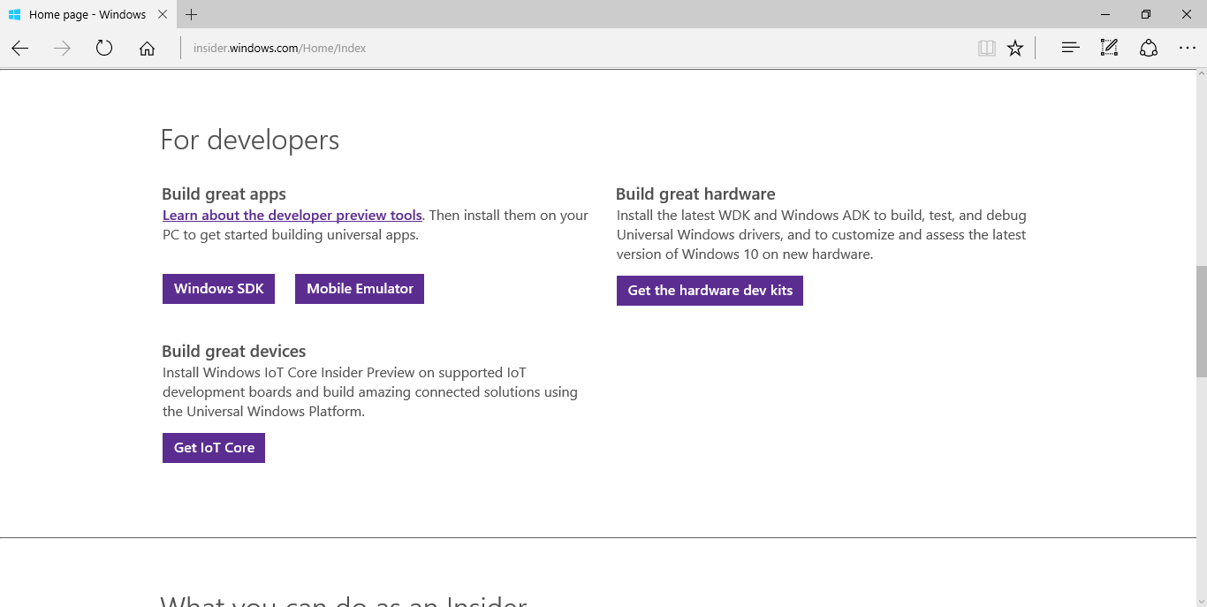
Windows 10 Preview SDK
Log In
Scroll down
Get SDK!
https://insider.windows.com/Home/Index
Notes:
Speaker notes:
Deliver video content or stream video to audiences large or small to any device(Web or Mobile) anywhere reliably and in scale.
Helps you create versatile media workflows for ingesting, encoding, protecting and streaming content to audiences on-demand or broadcast live.
Powerful and extensible platform with broad set of first and third-party capabilities to support complete end-to-end media workflows.
Integration with Office 365 empowers organizations of all sizes helps to use videos to enhance sharing, collaboration and communication.
Azure Media Player, an automated online player solution, supports all the usual industry standards like HTML5 video, Media Source Extensions and rights management through Encrypted Media Extensions. The focus here is on open standards, but on older browsers, the player can fall back on Flash or Silverlight.

Slide 10
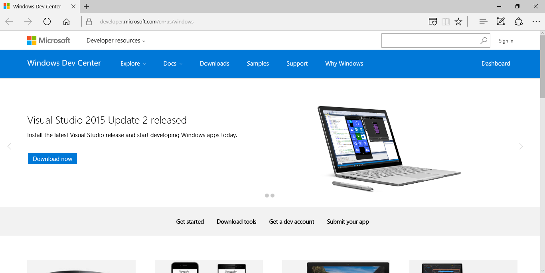
Windows Dev Center
http://dev.windows.com
https://developer.microsoft.com/en-us/windows
Notes:
Speaker notes:
Deliver video content or stream video to audiences large or small to any device(Web or Mobile) anywhere reliably and in scale.
Helps you create versatile media workflows for ingesting, encoding, protecting and streaming content to audiences on-demand or broadcast live.
Powerful and extensible platform with broad set of first and third-party capabilities to support complete end-to-end media workflows.
Integration with Office 365 empowers organizations of all sizes helps to use videos to enhance sharing, collaboration and communication.
Azure Media Player, an automated online player solution, supports all the usual industry standards like HTML5 video, Media Source Extensions and rights management through Encrypted Media Extensions. The focus here is on open standards, but on older browsers, the player can fall back on Flash or Silverlight.

Slide 11
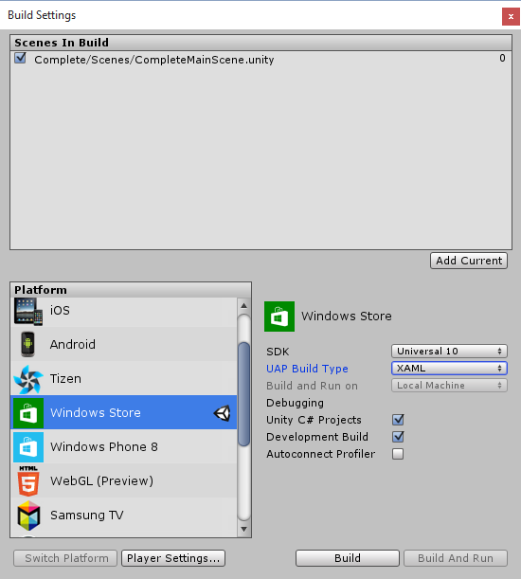
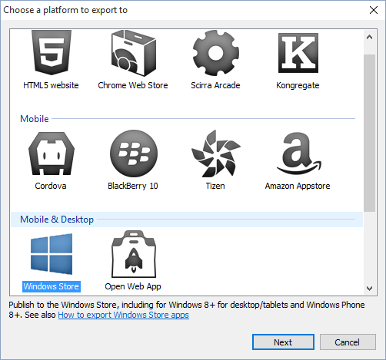
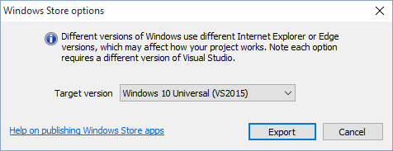
3rd-Party Tools
http://scirra.com
http://unity3d.com
Notes:
Speaker notes:
Deliver video content or stream video to audiences large or small to any device(Web or Mobile) anywhere reliably and in scale.
Helps you create versatile media workflows for ingesting, encoding, protecting and streaming content to audiences on-demand or broadcast live.
Powerful and extensible platform with broad set of first and third-party capabilities to support complete end-to-end media workflows.
Integration with Office 365 empowers organizations of all sizes helps to use videos to enhance sharing, collaboration and communication.
Azure Media Player, an automated online player solution, supports all the usual industry standards like HTML5 video, Media Source Extensions and rights management through Encrypted Media Extensions. The focus here is on open standards, but on older browsers, the player can fall back on Flash or Silverlight.

Slide 12
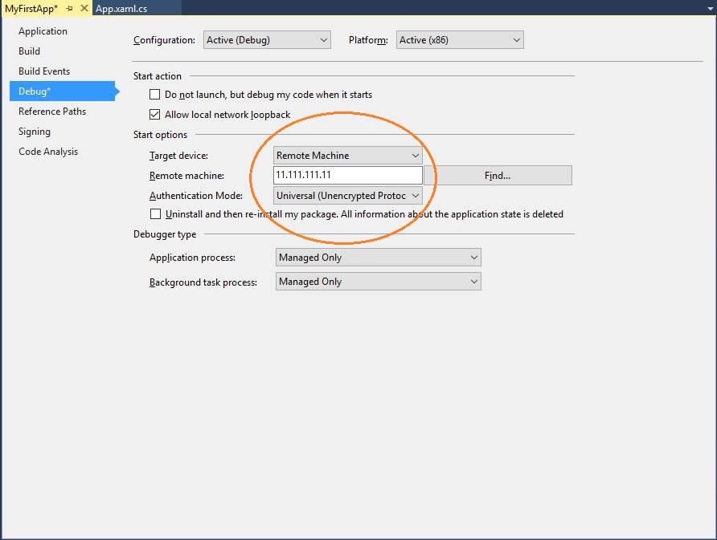
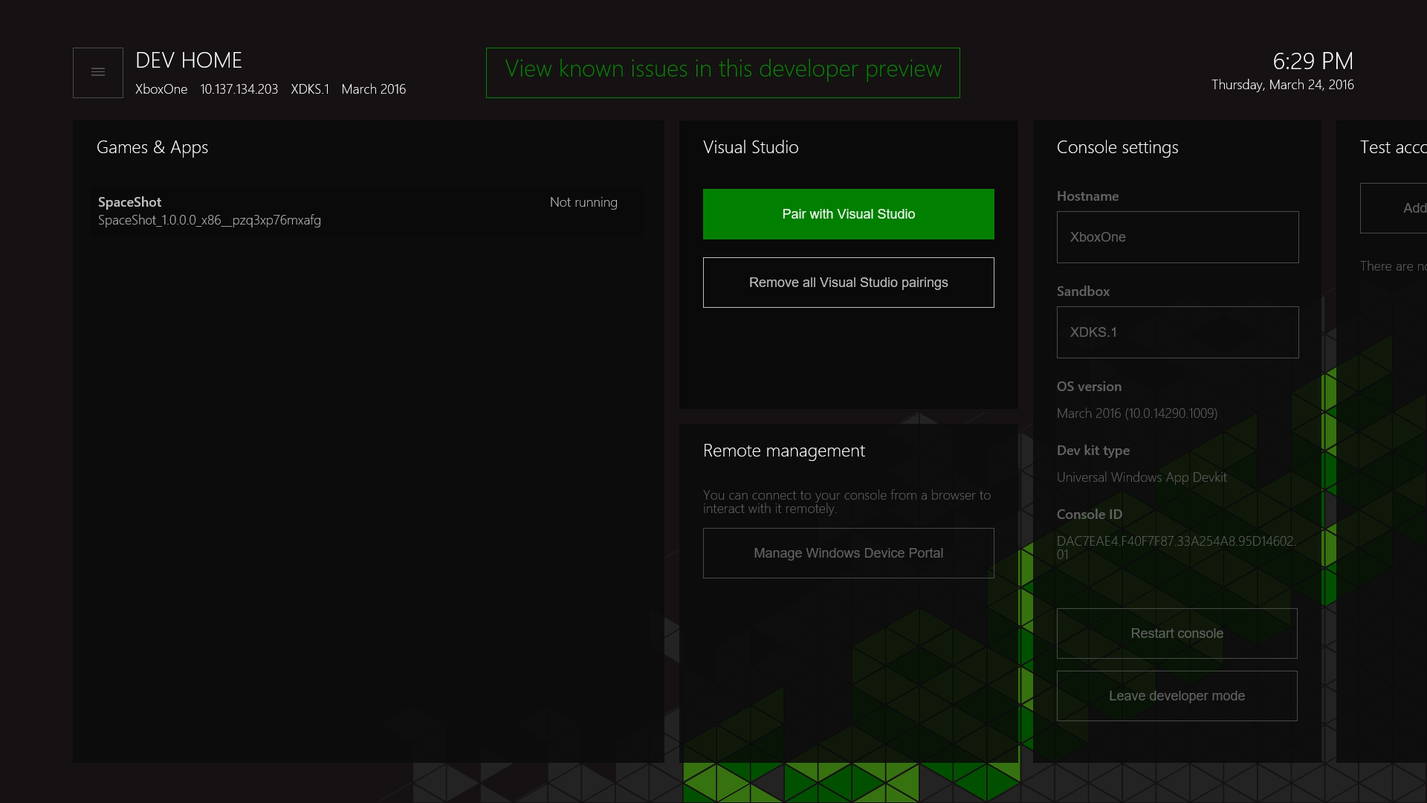
Setting Up Dev Mode…
https://msdn.microsoft.com/en-us/windows/uwp/xbox-apps/development-environment-setup
Notes:
Speaker notes:
Deliver video content or stream video to audiences large or small to any device(Web or Mobile) anywhere reliably and in scale.
Helps you create versatile media workflows for ingesting, encoding, protecting and streaming content to audiences on-demand or broadcast live.
Powerful and extensible platform with broad set of first and third-party capabilities to support complete end-to-end media workflows.
Integration with Office 365 empowers organizations of all sizes helps to use videos to enhance sharing, collaboration and communication.
Azure Media Player, an automated online player solution, supports all the usual industry standards like HTML5 video, Media Source Extensions and rights management through Encrypted Media Extensions. The focus here is on open standards, but on older browsers, the player can fall back on Flash or Silverlight.

Slide 13
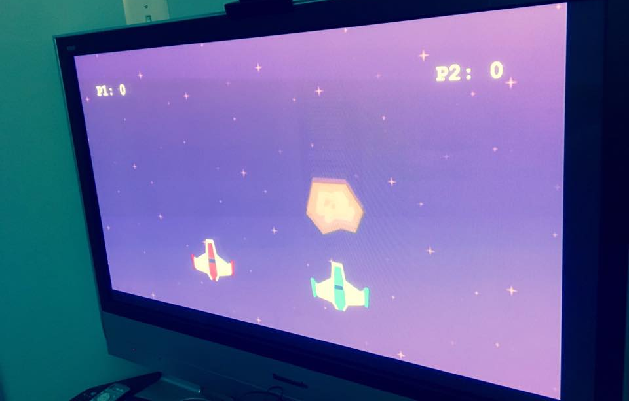
Running in Dev Mode!
Notes:
Speaker notes:
Deliver video content or stream video to audiences large or small to any device(Web or Mobile) anywhere reliably and in scale.
Helps you create versatile media workflows for ingesting, encoding, protecting and streaming content to audiences on-demand or broadcast live.
Powerful and extensible platform with broad set of first and third-party capabilities to support complete end-to-end media workflows.
Integration with Office 365 empowers organizations of all sizes helps to use videos to enhance sharing, collaboration and communication.
Azure Media Player, an automated online player solution, supports all the usual industry standards like HTML5 video, Media Source Extensions and rights management through Encrypted Media Extensions. The focus here is on open standards, but on older browsers, the player can fall back on Flash or Silverlight.

Slide 14
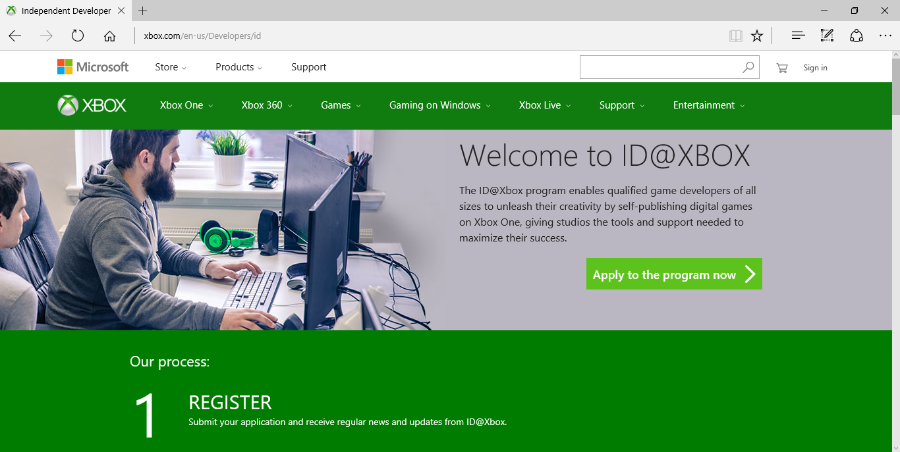
ID@Xbox
http://xbox.com/id
http://www.xbox.com/en-us/Developers/id
Notes:
Speaker notes:
Deliver video content or stream video to audiences large or small to any device(Web or Mobile) anywhere reliably and in scale.
Helps you create versatile media workflows for ingesting, encoding, protecting and streaming content to audiences on-demand or broadcast live.
Powerful and extensible platform with broad set of first and third-party capabilities to support complete end-to-end media workflows.
Integration with Office 365 empowers organizations of all sizes helps to use videos to enhance sharing, collaboration and communication.
Azure Media Player, an automated online player solution, supports all the usual industry standards like HTML5 video, Media Source Extensions and rights management through Encrypted Media Extensions. The focus here is on open standards, but on older browsers, the player can fall back on Flash or Silverlight.

Slide 15
More Info from ID@Xbox
https://twitter.com/id_xbox/status/715218215945670656
https://twitter.com/id_xbox/status/715574259205033984
https://twitter.com/ID_Xbox/status/716785692487995392
Notes:
Speaker notes:
Deliver video content or stream video to audiences large or small to any device(Web or Mobile) anywhere reliably and in scale.
Helps you create versatile media workflows for ingesting, encoding, protecting and streaming content to audiences on-demand or broadcast live.
Powerful and extensible platform with broad set of first and third-party capabilities to support complete end-to-end media workflows.
Integration with Office 365 empowers organizations of all sizes helps to use videos to enhance sharing, collaboration and communication.
Azure Media Player, an automated online player solution, supports all the usual industry standards like HTML5 video, Media Source Extensions and rights management through Encrypted Media Extensions. The focus here is on open standards, but on older browsers, the player can fall back on Flash or Silverlight.

Slide 16
Demo

Slide 17
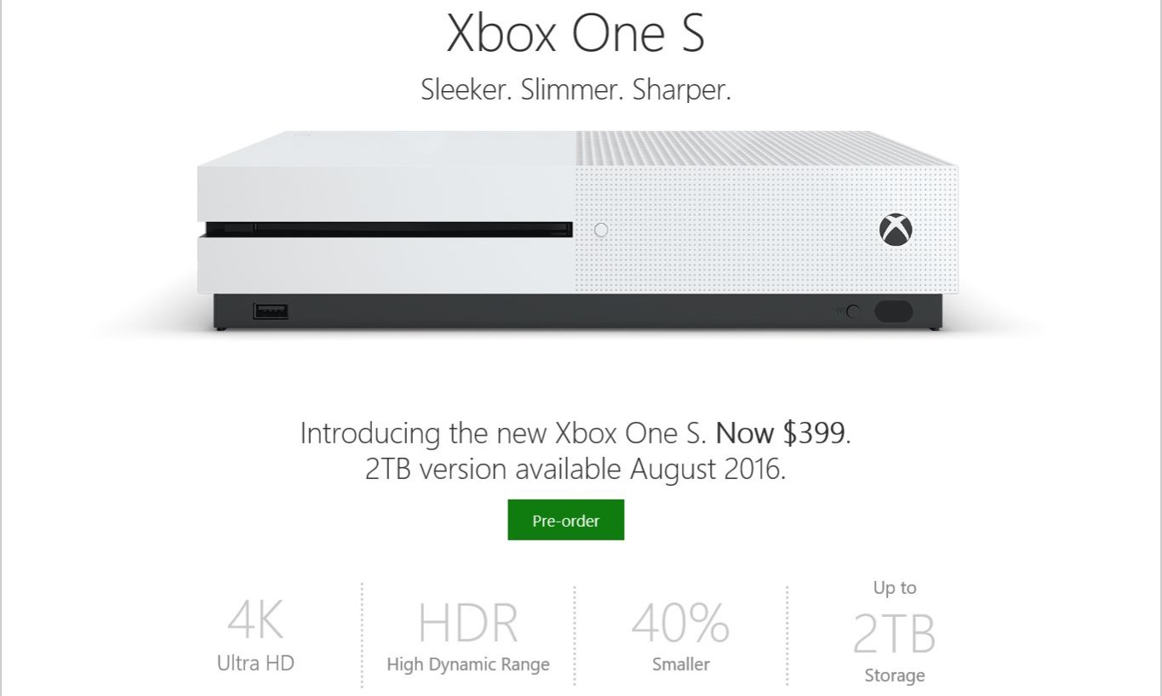
New From E3 2016: Xbox One S
http://news.xbox.com/2016/06/13/xbox-e3-2016-briefing-news-recap/
Notes:
Speaker notes:
Deliver video content or stream video to audiences large or small to any device(Web or Mobile) anywhere reliably and in scale.
Helps you create versatile media workflows for ingesting, encoding, protecting and streaming content to audiences on-demand or broadcast live.
Powerful and extensible platform with broad set of first and third-party capabilities to support complete end-to-end media workflows.
Integration with Office 365 empowers organizations of all sizes helps to use videos to enhance sharing, collaboration and communication.
Azure Media Player, an automated online player solution, supports all the usual industry standards like HTML5 video, Media Source Extensions and rights management through Encrypted Media Extensions. The focus here is on open standards, but on older browsers, the player can fall back on Flash or Silverlight.

Slide 18
Holiday 2017: Xbox Project Scorpio
Most powerful console ever created
6 teraflops of GPU
4K gaming
High-fidelity VR
Will coexist alongside Xbox One and Xbox One S
https://www.youtube.com/watch?v=F1dRgWpGePs
Notes:
Speaker notes:
Deliver video content or stream video to audiences large or small to any device(Web or Mobile) anywhere reliably and in scale.
Helps you create versatile media workflows for ingesting, encoding, protecting and streaming content to audiences on-demand or broadcast live.
Powerful and extensible platform with broad set of first and third-party capabilities to support complete end-to-end media workflows.
Integration with Office 365 empowers organizations of all sizes helps to use videos to enhance sharing, collaboration and communication.
Azure Media Player, an automated online player solution, supports all the usual industry standards like HTML5 video, Media Source Extensions and rights management through Encrypted Media Extensions. The focus here is on open standards, but on older browsers, the player can fall back on Flash or Silverlight.

Slide 19
Q & A
Notes:
Additional Topics

Slide 20
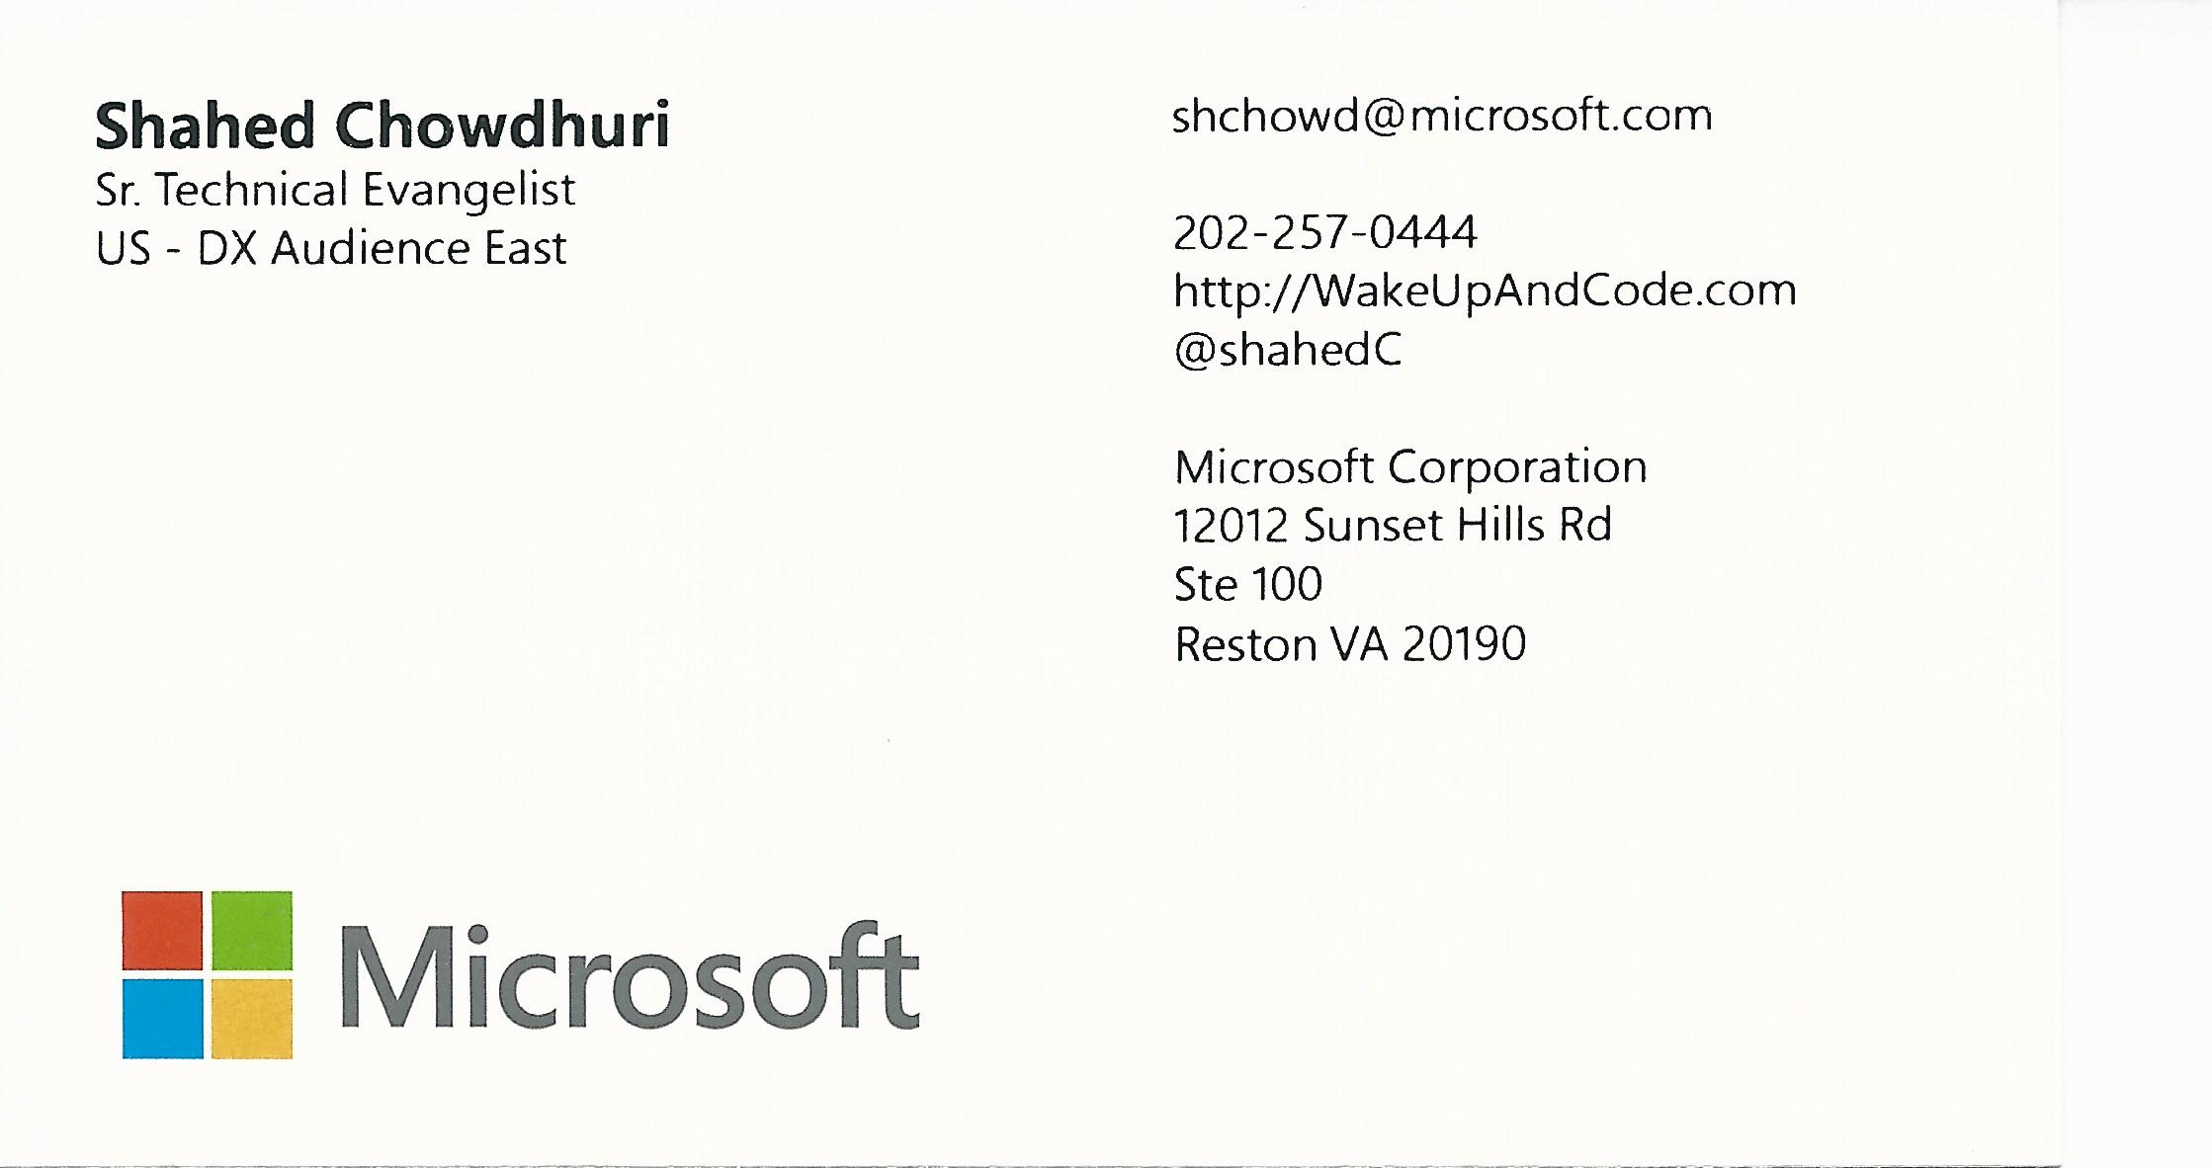
Email: shchowd@microsoft.com  Twitter: @shahedC
Notes:
Contact
Microsoft email: shchowd@microsoft.com
Personal Twitter: @shahedC
Dev Blog: WakeUpAndCode.com

