Slide 1
Your Host & Speaker
Shahed Chowdhuri
Sr. Technical Evangelist @ Microsoft
Technology Areas
Enterprise Web/Software Development
Game Development
Mobile Application Development
Cloud Solutions
Online
LinkedIn: http://linkedin.com/in/shahedc
Meetup: http://www.meetup.com/DC-MS-Devs/
Twitter: http://twitter.com/shahedC
Blog: http://WakeUpAndCode.com

Slide 2
Guest Speaker
Katherine “Kat” Harris
Technical Evangelist @ Microsoft
Background
Game Development
Virtual Reality & Augmented Reality
Bots & AI
UVA Alum
Online
LinkedIn: https://www.linkedin.com/in/katvharris
Twitter: https://twitter.com/katvharris
Blog: http://WakeUpAndCode.com

Slide 3
Intro to Bot Framework
Build and connect intelligent bots
Shahed Chowdhuri
Sr. Technical Evangelist @ Microsoft
@shahedC
WakeUpAndCode.com

Slide 4
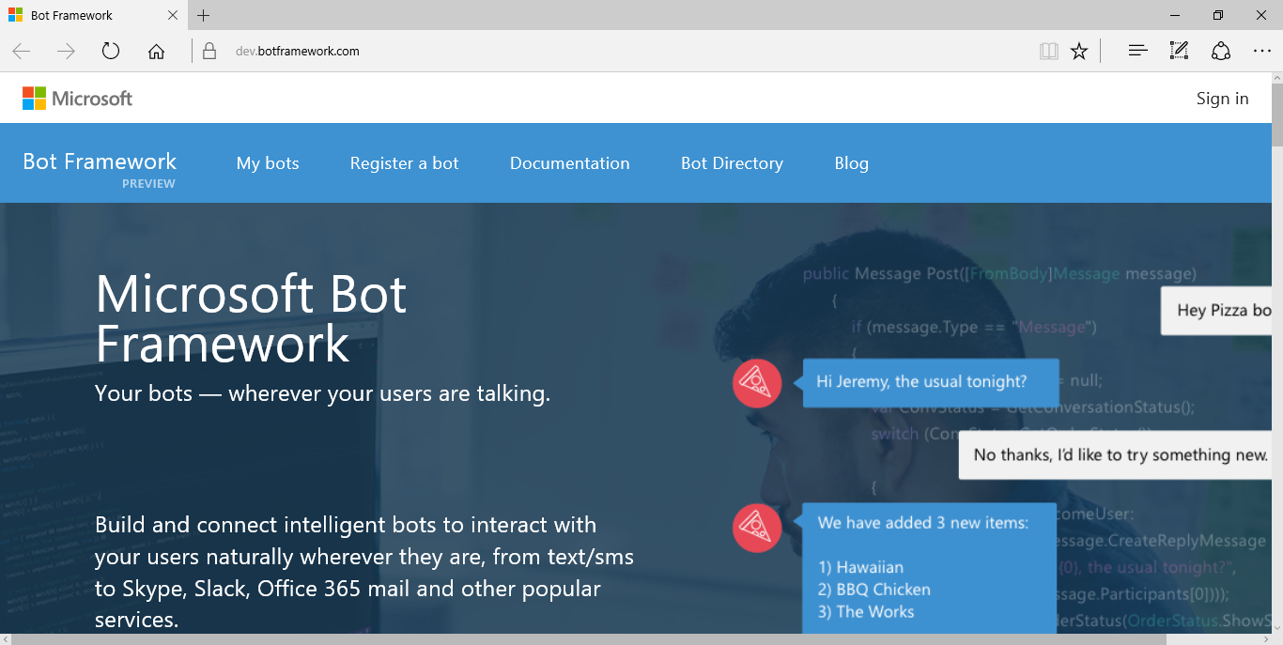
MS Bot Framework
https://dev.botframework.com

Slide 5
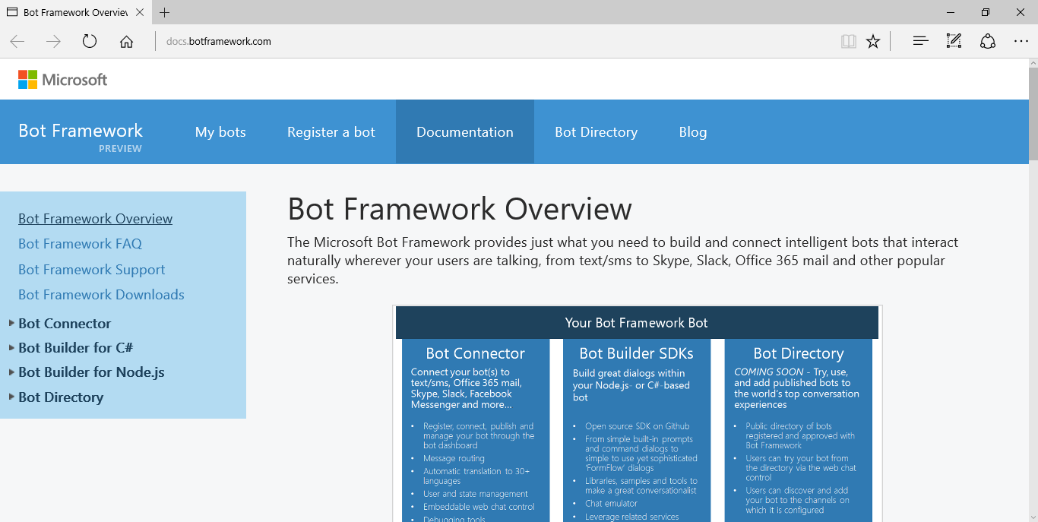
Overview
http://docs.botframework.com
Options:
Connector
Builder
Directory

Slide 6
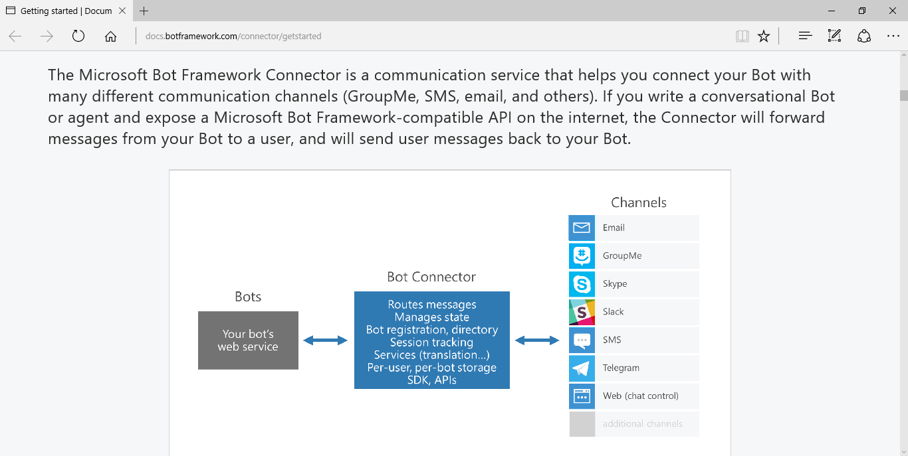
Bot Connector
Channels:
Email
GroupMe
Skype
Slack
SMS
Telegram
Web
etc...
http://docs.botframework.com/connector/getstarted

Slide 7
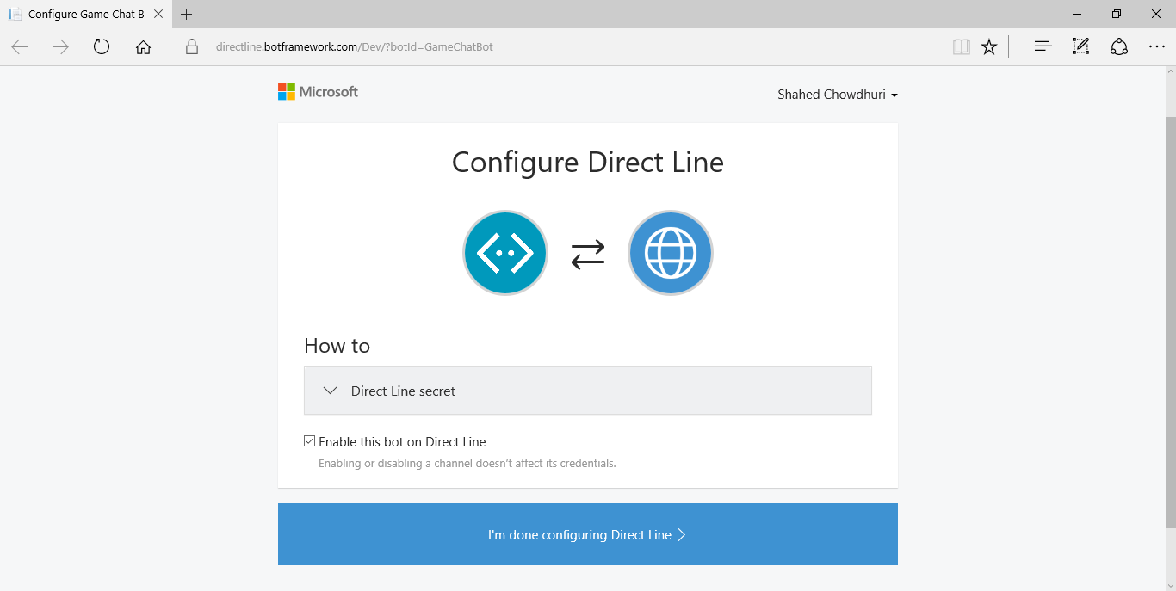
Configure: Direct Line
https://directline.botframework.com/Dev/?botId=YOUR-BOT-ID

Slide 8
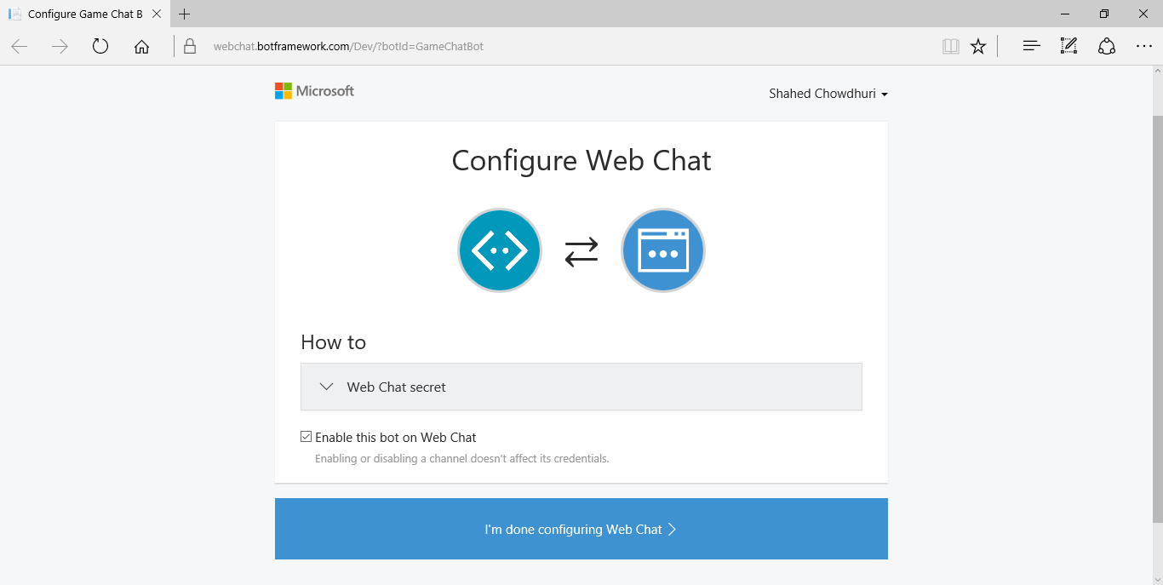
Configure: Web Chat
https://webchat.botframework.com/Dev/?botId=YOUR-BOT-ID

Slide 9
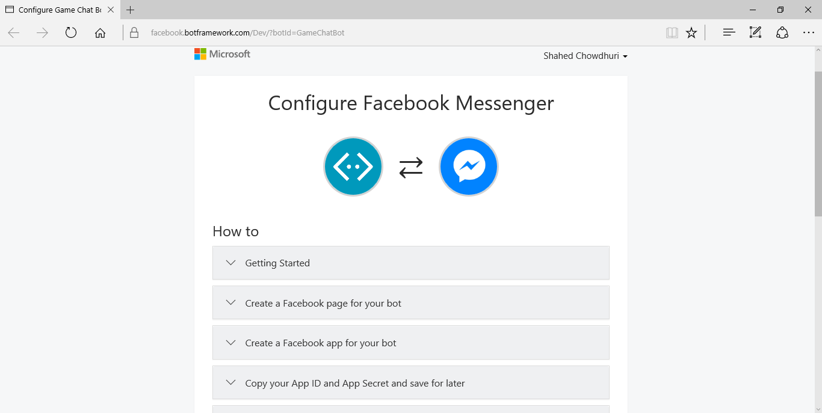
Configure: Facebook Messenger
https://facebook.botframework.com/Dev/?botId=YOUR-BOT-ID

Slide 10
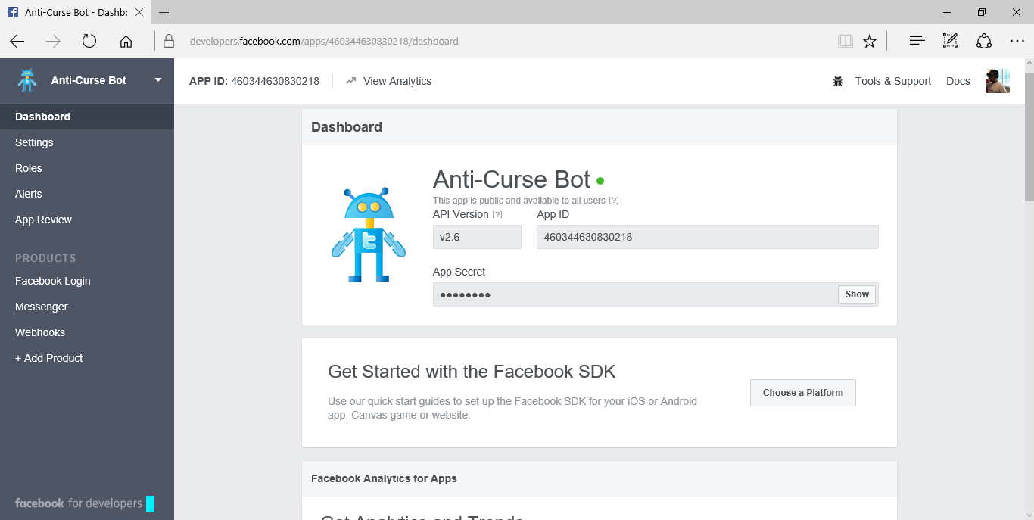
FB Developer Settings
https://developers.facebook.com

Slide 11
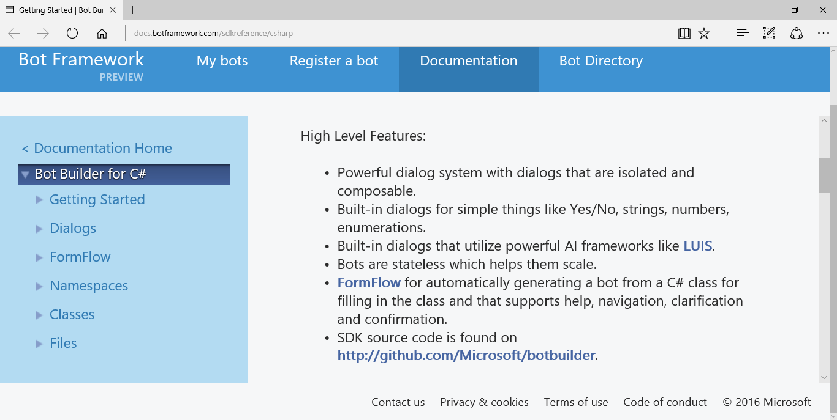
Bot Builder SDK for C#
Features:
Dialogs
AI
LUIS
Stateless
Scalable
FormFlow
GitHub!
http://docs.botframework.com/sdkreference/csharp

Slide 12
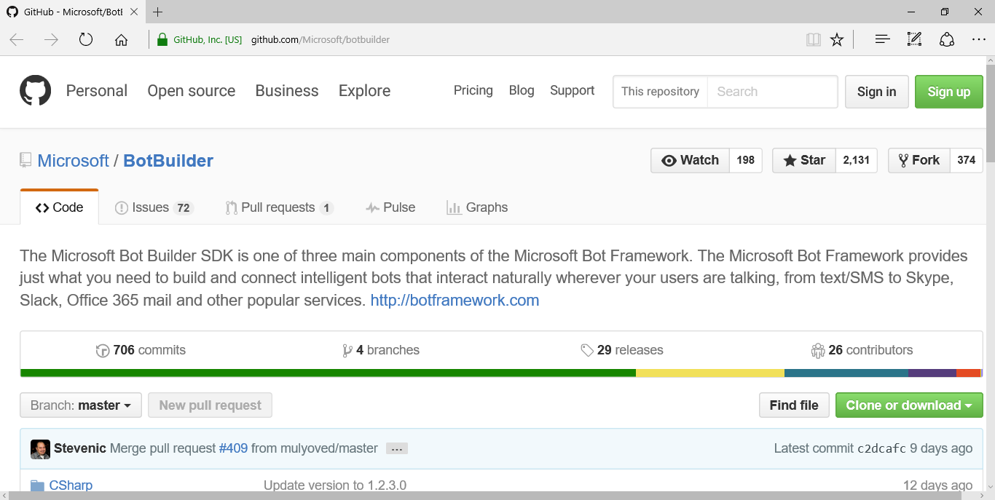
GitHub!
https://github.com/Microsoft/botbuilder

Slide 13
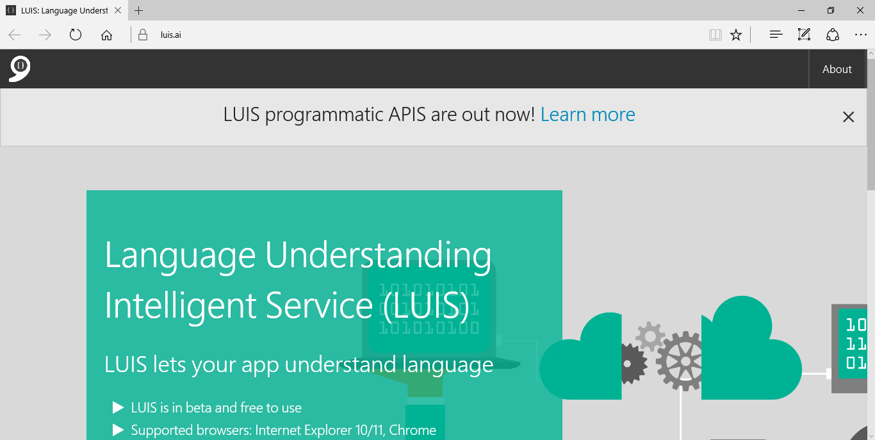
Language Understanding Intelligent Service
https://www.luis.ai/

Slide 14
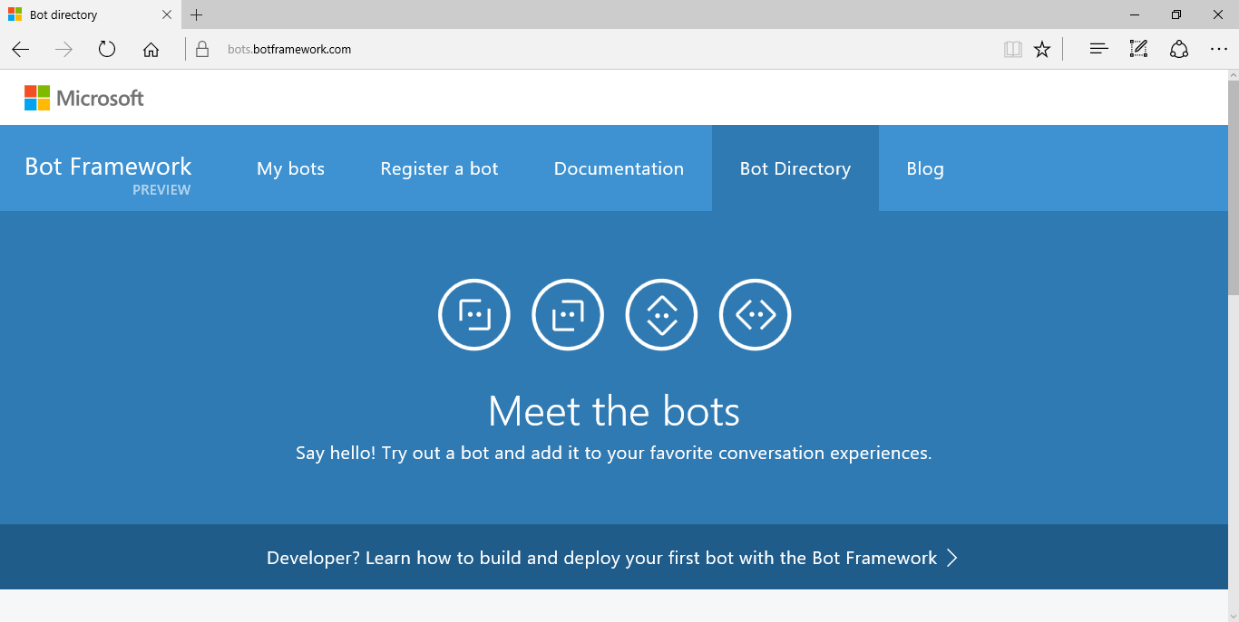
Bot Directory
https://bots.botframework.com/

Slide 15
Demo

Slide 16
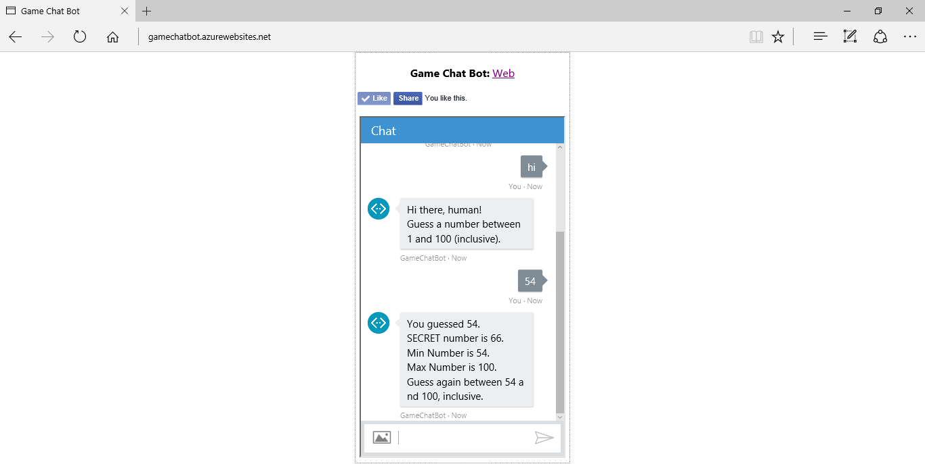
Game Chat Bot
http://gamechatbot.azurewebsites.net/

Slide 17
Q & A
Notes:
Additional Topics

Slide 18
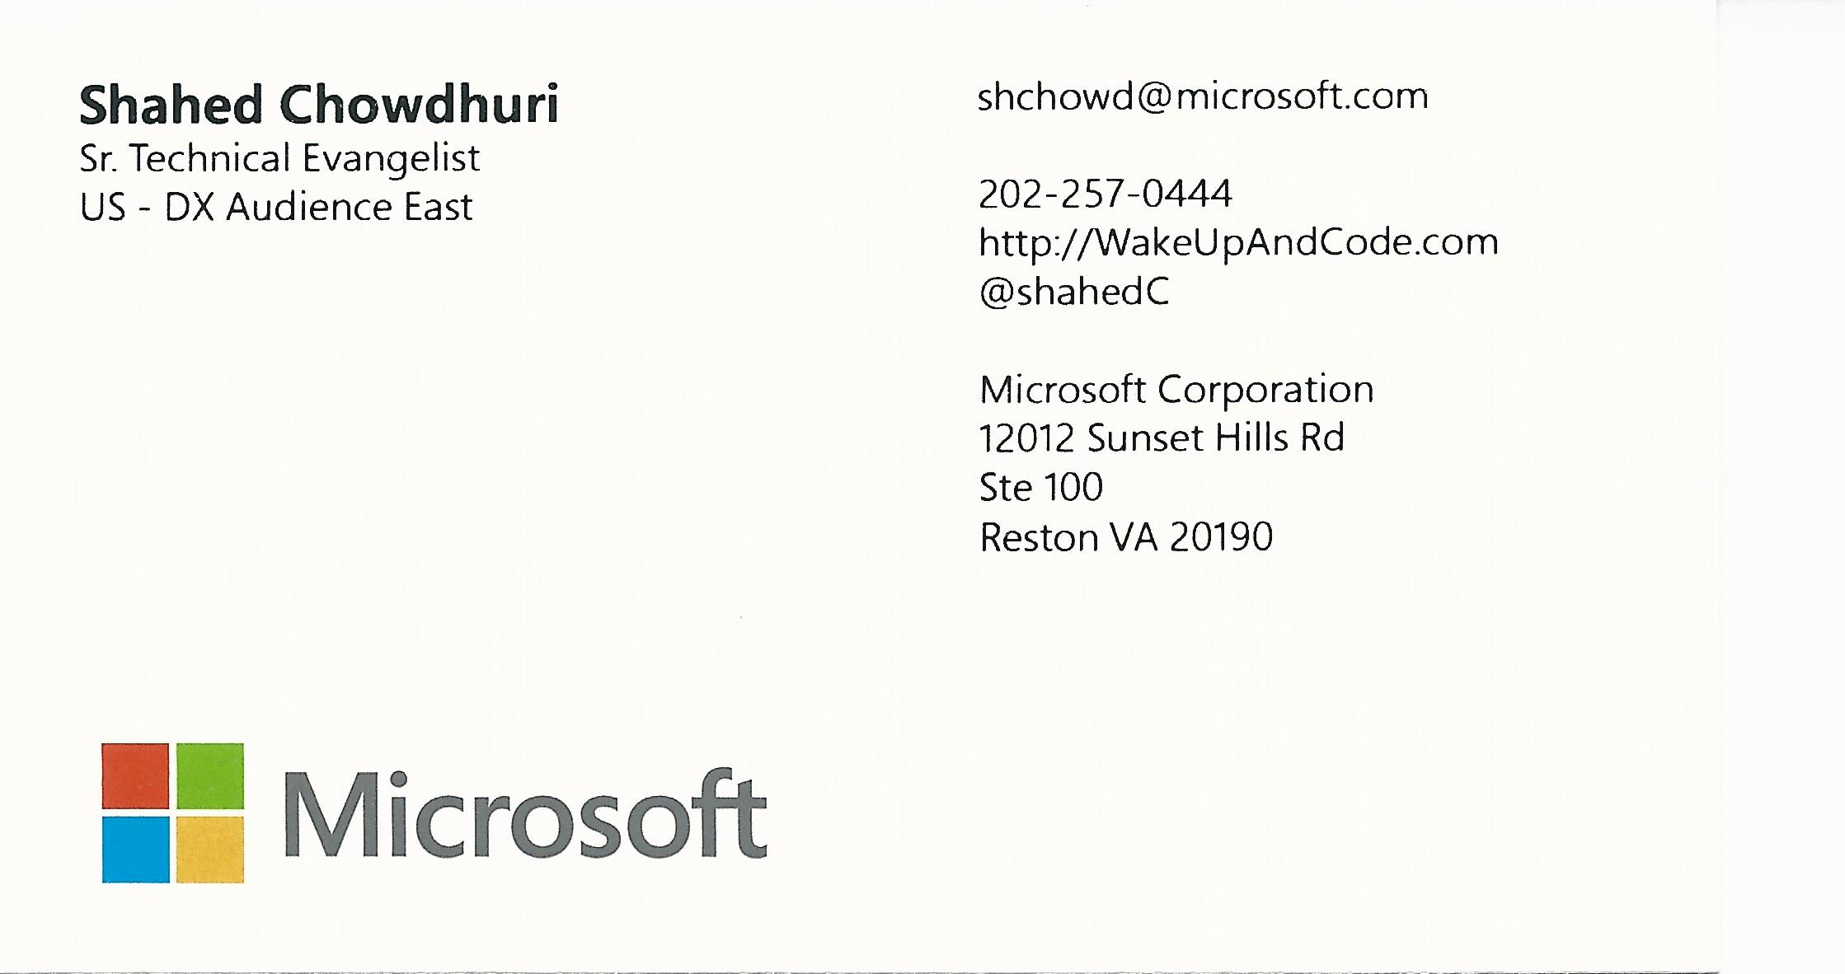
Email: shchowd@microsoft.com  Twitter: @shahedC
Notes:
Contact
Microsoft email: shchowd@microsoft.com
Personal Twitter: @shahedC
Dev Blog: WakeUpAndCode.com

