Slide 1
Intro to HoloLens Development
A new era of mixed reality
Shahed Chowdhuri
Sr. Technical Evangelist @ Microsoft
@shahedC
WakeUpAndCode.com

Slide 2
Your Host & Speaker
Shahed Chowdhuri
Sr. Technical Evangelist @ Microsoft
Technology Areas
Enterprise Web/Software Development
Game Development
Mobile Application Development
Cloud Solutions
Online
LinkedIn: http://linkedin.com/in/shahedc
Meetup: http://www.meetup.com/DC-MS-Devs/
Twitter: http://twitter.com/shahedC
Blog: http://WakeUpAndCode.com

Slide 3
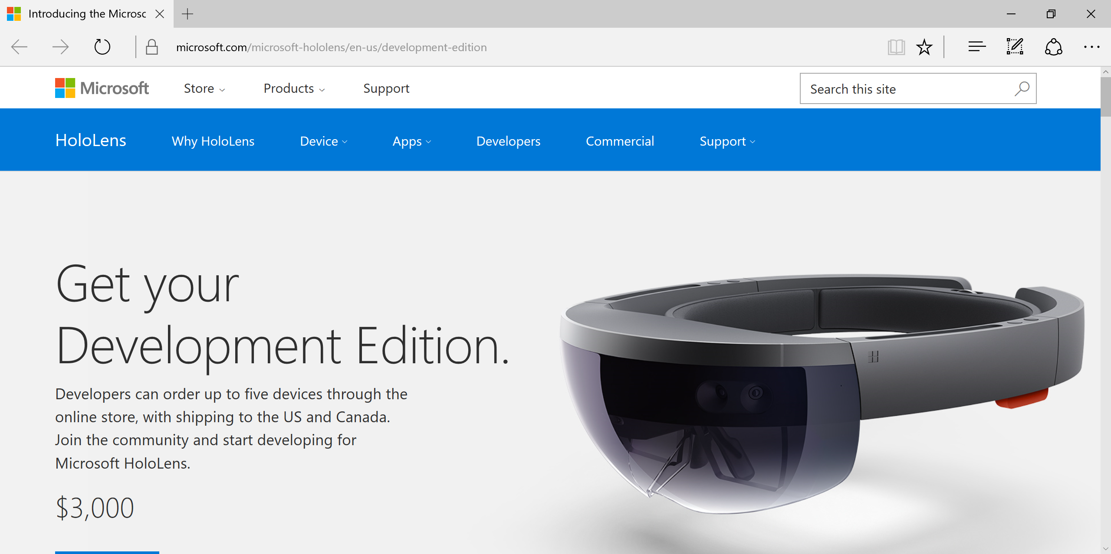
HoloLens Dev Kits are Shipping!
https://www.microsoft.com/microsoft-hololens/en-us/development-edition
Notes:
Speaker notes:
Deliver video content or stream video to audiences large or small to any device(Web or Mobile) anywhere reliably and in scale.
Helps you create versatile media workflows for ingesting, encoding, protecting and streaming content to audiences on-demand or broadcast live.
Powerful and extensible platform with broad set of first and third-party capabilities to support complete end-to-end media workflows.
Integration with Office 365 empowers organizations of all sizes helps to use videos to enhance sharing, collaboration and communication.
Azure Media Player, an automated online player solution, supports all the usual industry standards like HTML5 video, Media Source Extensions and rights management through Encrypted Media Extensions. The focus here is on open standards, but on older browsers, the player can fall back on Flash or Silverlight.

Slide 4
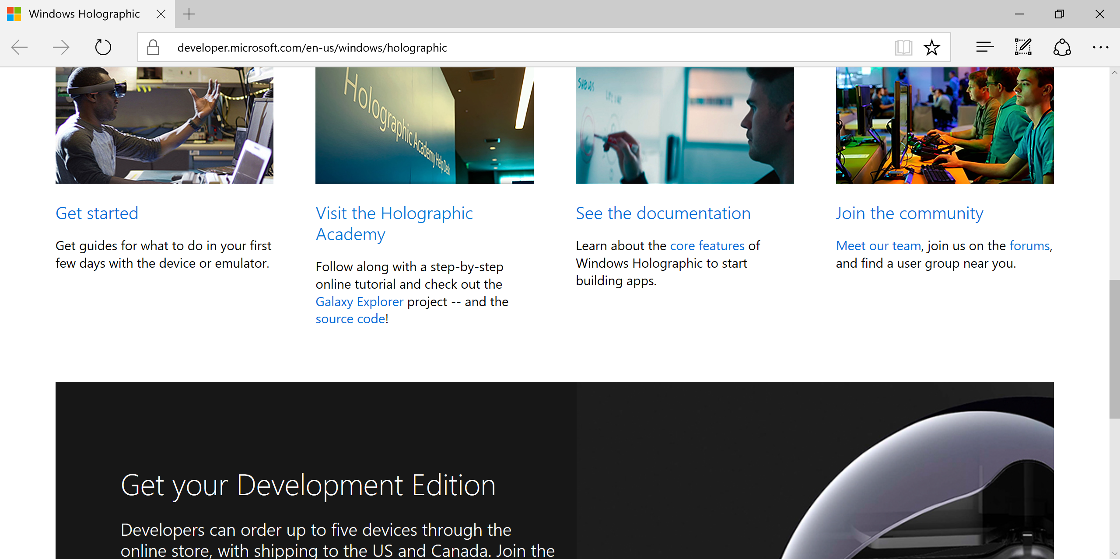
Start Here for Guides, Docs, Community
http://dev.windows.com/holographic
Notes:
Speaker notes:
Deliver video content or stream video to audiences large or small to any device(Web or Mobile) anywhere reliably and in scale.
Helps you create versatile media workflows for ingesting, encoding, protecting and streaming content to audiences on-demand or broadcast live.
Powerful and extensible platform with broad set of first and third-party capabilities to support complete end-to-end media workflows.
Integration with Office 365 empowers organizations of all sizes helps to use videos to enhance sharing, collaboration and communication.
Azure Media Player, an automated online player solution, supports all the usual industry standards like HTML5 video, Media Source Extensions and rights management through Encrypted Media Extensions. The focus here is on open standards, but on older browsers, the player can fall back on Flash or Silverlight.

Slide 5
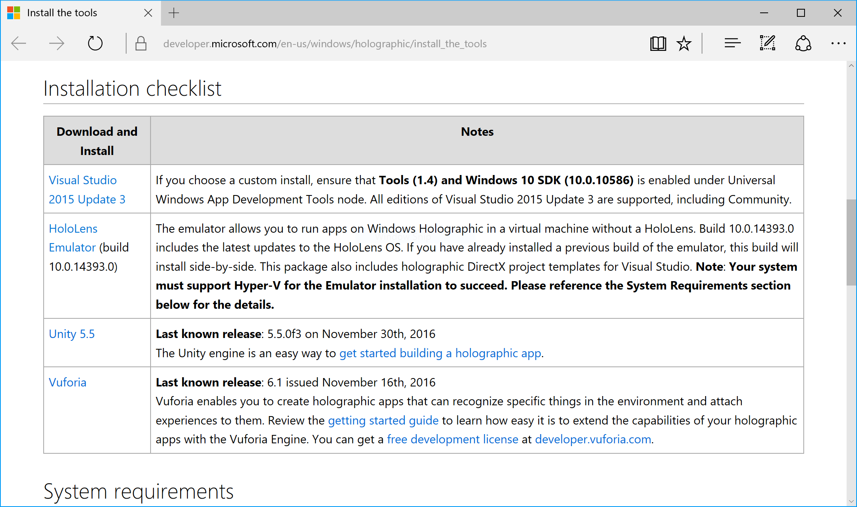
Install the Tools
Checklist
VS2015 + Update
Emulator
Unity
Vuforia
https://developer.microsoft.com/en-us/windows/holographic/install_the_tools
Notes:
Speaker notes:
Deliver video content or stream video to audiences large or small to any device(Web or Mobile) anywhere reliably and in scale.
Helps you create versatile media workflows for ingesting, encoding, protecting and streaming content to audiences on-demand or broadcast live.
Powerful and extensible platform with broad set of first and third-party capabilities to support complete end-to-end media workflows.
Integration with Office 365 empowers organizations of all sizes helps to use videos to enhance sharing, collaboration and communication.
Azure Media Player, an automated online player solution, supports all the usual industry standards like HTML5 video, Media Source Extensions and rights management through Encrypted Media Extensions. The focus here is on open standards, but on older browsers, the player can fall back on Flash or Silverlight.

Slide 6
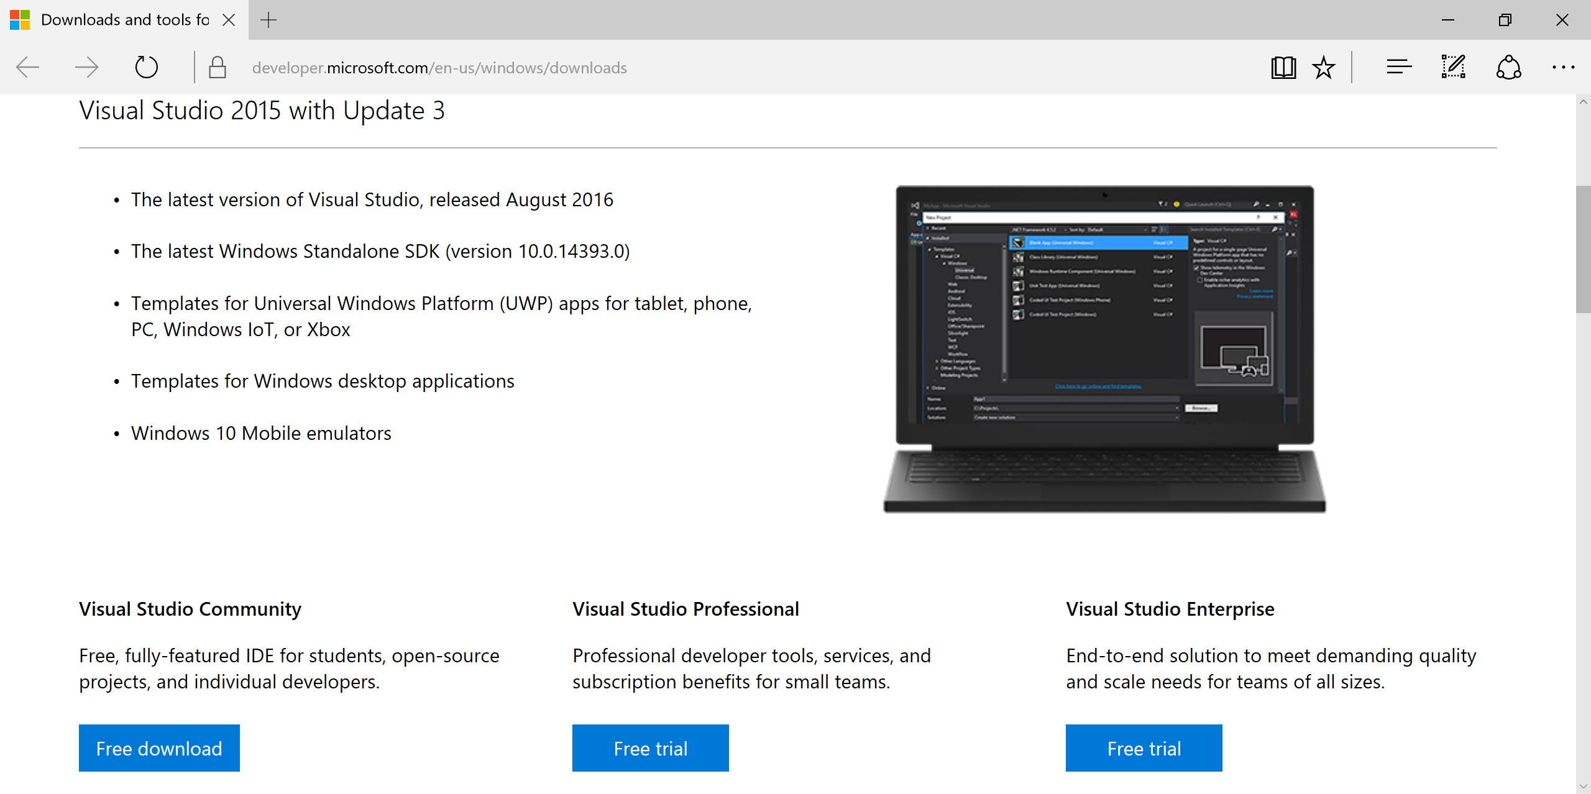
Visual Studio 2015 + Update
http://dev.windows.com/downloads
Notes:
Speaker notes:
Deliver video content or stream video to audiences large or small to any device(Web or Mobile) anywhere reliably and in scale.
Helps you create versatile media workflows for ingesting, encoding, protecting and streaming content to audiences on-demand or broadcast live.
Powerful and extensible platform with broad set of first and third-party capabilities to support complete end-to-end media workflows.
Integration with Office 365 empowers organizations of all sizes helps to use videos to enhance sharing, collaboration and communication.
Azure Media Player, an automated online player solution, supports all the usual industry standards like HTML5 video, Media Source Extensions and rights management through Encrypted Media Extensions. The focus here is on open standards, but on older browsers, the player can fall back on Flash or Silverlight.

Slide 7
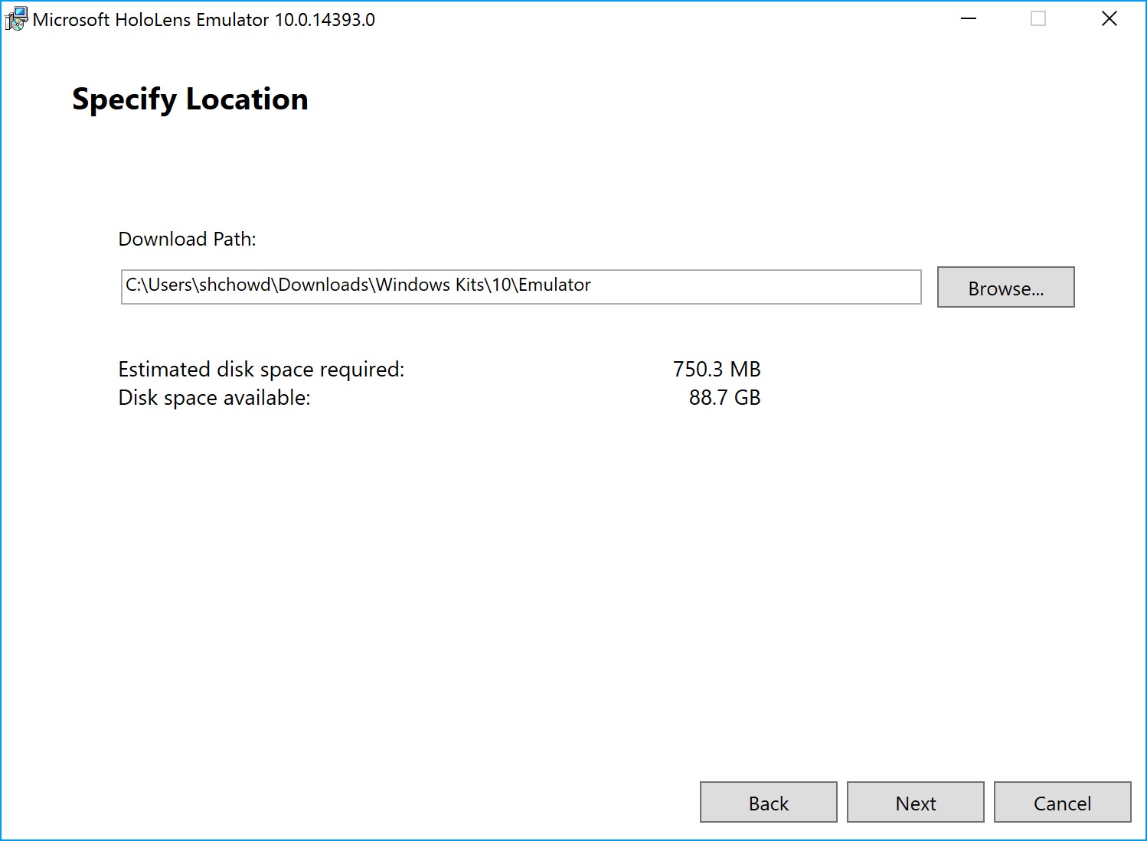
HoloLens Emulator
http://go.microsoft.com/fwlink/?LinkID=823018
Notes:
Speaker notes:
Deliver video content or stream video to audiences large or small to any device(Web or Mobile) anywhere reliably and in scale.
Helps you create versatile media workflows for ingesting, encoding, protecting and streaming content to audiences on-demand or broadcast live.
Powerful and extensible platform with broad set of first and third-party capabilities to support complete end-to-end media workflows.
Integration with Office 365 empowers organizations of all sizes helps to use videos to enhance sharing, collaboration and communication.
Azure Media Player, an automated online player solution, supports all the usual industry standards like HTML5 video, Media Source Extensions and rights management through Encrypted Media Extensions. The focus here is on open standards, but on older browsers, the player can fall back on Flash or Silverlight.

Slide 8
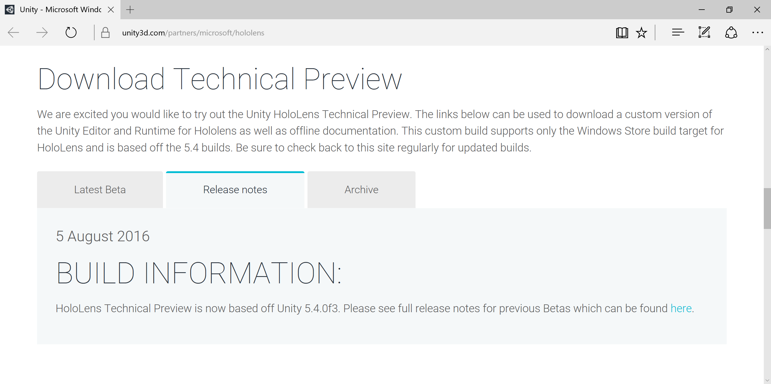
Unity HoloLens Technical Preview
https://unity3d.com/partners/microsoft/hololens
Notes:
Speaker notes:
Deliver video content or stream video to audiences large or small to any device(Web or Mobile) anywhere reliably and in scale.
Helps you create versatile media workflows for ingesting, encoding, protecting and streaming content to audiences on-demand or broadcast live.
Powerful and extensible platform with broad set of first and third-party capabilities to support complete end-to-end media workflows.
Integration with Office 365 empowers organizations of all sizes helps to use videos to enhance sharing, collaboration and communication.
Azure Media Player, an automated online player solution, supports all the usual industry standards like HTML5 video, Media Source Extensions and rights management through Encrypted Media Extensions. The focus here is on open standards, but on older browsers, the player can fall back on Flash or Silverlight.

Slide 9
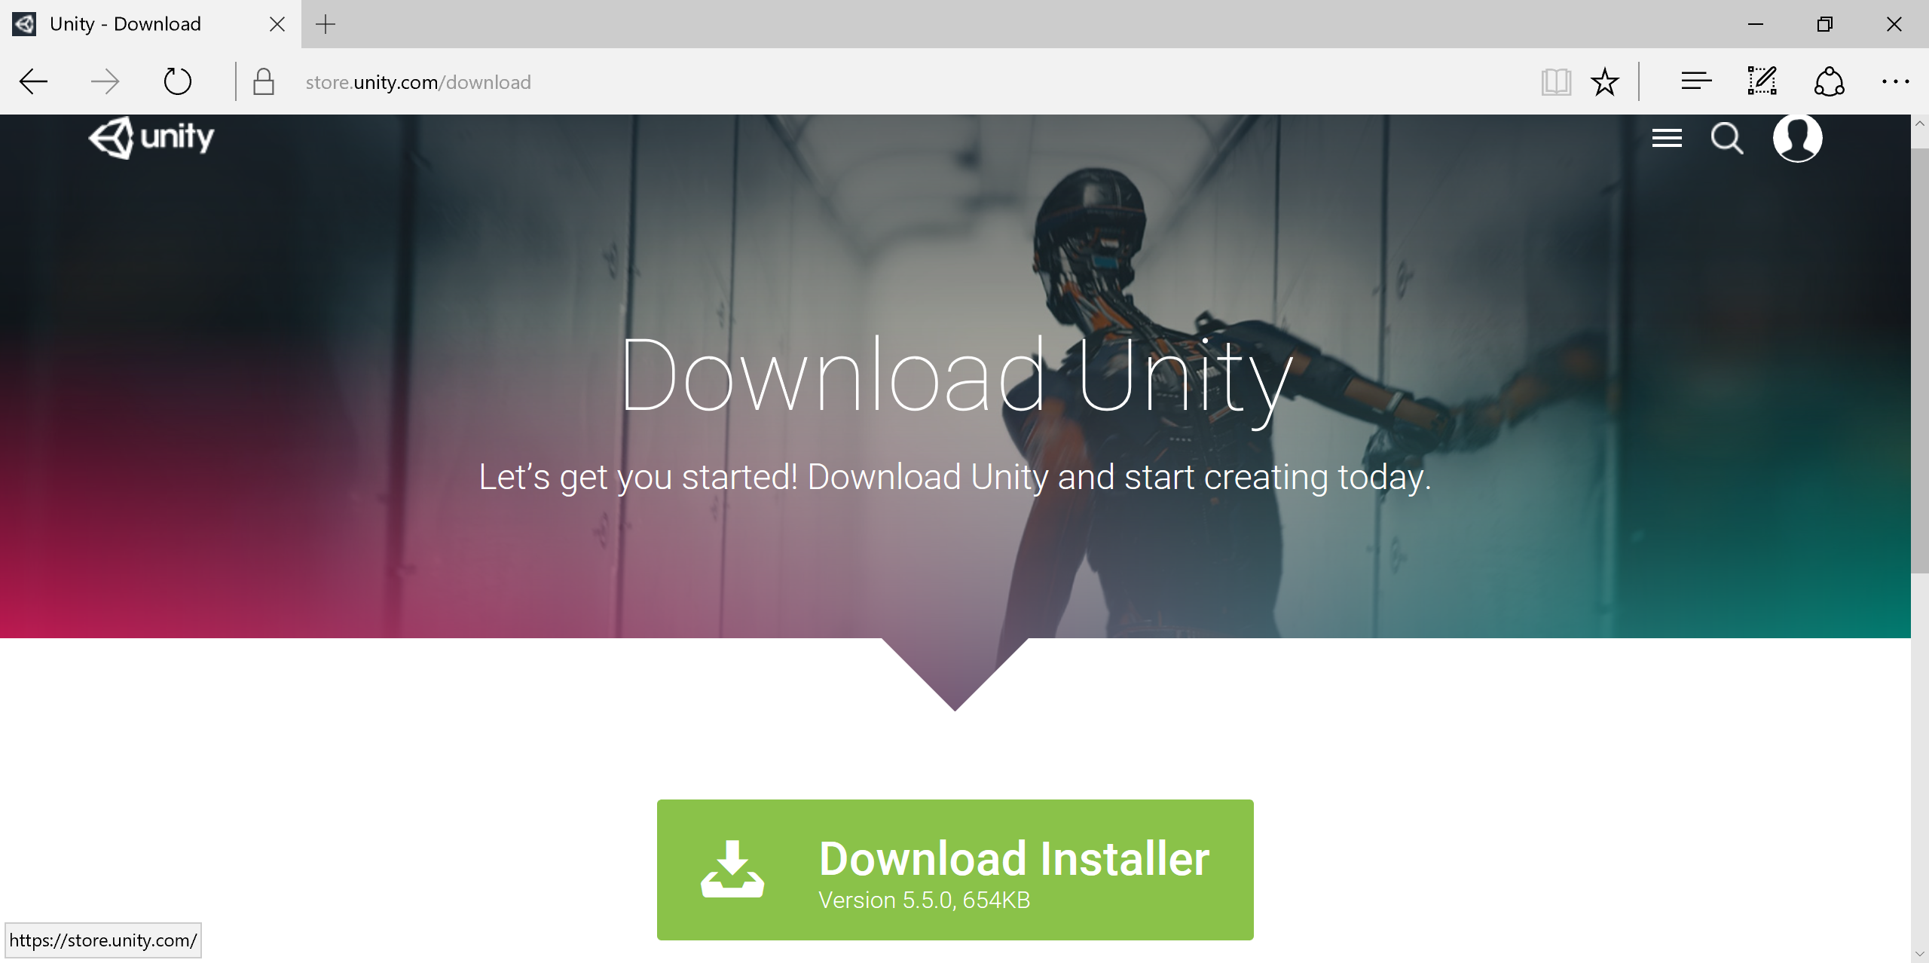
Unity Installer
https://store.unity.com/download
Notes:
Speaker notes:
Deliver video content or stream video to audiences large or small to any device(Web or Mobile) anywhere reliably and in scale.
Helps you create versatile media workflows for ingesting, encoding, protecting and streaming content to audiences on-demand or broadcast live.
Powerful and extensible platform with broad set of first and third-party capabilities to support complete end-to-end media workflows.
Integration with Office 365 empowers organizations of all sizes helps to use videos to enhance sharing, collaboration and communication.
Azure Media Player, an automated online player solution, supports all the usual industry standards like HTML5 video, Media Source Extensions and rights management through Encrypted Media Extensions. The focus here is on open standards, but on older browsers, the player can fall back on Flash or Silverlight.

Slide 10
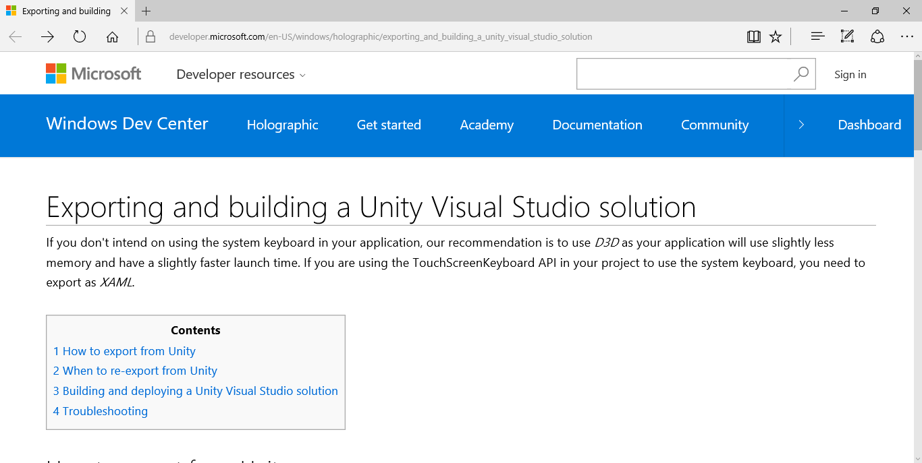
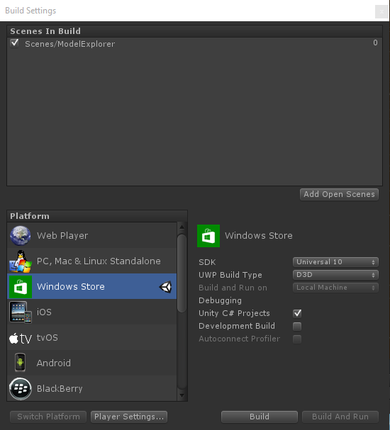
Exporting From Unity to Visual Studio
https://developer.microsoft.com/en-US/windows/holographic
/exporting_and_building_a_unity_visual_studio_solution
Notes:
Speaker notes:
Deliver video content or stream video to audiences large or small to any device(Web or Mobile) anywhere reliably and in scale.
Helps you create versatile media workflows for ingesting, encoding, protecting and streaming content to audiences on-demand or broadcast live.
Powerful and extensible platform with broad set of first and third-party capabilities to support complete end-to-end media workflows.
Integration with Office 365 empowers organizations of all sizes helps to use videos to enhance sharing, collaboration and communication.
Azure Media Player, an automated online player solution, supports all the usual industry standards like HTML5 video, Media Source Extensions and rights management through Encrypted Media Extensions. The focus here is on open standards, but on older browsers, the player can fall back on Flash or Silverlight.

Slide 11
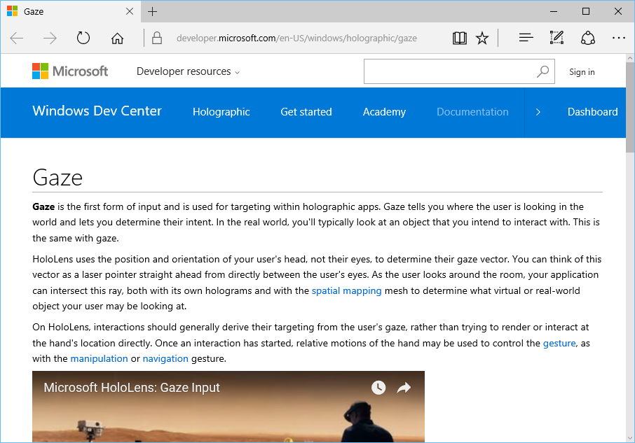
Gaze
What is Gaze?
Form of input
Real-world line of sight
Uses head, not eyes
Uses of Gaze
Intersect with holograms
Target gestures
Place holograms
Detect “away” objects
https://developer.microsoft.com/en-US/windows/holographic/gaze
Notes:
Speaker notes:
Deliver video content or stream video to audiences large or small to any device(Web or Mobile) anywhere reliably and in scale.
Helps you create versatile media workflows for ingesting, encoding, protecting and streaming content to audiences on-demand or broadcast live.
Powerful and extensible platform with broad set of first and third-party capabilities to support complete end-to-end media workflows.
Integration with Office 365 empowers organizations of all sizes helps to use videos to enhance sharing, collaboration and communication.
Azure Media Player, an automated online player solution, supports all the usual industry standards like HTML5 video, Media Source Extensions and rights management through Encrypted Media Extensions. The focus here is on open standards, but on older browsers, the player can fall back on Flash or Silverlight.

Slide 12
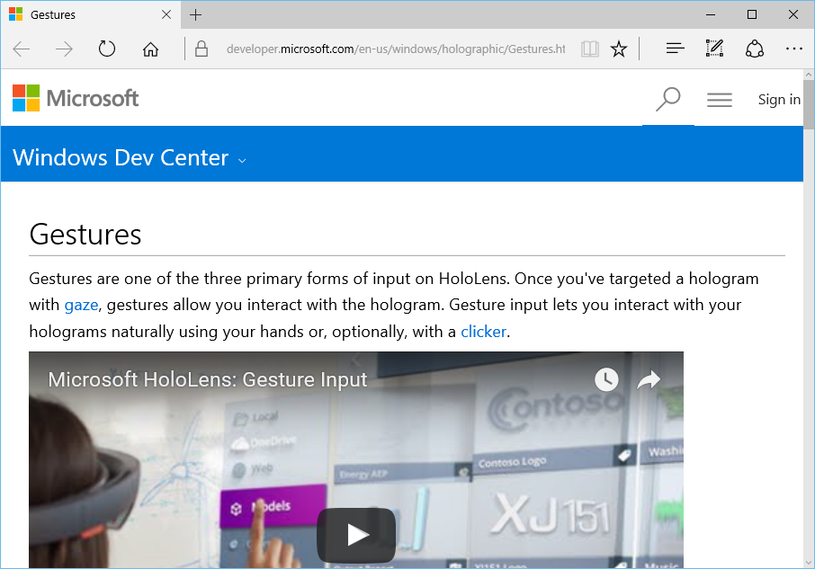
Gestures
What are Gestures?
Form of input
Use your hands/fingers
Use optional clicker
Uses of Gestures
Interact with holograms
Interact with apps
Interact with menu
https://developer.microsoft.com/en-us/windows/holographic/Gestures.html
Notes:
Speaker notes:
Deliver video content or stream video to audiences large or small to any device(Web or Mobile) anywhere reliably and in scale.
Helps you create versatile media workflows for ingesting, encoding, protecting and streaming content to audiences on-demand or broadcast live.
Powerful and extensible platform with broad set of first and third-party capabilities to support complete end-to-end media workflows.
Integration with Office 365 empowers organizations of all sizes helps to use videos to enhance sharing, collaboration and communication.
Azure Media Player, an automated online player solution, supports all the usual industry standards like HTML5 video, Media Source Extensions and rights management through Encrypted Media Extensions. The focus here is on open standards, but on older browsers, the player can fall back on Flash or Silverlight.

Slide 13
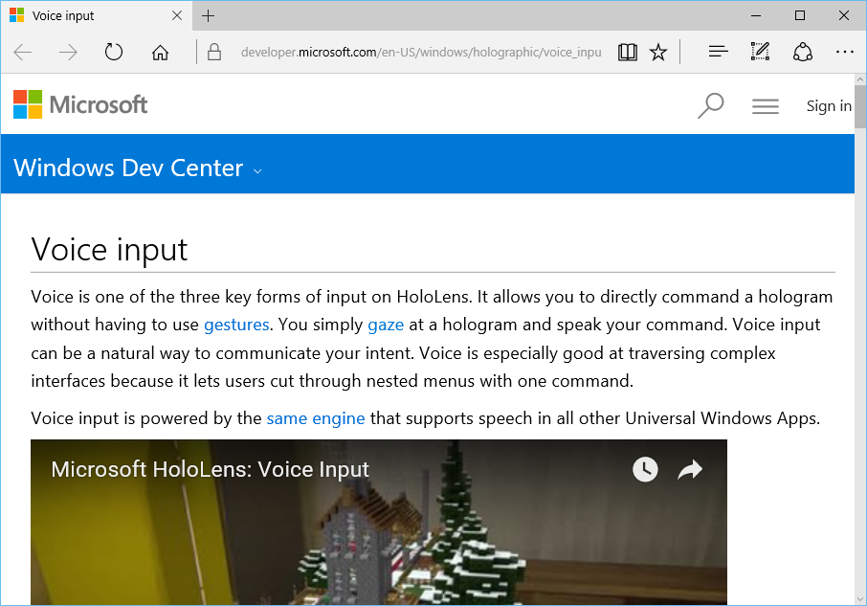
Voice Input
What is Voice Input?
Form of input
Powered by UWP speech engine
Uses of Voice Input
“Hey Cortana!”
Take photos/video
Command holograms
https://developer.microsoft.com/en-US/windows/holographic/voice_input
Notes:
Speaker notes:
Deliver video content or stream video to audiences large or small to any device(Web or Mobile) anywhere reliably and in scale.
Helps you create versatile media workflows for ingesting, encoding, protecting and streaming content to audiences on-demand or broadcast live.
Powerful and extensible platform with broad set of first and third-party capabilities to support complete end-to-end media workflows.
Integration with Office 365 empowers organizations of all sizes helps to use videos to enhance sharing, collaboration and communication.
Azure Media Player, an automated online player solution, supports all the usual industry standards like HTML5 video, Media Source Extensions and rights management through Encrypted Media Extensions. The focus here is on open standards, but on older browsers, the player can fall back on Flash or Silverlight.

Slide 14
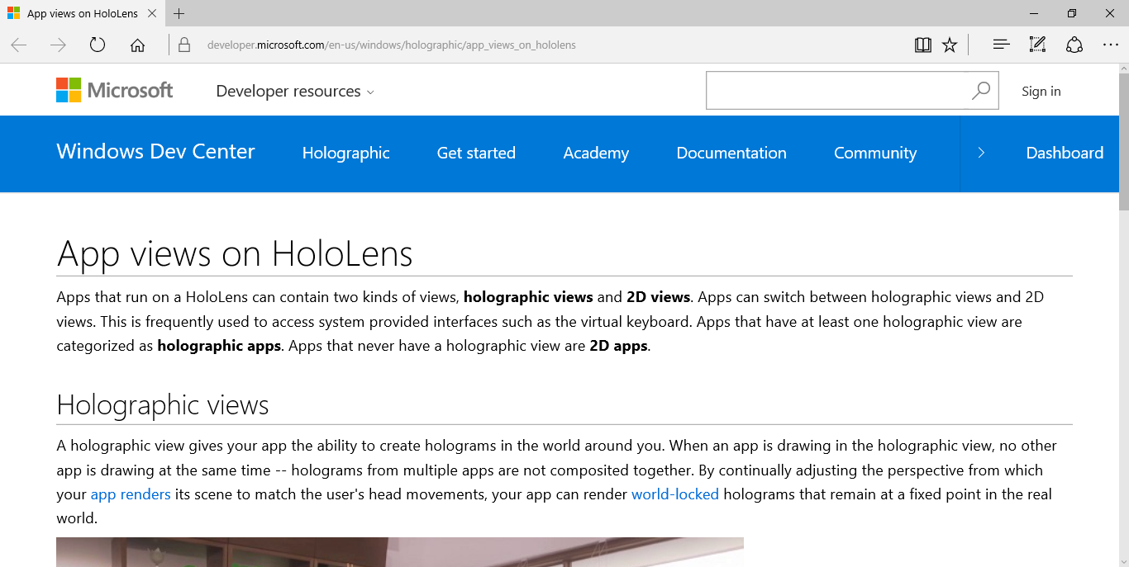
App Views: Holographic vs 2D
https://developer.microsoft.com/en-us/windows/holographic/app_views_on_hololens
Notes:
Speaker notes:
Deliver video content or stream video to audiences large or small to any device(Web or Mobile) anywhere reliably and in scale.
Helps you create versatile media workflows for ingesting, encoding, protecting and streaming content to audiences on-demand or broadcast live.
Powerful and extensible platform with broad set of first and third-party capabilities to support complete end-to-end media workflows.
Integration with Office 365 empowers organizations of all sizes helps to use videos to enhance sharing, collaboration and communication.
Azure Media Player, an automated online player solution, supports all the usual industry standards like HTML5 video, Media Source Extensions and rights management through Encrypted Media Extensions. The focus here is on open standards, but on older browsers, the player can fall back on Flash or Silverlight.

Slide 15
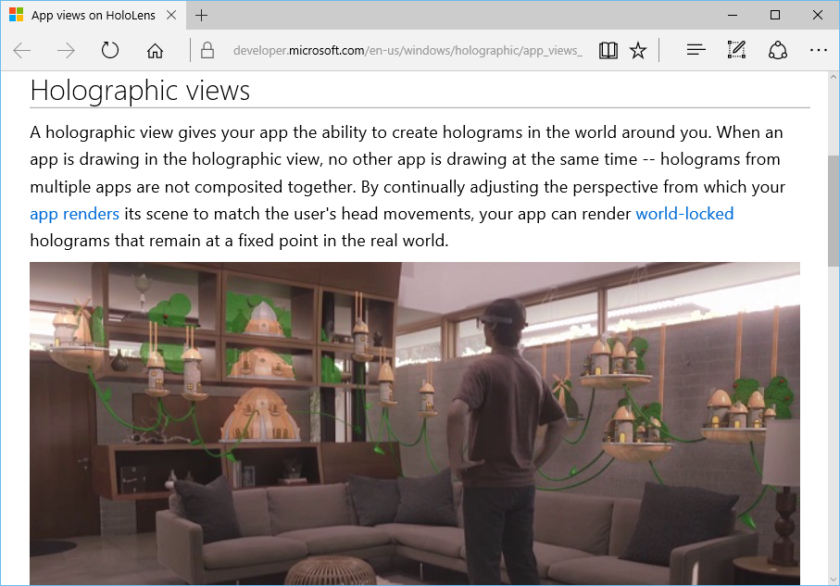
Holographic View
What is it?
View 3D holograms
One holographic app at a time
Lock to real world
https://developer.microsoft.com/en-us/windows/holographic/app_views_on_hololens
Notes:
Speaker notes:
Deliver video content or stream video to audiences large or small to any device(Web or Mobile) anywhere reliably and in scale.
Helps you create versatile media workflows for ingesting, encoding, protecting and streaming content to audiences on-demand or broadcast live.
Powerful and extensible platform with broad set of first and third-party capabilities to support complete end-to-end media workflows.
Integration with Office 365 empowers organizations of all sizes helps to use videos to enhance sharing, collaboration and communication.
Azure Media Player, an automated online player solution, supports all the usual industry standards like HTML5 video, Media Source Extensions and rights management through Encrypted Media Extensions. The focus here is on open standards, but on older browsers, the player can fall back on Flash or Silverlight.

Slide 16
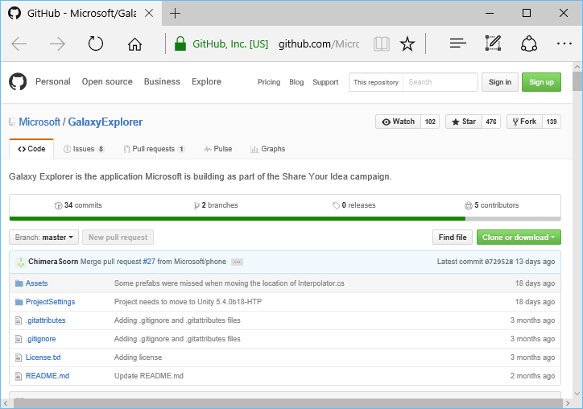
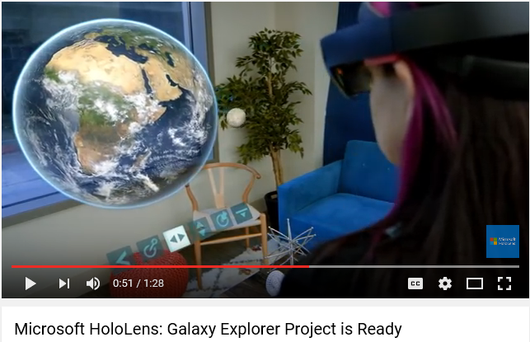
Galaxy Explorer: Open Source on GitHub
https://github.com/Microsoft/GalaxyExplorer
Notes:
Speaker notes:
Deliver video content or stream video to audiences large or small to any device(Web or Mobile) anywhere reliably and in scale.
Helps you create versatile media workflows for ingesting, encoding, protecting and streaming content to audiences on-demand or broadcast live.
Powerful and extensible platform with broad set of first and third-party capabilities to support complete end-to-end media workflows.
Integration with Office 365 empowers organizations of all sizes helps to use videos to enhance sharing, collaboration and communication.
Azure Media Player, an automated online player solution, supports all the usual industry standards like HTML5 video, Media Source Extensions and rights management through Encrypted Media Extensions. The focus here is on open standards, but on older browsers, the player can fall back on Flash or Silverlight.

Slide 17
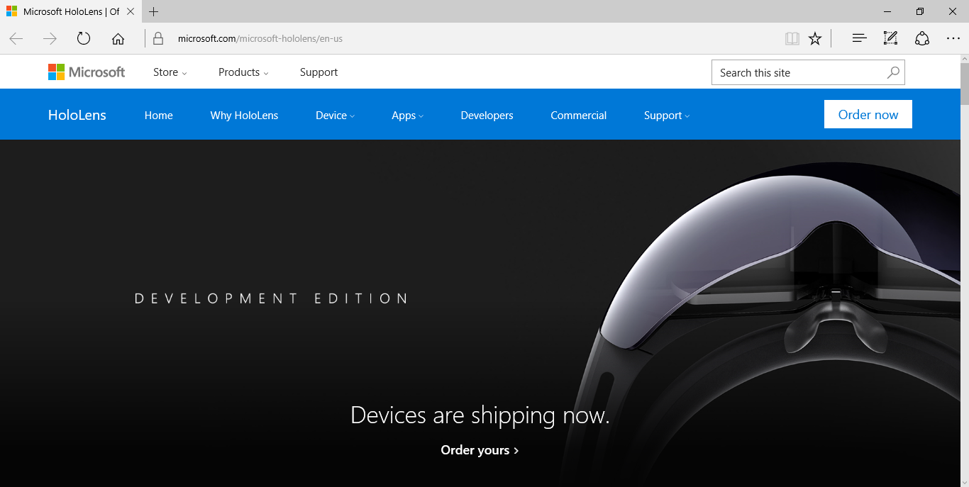
HoloLens: Official Website
http://hololens.com
Notes:
Speaker notes:
Deliver video content or stream video to audiences large or small to any device(Web or Mobile) anywhere reliably and in scale.
Helps you create versatile media workflows for ingesting, encoding, protecting and streaming content to audiences on-demand or broadcast live.
Powerful and extensible platform with broad set of first and third-party capabilities to support complete end-to-end media workflows.
Integration with Office 365 empowers organizations of all sizes helps to use videos to enhance sharing, collaboration and communication.
Azure Media Player, an automated online player solution, supports all the usual industry standards like HTML5 video, Media Source Extensions and rights management through Encrypted Media Extensions. The focus here is on open standards, but on older browsers, the player can fall back on Flash or Silverlight.

Slide 18
Demo

Slide 19
Q & A
Notes:
Additional Topics

Slide 20
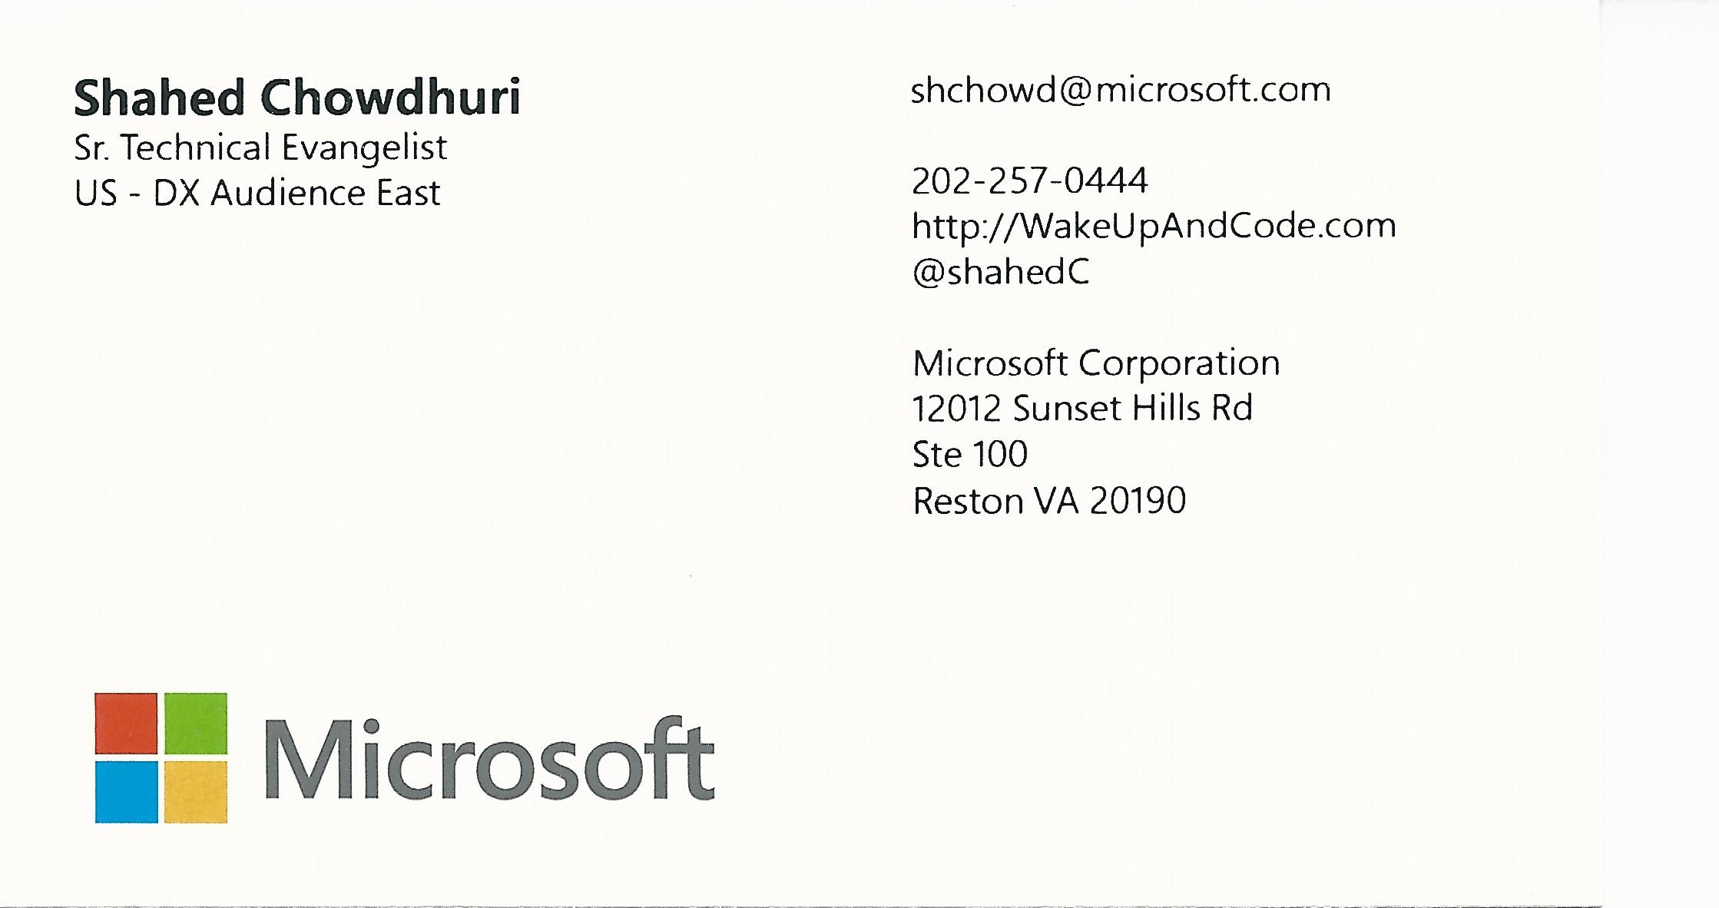
Email: shchowd@microsoft.com  Twitter: @shahedC
Notes:
Contact
Microsoft email: shchowd@microsoft.com
Personal Twitter: @shahedC
Dev Blog: WakeUpAndCode.com

