Slide 1
ASP.NET Core* 1.0
The Future of Web Apps
Shahed Chowdhuri
Sr. Technical Evangelist @ Microsoft
@shahedC
WakeUpAndCode.com
* aka ASP.NET 5 before RC1

Slide 2
Agenda
Introduction
> .NET (Framework & Core)
> ASP.NET Core
> Visual Studio
Q&A
Notes:
Agenda

Slide 3
Introduction
Notes:
Introduction

Slide 4
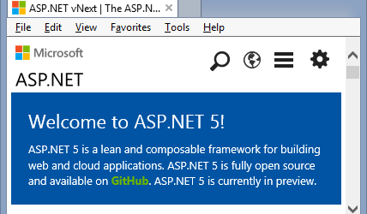
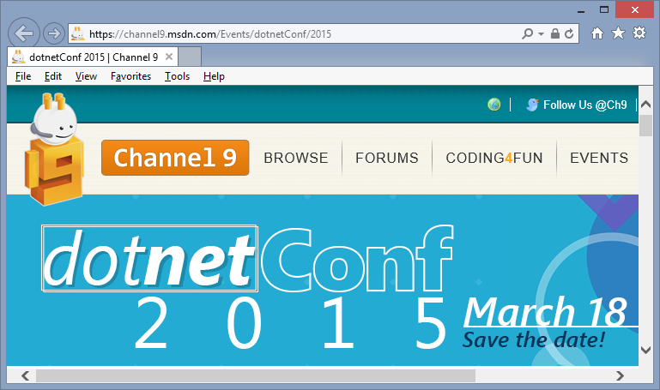
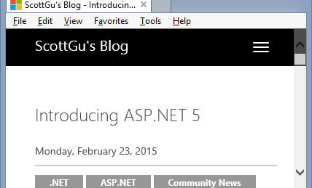
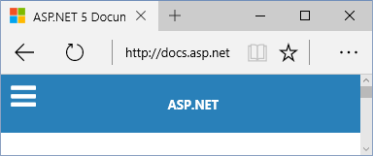
Sources
MSDN Blogs, Feb 2015 Update
asp.net/vNext
BuildWindows.com
docs.asp.net
Scott Guthrie’s Blog
dotnetConf 2015 on MSDN Ch9

Slide 5
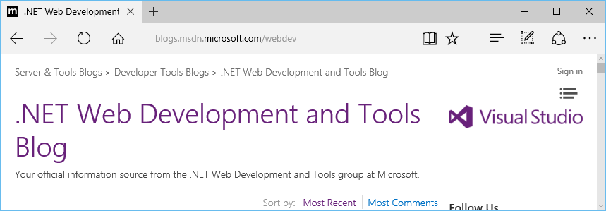
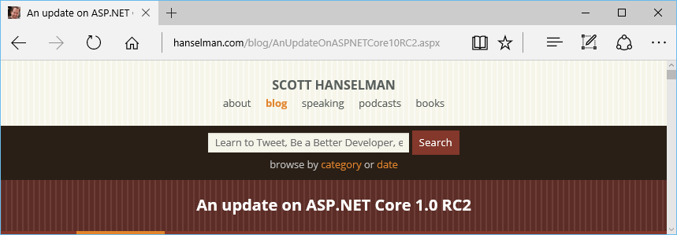
Newer Blog Posts in 2016
Community Standup Notes: https://blogs.msdn.microsoft.com/webdev/
RC2: http://www.hanselman.com/blog/AnUpdateOnASPNETCore10RC2.aspx

Slide 6
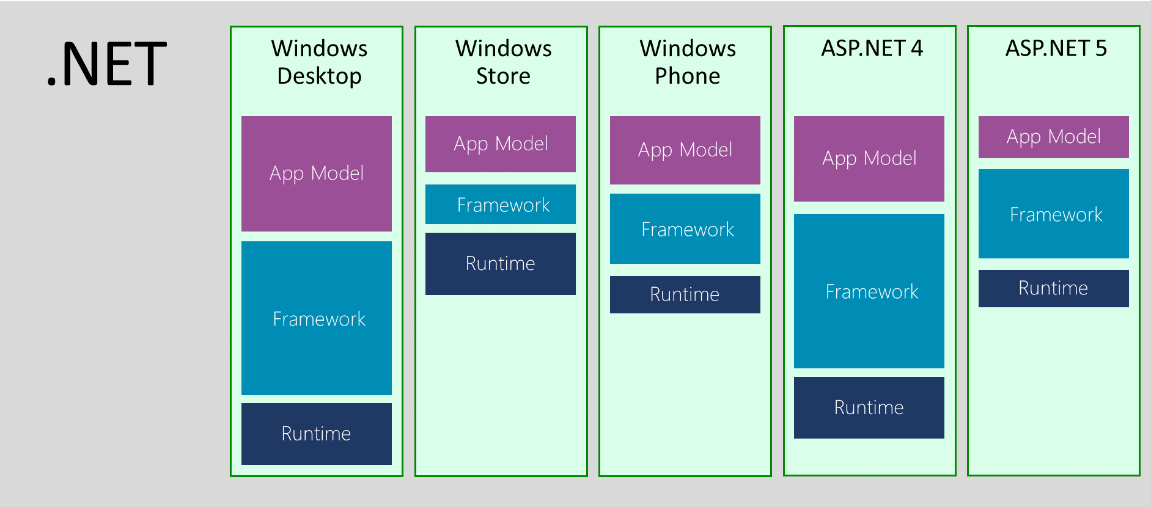
.NET Across Windows/Web Platforms
Source: http://blogs.msdn.com/b/dotnet/archive/2014/12/04/introducing-net-core.aspx

Slide 7
Evolution of ASP and ASP .NET
Active Server Pages
(Classic ASP)
Active Server Pages
(Classic ASP)
ASP.NET
MVC
1/2/3/4/5
ASP.NET
MVC
1/2/3/4/5
ASP.NET
MVC 6
Unified MVC, Web API and Web Pages
ASP.NET
(Web Forms)
ASP.NET
MVC 6
Core MVC
Unified MVC, Web API and Web Pages
ASP.NET
(Web Forms)
ASP.NET
Web Pages
ASP.NET
Web Pages
ASP.NET
Web API
ASP.NET
Web API

Slide 8
Names & Version Numbers
ASP.NET
MVC 6
C# 6.0
ASP.NET
MVC 6
Core MVC
C# 6.0
ASP.NET 5
(runs on .NET Core 5 or .NET Framework 4.5.2+)
ASP.NET 5 Core 1.0
(runs on .NET Core 5 1.0
or .NET Framework 4.5.2+)
SignalR 3
SignalR 3
.NET Framework 4.6
.NET Core 5
.NET Core 1.0
.NET Framework 4.6
.NET Core 5

Slide 9
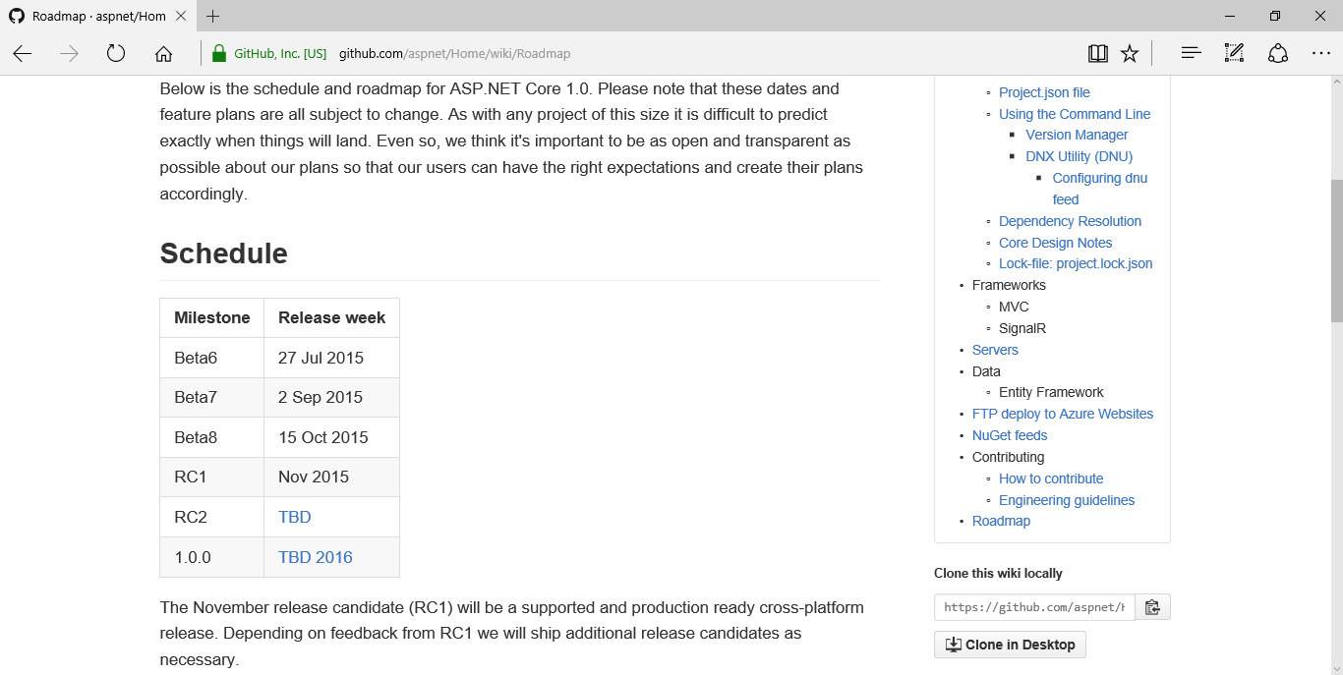
ASP.NET Roadmap
https://github.com/aspnet/Home/wiki/Roadmap

Slide 10
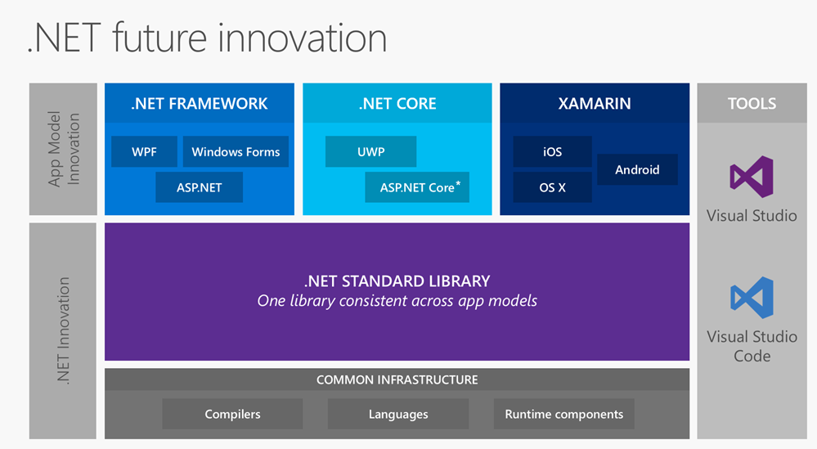
.NET Standard Library + Tooling
Source: http://www.hanselman.com/blog/AnUpdateOnASPNETCore10RC2.aspx

Slide 11
Agenda
Introduction
> .NET (Framework & Core)
> ASP.NET Core
> Visual Studio
Q&A
Notes:
Agenda

Slide 12
.NET Framework & .NET Core
Notes:
Variables, Operators & Loops

Slide 13
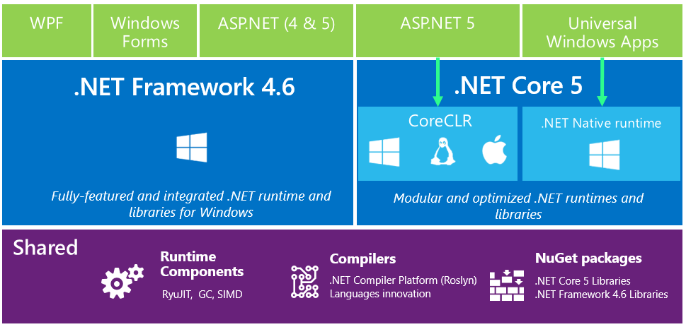
.NET in 2015: High-Level Overview

Slide 14
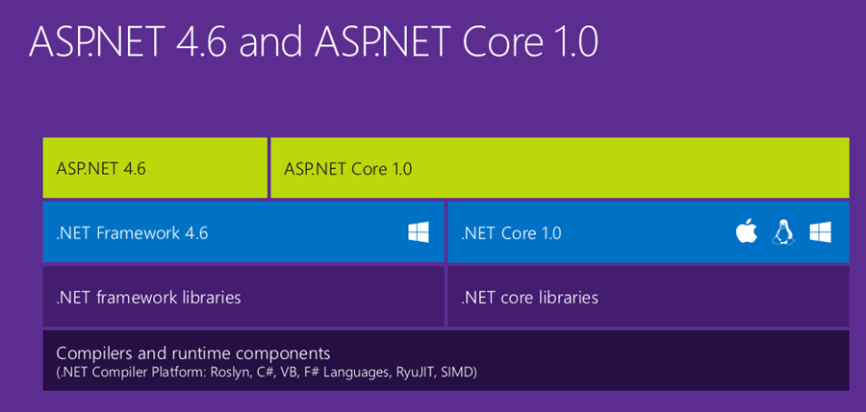
ASP.NET Core High-Level Overview

Slide 15
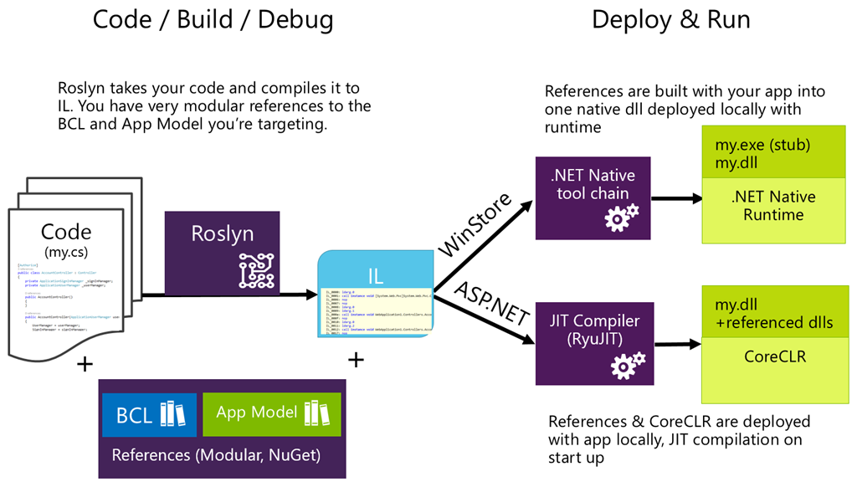
Compilation Process

Slide 16
What About .NET Framework 4.6?
Core is

Slide 17
ASP .NET Core
Notes:
ASP .NET 5.0

Slide 18
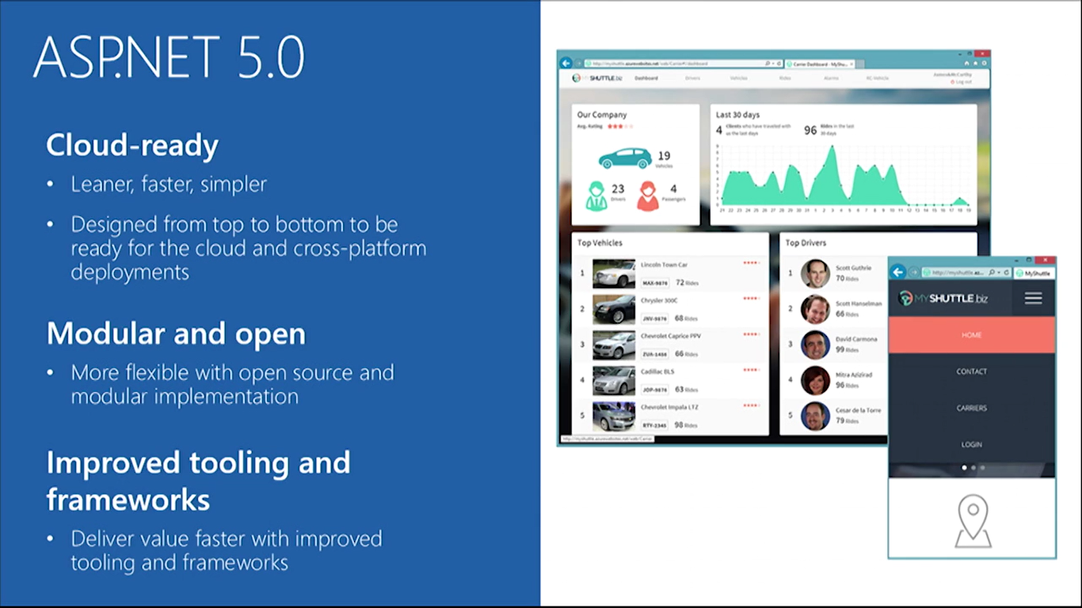
ASP.NET Core 1.0 Features

Slide 19
ASP.NET Core Summary

Slide 20
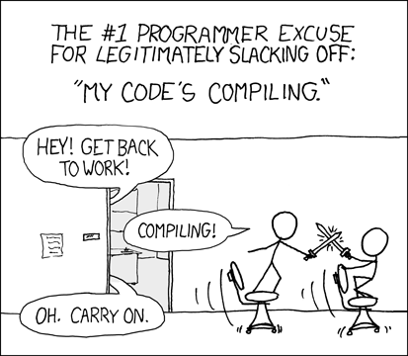
Relevant XKCD Comic
Source: https://xkcd.com/303/

Slide 21
ASP.NET Core Features in Detail
Flexible, Cross Platform runtime
Unified Programming Model
Tag Helpers
Dynamic Development
Bower, Grunt, Gulp
Simplified Dependency Mgmt
Cloud-Ready Config
Dependency Injection (DI)
Fast HTTP Performance
Open Source
New Project Templates
Identity Updates
Command Line Tools
New HTTP client-role API

Slide 22
ASP.NET Core Features in Detail
Flexible, Cross Platform runtime
Unified Programming Model
Tag Helpers
Dynamic Development
.NET Core or full .NET Framework
.NET Core is cross-platform
Deploy Core runtime with app
No need for unused features
Bower, Grunt, Gulp
Simplified Dependency Mgmt
Cloud-Ready Config
Dependency Injection (DI)
Fast HTTP Performance
Open Source
New Project Templates
Identity Updates
Command Line Tools
New HTTP client-role API

Slide 23
ASP.NET Core Features in Detail
Flexible, Cross Platform runtime
Unified Programming Model
Tag Helpers
Dynamic Development
Unified:
MVC
Web API
Web Pages
Bower, Grunt, Gulp
Simplified Dependency Mgmt
Cloud-Ready Config
Dependency Injection (DI)
Fast HTTP Performance
Open Source
New Project Templates
Identity Updates
Command Line Tools
New HTTP client-role API

Slide 24
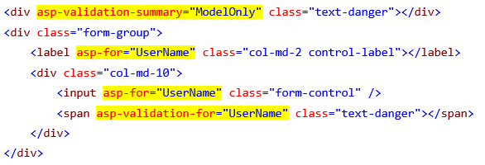
ASP.NET Core Features in Detail
HTML Helpers in your views!
Tag Helpers
Dynamic Development
Flexible, Cross Platform runtime
Unified Programming Model
Bower, Grunt, Gulp
Simplified Dependency Mgmt
Cloud-Ready Config
Dependency Injection (DI)
Fast HTTP Performance
Open Source
New Project Templates
Identity Updates
Command Line Tools
New HTTP client-role API

Slide 25
ASP.NET Core Features in Detail
Flexible, Cross Platform runtime
Unified Programming Model
Tag Helpers
Dynamic Development
Edit code
Save changes
Refresh browser
See changes!
Compiled language with benefits of interpreted language!
Bower, Grunt, Gulp
Simplified Dependency Mgmt
Cloud-Ready Config
Dependency Injection (DI)
Fast HTTP Performance
Open Source
New Project Templates
Identity Updates
Command Line Tools
New HTTP client-role API

Slide 26
ASP.NET Core Features in Detail
Flexible, Cross Platform runtime
Unified Programming Model
Tag Helpers
Dynamic Development
Bower → client-side pkg mgr
e.g. JS, CSS
Grunt & Gulp → task runners
compile LESS/CoffeeScript, Typescipt
run JSLint
minify JS files
Bower, Grunt, Gulp
Simplified Dependency Mgmt
Cloud-Ready Config
Dependency Injection (DI)
Fast HTTP Performance
Open Source
New Project Templates
Identity Updates
Command Line Tools
New HTTP client-role API

Slide 27
ASP.NET Core Features in Detail
Flexible, Cross Platform runtime
Unified Programming Model
Tag Helpers
Dynamic Development
Manage dependencies with NuGet packages
Edit project.json file
Enjoy IntelliSense!
Bower, Grunt, Gulp
Simplified Dependency Mgmt
Cloud-Ready Config
Dependency Injection (DI)
Fast HTTP Performance
Open Source
New Project Templates
Identity Updates
Command Line Tools
New HTTP client-role API

Slide 28
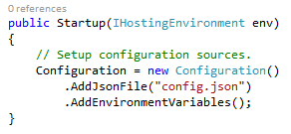
ASP.NET Core Features in Detail
Flexible, Cross Platform runtime
Unified Programming Model
Tag Helpers
Dynamic Development
Configuration in code
Edit Startup.cs file
No need to use Web.config
Use JSON, XML, env vars
Bower, Grunt, Gulp
Simplified Dependency Mgmt
Cloud-Ready Config
Dependency Injection (DI)
Fast HTTP Performance
Open Source
New Project Templates
Identity Updates
Command Line Tools
New HTTP client-role API

Slide 29
ASP.NET Core Features in Detail
Flexible, Cross Platform runtime
Unified Programming Model
Tag Helpers
Dynamic Development
Bower, Grunt, Gulp
Simplified Dependency Mgmt
Cloud-Ready Config
Dependency Injection (DI)
minimalistic DI container
replace with others
Autofac, Ninject, etc
use [FromServices] attribute
Fast HTTP Performance
Open Source
New Project Templates
Identity Updates
Command Line Tools
New HTTP client-role API

Slide 30
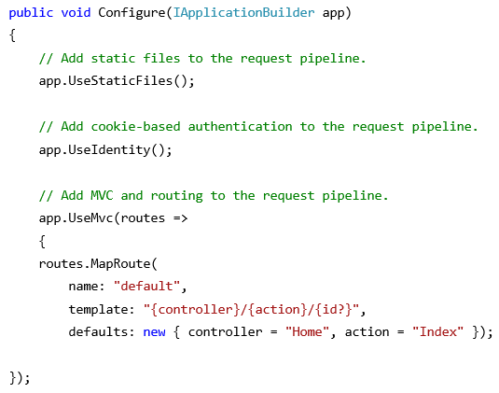
ASP.NET Core Features in Detail
Flexible, Cross Platform runtime
Unified Programming Model
Tag Helpers
Dynamic Development
New HTTP pipeline
modular
add components as needed
no longer dependent on System.Web
Bower, Grunt, Gulp
Simplified Dependency Mgmt
Cloud-Ready Config
Dependency Injection (DI)
Fast HTTP Performance
Open Source
New Project Templates
Identity Updates
Command Line Tools
New HTTP client-role API

Slide 31
ASP.NET Core Features in Detail
Flexible, Cross Platform runtime
Unified Programming Model
Tag Helpers
Dynamic Development
Bower, Grunt, Gulp
Simplified Dependency Mgmt
Cloud-Ready Config
Dependency Injection (DI)
GitHub!
Fast HTTP Performance
Open Source
New Project Templates
Identity Updates
Command Line Tools
New HTTP client-role API

Slide 32
ASP.NET Core Features in Detail
Flexible, Cross Platform runtime
Unified Programming Model
Tag Helpers
Dynamic Development
Bower, Grunt, Gulp
Simplified Dependency Mgmt
Cloud-Ready Config
Dependency Injection (DI)
K Package Manager (KPM)*
bundle application
build NuGet packages
build assemblies
* changes coming with RC2
Fast HTTP Performance
Open Source
New Project Templates
Identity Updates
Command Line Tools
New HTTP client-role API

Slide 33
ASP.NET Core Features in Detail
Flexible, Cross Platform runtime
Unified Programming Model
Tag Helpers
Dynamic Development
Bower, Grunt, Gulp
Simplified Dependency Mgmt
Cloud-Ready Config
Dependency Injection (DI)
ASP.NET Core Preview Templates
Empty
Starter Web
Web API
Fast HTTP Performance
Open Source
New Project Templates
Identity Updates
Command Line Tools
New HTTP client-role API

Slide 34
ASP.NET Core Features in Detail
Flexible, Cross Platform runtime
Unified Programming Model
Tag Helpers
Dynamic Development
Bower, Grunt, Gulp
Simplified Dependency Mgmt
Cloud-Ready Config
Dependency Injection (DI)
Open ID Connect
OAuth2
Template auth logic based on OWIN and Open ID Connect (not WIF)
Fast HTTP Performance
Open Source
New Project Templates
Identity Updates
Command Line Tools
New HTTP client-role API

Slide 35
ASP.NET Core Features in Detail
Flexible, Cross Platform runtime
Unified Programming Model
Tag Helpers
Dynamic Development
Bower, Grunt, Gulp
Simplified Dependency Mgmt
Cloud-Ready Config
Dependency Injection (DI)
More granular control (than HttpClientHandler) over individual aspects of HTTP
redirects, auth, cookies, etc
Fast HTTP Performance
Open Source
New Project Templates
Identity Updates
Command Line Tools
New HTTP client-role API

Slide 36
ASP.NET Core Features in Detail
Flexible, Cross Platform runtime
Unified Programming Model
Tag Helpers
Dynamic Development
Bower, Grunt, Gulp
Simplified Dependency Mgmt
Cloud-Ready Config
Dependency Injection (DI)
Fast HTTP Performance
Open Source
New Project Templates
Identity Updates
Command Line Tools
New HTTP client-role API

Slide 37
How about Entity Framework?
Entities in Code
Core
ORM
)
DB

Slide 38
Visual Studio 2015
Notes:
ASP .NET 5.0

Slide 39
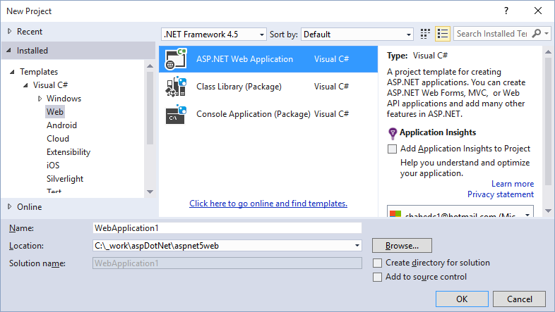
File → New Project → Web
Web App
Class Library
Console App

Slide 40
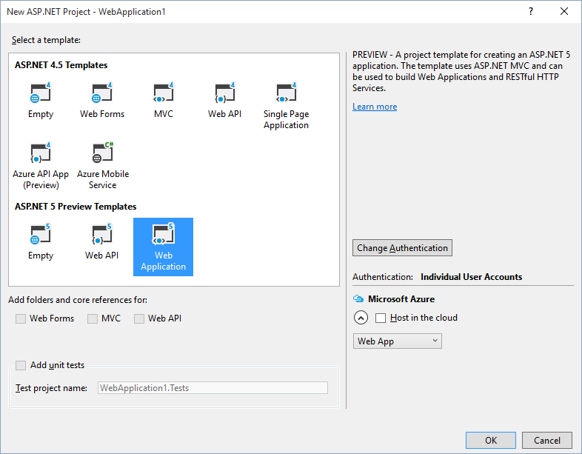
Select a Template*
* to be renamed in RC2

Slide 41
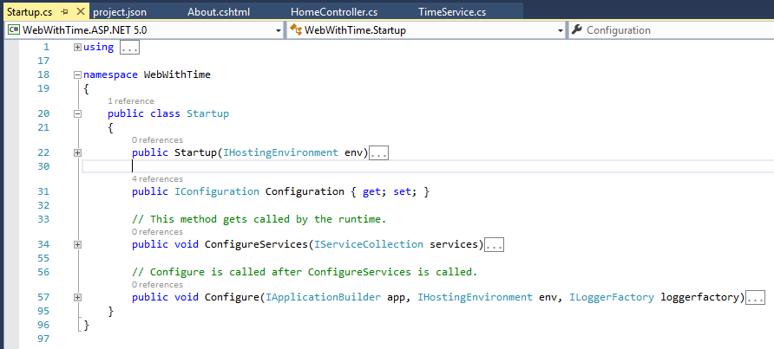
Startup.cs Configuration

Slide 42
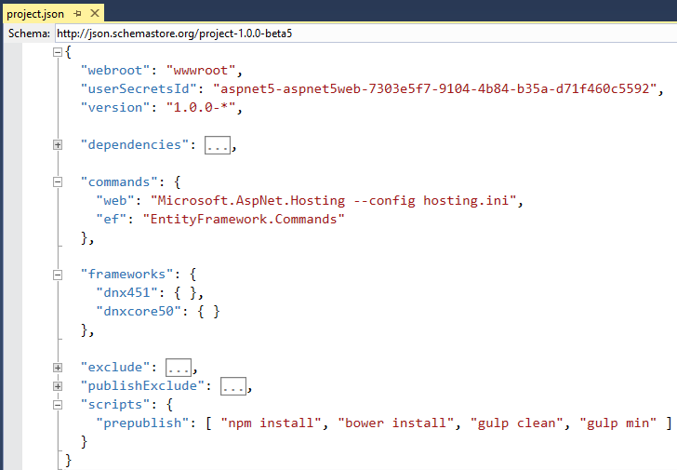
project.json

Slide 43
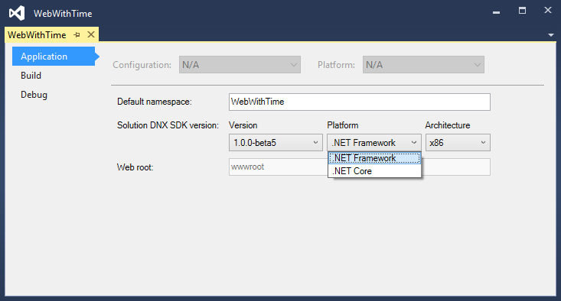
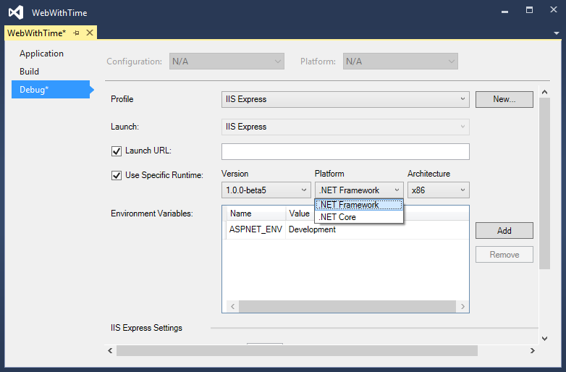
Right-click → (Project) Properties
Application tab
Debug tab
Use specific KRE/DNX/CLI version!

Slide 44
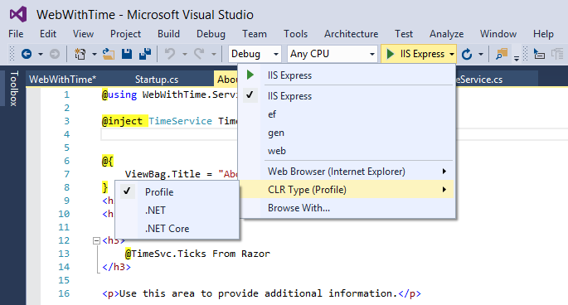
Choose CLR Type While Debugging

Slide 45
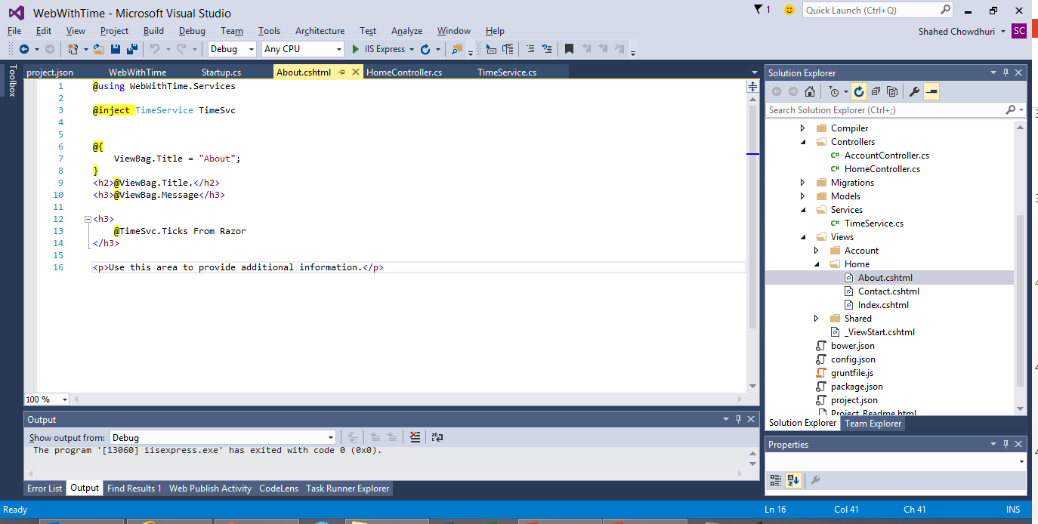
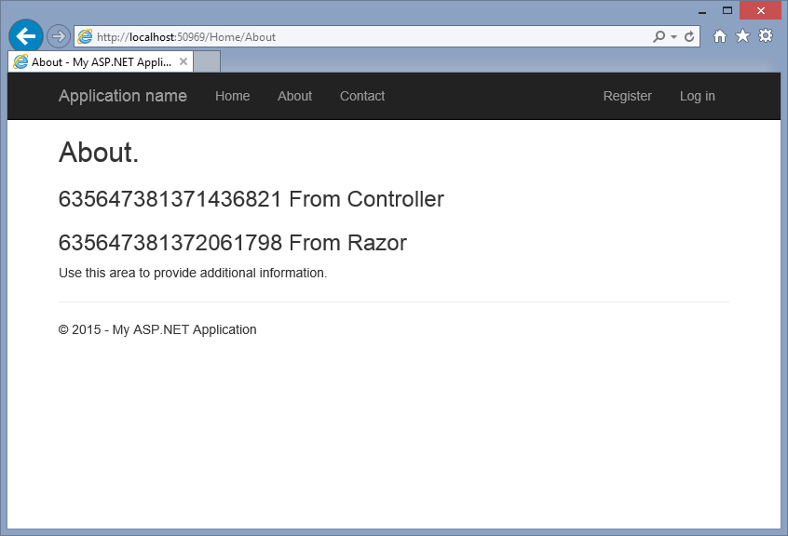
DEMO

Slide 46
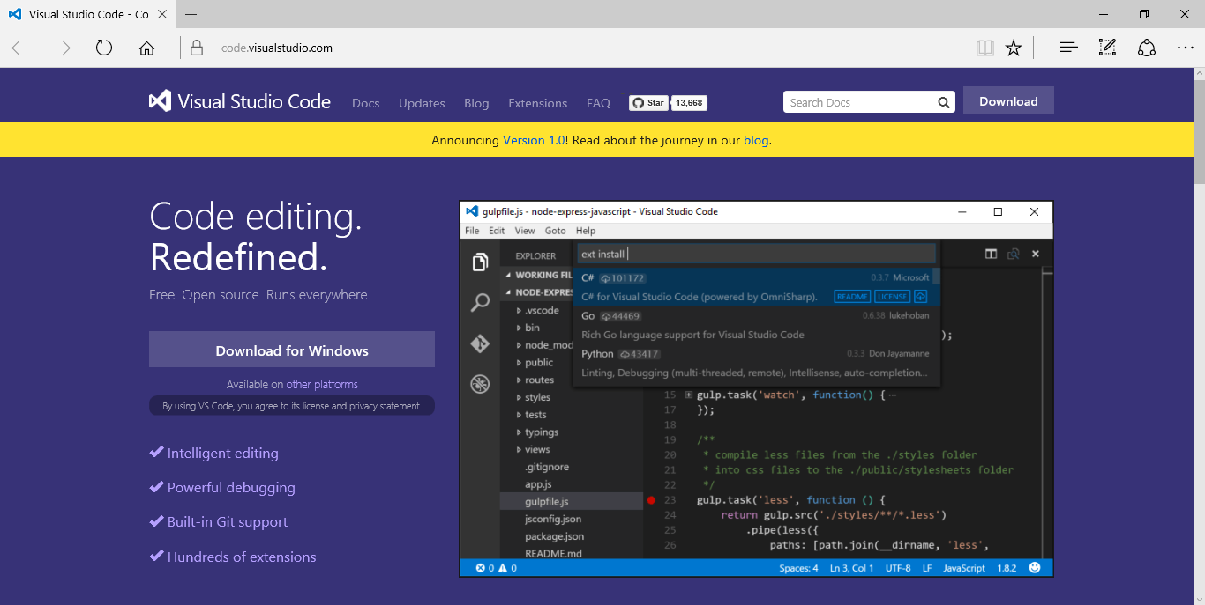
Visual Studio Code
Download: https://code.visualstudio.com

Slide 47
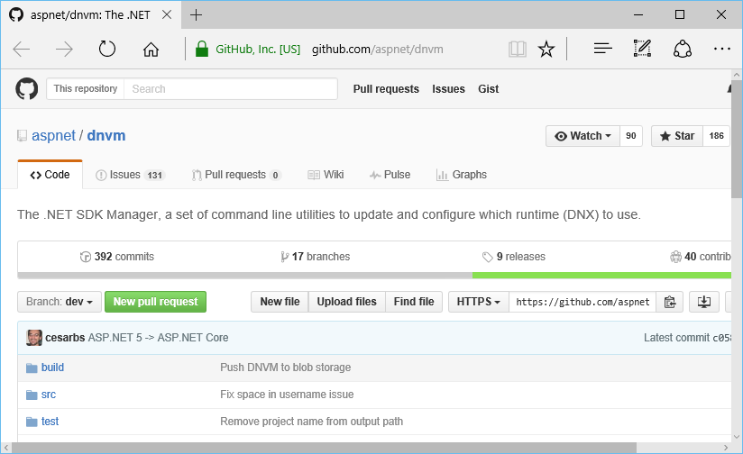
.NET Version Manager (DNVM)
.NET SDK Version Manager
Formerly KVM
Get list of DNXs (aka KRE)
GitHub: https://github.com/aspnet/dnvm

Slide 48
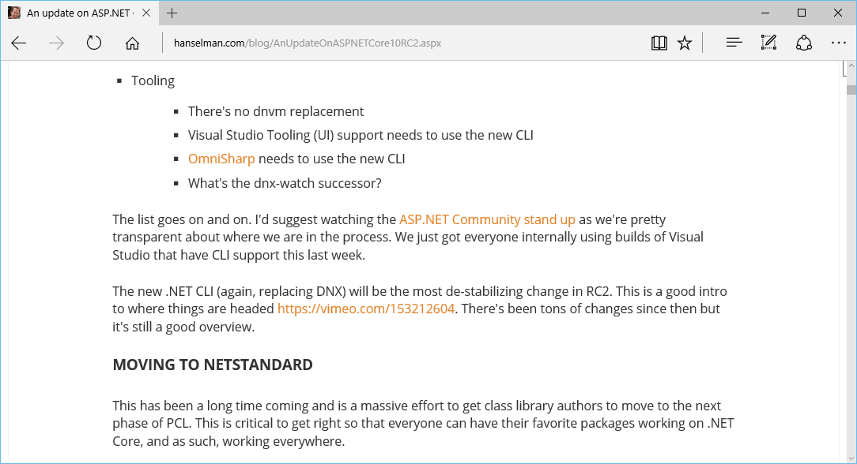
Tooling Changes and NETStandard

Slide 49
References
ASP.NET vNext: http://asp.net/vnext
Intro: https://weblogs.asp.net/scottgu/introducing-asp-net-5
Feb 2015 Updates: http://blogs.msdn.com/b/webdev/archive/2015/02/23/aspnet-5-updates-for-feb-2015.aspx
dotnetConf March 2015: https://channel9.msdn.com/Events/dotnetConf/2015
Build 2015: https://channel9.msdn.com/Events/Build/2015
Understanding .NET 2015: http://blogs.msdn.com/b/bethmassi/archive/2015/02/25/understanding-net-2015.aspx
Grunt & Bower: http://www.asp.net/vnext/overview/aspnet-vnext/grunt-and-bower-in-visual-studio-2015
Tutorial: http://www.asp.net/vnext/overview/aspnet-vnext/vc
ASP.NET Community Standup Notes: https://blogs.msdn.microsoft.com/webdev/
Update on ASP.NET RC2: http://www.hanselman.com/blog/AnUpdateOnASPNETCore10RC2.aspx
Additional Tutorials: See Starter Web Project Template

Slide 50
Other Resources
Roadmap: https://github.com/aspnet/Home/wiki/Roadmap
ASP.NET Identity: http://www.asp.net/identity/overview/getting-started/introduction-to-aspnet-identity
KRE, KVM, KPM: http://gunnarpeipman.com/2014/10/asp-net-5-what-are-kre-kvm-kpm/
Grunt, JS Task Runner: http://gruntjs.com/
Gulp, Workflow Automation: http://gulpjs.com/
Bower, Package Manager: http://bower.io/
npm, Node Package Manager: https://www.npmjs.com/

Slide 51
Agenda
Introduction
> .NET (Framework & Core)
> ASP.NET Core
> Visual Studio
Q&A
Notes:
Agenda

Slide 52
Q & A
Notes:
Additional Topics

Slide 53
Agenda
Introduction
> .NET (Framework & Core)
> ASP.NET Core
> Visual Studio
Q&A
Notes:
Agenda

Slide 54
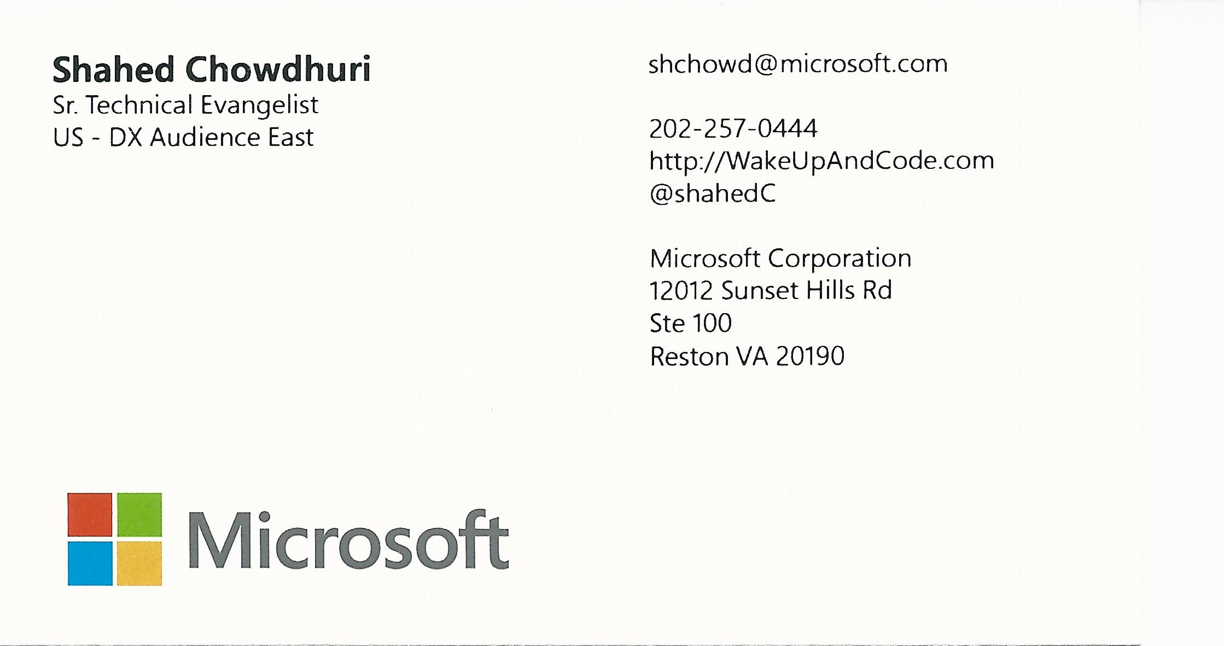
Email: shchowd@microsoft.com  Twitter: @shahedC
Notes:
Contact
Microsoft email: shchowd@microsoft.com
Personal Twitter: @shahedC
Dev Blog: WakeUpAndCode.com

