Slide 1
ASP .NET 5 (aka ASP .NET vNext)
The Future of Web Apps
By Shahed Chowdhuri
Sr. Technical Evangelist @ Microsoft
WakeUpAndCode.com
@shahedC
Notes:
Title Page: ASP .NET 5 (aka vNext) The Future of Web Apps
By Shahed Chowdhuri
Senior Technical Evangelist @ Microsoft
Blog: WakeUpAndCode.com
Twitter: @shahedC

Slide 2
Agenda
Introduction
> .NET (Framework & Core)
> ASP.NET 5.0
> VS2015
Q&A
Notes:
Agenda

Slide 3
Introduction
Notes:
Introduction

Slide 4
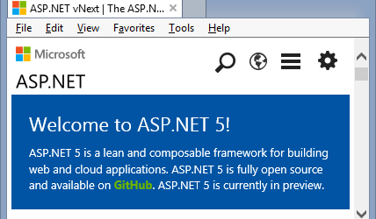
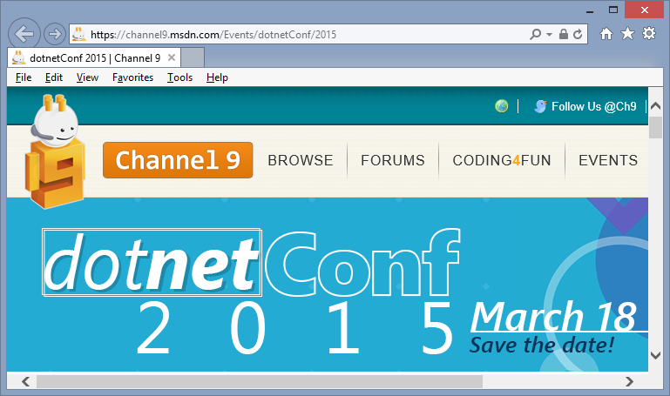
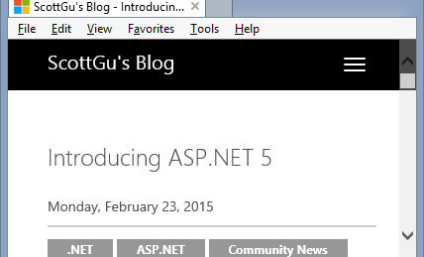
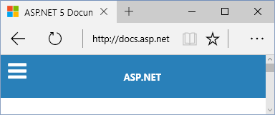
Sources
MSDN Blogs, Feb 2015 Update
asp.net/vNext
BuildWindows.com
docs.asp.net
Scott Guthrie’s Blog
dotnetConf 2015 on MSDN Ch9

Slide 5
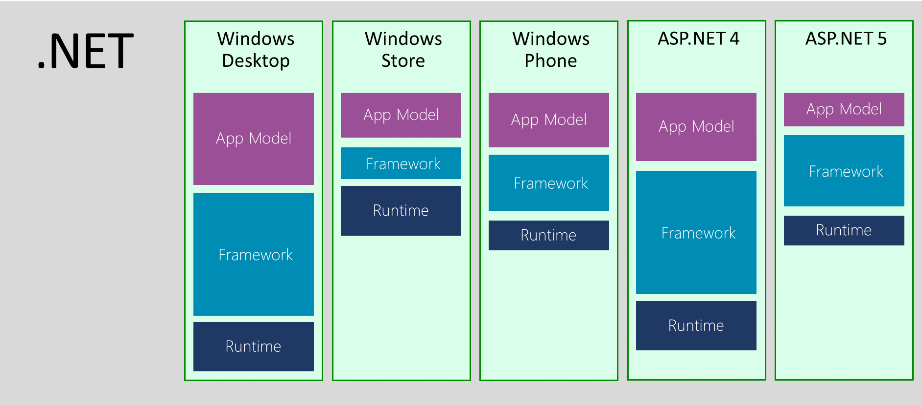
.NET Across Windows/Web Platforms
Source: http://blogs.msdn.com/b/dotnet/archive/2014/12/04/introducing-net-core.aspx

Slide 6
Evolution of ASP and ASP .NET
Active Server Pages
(Classic ASP)
ASP.NET
(Web Forms)
ASP.NET
MVC
1/2/3/4/5
ASP.NET
MVC
6
Unified MVC, Web API and Web Pages
ASP.NET
Web Pages
ASP.NET
Web API

Slide 7
Names & Version Numbers
C# 6.0
ASP.NET
MVC 6
ASP.NET 5
(runs on .NET Core 5 or .NET Framework 4.5.2+)
SignalR 3
.NET Framework 4.6
.NET Core 5

Slide 8
Agenda
Introduction
> .NET (Framework & Core)
> ASP.NET 5.0
> VS2015 Preview
Q&A
Notes:
Agenda

Slide 9
.NET Framework & .NET Core
Notes:
Variables, Operators & Loops

Slide 10
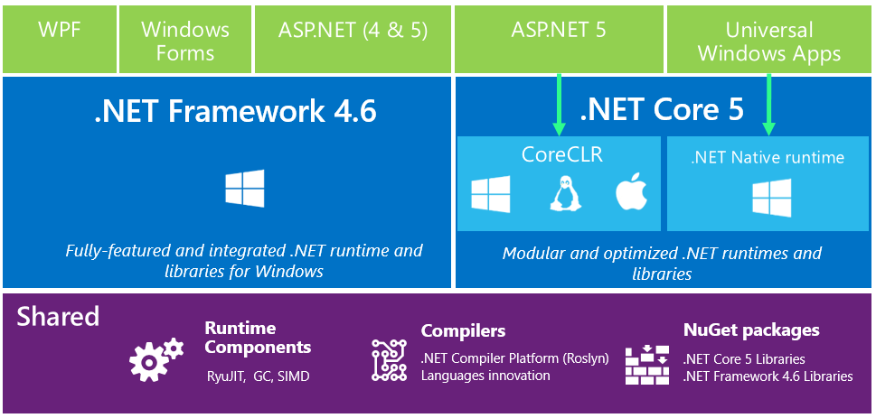
.NET 2015: High-Level Overview

Slide 11
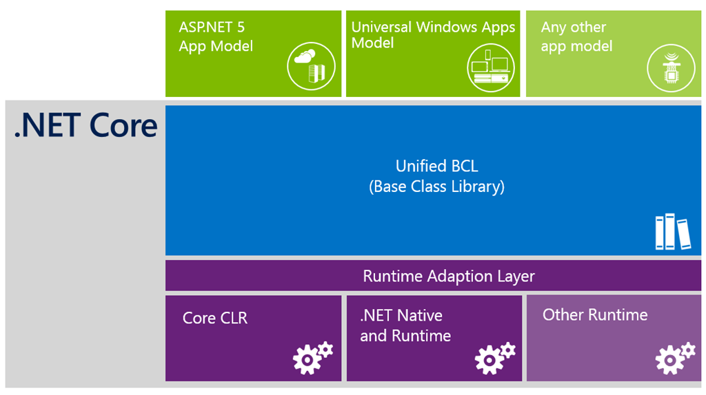
.NET Core & App Models

Slide 12
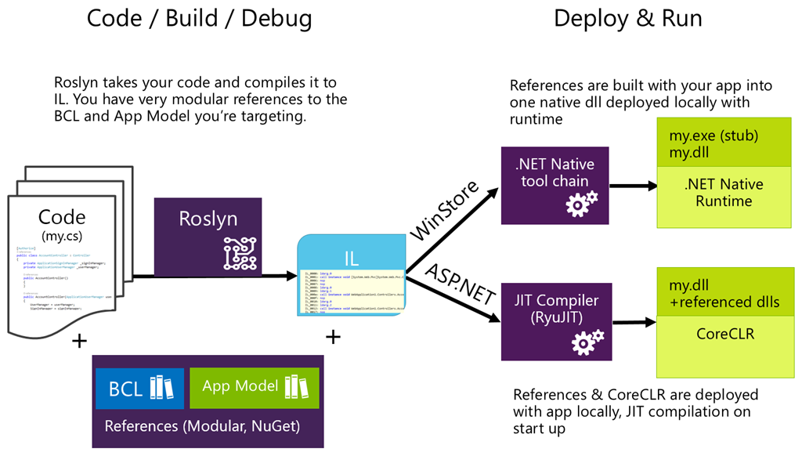
Compilation Process

Slide 13
What About .NET Framework 4.6?

Slide 14
ASP .NET 5.0
Notes:
ASP .NET 5.0

Slide 15
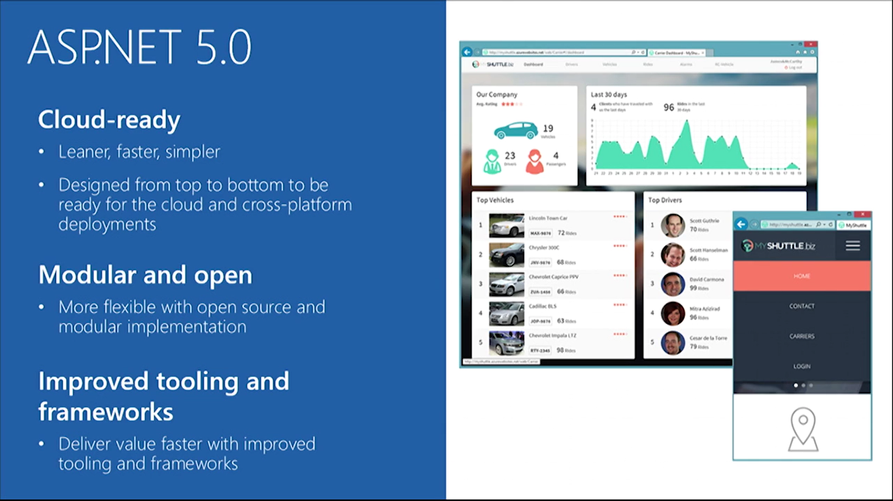
ASP.NET 5.0 Overview

Slide 16
ASP.NET 5.0 Summary

Slide 17
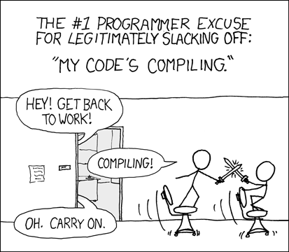
Relevant XKCD Comic
Source: https://xkcd.com/303/

Slide 18
ASP.NET 5.0 Features
Flexible, Cross Platform runtime
MVC6 – Unified Programming Model
Tag Helpers
Dynamic Development
Bower, Grunt, Gulp
Simplified Dependency Mgmt
Cloud-Ready Config
Dependency Injection (DI)
Fast HTTP Performance
Open Source
New Project Templates
Identity Updates
Command Line Tools
New HTTP client-role API

Slide 19
ASP.NET 5.0 Features
Flexible, Cross Platform runtime
MVC6 – Unified Programming Model
Tag Helpers
Dynamic Development
.NET Core or full .NET Framework
.NET Core is cross-platform
Deploy Core runtime with app
No need for unused features
Bower, Grunt, Gulp
Simplified Dependency Mgmt
Cloud-Ready Config
Dependency Injection (DI)
Fast HTTP Performance
Open Source
New Project Templates
Identity Updates
Command Line Tools
New HTTP client-role API

Slide 20
ASP.NET 5.0 Features
Flexible, Cross Platform runtime
MVC6 – Unified Programming Model
Tag Helpers
Dynamic Development
Unified:
MVC
Web API
Web Pages
Bower, Grunt, Gulp
Simplified Dependency Mgmt
Cloud-Ready Config
Dependency Injection (DI)
Fast HTTP Performance
Open Source
New Project Templates
Identity Updates
Command Line Tools
New HTTP client-role API

Slide 21
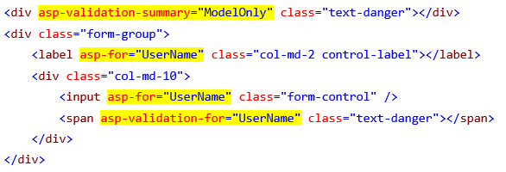
ASP.NET 5.0 Features
HTML Helpers in your views!
Tag Helpers
Dynamic Development
Flexible, Cross Platform runtime
MVC6 – Unified Programming Model
Bower, Grunt, Gulp
Simplified Dependency Mgmt
Cloud-Ready Config
Dependency Injection (DI)
Fast HTTP Performance
Open Source
New Project Templates
Identity Updates
Command Line Tools
New HTTP client-role API

Slide 22
ASP.NET 5.0 Features
Flexible, Cross Platform runtime
MVC6 – Unified Programming Model
Tag Helpers
Dynamic Development
Edit code
Save changes
Refresh browser
See changes!
Compiled language with benefits of interpreted language!
Bower, Grunt, Gulp
Simplified Dependency Mgmt
Cloud-Ready Config
Dependency Injection (DI)
Fast HTTP Performance
Open Source
New Project Templates
Identity Updates
Command Line Tools
New HTTP client-role API

Slide 23
ASP.NET 5.0 Features
Flexible, Cross Platform runtime
MVC6 – Unified Programming Model
Tag Helpers
Dynamic Development
Bower → client-side pkg mgr
e.g. JS, CSS
Grunt & Gulp → task runners
compile LESS/CoffeeScript, Typescipt
run JSLint
minify JS files
Bower, Grunt, Gulp
Simplified Dependency Mgmt
Cloud-Ready Config
Dependency Injection (DI)
Fast HTTP Performance
Open Source
New Project Templates
Identity Updates
Command Line Tools
New HTTP client-role API

Slide 24
ASP.NET 5.0 Features
Flexible, Cross Platform runtime
MVC6 – Unified Programming Model
Tag Helpers
Dynamic Development
Manage dependencies with NuGet packages
Edit project.json file
Enjoy IntelliSense!
Bower, Grunt, Gulp
Simplified Dependency Mgmt
Cloud-Ready Config
Dependency Injection (DI)
Fast HTTP Performance
Open Source
New Project Templates
Identity Updates
Command Line Tools
New HTTP client-role API

Slide 25
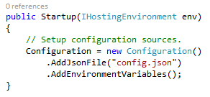
ASP.NET 5.0 Features
Flexible, Cross Platform runtime
MVC6 – Unified Programming Model
Tag Helpers
Dynamic Development
Configuration in code
Edit Startup.cs file
No need to use Web.config
Use JSON, XML, env vars
Bower, Grunt, Gulp
Simplified Dependency Mgmt
Cloud-Ready Config
Dependency Injection (DI)
Fast HTTP Performance
Open Source
New Project Templates
Identity Updates
Command Line Tools
New HTTP client-role API

Slide 26
ASP.NET 5.0 Features
Flexible, Cross Platform runtime
MVC6 – Unified Programming Model
Tag Helpers
Dynamic Development
Bower, Grunt, Gulp
Simplified Dependency Mgmt
Cloud-Ready Config
Dependency Injection (DI)
minimalistic DI container
replace with others
Autofac, Ninject, etc
use [FromServices] attribute
Fast HTTP Performance
Open Source
New Project Templates
Identity Updates
Command Line Tools
New HTTP client-role API

Slide 27
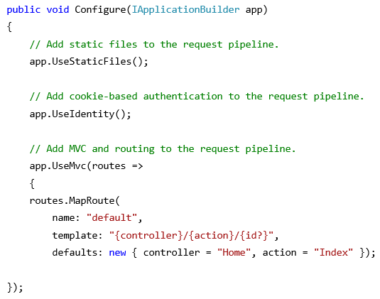
ASP.NET 5.0 Features
Flexible, Cross Platform runtime
MVC6 – Unified Programming Model
Tag Helpers
Dynamic Development
New HTTP pipeline
modular
add components as needed
no longer dependent on System.Web
Bower, Grunt, Gulp
Simplified Dependency Mgmt
Cloud-Ready Config
Dependency Injection (DI)
Fast HTTP Performance
Open Source
New Project Templates
Identity Updates
Command Line Tools
New HTTP client-role API

Slide 28
ASP.NET 5.0 Features
Flexible, Cross Platform runtime
MVC6 – Unified Programming Model
Tag Helpers
Dynamic Development
Bower, Grunt, Gulp
Simplified Dependency Mgmt
Cloud-Ready Config
Dependency Injection (DI)
GitHub!
Fast HTTP Performance
Open Source
New Project Templates
Identity Updates
Command Line Tools
New HTTP client-role API

Slide 29
ASP.NET 5.0 Features
Flexible, Cross Platform runtime
MVC6 – Unified Programming Model
Tag Helpers
Dynamic Development
Bower, Grunt, Gulp
Simplified Dependency Mgmt
Cloud-Ready Config
Dependency Injection (DI)
K Package Manager (KPM)
bundle application
build NuGet packages
build assemblies
Fast HTTP Performance
Open Source
New Project Templates
Identity Updates
Command Line Tools
New HTTP client-role API

Slide 30
ASP.NET 5.0 Features
Flexible, Cross Platform runtime
MVC6 – Unified Programming Model
Tag Helpers
Dynamic Development
Bower, Grunt, Gulp
Simplified Dependency Mgmt
Cloud-Ready Config
Dependency Injection (DI)
ASP.NET 5 Preview Templates
Empty
Starter Web
Web API
Fast HTTP Performance
Open Source
New Project Templates
Identity Updates
Command Line Tools
New HTTP client-role API

Slide 31
ASP.NET 5.0 Features
Flexible, Cross Platform runtime
MVC6 – Unified Programming Model
Tag Helpers
Dynamic Development
Bower, Grunt, Gulp
Simplified Dependency Mgmt
Cloud-Ready Config
Dependency Injection (DI)
Open ID Connect
OAuth2
Template auth logic based on OWIN and Open ID Connect (not WIF)
Fast HTTP Performance
Open Source
New Project Templates
Identity Updates
Command Line Tools
New HTTP client-role API

Slide 32
ASP.NET 5.0 Features
Flexible, Cross Platform runtime
MVC6 – Unified Programming Model
Tag Helpers
Dynamic Development
Bower, Grunt, Gulp
Simplified Dependency Mgmt
Cloud-Ready Config
Dependency Injection (DI)
More granular control (than HttpClientHandler) over individual aspects of HTTP
redirects, auth, cookies, etc
Fast HTTP Performance
Open Source
New Project Templates
Identity Updates
Command Line Tools
New HTTP client-role API

Slide 33
ASP.NET 5.0 Features
Flexible, Cross Platform runtime
MVC6 – Unified Programming Model
Tag Helpers
Dynamic Development
Bower, Grunt, Gulp
Simplified Dependency Mgmt
Cloud-Ready Config
Dependency Injection (DI)
Fast HTTP Performance
Open Source
New Project Templates
Identity Updates
Command Line Tools
New HTTP client-role API

Slide 34
How about Entity Framework?
Entities in Code
ORM
DB

Slide 35
Visual Studio 2015
Notes:
ASP .NET 5.0

Slide 36
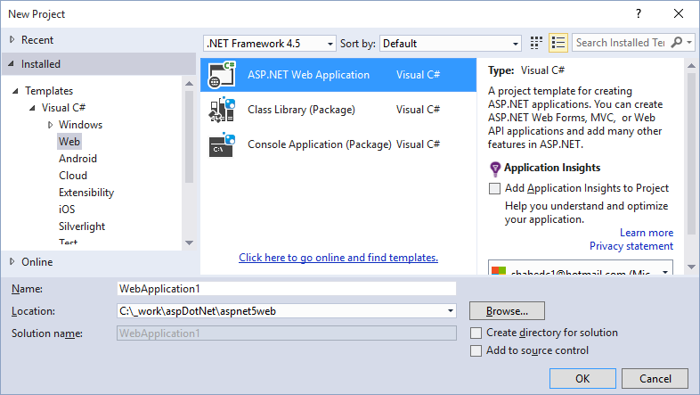
File → New Project → Web
Web App
Class Library
Console App

Slide 37
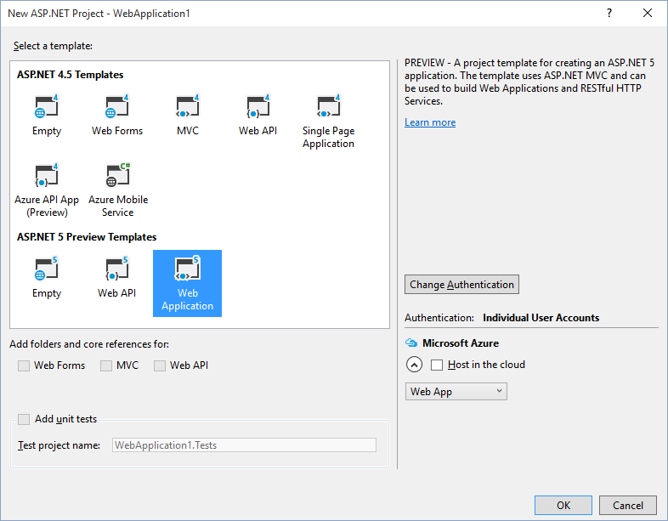
Select a Template

Slide 38
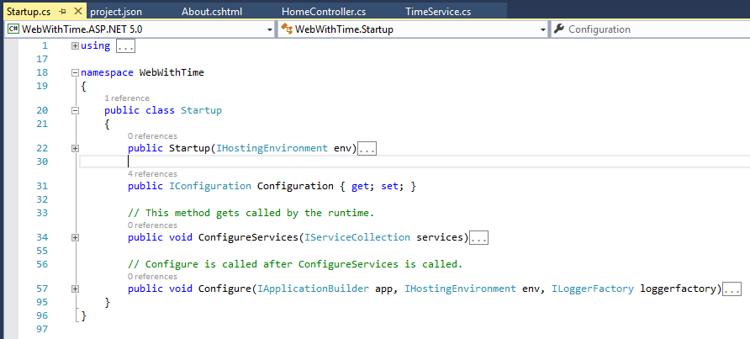
Startup.cs Configuration

Slide 39
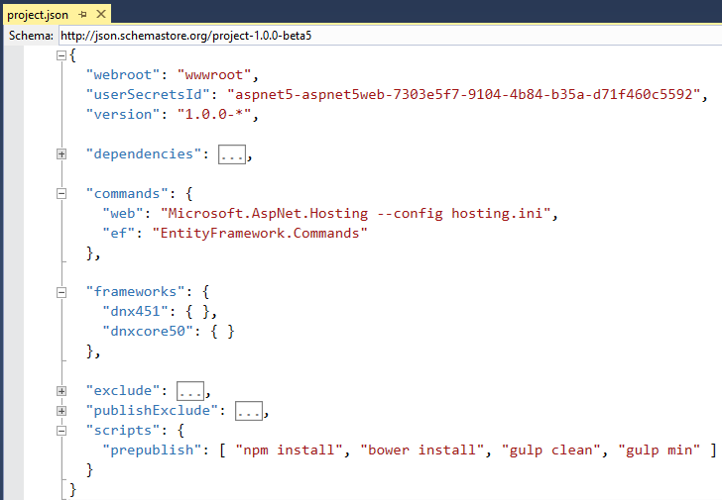
project.json
packages.config
not needed!

Slide 40
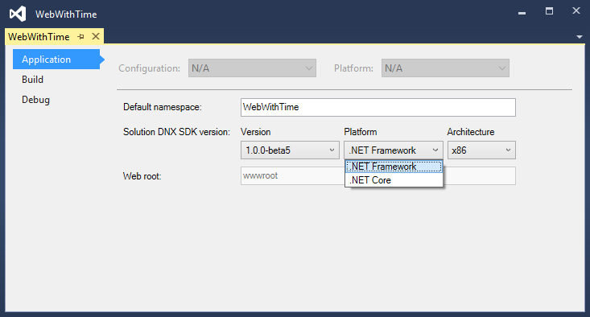
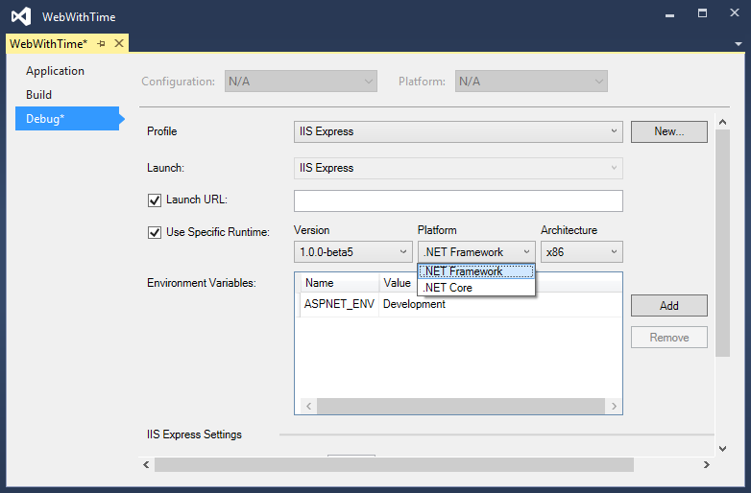
Right-click → (Project) Properties
Application tab
Debug tab
Use specific KRE/DNX version!

Slide 41
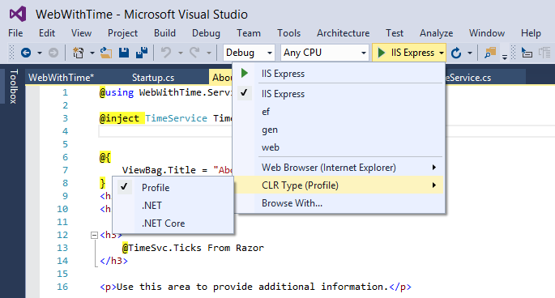
Choose CLR Type While Debugging

Slide 42
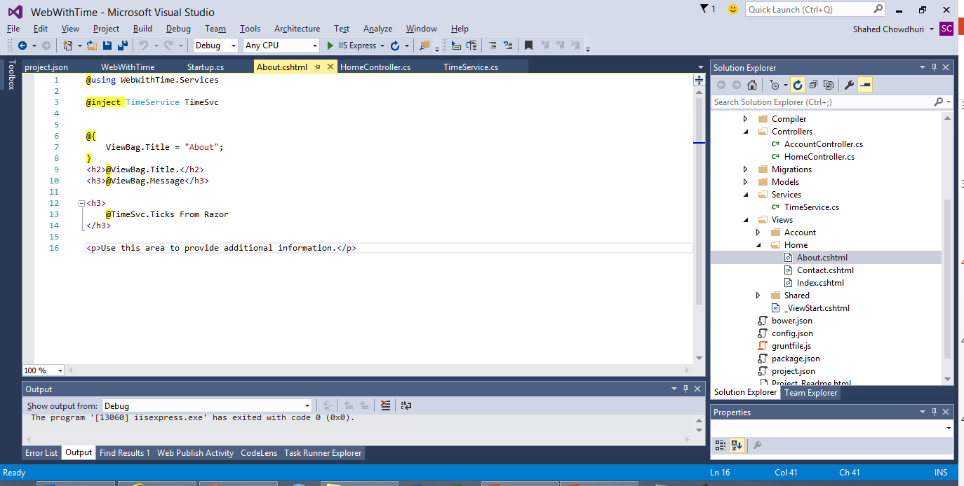
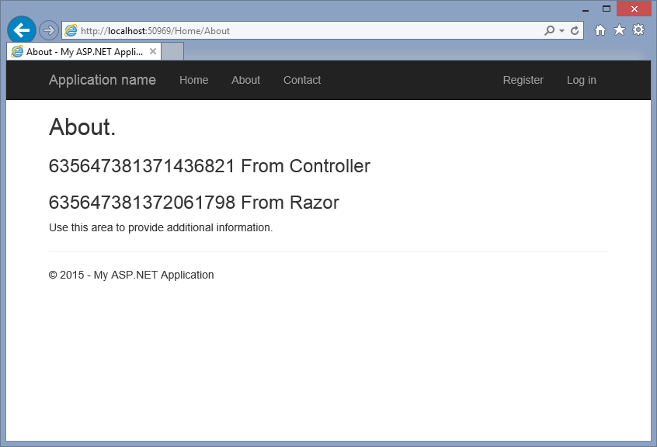
DEMO

Slide 43
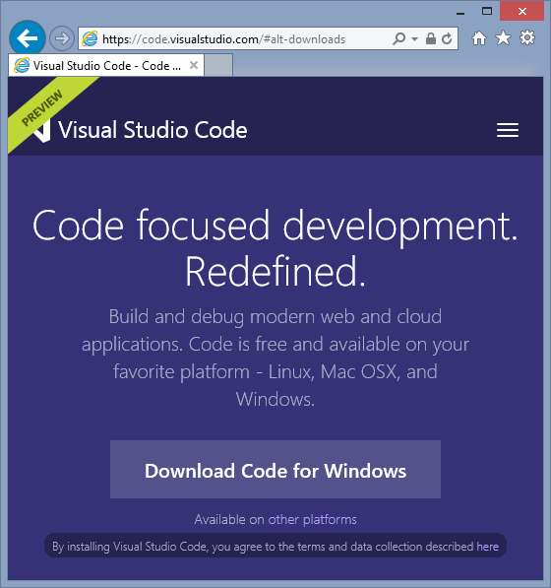
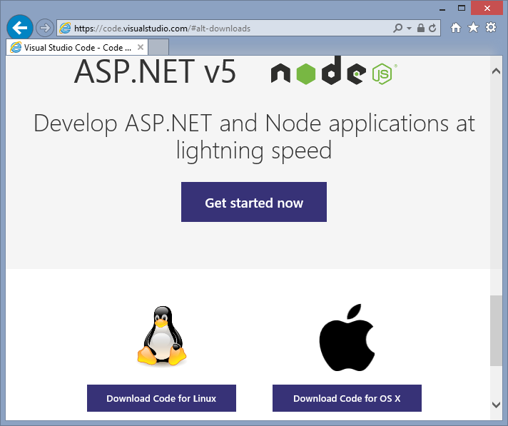
Visual Studio Code: Preview
Download: https://code.visualstudio.com/

Slide 44
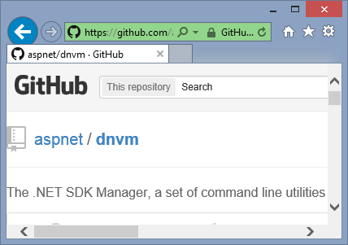
.NET Version Manager (DNVM)
https://github.com/aspnet/dnvm/
.NET SDK Version Manager
Formerly KVM
Get list of DNXs (aka KRE)

Slide 45
References
ASP.NET vNext: http://asp.net/vnext
Intro: https://weblogs.asp.net/scottgu/introducing-asp-net-5
Feb 2015 Updates: http://blogs.msdn.com/b/webdev/archive/2015/02/23/aspnet-5-updates-for-feb-2015.aspx
dotnetConf March 2015: https://channel9.msdn.com/Events/dotnetConf/2015
Build 2015: https://channel9.msdn.com/Events/Build/2015
Understanding .NET 2015: http://blogs.msdn.com/b/bethmassi/archive/2015/02/25/understanding-net-2015.aspx
Grunt & Bower: http://www.asp.net/vnext/overview/aspnet-vnext/grunt-and-bower-in-visual-studio-2015
Tutorial: http://www.asp.net/vnext/overview/aspnet-vnext/vc
Additional Tutorials: See Starter Web Project Template

Slide 46
Other Resources
ASP.NET Identity: http://www.asp.net/identity/overview/getting-started/introduction-to-aspnet-identity
KRE, KVM, KPM: http://gunnarpeipman.com/2014/10/asp-net-5-what-are-kre-kvm-kpm/
Grunt, JS Task Runner: http://gruntjs.com/
Gulp, Workflow Automation: http://gulpjs.com/
Bower, Package Manager: http://bower.io/
npm, Node Package Manager: https://www.npmjs.com/

Slide 47
Agenda
Introduction
> .NET (Framework & Core)
> ASP.NET 5.0
> VS2015 Preview
Q&A
Notes:
Agenda

Slide 48
Q & A
Notes:
Additional Topics

Slide 49
Agenda
Introduction
> .NET (Framework & Core)
> ASP.NET 5.0
> VS2015 Preview
Q&A
Notes:
Agenda

Slide 50
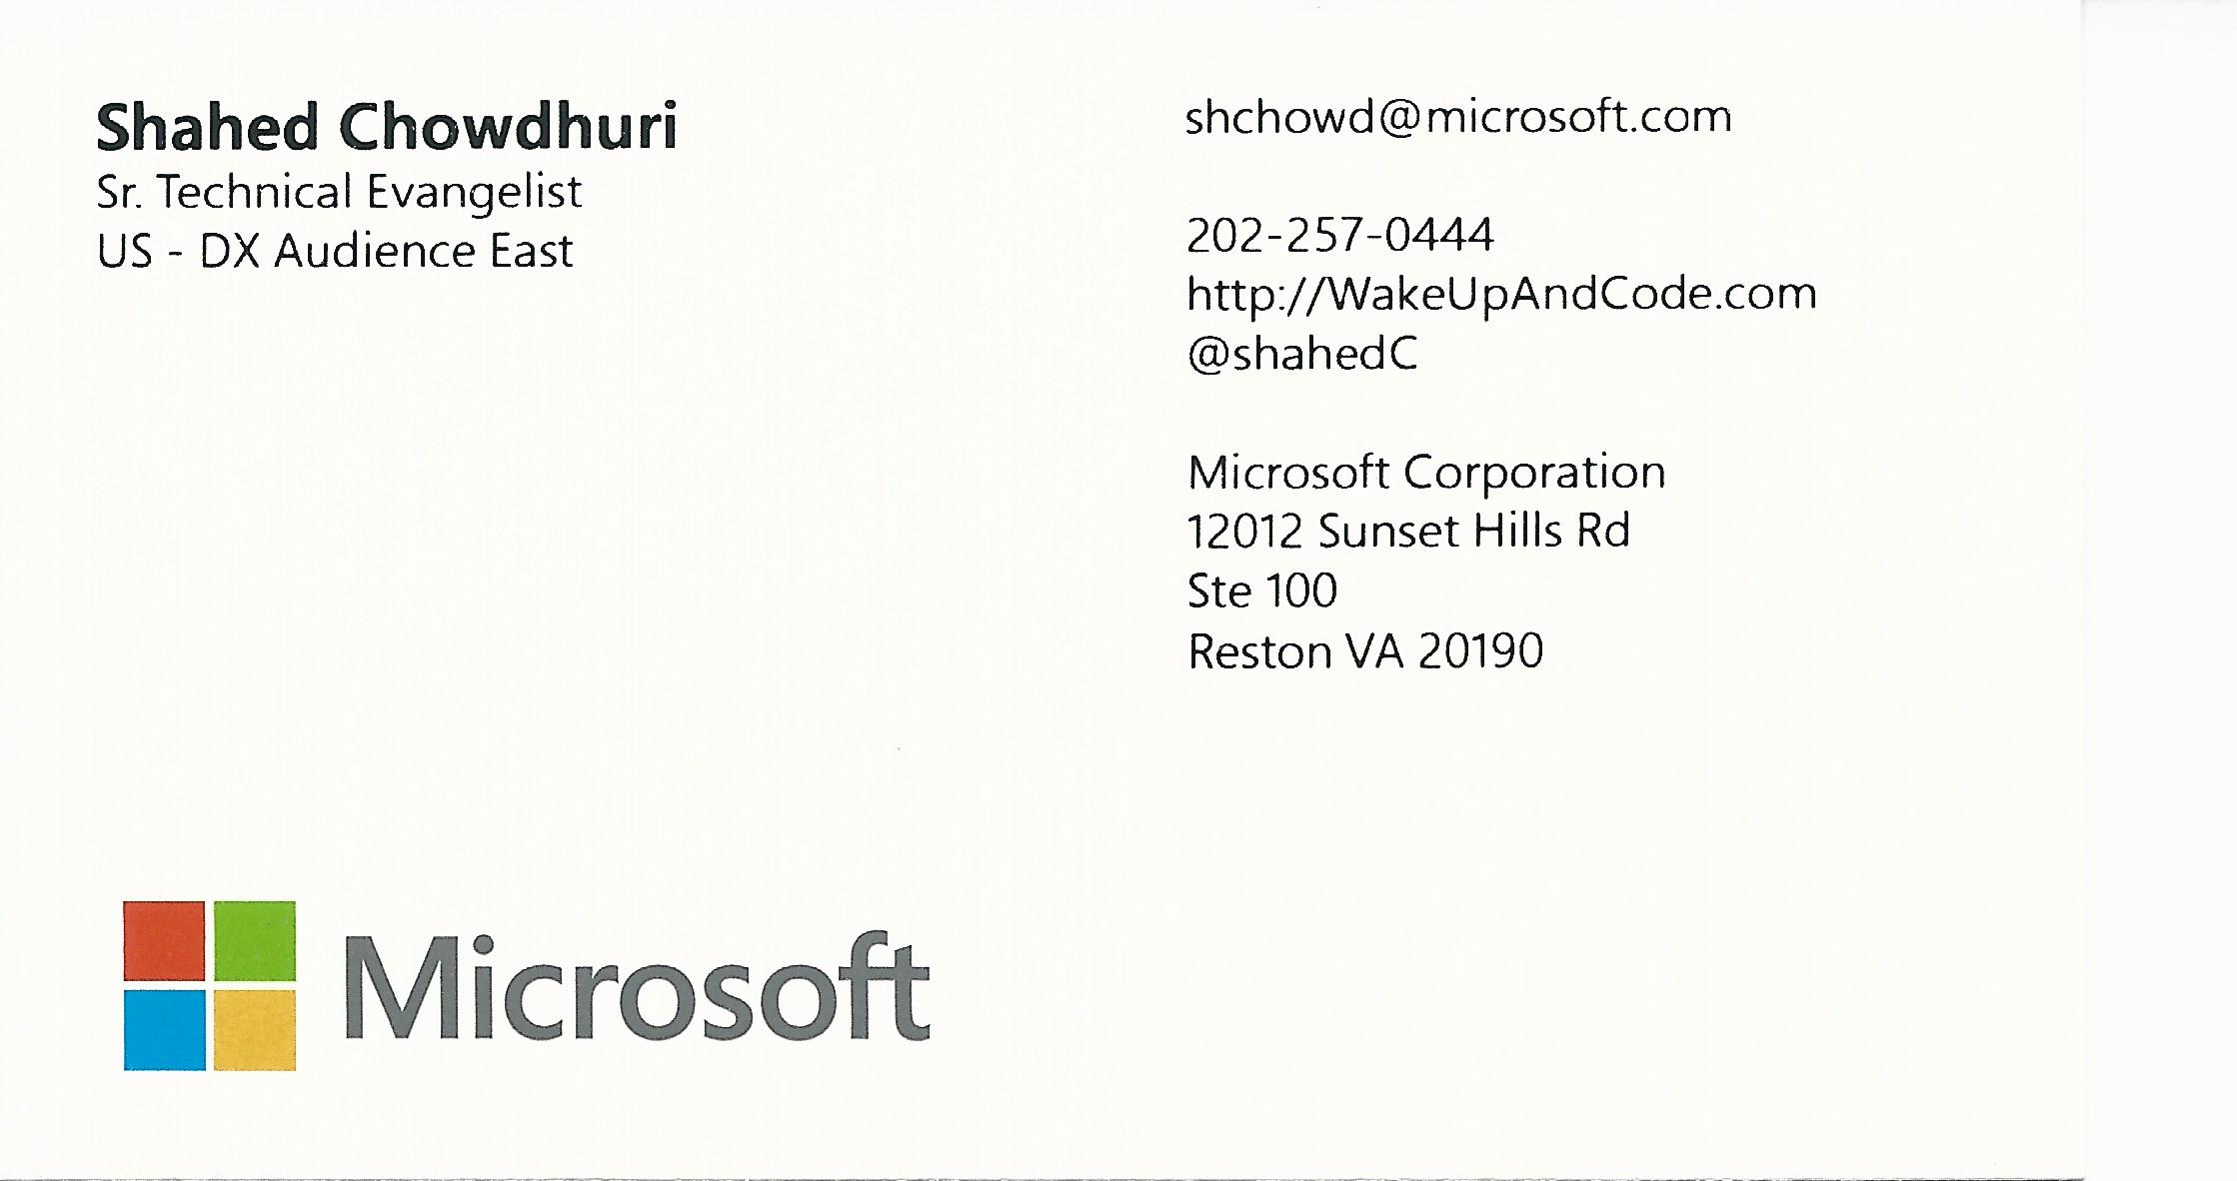
Contact
Email: shchowd@microsoft.com  Twitter: @shahedC
Notes:
Contact
Microsoft email: shchowd@microsoft.com
Personal Twitter: @shahedC
Dev Blog: WakeUpAndCode.com

