Slide 1
ASP .NET 5 & Unit Testing
Build Robust Web Apps in the Real World
By Shahed Chowdhuri
Sr. Technical Evangelist
WakeUpAndCode.com
@shahedC
Notes:
Title Page: ASP .NET & Unit Testing Build Robust Web Apps in the Real World
By Shahed Chowdhuri
Senior Technical Evangelist @ Microsoft
Blog: WakeUpAndCode.com
Twitter: @shahedC

Slide 2
Session Objectives And Takeaways
Session Objective(s):
Explain why you would need unit tests
Plan a more robust software architecture
Implement unit testing for your web apps
Unit tests provide the confidence needed to add new features to software while minimizing bugs
Not having any unit tests will actually cost you more in the long run

Slide 3
Agenda
Why Unit Testing?
> Getting Started
> Writing and Running Tests
> Mocking
What’s Next?
Notes:
Agenda

Slide 4
Why Unit Testing?
Notes:
Introduction

Slide 5
Manual Testing
> Nothing new to learn
> Error-prone
> Expensive
> Slower

Slide 6
Automated Testing
> Less human error
> Faster!
> Decreasing costs
> Learning curve

Slide 7
Legacy
Refactor
Restructure
New/
Improved
Design Patterns
S.O.L.I.D.
TDD
SRP
OCP
LSP
ISP
DIP

Slide 8
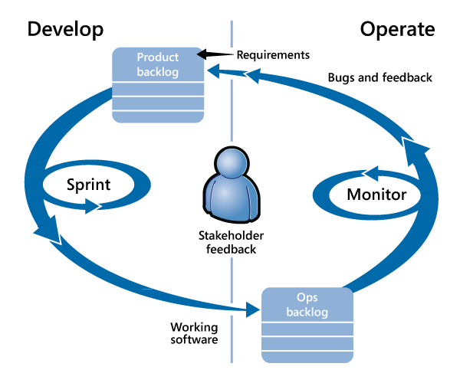
Continuous Integration with Agile/Scrum
Source: https://msdn.microsoft.com/en-us/library/jj159342.aspx

Slide 9
Agenda
Why Unit Testing?
> Getting Started
> Writing and Running Tests
> Mocking
What’s Next?
Notes:
Agenda

Slide 10
Getting Started
Notes:
Introduction

Slide 11
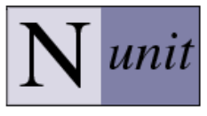
Unit Testing Frameworks

Slide 12
Types of Automated Tests
Unit Tests
Integration Tests
UI Tests

Slide 13
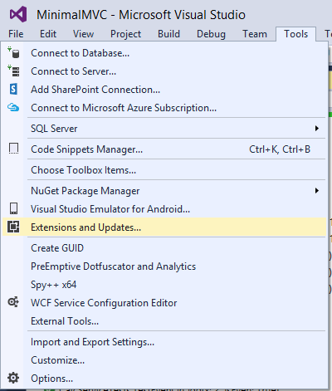
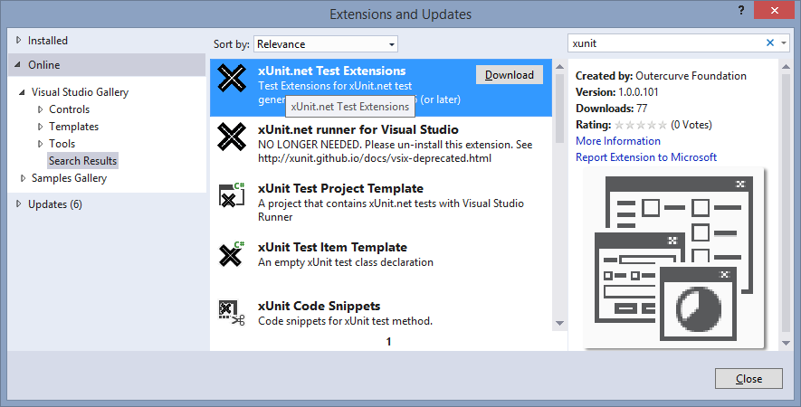
xUnit.net Test Extensions
Click Tools → Extensions and Updates
Search for xunit and install it

Slide 14
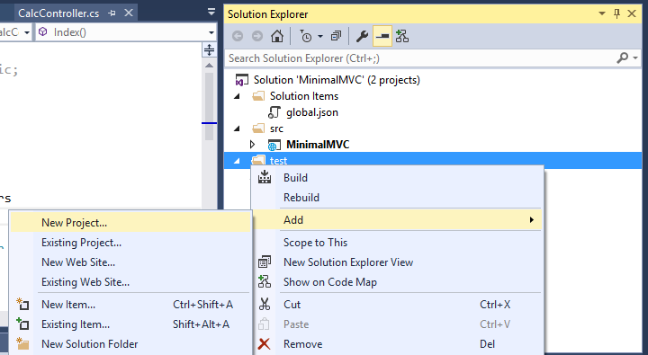
Test Project
In Solution Explorer:
Create “test” folder
Right-click “test”
Click Add
Click New Project

Slide 15
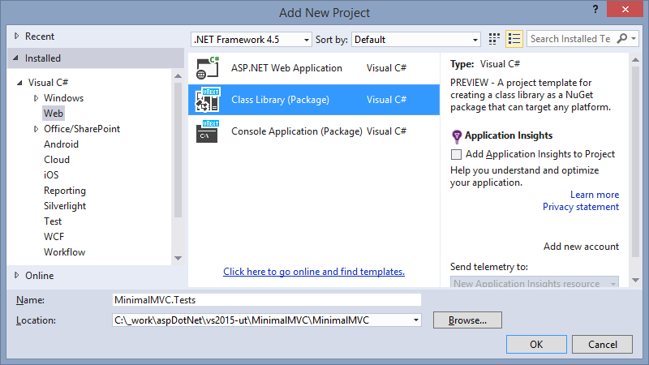
Add New Project
Select Class Library
under Visual C#

Slide 16
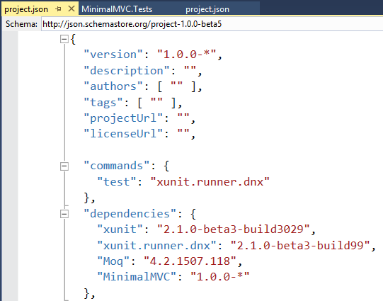
xUnit.net Config (Test Project)

Slide 17
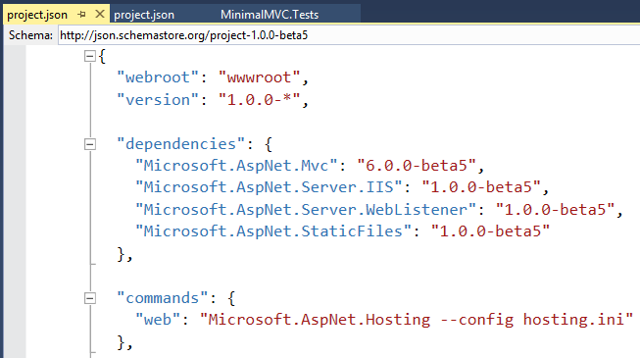
xUnit.net Config (App Project)

Slide 18
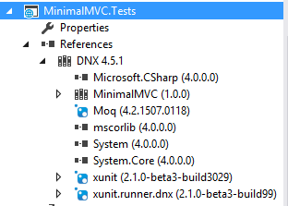
References in Test Project
Web App being tested
xUnit.net references

Slide 19
Writing and Running Tests
Notes:
Introduction

Slide 20
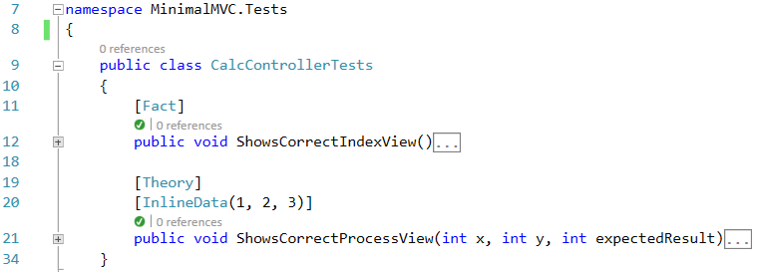
Test Class Attributes
public test class
[Fact] for public methods without parameters
[Theory] and [InlineData] for methods with parameters

Slide 21
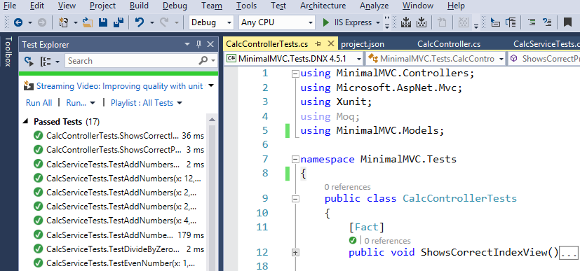
Test Explorer
Build Solution
Run Tests in Test Explorer

Slide 22
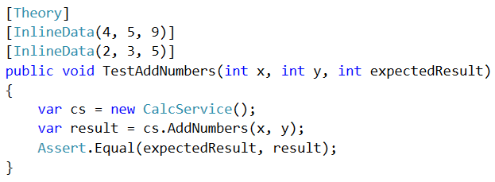
Assert.Equal( ) for Returned Values
Note “var” keyword
Verify actual result against expected result

Slide 23
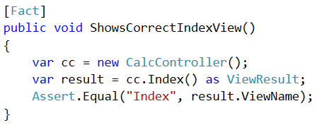
Assert.Equal( ) for View Names
Verify that expected view equal to returned view

Slide 24
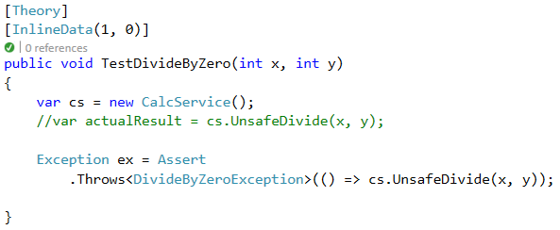
Assert.Throws<Exception>()

Slide 25
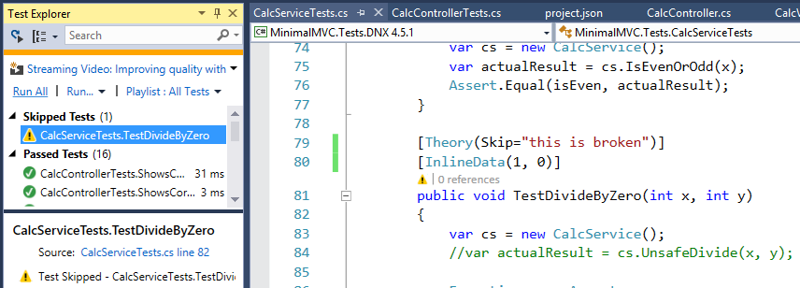
Theory/Fact(Skip=“Reason”)]
Temporarily ignore tests with an optional message.

Slide 26
Testing Your Controllers
Correct Views?
Redirect to URL?
Correct Models?
HTTP Code?
Mock Depen-
dencies!
Model Populated?

Slide 27
Mocking
Notes:
Introduction

Slide 28
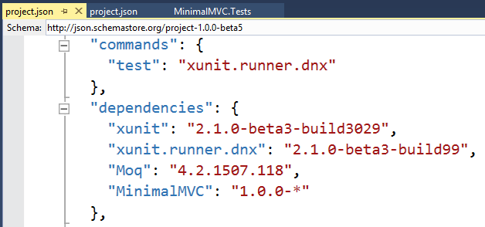
Moq Config

Slide 29
Moq Reference (Test Project)

Slide 30
Mocking Terms
Mocks
Pre-programmed with expected results, doesn’t actually connect to DB, behavior verification.
Fakes
Working examples, but not production-ready
(e..g in-memory database)
Stubs
Provides canned answers
Reference: http://martinfowler.com/articles/mocksArentStubs.html

Slide 31
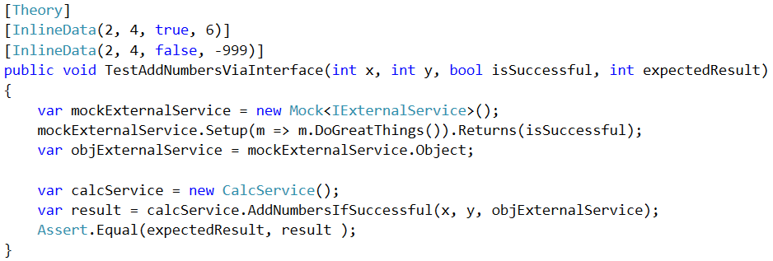
Mocking Example
HINT: Use mock.Object to get mocked object.

Slide 32
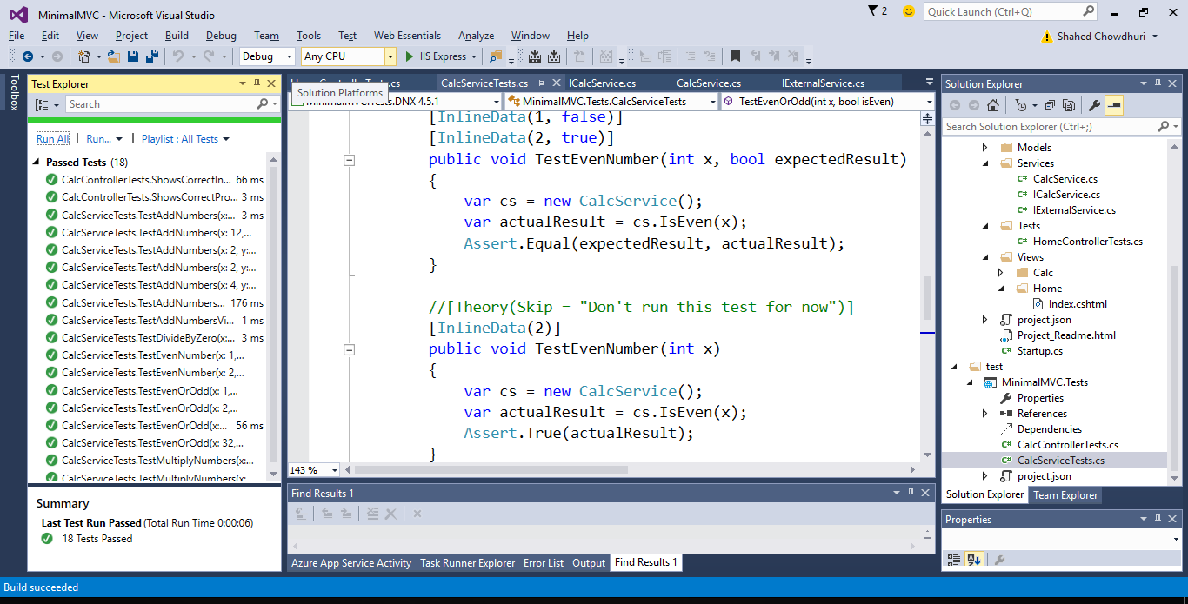
Demo

Slide 33
What’s Next?
Notes:
Introduction

Slide 34
What About Human Testers?
Smoke Tests
New Features
Edge Cases

Slide 35
Cost of Unit Tests
Cost of Adding Unit Tests
Cost of Not Having Unit Tests
less
Bugs
more
more
Features
no confidence, no time!
reduced
Expenses
piling up

Slide 36
Decouple Your Dependencies
Inversion of Control
Dependency
Injection

Slide 37
Improve Your Software Architecture
Views & ViewModels
Controllers
SQL Server (database)
Service Layer
Repository Layer
Entity Framework (ORM)

Slide 38
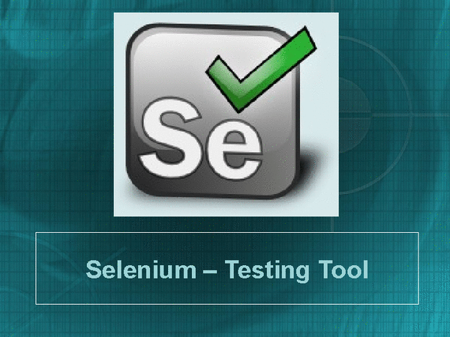
Functional UI Testing

Slide 39
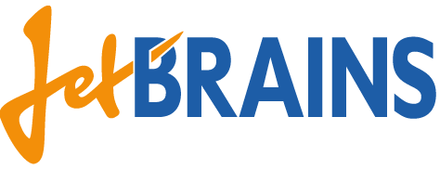
Code Coverage and Continuous Integration
60 to 80% coverage ok?

Slide 40
In Review: Session Objectives And Takeaways
Session Objective(s):
Explain why you would need unit tests
Plan a more robust software architecture
Implement unit testing for your web apps
Unit tests provide the confidence needed to add new features to software while minimizing bugs
Not having any unit tests will actually cost you more in the long run

Slide 41
Agenda
Why Unit Testing?
> Getting Started
> Writing and Running Tests
> Mocking
What’s Next?
Notes:
Agenda

Slide 42
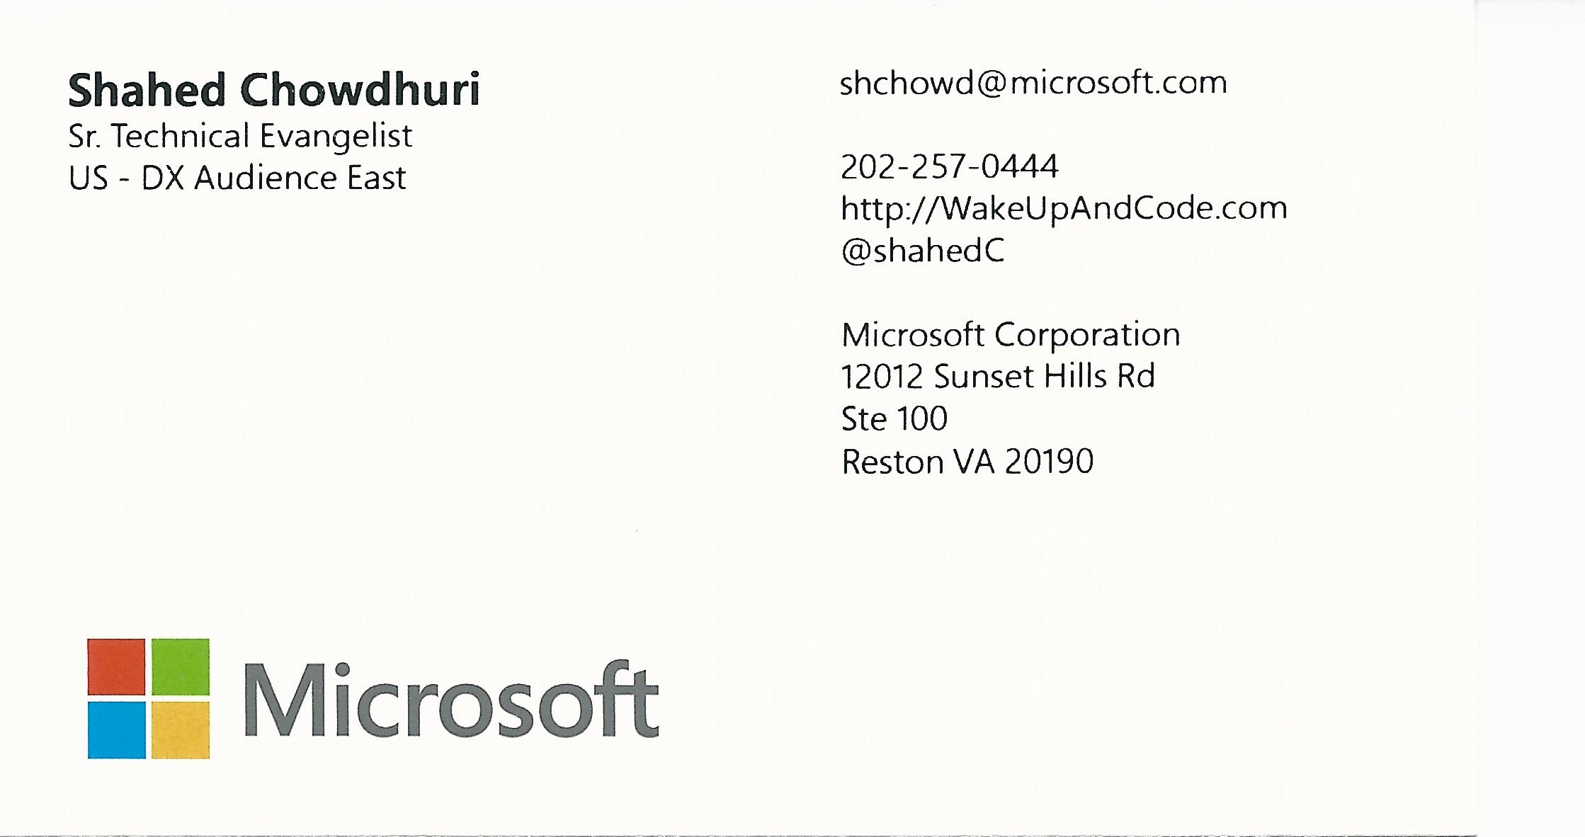
Contact
Email: shchowd@microsoft.com  Twitter: @shahedC
Notes:
Contact
Microsoft email: shchowd@microsoft.com
Personal Twitter: @shahedC
Dev Blog: WakeUpAndCode.com

