Slide 1
ASP.NET Core*
A Quick Overview of ASP.NET Core
Shahed Chowdhuri
Sr. Technical Evangelist @ Microsoft
@shahedC
WakeUpAndCode.com
* aka ASP.NET 5 before RC1

Slide 2
Evolution of ASP and ASP .NET
Active Server Pages
(Classic ASP)
Active Server Pages
(Classic ASP)
ASP.NET
MVC
1/2/3/4/5
ASP.NET
MVC
1/2/3/4/5
ASP.NET
MVC 6
Unified MVC, Web API and Web Pages
ASP.NET
(Web Forms)
ASP.NET
MVC 6
Core MVC
Unified MVC, Web API and Web Pages
ASP.NET
(Web Forms)
ASP.NET
Web Pages
ASP.NET
Web Pages
ASP.NET
Web API
ASP.NET
Web API

Slide 3
Names & Version Numbers
ASP.NET
MVC 6
C# 6.0
ASP.NET
MVC 6
Core MVC
C# 6.0
ASP.NET 5
(runs on .NET Core 5 or .NET Framework 4.5.2+)
ASP.NET 5 Core 1.0
(runs on .NET Core 5 1.0
or .NET Framework 4.5.2+)
SignalR 3
SignalR 3
.NET Framework 4.6
.NET Core 5
.NET Core 1.0
.NET Framework 4.6
.NET Core 5

Slide 4
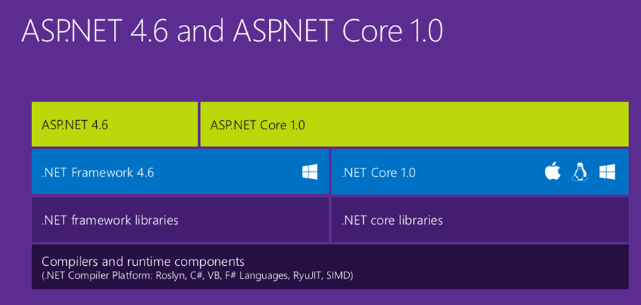
ASP.NET Core High-Level Overview

Slide 5
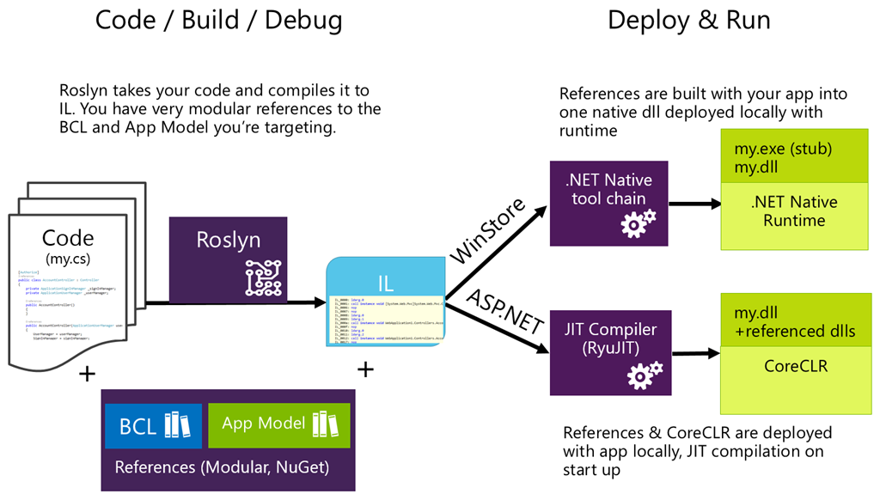
Compilation Process

Slide 6
What About .NET Framework 4.6?

Slide 7
How about Entity Framework?
Entities in Code
ORM
DB

Slide 8
ASP.NET Core*
MVC and Web API
Shahed Chowdhuri
Sr. Technical Evangelist @ Microsoft
@shahedC
WakeUpAndCode.com
* aka ASP.NET 5 before RC1

Slide 9
Agenda
ASP.NET Architecture
Model-View-Controller
ASP.NET MVC Web Project
Tag Helpers in Views
ASP.NET Web API Project
Consuming Web API
JavaScript Frameworks

Slide 10
ASP .NET Architecture
Sites
Services
Web Forms
MVC + Web Pages + Web API
SignalR
ASP.NET

Slide 11
Model-View-Controller
Request
Controller
Update
Update
View
Model
Get Data From

Slide 12
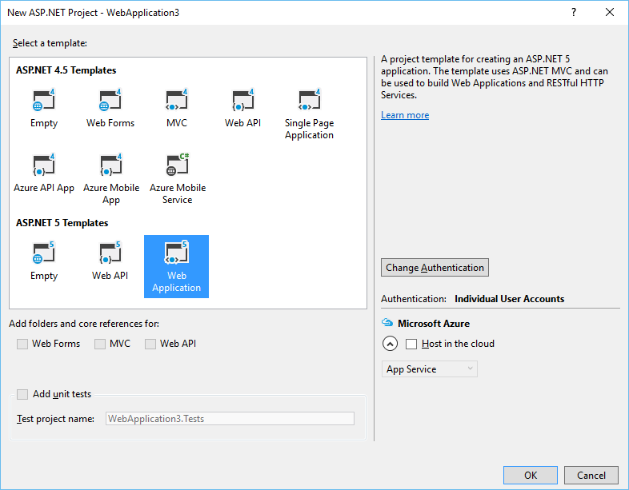
ASP.NET MVC Web Project Template*
* Subject to rename with the release of RC2

Slide 13
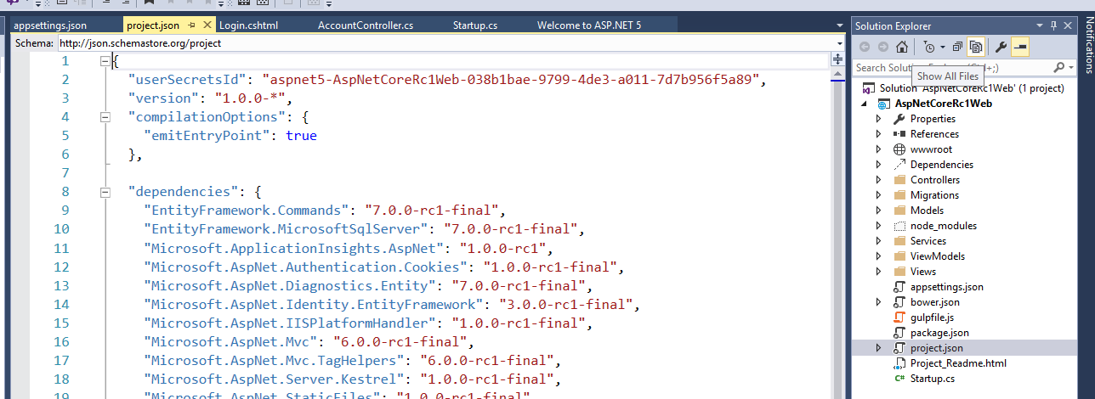
Project Files and Configuration

Slide 14
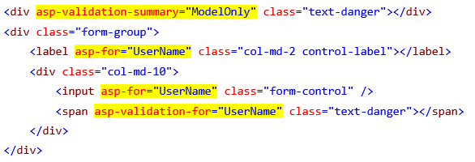
Tag Helpers: Evolution of HTML Forms

Slide 15
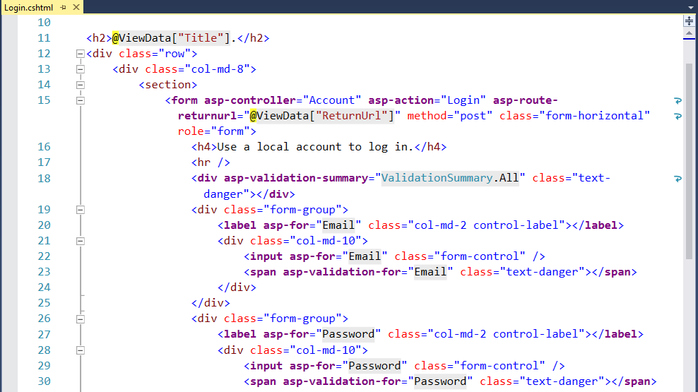
Tag Helpers in Views

Slide 16
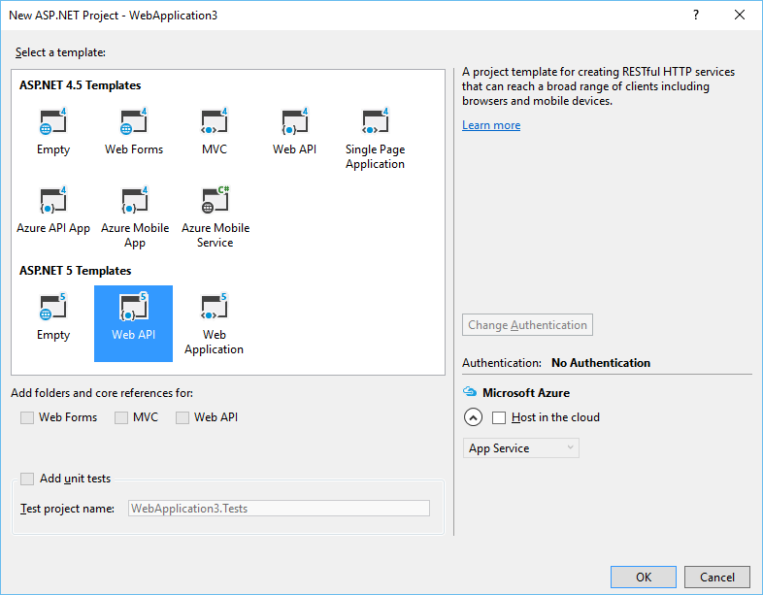
ASP.NET Web API Project Template*
* Subject to rename with the release of RC2

Slide 17
Consuming Web APIs
Web API
MVC App
HTML5 App
Mobile App

Slide 18
JavaScript Frameworks
https://docs.asp.net/en/latest/client-side/knockout.html
https://docs.asp.net/en/latest/client-side/angular.html

Slide 19
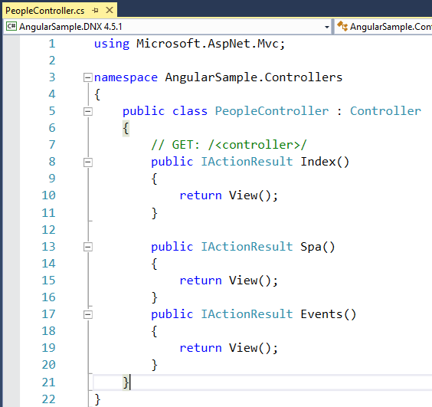
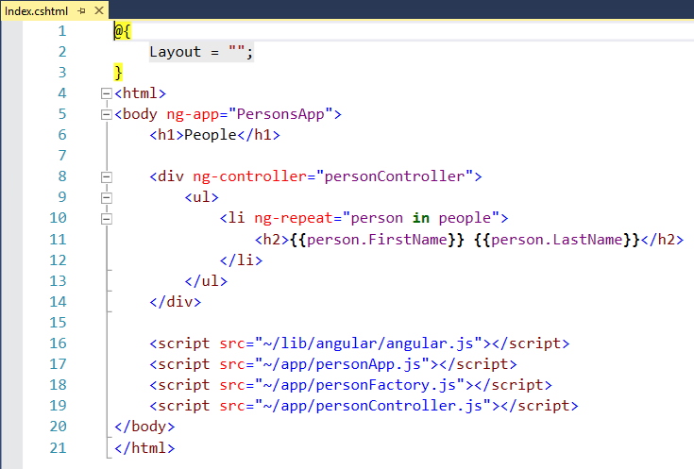
Controller -> View -> Web API
https://github.com/aspnet/Docs/tree/master/aspnet/client-side/angular/sample/AngularSample

Slide 20
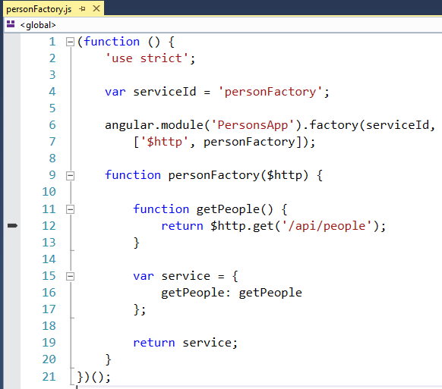
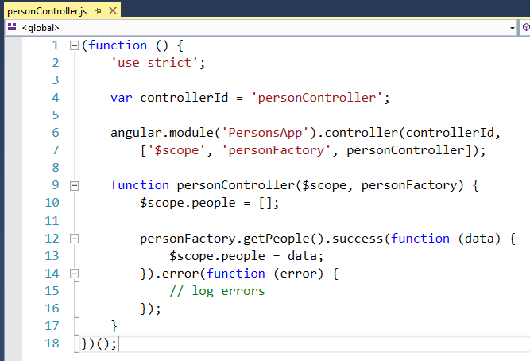
Angular App

Slide 21
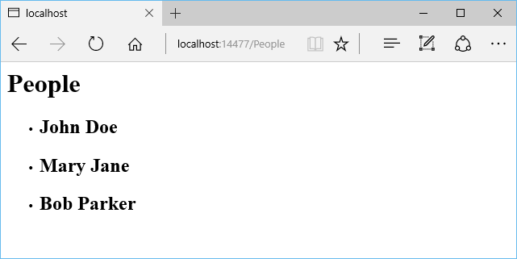
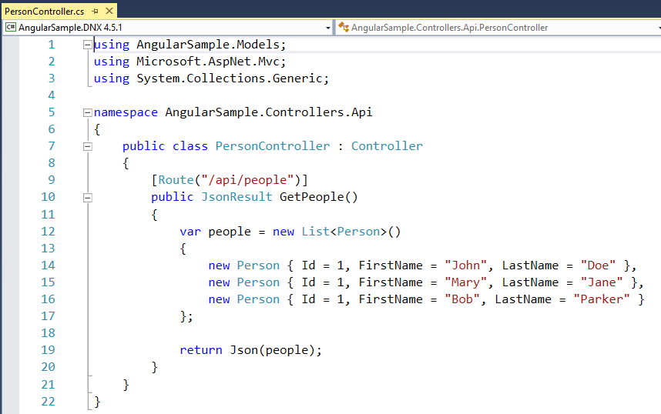
Web API Controller

Slide 22
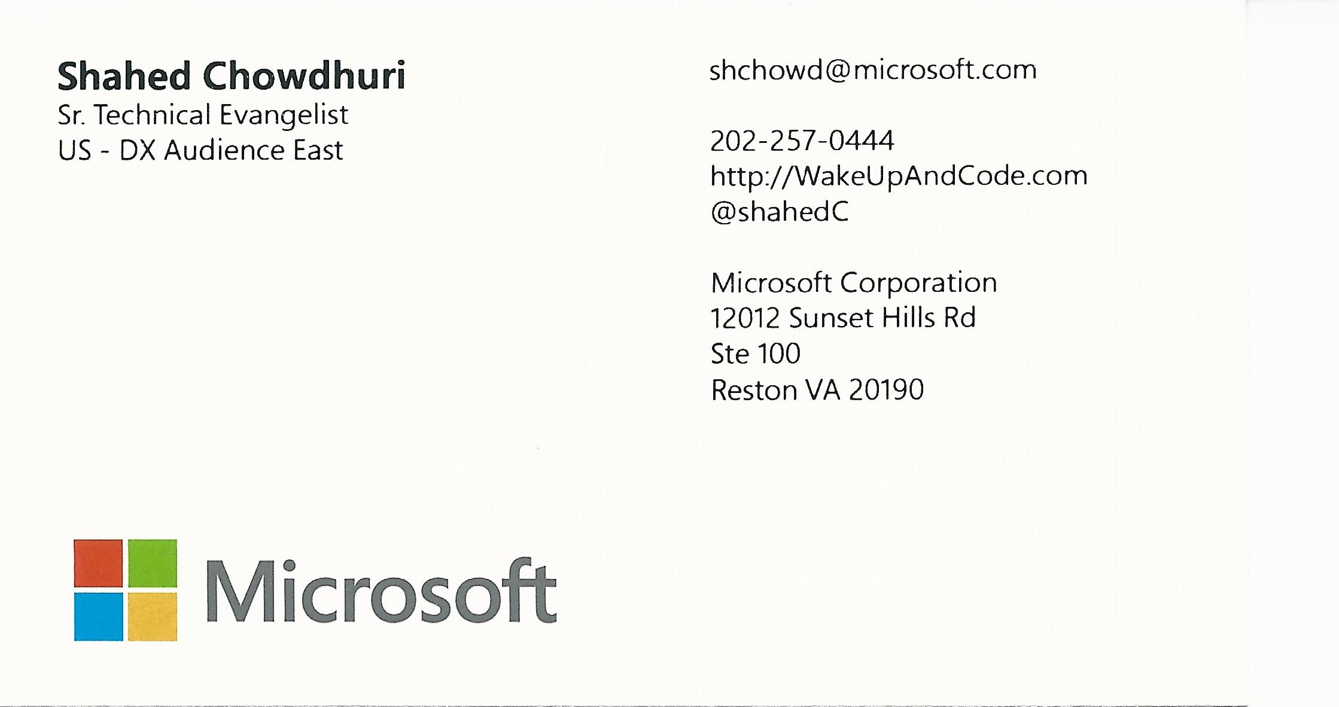
Email: shchowd@microsoft.com  Twitter: @shahedC
Notes:
Contact
Microsoft email: shchowd@microsoft.com
Personal Twitter: @shahedC
Dev Blog: WakeUpAndCode.com

