Slide 1
ASP.NET Core*
A Quick Overview of ASP.NET Core RC2
Shahed Chowdhuri
Sr. Technical Evangelist @ Microsoft
@shahedC
WakeUpAndCode.com
* aka ASP.NET 5 before RC1

Slide 2
Evolution of ASP and ASP .NET
Active Server Pages
(Classic ASP)
Active Server Pages
(Classic ASP)
ASP.NET
MVC
1/2/3/4/5
ASP.NET
MVC
1/2/3/4/5
ASP.NET
MVC 6
Unified MVC, Web API and Web Pages
ASP.NET
(Web Forms)
ASP.NET
MVC 6
Core MVC
Unified MVC, Web API and Web Pages
ASP.NET
(Web Forms)
ASP.NET
Web Pages
ASP.NET
Web Pages
ASP.NET
Web API
ASP.NET
Web API

Slide 3
Names & Version Numbers
ASP.NET
MVC 6
C# 6.0
ASP.NET
MVC 6
Core MVC
C# 6.0
ASP.NET 5
(runs on .NET Core 5 or .NET Framework 4.5.2+)
ASP.NET 5 Core 1.0
(runs on .NET Core 5 1.0
or .NET Framework 4.5.2+)
SignalR 3
SignalR 3
.NET Framework 4.6
.NET Core 5
.NET Core 1.0
.NET Framework 4.6
.NET Core 5

Slide 4
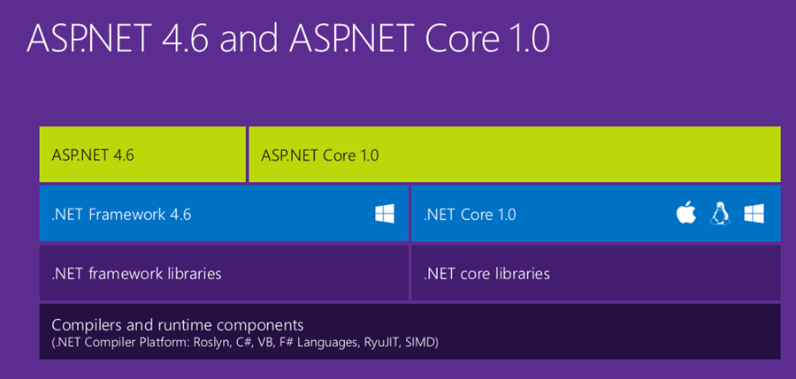
ASP.NET Core High-Level Overview

Slide 5
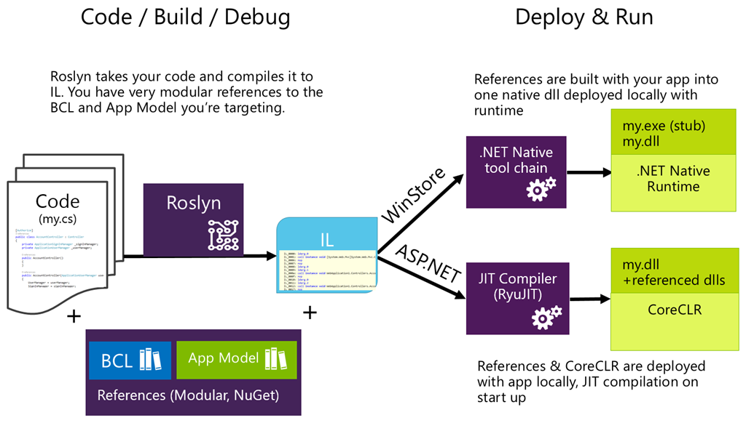
Compilation Process

Slide 6
What About .NET Framework 4.6?

Slide 7
How about Entity Framework?
Entities in Code
Core
ORM
)
DB

Slide 8
ASP.NET Core*
MVC and Web API
Shahed Chowdhuri
Sr. Technical Evangelist @ Microsoft
@shahedC
WakeUpAndCode.com
* aka ASP.NET 5 before RC1

Slide 9
Agenda
ASP.NET Architecture
Model-View-Controller
ASP.NET MVC Web Project
Tag Helpers in Views
ASP.NET Web API Project
Consuming Web API
JavaScript Frameworks

Slide 10
ASP .NET Architecture
Sites
Services
Web Forms
MVC + Web Pages + Web API
SignalR
ASP.NET

Slide 11
Model-View-Controller
Request
Controller
Update
Update
View
Model
Get Data From

Slide 12
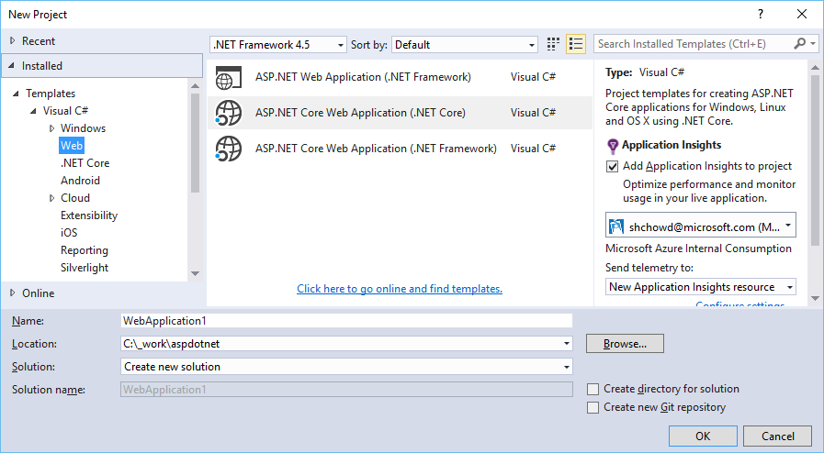
File → New Project → Web
Web App (4.x)
Core Web App (.NET Core)
Core Web App (.NET framework)

Slide 13
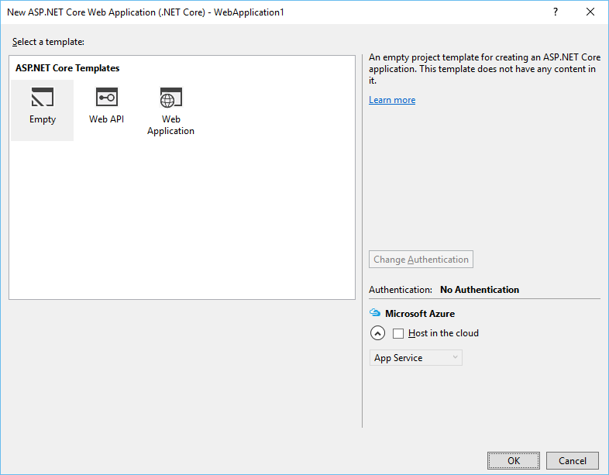
ASP.NET MVC Web Project Template
ASP. NET Core Templates
Empty
Web API
Web Application
* Subject t rename with the release of RC2

Slide 14
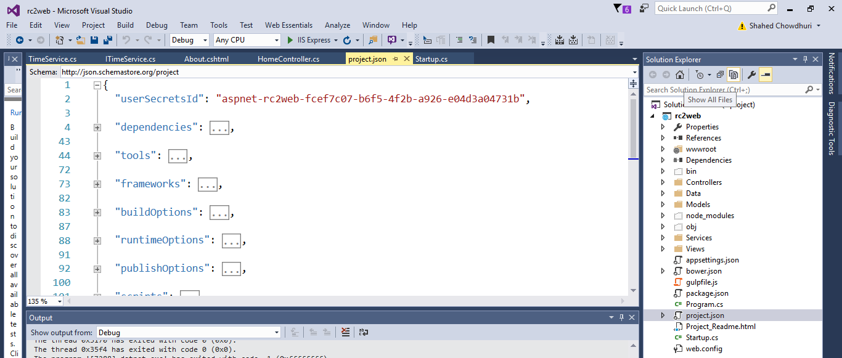
Project Files and Configuration

Slide 15
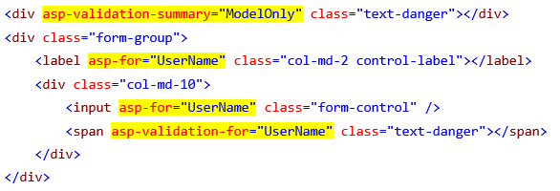
Tag Helpers: Evolution of HTML Forms

Slide 16
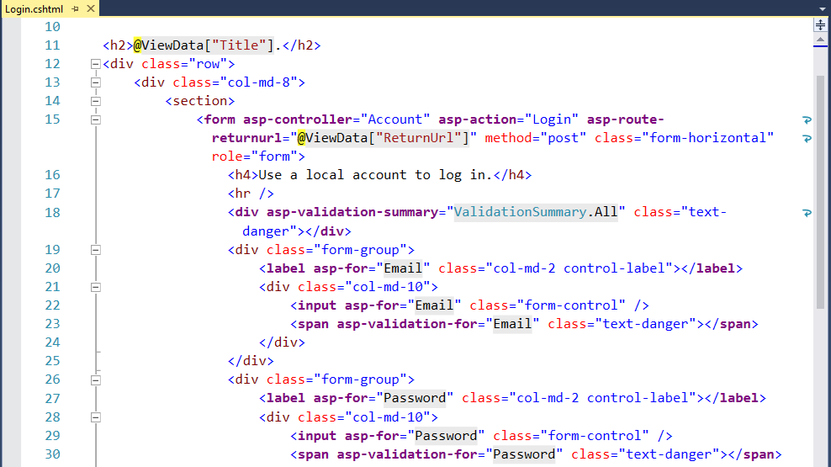
Tag Helpers in Views

Slide 17
ASP.NET Web API Project Template

Slide 18
Consuming Web APIs
Web API
MVC App
HTML5 App
Mobile App

Slide 19
JavaScript Frameworks
https://docs.asp.net/en/latest/client-side/knockout.html
https://docs.asp.net/en/latest/client-side/angular.html

Slide 20
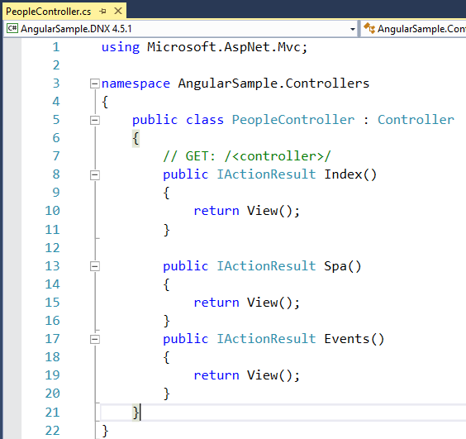
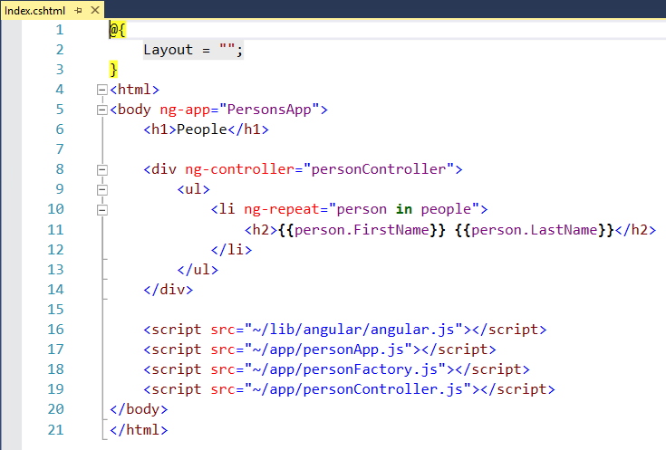
Controller -> View -> Web API
https://github.com/aspnet/Docs/tree/master/aspnet/client-side/angular/sample/AngularSample

Slide 21
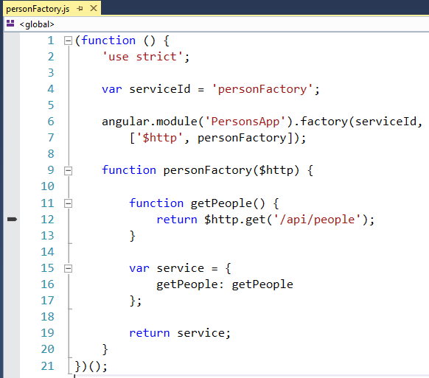
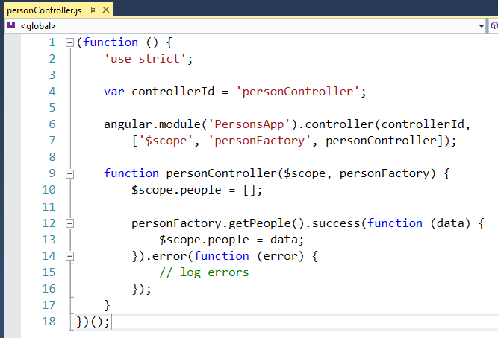
Angular App

Slide 22
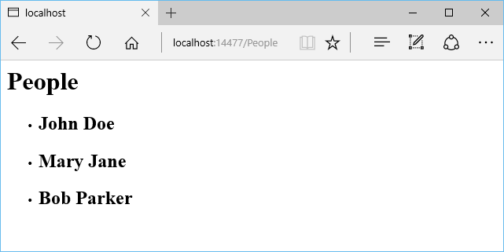
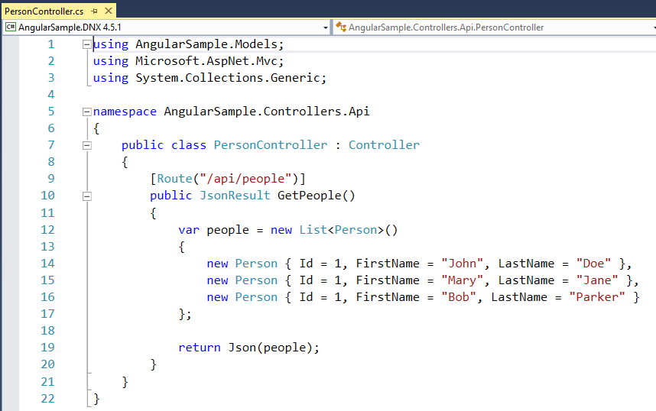
Web API Controller

Slide 23
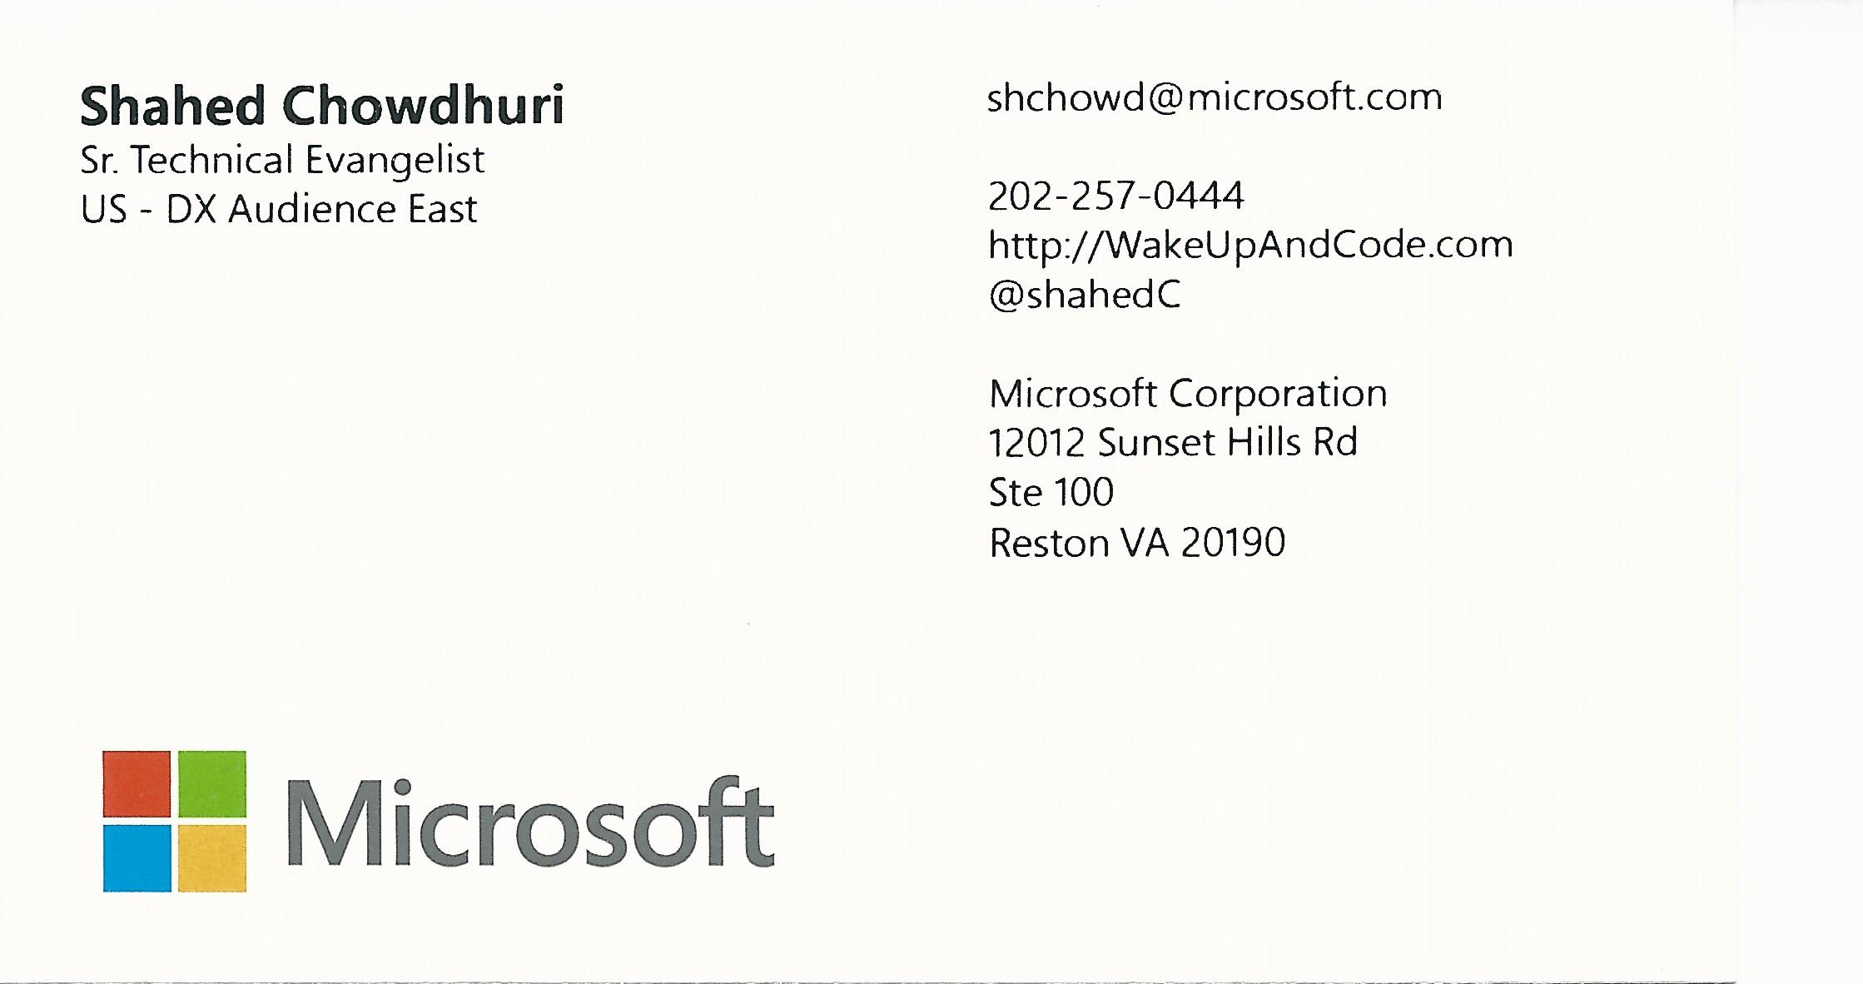
Email: shchowd@microsoft.com  Twitter: @shahedC
Notes:
Contact
Microsoft email: shchowd@microsoft.com
Personal Twitter: @shahedC
Dev Blog: WakeUpAndCode.com

