Slide 1
ASP.NET Core 2.1
Cross-Platform Web Apps
Shahed Chowdhuri
Sr. Technical Evangelist @ Microsoft
@shahedC
WakeUpAndCode.com

Slide 2
Agenda
Introduction
> .NET (Framework & Core)
> ASP.NET Core
> Visual Studio & VS Code
References + Wrap-up
Notes:
Agenda

Slide 3
Introduction
Notes:
Introduction

Slide 4
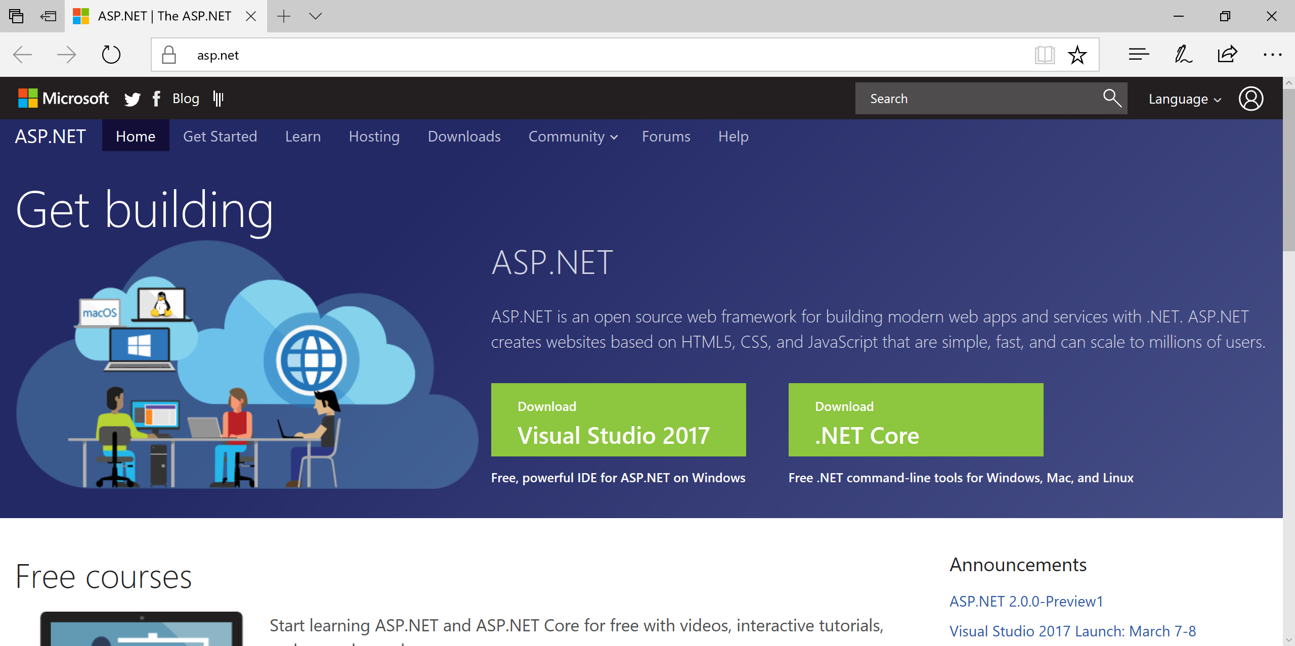
ASP.NET
Info and Downloads: http://www.asp.net/

Slide 5
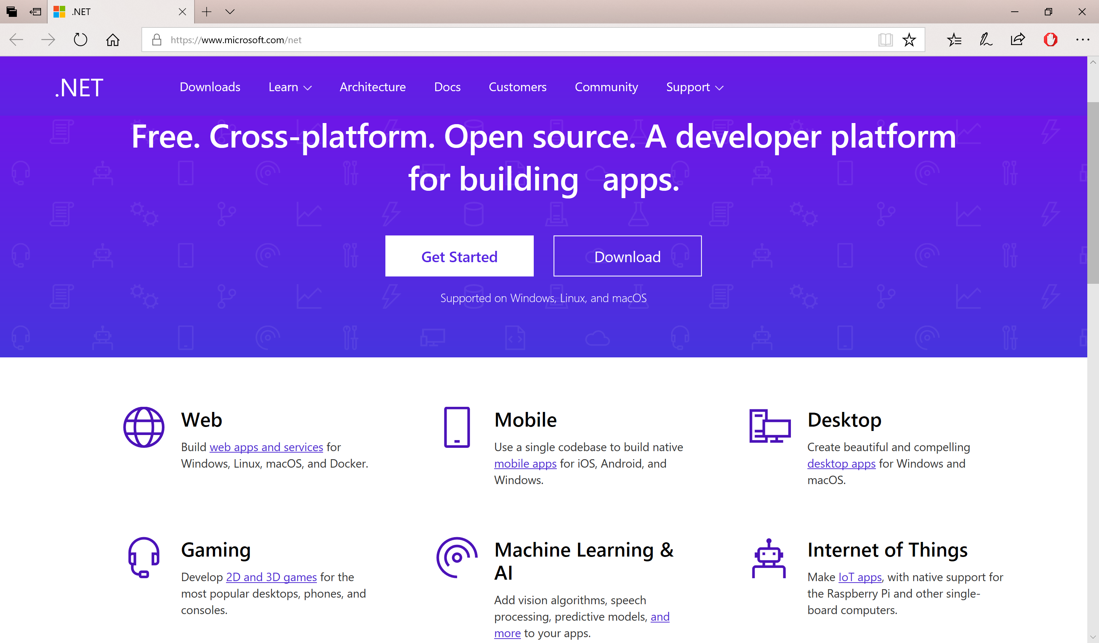
.NET for Cross-Platform Dev
.NET Info + Download: https://www.microsoft.com/net

Slide 6
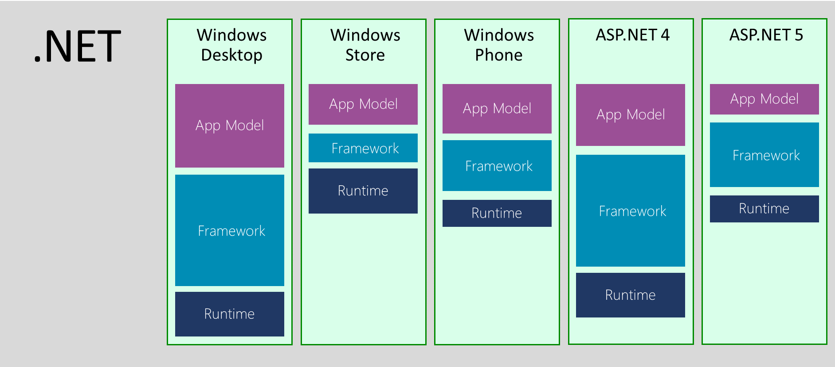
.NET Across Windows/Web Platforms
Source: http://blogs.msdn.com/b/dotnet/archive/2014/12/04/introducing-net-core.aspx

Slide 7


.NET Standard in 2017 and 2018
WINDOWS
DESKTOP
CLOUD MICROSERVICES
WINDOWS
UWP
IOS,
ANDROID
GAMES/
3D
Visual Studio
.NET STANDARD
Visual Studio for Mac
INFRASTRUCTURE
COMPILERS
LANGUAGES
RUNTIME COMPONENTS
Visual Studio Code
.NET Standard allows sharing code, binaries, and skills between .NET client,
server, and all flavors
.NET Standard provides a specification for any platform to implement
All .NET runtimes provided by Microsoft implement the standard

Slide 8
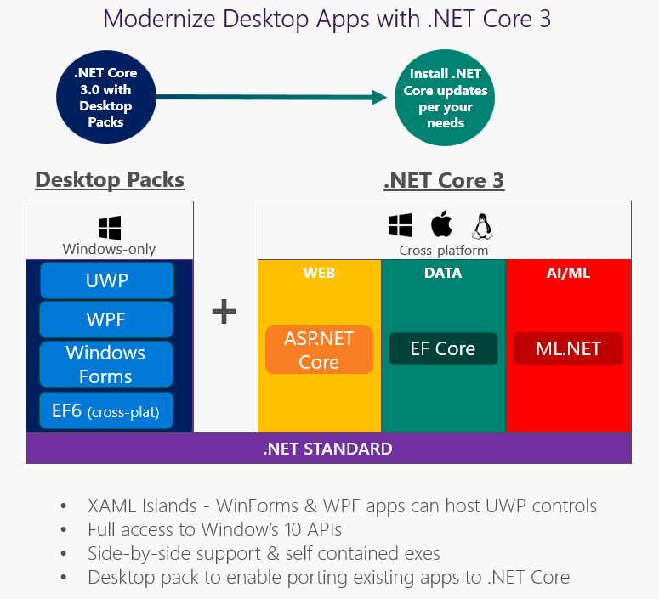
.NET 3.0 in 2019 and Beyond…
https://blogs.msdn.microsoft.com/dotnet/2018/05/07/net-core-3-and-support-for-windows-desktop-applications

Slide 9
Evolution of ASP and ASP .NET
Active Server Pages
(Classic ASP)
ASP.NET
(Web Forms)
ASP.NET
MVC
1/2/3/4/5
ASP.NET
Core MVC
Unified MVC, Web API and Razor Web Pages
ASP.NET
Web Pages
ASP.NET
Web API

Slide 10
Names & Version Numbers
C# 6.0
ASP.NET
Core MVC
C# 7.x
ASP.NET Core 2.x
(runs on .NET Core 2.x)
or .NET Framework 4.5.2+)
SignalR
.NET Framework 4.6
.NET Framework 4.7
.NET Core 2.x

Slide 11
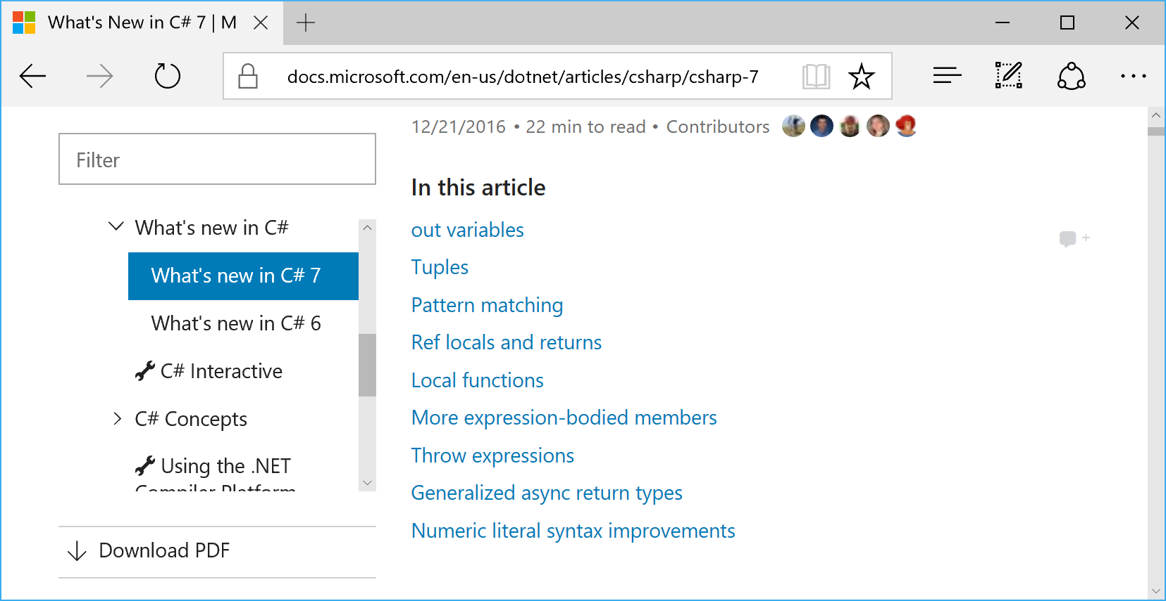
C# 7.x in VS2017
https://docs.microsoft.com/en-us/dotnet/csharp/whats-new/

Slide 12

Agenda
Introduction
> .NET (Framework & Core)
> ASP.NET Core
> Visual Studio & VS Code
References + Wrap-up
Notes:
Agenda

Slide 13
.NET Framework
& .NET Core
Notes:
Variables, Operators & Loops

Slide 14
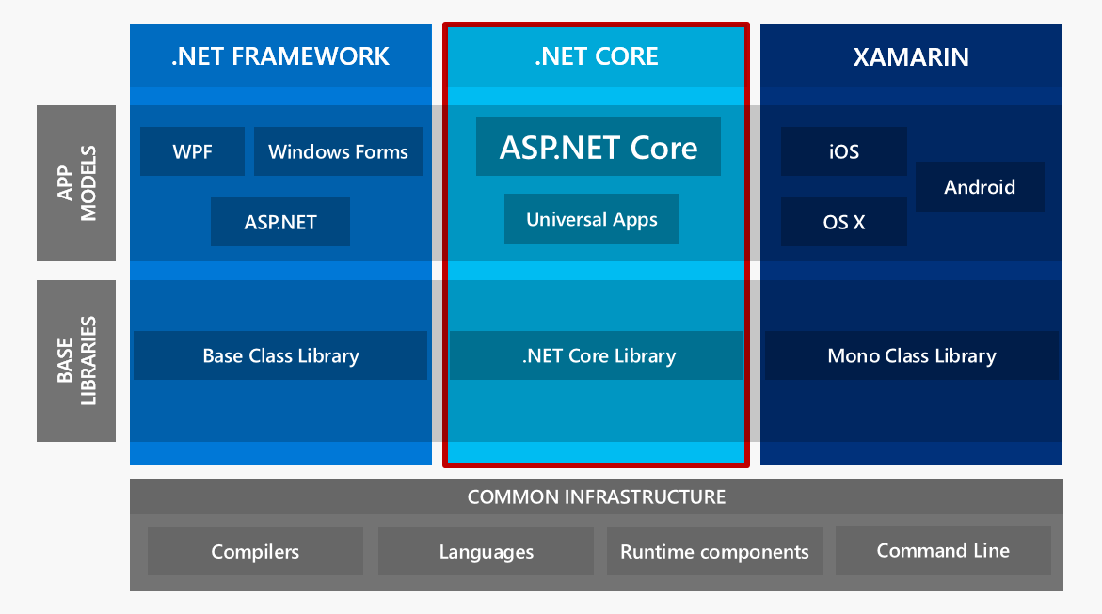
ASP.NET Core High-Level Overview

Slide 15
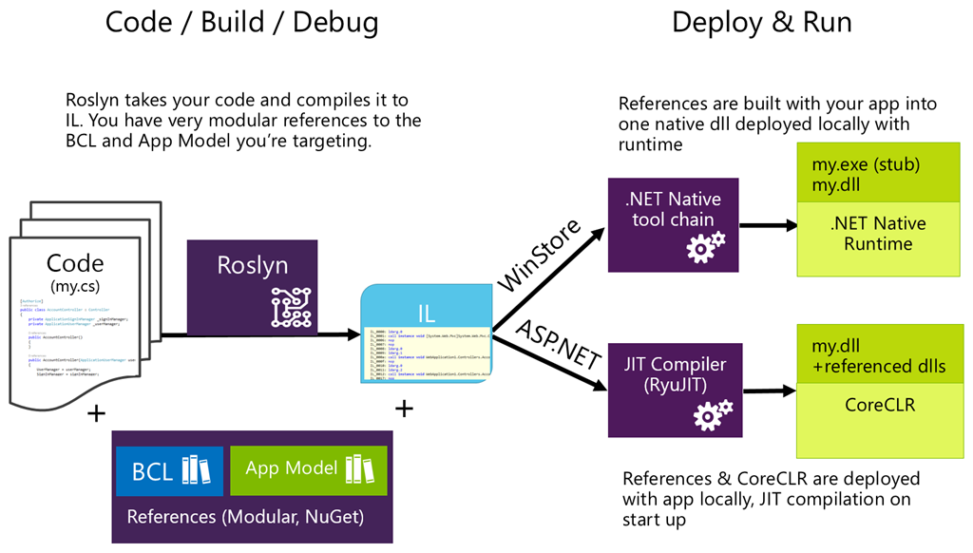
Compilation Process

Slide 16
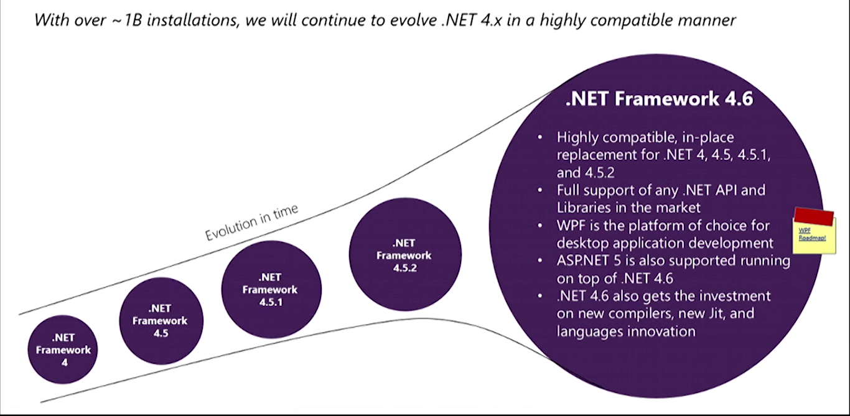

What About .NET Framework 4.6+?
4.7
Core is

Slide 17
ASP .NET Core
Notes:
ASP .NET 5.0

Slide 18
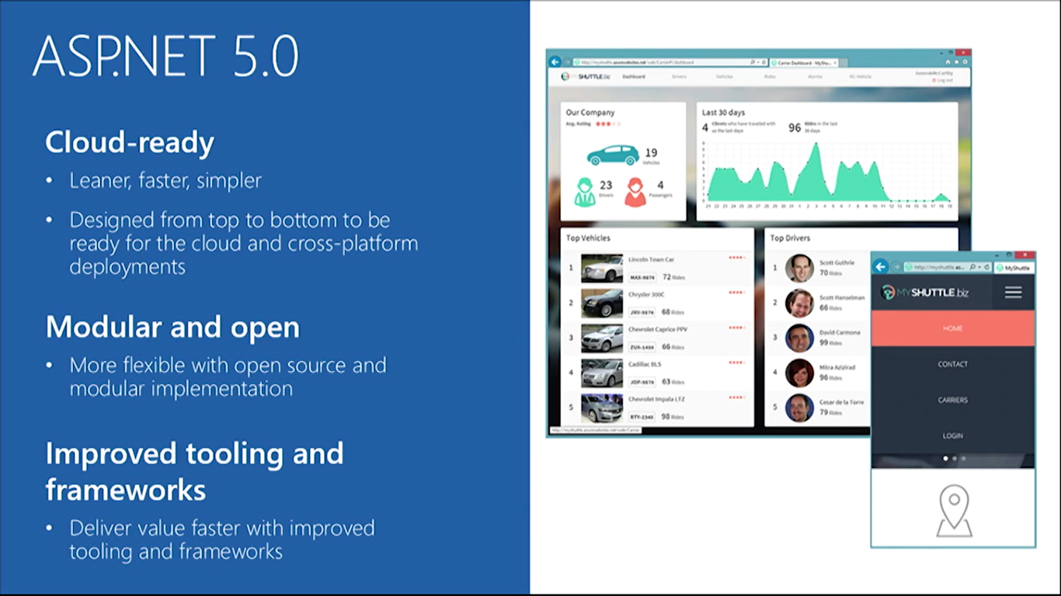

ASP.NET Core Features

Slide 19
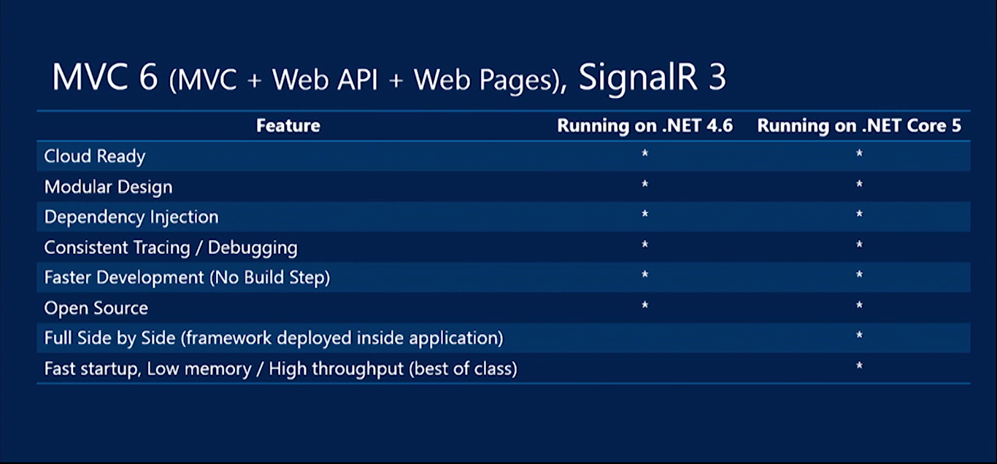

ASP.NET Core Summary

Slide 20
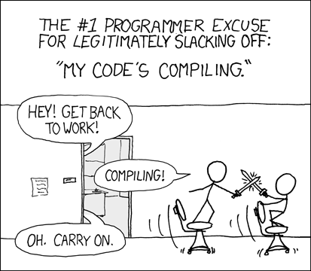
Relevant XKCD Comic
Source: https://xkcd.com/303/

Slide 21
ASP .NET Core MVC
Notes:
ASP .NET 5.0

Slide 22
MVC Web App Basics
Updates
View
User Requests
Controller
View
Updates
Model
Model
Gets
Data

Slide 23
MVC (Web) Controllers
public class HumanController : Controller
{
private readonly ApplicationDbContext _context;
public HumanController(ApplicationDbContext context) {}
// GET: Human, Human/Details/5
public async Task<IActionResult> Index() {}
public async Task<IActionResult> Details(int? id) {}
// GET: Human/Create
public IActionResult Create() {}
// POST: Human
[HttpPost]
[ValidateAntiForgeryToken]
public async Task<IActionResult> Create([Bind("Id,FirstName,LastName")] Human human) {}
// GET: Human/Edit/5
public async Task<IActionResult> Edit(int? id) {}
// POST: Human/Edit/5
[HttpPost]
[ValidateAntiForgeryToken]
public async Task<IActionResult> Edit(int id, [Bind("Id,FirstName,LastName")] Human human) {}
}

Slide 24
MVC (API) Controllers
public class ValuesController : Controller
{
// GET: api/Values, api/Values/5
[HttpGet]
public IEnumerable<string> Get() {}
[HttpGet("{id}", Name = "Get")]
public string Get(int id) {}
// POST: api/Values
[HttpPost]
public void Post([FromBody]string value) {}
// PUT: api/Values/5
[HttpPut("{id}")]
public void Put(int id, [FromBody]string value) {}
// DELETE: api/ApiWithActions/5
[HttpDelete("{id}")]
public void Delete(int id) {}
}

Slide 25
MVC (Web) Views
@model NiceStackWeb.Models.Human
@{
ViewData["Title"] = "Details";
}
<h2>Details</h2>
<div>
<h4>Human</h4>
<hr />
<dl class="dl-horizontal">
<dt>
@Html.DisplayNameFor(model => model.FirstName)
</dt>
<dd>
@Html.DisplayFor(model => model.FirstName)
</dd> ...
</dl>
</div>
<div>
<a asp-action="Edit" asp-route-id="@Model.Id">Edit</a> |
<a asp-action="Index">Back to List</a>
</div>

Slide 26
MVC Models
using System.ComponentModel;
using System.ComponentModel.DataAnnotations;
public class Human
{
[Key]
public int Id { get; set; }
[DisplayName("First Name")]
public string FirstName { get; set; }
[DisplayName("First Name")]
public string LastName { get; set; }
}

Slide 27
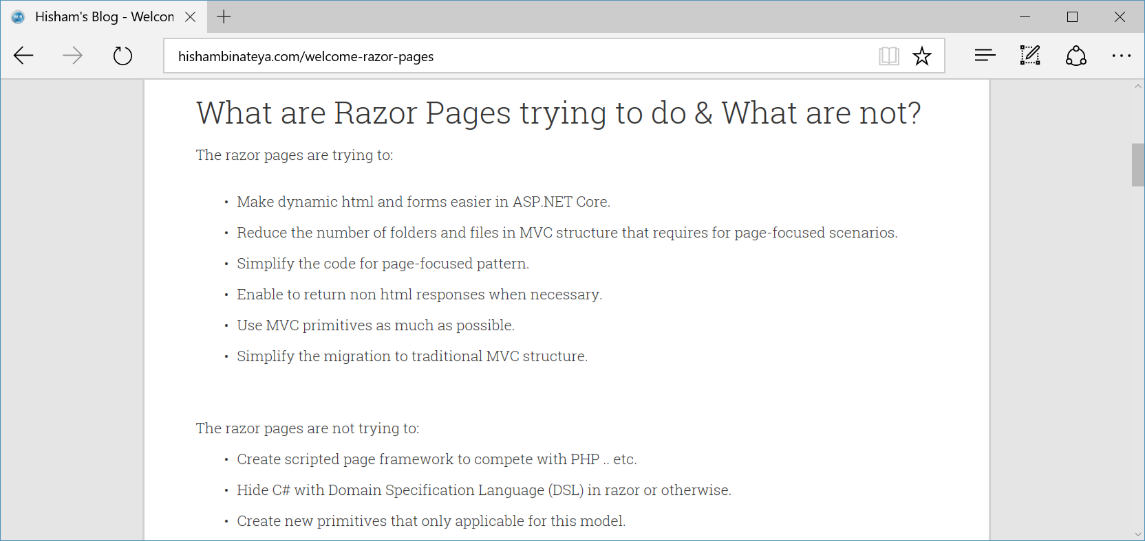
New Razor Pages!
http://www.hishambinateya.com/welcome-razor-pages

Slide 28
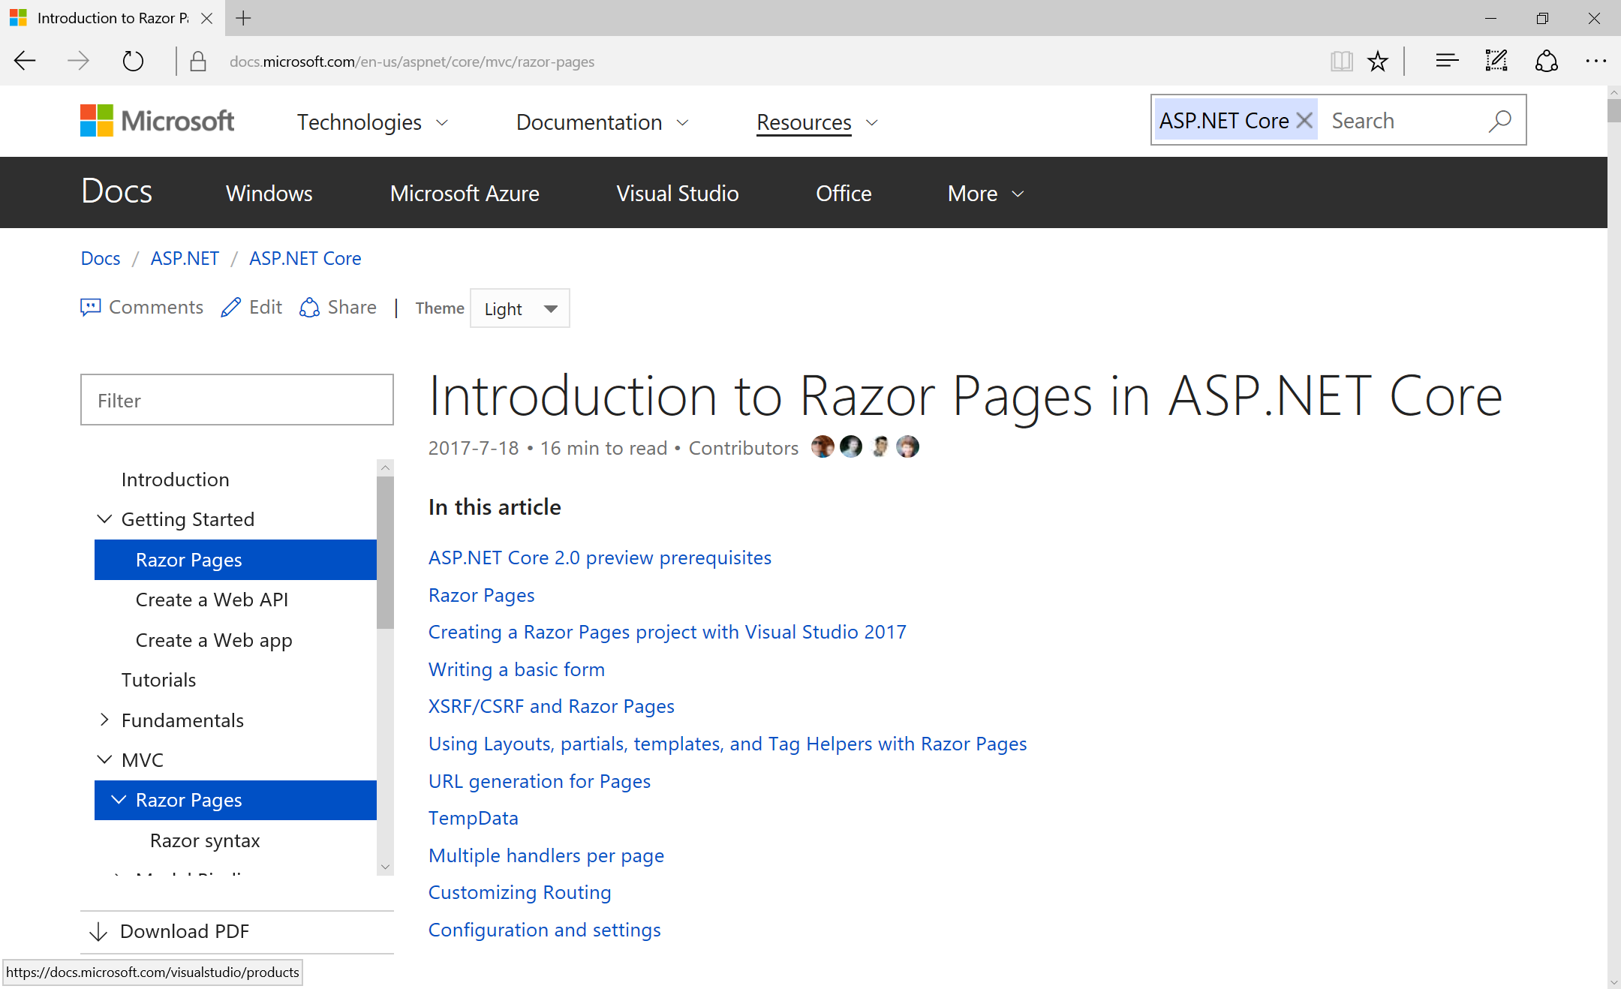
Intro to Razor Pages
https://docs.microsoft.com/en-us/aspnet/core/mvc/razor-pages

Slide 29
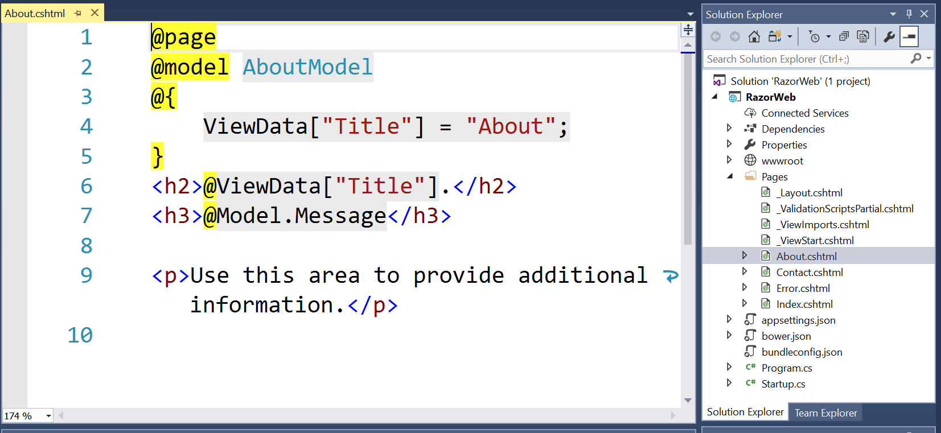
Razor Syntax

Slide 30
SignalR in ASP.NET Core 2.1 (Stable!)
using Microsoft.AspNetCore.SignalR;
namespace SignalRTutorial.Hubs
{
[Authorize]
public class ChatHub : Hub
{
public override async Task OnConnectedAsync()
{
await Clients.All.SendAsync("SendAction", Context.User.Identity.Name, "joined");
}
public override async Task OnDisconnectedAsync(Exception ex)
{
await Clients.All.SendAsync("SendAction", Context.User.Identity.Name, "left");
}
public async Task Send(string message)
{
await Clients.All.SendAsync("SendMessage", Context.User.Identity.Name, message);
}
}
}
https://blogs.msdn.microsoft.com/webdev/2018/02/27/asp-net-core-2-1-0-preview1-getting-started-with-signalr

Slide 31
ASP.NET Core 2.1: What’s New?
SignalR
HSTS Protocol
&
HTTPS by default
New Web API conventions
Swagger support
ActionResult<T>
HTTP Client Factory
ANCM in-process mode for IIS performance
ASP.NET Identity as UI Library
GDPR Compliance
Build-time Razor Compilation
New Razor SDK
Virtual Auth Schemes
MVC Functional Test Fixture
http://www.talkingdotnet.com/quick-summary-whats-new-asp-net-core-2-1/

Slide 32
ASP.NET Core 2.1: What’s New?
SignalR
HSTS Protocol
&
HTTPS by default
New Web API conventions
Swagger support
Real-time web development
New Typescript client, jQuery
Built-in Hub protocols:
  JSON-based for text
  MessagePack for binary
Improved scale-out model
  Sticky sessions required*
*required when using WebSockets unless skipNegotiation flag is set to true
var connection = new signalR.HubConnectionBuilder().withUrl("/chat",
{
skipNegotiation: true,
transport: signalR.HttpTransportType.WebSockets
})
.build();
ActionResult<T>
HTTP Client Factory
ANCM in-process mode for IIS performance
ASP.NET Identity as UI Library
GDPR Compliance
Build-time Razor Compilation
New Razor SDK
Virtual Auth Schemes
MVC Functional Test Fixture
http://www.talkingdotnet.com/quick-summary-whats-new-asp-net-core-2-1/

Slide 33
ASP.NET Core 2.1: What’s New?
SignalR
HSTS Protocol
&
HTTPS by default
New Web API conventions
Swagger support
UseHttpsRedirection by default
HSTS protocol support (non-dev)
>dotnet dev-certs https --trust
ActionResult<T>
HTTP Client Factory
ANCM in-process mode for IIS performance
ASP.NET Identity as UI Library
GDPR Compliance
Build-time Razor Compilation
New Razor SDK
Virtual Auth Schemes
MVC Functional Test Fixture
http://www.talkingdotnet.com/quick-summary-whats-new-asp-net-core-2-1/

Slide 34
ASP.NET Core 2.1: What’s New?
SignalR
HSTS Protocol
&
HTTPS by default
New Web API conventions
Swagger support
New ApiController attribute
Auto model validation
ActionResult<T>
HTTP Client Factory
ANCM in-process mode for IIS performance
ASP.NET Identity as UI Library
GDPR Compliance
Build-time Razor Compilation
New Razor SDK
Virtual Auth Schemes
MVC Functional Test Fixture
http://www.talkingdotnet.com/quick-summary-whats-new-asp-net-core-2-1/

Slide 35
ASP.NET Core 2.1: What’s New?
SignalR
HSTS Protocol
&
HTTPS by default
New Web API conventions
Swagger support
Rich Swagger support
Easier API documentation
ActionResult<T>
HTTP Client Factory
ANCM in-process mode for IIS performance
ASP.NET Identity as UI Library
GDPR Compliance
Build-time Razor Compilation
New Razor SDK
Virtual Auth Schemes
MVC Functional Test Fixture
http://www.talkingdotnet.com/quick-summary-whats-new-asp-net-core-2-1/

Slide 36
ASP.NET Core 2.1: What’s New?
SignalR
HSTS Protocol
&
HTTPS by default
New Web API conventions
Swagger support
ActionResult<T>
HTTP Client Factory
ANCM in-process mode for IIS performance
New type ActionResult<T>
Indicate response type for any action result
ASP.NET Identity as UI Library
GDPR Compliance
Build-time Razor Compilation
New Razor SDK
Virtual Auth Schemes
MVC Functional Test Fixture
http://www.talkingdotnet.com/quick-summary-whats-new-asp-net-core-2-1/

Slide 37
ASP.NET Core 2.1: What’s New?
SignalR
HSTS Protocol
&
HTTPS by default
New Web API conventions
Swagger support
ActionResult<T>
HTTP Client Factory
ANCM in-process mode for IIS performance
HttpClient as a service
Register, configure, consume HttpClient instances
ASP.NET Identity as UI Library
GDPR Compliance
Build-time Razor Compilation
New Razor SDK
Virtual Auth Schemes
MVC Functional Test Fixture
http://www.talkingdotnet.com/quick-summary-whats-new-asp-net-core-2-1/

Slide 38
ASP.NET Core 2.1: What’s New?
SignalR
HSTS Protocol
&
HTTPS by default
New Web API conventions
Swagger support
ActionResult<T>
HTTP Client Factory
ANCM in-process mode for IIS performance
ASP.NET Core (native IIS) Module
Hooks into IIS pipeline
Improved Performance
ASP.NET Identity as UI Library
GDPR Compliance
Build-time Razor Compilation
New Razor SDK
Virtual Auth Schemes
MVC Functional Test Fixture
http://www.talkingdotnet.com/quick-summary-whats-new-asp-net-core-2-1/

Slide 39
ASP.NET Core 2.1: What’s New?
SignalR
HSTS Protocol
&
HTTPS by default
New Web API conventions
Swagger support
ActionResult<T>
HTTP Client Factory
ANCM in-process mode for IIS performance
Default UI implemented in a library
Available as NuGet package
Enable via Startup class
ASP.NET Identity as UI Library
GDPR Compliance
Build-time Razor Compilation
New Razor SDK
Virtual Auth Schemes
MVC Functional Test Fixture
http://www.talkingdotnet.com/quick-summary-whats-new-asp-net-core-2-1/

Slide 40
ASP.NET Core 2.1: What’s New?
SignalR
HSTS Protocol
&
HTTPS by default
New Web API conventions
Swagger support
ActionResult<T>
HTTP Client Factory
ANCM in-process mode for IIS performance
Compliance for EU General Data Protection Regulation reqts
Request user consent for info
ASP.NET Identity as UI Library
GDPR Compliance
Build-time Razor Compilation
New Razor SDK
Virtual Auth Schemes
MVC Functional Test Fixture
http://www.talkingdotnet.com/quick-summary-whats-new-asp-net-core-2-1/

Slide 41
ASP.NET Core 2.1: What’s New?
SignalR
HSTS Protocol
&
HTTPS by default
New Web API conventions
Swagger support
ActionResult<T>
HTTP Client Factory
ANCM in-process mode for IIS performance
Mix authentication schemes
e.g. Bearer tokens, cookie auth
ASP.NET Identity as UI Library
GDPR Compliance
Build-time Razor Compilation
New Razor SDK
Virtual Auth Schemes
MVC Functional Test Fixture
http://www.talkingdotnet.com/quick-summary-whats-new-asp-net-core-2-1/

Slide 42
ASP.NET Core 2.1: What’s New?
SignalR
HSTS Protocol
&
HTTPS by default
New Web API conventions
Swagger support
ActionResult<T>
HTTP Client Factory
ANCM in-process mode for IIS performance
Compiled during build process
Improved startup performance
ASP.NET Identity as UI Library
GDPR Compliance
Build-time Razor Compilation
New Razor SDK
Virtual Auth Schemes
MVC Functional Test Fixture
http://www.talkingdotnet.com/quick-summary-whats-new-asp-net-core-2-1/

Slide 43
ASP.NET Core 2.1: What’s New?
SignalR
HSTS Protocol
&
HTTPS by default
New Web API conventions
Swagger support
ActionResult<T>
HTTP Client Factory
ANCM in-process mode for IIS performance
Razor UI as class library
Share across projects
Share as Nuget package
ASP.NET Identity as UI Library
GDPR Compliance
Build-time Razor Compilation
New Razor SDK
Virtual Auth Schemes
MVC Functional Test Fixture
http://www.talkingdotnet.com/quick-summary-whats-new-asp-net-core-2-1/

Slide 44
ASP.NET Core 2.1: What’s New?
SignalR
HSTS Protocol
&
HTTPS by default
New Web API conventions
Swagger support
ActionResult<T>
HTTP Client Factory
ANCM in-process mode for IIS performance
Improved end-to-end testing
e.g. routing, filters, controllers, actions, views and pages
ASP.NET Identity as UI Library
GDPR Compliance
Build-time Razor Compilation
New Razor SDK
Virtual Auth Schemes
MVC Functional Test Fixture
http://www.talkingdotnet.com/quick-summary-whats-new-asp-net-core-2-1/

Slide 45
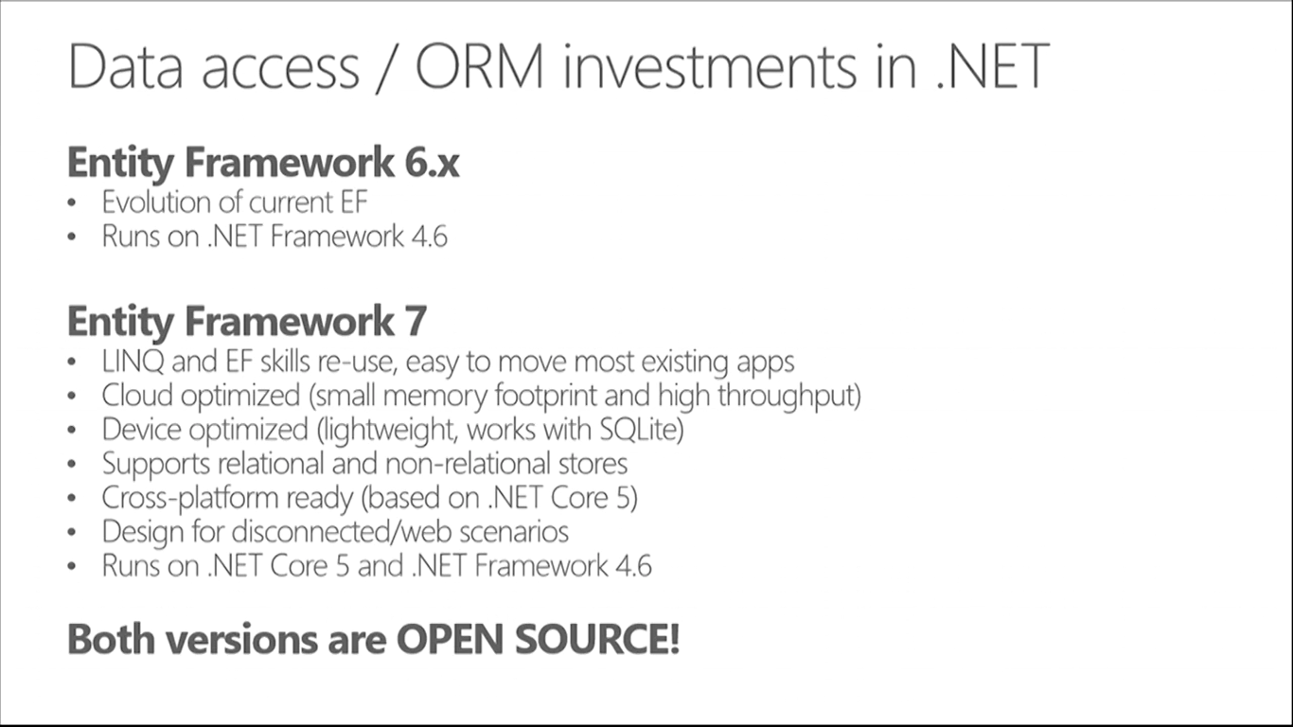
How about Entity Framework?
Entities in Code
4.6+
Core
ORM
)
4.6+
DB

Slide 46
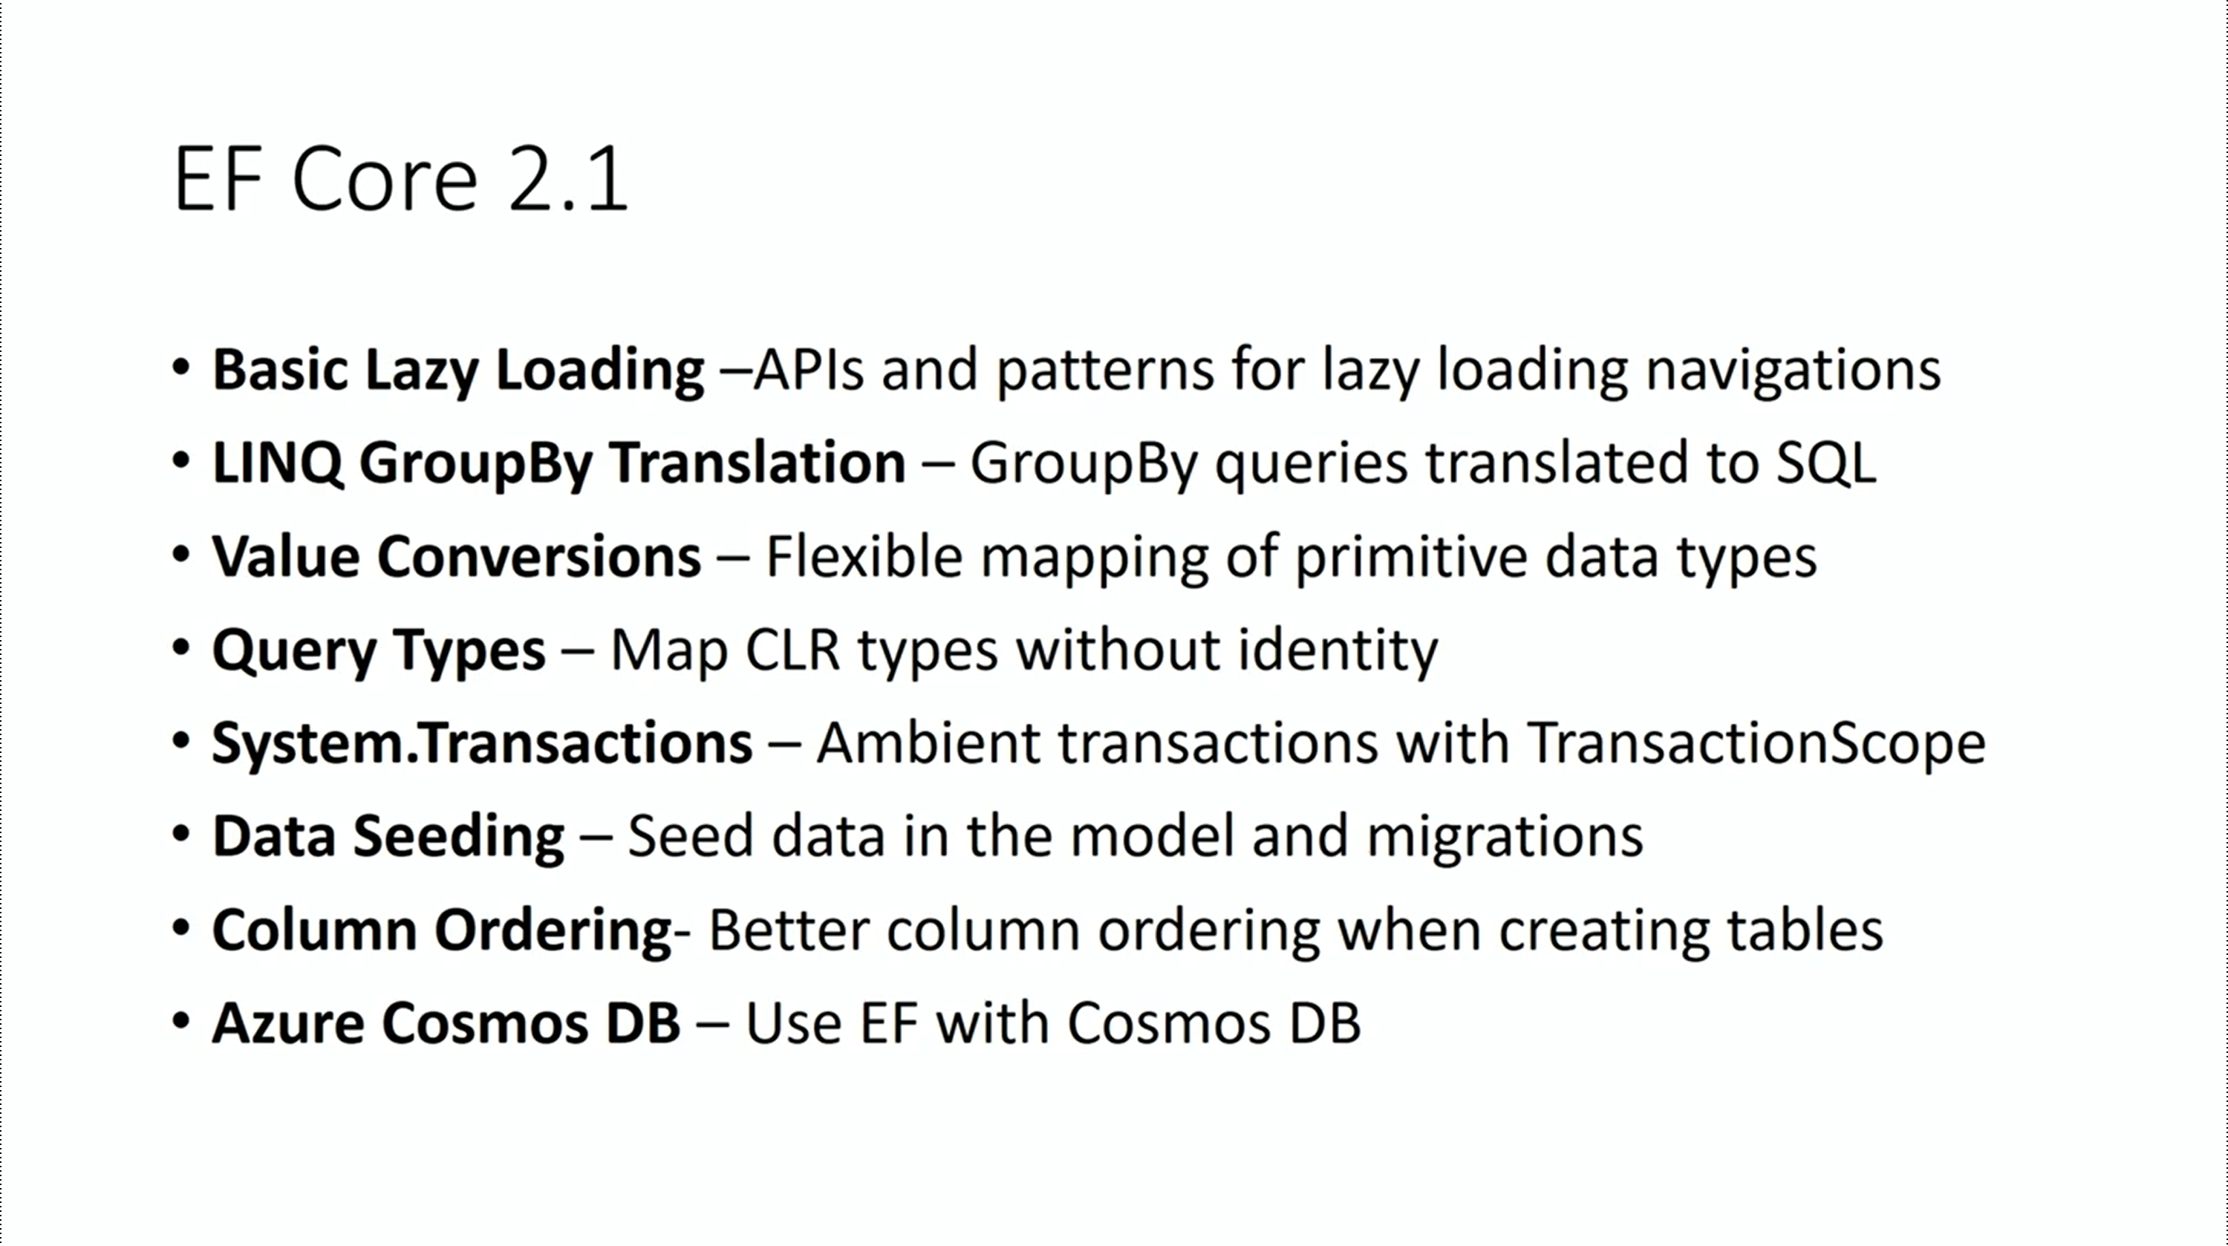

Slide 47
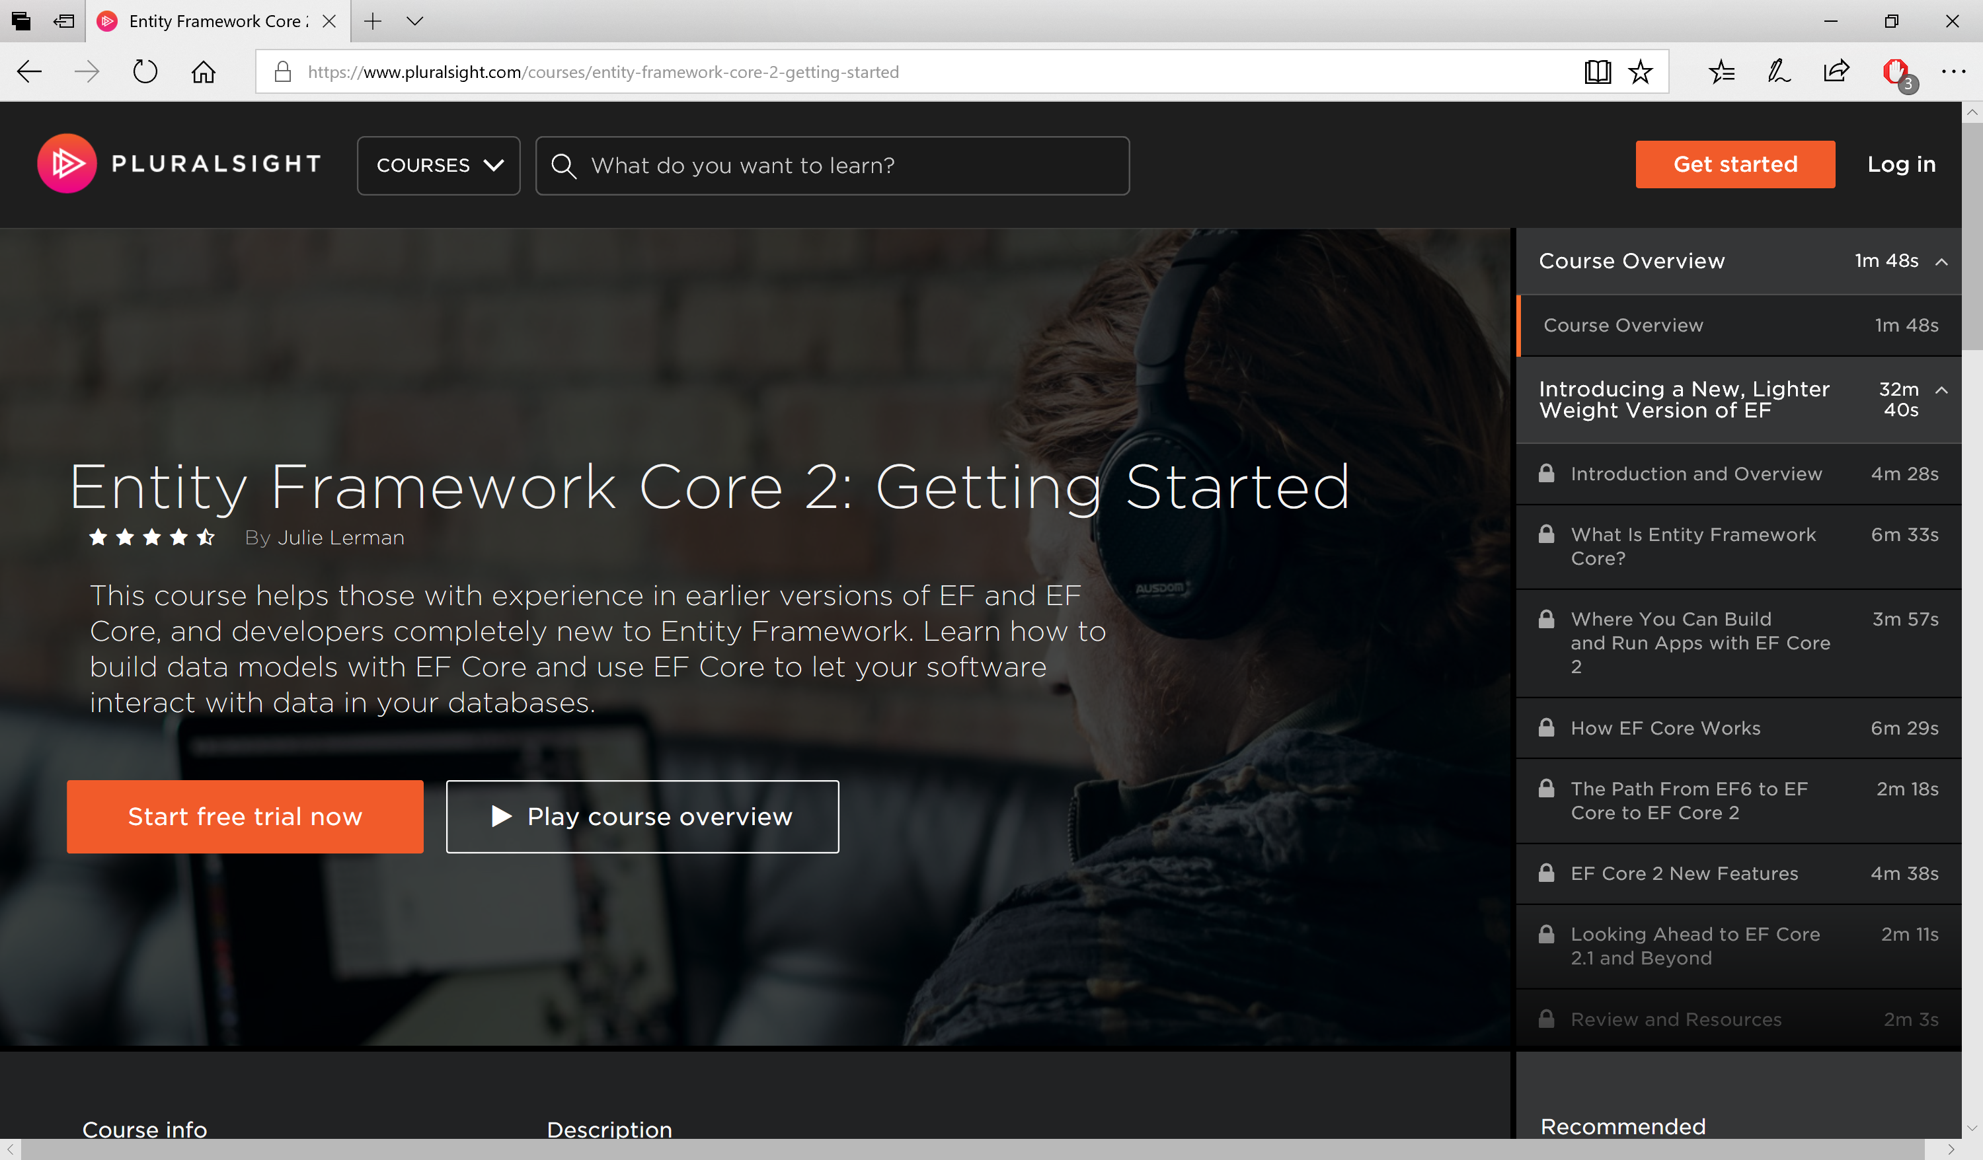
Pluralsight Course by Julie Lerman
https://app.pluralsight.com/library/courses/entity-framework-core-2-getting-started

Slide 48
Visual Studio 2017
& VS Code
Notes:
ASP .NET 5.0

Slide 49
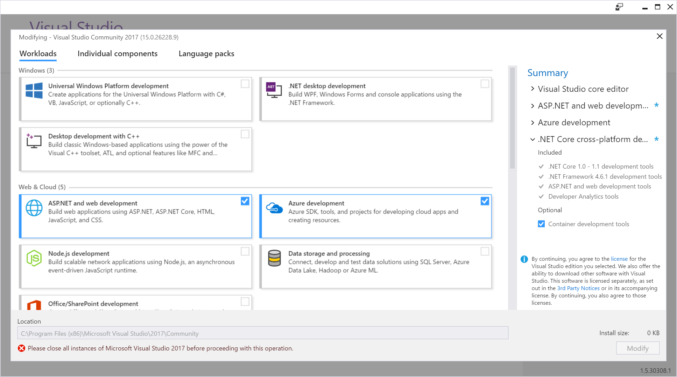
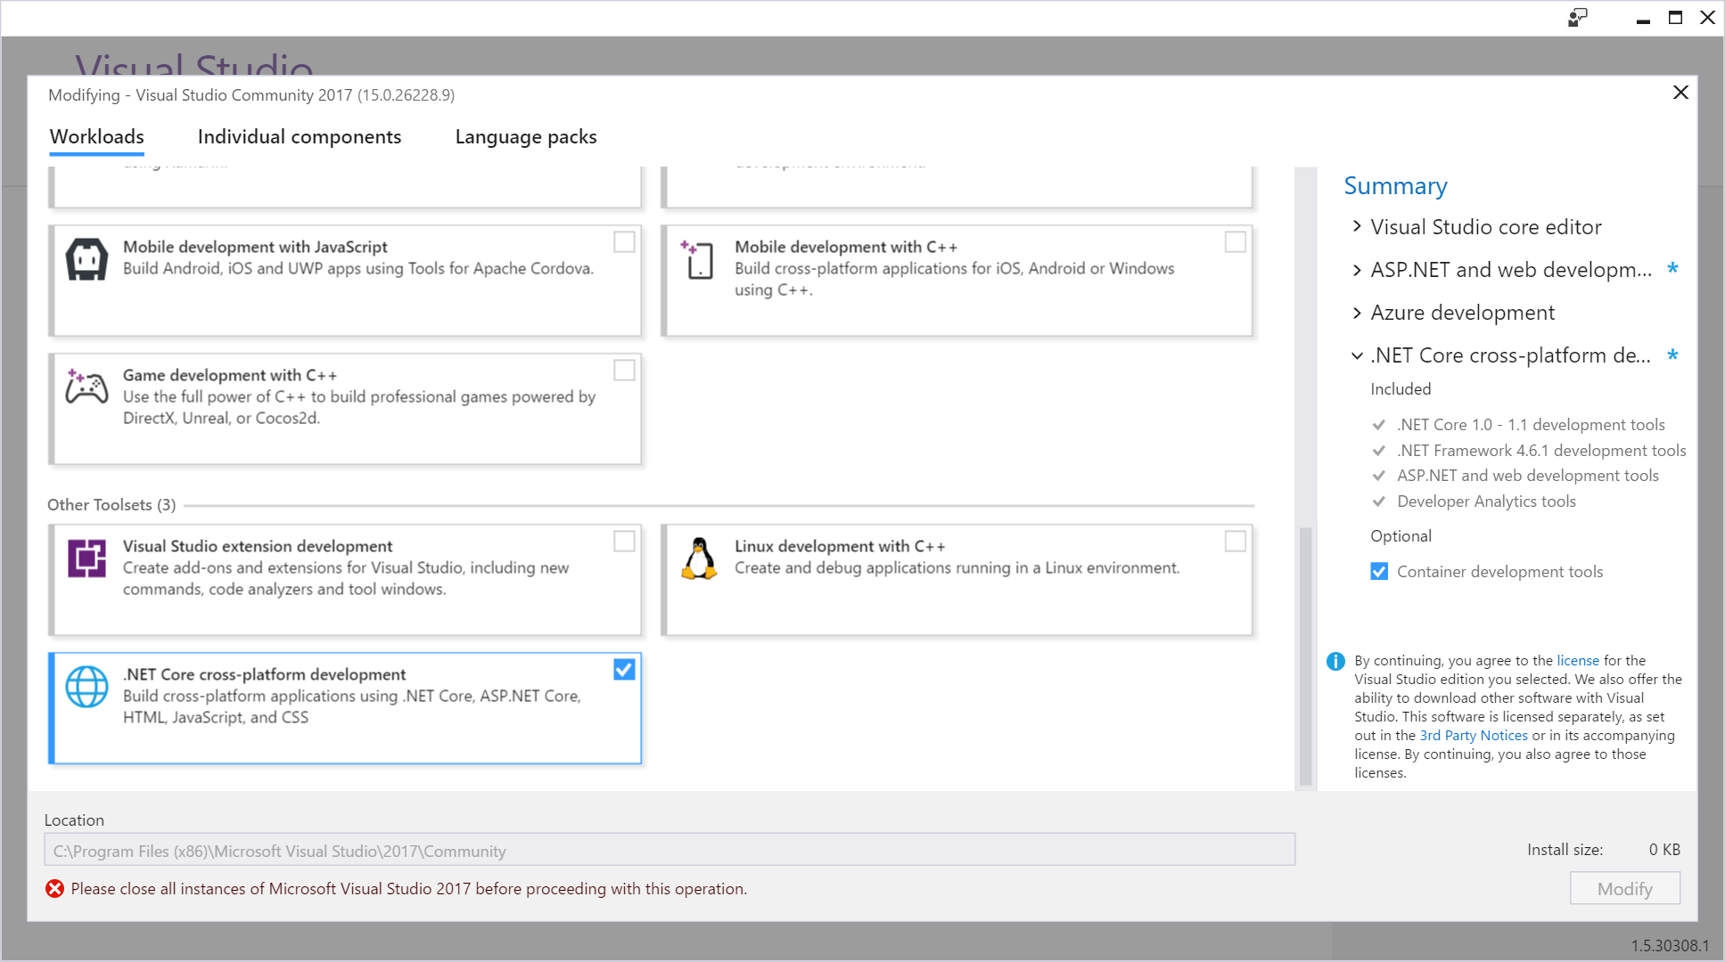
New Installer!

Slide 50
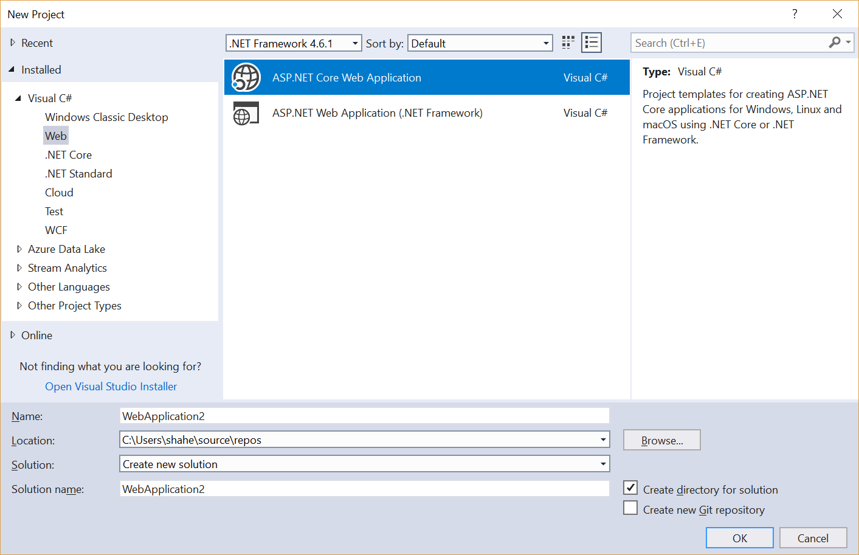
File → New Project → Web
ASP .NET Core Web App
Web App (4.x)

Slide 51
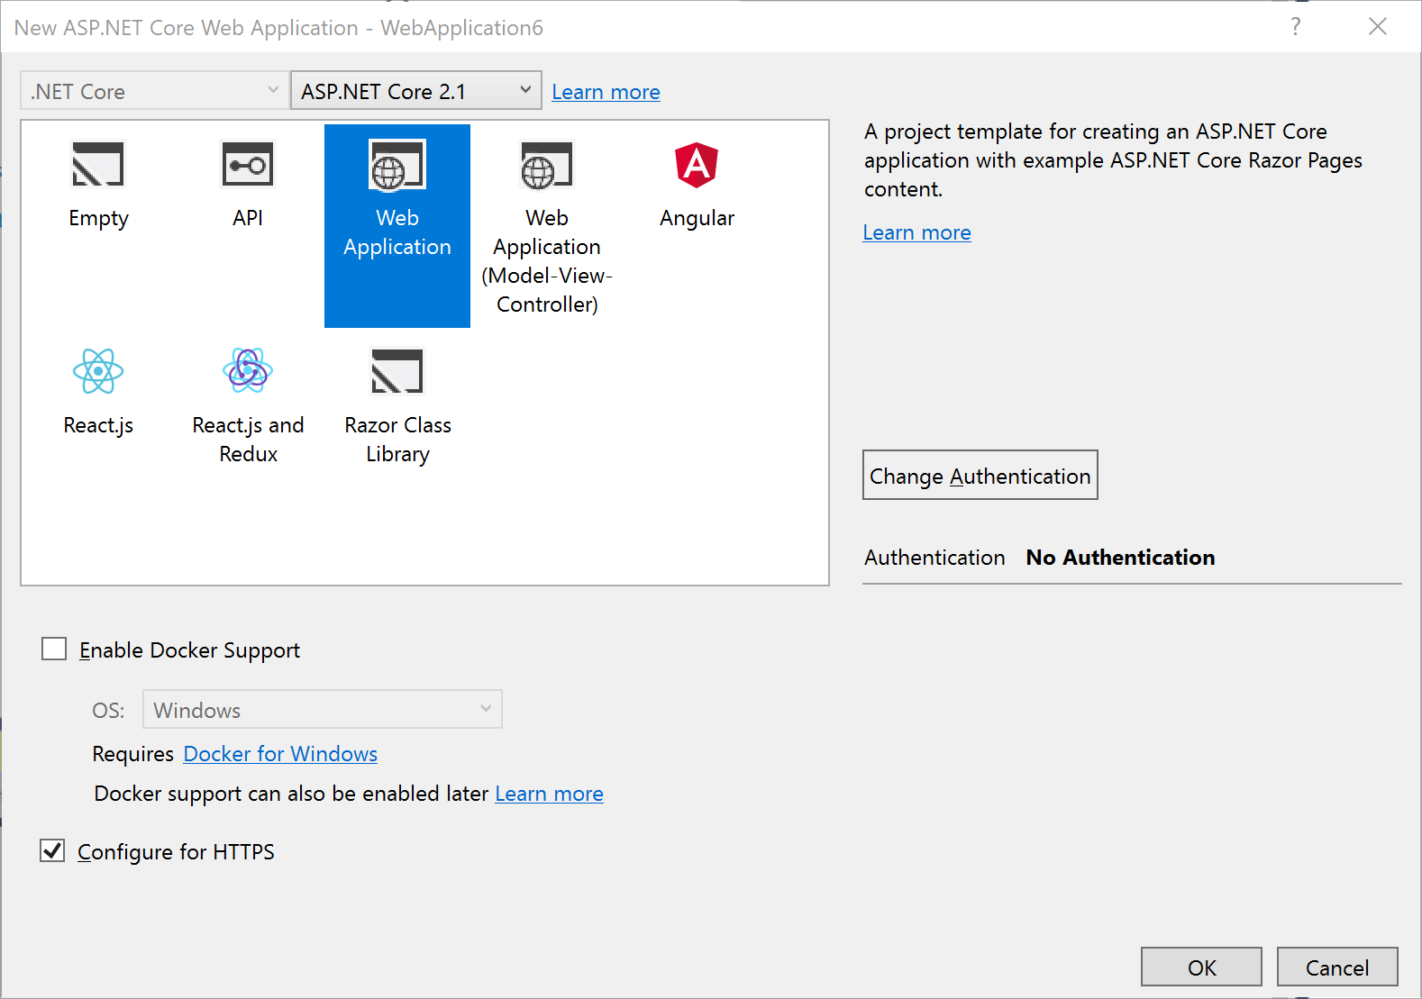
Select a Template
1.0 , 1.1, 2.0 or 2.1
Empty
API
Web App (Razor)
Web App (MVC)
Angular
React.js
React.js & Redux
Razor Class Library
Other settings:
Authentication
Docker Support

Slide 52
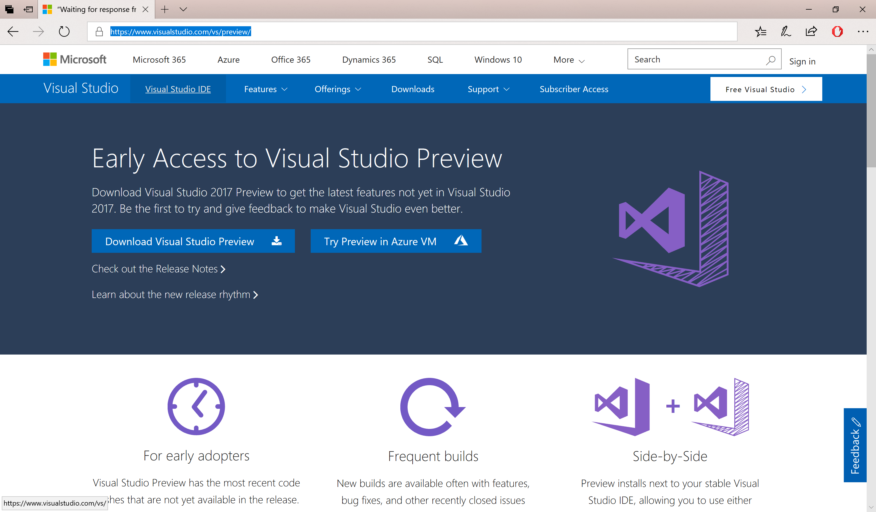
VS 2017 Preview with ASP.NET Core 2.1
https://www.visualstudio.com/vs/preview/

Slide 53
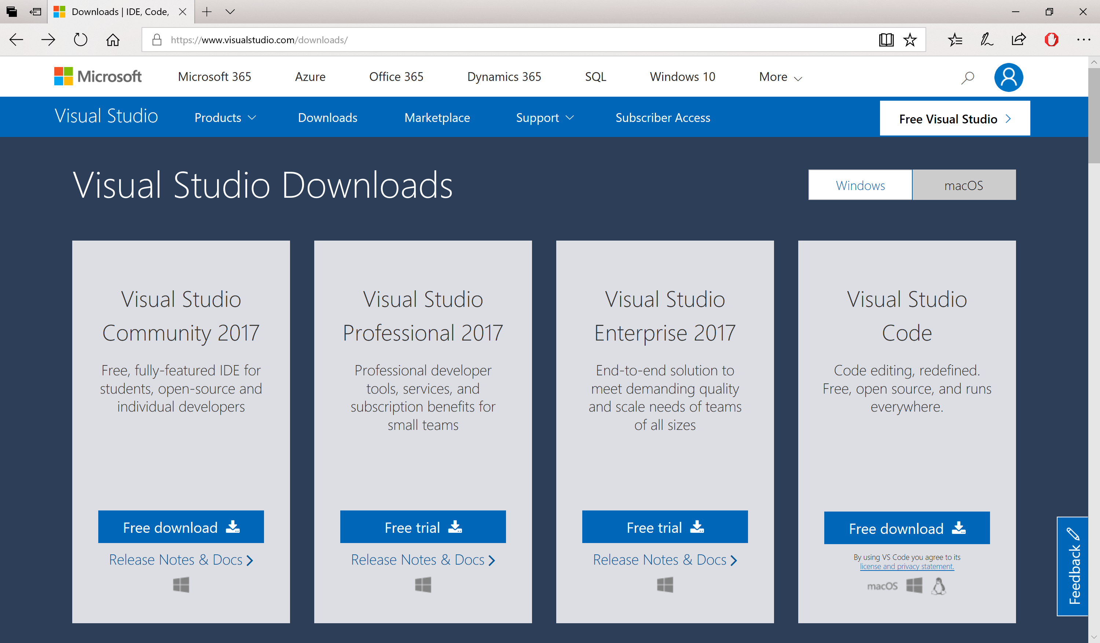
VS 2017 15.7 + ASP.NET Core 2.1
https://www.visualstudio.com/downloads

Slide 54
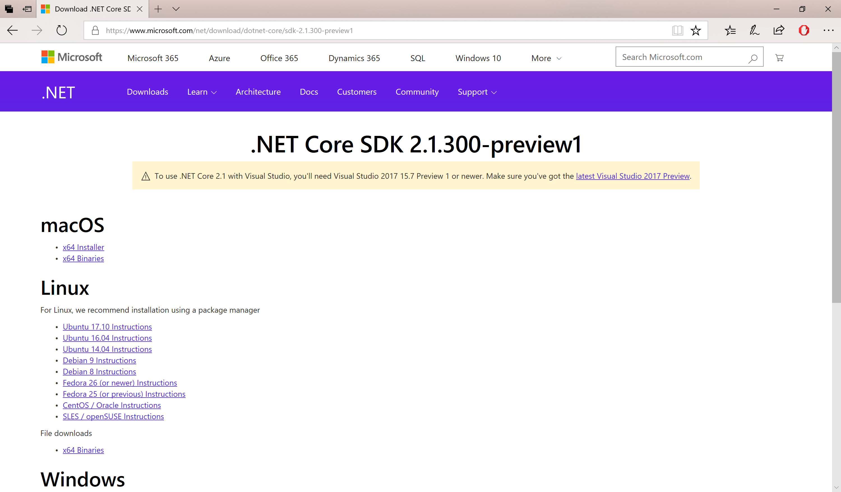
.NET Core SDK 2.1.300-preview1
https://www.microsoft.com/net/download/dotnet-core/sdk-2.1.300-preview1

Slide 55
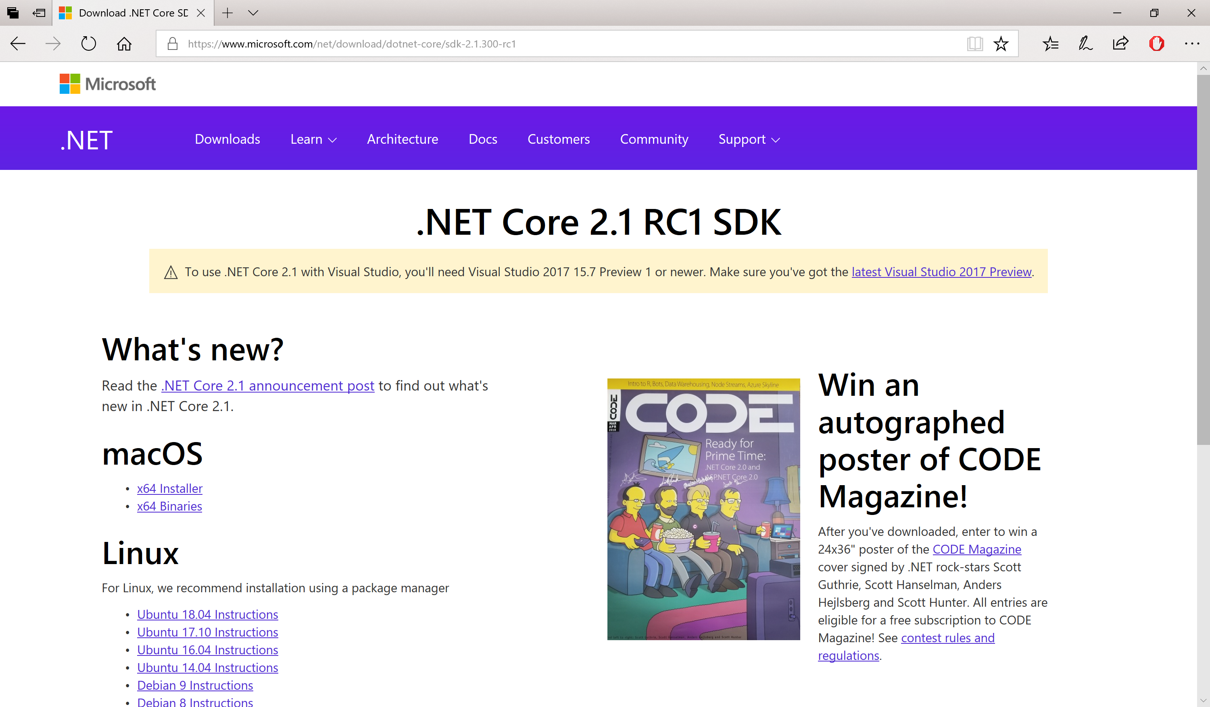
.NET Core SDK 2.1 RC1
https://www.microsoft.com/net/download/dotnet-core/sdk-2.1.300-rc1

Slide 56
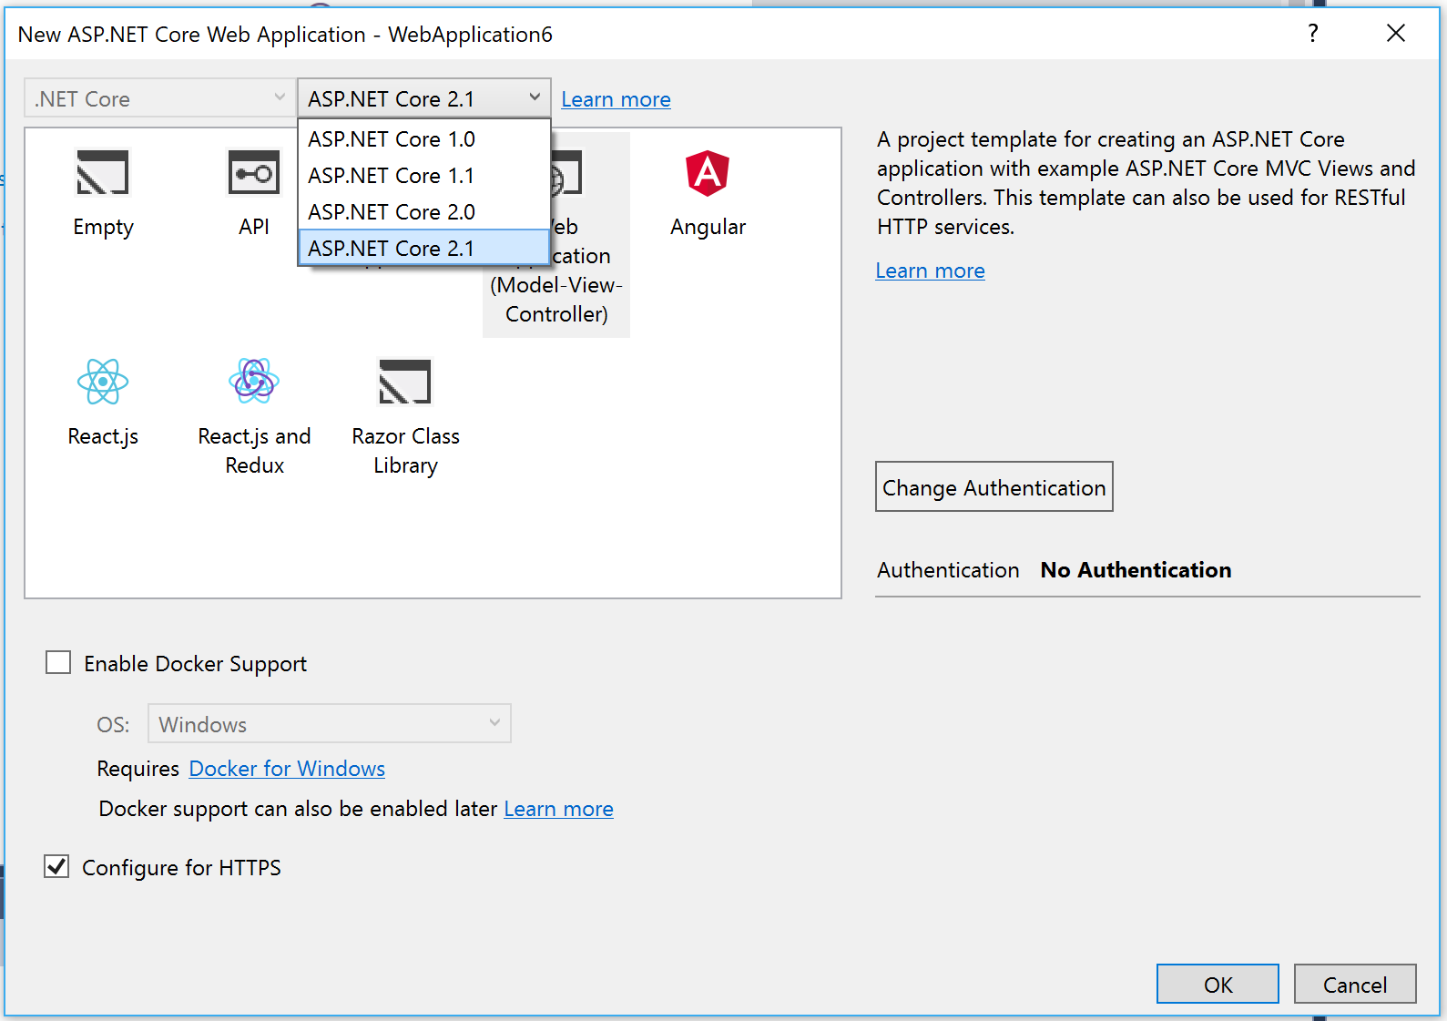
Select a Template (VS 2017 15.7)
Includes:
ASP .NET Core 2.1

Slide 57
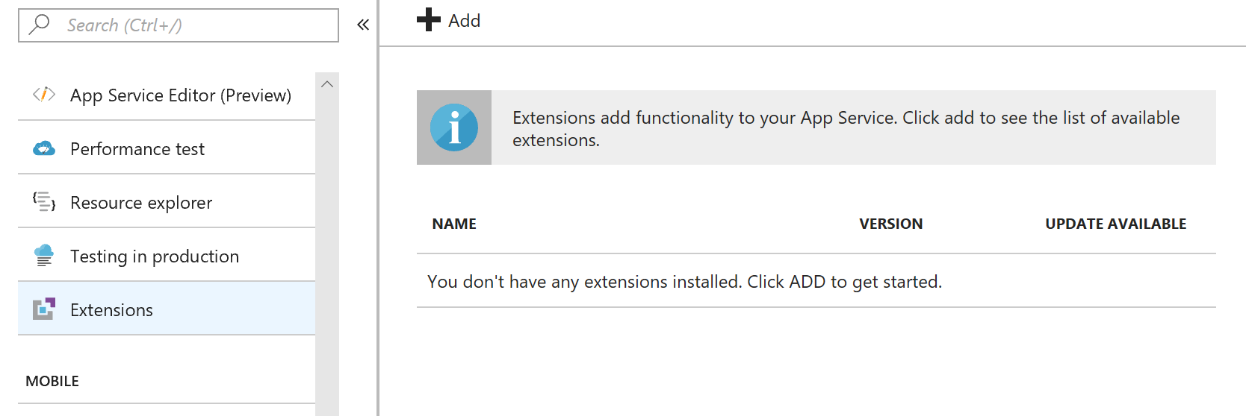
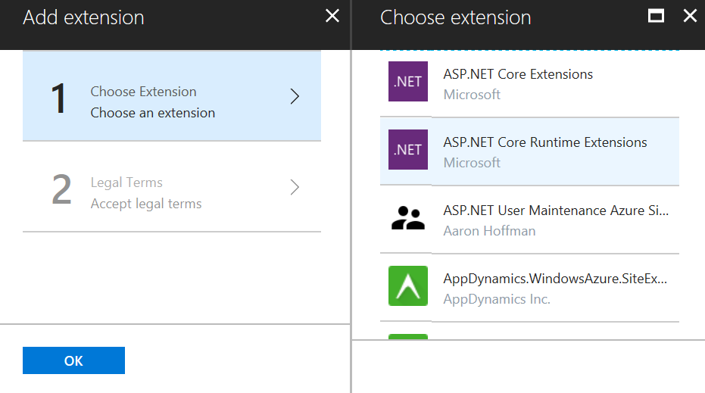
ASP.NET Core Runtime Extension on Azure
https://blogs.msdn.microsoft.com/webdev/2018/02/27/asp-net-core-2-1-0-preview1-using-asp-net-core-previews-on-azure-app-service/

Slide 58
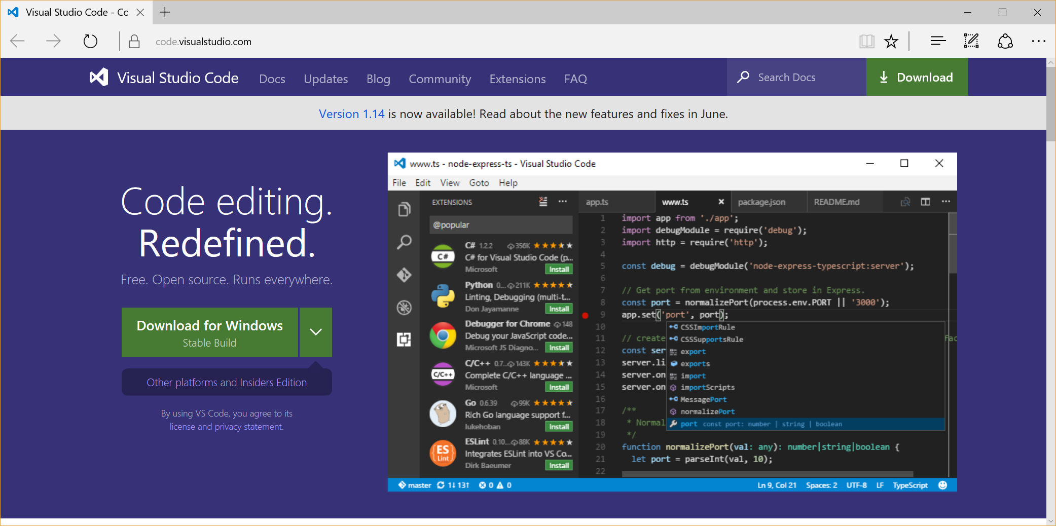
Visual Studio Code
Download: https://code.visualstudio.com

Slide 59
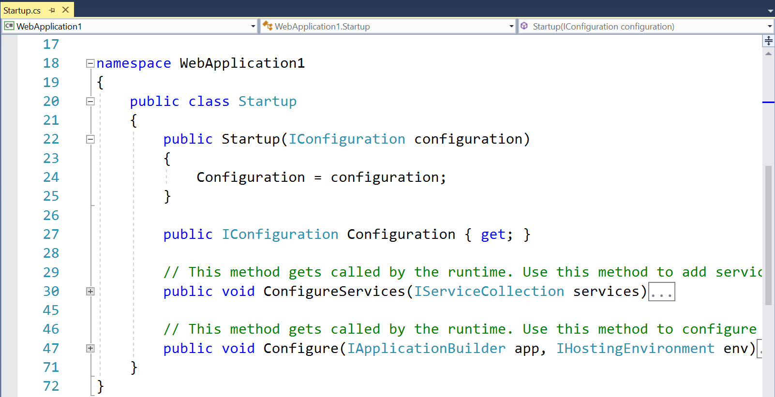
Startup.cs Configuration

Slide 60
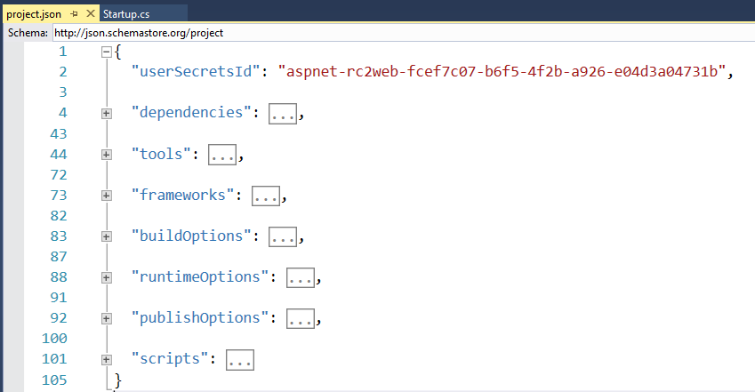
project.json

Slide 61
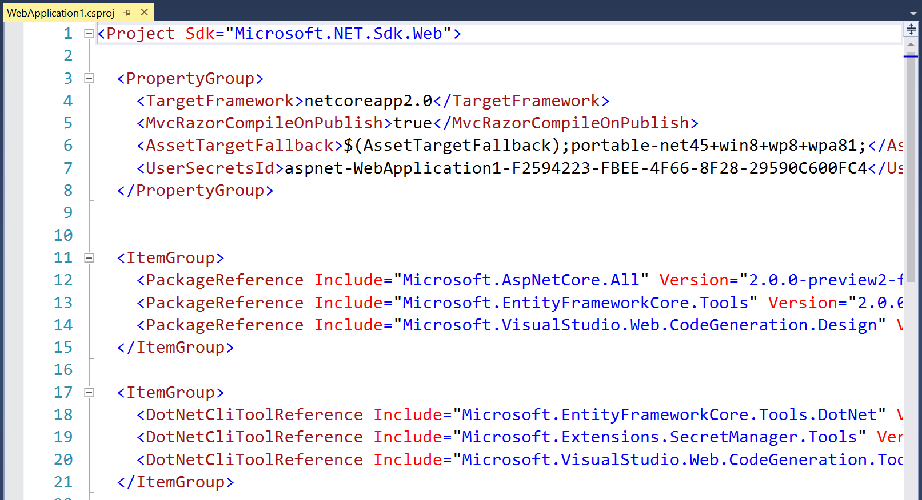
.csproj project file 2.0

Slide 62
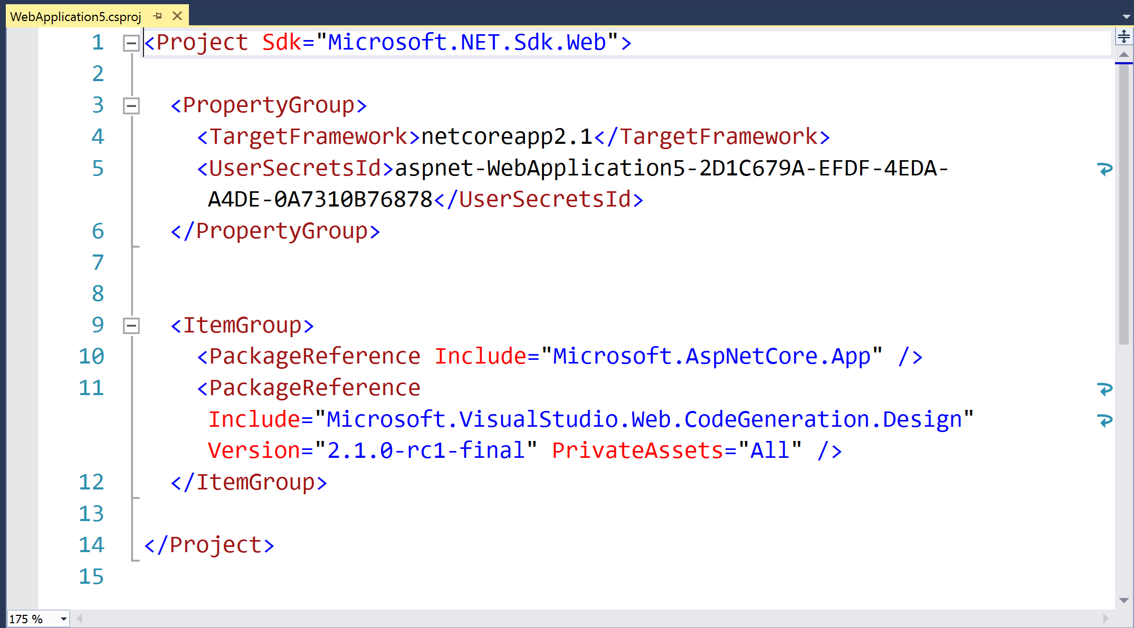
.csproj project file 2.1

Slide 63
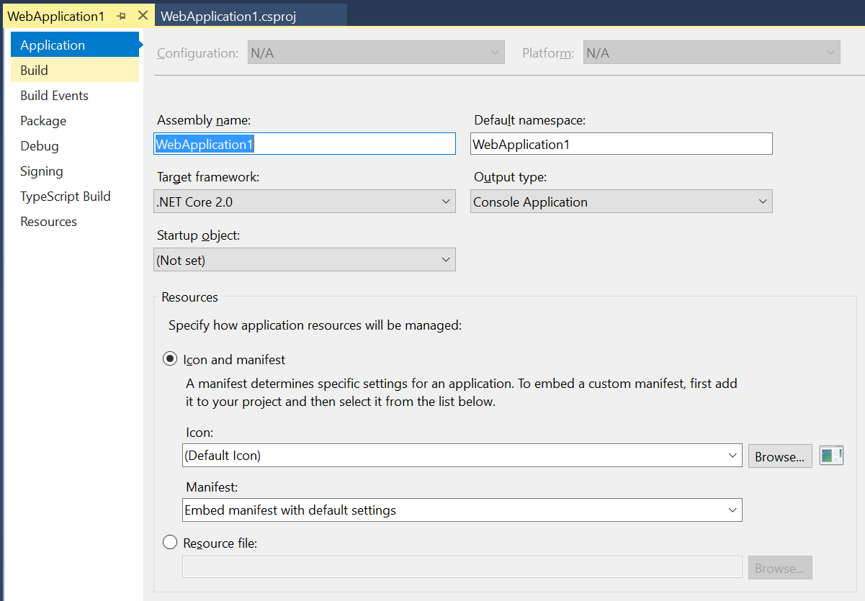
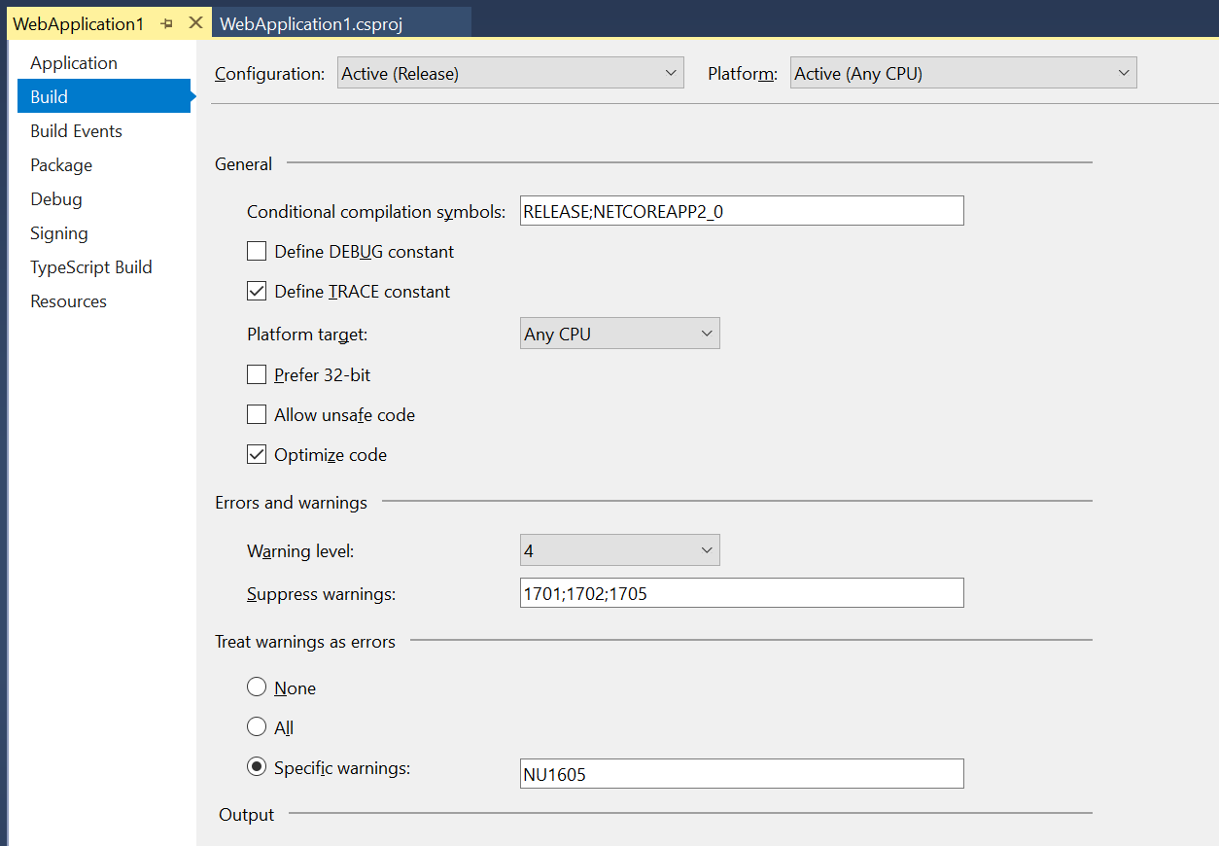
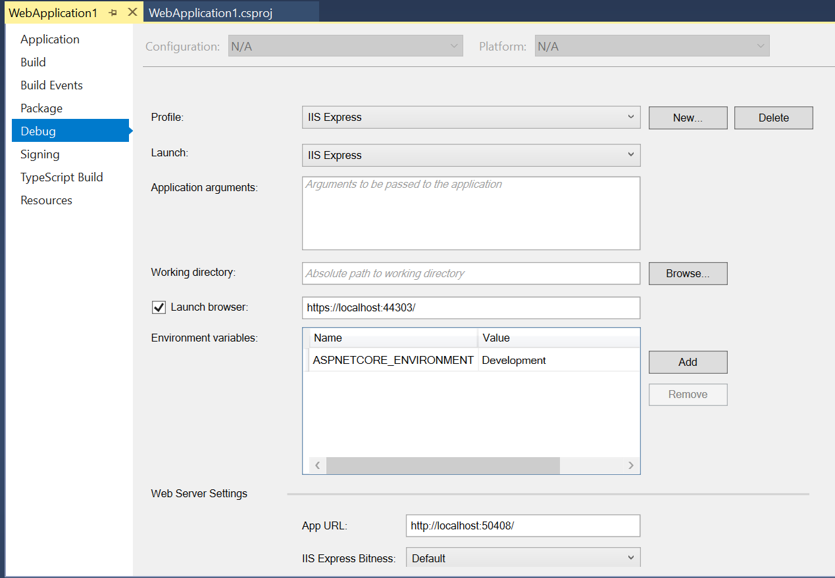
Right-click → (Project) Properties

Slide 64
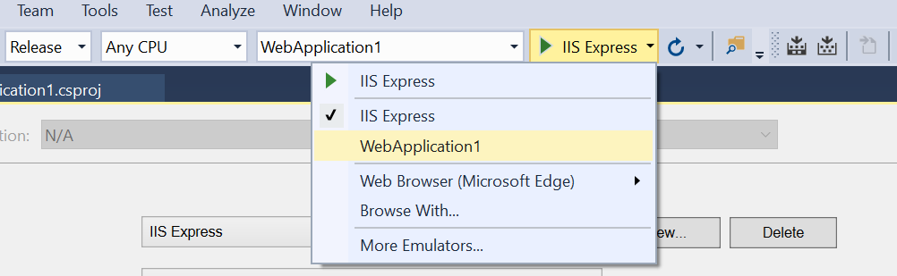
Choose Profile While Debugging

Slide 65
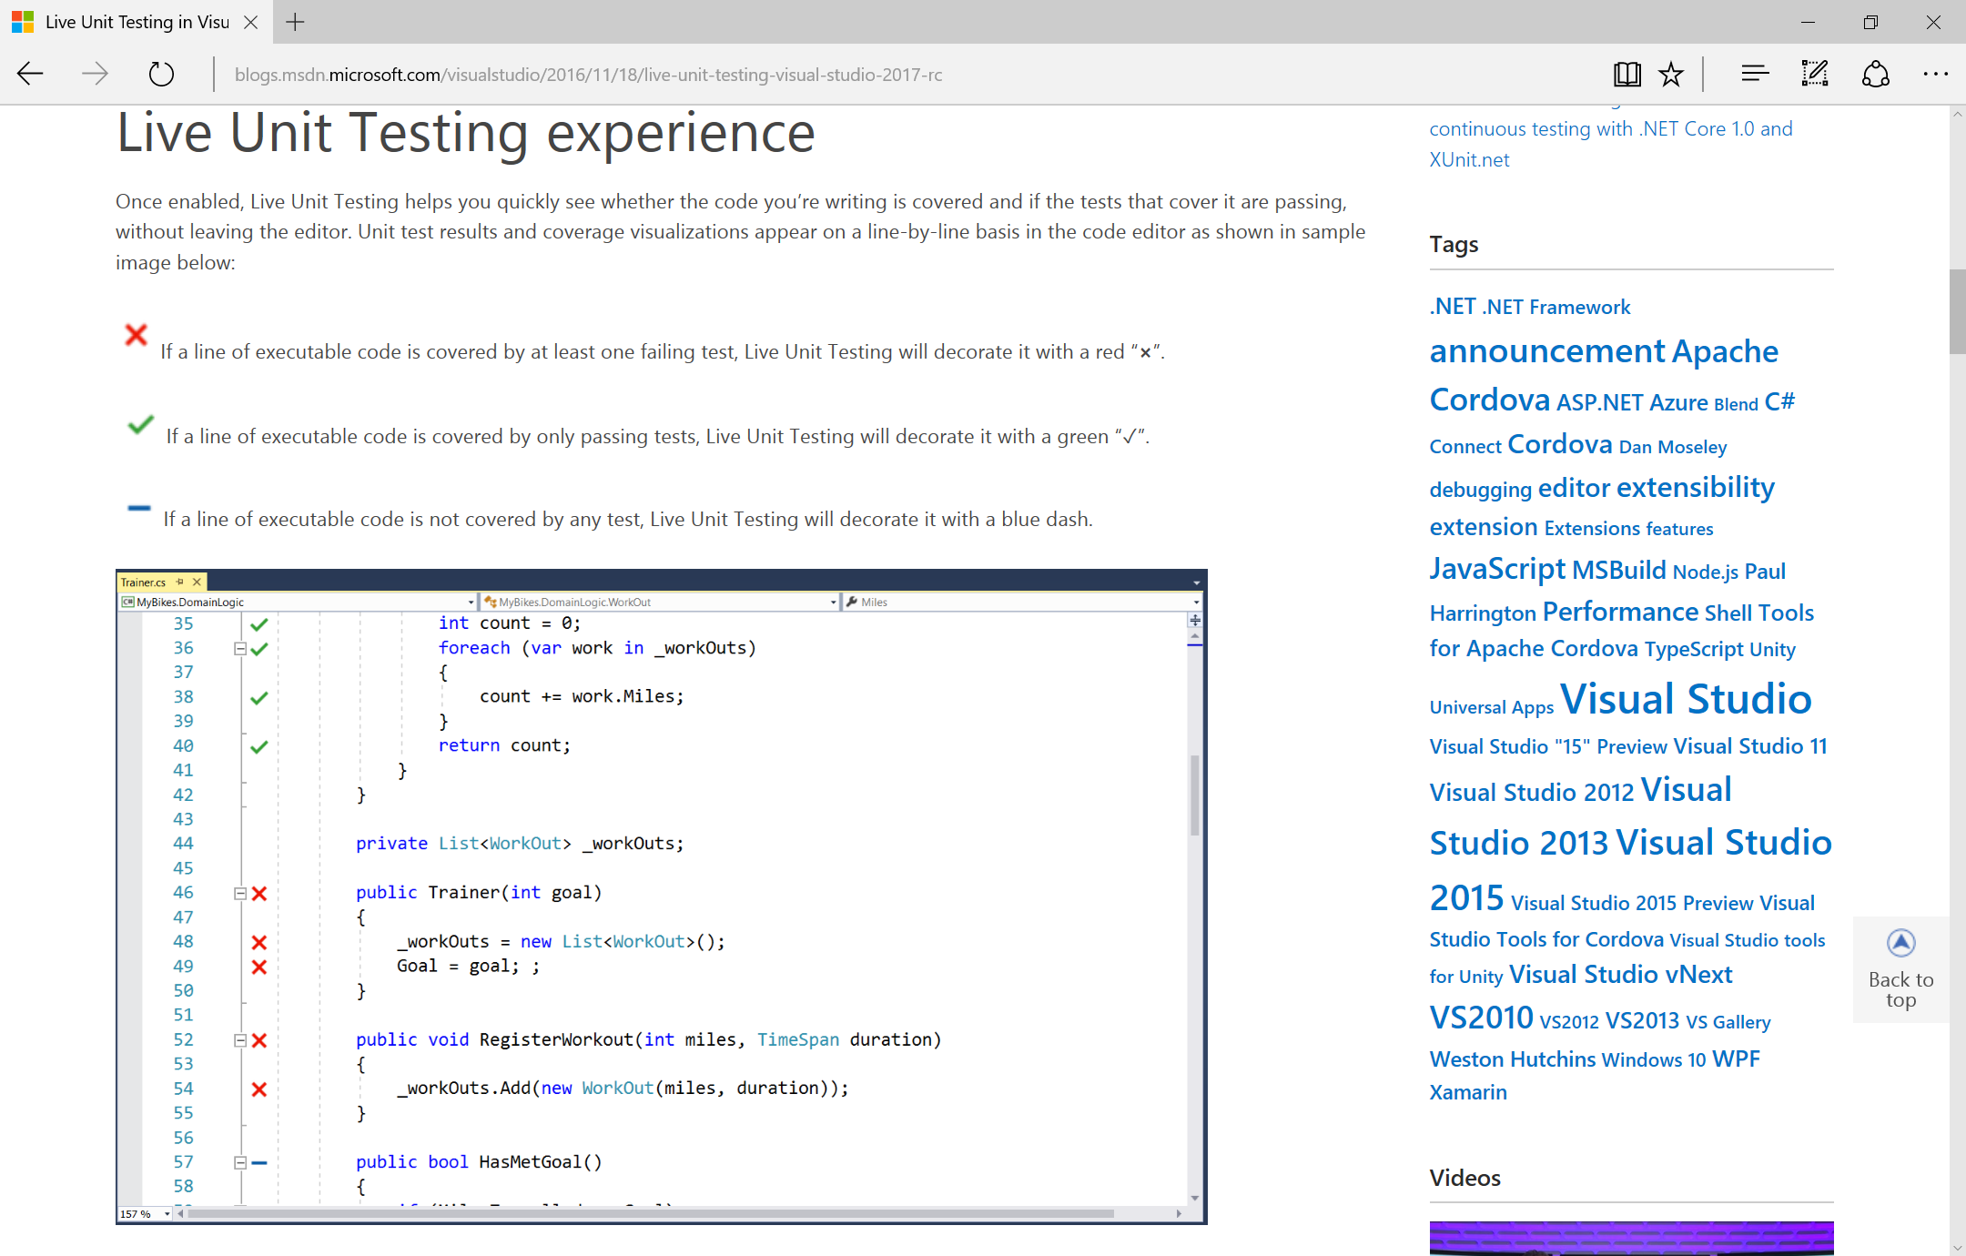
Live Unit Testing
https://blogs.msdn.microsoft.com/visualstudio/2016/11/18/live-unit-testing-visual-studio-2017-rc/

Slide 66
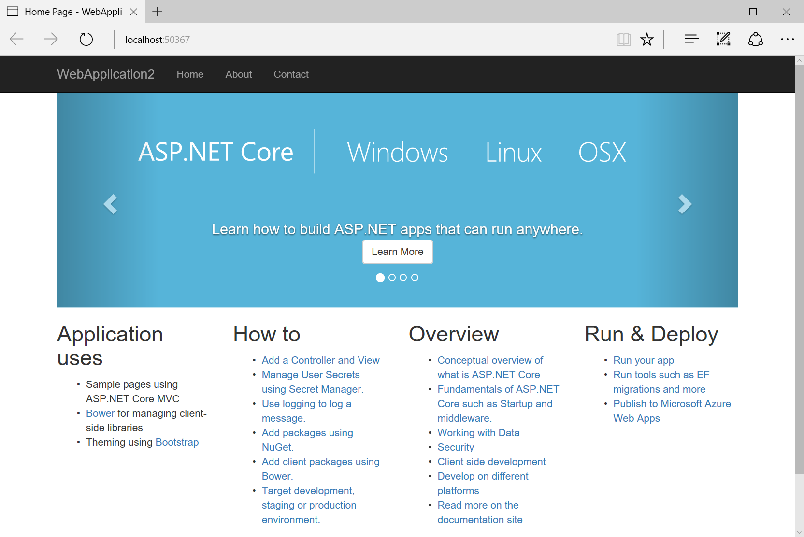
DEMO

Slide 67
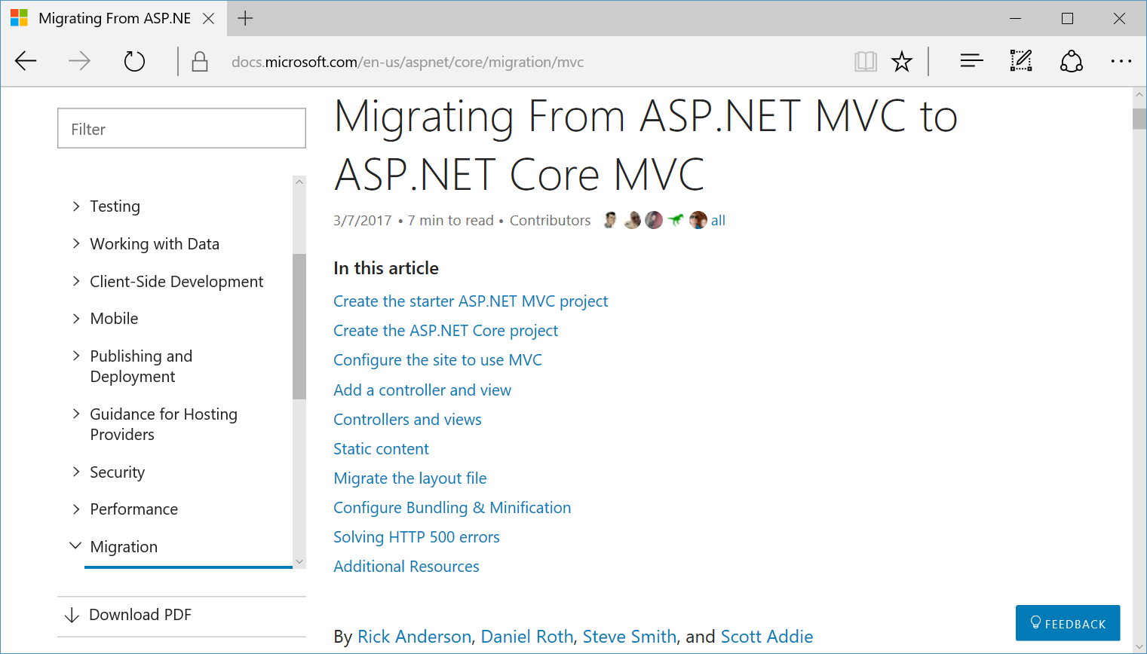
Migrating from MVC to MVC Core
https://docs.microsoft.com/en-us/aspnet/core/migration/mvc

Slide 68
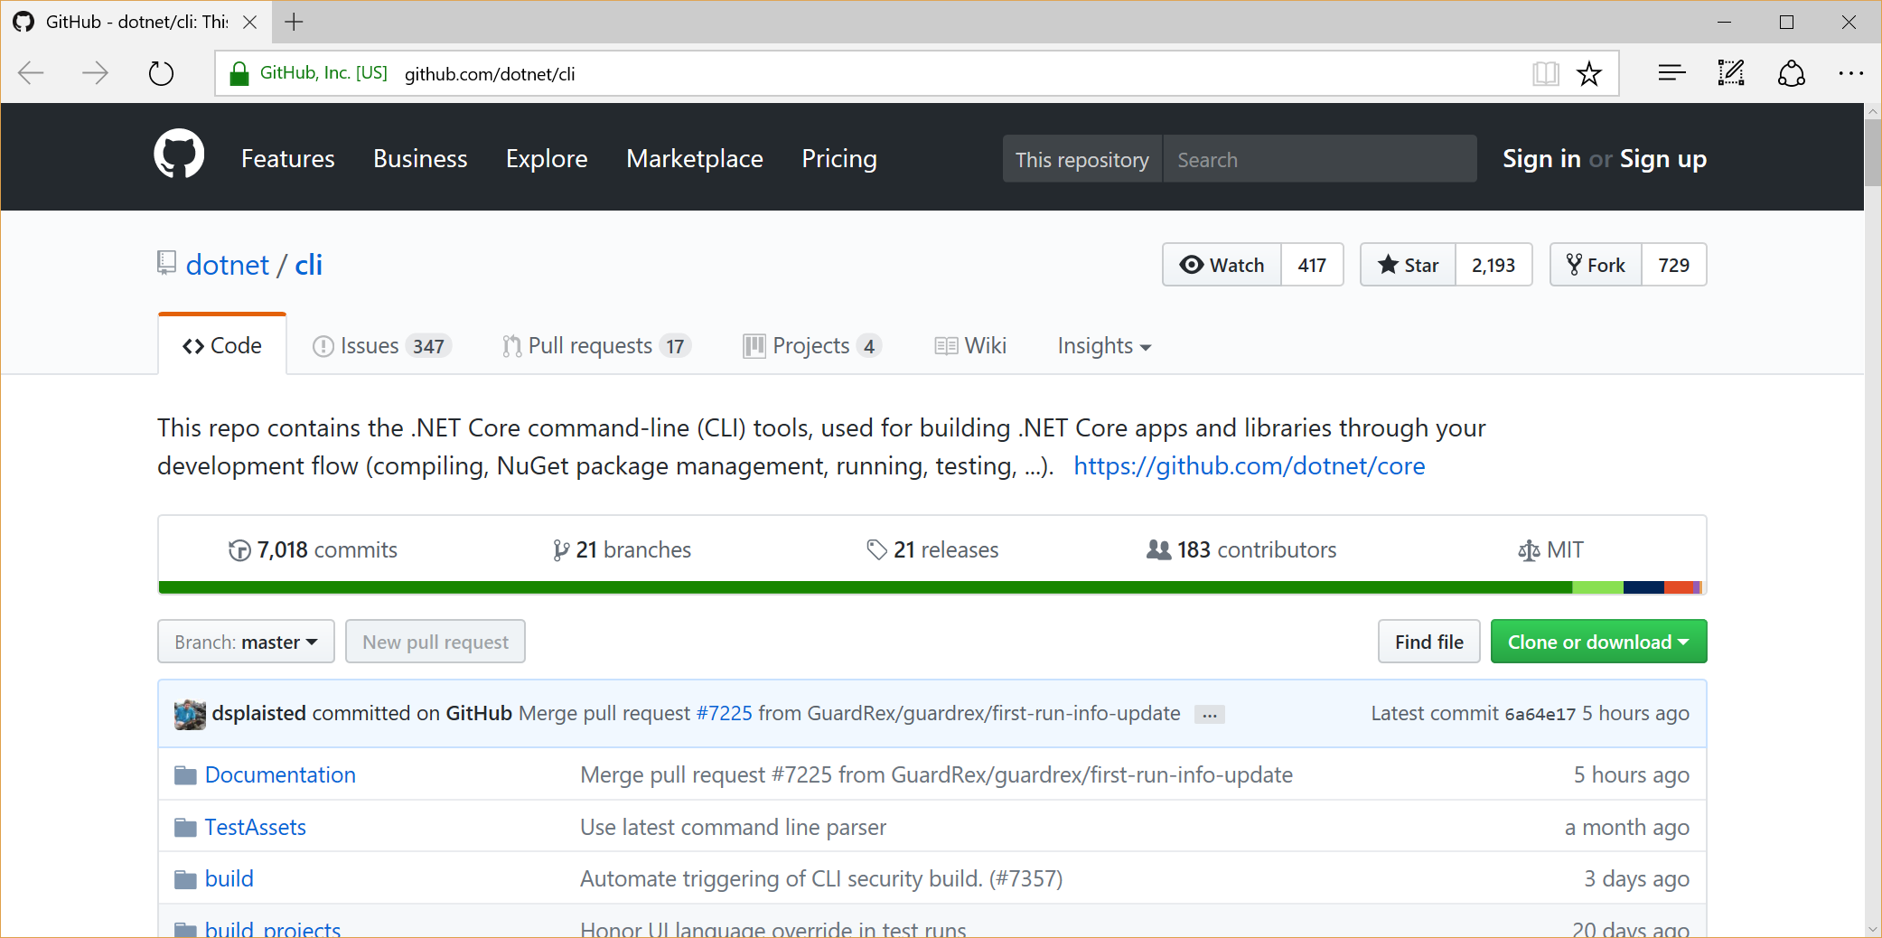
dotnet/cli on GitHub
This repo contains the .NET Core command-line (CLI) tools, used for building .NET Core apps and libraries.
GitHub: https://github.com/dotnet/cli

Slide 69
.NET Core 2.x CLI Commands
>dotnet --version
>dotnet --info
>dotnet new <TEMPLATE> --auth <AUTH_TYPE> -o <OUTPUT_DIR>
<TEMPLATE> = web | mvc | razor | angular | react | webapi
<AUTH_TYPE> for mvc,razor = None | Individual | SingleOrg | Windows
>dotnet new console -o MyConsoleApp
>dotnet new mvc --auth Individual -o MyMvcWebApp
>dotnet restore
>dotnet build
>dotnet run
https://docs.microsoft.com/en-us/dotnet/core/tools/?tabs=netcore2x

Slide 70
Azure CLI Commands
>az login
>az group create -l <REGION> -n <RSG>
>az appservice plan create -g <RSG> -n <ASP> --sku <PLAN> (e.g. F1)
>az webapp create -g <RSG> -p <ASP> -n <APP>
RESULT → http://<APP>.azurewebsites.net
>git init
>git add .
>git commit -m "<COMMIT MESSAGE>“
>az webapp deployment user set --user-name <USER>
>az webapp deployment source config-local-git -g <RSG> -n <APP> --out tsv
>git remote add azure <GIT URL>
>git push azure master
GIT URL → https://<USER>@<APP>.scm.azurewebsites.net/<APP>.git
https://docs.microsoft.com/en-us/azure/app-service/scripts/app-service-cli-deploy-github

Slide 71
Agenda
Introduction
> .NET (Framework & Core)
> ASP.NET Core
> Visual Studio & VS Code
References + Wrap-up
Notes:
Agenda

Slide 72
References
& Wrap-up
Notes:
Introduction

Slide 73
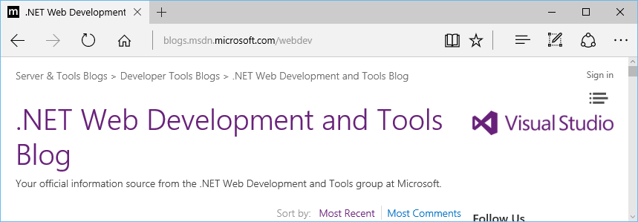
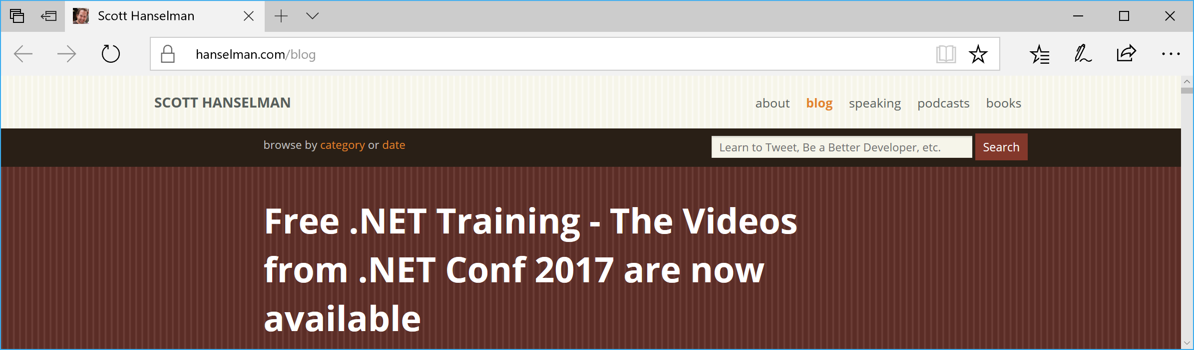
Blog Sources
.NET Web Dev Blog: https://blogs.msdn.microsoft.com/webdev/
Scott Hanselman’s Blog: https://www.hanselman.com/blog/

Slide 74
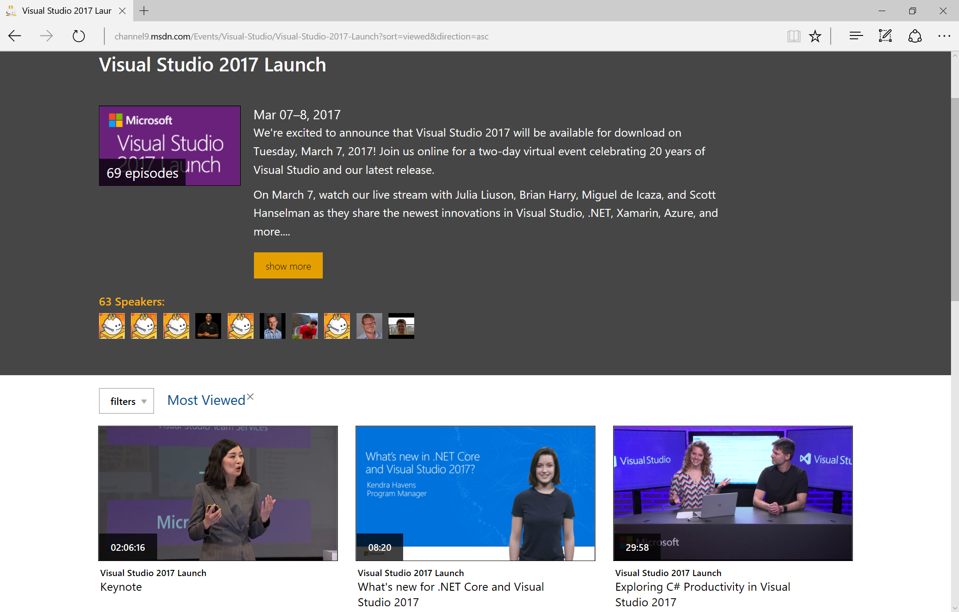
Visual Studio 2017 Launch Videos
https://channel9.msdn.com/Events/Visual-Studio/Visual-Studio-2017-Launch?sort=viewed&direction=asc

Slide 75
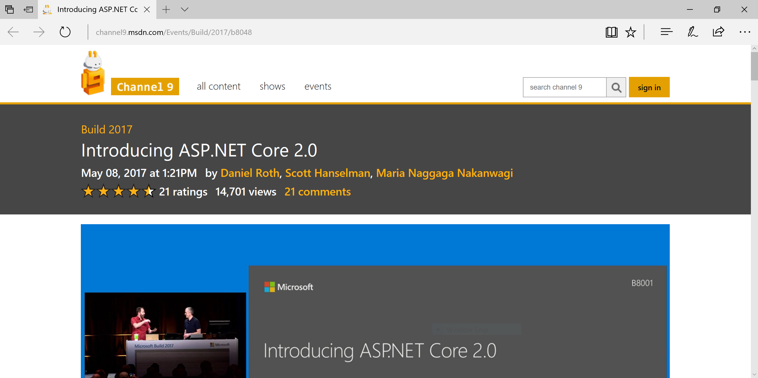
Build 2017: ASP .NET Core 2.0
https://channel9.msdn.com/Events/Build/2017/b8048

Slide 76
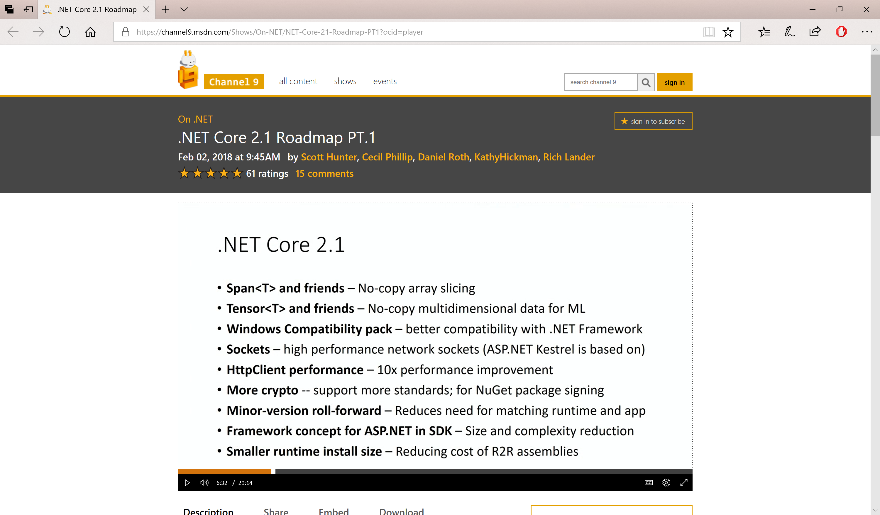
.NET Core 2.1 Roadmap PT.1
https://channel9.msdn.com/Shows/On-NET/NET-Core-21-Roadmap-PT1

Slide 77
.NET Core 2.1 Roadmap PT.2
https://channel9.msdn.com/Shows/On-NET/NET-Core-21-Roadmap-PT2

Slide 78
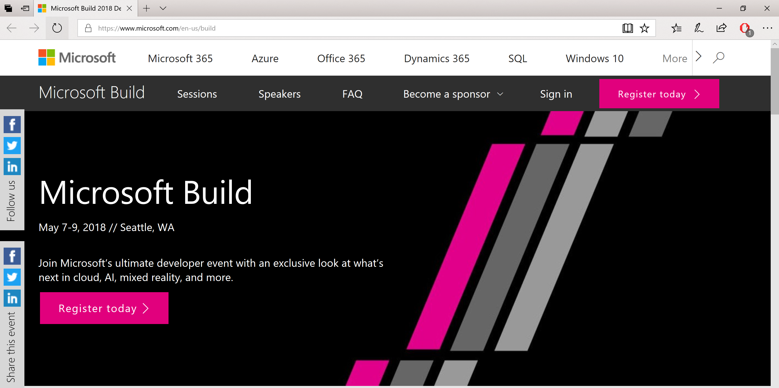
Build Conference 2018
http://build.microsoft.com

Slide 79
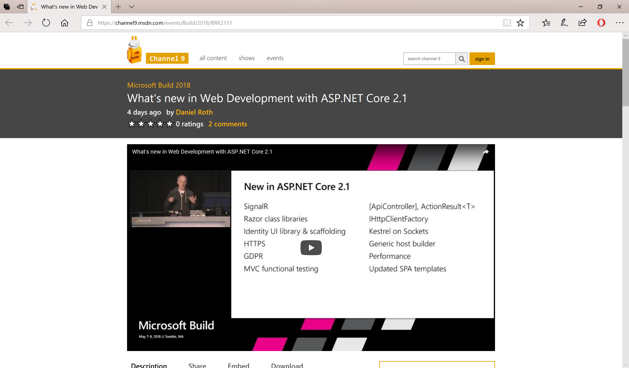
Build 2018: ASP .NET Core 2.1
https://channel9.msdn.com/events/Build/2018/BRK2151

Slide 80
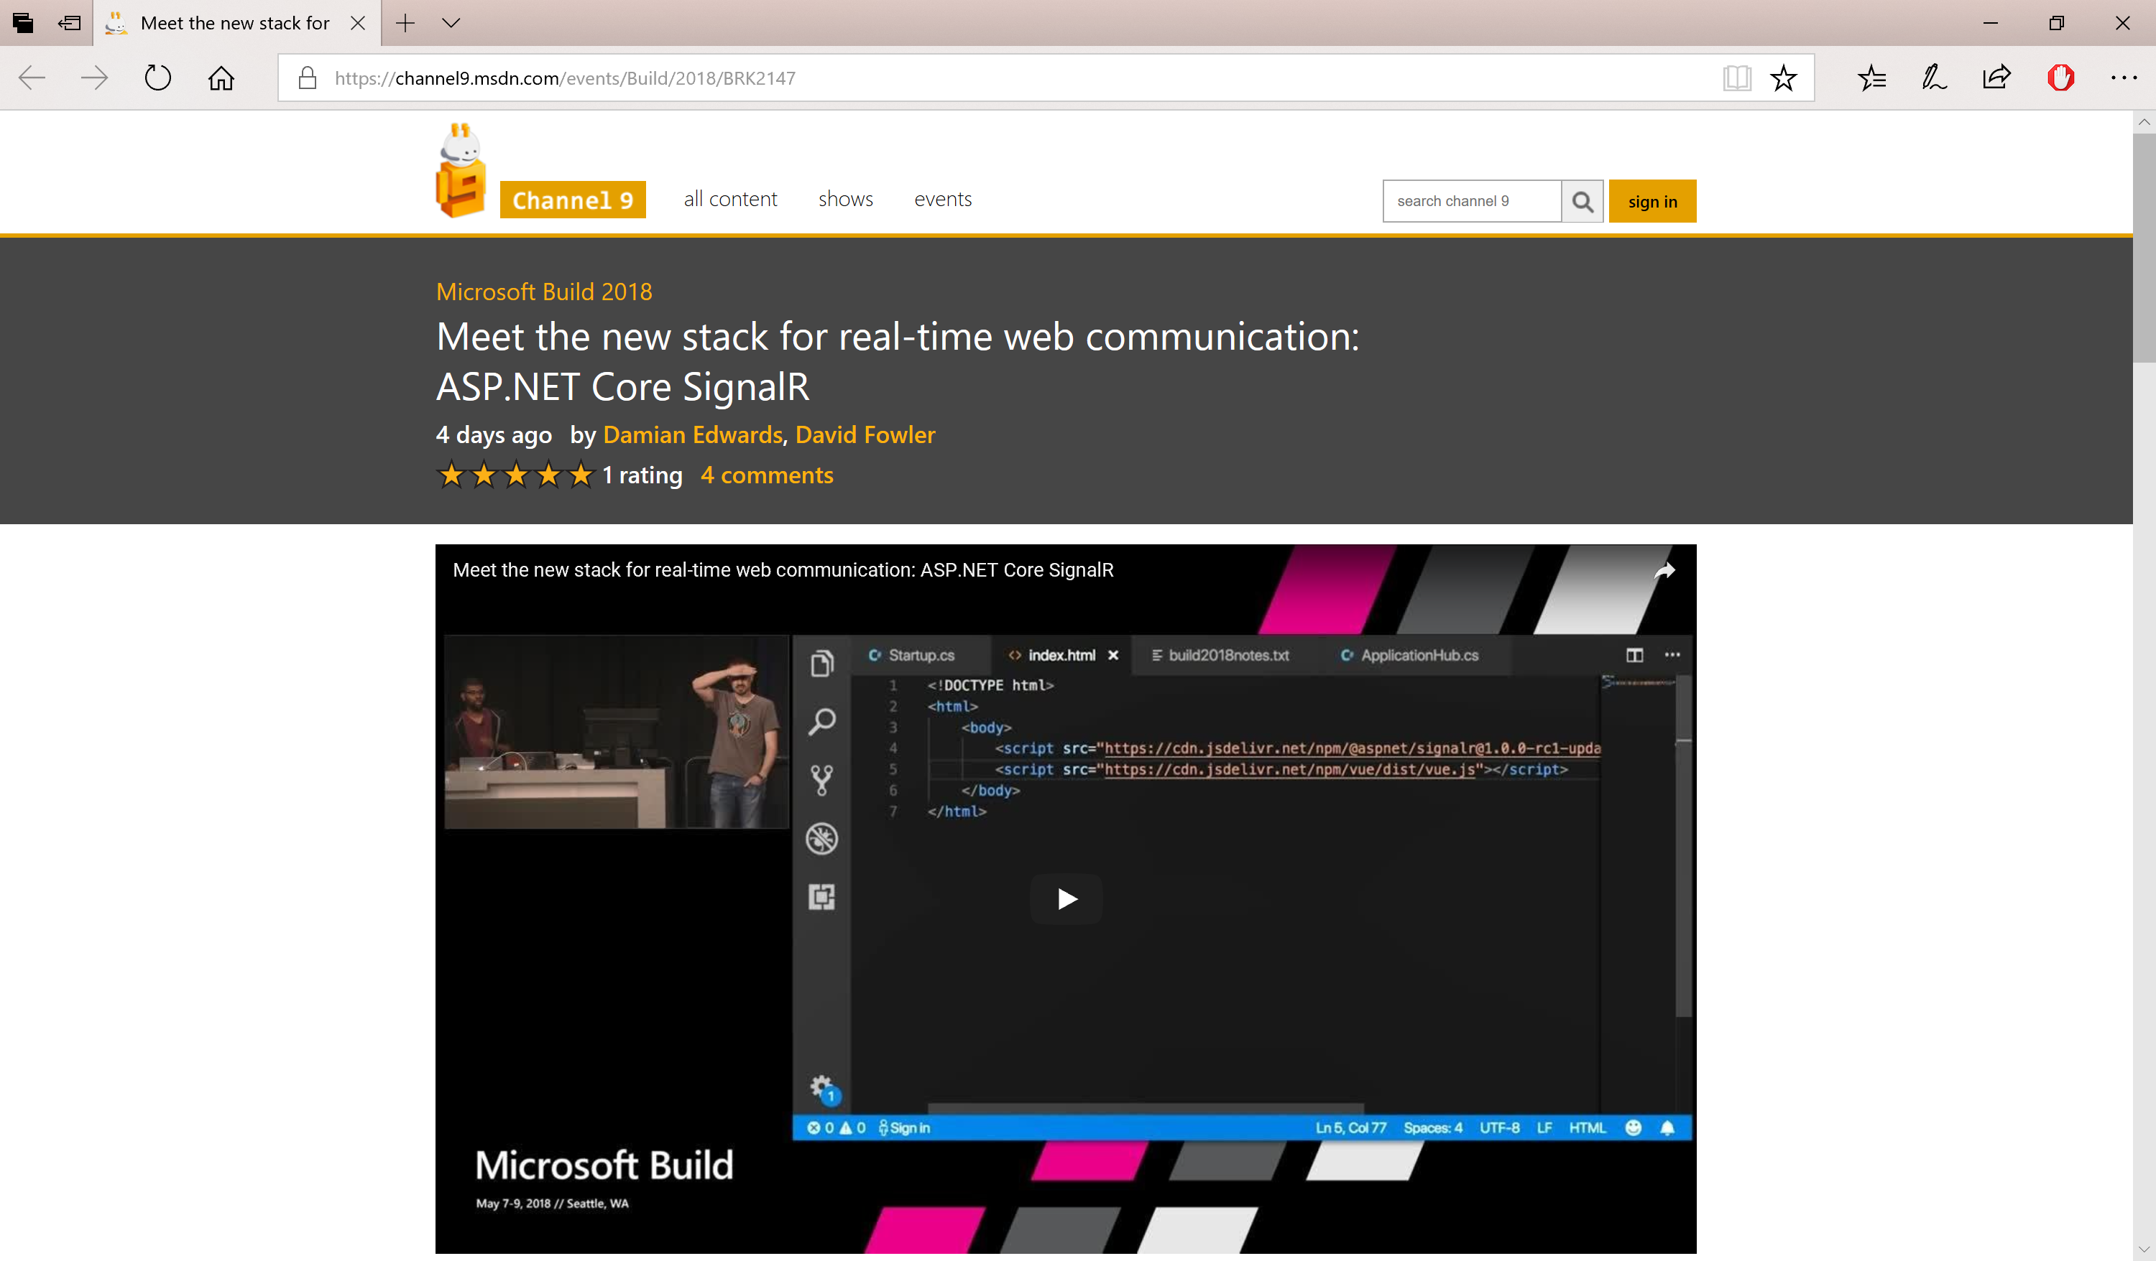
SignalR for ASP .NET Core 2.1
https://channel9.msdn.com/events/Build/2018/BRK2147

Slide 81
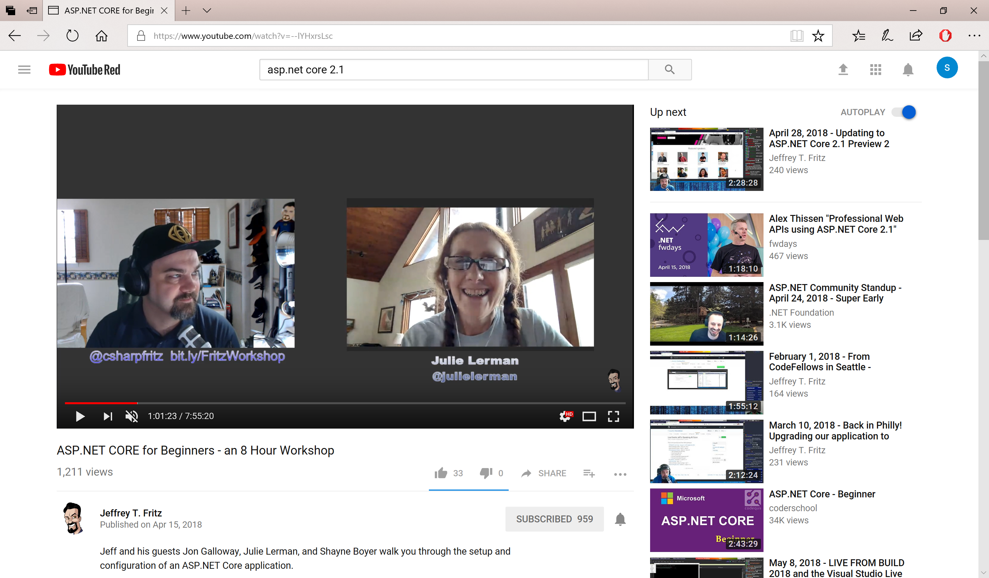

Jeff Fritz on YouTube
https://www.youtube.com/watch?v=--lYHxrsLsc

Slide 82


Other Video Sources
.NET Conf: http://www.dotnetconf.net
MSDN Channel 9: https://channel9.msdn.com

Slide 83


Docs + Tutorials
Docs: https://blogs.msdn.microsoft.com/webdev/2017/02/07/asp-net-documentation-now-on-docs-microsoft-com/
Tutorials: https://docs.microsoft.com/en-us/aspnet/core/tutorials/first-mvc-app/

Slide 84

ASP.NET Core 2.0 Release
https://blogs.msdn.microsoft.com/webdev/2017/08/14/announcing-asp-net-core-2-0/

Slide 85

ASP.NET Core 2.1 Roadmap
https://blogs.msdn.microsoft.com/webdev/2018/02/02/asp-net-core-2-1-roadmap/

Slide 86

.NET Core Roadmap
https://github.com/dotnet/core/blob/master/roadmap.md

Slide 87

ASP.NET Core 2.1 RC
https://blogs.msdn.microsoft.com/webdev/2018/05/07/asp-net-core-2-1-0-rc1-now-available/

Slide 88

ASP.NET Core 2.1 Released
https://blogs.msdn.microsoft.com/dotnet/2018/05/30/announcing-net-core-2-1/

Slide 89
MEAN Stack…?

Slide 90

NICE Stack!
.NET
IIS (optional)
C#
Entity Framework
nicestack.io

Slide 91
References
ASP .NET: http://www.asp.net
.NET Core: https://www.microsoft.com/net
.NET Web Dev Blog: https://blogs.msdn.microsoft.com/webdev
Scott Hanselman’s Blog: https://www.hanselman.com/blog
.NET Conf: http://www.dotnetconf.net
MSDN Channel 9: https://channel9.msdn.com
Tutorials: https://docs.microsoft.com/en-us/aspnet/core/tutorials/first-mvc-app
C# 7: https://docs.microsoft.com/en-us/dotnet/articles/csharp/csharp-7
ASP.NET Core Roadmap: https://github.com/aspnet/Home/wiki/Roadmap
.NET Core Roadmap: https://github.com/dotnet/core/blob/master/roadmap.md

Slide 92
Other Resources
New Razor Pages: http://www.hishambinateya.com/welcome-razor-pages
Intro to Razor: https://docs.microsoft.com/en-us/aspnet/core/mvc/razor-pages
Live Unit Testing: https://blogs.msdn.microsoft.com/visualstudio/2016/11/18/live-unit-testing-visual-studio-2017-rc
Migrating from MVC to MVC Core: https://docs.microsoft.com/en-us/aspnet/core/migration/mvc
Visual Studio Code: https://code.visualstudio.com
dotnet/cli on GitHub: https://github.com/dotnet/cli

Slide 93
Q & A
Notes:
Additional Topics

Slide 94
Agenda
Introduction
> .NET (Framework & Core)
> ASP.NET Core
> Visual Studio & VS Code
References + Wrap-up
Notes:
Agenda

Slide 95

Email: shchowd@microsoft.com  Twitter: @shahedC
Notes:
Contact
Microsoft email: shchowd@microsoft.com
Personal Twitter: @shahedC
Dev Blog: WakeUpAndCode.com

