Slide 1
ASP.NET Core 2.0
The Future of Web Apps
Shahed Chowdhuri
Sr. Technical Evangelist @ Microsoft
@shahedC
WakeUpAndCode.com

Slide 2
Agenda
Introduction
> .NET (Framework & Core)
> ASP.NET Core
> Visual Studio
Wrap-up + Q&A
Notes:
Agenda

Slide 3
Introduction
Notes:
Introduction

Slide 4
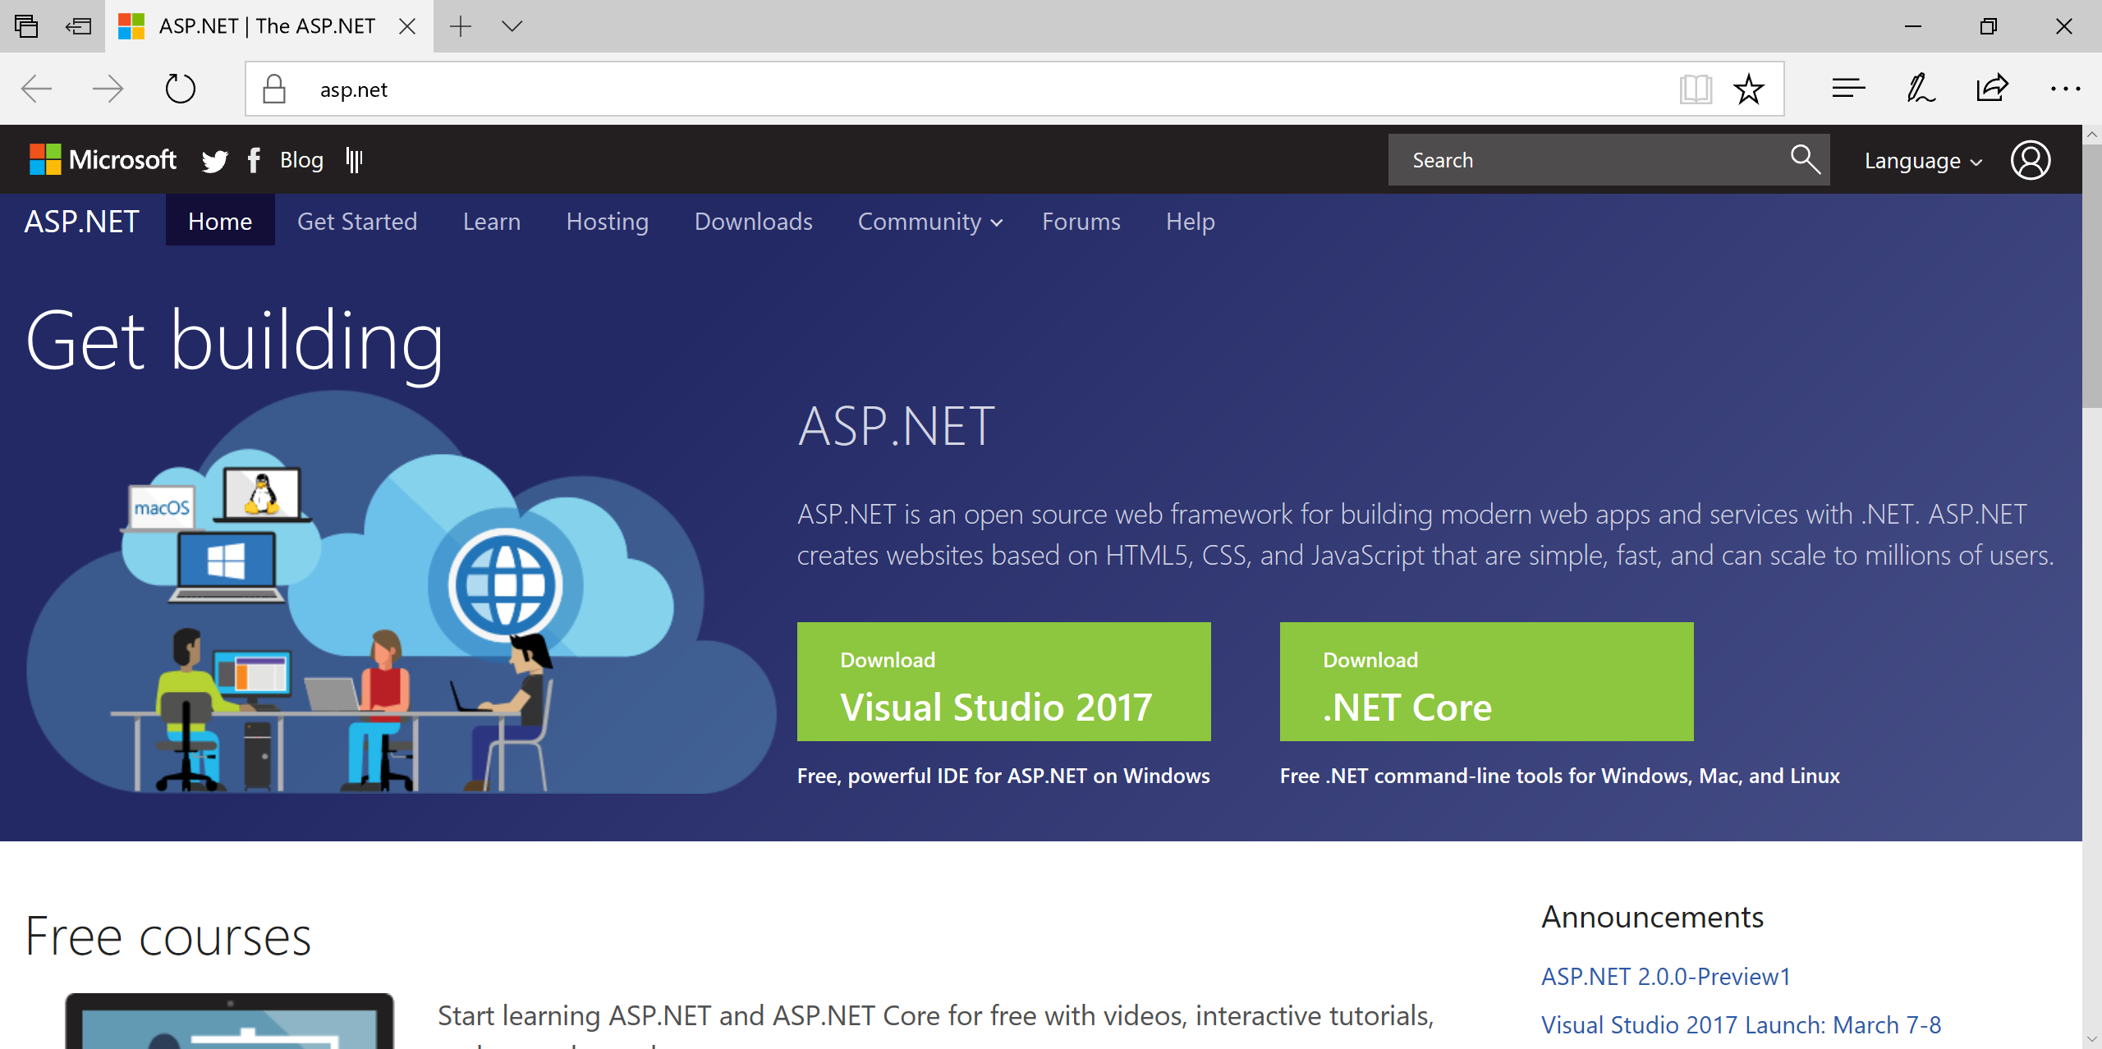
ASP.NET Core 2.0
Info and Downloads: http://www.asp.net/

Slide 5
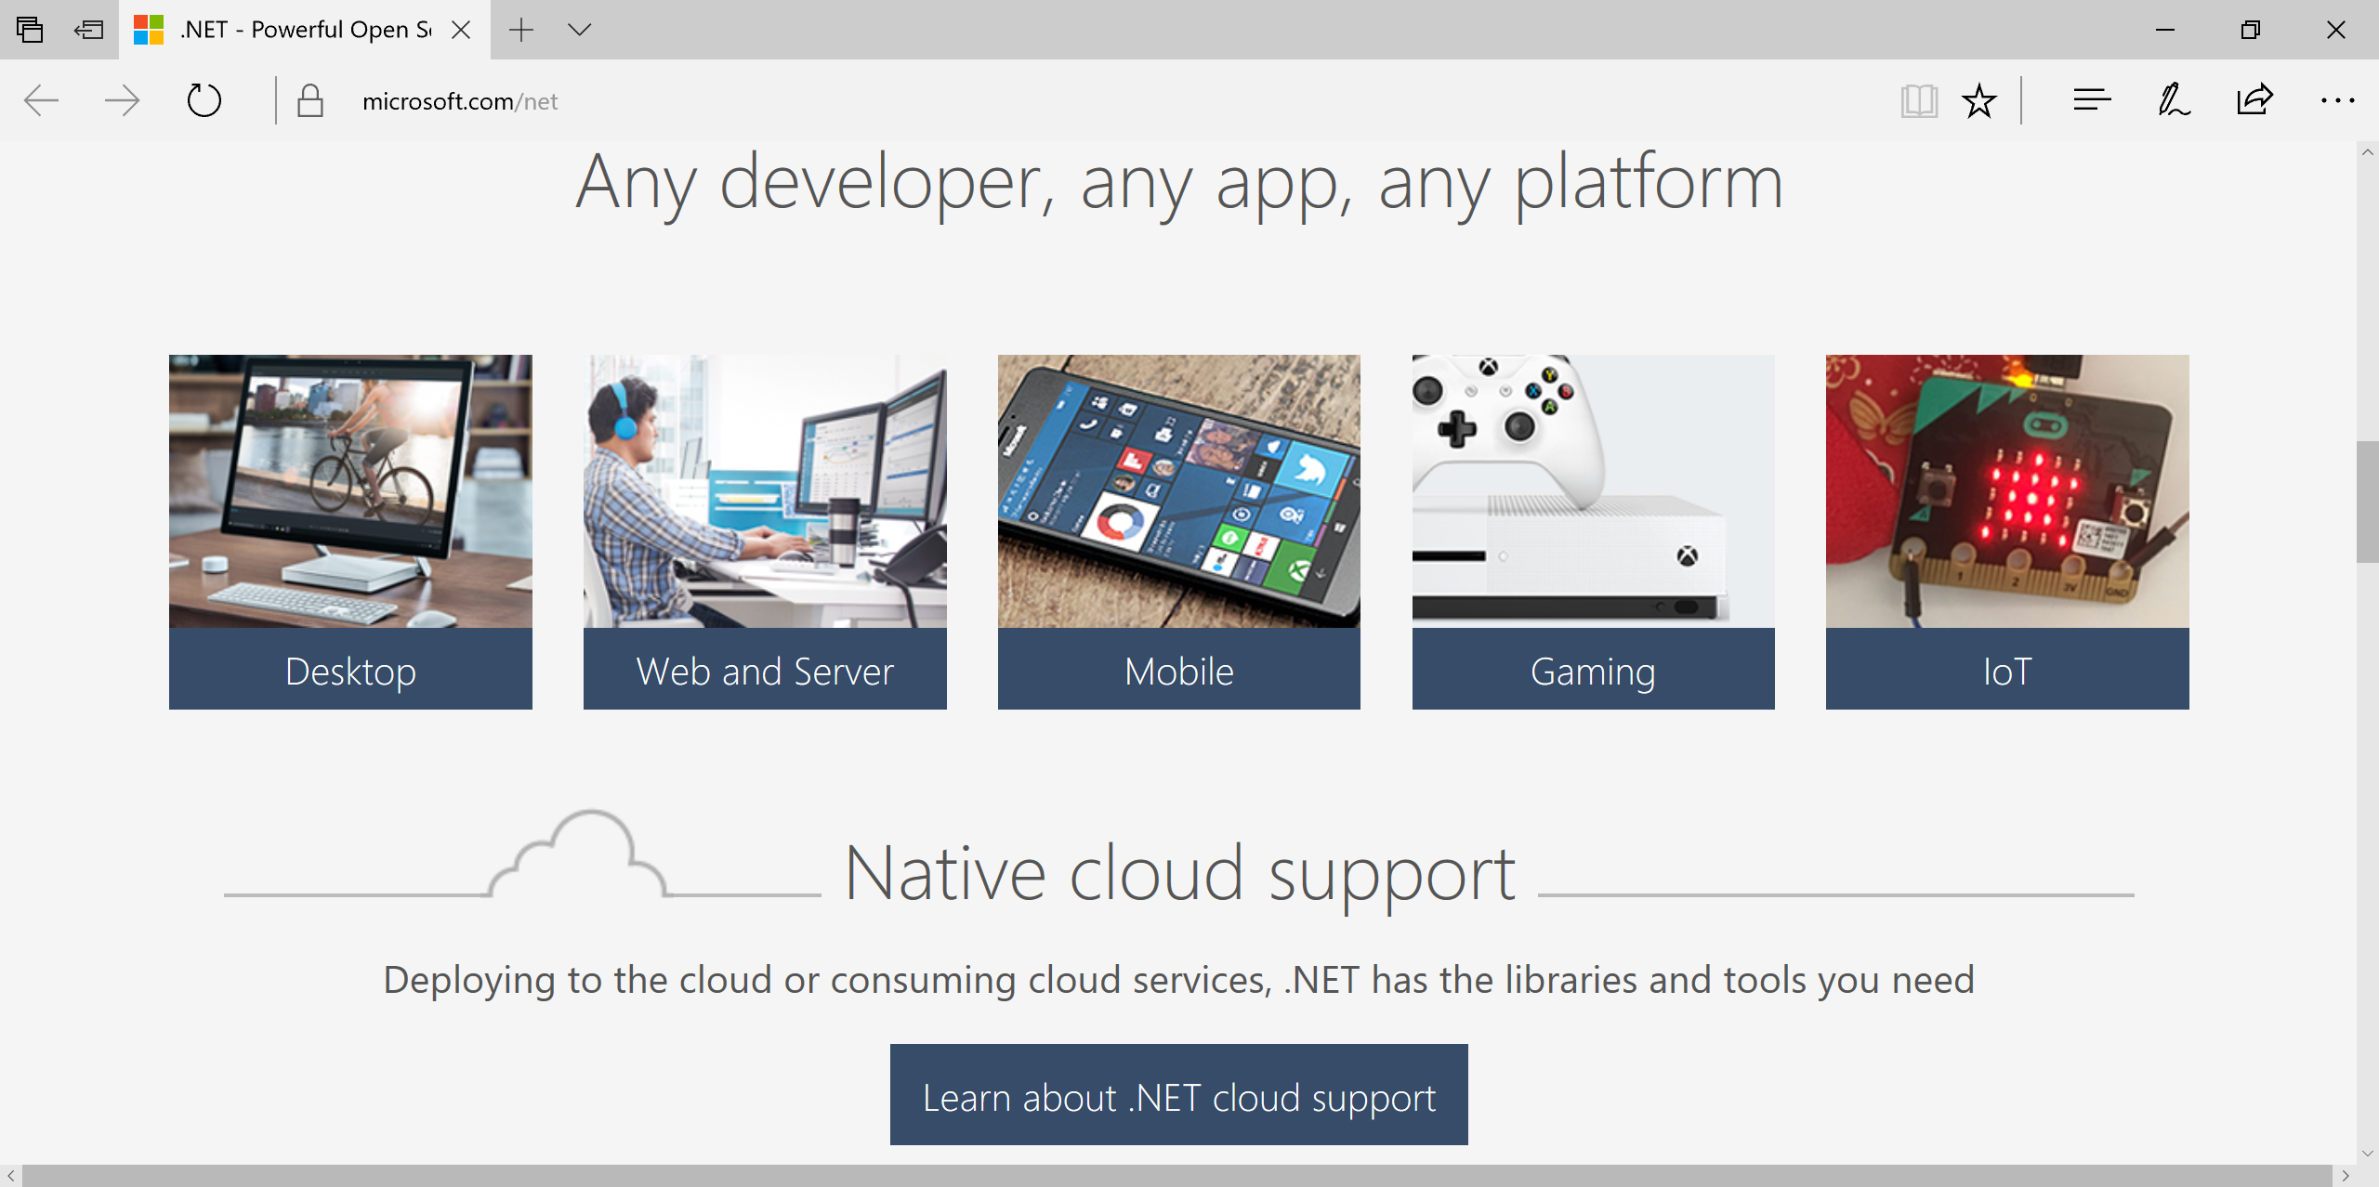
.NET Core for Cross-Platform Dev
.NET Core: https://www.microsoft.com/net

Slide 6
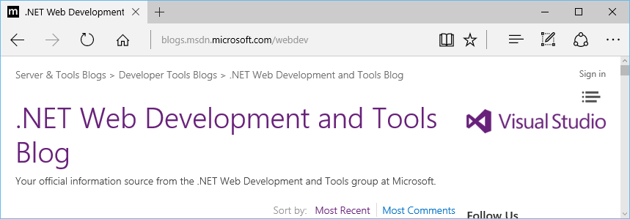
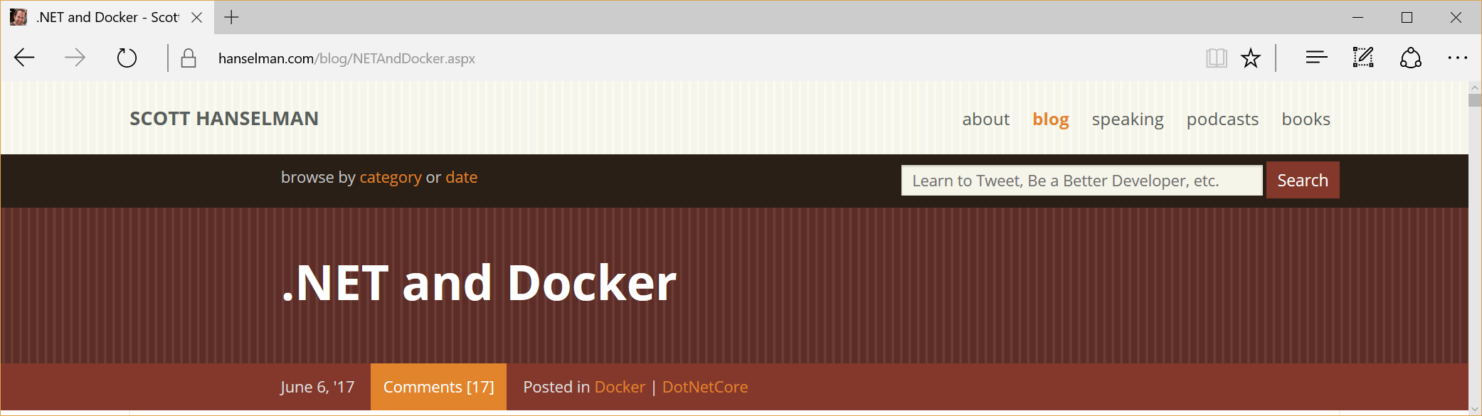
Blog Sources
.NET Web Dev Blog: https://blogs.msdn.microsoft.com/webdev/
Scott Hanselman’s Blog: https://www.hanselman.com/blog/

Slide 7
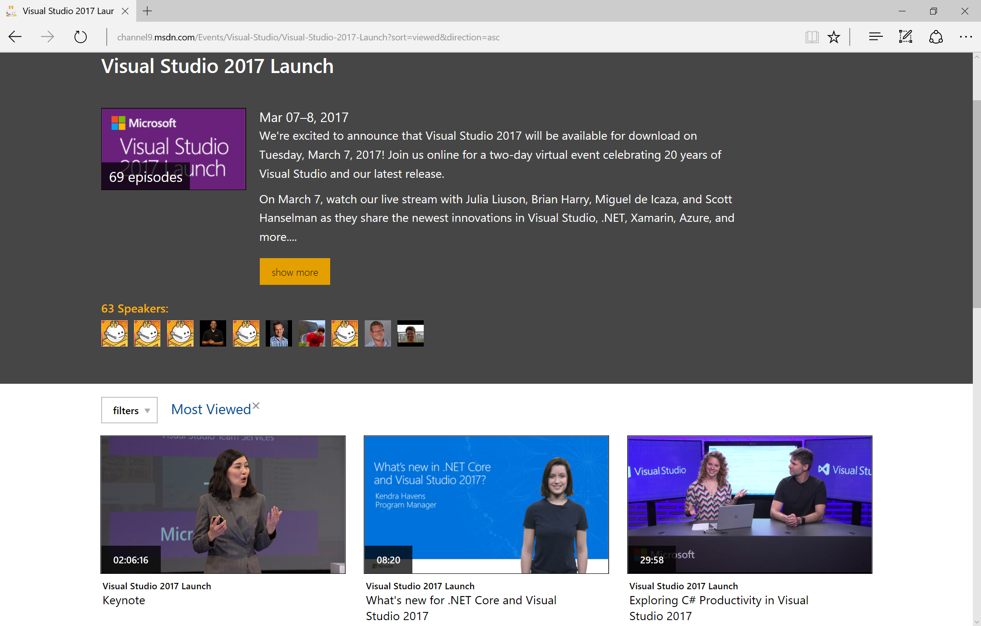
Visual Studio 2017 Launch Videos
https://channel9.msdn.com/Events/Visual-Studio/Visual-Studio-2017-Launch?sort=viewed&direction=asc

Slide 8
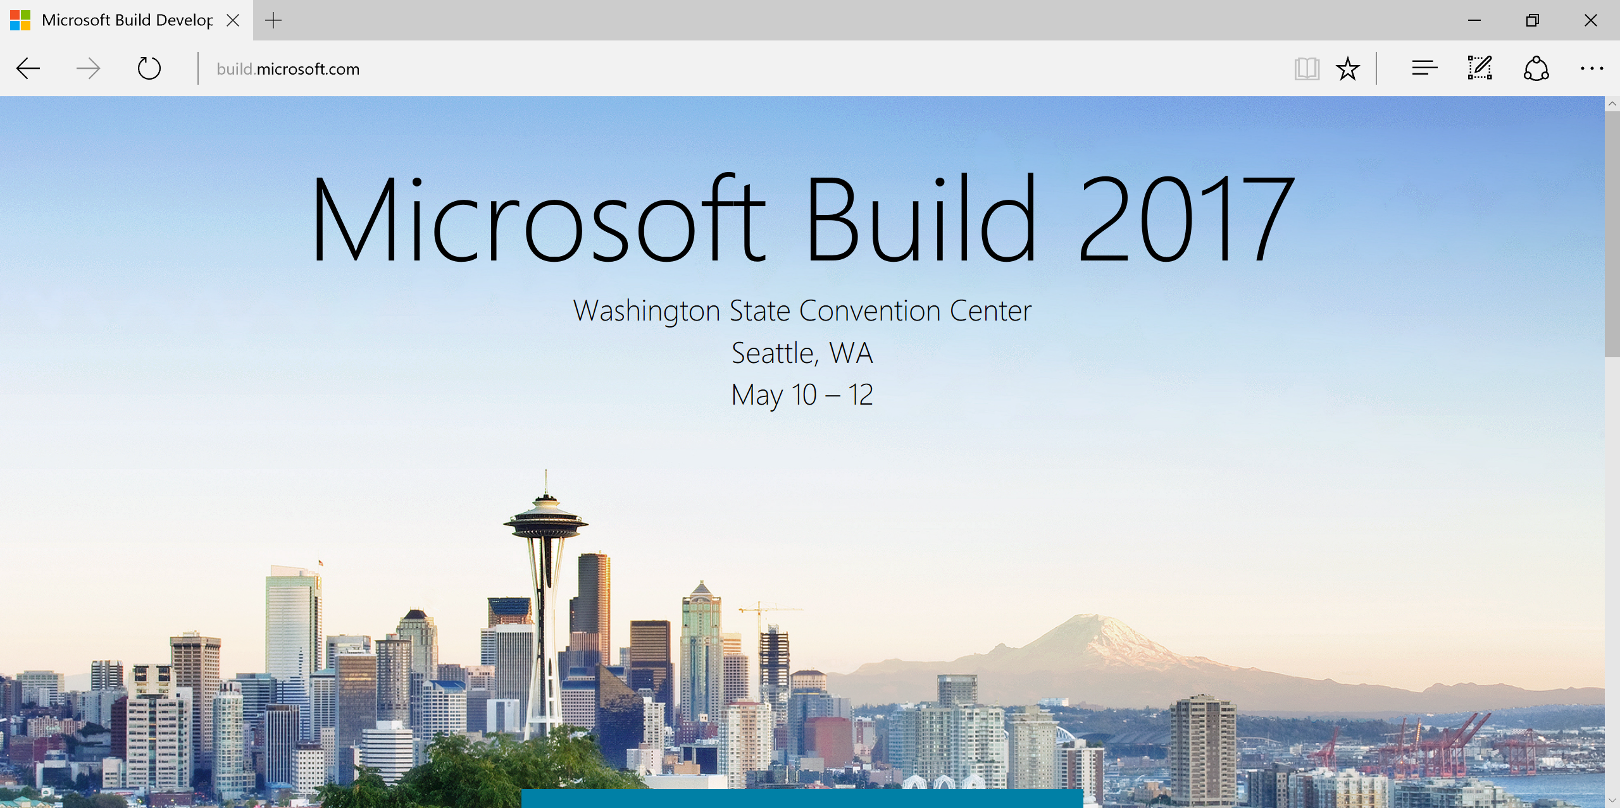
Build Conference
http://build.microsoft.com

Slide 9
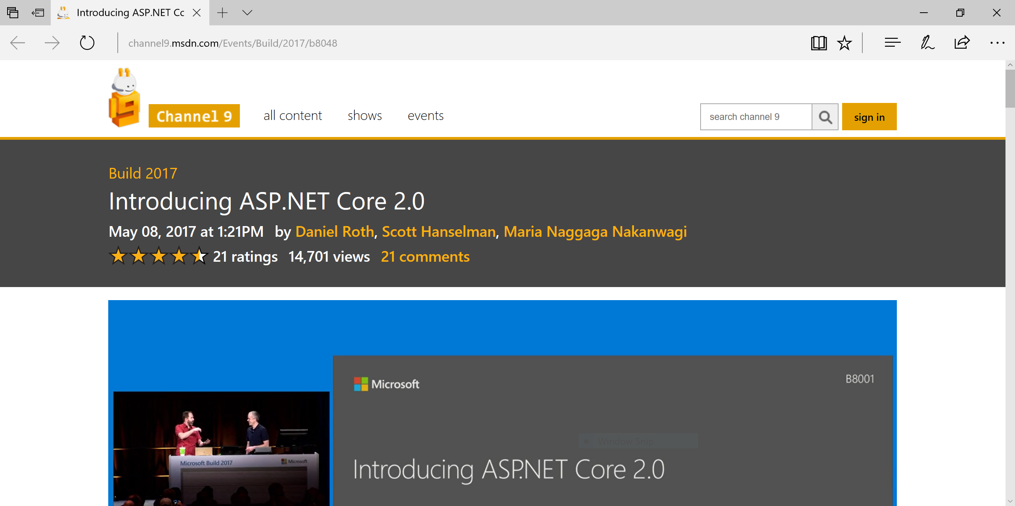
Build 2017: ASP .NET Core 2.0
https://channel9.msdn.com/Events/Build/2017/b8048

Slide 10
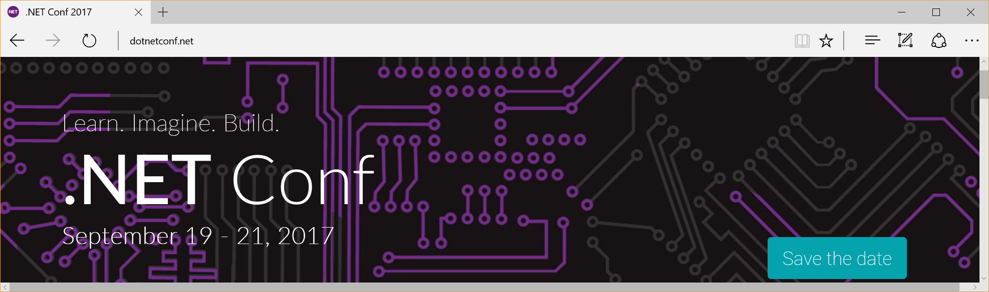
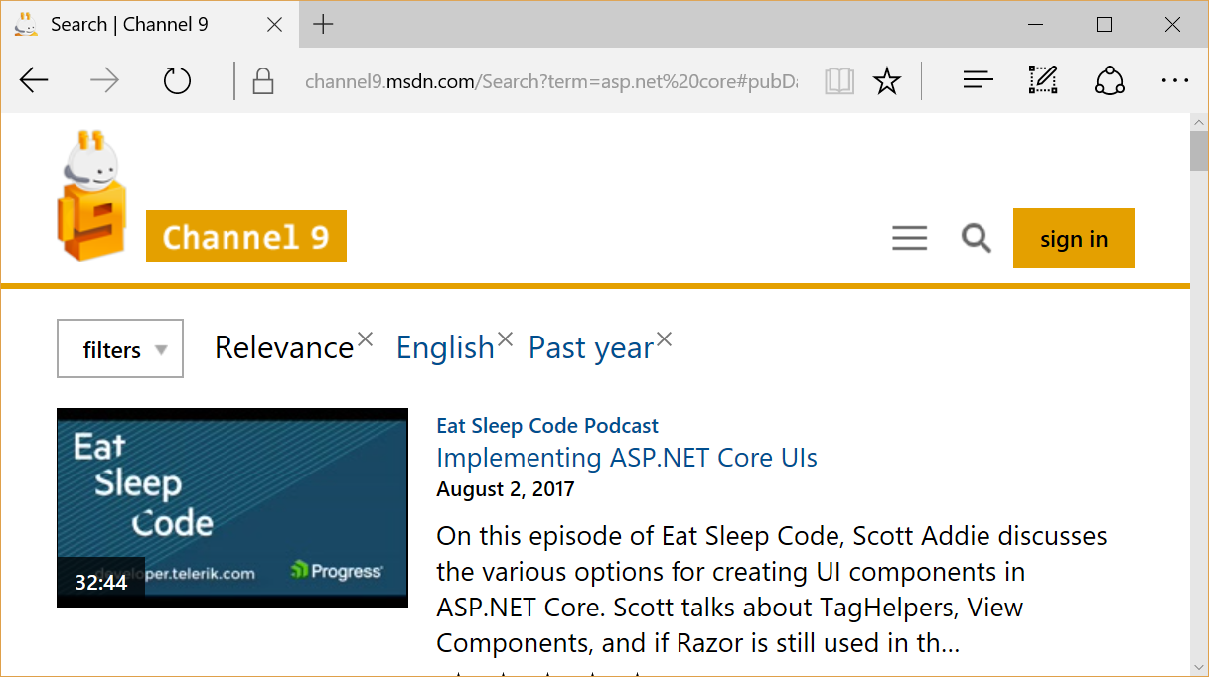
Other Video Sources
.NET Conf 2017: http://www.dotnetconf.net
MSDN Channel 9: https://channel9.msdn.com

Slide 11
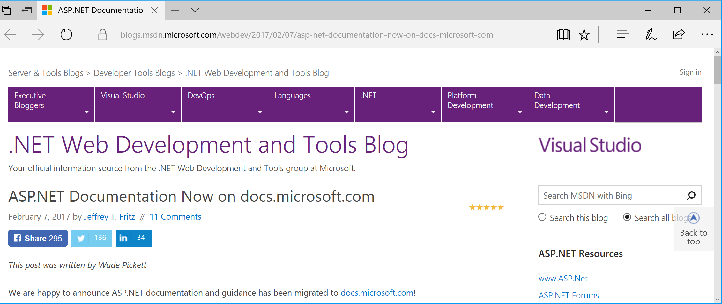
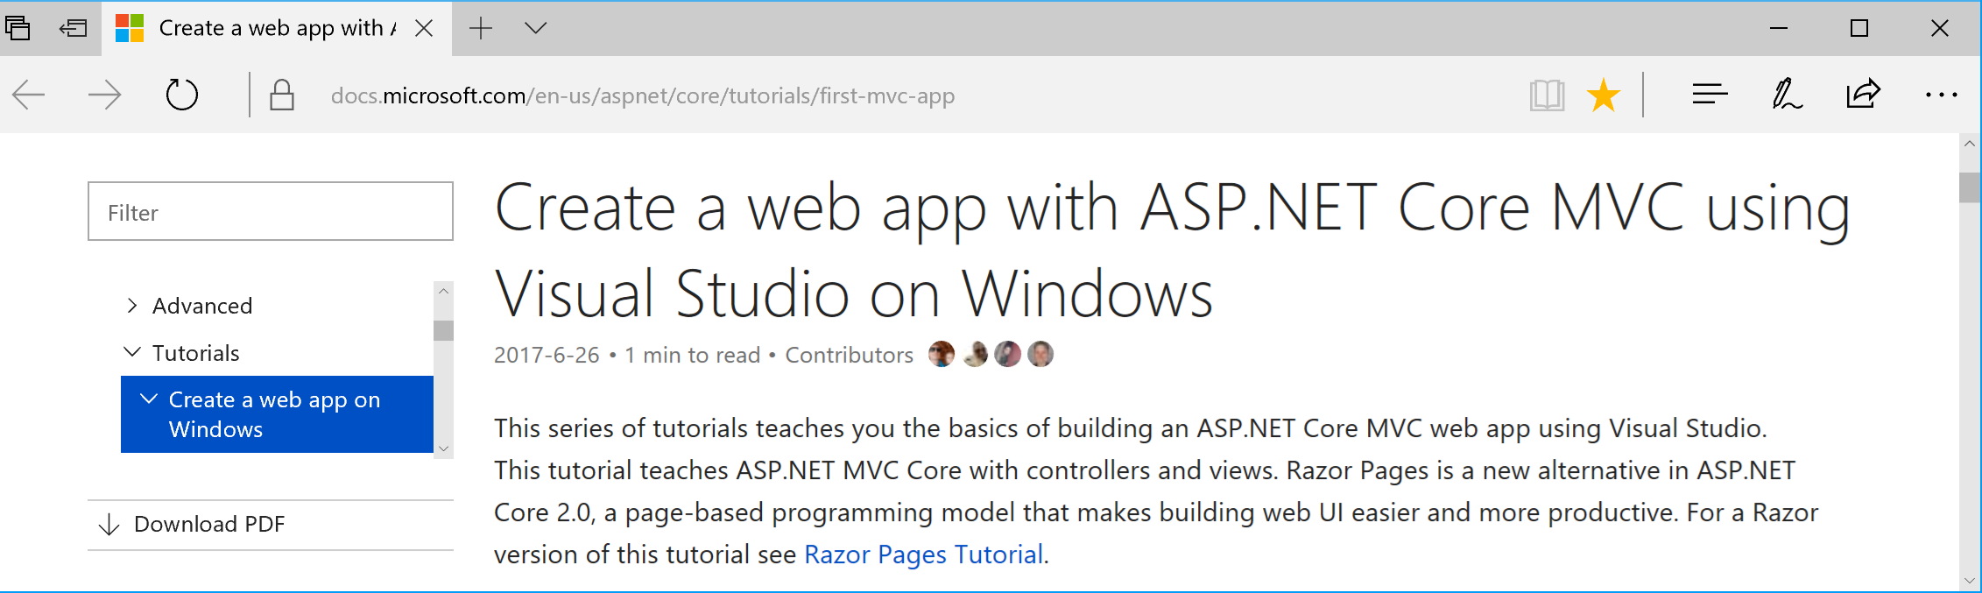
Docs + Tutorials
Docs: https://blogs.msdn.microsoft.com/webdev/2017/02/07/asp-net-documentation-now-on-docs-microsoft-com/
Tutorials: https://docs.microsoft.com/en-us/aspnet/core/tutorials/first-mvc-app/

Slide 12
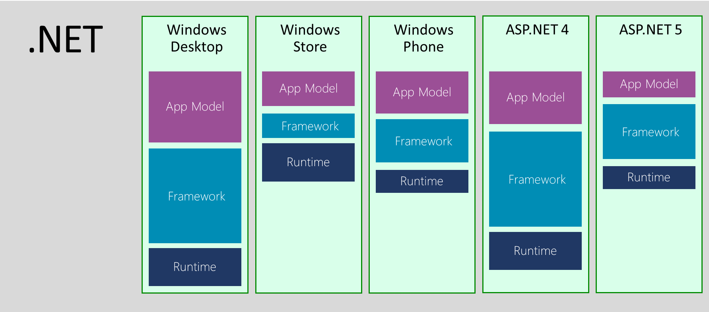
.NET Across Windows/Web Platforms
Source: http://blogs.msdn.com/b/dotnet/archive/2014/12/04/introducing-net-core.aspx

Slide 13


.NET Standard in 2017
WINDOWS
DESKTOP
CLOUD MICROSERVICES
WINDOWS
UWP
IOS,
ANDROID
GAMES/
3D
Visual Studio
.NET STANDARD
Visual Studio for Mac
INFRASTRUCTURE
COMPILERS
LANGUAGES
RUNTIME COMPONENTS
Visual Studio Code
.NET Standard allows sharing code, binaries, and skills between .NET client,
server, and all flavors
.NET Standard provides a specification for any platform to implement
All .NET runtimes provided by Microsoft implement the standard

Slide 14
Evolution of ASP and ASP .NET
Active Server Pages
(Classic ASP)
ASP.NET
(Web Forms)
ASP.NET
MVC
1/2/3/4/5
ASP.NET
Core MVC
Unified MVC, Web API and Razor Web Pages
ASP.NET
Web Pages
ASP.NET
Web API

Slide 15
Names & Version Numbers
C# 6.0
ASP.NET
Core MVC
C# 7.0
ASP.NET Core 2.0
(runs on .NET Core 2.x
or .NET Framework 4.5.2+)
SignalR 3
.NET Framework 4.6
.NET Framework 4.7
.NET Core 2.x

Slide 16
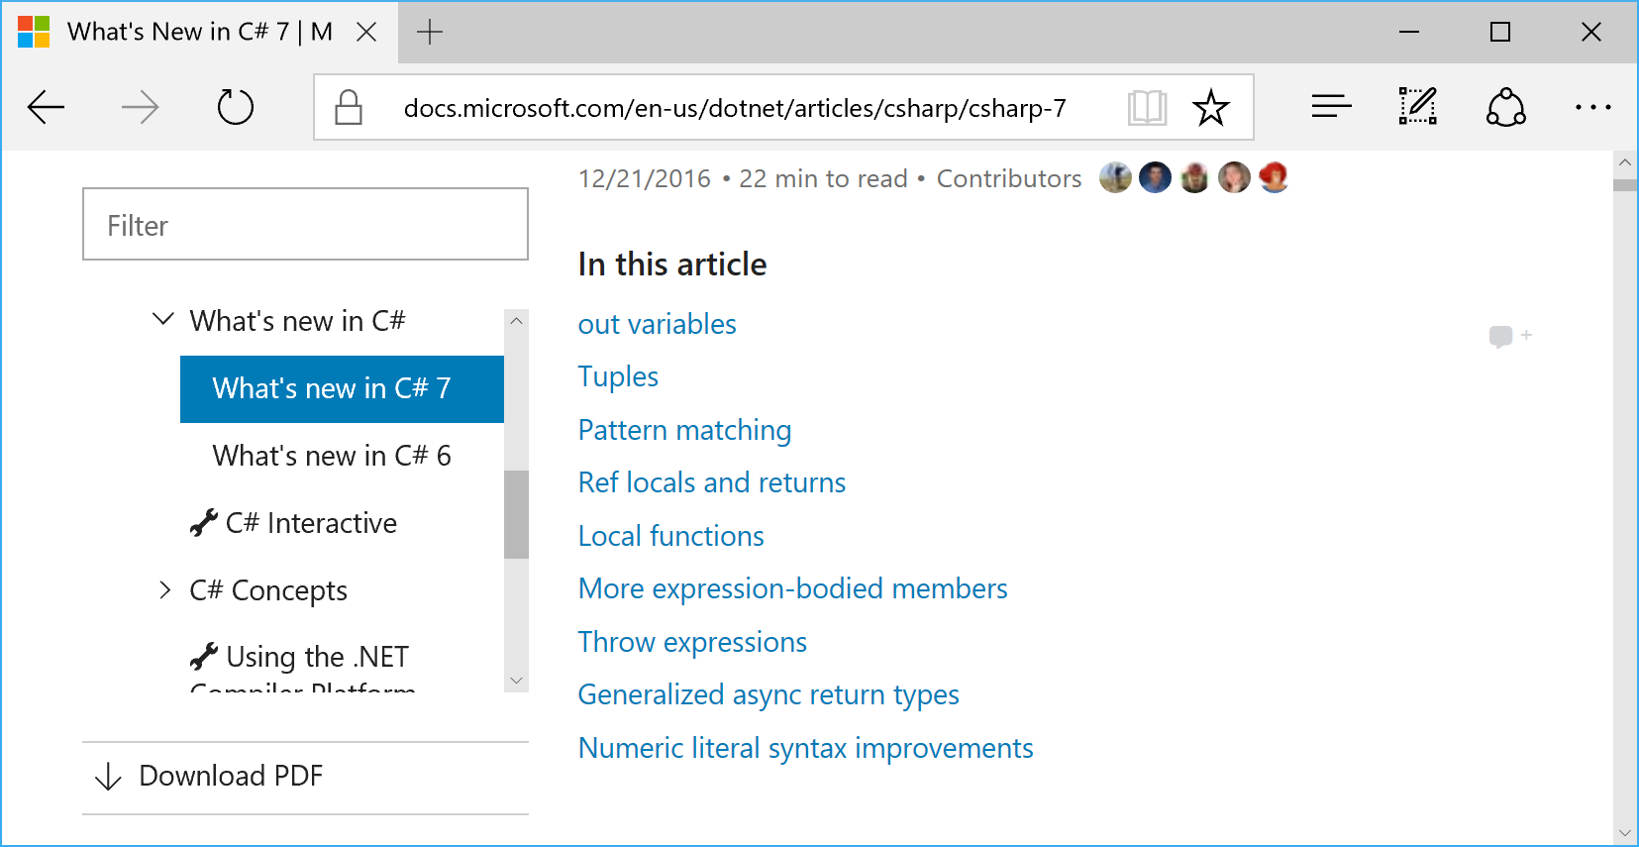
C# 7.0 in VS2017
https://docs.microsoft.com/en-us/dotnet/articles/csharp/csharp-7

Slide 17
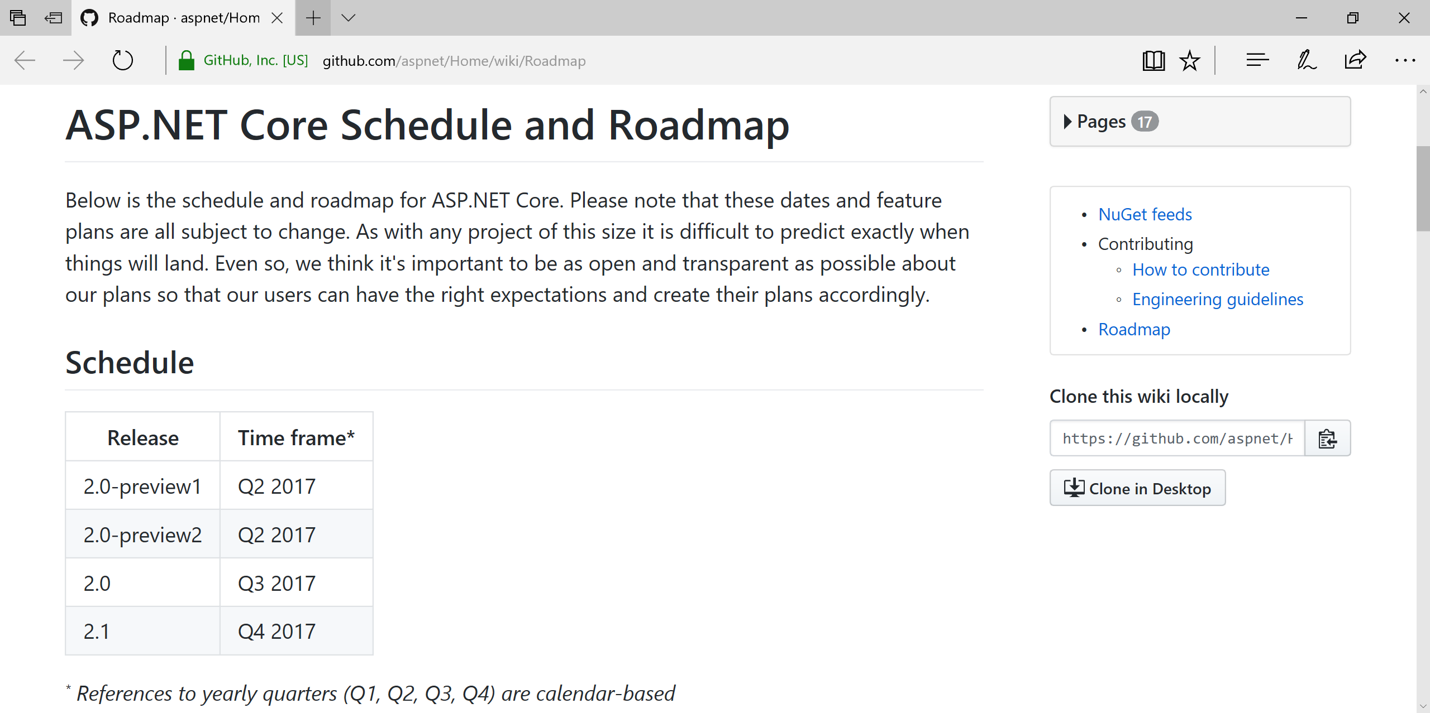
ASP.NET Core Roadmap
https://github.com/aspnet/Home/wiki/Roadmap

Slide 18
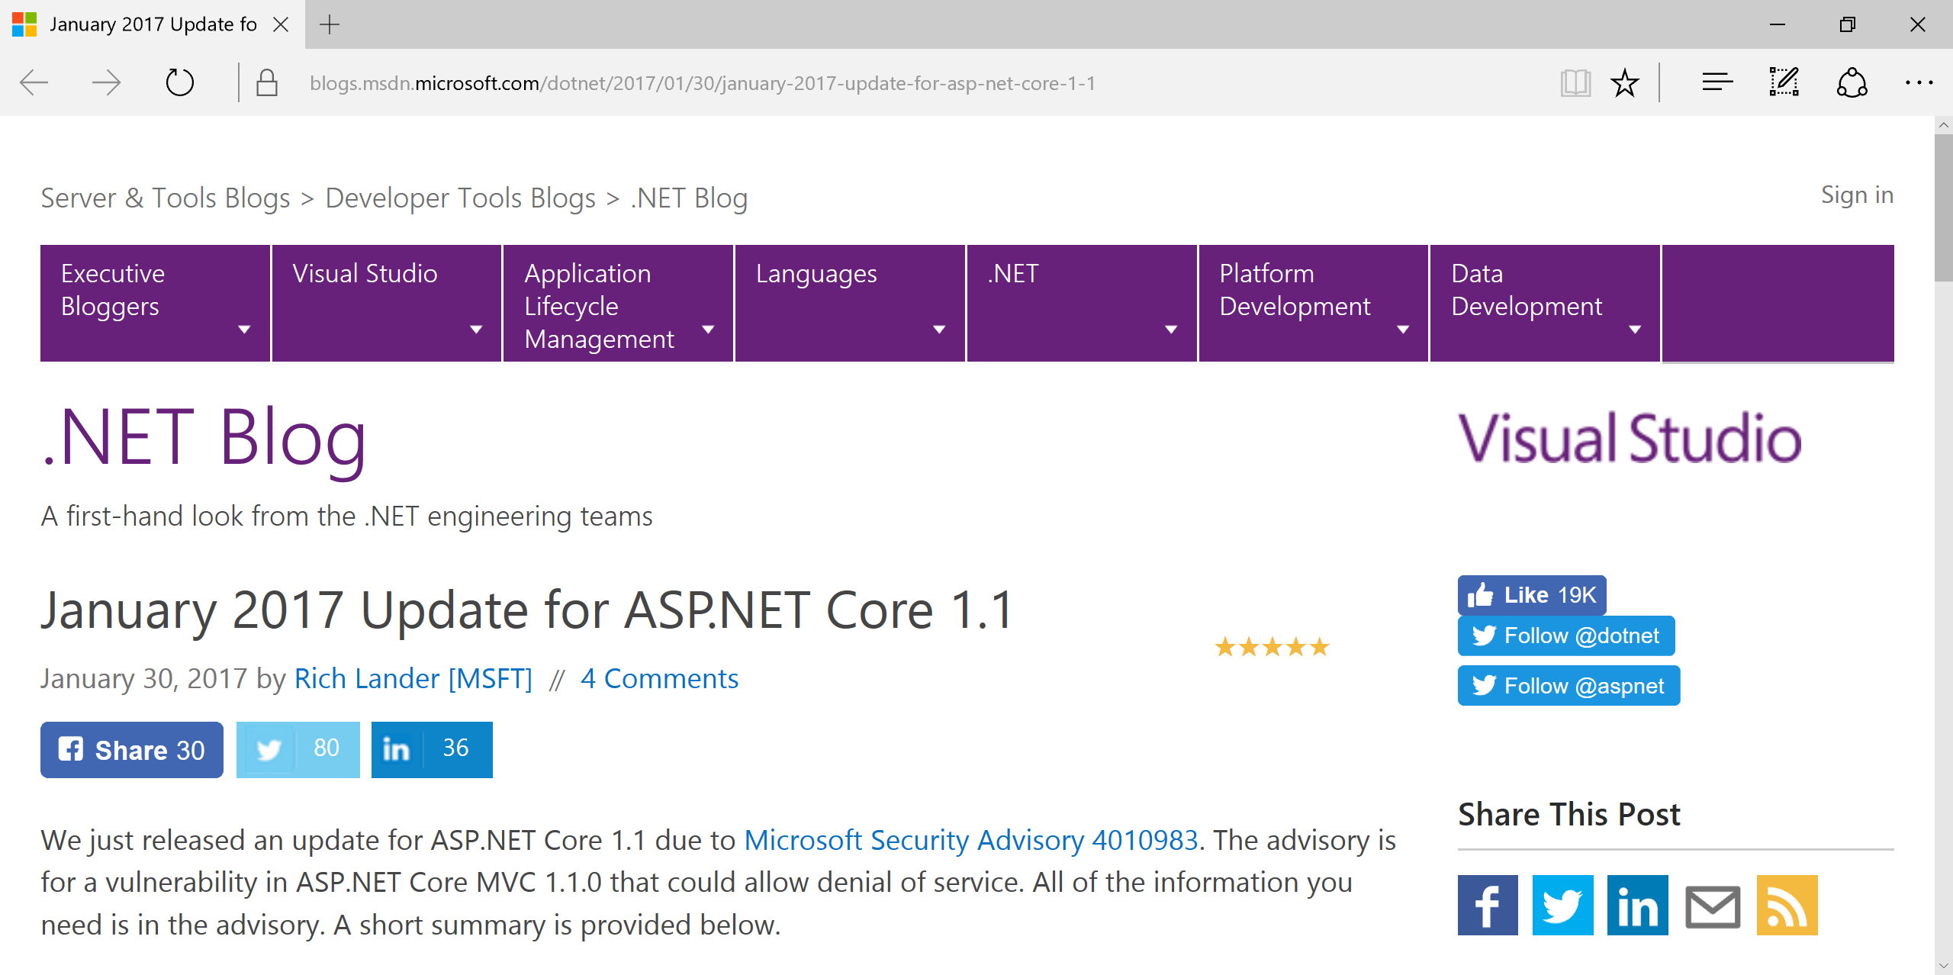
ASP.NET Core 1.1 Update
https://blogs.msdn.microsoft.com/dotnet/2017/01/30/january-2017-update-for-asp-net-core-1-1/

Slide 19
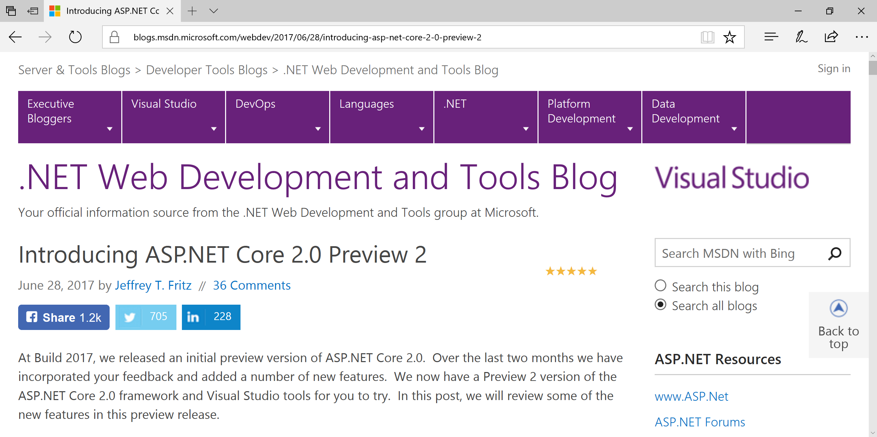
ASP.NET Core 2.0 Update
https://blogs.msdn.microsoft.com/webdev/2017/06/28/introducing-asp-net-core-2-0-preview-2/

Slide 20
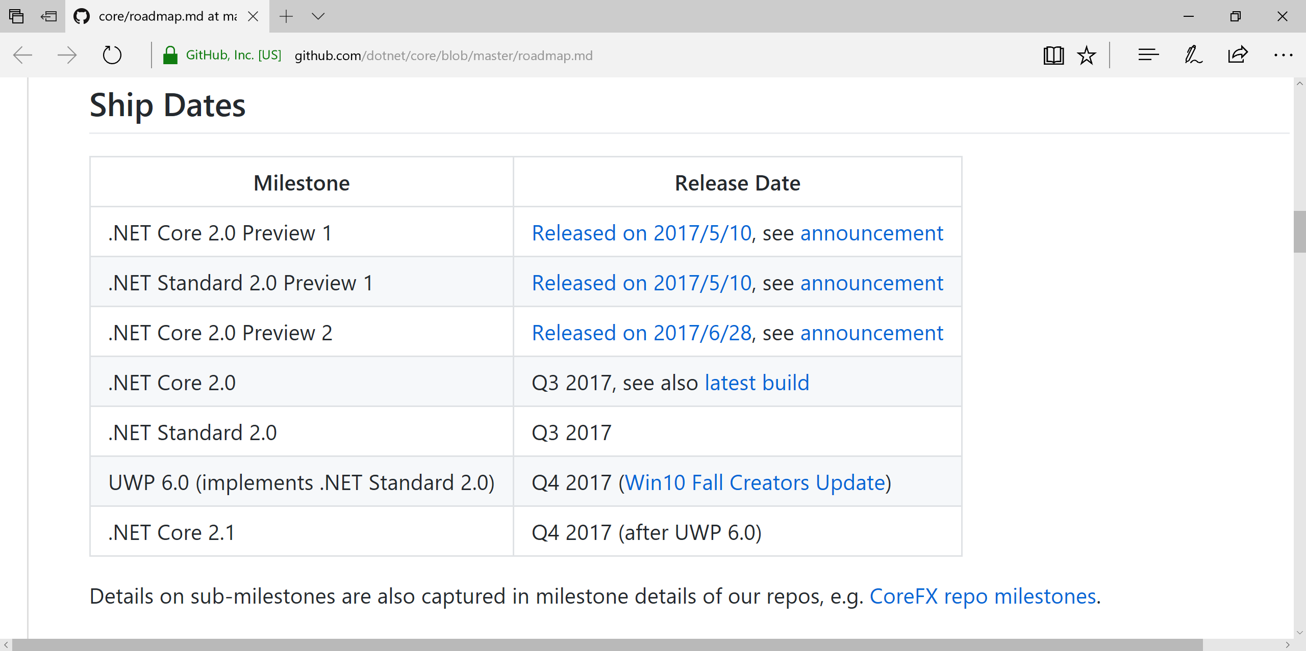
.NET Core Roadmap
https://github.com/dotnet/core/blob/master/roadmap.md

Slide 21
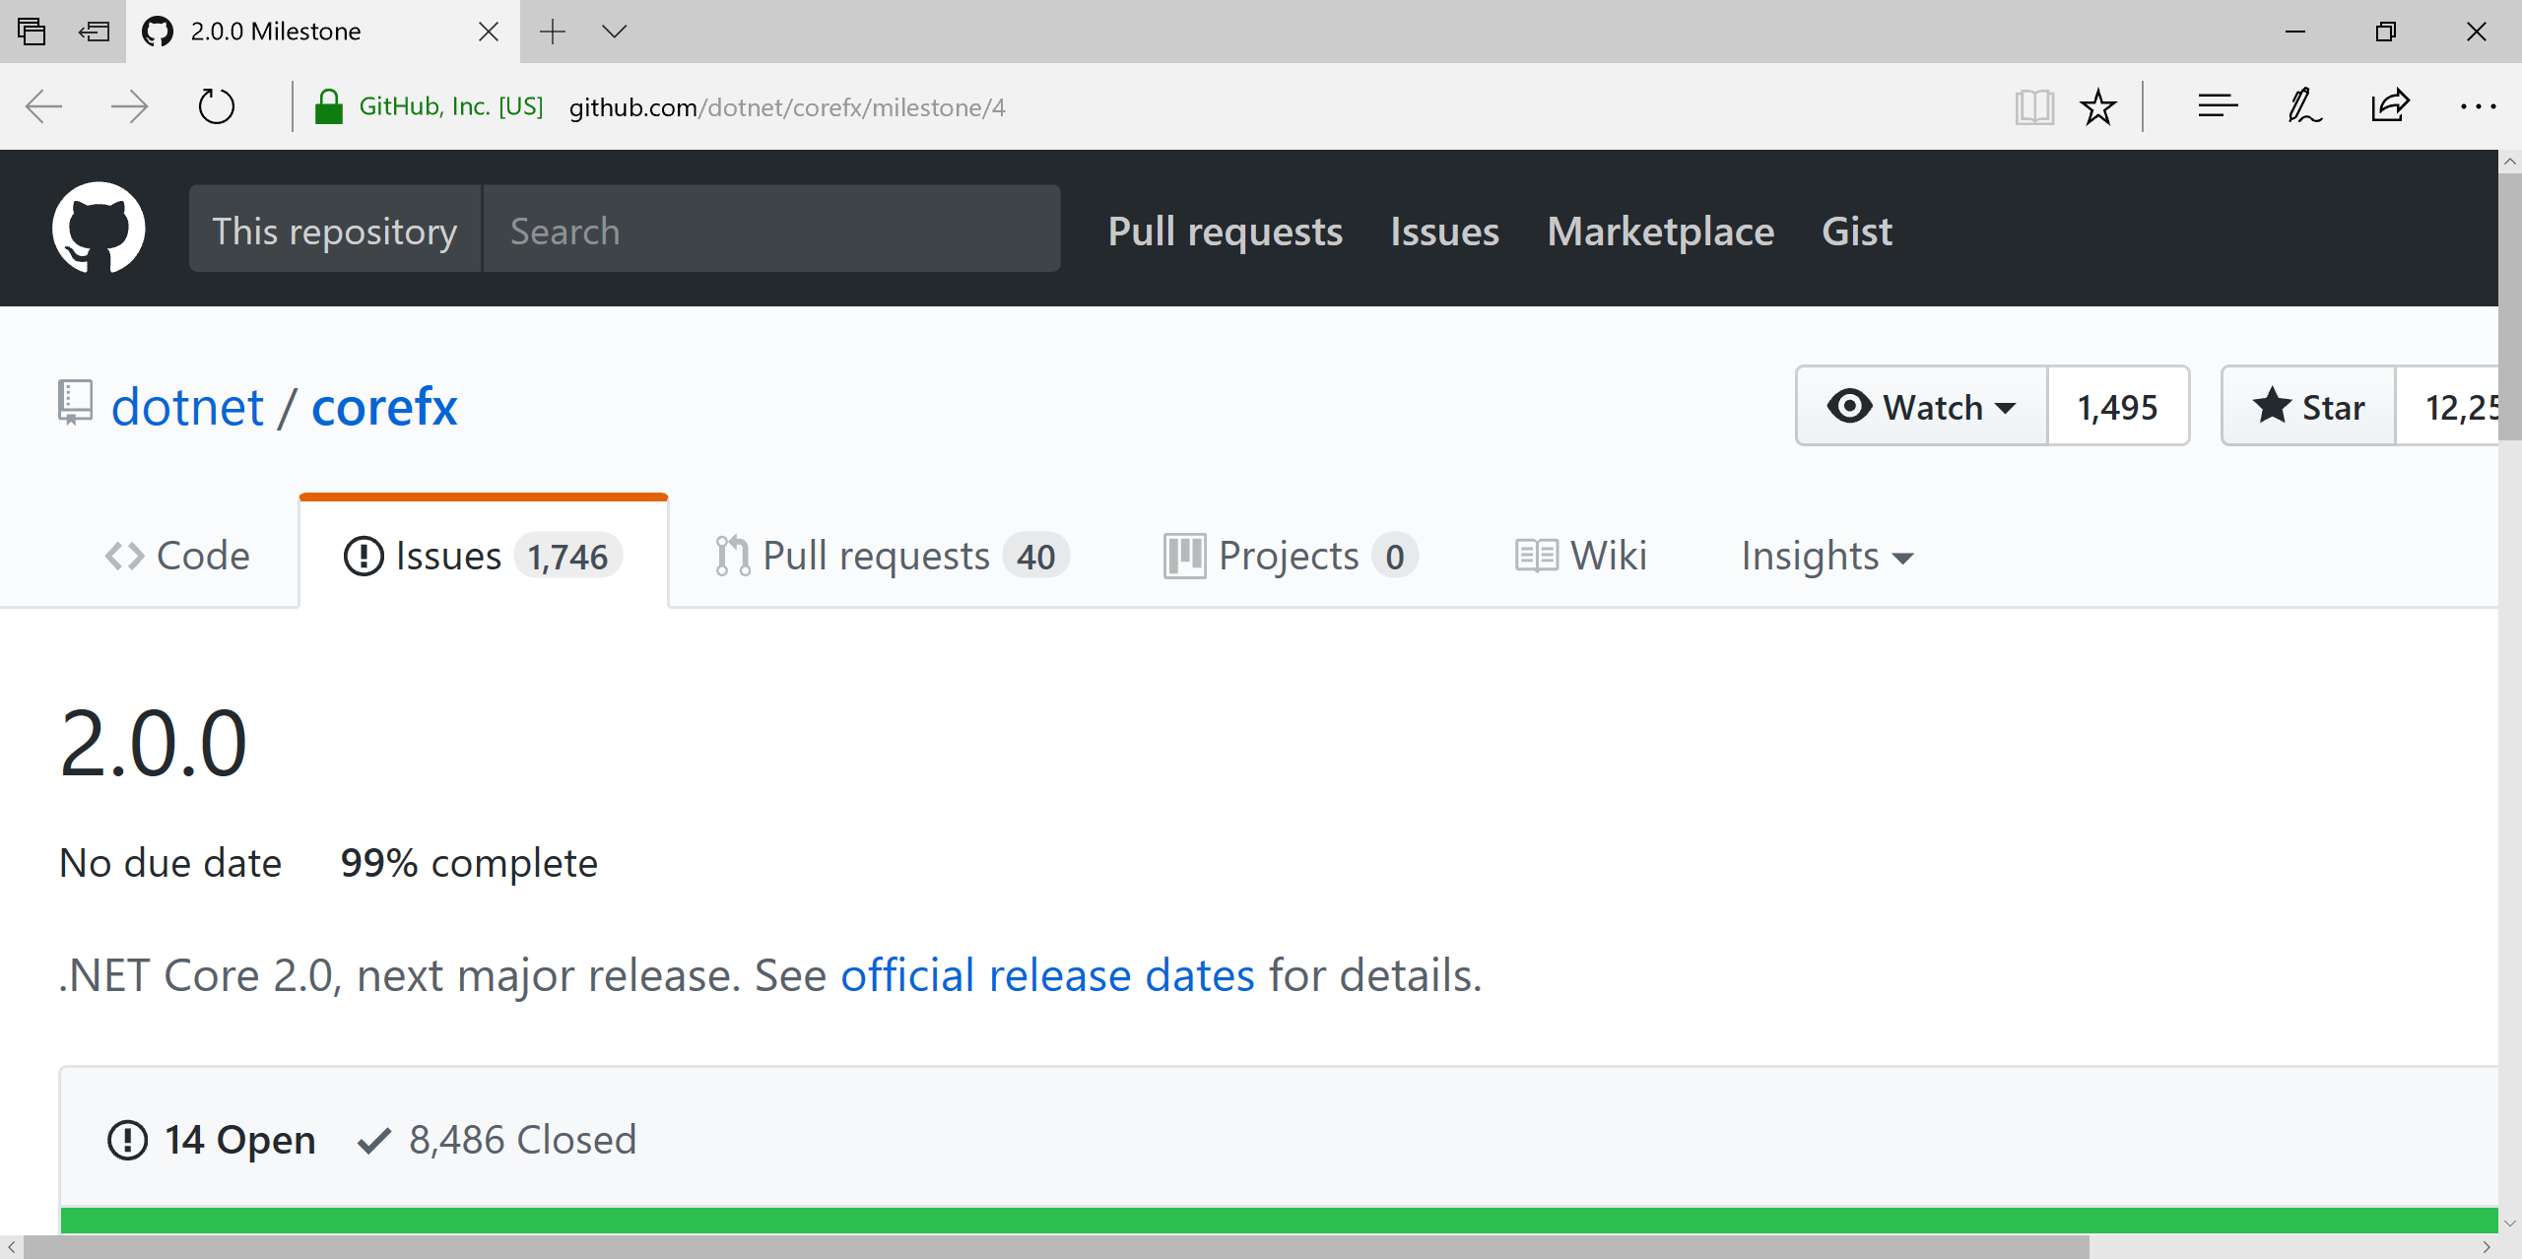
.NET Core 2.0 (Q3 2017)
https://github.com/dotnet/corefx/milestone/4

Slide 22
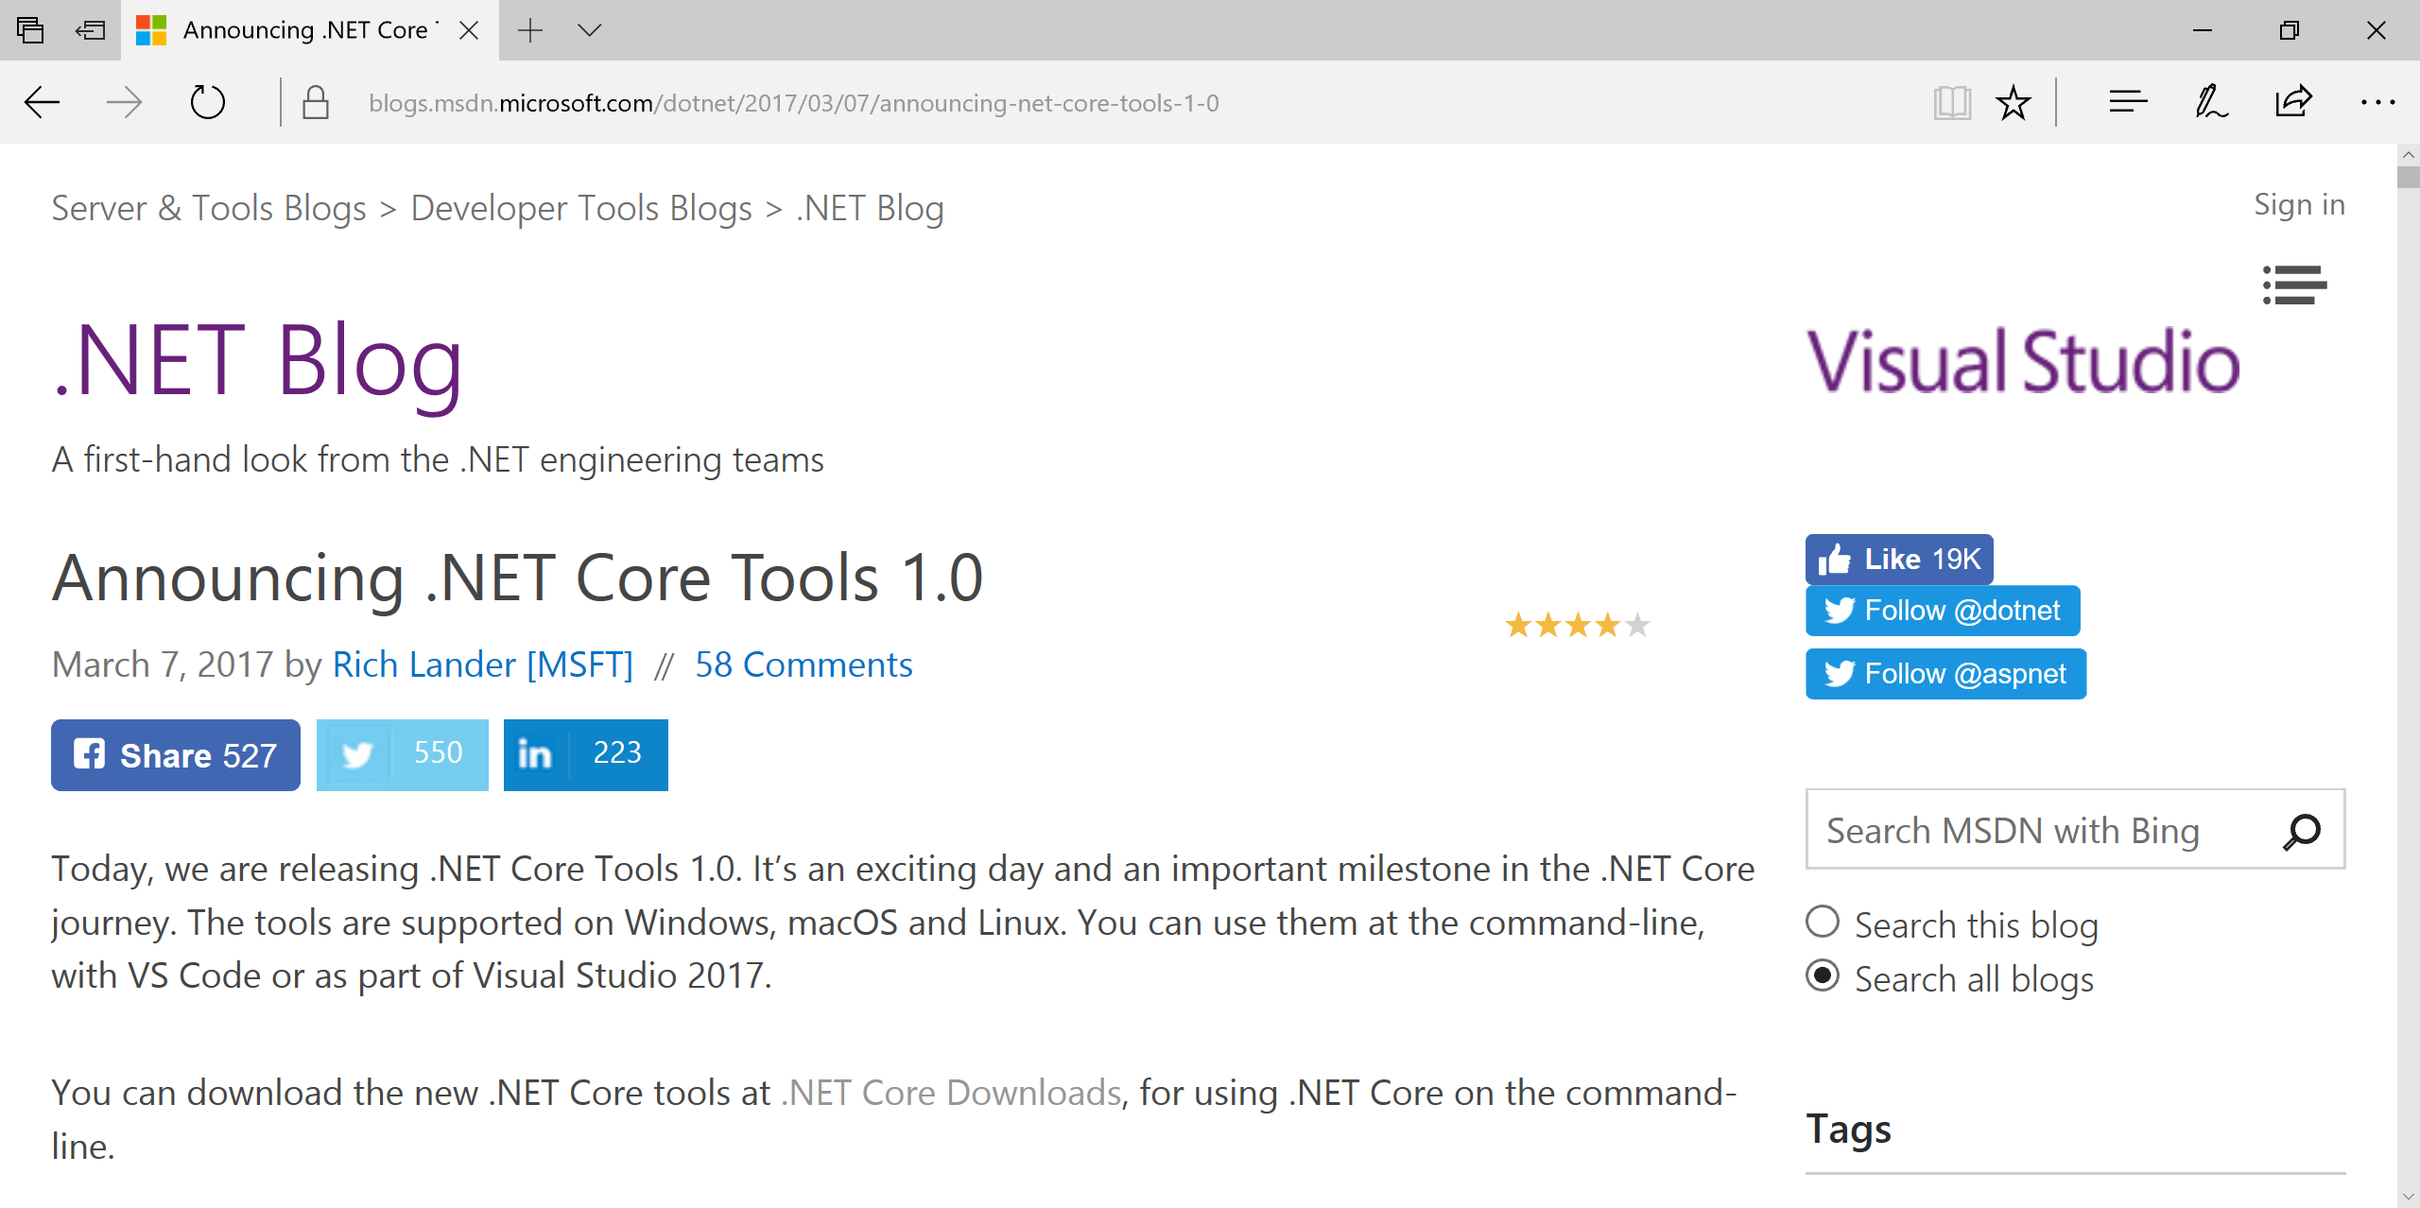
Announcing .NET Core Tools 1.0 in VS2017
https://blogs.msdn.microsoft.com/dotnet/2017/03/07/announcing-net-core-tools-1-0/

Slide 23
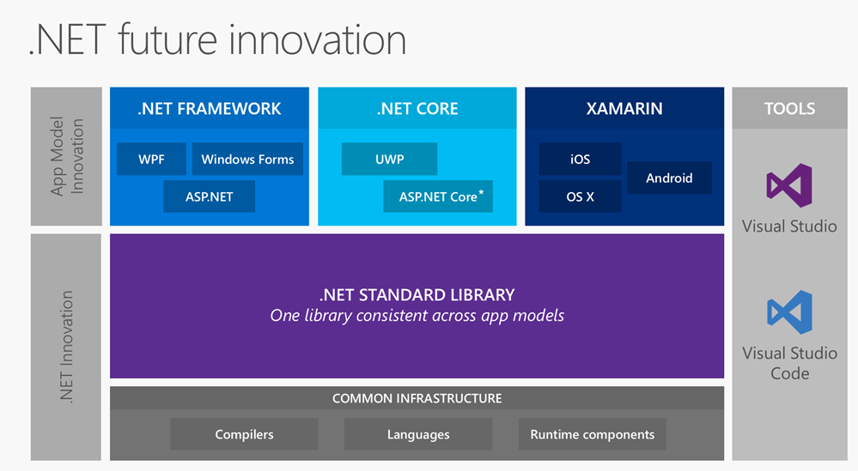
.NET Standard Library + Tooling
Source: http://www.hanselman.com/blog/AnUpdateOnASPNETCore10RC2.aspx

Slide 24

Agenda
Introduction
> .NET (Framework & Core)
> ASP.NET Core
> Visual Studio
Wrap-up + Q&A
Notes:
Agenda

Slide 25
.NET Framework
& .NET Core
Notes:
Variables, Operators & Loops

Slide 26
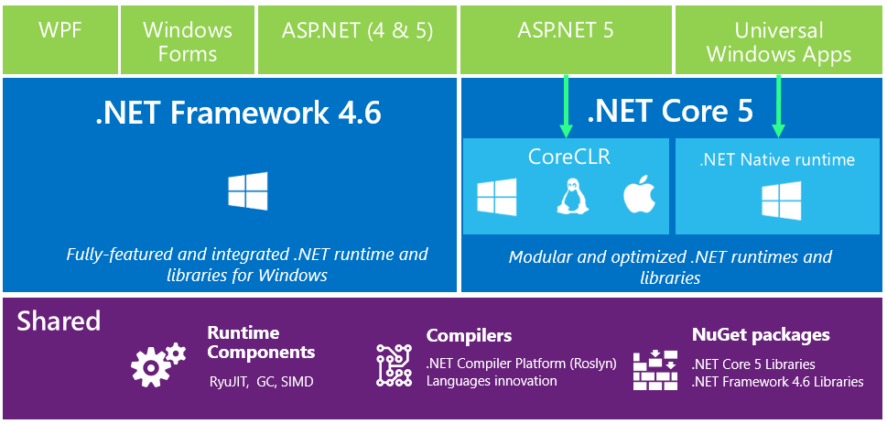
.NET in 2015: High-Level Overview

Slide 27
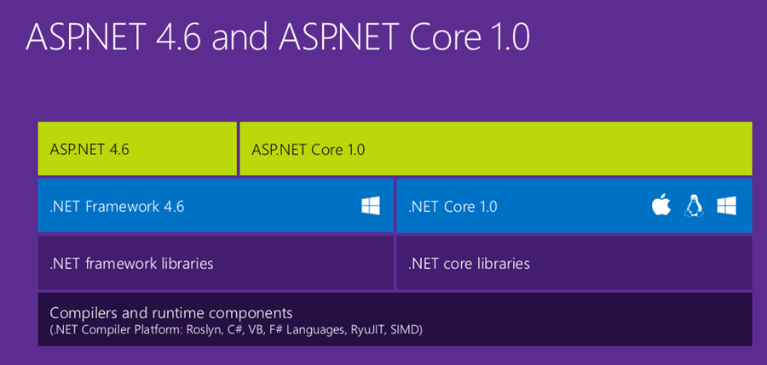
ASP.NET Core High-Level Overview

Slide 28
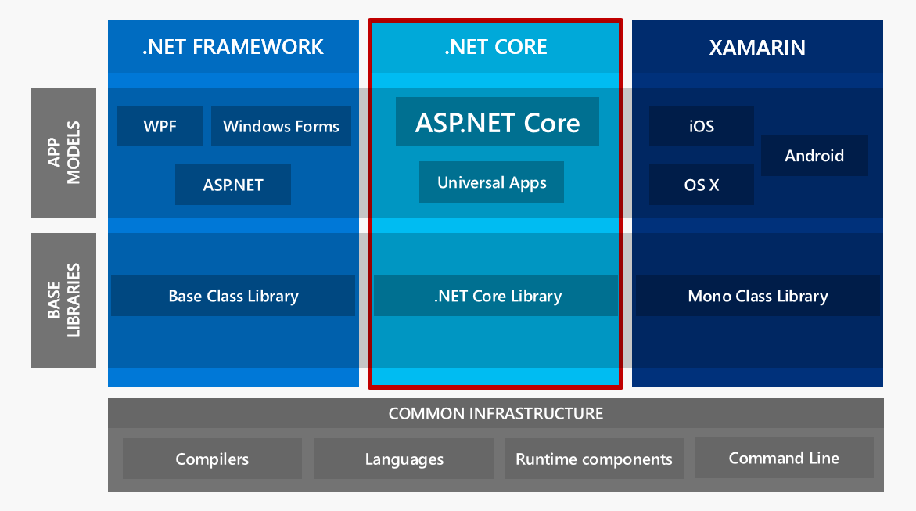
ASP.NET Core High-Level Overview

Slide 29
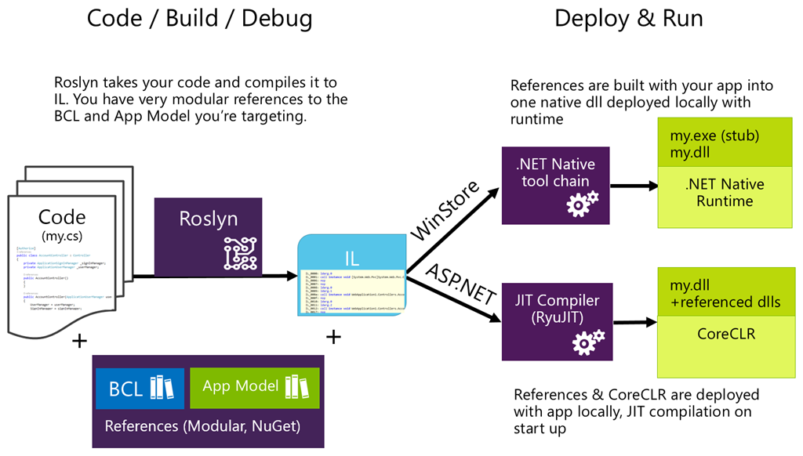
Compilation Process

Slide 30
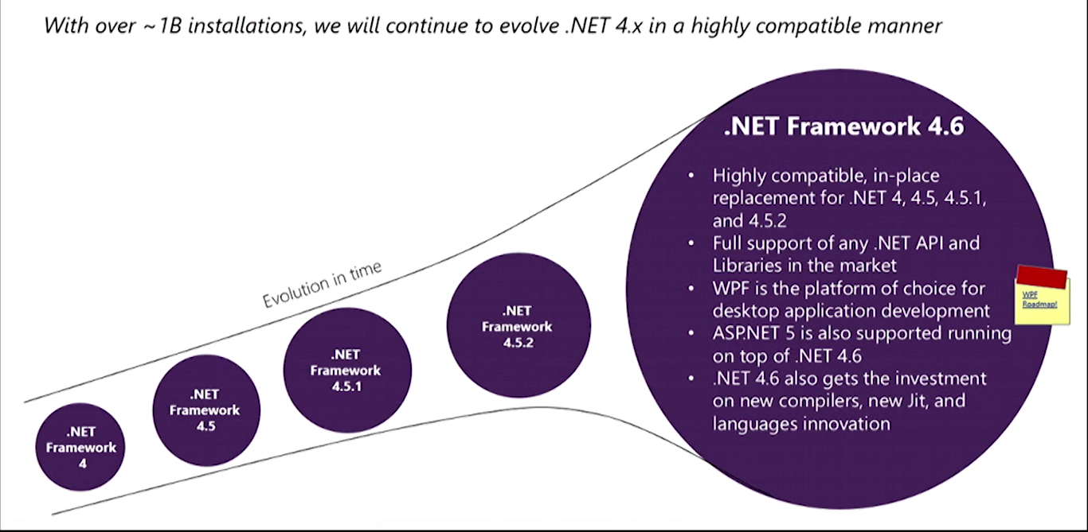

What About .NET Framework 4.6+?
4.7
Core is

Slide 31
ASP .NET Core
Notes:
ASP .NET 5.0

Slide 32
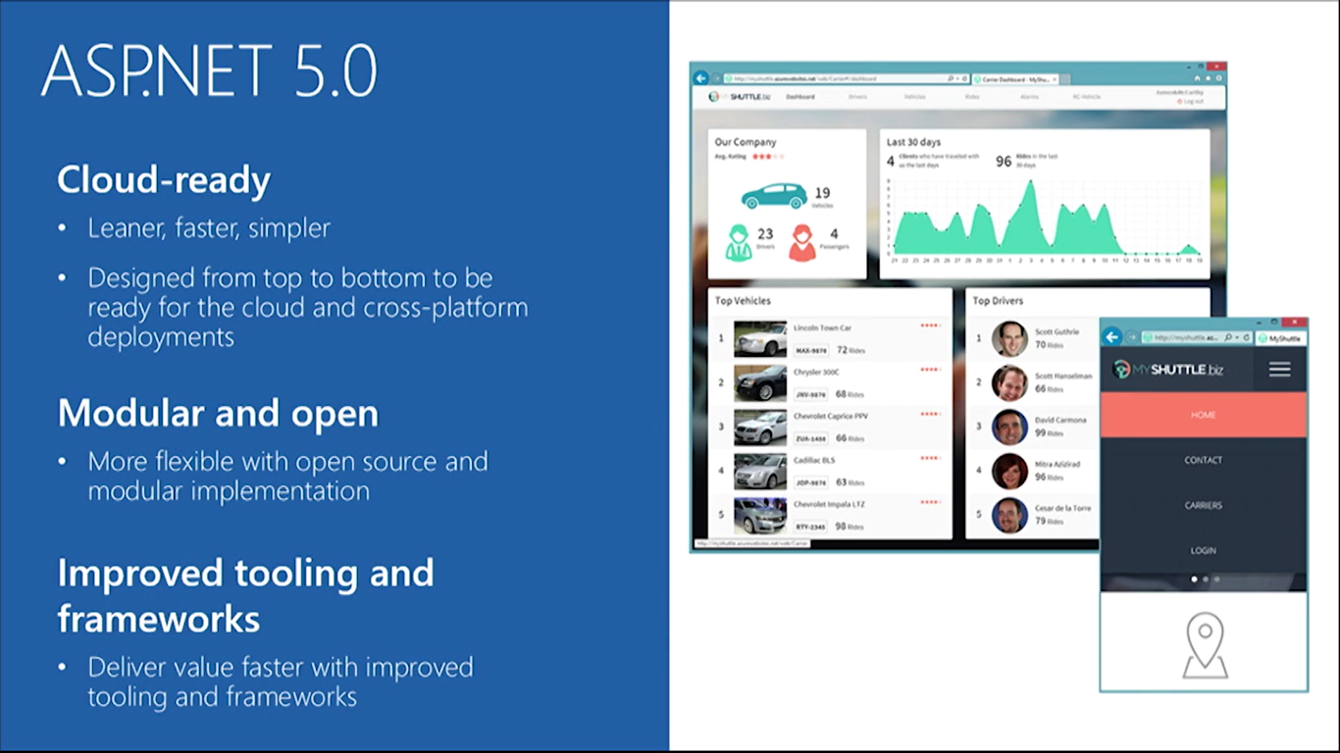

ASP.NET Core Features

Slide 33
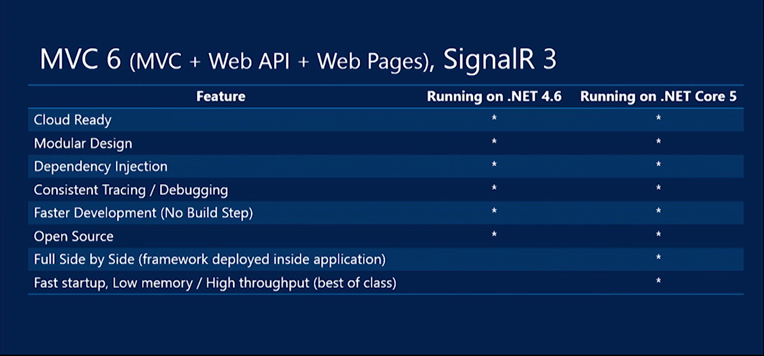
ASP.NET Core Summary

Slide 34
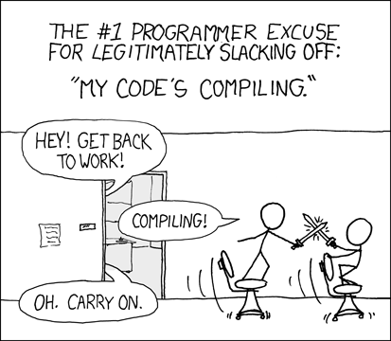
Relevant XKCD Comic
Source: https://xkcd.com/303/

Slide 35
ASP.NET Core Features in Detail
Flexible, Cross Platform runtime
Unified Programming Model
Tag Helpers
Dynamic Development
Bower, Grunt, Gulp
Simplified Dependency Mgmt
Cloud-Ready Config
Dependency Injection (DI)
Fast HTTP Performance
Open Source
New Project Templates
Identity Updates
Command Line Tools
New HTTP client-role API

Slide 36
ASP.NET Core Features in Detail
Flexible, Cross Platform runtime
Unified Programming Model
Tag Helpers
Dynamic Development
.NET Core or full .NET Framework
.NET Core is cross-platform
Deploy Core runtime with app
No need for unused features
Bower, Grunt, Gulp
Simplified Dependency Mgmt
Cloud-Ready Config
Dependency Injection (DI)
Fast HTTP Performance
Open Source
New Project Templates
Identity Updates
Command Line Tools
New HTTP client-role API

Slide 37
ASP.NET Core Features in Detail
Flexible, Cross Platform runtime
Unified Programming Model
Tag Helpers
Dynamic Development
Unified:
MVC
Web API
Web Pages
Bower, Grunt, Gulp
Simplified Dependency Mgmt
Cloud-Ready Config
Dependency Injection (DI)
Fast HTTP Performance
Open Source
New Project Templates
Identity Updates
Command Line Tools
New HTTP client-role API

Slide 38
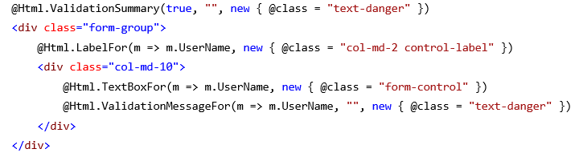
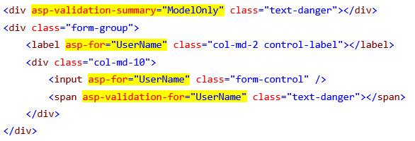
ASP.NET Core Features in Detail
HTML Helpers in your views!
Tag Helpers
Dynamic Development
Flexible, Cross Platform runtime
Unified Programming Model
Bower, Grunt, Gulp
Simplified Dependency Mgmt
Cloud-Ready Config
Dependency Injection (DI)
Fast HTTP Performance
Open Source
New Project Templates
Identity Updates
Command Line Tools
New HTTP client-role API

Slide 39
ASP.NET Core Features in Detail
Flexible, Cross Platform runtime
Unified Programming Model
Tag Helpers
Dynamic Development
Edit code
Save changes
Refresh browser
See changes!
Compiled language with benefits of interpreted language!
Bower, Grunt, Gulp
Simplified Dependency Mgmt
Cloud-Ready Config
Dependency Injection (DI)
Fast HTTP Performance
Open Source
New Project Templates
Identity Updates
Command Line Tools
New HTTP client-role API

Slide 40
ASP.NET Core Features in Detail
Flexible, Cross Platform runtime
Unified Programming Model
Tag Helpers
Dynamic Development
Bower → client-side pkg mgr
  e.g. JS, CSS
Grunt & Gulp → task runners
  compile LESS/CoffeeScript, Typescipt
  run JSLint
  minify JS files
Bower, Grunt, Gulp
Simplified Dependency Mgmt
Cloud-Ready Config
Dependency Injection (DI)
Fast HTTP Performance
Open Source
New Project Templates
Identity Updates
Command Line Tools
New HTTP client-role API

Slide 41
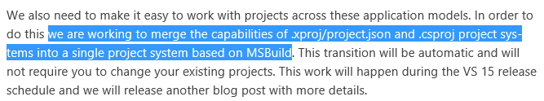
ASP.NET Core Features in Detail
Flexible, Cross Platform runtime
Unified Programming Model
Tag Helpers
Dynamic Development
Manage dependencies with NuGet packages
Edit project.json file (?)
Enjoy IntelliSense!
Bower, Grunt, Gulp
Simplified Dependency Mgmt
Cloud-Ready Config
Dependency Injection (DI)
Fast HTTP Performance
Open Source
New Project Templates
Identity Updates
Command Line Tools
New HTTP client-role API

Slide 42
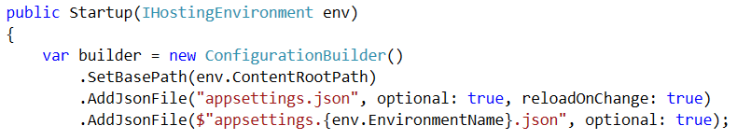
ASP.NET Core Features in Detail
Flexible, Cross Platform runtime
Unified Programming Model
Tag Helpers
Dynamic Development
Configuration in code
Edit Startup.cs file
No need to use Web.config
Use JSON, XML, env vars
Bower, Grunt, Gulp
Simplified Dependency Mgmt
Cloud-Ready Config
Dependency Injection (DI)
Fast HTTP Performance
Open Source
New Project Templates
Identity Updates
Command Line Tools
New HTTP client-role API

Slide 43
ASP.NET Core Features in Detail
Flexible, Cross Platform runtime
Unified Programming Model
Tag Helpers
Dynamic Development
Bower, Grunt, Gulp
Simplified Dependency Mgmt
Cloud-Ready Config
Dependency Injection (DI)
minimalistic DI container
replace with others
  Autofac, Ninject, etc
use [FromServices] attribute
Fast HTTP Performance
Open Source
New Project Templates
Identity Updates
Command Line Tools
New HTTP client-role API

Slide 44

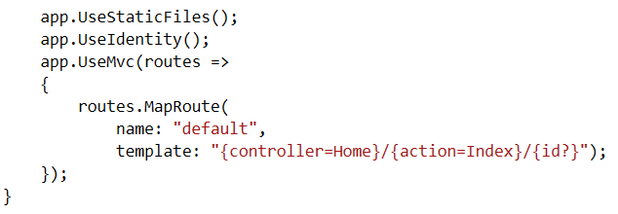
ASP.NET Core Features in Detail
Flexible, Cross Platform runtime
Unified Programming Model
Tag Helpers
Dynamic Development
New HTTP pipeline
modular
add components as needed
no longer dependent on System.Web
Bower, Grunt, Gulp
Simplified Dependency Mgmt
Cloud-Ready Config
Dependency Injection (DI)
Fast HTTP Performance
Open Source
New Project Templates
Identity Updates
Command Line Tools
New HTTP client-role API

Slide 45
ASP.NET Core Features in Detail
Flexible, Cross Platform runtime
Unified Programming Model
Tag Helpers
Dynamic Development
Bower, Grunt, Gulp
Simplified Dependency Mgmt
Cloud-Ready Config
Dependency Injection (DI)
GitHub!
Fast HTTP Performance
Open Source
New Project Templates
Identity Updates
Command Line Tools
New HTTP client-role API

Slide 46
ASP.NET Core Features in Detail
Flexible, Cross Platform runtime
Unified Programming Model
Tag Helpers
Dynamic Development
Bower, Grunt, Gulp
Simplified Dependency Mgmt
Cloud-Ready Config
Dependency Injection (DI)
Post-RC2
Tooling Changes
Fast HTTP Performance
Open Source
New Project Templates
Identity Updates
Command Line Tools
New HTTP client-role API

Slide 47
ASP.NET Core Features in Detail
Flexible, Cross Platform runtime
Unified Programming Model
Tag Helpers
Dynamic Development
Bower, Grunt, Gulp
Simplified Dependency Mgmt
Cloud-Ready Config
Dependency Injection (DI)
ASP.NET Core Preview Templates
Empty
Starter Web
Web API
Fast HTTP Performance
Open Source
New Project Templates
Identity Updates
Command Line Tools
New HTTP client-role API

Slide 48
ASP.NET Core Features in Detail
Flexible, Cross Platform runtime
Unified Programming Model
Tag Helpers
Dynamic Development
Bower, Grunt, Gulp
Simplified Dependency Mgmt
Cloud-Ready Config
Dependency Injection (DI)
Open ID Connect
OAuth2
Template auth logic based on OWIN and Open ID Connect (not WIF)
Fast HTTP Performance
Open Source
New Project Templates
Identity Updates
Command Line Tools
New HTTP client-role API

Slide 49
ASP.NET Core Features in Detail
Flexible, Cross Platform runtime
Unified Programming Model
Tag Helpers
Dynamic Development
Bower, Grunt, Gulp
Simplified Dependency Mgmt
Cloud-Ready Config
Dependency Injection (DI)
More granular control (than HttpClientHandler) over individual aspects of HTTP
redirects, auth, cookies, etc
Fast HTTP Performance
Open Source
New Project Templates
Identity Updates
Command Line Tools
New HTTP client-role API

Slide 50
ASP.NET Core Features in Detail
Flexible, Cross Platform runtime
Unified Programming Model
Tag Helpers
Dynamic Development
Bower, Grunt, Gulp
Simplified Dependency Mgmt
Cloud-Ready Config
Dependency Injection (DI)
Fast HTTP Performance
Open Source
New Project Templates
Identity Updates
Command Line Tools
New HTTP client-role API

Slide 51
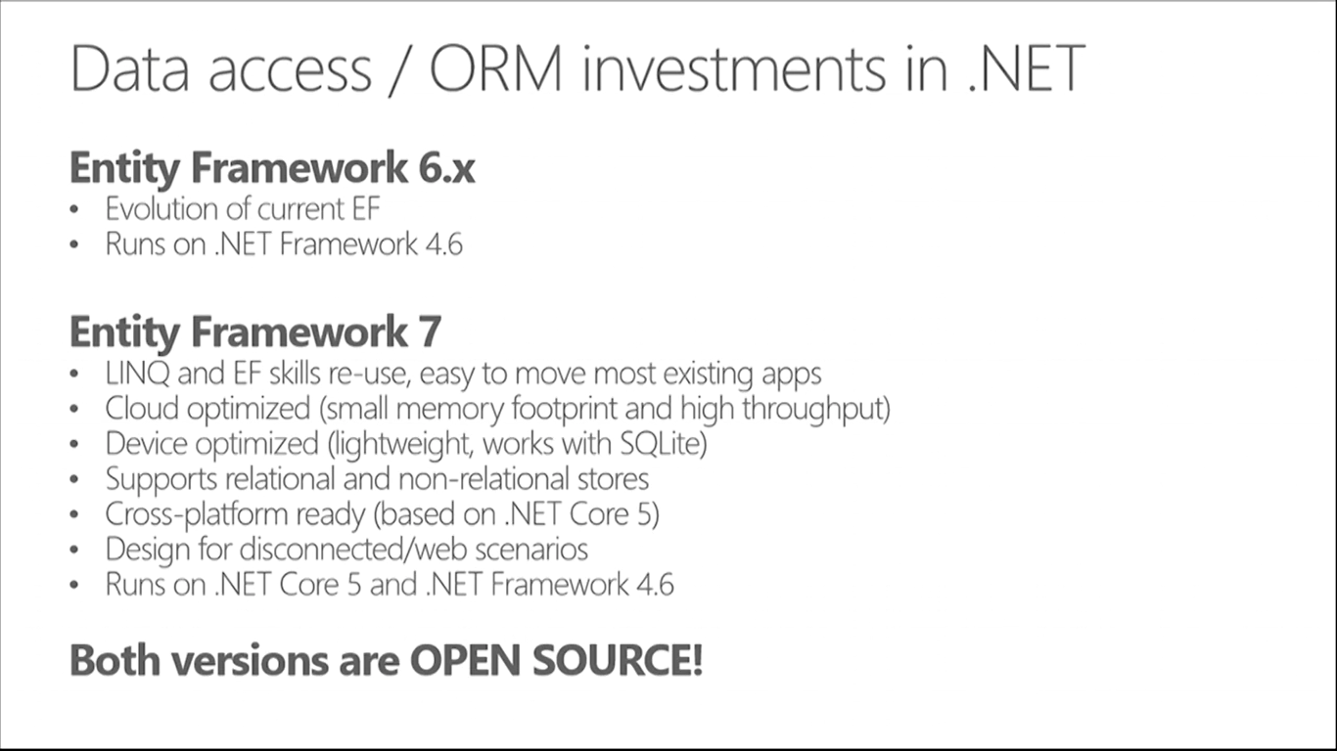
How about Entity Framework?
Entities in Code
4.6+
Core
ORM
)
4.6+
DB

Slide 52
Visual Studio 2017
Notes:
ASP .NET 5.0

Slide 53
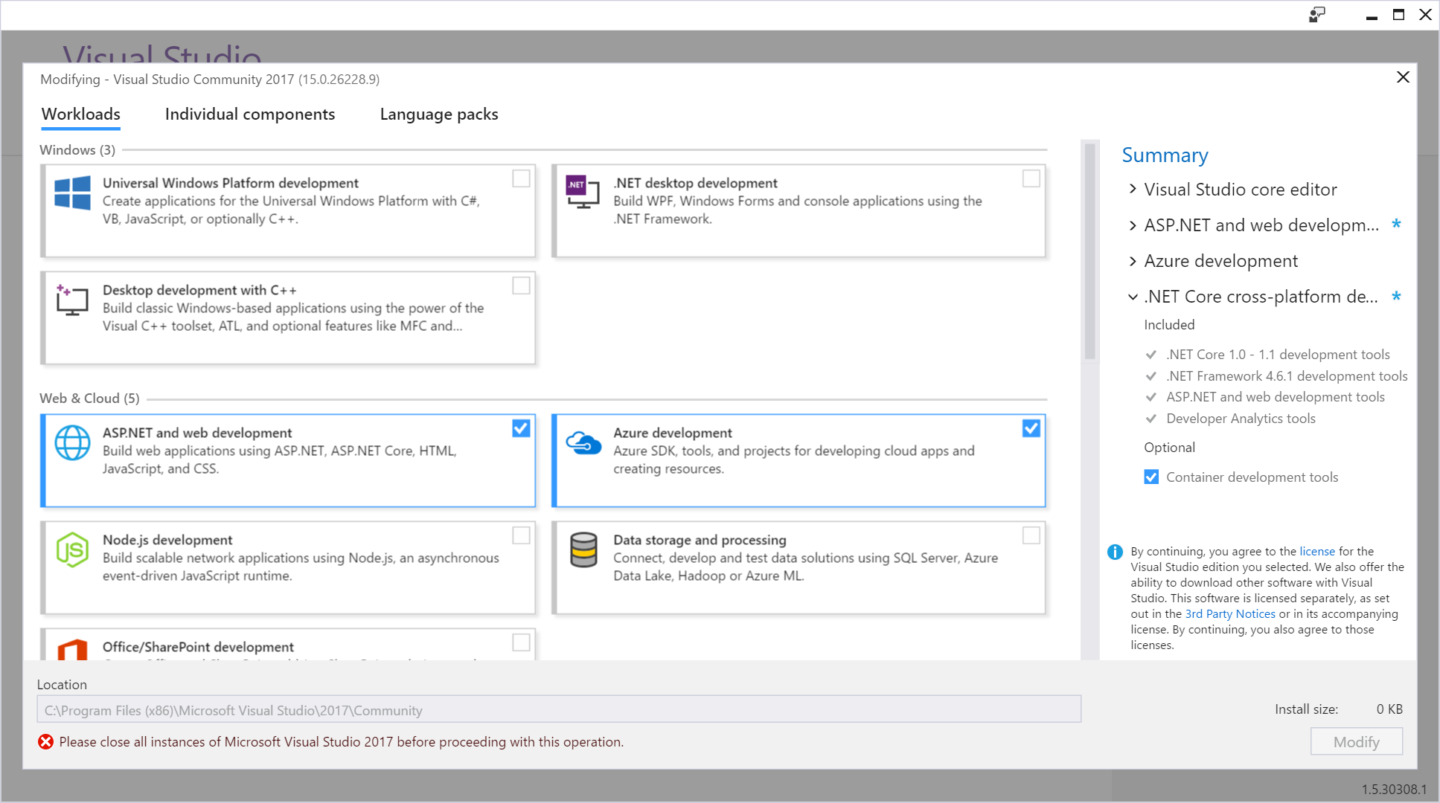
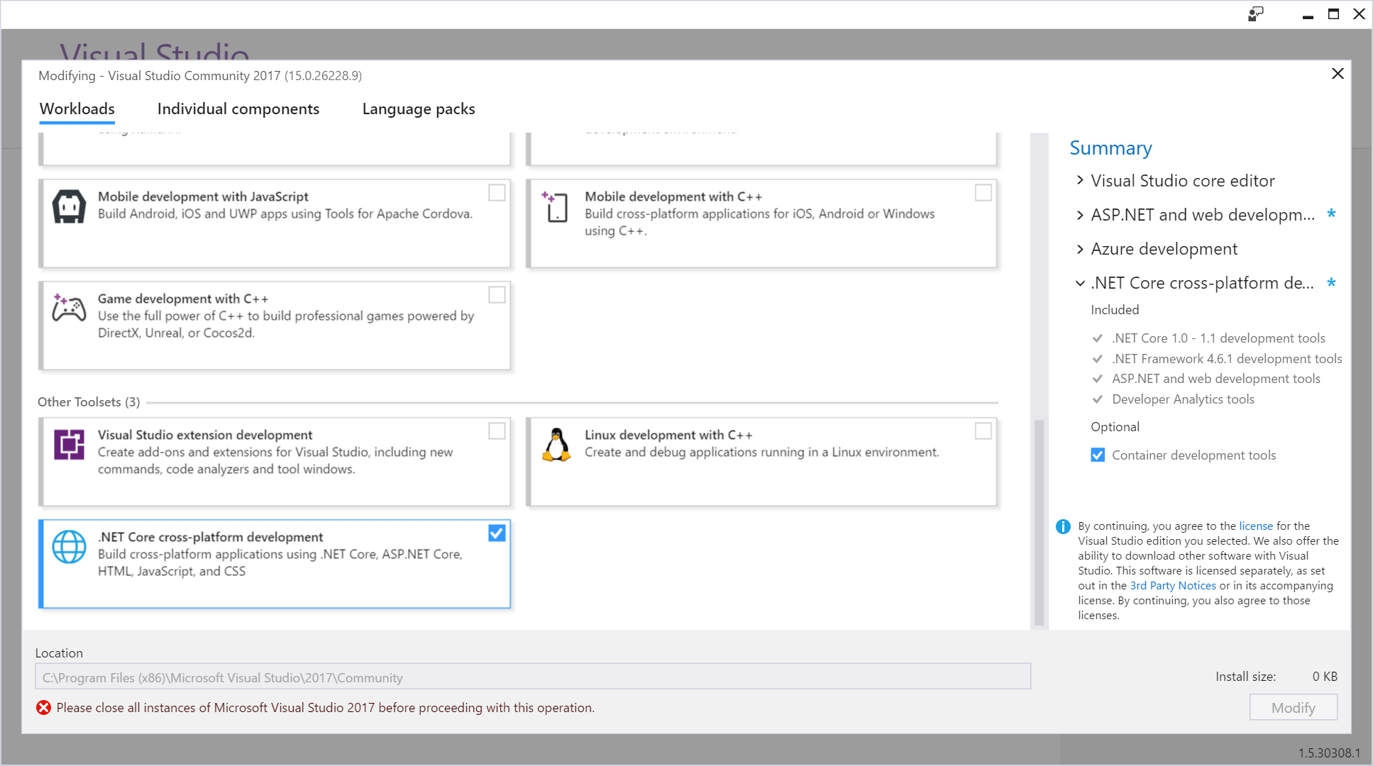
New Installer!

Slide 54
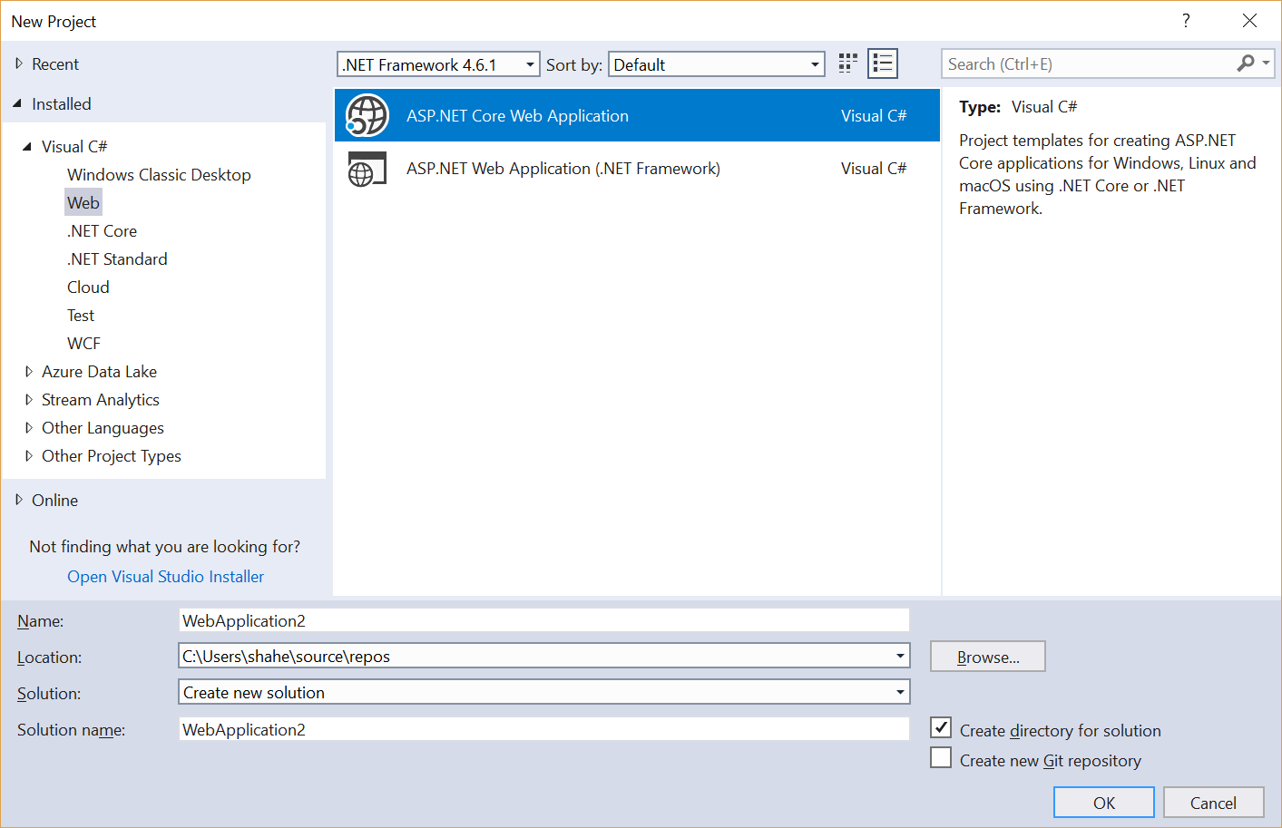
File → New Project → Web
ASP .NET Core Web App
Web App (4.x)

Slide 55
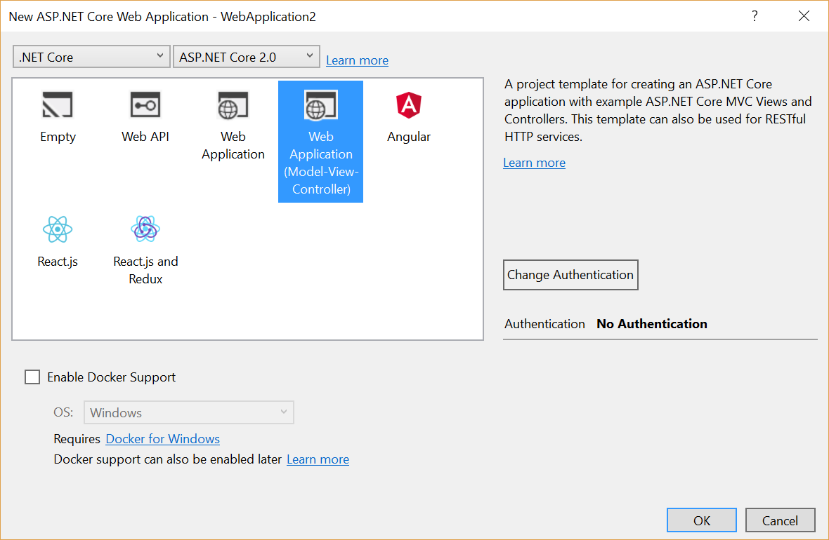
Select a Template
1.0 , 1.1, 2.0 Templates
Empty
Web API
Web App (Razor)
Web App (MVC)
Angular
React.js
React.js & Redux
Other settings:
Authentication
Docker Support

Slide 56
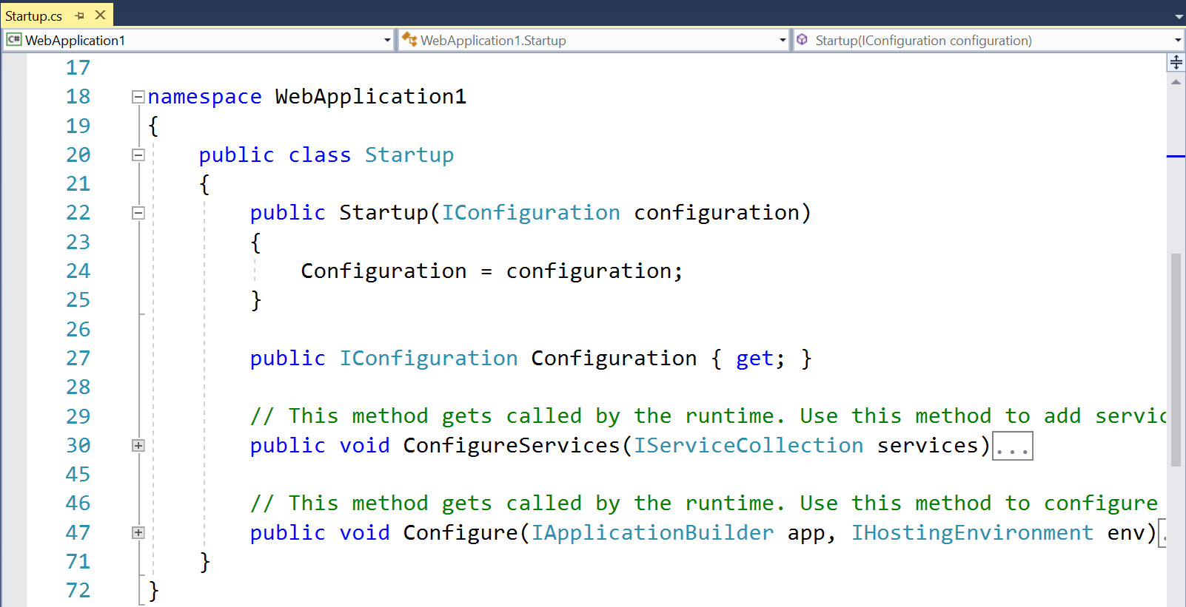
Startup.cs Configuration

Slide 57
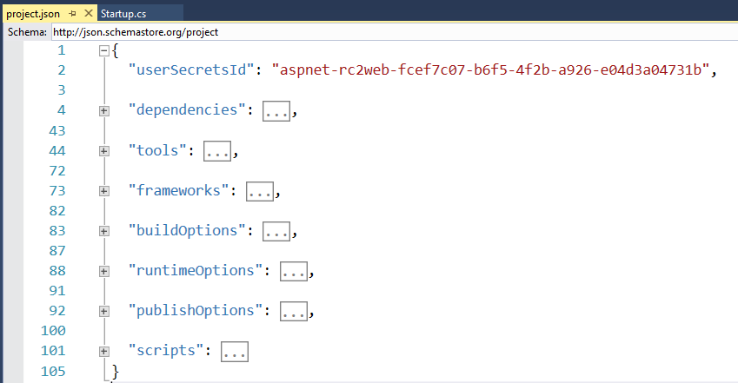
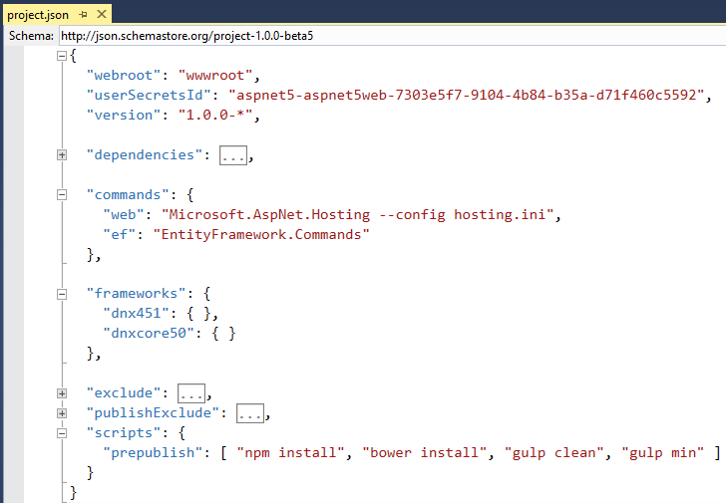
project.json

Slide 58
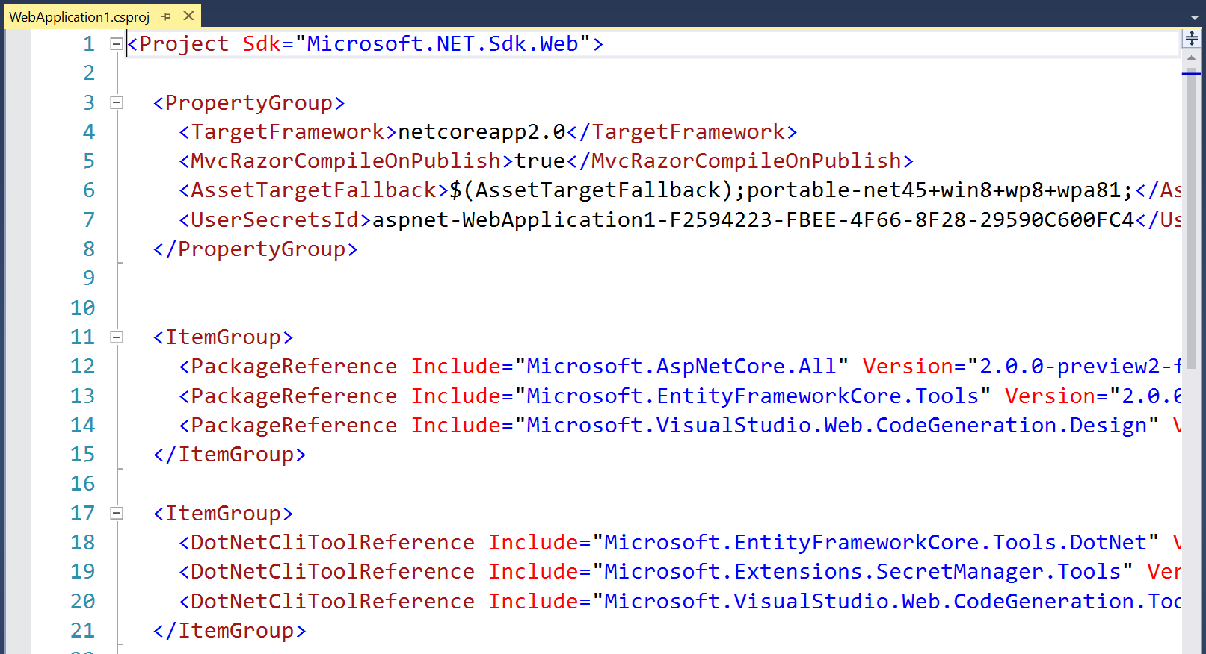
.csproj project file

Slide 59
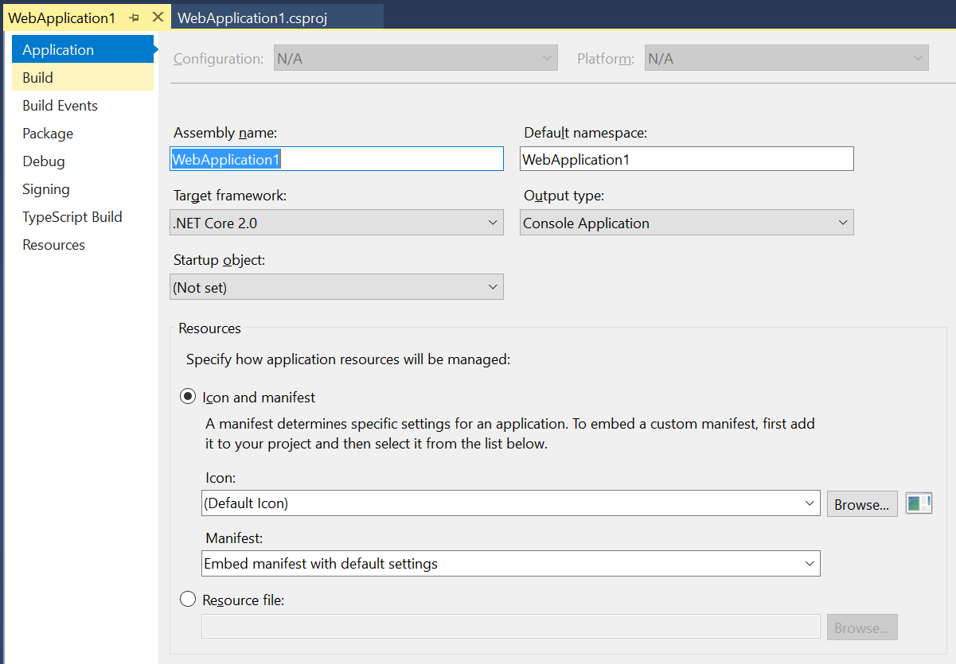
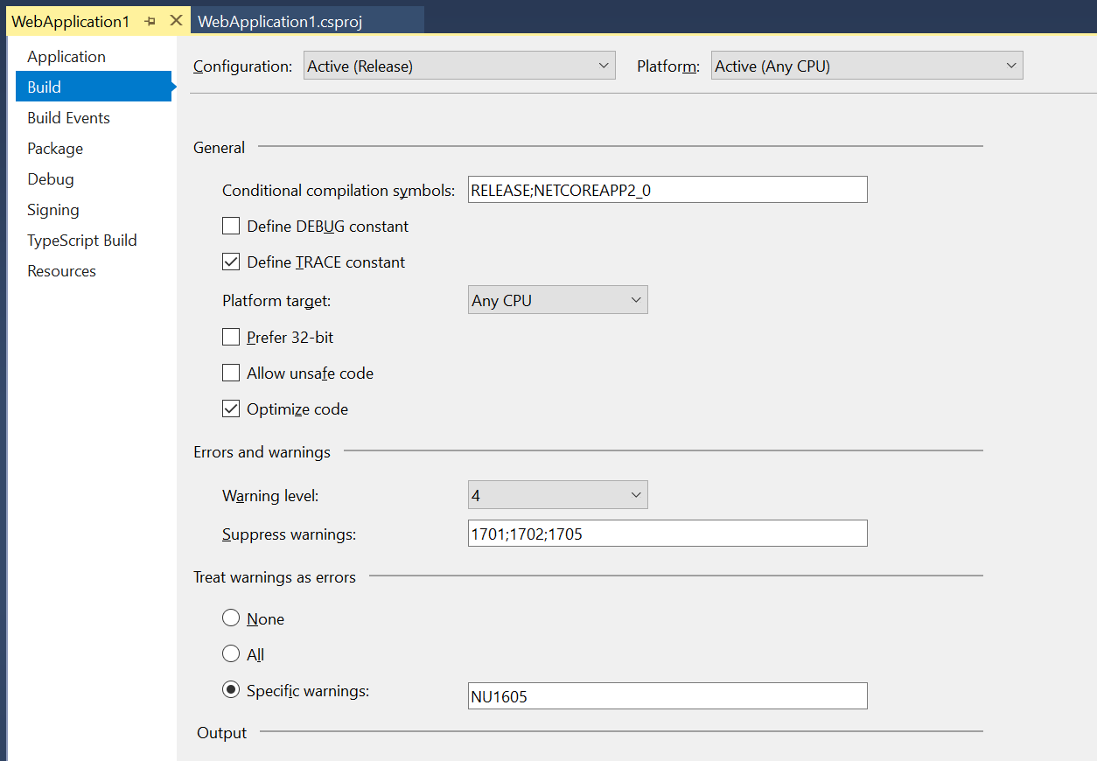
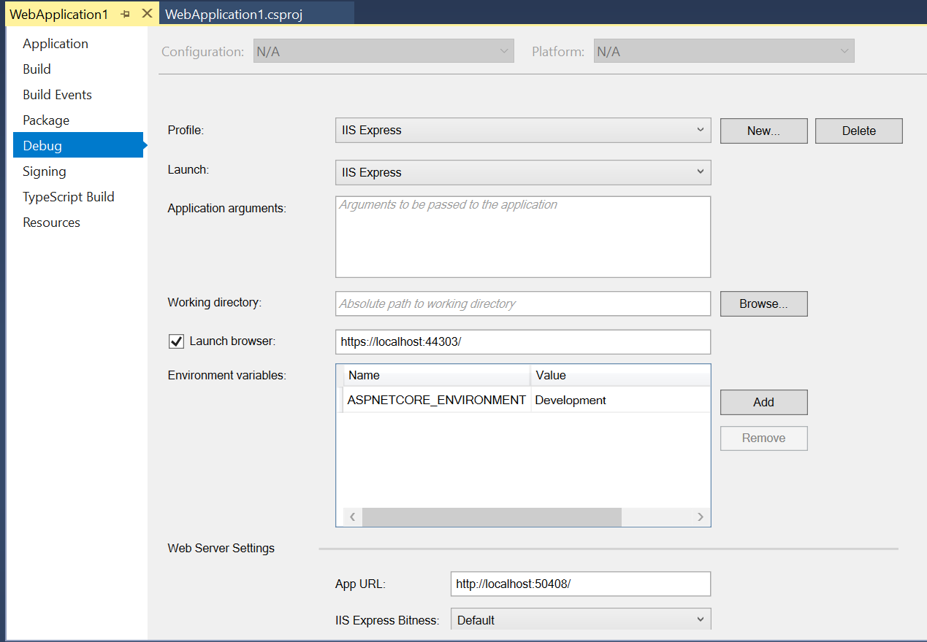
Right-click → (Project) Properties

Slide 60
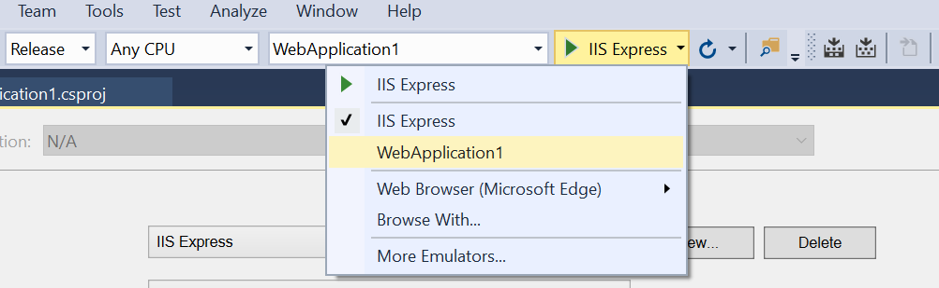
Choose Profile While Debugging

Slide 61
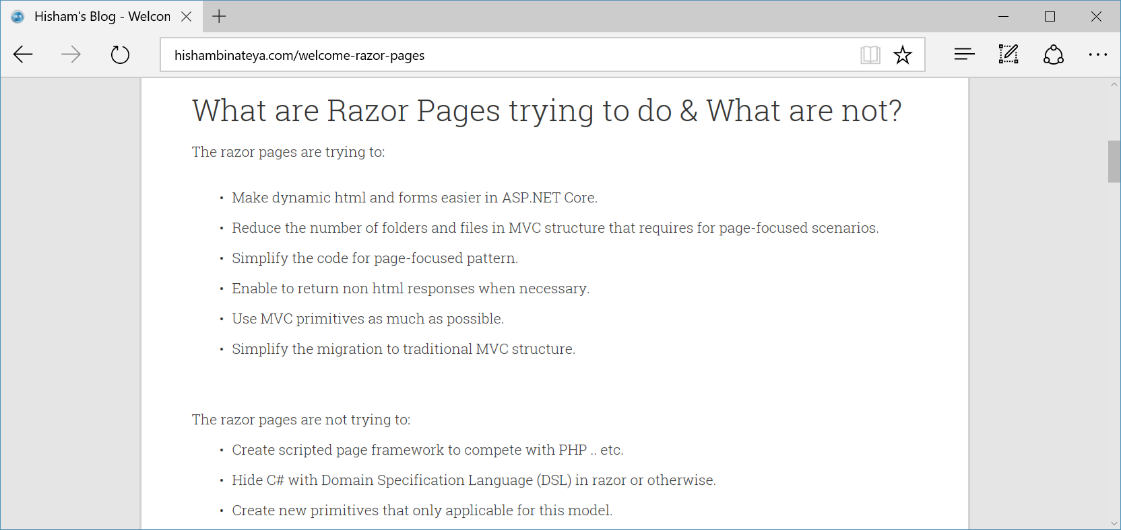
New Razor Pages!
http://www.hishambinateya.com/welcome-razor-pages

Slide 62
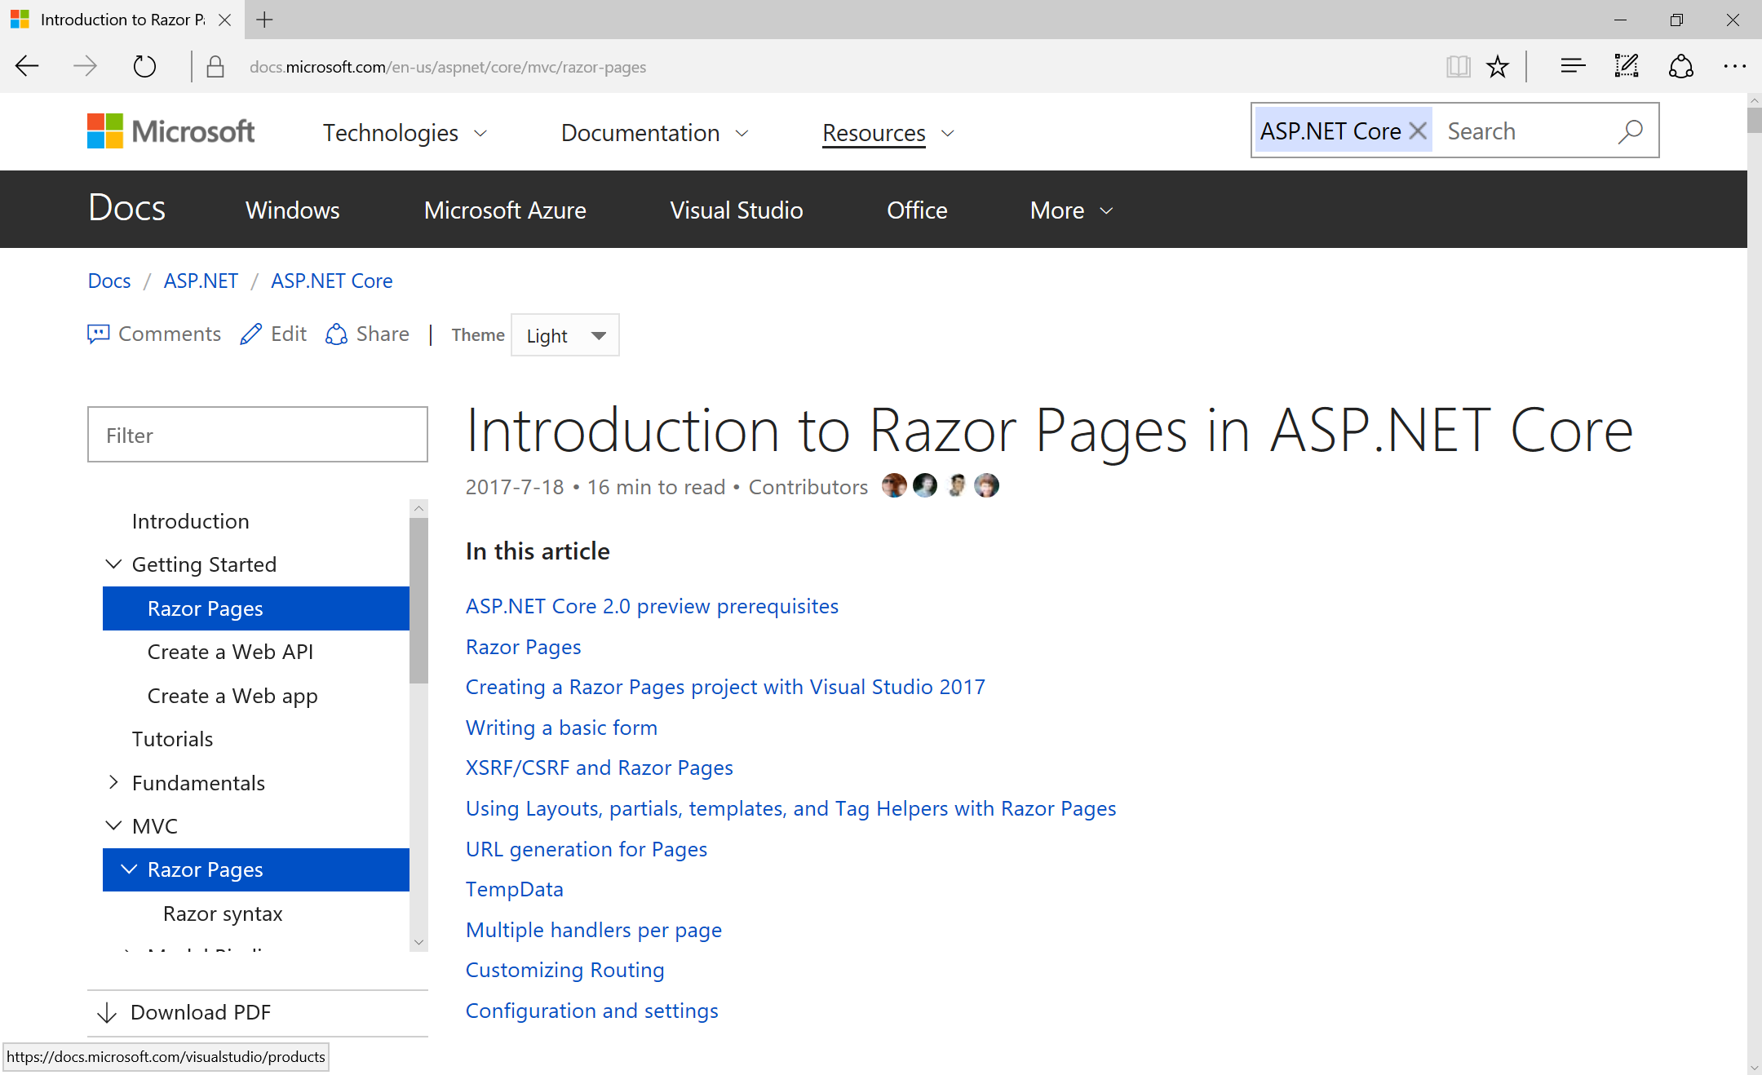
Intro to Razor Pages
https://docs.microsoft.com/en-us/aspnet/core/mvc/razor-pages

Slide 63
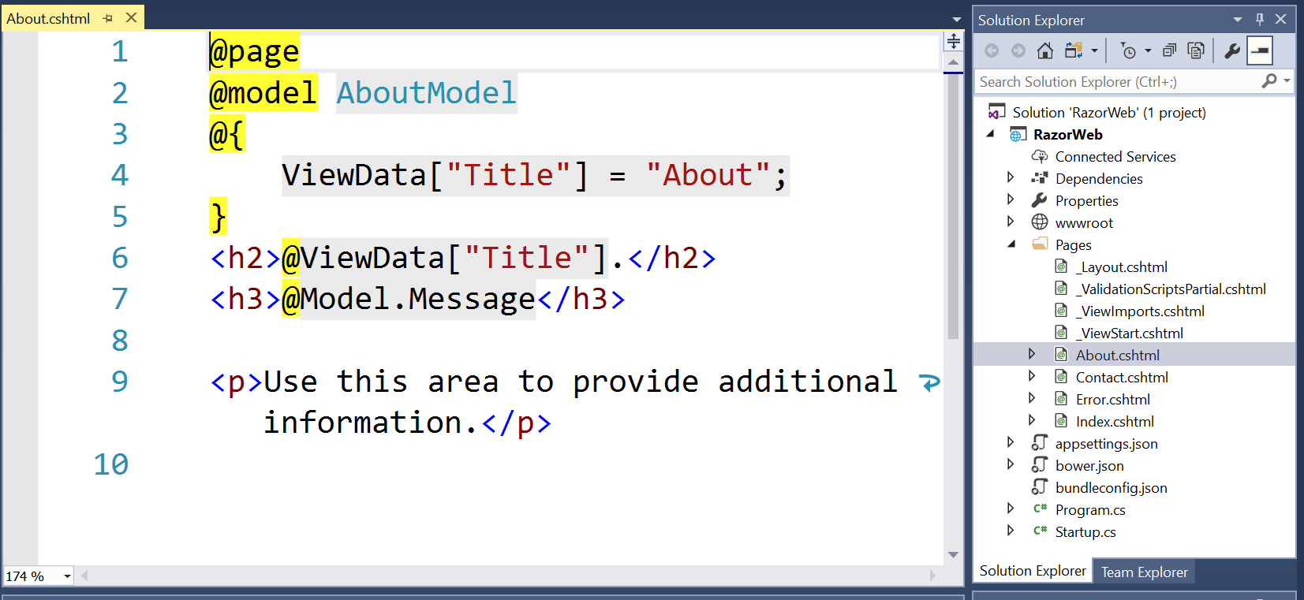
Razor Syntax

Slide 64
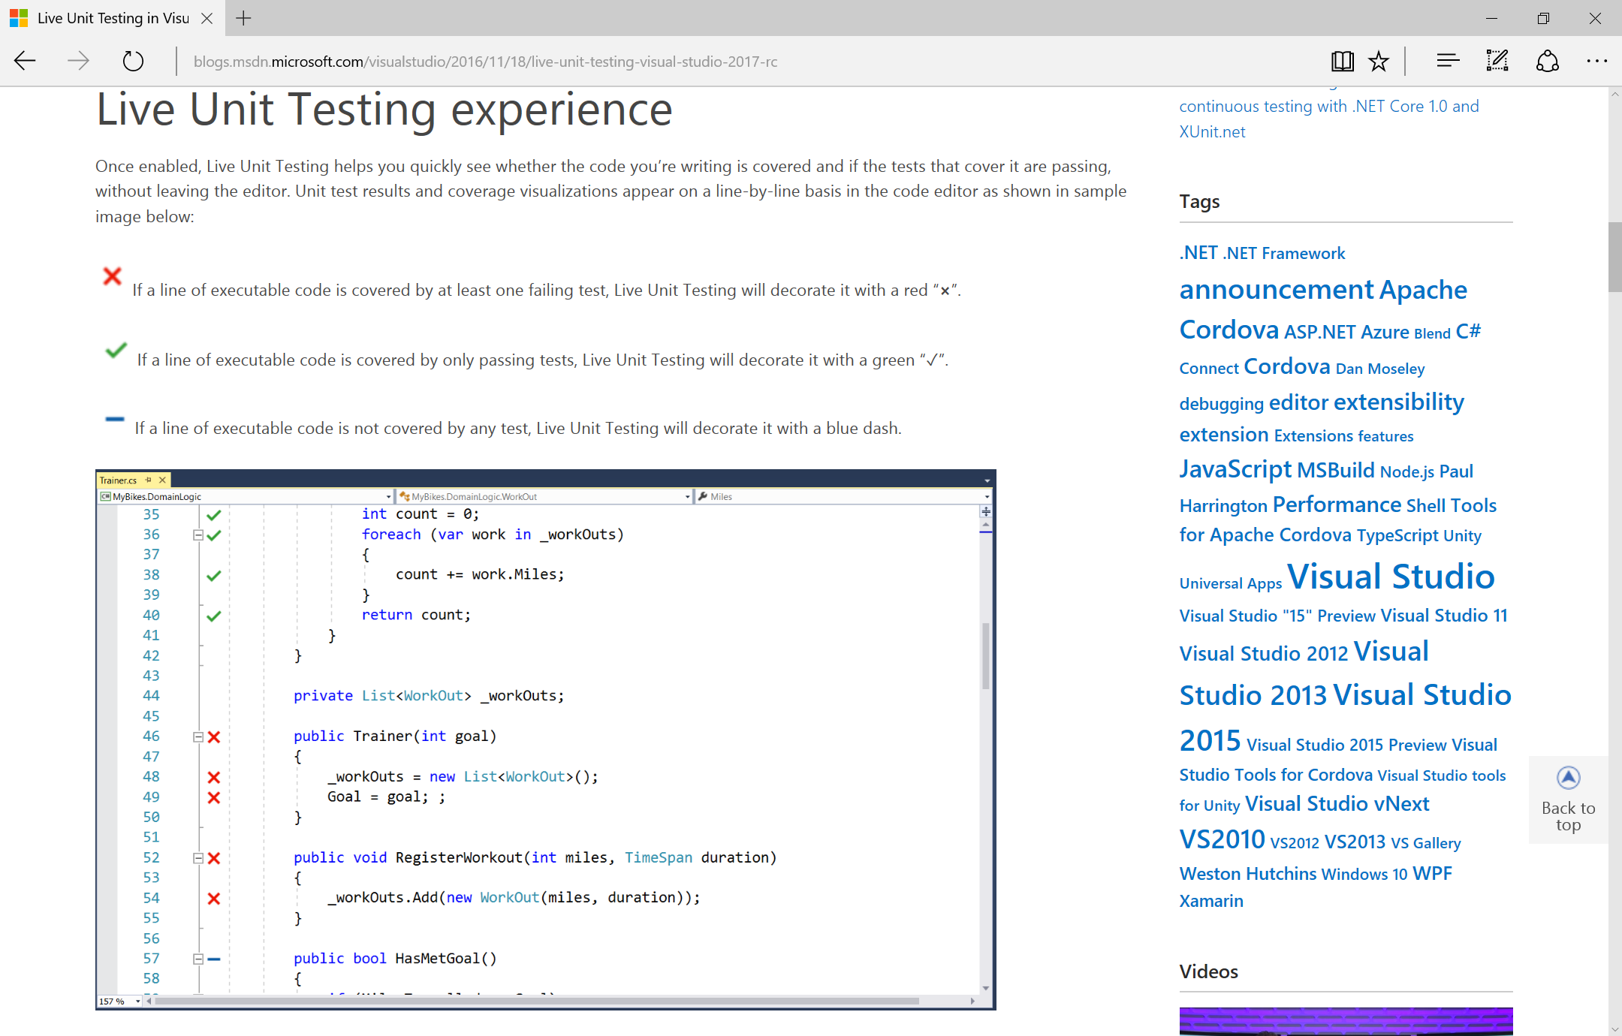
Live Unit Testing
https://blogs.msdn.microsoft.com/visualstudio/2016/11/18/live-unit-testing-visual-studio-2017-rc/

Slide 65

DEMO

Slide 66

Migrating from MVC to MVC Core
https://docs.microsoft.com/en-us/aspnet/core/migration/mvc

Slide 67

Visual Studio Code
Download: https://code.visualstudio.com

Slide 68

.NET Version Manager (DNVM)
(OBSOLETE)
.NET SDK Version Manager
Formerly KVM
Get list of DNXs (aka KRE)
GitHub: https://github.com/aspnet/dnvm

Slide 69

Tooling Changes and NETStandard

Slide 70

dotnet/cli on GitHub
This repo contains the .NET Core command-line (CLI) tools, used for building .NET Core apps and libraries.
GitHub: https://github.com/dotnet/cli

Slide 71
Agenda
Introduction
> .NET (Framework & Core)
> ASP.NET Core
> Visual Studio
Wrap-up + Q&A
Notes:
Agenda

Slide 72
References
ASP .NET: http://www.asp.net
.NET Core: https://www.microsoft.com/net
.NET Web Dev Blog: https://blogs.msdn.microsoft.com/webdev
Scott Hanselman’s Blog: https://www.hanselman.com/blog
.NET Conf: http://www.dotnetconf.net
MSDN Channel 9: https://channel9.msdn.com
Tutorials: https://docs.microsoft.com/en-us/aspnet/core/tutorials/first-mvc-app
C# 7: https://docs.microsoft.com/en-us/dotnet/articles/csharp/csharp-7
ASP.NET Core Roadmap: https://github.com/aspnet/Home/wiki/Roadmap
.NET Core Roadmap: https://github.com/dotnet/core/blob/master/roadmap.md

Slide 73
Other Resources
New Razor Pages: http://www.hishambinateya.com/welcome-razor-pages
Intro to Razor: https://docs.microsoft.com/en-us/aspnet/core/mvc/razor-pages
Live Unit Testing: https://blogs.msdn.microsoft.com/visualstudio/2016/11/18/live-unit-testing-visual-studio-2017-rc
Migrating from MVC to MVC Core: https://docs.microsoft.com/en-us/aspnet/core/migration/mvc
Visual Studio Code: https://code.visualstudio.com
dotnet/cli on GitHub: https://github.com/dotnet/cli

Slide 74
Q & A
Notes:
Additional Topics

Slide 75
Agenda
Introduction
> .NET (Framework & Core)
> ASP.NET Core
> Visual Studio
Wrap-up + Q&A
Notes:
Agenda

Slide 76

Email: shchowd@microsoft.com  Twitter: @shahedC
Notes:
Contact
Microsoft email: shchowd@microsoft.com
Personal Twitter: @shahedC
Dev Blog: WakeUpAndCode.com

