Slide 1
Capture the Cloud with Azure
Shahed Chowdhuri
Sr. Technical Evangelist @ Microsoft

Slide 2
Why the cloud?

Slide 3
Why the cloud?
  Hosting models
  Business model
  On Premises
  Infrastructure
  (as a Service)
  Platform
  (as a Service)
  Software
  (as a Service)
  Applications
Applications
  You manage
Applications
Applications
  You scale, make resilient and manage
  You scale, make
  resilient & manage
Data
Data
Data
Data
Runtime
Runtime
Runtime
Runtime
  Scale, resilience and
  management by vendor
Middleware
Middleware
Middleware
  Scale, resilience and
  management by vendor
Middleware
O/S
O/S
O/S
O/S
Virtualization
Virtualization
  Managed by vendor
Virtualization
Virtualization
Servers
Servers
Servers
Servers
Storage
Storage
Storage
Storage
Networking
Networking
Networking
Networking

Slide 4
Azure

Slide 5
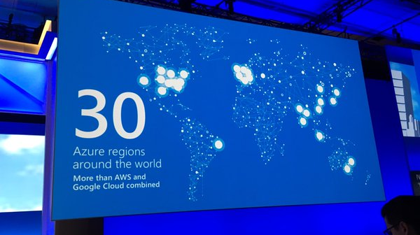
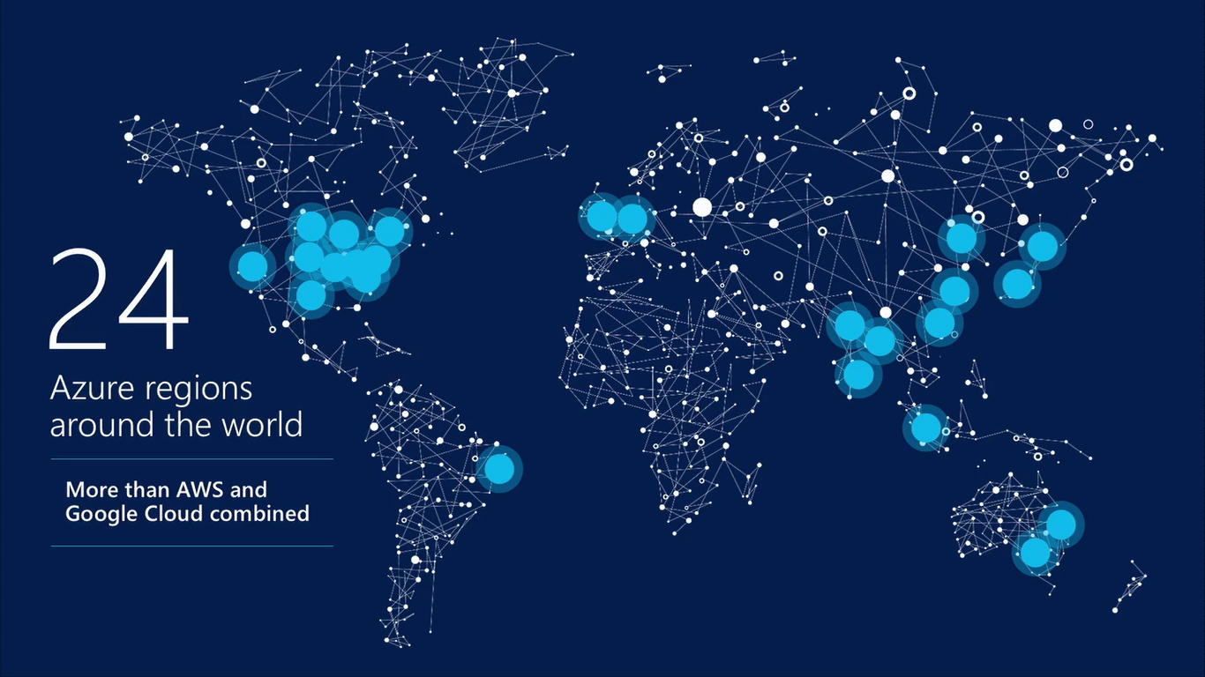
17 regions worldwide in 2015
Azure footprint
Data Centers
Regional Partners
Source: https://twitter.com/PaulSpain/status/715564339114053632
Notes:
Speaker notes:
Broad global reach
Azure maintains a global presence across 17 datacenter around the world to help customers and partners meet their goal of providing applications close to their user base.
Mention contribution of regional partners help Azure’s global presence.
Microsoft's continued investment in subsea and terrestrial dark fiber capacity helping deliver data at higher speeds, with higher capacity and lower latency for our customers across the globe.
Use the following notes if you want to address some or all security, compliance, transparency and privacy concerns of the audience.
Microsoft has leveraged its decades-long experience in operating some of the world’s largest online services to create a robust set of security technologies and practices to keep your data at rest or in motion secured in Azure.
Azure meets a broad set of international and industry-specific compliance standards as part of help customer attain compliance for their own infrastructure running on the platform.
Azure is subjected to rigorous audits by independent organizations and the results are available to you as a part of Microsoft's commitment to transparency.
Azure adheres to stringent privacy policies through a program called Privacy by Design which describes Microsoft's core privacy concerns to protect customer data and how to address them. Those protections are then backed with strong contractual commitments to safeguard customer data with by abiding by the EU Model Clauses, Safe Harbor programs, and ISO/IEC 27018 (which governs the processing of personal information).

Slide 6



Achieve global scale, in local regions
Achieve global scale, in local regions
Achieve global scale, in local regions
34
regions
34
regions
34
regions

Slide 7
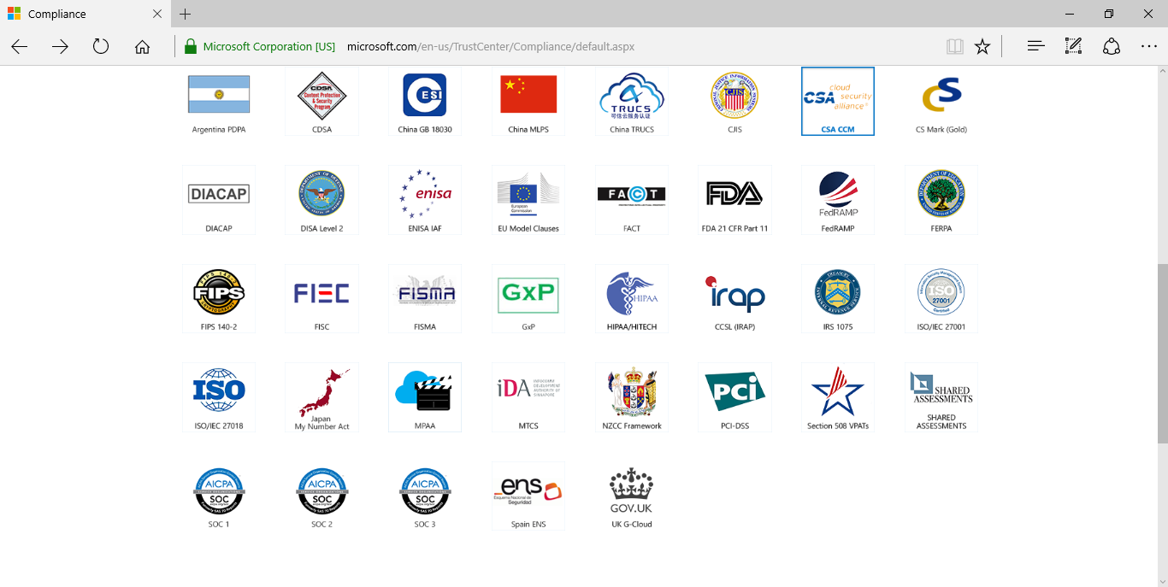
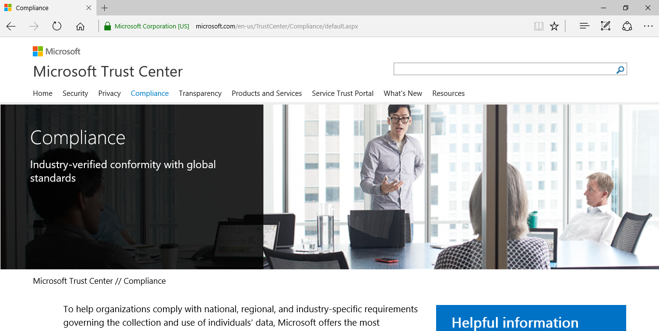
Compliance: Microsoft Trust Center
Azure Compliance: http://aka.ms/AzureCompliance
Notes:
Speaker notes:
Broad global reach
Azure maintains a global presence across 17 datacenter around the world to help customers and partners meet their goal of providing applications close to their user base.
Mention contribution of regional partners help Azure’s global presence.
Microsoft's continued investment in subsea and terrestrial dark fiber capacity helping deliver data at higher speeds, with higher capacity and lower latency for our customers across the globe.
Use the following notes if you want to address some or all security, compliance, transparency and privacy concerns of the audience.
Microsoft has leveraged its decades-long experience in operating some of the world’s largest online services to create a robust set of security technologies and practices to keep your data at rest or in motion secured in Azure.
Azure meets a broad set of international and industry-specific compliance standards as part of help customer attain compliance for their own infrastructure running on the platform.
Azure is subjected to rigorous audits by independent organizations and the results are available to you as a part of Microsoft's commitment to transparency.
Azure adheres to stringent privacy policies through a program called Privacy by Design which describes Microsoft's core privacy concerns to protect customer data and how to address them. Those protections are then backed with strong contractual commitments to safeguard customer data with by abiding by the EU Model Clauses, Safe Harbor programs, and ISO/IEC 27018 (which governs the processing of personal information).

Slide 8
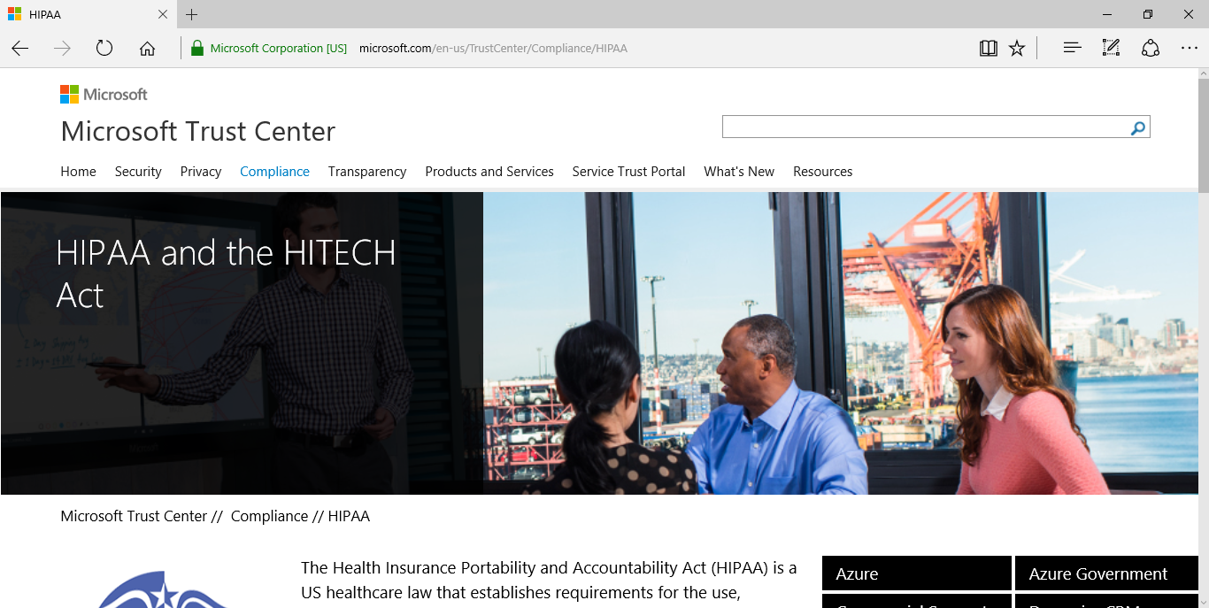
HIPAA Compliance and BAA Docs
HIPAA Compliance: https://www.microsoft.com/en-us/TrustCenter/Compliance/HIPAA
Notes:
Speaker notes:
Broad global reach
Azure maintains a global presence across 17 datacenter around the world to help customers and partners meet their goal of providing applications close to their user base.
Mention contribution of regional partners help Azure’s global presence.
Microsoft's continued investment in subsea and terrestrial dark fiber capacity helping deliver data at higher speeds, with higher capacity and lower latency for our customers across the globe.
Use the following notes if you want to address some or all security, compliance, transparency and privacy concerns of the audience.
Microsoft has leveraged its decades-long experience in operating some of the world’s largest online services to create a robust set of security technologies and practices to keep your data at rest or in motion secured in Azure.
Azure meets a broad set of international and industry-specific compliance standards as part of help customer attain compliance for their own infrastructure running on the platform.
Azure is subjected to rigorous audits by independent organizations and the results are available to you as a part of Microsoft's commitment to transparency.
Azure adheres to stringent privacy policies through a program called Privacy by Design which describes Microsoft's core privacy concerns to protect customer data and how to address them. Those protections are then backed with strong contractual commitments to safeguard customer data with by abiding by the EU Model Clauses, Safe Harbor programs, and ISO/IEC 27018 (which governs the processing of personal information).

Slide 9
Demo: Azure Portal

Slide 10
Azure Services

Slide 11

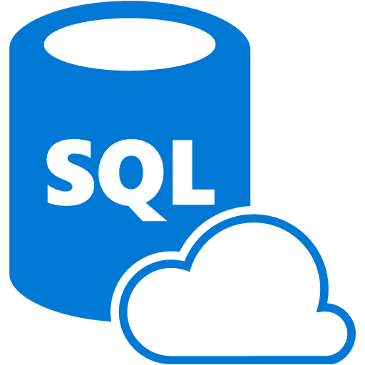







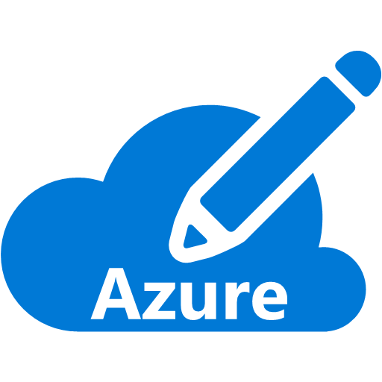

























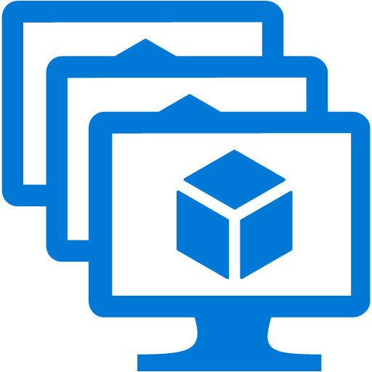



























IaaS & PaaS Offerings
Platform Services
Security & Management
Hybrid
Cloud
Media & CDN
Application Platform
Data
Security Center
SQL
Database
Azure AD
Health Monitoring
Media
Services
Media
Analytics
Content
Delivery
Network
Web
Apps
Mobile
Apps
SQL Data
Warehouse
DocumentDB
Portal
AD Privileged
Identity
Management
Azure Active
Directory
Integration
SQL Server
Stretch Database
Redis
Cache
Storage
Tables
Azure
Search
API
Apps
Cloud
Services
Azure AD
B2C
API
Management
BizTalk
Services
Domain Services
Service
Fabric
Notification
Hubs
Intelligence
Multi-Factor
Authentication
Logic
Apps
Service Bus
Functions
Cognitive Services
Bot Framework
Cortana
Backup
Automation
Developer Services
Analytics & IoT
Operational
Analytics
Compute Services
Scheduler
HDInsight
Machine
Learning
Stream Analytics
Container
Service
VM
Scale Sets
Visual Studio
Mobile
Engagement
Import/Export
Key Vault
Data
Catalog
Data Lake
Analytics Service
Data Lake Store
Store/
Marketplace
Batch
RemoteApp
VS Team Services
Xamarin
Azure Site
Recovery
Application
Insights
HockeyApp
IoT Hub
Event
Hubs
Data
Factory
Power BI
Embedded
VM Image Gallery
& VM Depot
Dev/Test Lab
StorSimple
Infrastructure Services
Compute
Storage
Networking
Virtual Machines
Containers
Blob
Queues
Files
Disks
Virtual Network
Load Balancer
DNS
Express
Route
Traffic Manager
VPN Gateway
App
Gateway

Slide 12
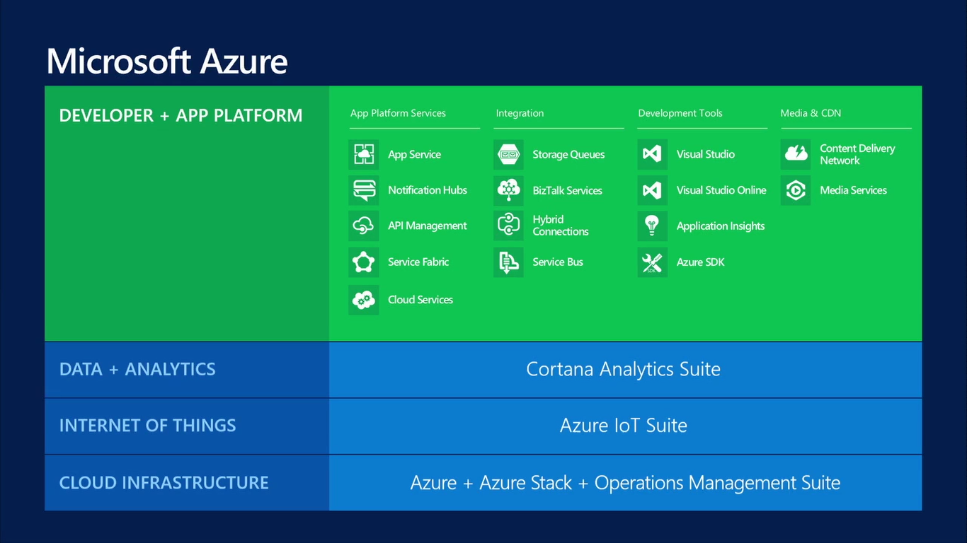

Slide 13
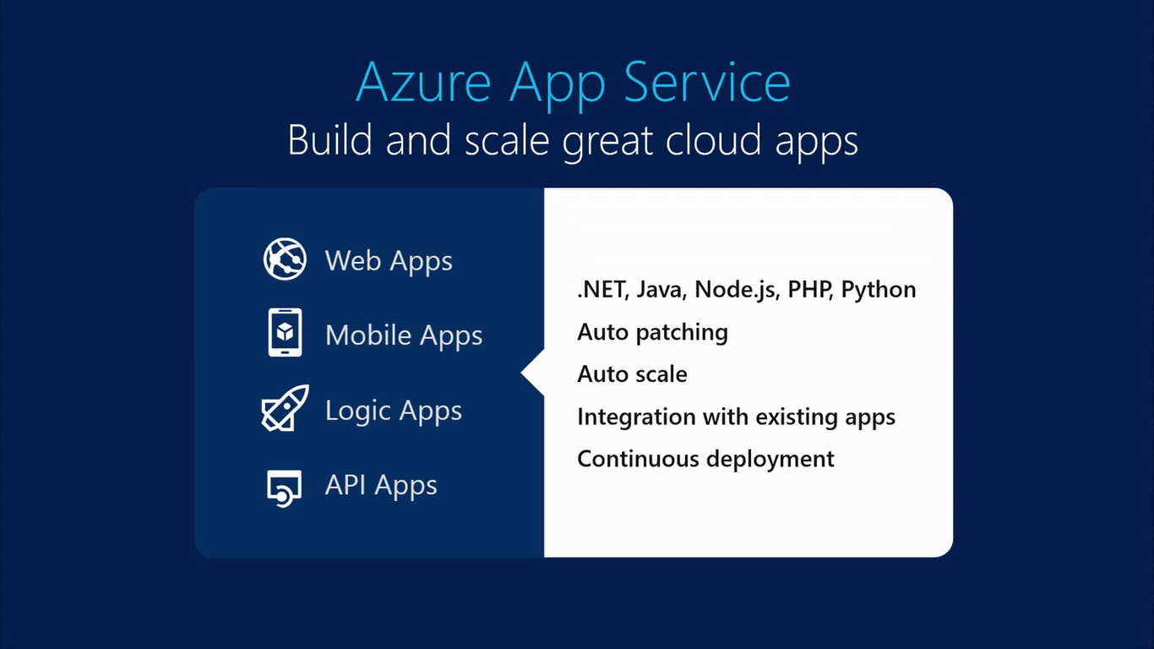

Slide 14
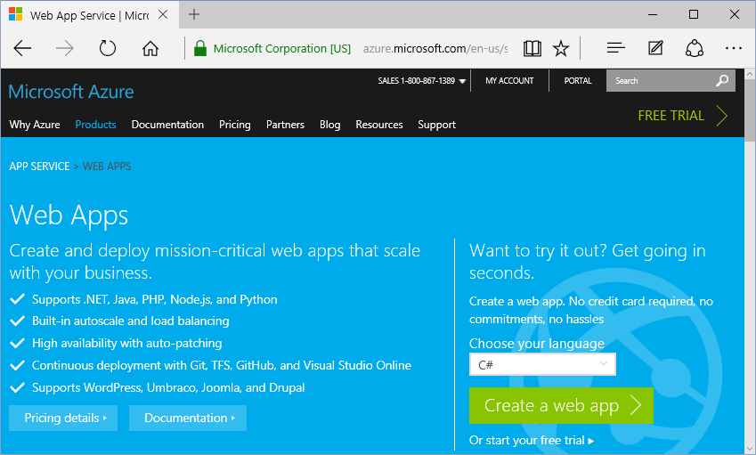
Web Apps
Languages:
.NET
Java
PHP
Node.js
Python
https://azure.microsoft.com/en-us/services/app-service/web/

Slide 15
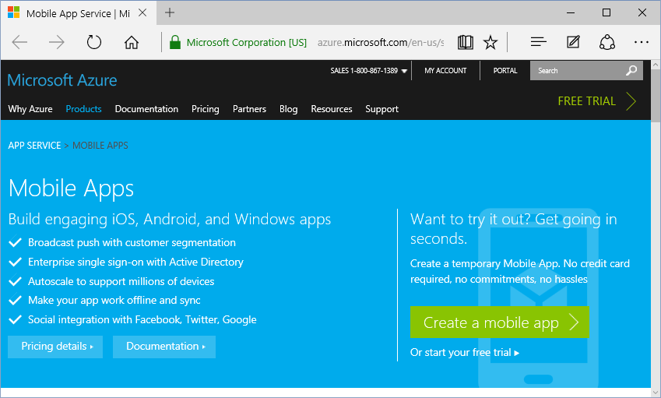
Mobile Apps
Platforms:
iOS
Android
Windows
https://azure.microsoft.com/en-us/services/app-service/mobile/

Slide 16
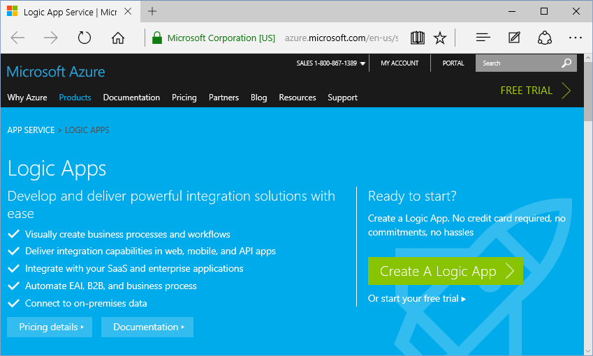
Logic Apps
Features:
Integrate
Automate
Connect
https://azure.microsoft.com/en-us/services/app-service/logic/

Slide 17
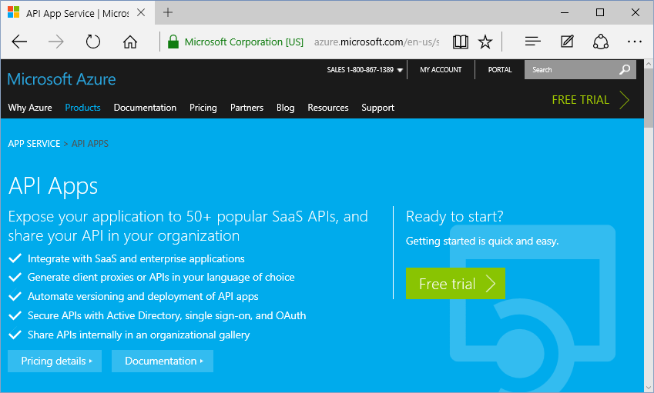
API Apps
Features:
Expose
Secure
Share
https://azure.microsoft.com/en-us/services/app-service/api/

Slide 18
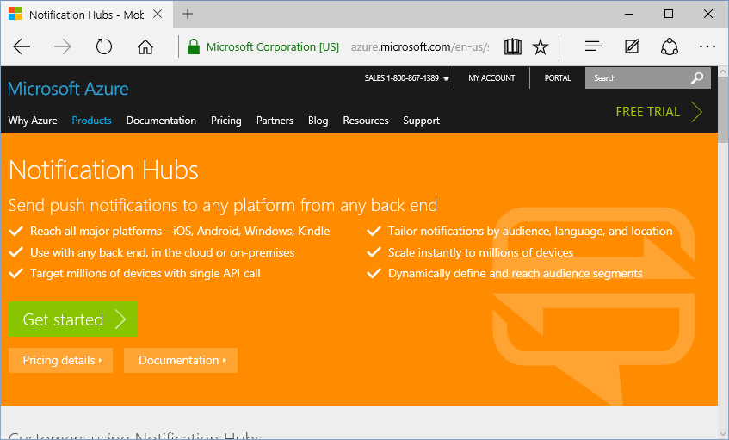
Notification Hubs
Platforms:
iOS
Android
Windows
Kindle
https://azure.microsoft.com/en-us/services/notification-hubs/

Slide 19
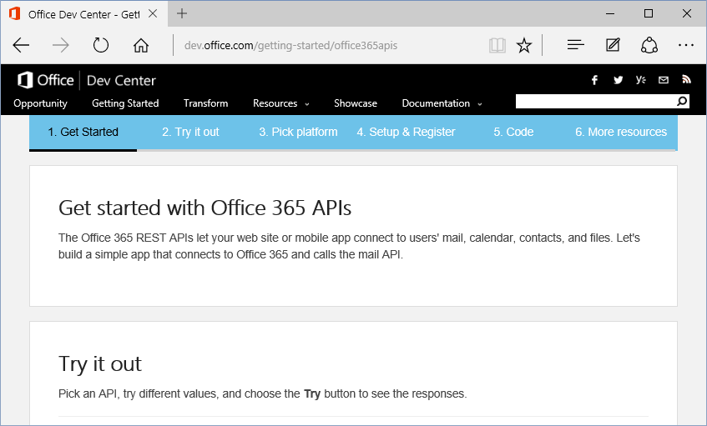
Office365 API
Connect:
Mail
Calendar
Contacts
Files
http://dev.office.com/getting-started/office365apis

Slide 20
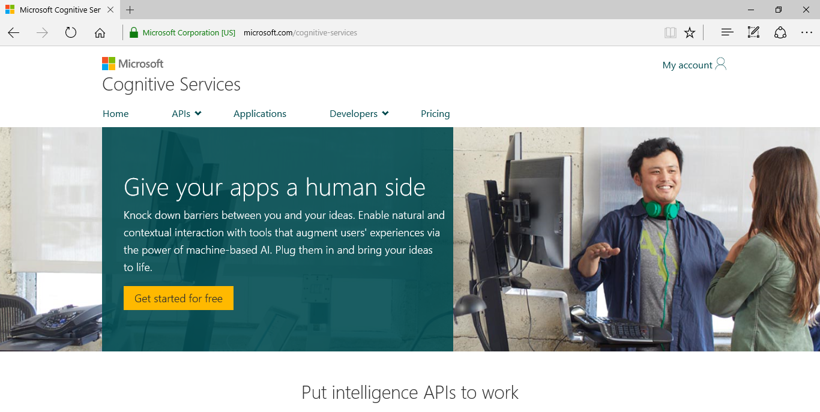
Cognitive Services
https://www.microsoft.com/cognitive-services/

Slide 21
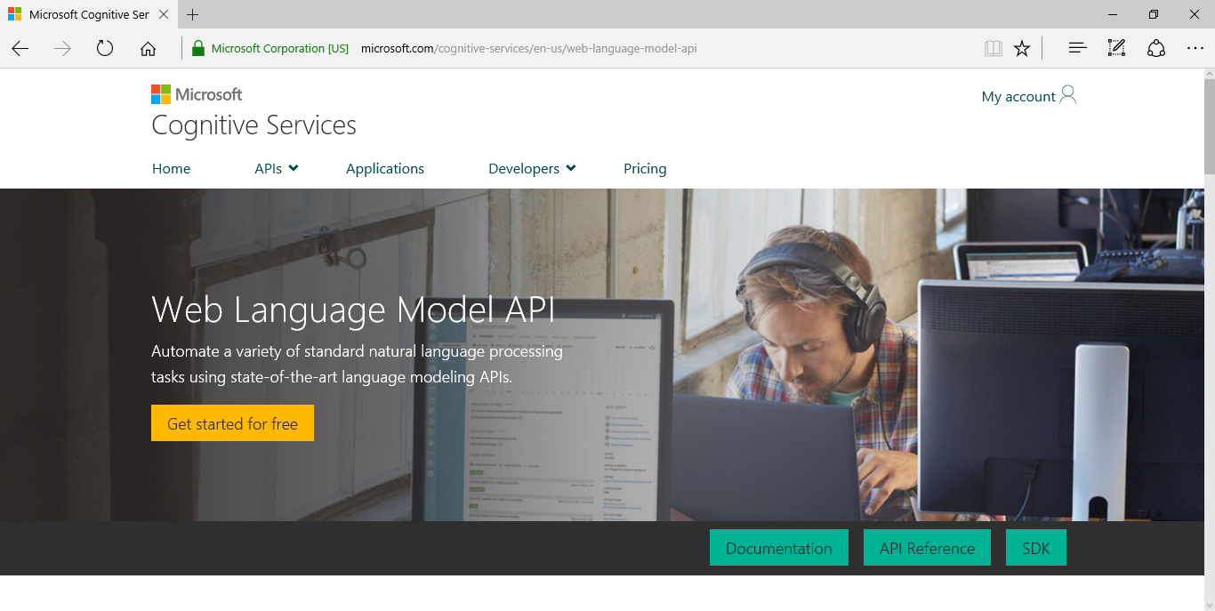
Natural Language Processing
https://www.microsoft.com/cognitive-services/en-us/web-language-model-api

Slide 22
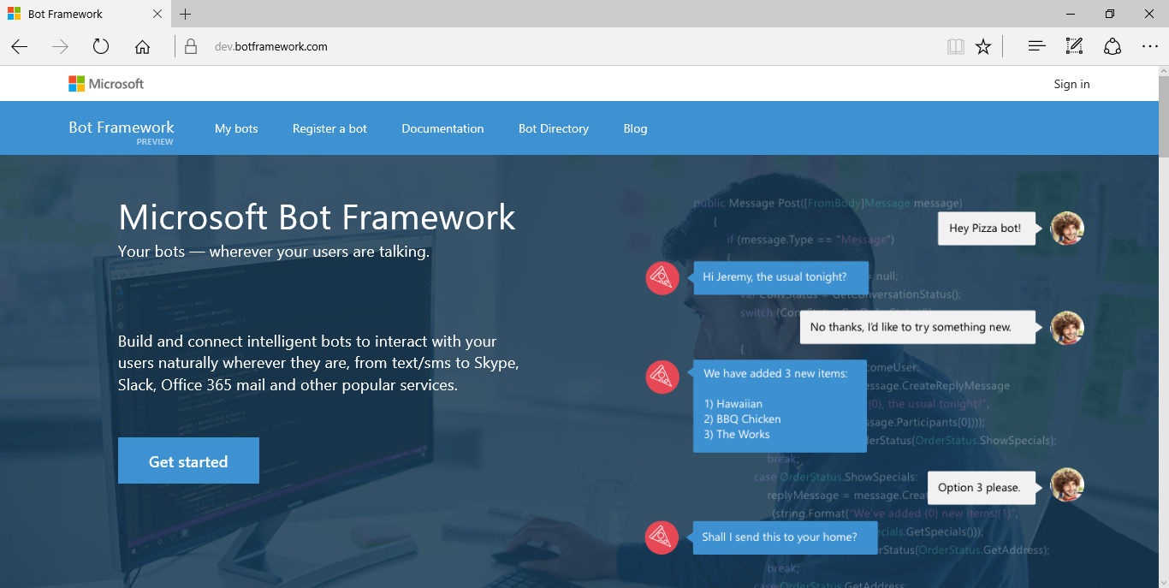
Bot Framework
https://dev.botframework.com/

Slide 23
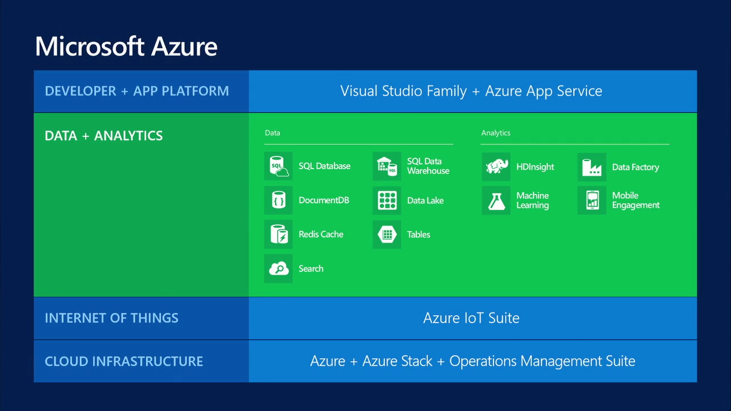

Slide 24
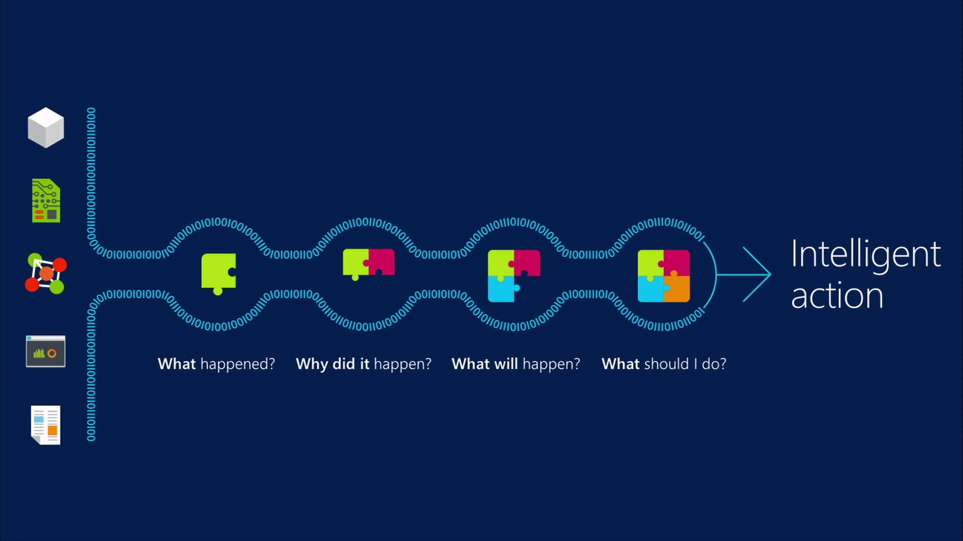
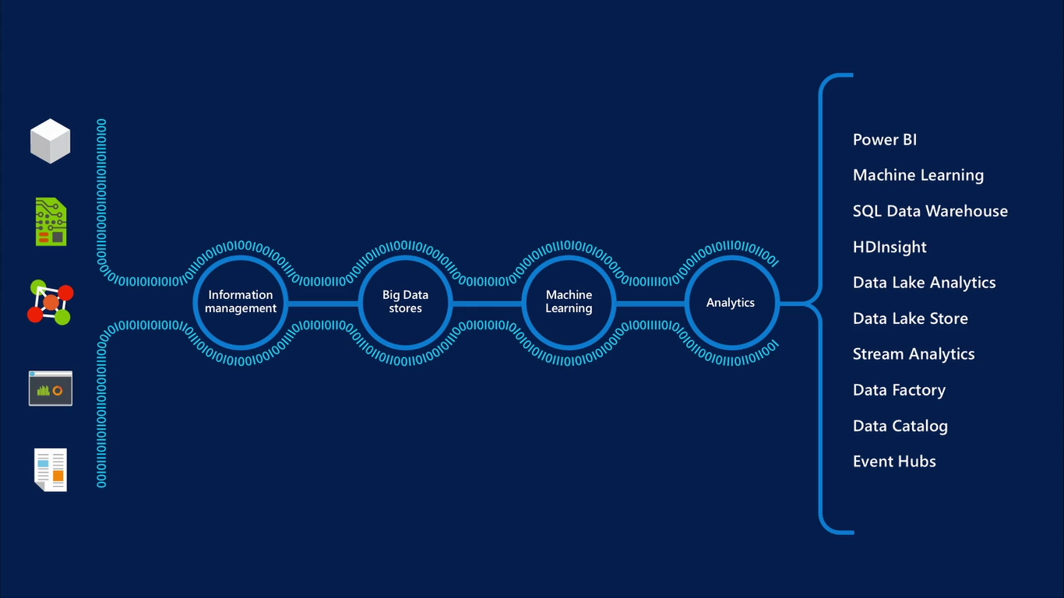

Slide 25

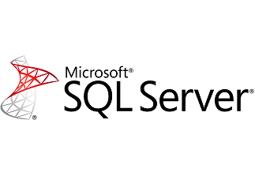




Database Options
{DocumentDB}
{HDInsight}

Slide 26

SQL Database
Fully managed SQL Server database technology as a service
  Ideal for simple and complex applications
  Enterprise-ready with automatic support for HA
Secondary
Replica
Primary
Secondary
Replica
Secondary
Replica
Notes:
Speaker notes:
How is HA achieved? At any one time, three database replicas are running—one primary replica and two or more secondary replicas. If the hardware fails on the primary replica, Azure SQL Database detects the failure and fails over to the secondary replica. In case of a physical loss of a replica, a new replica is automatically created. So there are always at minimum two physical, transitionally consistent copies of your data in the datacenter.

Slide 27
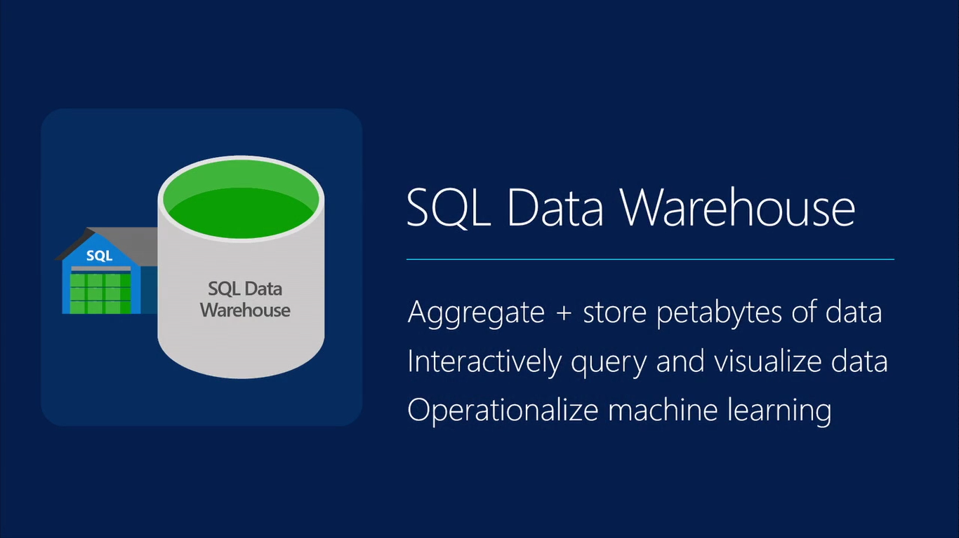

Slide 28
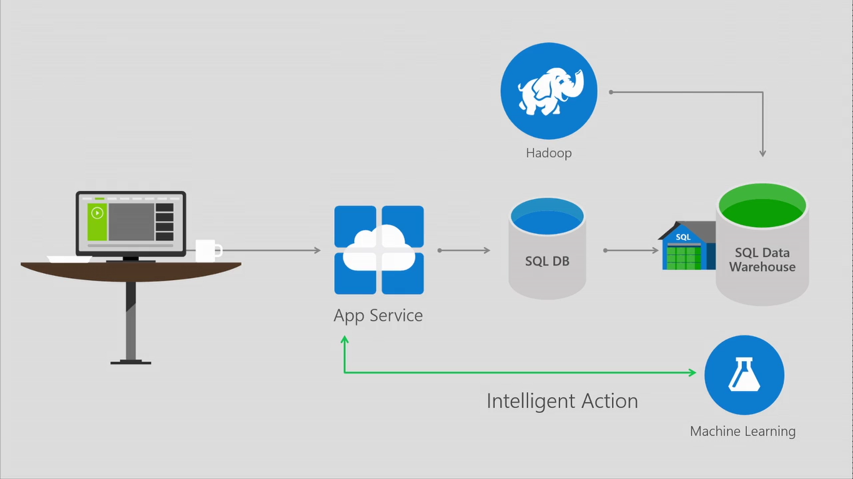

Slide 29
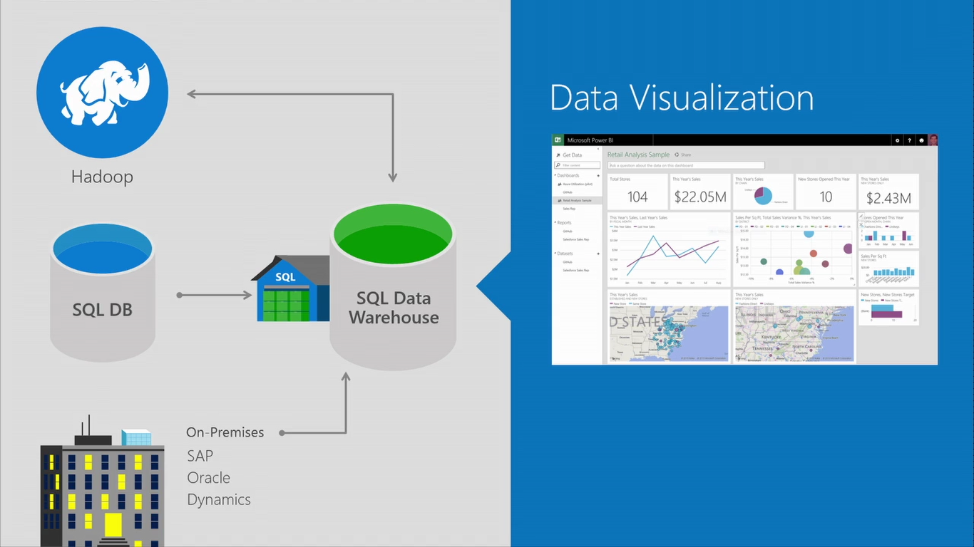

Slide 30
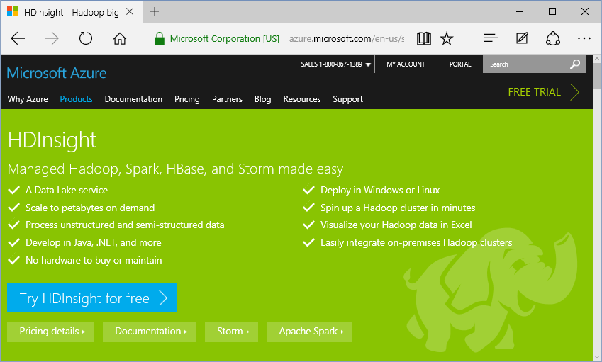
HDInsight: Big Data with Hadoop
Develop:
Java
.NET
… and more!
Deploy:
Windows
Linux
https://azure.microsoft.com/en-us/services/hdinsight/

Slide 31
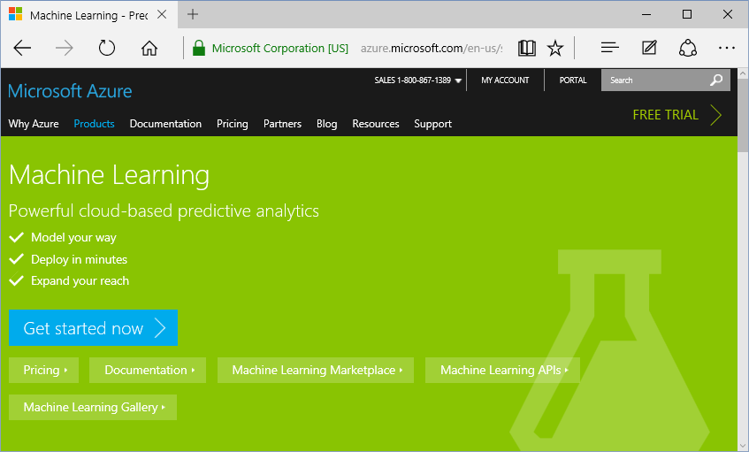
Machine Learning (Predictive Analytics)
Features:
Model
Deploy
Expand
https://azure.microsoft.com/en-us/services/machine-learning/

Slide 32

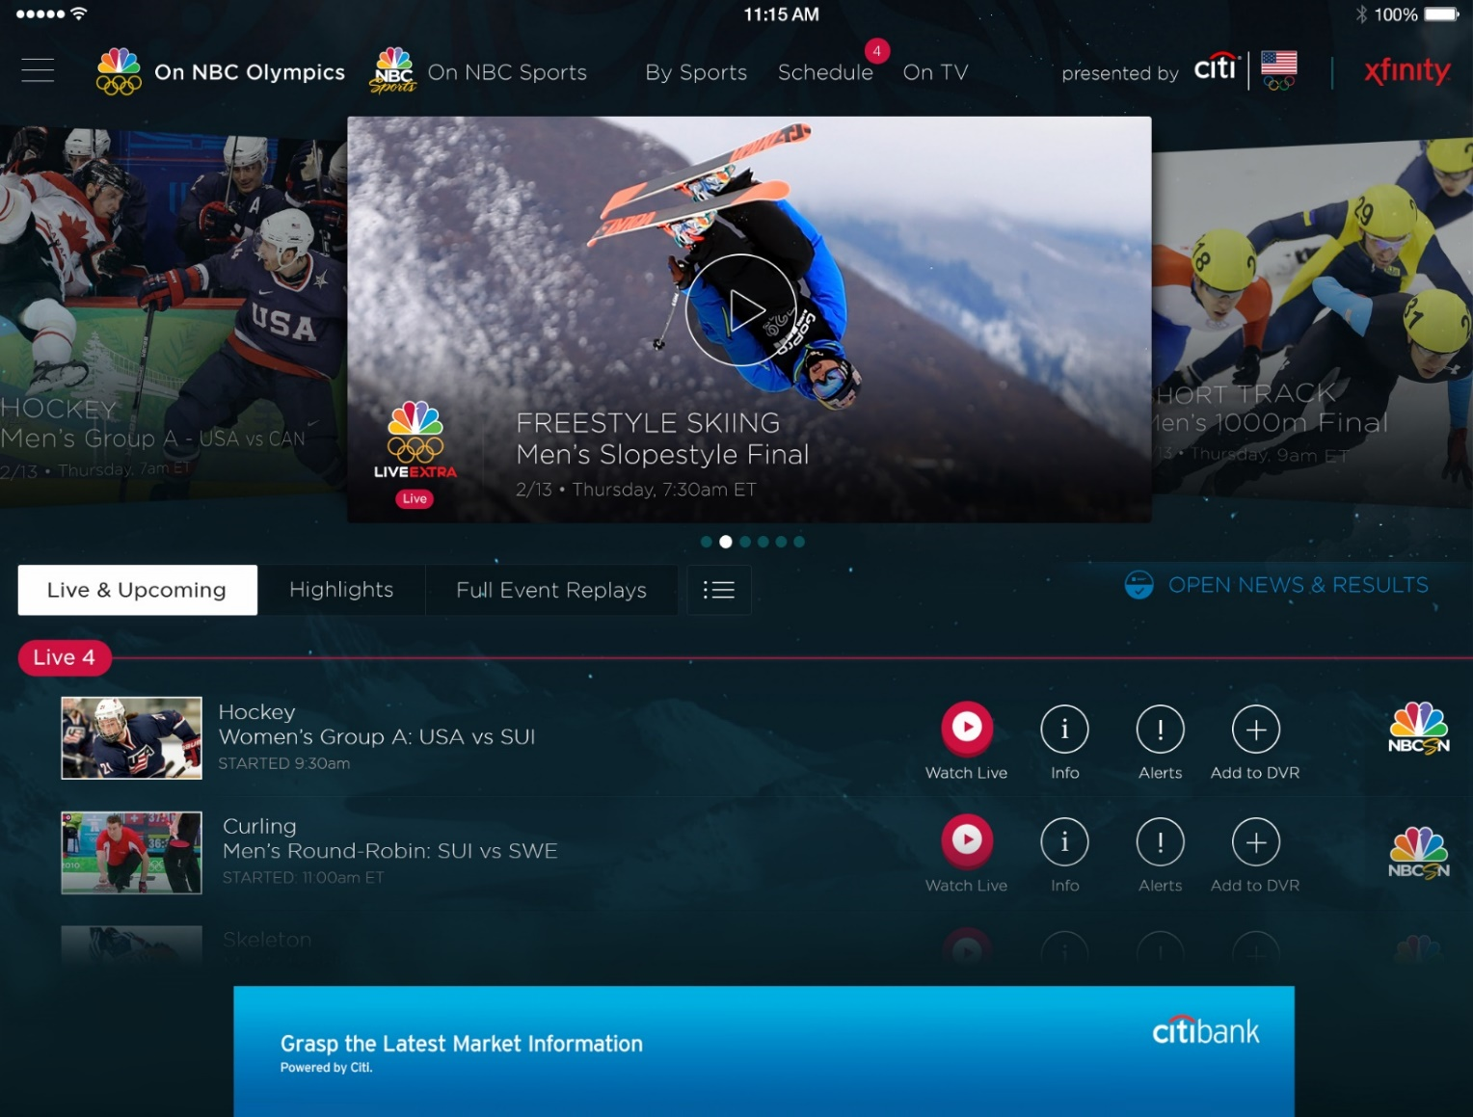
Azure Media Services
Olympics NBC Sports
On Demand Media Services
Video-on-demand
  Ingest
  Encode
  Package
  Encrypt
  Delivery
Live Streaming Support
Office 365 Integration
Azure Media Player
Live video encoding and streaming
Web + Mobile
100 million viewers
2.1 million concurrent HD viewers during the
USA vs. Canada hockey match
https://azure.microsoft.com/en-us/services/media-services/
Notes:
Speaker notes:
Deliver video content or stream video to audiences large or small to any device(Web or Mobile) anywhere reliably and in scale.
Helps you create versatile media workflows for ingesting, encoding, protecting and streaming content to audiences on-demand or broadcast live.
Powerful and extensible platform with broad set of first and third-party capabilities to support complete end-to-end media workflows.
Integration with Office 365 empowers organizations of all sizes helps to use videos to enhance sharing, collaboration and communication.
Azure Media Player, an automated online player solution, supports all the usual industry standards like HTML5 video, Media Source Extensions and rights management through Encrypted Media Extensions. The focus here is on open standards, but on older browsers, the player can fall back on Flash or Silverlight.

Slide 33
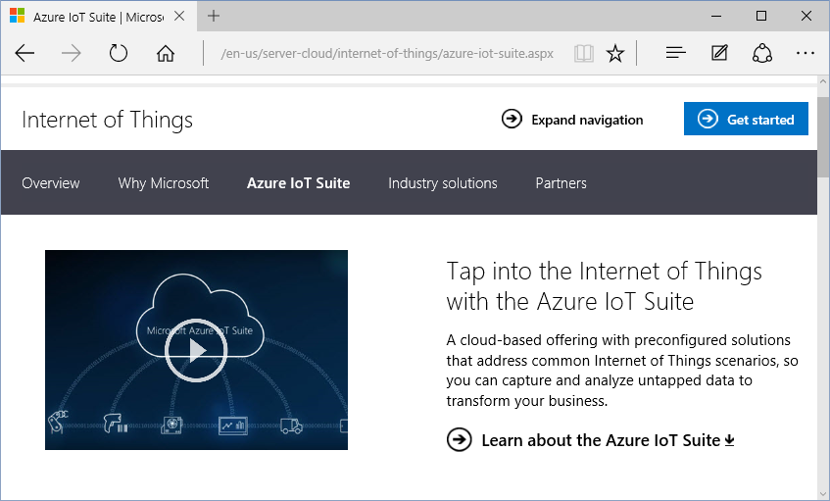
IoT (Internet of Things)
Iot Suite:
Connect
Monitor
Innovate
http://www.microsoft.com/en-us/server-cloud/internet-of-things/azure-iot-suite.aspx

Slide 34
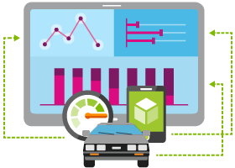

Internet of Things
  Event Hubs
  Notification Hubs
  Stream Analytics
  Machine Learning
  HDInsight
  Power BI for Office 365
With Microsoft Azure IoT services, you can monitor assets to improve efficiencies, drive operational performance to enable innovation, and leverage advance data analytics to transform your company with new business models and revenue streams.
Notes:
Speaking Notes
Azure Mobile Services is a Backend-as-a-Service
Instead of you having to design, build, test, deploy, manage, and upgrade your whole backend, we do it for you
Features of Mobile Services
Storage – SQL DB
Authentication – built in support for social providers w/ ability to custom auth
Backend logic – data validation, logical flows, etc
Push Notifications – across all major mobile platforms
Scheduler – backend job processing

Slide 35
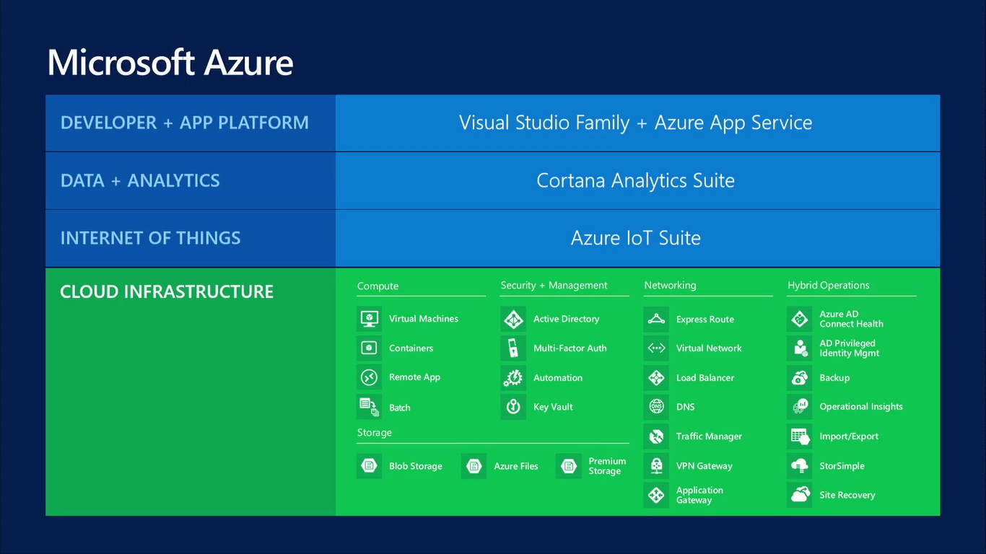

Slide 36
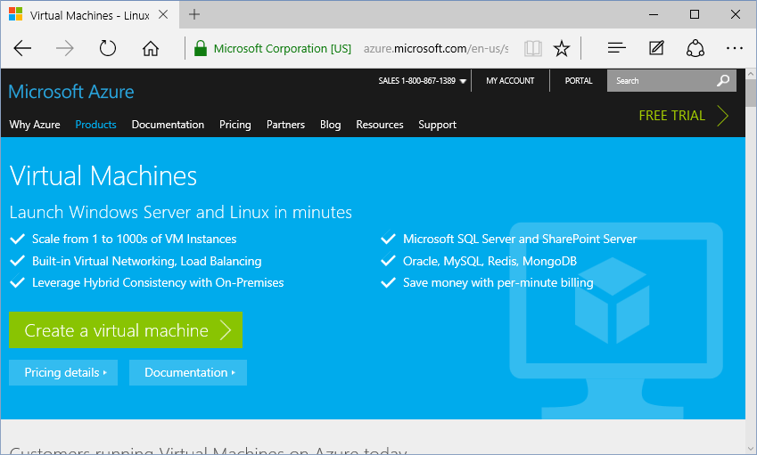
Virtual Machines
Options:
Windows
Linux
Pre-configured
https://azure.microsoft.com/en-us/services/virtual-machines/

Slide 37
Virtual Machines
Getting started
Select image
and VM size
New disk persisted in storage
Management portal
Windows Server
Boot VM from new disk
>_
Linux
Scripting
(Windows, Linux and Mac)
Blob
Storage
General Purpose
Basic
Standard
Optimized Compute
Performance Optimized
Network Optimized
REST API
Cloud
Comprehensive
Networking

Slide 38
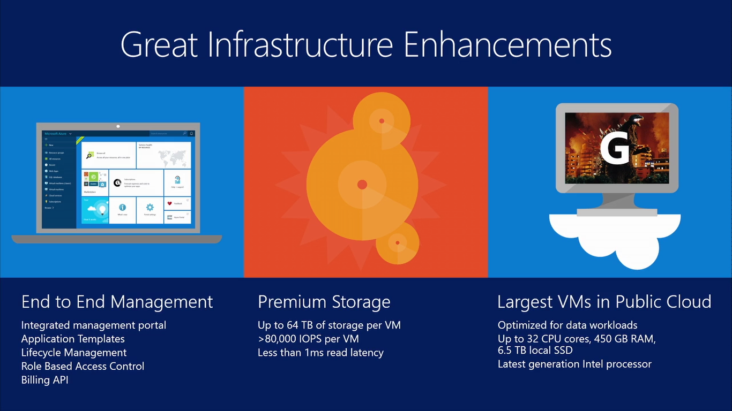

Slide 39
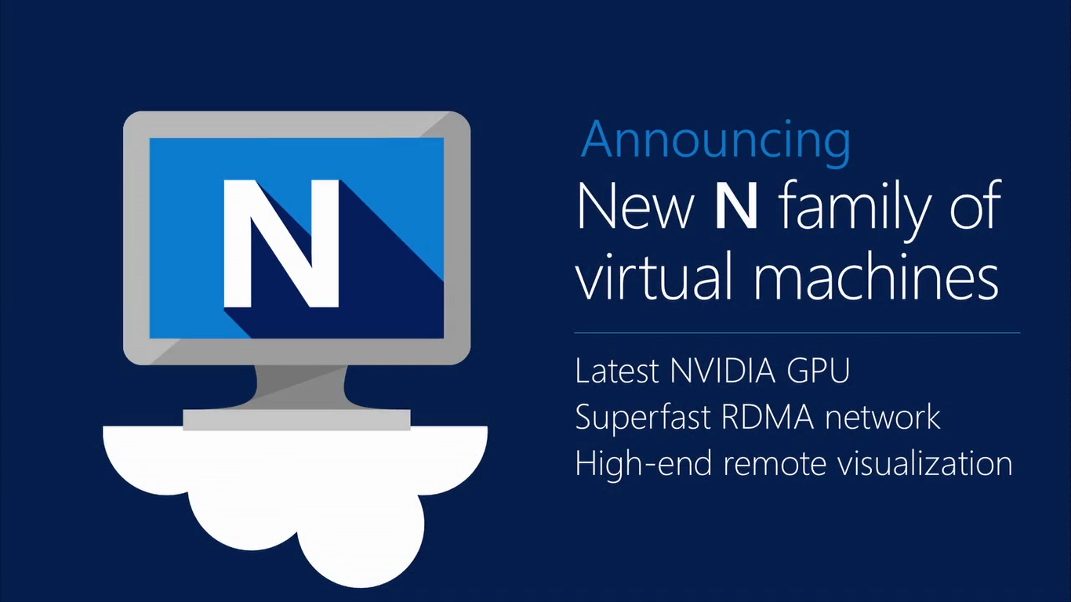

Slide 40
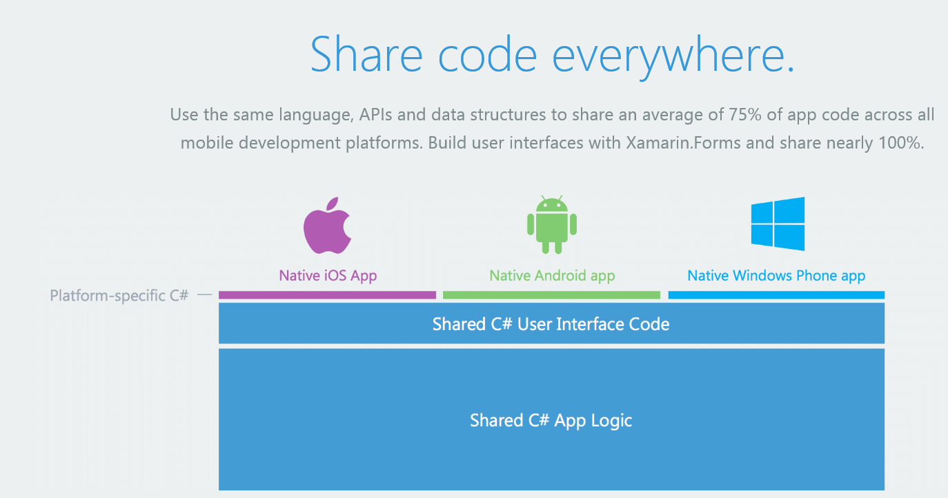
Xamarin: Cross-Platform Mobile Apps
“Use the same language, APIs and data structures to share an average of 75% of app code across all mobile development platforms. Build user interfaces with Xamarin.Forms and share nearly 100%.”

Slide 41
Key Scenarios to Get Started with Microsoft Azure

Slide 42

Key Scenarios to get started with Microsoft Azure
Full Dev/Test environments
Build
Production
Visual Studio
Team Services
Master branch
GIT / TFS
Staging
Check-in
Test branch
Dev/Test
Developers
Notes:
Speaker notes:
Create full Dev, Test, Staging and Production environments in minutes
Availability of Visual Studio Online(VSO) integration with build option available
Validate web app changes in a staging or test deployment slot before swapping it with the production slot
Swap to get your "last known good site" instantaneously if there is a problem with a new deployment in production
Swapping to production from staging as opposed to direct deployment eliminates downtime
Dev, Test, Staging and Production deployment workflow can be automated when pre-swap validation isn’t needed

Slide 43


Key Scenarios to get started with Microsoft Azure
Microsoft SQL Server
VM
Microsoft SQL Server
VM
Microsoft Azure
Lift and Shift
  Application VM
  Storage
Corporate
Network
  Application VM
  Archive
  key data inexpensively
  PDF
  JPG
  VIDEO
  DB
  DOCX
Notes:
Speaker notes:
Lift and Shift
Take existing work loads and run them in a certified instance. Emphasize image mobility and Azure Files to help move applications that require SMB shared folders very easily to Azure.
Storage
Archive key data in inexpensive cloud storage. Mention corporate finance databases, industry compliance documents and other key data can be inexpensively archived to Azure storage.

Slide 44

Key Scenarios to get started with Microsoft Azure
HDInsight
Visualization
and reporting
tools
Input
Process
Results
Output
Iterative exploration - Process key data into business intelligence using Hadoop
Notes:
Speaker notes:
Iterative exploration
The source data files(log files, email messages, tweets, and more) are loaded into the cluster, processed by one or more queries within HDInsight, and the output is consumed by the chosen reporting and visualization tools. The cycle repeats using the same data until useful insights have been found, or it becomes clear that there is no useful information available from the data—in which case you might choose to restart the process with a different source dataset.

Slide 45
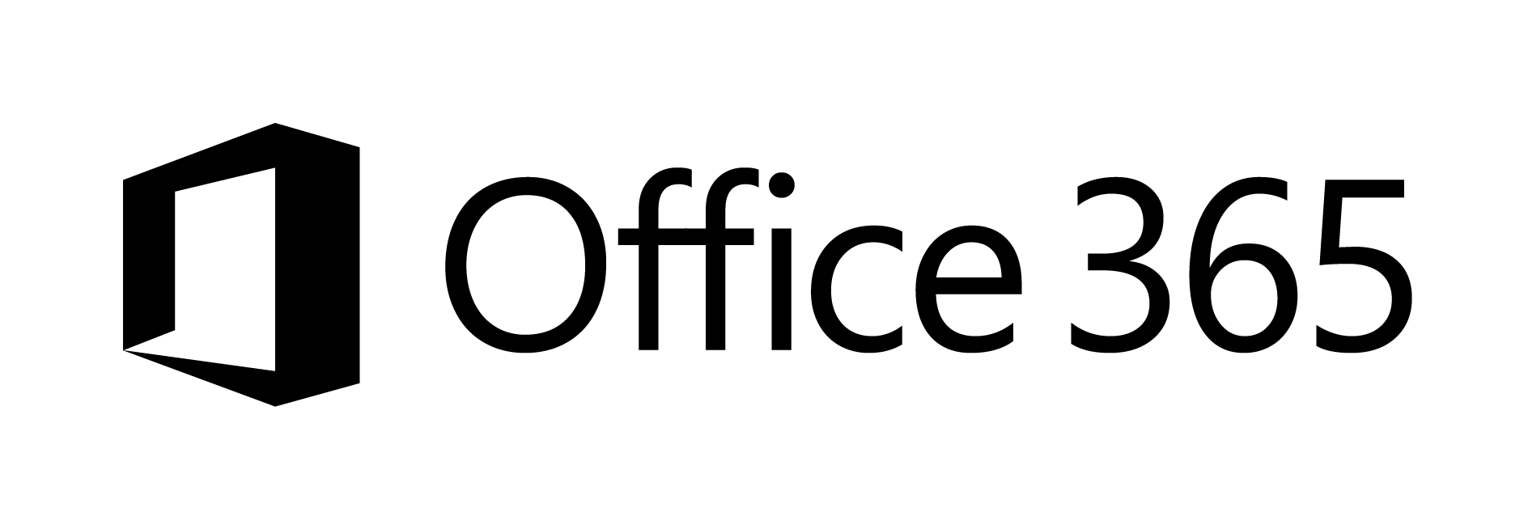





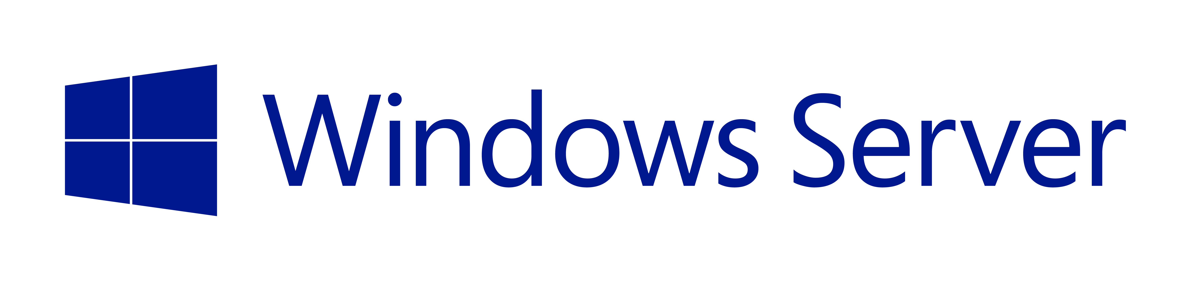

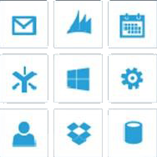
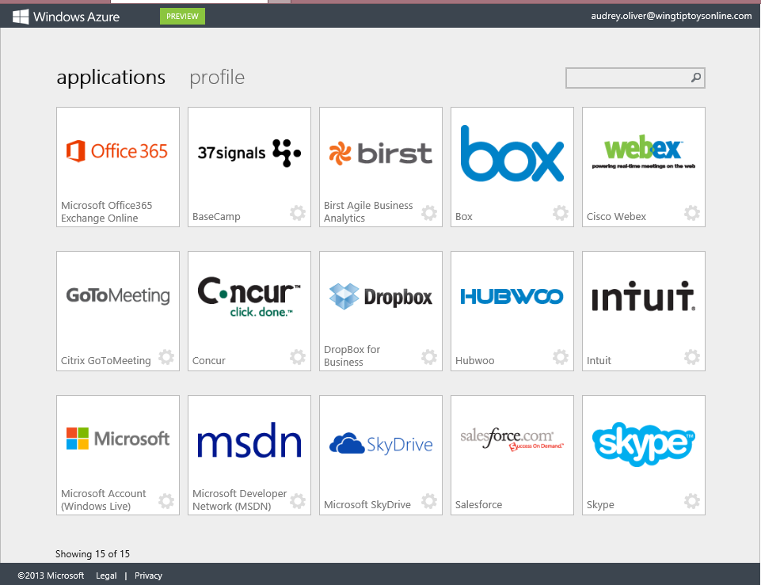
Key Scenarios to get started with Microsoft Azure
Identity as a Service
SaaS
Active Directory
Active Directory
Synchronize and
consolidate
identities
Custom
LOB apps
ISV/CSV
apps
Azure App Service and Non-MS cloud-based apps
PCs and devices
Notes:
Speaker notes:
Identity as a Service; Control and protect your apps, data and services in Azure together with assets in non-MS cloud using a single AD account.
Consolidate all your identities using one account for single sign-on to any cloud and on-premises services, using your favorite device, including iOS, Mac OS X, Android, and Windows devices.
As a developer you must also need to understand implications of extending your credentials in on-premises Active Directory to Azure Active Directory to protect your assets in on-premises and in the cloud.

Slide 46



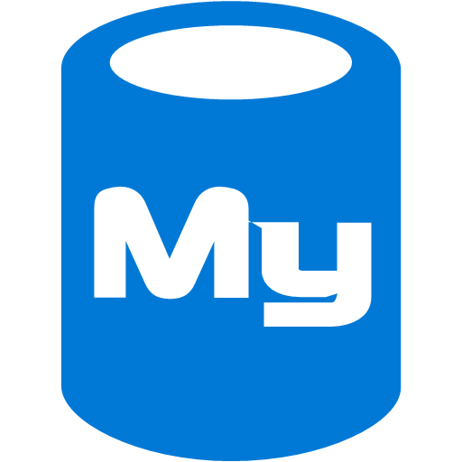



On-premises /
Hosting Services
IIS/SQL Server Based
Web Apps
Microsoft
SQL
Server
IIS
Non-IIS Open Source
Web Apps
Microsoft Azure
MySql
Web Apps - Take your web apps to the cloud using inexpensive App Service Web Apps
Key Scenarios to get started with Microsoft Azure
Notes:
Speaker notes:
You can easily move your existing IIS based web apps including SQL Server databases to Azure App Service easily with a migration tool provided by Microsoft called Azure App Service Migration Assistant.
If your open source web app’s framework is supported on App Service, the languages and frameworks needed by your application are configured for you automatically. Migrate an existing application or create a new one from the Application Gallery.
Consider using Azure Cloud Services or IaaS Virtual Machines if you are unable to migrate your application via Migration Assistant or your open source web app’s framework isn’t supported on App Service.
Other notes:
Windows Server 2003 will reach end of support on July 14th 2015. If you are currently hosting your websites on an IIS server that is Windows Server 2003, Web Apps is a low-risk, low-cost, and low-friction way to keep your websites online, and Web Apps Migration Assistant can help automate the migration process for you.
Moving to Web Apps require less time and IT expertise to configure and secure your apps compared to apps running in VM environment.
Web Apps require no maintenance effort on your part to patch, update, and manage underlying VM environment.

Slide 47
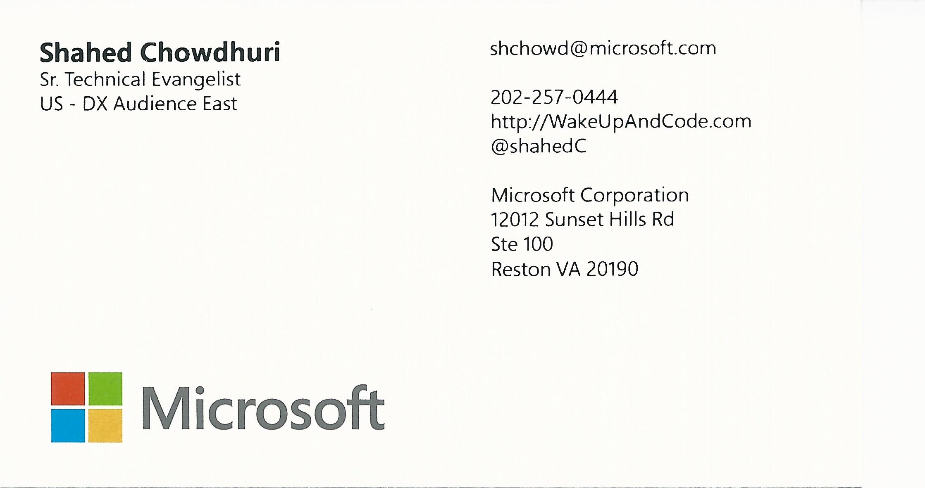
Contact
Email: shchowd@microsoft.com  Twitter: @shahedC
Notes:
Contact
Microsoft email: shchowd@microsoft.com
Personal Twitter: @shahedC
Dev Blog: WakeUpAndCode.com

