Slide 1
Going Serverless With
Azure Functions
Shahed Chowdhuri
Sr. Technical Evangelist @ Microsoft
@shahedC

Slide 2


Shahed Chowdhuri
Sr. Technical Evangelist
CSE, Microsoft
Shahed.Chowdhuri@microsoft.com
@shahedC
github.com/shahedc
DC/MD/VA, Mid-Atlantic, East Coast, US
Notes:
What is a technical evangelist?

Slide 3
Agenda
What is Serverless?
Serverless @ Microsoft
Tooling & Getting started
Serverless patterns/
real-world examples

Slide 4
Serverless is to servers as wireless is to wired.
Wireless internet still requires wires, but customers don't need to interact with them

Slide 5
The “evolution” of application platforms
On-Premises
IaaS
PaaS
Serverless

Slide 6
Serverless, the future platform for next gen apps
How do I architect my app to become Serverless?
Notes:
Talking points: (New)
What do we go from here?
Introducing Serverless, an event-driven process, which will grow and scale on demand.
The only remaining question now becomes: How I architect my app to become Serverless? Pretty neat, right?
It all sounds great, naturally, you may ask, how does Serverless fit into the picture?

Slide 7
What is Serverless?
$
Abstraction
of servers
Event-driven/ instant scale
Micro-billing
Notes:
Abstraction of servers, infrastructure and configuration of operating system
Event-driven scale
Sub-second billing
Stateless
Serverless compute is a fully managed service. Some refer to it as Functions as a Service
OS and Framework patching is performed for you
There is zero administrative tasks and no need to manage any infrastructure
You just deploy your code (function) and it runs
Your code runs within seconds and for very short period of time
Serverless compute scales quickly (almost instantly) and vastly
Automatically scales within seconds
No scale configuration is required (there is no way to configure scale or limits)
Scales to match any given workload. Scales from zero to handle tens of thousands concurrent functions invocations within seconds
Pay only for the time your code is running
Serverless compute reacts to events
React, in near real-time, to events and triggers
Triggered by virtually any event from Azure service or 3rd party services
Setup time, provisioning is long & costly

Slide 8
Do more. Serverless.
DevOps Productivity
Focus on business logic
Faster time to market
Notes:
“Pinnacle of PaaS compute”
Not just hardware “servers”, but software servers are also managed for you
Focus on business logic, not solving technical problems not core to business
Lower effort to get started makes it easier to experiment (bots, etc.)
Benefits of “Serverless”

Slide 9


Serverless application platform components
Development
Platform
IDE support
Functions
Logic apps
Developer tooling
Bindings and triggers
Open source
Visual designer
100+ connectors
Functions orchestration
Visual
debug history
Local development
Data/storage
Messaging
Gateway Connectors
Intelligence
Bots
Verbose debugging
Notes:
Bindings abstract away where the data is coming to
Logic Apps
Programming free paradigm with a visual designer, drag and drop workflows
With Connectors to different types of services (eg an FTP server)
Talking Points: (Updated on 4/3/17)
Lets talk about what really makes up MSFT’s Serverless platform: At the center of the Serverless platform, is our compute offerings: Azure Functions and Azure Logic Apps. Azure Functions is an event based Serverless compute experience that helps you accelerate your development. Run time is open. Function code can be executed in vm or somewhere else, on prem or in clould. Logic Apps is a powerful orchestration tool. It enables building a Serverless app in minutes – by orchestrating multiple functions using a visual workflow tool.
Say you have your apps up and running using Serverless. Congratulations! You now need to collect intelligence from different apps across platforms to take actions upon. There are a few essential components which we think are core to building Serverless applications are:
Data/ Storage –Functions has triggers and bindings with Azure document DB and Azure Blob storage
** Triggers: Triggers are event responses used to trigger your custom code. They allow you to respond to events across the Azure platform or on premise.
** Bindings: Bindings represent the necessary meta data used to connect your code to the desired trigger or associated input or output data.
Messaging such as queues and topics using Azure Service Bus and Azure Event Hubs
Integration – that includes core LOB apps and SaaS apps integration via Azure Logic Apps.
Intelligence on data and sentiment/ predictive analysis using Cognitive services and Machine learning
Conversation as a service – how do we equip developers to build apps that offer an end-to-end experience for their end users – Azure Bot Service offers a Serverless interactive bot experience.
More, developers are spending more time writing code that allows them to add huge business impact with Serverless. MSFT offers numerous development tools such as IDE Support for Visual Studio in functions and Logic Apps, enables local development (vs web browser coding environment), visual debugging capability, all with your tools of choice.
Lastly, I also want to highlight top scenarios and use cases for Serverless:
Real-time Stream analytics: Customers can use Functions to feed real-time streams of data from application tracking into structured data and store it in SQL online.
SaaS event processing: Customers can use Functions and Logic Apps to analyze data from an excel file in Onedrive and perform validation, filtration, sorting and convert data into consumable business charts
Web app architecture: Used a lot in creating targeted marketing collaterals – when a customer clicks on a webpage, it triggers a webhook, that uses a function to create an ad that matches the customer profile and displays a completed webpage.
Real-time bot messaging: When customers send a message to a chatbox, Functions calls Cortana analytics to generate appropriate answers and sends a response back.
//from before: Customers have different paths to build a Serverless app – start by building the distributed application components using functions by leveraging the numerous templates and declarative bindings Or
Start with the workflow and orchestration of Serverless application using Azure Logic Apps. The visual designer enables developers to quickly and easily author, edit and visualize orchestration of multiple functions and workflow.

Slide 10


Introducing Functions
Code
Azure Functions
Events + data

Slide 11
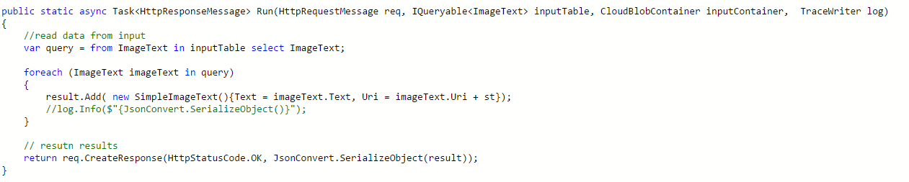
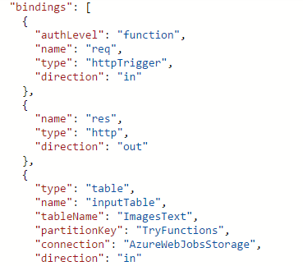
Functions Programming Model
Output
Trigger (data)
Input
Input
Input
Code
Output

Slide 12
Triggers and Bindings
Type | Service | Trigger | Input | Output
Schedule | Azure Functions | ü
HTTP | Azure Functions | ü |  | ü
Blob Storage | Azure Storage | ü | ü | ü
Events | Azure Event Hubs | ü |  | ü
Queues | Azure Storage | ü |  | ü
Queues and topics | Azure Service Bus | ü |  | ü
Storage tables | Azure Storage |  | ü | ü
No-SQL DB | Azure CosmosDB |  | ü | ü
Push notifications | Azure Notification Hubs |  |  | ü
Twilio SMS Text | Twilio |  |  | ü
SendGrid email | SendGrid |  |  | ü
Notes:
The difference between trigger and binding…

Slide 13
Use Bindings in Your Code (JS)
Index.js
function.json
module.exports = function (context, myQueueItem, myOutputBlob) {
context.log('JavaScript queue trigger function ', myQueueItem);
//validate
if (myQueueItem.apiId && myQueueItem.method && myQueueItem.body)
{
const value = DoWork(myQueueItem);
if(value) {
context.bindings.myOutputBlob = JSON.stringify(value);
//myOutputBlob = JSON.stringify(value);
}
}
else {
//handle error queue item missing params
context.log('invalid queue item ', myQueueItem);
}
context.done();
}
{
"bindings": [
{
"name": "myQueueItem",
"type": "queueTrigger",
"direction": "in",
“queueName": "outputqueue",
"connection": "AzureWebJobsStorage"
},
{
"type": "blob",
"name": "outputBlob",
"path": "outblob/{rand-guid}.txt",
"connection": "AzureWebJobsStorage",
"direction": "out"
}
]
}

Slide 14
Use bindings in your code (C#)
run.csx
function.json
public static void Run(byte[] image, string filename,
Stream outputBlob, TraceWriter log)
{
log.Info($"Processing image: {filename}");
var imageBuilder = ImageResizer.ImageBuilder.Current;
imageBuilder.Build(
image, outputBlob,
new ResizeSettings(640, 400, FitMode.Max, null), false);
}
{
"bindings": [
{
"name": "image",
"type": "blobTrigger",
"direction": "in",
"path": "card-input/{filename}.jpg",
"connection": "AzureWebJobsStorage"
},
{
"type": "blob",
"name": "outputBlob",
"path": "card-output/{filename}.jpg",
"connection": "AzureWebJobsStorage",
"direction": "out"
}
]
}

Slide 15







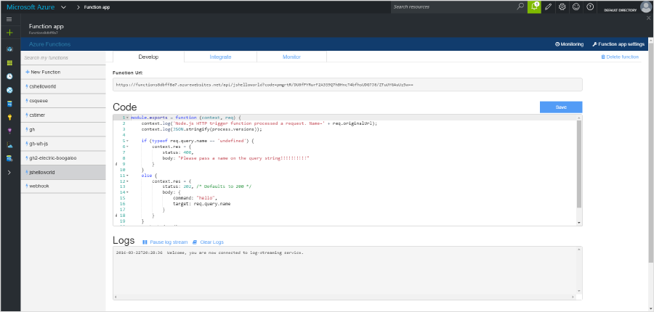
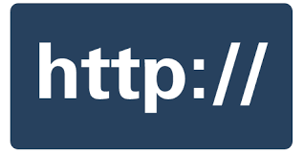




Seamless DevOps experience with Functions
1) Trigger
2) Input binding
3) Develop
4) Execute
5) Output binding
Web
Hooks
App Services
Hosting Plans
Azure Services
Azure Services
Azure Services
7) Develop locally
6) Monitor and improve
Notes:
This is the whole (top level) Dev Ops story where Dev build wounderful apps, using CI they mange their code, builds, and releases. Connecting to a repository, they can deploy to Azure Websites, build in the cloud, deploy to a slot to test and validate, swap into production, deployed across the globe as needed, monitor and get feedback, on which devs can make updates. Rinse and repeat

Slide 16
Azure Functions usage patterns
Great customer and community traction so far
“Brown field” – used as an integration, scripting tool (typically enterprises or larger ISVs)
“Green field” – used for backend creation (typically start-ups or smaller ISVs)
IoT – leveraged autonomously or as part of Azure IoT implementations

Slide 17
Applications
Example: Timer based processing
Eve
r
y 15 minutes
Find and clean invalid data
Clean table

Slide 18
Applications
Example: Azure service event processing
CSV
File added to
T
ransfo
r
m CSV to data
r
ows
P
ower BI
Blob Storage
Cha
r
t graphic

Slide 19
Applications
Example: SaaS event processing
Excel file saved
Mic
r
os
o
f
t Graph API analyzes content
C
r
eates new sheets
to OneDrive
with cha
r
ts

Slide 20
Applications
Example: Serverless Web Applications architectures
Loaded web page
C
r
eate ad based on user p
r
o
file
Completed page
calls
W
ebHook

Slide 21
Async background processing
Example: Serverless Mobile back ends
Photo taken and
Sto
r
es in blob storage
P
r
W
ebHook called
oduces scaled images

Slide 22
Applications
Example: Real-time stream processing
Millions
o
f devices feed
T
ransfo
r
m to structu
r
ed data
Sto
r
e data in
into St
r
eam Analytics
SQL Online

Slide 23
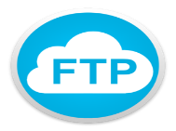


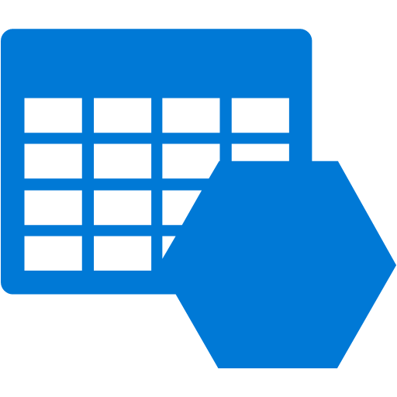
Tasks/ Activities
Replicate logs from one data center to another
Analyze the logs
Take action
Before Functions
Setup a VM/ Container/ WebJobs
Build/ patch/ deploy
Monitor infra
Manage FTP cred
Use FTP library
Use Azure SDK
Using Functions
Setup a VM/ Container/ WebJobs
Build/ patch/ deploy
Monitor infra
Manage FTP cred but with automation
Use FTP library
Use Azure SDK

Slide 24
Proxies

Slide 25



Deployment and management isolation
Customers
customers.azurewebsites.net
Products
products.azurewebsites.net
API calls
Orders
orders.azurewebsites.net

Slide 26
Function app B
/products
Function2
Function app A
/customers
Function1
/products
Function app C
/orders
/orders
Function3
Key:
HttpTrigger function endpoints
API proxy endpoints

Slide 27
New file on site root: proxies.json
{
"proxies": {
"proxy1": {
"matchCondition": {
"methods": [],
"route": "/api/{test}"
},
"backendUri": "https://contoso.azurewebsites.net/api/{test}"
}
}
}

Slide 28







Azure Functions
Serverless
Accelerate development
Bind into services
Azure
Service Bus
Azure
Event Hub
Azure
Storage
</>
Dropbox
Sendgrid
AzureDocDb
Event-driven
scale
Reduced
Dev Ops
Develop
your way
Local
development
OneDrive
Box
Twilio
Notes:
Languages: C#, F#, Node.js, Python, PHP, batch, bash

Slide 29
Functions Programming Model—Best Practices
Functions should “do one thing”
Functions should finish as quickly as possible
Functions should be stateless
Functions should be idempotent
1
Notes:
With that opening in mind and somewhat general understanding of what we are trying to prove here
Now that we understand some of the pain points with having big application with many functions.
It is important to take a moment to review some basic best practices for Functions:
Functions should do one thing
Functions should finish as quickly as possible
Functions should be stateless
Functions should be idempotent %

Slide 30
Signs that a Serverless pattern might be useful for a given scenario
Stateless → Scale
Not worth deploying a traditional backend
Workload is sporadic (very low & high scale)
Lots of different services involved that need “glue”
Notes:
Stateless application that needs to scale

Slide 31
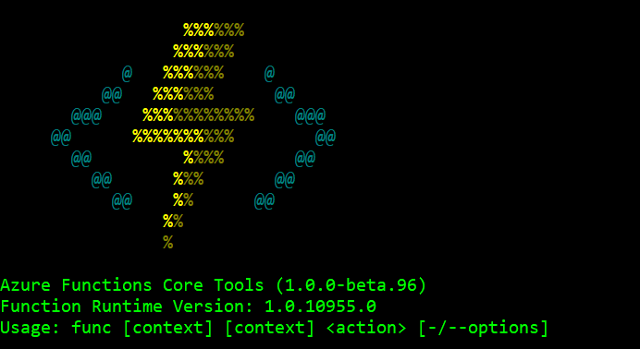
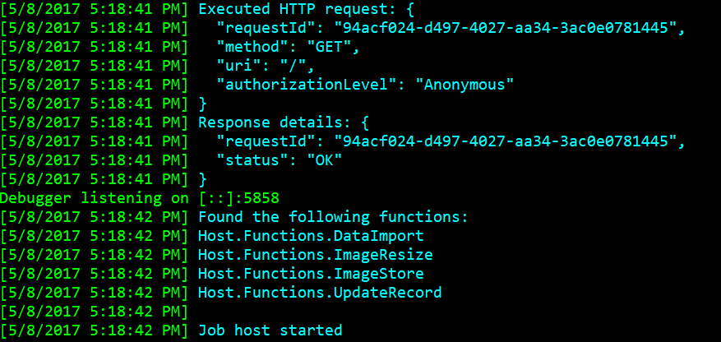
Azure Functions Core Tools – (CLI)
Run and Debug locally
Not an emulator or simulator!
Run the Functions runtime on your local machine
Functions invoked (triggered) based on events in Azure
Install via NPM Package:
https://www.npmjs.com/package/azure-functions-core-tools
Create/ Developer/ Manage Azure Functions

Slide 32
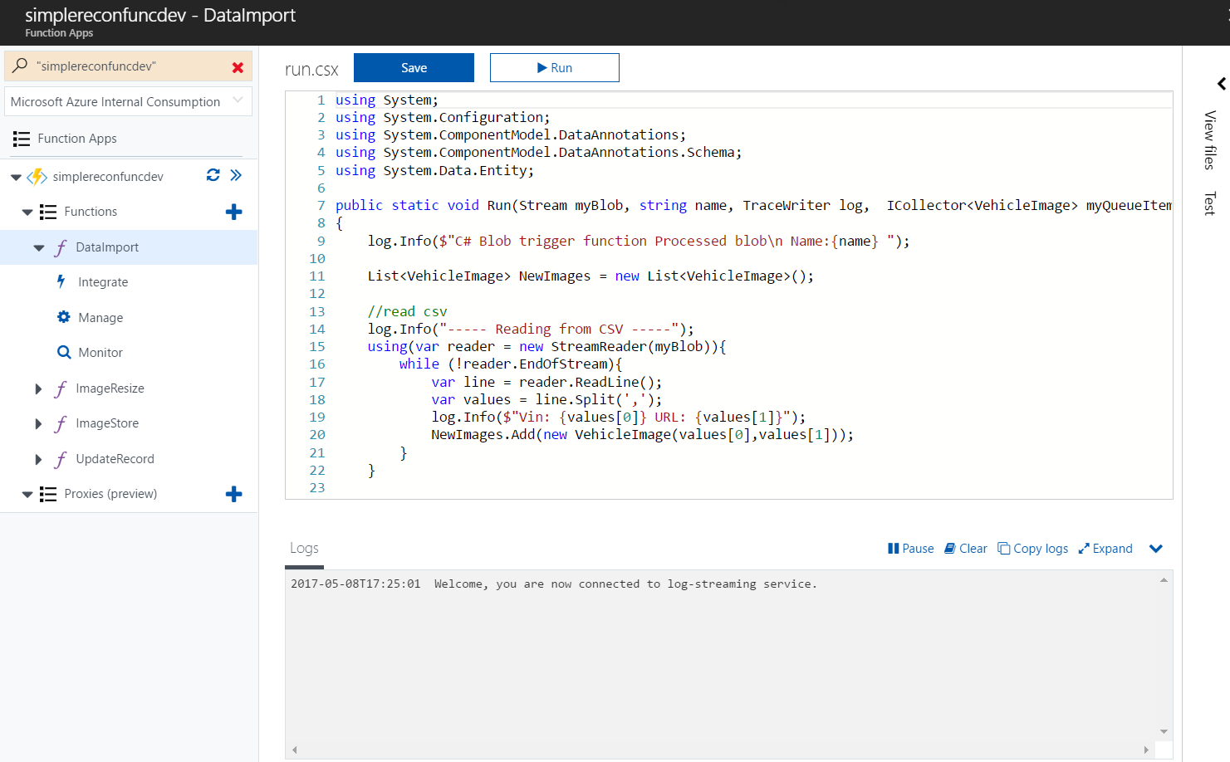
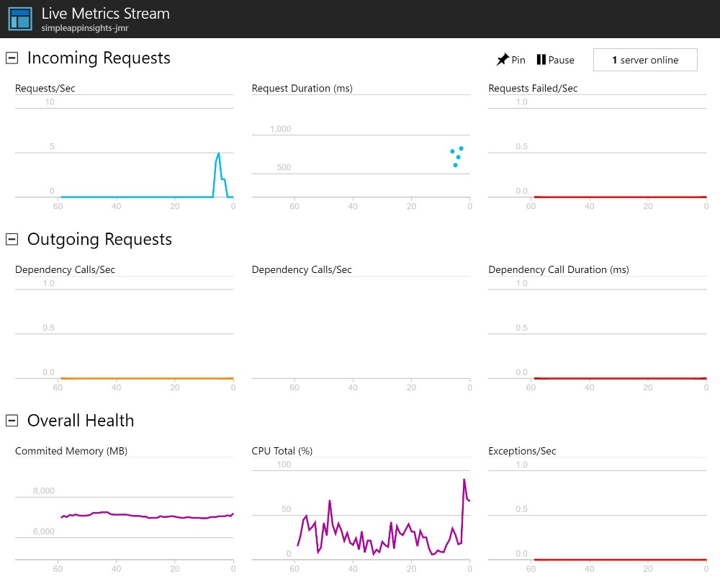
Azure Functions Portal
Code directly in the browser
Easily setup triggers & bindings
Live execution log
Manage secure application settings
Setup continuous deployment
Top down view of all functions
Monitor function execution history
Application Insights

Slide 33
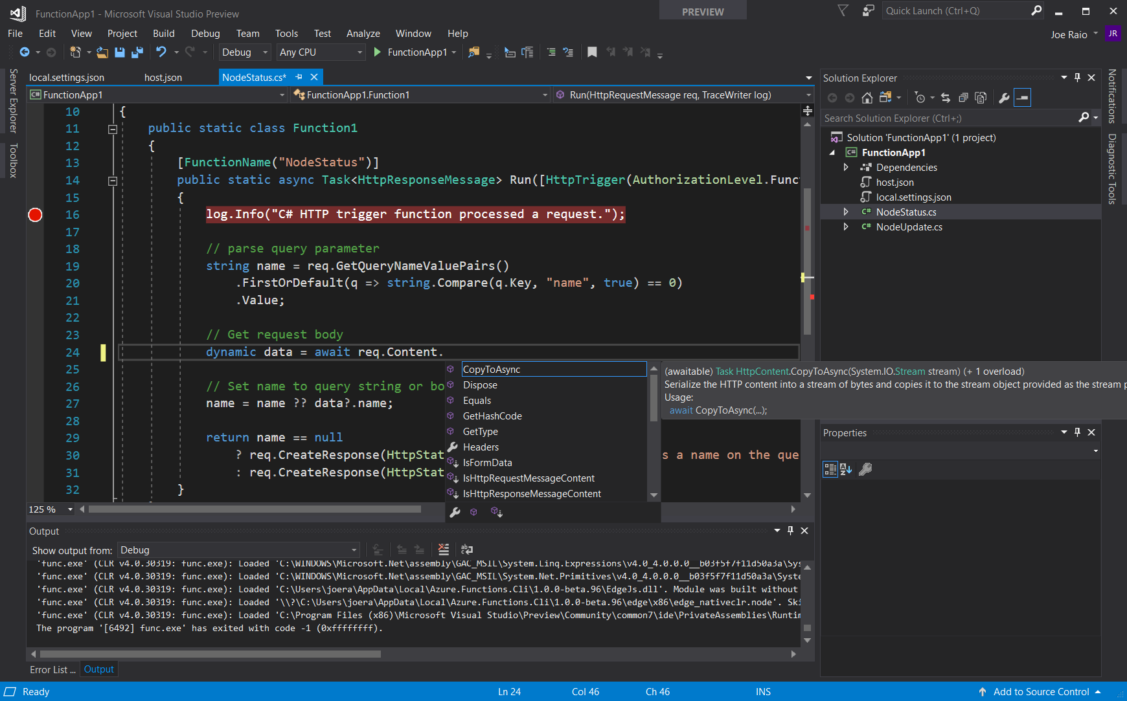
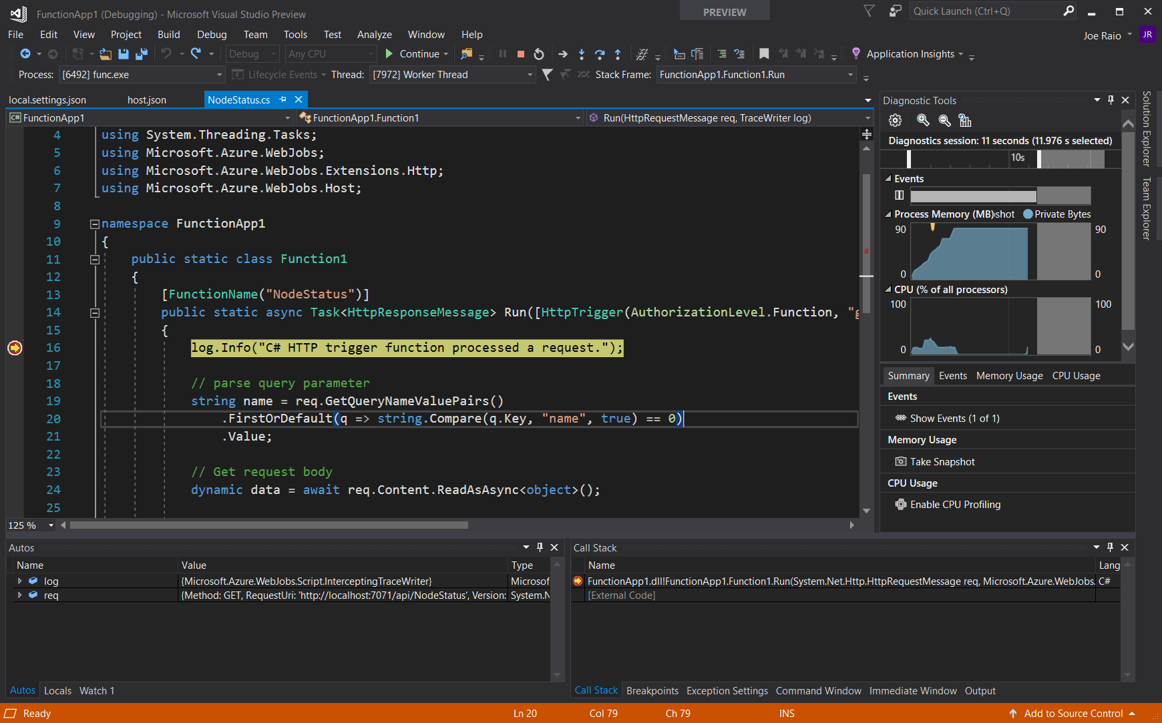
Visual Studio 2017
VS 2017 Tools for Azure Functions
Now included in Azure dev workload
Full IntelliSense Experience
F5 Debugging
vs C# Script
Develop in C#
Right-click deploy to Azure
Pre-Compile functions for better cold start performance

Slide 34
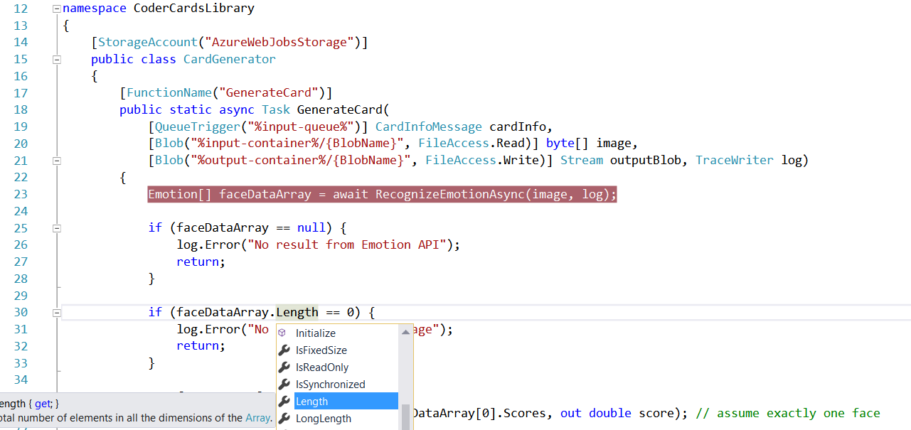
Visual Studio 2017 Tooling

Slide 35
Azure Functions CLI
> npm i -g azure-functions-core-tools
> func init
> func new
Next:
* Select a language, e.g. C#
* Select a template, e.g. HttpTriggerWithParameters
* Enter a name for your new Function, e.g. “MyFunction”, which will create a subfolder using the Function’s name.
> func azure login
> func azure functionapp list
> func azure functionapp fetch-app-settings <fn-app-name>
> func host start
> func azure functionapp publish <fn-app-name>
http://wakeupandcode.com/azure-functions-dev-workflow/

Slide 36
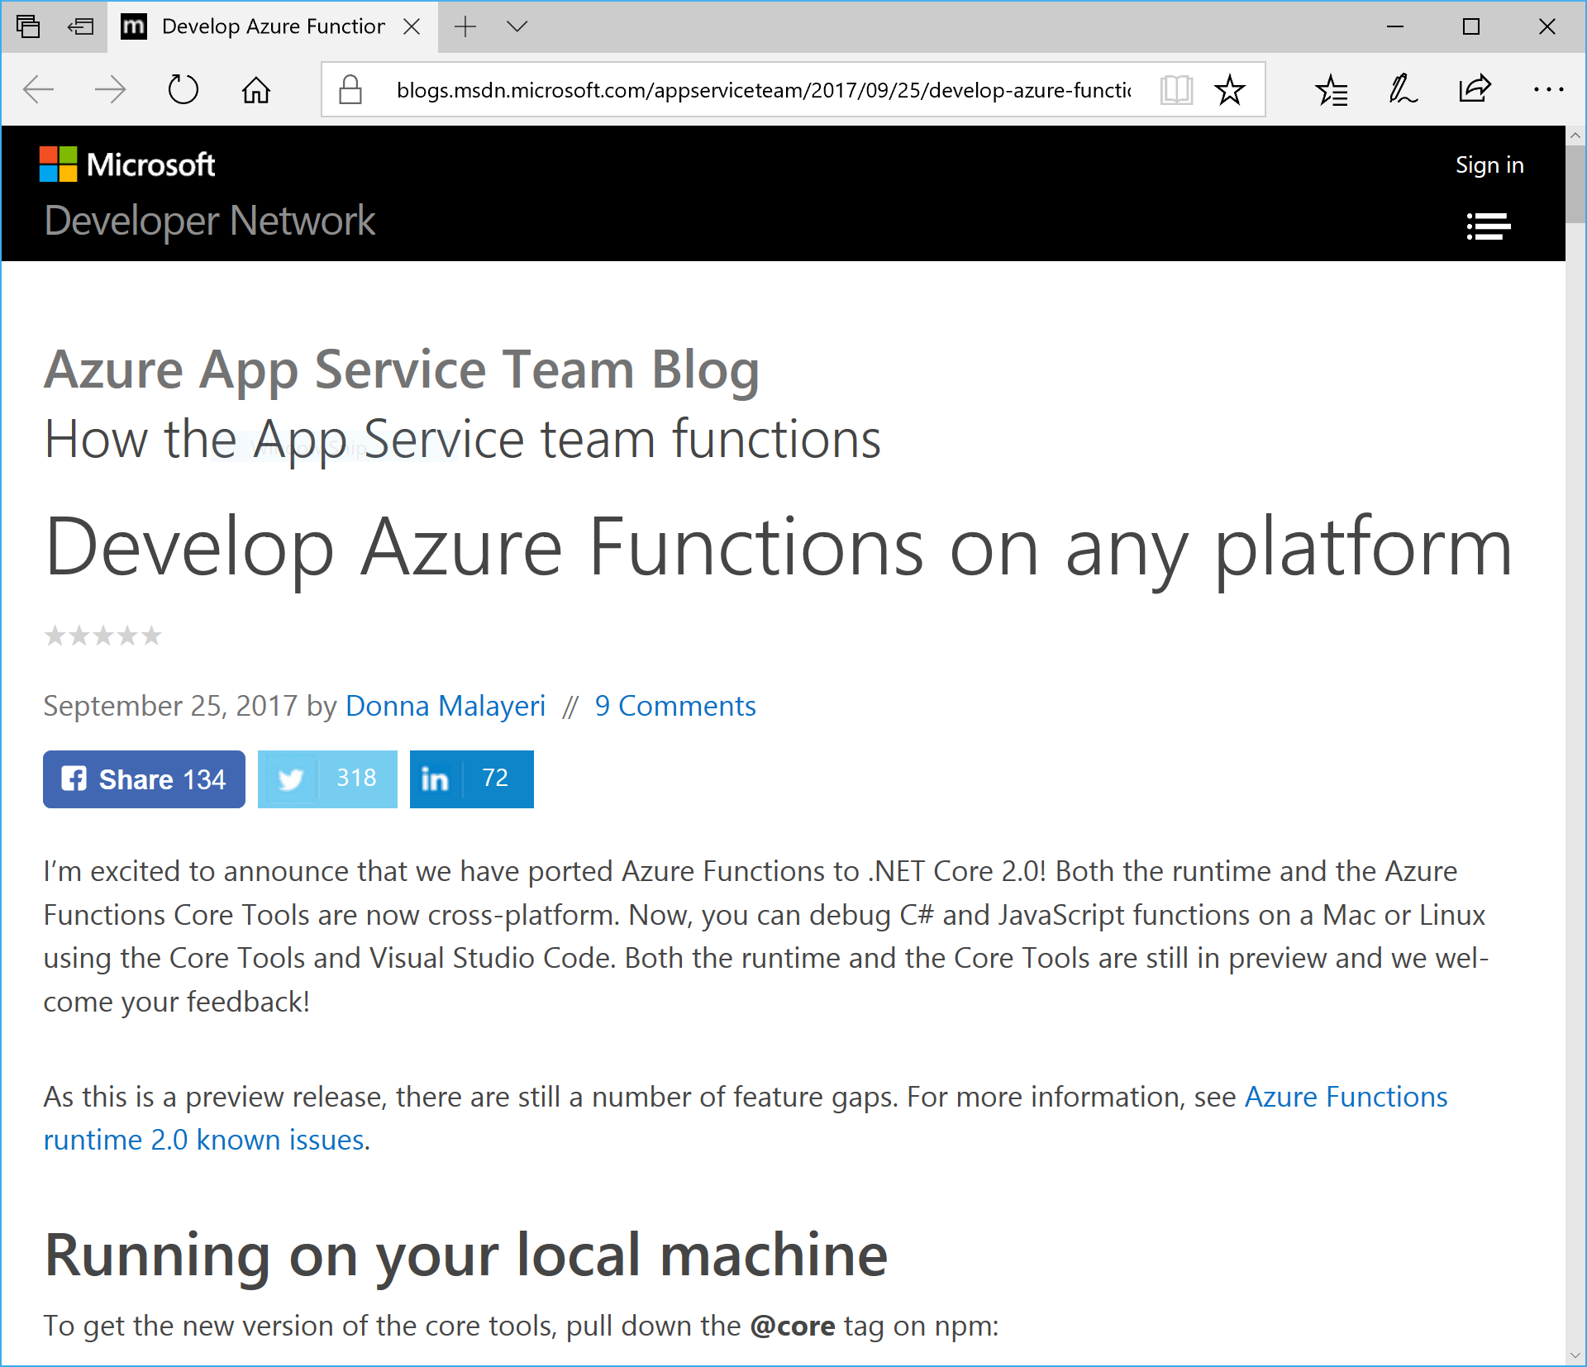
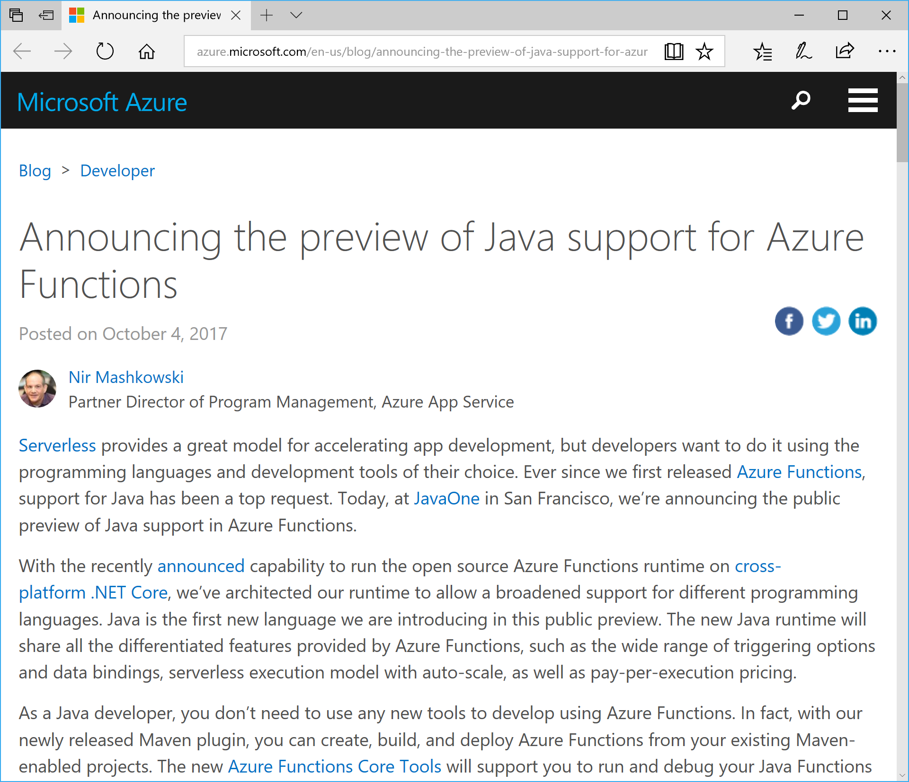
Cross-Platform, Multiple Languages
https://azure.microsoft.com/en-us/blog/announcing-the-preview-of-java-support-for-azure-functions
https://blogs.msdn.microsoft.com/appserviceteam/2017/09/25/develop-azure-functions-on-any-platform

Slide 37
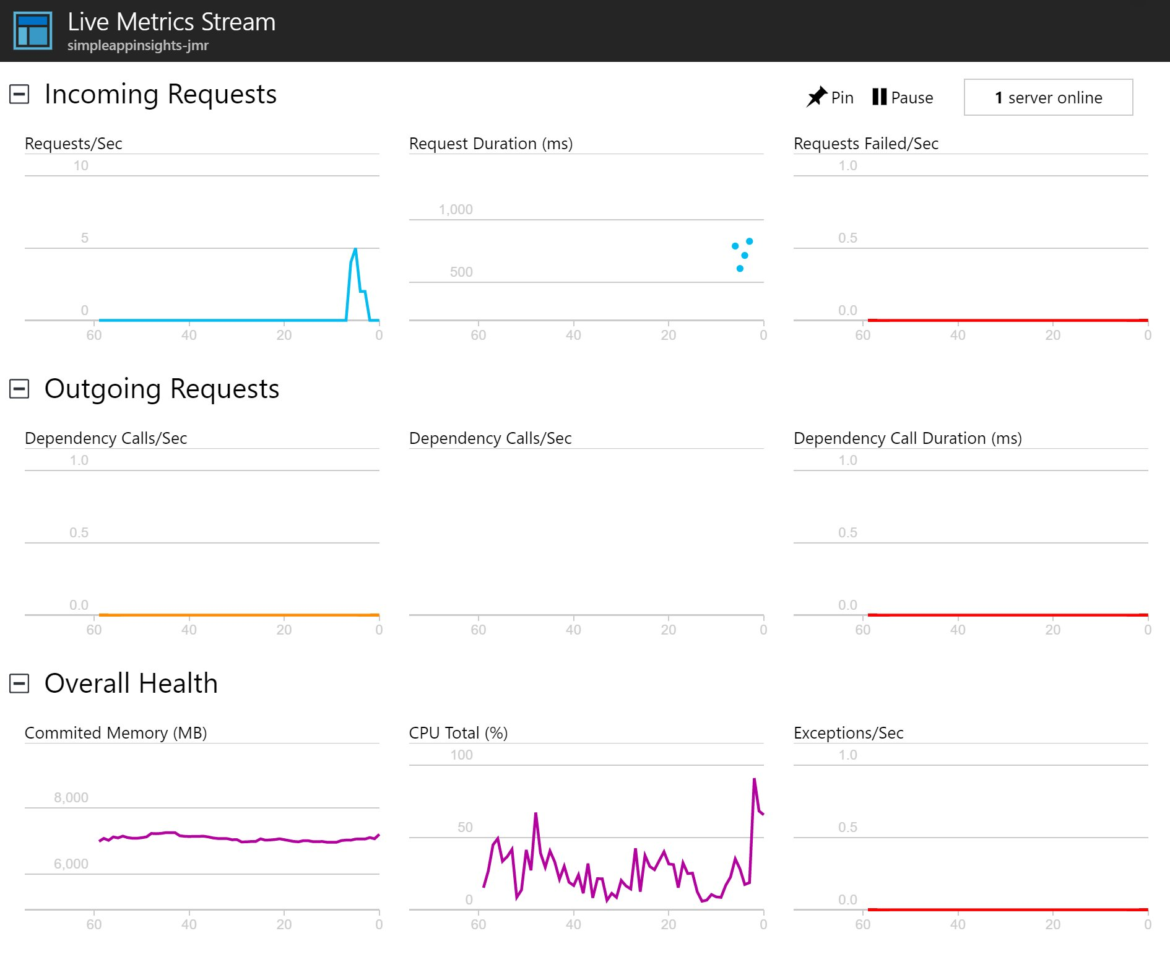
Application Insights

Slide 38
Azure Functions Demo

Slide 39
Azure Functions in Use
Serverless Projects
  https://aka.ms/functionprojects
Costa Farms
  http://aka.ms/costafarms
  https://github.com/joescars/CostaIoTSensorProject
Fish Angler
  http://aka.ms/fishangler
  https://github.com/FishAngler/AzureFunctions
Simple Recon
  https://github.com/simpledealersuite/media2azure
NullspaceVR
  https://github.com/DaveVoyles/NullspaceVR-web-portal/tree/master/AzureFunctions
Missing Children Society of Canada
  https://github.com/Missing-Children-Society-Canada

Slide 40
Azure Functions is an Open Source project
https://github.com/Azure/Azure-Functions
Azure WebJobs SDK script - the Azure Functions runtime
Azure WebJobs SDK - the "core" of the Azure Functions runtime and many bindings
Azure WebJobs SDK extensions - the repositories of many bindings
Azure Functions CLI - the command line tool for Azure Functions
Azure Functions Portal - the UX for the Functions development portal
Azure Functions templates - the templates which show up the Azure Functions portal
Azure Functions samples - repository for some samples on how the runtime works

Slide 41

Azure offers a comprehensive
Serverless Application Platform
Azure Functions Bindings and Local DevEx get you faster to market
Azure Logic Apps provides orchestration and integrations with 125+ APIs
Try Functions and Logic App http://aka.ms/TryFunctions
Join the Azure Functions Community https://aka.ms/func-github

Slide 42
Survey
https://aka.ms/phillyfunctions

Slide 43
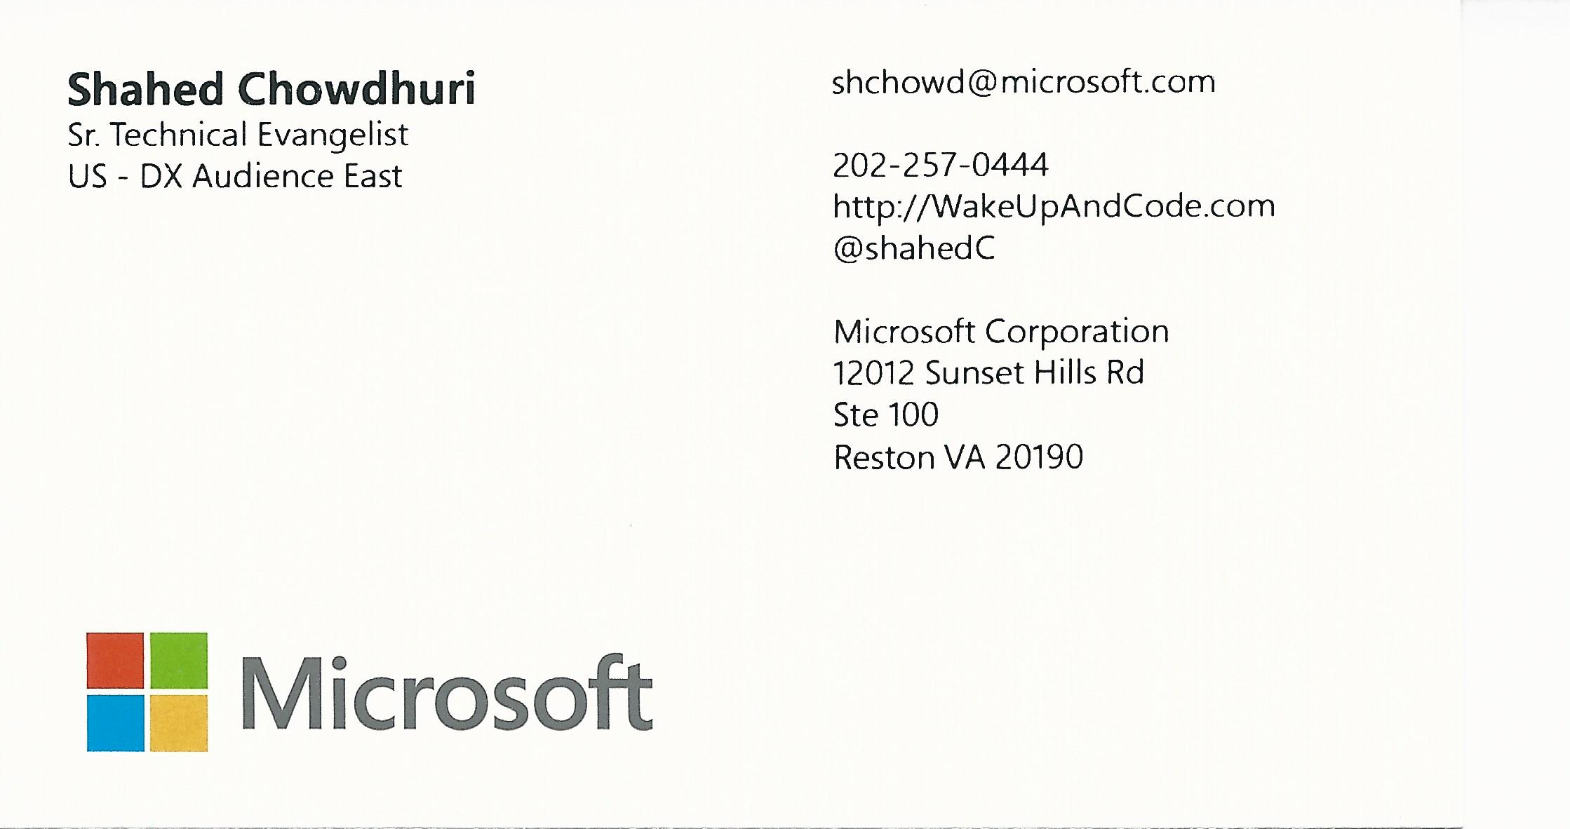
Email: shchowd@microsoft.com  Twitter: @shahedC
Notes:
Contact
Microsoft email: shchowd@microsoft.com
Personal Twitter: @shahedC
Dev Blog: WakeUpAndCode.com

