Slide 1
BizSpark and Azure for Startups
Shahed Chowdhuri
Sr. Technical Evangelist @ Microsoft
@shahedC
WakeUpAndCode.com

Slide 2
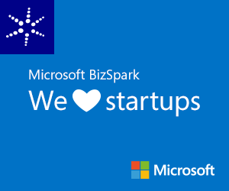
Microsoft BizSpark
  Hosting models
Is your startup:
Developing software or apps?
Less than 5 years old and privately held?
Making less than US$1M annually?
Get FREE software with BizSpark!
To apply for BizSpark:
Go to www.bizspark.com

Slide 3
BizSpark Benefits
  Hosting models
900+ current, full-featured software development tools and server products
Get access to investors, advisors, and valuable offers
$150/month of Azure cloud credits for up to 5 members ($750/month)
Virtual Machines, Websites, Cloud Services, Mobile Services, and more!

Slide 4
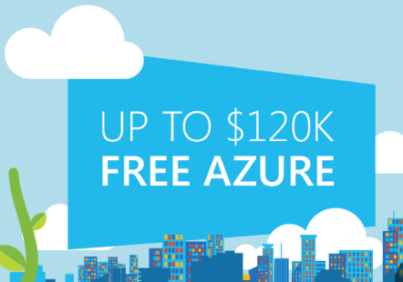
BizSpark Plus ($120k for 1 year)
  Hosting models
Outgrowing your Azure usage?
The BizSpark Plus $120k Offer helps cover your startup’s cloud computing costs by providing a US $10,000 monthly credit on Azure for 12 months.

Slide 5
Why the cloud?

Slide 6
Why the cloud?
  Hosting models
  Business model
  On Premises
  Infrastructure
  (as a Service)
  Platform
  (as a Service)
  Software
  (as a Service)
  Applications
Applications
  You manage
Applications
Applications
  You scale, make resilient and manage
  You scale, make
  resilient & manage
Data
Data
Data
Data
Runtime
Runtime
Runtime
Runtime
  Scale, resilience and
  management by vendor
Middleware
Middleware
Middleware
  Scale, resilience and
  management by vendor
Middleware
O/S
O/S
O/S
O/S
Virtualization
Virtualization
  Managed by vendor
Virtualization
Virtualization
Servers
Servers
Servers
Servers
Storage
Storage
Storage
Storage
Networking
Networking
Networking
Networking

Slide 7
Azure

Slide 8
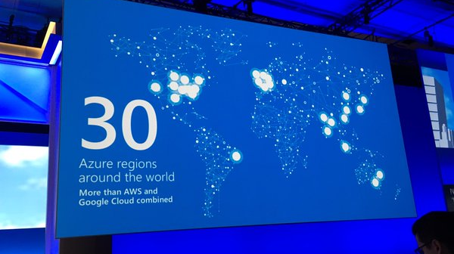
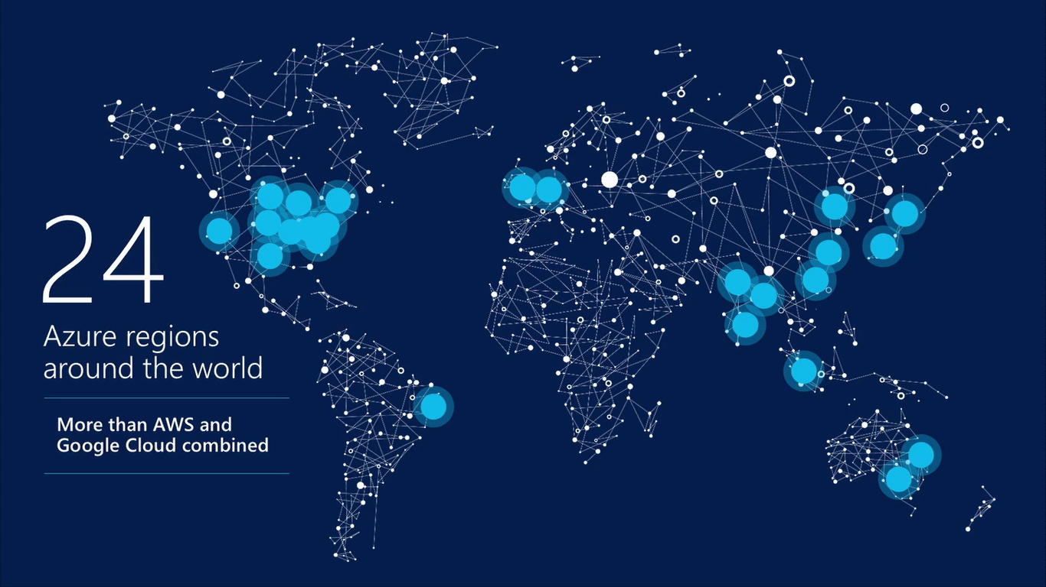
17 regions worldwide in 2015
Azure footprint
Data Centers
Regional Partners
Source: https://twitter.com/PaulSpain/status/715564339114053632
Notes:
Speaker notes:
Broad global reach
Azure maintains a global presence across 17 datacenter around the world to help customers and partners meet their goal of providing applications close to their user base.
Mention contribution of regional partners help Azure’s global presence.
Microsoft's continued investment in subsea and terrestrial dark fiber capacity helping deliver data at higher speeds, with higher capacity and lower latency for our customers across the globe.
Use the following notes if you want to address some or all security, compliance, transparency and privacy concerns of the audience.
Microsoft has leveraged its decades-long experience in operating some of the world’s largest online services to create a robust set of security technologies and practices to keep your data at rest or in motion secured in Azure.
Azure meets a broad set of international and industry-specific compliance standards as part of help customer attain compliance for their own infrastructure running on the platform.
Azure is subjected to rigorous audits by independent organizations and the results are available to you as a part of Microsoft's commitment to transparency.
Azure adheres to stringent privacy policies through a program called Privacy by Design which describes Microsoft's core privacy concerns to protect customer data and how to address them. Those protections are then backed with strong contractual commitments to safeguard customer data with by abiding by the EU Model Clauses, Safe Harbor programs, and ISO/IEC 27018 (which governs the processing of personal information).

Slide 9
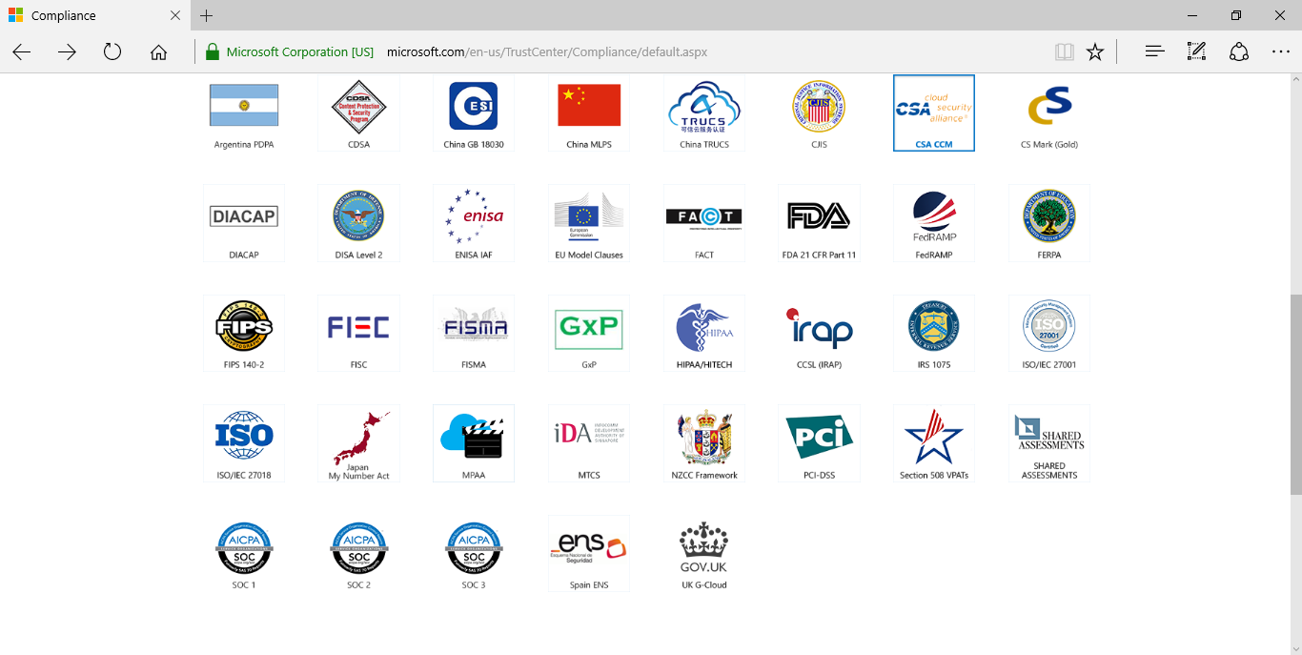
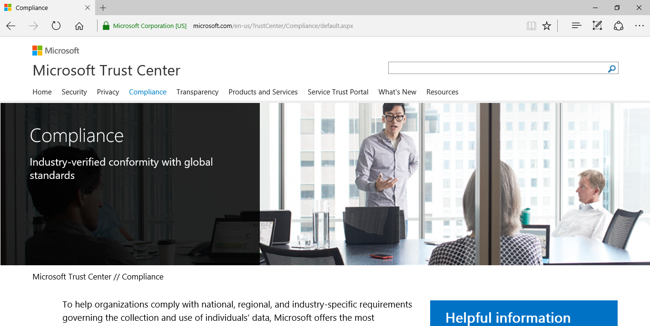
Compliance: Microsoft Trust Center
Azure Compliance: http://aka.ms/AzureCompliance
Notes:
Speaker notes:
Broad global reach
Azure maintains a global presence across 17 datacenter around the world to help customers and partners meet their goal of providing applications close to their user base.
Mention contribution of regional partners help Azure’s global presence.
Microsoft's continued investment in subsea and terrestrial dark fiber capacity helping deliver data at higher speeds, with higher capacity and lower latency for our customers across the globe.
Use the following notes if you want to address some or all security, compliance, transparency and privacy concerns of the audience.
Microsoft has leveraged its decades-long experience in operating some of the world’s largest online services to create a robust set of security technologies and practices to keep your data at rest or in motion secured in Azure.
Azure meets a broad set of international and industry-specific compliance standards as part of help customer attain compliance for their own infrastructure running on the platform.
Azure is subjected to rigorous audits by independent organizations and the results are available to you as a part of Microsoft's commitment to transparency.
Azure adheres to stringent privacy policies through a program called Privacy by Design which describes Microsoft's core privacy concerns to protect customer data and how to address them. Those protections are then backed with strong contractual commitments to safeguard customer data with by abiding by the EU Model Clauses, Safe Harbor programs, and ISO/IEC 27018 (which governs the processing of personal information).

Slide 10
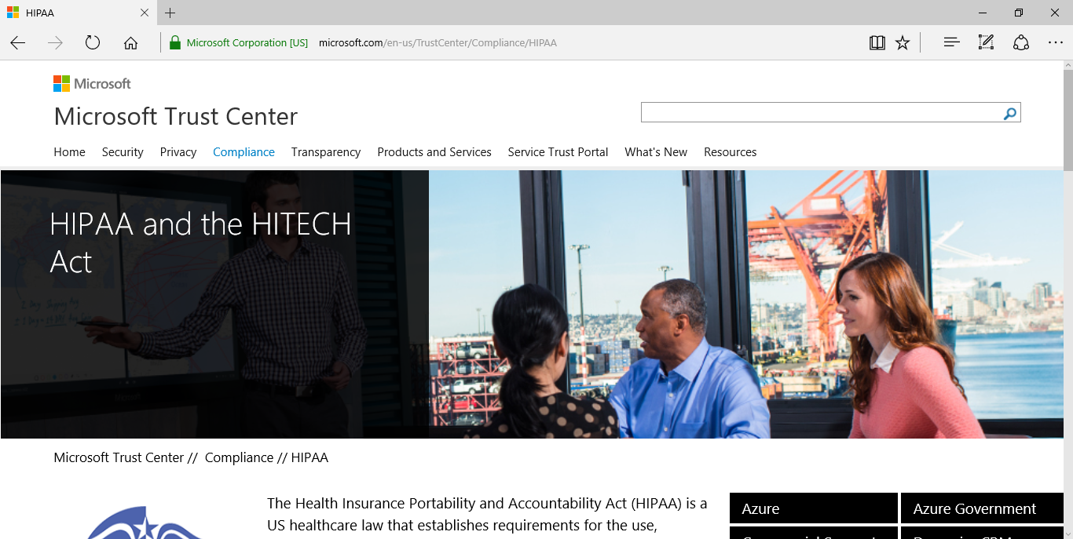
HIPAA Compliance and BAA Docs
HIPAA Compliance: https://www.microsoft.com/en-us/TrustCenter/Compliance/HIPAA
Notes:
Speaker notes:
Broad global reach
Azure maintains a global presence across 17 datacenter around the world to help customers and partners meet their goal of providing applications close to their user base.
Mention contribution of regional partners help Azure’s global presence.
Microsoft's continued investment in subsea and terrestrial dark fiber capacity helping deliver data at higher speeds, with higher capacity and lower latency for our customers across the globe.
Use the following notes if you want to address some or all security, compliance, transparency and privacy concerns of the audience.
Microsoft has leveraged its decades-long experience in operating some of the world’s largest online services to create a robust set of security technologies and practices to keep your data at rest or in motion secured in Azure.
Azure meets a broad set of international and industry-specific compliance standards as part of help customer attain compliance for their own infrastructure running on the platform.
Azure is subjected to rigorous audits by independent organizations and the results are available to you as a part of Microsoft's commitment to transparency.
Azure adheres to stringent privacy policies through a program called Privacy by Design which describes Microsoft's core privacy concerns to protect customer data and how to address them. Those protections are then backed with strong contractual commitments to safeguard customer data with by abiding by the EU Model Clauses, Safe Harbor programs, and ISO/IEC 27018 (which governs the processing of personal information).

Slide 11
Demo: Azure Portal

Slide 12
Azure Services

Slide 13
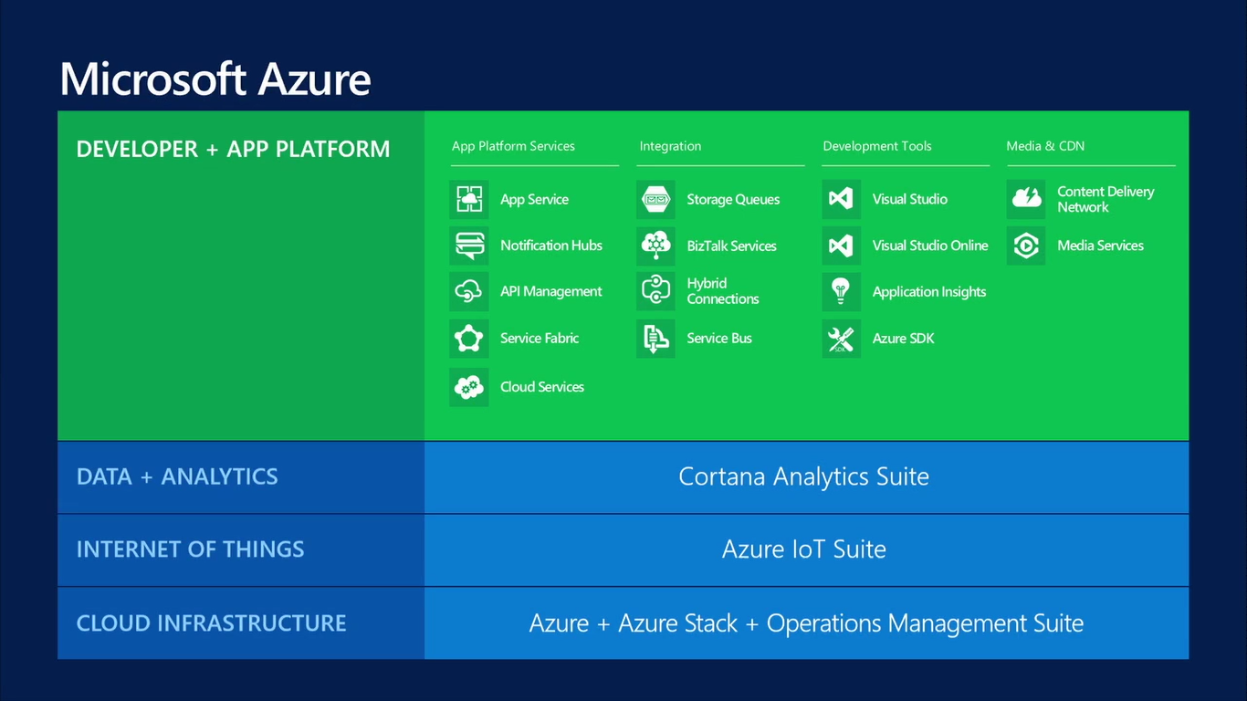

Slide 14
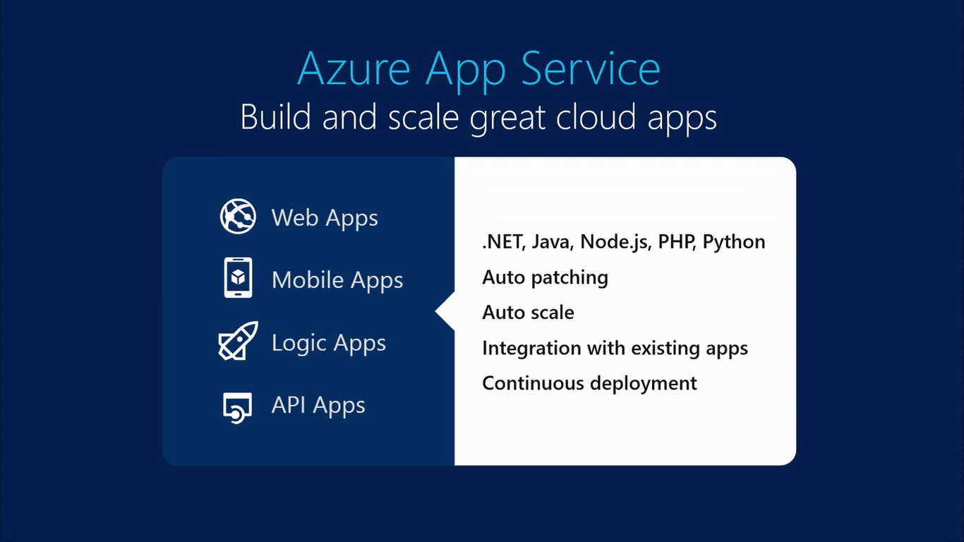

Slide 15
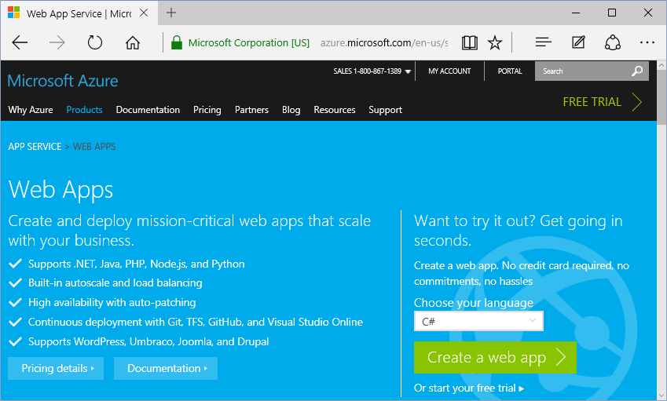
Web Apps
Languages:
.NET
Java
PHP
Node.js
Python
https://azure.microsoft.com/en-us/services/app-service/web/

Slide 16
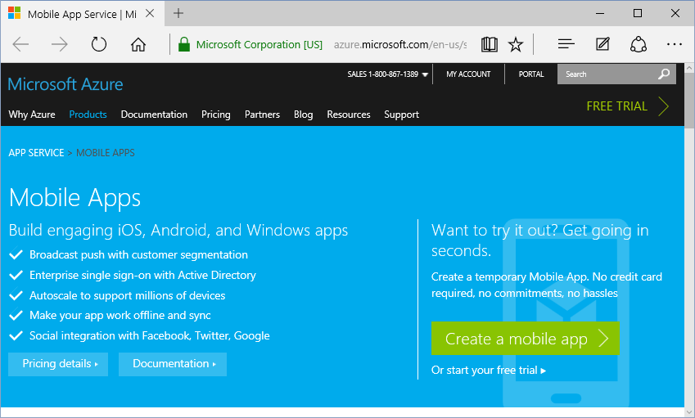
Mobile Apps
Platforms:
iOS
Android
Windows
https://azure.microsoft.com/en-us/services/app-service/mobile/

Slide 17
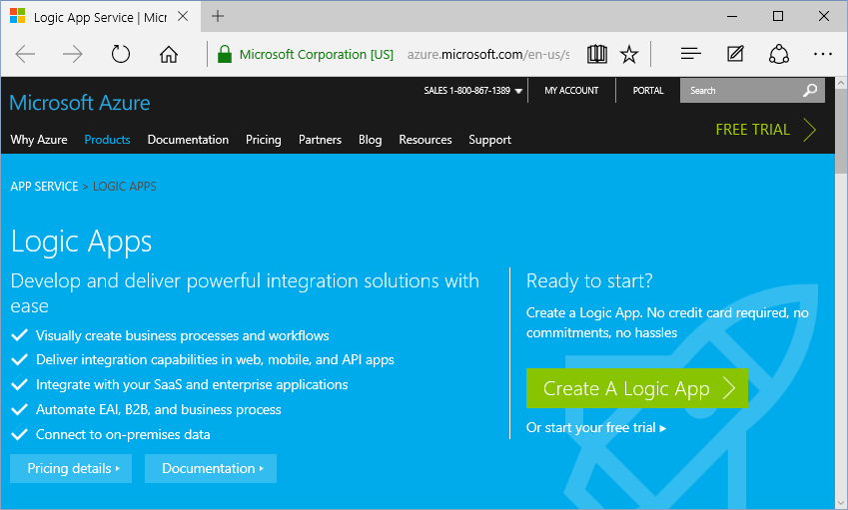
Logic Apps
Features:
Integrate
Automate
Connect
https://azure.microsoft.com/en-us/services/app-service/logic/

Slide 18
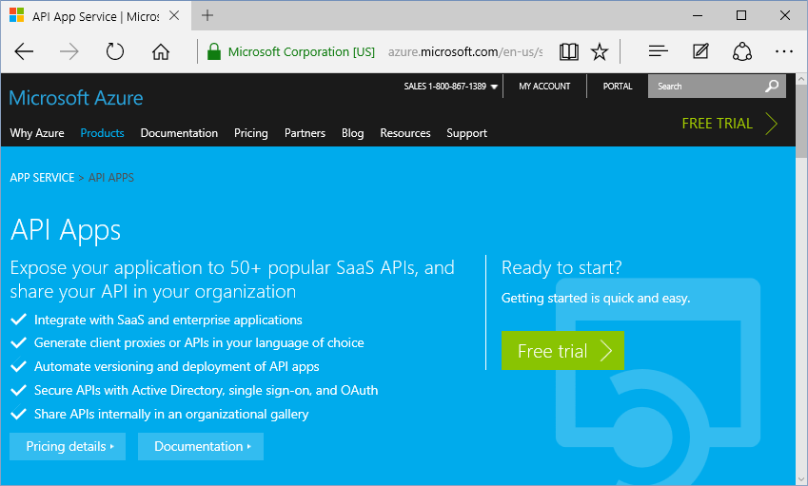
API Apps
Features:
Expose
Secure
Share
https://azure.microsoft.com/en-us/services/app-service/api/

Slide 19
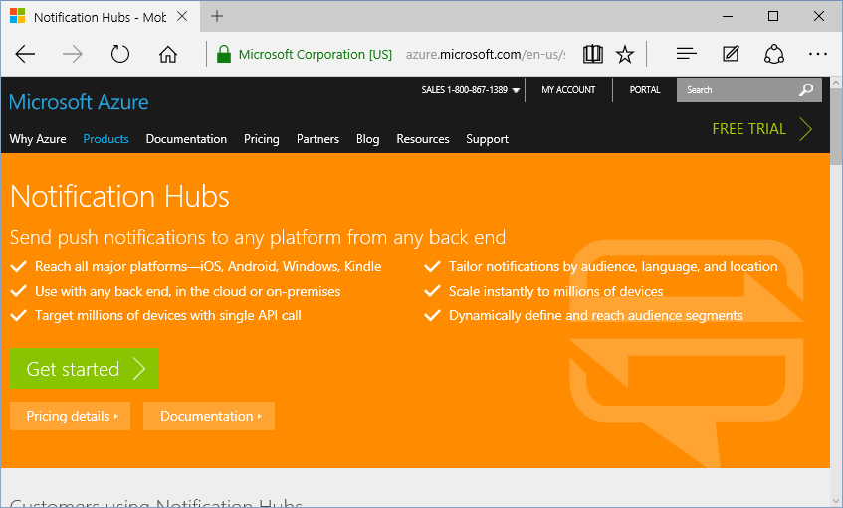
Notification Hubs
Platforms:
iOS
Android
Windows
Kindle
https://azure.microsoft.com/en-us/services/notification-hubs/

Slide 20
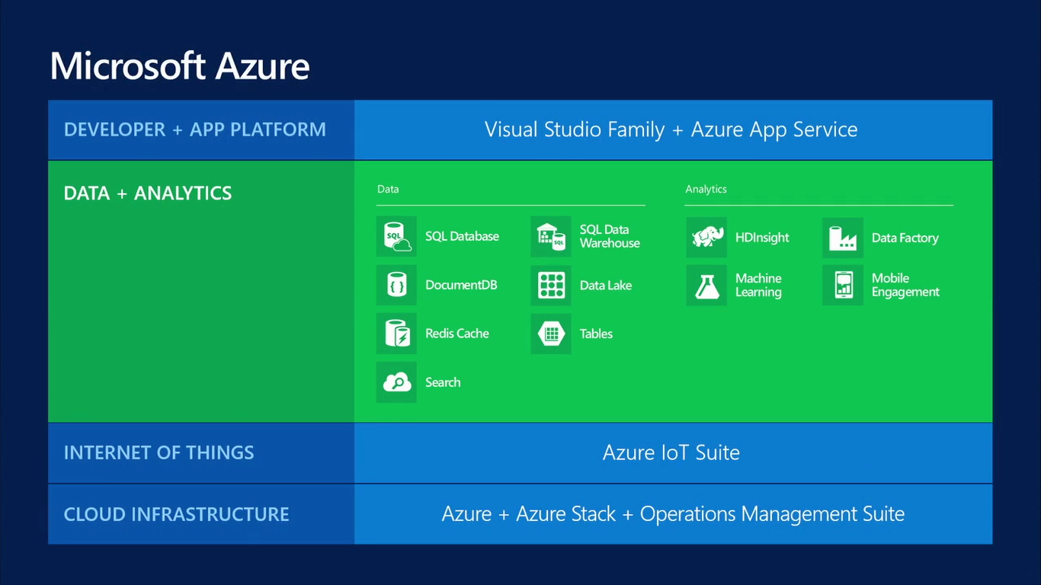

Slide 21
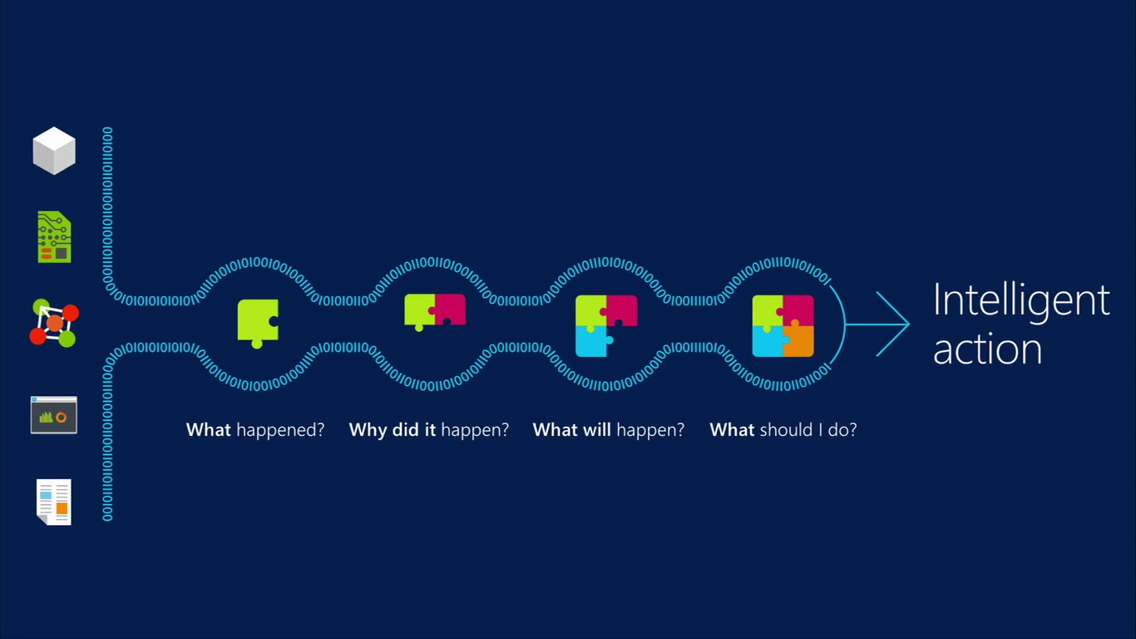
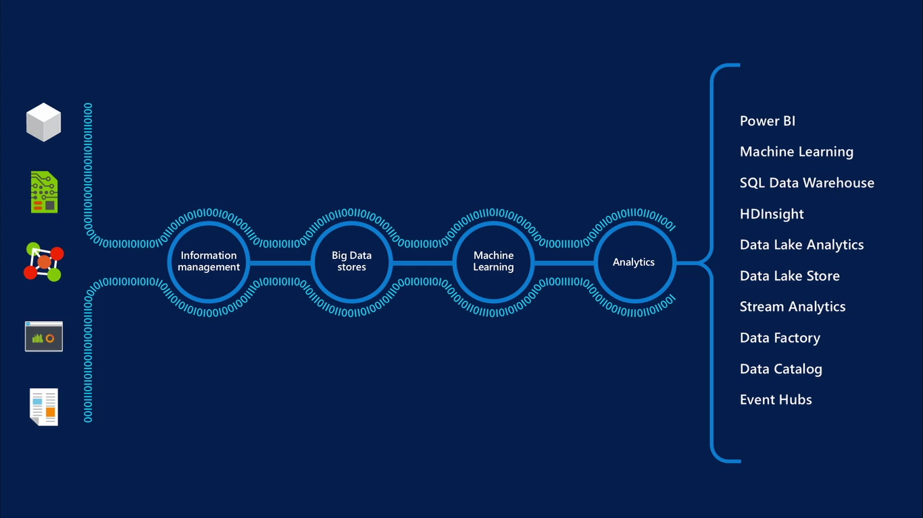

Slide 22






Database Options
{DocumentDB}
{HDInsight}

Slide 23
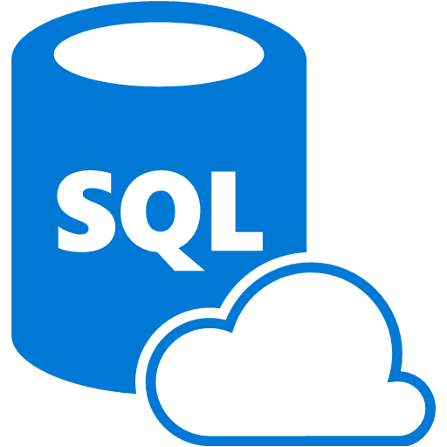

SQL Database
Fully managed SQL Server database technology as a service
  Ideal for simple and complex applications
  Enterprise-ready with automatic support for HA
Secondary
Replica
Primary
Secondary
Replica
Secondary
Replica
Notes:
Speaker notes:
How is HA achieved? At any one time, three database replicas are running—one primary replica and two or more secondary replicas. If the hardware fails on the primary replica, Azure SQL Database detects the failure and fails over to the secondary replica. In case of a physical loss of a replica, a new replica is automatically created. So there are always at minimum two physical, transitionally consistent copies of your data in the datacenter.

Slide 24
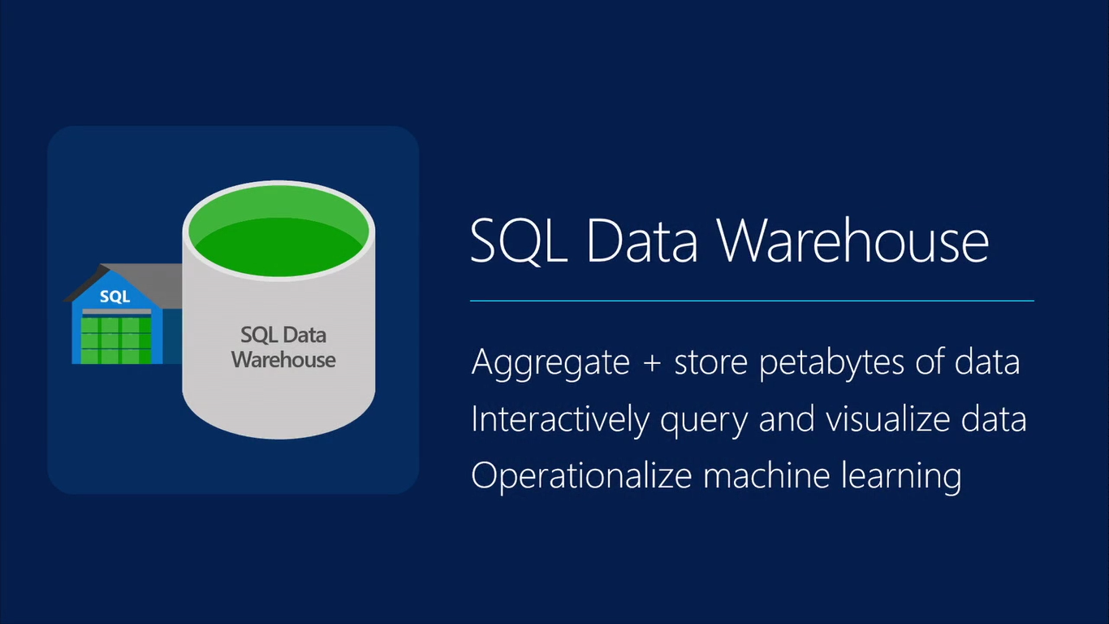

Slide 25
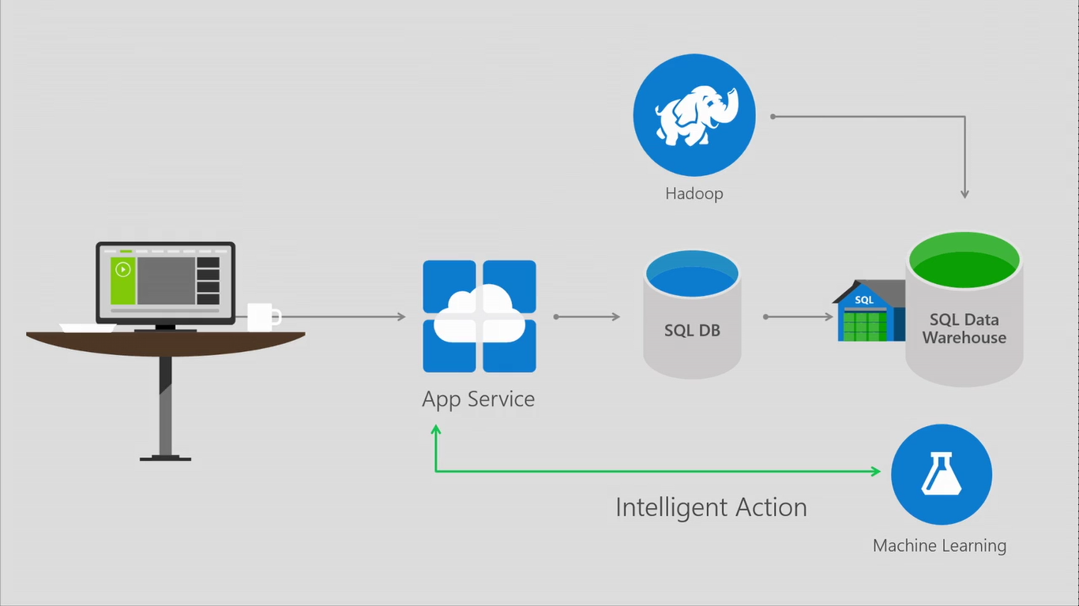

Slide 26
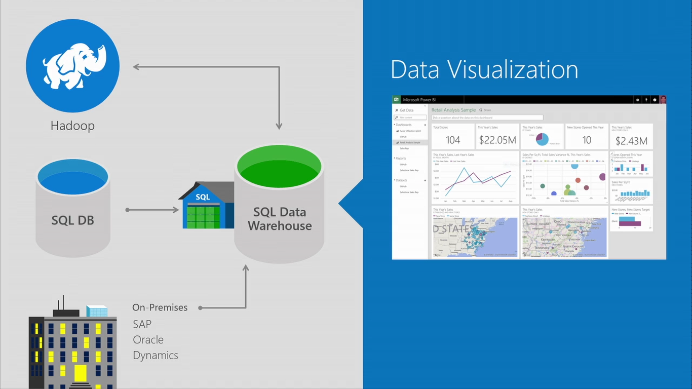

Slide 27
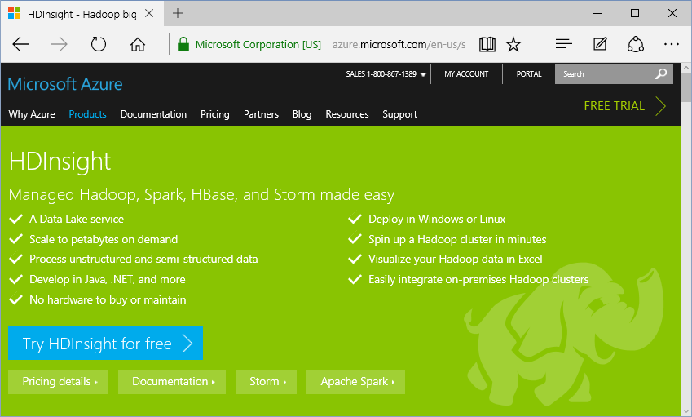
HDInsight: Big Data with Hadoop
Develop:
Java
.NET
… and more!
Deploy:
Windows
Linux
https://azure.microsoft.com/en-us/services/hdinsight/

Slide 28
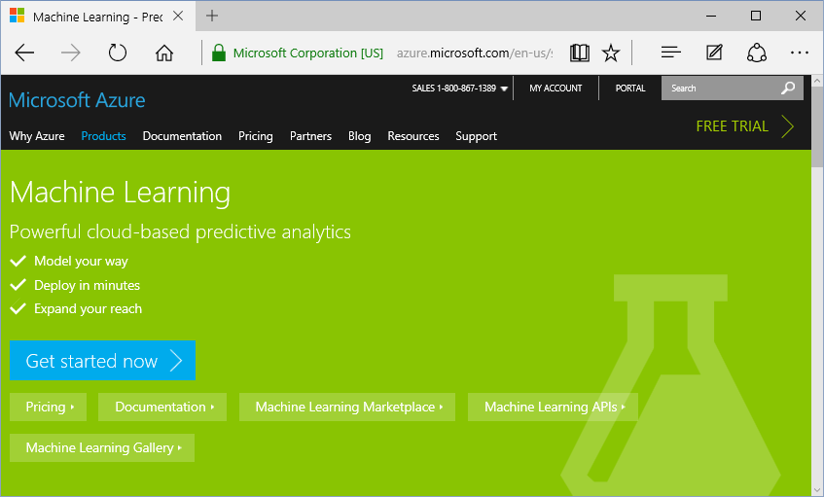
Machine Learning (Predictive Analytics)
Features:
Model
Deploy
Expand
https://azure.microsoft.com/en-us/services/machine-learning/

Slide 29

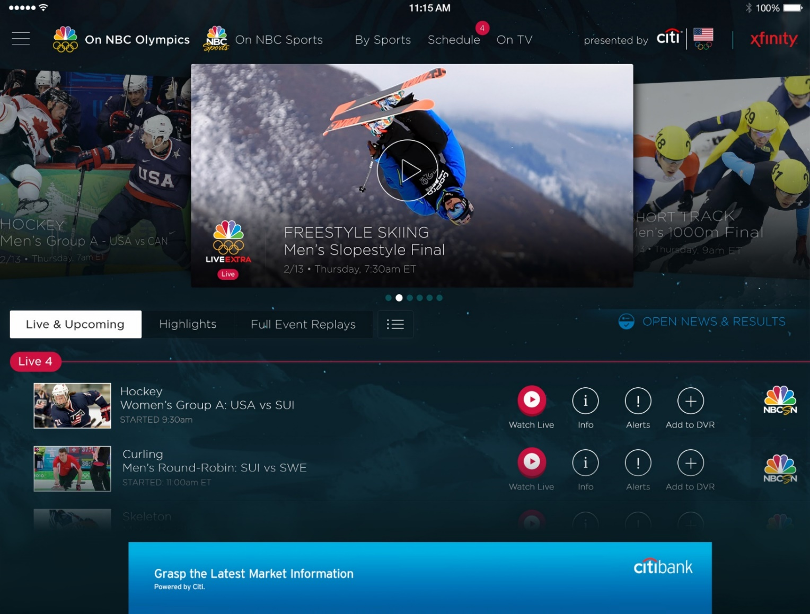
Azure Media Services
Olympics NBC Sports
On Demand Media Services
Video-on-demand
  Ingest
  Encode
  Package
  Encrypt
  Delivery
Live Streaming Support
Office 365 Integration
Azure Media Player
Live video encoding and streaming
Web + Mobile
100 million viewers
2.1 million concurrent HD viewers during the
USA vs. Canada hockey match
https://azure.microsoft.com/en-us/services/media-services/
Notes:
Speaker notes:
Deliver video content or stream video to audiences large or small to any device(Web or Mobile) anywhere reliably and in scale.
Helps you create versatile media workflows for ingesting, encoding, protecting and streaming content to audiences on-demand or broadcast live.
Powerful and extensible platform with broad set of first and third-party capabilities to support complete end-to-end media workflows.
Integration with Office 365 empowers organizations of all sizes helps to use videos to enhance sharing, collaboration and communication.
Azure Media Player, an automated online player solution, supports all the usual industry standards like HTML5 video, Media Source Extensions and rights management through Encrypted Media Extensions. The focus here is on open standards, but on older browsers, the player can fall back on Flash or Silverlight.

Slide 30
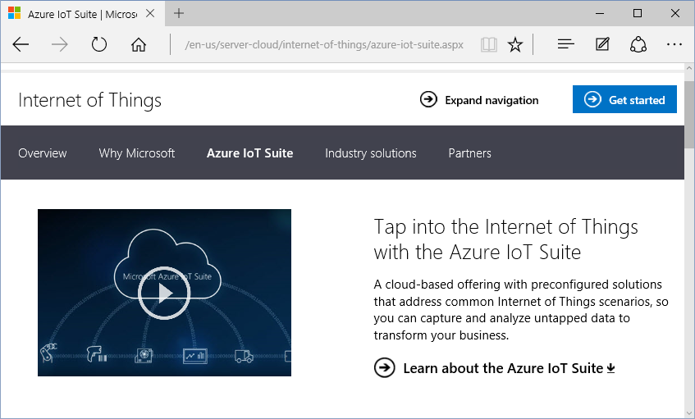
IoT (Internet of Things)
Iot Suite:
Connect
Monitor
Innovate
http://www.microsoft.com/en-us/server-cloud/internet-of-things/azure-iot-suite.aspx

Slide 31

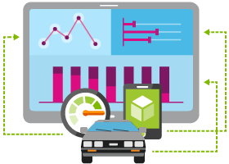





Internet of Things
  Event Hubs
  Notification Hubs
  Stream Analytics
  Machine Learning
  HDInsight
  Power BI for Office 365
With Microsoft Azure IoT services, you can monitor assets to improve efficiencies, drive operational performance to enable innovation, and leverage advance data analytics to transform your company with new business models and revenue streams.
Notes:
Speaking Notes
Azure Mobile Services is a Backend-as-a-Service
Instead of you having to design, build, test, deploy, manage, and upgrade your whole backend, we do it for you
Features of Mobile Services
Storage – SQL DB
Authentication – built in support for social providers w/ ability to custom auth
Backend logic – data validation, logical flows, etc
Push Notifications – across all major mobile platforms
Scheduler – backend job processing

Slide 32
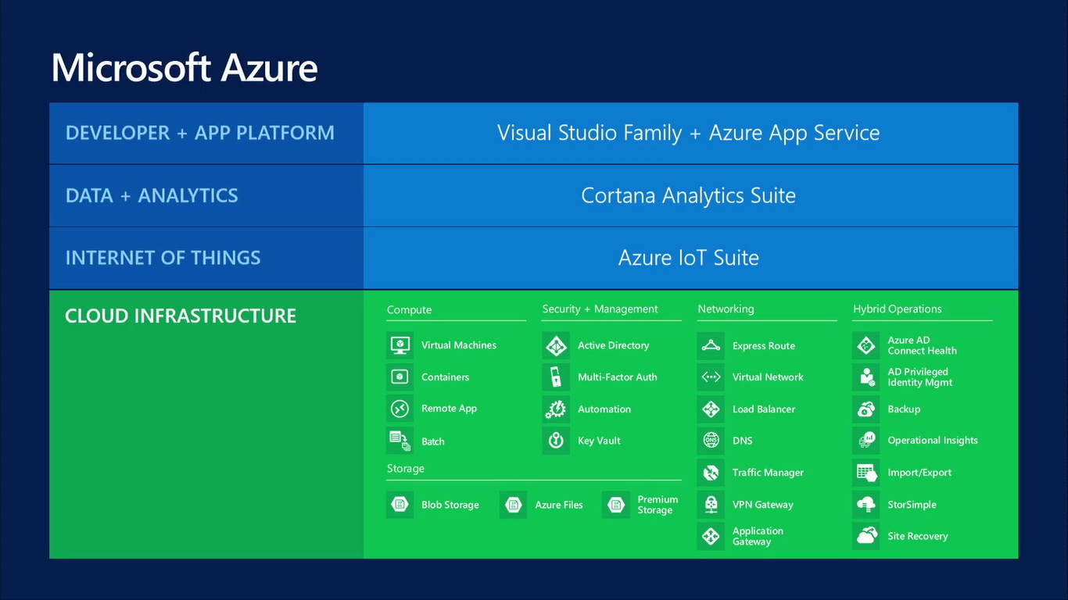

Slide 33
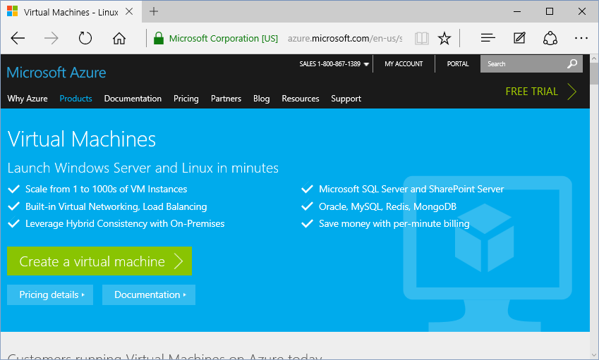
Virtual Machines
Options:
Windows
Linux
Pre-configured
https://azure.microsoft.com/en-us/services/virtual-machines/

Slide 34
Virtual Machines
Getting started
Select image
and VM size
New disk persisted in storage
Management portal
Windows Server
Boot VM from new disk
>_
Linux
Scripting
(Windows, Linux and Mac)
Blob
Storage
General Purpose
Basic
Standard
Optimized Compute
Performance Optimized
Network Optimized
REST API
Cloud
Comprehensive
Networking

Slide 35
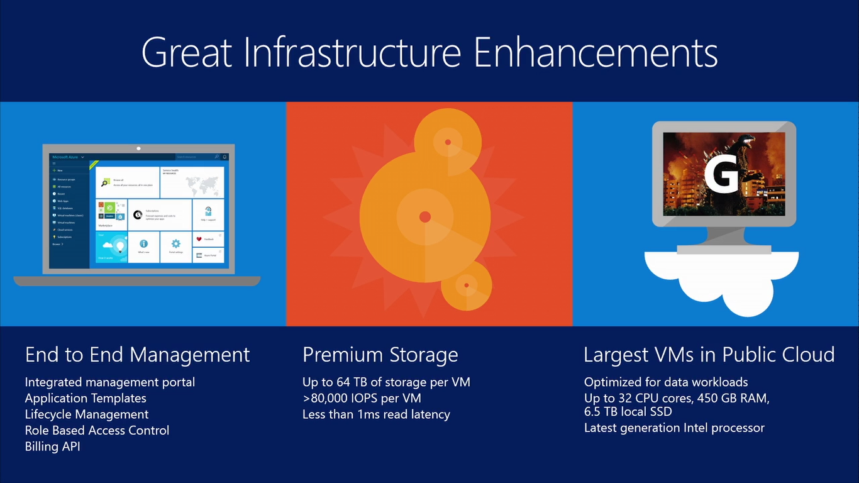

Slide 36
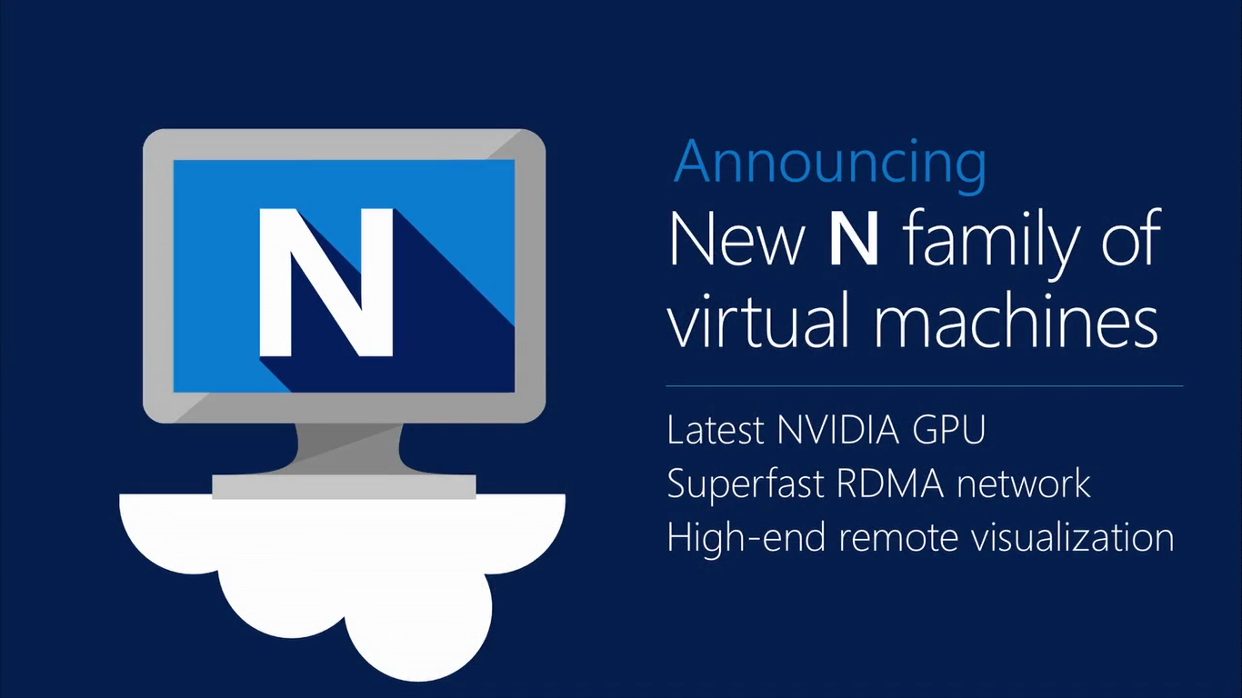

Slide 37
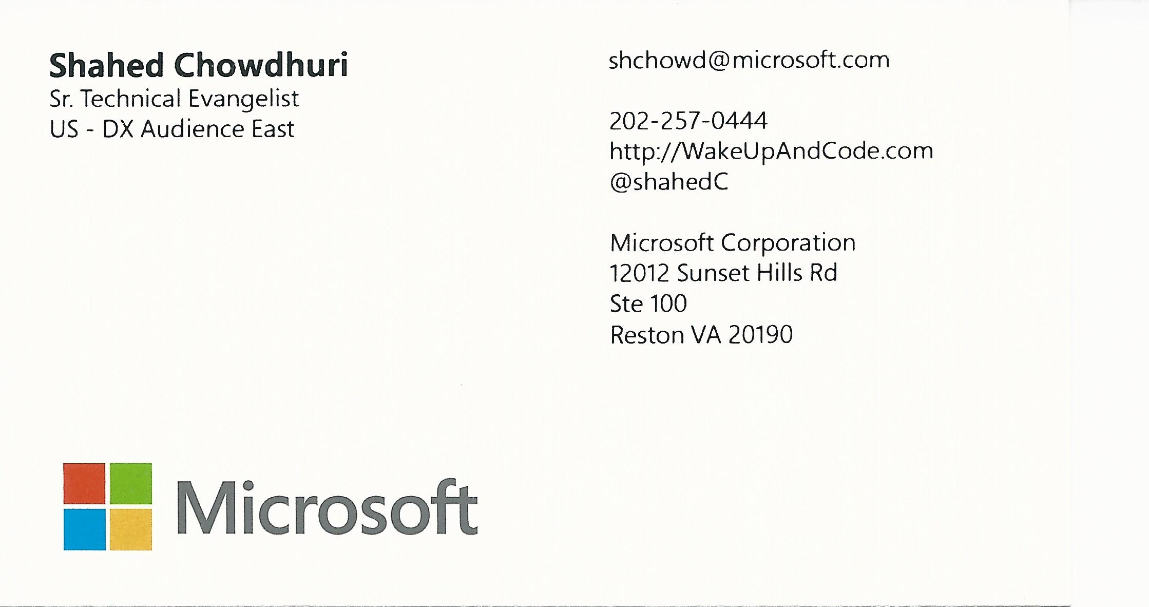
Contact
Email: shchowd@microsoft.com  Twitter: @shahedC
Notes:
Contact
Microsoft email: shchowd@microsoft.com
Personal Twitter: @shahedC
Dev Blog: WakeUpAndCode.com

