Slide 1
Intro to Bot Framework
Build and connect intelligent bots
Shahed Chowdhuri
Sr. Technical Evangelist @ Microsoft
@shahedC
WakeUpAndCode.com

Slide 2
Speaker
Shahed Chowdhuri
Sr. Technical Evangelist @ Microsoft
Technology Areas
Enterprise Web/Software Development
Game Development
Mobile Application Development
Cloud Solutions
Online
LinkedIn: http://linkedin.com/in/shahedc
Meetup: http://www.meetup.com/DC-MS-Devs/
Twitter: http://twitter.com/shahedC
Blog: http://WakeUpAndCode.com

Slide 3
Guest Speaker
Katherine “Kat” Harris
Technical Evangelist @ Microsoft
Background
Game Development
Virtual Reality & Augmented Reality
Bots & AI
UVA Alum
Online
LinkedIn: https://www.linkedin.com/in/katvharris
Twitter: https://twitter.com/katvharris
Blog: http://WakeUpAndCode.com

Slide 4
What Are Bots?
Notes:
Additional Topics

Slide 5
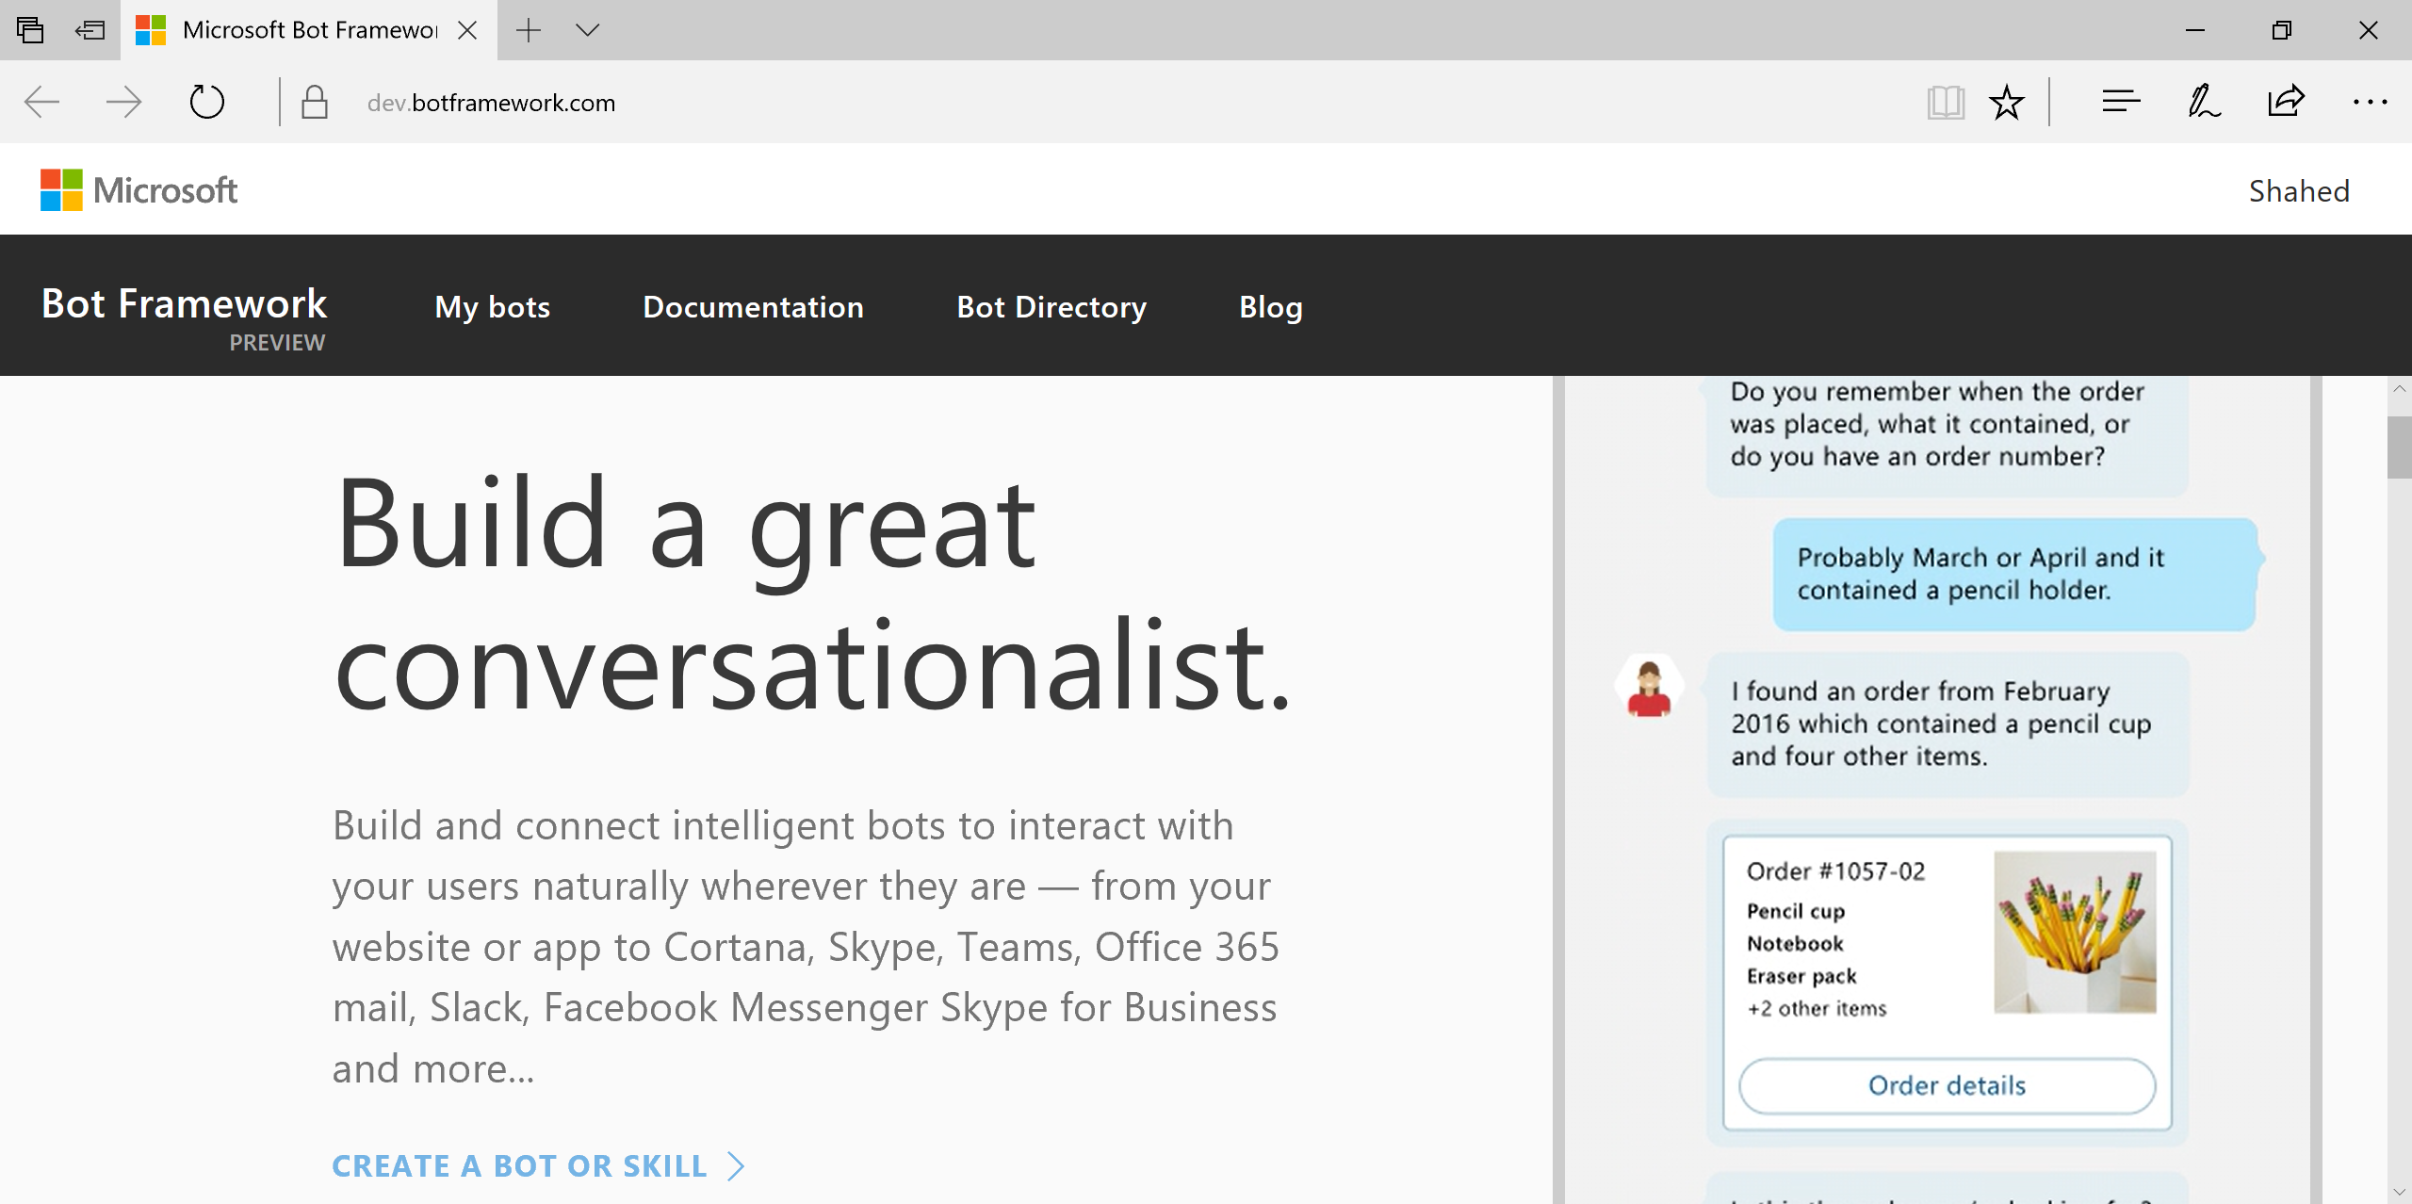
MS Bot Framework
https://dev.botframework.com

Slide 6
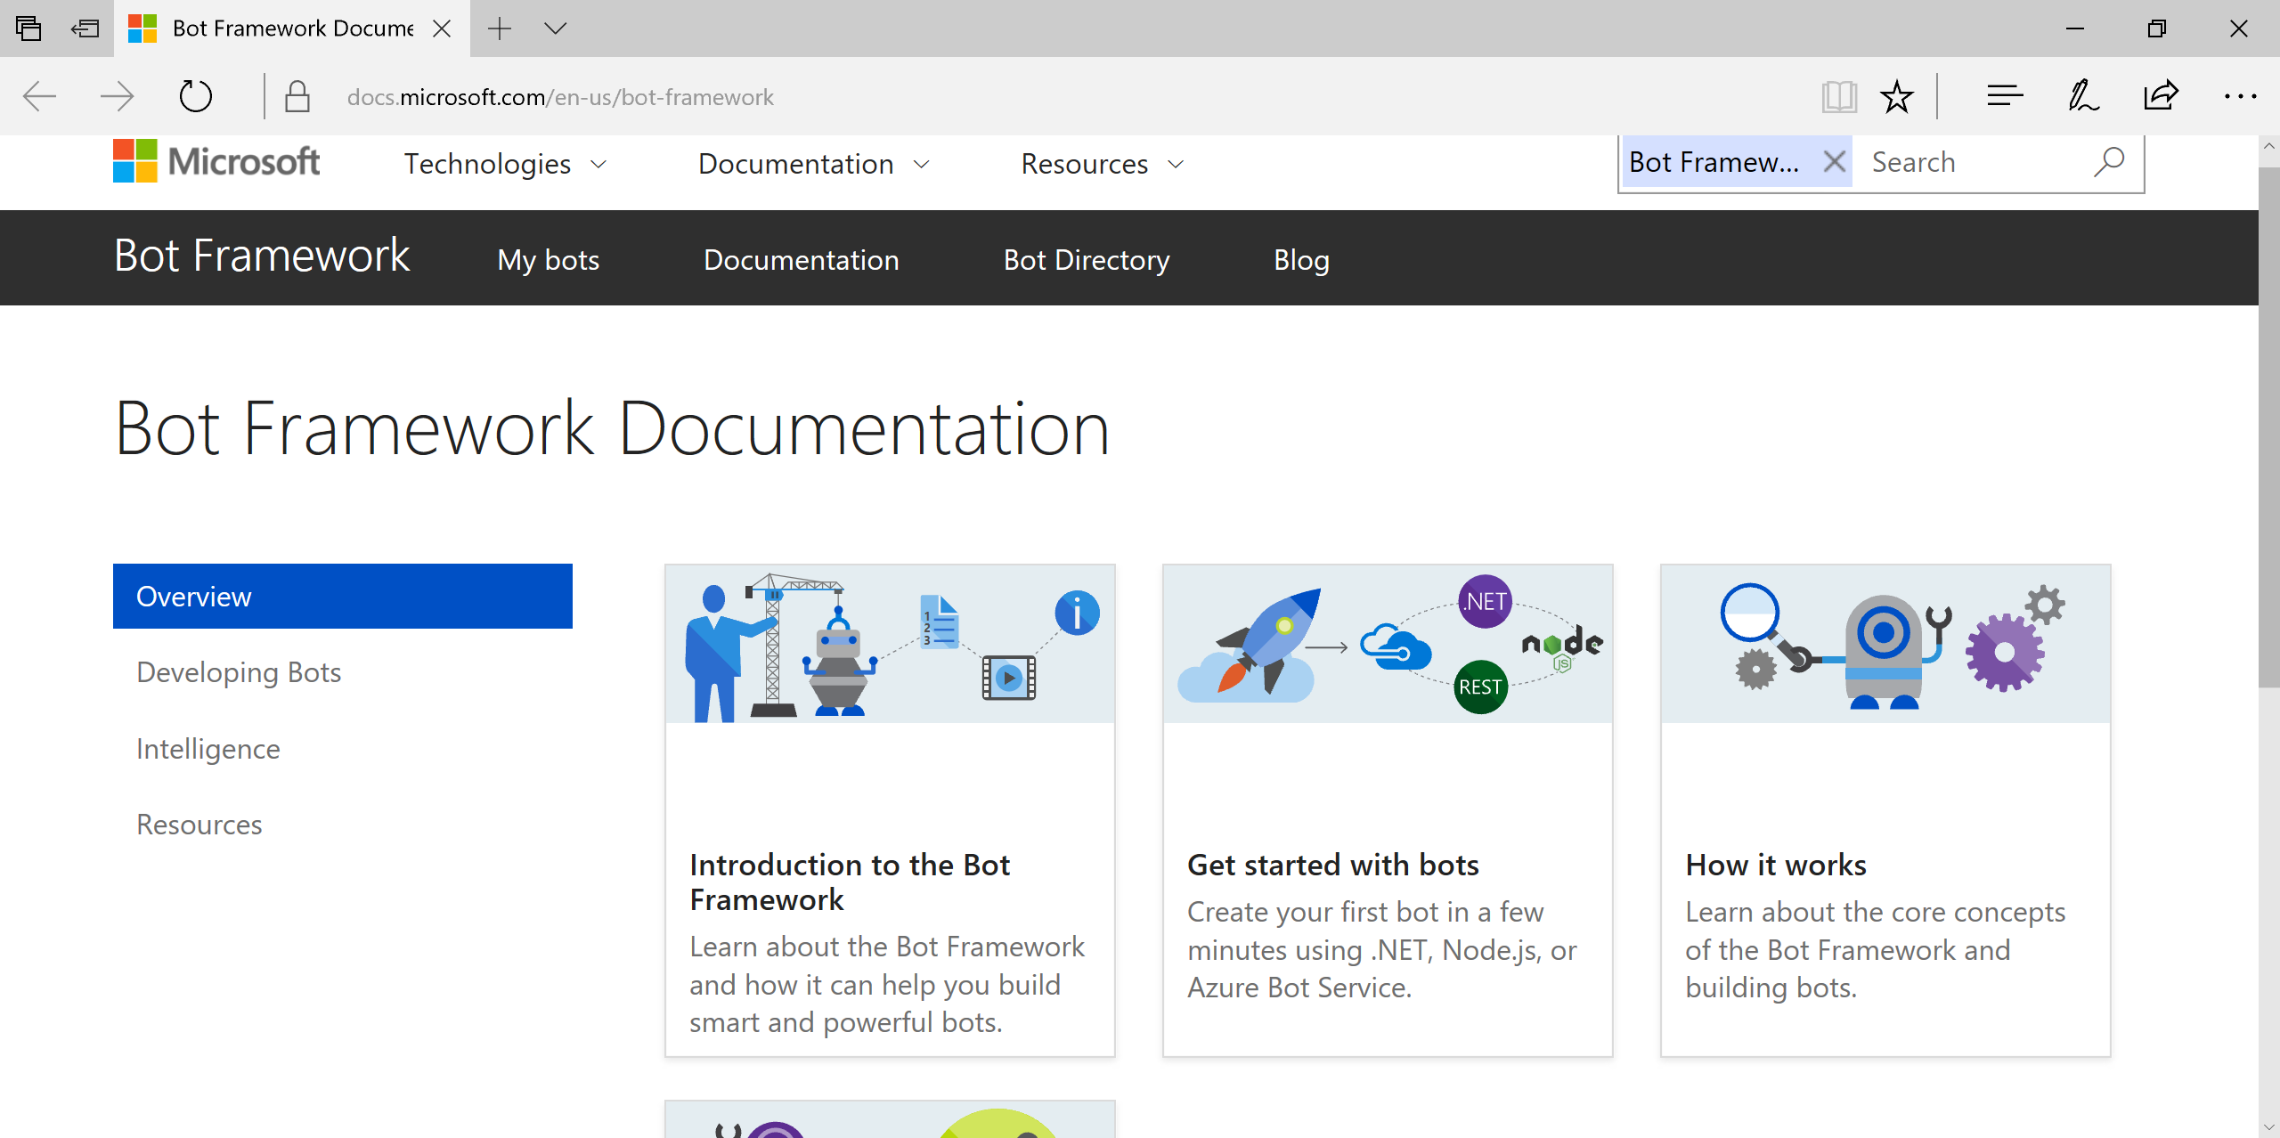
Overview
http://docs.botframework.com
Bot Framework:
Builder SDK
Connector
Dev Portal
Directory

Slide 7
What’s New in V3
BotBuilder + Connector = 1 SDK
Message => Activity
ActivityTypes enum
Message properties
Sending replies with HttpResponseMessage
Starting conversations with 1 user or group
Options => Cards
Bot State service for user data
Web.config changes for ID/Password fields
https://docs.microsoft.com/en-us/bot-framework/resources-upgrade-to-v3

Slide 8
Building a Bot
Notes:
Additional Topics

Slide 9
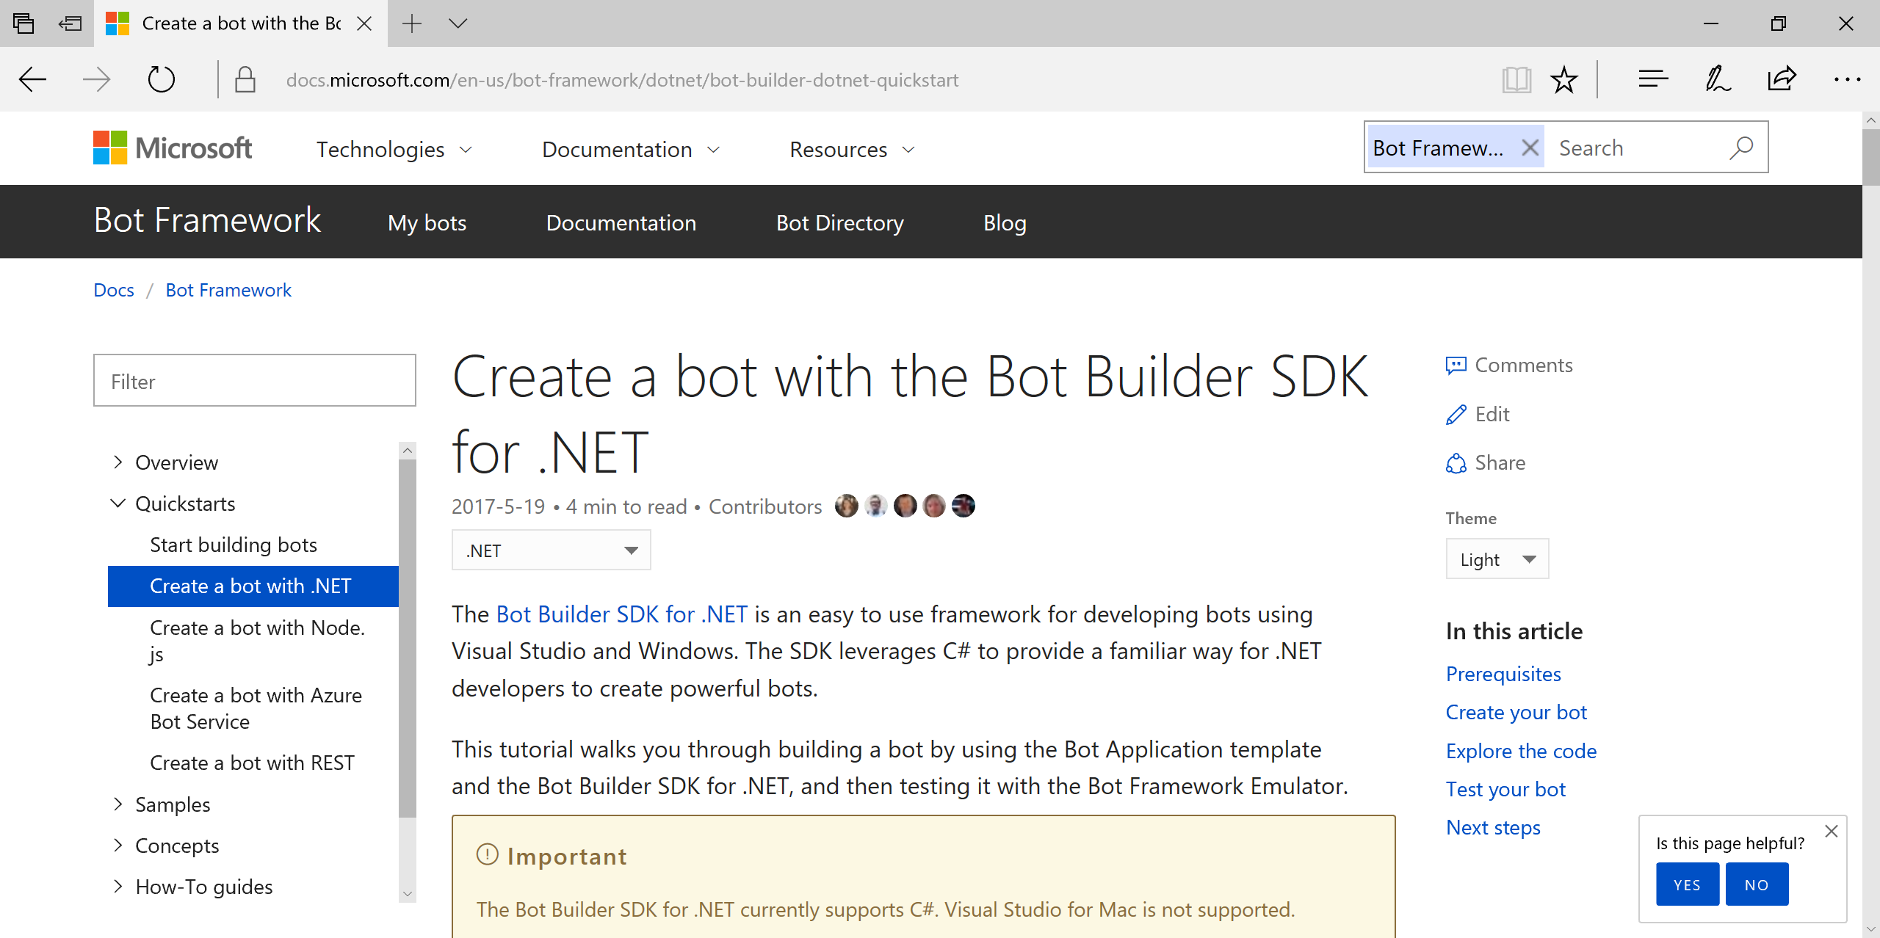
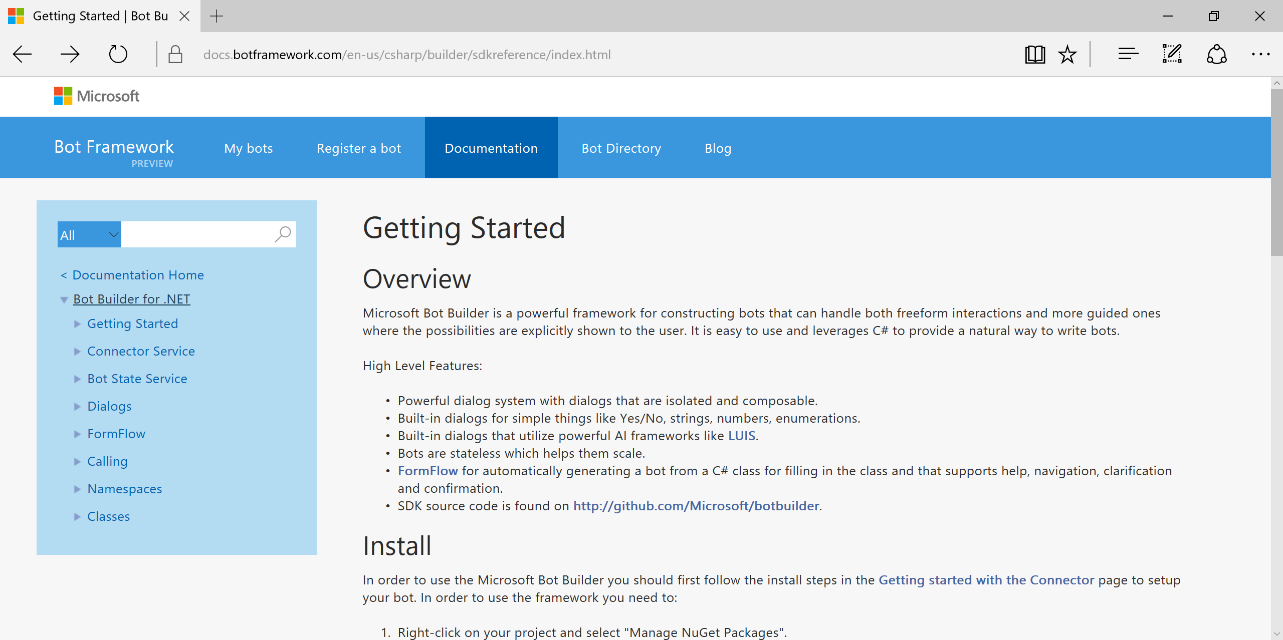
Bot Builder SDK for .NET with C#
https://docs.microsoft.com/en-us/bot-framework/dotnet/bot-builder-dotnet-quickstart

Slide 10
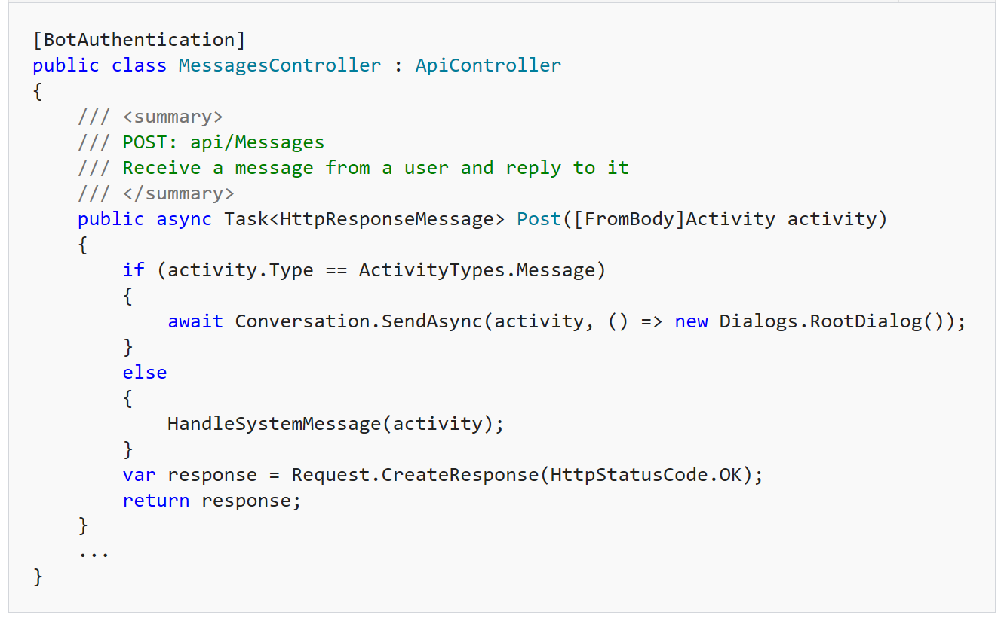
MessagesController

Slide 11
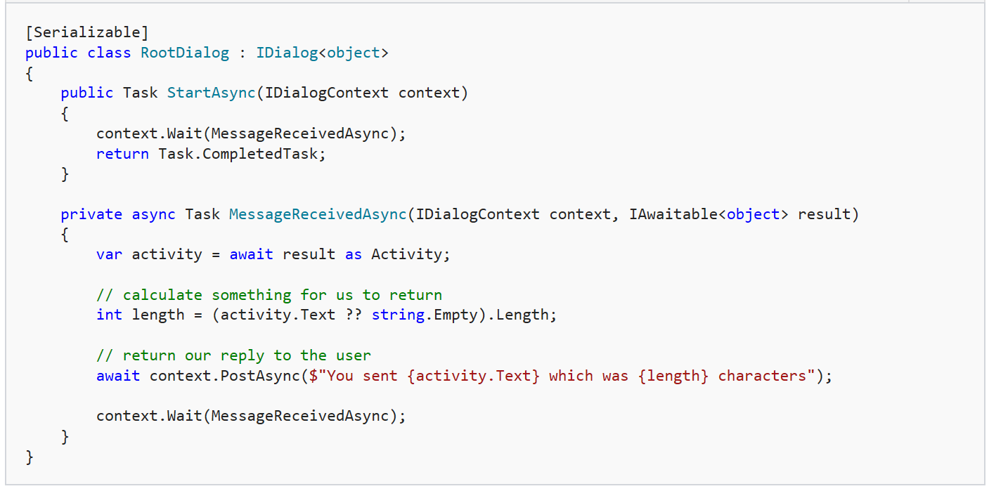
RootDialog

Slide 12
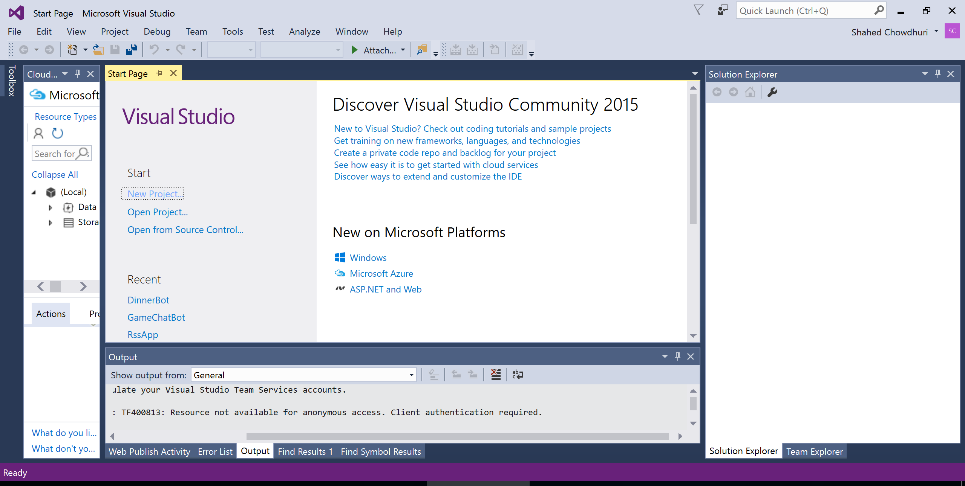
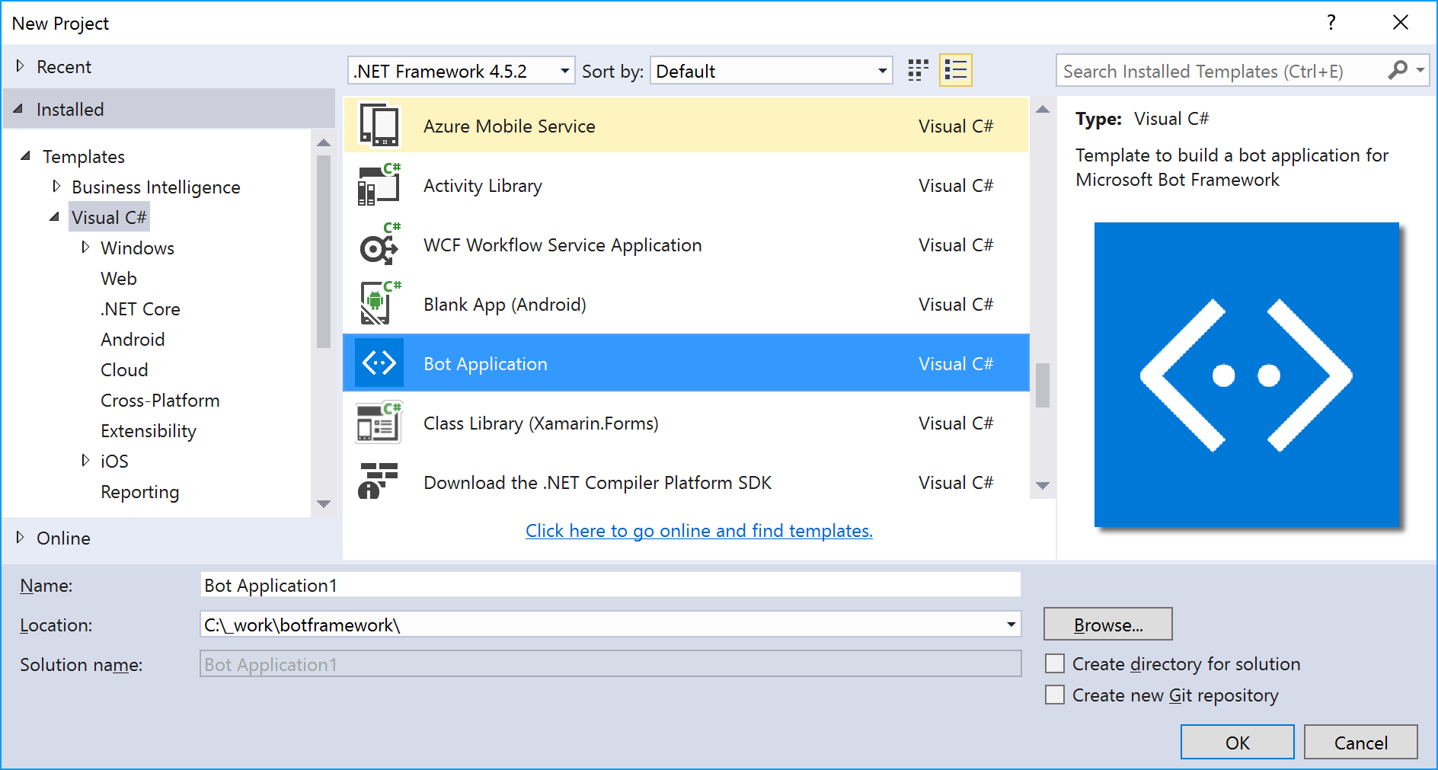
Visual Studio: File | New | Project

Slide 13
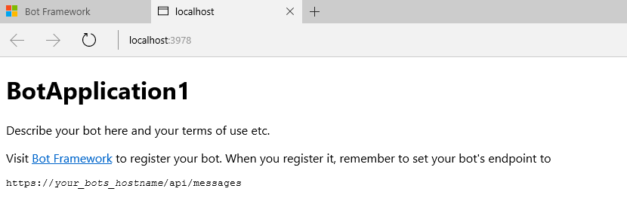
Test Your Bot
Emulator: https://aka.ms/bf-bc-emulator

Slide 14
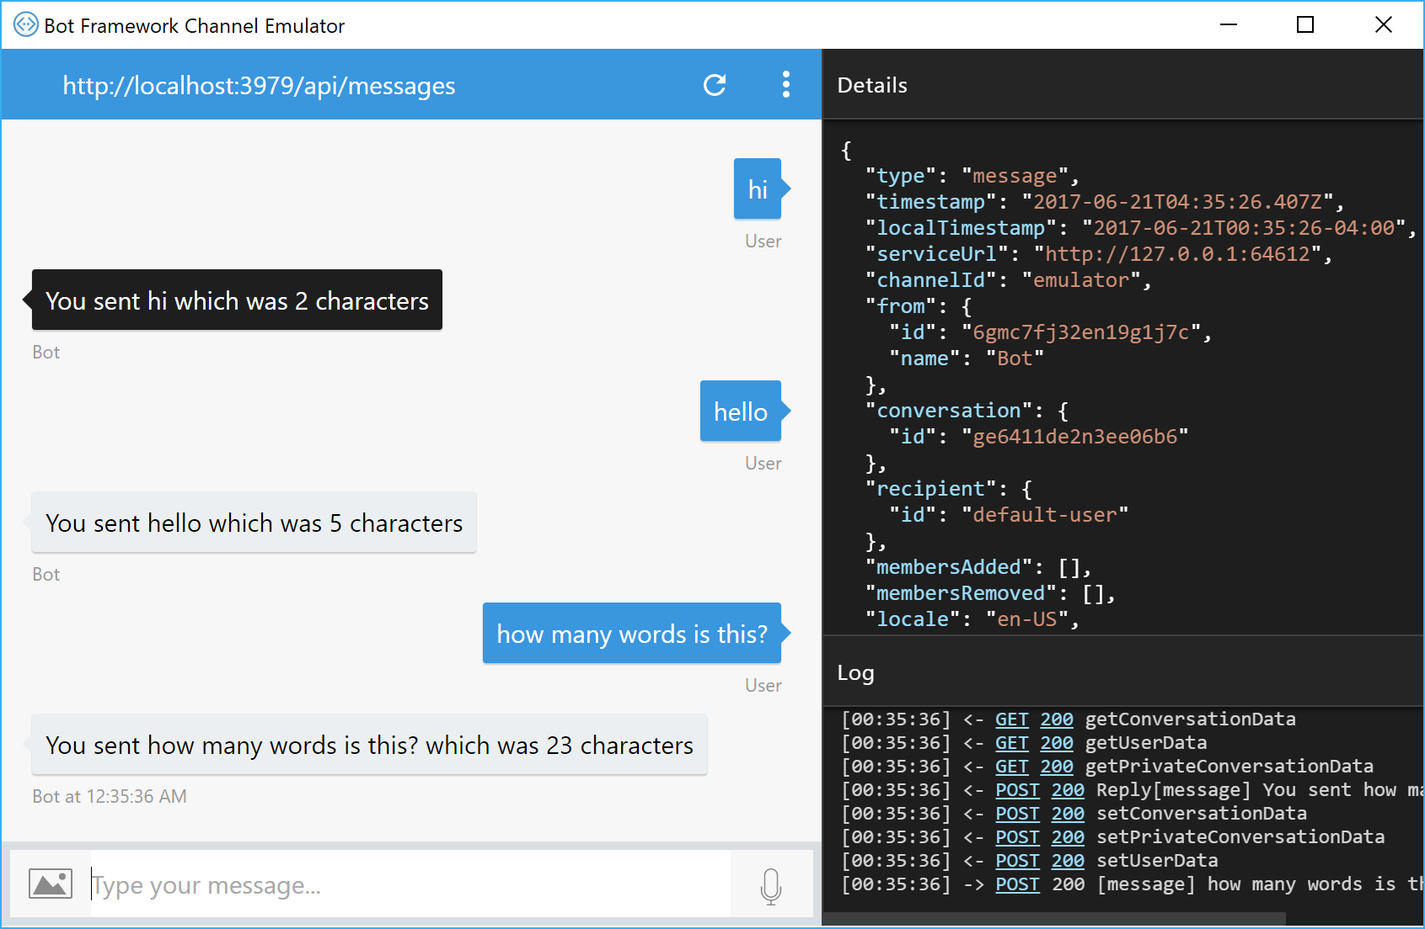
Bot Framework Emulator
Direct Download: https://emulator.botframework.com/

Slide 15
DB Connectivity with Entity Framework
Application Code
Entities in Code
DB
ORM
https://blog.botframework.com/2017/07/26/saving-state-sql-dotnet/

Slide 16
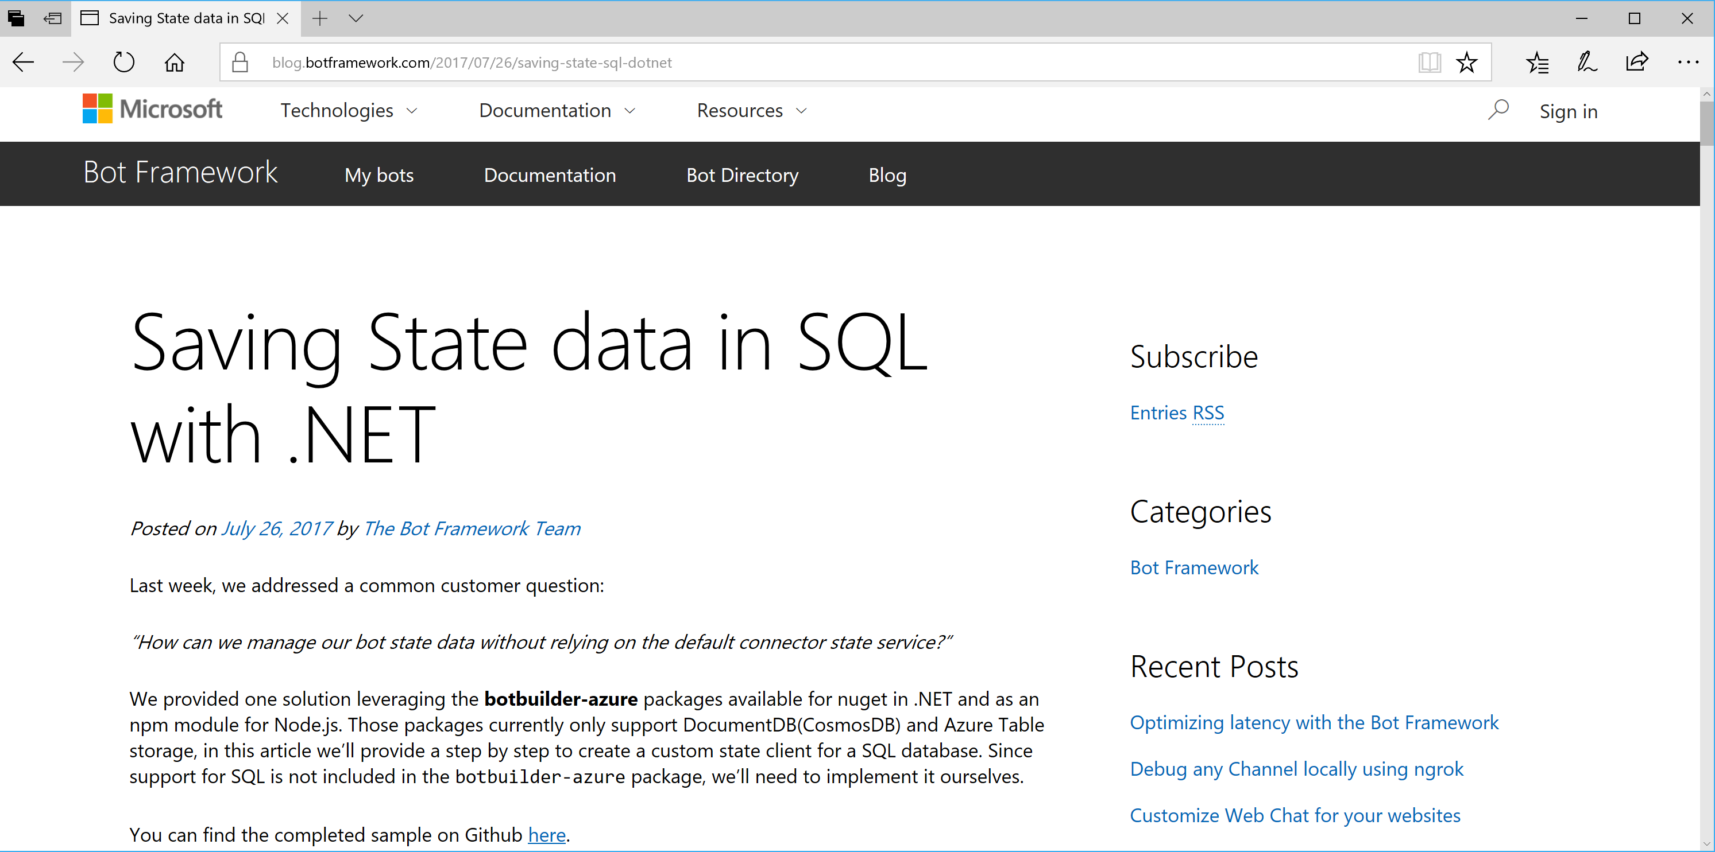
Saving State to SQL Azure
https://blog.botframework.com/2017/07/26/saving-state-sql-dotnet/

Slide 17
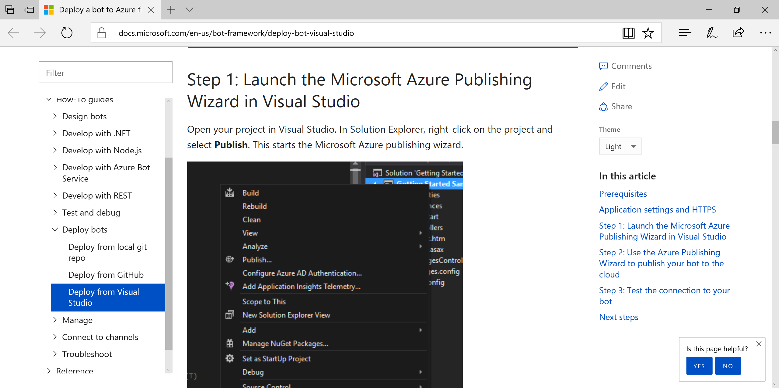
Deploy to Azure
https://docs.microsoft.com/en-us/bot-framework/deploy-bot-visual-studio

Slide 18
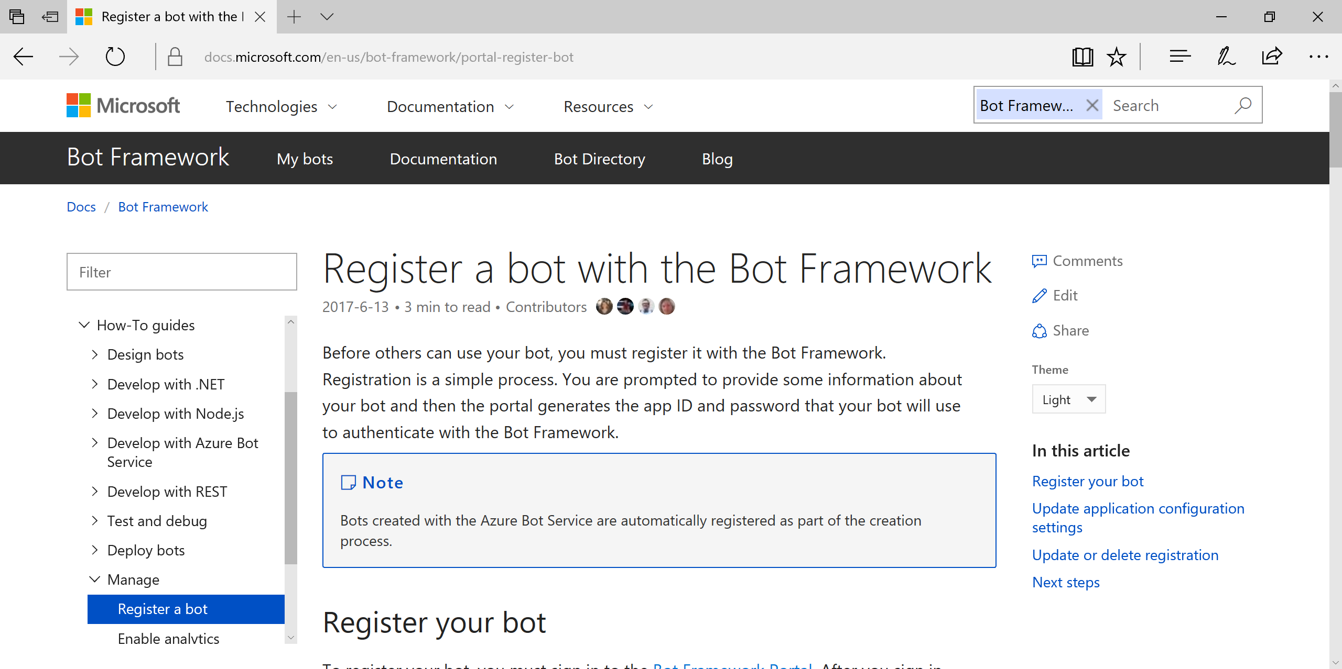
Register Your Bot
https://docs.microsoft.com/en-us/bot-framework/portal-register-bot

Slide 19
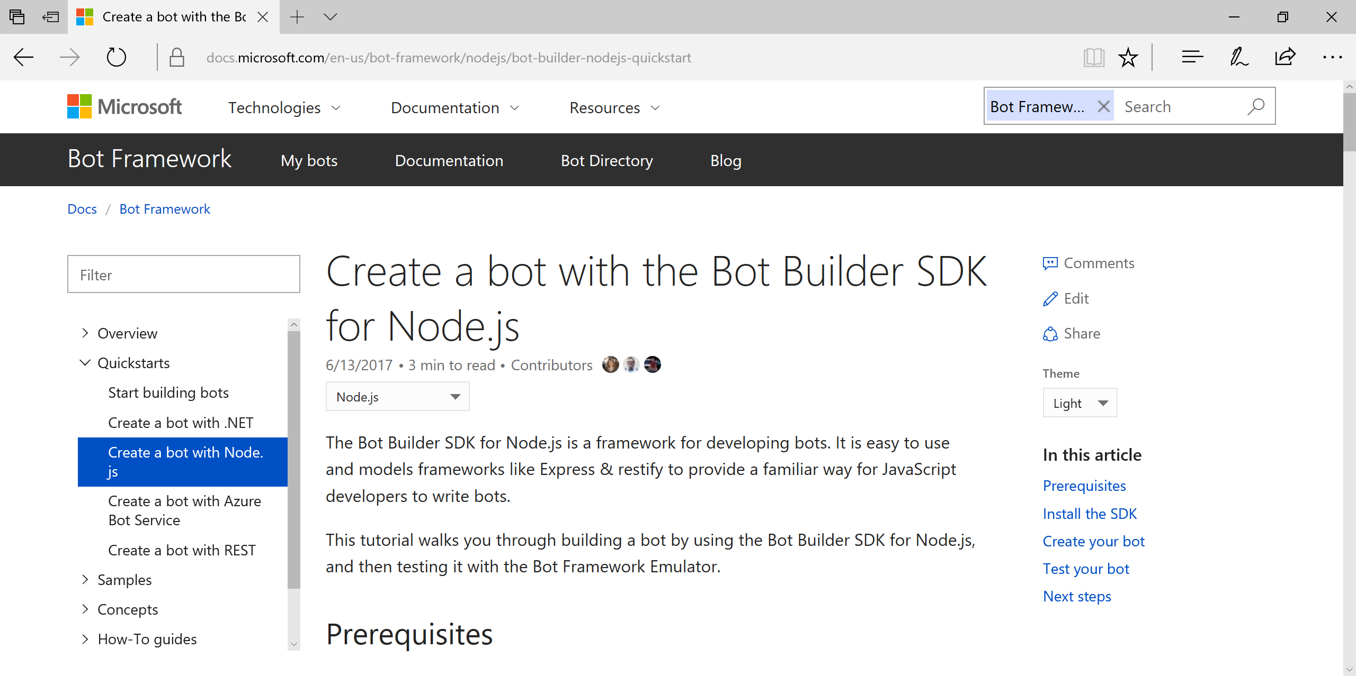
Bot Builder SDK for Node.js
https://docs.microsoft.com/en-us/bot-framework/nodejs/bot-builder-nodejs-quickstart

Slide 20
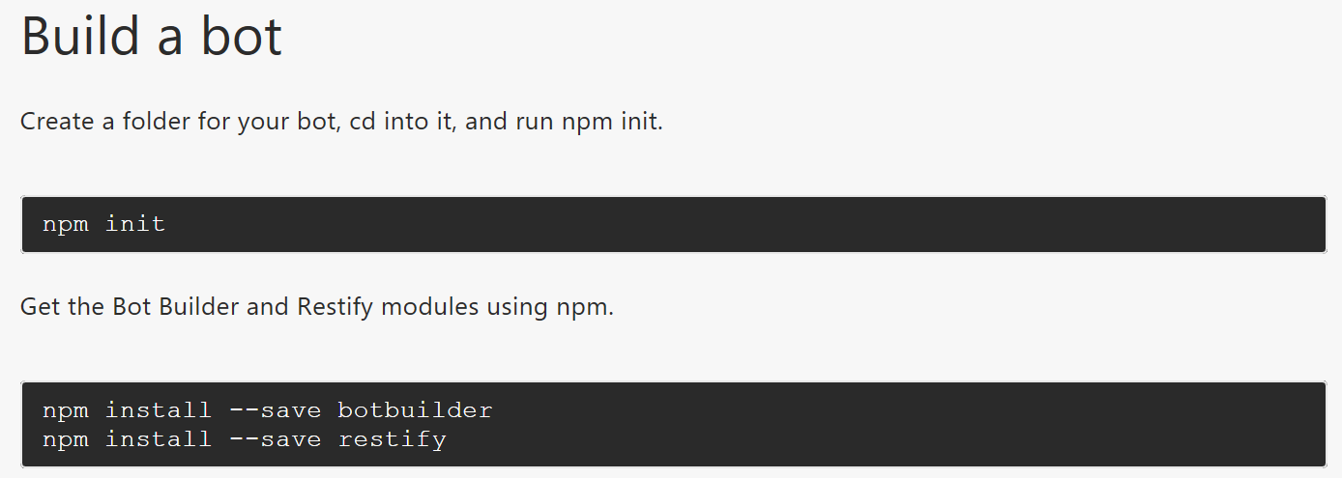
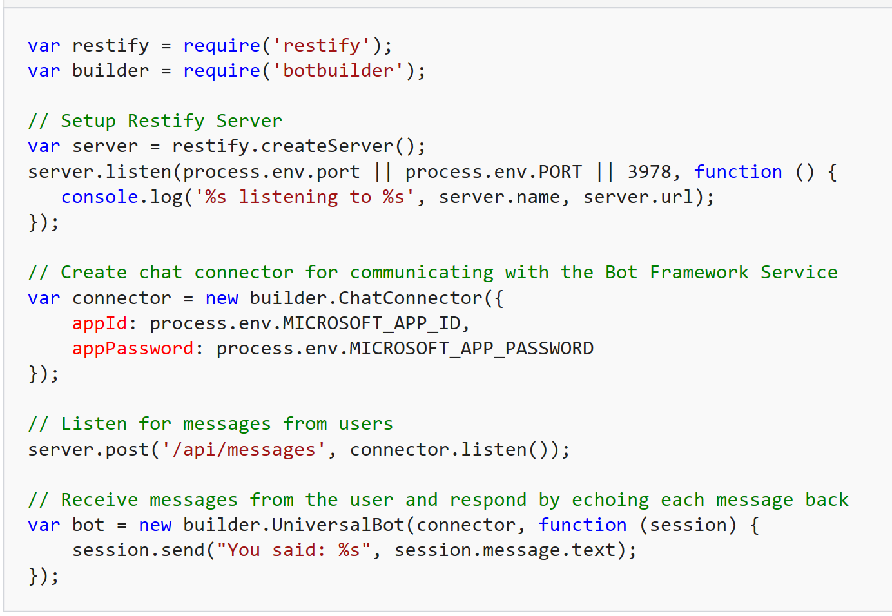
Build a Bot with Node.js

Slide 21
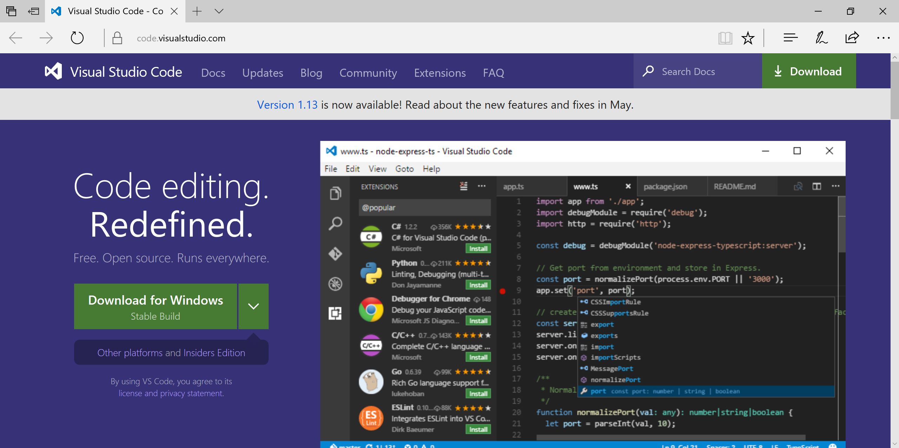
Visual Studio Code
Download: http://code.visualstudio.com/

Slide 22
Test Your Bot
Emulator: https://aka.ms/bf-bc-emulator

Slide 23
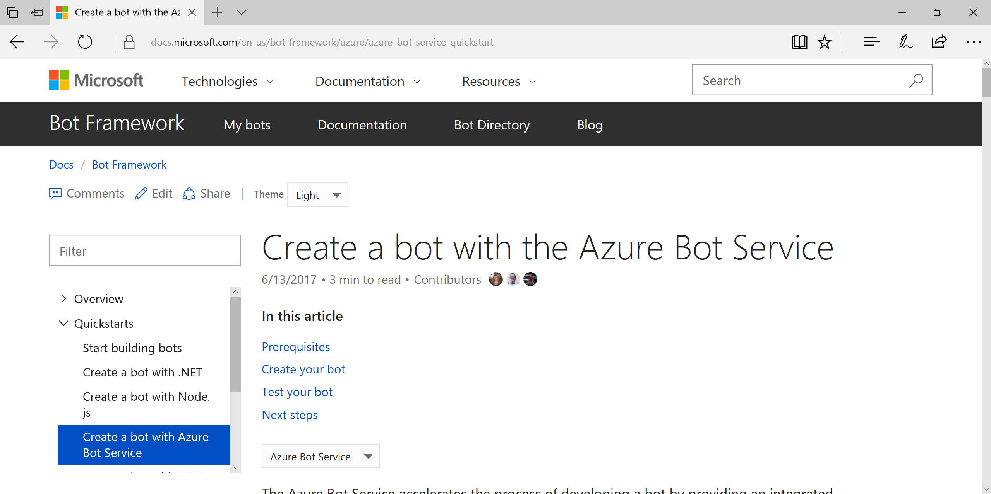
Azure Bot Service
https://docs.microsoft.com/en-us/bot-framework/azure/azure-bot-service-quickstart

Slide 24
Connect & Config
Notes:
Additional Topics

Slide 25
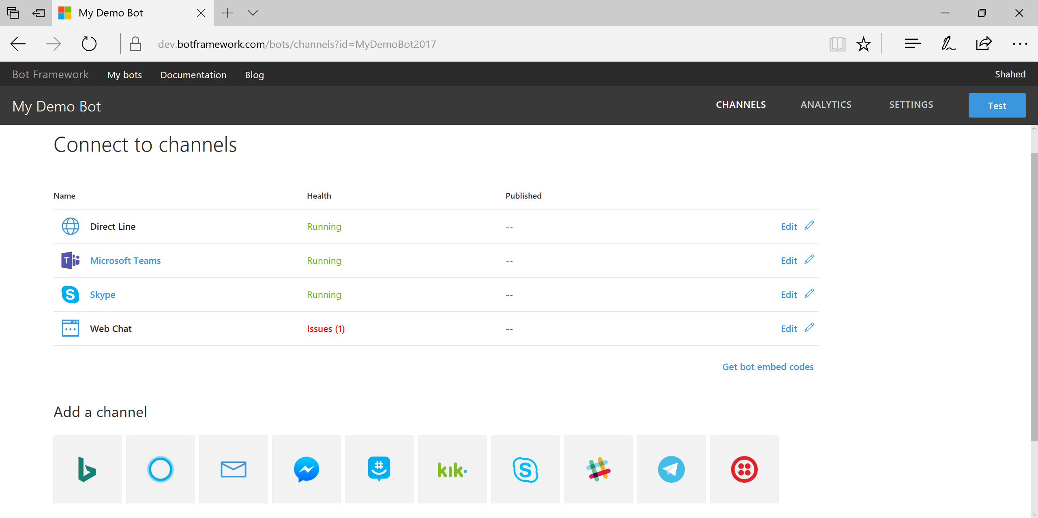
Connect to Channels
Channels:
Email
GroupMe
Skype
Slack
SMS
Telegram
Web
etc...

Slide 26
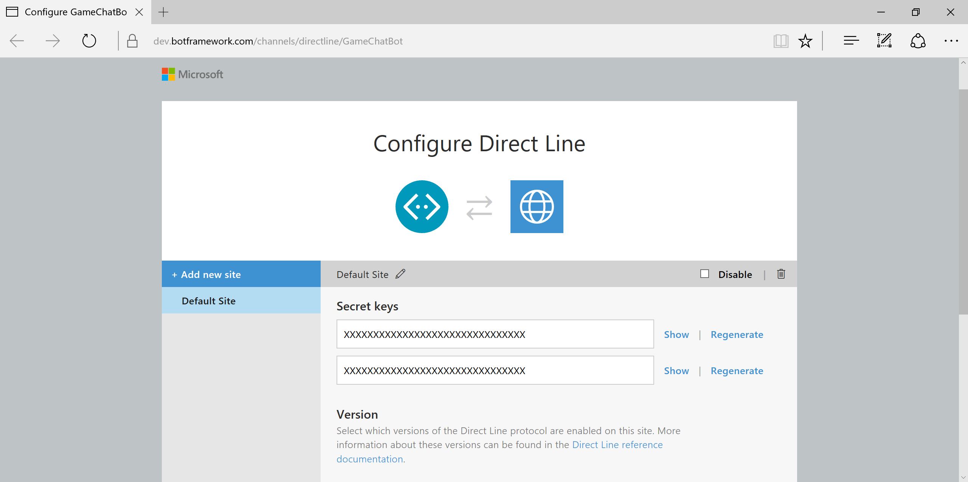
Configure: Direct Line
https://dev.botframework.com/channels/directline/YOUR-BOT-ID

Slide 27
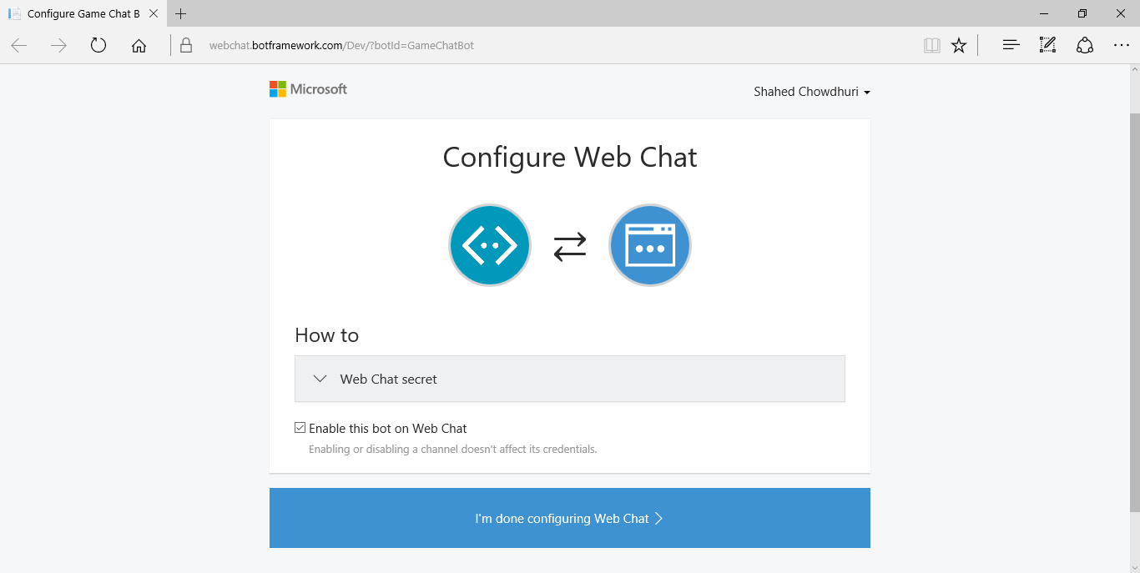
Configure: Web Chat
https://dev.botframework.com/channels/webchat/YOUR-BOT-ID

Slide 28
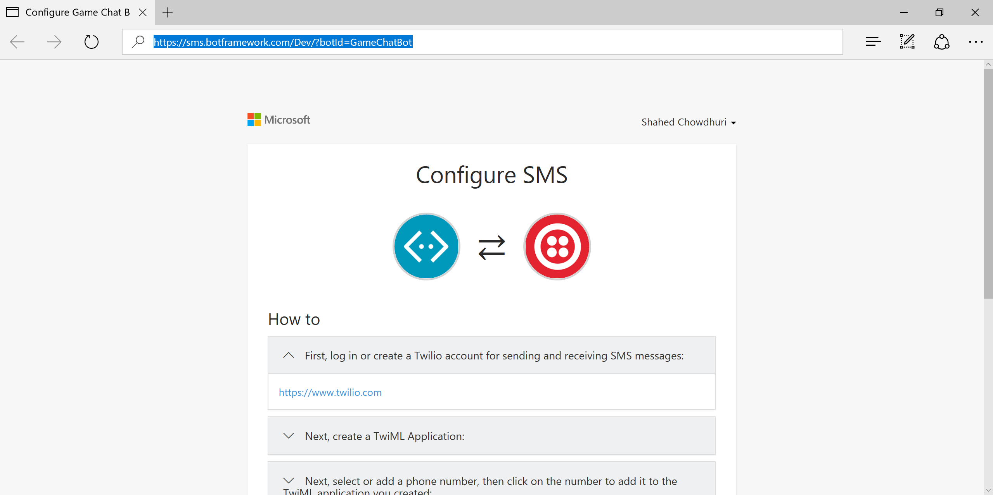
Configure: SMS (via Twilio)
https://sms.botframework.com/Dev/?botId=YOUR-BOT-ID

Slide 29
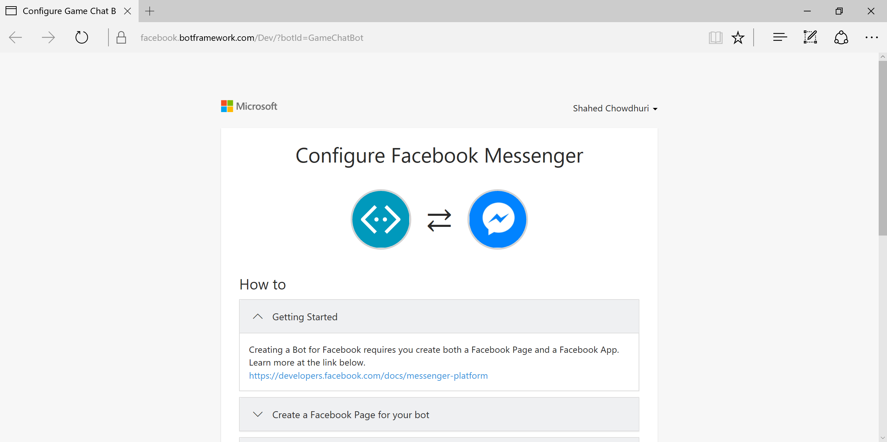
Configure: Facebook Messenger
https://facebook.botframework.com/Dev/?botId=YOUR-BOT-ID

Slide 30
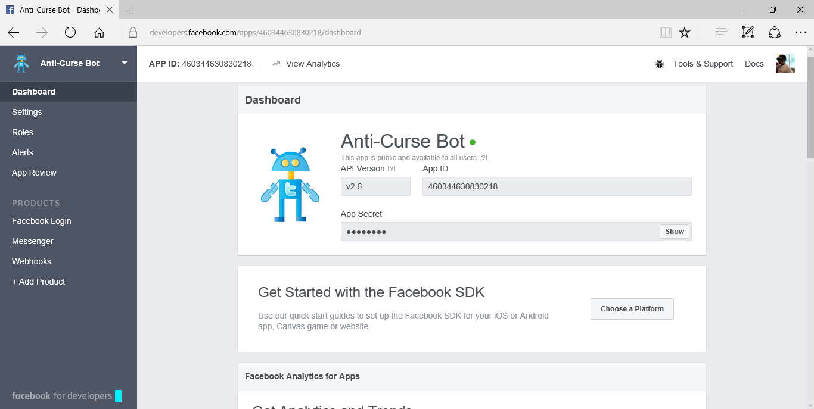
FB Developer Settings
https://developers.facebook.com

Slide 31
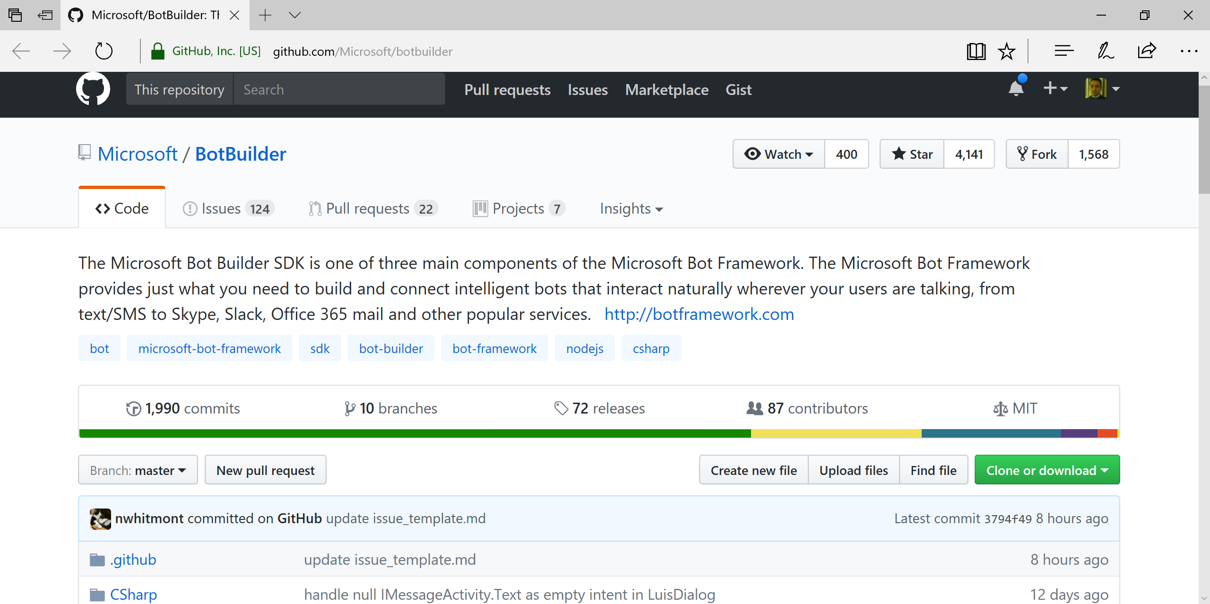
BotBuilder on GitHub!
https://github.com/Microsoft/botbuilder

Slide 32
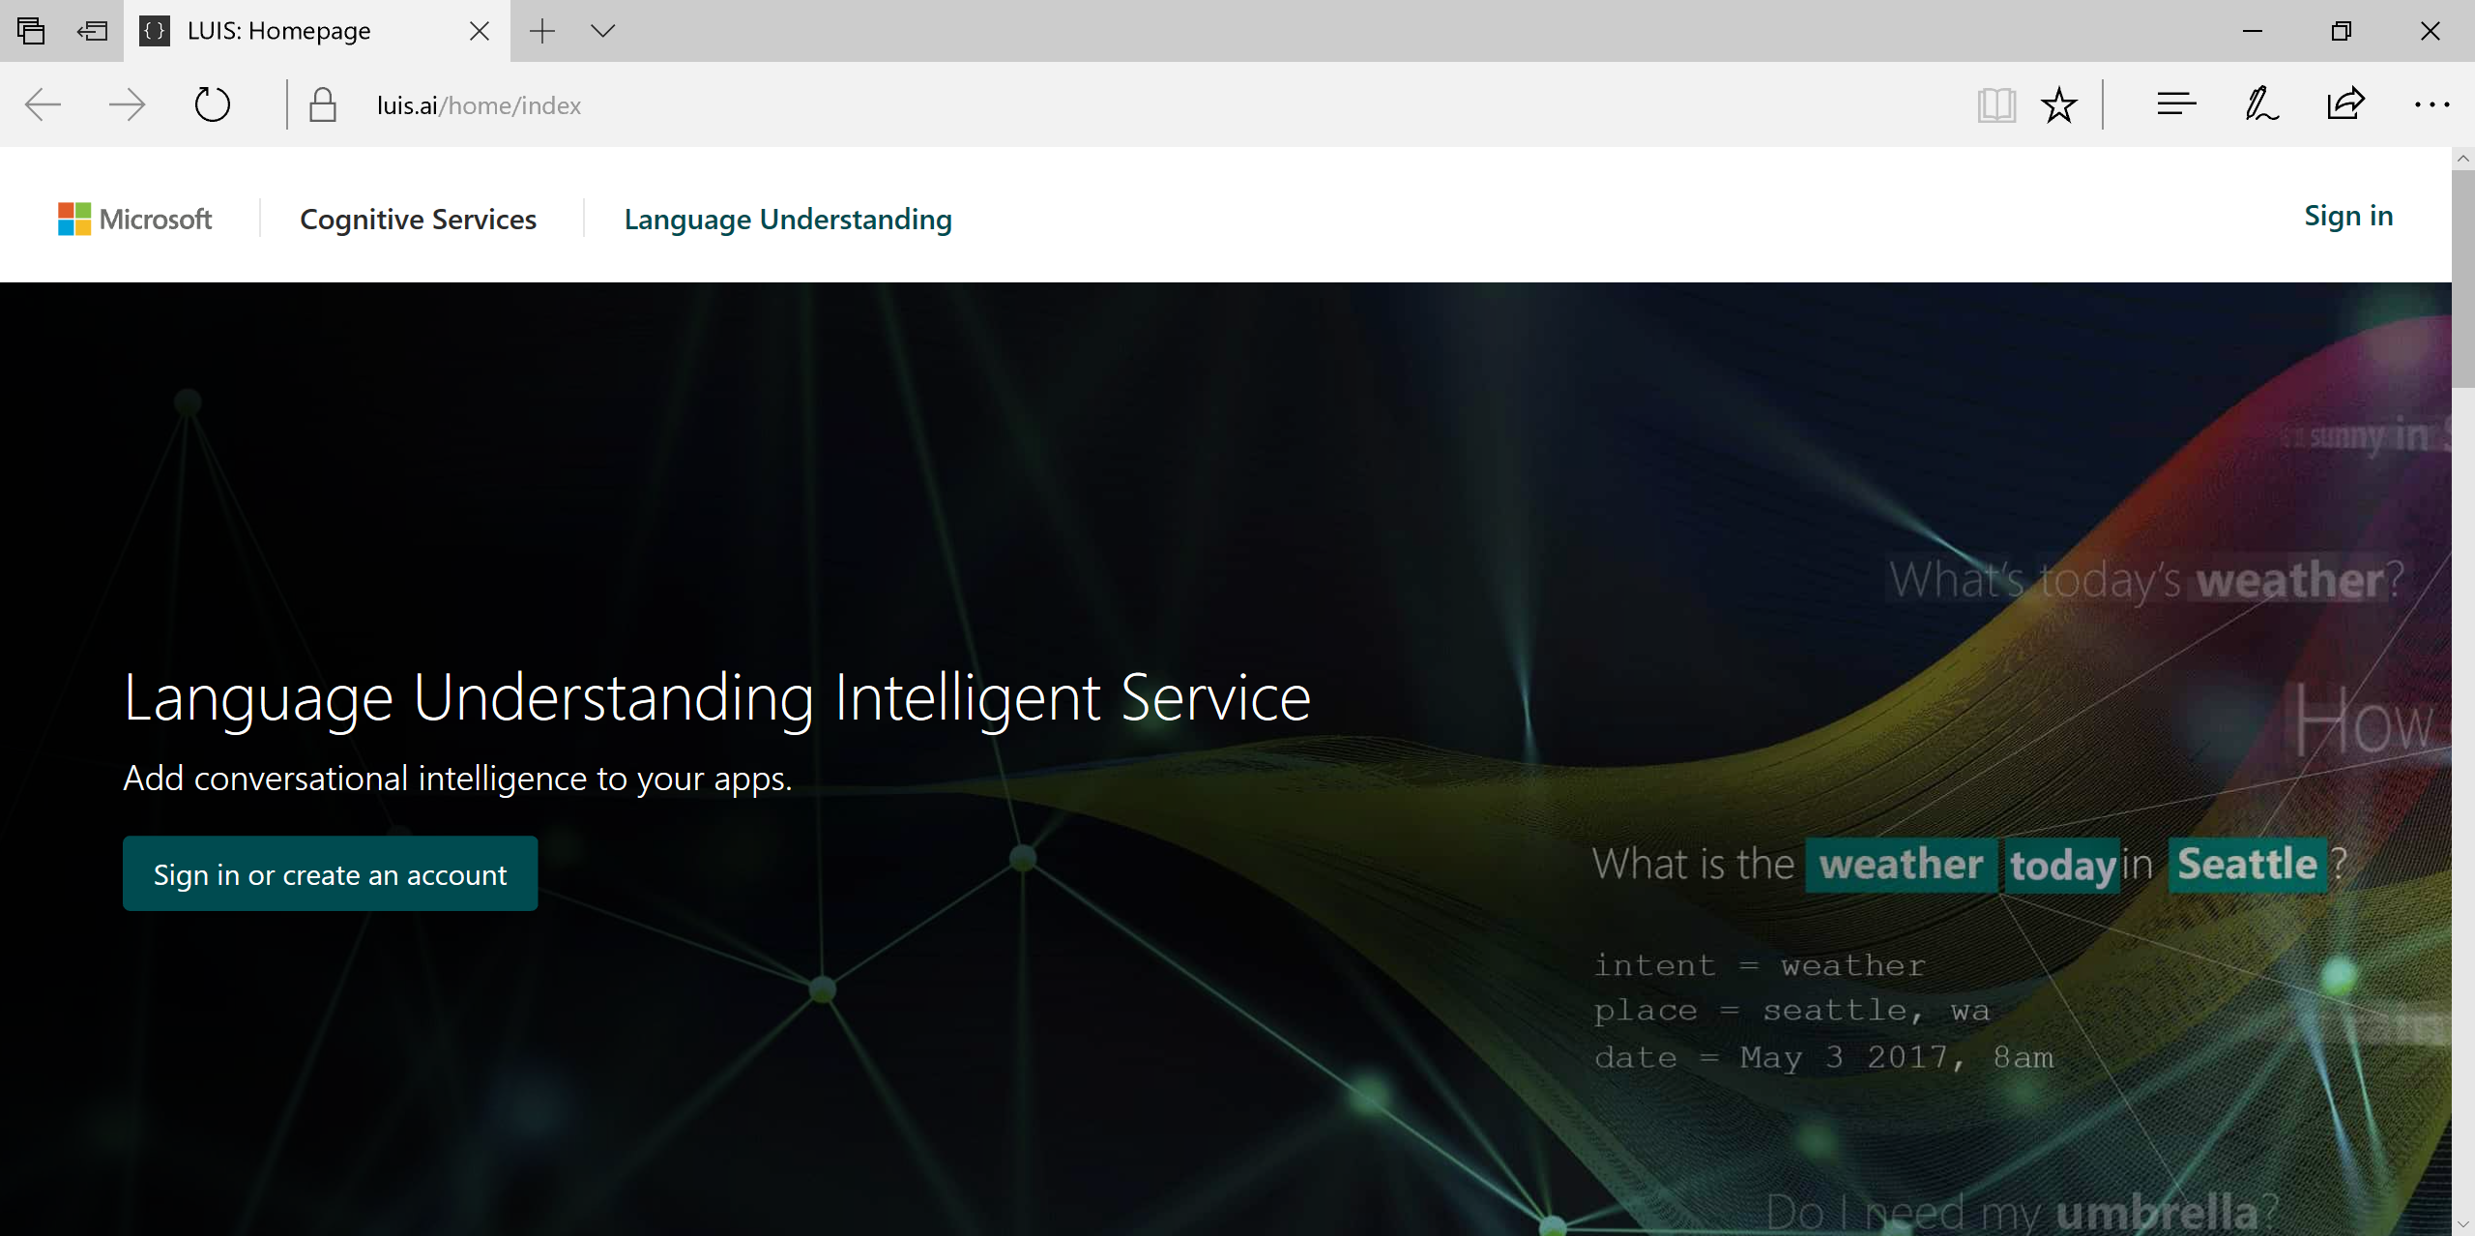
Language Understanding Intelligent Service
https://www.luis.ai/
Help: https://www.luis.ai/Help

Slide 33
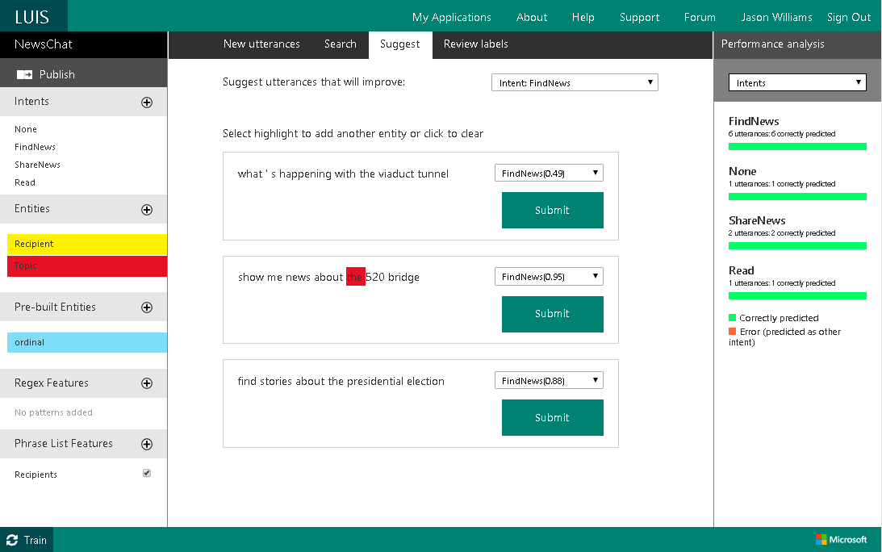
LUIS: Intents, Entities & Labels

Slide 34
Intents in LUIS
Intent: Summarizes the intentions of an utterance

Slide 35
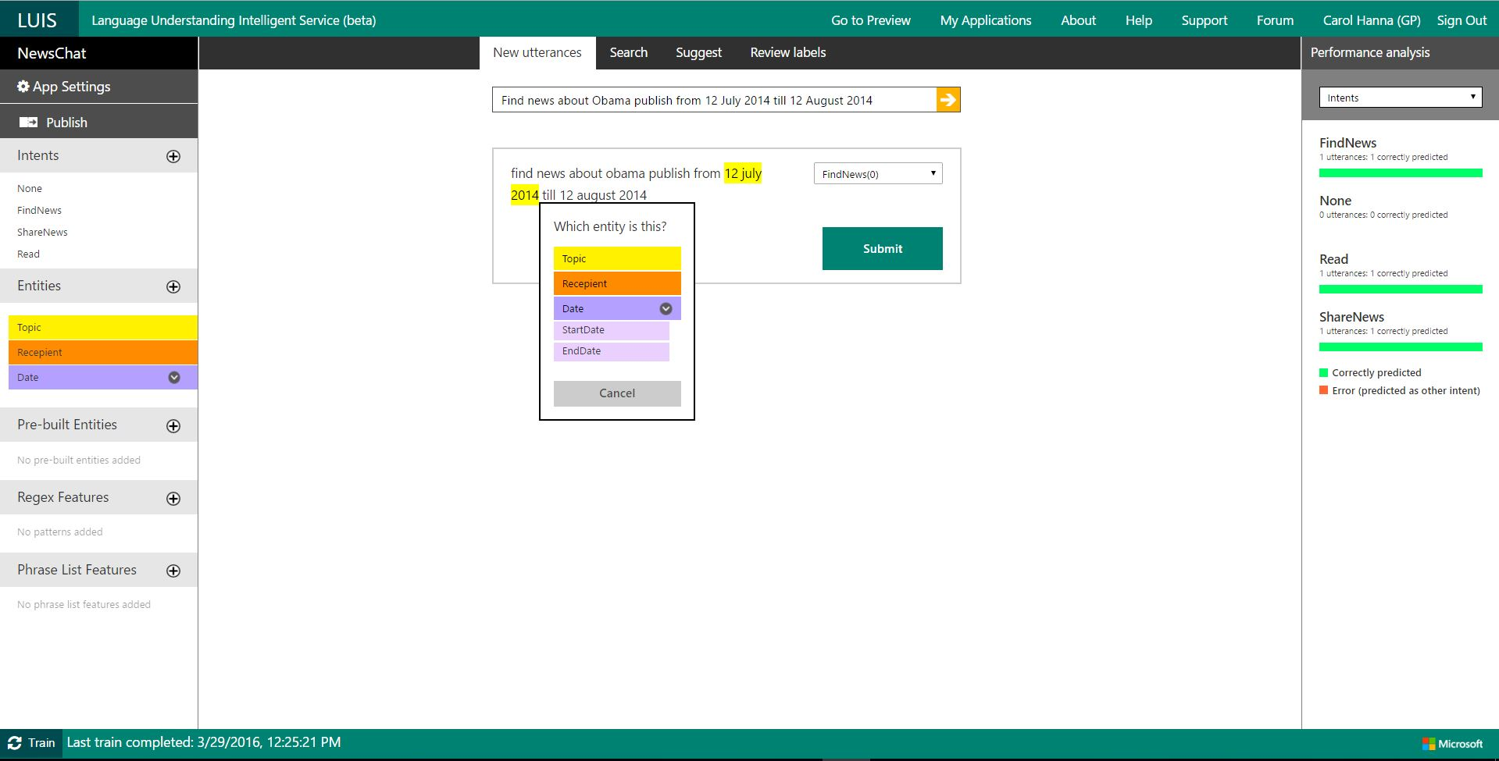
Utterances in LUIS

Slide 36
Entities in LUIS
Entity: Data object that can be pre-built or custom-defined.

Slide 37
Labels in LUIS
Label: Marked segment of utterance to associate terms with corresponding entities.

Slide 38
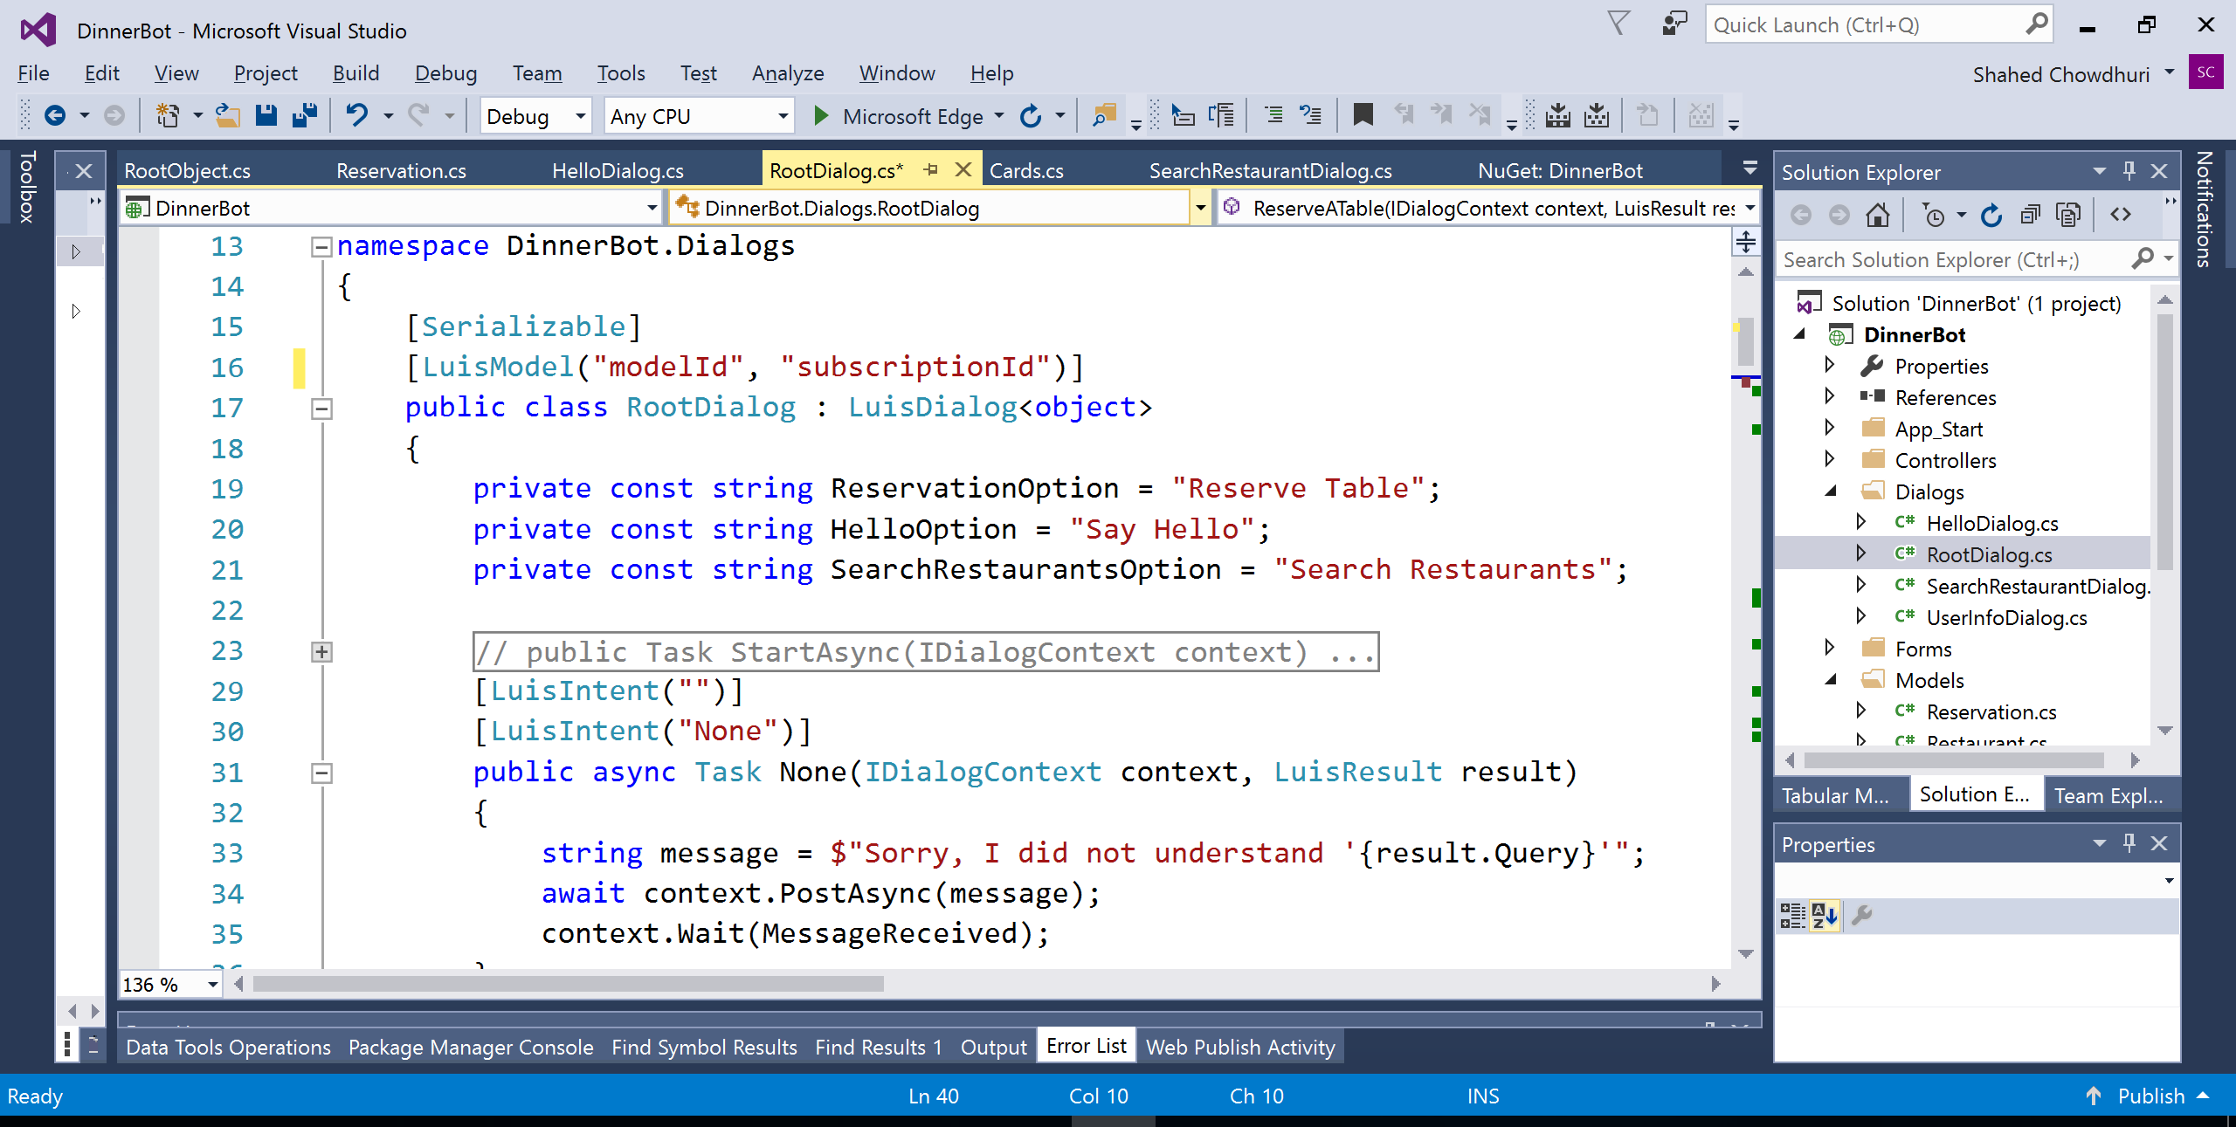
Using LUIS in your Code

Slide 39
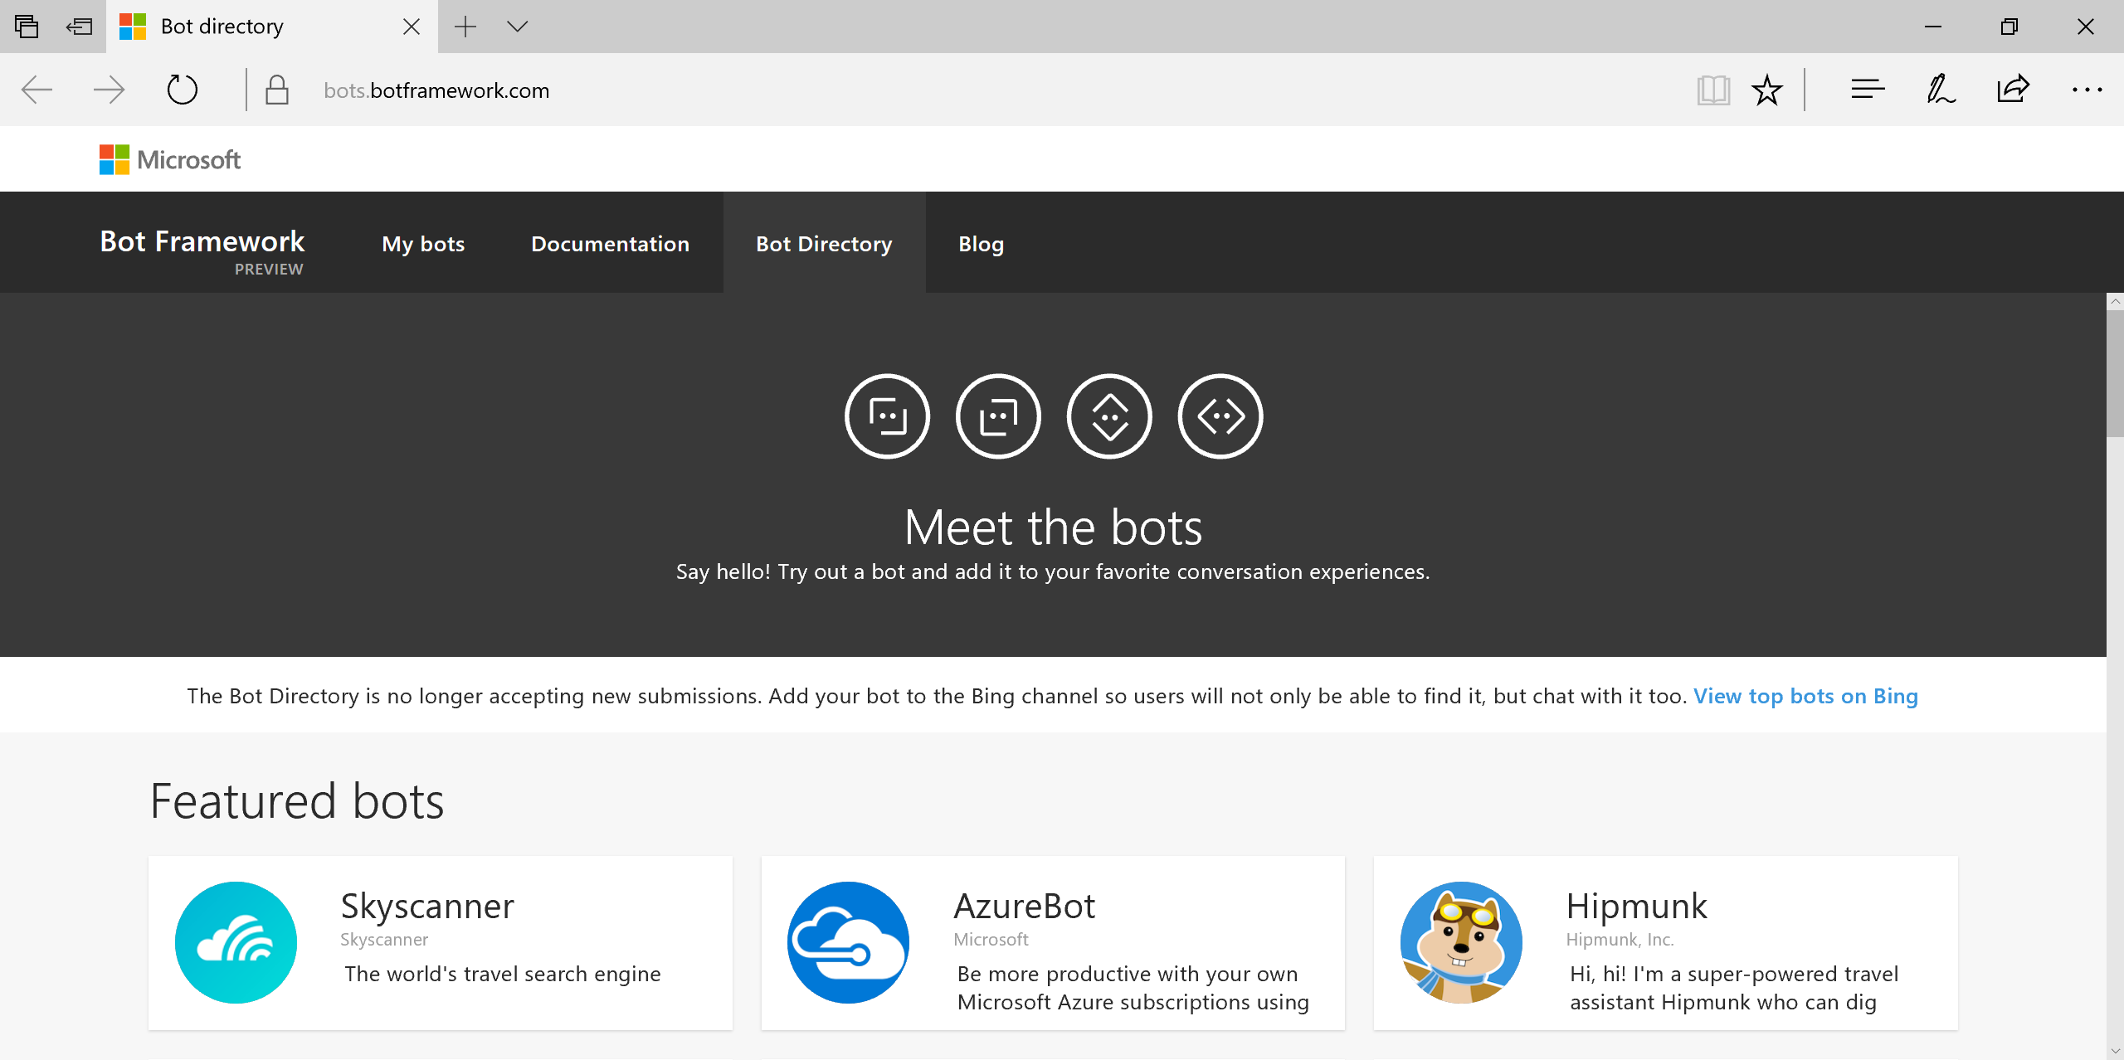
Bot Directory
https://bots.botframework.com/

Slide 40
Demo

Slide 41
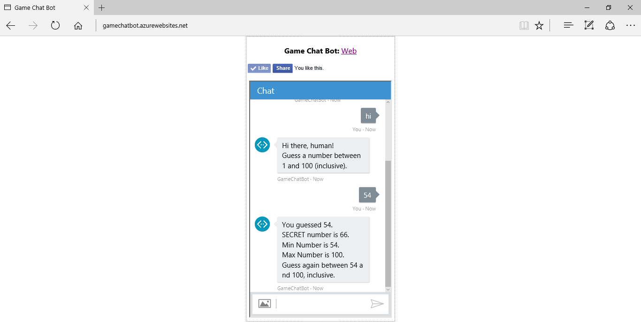
Game Chat Bot
http://gamechatbot.azurewebsites.net/

Slide 42
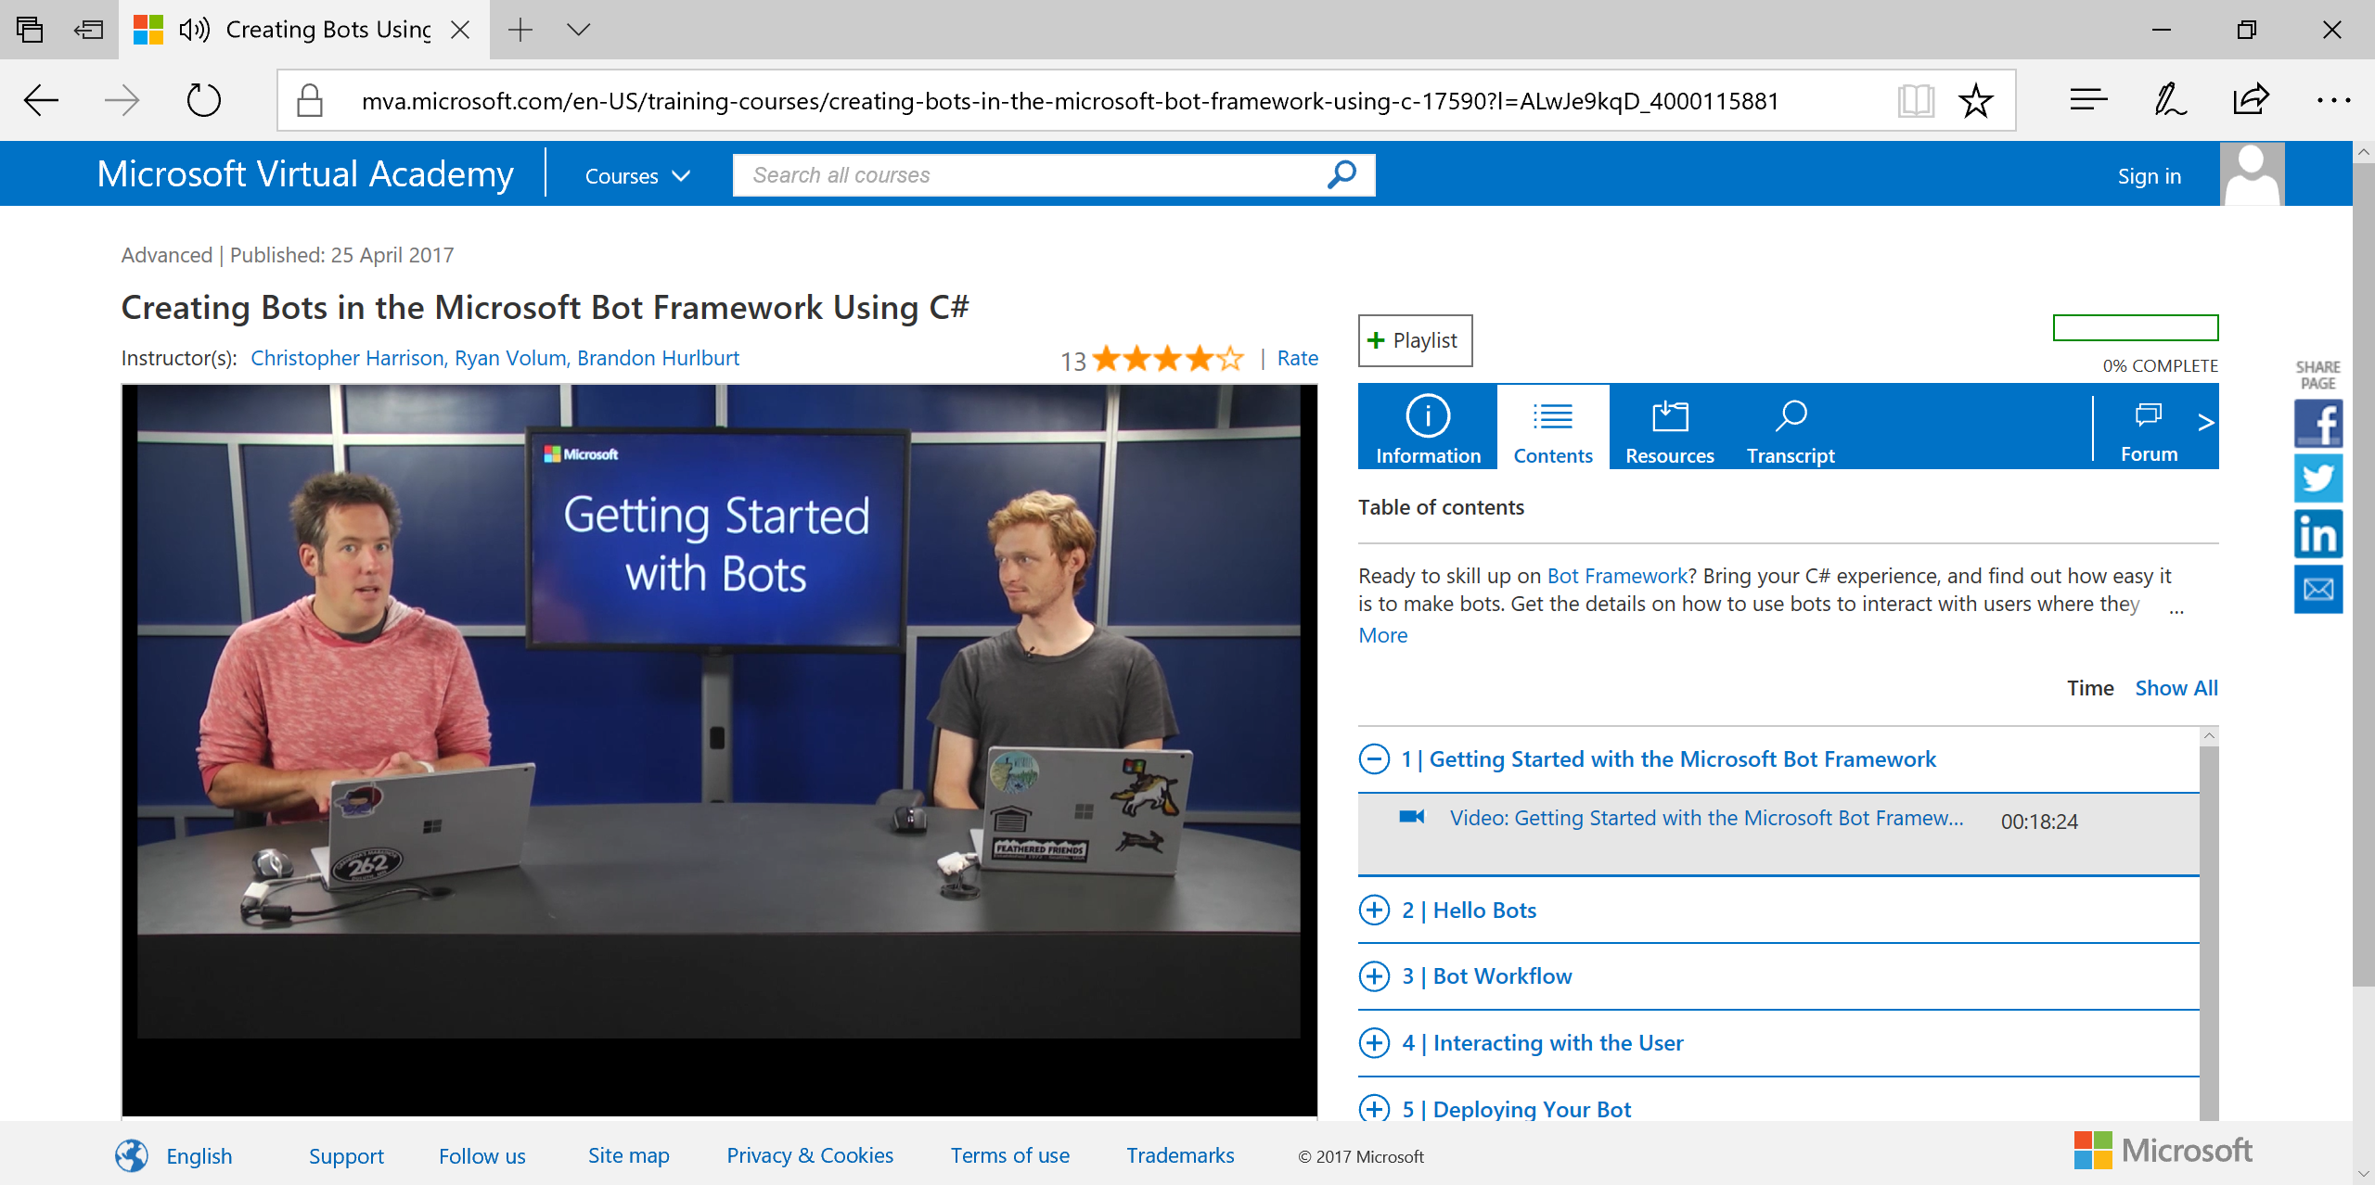
MVA: Bots with C#
Link: https://aka.ms/mvabots-cs

Slide 43
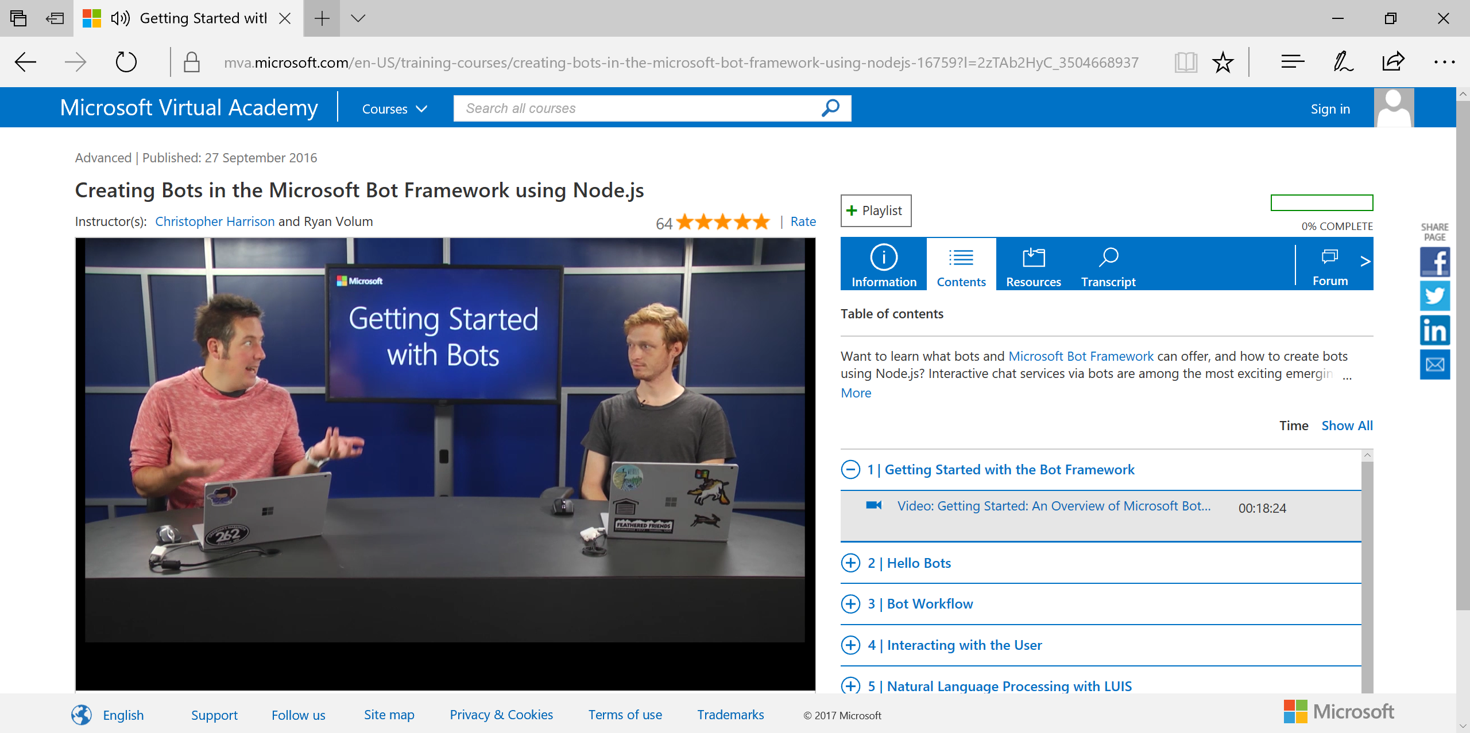
MVA: Bots with NodeJS
Link: https://aka.ms/mvabots-js

Slide 44
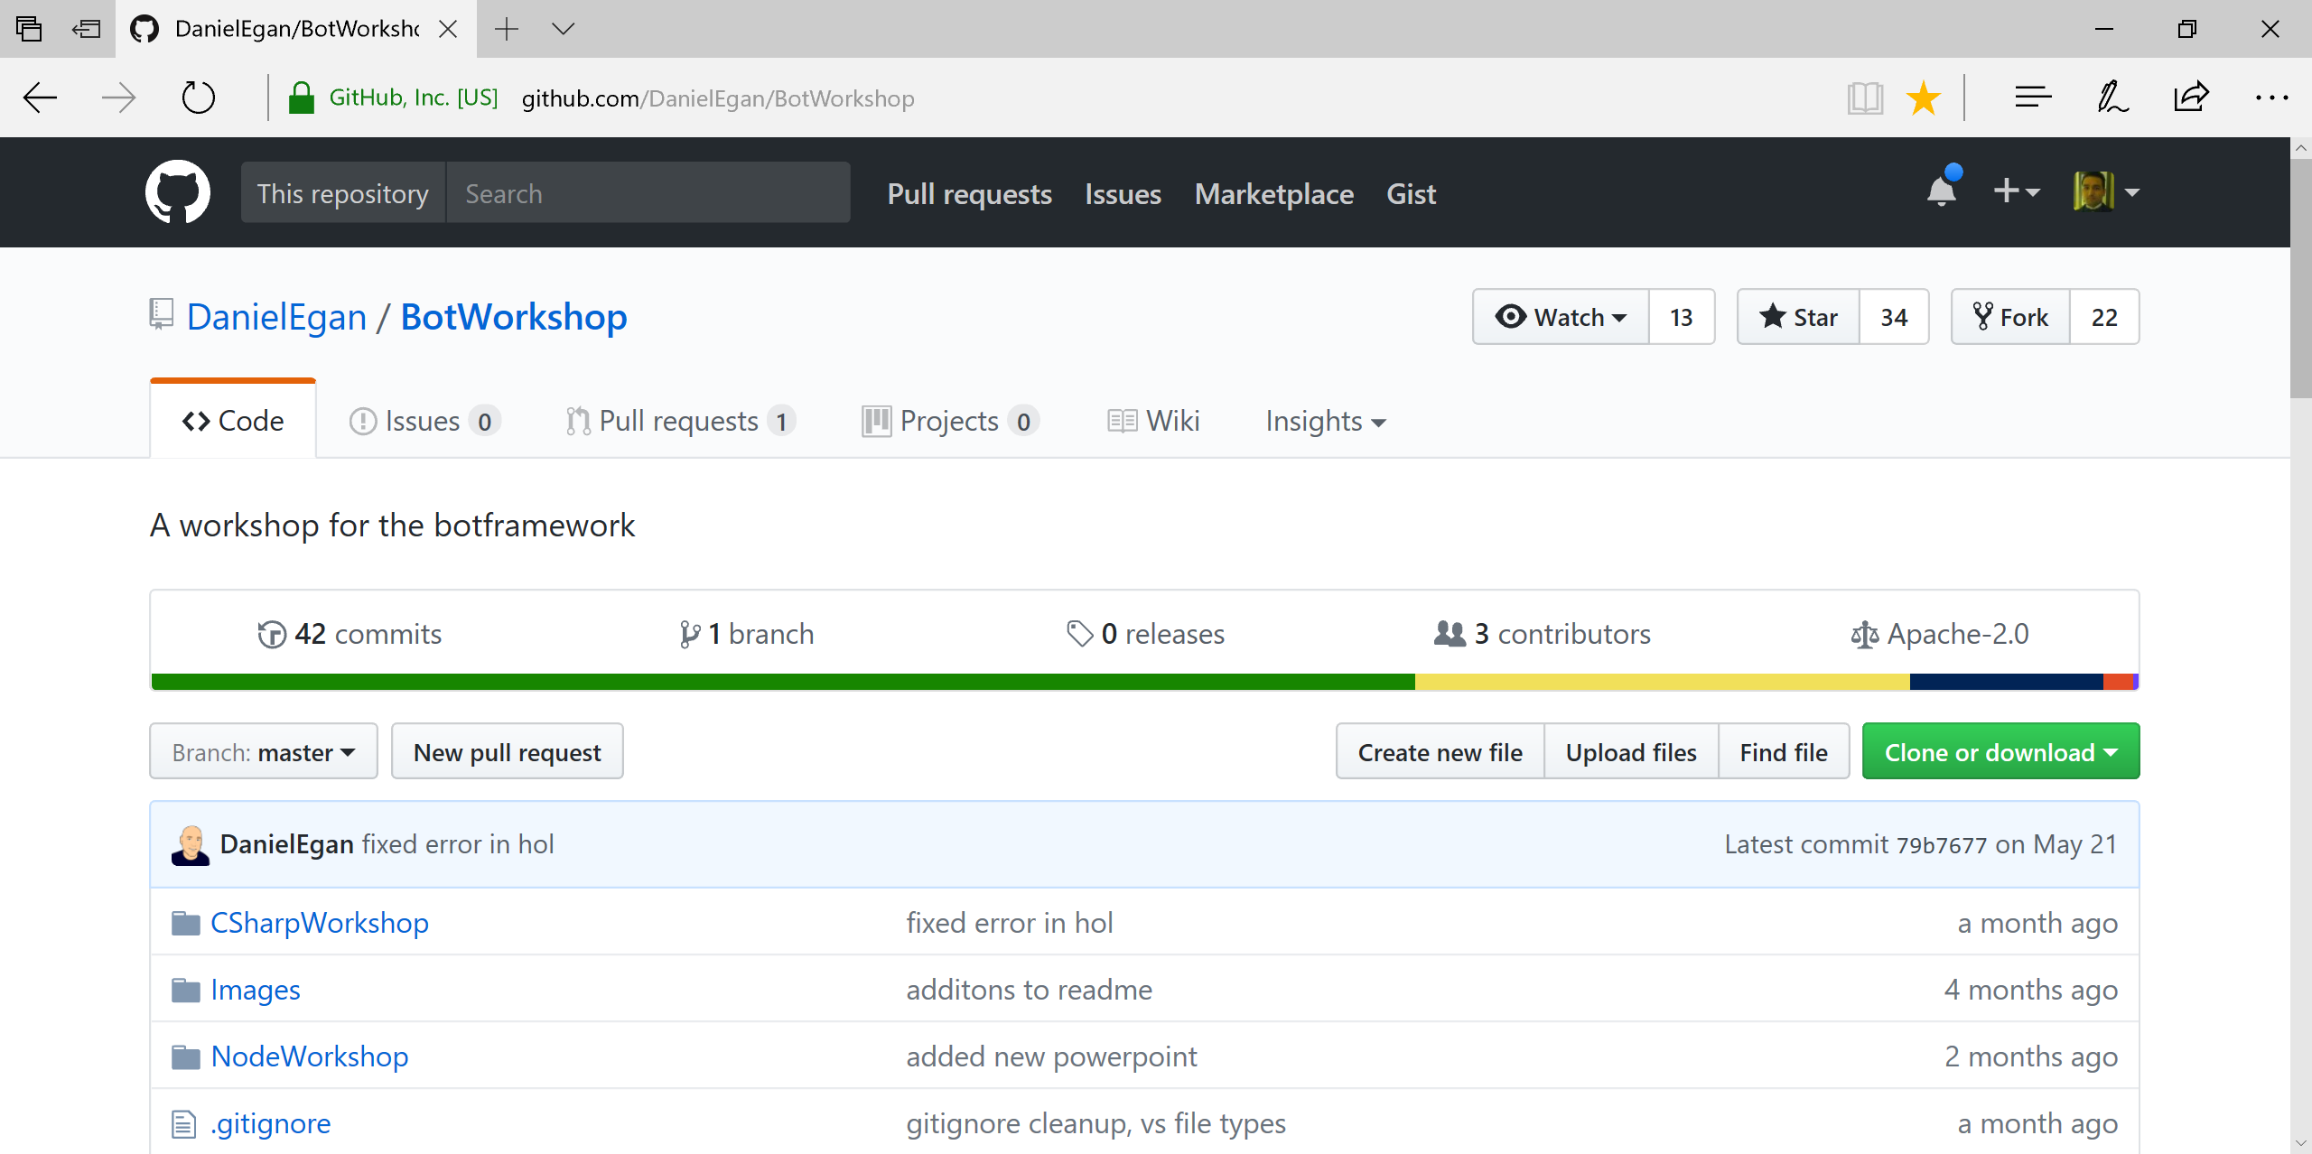
Daniel Egan’s Bot Workshop
Link: https://github.com/DanielEgan/BotWorkshop

Slide 45
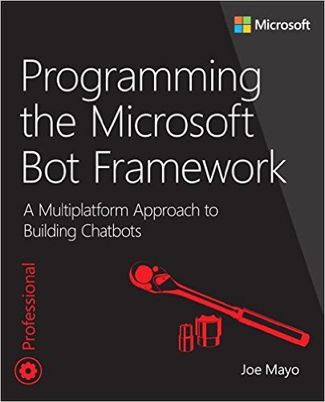
Official Bot Book from Microsoft Press
Programming the Microsoft Bot Framework
Author: (MVP) Joe Mayo
Tech Editor: Shahed Chowdhuri
Publisher: Microsoft Press
Coming Soon: Nov 14, 2017
http://aka.ms/BotBook

Slide 46
Q & A
Notes:
Additional Topics

Slide 47
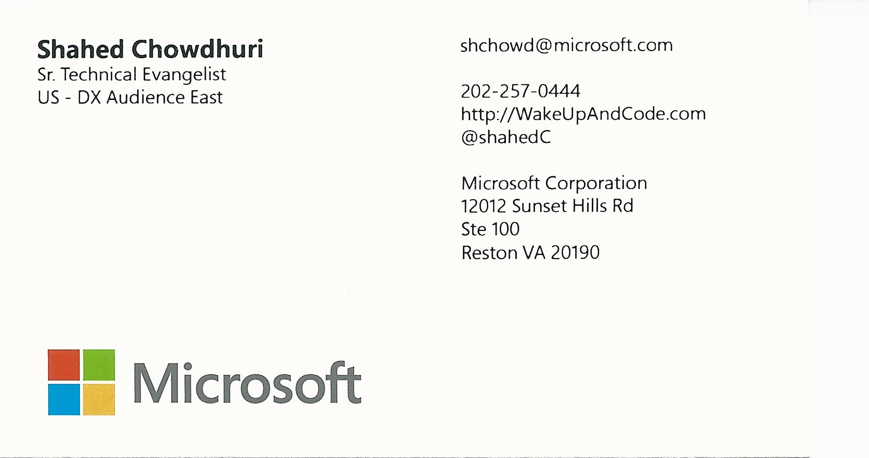
Email: shchowd@microsoft.com  Twitter: @shahedC
Notes:
Contact
Microsoft email: shchowd@microsoft.com
Personal Twitter: @shahedC
Dev Blog: WakeUpAndCode.com

