Slide 1
Construct 2 Exporting & Publishing
Windows 8  Windows Phone 8  Web  Mobile  … and more!
By Shahed Chowdhuri
Sr. Technical Evangelist
WakeUpAndCode.com
@shahedC
Notes:
Title Page: Intro to Indie Game Development Windows  Web  Xbox  Mobile
By Shahed Chowdhuri
Technical Evangelist
Blog: WakeUpAndCode.com
Twitter: @shahedC

Slide 2
Update Project Settings

Slide 3
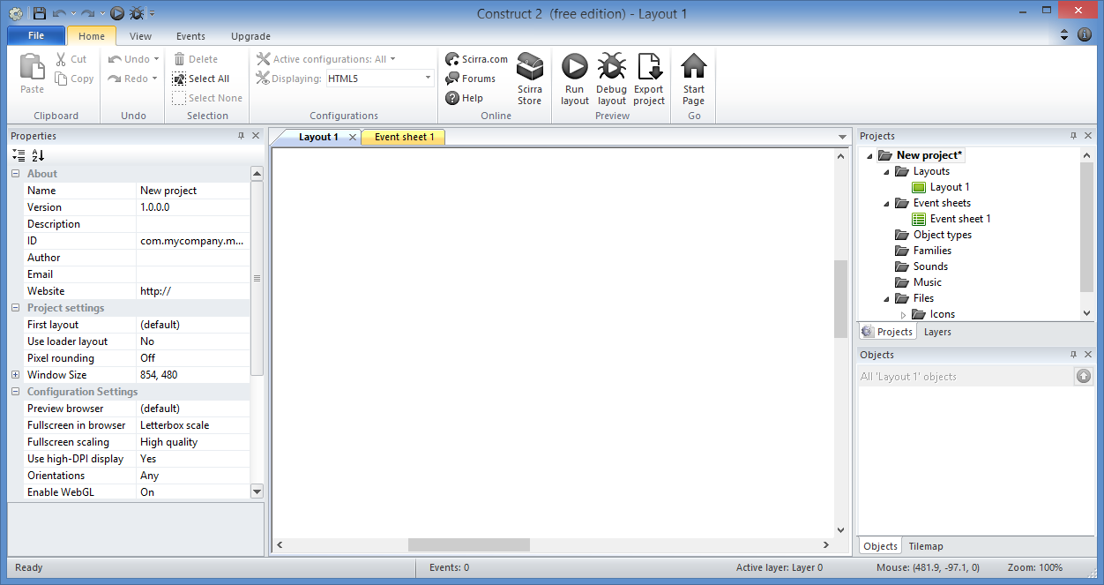
Update Project Settings: Step 1
Click on your
untitled project

Slide 4
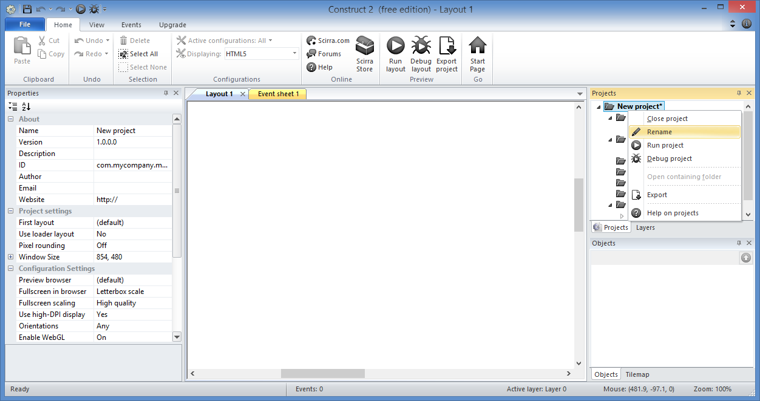
Update Project Settings: Step 2
Right-Click to
Rename project

Slide 5
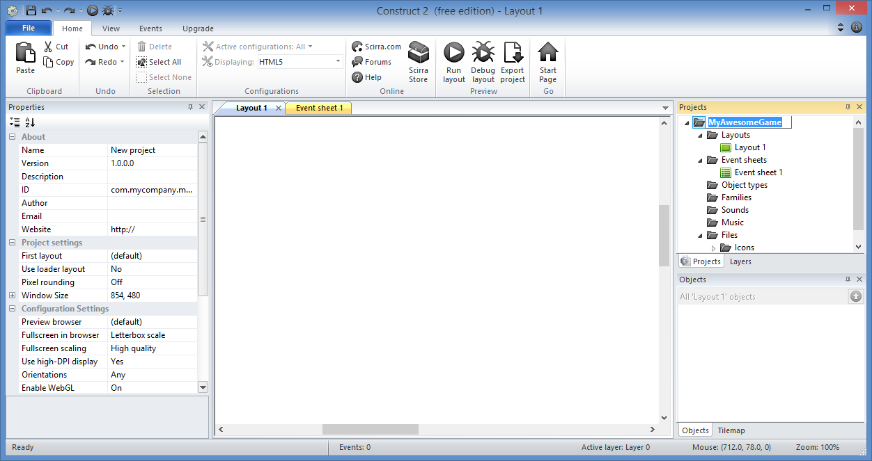
Update Project Settings: Step 3
Enter new
project name
e.g. MyAwesomeGame

Slide 6
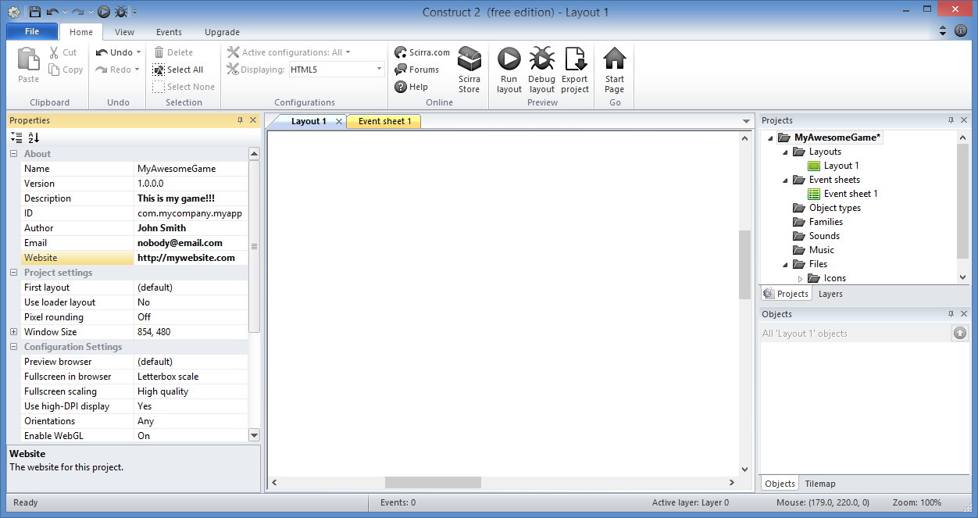
Update Project Settings: Step 4
Update Properties:
Name
Description
ID
Author
Email
Website

Slide 7
Update Project Settings: Step 5
Verify or Update
Fullscreen in browser
set to
“Letterbox scale”

Slide 8
Export to HTML5 Website

Slide 9
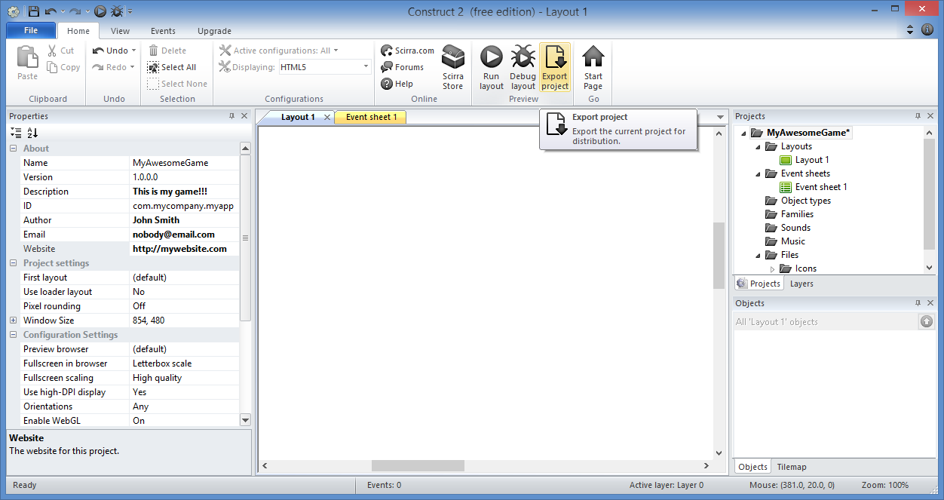
Export to HTML5 Website: Step 1
Click the
Export Project
button
(Home tab)

Slide 10
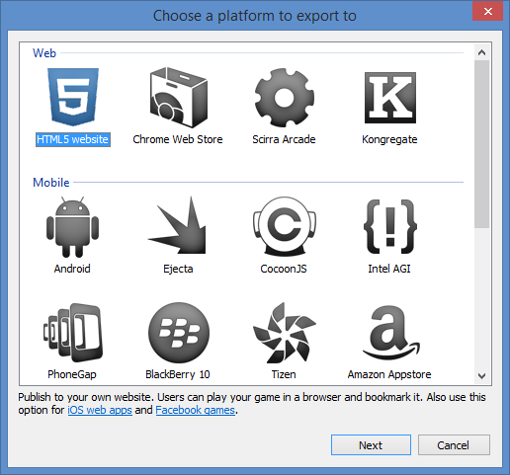
Export to HTML5 Website: Step 2
Select
“HTML5 website”
Click “Next”

Slide 11
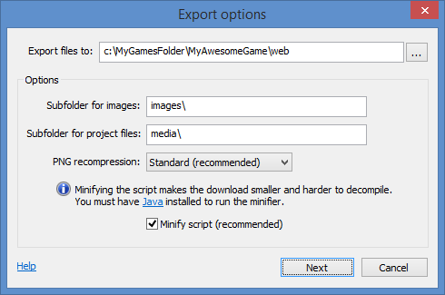
Export to HTML5 Website: Step 3
Type a location for your web files
- OR -
Select a location on your computer
Click “Next”

Slide 12
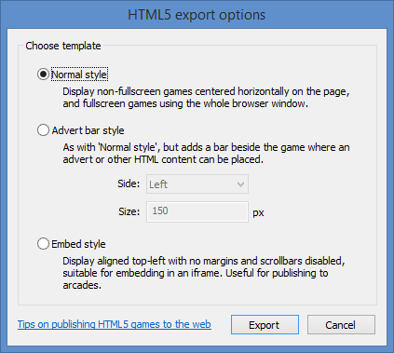
Export to HTML5 Website: Step 4
Click “Export”

Slide 13
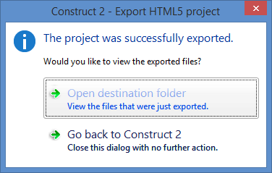
Export to HTML5 Website: Step 5
Click “Open
destination folder”
to verify files

Slide 14
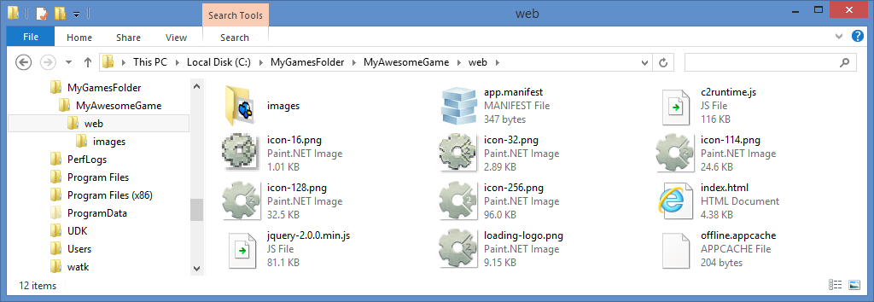
Export to HTML5 Website: Step 6
Verify your files, e.g. “index.html” and “images” folder

Slide 15
Publish on the Web

Slide 16
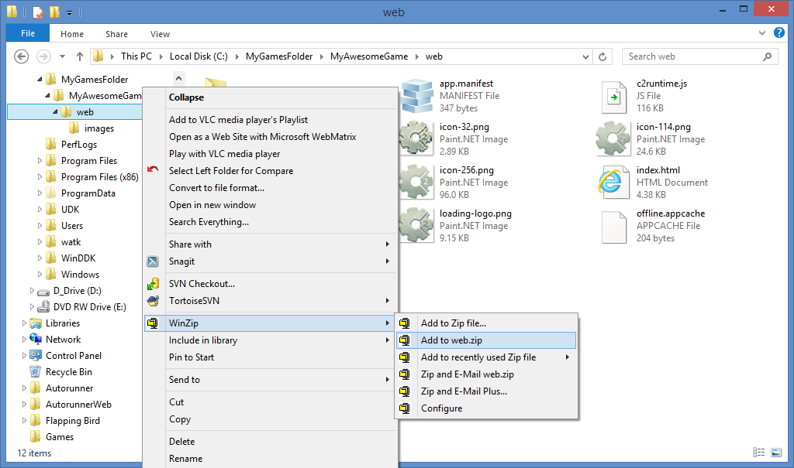
Publish on the Web: Step 1
Use a compression
tool to zip up
your web files
e.g. WinZip, 7-Zip, etc
NOTE: this is helpful if you want to share your game via email.

Slide 17
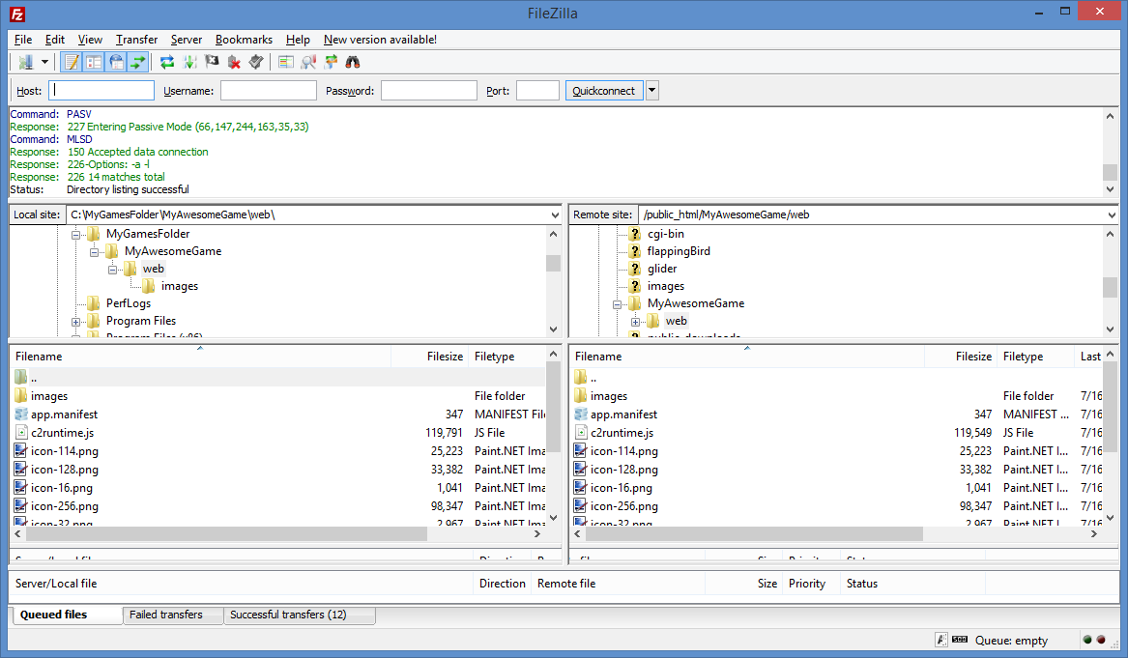
Publish on the Web: Step 2
Copy all web
files to a
subfolder on
a website
e.g. use a
free FTP
tool, such
as FileZilla

Slide 18
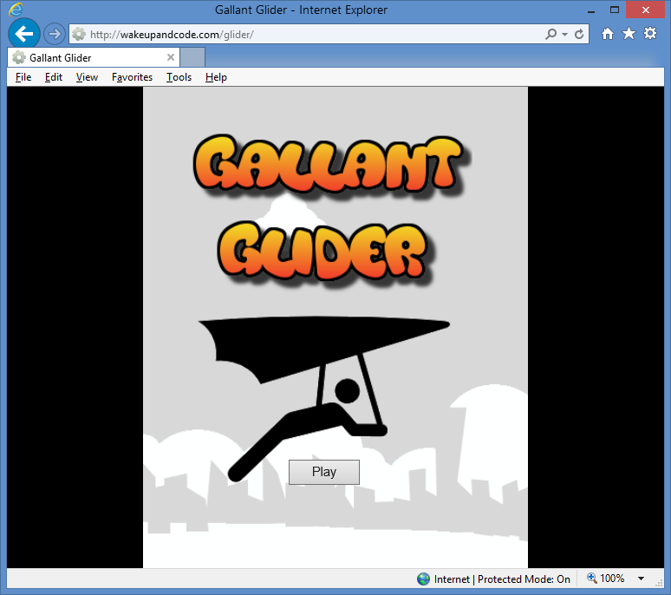
Publish on the Web: Step 3
Verify that the web game
works on all your browsers!
NOTE: this example shows Gallant Glider on http://WakeUpAndCode.com/glider

Slide 19
Export to Windows

Slide 20
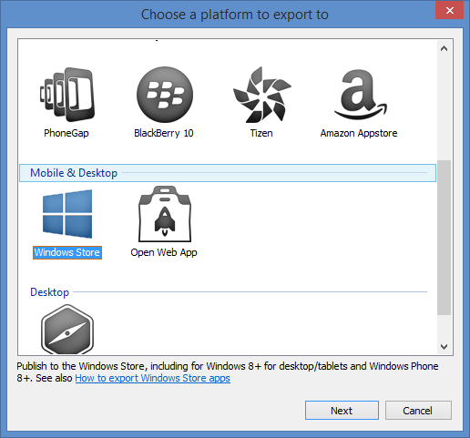
Export to Windows: Step 1
Click “Next”
NOTE: As of Summer 2014, Win8 and WP8 icons have been consolidated into a single Windows icon.

Slide 21
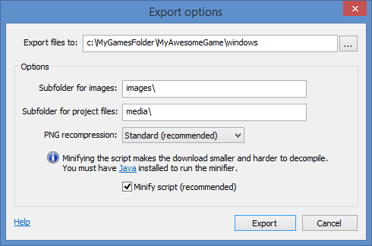
Export to Windows: Step 2
Type a location for your Windows files
- OR -
Select a location on your computer
Click “Export”

Slide 22
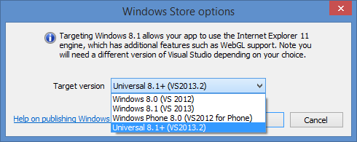
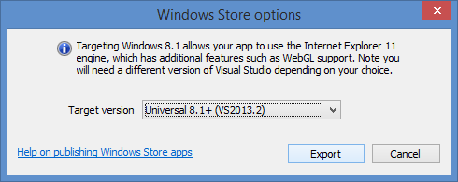
Export to Windows: Step 3
Select “Universal 8.1 (VS2013.2)
… then, Click “Export”

Slide 23
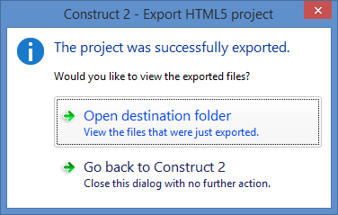
Export to Windows : Step 4
Click “Open
destination folder”
to verify files

Slide 24
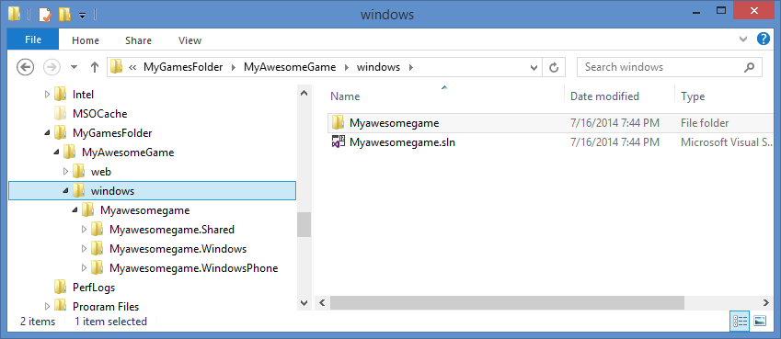
Export to Windows : Step 5
Verify your files, e.g. a .sln file and subfolders for Windows and WindowsPhone

Slide 25
Create Certificate

Slide 26
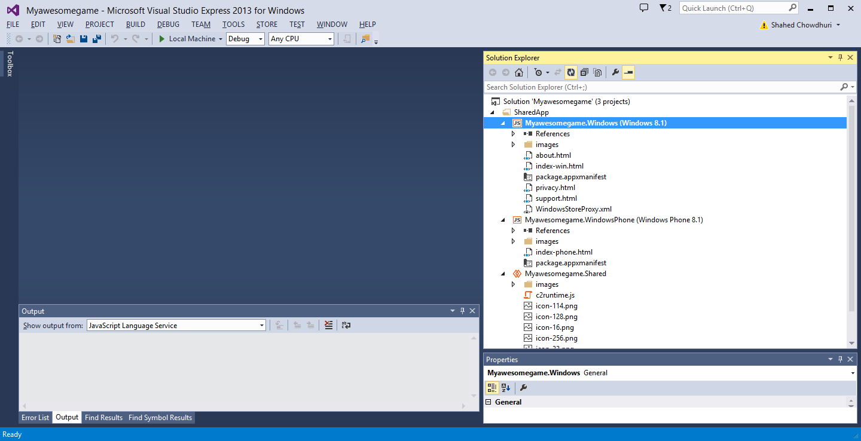
Create Certificate: Step 1
Open your solution
in Visual Studio 2013
NOTE: This example shows Visual Studio Express 2013 for Windows, running on Windows 8.1

Slide 27
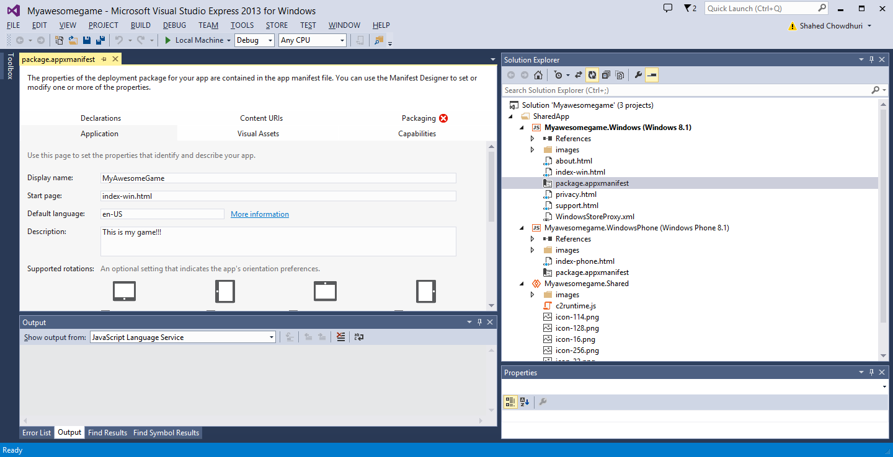
Create Certificate: Step 2
Open the file
“package.appxmanifest”

Slide 28
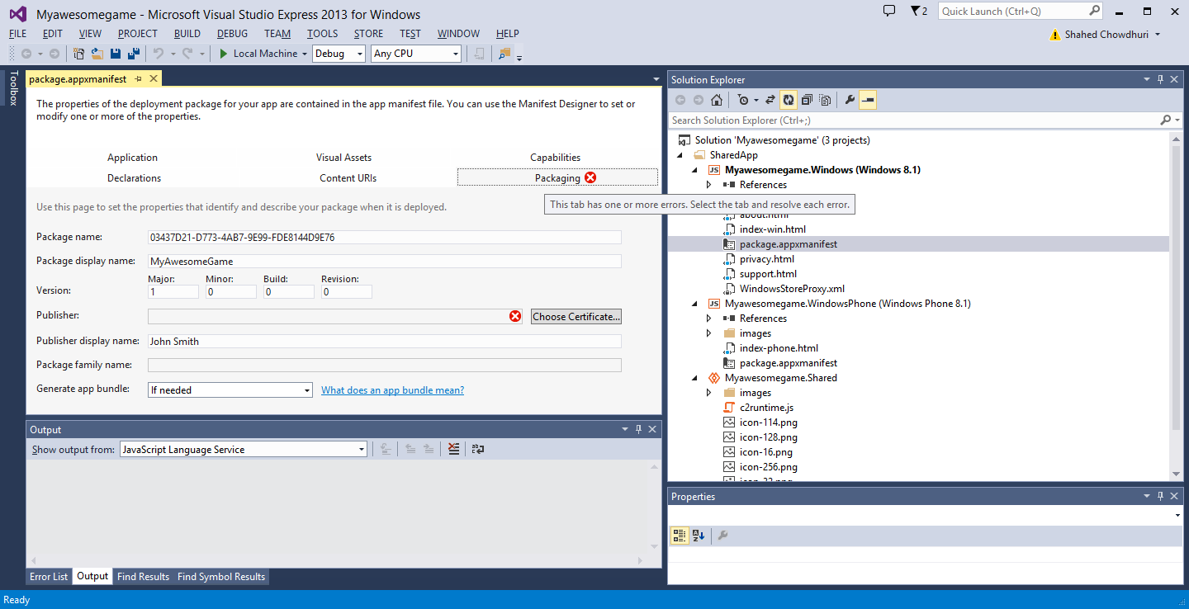
Create Certificate: Step 3
Click on
Packaging tab

Slide 29
Create Certificate: Step 4
Click on Choose
Certificate

Slide 30
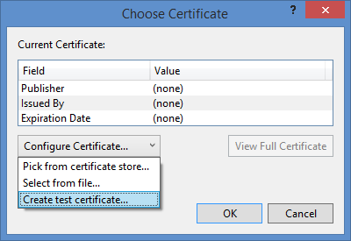
Create Certificate: Step 5
Select
“Create test
Certificate…”
Click “OK”

Slide 31
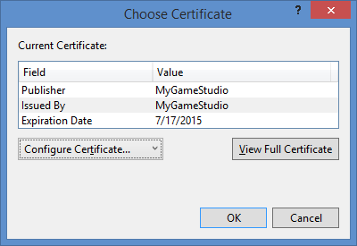
Create Certificate: Step 6
Click “OK”

Slide 32
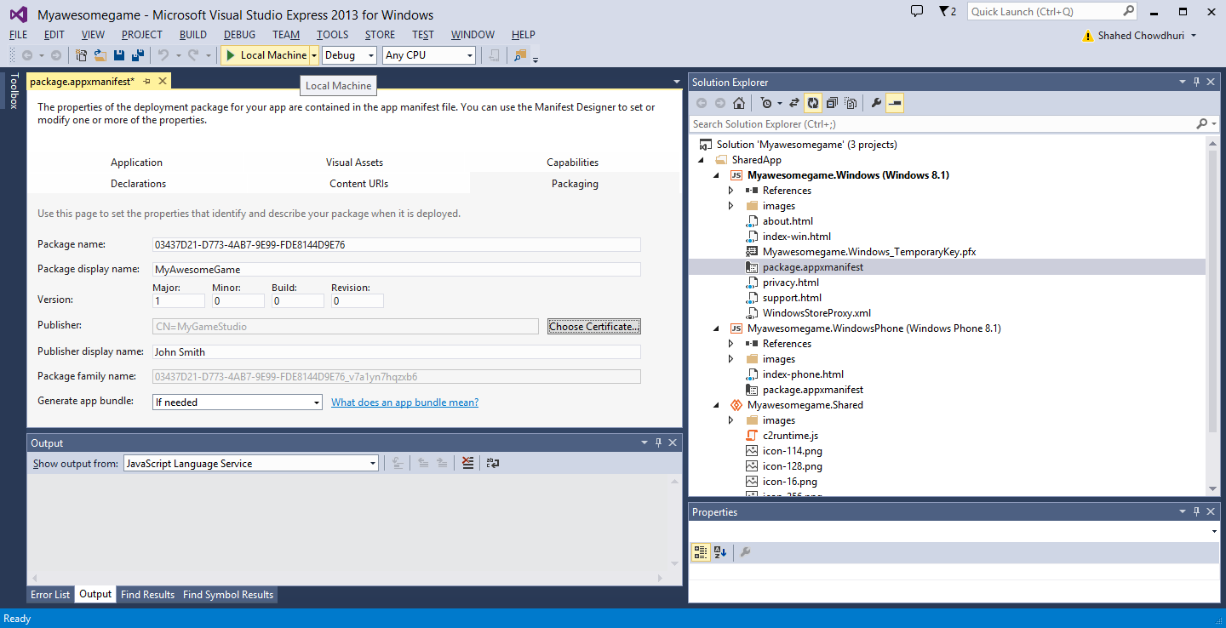
Create Certificate: Step 7
Click “Play” button to run it
NOTE: This step assumes that you’re running Windows 8.1

Slide 33
Open Developer Account

Slide 34
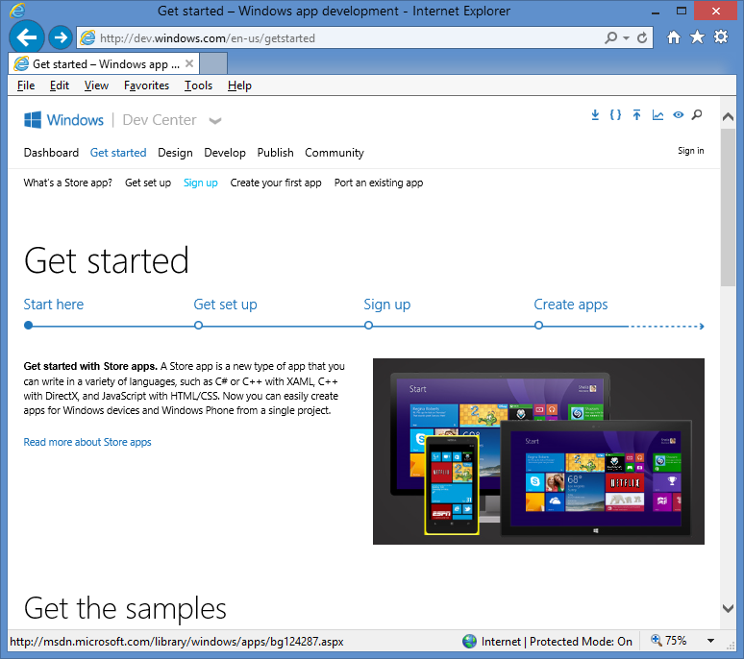
Open Developer Account: Step 1
Sign up for a
developer account on:
http://dev.windows.com
Click “Get Started”
Click “Sign up”
NOTE: A dev account requires an adult with a credit card.

Slide 35
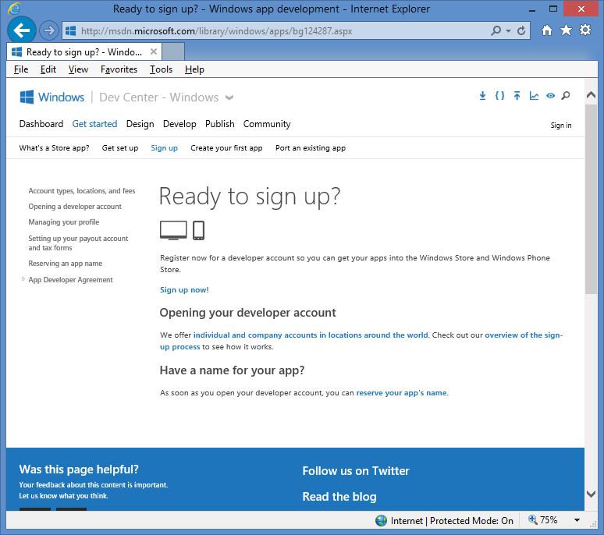
Open Developer Account: Step 2
Follow the onscreen
instructions to
set up your
developer account

Slide 36
Publish on Windows

Slide 37
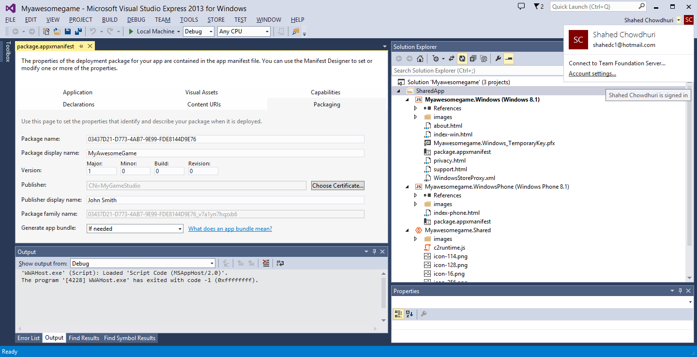
Publish on Windows: Step 1
Log in with your
dev account

Slide 38
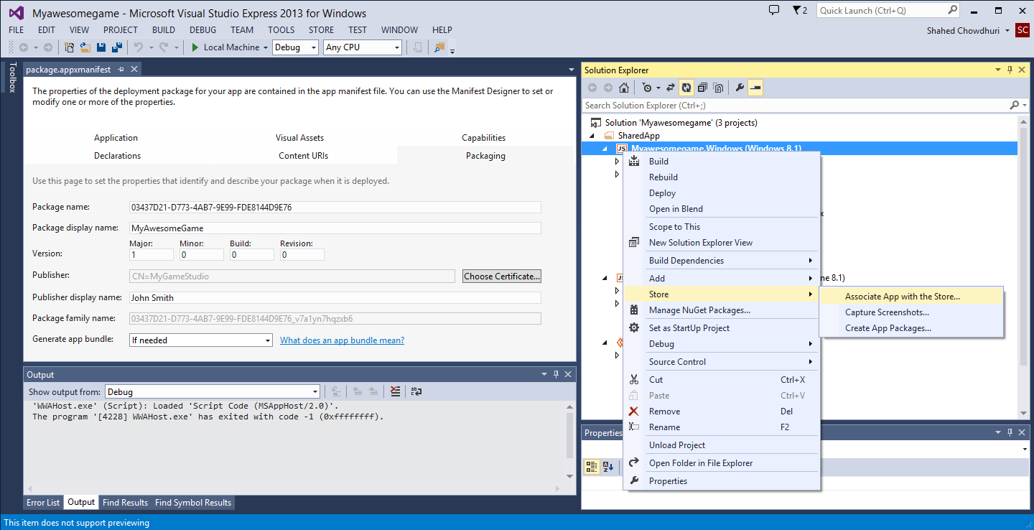
Publish on Windows: Step 2
Right-click project,
… then select Store

Slide 39
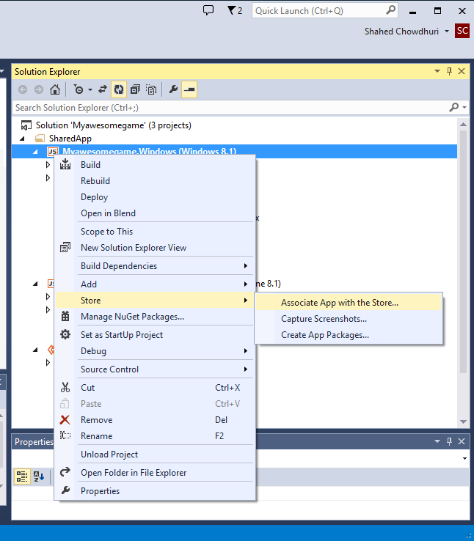
Publish on Windows: Step 3
Associate App with the Store…

Slide 40
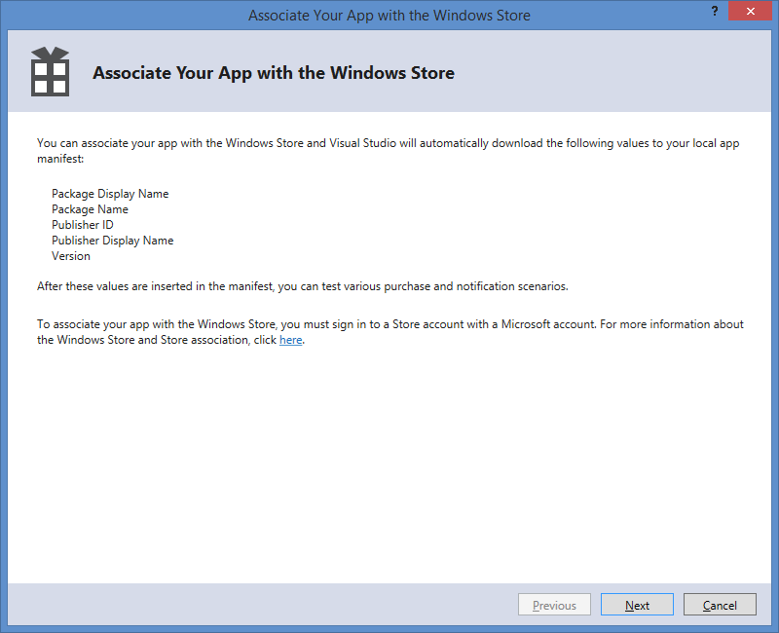
Publish on Windows: Step 4
Click Next to Log In
then associate your app
with the Windows Store

Slide 41
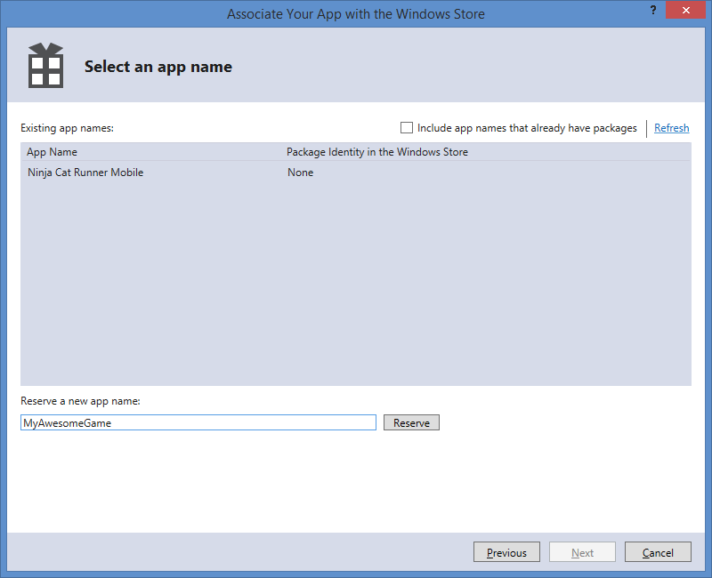
Publish on Windows: Step 5
Select an existing
App Name
- OR -
Reserve a new
app name, then
select it

Slide 42
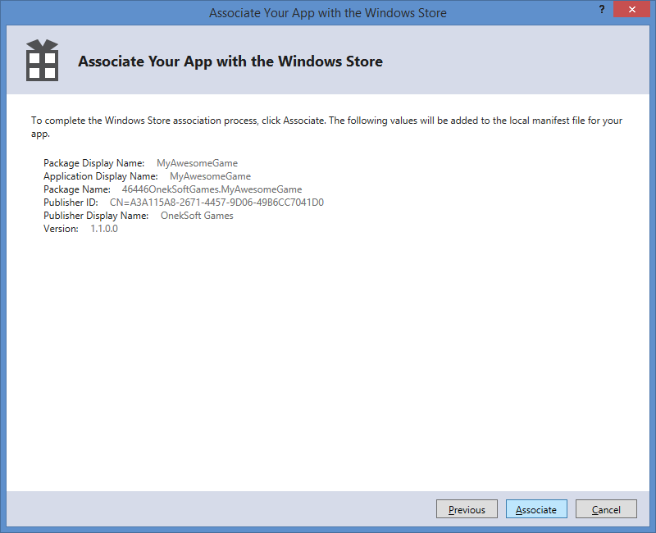
Publish on Windows: Step 6
Click “Associate”

Slide 43
Create Store Graphics

Slide 44
Create Store Graphics: Step 1
Capture Screenshots

Slide 45
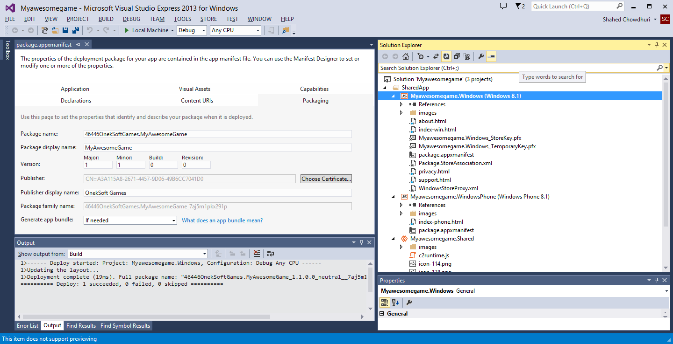
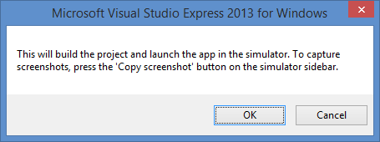
Create Store Graphics: Step 2
Click “OK”

Slide 46
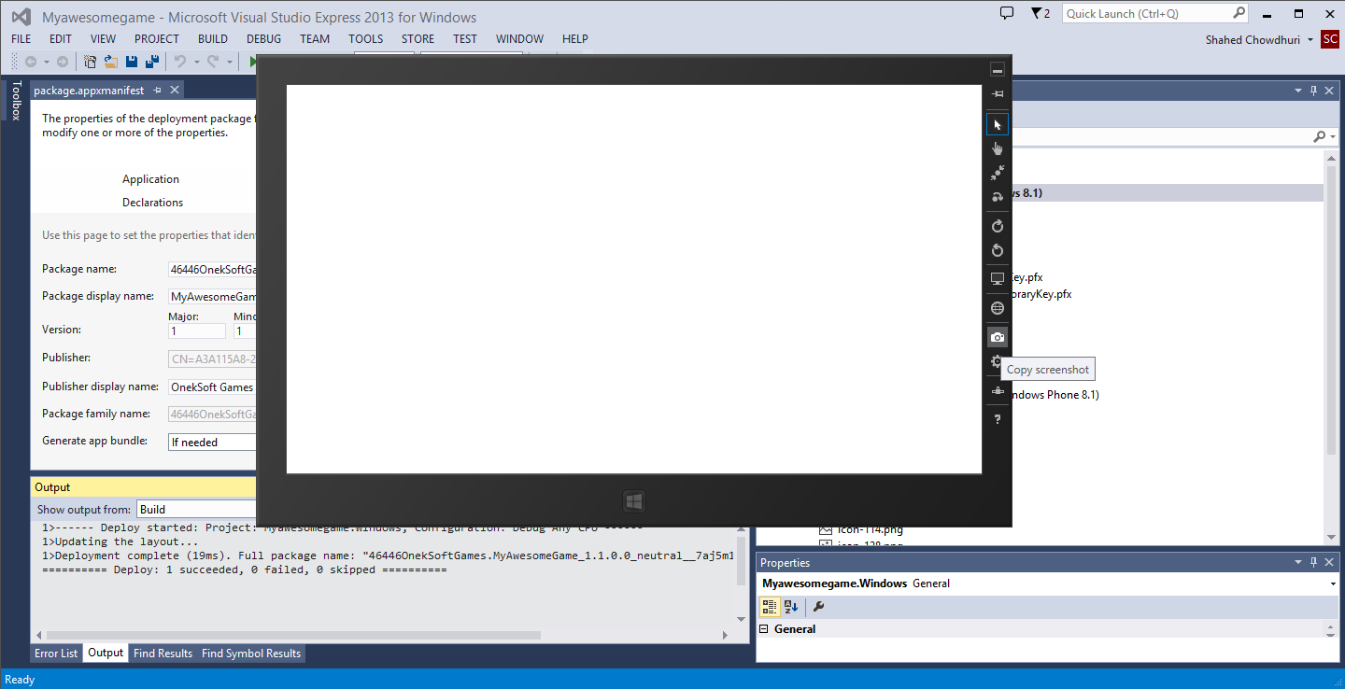
Create Store Graphics: Step 3
Copy Screenshots
in the Simulator

Slide 47
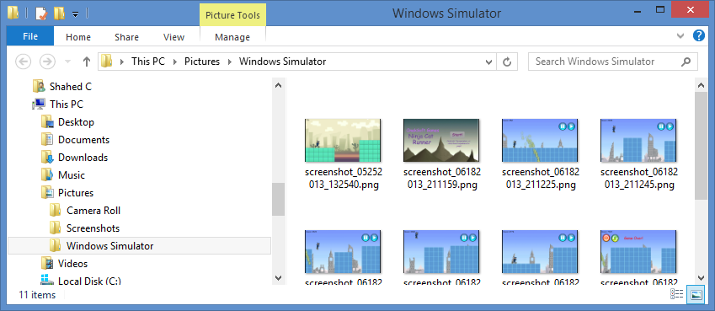
Create Store Graphics: Step 4
Verify the screenshots in your “Pictures” folder, “Windows Simulator” subfolder

Slide 48
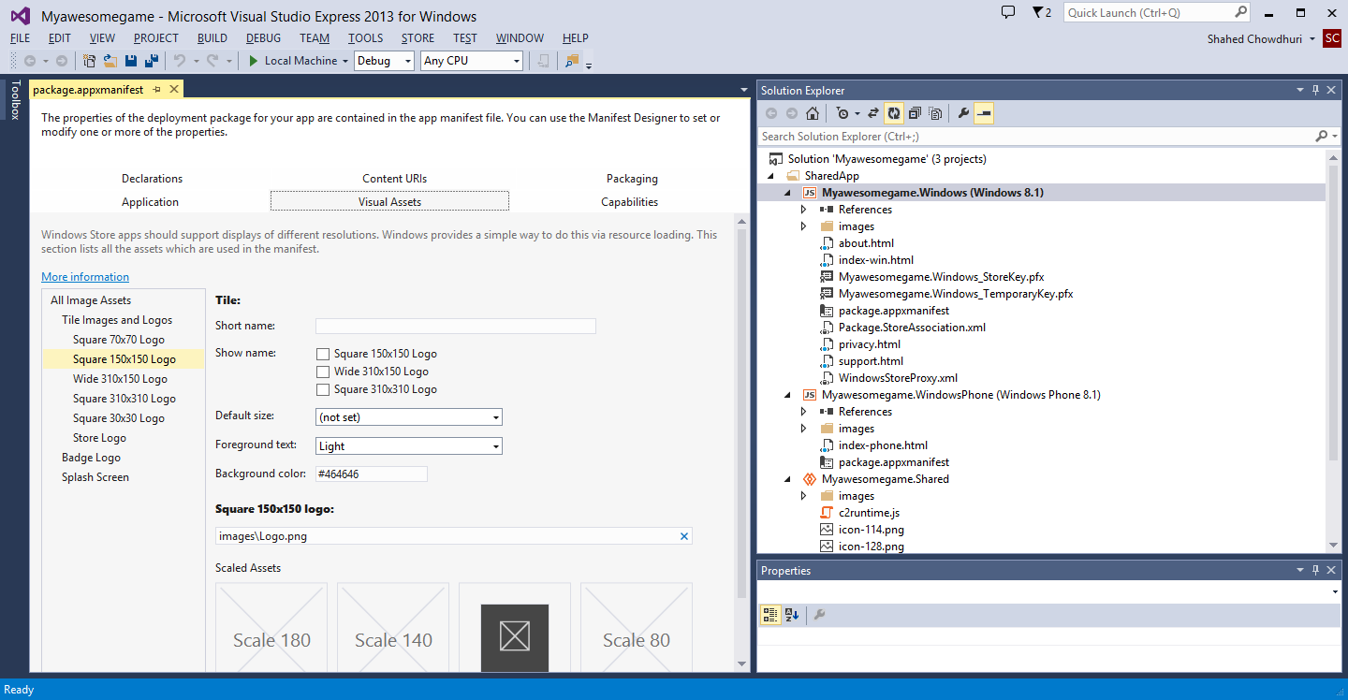
Create Store Graphics: Step 5
Identify
placeholder
images

Slide 49
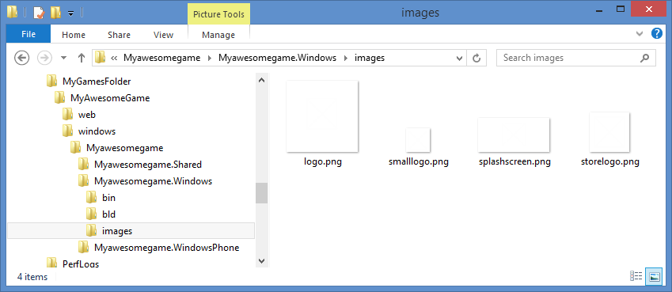
Create Store Graphics: Step 6
Edit or replace these images with your own

Slide 50
Create and Certify Package

Slide 51
Create and Certify Package: Step 1
Create App Packages…

Slide 52
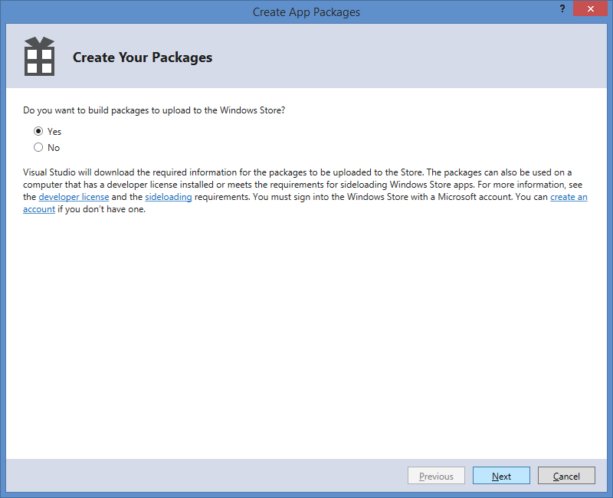
Create and Certify Package: Step 2
Click “Next” to Proceed
(log in if necessary)

Slide 53
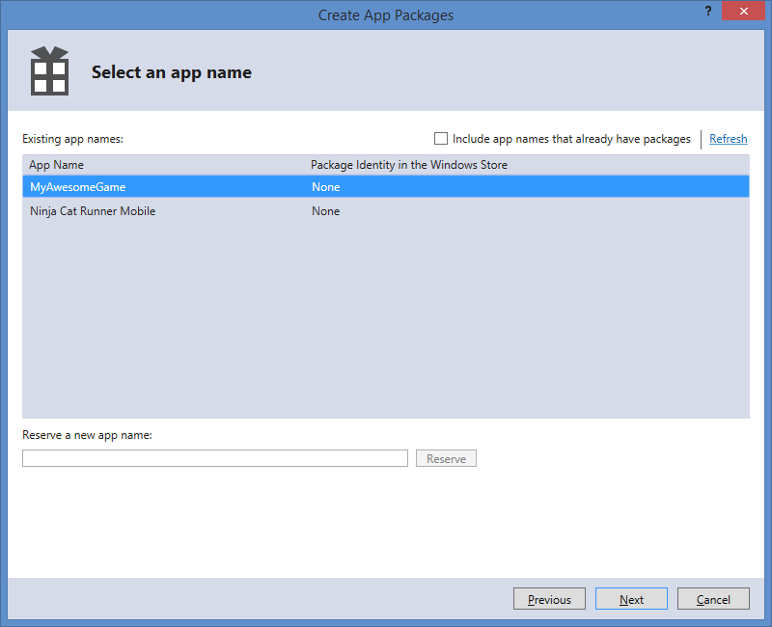
Create and Certify Package: Step 3
Select an existing
App Name
… then, click “Next”

Slide 54
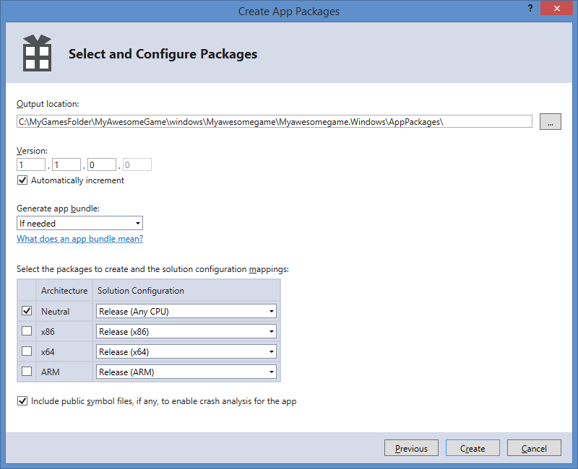
Create and Certify Package: Step 4
Observe the
AppPackages
location
… then, click “Create”

Slide 55
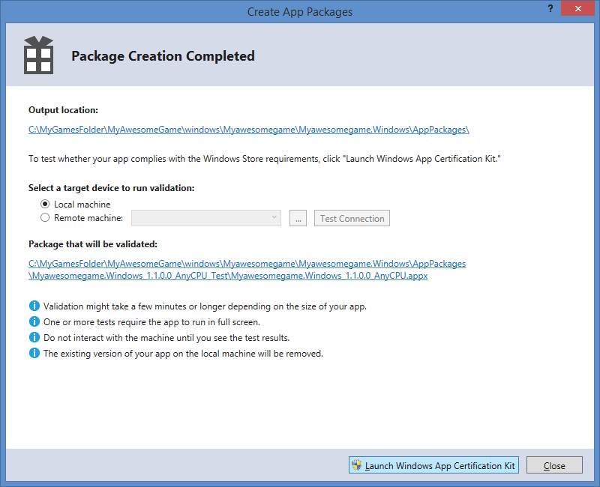
Create and Certify Package: Step 5
Launch
Windows App
Certification Kit

Slide 56
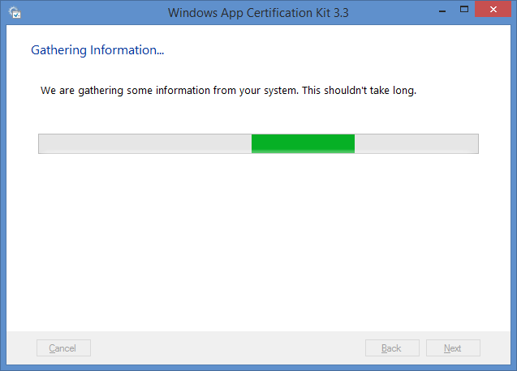
Create and Certify Package: Step 6
Allow the
tool to
gather info

Slide 57
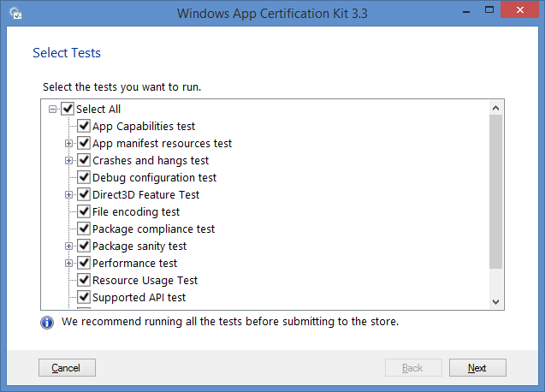
Create and Certify Package: Step 7
Verify that
all tests are
selected

Slide 58
Create and Certify Package: Step 8
Verify that
all tests are
selected
… then, click “Next”

Slide 59
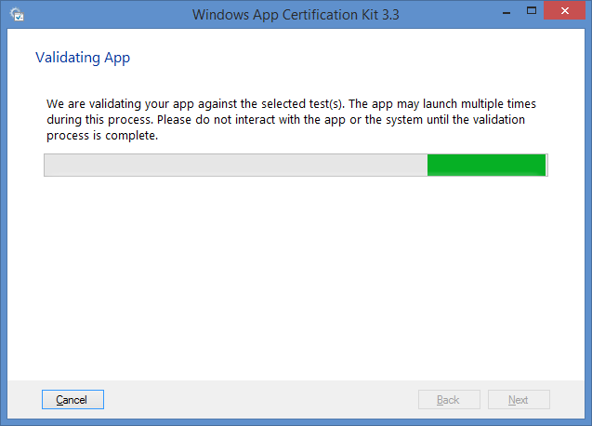
Create and Certify Package: Step 9
Allow the
tool to
run validation

Slide 60
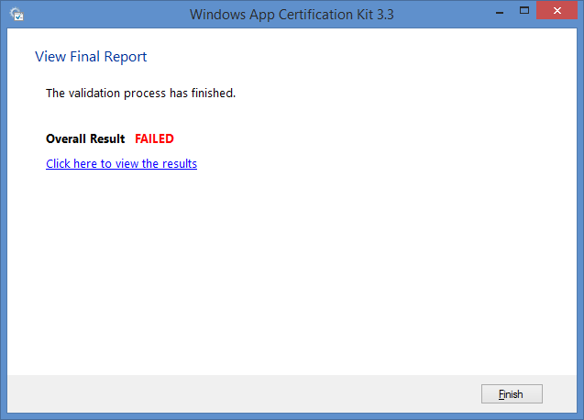
Create and Certify Package: Step 10
If the
Overall Result
says FAILED,
view the results
to fix issues
Click “Finish”
NOTE: Repeat these steps after fixing issues, to submit your app.

Slide 61
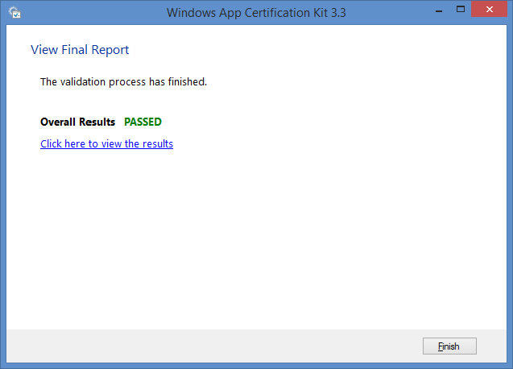
Create and Certify Package: Step 11
If the
Overall Result
says PASSED,
you can proceed
Click “Finish”

Slide 62
Publish App

Slide 63
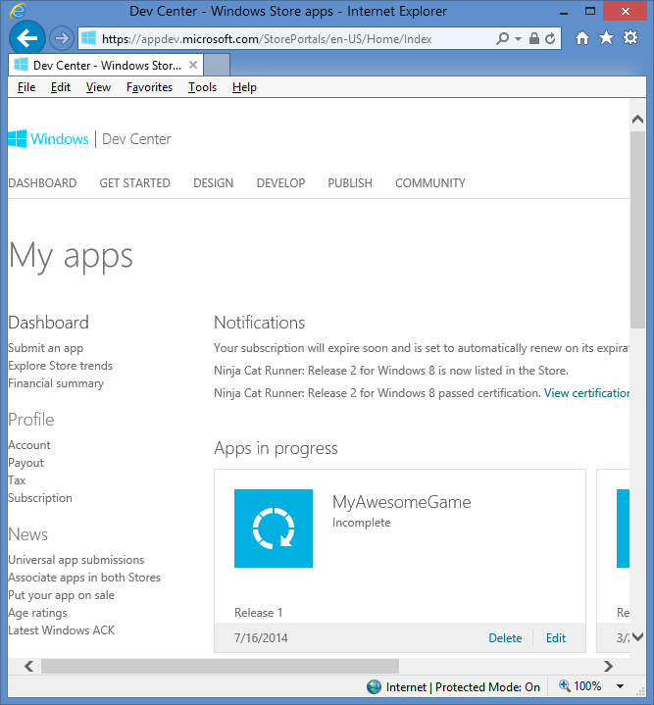
Publish Package: Step 1
In the Dashboard of the
Windows Dev Center…
… click “Edit” for your App

Slide 64
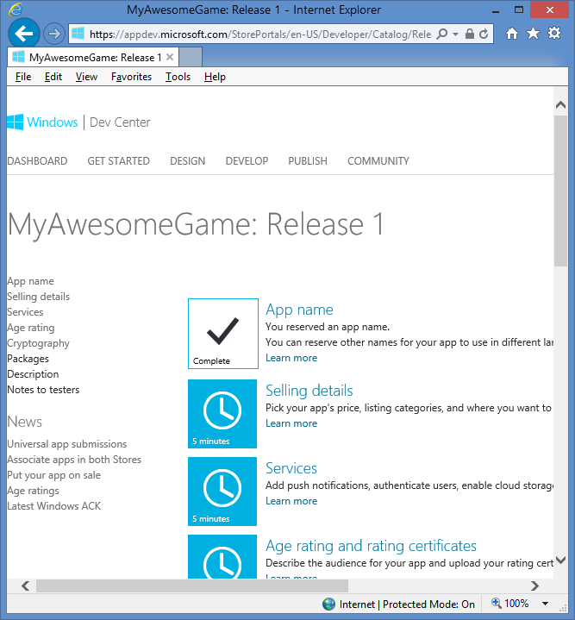
Publish Package: Step 2
Follow the instructions
to fill out the remaining
information about your app

Slide 65
Publish Package: Step 3
Once all the
information
has been
entered, and
the package
has been
uploaded...
… the “Submit for certification” button
will be enabled for you to click on

Slide 66
Windows Phone 8
BONUS

Slide 67
Windows Phone 8: Step 1
Right-click
your WP8 package
file, view code

Slide 68
Windows Phone 8: Step 2
Manually add a
Publisher value to
<Identity> section,
Prefixed by “CN=“
e.g. “CN=MyGameStudio”
NOTE: this is a workaround for a bug that may cause Publisher to be missing.

Slide 69
Windows Phone 8: Step 3
Right-click the Windows Phone project,
… then click “Set as StartUp Project”

Slide 70
Windows Phone 8: Step 4
Click the “Play” button
to run your app
in the WP8 Emulator

Slide 71
Windows Phone 8: Step 5…
Perform additional steps, similar to Windows 8 publishing:
Associate App with the Store
Create App Packages…
Associate App with the Store
Create App Packages…

Slide 72
Windows Phone 8: Additional Steps
Go to the Dashboard on http://dev.windowsphone.com to submit your app

Slide 73
Windows Phone 8: Final Steps
Follow the instructions
to fill out the remaining
information about your app

Slide 74
Windows Phone 8: Review & Submit!
Once all the
information
has been
entered, and
the package
has been
uploaded…
… the “Review and Submit” button
will be enabled for you to click on

Slide 75
(END of Construct 2 Exporting & Publishing)

