Slide 1
Construct 2 Game Development: Flapping Bird
Windows 8  Windows Phone 8  Web  Mobile  … and more!
By Shahed Chowdhuri
Sr. Technical Evangelist
WakeUpAndCode.com
@shahedC
Notes:
Title Page: Intro to Indie Game Development Windows  Web  Xbox  Mobile
By Shahed Chowdhuri
Technical Evangelist
Blog: WakeUpAndCode.com
Twitter: @shahedC

Slide 2
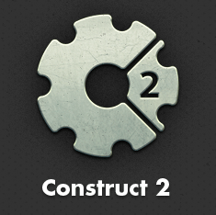
Getting Started

Slide 3
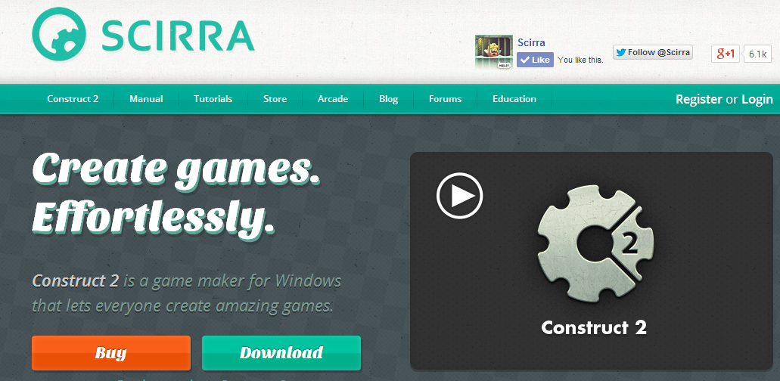
Getting Started: Step 1
https://www.scirra.com/
Download!

Slide 4
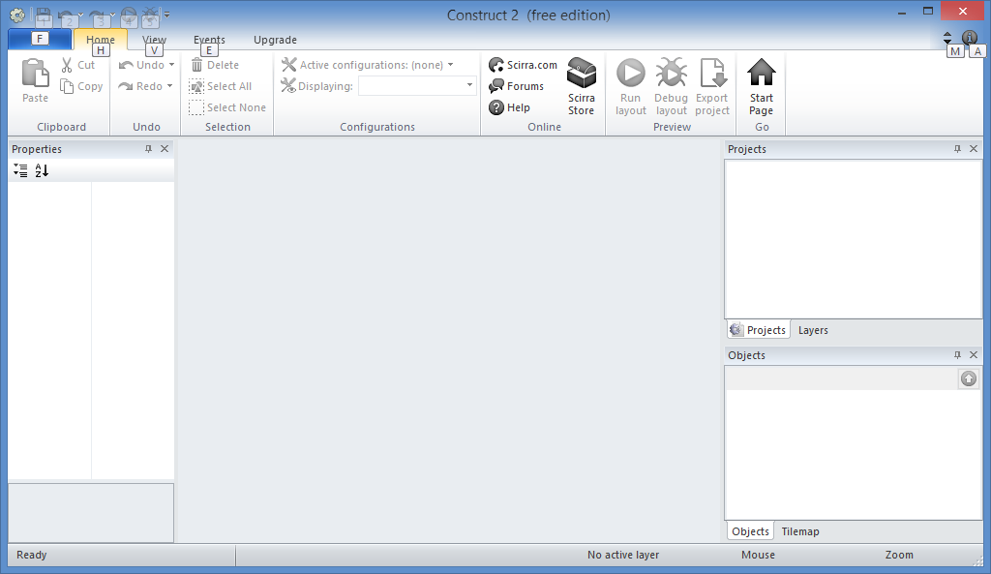
Getting Started: Step 2
Run it!

Slide 5
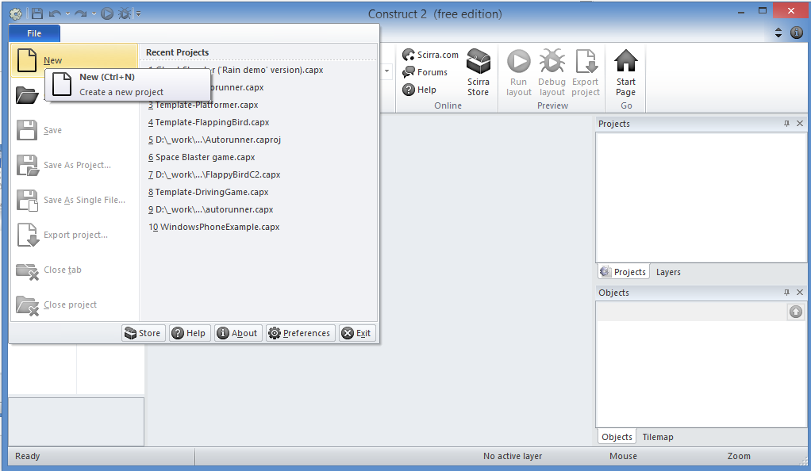
Getting Started: Step 3
Click
File → New

Slide 6
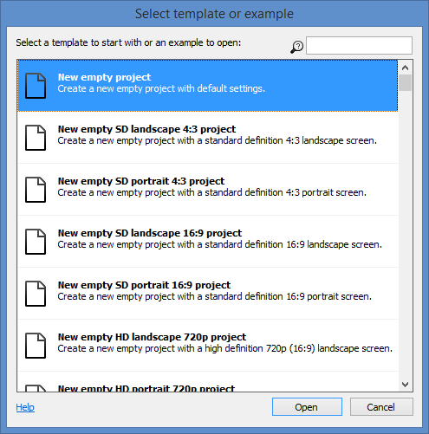
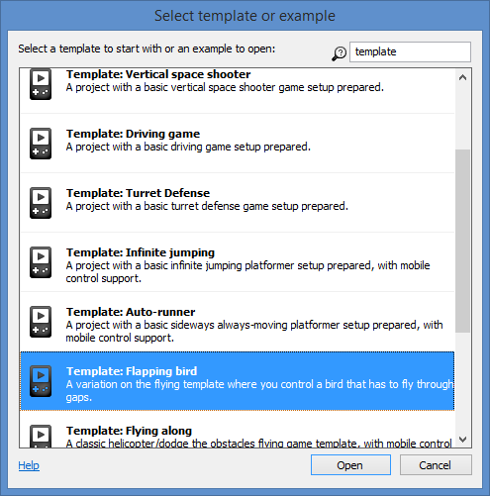
Getting Started: Step 4
Filter
Scroll
Up
Or
Down
Open!

Slide 7
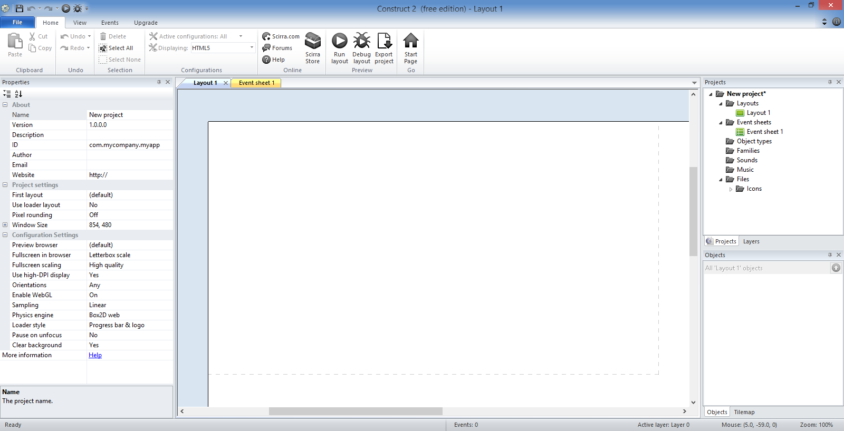
Getting Started: Step 5
Toolbar
Projects/Layers
Tabs for Layouts & Event Sheets
Properties
Layout
Objects

Slide 8
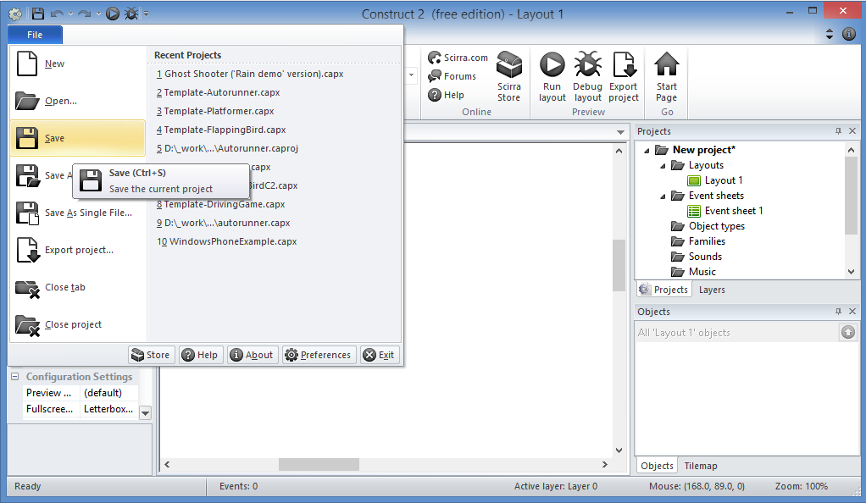
Getting Started: Step 6
Click
File → Save

Slide 9
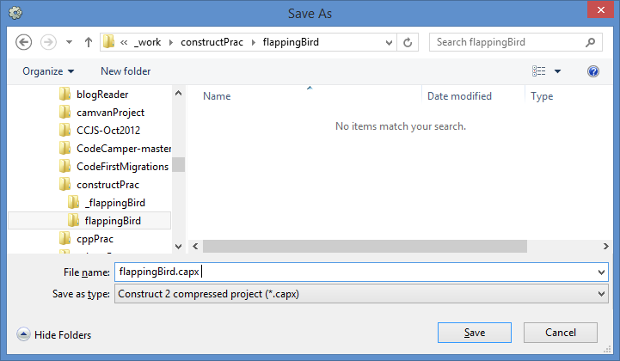
Getting Started: Step 7
Enter
File name
Save!

Slide 10
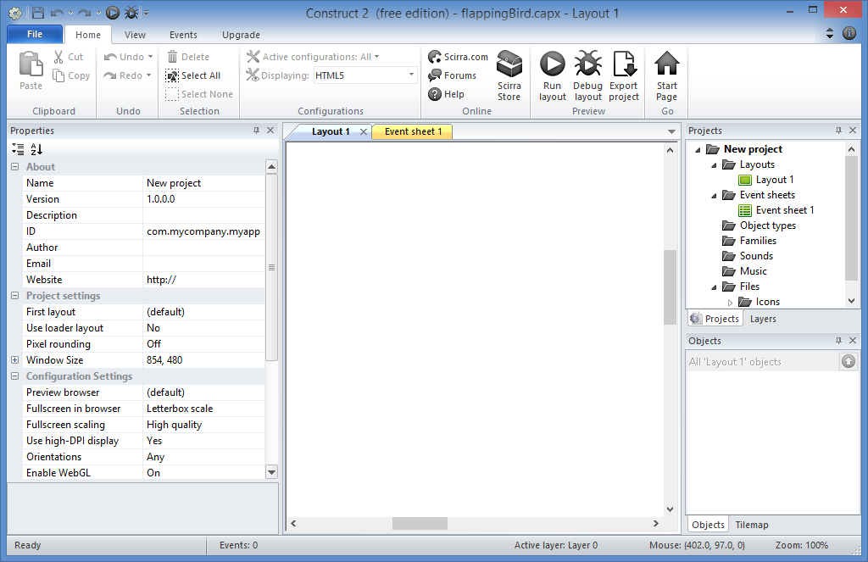
Getting Started: Done!

Slide 11
Prepare Your Layouts

Slide 12
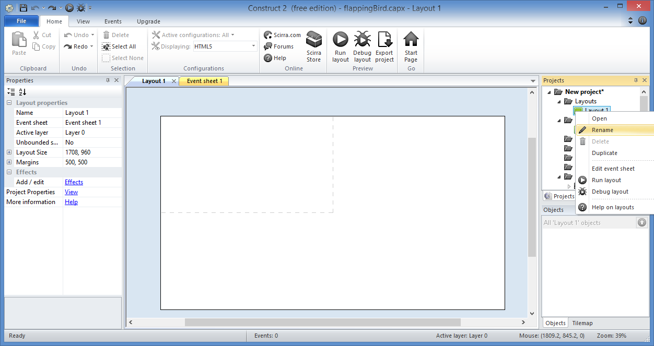
Prepare Your Layouts: Step 1
Right-Click to
Rename Layout

Slide 13
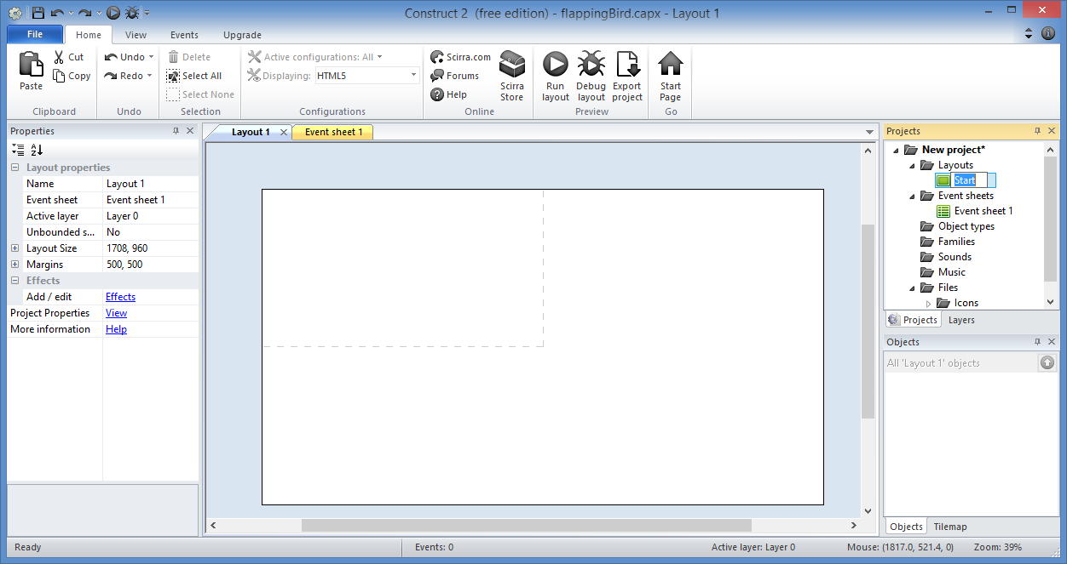
Prepare Your Layouts: Step 2
Enter “Start”

Slide 14
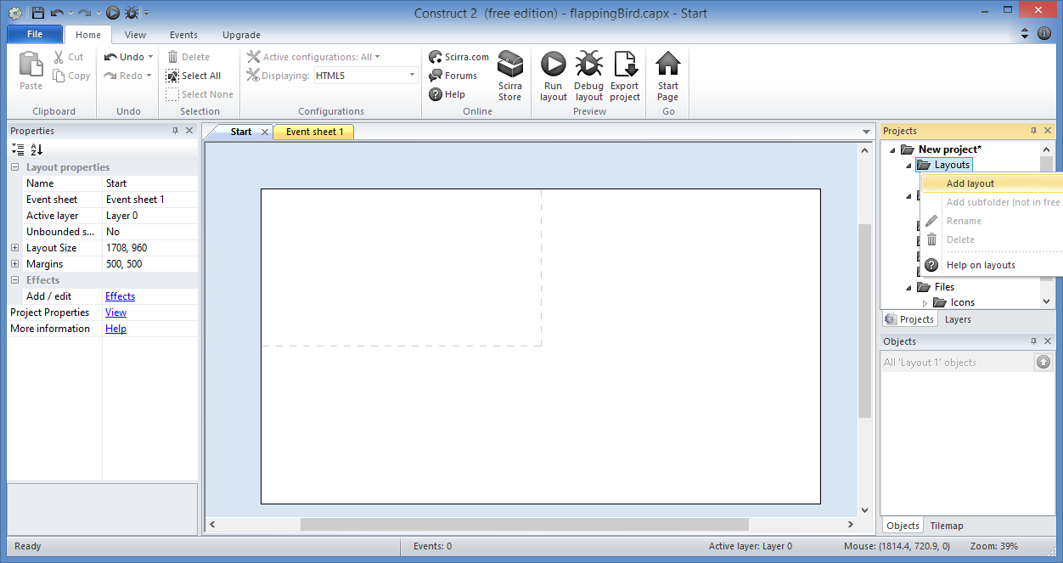
Prepare Your Layouts: Step 3
Right-click
Layouts folder
to Add layout

Slide 15
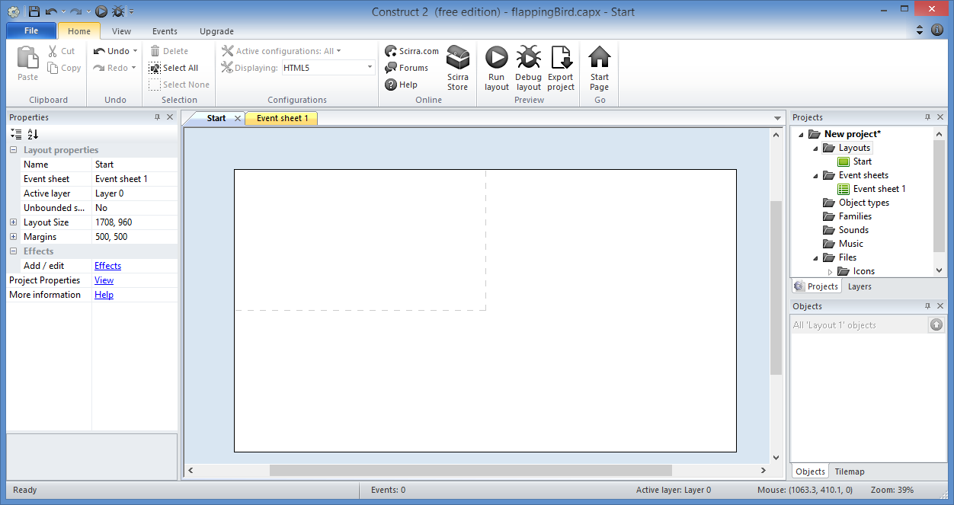
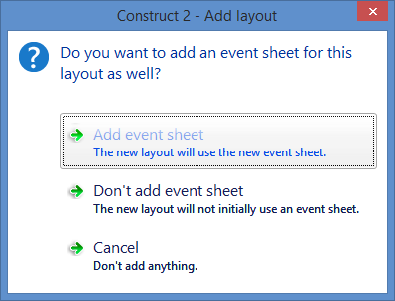
Prepare Your Layouts: Step 4
Add event sheet

Slide 16
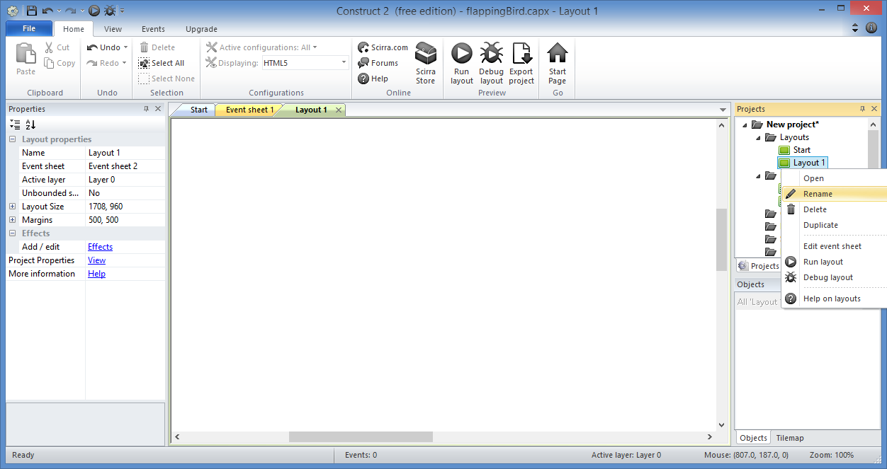
Prepare Your Layouts: Step 5
Right-Click
new Layout
to Rename it

Slide 17
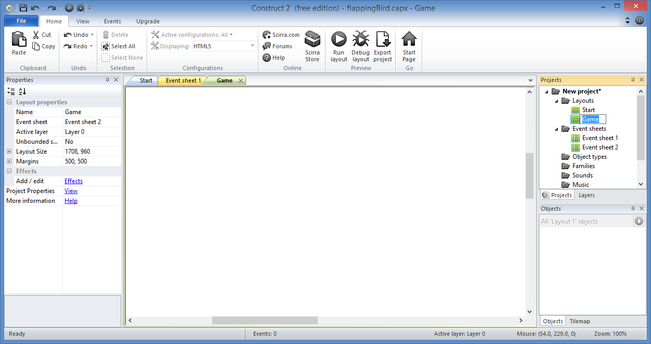
Prepare Your Layouts: Step 6
Enter “Game”

Slide 18
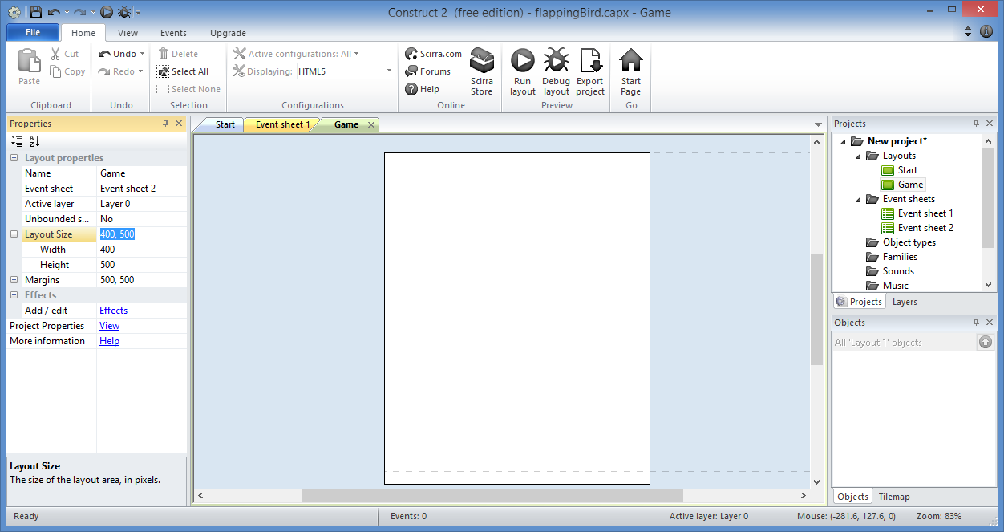
Prepare Your Layouts: Step 7
Change Layout Size
for the “Game” Layer
Layout Size:
Width: 400
Height: 500

Slide 19
Prepare Your Layouts: Step 8
Change Layout Size
for the “Start” Layer
Layout Size:
Width: 400
Height: 500

Slide 20
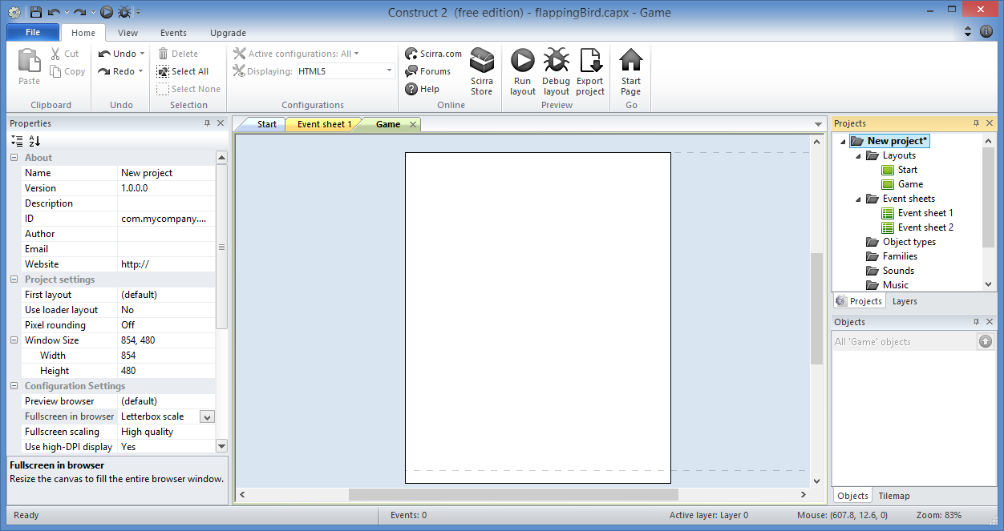
Prepare Your Layouts: Step 9
Select project

Slide 21
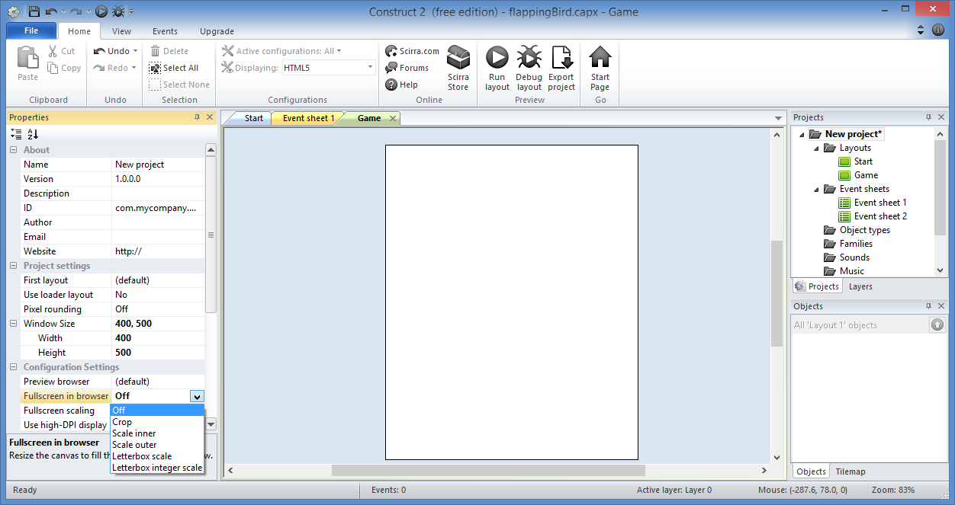
Prepare Your Layouts: Step 10
Update project
properties
Window Size:
Width: 400
Height: 500
Fullscreen in browser: Off

Slide 22
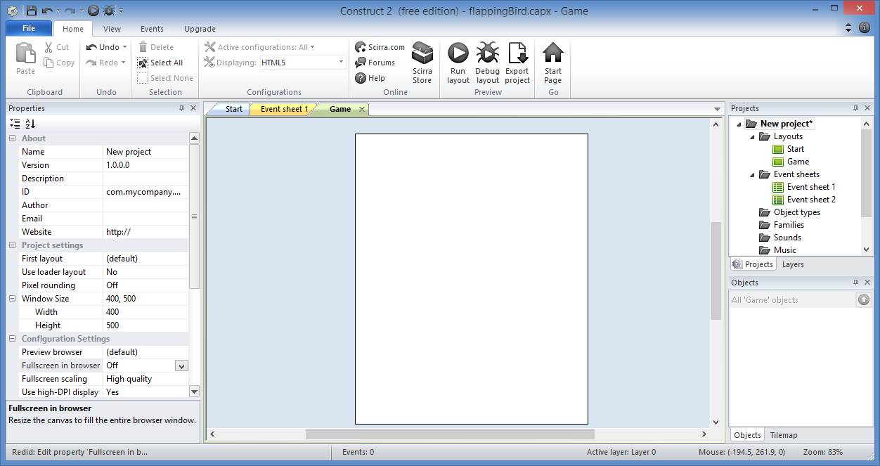
Prepare Your Layouts: Done!

Slide 23
Add Play Button

Slide 24
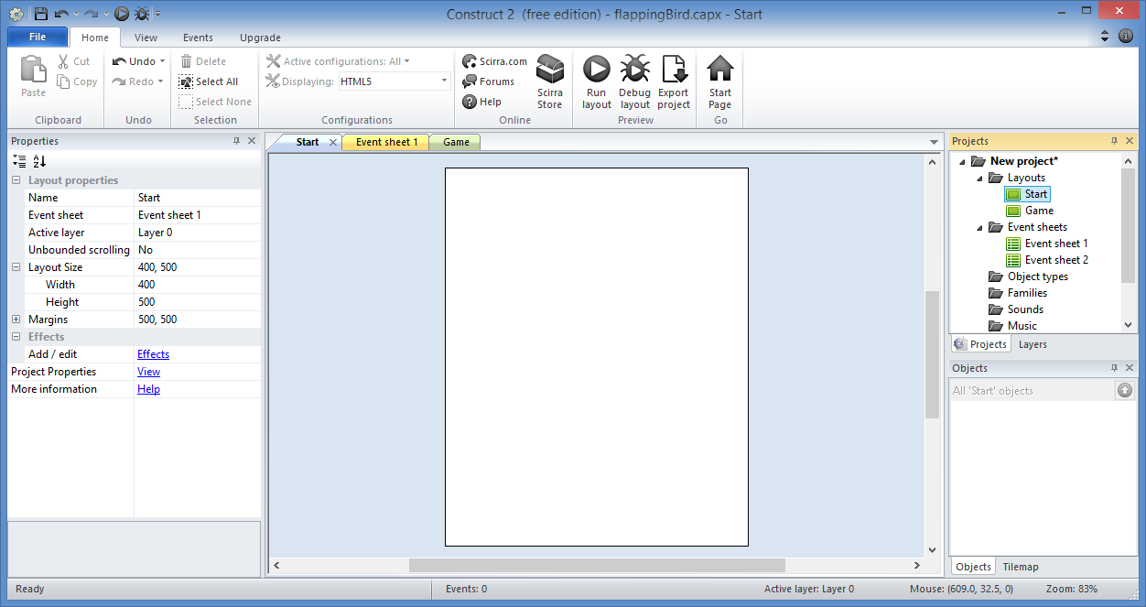
Add Play Button: Step 1
Go to
“Start” screen

Slide 25
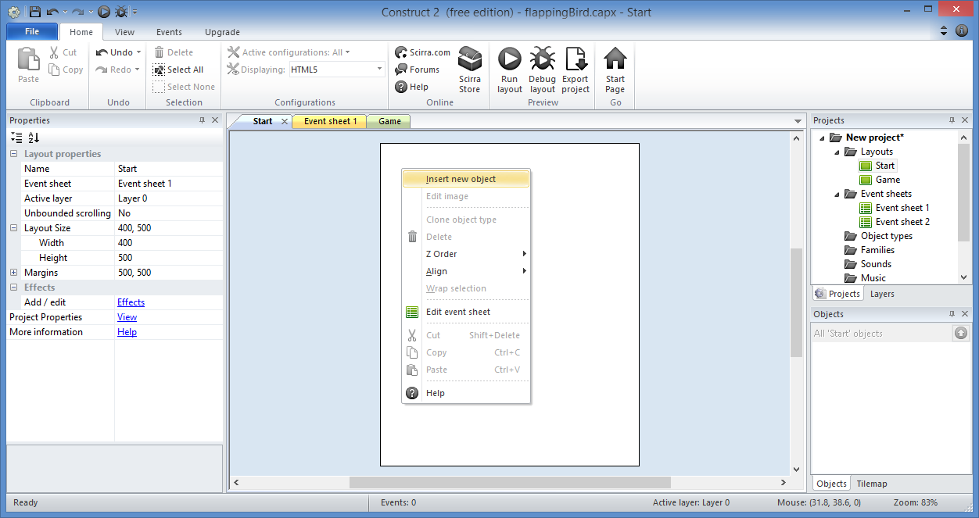
Add Play Button: Step 2
Right-click, then
Insert New Object

Slide 26
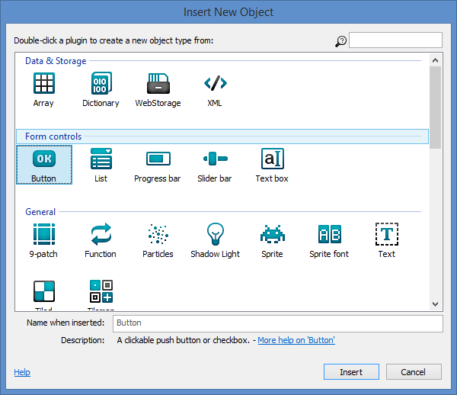
Add Play Button: Step 3
Select
“Button”
Click “Insert”

Slide 27
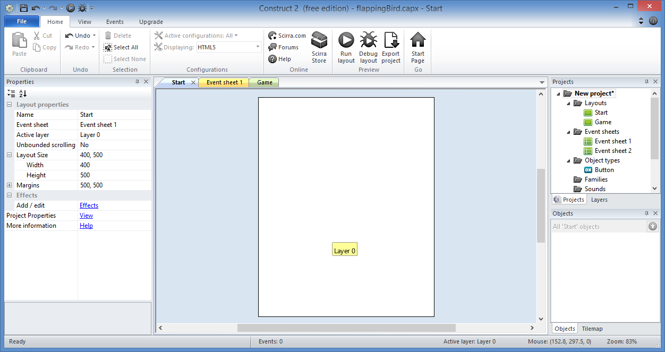
Add Play Button: Step 4
Click
anywhere

Slide 28
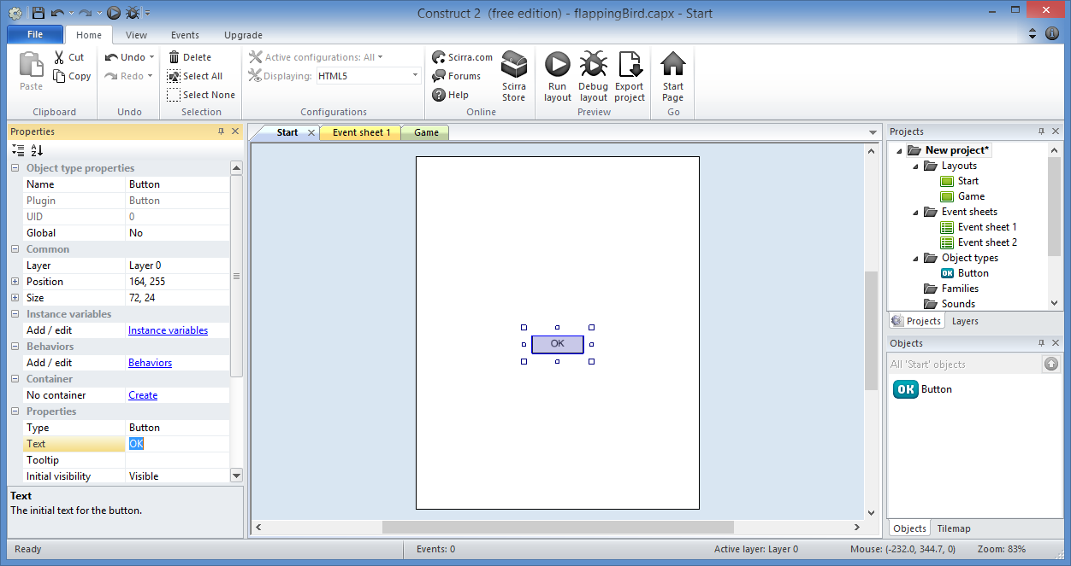
Add Play Button: Step 5
Update the Text

Slide 29
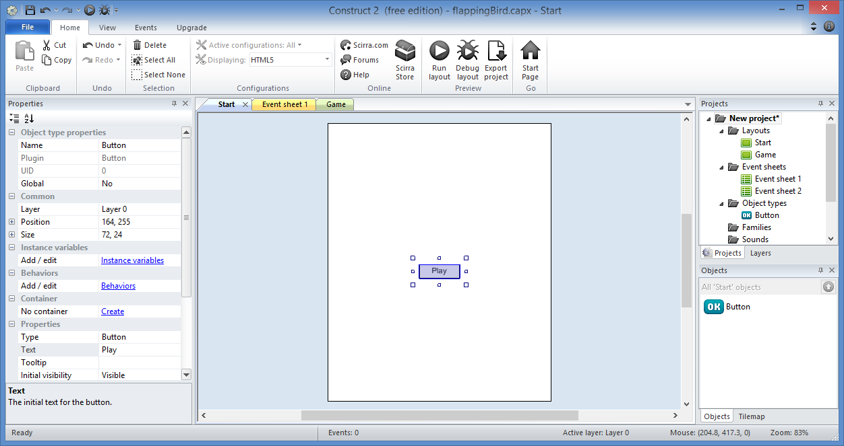
Add Play Button: Step 6
Enter
“Play”

Slide 30
Add Play Button: Done!

Slide 31
Add Button Event

Slide 32
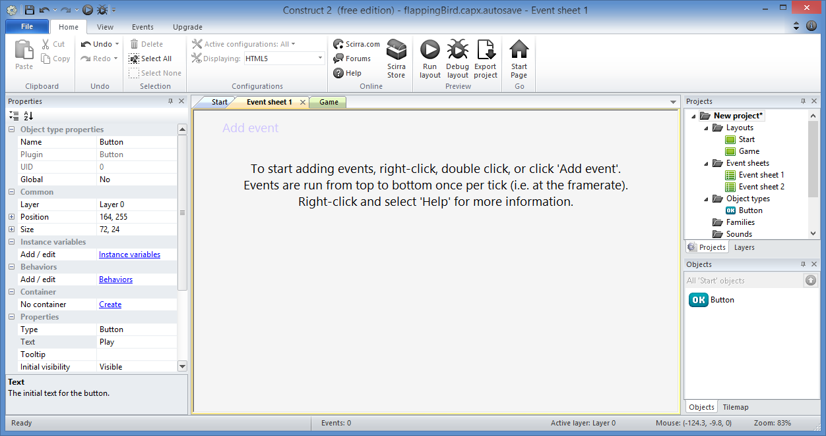
Add Button Event: Step 1
Go to “Event sheet 1”
for “Start” layout

Slide 33
Add Button Event: Step 2
Click “Add event”

Slide 34
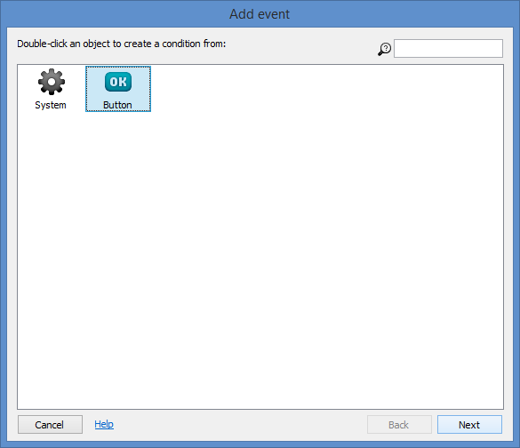
Add Button Event: Step 3
Select
“Button”
Click “Next”

Slide 35
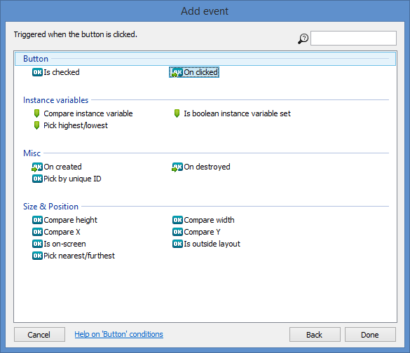
Add Button Event: Step 4
Select
“On clicked”
Click “Done”

Slide 36
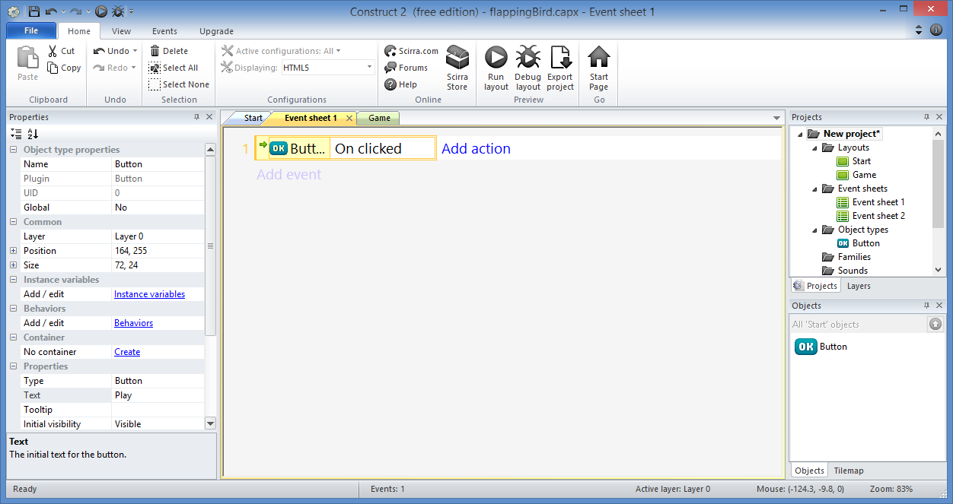
Add Button Event: Step 5
Click “Add action”

Slide 37
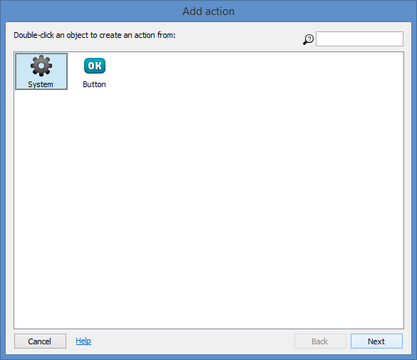
Add Button Event: Step 6
Select
“System”
Click “Next”

Slide 38
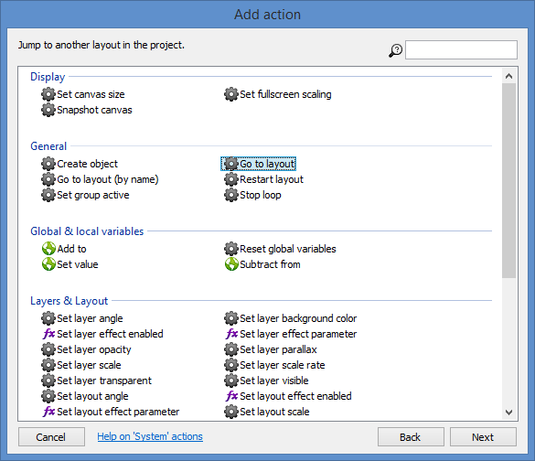
Add Button Event: Step 7
Select
“Go to layout”
Click “Next”

Slide 39
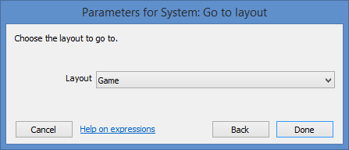
Add Button Event: Step 8
Click “Done”

Slide 40
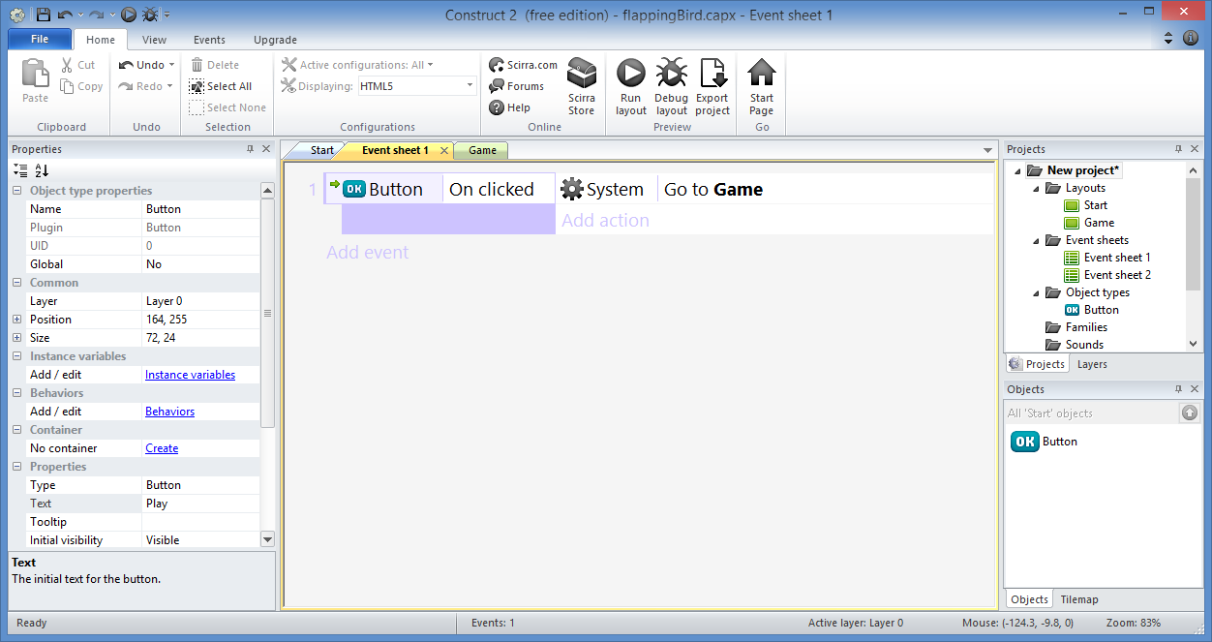
Add Button Event: Done!

Slide 41
Add Game Graphics

Slide 42
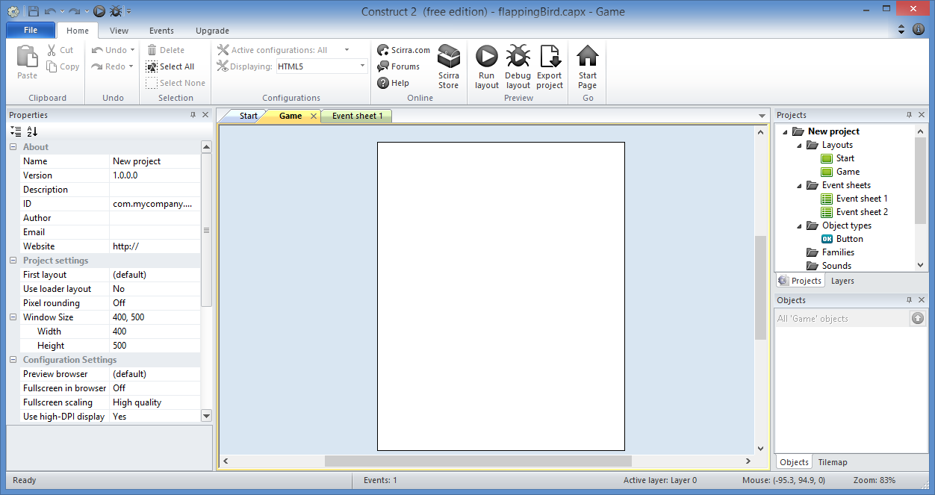
Add Game Graphics: Step 1
Go to the
“Game”
layout

Slide 43
Add Game Graphics: Step 2
Drag in these 4 images
image one by one

Slide 44
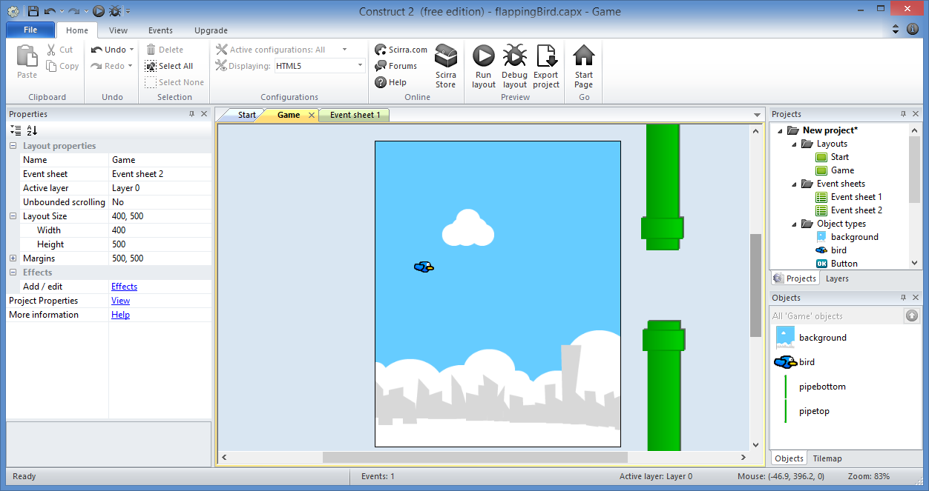
Add Game Graphics: Step 3
Arrange
them
like this.

Slide 45
Add Game Graphics: Step 4
Top-left
outside
Near
left
edge

Slide 46
Add Game Graphics: Done!

Slide 47
Add Tiled Background

Slide 48
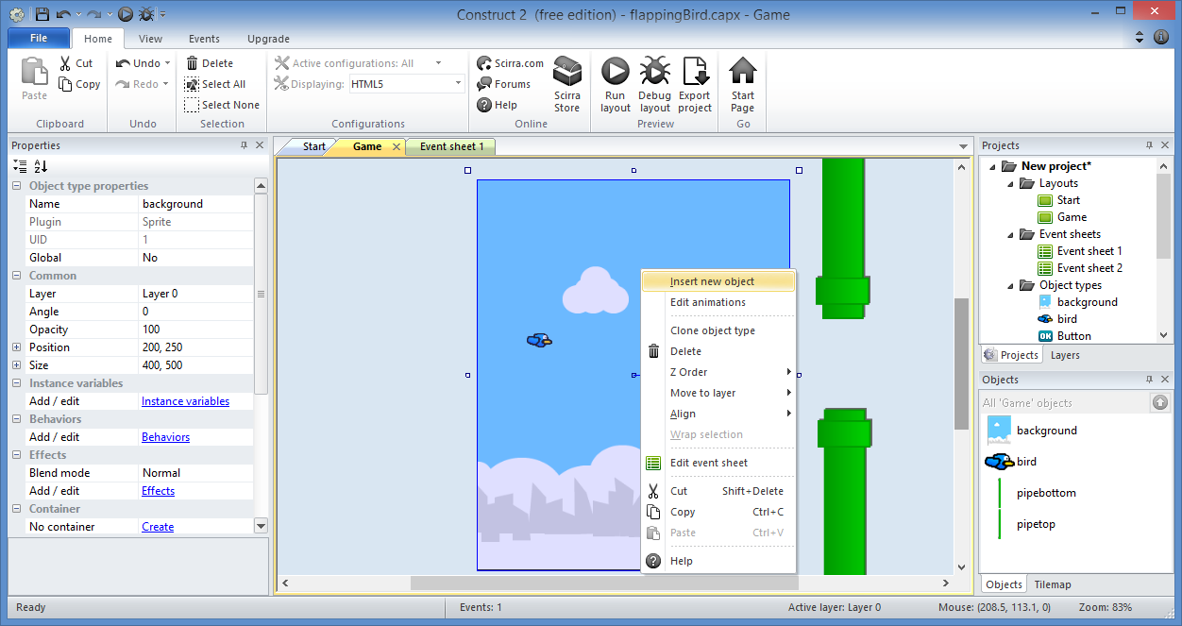
Add Tiled Background: Step 1
Right-click
then
Insert new
object

Slide 49
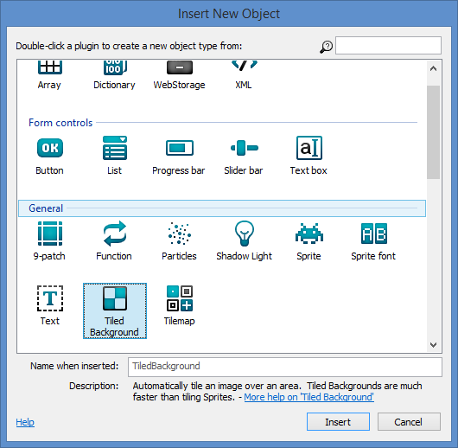
Add Tiled Background: Step 2
Select
“Tiled
Background”
Click “Insert”

Slide 50
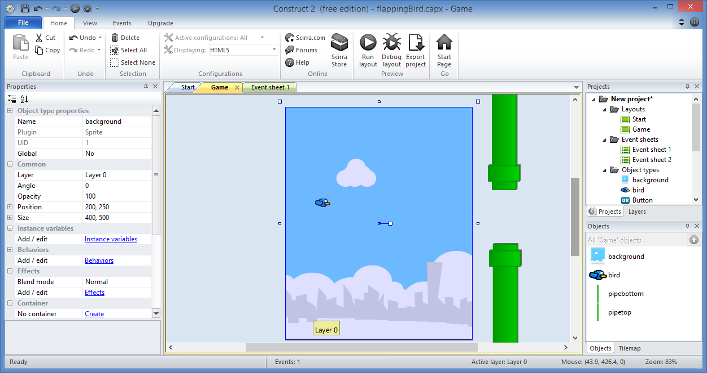
Add Tiled Background: Step 3
Click
near
the
bottom

Slide 51
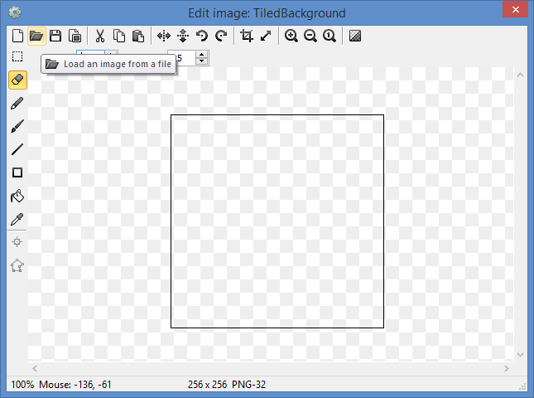
Add Tiled Background: Step 4
Load
an image

Slide 52
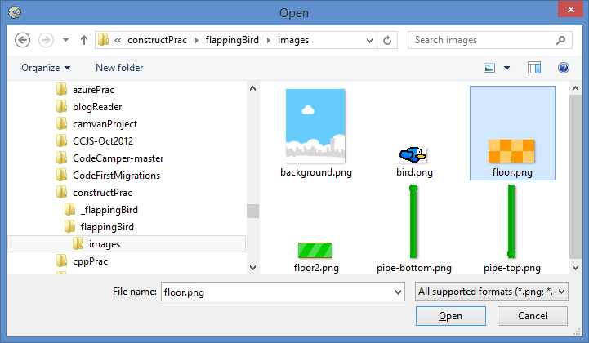
Add Tiled Background: Step 5
Select
“floor.png”
Click “Open”

Slide 53
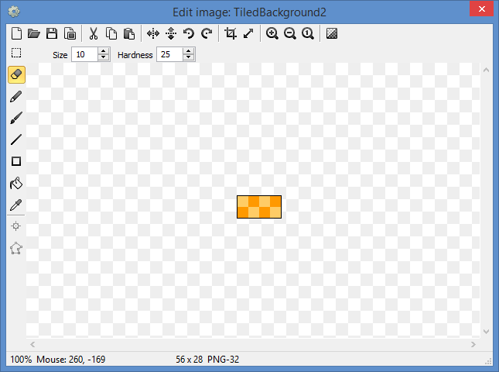
Add Tiled Background: Step 6
Close popup

Slide 54
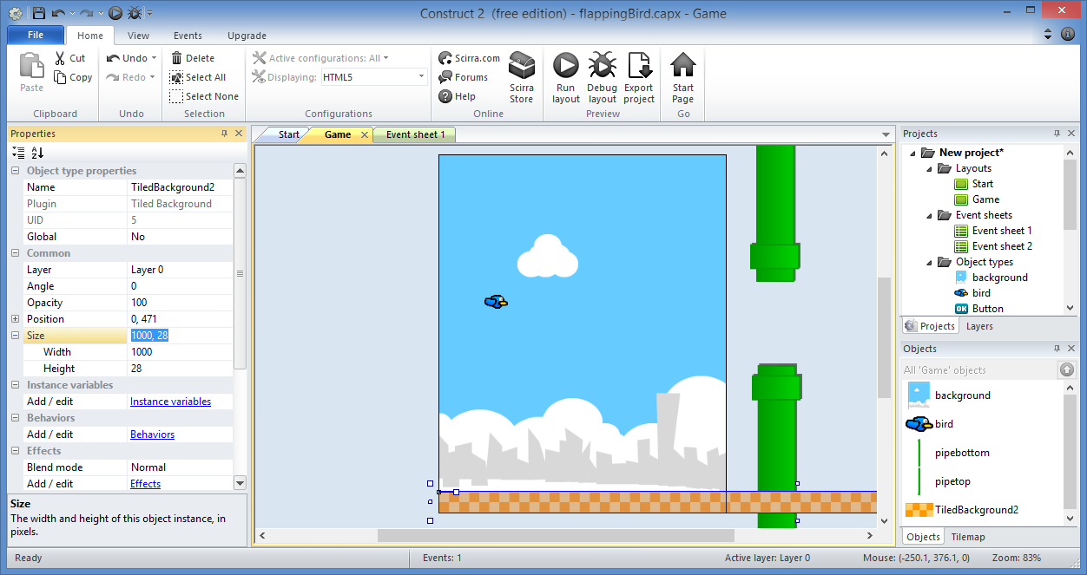
Add Tiled Background: Step 7
Size
Width: 1000
Height: 28
Drag to
lower left

Slide 55
Add Tiled Background: Done!

Slide 56
Add Floor

Slide 57
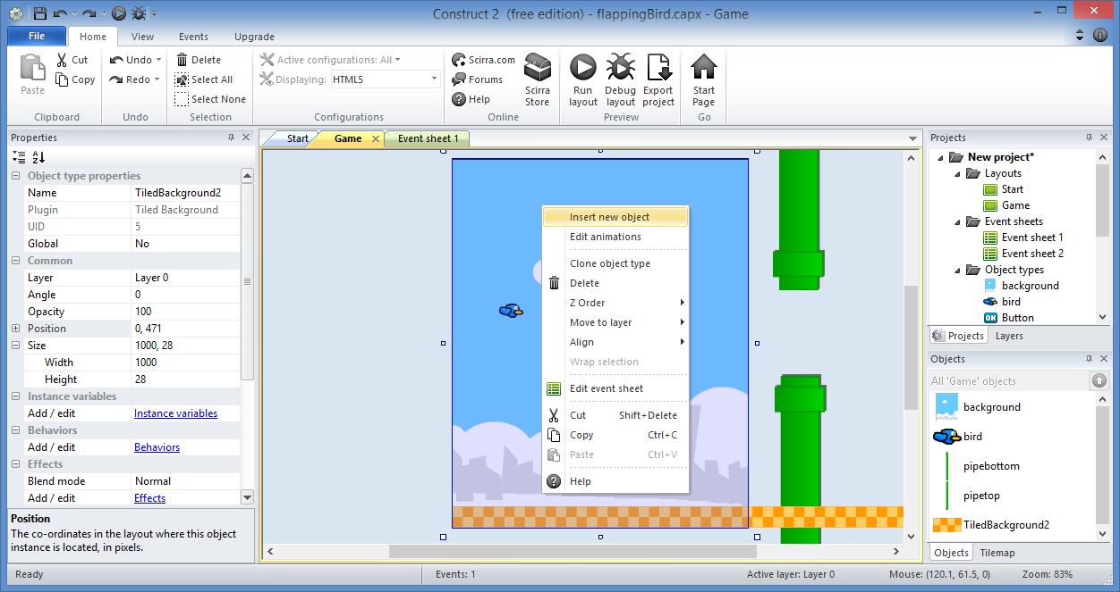
Add Floor: Step 1
Right-click
again
then
Insert new
object

Slide 58
Add Floor: Step 2
Select
“Tiled
Background”
Click “Insert”

Slide 59
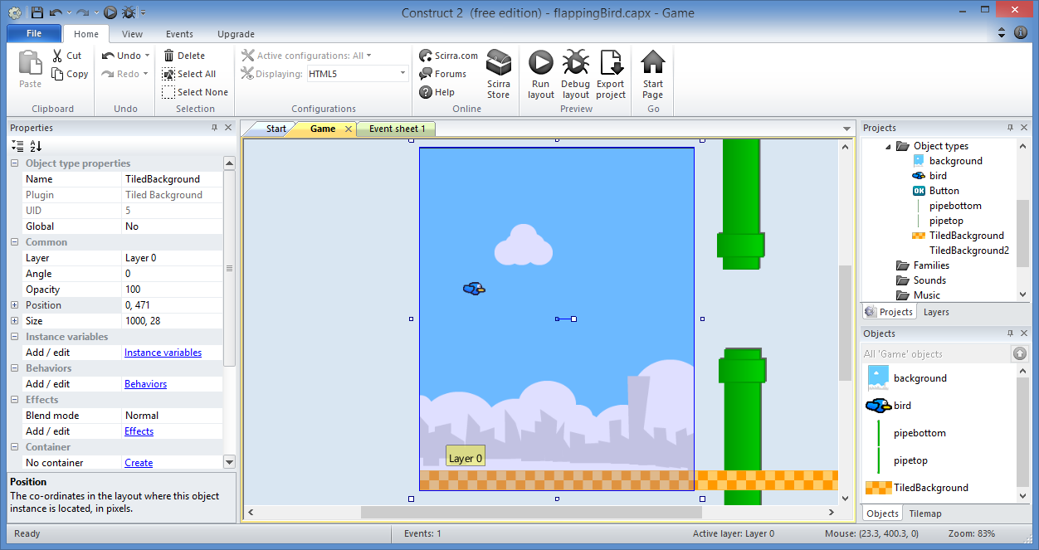
Add Floor: Step 3
Click
above
ground

Slide 60
Add Floor: Step 4
Load
an image

Slide 61
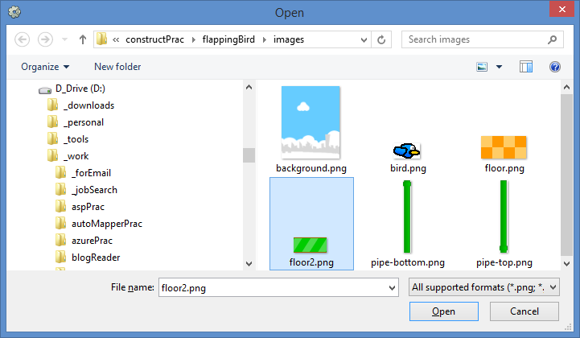
Add Floor: Step 5
Select
“floor2.png”
Click “Open”

Slide 62
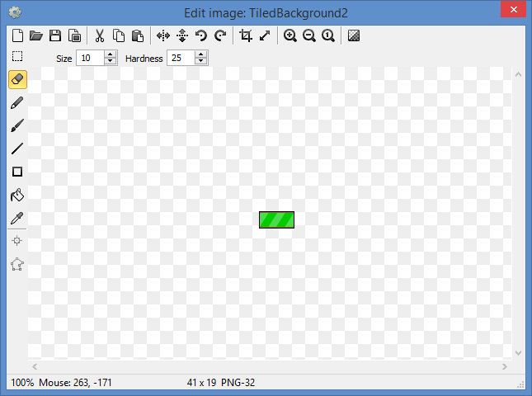
Add Floor: Step 6
Close popup

Slide 63
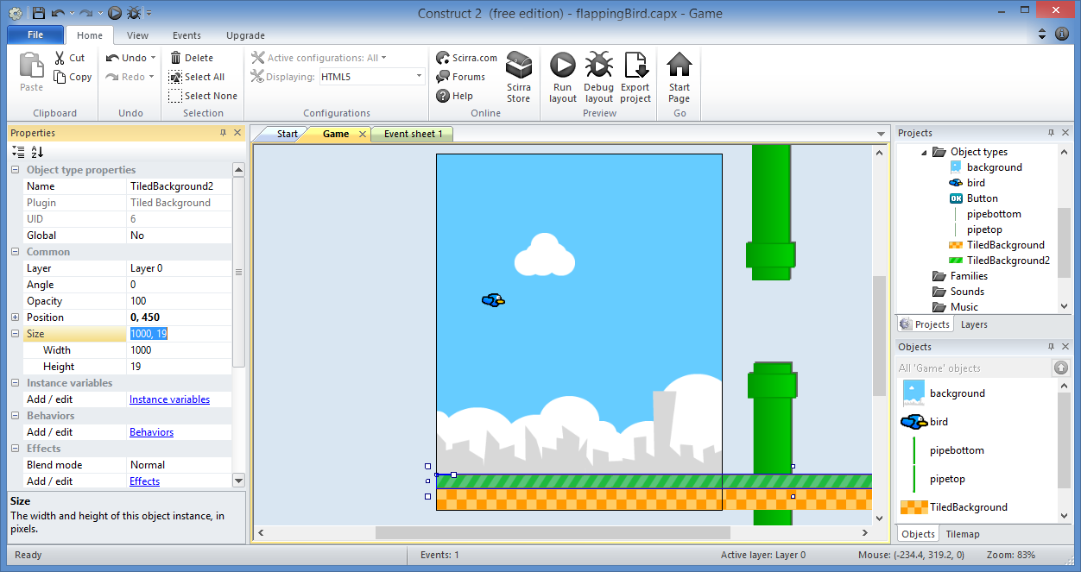
Add Floor: Step 7
Size
Width: 1000
Height: 19
Drag above
ground

Slide 64
Add Floor: Done!

Slide 65
Add Movement

Slide 66
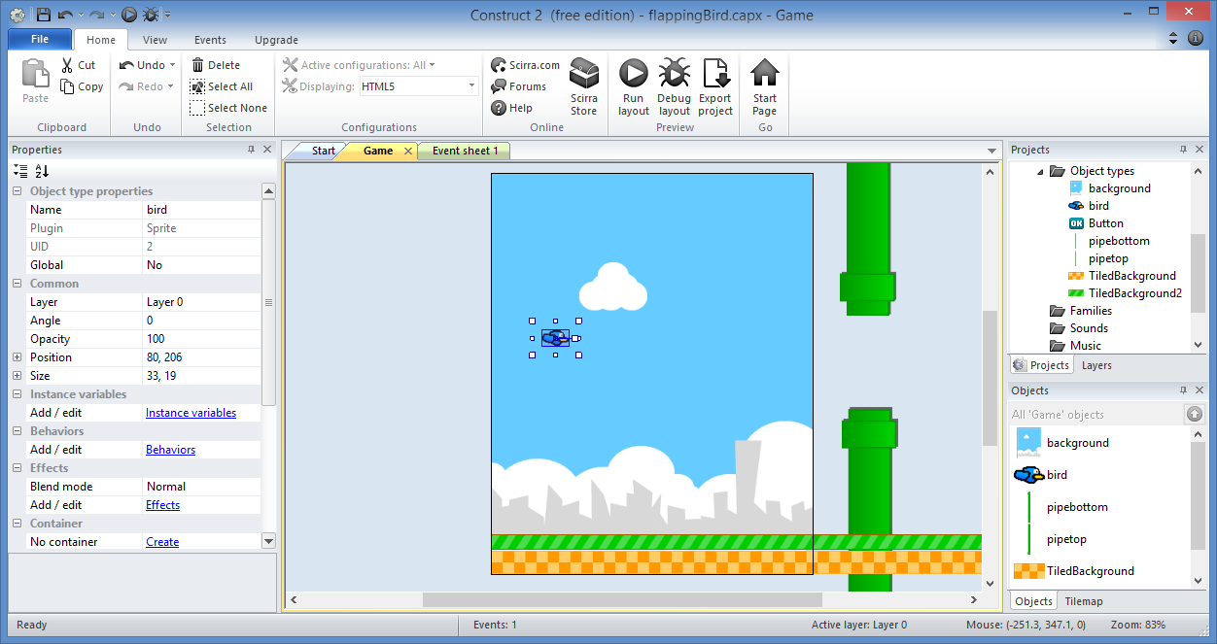
Add Movement: Step 1
Select
the bird

Slide 67
Add Movement: Step 2
Click
Behaviors

Slide 68
Add Movement: Step 3
Click to
“Add new”

Slide 69
Add Movement: Step 4
Select
“Platform”
Click “Add”

Slide 70
Add Movement: Step 5
Close popup

Slide 71
Add Movement: Step 6
Reduce
Max Speed
to 0
(prevents
left-right
movement)

Slide 72
(END of Part 1)
Derived from ‘Make your own "Flappy Bird" game in 10 minutes’ originally published by Tom
Updated with enhancements from Flappy Bird template

