Slide 1
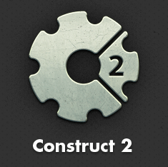
Add Globals

Slide 2
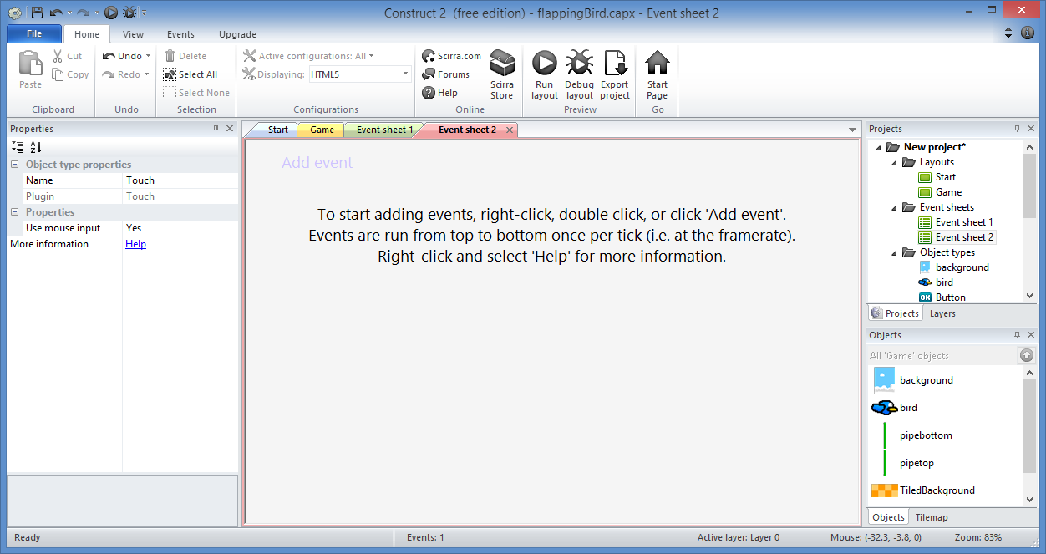
Add Globals: Step 1
Double-click
“Event sheet 2”

Slide 3
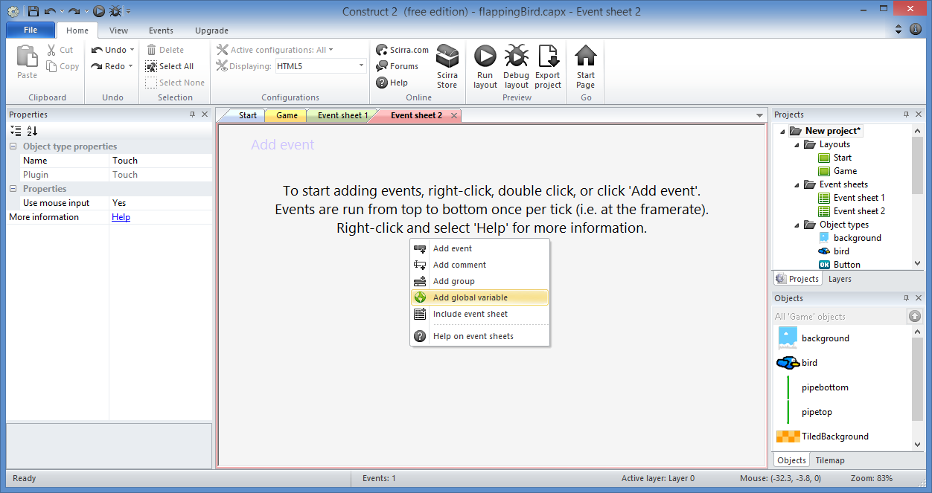
Add Globals: Step 2
Right-click, then
“Add global variable”

Slide 4
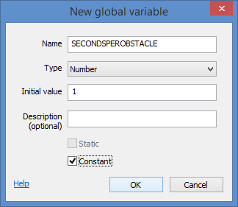
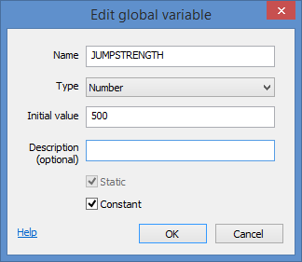
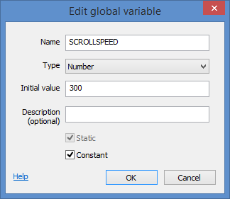
Add Globals: Step 3
Add New Global Variable 3 times
Name: SECONDSPEROBSTACLE
Type: Number
Initial Value: 1
Constant: [checked]
Name: JUMPSTRENGTH
Type: Number
Initial Value: 500
Constant: [checked]
Name: SCROLLSPEED
Type: Number
Initial Value: 300
Constant: [checked]

Slide 5
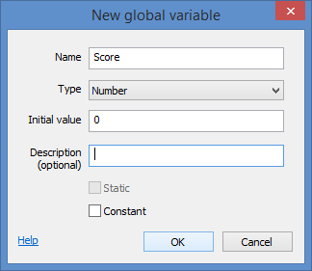
Add Globals: Step 4
Also, add another global variable for Score
Name: Score
Type: Number
Initial Value: 0
Constant: [NOT checked]

Slide 6
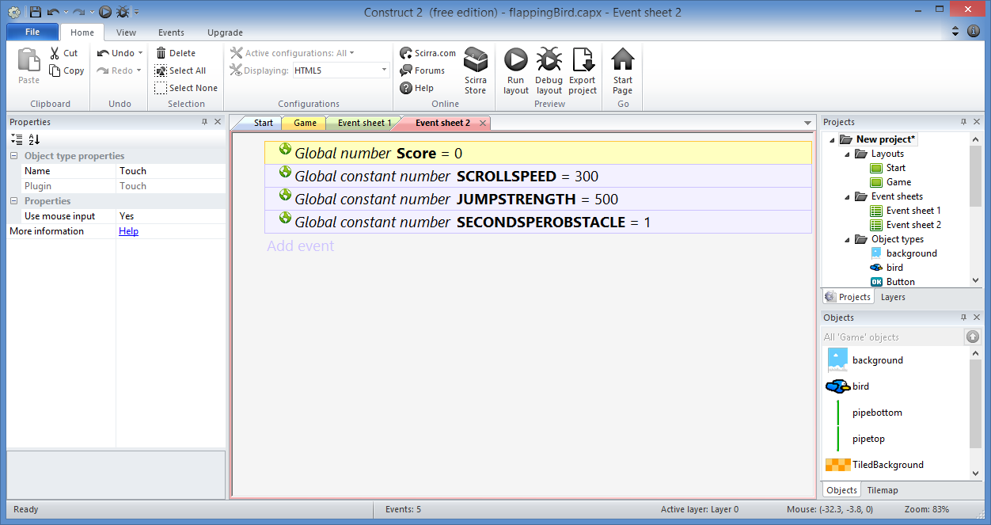
Add Globals: Done!

Slide 7
Add Touch Support

Slide 8
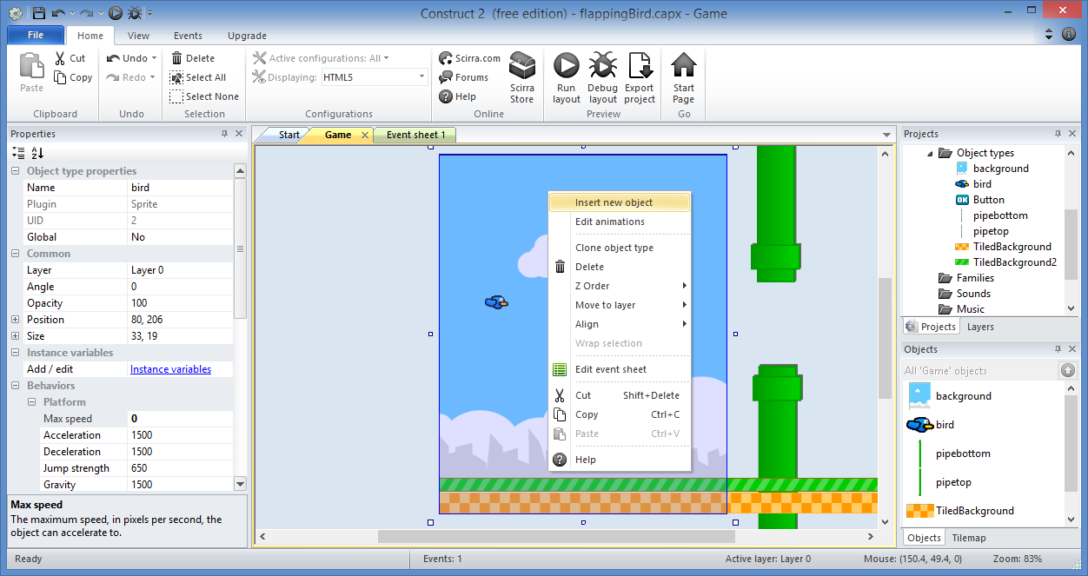
Add Touch Support: Step 1
Right-click
then
Insert new
object

Slide 9
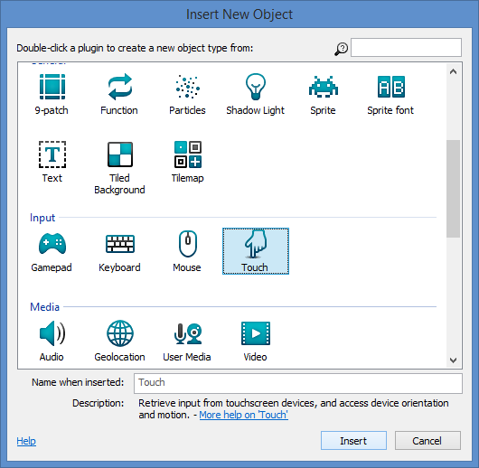
Add Touch Support: Step 2
Select
“Touch”
Click “Insert”

Slide 10
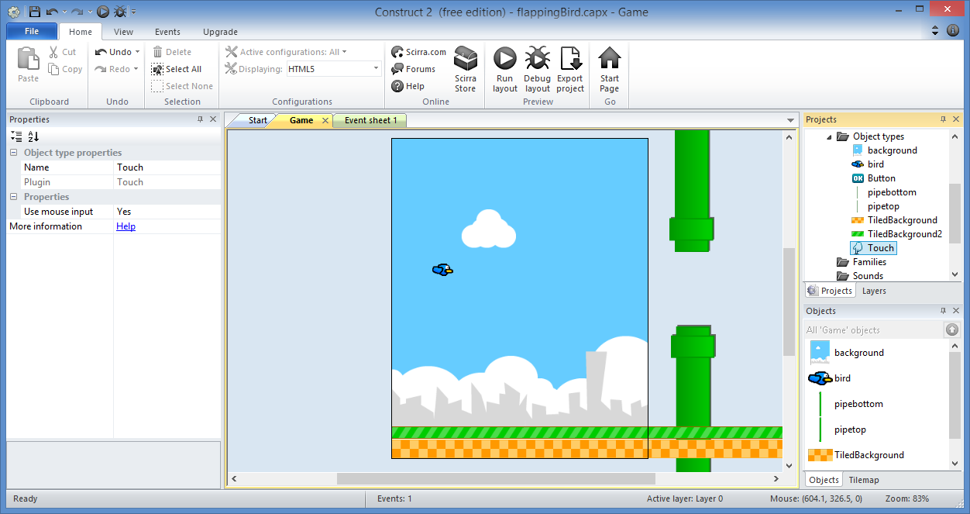
Add Touch Support: Step 3
Verify
that
“Touch”
has been
added

Slide 11
Add Touch Input

Slide 12
Add Touch Input: Step 1
Stay on
“Event sheet 2”

Slide 13
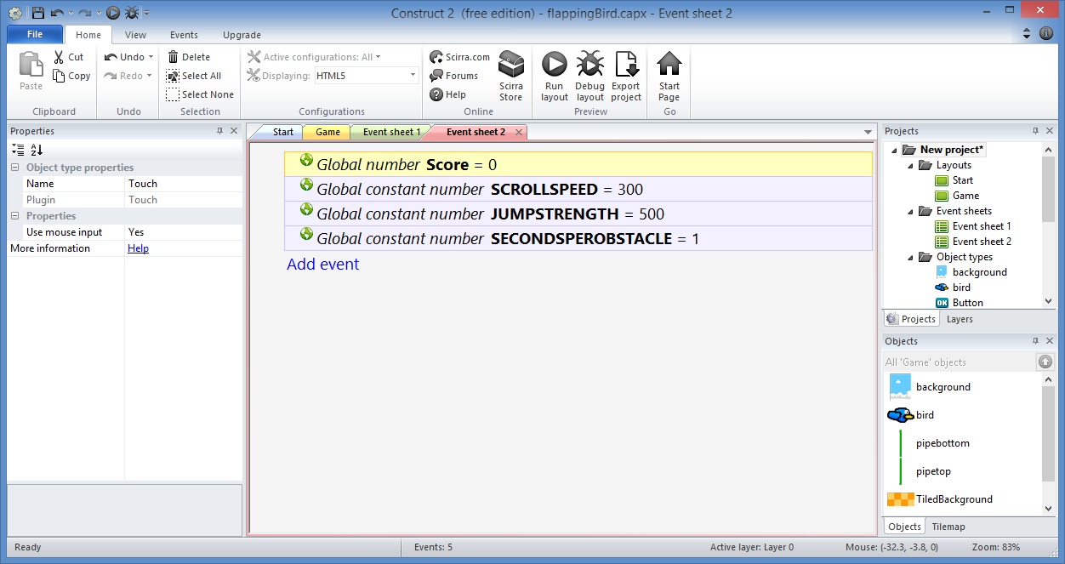
Add Touch Input: Step 2
Click “Add event”

Slide 14
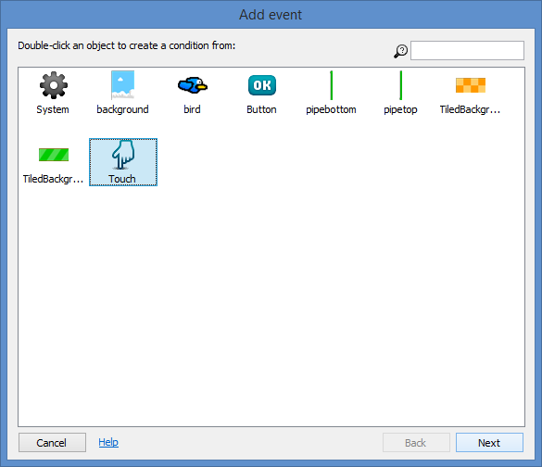
Add Touch Input: Step 3
Select
“Touch”
Click “Next”

Slide 15
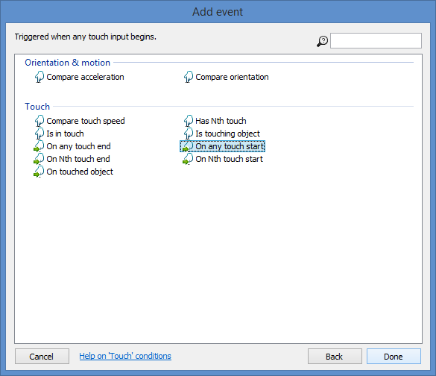
Add Touch Input: Step 4
Select
“On any
touch start”
Click “Done”

Slide 16
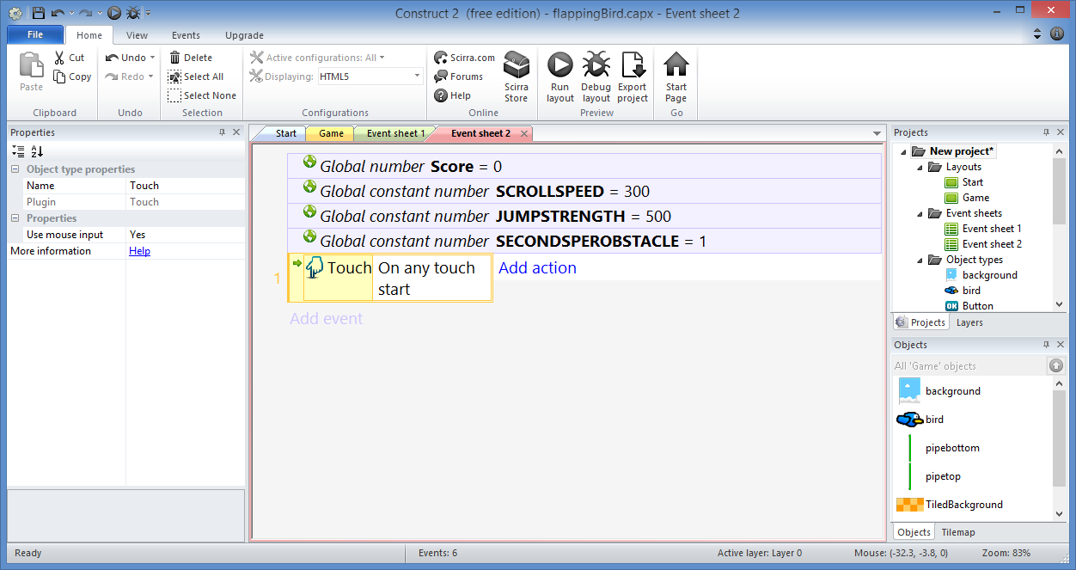
Add Touch Input: Step 5
Click “Add action”

Slide 17
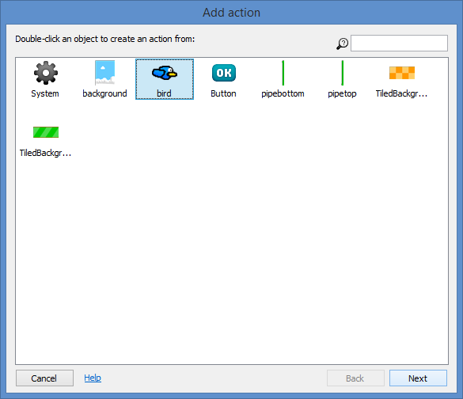
Add Touch Input: Step 6
Select
“bird”
Click “Next”

Slide 18
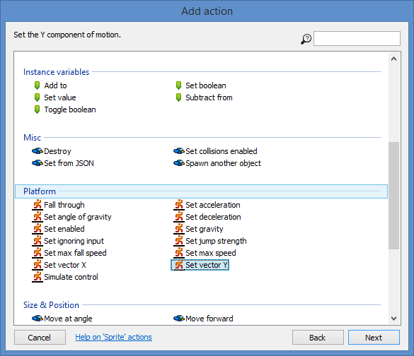
Add Touch Input: Step 7
Select
“Set vector Y”
Click “Next”

Slide 19
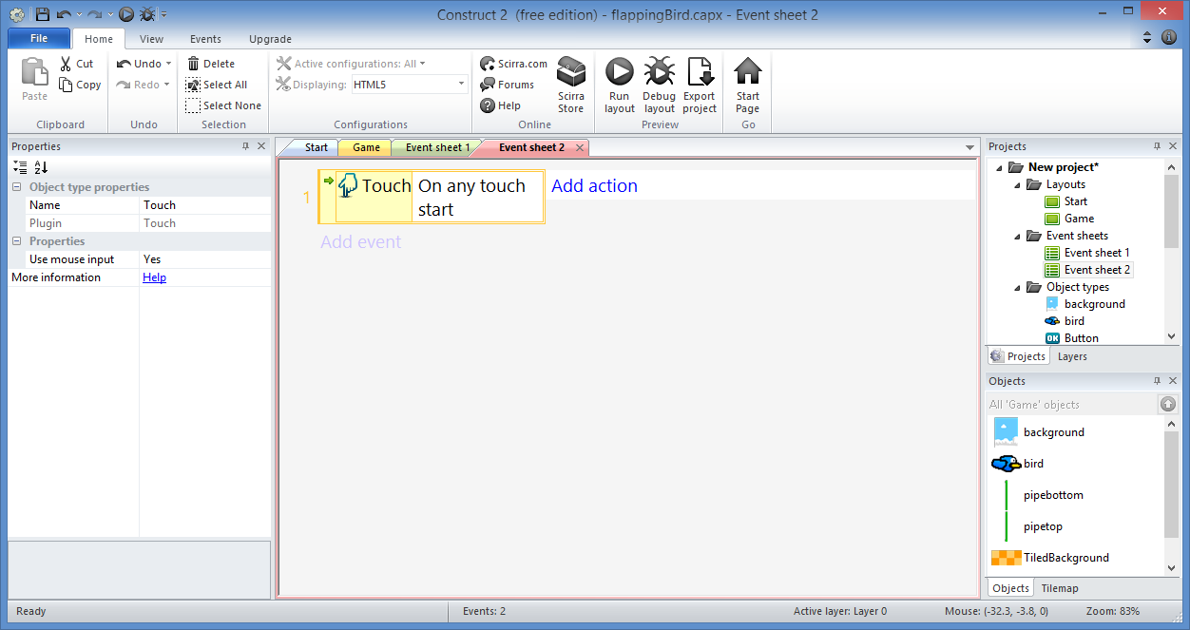
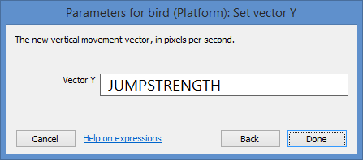
Add Touch Input: Step 8
Enter:
Vector Y: -JUMPSTRENGTH
Click “Done”

Slide 20
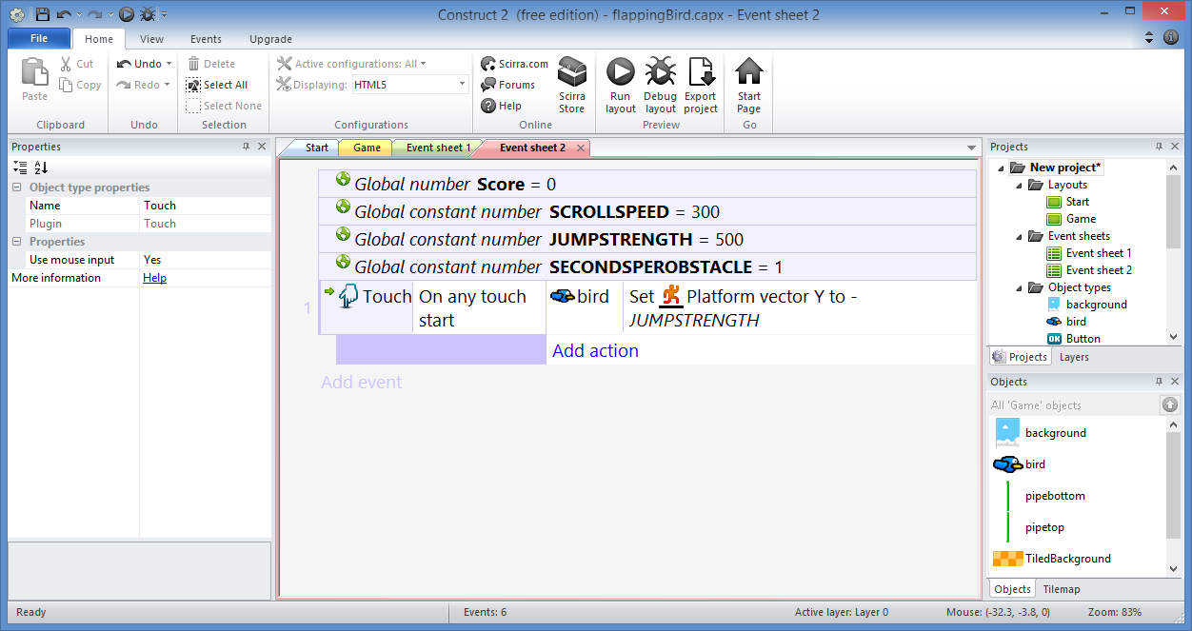
Add Touch Input: Step 9
Click “Add action”

Slide 21
Add Touch Input: Step 10
Select
“bird”
Click “Next”

Slide 22
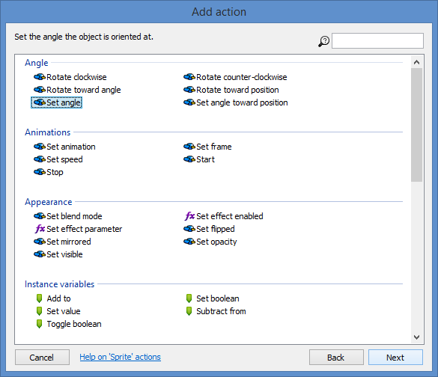
Add Touch Input: Step 11
Select
“Set angle”
Click “Next”

Slide 23
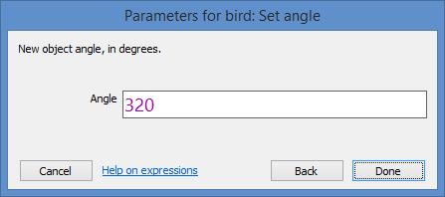
Add Touch Input: Step 12
Enter:
Angle: 320
Click “Done”

Slide 24
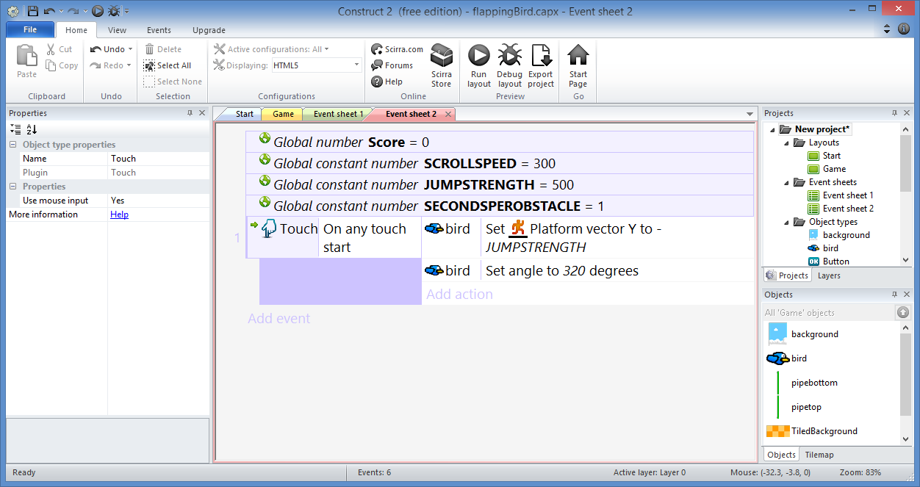
Add Touch Input: Done!

Slide 25
Rotate Bird

Slide 26
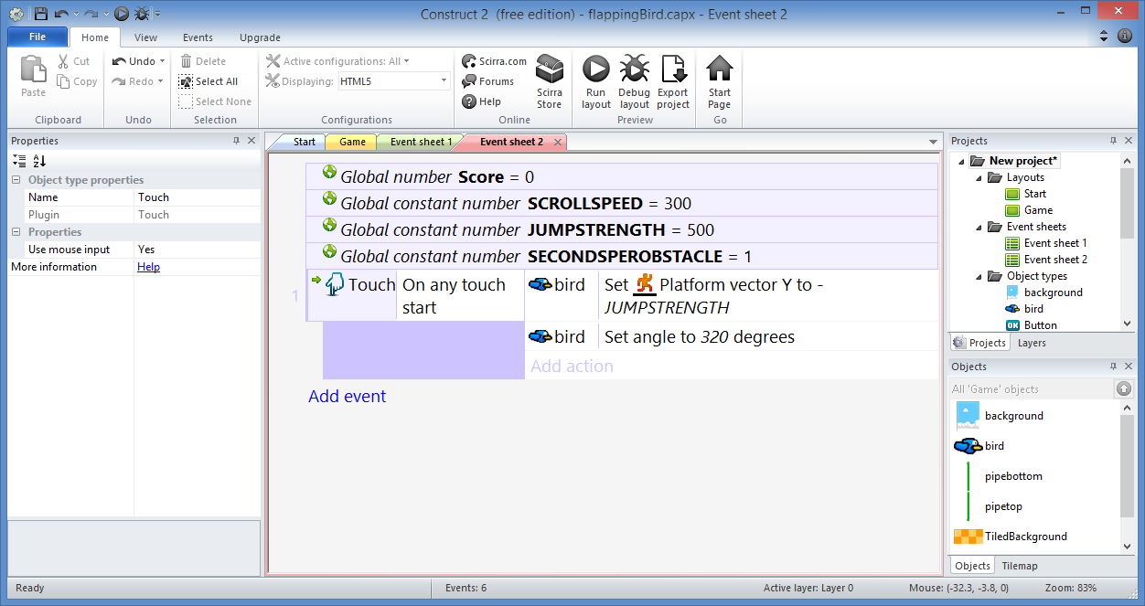
Rotate Bird: Step 1
Click “Add event”

Slide 27
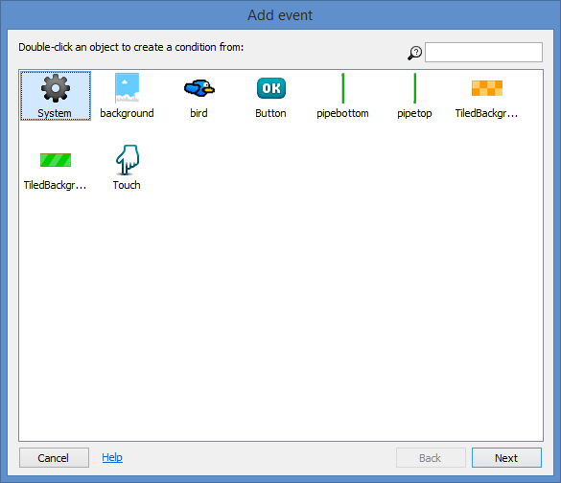
Rotate Bird: Step 2
Select
“System”
Click “Next”

Slide 28
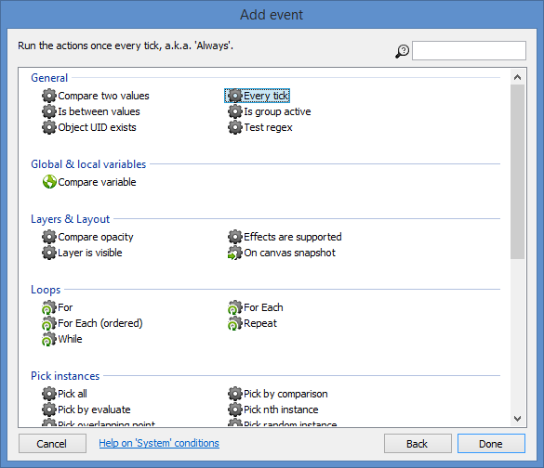
Rotate Bird: Step 3
Select
“Every tick”
Click “Done”

Slide 29
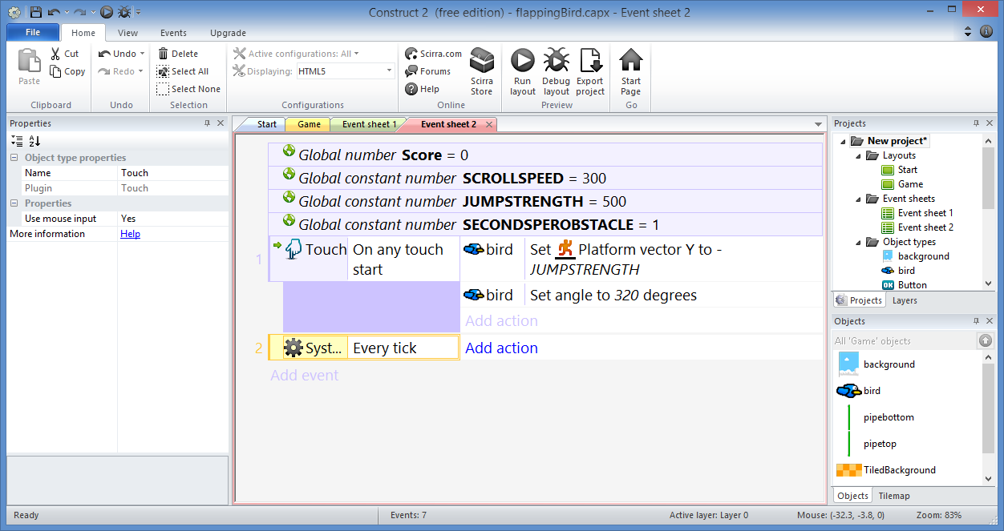
Rotate Bird: Step 4
Click “Add action”

Slide 30
Rotate Bird: Step 5
Select
“bird”
Click “Next”

Slide 31
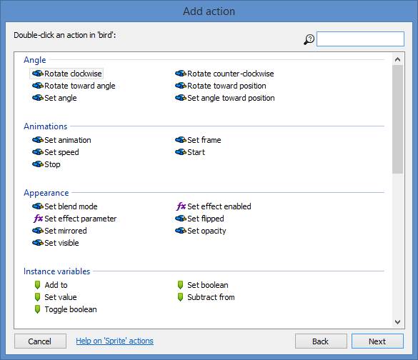
Rotate Bird: Step 6
Select
“Rotate
clockwise”
Click “Next”

Slide 32
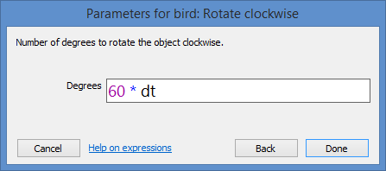
Rotate Bird: Step 7
Enter:
Degrees: 60 * dt
Click “Done”
(dt means delta time)

Slide 33
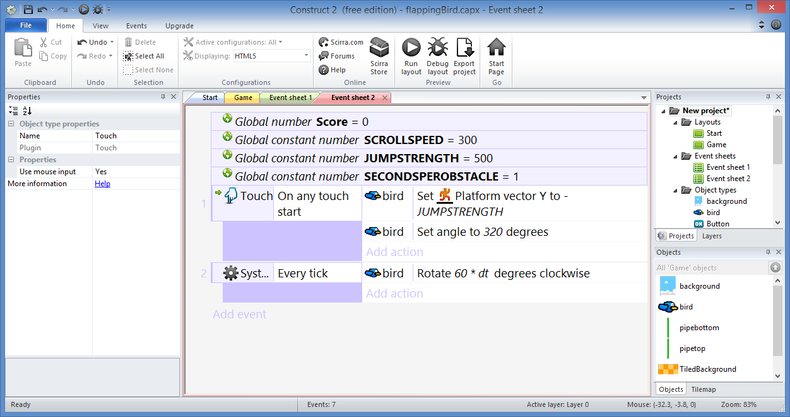
Rotate Bird: Done!

Slide 34
Add Collisions

Slide 35
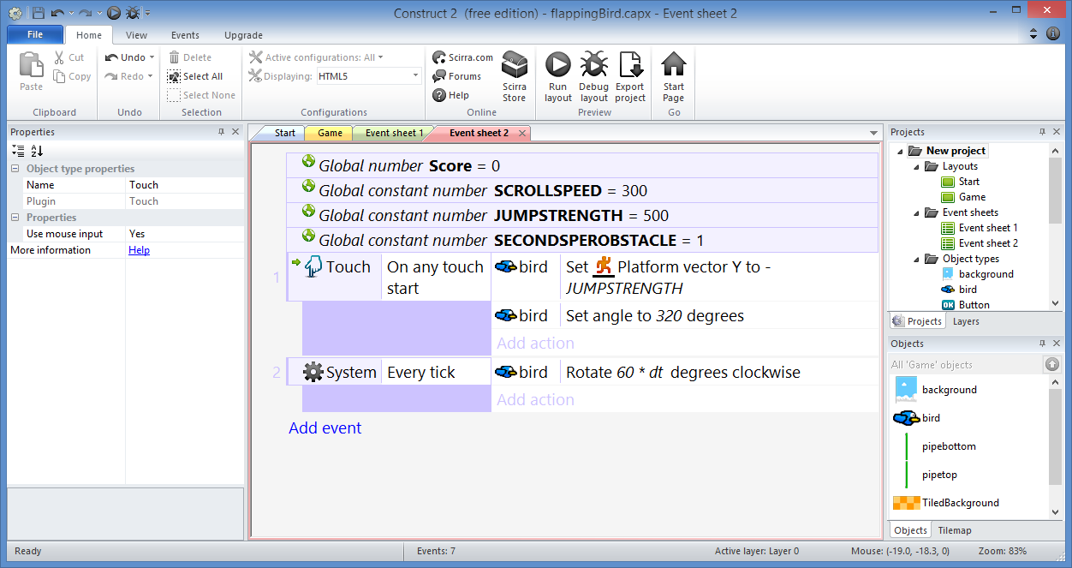
Add Collisions: Step 1
Click “Add event”

Slide 36
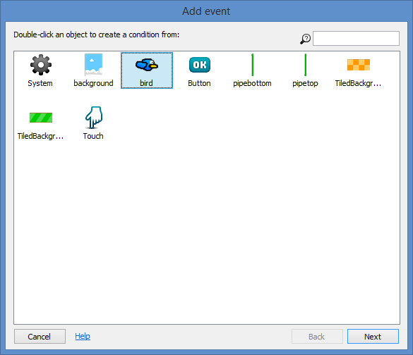
Add Collisions: Step 2
Select
“bird”
Click “Next”

Slide 37
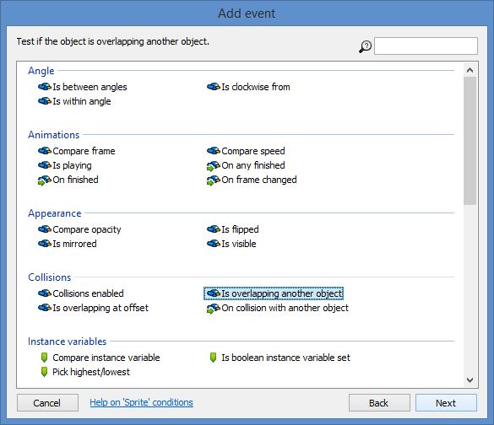
Add Collisions: Step 3
Select
“Is overlapping
another object”
Click “Next”

Slide 38
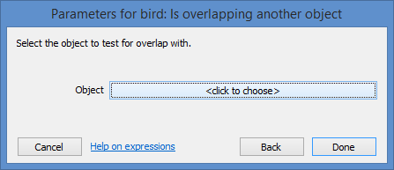
Add Collisions: Step 4
<click to choose>

Slide 39
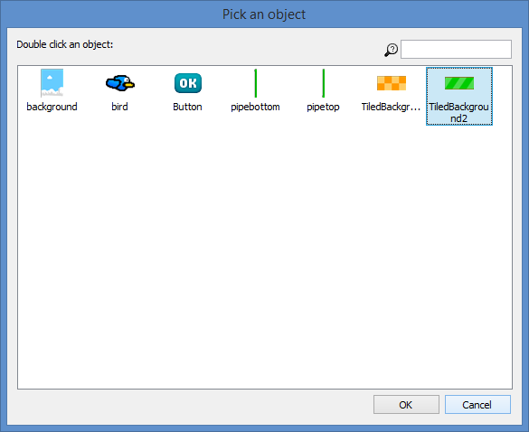
Add Collisions: Step 5
Select
“TiledBackground2”
Click “OK”

Slide 40
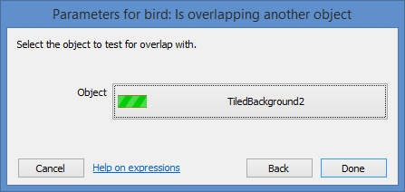
Add Collisions: Step 6
Click “Done”

Slide 41
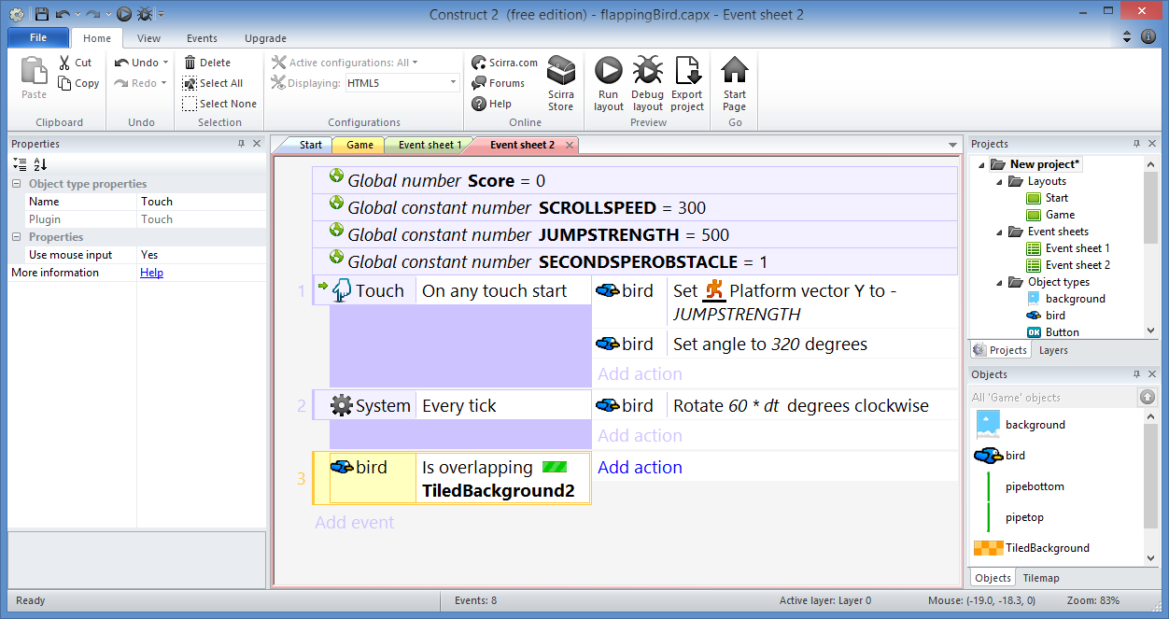
Add Collisions: Step 7
Click “Add action”

Slide 42
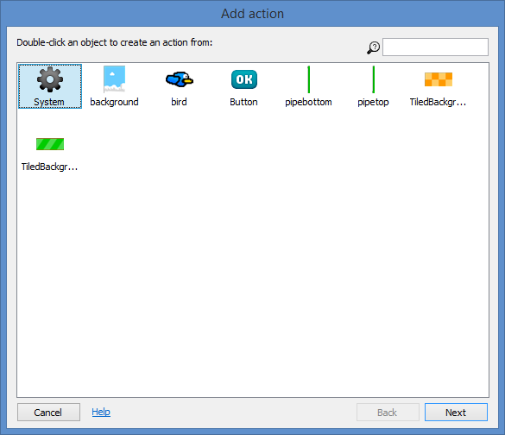
Add Collisions: Step 8
Select
“System”
Click “Next”

Slide 43
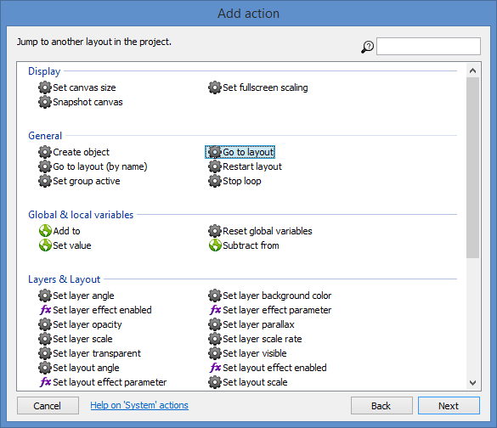
Add Collisions: Step 9
Select
“Go to layout”
Click “Next”

Slide 44
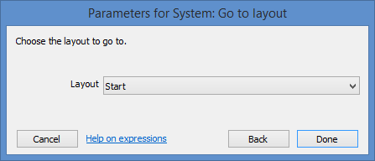
Add Collisions: Step 10
Select “Start” Layout
Click “Done”

Slide 45
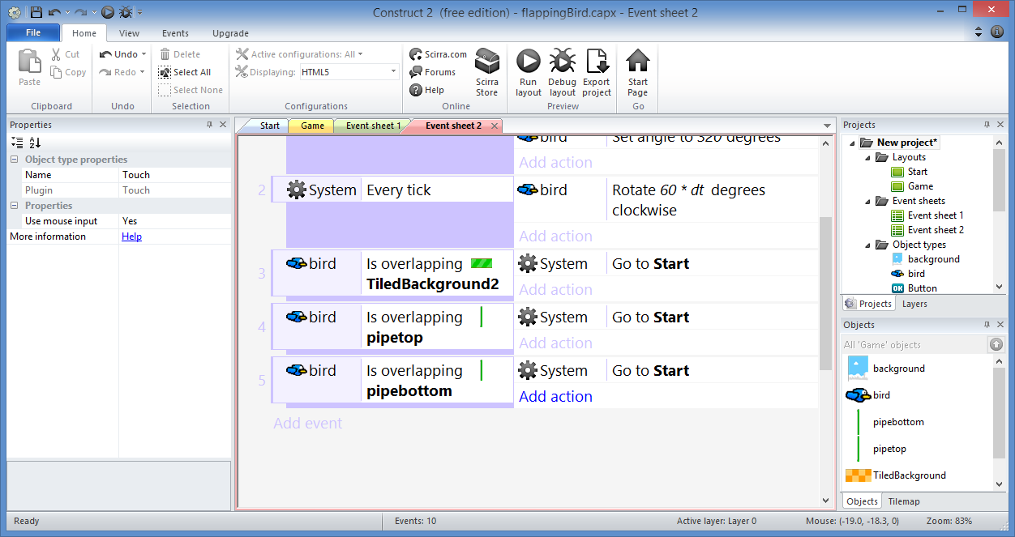
Add Collisions: Step 11…
Repeat previous steps for pipe top and bottom

Slide 46
Add Collisions: Done!

Slide 47
Enforce Boundary

Slide 48
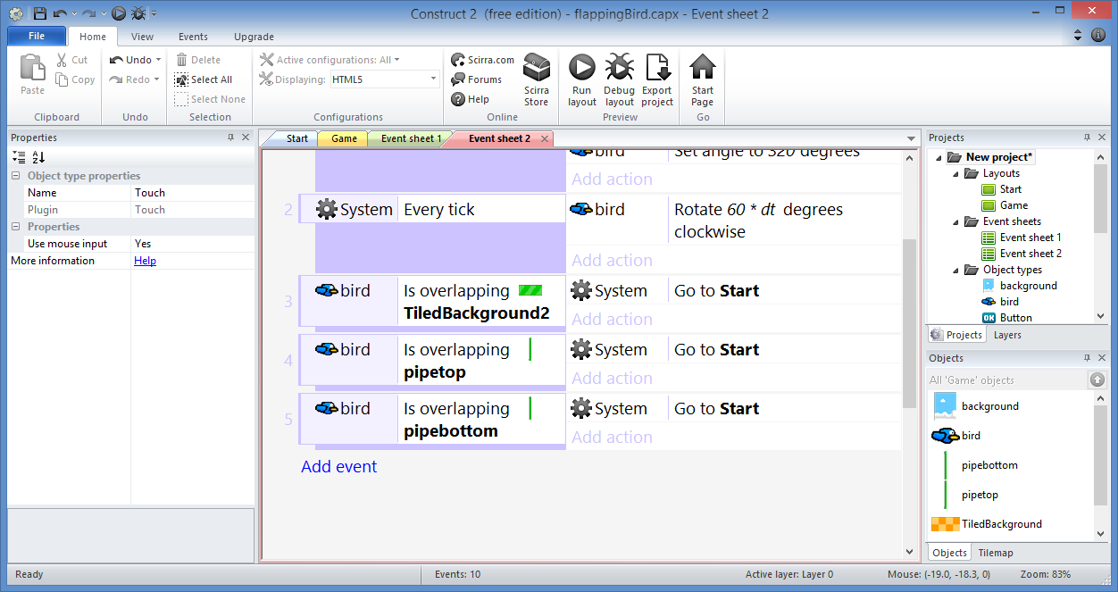
Enforce Boundary: Step 1
Click “Add event”

Slide 49
Enforce Boundary: Step 2
Select
“bird”
Click “Next”

Slide 50
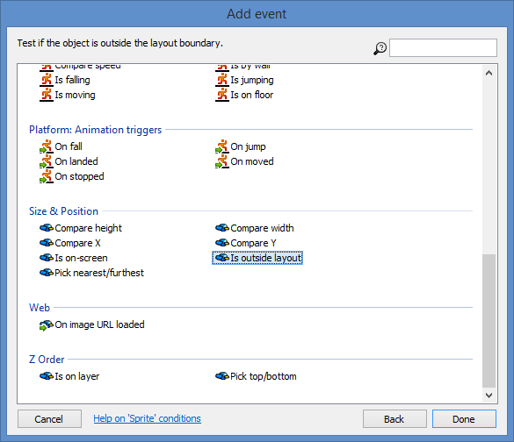
Enforce Boundary: Step 3
Select
“Is outside
layout”
Click “Done”

Slide 51
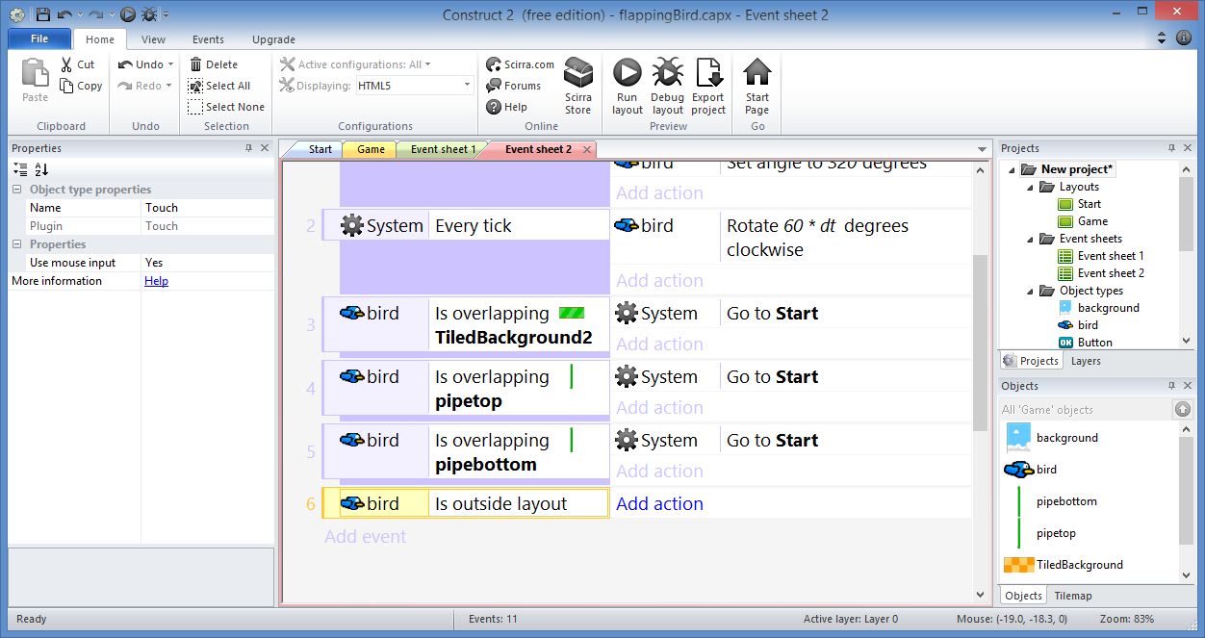
Enforce Boundary: Step 4
Click “Add action”

Slide 52
Enforce Boundary: Step 5
Select
“System”
Click “Next”

Slide 53
Enforce Boundary: Step 6
Select
“Go to layout”
Click “Next”

Slide 54
Enforce Boundary: Step 7
Select “Start” Layout
Click “Done”

Slide 55
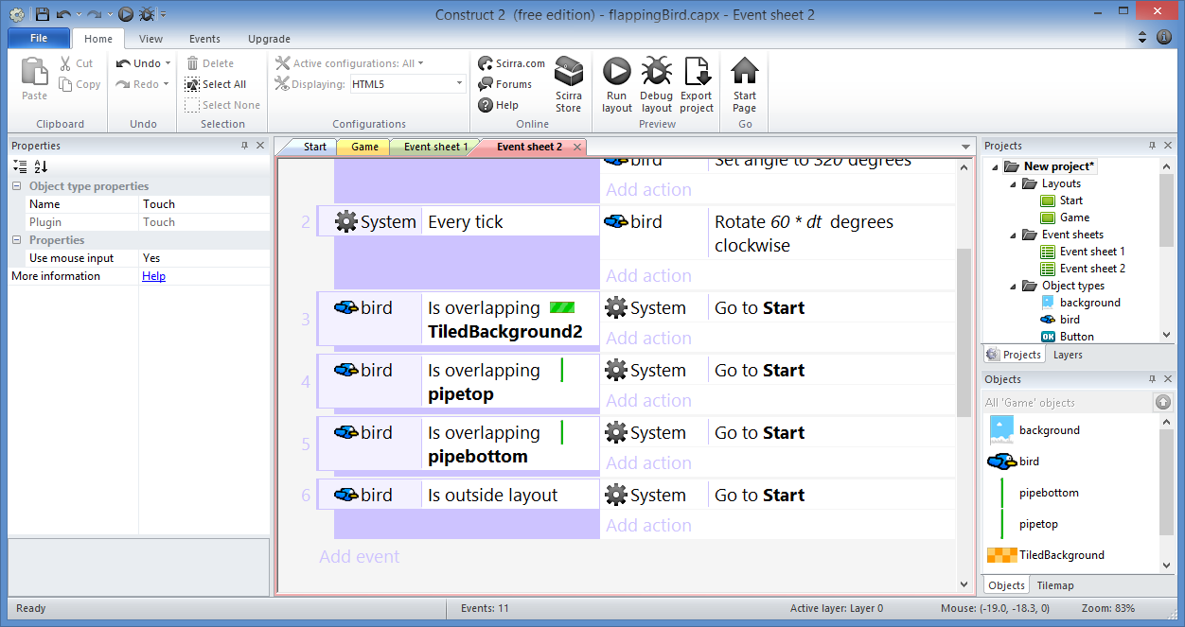
Enforce Boundary: Done!

Slide 56
Repeat Background

Slide 57
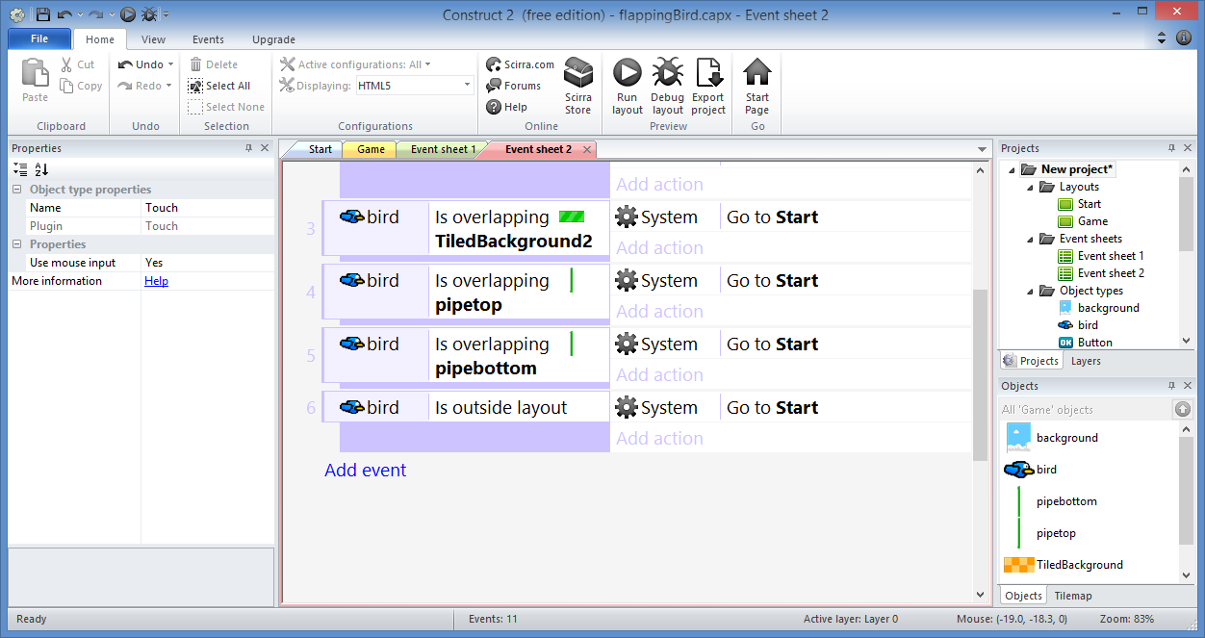
Repeat Background: Step 1
Click “Add event”

Slide 58
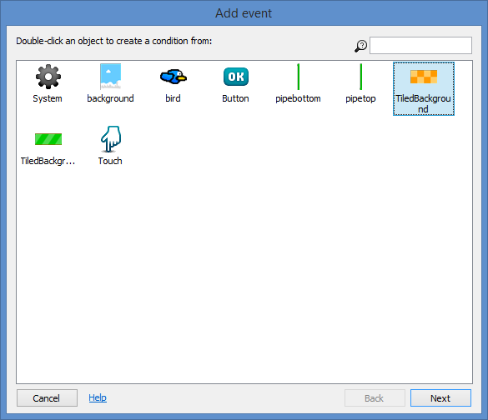
Repeat Background: Step 2
Select
“TiledBackground”
Click “Next”

Slide 59
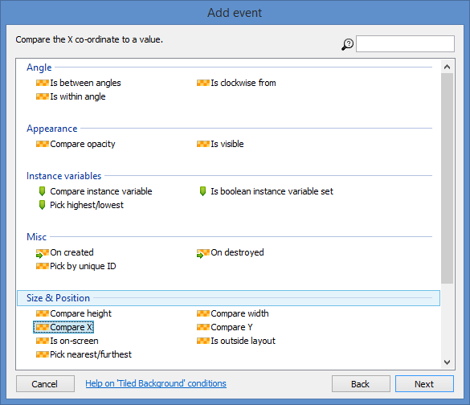
Repeat Background: Step 3
Select
“Compare X”
Click “Next”

Slide 60
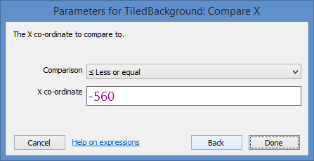
Repeat Background: Step 4
Select/Enter:
Comparison: ≤ Less or Equal
X co-ordinate: -560
Click “Done”

Slide 61
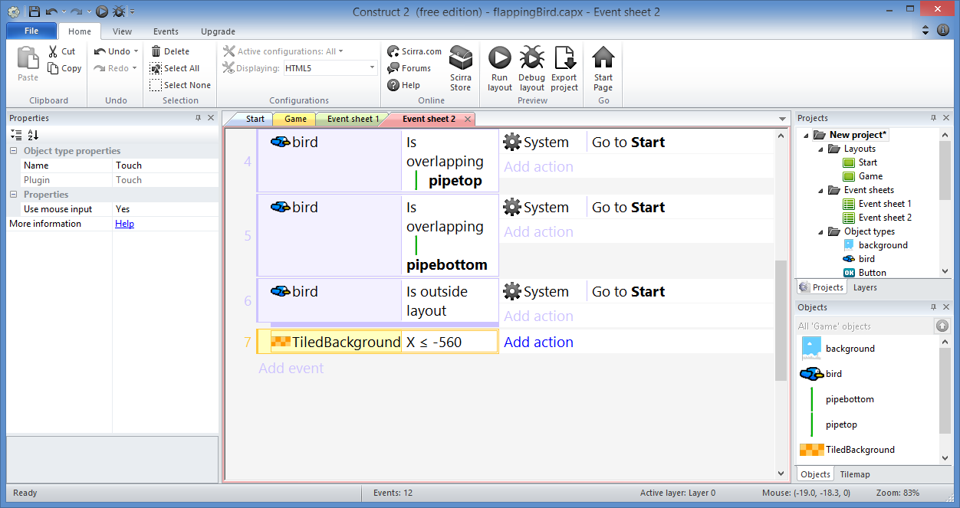
Repeat Background: Step 5
Click “Add action”

Slide 62
Repeat Background: Step 6
Select
“TiledBackground”
Click “Next”

Slide 63
Repeat Background: Step 7
Select
“Set X”
Click “Next”

Slide 64
Repeat Background: Step 8
Enter 0
Click “Done”

Slide 65
Repeat Background: Step 9…
Repeat previous steps for TileBackground2,
… but check for X ≤ -410

Slide 66
Repeat Background: Done!

Slide 67
Scroll Background

Slide 68
Scroll Background: Step 1
Click “Add event”

Slide 69
Scroll Background: Step 2
Select
“System”
Click “Next”

Slide 70
Scroll Background: Step 3
Select
“Every tick”
Click “Done”

Slide 71
Scroll Background: Step 4
Click “Add action”

Slide 72
Scroll Background: Step 5
Select
“pipebottom”
Click “Next”

Slide 73
Scroll Background: Step 7
Select
“Set X”
Click “Next”

Slide 74
Scroll Background: Step 8
Enter
pipebottom.X – SCROLLSPEED * dt
Click
“Done”

Slide 75
Scroll Background: Step 9…
Add similar actions for:
pipetop, TiledBackground, TileBackground2

Slide 76
Scroll Background: Done!
Hint: Set X to [object].X – SCROLLSPEED * dt

Slide 77
(END of Part 2)
Derived from ‘Make your own "Flappy Bird" game in 10 minutes’ originally published by Tom
Updated with enhancements from Flappy Bird template

