Slide 1
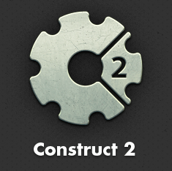
Create Pipes

Slide 2
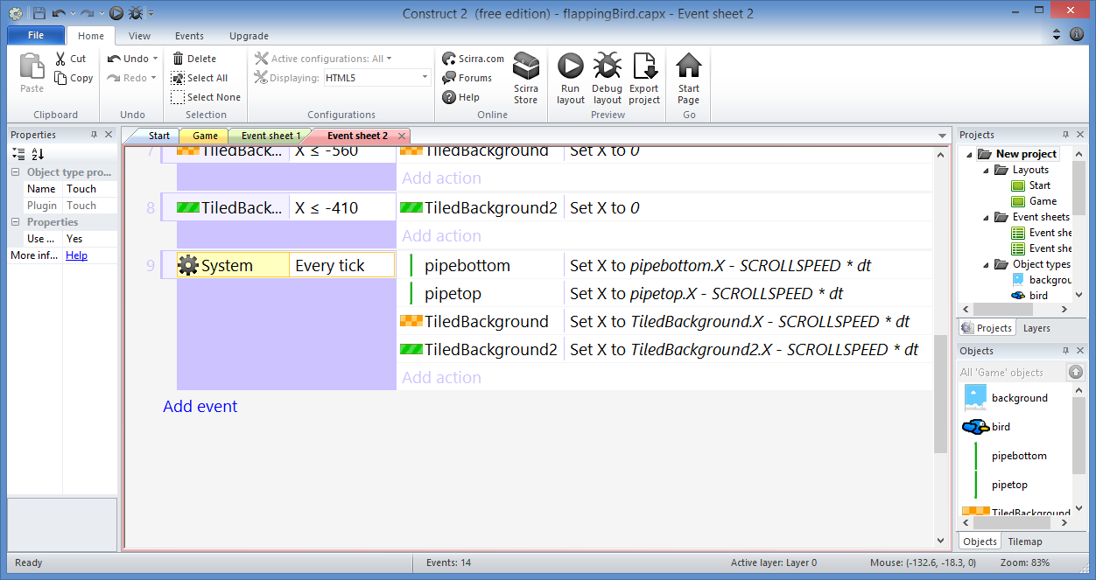
Create Pipes: Step 1
Click “Add event”

Slide 3
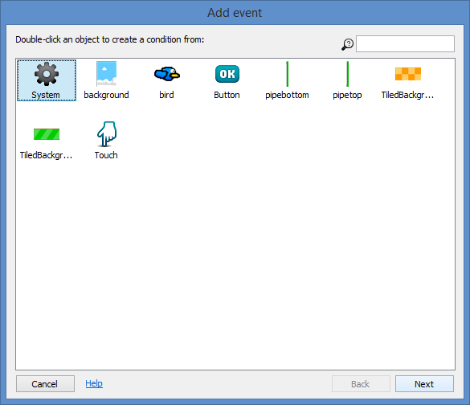
Create Pipes: Step 2
Select
“System”
Click “Next”

Slide 4
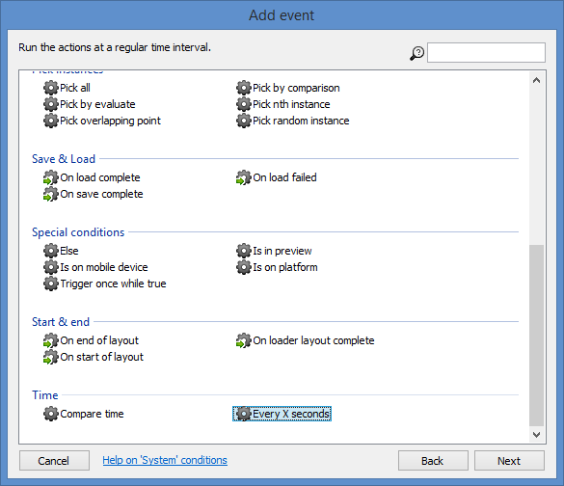
Create Pipes: Step 3
Select
“Every X seconds”
Click “Next”

Slide 5
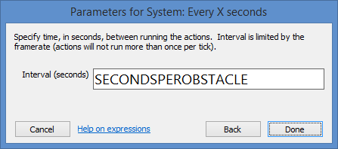
Create Pipes: Step 4
Enter:
Interval: SECONDSPEROBSTACLE
Click
“Done”

Slide 6
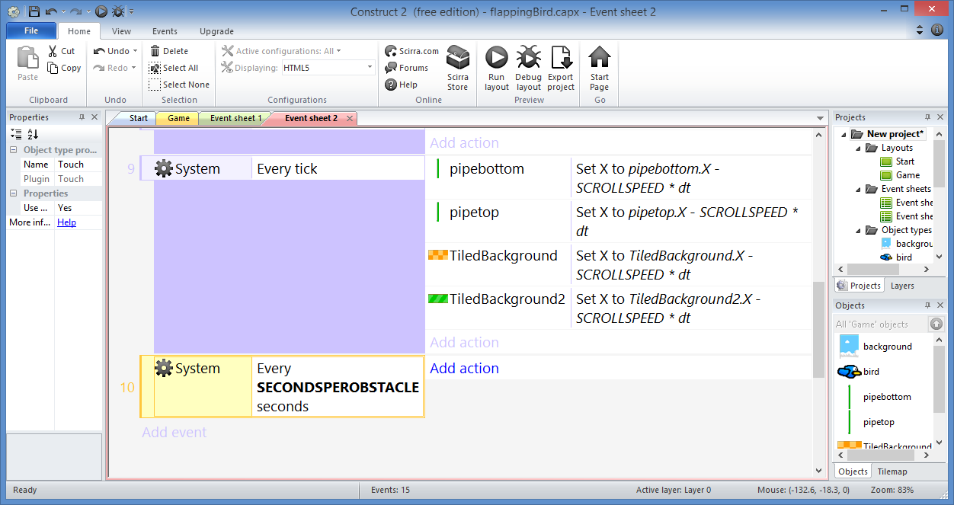
Create Pipes: Step 5
Click “Add action”

Slide 7
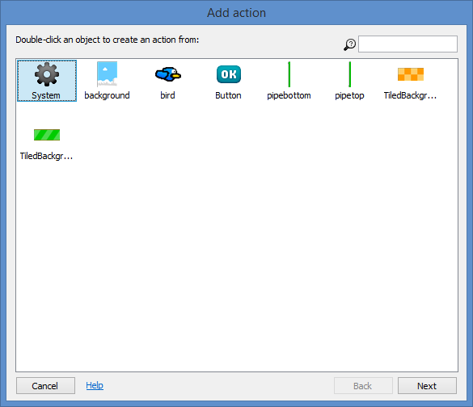
Create Pipes: Step 6
Select
“System”
Click “Next”

Slide 8
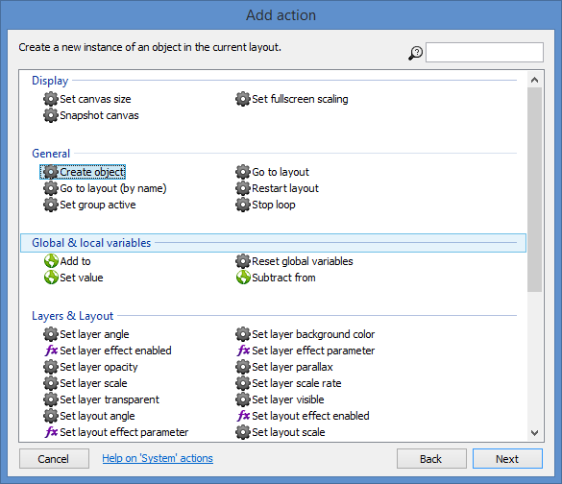
Create Pipes: Step 7
Select
“Create object”
Click “Next”

Slide 9
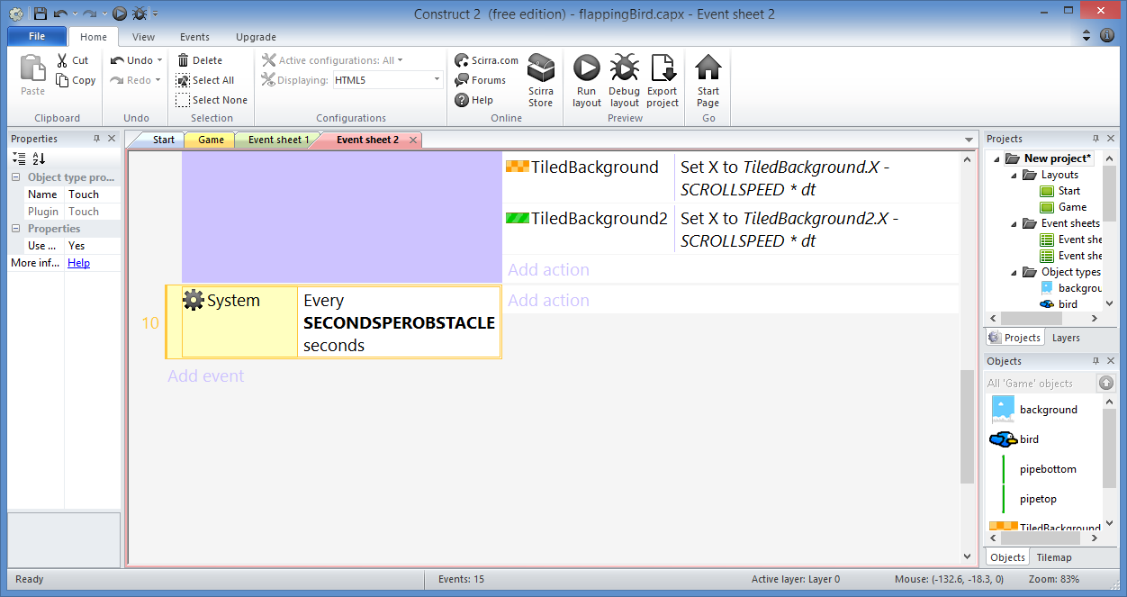
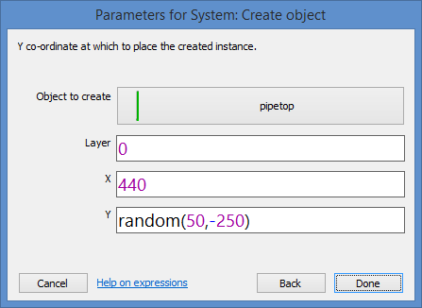
Create Pipes: Step 8
Select/Enter:
Object to create: pipetop
Layer: 0
X: 440
Y: random(50, -250)
Click
“Done”

Slide 10
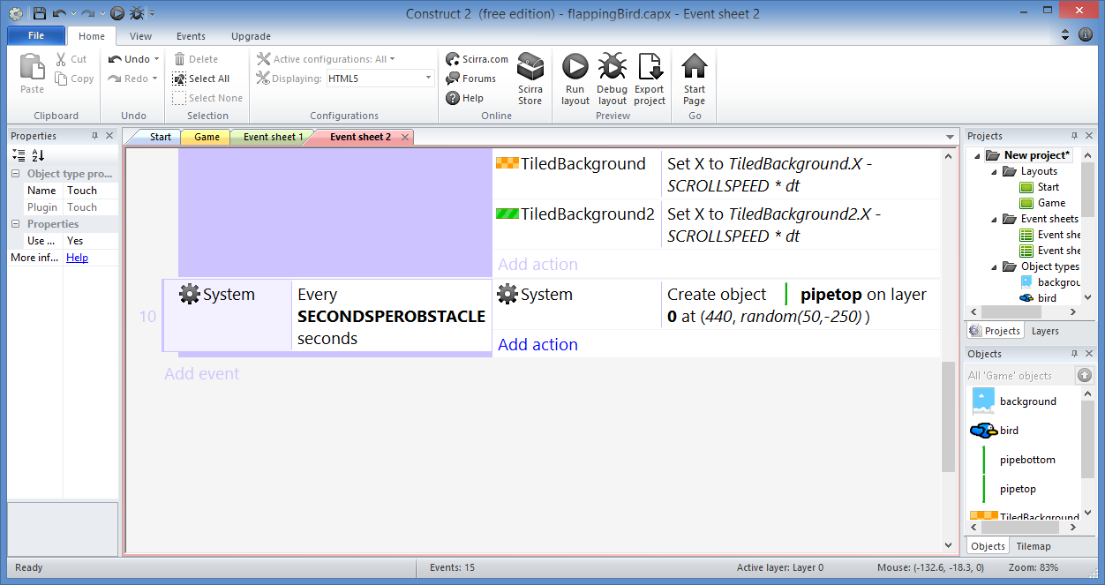
Create Pipes: Step 9…
Add similar action for pipebottom
… but use Y = TopPipe.Y + 750

Slide 11
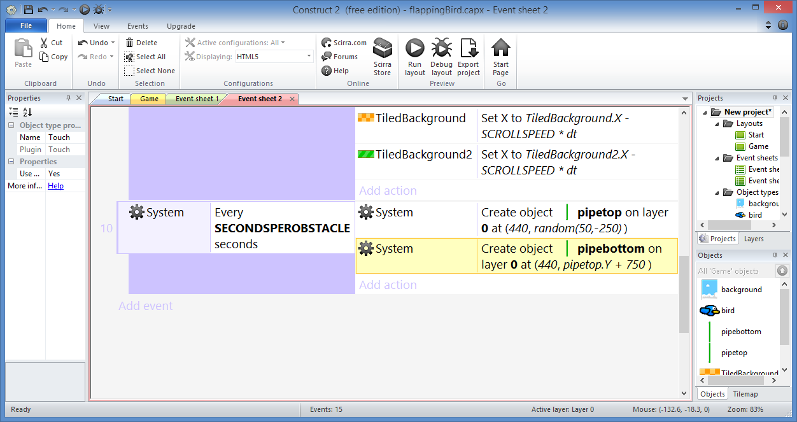
Create Pipes: Done!

Slide 12
Add Instance Variable

Slide 13
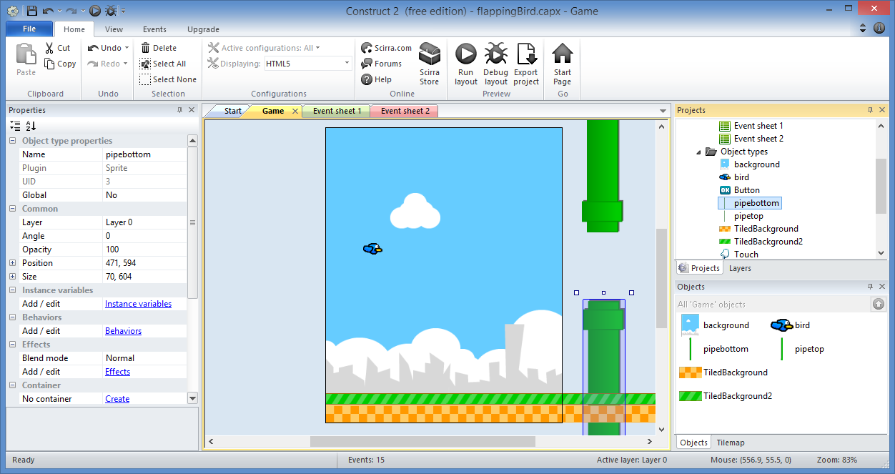
Add Instance Variable: Step 1
Select
“pipebottom”

Slide 14
Add Instance Variable: Step 2
Click
Instance
variables

Slide 15
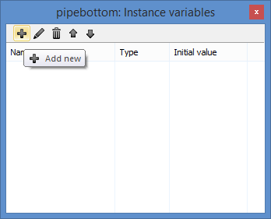
Add Instance Variable: Step 3
Click
“Add new”

Slide 16
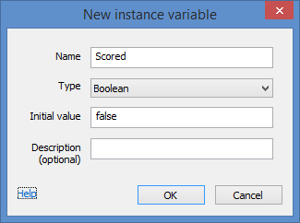
Add Instance Variable: Step 4
Enter:
Name: Scored
Type: Boolean
Initial value: false
Description (optional)
Click “OK”

Slide 17
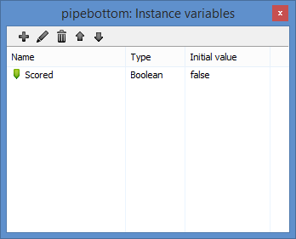
Add Instance Variable: Step 5
Close
popup

Slide 18
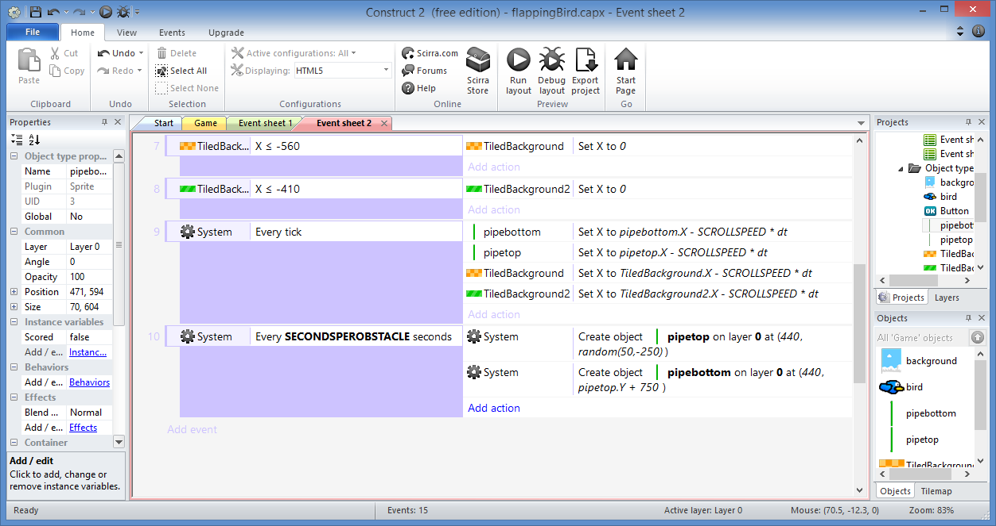
Add Instance Variable: Step 6
Click “Add action”

Slide 19
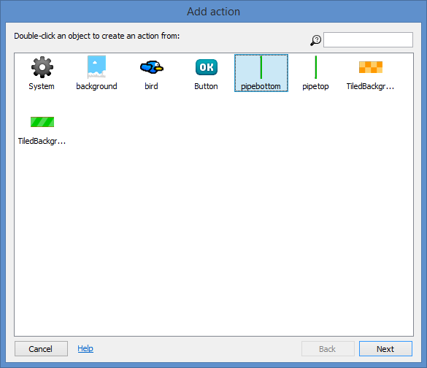
Add Instance Variable: Step 7
Select
“pipebottom”
Click “Next”

Slide 20
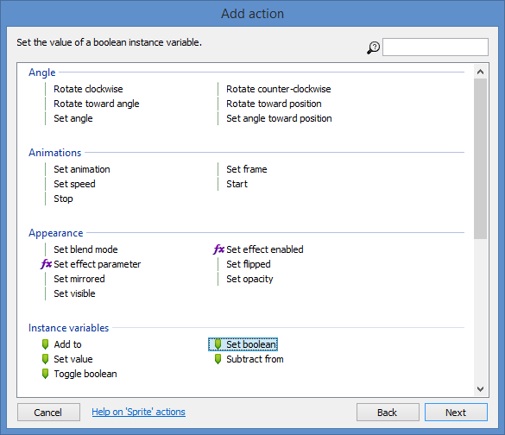
Add Instance Variable: Step 8
Select
“boolean”
Click “Next”

Slide 21
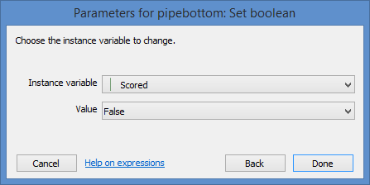
Add Instance Variable: Step 9
Select
Value: False
Click
“Done”

Slide 22
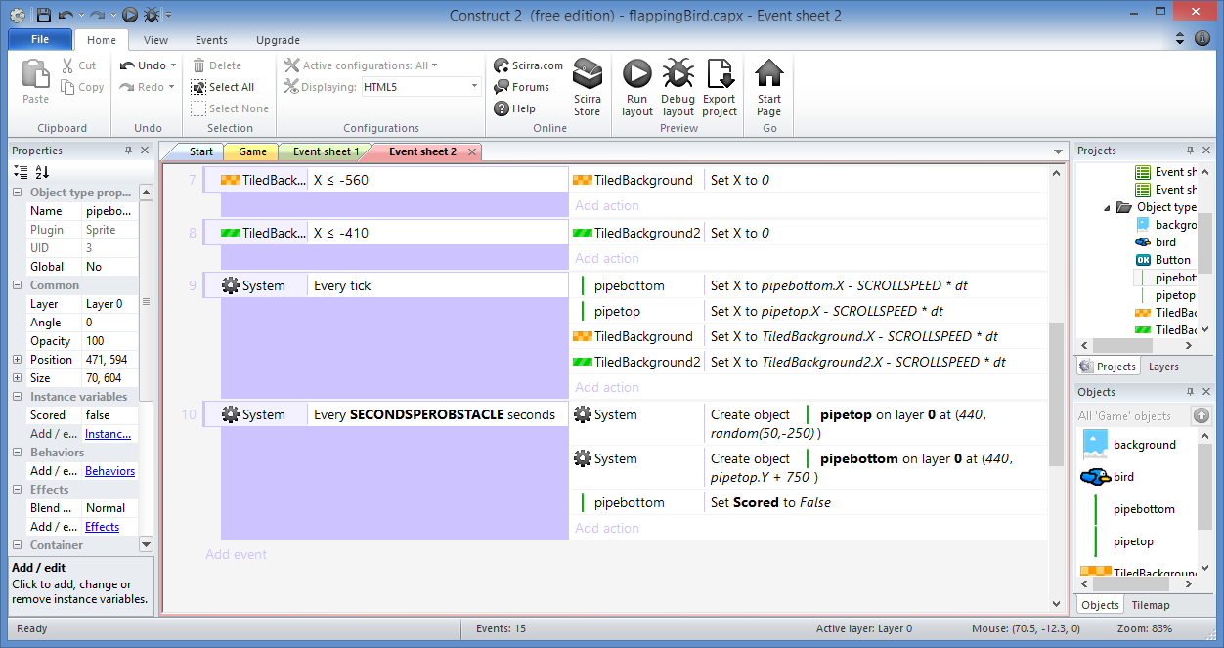
Add Instance Variable: Done!

Slide 23
Add Score TextBox

Slide 24
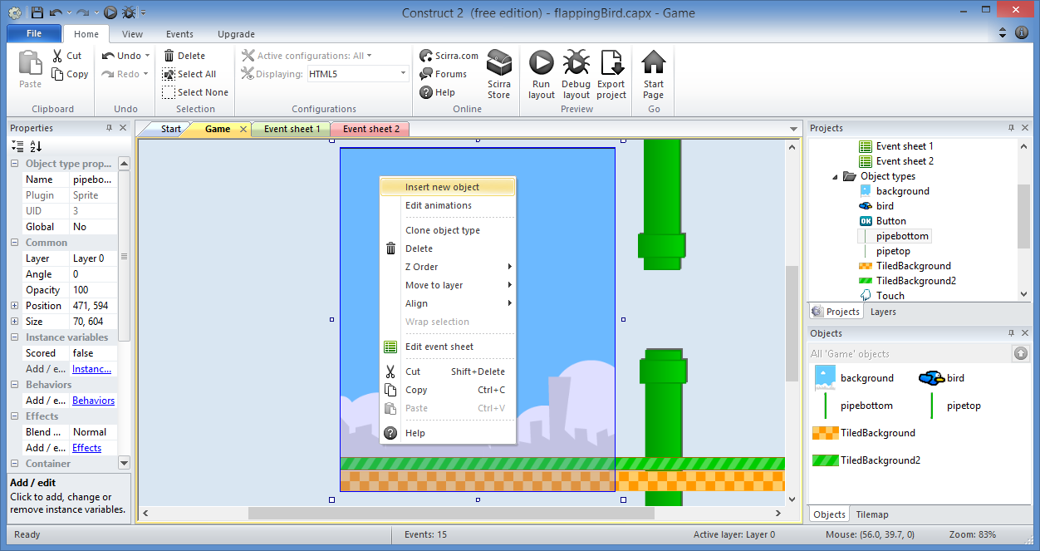
Add Score TextBox: Step 1
Right-click
then
Insert
new
object

Slide 25
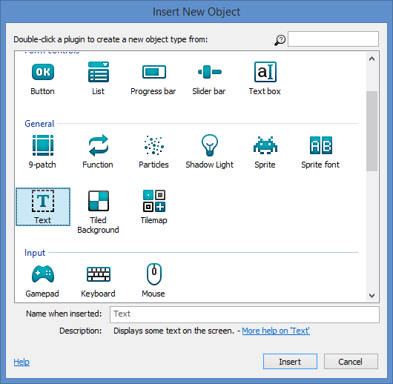
Add Score TextBox: Step 2
Select
“Text”
Click “Insert”

Slide 26
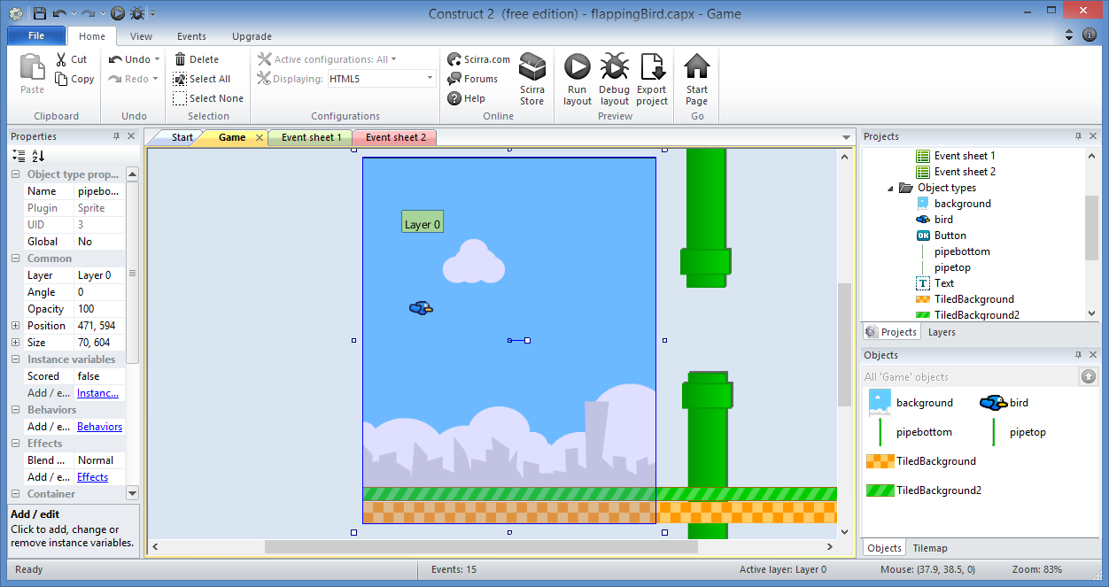
Add Score TextBox: Step 3
Click inside
Layout
to place
TextBox

Slide 27
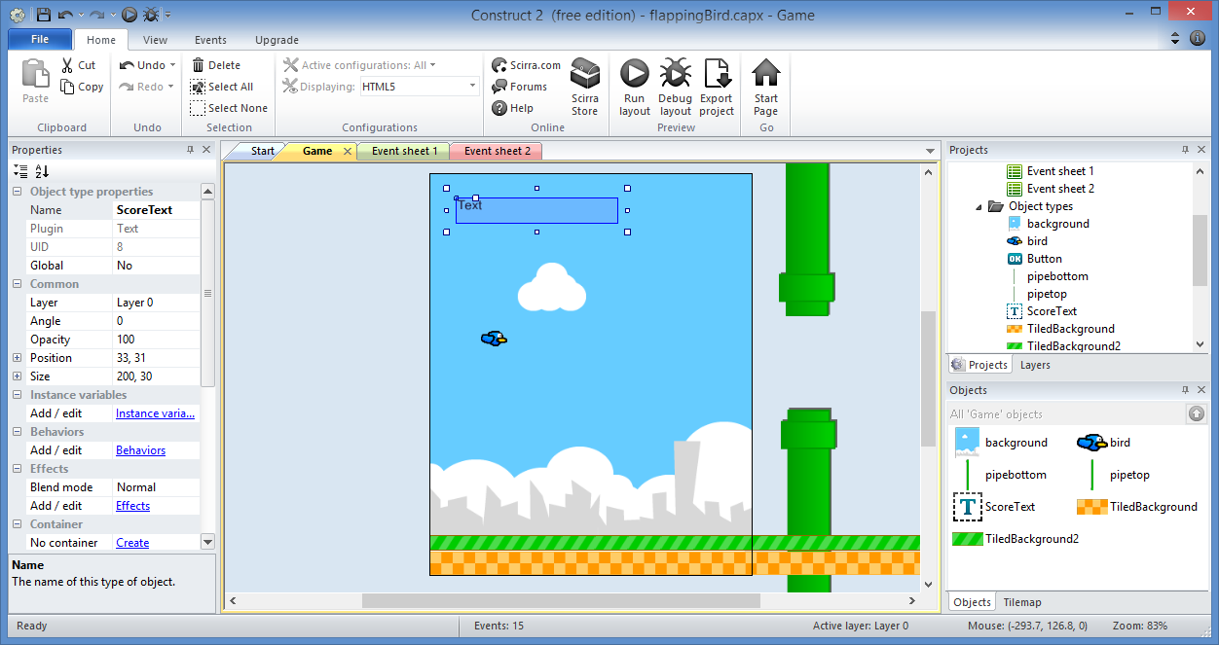
Add Score TextBox: Step 3
Rename
to
“ScoreText”

Slide 28
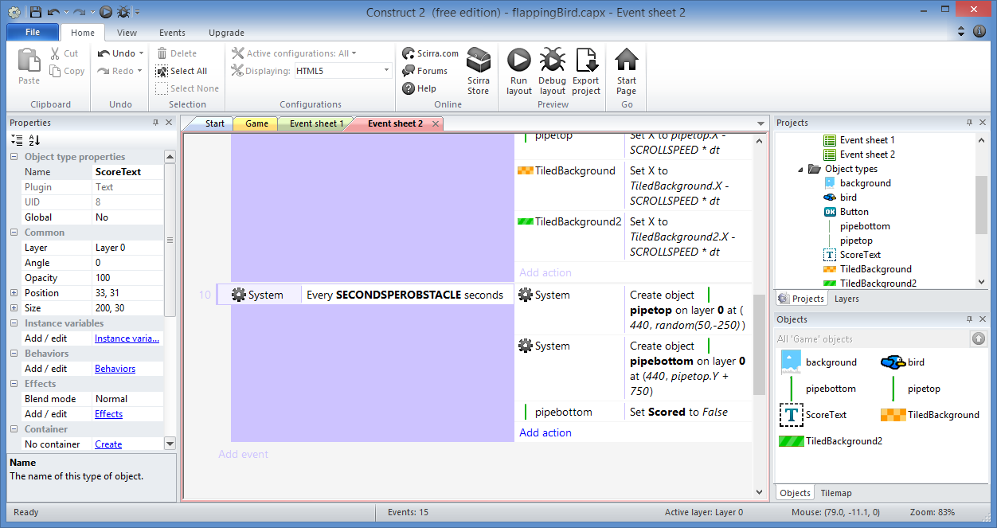
Add Score TextBox: Step 4
Click “Add action”in Event Sheet 2

Slide 29
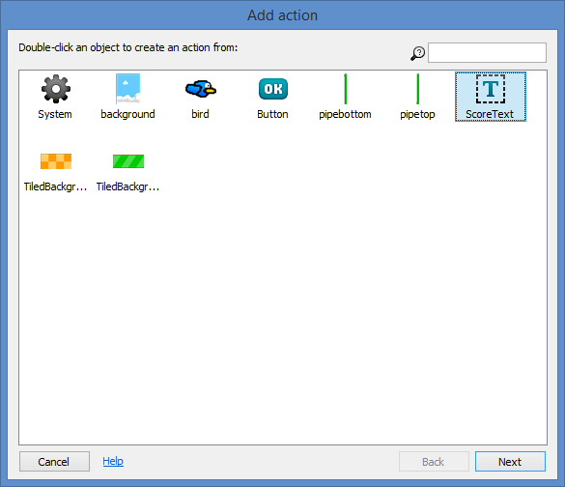
Add Score TextBox: Step 5
Select
“ScoreText”
Click “Next”

Slide 30
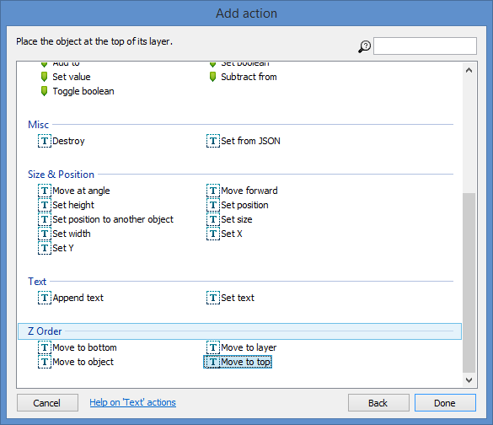
Add Score TextBox: Step 6
Select
“Move to top”
Click “Done”

Slide 31
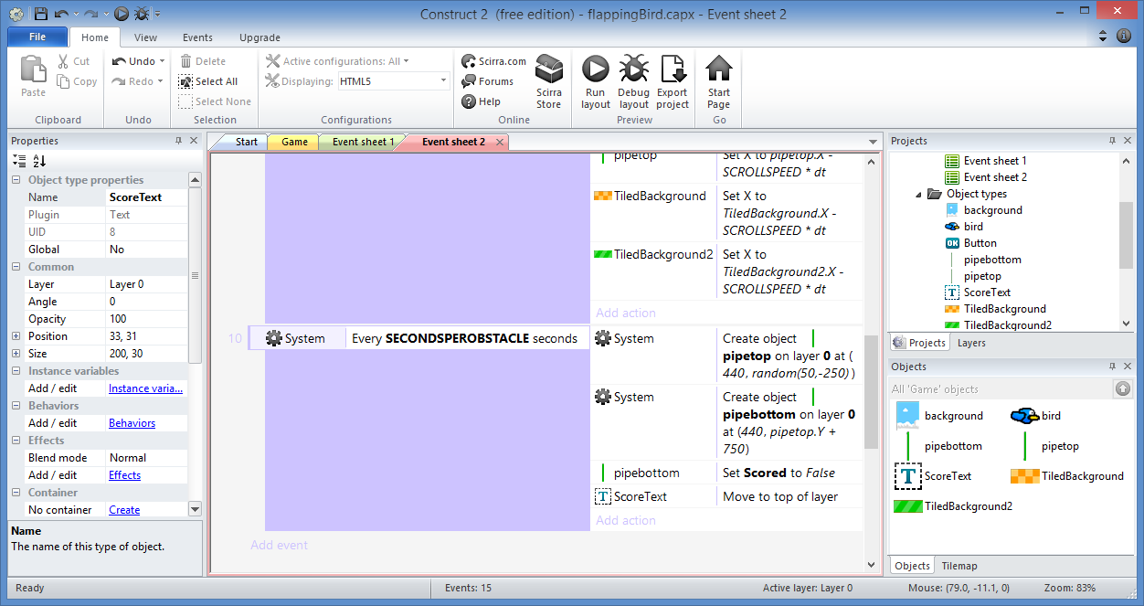
Add Score TextBox: Done!

Slide 32
Add OnStart Events

Slide 33
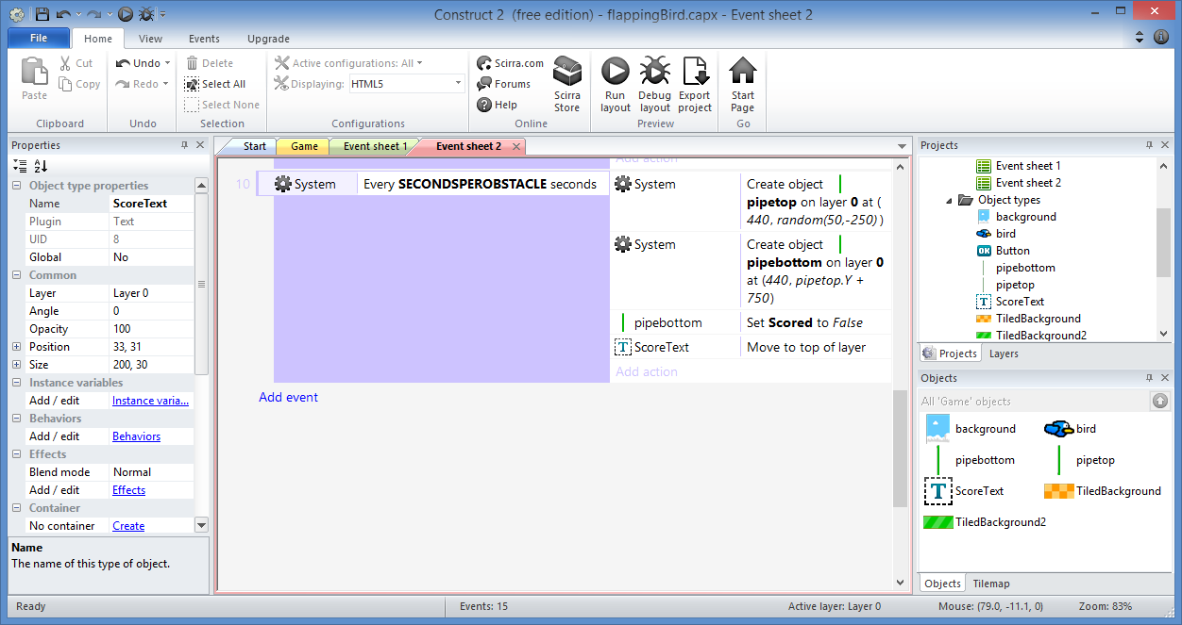
Add OnStart Events: Step 1
Click “Add event”

Slide 34
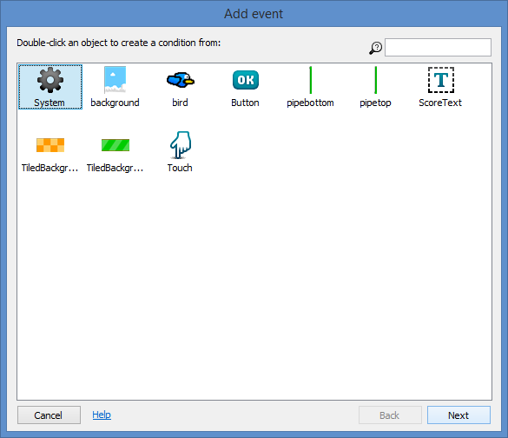
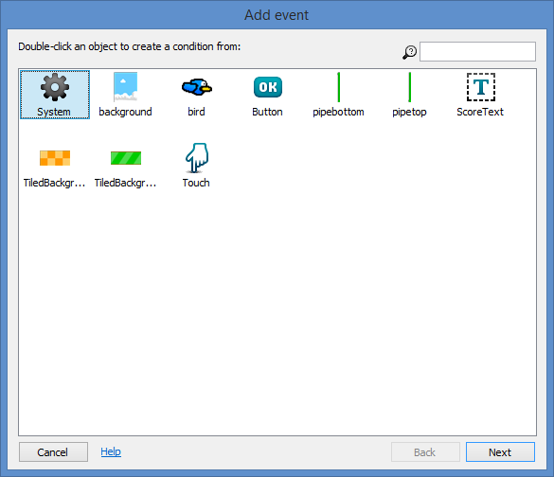
Add OnStart Events: Step 2
Select
“System”
Click “Next”

Slide 35
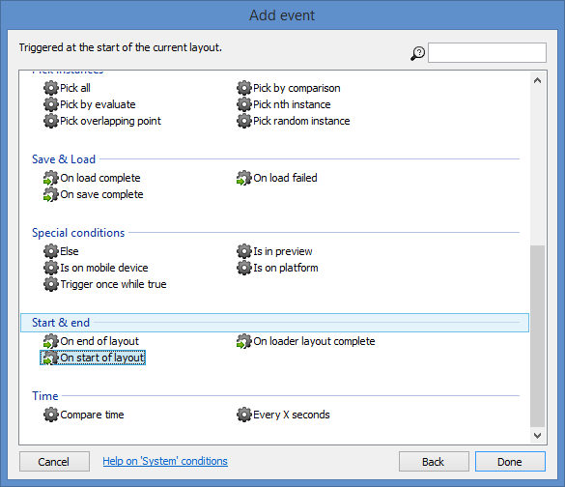
Add OnStart Events: Step 3
Select
“On start of layout”
Click “Done”

Slide 36
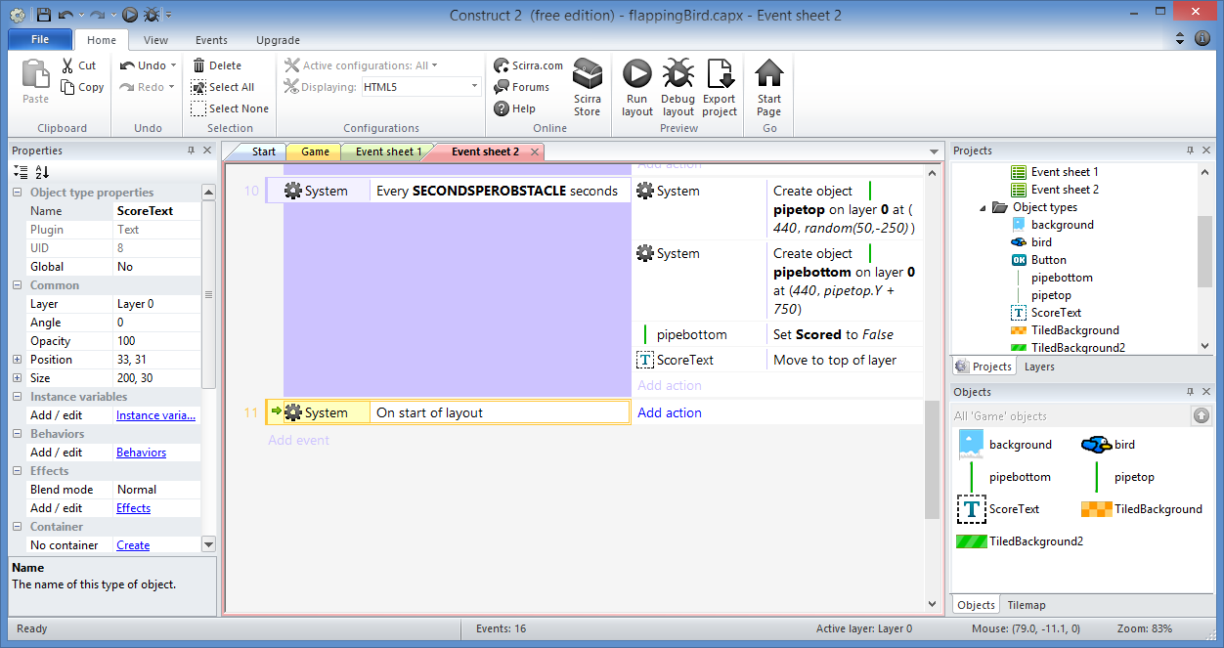
Add OnStart Events: Step 4
Click “Add action”

Slide 37
Add OnStart Events: Step 5
Select
“ScoreText”
Click “Next”

Slide 38
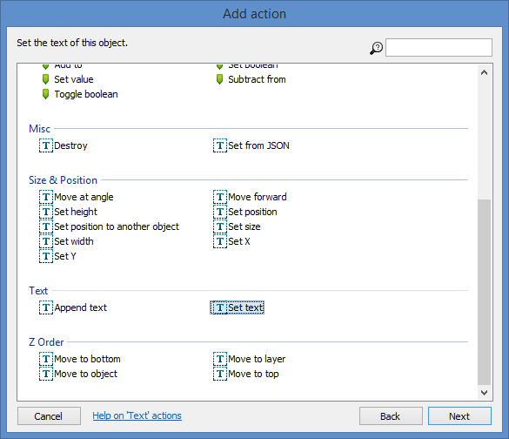
Add OnStart Events: Step 6
Select
“Set text”
Click “Next”

Slide 39
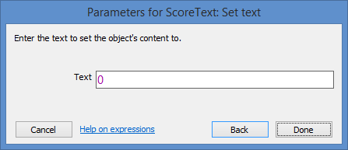
Add OnStart Events: Step 8
Enter:
Text: 0
Click
“Done”

Slide 40
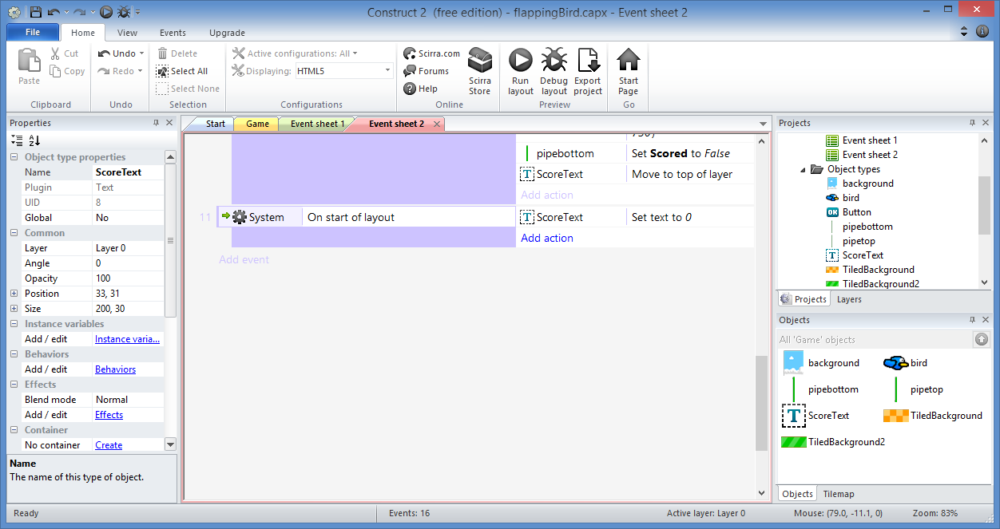
Add OnStart Events: Step 9…
Add more actions:
TiledBackground2: Set X to 0
TiledBackground: Set X to 0
System: Set Score to 0

Slide 41
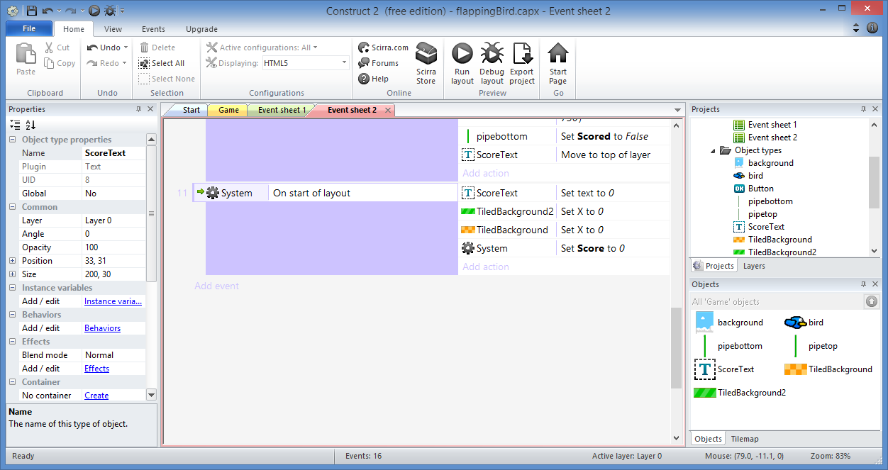
Add OnStart Events: Done!

Slide 42
Destroy Pipes

Slide 43
Destroy Pipes: Step 1
Click “Add action”

Slide 44
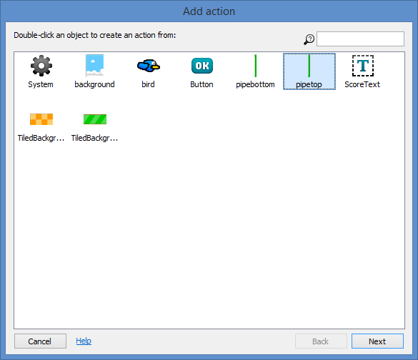
Destroy Pipes: Step 2
Select
“pipetop”
Click “Next”

Slide 45
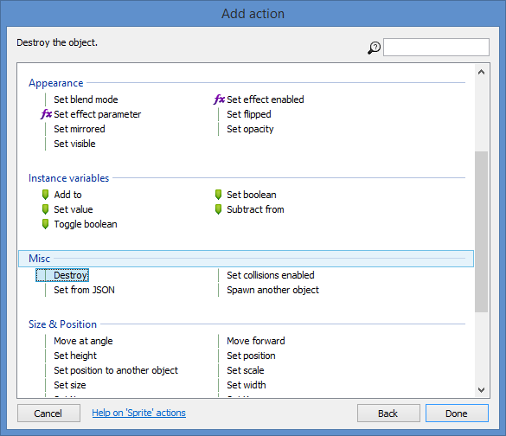
Destroy Pipes: Step 3
Select
“Destroy”
Click “Done”

Slide 46
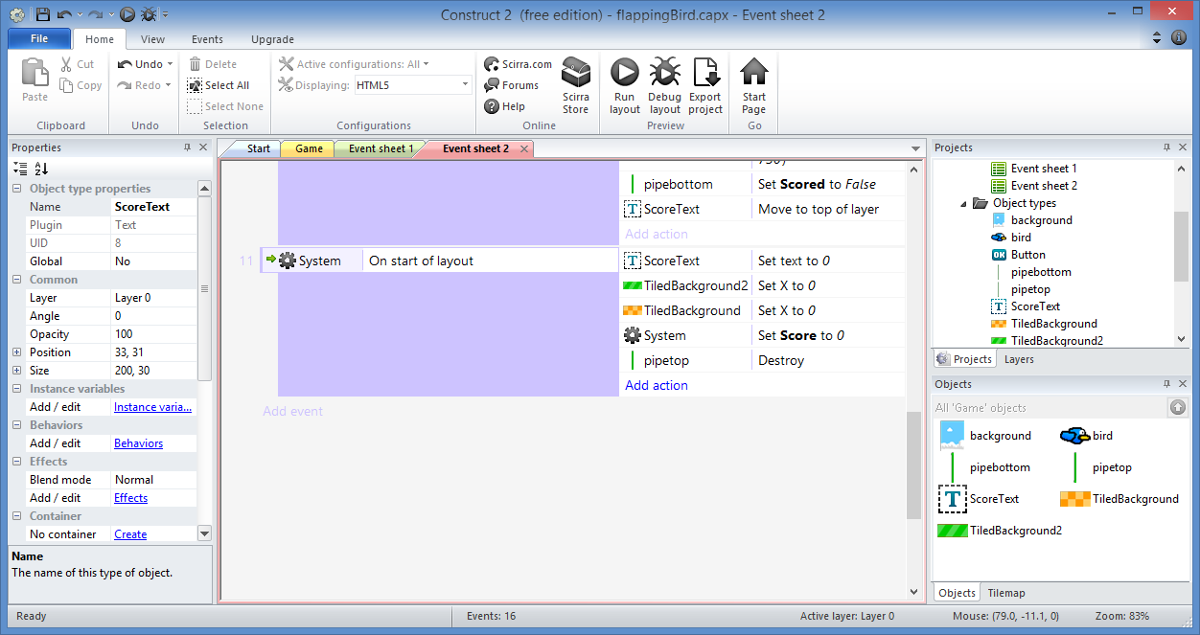
Destroy Pipes: Step 4…
Add a similar action
for pipebottom to Destroy it

Slide 47
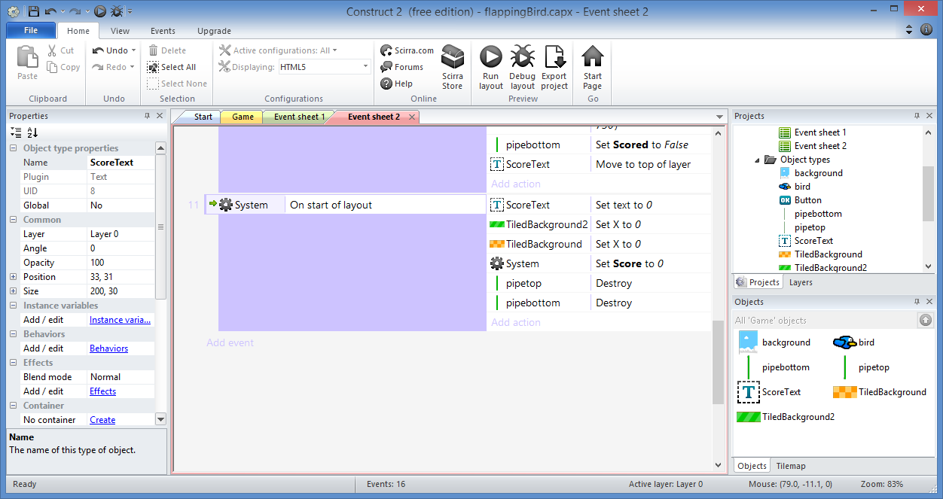
Destroy Pipes: Done!

Slide 48
Initialize Bird

Slide 49
Initialize Bird: Step 1
Click “Add action”

Slide 50
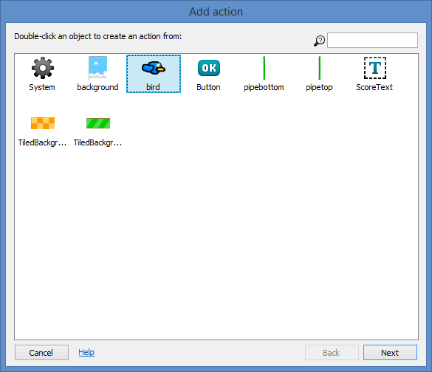
Initialize Bird: Step 2
Select
“bird”
Click “Next”

Slide 51
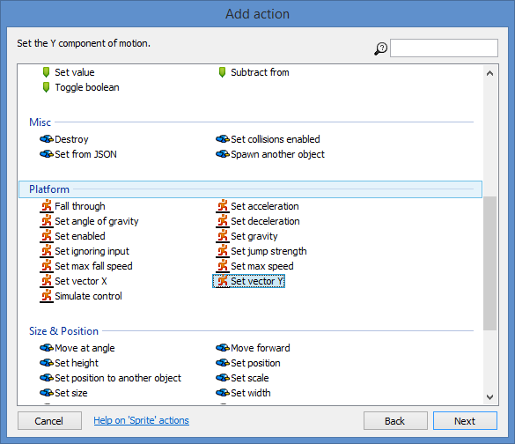
Initialize Bird: Step 3
Select
“Set Vector Y”
Click “Next”

Slide 52
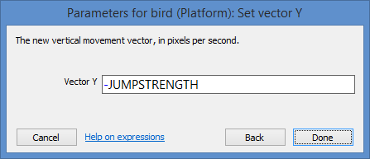
Initialize Bird: Step 4
Enter:
Vector Y: -JUMPSTRENGTH
Click
“Done”

Slide 53
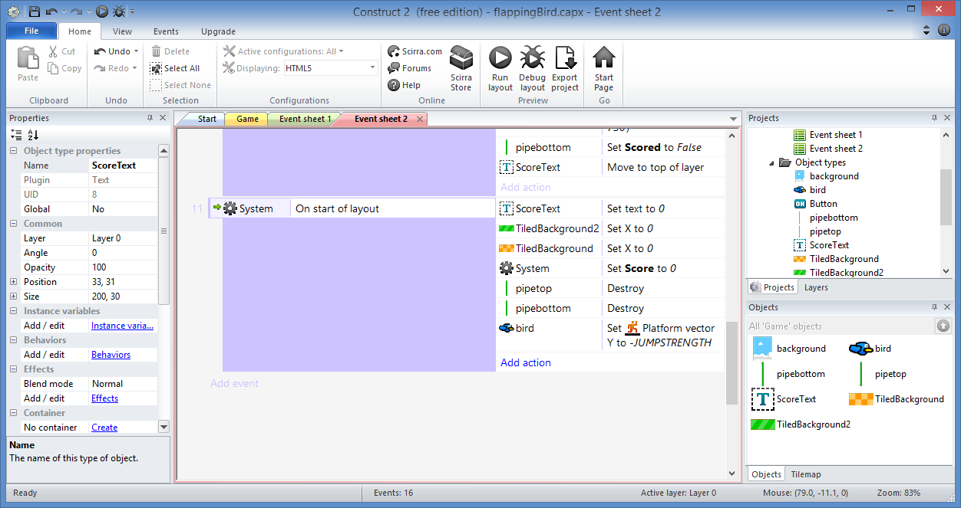
Initialize Bird: Step 5
Click “Add action”

Slide 54
Initialize Bird: Step 6
Select
“bird”
Click “Next”

Slide 55
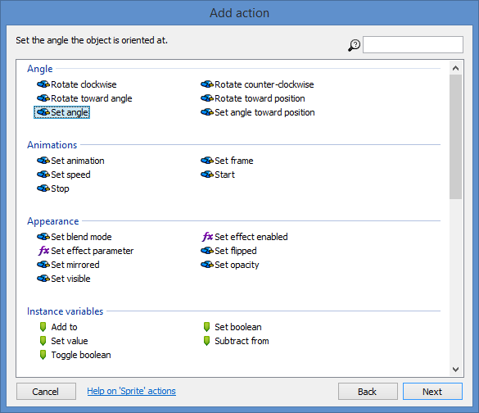
Initialize Bird: Step 7
Select
“Set angle”
Click “Next”

Slide 56
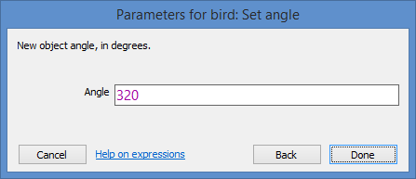
Initialize Bird: Step 8
Enter:
Angle: 320
Click
“Done”

Slide 57
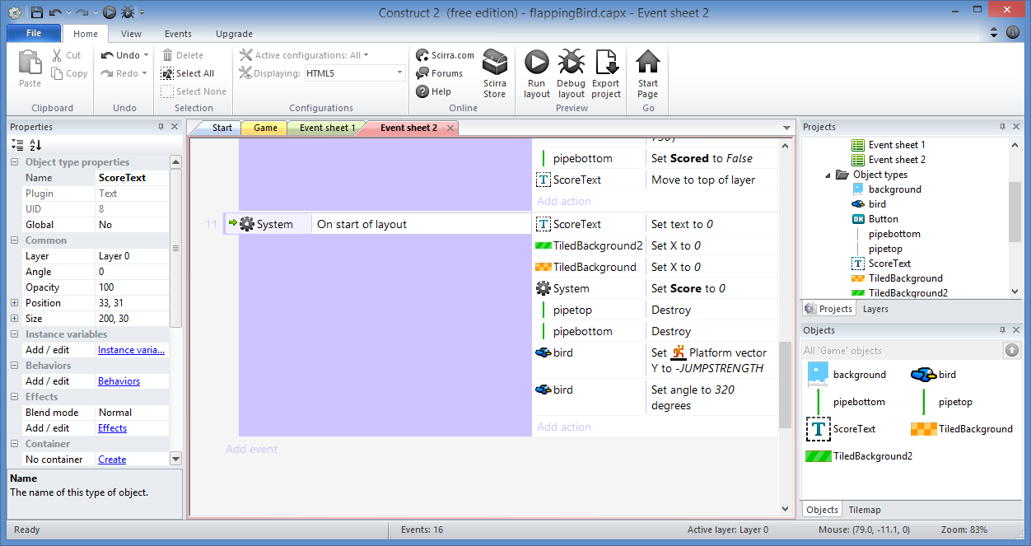
Initialize Bird: Done!

Slide 58
Add Scoring Events

Slide 59
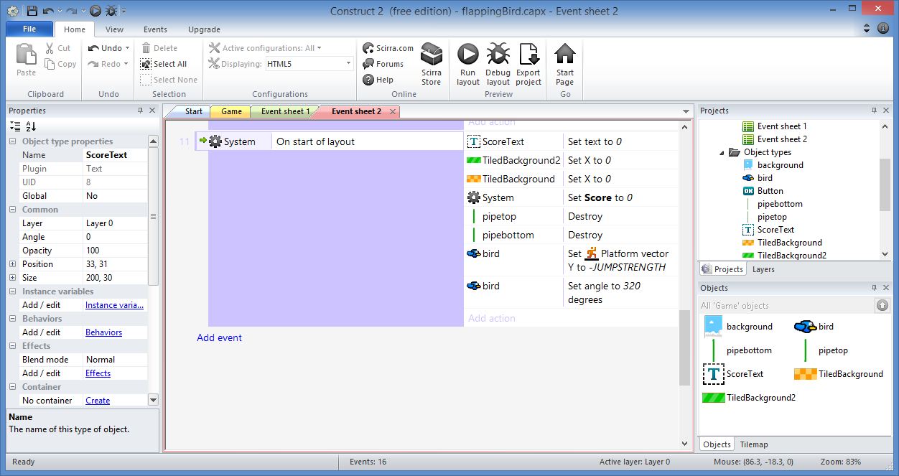
Add Scoring Events: Step 1
Click “Add event”

Slide 60
Add Scoring Events: Step 2
Select
“pipebottom”
Click “Next”

Slide 61
Add Scoring Events: Step 3
Select
“Compare X”
Click “Next”

Slide 62
Add Scoring Events: Step 4
Select/Enter:
Comparison: ≤ Less or equal
X co-ordinate: Bird.X
Click
“Done”

Slide 63
Add Scoring Events: Step 5
Click “Add action”

Slide 64
Add Scoring Events: Step 6
Select
“System”
Click “Next”

Slide 65
Add Scoring Events: Step 7
Select
“Add to”
Click “Next”

Slide 66
Add Scoring Events: Step 8
Select/Enter:
Variable: Score
Value: 1
Click
“Done”

Slide 67
Add Scoring Events: Step 9
Right-click, then
Add another condition (C)

Slide 68
Add Scoring Events: Step 10
Select
“pipebottom”
Click “Next”

Slide 69
Add Scoring Events: Step 11
Select
“Is boolean instance
Variable set”
Click “Next”

Slide 70
Add Scoring Events: Step 12
Select:
Instance variable: Scored
Click
“Done”

Slide 71
Add Scoring Events: Step 13
Click “Add action”

Slide 72
Add Scoring Events: Step 14
Select
“ScoreText”
Click “Next”

Slide 73
Add Scoring Events: Step 15
Select
“Set text”
Click “Next”

Slide 74
Create Pipes: Step 16
Enter:
Text: Score
Click
“Done”

Slide 75
Add Scoring Events: Step 17
Click “Add action”

Slide 76
Add Scoring Events: Step 19
Select
“pipebottom”
Click “Next”

Slide 77
Add Scoring Events: Step 20
Select
“Set boolean”
Click “Next”

Slide 78
Add Scoring Events: Step 16
Select/Enter:
Instance variable: Scored
Value: True
Click
“Done”

Slide 79
Add Scoring Events: Step 17
Right-click,
then
Invert

Slide 80
Add Scoring Events: Done!

Slide 81
(END of Part 3)
Derived from ‘Make your own "Flappy Bird" game in 10 minutes’ originally published by Tom
Updated with enhancements from Flappy Bird template

