Slide 1
Capture the Cloud with Azure
Shahed Chowdhuri
Sr. Technical Evangelist @ Microsoft

Slide 2
Why the cloud?

Slide 3
Why the cloud?
Rapidly setup environments to drive business priorities
Scale to meet peak demands
Increase daily activities, efficiency and reduced cost.
Speed
Scale
Economics

Slide 4
Why the cloud?
  Hosting models
  Business model
  On Premises
  Infrastructure
  (as a Service)
  Platform
  (as a Service)
  Software
  (as a Service)
  Applications
Applications
  You manage
Applications
Applications
  You scale, make resilient and manage
  You scale, make
  resilient & manage
Data
Data
Data
Data
Runtime
Runtime
Runtime
Runtime
  Scale, resilience and
  management by vendor
Middleware
Middleware
Middleware
  Scale, resilience and
  management by vendor
Middleware
O/S
O/S
O/S
O/S
Virtualization
Virtualization
  Managed by vendor
Virtualization
Virtualization
Servers
Servers
Servers
Servers
Storage
Storage
Storage
Storage
Networking
Networking
Networking
Networking

Slide 5
Azure

Slide 6
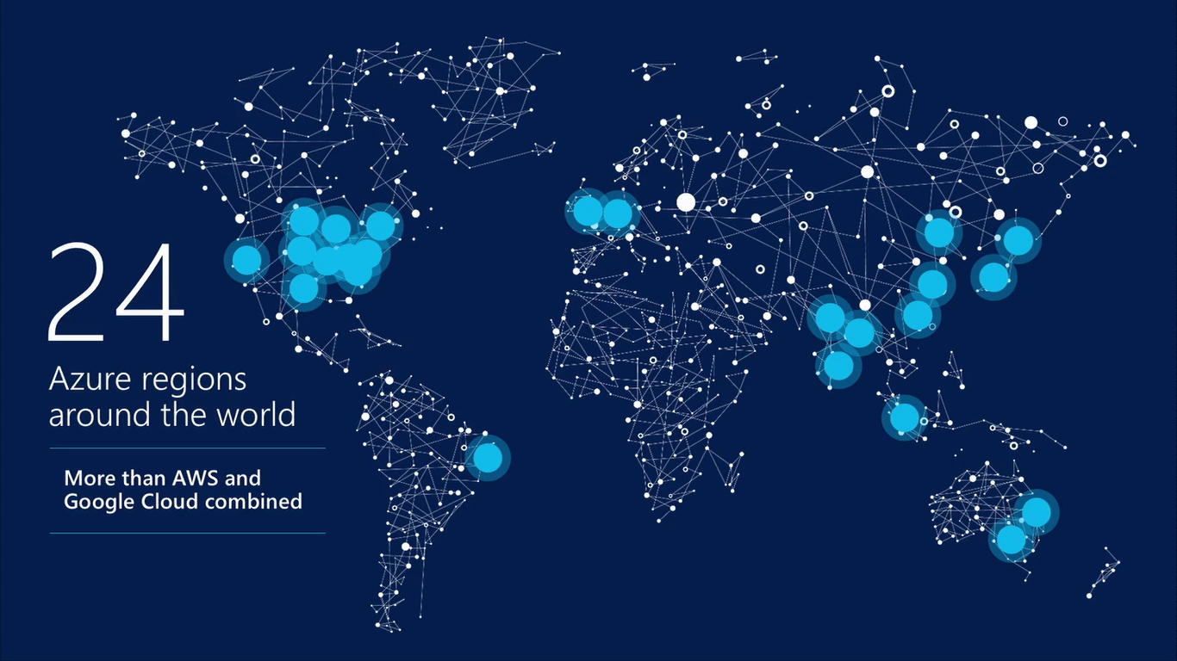
17 regions worldwide in 2015
Azure footprint
Data Centers
Regional Partners
Notes:
Speaker notes:
Broad global reach
Azure maintains a global presence across 17 datacenter around the world to help customers and partners meet their goal of providing applications close to their user base.
Mention contribution of regional partners help Azure’s global presence.
Microsoft's continued investment in subsea and terrestrial dark fiber capacity helping deliver data at higher speeds, with higher capacity and lower latency for our customers across the globe.
Use the following notes if you want to address some or all security, compliance, transparency and privacy concerns of the audience.
Microsoft has leveraged its decades-long experience in operating some of the world’s largest online services to create a robust set of security technologies and practices to keep your data at rest or in motion secured in Azure.
Azure meets a broad set of international and industry-specific compliance standards as part of help customer attain compliance for their own infrastructure running on the platform.
Azure is subjected to rigorous audits by independent organizations and the results are available to you as a part of Microsoft's commitment to transparency.
Azure adheres to stringent privacy policies through a program called Privacy by Design which describes Microsoft's core privacy concerns to protect customer data and how to address them. Those protections are then backed with strong contractual commitments to safeguard customer data with by abiding by the EU Model Clauses, Safe Harbor programs, and ISO/IEC 27018 (which governs the processing of personal information).

Slide 7
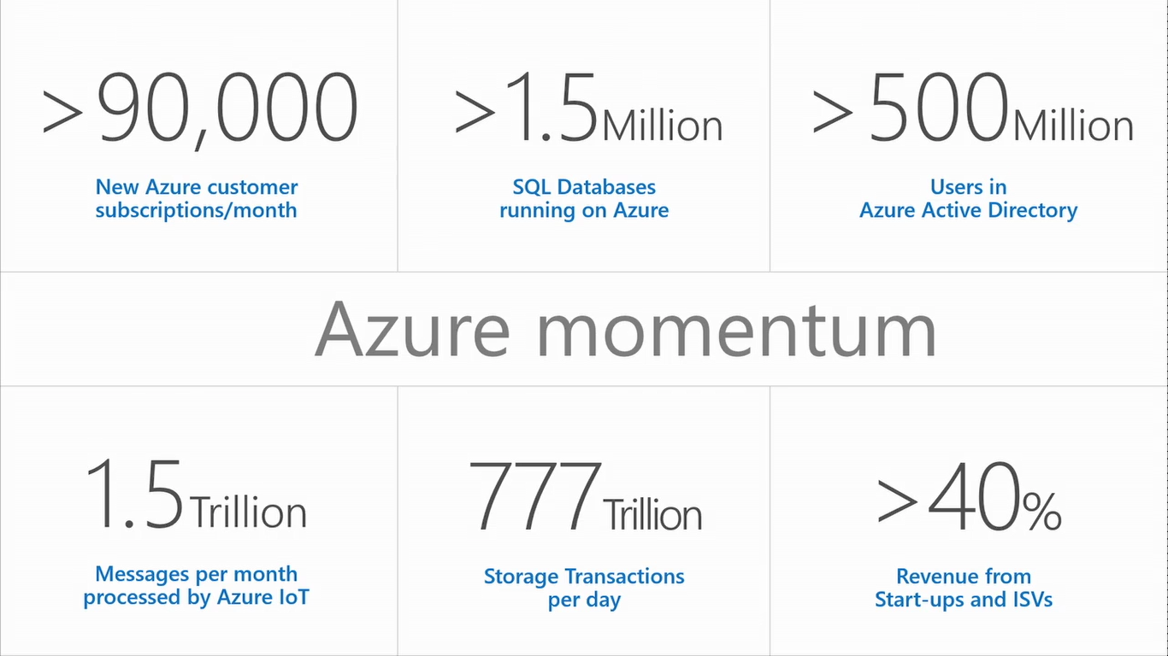

Slide 8






















































Partners

Slide 9
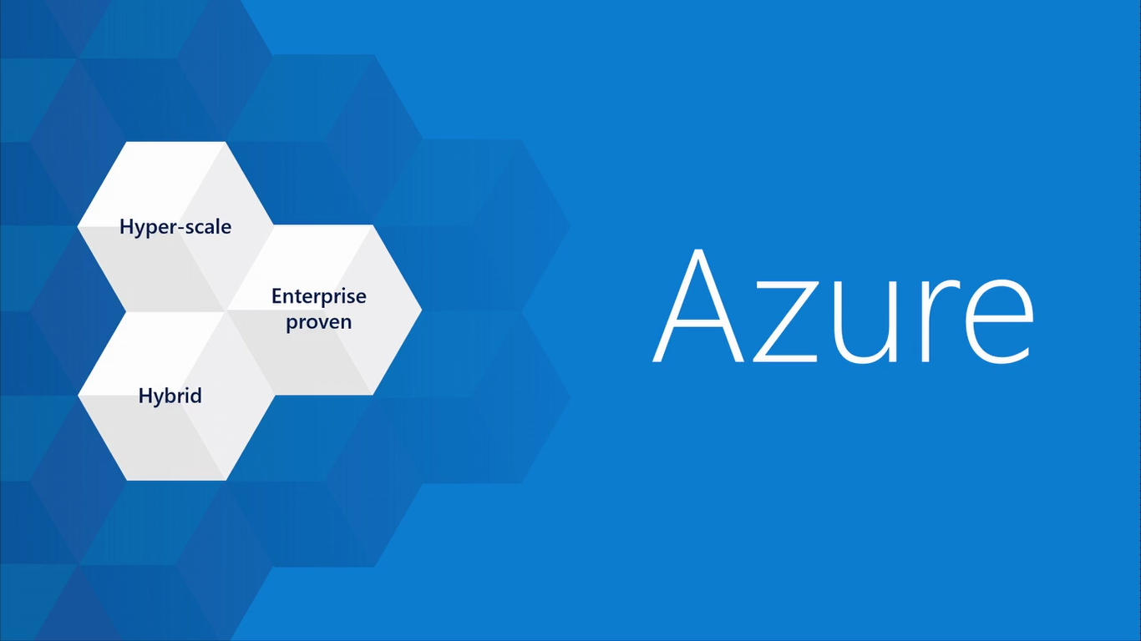
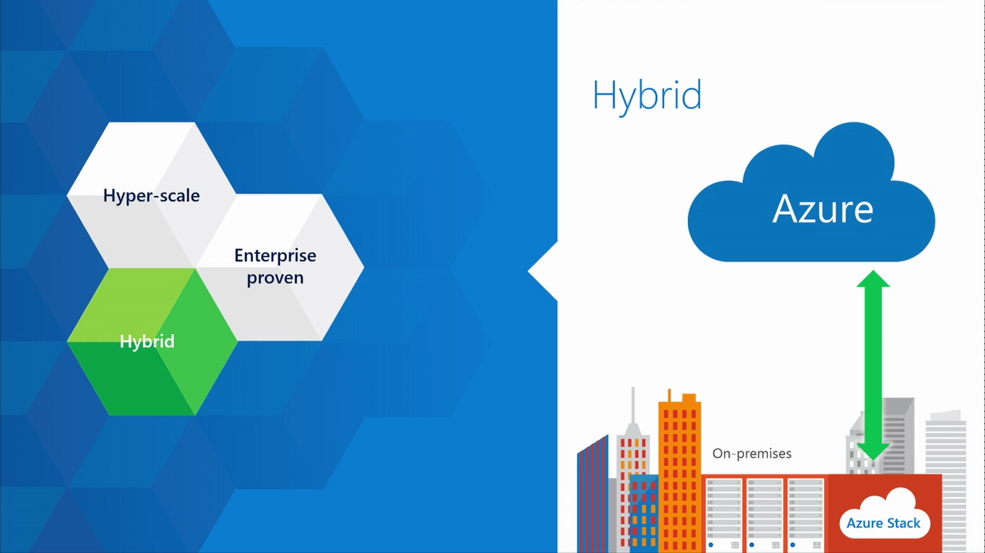
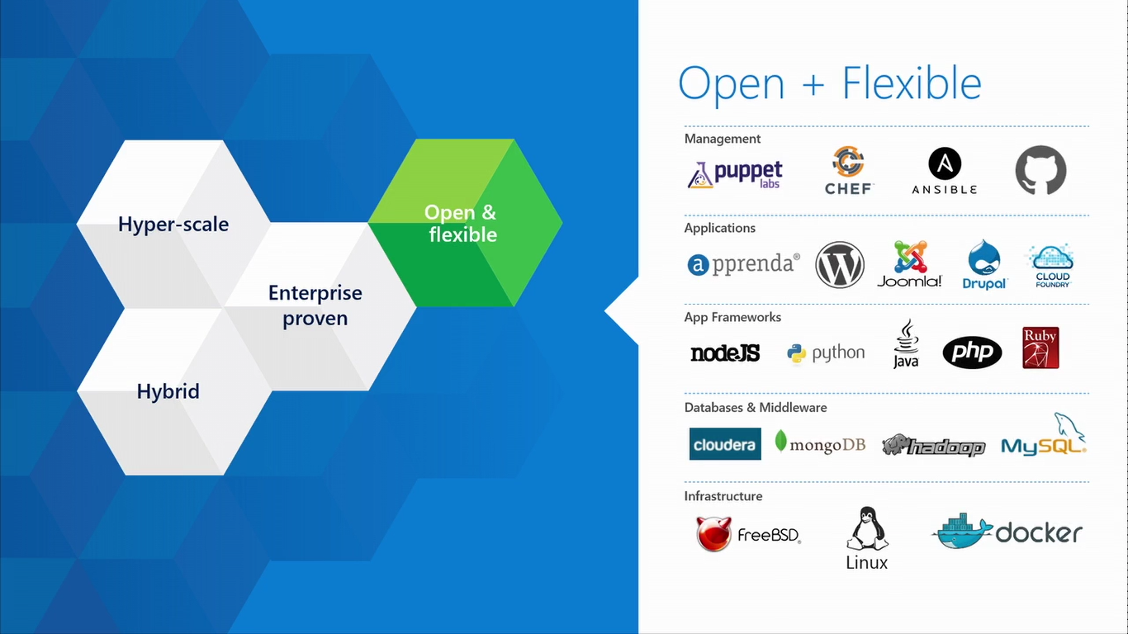
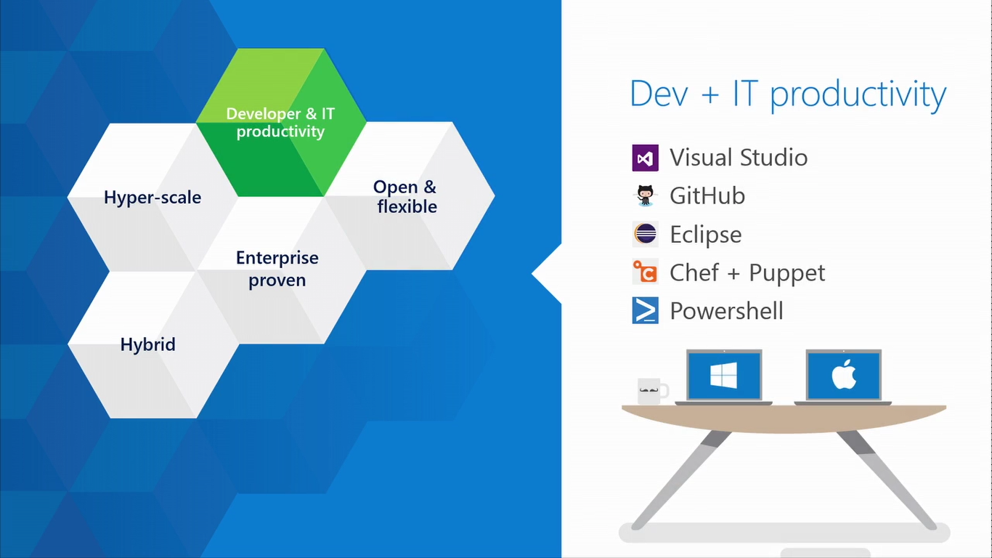
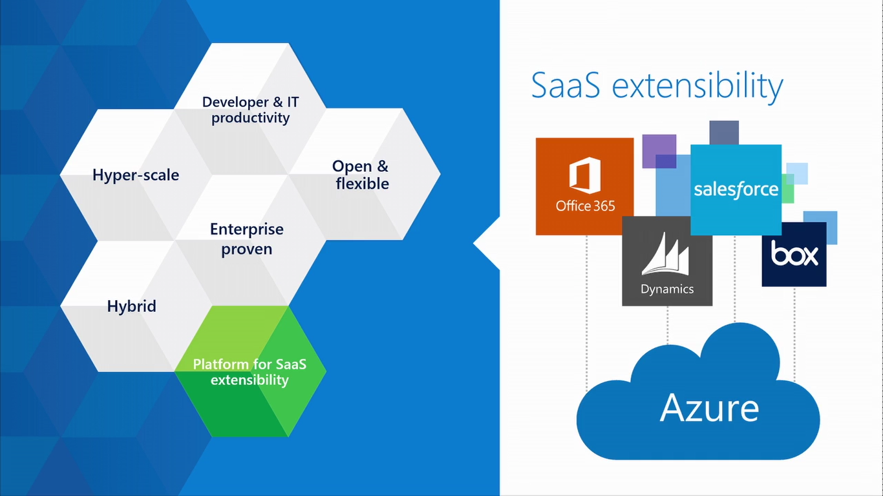
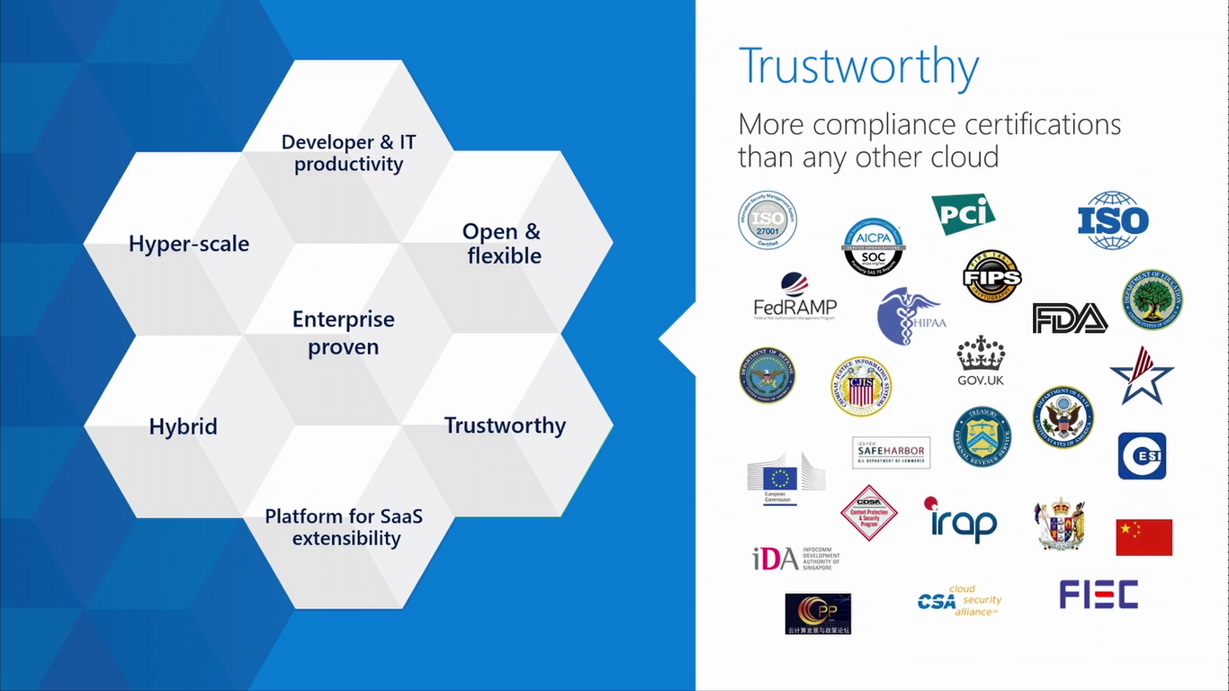

Slide 10
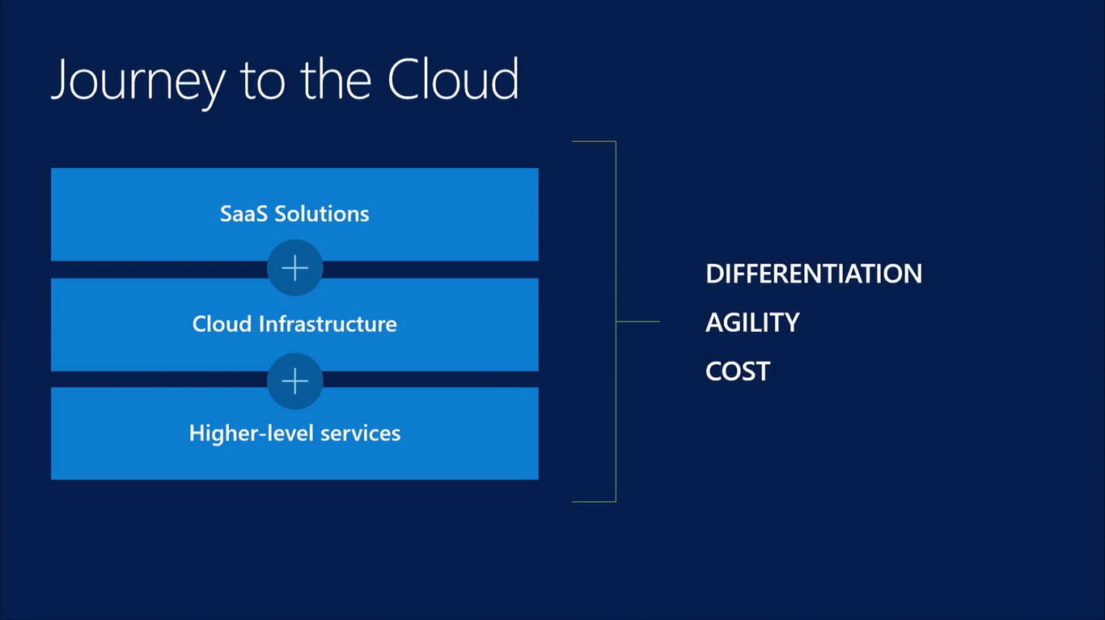

Slide 11
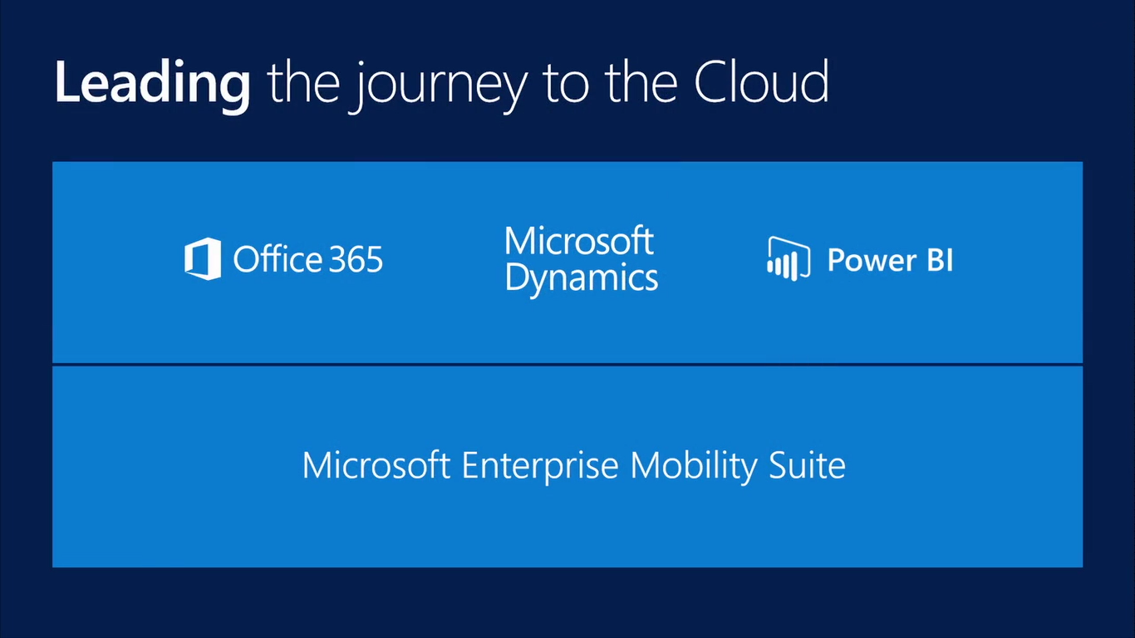

Slide 12
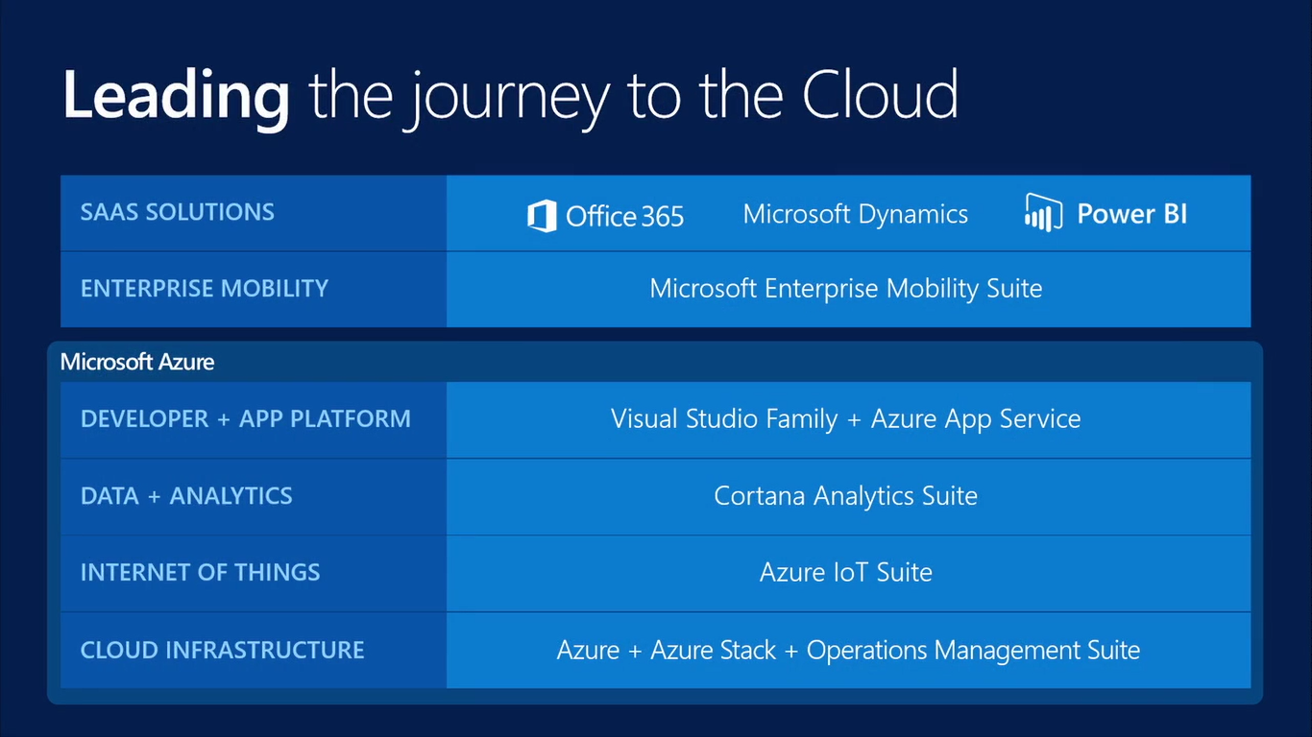

Slide 13
Demo: Azure Portal

Slide 14
Azure Services

Slide 15
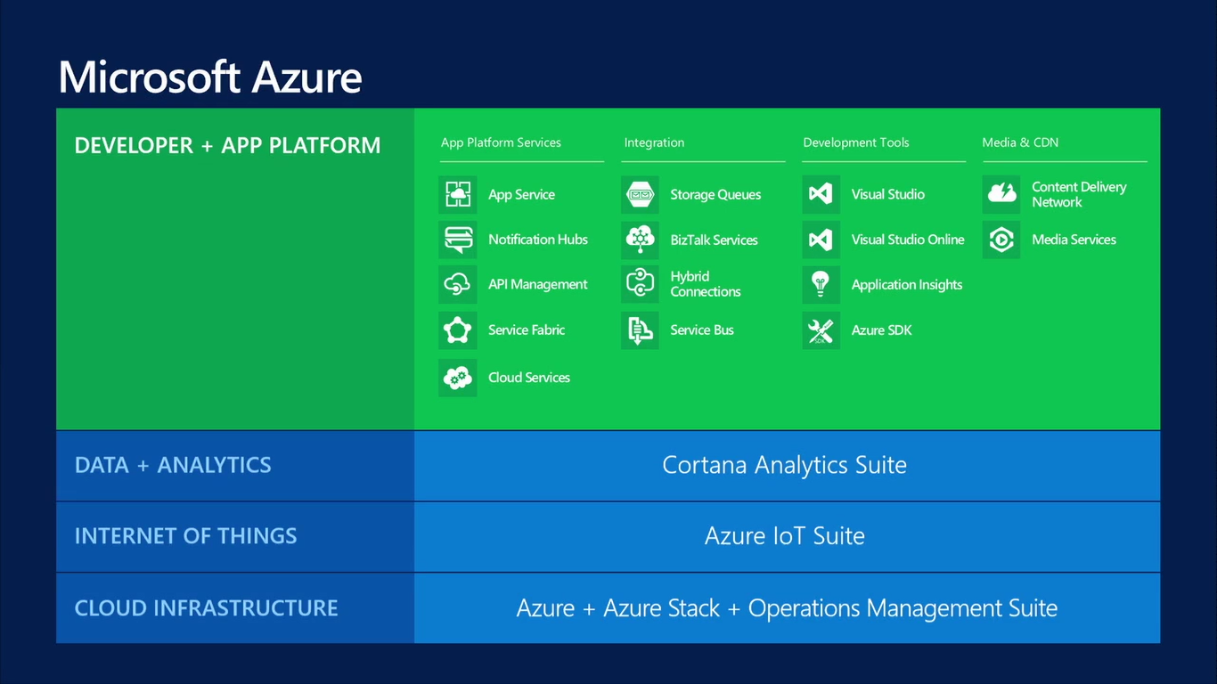

Slide 16
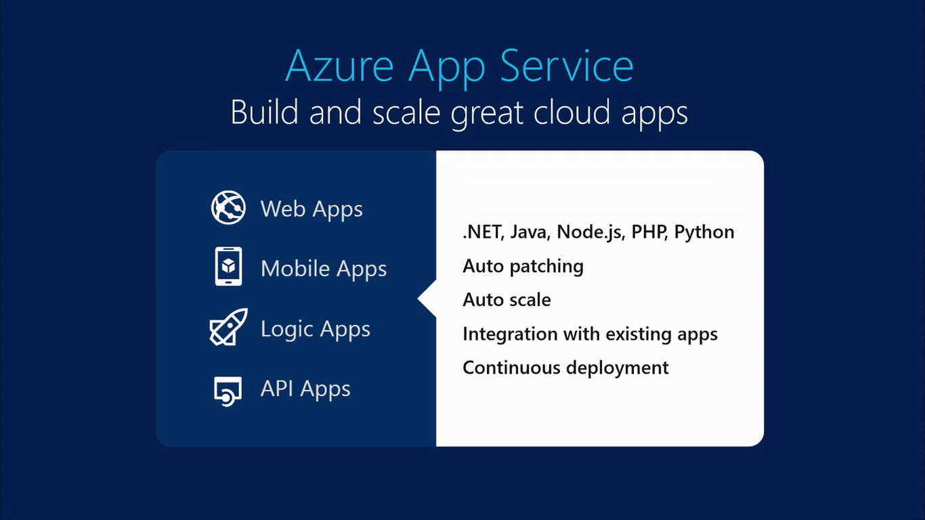

Slide 17
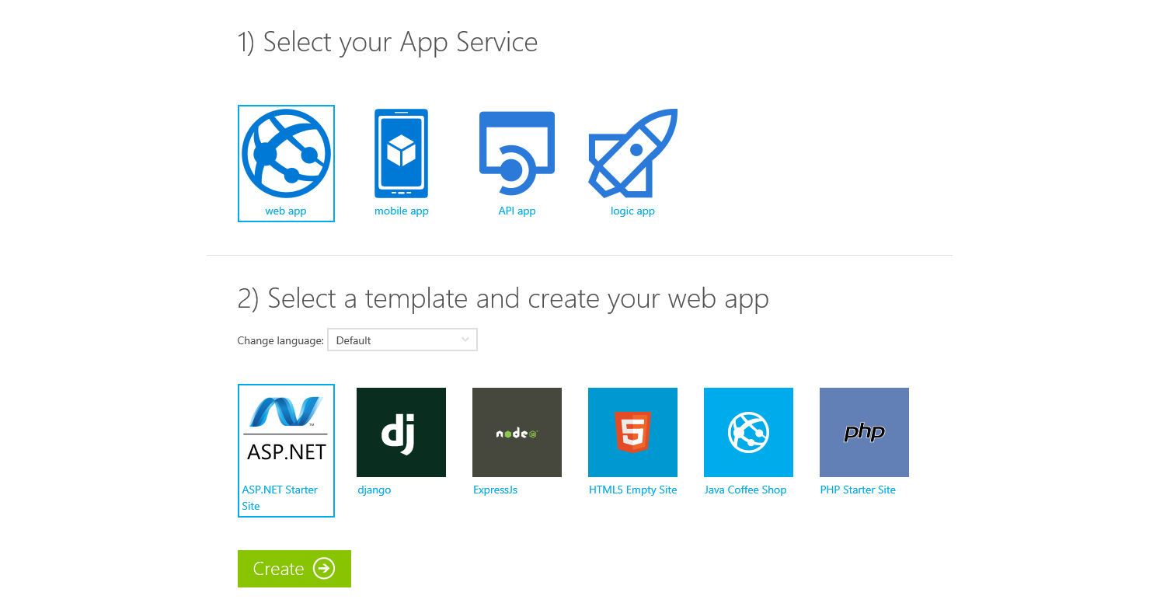
Try App Service Today
https://tryappservice.azure.com
Free
No Signup or Account Required

Slide 18
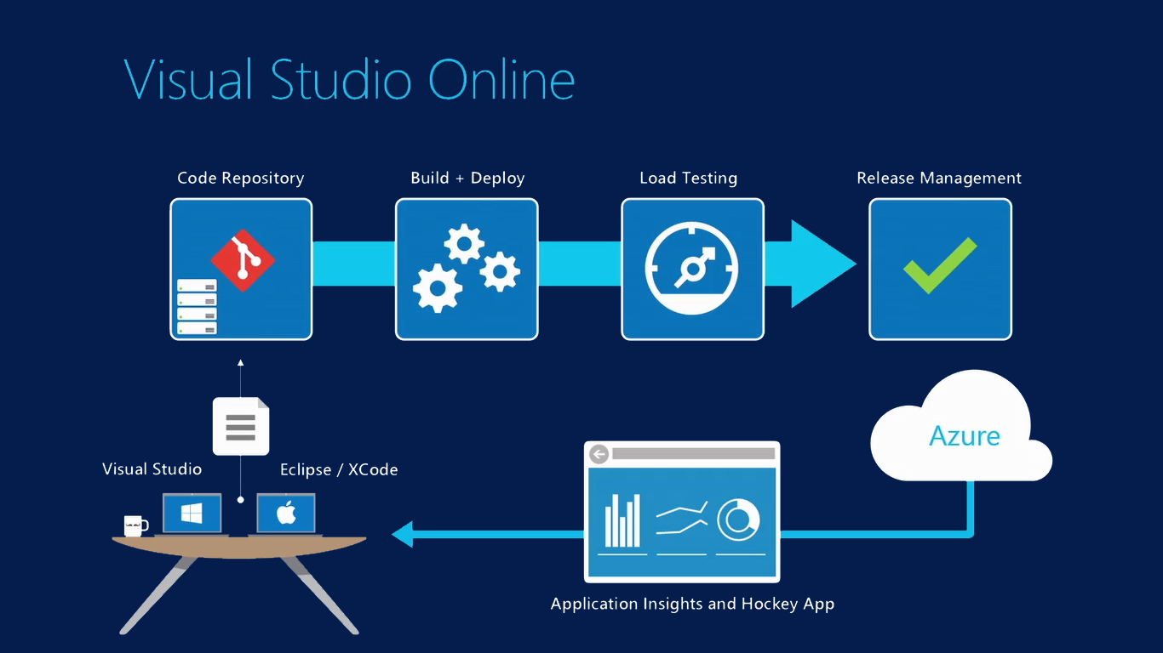

Slide 19
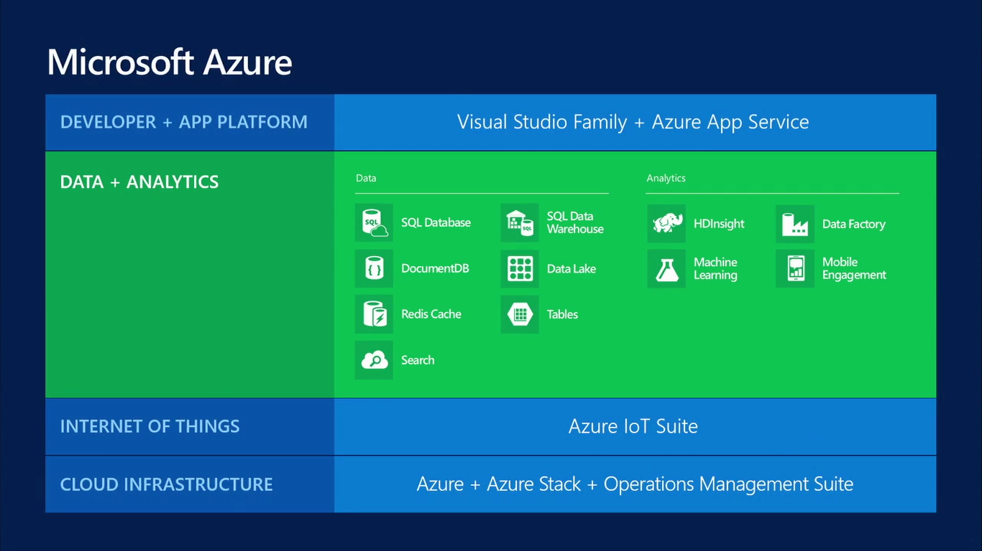

Slide 20
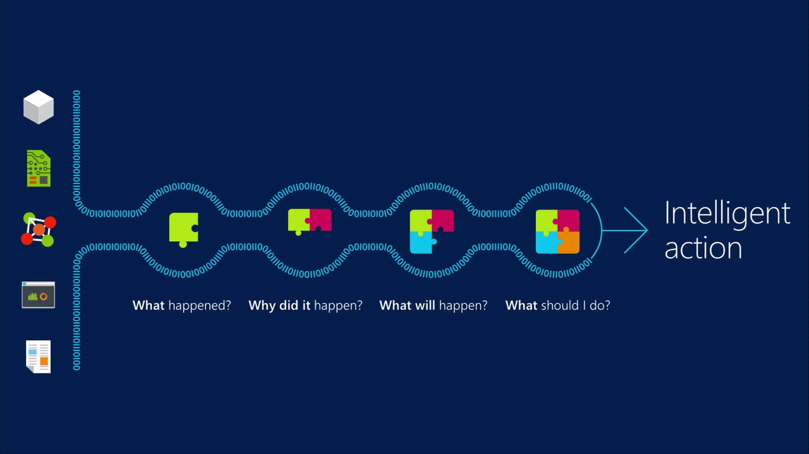
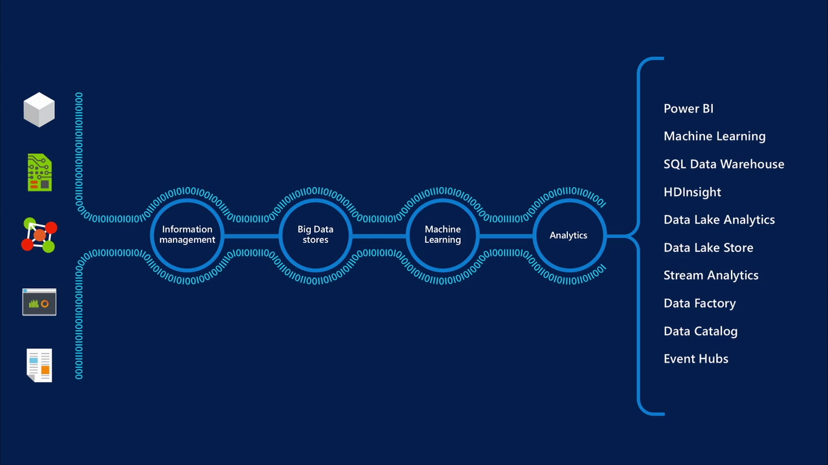

Slide 21
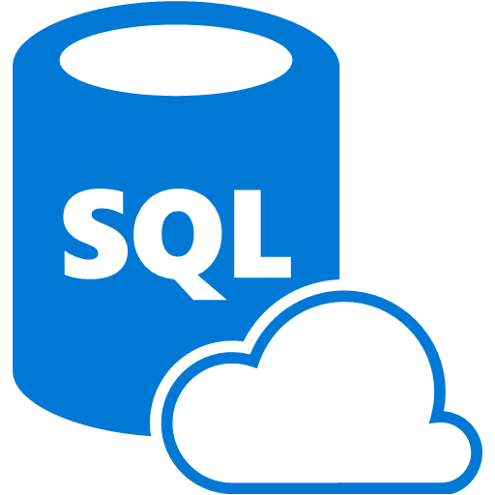

SQL Database
Fully managed SQL Server database technology as a service
  Ideal for simple and complex applications
  Enterprise-ready with automatic support for HA
Secondary
Replica
Primary
Secondary
Replica
Secondary
Replica
Notes:
Speaker notes:
How is HA achieved? At any one time, three database replicas are running—one primary replica and two or more secondary replicas. If the hardware fails on the primary replica, Azure SQL Database detects the failure and fails over to the secondary replica. In case of a physical loss of a replica, a new replica is automatically created. So there are always at minimum two physical, transitionally consistent copies of your data in the datacenter.

Slide 22
Azure Data Factory
Compose and orchestrate
Connect to data of diverse shapes and location
Orchestrate processing to produce trusted data
Manage from single pane of glass
Manage a network of data pipelines
See lineage and impact analysis
Set data production policy
Retry, concurrency, late data handling
Identify and debug errors
Automatic dataset health alerts
Troubleshoot complex pipelines
AZURE DATA FACTORY
Manage and monitor
Data and operational lineage
Coordination and scheduling
Policy
DATA PIPELINES
Activity
Activity

Slide 23

Azure Stream Analytics
Event producers
Collection
Ingestor (broker)
Transformation
Long-term storage
Presentation and action
Stream Analytics
Web/thick client
dashboards
Applications
Service bus
Legacy IOT
(custom protocols)
Event hubs
Azure DBs
Stream
processing
Search and query
Devices
Cloud gateways
(web APIs)
Azure storage
IP-capable devices
(Windows/Linux)
Storage
adapters
HDInsight
Data analytics (Excel)
Low-power devices (RTOS)
Field
gateways
Devices to take action

Slide 24
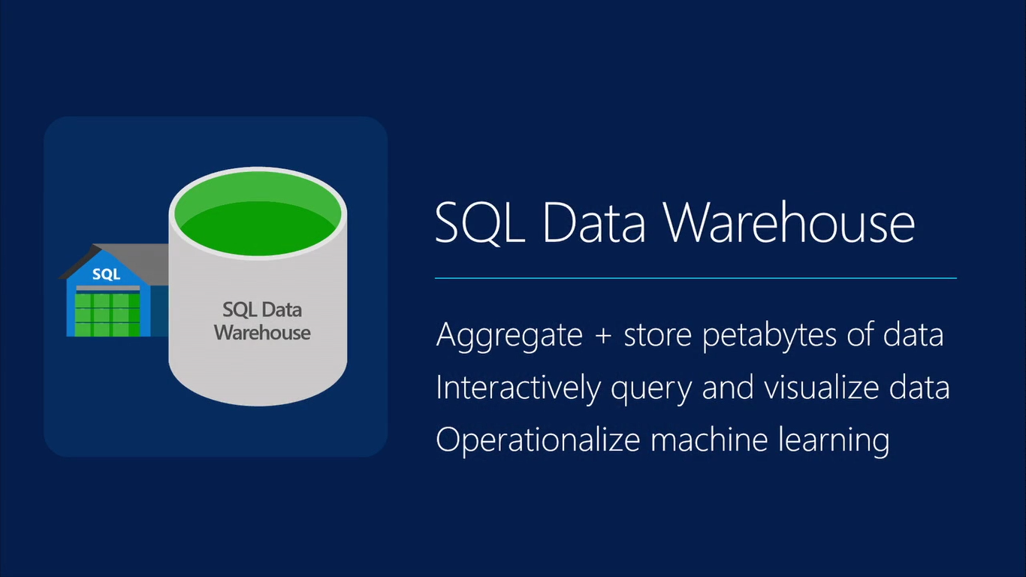

Slide 25
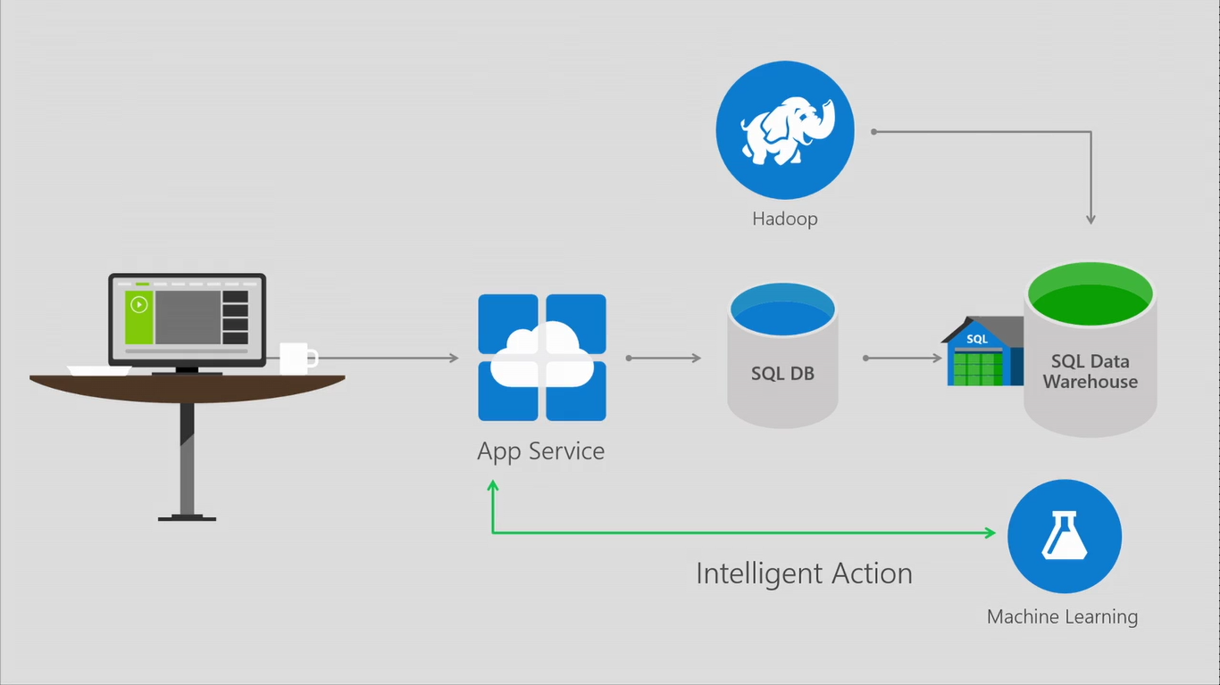

Slide 26
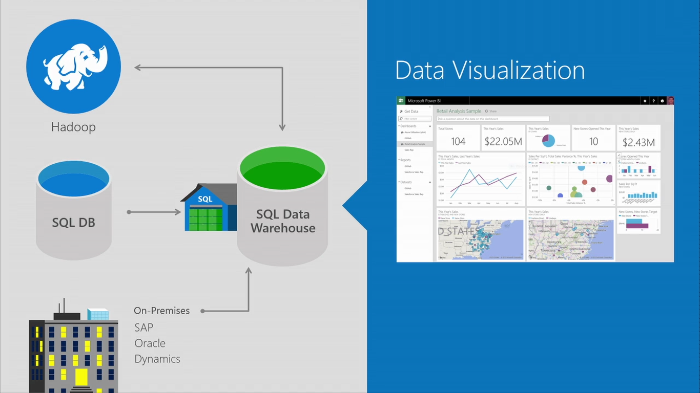

Slide 27

Big Data Insights
Microsoft Azure HDInsight
Microsoft instance of Hadoop distribution running as service
Support existing ecosystem from Hive, Pig, etc
Includes HBase and Storm
Extended to support Excel and BI tooling
Integration with diverse sources of data
Notes:
Speaker notes.
HDInsight is Microsoft instance of Apache Hadoop distribution running as a service in Azure cloud that you can spin up in minutes. It’s architected to handle any amount of data, scaling from terabytes to petabytes on demand.
Supports existing ecosystem such as Hive to explore your data or to create reusable batch processing jobs. Includes Pig to implement complex processing logic.
Uncover business insights by processing and analyzing structured or semi-structured data from web clickstreams, social media, server logs, devices and sensors, and more.
Because it's integrated with Excel, HDInsight lets you visualize and analyze your Hadoop data in compelling new ways in a tool familiar to your business users.
Includes NoSQL transactional capabilities with Apache Hbase. Provides real-time stream processing capabilities with Apache Storm
Leverage existing skills for configuration, submission, and monitoring of Hadoop jobs using languages you know such as Java, C#, PowerShell, .Net SDK

Slide 28
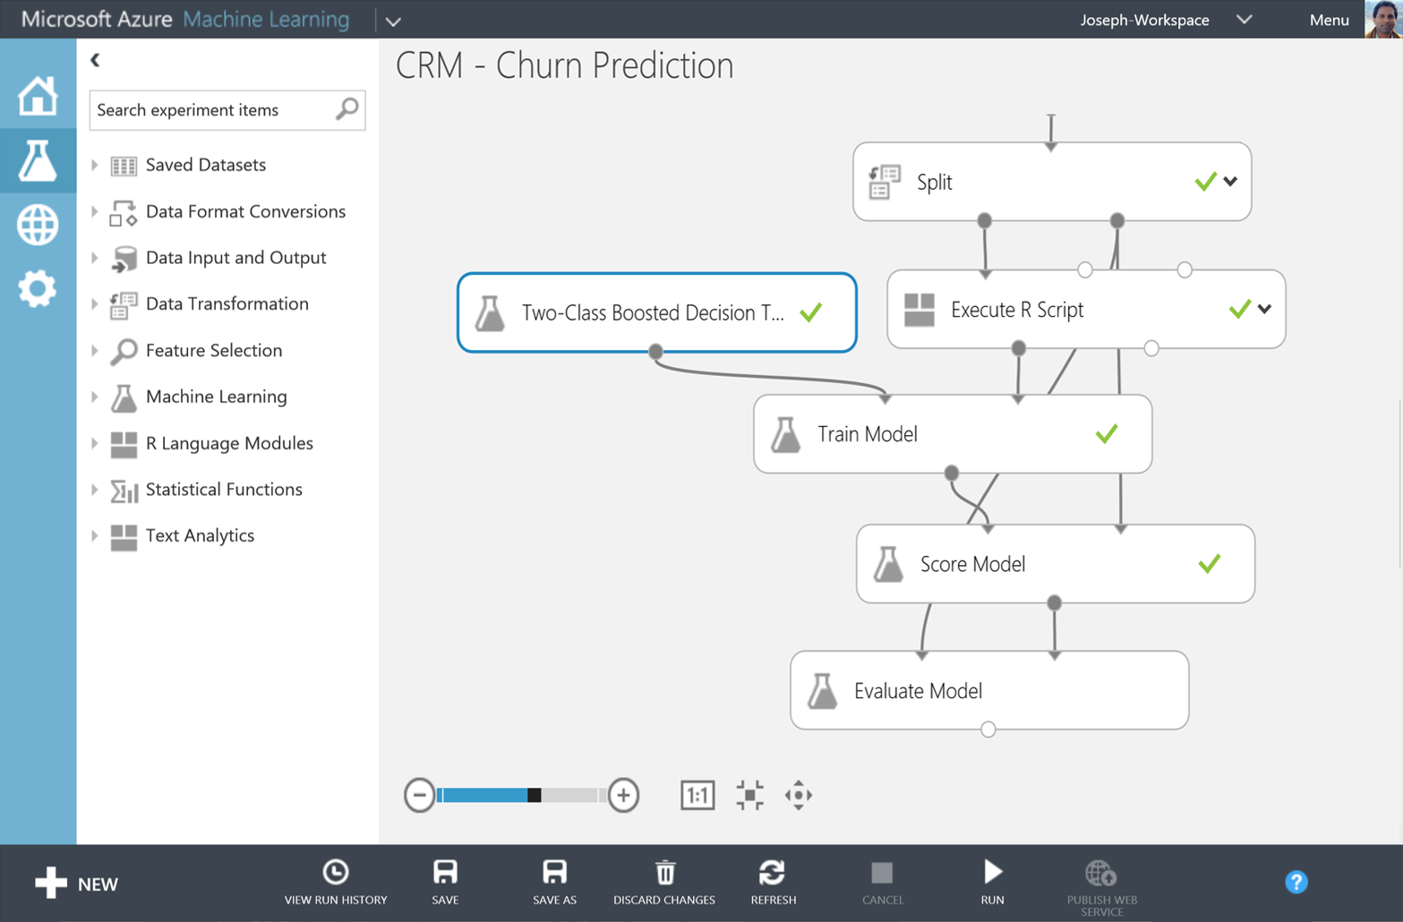
Big Data Insights
Microsoft Azure Machine Learning
Democratized platform for Machine Learning
Fully-managed cloud service for building predictive
analytics solutions
Elastic, pay as you go with low operating costs
Extend with Power BI, HDInsight and cloud hosted data
Extensible, supports R and Python
Notes:
Speaker notes:
Democratized; Azure Machine Learning lets the masses and scientists alike learn, experiment, mashup and create high quality powerful algorithms.
Visually compose ML workflow through a web browser with no software to install and without learning multiple tools from data acquisition, cleaning and prep, machine learning, and experimentation.
Fully-managed cloud service for building predictive analytics solutions, helps overcome the challenges most businesses have in deploying and using machine learning.
Enables data scientists and developers to efficiently embed predictive analytics into their applications.
Azure ML is supports today’s Data scientists’ choice of language R and can bring their existing assets in R and integrate them seamlessly into Azure ML workflows.

Slide 29
You
Microsoft Azure Active Directory
Synchronize your corporate
and 3rd party identities
Integration with O365
Support modern protocols
  OAuth 2.0
  OpenID Connect
  WS-Fed
  SAML 2.0
Identity and Access Mgmt Permissions
  Users
  Groups
  Applications
Microsoft Azure AD
3rd party clouds/hosting
PCs and devices

Slide 30

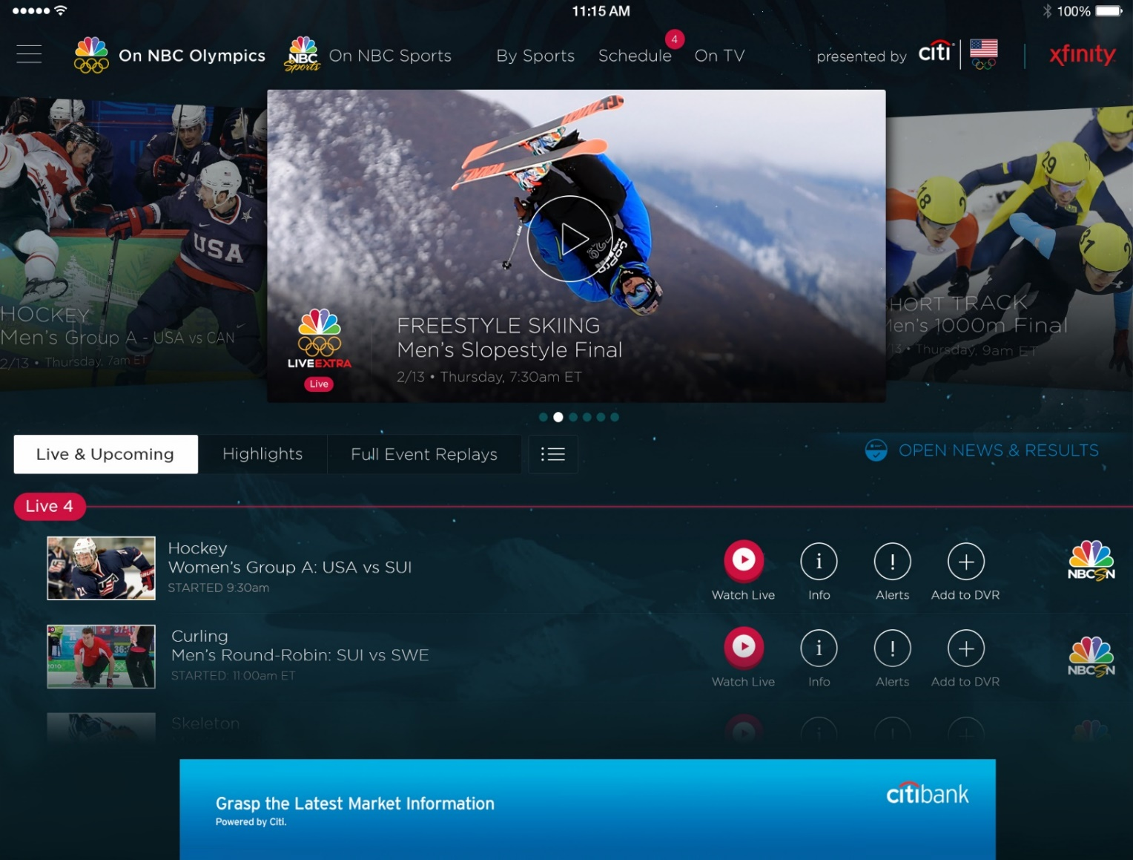
Azure Media Services
Olympics NBC Sports
On Demand Media Services
Video-on-demand
  Ingest
  Encode
  Package
  Encrypt
  Delivery
Live Streaming Support
Office 365 Integration
Azure Media Player
Live video encoding and streaming
Web + Mobile
100 million viewers
2.1 million concurrent HD viewers during the
USA vs. Canada hockey match
Notes:
Speaker notes:
Deliver video content or stream video to audiences large or small to any device(Web or Mobile) anywhere reliably and in scale.
Helps you create versatile media workflows for ingesting, encoding, protecting and streaming content to audiences on-demand or broadcast live.
Powerful and extensible platform with broad set of first and third-party capabilities to support complete end-to-end media workflows.
Integration with Office 365 empowers organizations of all sizes helps to use videos to enhance sharing, collaboration and communication.
Azure Media Player, an automated online player solution, supports all the usual industry standards like HTML5 video, Media Source Extensions and rights management through Encrypted Media Extensions. The focus here is on open standards, but on older browsers, the player can fall back on Flash or Silverlight.

Slide 31

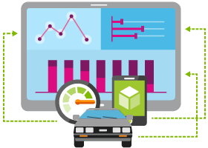





Internet of Things
  Event Hubs
  Notification Hubs
  Stream Analytics
  Machine Learning
  HDInsight
  Power BI for Office 365
With Microsoft Azure IoT services, you can monitor assets to improve efficiencies, drive operational performance to enable innovation, and leverage advance data analytics to transform your company with new business models and revenue streams.
Notes:
Speaking Notes
Azure Mobile Services is a Backend-as-a-Service
Instead of you having to design, build, test, deploy, manage, and upgrade your whole backend, we do it for you
Features of Mobile Services
Storage – SQL DB
Authentication – built in support for social providers w/ ability to custom auth
Backend logic – data validation, logical flows, etc
Push Notifications – across all major mobile platforms
Scheduler – backend job processing

Slide 32
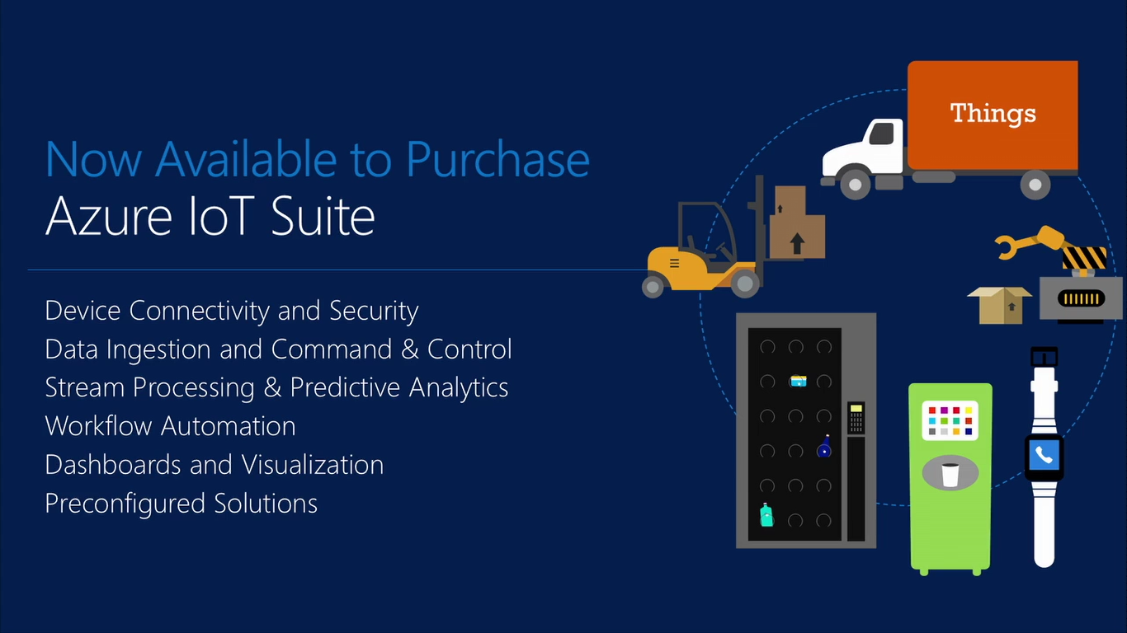

Slide 33
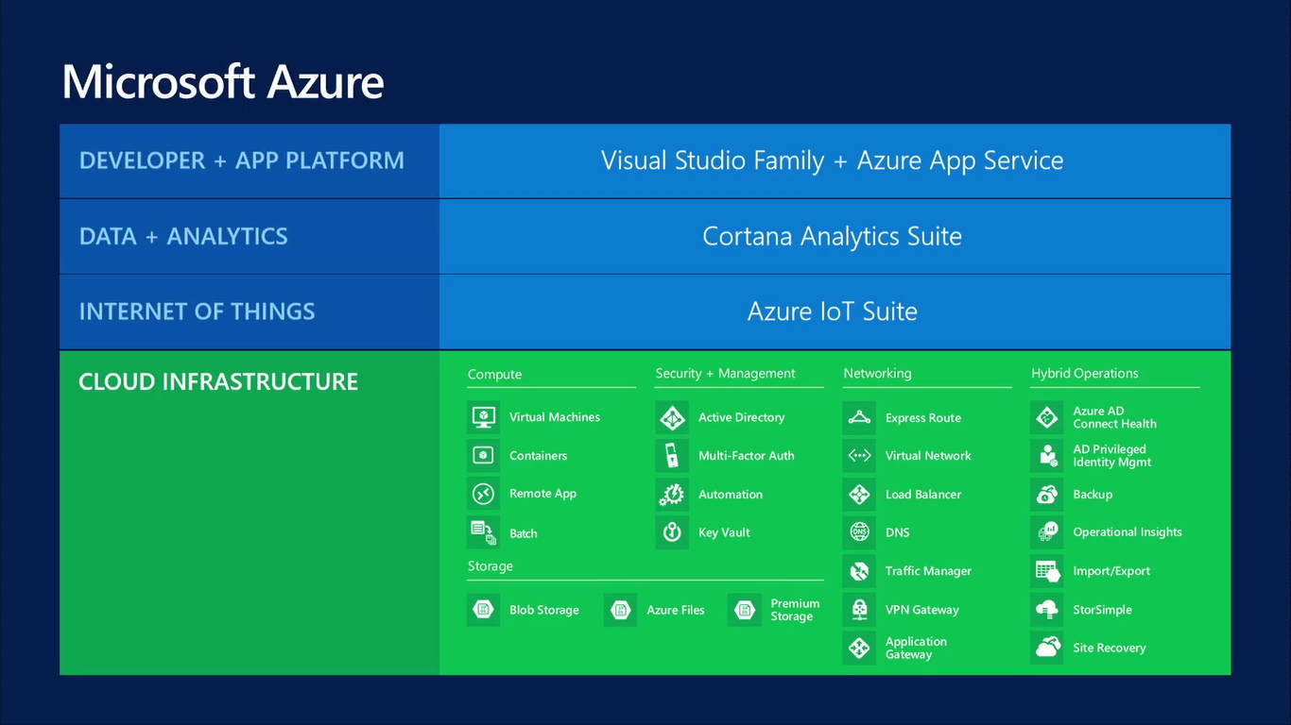

Slide 34
Virtual Machines
Getting started
Select image
and VM size
New disk persisted in storage
Management portal
Windows Server
Boot VM from new disk
>_
Linux
Scripting
(Windows, Linux and Mac)
Blob
Storage
General Purpose
Basic
Standard
Optimized Compute
Performance Optimized
Network Optimized
REST API
Cloud
Comprehensive
Networking

Slide 35
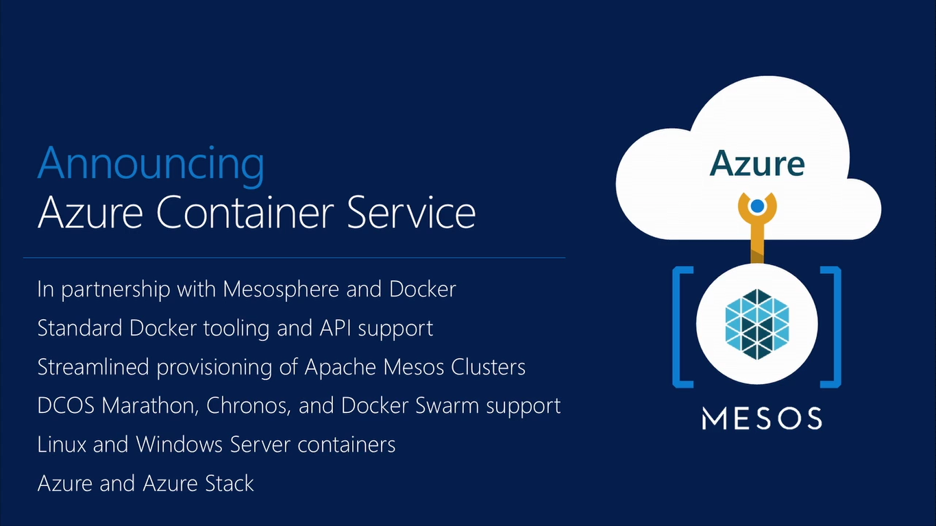

Slide 36
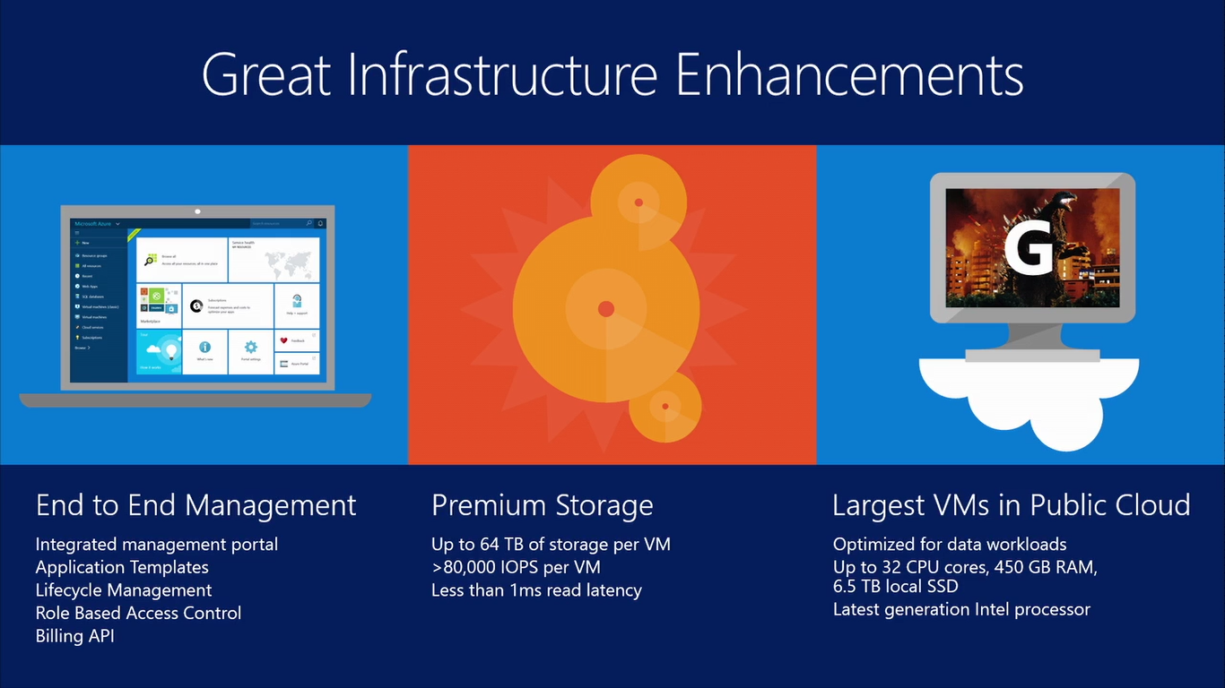

Slide 37
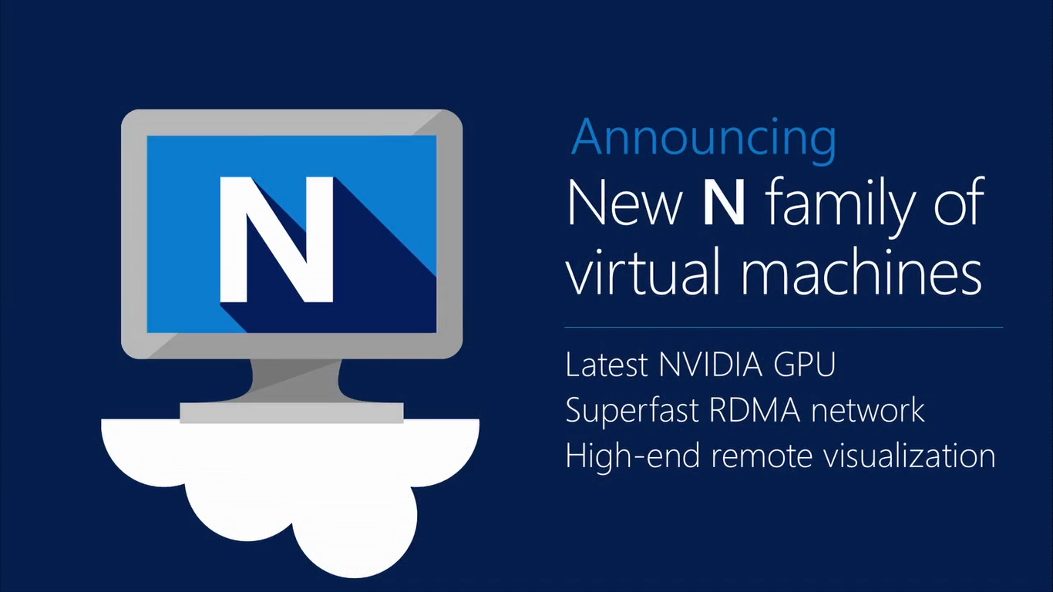

Slide 38
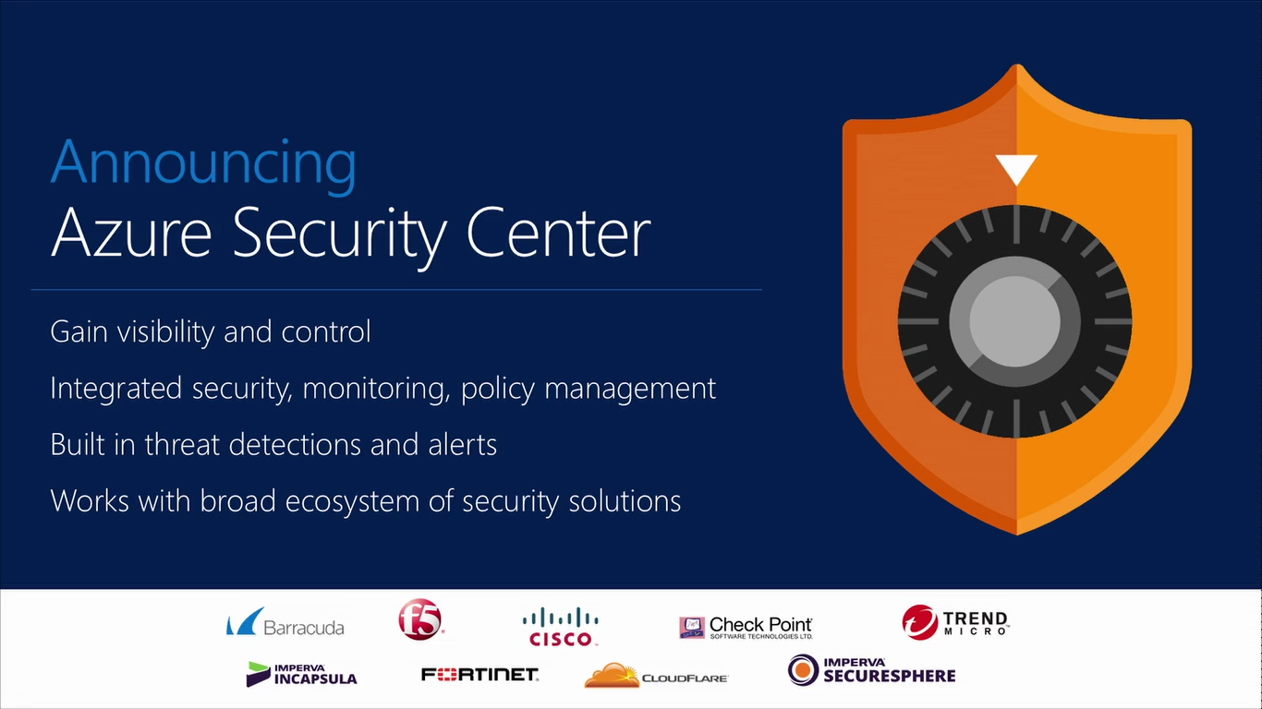

Slide 39
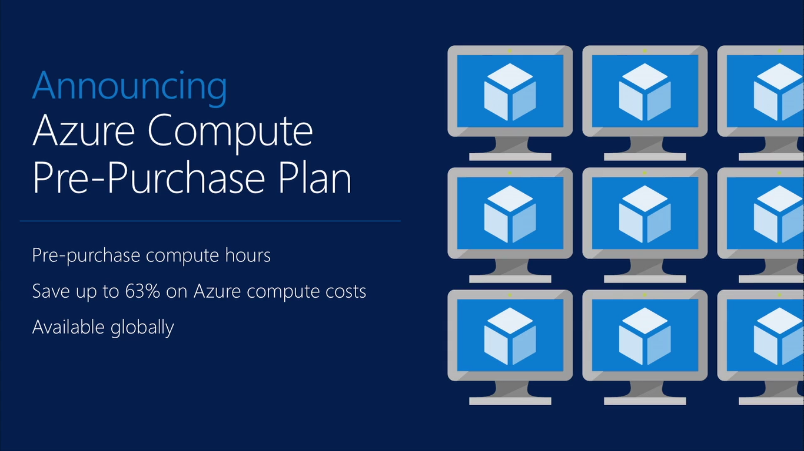

Slide 40
Key Scenarios to Get Started with Microsoft Azure

Slide 41



Key Scenarios to get started with Microsoft Azure
Full Dev/Test environments
Build
Production
Visual Studio Online
Master branch
GIT / TFS
Staging
Check-in
Test branch
Dev/Test
Developers
Notes:
Speaker notes:
Create full Dev, Test, Staging and Production environments in minutes
Availability of Visual Studio Online(VSO) integration with build option available
Validate web app changes in a staging or test deployment slot before swapping it with the production slot
Swap to get your "last known good site" instantaneously if there is a problem with a new deployment in production
Swapping to production from staging as opposed to direct deployment eliminates downtime
Dev, Test, Staging and Production deployment workflow can be automated when pre-swap validation isn’t needed

Slide 42




Key Scenarios to get started with Microsoft Azure
Microsoft SQL Server
VM
Microsoft SQL Server
VM
Microsoft Azure
Lift and Shift
  Application VM
  Storage
Corporate
Network
  Application VM
  Archive
  key data inexpensively
  PDF
  JPG
  VIDEO
  DB
  DOCX
Notes:
Speaker notes:
Lift and Shift
Take existing work loads and run them in a certified instance. Emphasize image mobility and Azure Files to help move applications that require SMB shared folders very easily to Azure.
Storage
Archive key data in inexpensive cloud storage. Mention corporate finance databases, industry compliance documents and other key data can be inexpensively archived to Azure storage.

Slide 43


Key Scenarios to get started with Microsoft Azure
HDInsight
Visualization
and reporting
tools
Input
Process
Results
Output
Iterative exploration - Process key data into business intelligence using Hadoop
Notes:
Speaker notes:
Iterative exploration
The source data files(log files, email messages, tweets, and more) are loaded into the cluster, processed by one or more queries within HDInsight, and the output is consumed by the chosen reporting and visualization tools. The cycle repeats using the same data until useful insights have been found, or it becomes clear that there is no useful information available from the data—in which case you might choose to restart the process with a different source dataset.

Slide 44
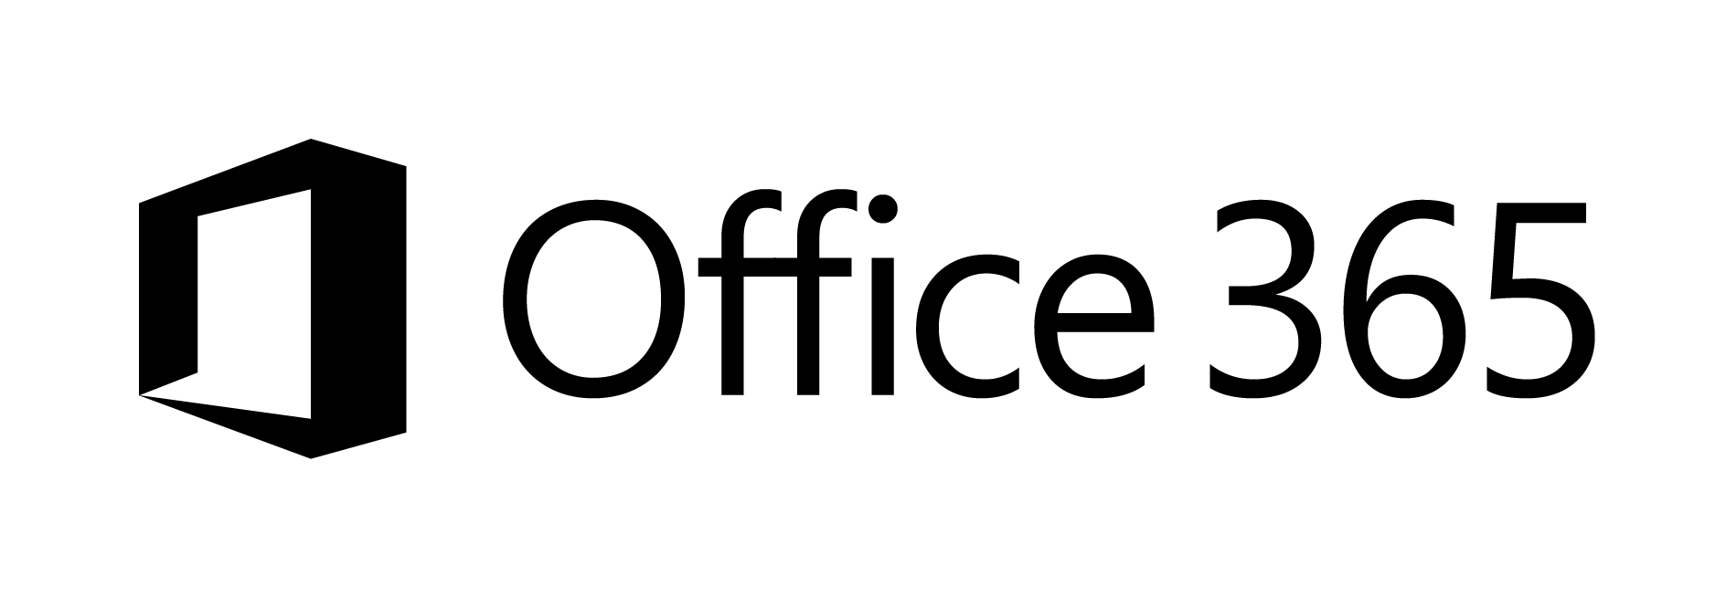





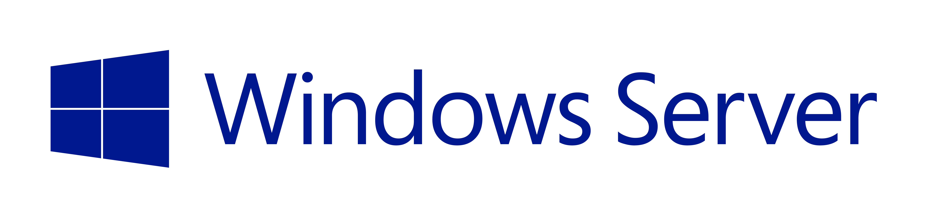


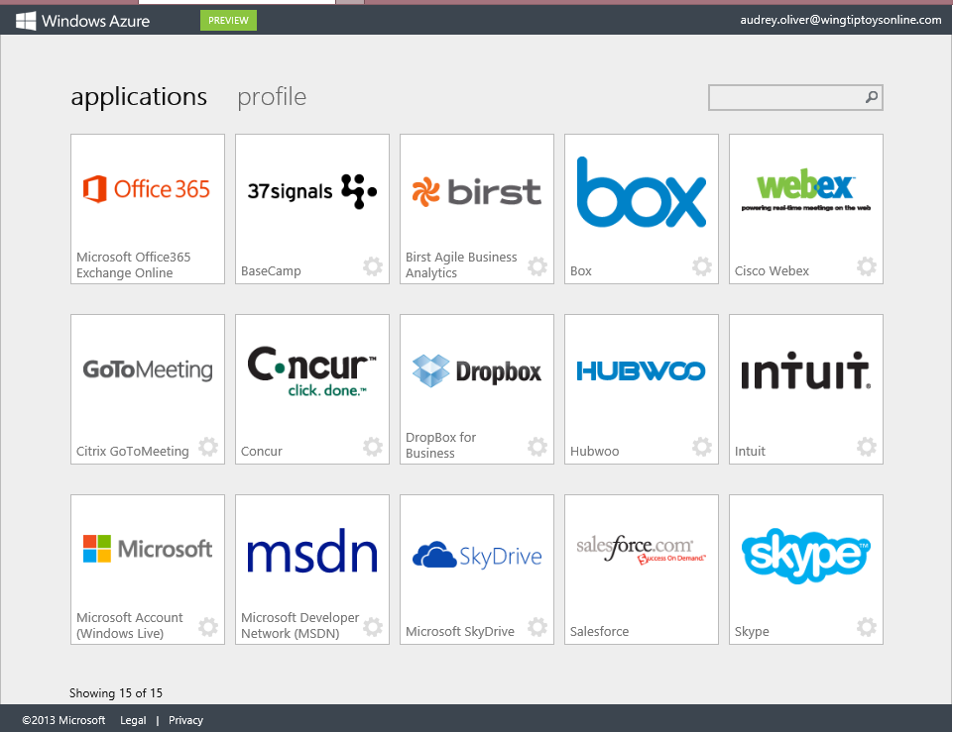
Key Scenarios to get started with Microsoft Azure
Identity as a Service
SaaS
Active Directory
Active Directory
Synchronize and
consolidate
identities
Custom
LOB apps
ISV/CSV
apps
Azure App Service and Non-MS cloud-based apps
PCs and devices
Notes:
Speaker notes:
Identity as a Service; Control and protect your apps, data and services in Azure together with assets in non-MS cloud using a single AD account.
Consolidate all your identities using one account for single sign-on to any cloud and on-premises services, using your favorite device, including iOS, Mac OS X, Android, and Windows devices.
As a developer you must also need to understand implications of extending your credentials in on-premises Active Directory to Azure Active Directory to protect your assets in on-premises and in the cloud.

Slide 45







On-premises /
Hosting Services
IIS/SQL Server Based
Web Apps
Microsoft
SQL
Server
IIS
Non-IIS Open Source
Web Apps
Microsoft Azure
MySql
Web Apps - Take your web apps to the cloud using inexpensive App Service Web Apps
Key Scenarios to get started with Microsoft Azure
Notes:
Speaker notes:
You can easily move your existing IIS based web apps including SQL Server databases to Azure App Service easily with a migration tool provided by Microsoft called Azure App Service Migration Assistant.
If your open source web app’s framework is supported on App Service, the languages and frameworks needed by your application are configured for you automatically. Migrate an existing application or create a new one from the Application Gallery.
Consider using Azure Cloud Services or IaaS Virtual Machines if you are unable to migrate your application via Migration Assistant or your open source web app’s framework isn’t supported on App Service.
Other notes:
Windows Server 2003 will reach end of support on July 14th 2015. If you are currently hosting your websites on an IIS server that is Windows Server 2003, Web Apps is a low-risk, low-cost, and low-friction way to keep your websites online, and Web Apps Migration Assistant can help automate the migration process for you.
Moving to Web Apps require less time and IT expertise to configure and secure your apps compared to apps running in VM environment.
Web Apps require no maintenance effort on your part to patch, update, and manage underlying VM environment.

Slide 46
Activate your MSDN Benefits…
+
3 VMs for 16 hrs a day
80 VMs for 20 hour load test
Up to 100 web sites + DB
Up to
$150
33%^{off}
25%^{off}
89
per Month
Dev/Test VMs
Other Dev/Test
Countries

Slide 47
Get started today at http://azure.microsoft.com

