Slide 1
Indie Game Development
Getting Started, Lessons Learned & More!
By Shahed Chowdhuri
Senior Technical Evangelist
WakeUpAndCode.com
@shahedC
Notes:
Title Page: Indie Game Development Getting Started, Lessons Learned & More!
By Shahed Chowdhuri
Sr. Technical Evangelist
Blog: WakeUpAndCode.com
Twitter: @shahedC

Slide 2
Dev Tools, SDKs & Game Engines

Slide 3
Suggested Paths
Visual
Programming

Slide 4
Platforms & Devices

Slide 5
Real-world Lessons
1. UI Design
2. Multiplatform
3. Optimization
4. Work-Life Balance
5. Feedback and Ratings
Notes:
Real-world Lessons
UI Design: predicting human behavior
Targeting multiple platforms and screen sizes
Memory allocation and code optimization
Work-life balance
User feedback + Anonymous Ratings

Slide 6
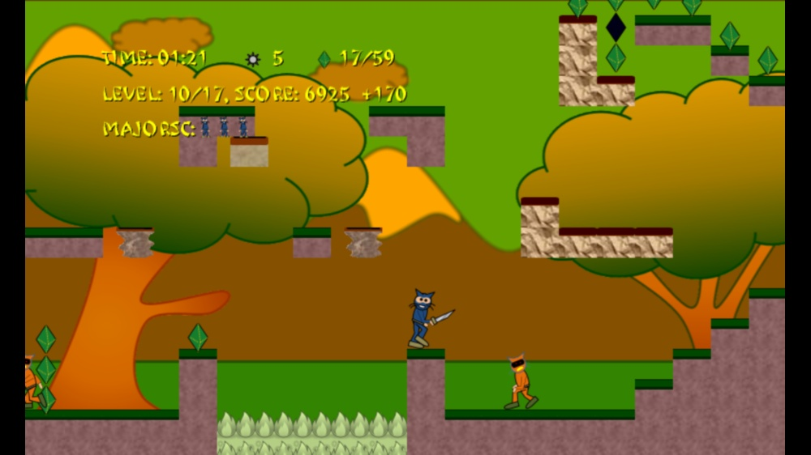
1. UI Design
Special items
HUD in “safe area”
Focus on primary user action
Notes:
1. UI Design
HUD in “safe area”
Special items
Focus on primary user action

Slide 7
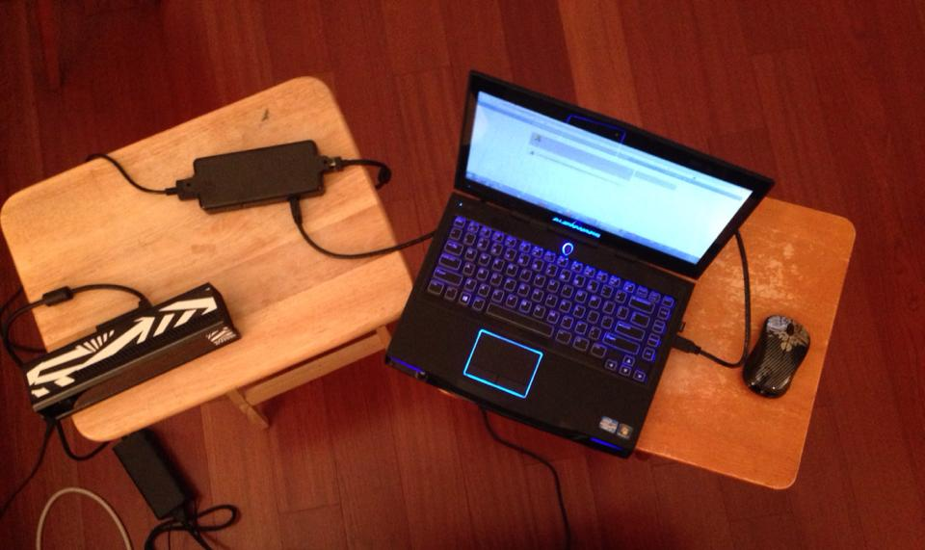
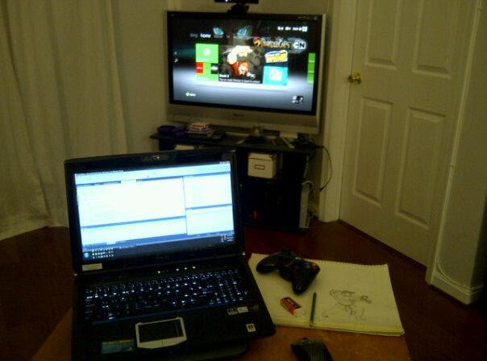
2. Target Multiple Platforms
Kinect v2 dev kit
HDTV via Xbox console
Windows
Notes:
2. Target Multiple Platforms
Windows
Xbox 360
Xbox One
Kinect v2

Slide 8
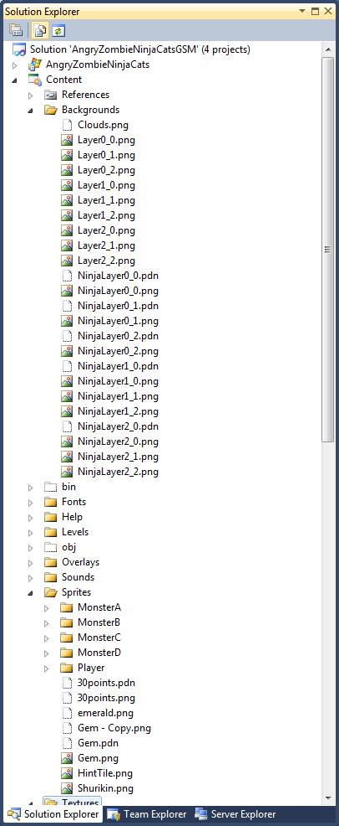
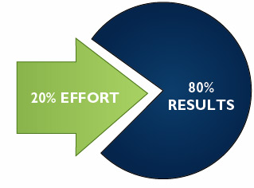
3. Optimization & Cleanup
Notes:
3. Optimization & Cleanup
80-20 rule

Slide 9
4. Work-Life Balance
Notes:
4. Work-Life Balance

Slide 10
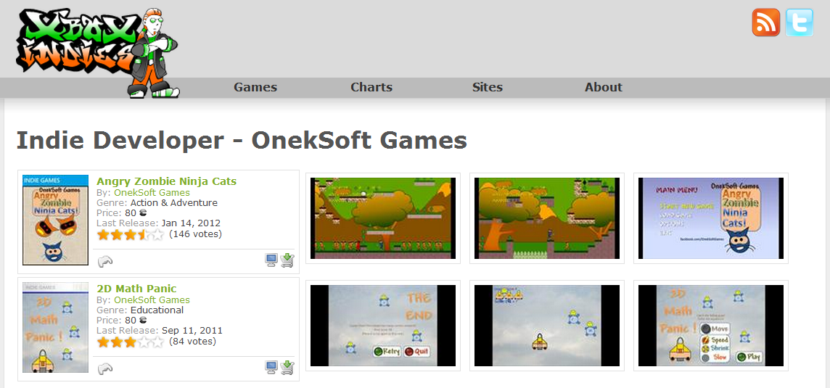
5. Feedback & Ratings
Anonymous ratings from Xbox Marketplace on XboxIndies.com
Notes:
5. Feedback & Ratings
Anonymous ratings from Xbox Marketplace on XboxIndies.com

Slide 11
* Business Intelligence
Measuring Sales and Performance
Spotting Trends
Pricing and Competition
Making Better Business Decisions
Learning From Past Success (and Mistakes)
Notes:
* Business Intelligence
Measuring Sales and Performance
Spotting Trends
Pricing and Competition
Making Better Business Decisions
Learning From Past Success (and Mistakes)

Slide 12
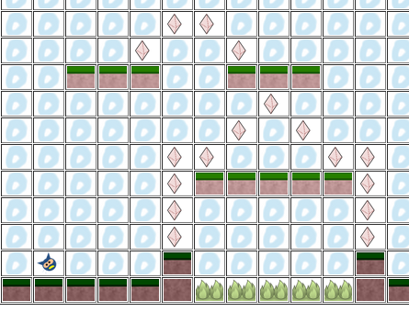
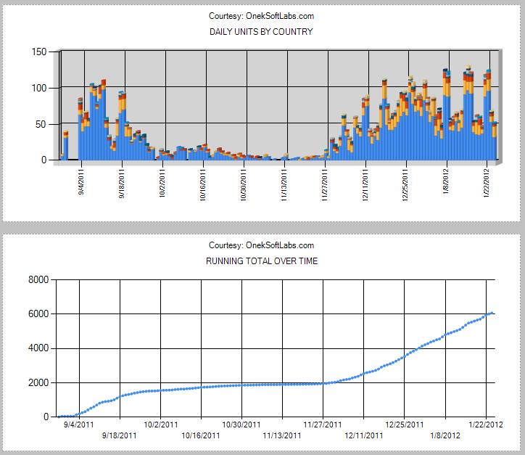
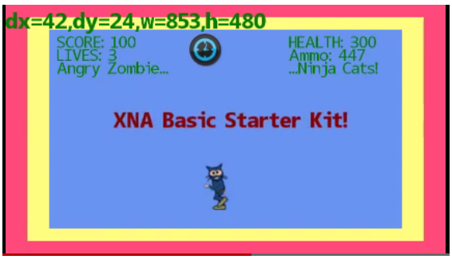
* Community
Platformer Level Editor
XBLIG Sales Data Analyzer
XNA Basic Starter Kit
Notes:
* Community
XBLIG Sales Data Analyzer
XNA Basic Starter Kit
Platformer Level Editor

Slide 13
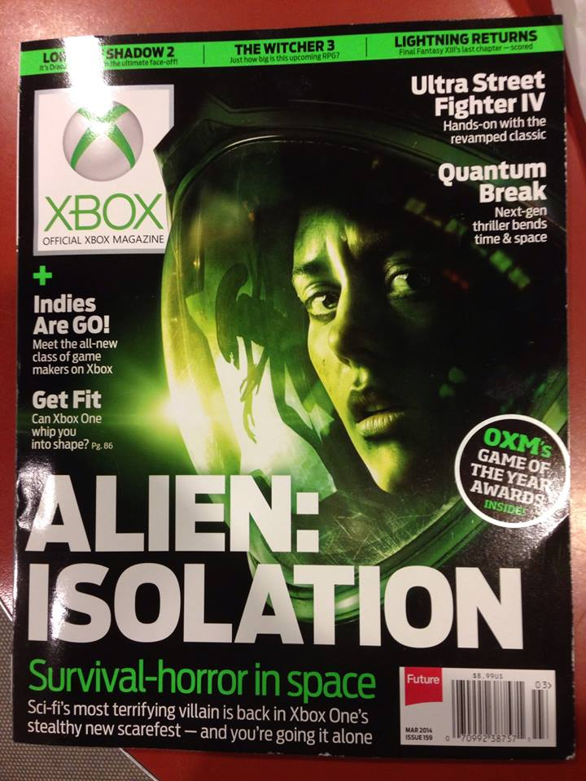
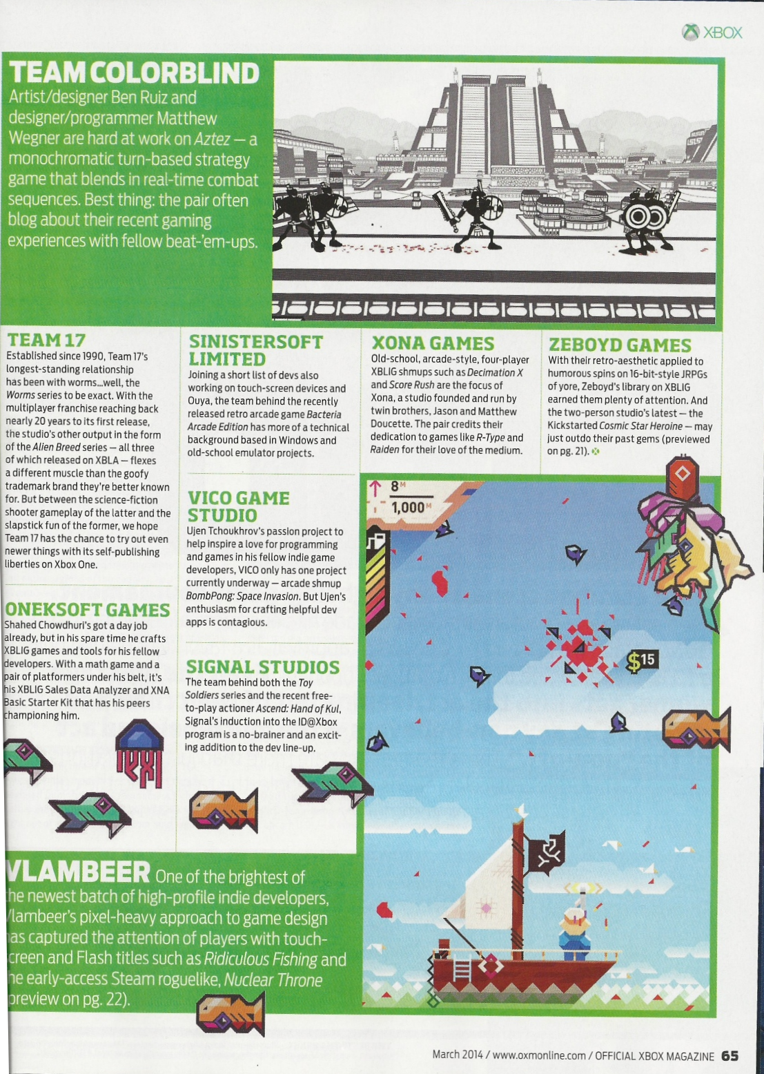
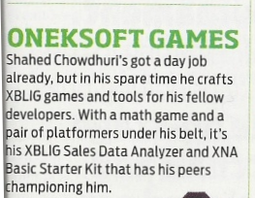
Official Xbox Magazine
`
Source: Official Xbox Magazine, March 2014, Page 65
Notes:
Official Xbox Magazine, March 2014, Page 65
"Shahed Chowdhuri's got a day job already,
but in his spare time he crafts XBLIG games and tools for his fellow developers.”
“With a math game and a pair of platformers under his belt,
it's his XBLIG Sales Data Analyzer and XNA Basic Starter Kit that has his peers championing him."

Slide 14
Dev Showcase Event @ Reston VA
Thu June 25, 2015
Free Food
Raffle + Prizes
Dev Showcase
Publishing Tutorial
RSVP:
http://www.meetup.com/DC-MS-Devs/events/222208611/

Slide 15
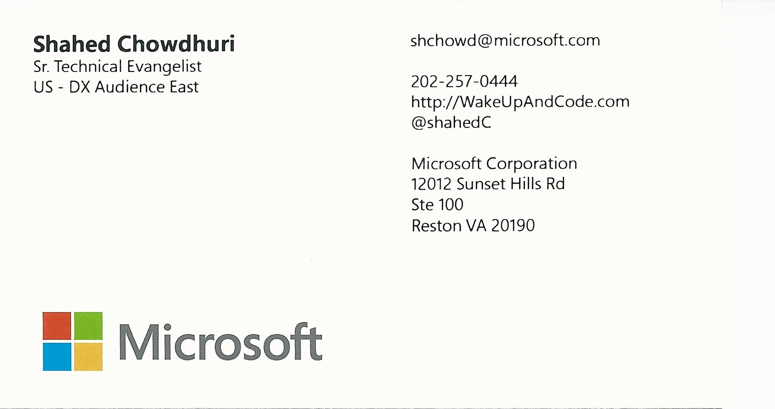
Contact
Email: shchowd@microsoft.com  Twitter: @shahedC
Notes:
Contact
Microsoft email: shchowd@microsoft.com
Personal Twitter: @shahedC
Dev Blog: WakeUpAndCode.com

