Slide 1
Indie Game Development
Windows 10, Universal Apps, Xbox One & HoloLens!
By Shahed Chowdhuri
Senior Technical Evangelist
WakeUpAndCode.com
@shahedC
Notes:
Title Page: Indie Game Development Getting Started, Lessons Learned & More!
By Shahed Chowdhuri
Sr. Technical Evangelist
Blog: WakeUpAndCode.com
Twitter: @shahedC

Slide 2
Dev Tools, SDKs & Game Engines

Slide 3
Suggested Paths
Visual
Programming

Slide 4
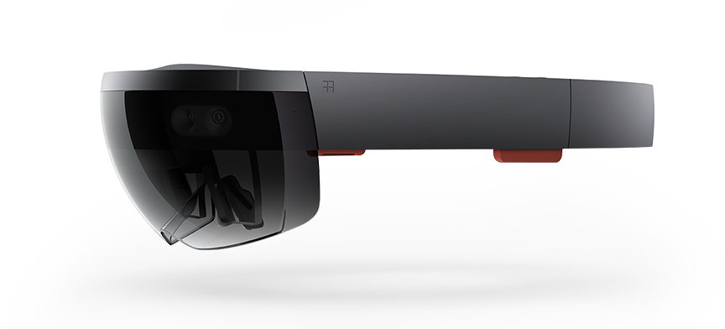
Platforms & Devices

Slide 5
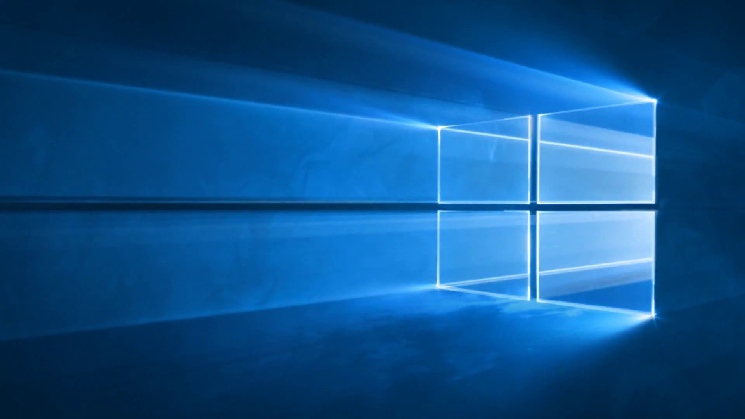
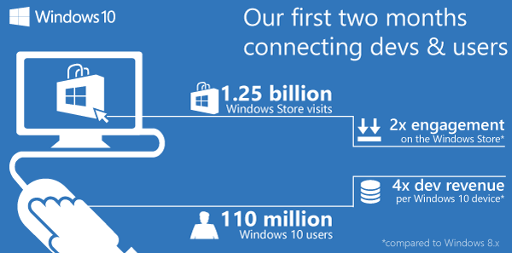
Windows 10 Stats, as of Sep 2015
Source: https://blogs.windows.com/buildingapps/2015/10/12/windows-store-trends-september-2015/

Slide 6
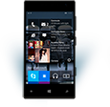
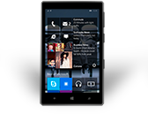
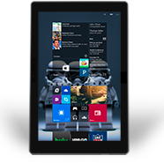
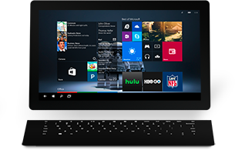
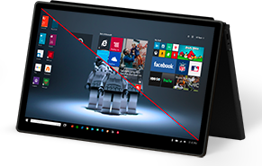
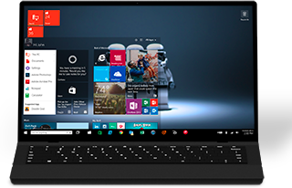
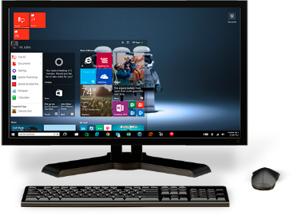
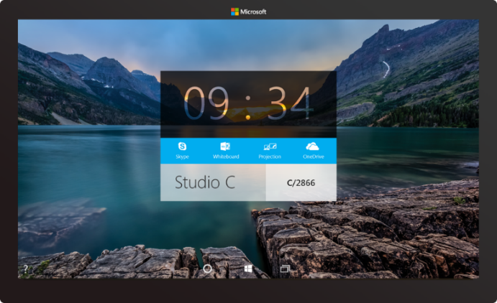
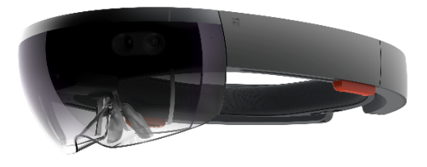
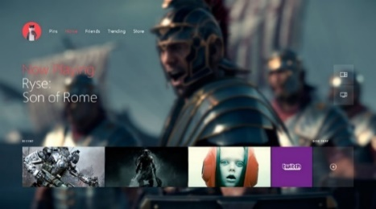
2-in-1s (Tablet or Laptop)
Classic Laptop
Desktops & All-in-Ones
Phone
Phablet
Small Tablet
Large Tablet
Windows 10
Surface Hub
Xbox
Holographic
IoT

Slide 7
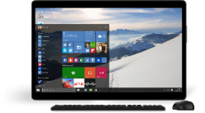
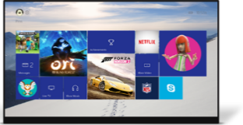
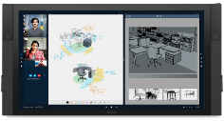
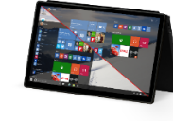
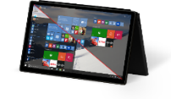
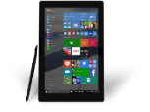
PC
XBox
Mobile
Surface Hub
Devices +IoT
HoloLens
Universal Windows Apps
Multiple device families
Adaptive User Interface
Reuse Existing Code
Natural User Inputs
One Store + One Dev Center
One SDK + Tooling
One Universal Windows Platform

Slide 8
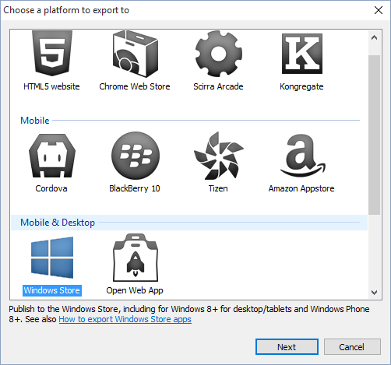
Construct 2: Export to Windows Store
Click “Export Project”
Select “Windows Store”
Guide: http://wakeupandcode.com/publish-a-windows-10-game-with-construct-2

Slide 9
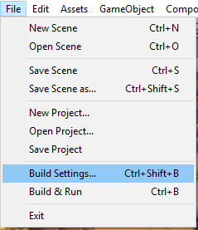
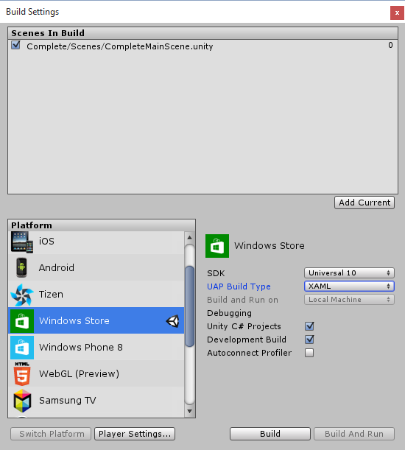
Unity: Publish to Windows Store
c. Select:
SDK: Universal 10
UAP Build type: XAML
D3D optional
d. Optional:
Unity C# Projects
Development Build
Autoconnect Profilder
a. Click File, then
Build Settings…
b. Select
Windows Store
Guide: http://wakeupandcode.com/publish-a-windows-10-game-with-unity-5

Slide 10
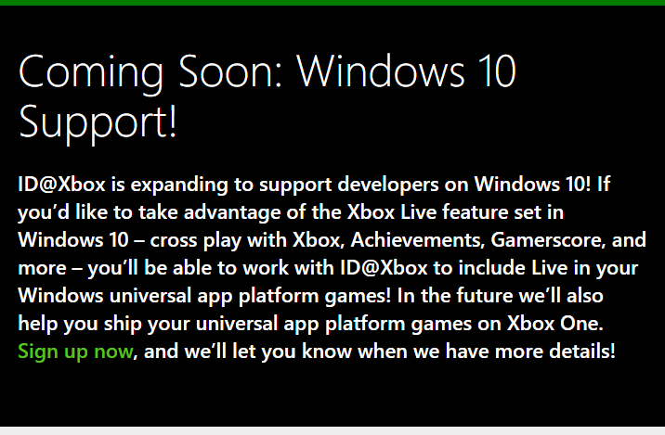
Xbox One: ID@Xbox and Windows 10
Apply: http://xbox.com/id

Slide 11
HoloLens: Apply Now!
Apply: https://www.microsoft.com/microsoft-hololens/en-us/development-edition

Slide 12
Facebook groups
Construct 2 Devs:
https://www.facebook.com/groups/construct2devs
Unity Indie Devs:
https://www.facebook.com/groups/UnityIndieDevs
Xbox One Indie Devs:
https://www.facebook.com/groups/XboxOneIndieDevs
HoloLens Indie Devs:
https://www.facebook.com/groups/HoloLensIndieDevs

Slide 13
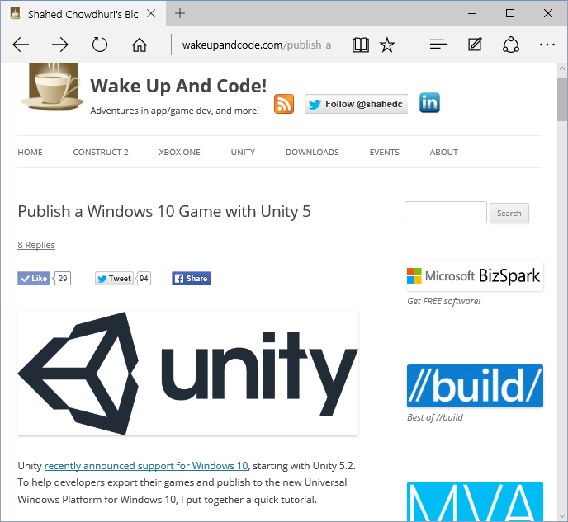
Wake Up And Code!
WakeUpAndCode.com
Step-by-step guides
Video tutorials
Event Announcements
… and more!

Slide 14
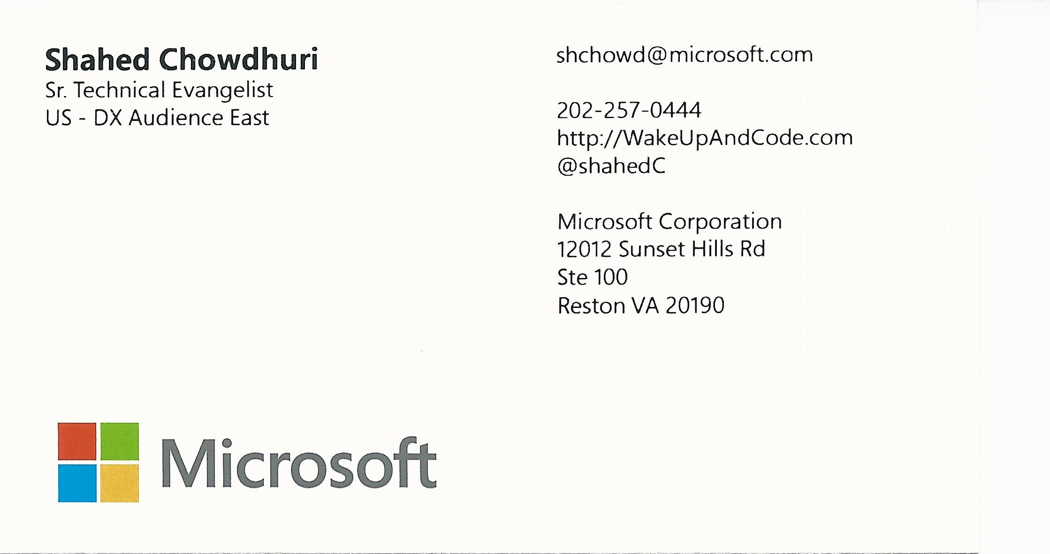
Contact
Email: shchowd@microsoft.com  Twitter: @shahedC
Notes:
Contact
Microsoft email: shchowd@microsoft.com
Personal Twitter: @shahedC
Dev Blog: WakeUpAndCode.com

