Slide 1
Intro to HoloLens Development
A New Era of Mixed Reality
Going Beyond Virtual Reality + Augmented Reality

Slide 2
Speaker Info
Shahed Chowdhuri
Sr. Technical Evangelist @ Microsoft
Technology Areas
Enterprise Web/Software Development
Game Development
Mobile Application Development
Cloud Solutions
Online
LinkedIn: http://linkedin.com/in/shahedc
Meetup: http://www.meetup.com/DC-MS-Devs
Twitter: http://twitter.com/shahedC
Blog: http://WakeUpAndCode.com

Slide 3
HoloLens Overview

Slide 4
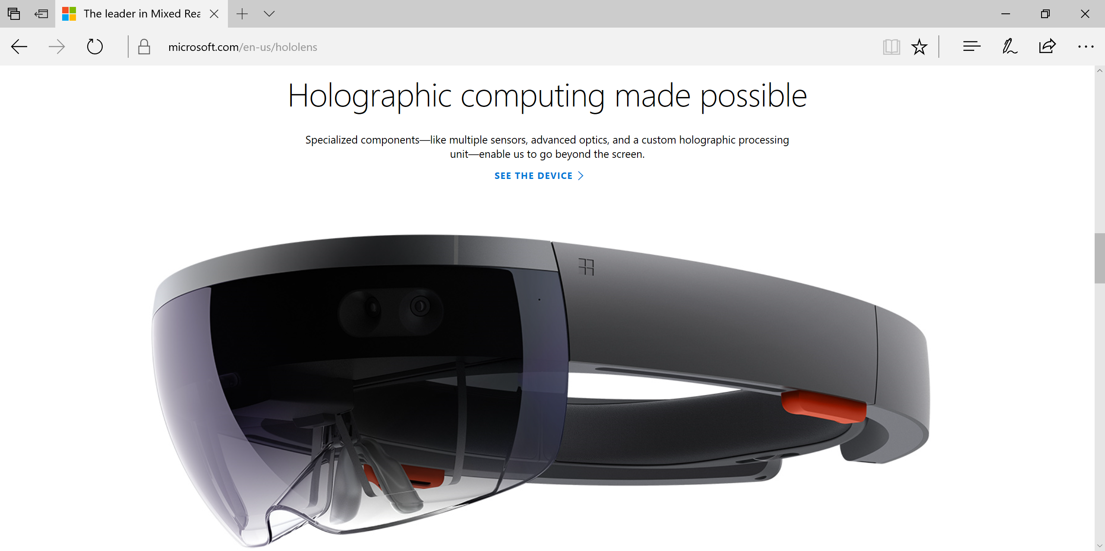
Holographic Computing with HoloLens
http://hololens.com

Slide 5
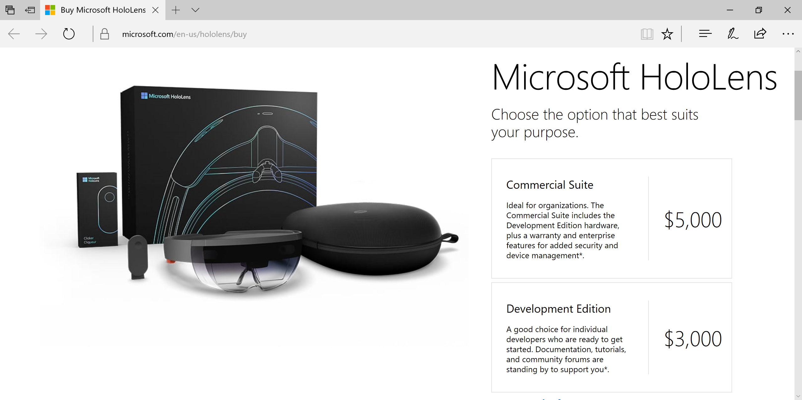
HoloLens: Dev Edition vs Commercial Suite
http://hololens.com/buy

Slide 6
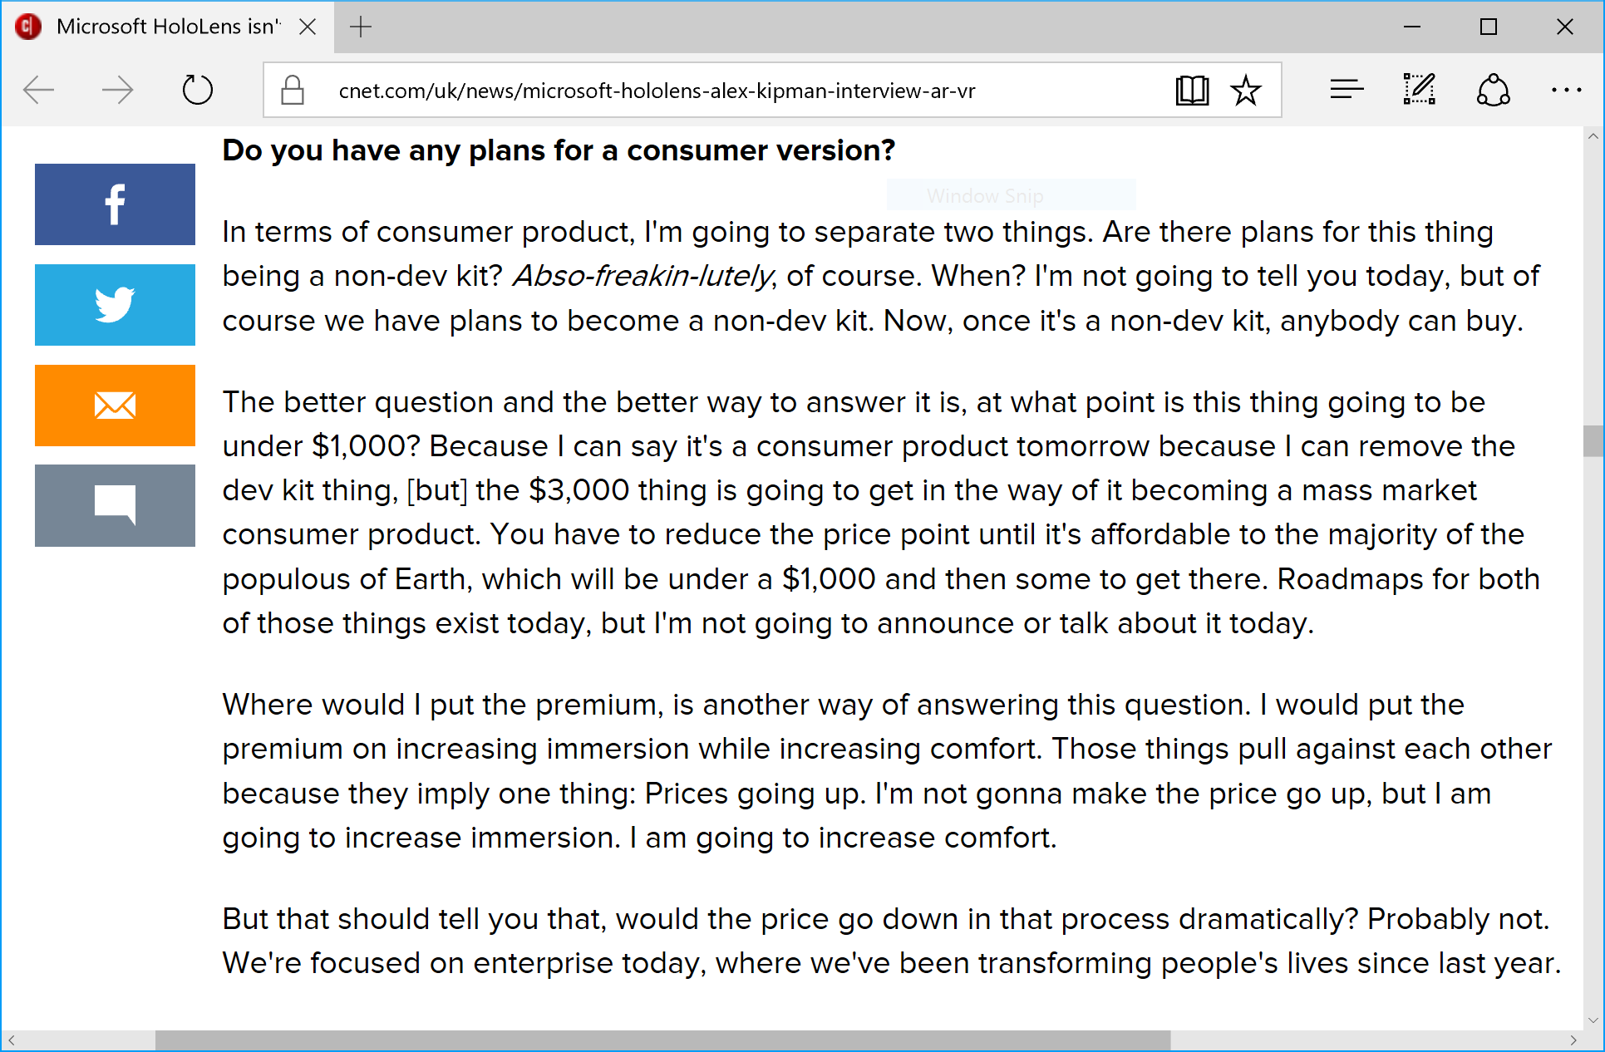
Consumer Version? Price Reduction?
Alex Kipman,
Microsoft
“In terms of consumer product, I'm going to separate two things. Are there plans for this thing being a non-dev kit? Abso-freakin-lutely, of course. When? I'm not going to tell you today, but of course we have plans to become a non-dev kit. Now, once it's a non-dev kit, anybody can buy…. would the price go down in that process dramatically? Probably not. We're focused on enterprise today, where we've been transforming people's lives since last year.”
https://www.cnet.com/uk/news/microsoft-hololens-alex-kipman-interview-ar-vr/

Slide 7
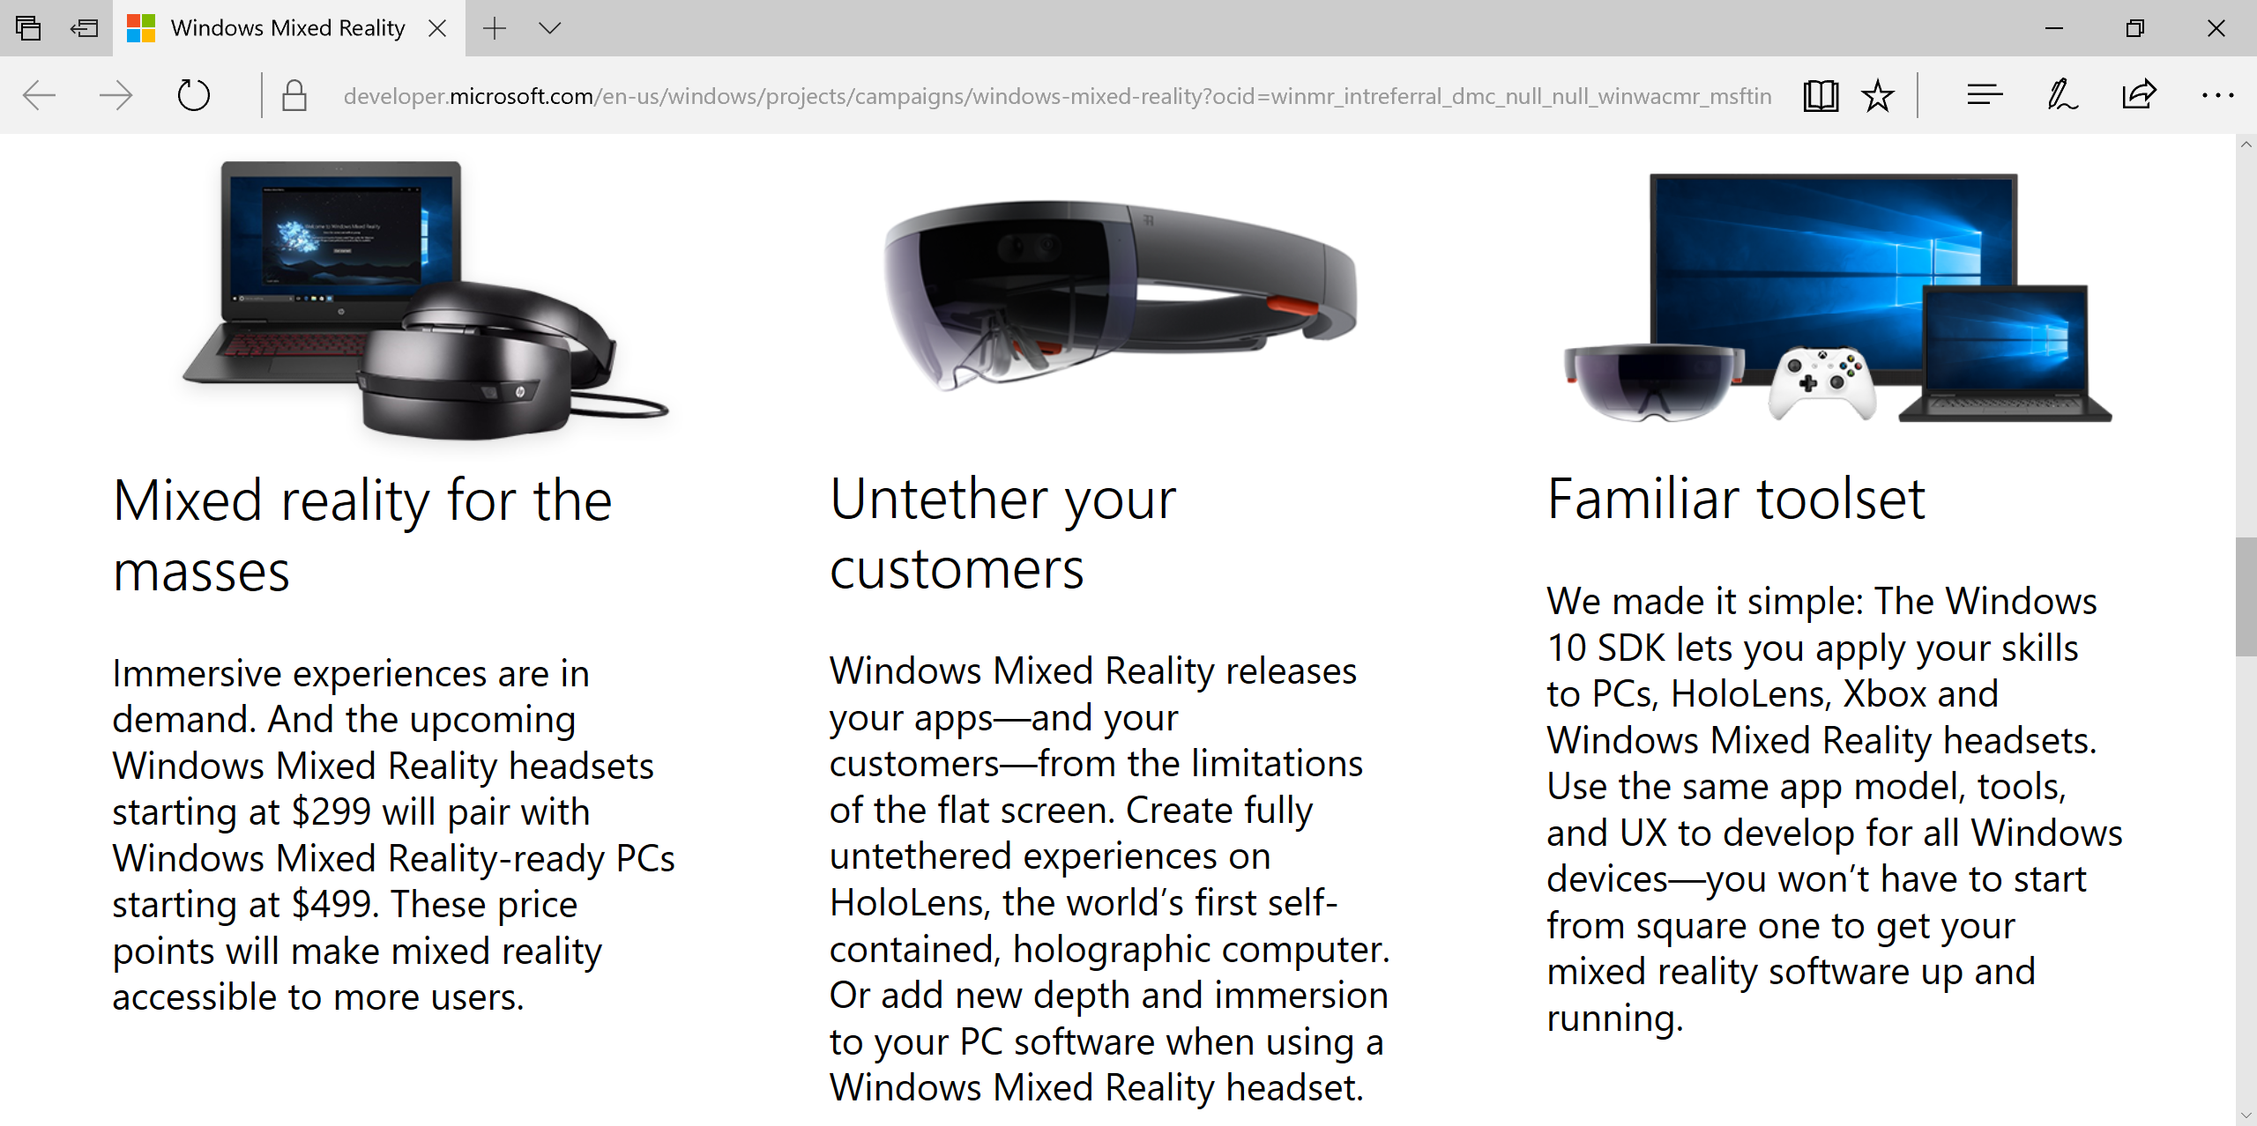
Windows Mixed Reality: More Devices!
https://aka.ms/windows-mixed-reality

Slide 8
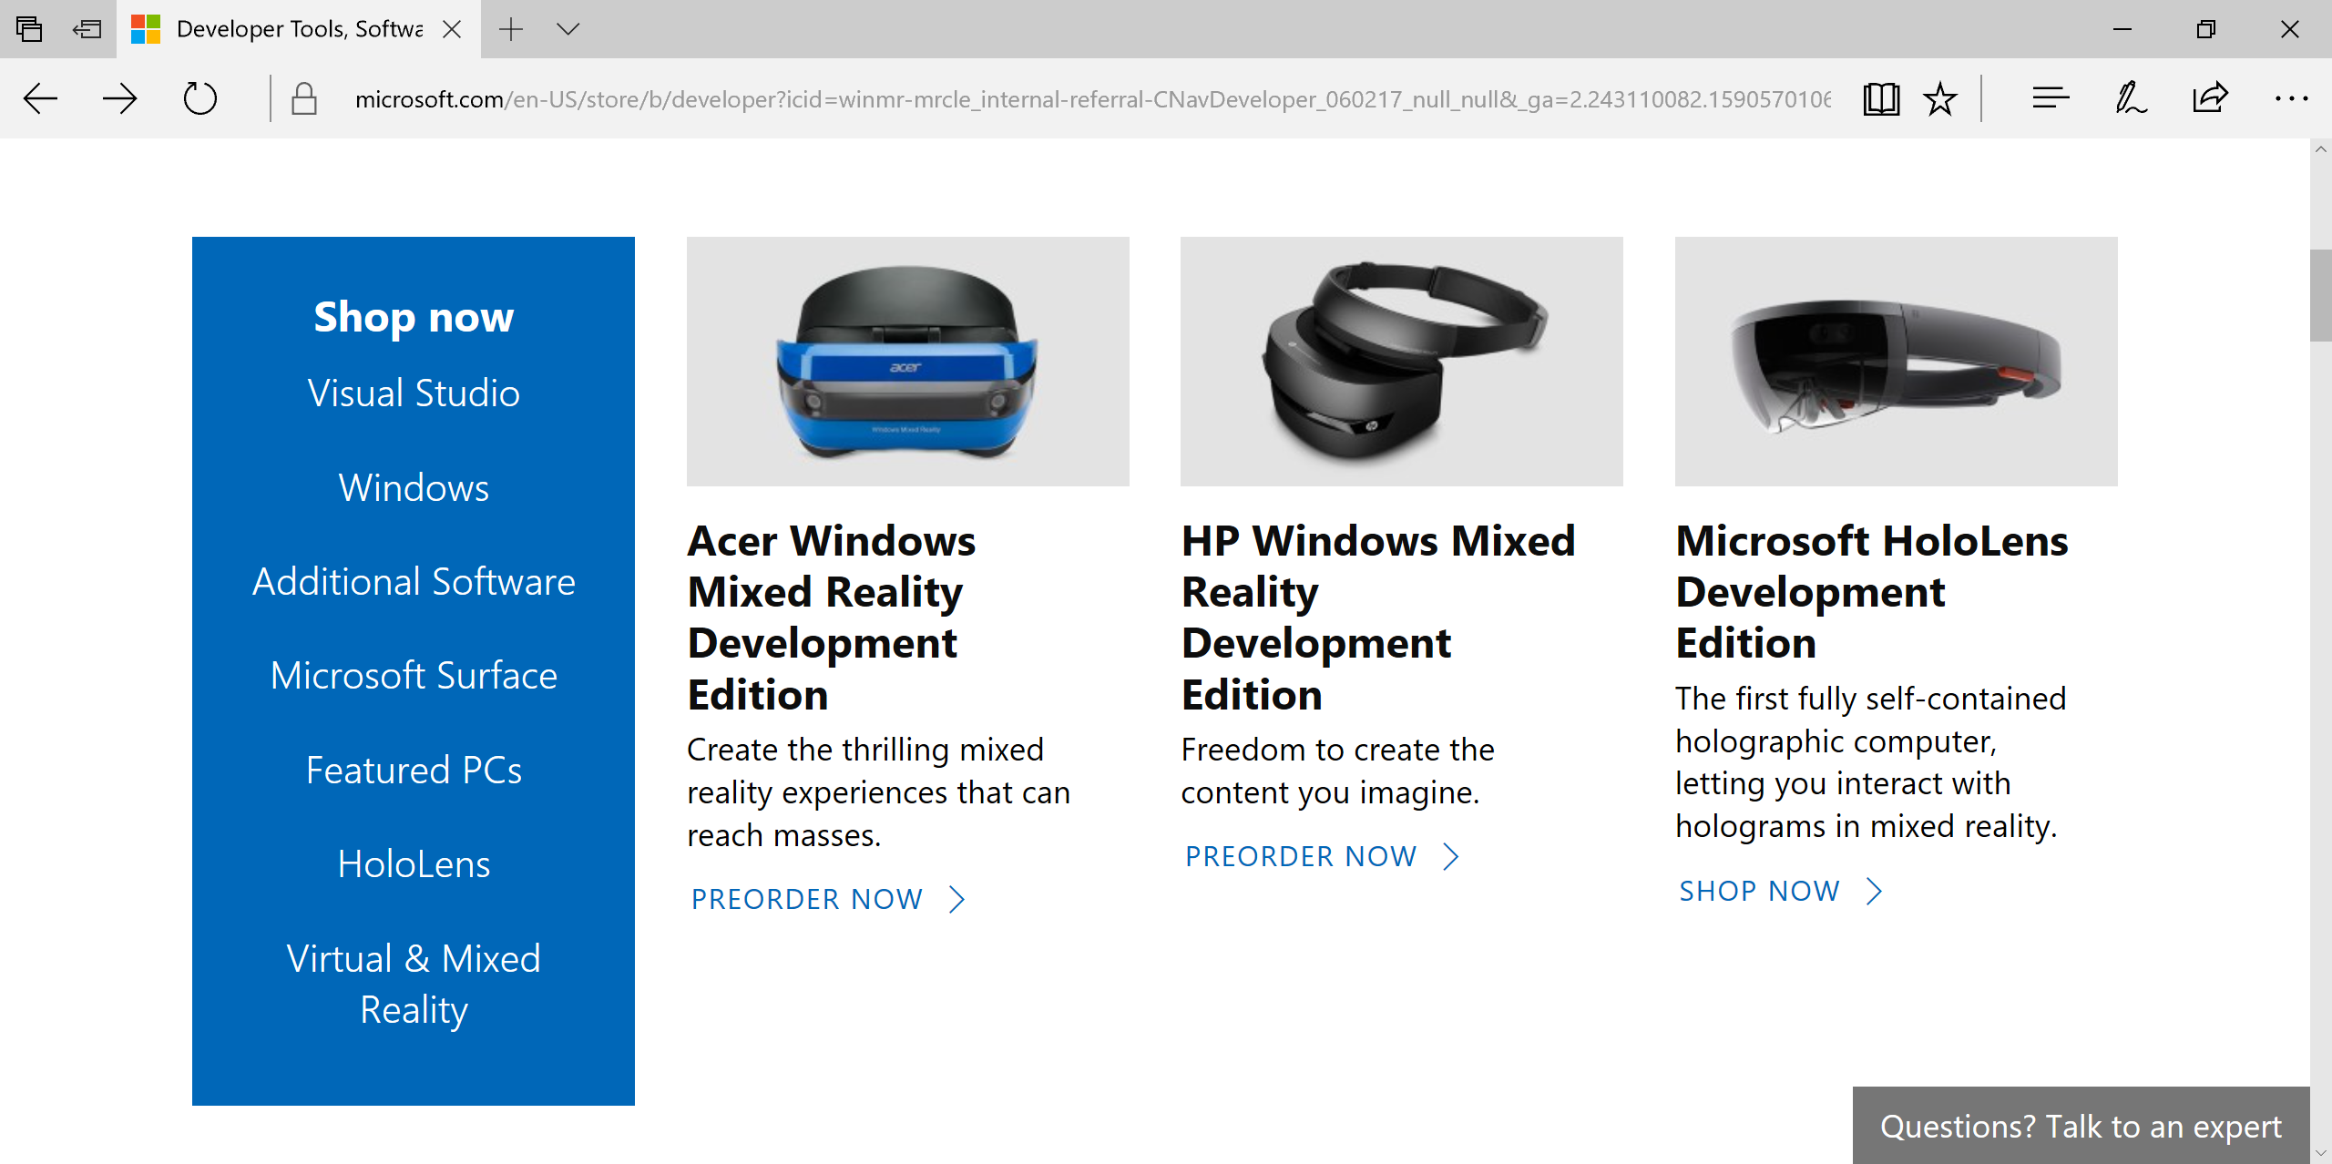
Acer ($299), HP ($329), HoloLens ($3,000)
Order Now!

Slide 9
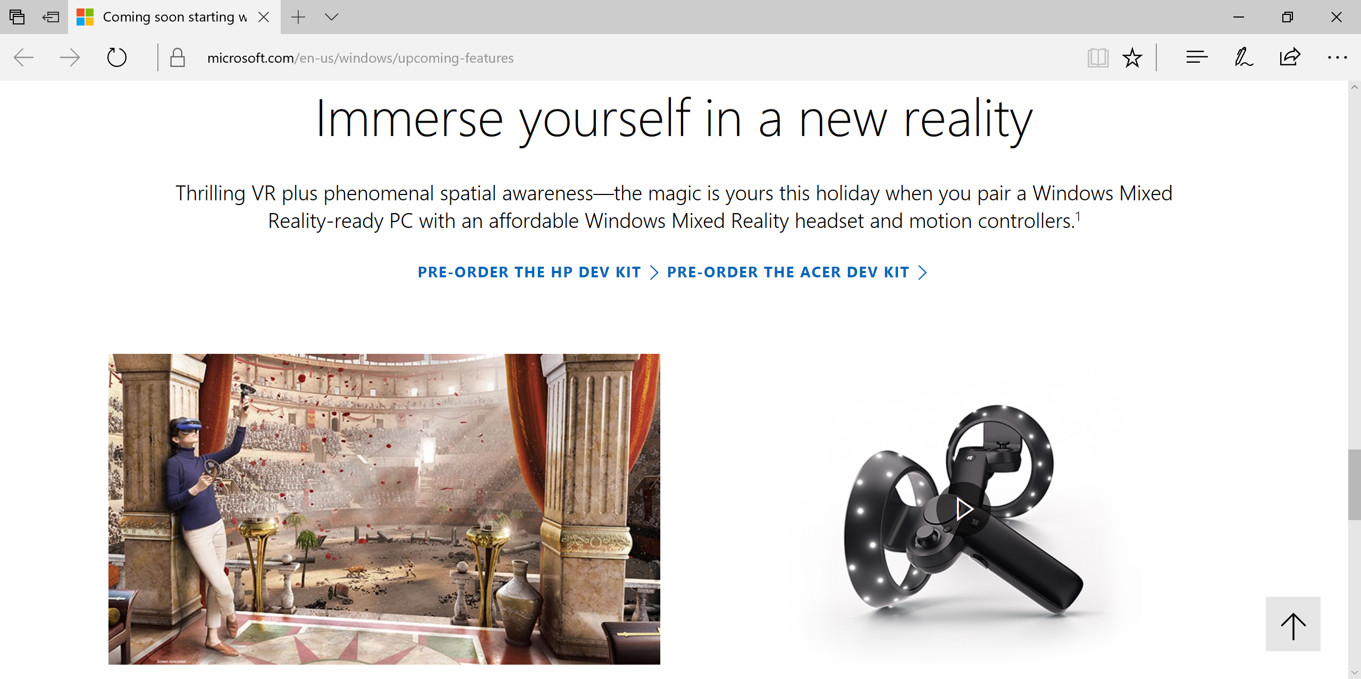
Windows Creators Update + Mixed Reality
https://www.microsoft.com/en-us/windows/upcoming-features

Slide 10
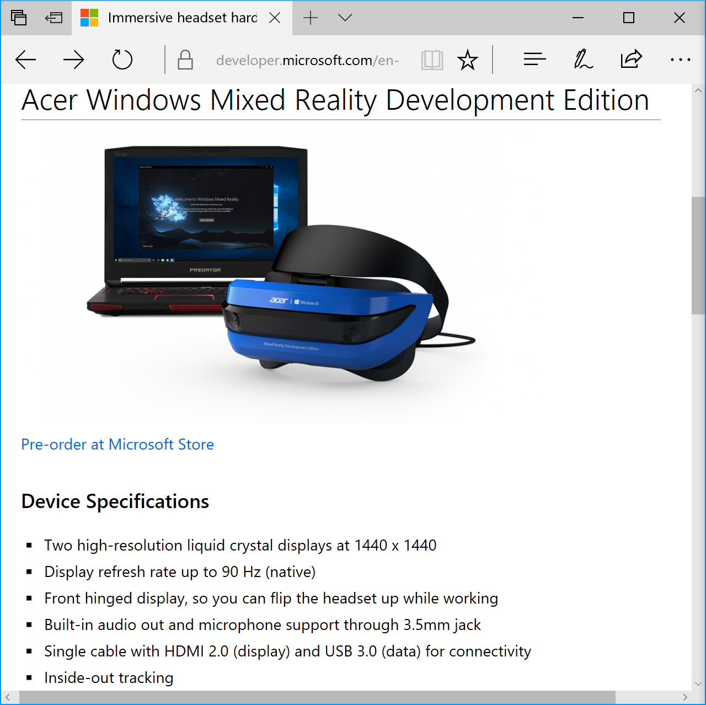
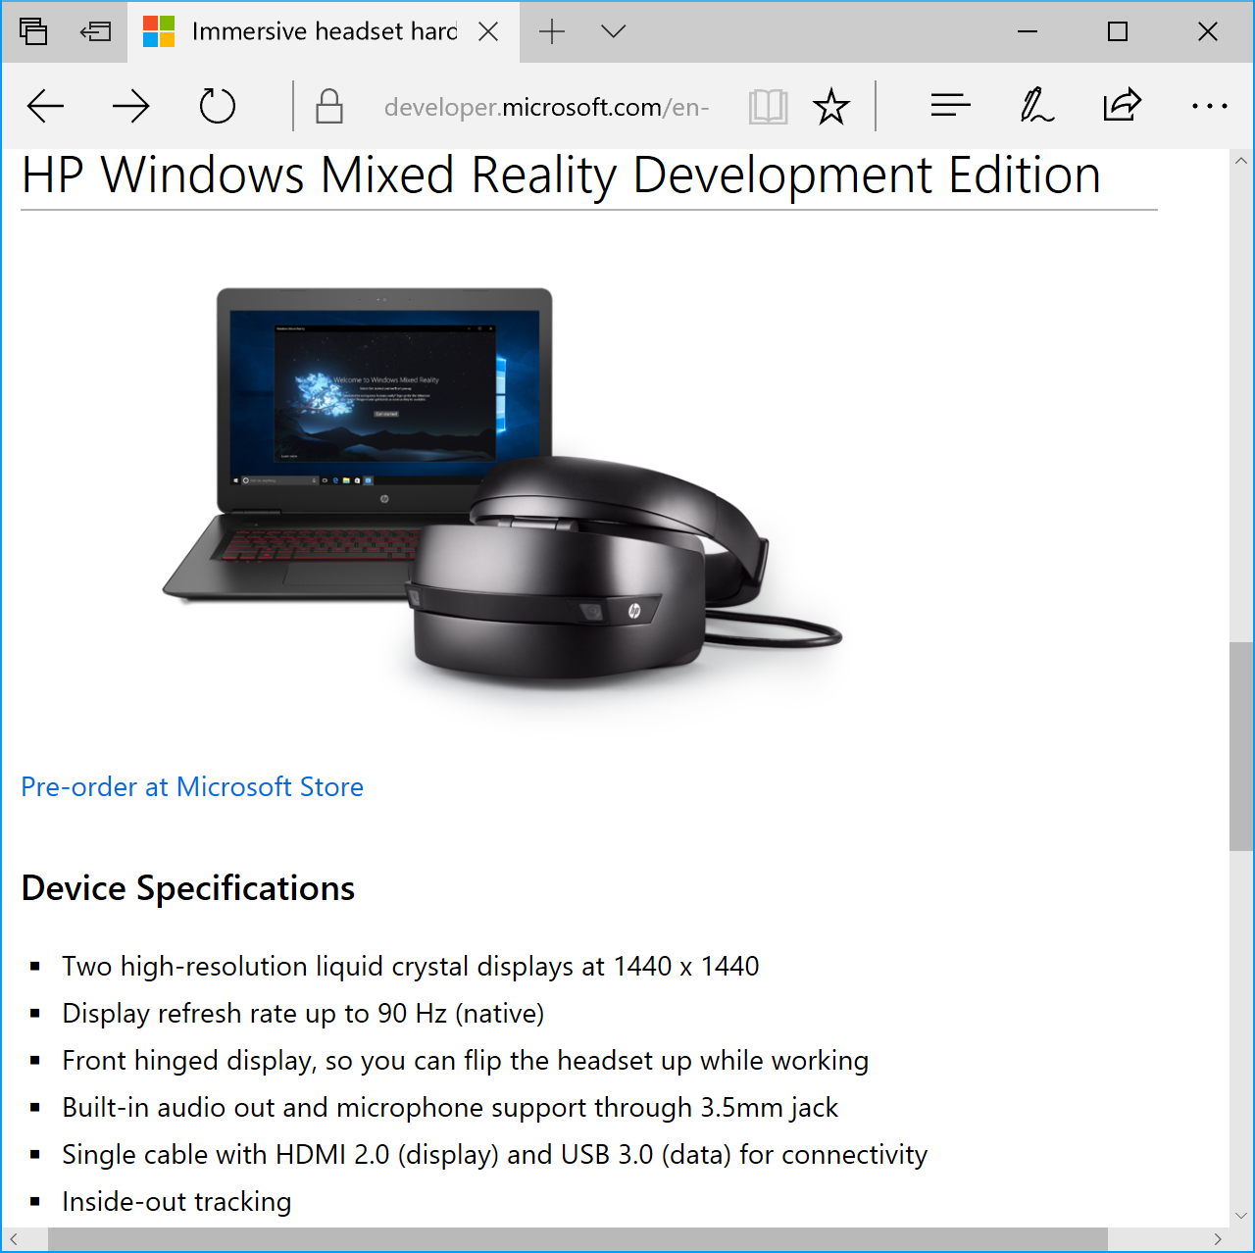
Immersive Headset Details
https://developer.microsoft.com/en-us/windows/mixed-reality/immersive_headset_hardware_details

Slide 11
Getting Started
Tools and Documentation

Slide 12
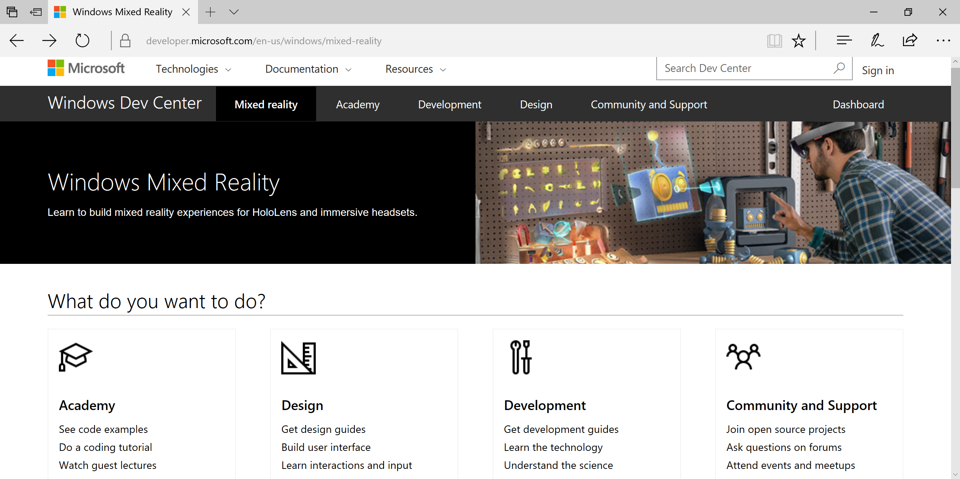
Start Here for Guides, Docs, Community
https://developer.microsoft.com/en-us/windows/mixed-reality

Slide 13
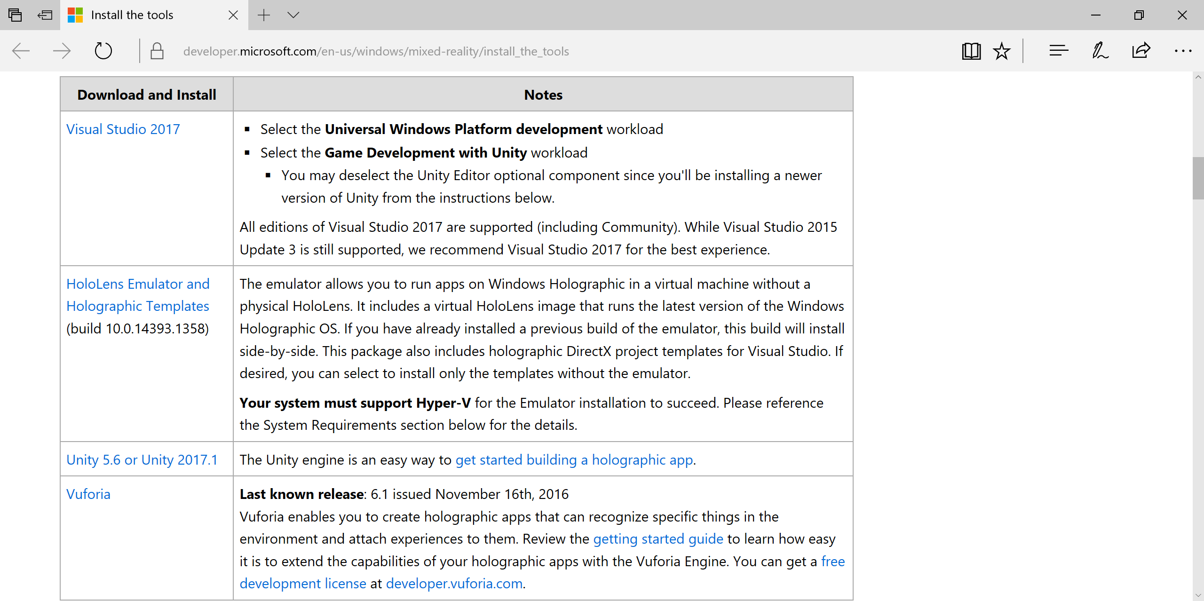
Install the Tools
Checklist
Visual Studio
Emulator
Unity
Vuforia (optional)
https://developer.microsoft.com/en-us/windows/mixed-reality/install_the_tools

Slide 14
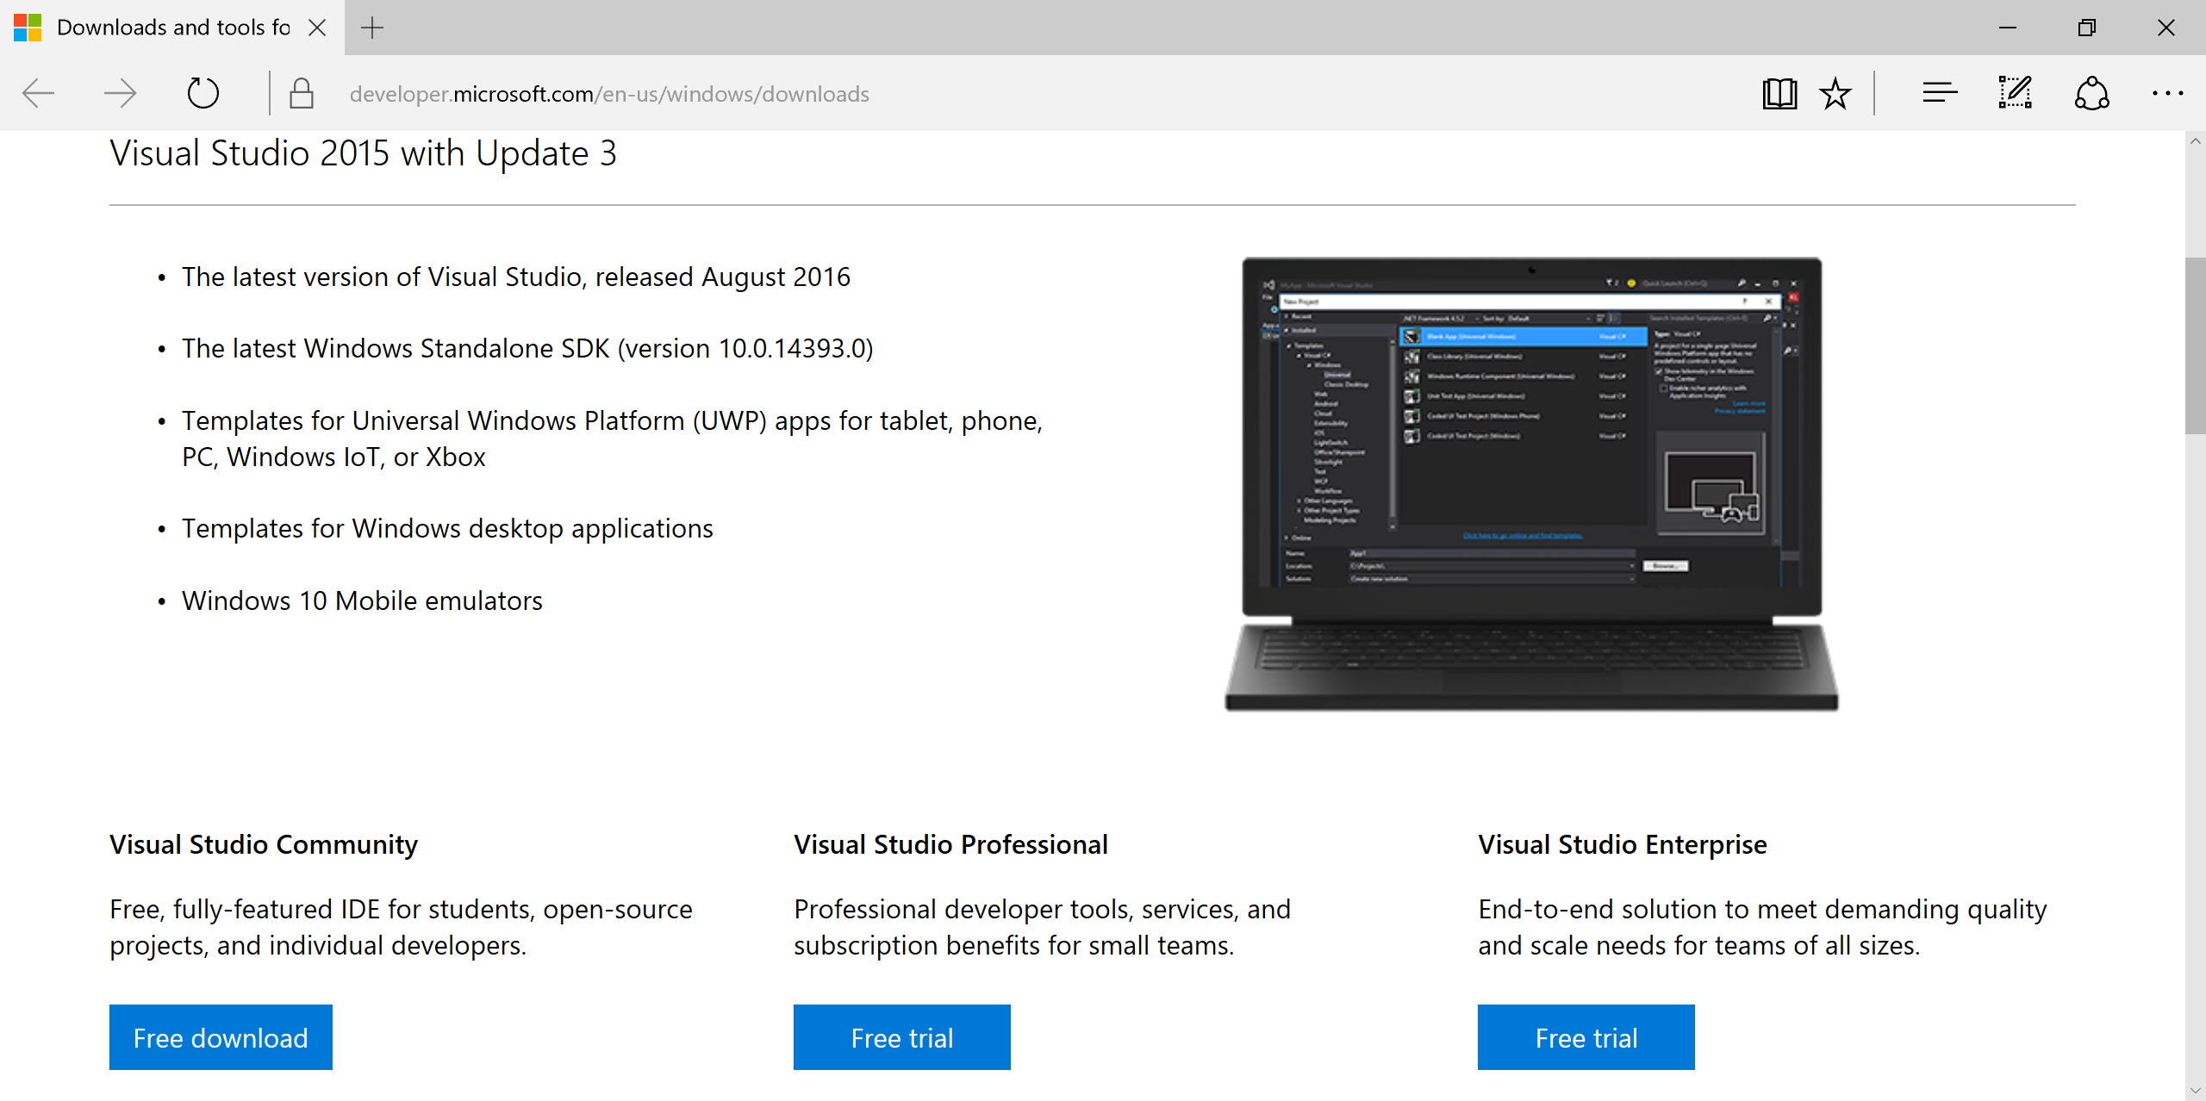
Visual Studio 2015 + Update 3
Older version download: http://go.microsoft.com/fwlink/?LinkId=534599

Slide 15
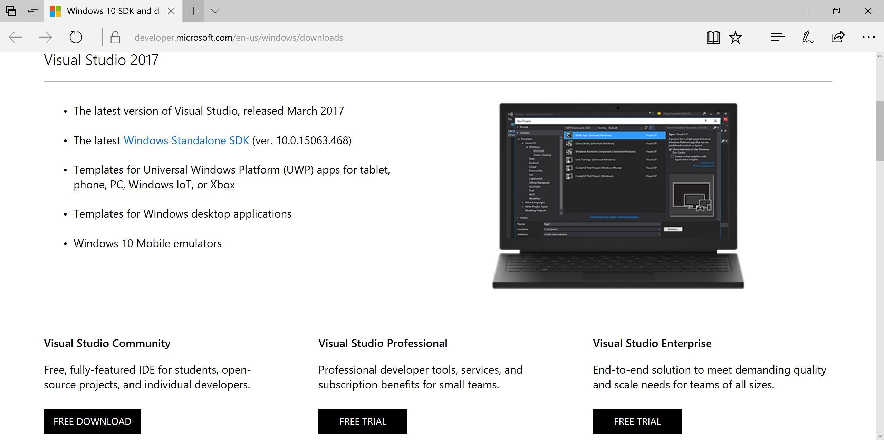
Visual Studio 2017!
http://dev.windows.com/downloads

Slide 16
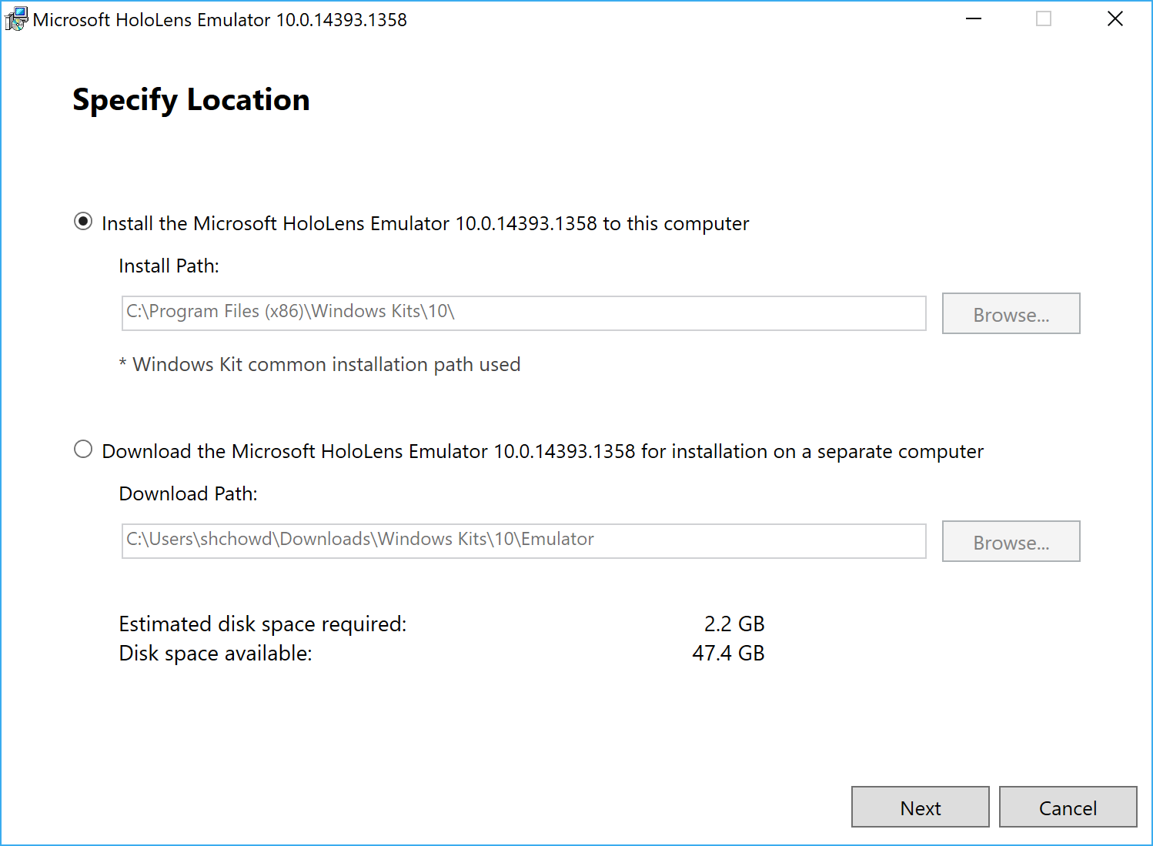
HoloLens Emulator
https://go.microsoft.com/fwlink/?linkid=852626

Slide 17
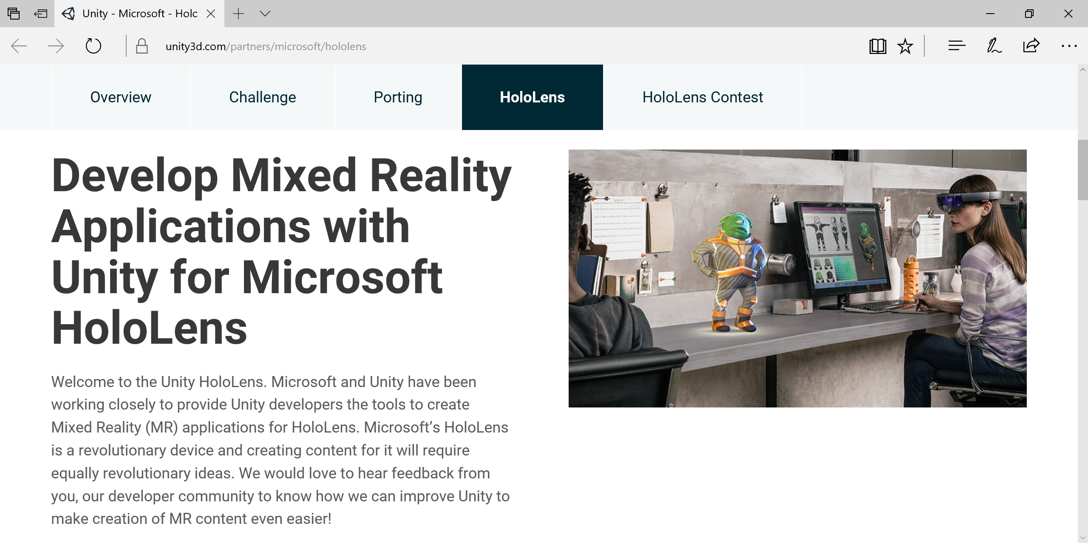
Unity - Microsoft Windows - HoloLens
https://unity3d.com/partners/microsoft/hololens

Slide 18
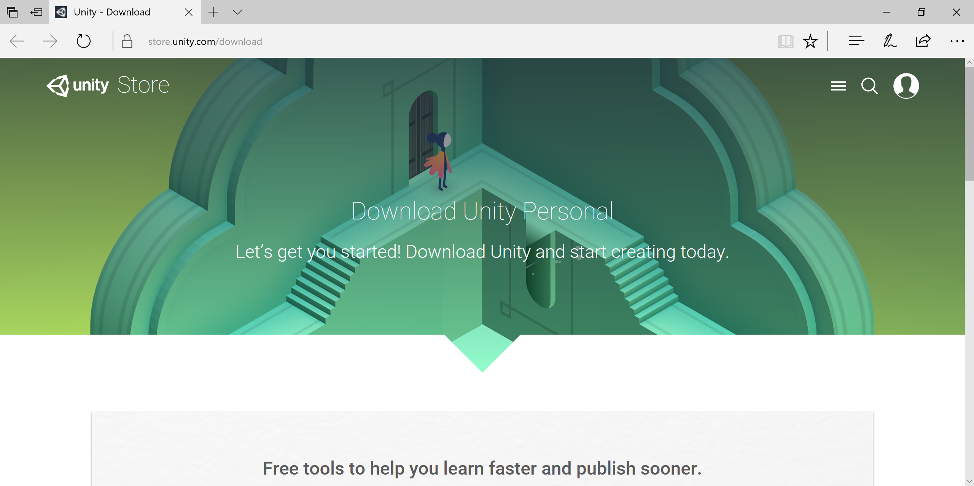
Unity Installer
https://store.unity.com/download

Slide 19
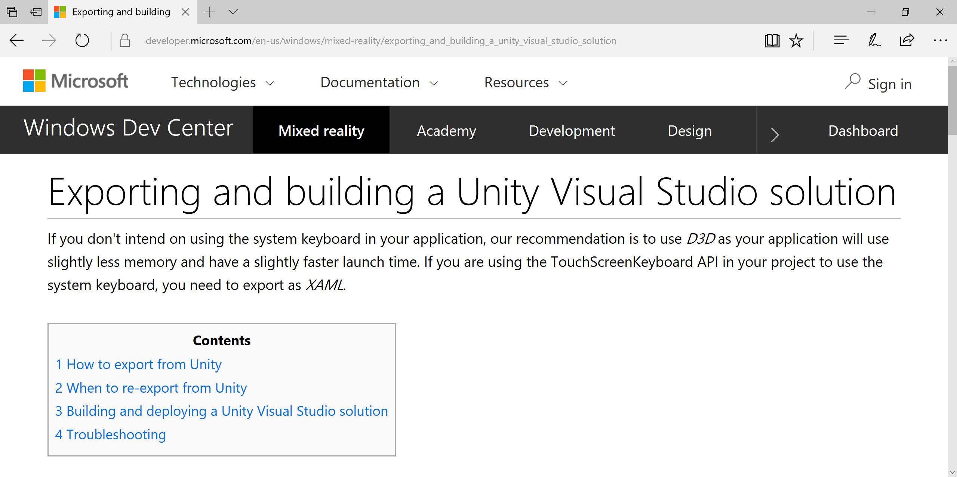
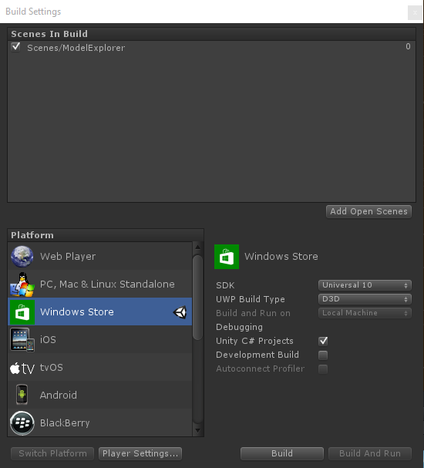
Exporting From Unity to Visual Studio
https://developer.microsoft.com/en-us/windows/mixed-reality/exporting_and_building_a_unity_visual_studio_solution

Slide 20
Things to Know
Gaze
Gesture
Voice
3D vs 2D

Slide 21
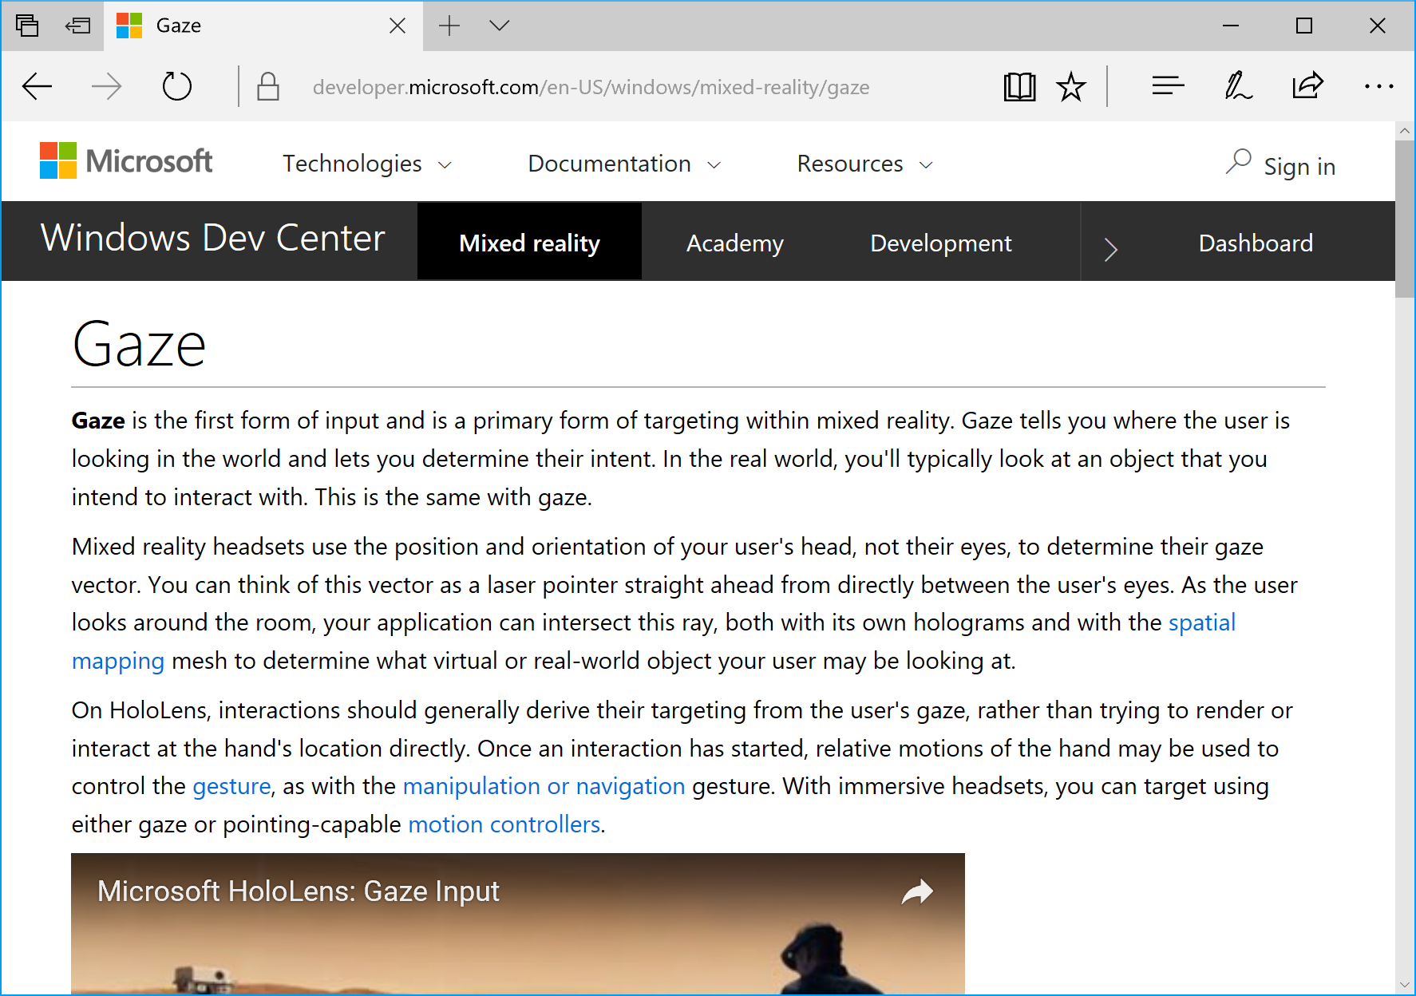
Gaze
What is Gaze?
Form of input
Real-world line of sight
Uses head, not eyes
Uses of Gaze
Intersect with holograms
Target gestures
Place holograms
Detect “away” objects
https://developer.microsoft.com/en-US/windows/mixed-reality/gaze

Slide 22
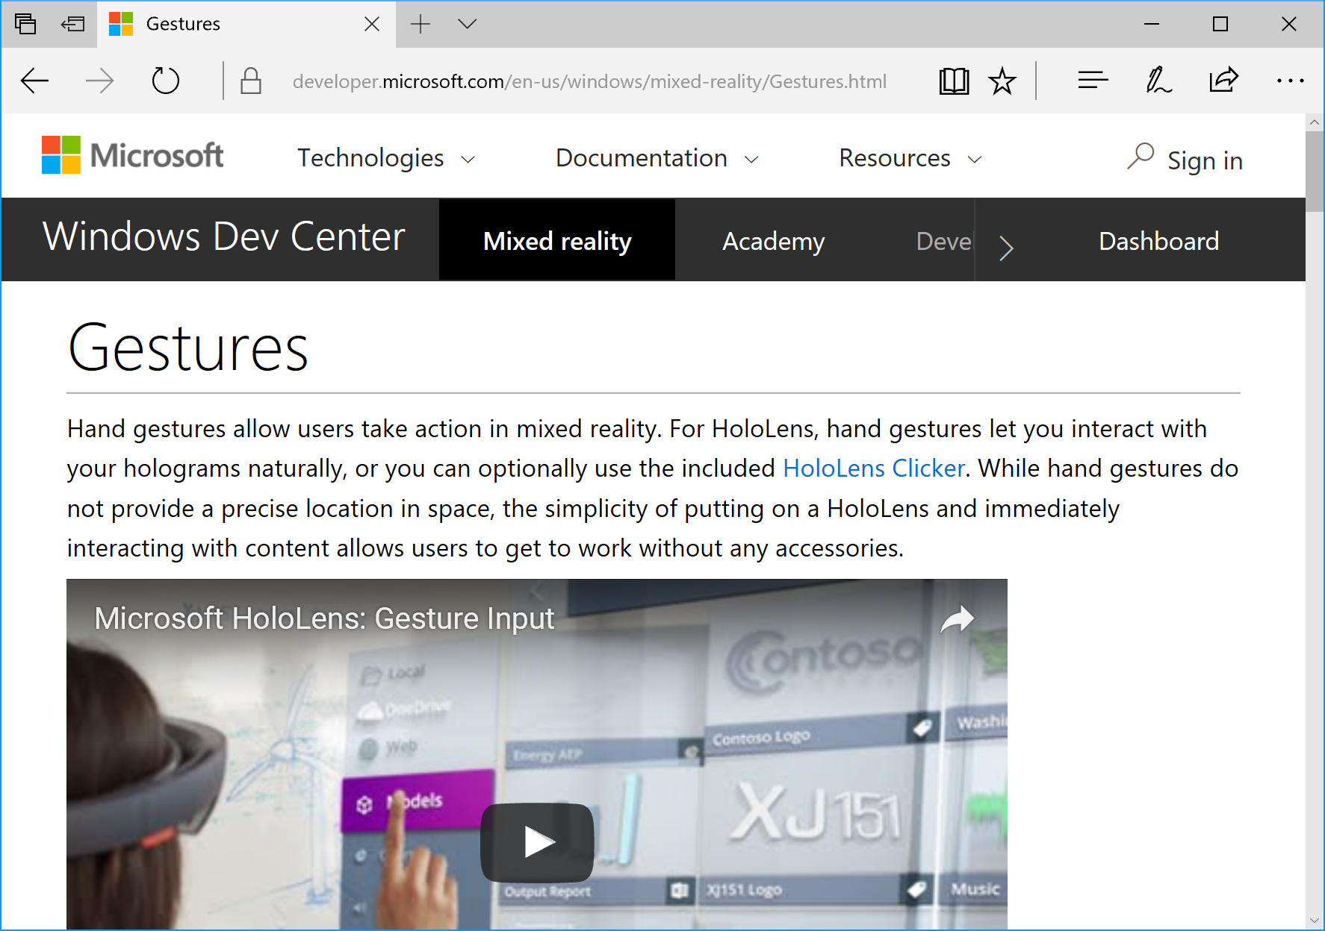
Gestures
What are Gestures?
Form of input
Use your hands/fingers
Use optional clicker
Uses of Gestures
Interact with holograms
Interact with apps
Interact with menu
https://developer.microsoft.com/en-US/windows/mixed-reality/gestures

Slide 23
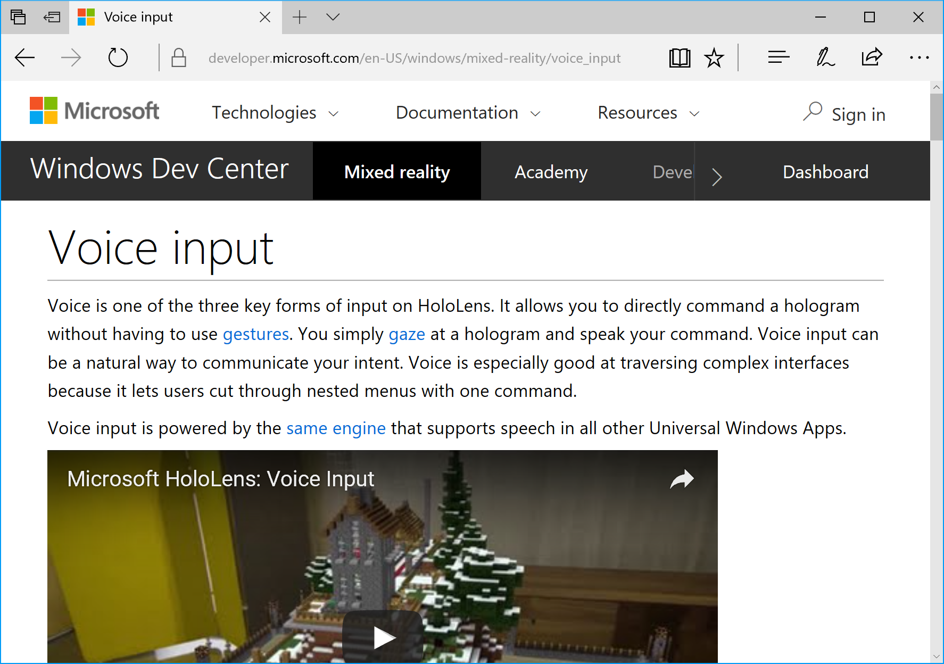
Voice Input
What is Voice Input?
Form of input
Powered by UWP speech engine
Uses of Voice Input
“Hey Cortana!”
Take photos/video
Command holograms
https://developer.microsoft.com/en-US/windows/mixed-reality/voice_input

Slide 24
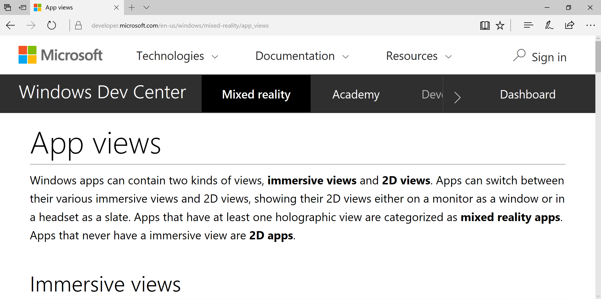
App Views: Mixed Reality vs 2D
https://developer.microsoft.com/en-us/windows/mixed-reality/app_views

Slide 25
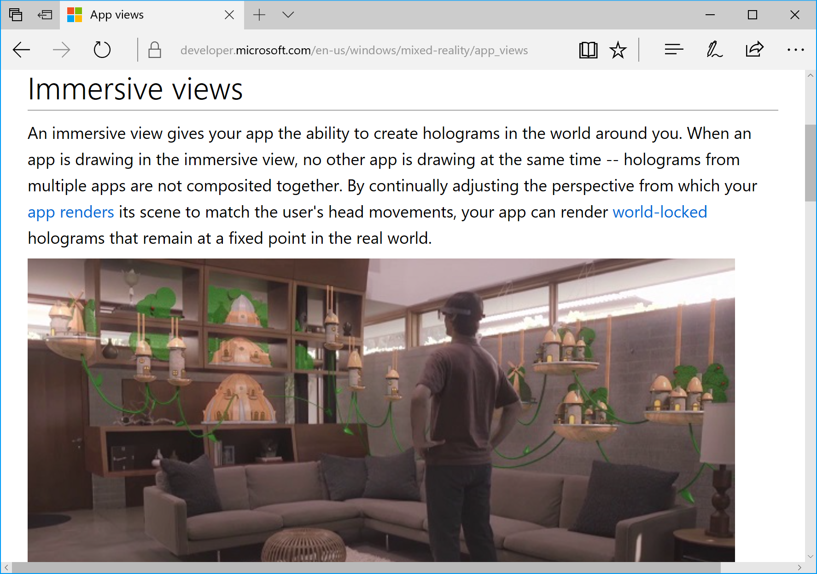
Immersive (Holographic) Views
What is it?
View 3D holograms
One holographic app at a time
Lock to real world
https://developer.microsoft.com/en-us/windows/mixed-reality/app_views

Slide 26
Next Steps
GitHub
Website
Forums

Slide 27
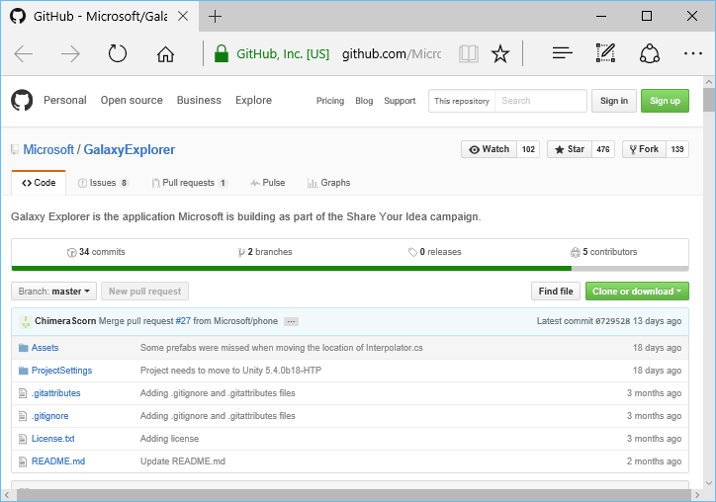
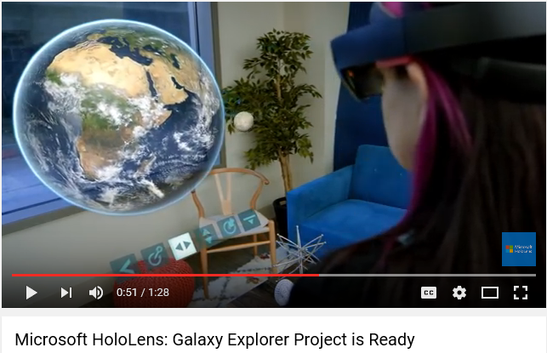
Galaxy Explorer: Open Source on GitHub
https://github.com/Microsoft/GalaxyExplorer

Slide 28
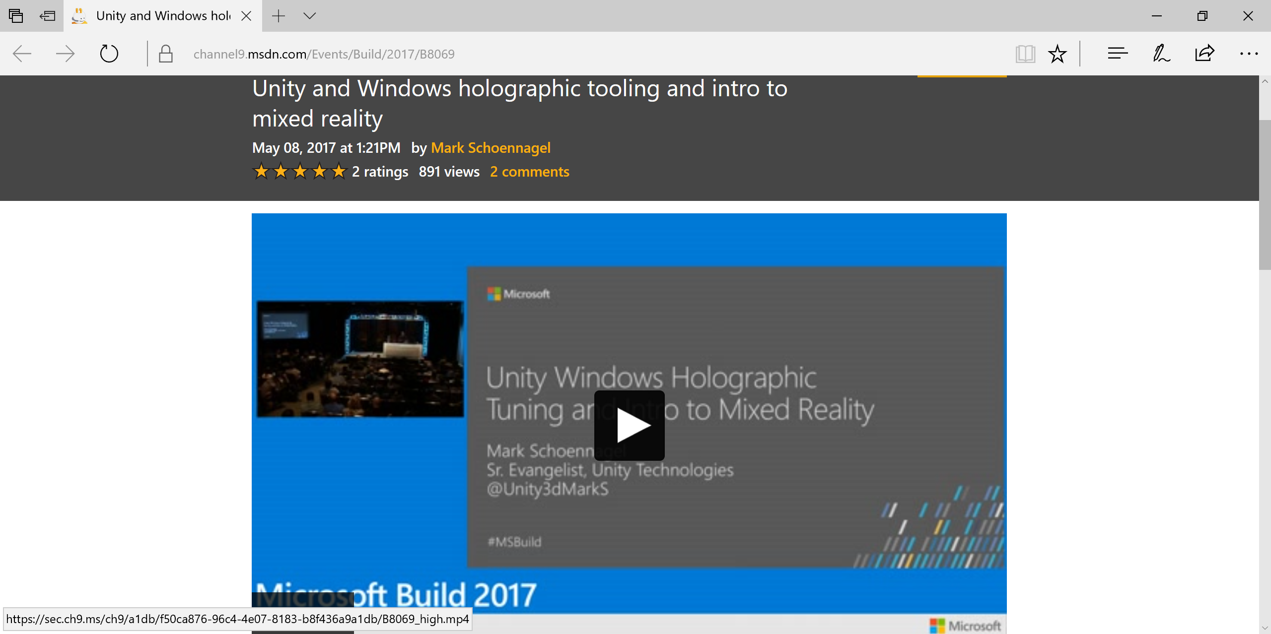
MSDN Ch9: Videos from Build
https://channel9.msdn.com/Events/Build/2017/B8069

Slide 29
HoloLens: Official Website
http://hololens.com

Slide 30
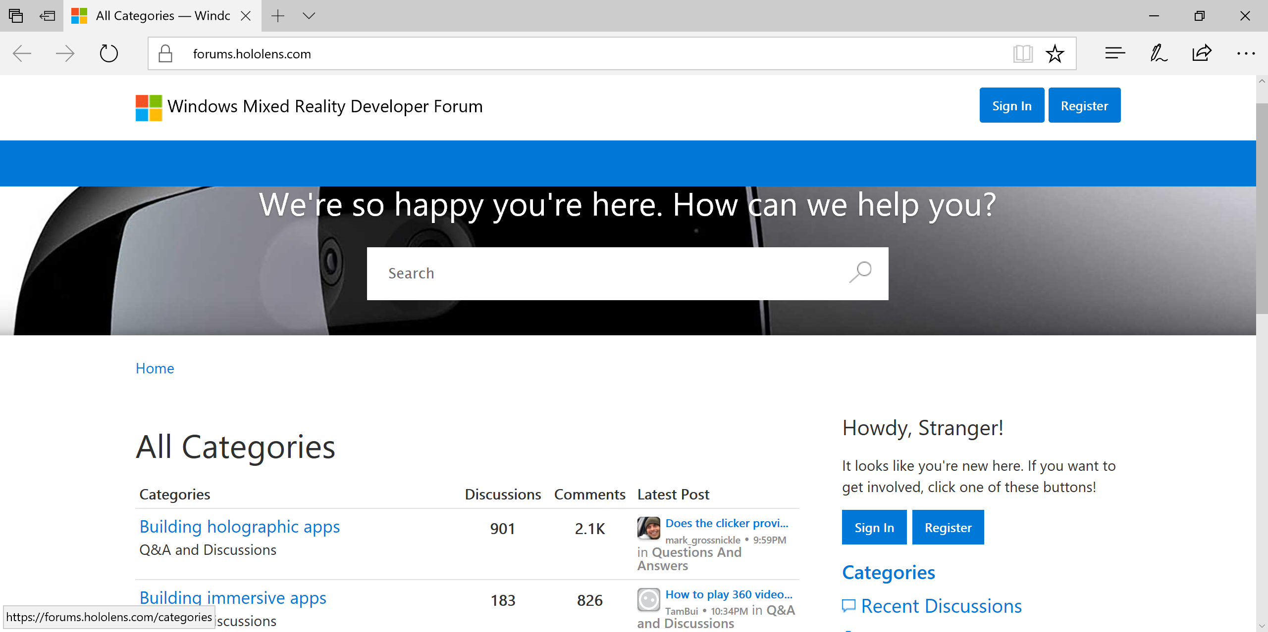
Windows Mixed Reality Developer Forum
https://forums.hololens.com/

Slide 31
Demo

Slide 32
Q&A

Slide 33
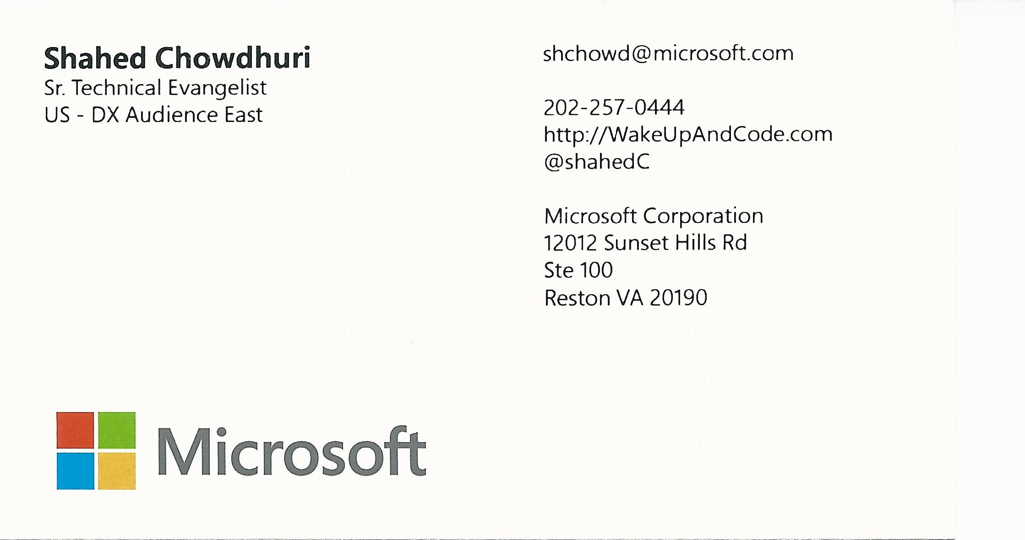
Email: shchowd@microsoft.com  Twitter: @shahedC
Notes:
Contact
Microsoft email: shchowd@microsoft.com
Personal Twitter: @shahedC
Dev Blog: WakeUpAndCode.com

