Slide 1
Intro to Indie Game Development
Windows  Web  Xbox  Mobile
By Shahed Chowdhuri
WakeUpAndCode.com
@shahedC
Notes:
Intro to Indie Game Development (title page)
Windows  Web  Xbox  Mobile

Slide 2
Agenda
Intro + XNA/XBLIG
> Construct2
> C++ and DirectX
> Unity with C#
Being an Indie in the Real World
Notes:
* Learn about how you can build games for Windows, Web and Xbox platforms.
* Visual tools like Construct 2, programming with C++ and DirectX, and using your C# experience with Unity.
* Not a deep dive into each topic, but enough info for you to get started and pick a direction.

Slide 3
My Background
Period | Background/Experience
1997 – present | Microsoft web/software development
2011 | XNA games on XBLIG 2D Math Panic Angry Zombie Ninja Cats
2012 | Tools for XNA developers XBLIG Sales Data Analyzer (OnekSoftLabs.com) XNA Basic Starter Kit (CodePlex)
Online: http://facebook.com/OnekSoftGames
Notes:
My Background
1997 – present: Microsoft web/software development
2011: XNA games on XBLIG
2D Math Panic
Angry Zombie Ninja Cats
2012: Tools for XNA developers
XBLIG Sales Data Analyzer (OnekSoftLabs.com)
XNA Basic Starter Kit (CodePlex)
Online: http://facebook.com/OnekSoftGames

Slide 4
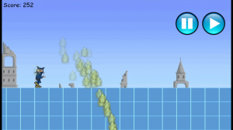
My Background (continued)
Period | Background/Experience
2013 | Ninja Cat Runner on Windows 8 (Construct2) Video Q&A with MS Tech Evangelist Frank La Vigne Founder/Admin of Xbox One Indie Devs Group (FB) Attended ID@Seattle, Microsoft’s ID@Xbox summit
2014 | Public Speaking on Indie Game Development
Video: http://youtu.be/lRjrQPvVOpo
Notes:
My Background (continued) 2013
Ninja Cat Runner on Windows 8 (Construct2)
Video Q&A with MS Tech Evangelist Frank La Vigne
Founder/Admin of Xbox One Indie Devs Group (FB)
Attended ID@Seattle, Microsoft’s ID@Xbox summit
2014
Public Speaking on Indie Game Development
Video: http://youtu.be/lRjrQPvVOpo

Slide 5
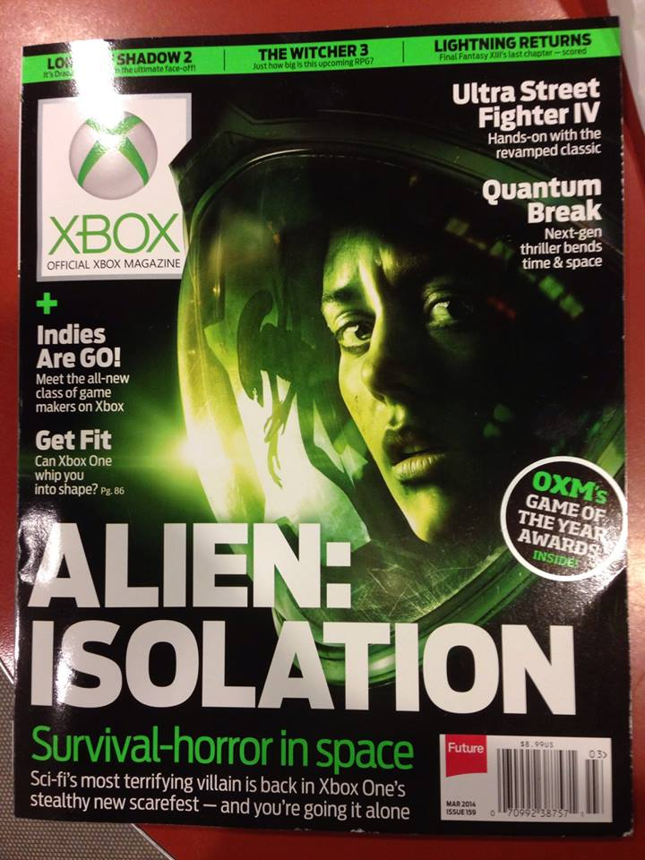
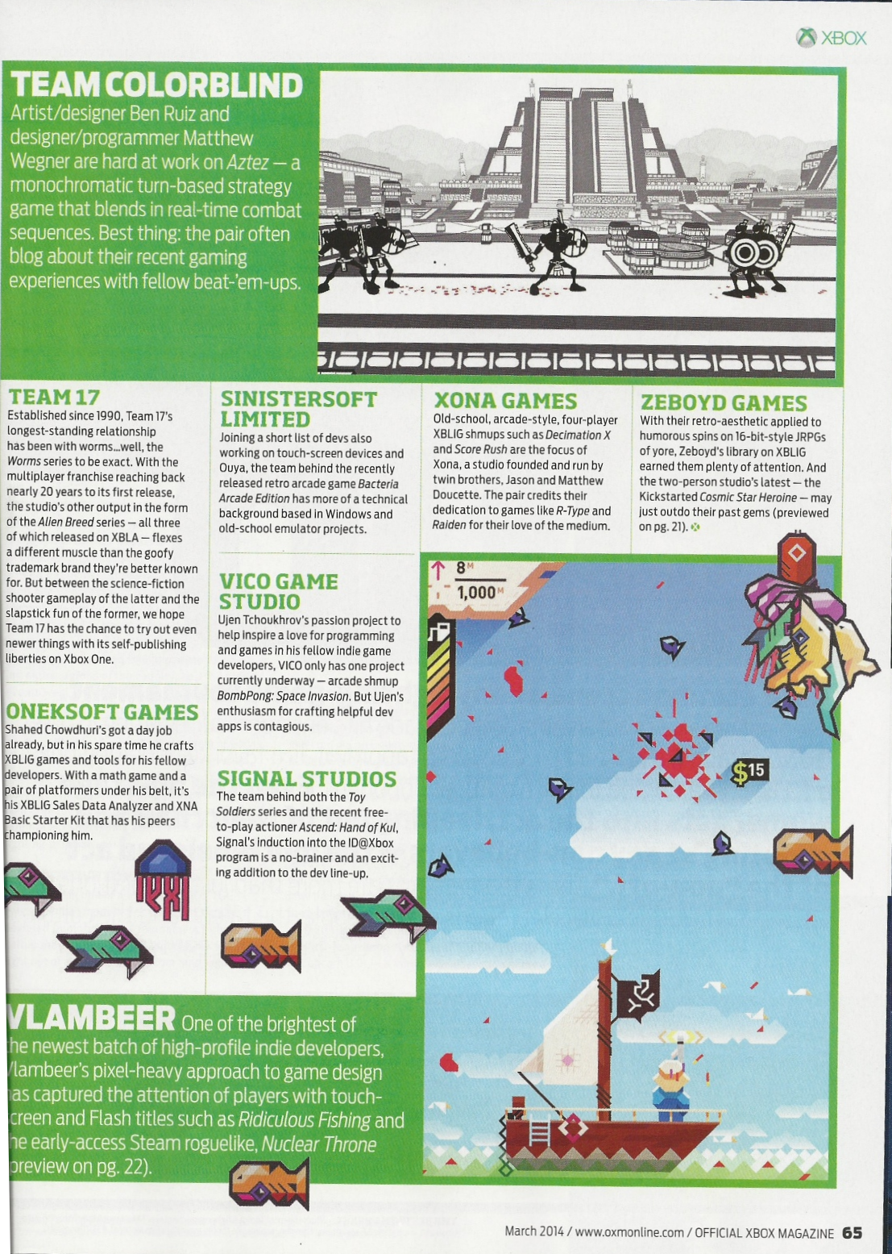
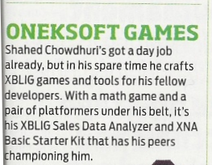
Official Xbox Magazine
`
Source: Official Xbox Magazine, March 2014, Page 65
Notes:
Official Xbox Magazine, March 2014, Page 65
"Shahed Chowdhuri's got a day job already,
but in his spare time he crafts XBLIG games and tools for his fellow developers.”
“With a math game and a pair of platformers under his belt,
it's his XBLIG Sales Data Analyzer and XNA Basic Starter Kit that has his peers championing him."

Slide 6
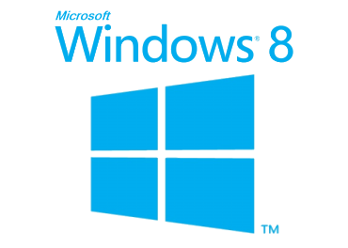
Tools & Technologies
Notes:
Tools & Technologies
Visual Studio 2013
Windows 8
Microsoft .NET and Visual C#
Xbox One
Construct2
C++ and DirectX 11.1
Unity
Paint.net

Slide 7
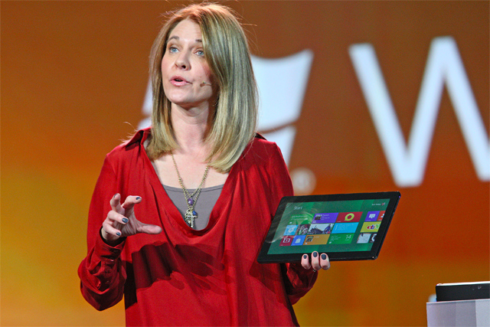
Why Windows 8?
"We surpassed 200 million licenses now on Windows 8, which is pretty stunning," she said, adding that while the platform has received a lot of traction, there is still a lot more work to do.
Tami Reller, Microsoft's executive vice president of marketing
Notes:
Why Windows 8?
Tami Reller, Microsoft's executive vice president of marketing
"We surpassed 200 million licenses now on Windows 8”

Slide 8
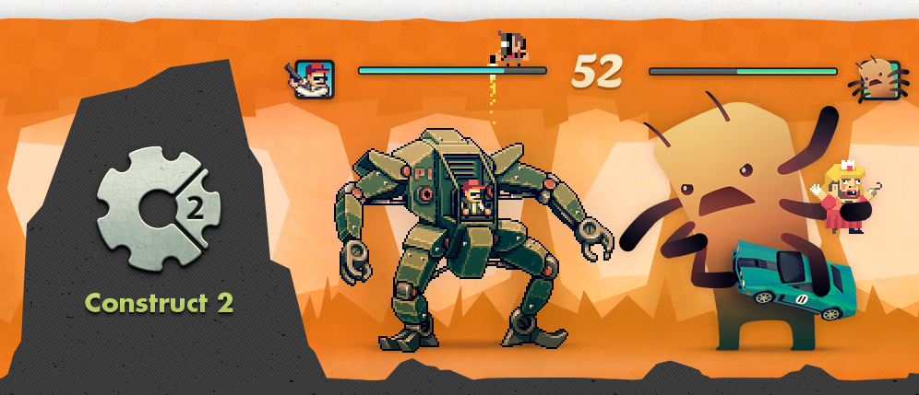
Construct 2
Source: https://www.scirra.com/construct2
Notes:
Construct 2
Source: https://www.scirra.com/construct2

Slide 9
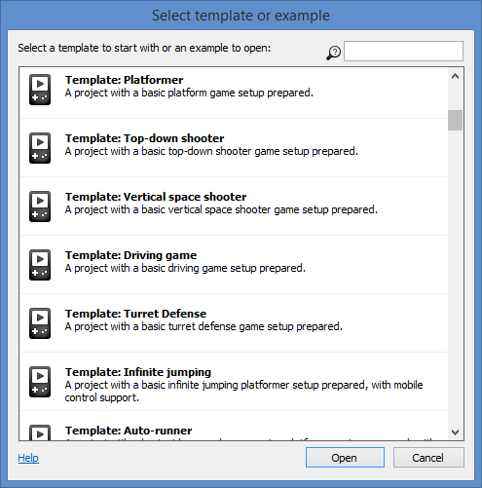
Construct 2 – Getting Started
Choose a genre or sub-genre, use a template, download complete examples
Templates
Platformer
Top-down shooter
Vertical space shooter
Driving Game
Turret Defense
Infinite jumping
Auto-runner
etc.
Notes:
Construct 2 – Getting Started
Choose a genre or sub-genre, use a template, download complete examples
Templates
Platformer
Top-down shooter
Vertical space shooter
Driving Game
Turret Defense
Infinite jumping
Auto-runner
etc.

Slide 10
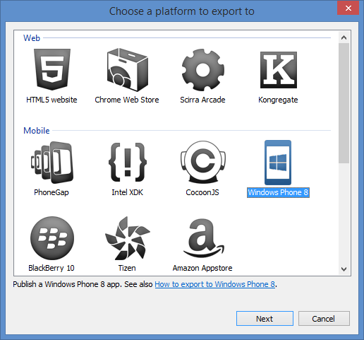
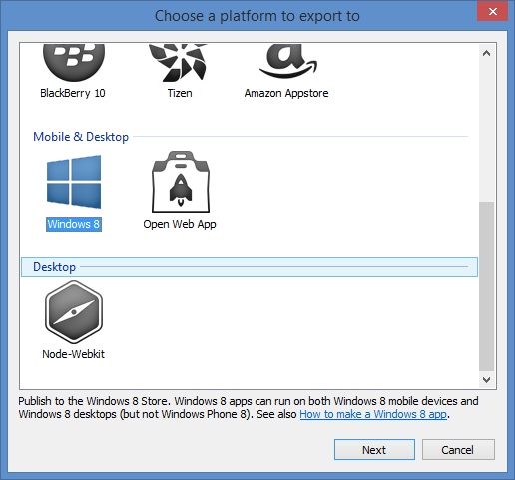
Construct 2: Export
Multiplatform Support
Notes:
Construct 2: Export
Multiplatform Support
Web (HTML5 website, etc)
Mobile (PhoneGap, WP8, etc)
Desktop (Windows 8)

Slide 11
Construct 2 publishing
Notes:
Construct 2 publishing
HTML5 website -> web server
Scirra Arcade
WP8 or Windows 8
PhoneGap -> iOS or Android

Slide 12
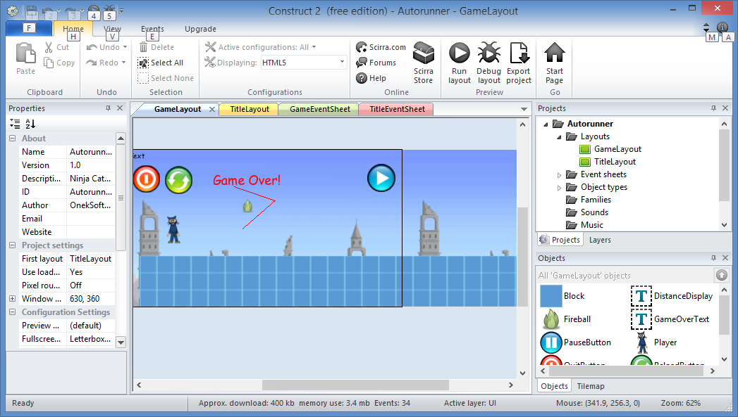
Construct 2 - demo
Properties
Layouts and Event Sheets
Online: http://OnekSoftLabs.com/ninja-cat-runner
Notes:
Construct 2 – demo
Online: http://OnekSoftLabs.com/ninja-cat-runner

Slide 13
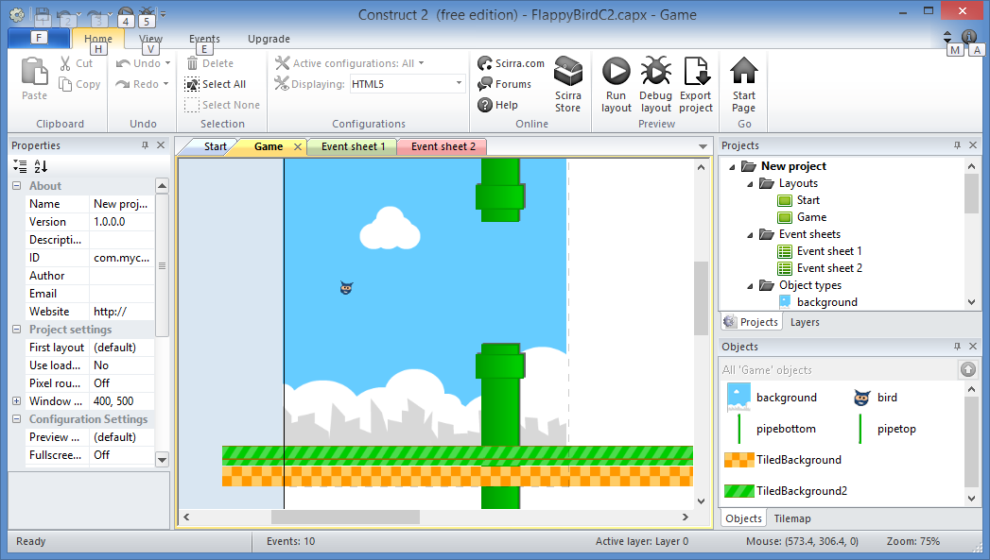
Flappy Bird clone
Tutorial:
https://www.scirra.com/tutorials/857/flappy-birds-clone-in-10-minutes
Notes:
Flappy Bird clone
Tutorial:
https://www.scirra.com/tutorials/857/flappy-birds-clone-in-10-minutes

Slide 14
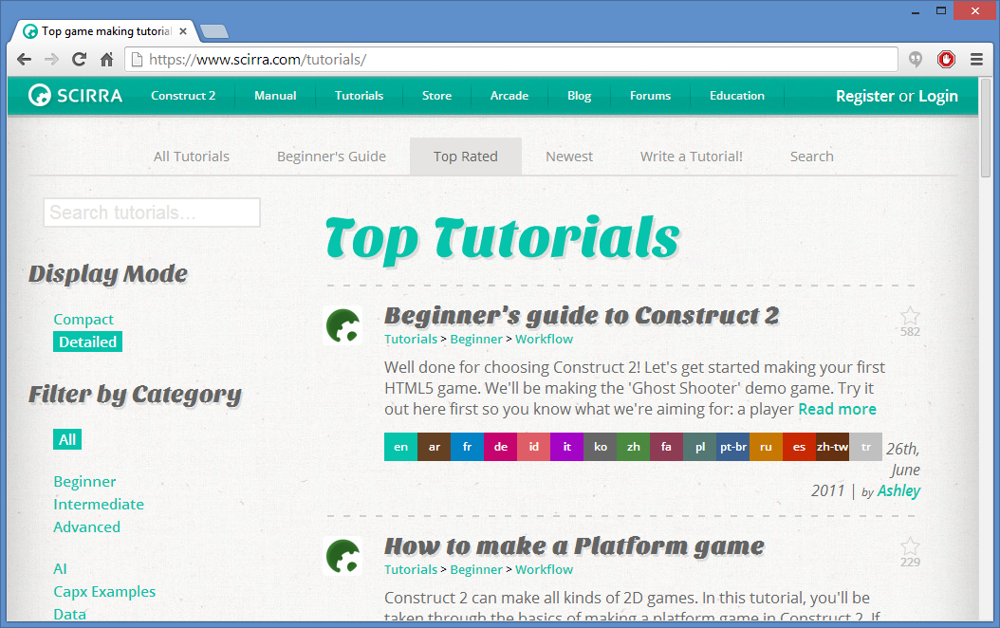
Construct 2 Tutorials
Online: http://www.scirra.com/tutorials
Notes:
Construct 2 Tutorials
Online: http://www.scirra.com/tutorials

Slide 15
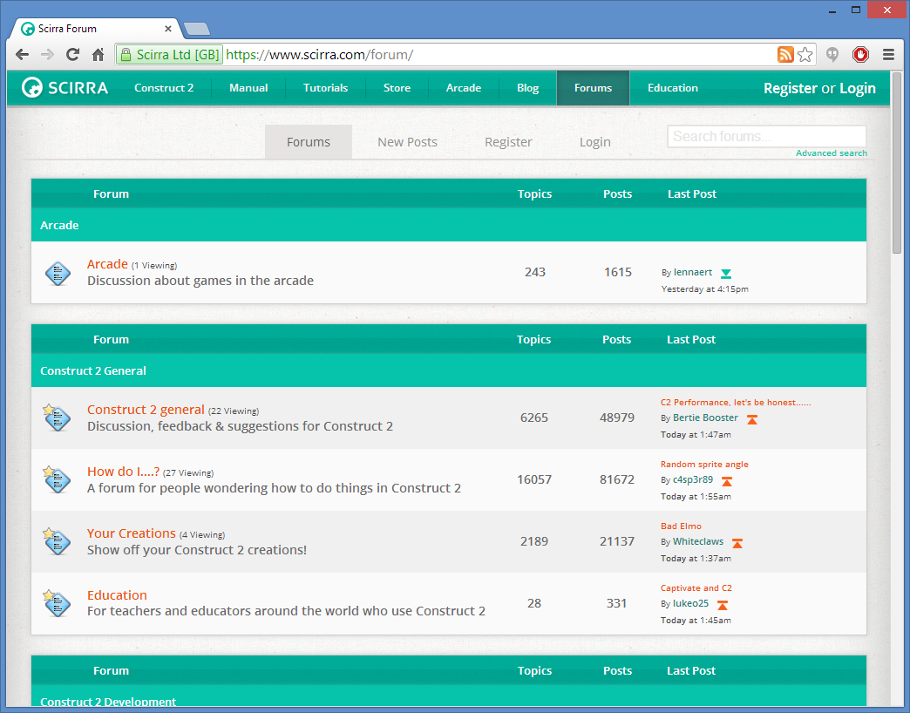
Construct 2 Forum & FB group
Forum: https://www.scirra.com/forum/
FB: https://www.facebook.com/groups/construct2devs/
Notes:
Construct 2 Forum & FB group
Forum: https://www.scirra.com/forum/
FB: https://www.facebook.com/groups/construct2devs/

Slide 16
C++, DirectX, etc
DirectX Tool Kit (aka DirectX TK)
DirectX Tex (texture processing library)
RandomChaos game engine
from former MVP Charles Humphrey
Target Windows 8 or Xbox One
Notes:
C++, DirectX, etc
DirectX Tool Kit (aka DirectX TK)
DirectX Tex (texture processing library)
RandomChaos game engine (from former MVP Charles Humphrey)
Target Windows 8 or Xbox One

Slide 17
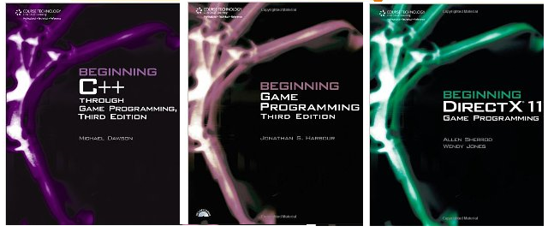
Learning C++
New to C++? Read beginner books
Experienced with C++? Learn game programming
Coming from C#? Learn C++ from a C# coder’s perspective
More info: http://tinyurl.com/learn-cpp-directx
Notes:
Learning C++
New to C++? Read beginner books
Experienced with C++? Learn game programming
Coming from C#? Learn C++ from a C# coder’s perspective
More info: http://tinyurl.com/learn-cpp-directx

Slide 18
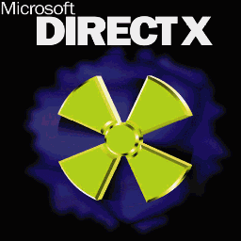
Learning DirectX
MSDN: http://msdn.microsoft.com/directx
Notes:
Learning DirectX
DirectX has a learning curve
Experience with OpenGL may help somewhat
C# and XNA background? You will have to unlearn some things
But there are things to make it better
MSDN: http://msdn.microsoft.com/directx

Slide 19
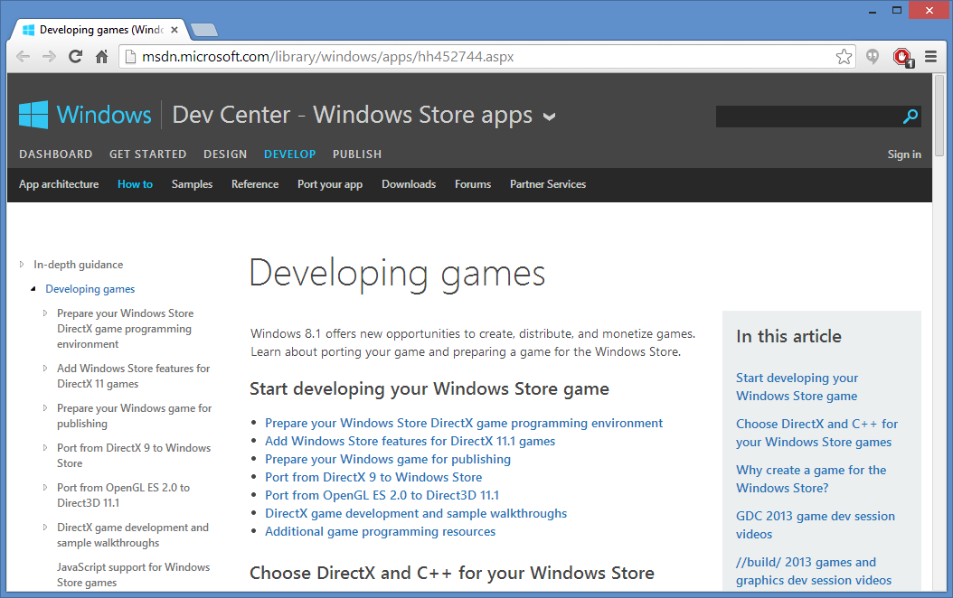
DirectX on MSDN
http://msdn.microsoft.com/library/windows/apps/hh452744.aspx
Notes:
DirectX on MSDN
http://msdn.microsoft.com/library/windows/apps/hh452744.aspx

Slide 20
DirectX TK and DirectX Tex
DirectX Tool Kit
“collection of helper classes for writing DirectX 11.x code in C++”
Features include SpriteBatch for “simple & efficient 2D sprite rendering” and SpriteFont for “bitmap based text rendering”
https://directxtk.codeplex.com/
DirectX Tex
“shared source library for reading and writing DDS [DirectDraw Surface] files, and performing various texture content processing operations”
http://directxtex.codeplex.com/
Notes:
DirectX TK and DirectX Tex
DirectX Tool Kit
“collection of helper classes for writing DirectX 11.x code in C++”
Features include SpriteBatch for “simple & efficient 2D sprite rendering” and SpriteFont for “bitmap based text rendering”
https://directxtk.codeplex.com/
DirectX Tex
“shared source library for reading and writing DDS [DirectDraw Surface] files, and performing various texture content processing operations”
http://directxtex.codeplex.com/

Slide 21
DirectX TK Sample
Source: http://code.msdn.microsoft.com/windowsapps
/DirectXTK-Simple-Sample-608bc274
Notes:
DirectX TK Sample
Source: http://code.msdn.microsoft.com/windowsapps/DirectXTK-Simple-Sample-608bc274

Slide 22
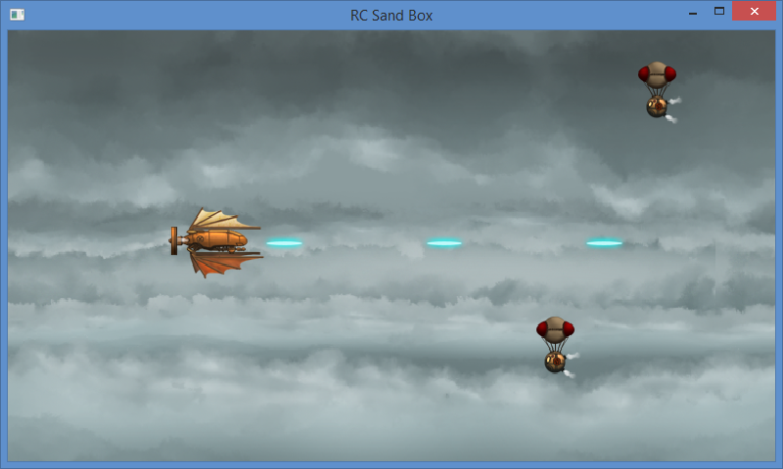
RandomChaos
Charles Humphrey’s open source C++ engine for DX11
Source: https://randomchaosdx11engine.codeplex.com/
Tutorial: http://davevoyles.azurewebsites.net/c-directx-11/
Notes:
RandomChaos
Charles Humphrey’s open source C++ engine for DX11
Source: https://randomchaosdx11engine.codeplex.com/
Tutorial: http://davevoyles.azurewebsites.net/c-directx-11/

Slide 23
Game Loop: Update-Draw
Run
Handle Input and Update
Stop
Startup
Shutdown
Loop
Draw/Render
Notes:
Game Loop: Update-Draw
Run→ [Startup] → [Update←→ Draw] → Stop → [Shutdown]

Slide 24
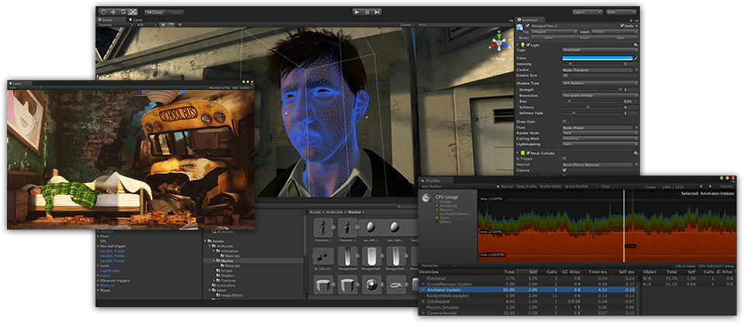
Unity
Source: http://unity3d.com/
Notes:
Unity3D
Source: http://unity3d.com/

Slide 25
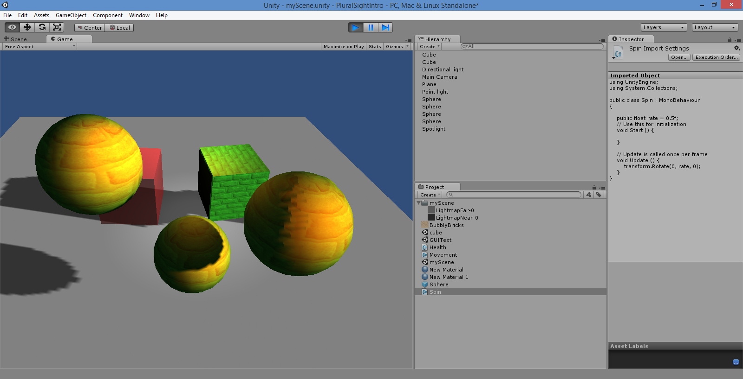
Unity UI
3D scene
C# script
Assets
More info: http://tinyurl.com/learn-unity-3d-2d
Notes:
Unity UI
Scripting: Boo, JavaScript, C#
More info: http://tinyurl.com/learn-unity-3d-2d

Slide 26
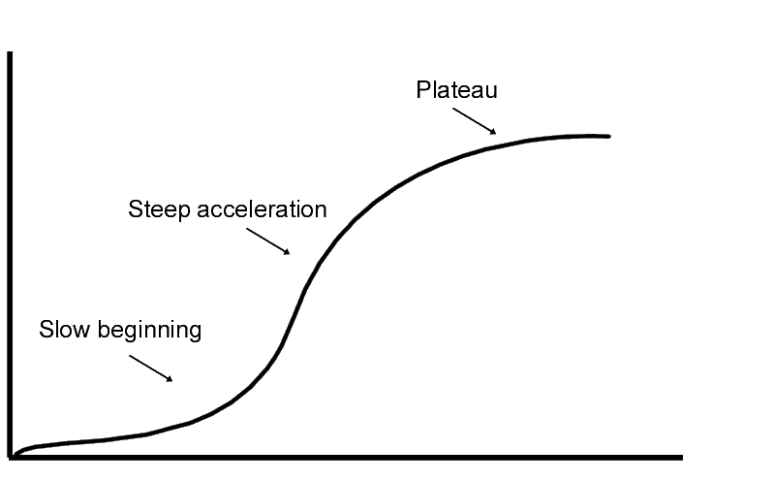
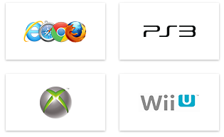
Unity: Things to Know
Learning curve
Create/Import models
Download/purchase models
Publish virtually anywhere!
Notes:
Unity: Things to Know
Learning curve for beginners
Need to create your own models
Or download/purchase pre-built models
Publish to Web, mobile, desktop, consoles

Slide 27
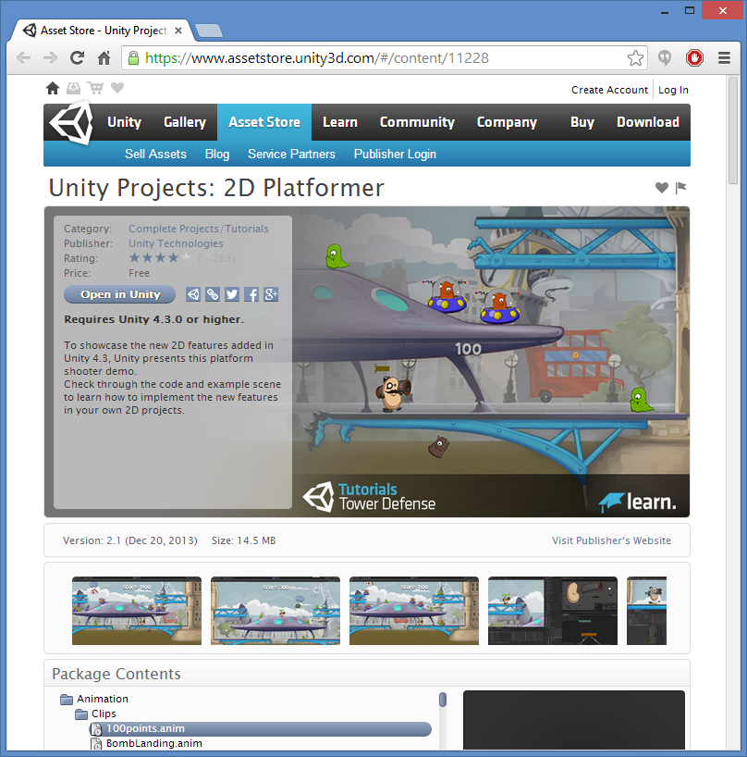
Unity 2D features
Announced for 4.3
Native 2D support
2D Platformer sample project available
Walkthrough videos available
Source: http://blogs.unity3d.com/2013/08/28/unity-native-2d-tools
Notes:
Unity 2D features
Announced for 4.3
Native 2D support
2D Platformer sample project available
Walkthrough videos available
Source: http://blogs.unity3d.com/2013/08/28/unity-native-2d-tools

Slide 28
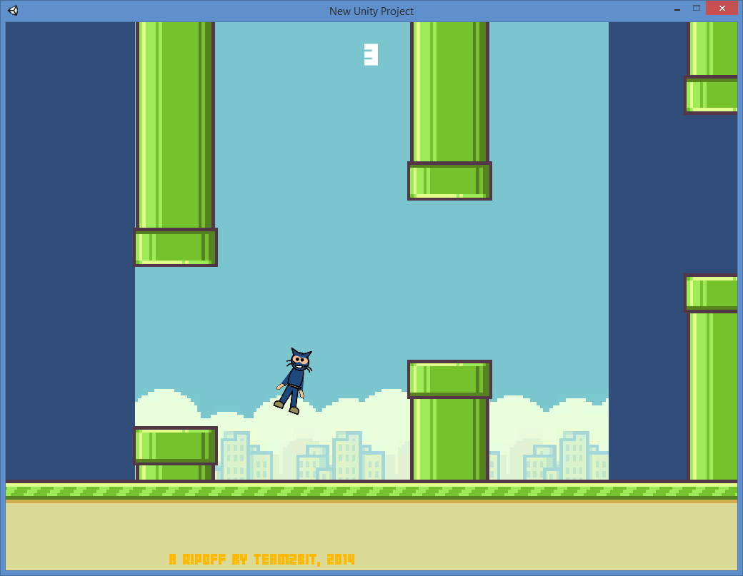
Flappy Bird clone
Credit: Team2Bit, Fist Puncher developer
Notes:
Flappy Bird clone
Credit: Team2Bit, Fist Puncher developer

Slide 29
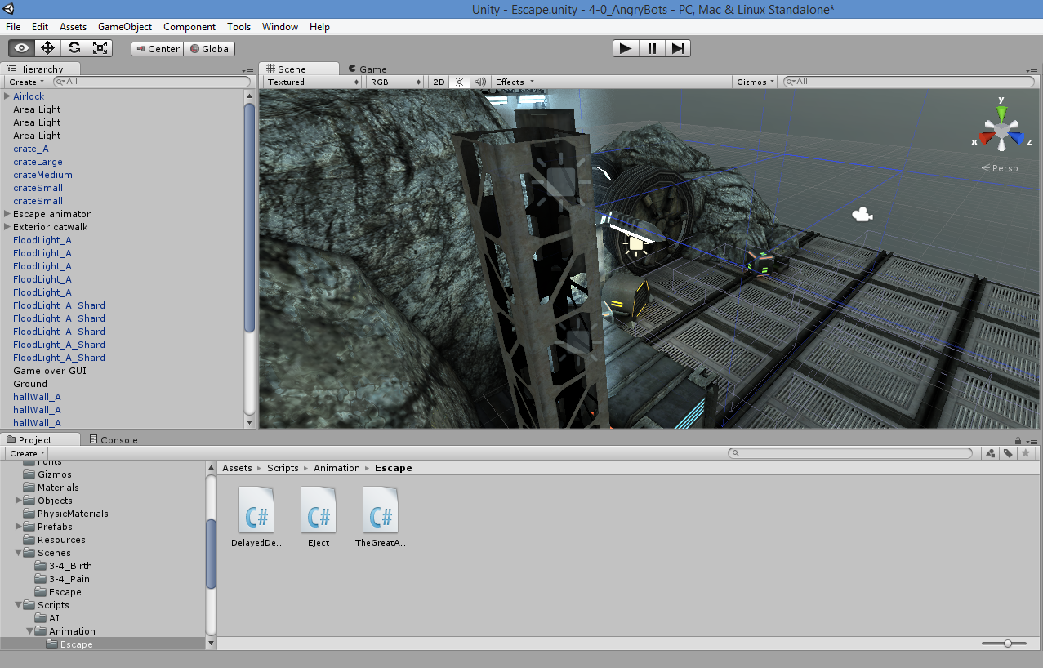
Angry Bots Sample
Unity Asset Store, https://www.assetstore.unity3d.com/
Notes:
Angry Bots Sample
Unity Asset Store, https://www.assetstore.unity3d.com/

Slide 30
Real-world Lessons
1. UI Design
2. Multiplatform
3. Optimization
4. Work-Life Balance
5. Feedback and Ratings
Notes:
Real-world Lessons
UI Design: predicting human behavior
Targeting multiple platforms and screen sizes
Memory allocation and code optimization
Work-life balance
User feedback + Anonymous Ratings

Slide 31
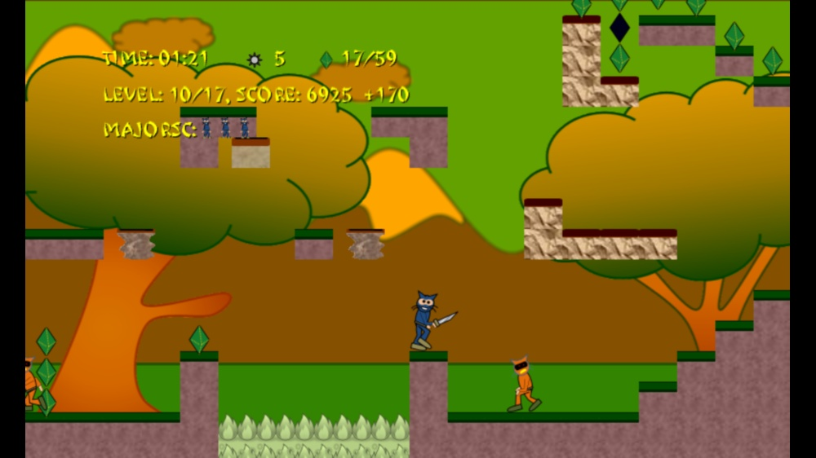
1. UI Design
Special items
HUD in “safe area”
Focus on primary user action
Notes:
1. UI Design
HUD in “safe area”
Special items
Focus on primary user action

Slide 32
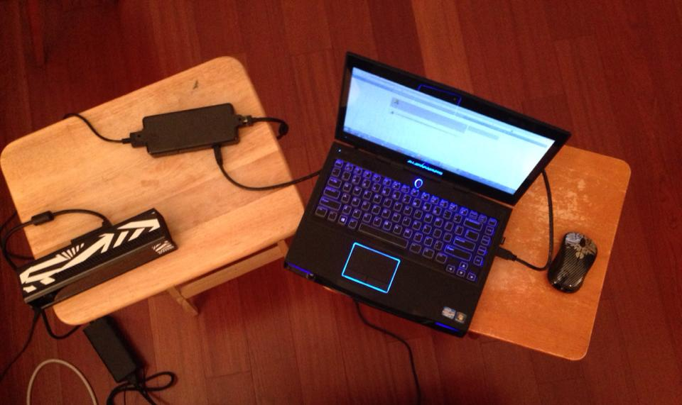
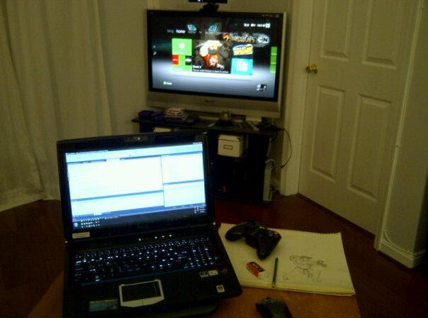
2. Target Multiple Platforms
Kinect v2 dev kit
HDTV via Xbox 360 console
Windows
Notes:
2. Target Multiple Platforms
Windows
Xbox 360
Xbox One
Kinect v2

Slide 33
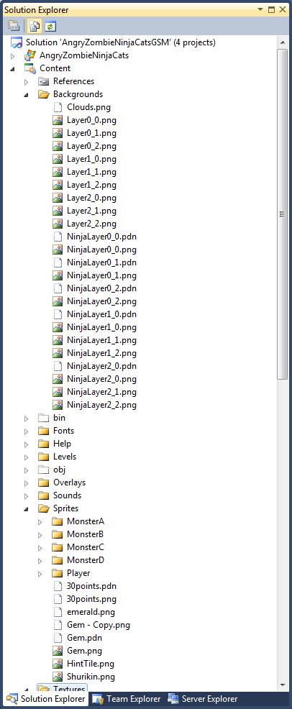
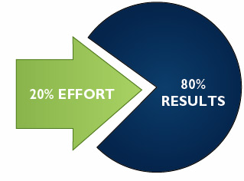
3. Optimization & Cleanup
Notes:
3. Optimization & Cleanup
80-20 rule

Slide 34
4. Work-Life Balance
Notes:
4. Work-Life Balance

Slide 35
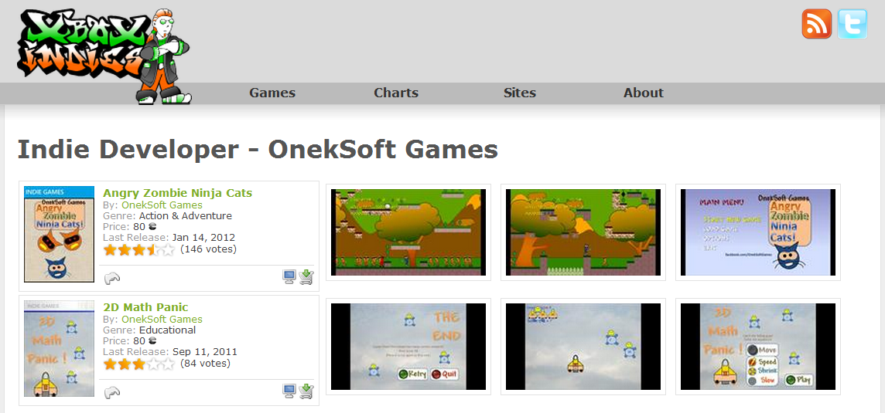
5. Feedback & Ratings
Anonymous ratings from Xbox Marketplace on XboxIndies.com
Notes:
5. Feedback & Ratings
Anonymous ratings from Xbox Marketplace on XboxIndies.com

Slide 36
* Business Intelligence
Measuring Sales and Performance
Spotting Trends
Pricing and Competition
Making Better Business Decisions
Learning From Past Success (and Mistakes)
Notes:
* Business Intelligence
Measuring Sales and Performance
Spotting Trends
Pricing and Competition
Making Better Business Decisions
Learning From Past Success (and Mistakes)

Slide 37
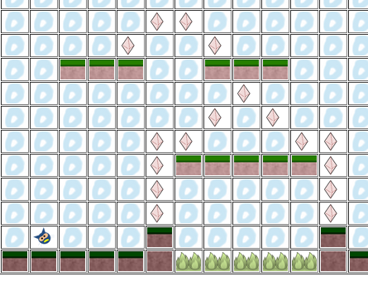
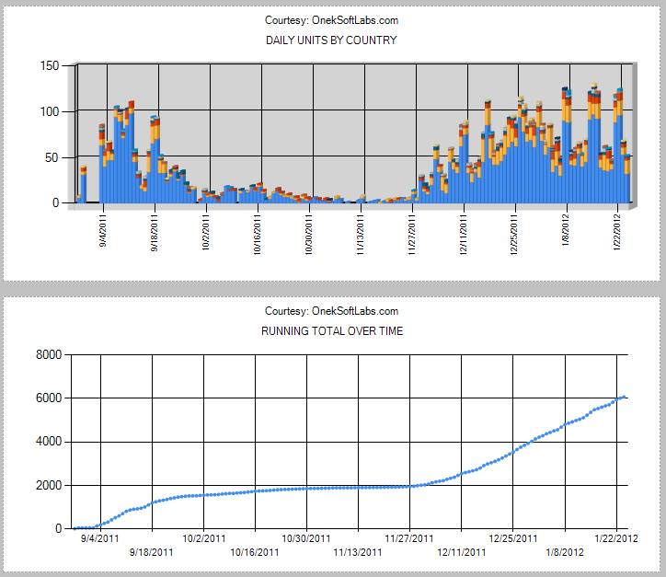
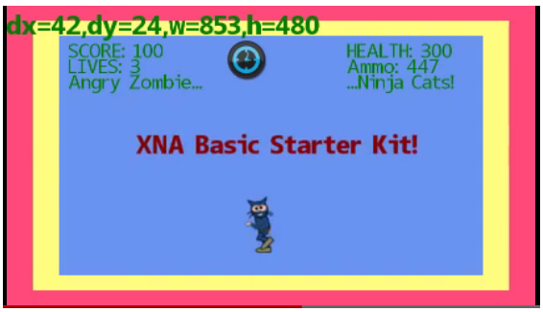
* Community
Platformer Level Editor
XBLIG Sales Data Analyzer
XNA Basic Starter Kit
Notes:
* Community
XBLIG Sales Data Analyzer
XNA Basic Starter Kit
Platformer Level Editor

Slide 38
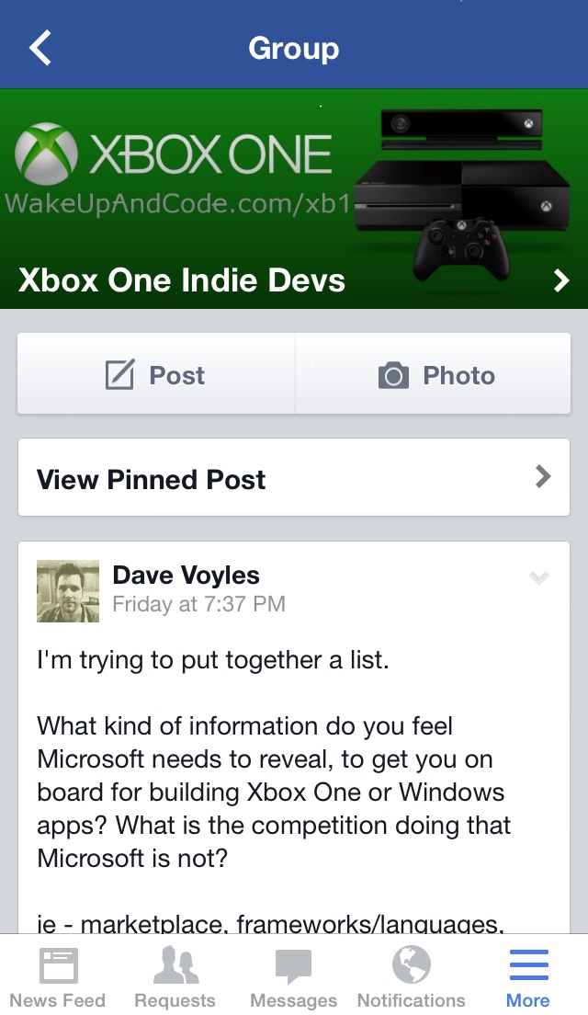
* Xbox One Community
Xbox One index page: http://WakeUpAndCode.com/xb1
Notes:
Xbox One Community
Xbox One index page: http://WakeUpAndCode.com/xb1

Slide 39
For more info:
Xbox One Indie Game Devs: http://facebook.com/groups/XboxOneIndieDevs
Xbox One page on blog: http://WakeUpAndCode.com/xb1
C++ and DirectX resources
Unity resources
Facebook permalinks to polls, discussions, etc
Notes:
For more info:
Xbox One Indie Game Devs: http://facebook.com/groups/XboxOneIndieDevs
Xbox One page on blog: http://WakeUpAndCode.com/xb1
C++ and DirectX resources
Unity resources
Facebook permalinks to polls, discussions, etc

Slide 40
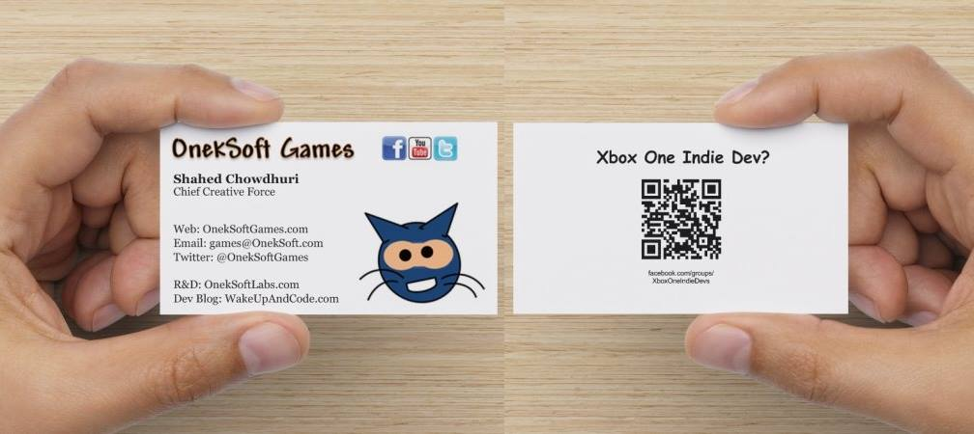
Contact
http://facebook.com/groups/XboxOneIndieDevs
Notes:
Contact
Web: OnekSoft.com
Email: games@OnekSoft.com
Twitter: @OnekSoftGames
R&D: OnekSoftLabs.com
Dev Blog: WakeUpAndCode.com
FB: http://facebook.com/groups/XboxOneIndieDevs

