Slide 1
Unity 5 JumpStart
Featuring: Microsoft Student Partners
Shahed Chowdhuri
Sr. Technical Evangelist @ Microsoft
@shahedC
WakeUpAndCode.com

Slide 2
Microsoft Student Partners
Ramsey Khadder (UMD)
Praneeth Thalla (UMD)
Allee Clark (Howard)
Brandon Peck (UVA)
Kasra Eslami (VA Tech)
John Duvall (WFU)

Slide 3
What You’ll Need
Unity 5 (Personal Edition OK):
http://unity3d.com/get-unity
Visual Studio (Community Edition OK):
http://aka.ms/vs2015ce
Optional: Visual Studio Code (PC, Mac, Linux)
http://code.visualstudio.com

Slide 4
Wired or Wireless Controller

Slide 5
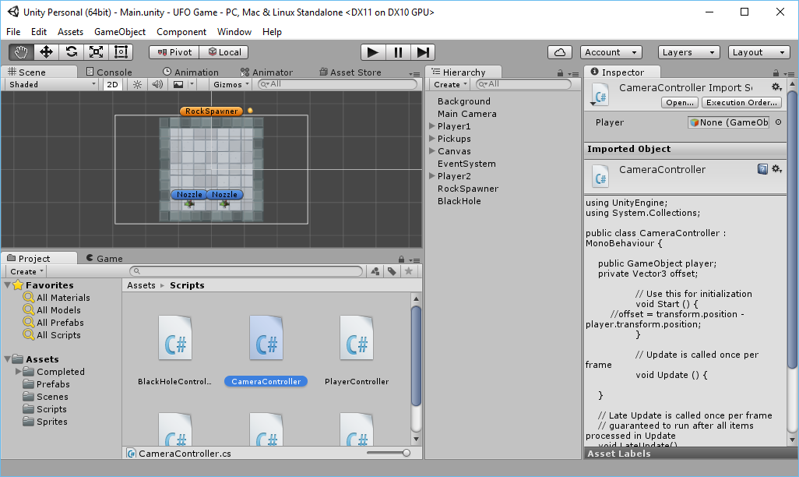
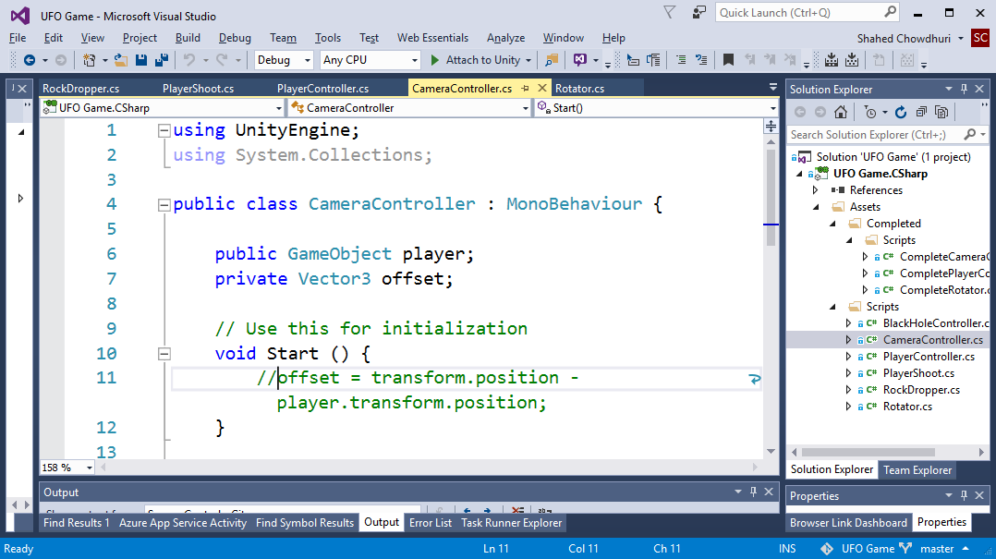
Demo

Slide 6
What’s Next?
Player Selection & Scores
PowerUps and Ammo Upgrades Ammo Collisions
Damage from Objects
Visual Effects and Sound Effects
Publishing to the Windows Store
High Scores in the Cloud with Azure
Networked Multiplayer
Notes:
Shahed Chowdhuri
Web Application Security
Overview
SQL Injection
Cross-Site Scripting (XSS)
Data Exposure
In the Real World
Next Steps
Q&A

Slide 7
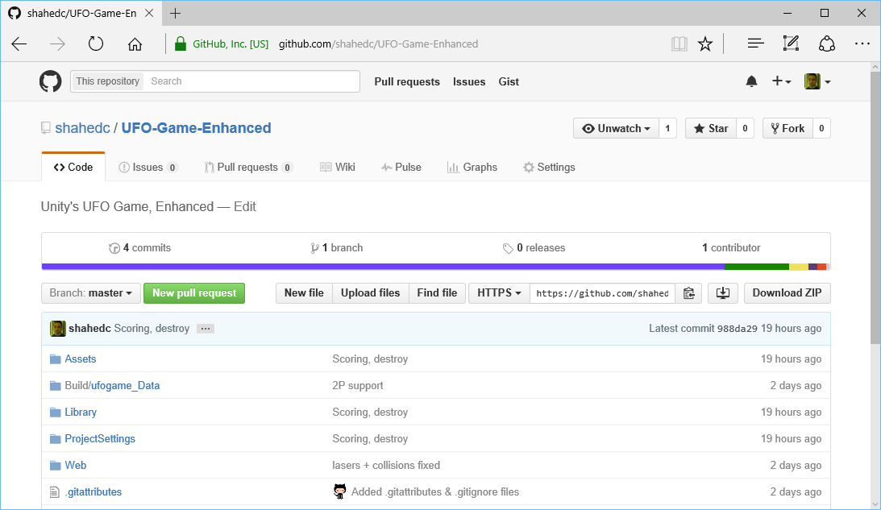
GitHub
https://github.com/shahedc/UFO-Game-Enhanced

Slide 8
Useful Links
Blog:
http://WakeUpAndCode.com
Learn @ Unity:
http://unity3d.com/learn
Reference Project:
http://unity3d.com/learn/tutorials/projects/2d-ufo-tutorial

Slide 9
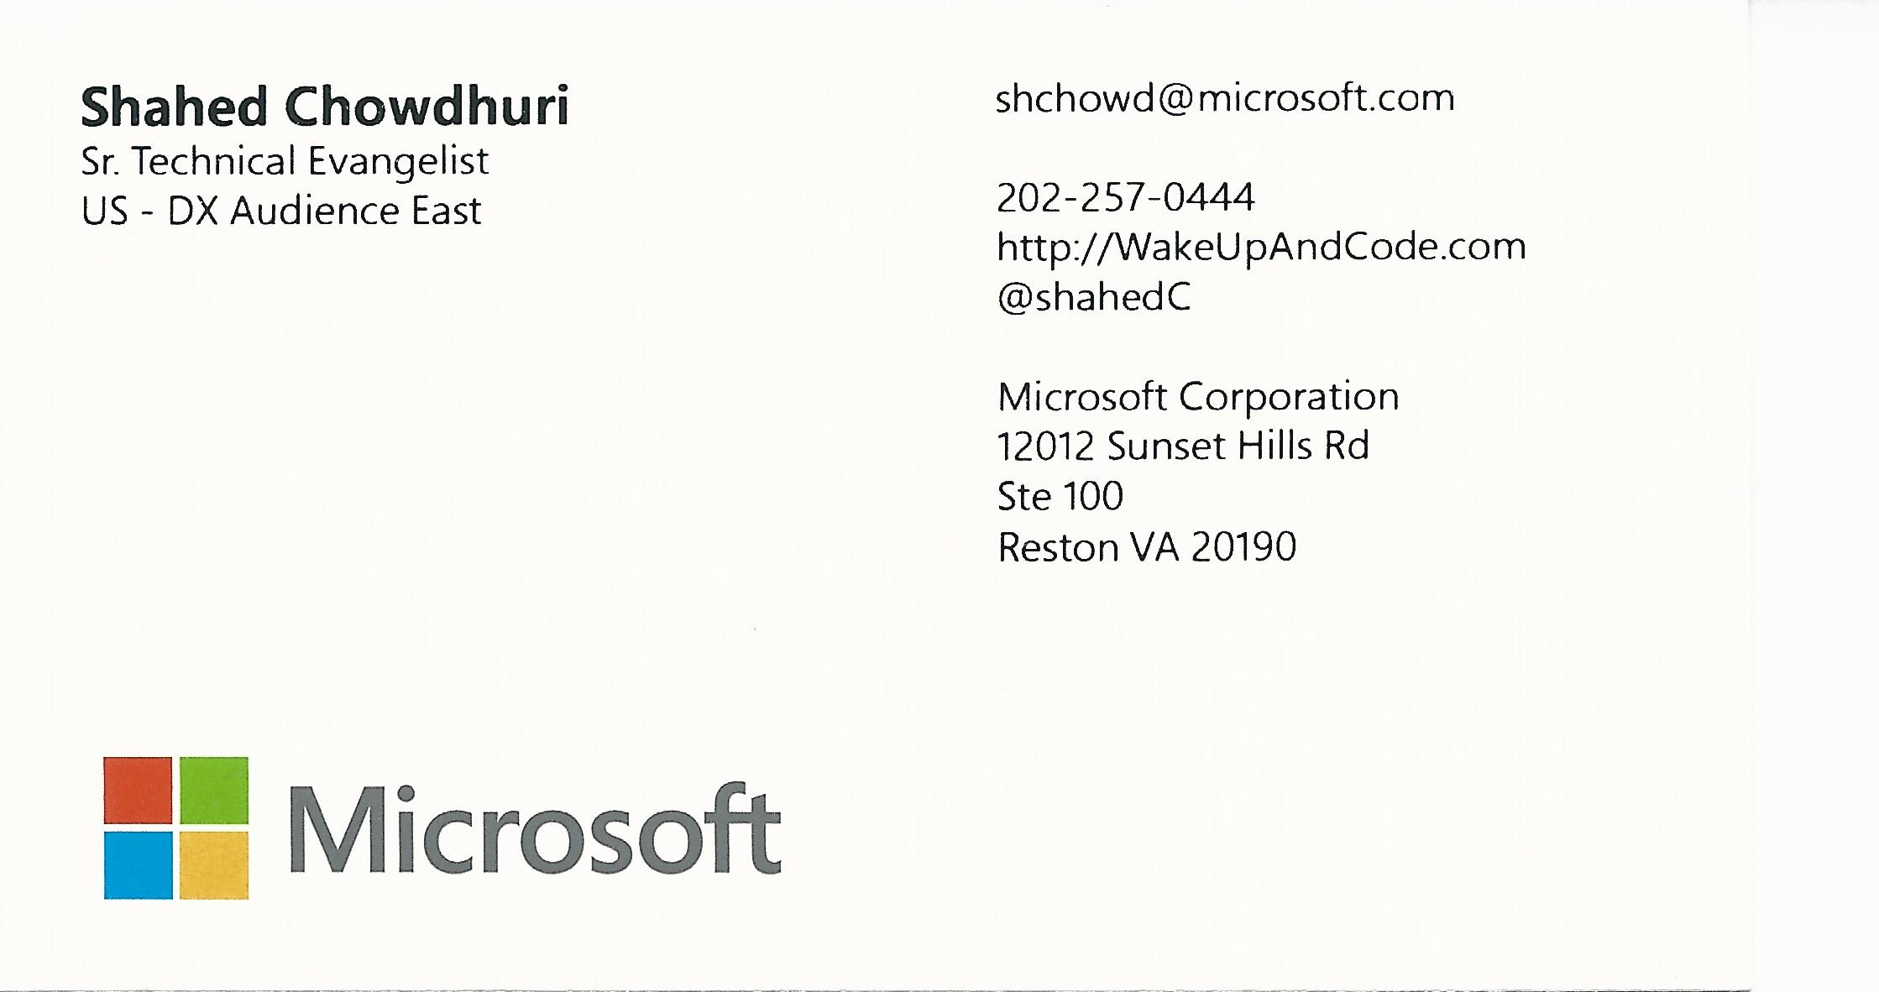
Email: shchowd@microsoft.com  Twitter: @shahedC
Notes:
Contact
Microsoft email: shchowd@microsoft.com
Personal Twitter: @shahedC
Dev Blog: WakeUpAndCode.com

