Slide 1
Unity 5: First Person Tutorial
First-person controls, terrain & environment
By Shahed Chowdhuri
Senior Technical Evangelist
WakeUpAndCode.com
@shahedC
Notes:
Title Page: Game Development with Unity 5 and C# Windows  Web  Xbox  Mobile  … and more!
By Shahed Chowdhuri
Technical Evangelist
Blog: WakeUpAndCode.com
Twitter: @shahedC

Slide 2
Agenda
Initial Setup, Asset Store
> First-Person Controls
> Terrain, Trees, Colliders
> Textures, Grass & Rocks, Water
Wrap-Up
Notes:
Agenda

Slide 3
Initial Setup

Slide 4
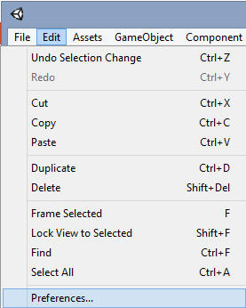
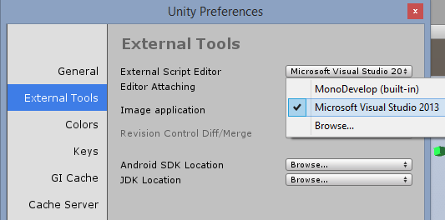
Assign Code Editor
Under External Tools, select your Script Editor
e.g. MonoDevelop or Visual Studio
Click Edit → Preferences
Tip: Browse for devenv.exe in your Program Files folder if you don’t see Visual Studio
"C:\Program Files (x86)\Microsoft Visual Studio 12.0\Common7\IDE\devenv.exe"

Slide 5
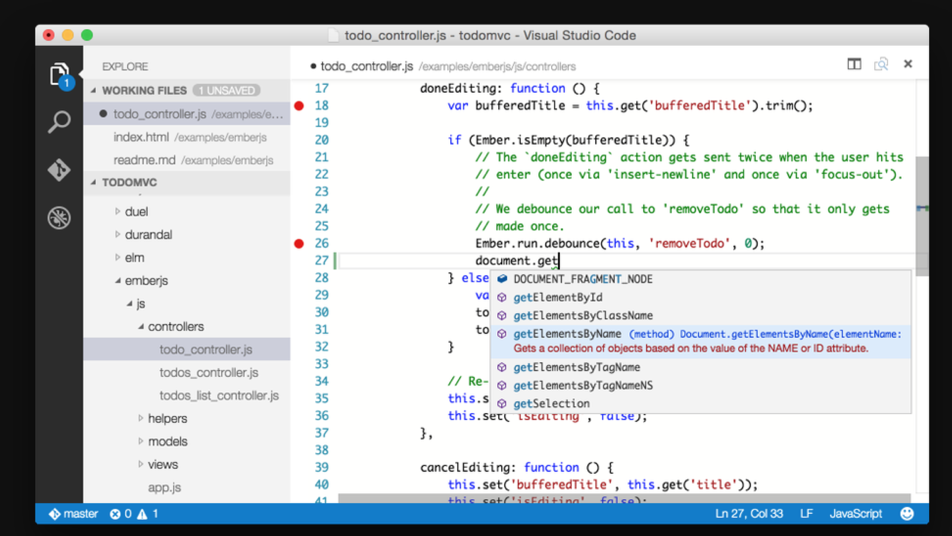
Visual Studio Code
http://code.visualstudio.com

Slide 6
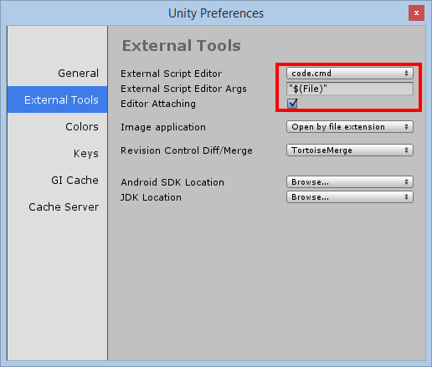
VS Code Setup on Windows
Click Edit → Preferences
External Tools
Browse to:
“C:\Users\<profile>\AppData\Local\Code\Bin\”
Select code.cmd
OPTIONAL:
In VS Code, open the project folder to use Intellisense
http://darkgenesis.zenithmoon.com/configuring-unity3d-to-use-the-new-lightweight-visual-studio-code-editor/

Slide 7
VS Code Setup on Mac
Click Assets → Sync MonoDevelop Project
Open VS Code, pick project folder
Pick a project (-csharp.sln) file
http://unreferencedinstance.com/how-to-integrate-visual-studio-code-with-unity3d-project/

Slide 8
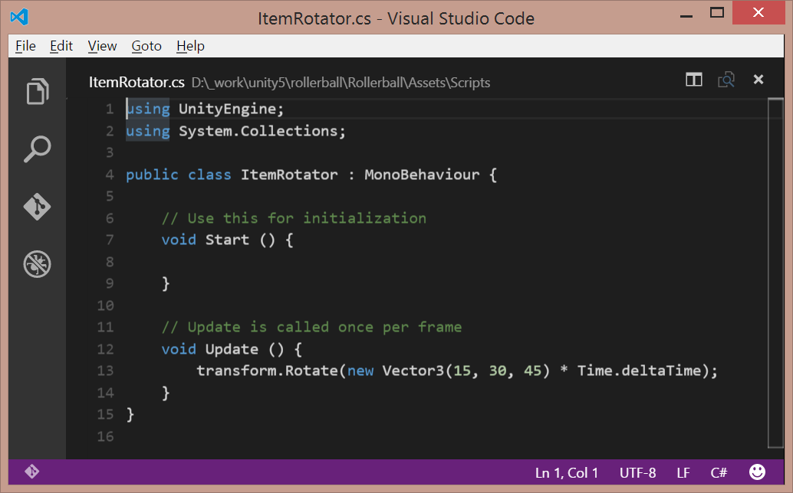
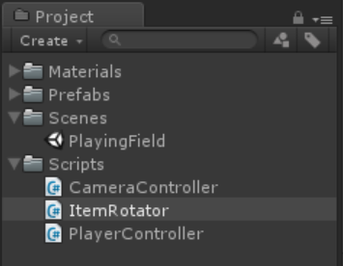
Launch Any Script from Unity
Double-click Script file

Slide 9
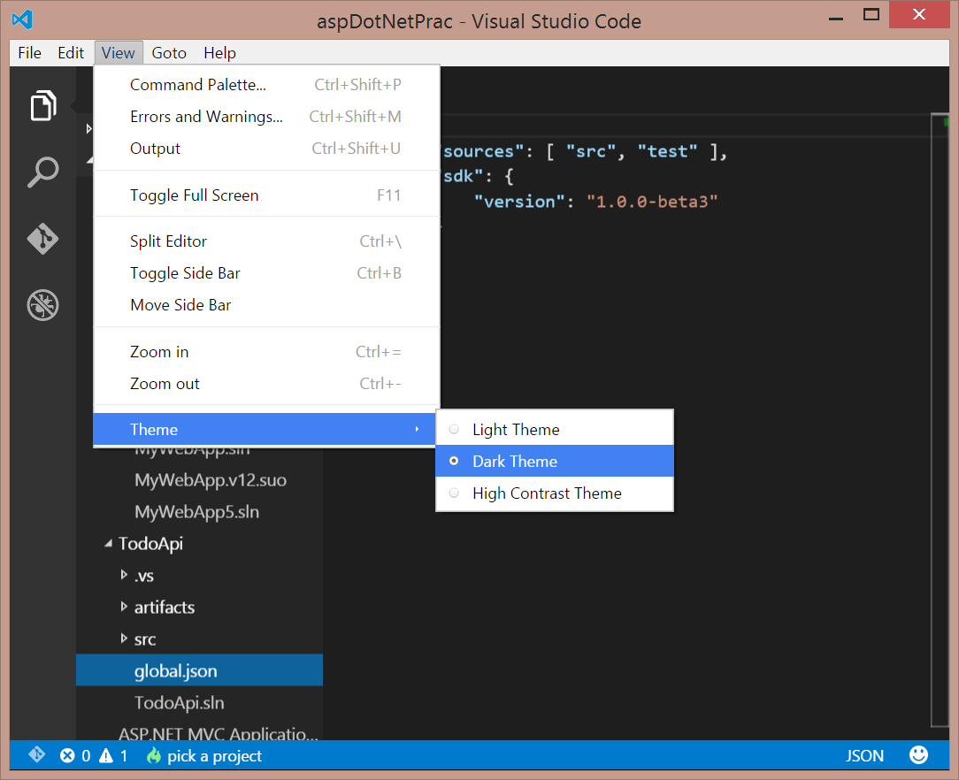
Choose Theme: Light, Dark, High Contrast
On the top menu,
Click View
Click Theme
Choose a theme:
Light Theme
Dark Theme
High Contrast Theme

Slide 10
Asset Store

Slide 11
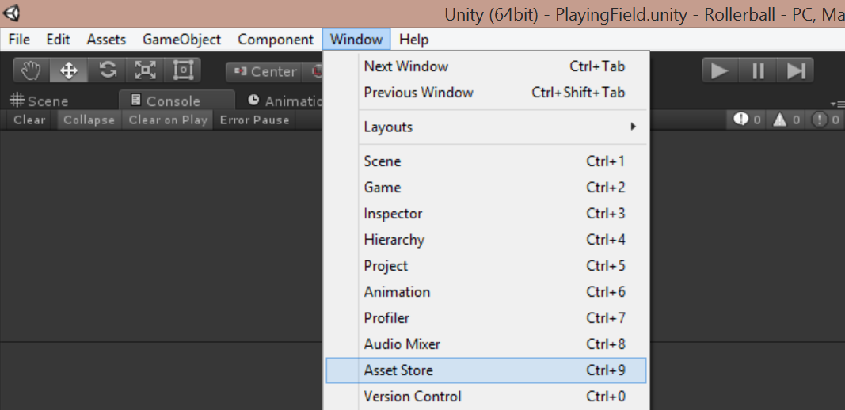
Launch Unity’s Asset Store
On the top menu,
Click Window
Click Asset Store
Shortcut: Ctrl+9

Slide 12
Asset Store Window
Verify that
you’re logged in.

Slide 13
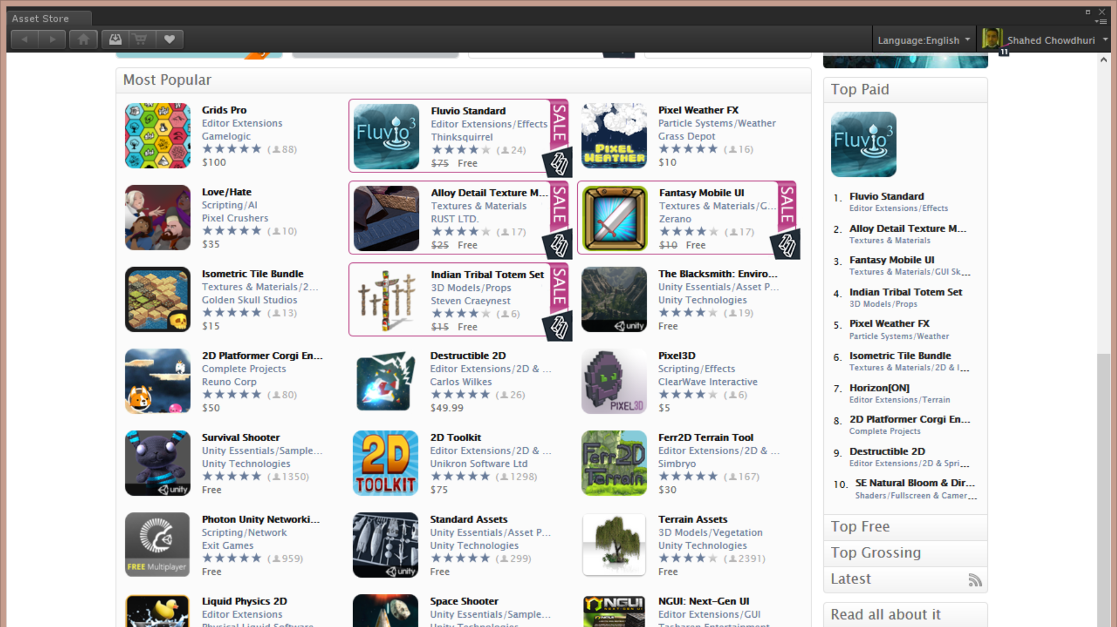
Asset Store: Top Paid
Scroll down
for top charts

Slide 14
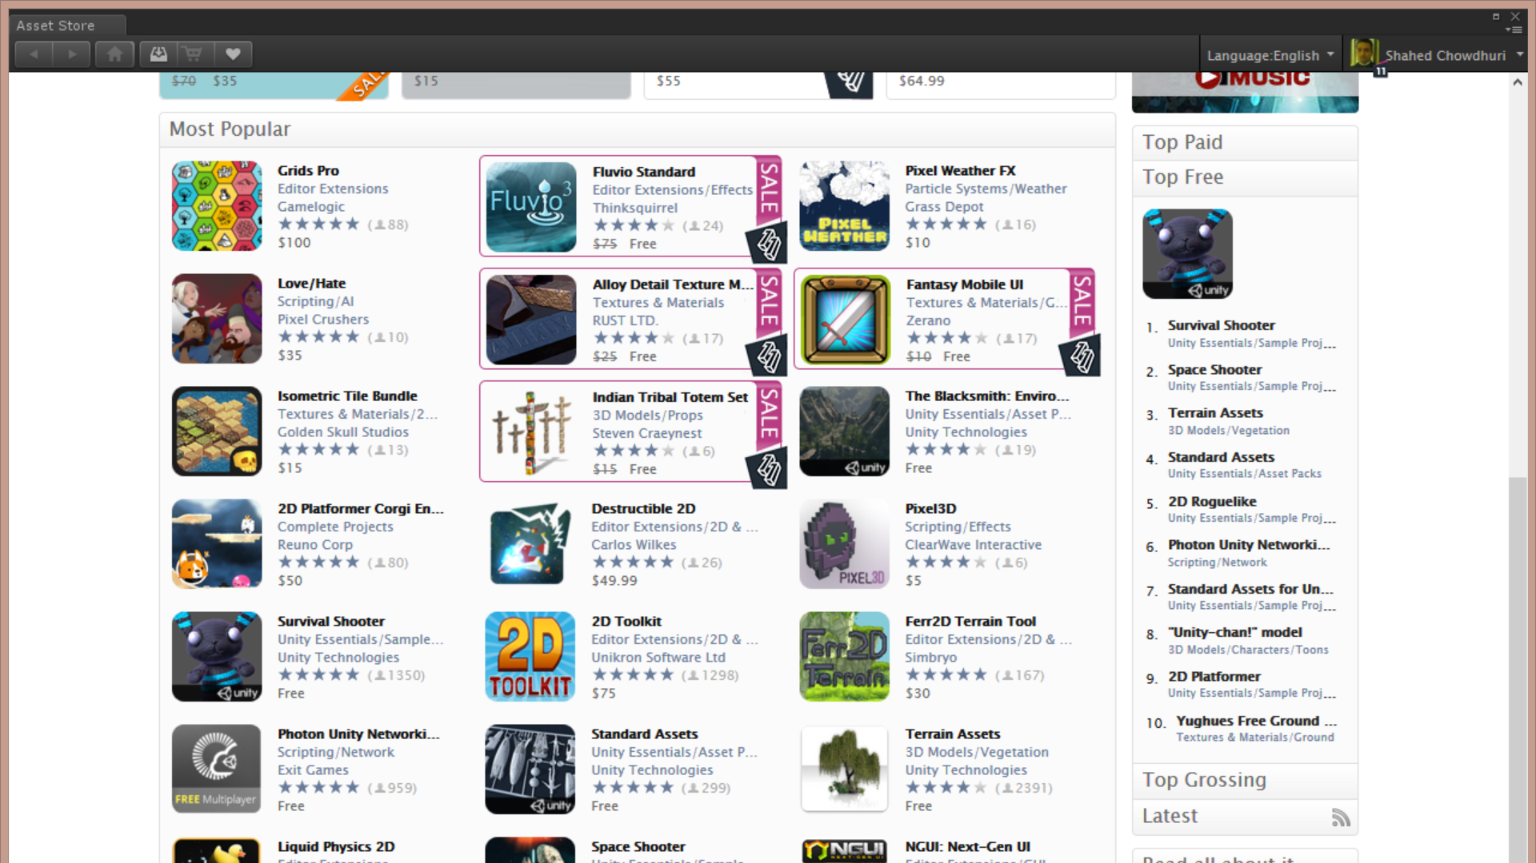
Asset Store: Top Free
Click on
Top Free
(below
Top Paid)

Slide 15
Agenda
Initial Setup, Asset Store
> First-Person Controls
> Terrain, Trees, Colliders
> Textures, Grass & Rocks, Water
Wrap-Up
Notes:
Agenda

Slide 16
First-Person Controls

Slide 17
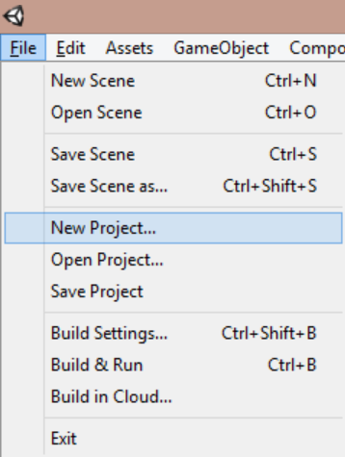
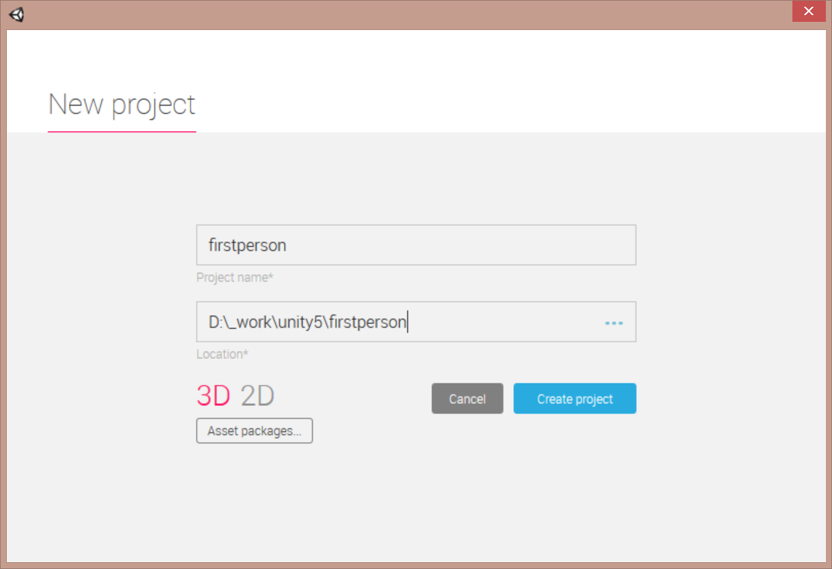
Create New 3D Project
Click File → New Project…
Name your project…
… choose 3D, then click “Create project”

Slide 18
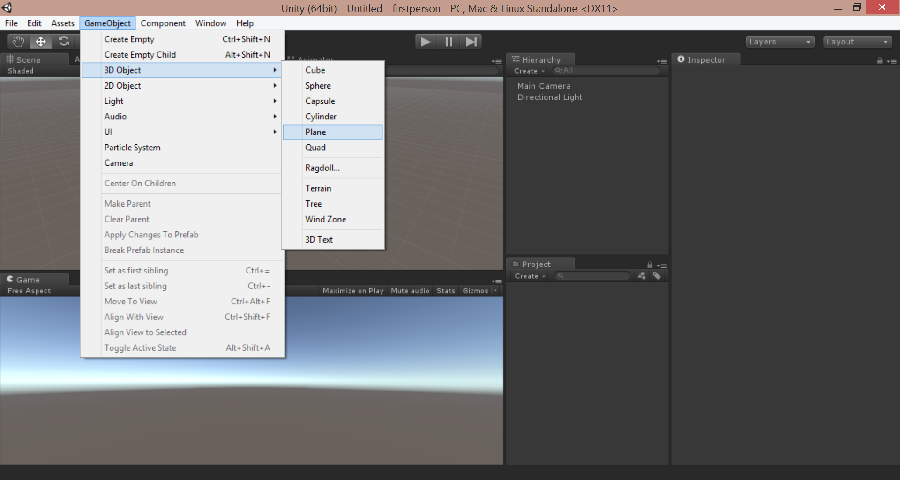
Create Ground
From top menu, click GameObject → 3D Object → Plane

Slide 19
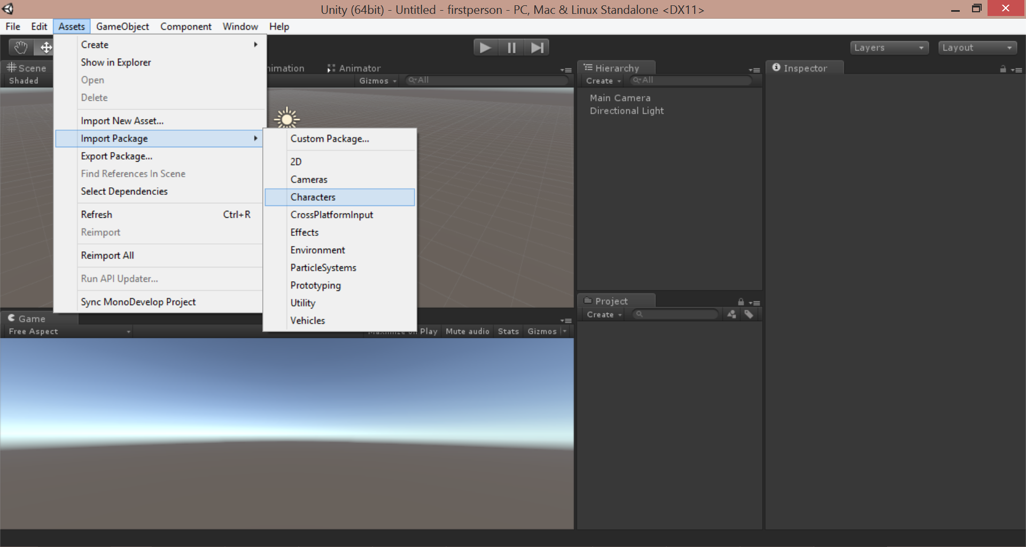
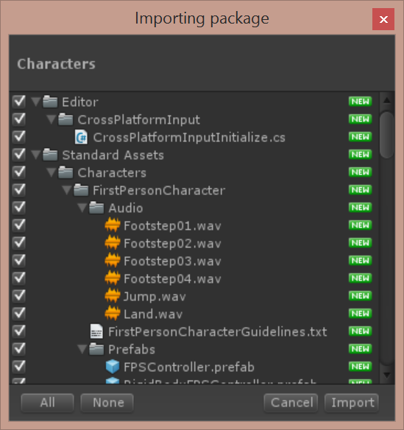
Import Characters Package
Click Assets → Import Package → Characters
Import All!

Slide 20
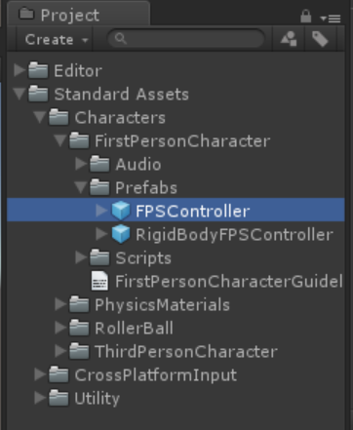
Locate FPS Controller in Project Panel
In the Project Panel,
Open the following:
Standard Assets
Characters
FirstPersonCharacter
Prefabs
FPSController

Slide 21
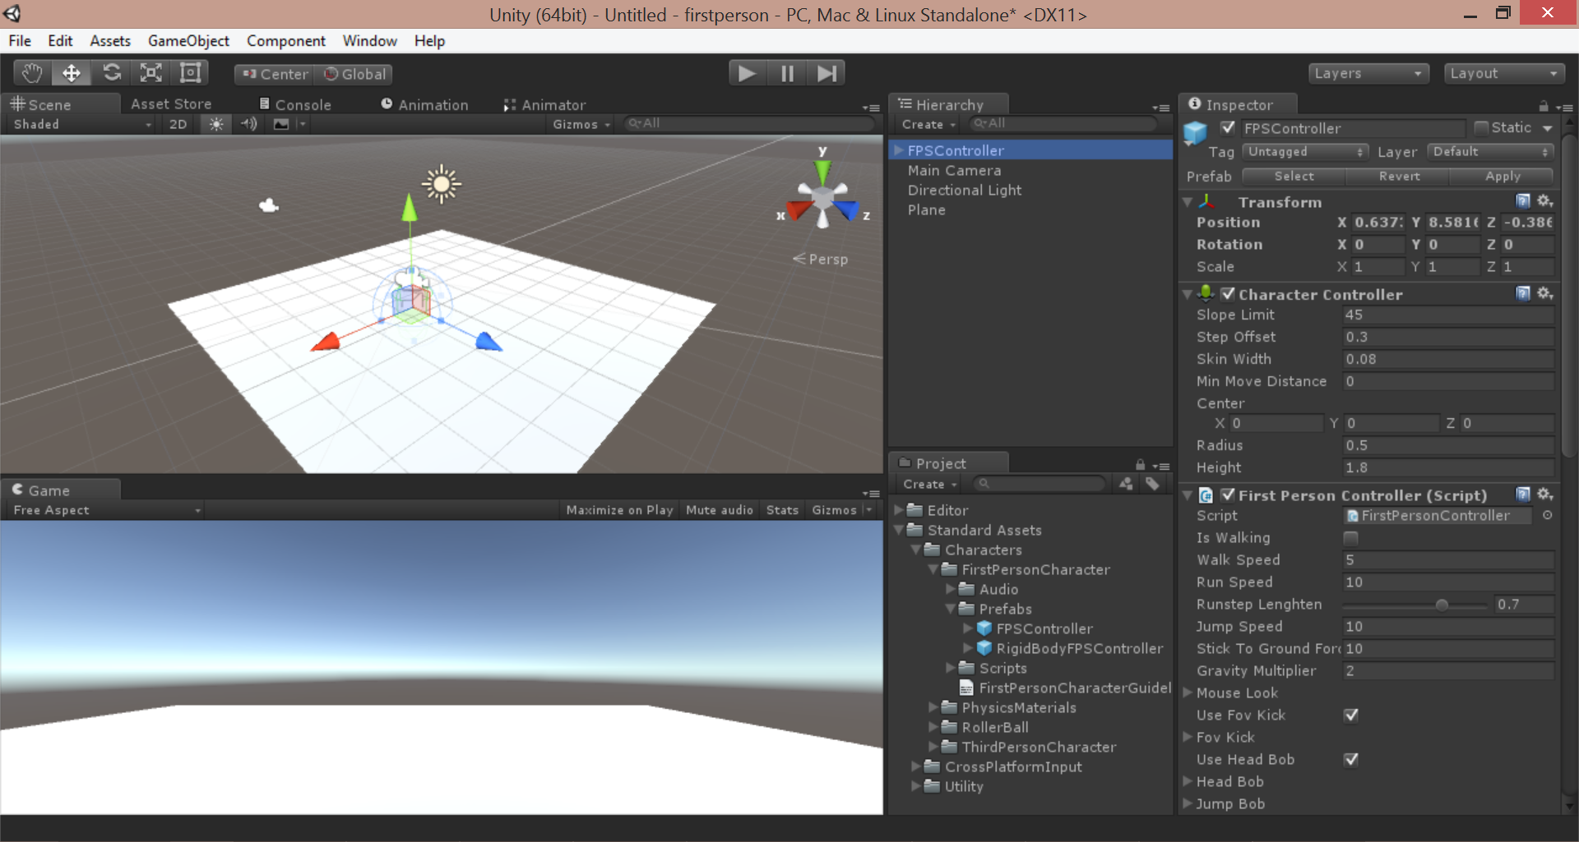
Drag FPSController to Scene

Slide 22
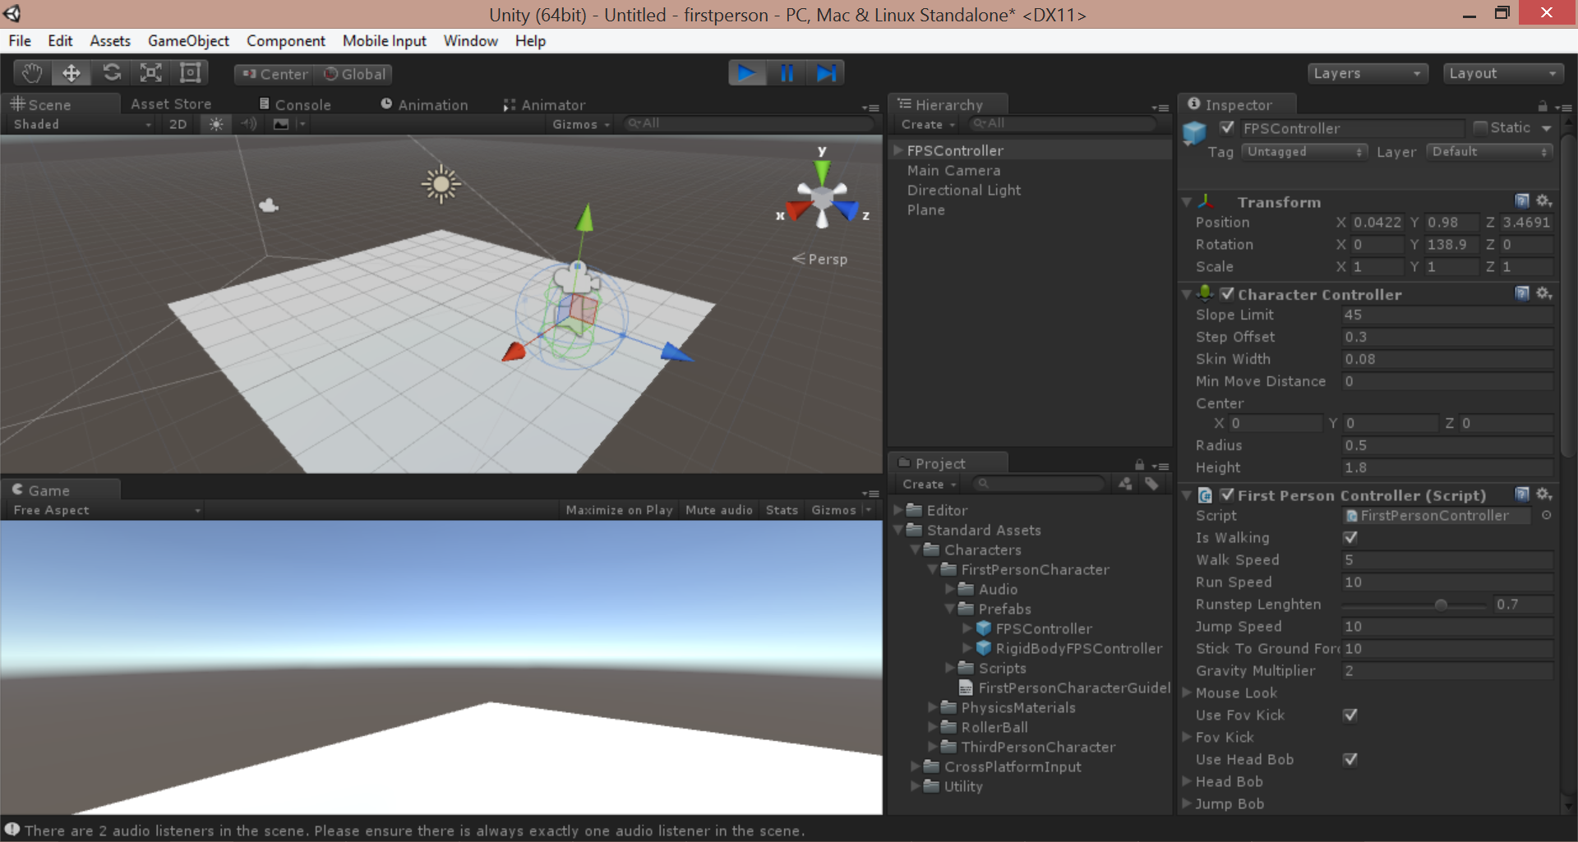
Run the Game!
Click Play button, move with arrow keys
Notice
FPSController
in Hierachy

Slide 23
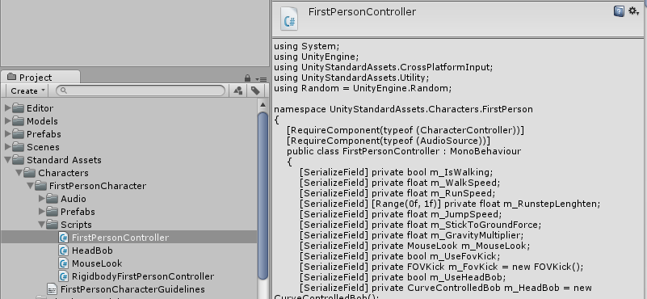
FirstPersonController Script
Locate FirstPersonController script under:
/Assets/Standard Assets/Characters/FirstPersonCharacter/Scripts/

Slide 24
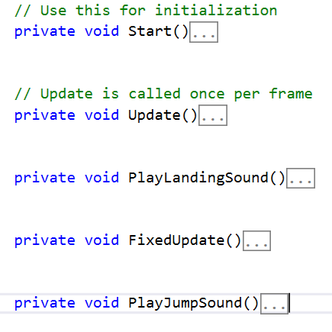
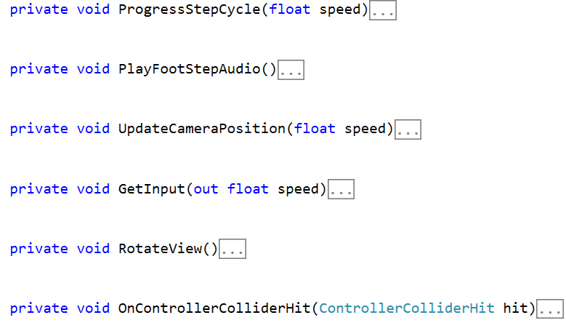
Inspect FirstPerson Code

Slide 25
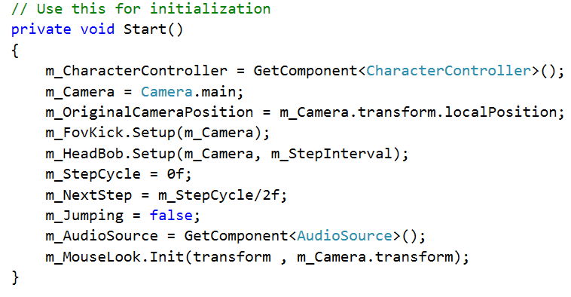
Start()

Slide 26
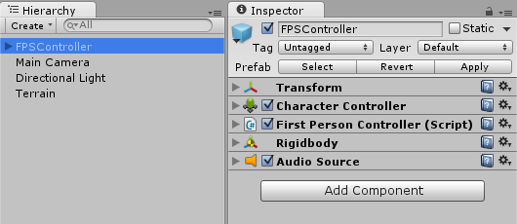
FPSController Components

Slide 27
FixedUpdate()

Slide 28
GetInput()

Slide 29
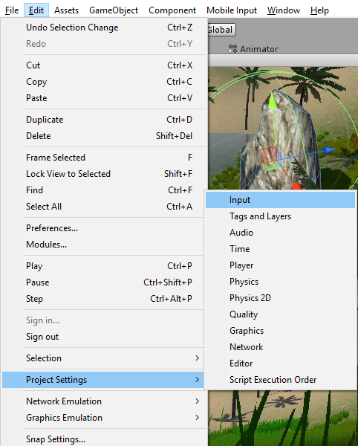
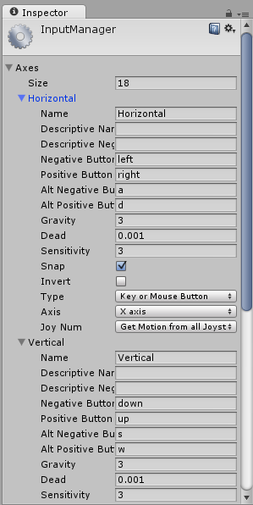
Edit Project Settings Input

Slide 30
Update()

Slide 31
Terrain

Slide 32
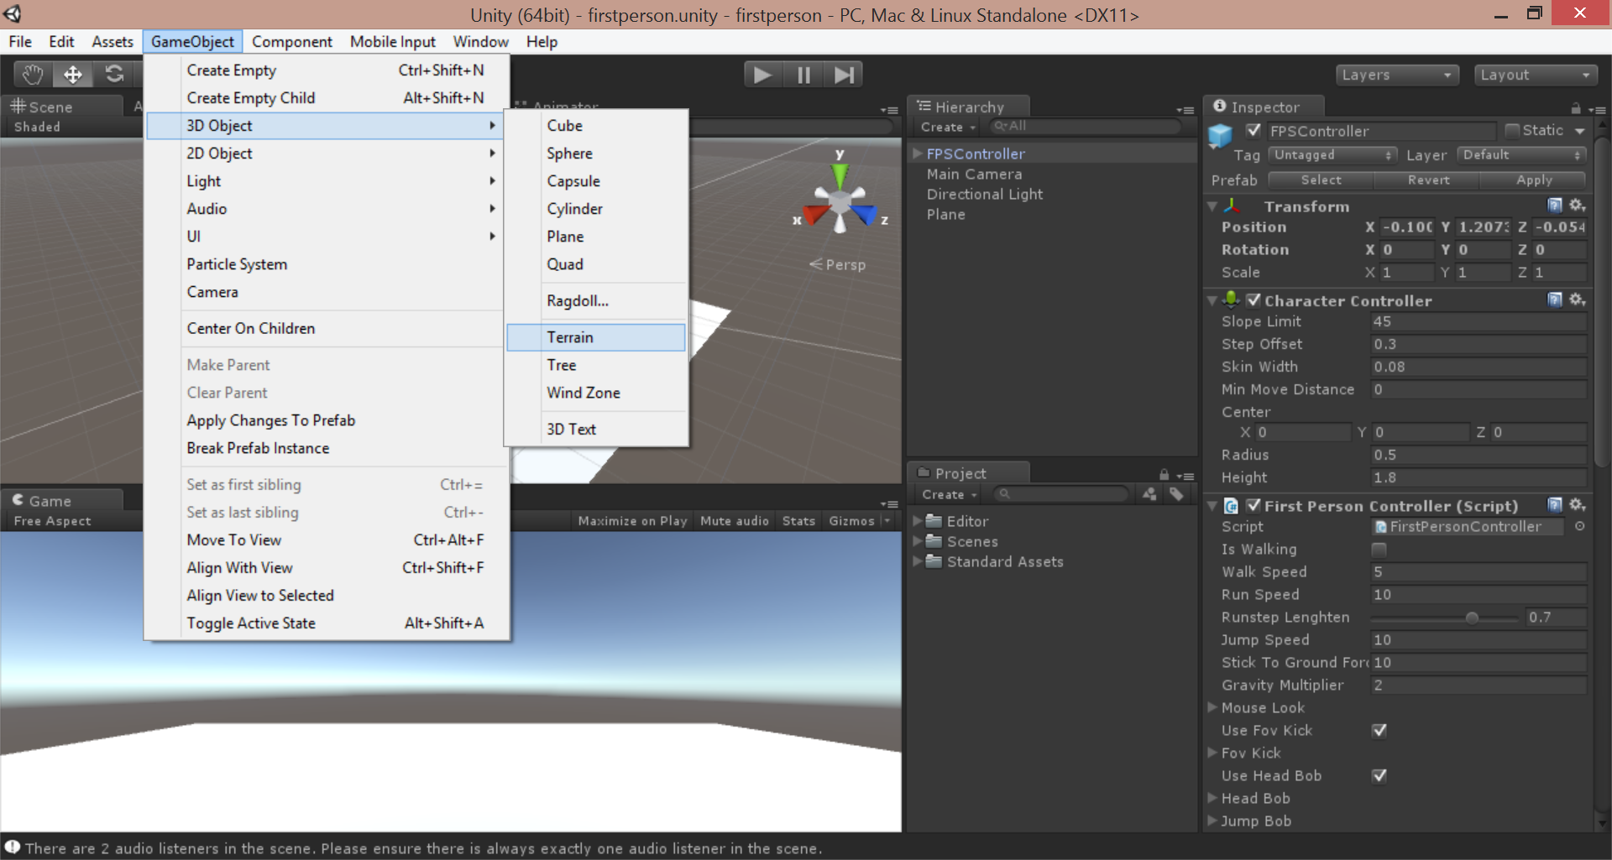
Add Terrain
From top menu, click GameObject → 3D Object → Terrain

Slide 33
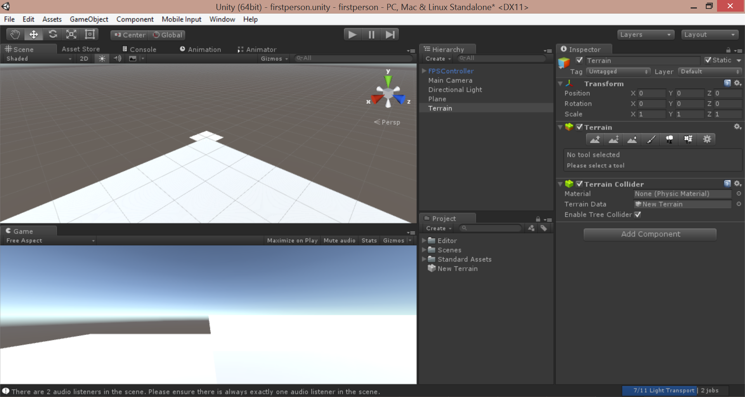
Zoom Out and Focus on Terrain

Slide 34
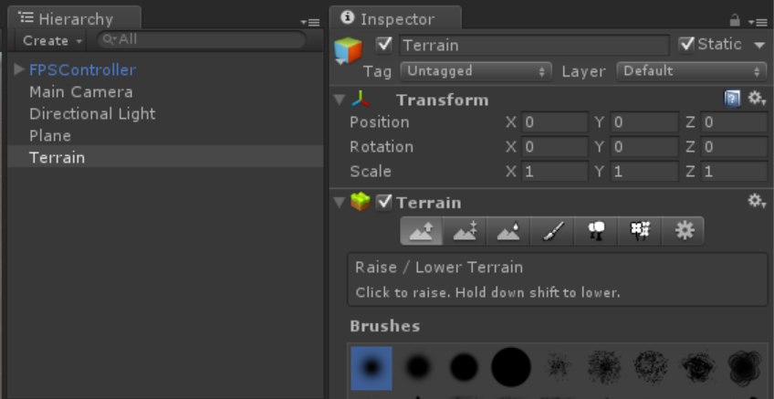
Select Tool to Raise/Lower Terrain

Slide 35
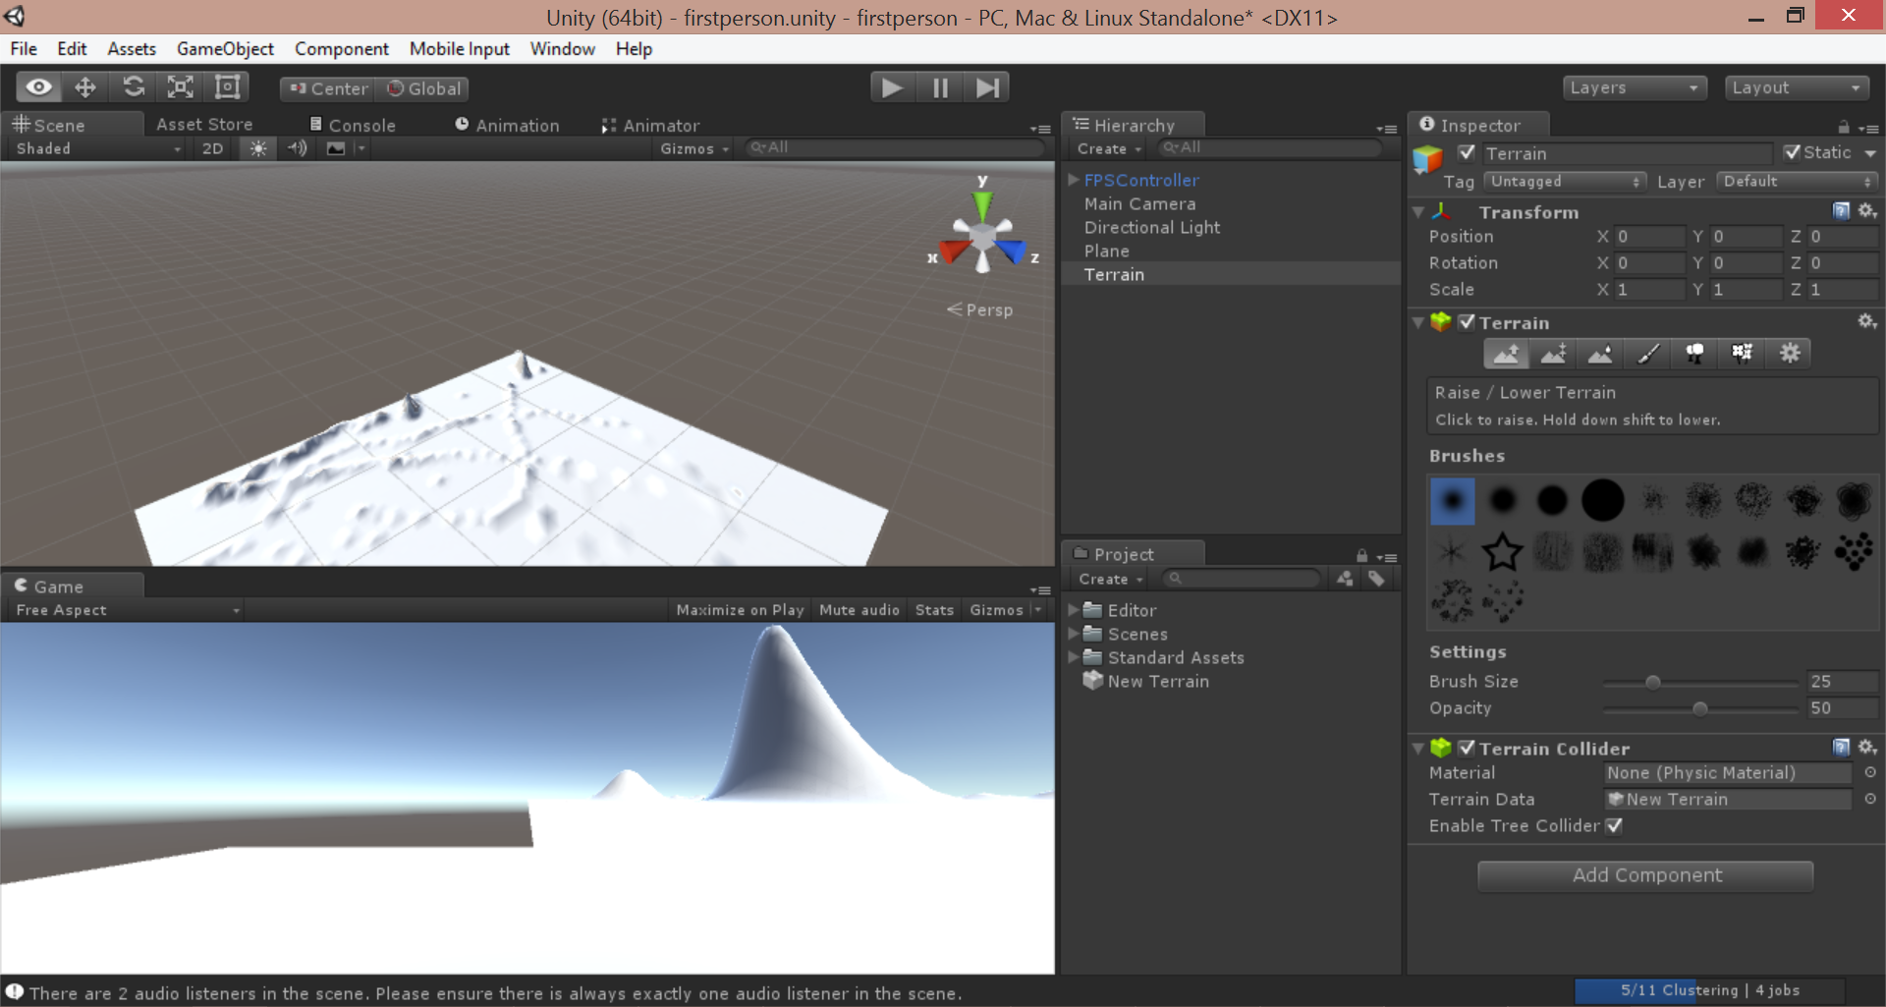
Drag Mouse on Terrain in Scene

Slide 36
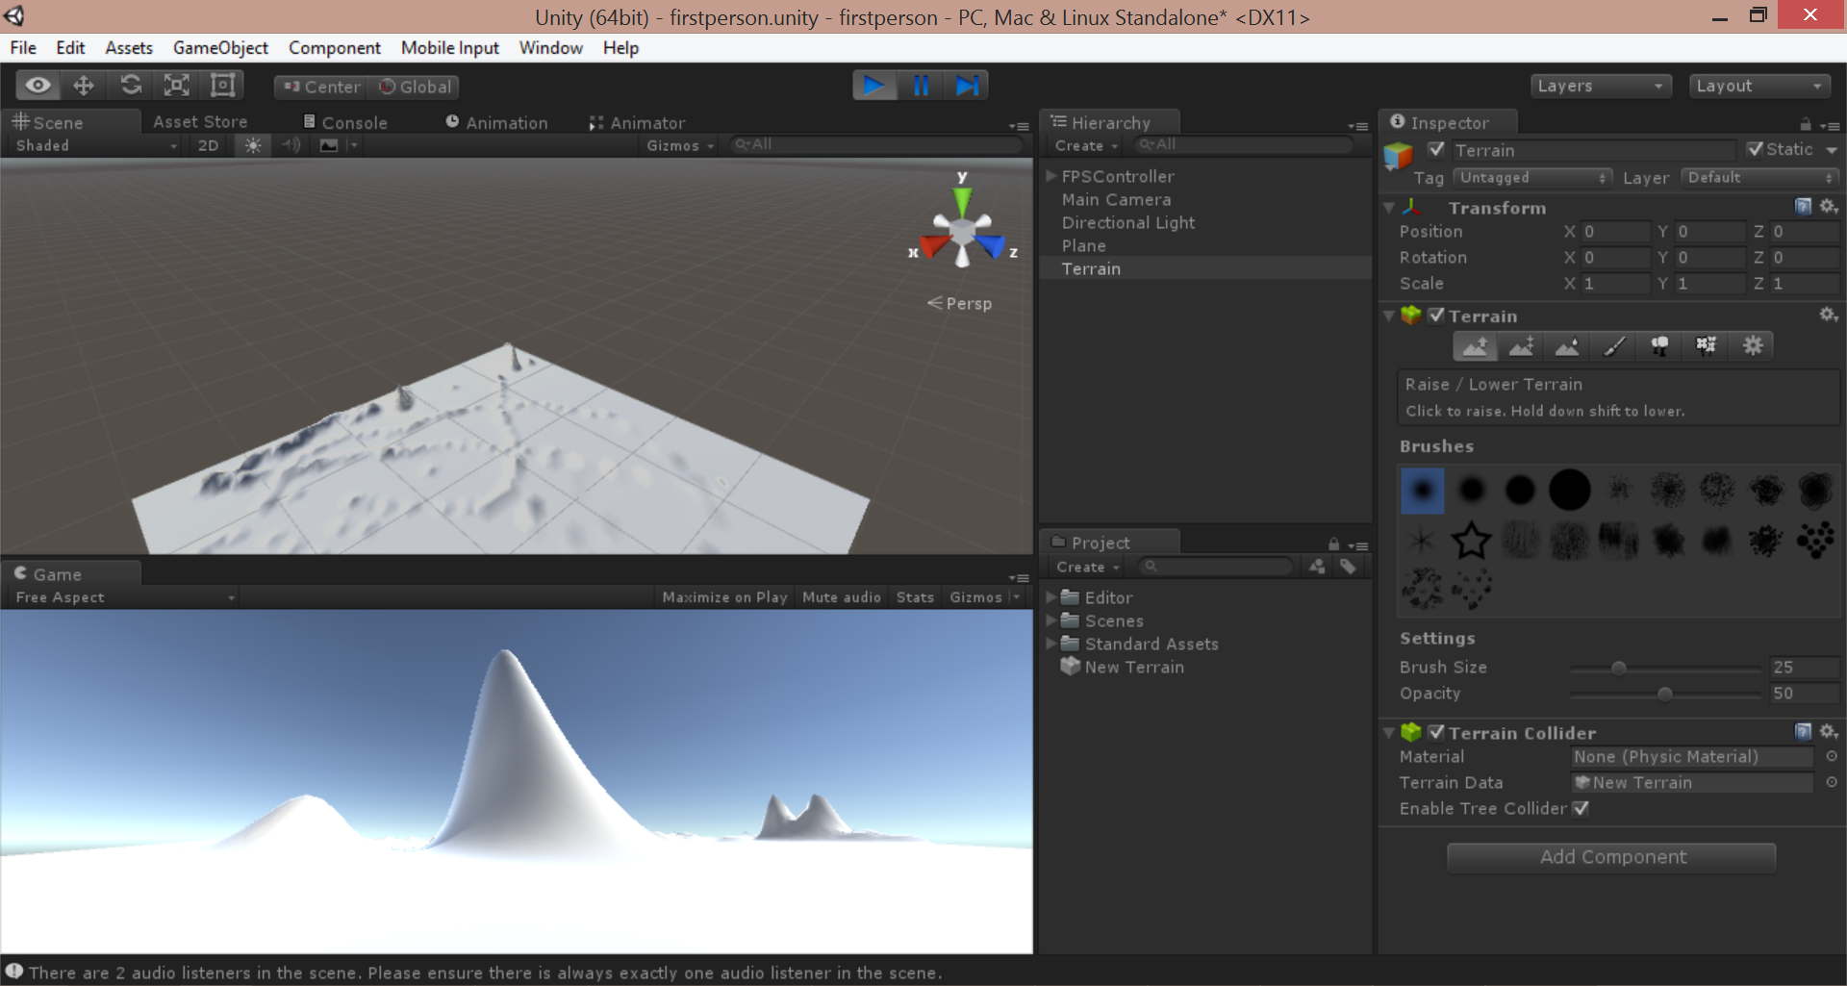
Run the game!
Click Play button, move with arrow keys

Slide 37
Trees

Slide 38
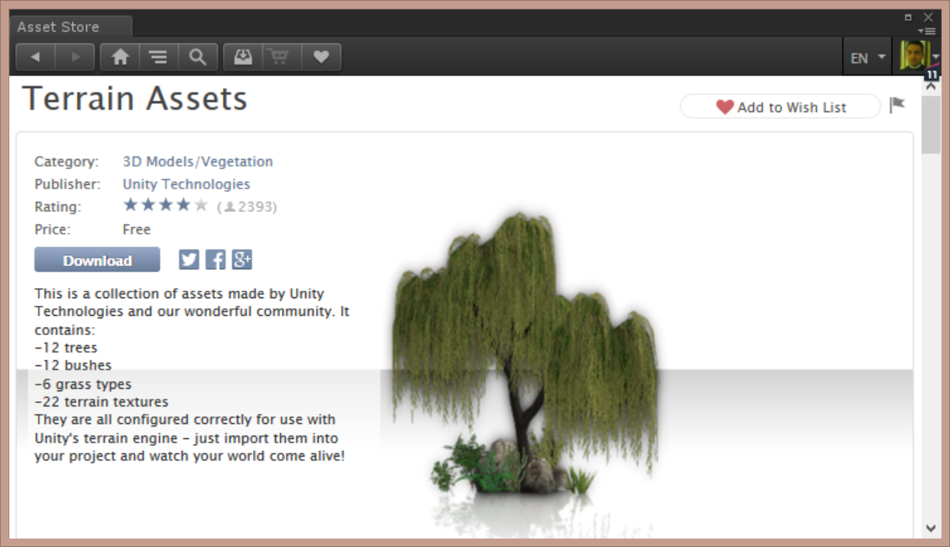
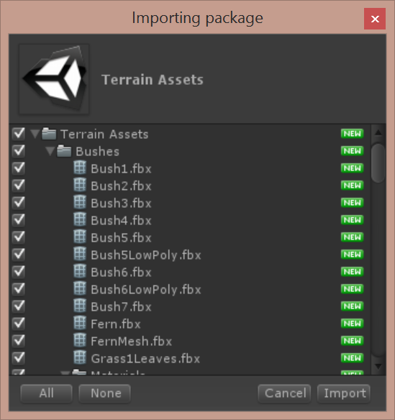
Download & Import Unity’s Terrain Assets

Slide 39
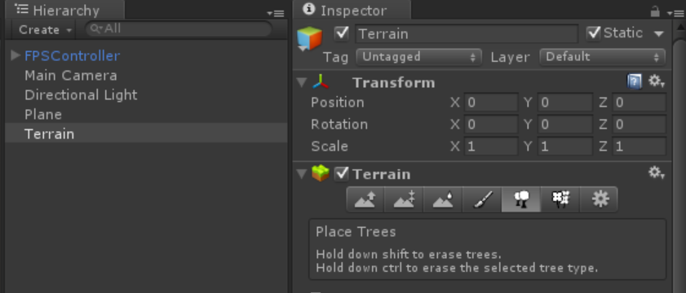
Select Tool to Place Trees

Slide 40
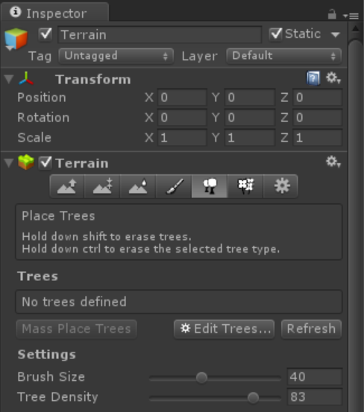
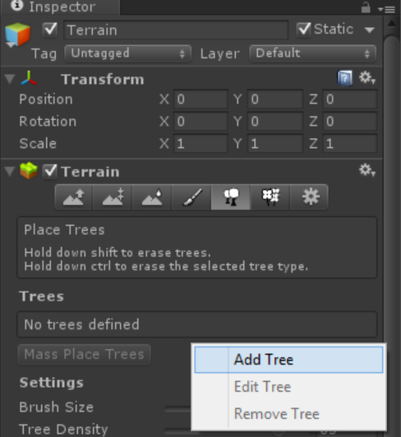
Edit Trees for Terrain to Add Tree
In the Terrain’s Inspector window, click Edit Trees → Add Tree

Slide 41
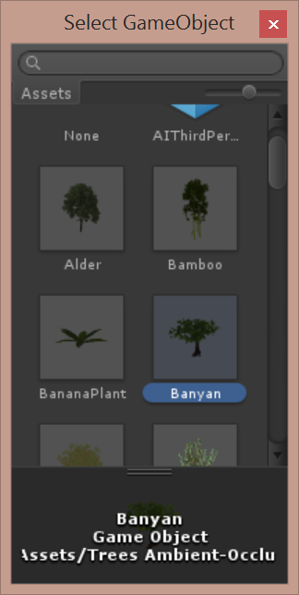
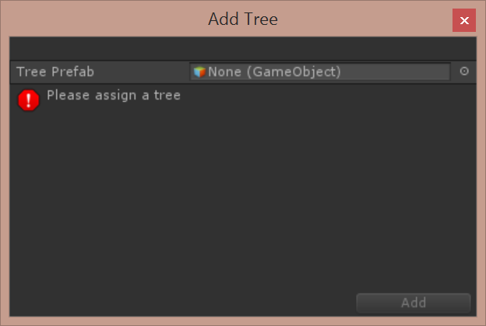
Assign Tree Prefab
In the Add Tree dialog, click the tiny circle, then choose a tree, e.g. Banyan

Slide 42
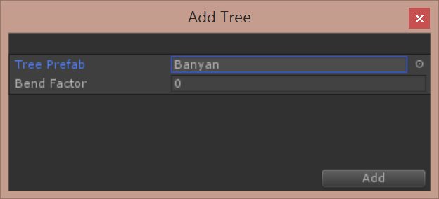
Confirm Add
Click the Add button to confirm.

Slide 43
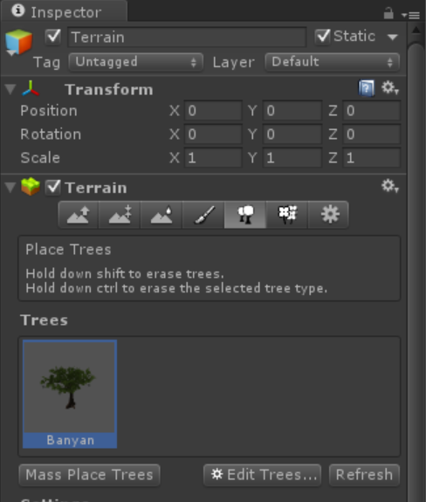
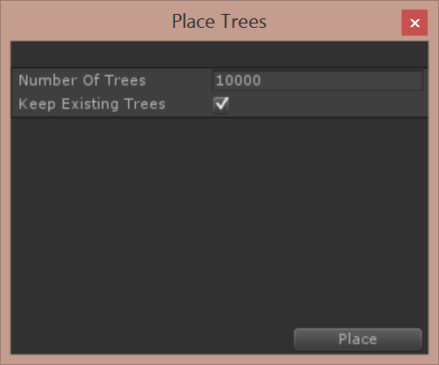
Mass Place Trees
Click “Mass Place Trees, then click Place to confirm

Slide 44
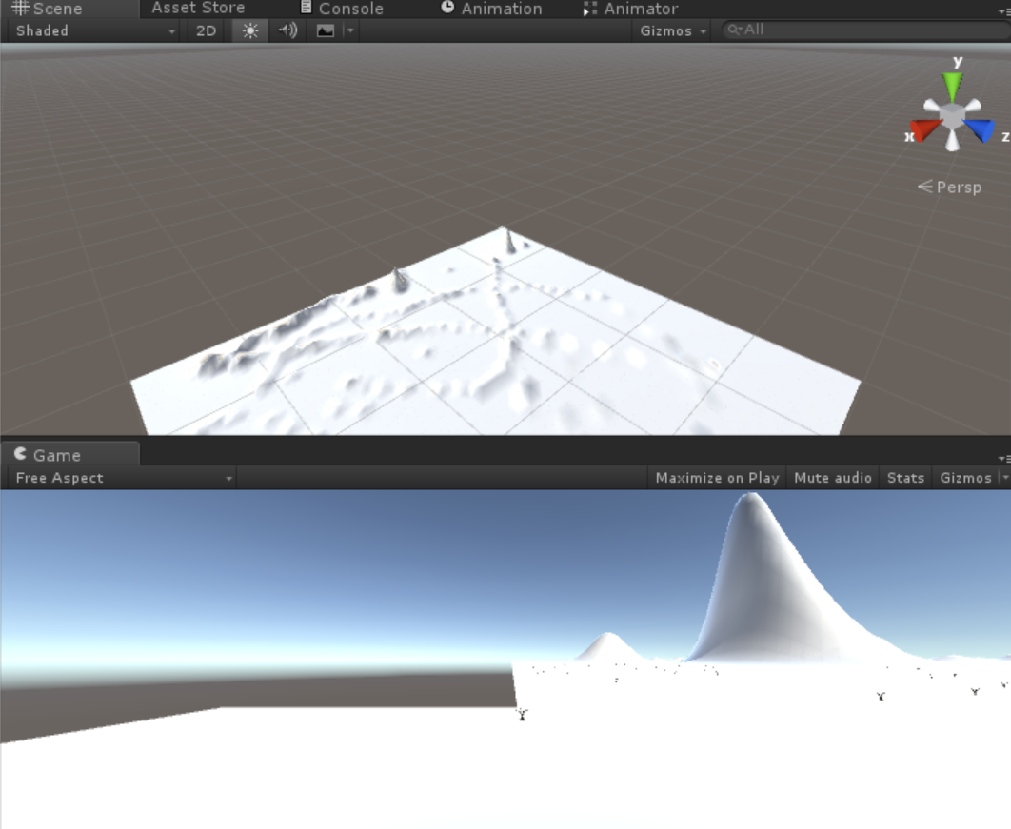
Trees Too Small…?
Too Small!

Slide 45
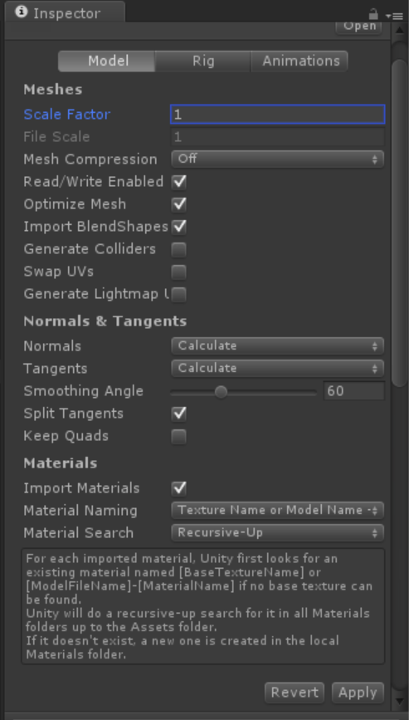
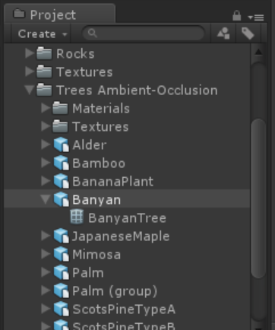
Update Scale for Tree Prefab
In the
Project panel,
click the Prefab
for the tree you
selected,
e.g. Banyan
Enter a larger
Scale Factor
e.g. 1
Click Apply to
update all trees!

Slide 46
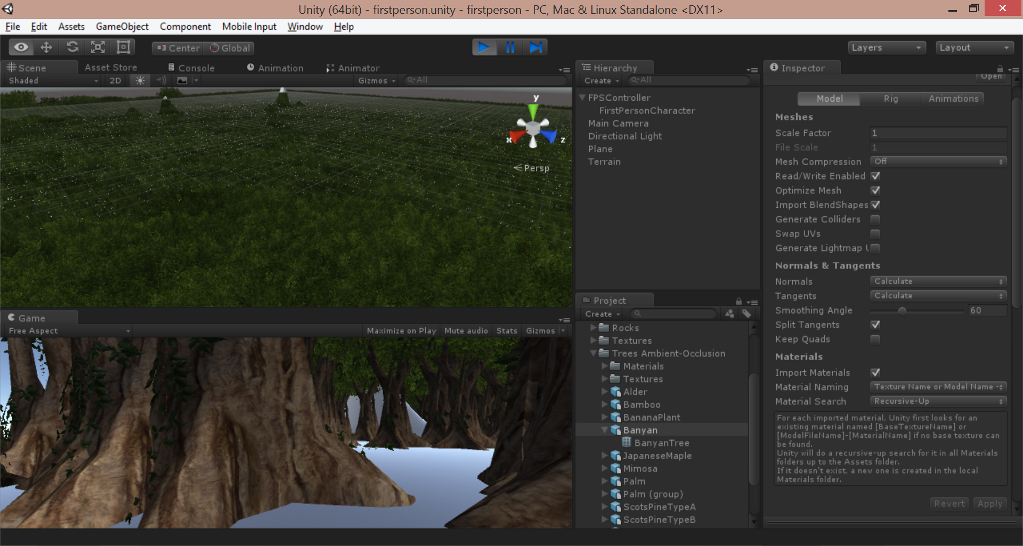
Enjoy Larger Trees!

Slide 47
Colliders

Slide 48
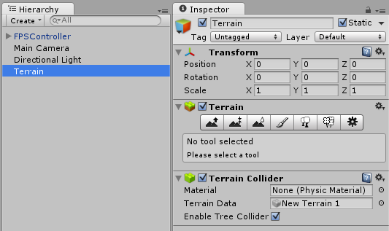
Verify Tree Collider Enabled

Slide 49
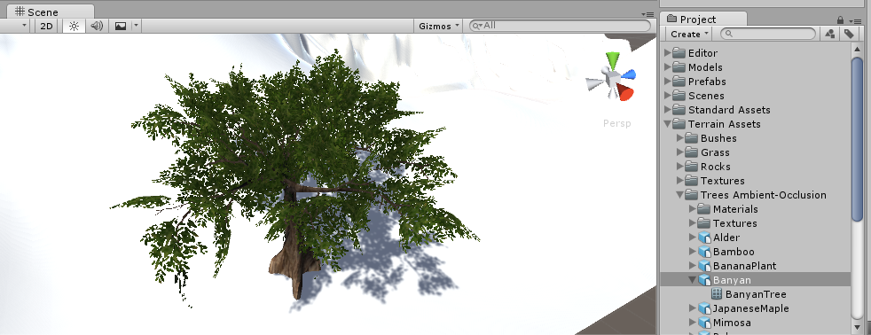
Drag Tree Prefab to Scene
From Project panel, drag any tree prefab to the Scene
Path: /Assets/Terrain Assets/Trees Ambient-Occlusion/

Slide 50
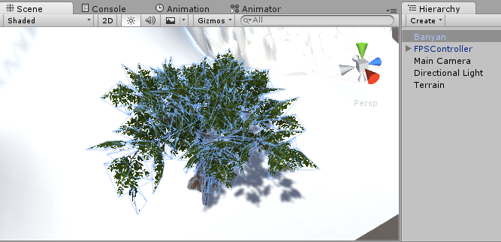
Verify Tree in Hierarchy

Slide 51
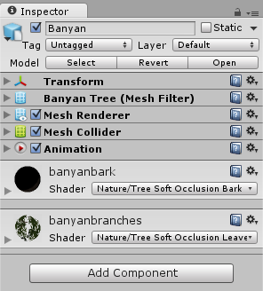
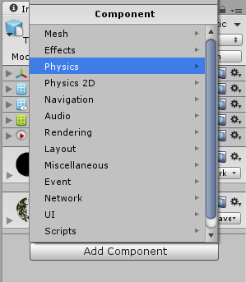
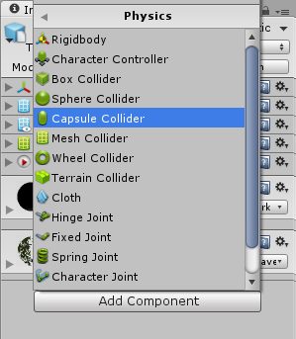
Add Capsule Collider
With the tree selected in the Hierarchy, click Add Component → Physics → Capsule Collider in the Inspector panel

Slide 52
Edit Collider Position & Dimensions

Slide 53
Create Folder for Prefabs

Slide 54
Create New Prefab in Prefabs Folder
Rename it, e.g. “BanyanCollider”

Slide 55
Drag Tree into Prefab
NOTE: You may now delete the tree from the Hierarchy.

Slide 56
Mass Place New Tree with Collider
1
3
2
Click “Place Trees” tool in Inspector with Terrain selected in Hierarchy
Click Edit Trees… to Add Tree (prefab with collider)
Mass Place Trees!

Slide 57
Textures

Slide 58
Import Environment Package
Click Assets → Import Package → Environment
Import All!

Slide 59
Add Texture to Terrain
1
Click “Paint Texture” tool
Click Edit Textures…
Click Add Texture…
2
3

Slide 60
Choose Terrain Texture
2
1
3
Click Select button
Choose a Texture, e.g. SandAlbedo
Click Add

Slide 61
Verify New Terrain Texture

Slide 62
Add Another Texture with Normal Map
2
1
3
Click Select button
Choose another Texture, e.g. Mud Rocky Albedo and Mud Rocky Normal
Click Add

Slide 63
Apply New Texture
With new Texture selected, drag mouse cursor along terrain to apply it.

Slide 64
Add a Grassy Texture
2
1
3
Click Select button
Choose another Texture, e.g. Grassy Hill Albedo
Click Add

Slide 65
Apply Grassy Texture
With new Texture selected, drag mouse cursor along terrain to apply it.

Slide 66
Grass & Rocks

Slide 67
Add Grass
1
Click “Paint Details” tool
Click Edit Details…
Click Add Grass Texture…
2
3

Slide 68
Choose Grass Texture
1
2
3
Click icon next to Detail Texture
Choose a Grass Texture, e.g. Grass Hill Albedo
Click Add

Slide 69
Add Rocks
1
Click “Paint Details” tool
Click Edit Details…
Click Add Detail Mesh…
2
3

Slide 70
Choose Rock Texture
1
2
3
4
Click icon next to Detail Texture
Choose a Rock Texture, e.g. Rock Mesh
Update color and change Render Mode (Vertex Lit)
Click Add

Slide 71
Apply Grass and Rocks
With Grass/Rock selected, drag mouse cursor along terrain to apply each.

Slide 72
Need a Rock with Collider?
2
Drag RockMesh into Scene.
Rename it in Hierachy.
Create empty Prefab, and drag rock into it.
3
1

Slide 73
Add Capsule Collider
With the rock selected in the Hierarchy, click Add Component → Physics → Capsule Collider in the Inspector panel

Slide 74
Edit Collider Position & Dimensions

Slide 75
Water

Slide 76
Drag Water Prefab into Scene

Slide 77
Agenda
Initial Setup, Asset Store
> First-Person Controls
> Terrain, Trees, Colliders
> Textures, Grass & Rocks, Water
Wrap-Up
Notes:
Agenda

Slide 78
Weapon

Slide 79
Download Models Zip File
From OneDrive: http://1drv.ms/1TUMufE
Extract into Assets folder…

Slide 80
Verify Models Folder in Project Panel

Slide 81
Drag Prefab into Hierarchy
Drag “bazooka” prefab into “FirstPersonCharacter”
(just below FPSController)

Slide 82
Adjust Weapon Position
Adjust Position:
X, Y and Z values

Slide 83
Adjust Weapon Position
Adjust Position:
X, Y and Z values

Slide 84
For More Info:
Unity Indie Devs:
http://facebook.com/groups/UnityIndieDevs
http://WakeUpAndCode.com/unity
Xbox One Indie Devs:
http://facebook.com/groups/XboxOneIndieDevs
http://WakeUpAndCode.com/xb1
Notes:
For more info:
Xbox One Indie Devs:
http://facebook.com/groups/XboxOneIndieDevs
http://WakeUpAndCode.com/xb1
Unity Indie Devs:
http://facebook.com/groups/UnityIndieDevs
http://WakeUpAndCode.com/unity
Construct2 Devs:
https://www.facebook.com/groups/construct2devs

Slide 85
Contact
Email: shchowd@microsoft.com  Twitter: @shahedC
Notes:
Contact
Microsoft email: shchowd@microsoft.com
Personal Twitter: @shahedC
Dev Blog: WakeUpAndCode.com

Slide 86
Agenda
Initial Setup, Asset Store
> First-Person Controls
> Terrain, Trees, Colliders
> Textures, Grass & Rocks, Water
Wrap-Up
Notes:
Agenda

