Slide 1
Web Application Security
in the Real World
Shahed Chowdhuri
Sr. Technical Evangelist @ Microsoft
@shahedC
WakeUpAndCode.com

Slide 2
Agenda
Overview
SQL Injection
Cross-Site Scripting (XSS)
Data Exposure
Next Steps
Q&A
Notes:
Shahed Chowdhuri
Web Application Security
Overview
SQL Injection
Cross-Site Scripting (XSS)
Data Exposure
In the Real World
Next Steps
Q&A

Slide 3
Overview of Web Applications
Web Server
Internet
Database
Users

Slide 4
SQL Injection
Username
myusername
Password
' or 1=1)#
Submit
Enter your username and password…
… but what if you can inject SQL code in the input field?

Slide 5
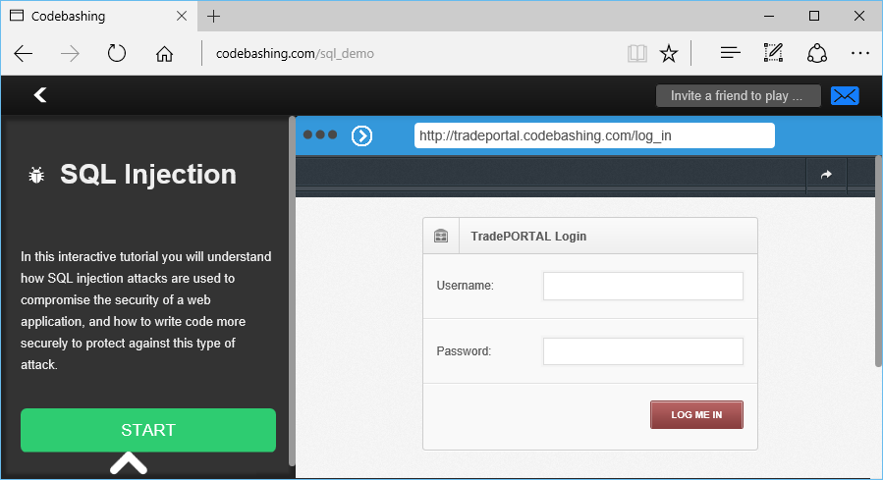
SQL Injection Demo
codebashing.com/sql_demo

Slide 6
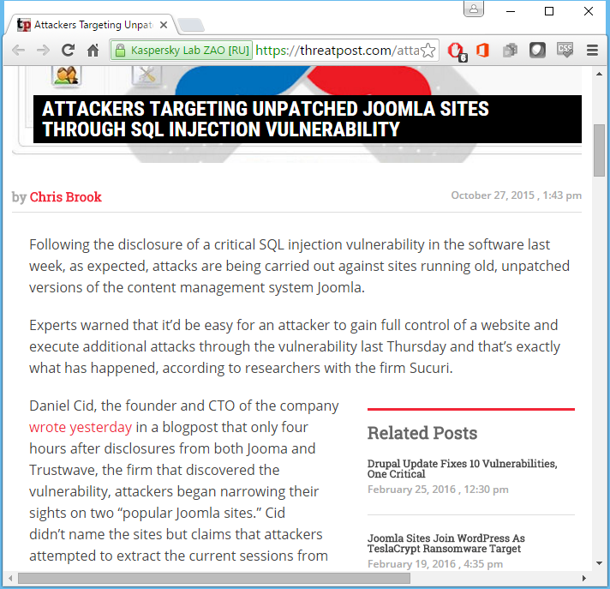
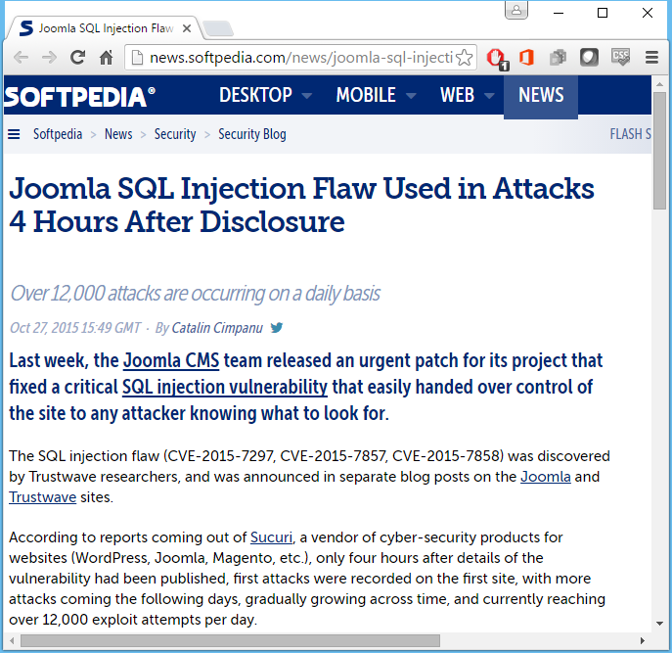
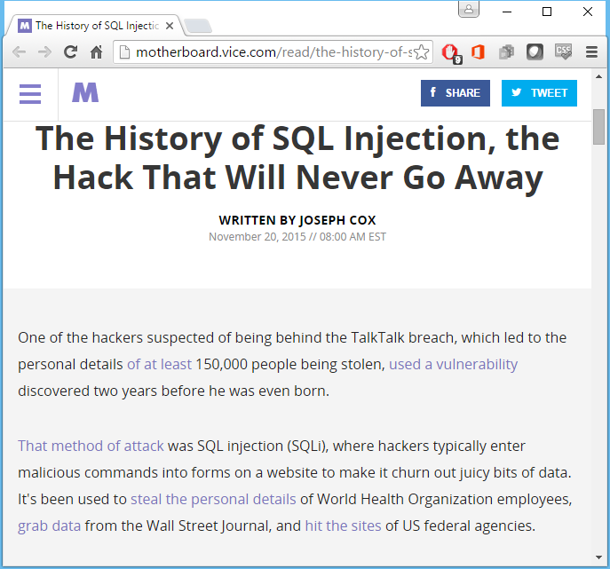
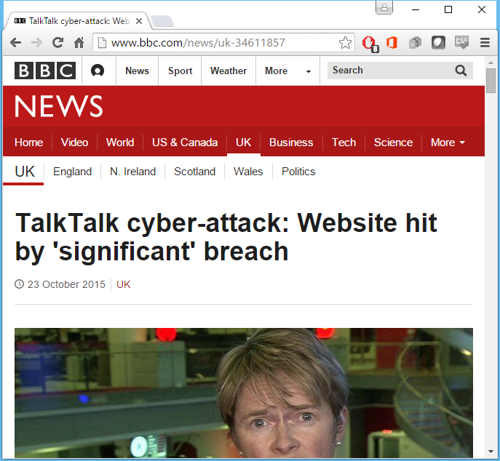
SQL Injection in the Real World
Link 4
Link 1
Link 2
Link 3

Slide 7
Solutions for SQL Injection
Avoid SQL strings with parameters
Encode user input in parameters
Use framework-specific features

Slide 8
Cross-Site Scripting (XSS)
Enter text:
Hello World!
Submit
Text Submitted:
Hello World!
Enter some text and submit it…
… but what if you could submit script code?

Slide 9
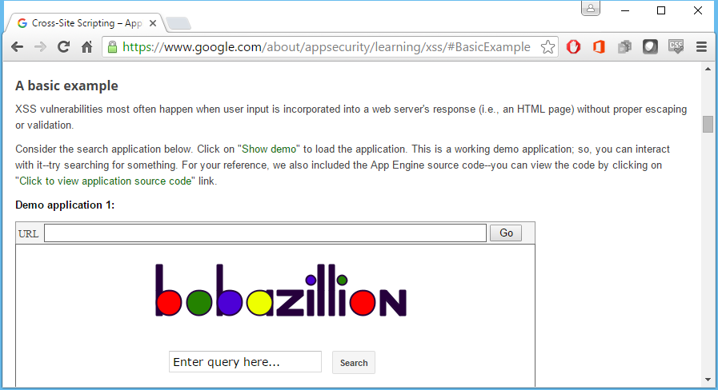
XSS Demo
google.com/about/appsecurity/learning/xss/#BasicExample

Slide 10
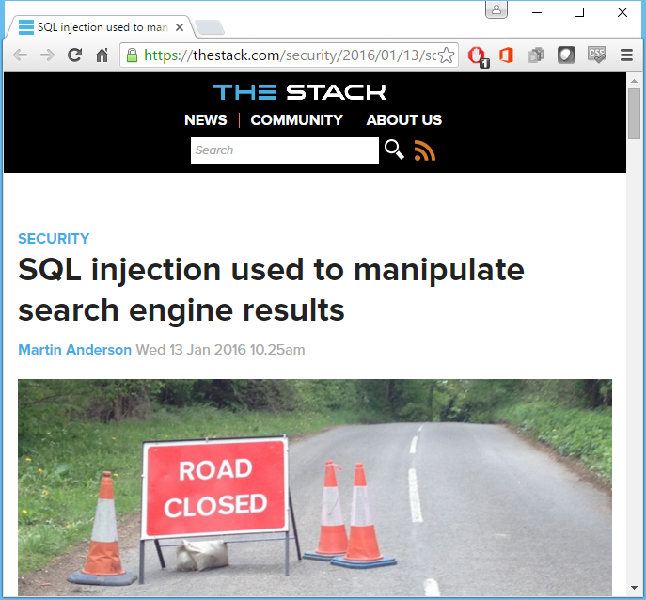
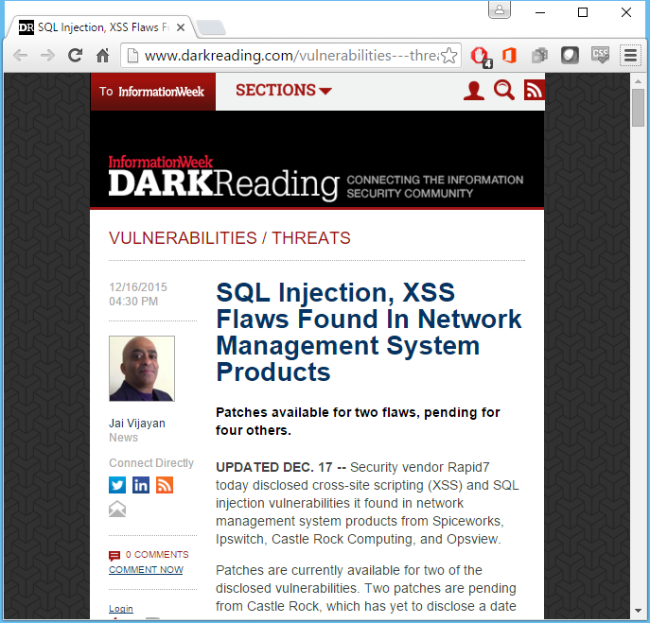
Cross-Site Scripting in the Real World
Link 3
Link 1
Link 2

Slide 11
Solutions for XSS
HTML-Encode <script> tags
Strip out <script> tags
Use framework-specific features

Slide 12
Data Exposure
Enter item:
New Item?!!
Submit
Text Submitted:
Error: servername.dbname in code file, line 21
Perform an action that causes an error…
… unnecessary information is displayed!

Slide 13
Solutions for Data Exposure
Don’t display unnecessary details
Log errors in a database
Provide an error code for troubleshooting

Slide 14
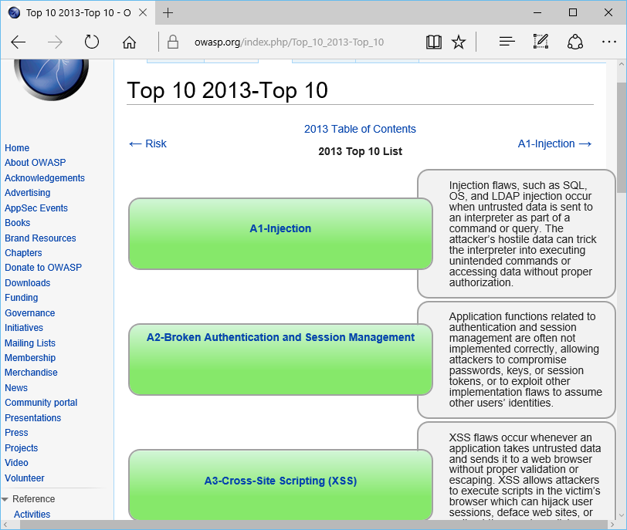
Next Steps: OWASP Top 10
OWASP Top 10

Slide 15
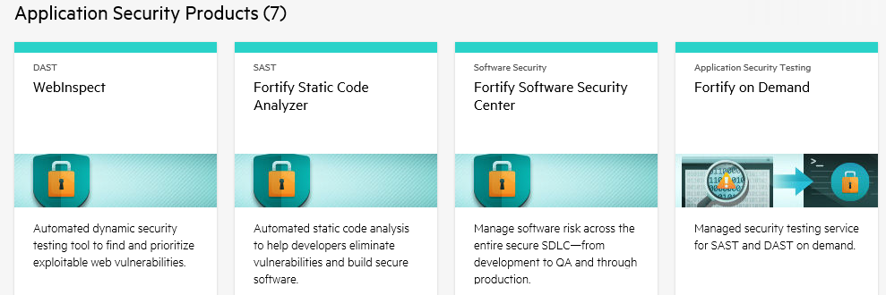
HP WebInpsect & Fortify Tools
http://hp.com/go/fortify

Slide 16
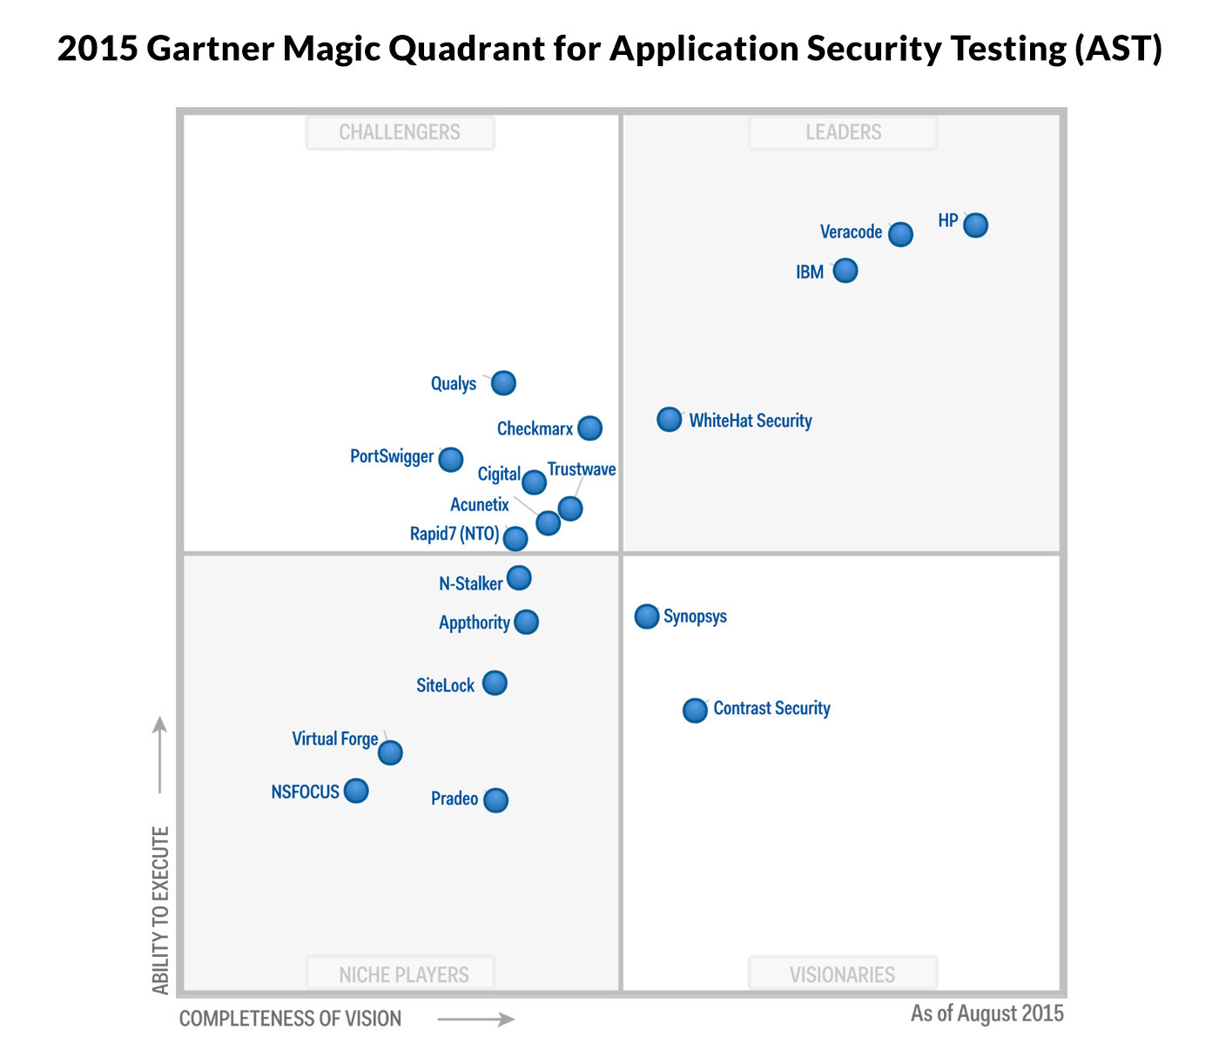
Gartner Magic Quadrant for AST
http://www.gartner.com/doc/reprints?id=1-2KU6OUB&ct=150806&st=sb

Slide 17
Q&A

Slide 18
To apply for the Microsoft Student Partners program: Go to: http://aka.ms/mspapply2016 As an MSP, you will: build apps and demos demonstrate the newest technologies and host tech events on your campus acquire the tools and training to lead technology discussions on your campus build your global network with industry experts connect with like-minded students and faculty around the world attend trainings from Microsoft leaders to enhance your knowledge about cutting edge technologies be the one on your campus with insight and answers on Microsoft technologies
Does this describe you? Passionate about technology! Tech-savvy! Thrilled to learn new skills! Actively involved with student orgs! You could be the Microsoft rock star on campus!
Contact: SHAHED CHOWDHURI, Sr. Technical Evangelist @ Microsoft
shchowd@microsoft.com • http://WakeUpAndCode.com/msp

Slide 19
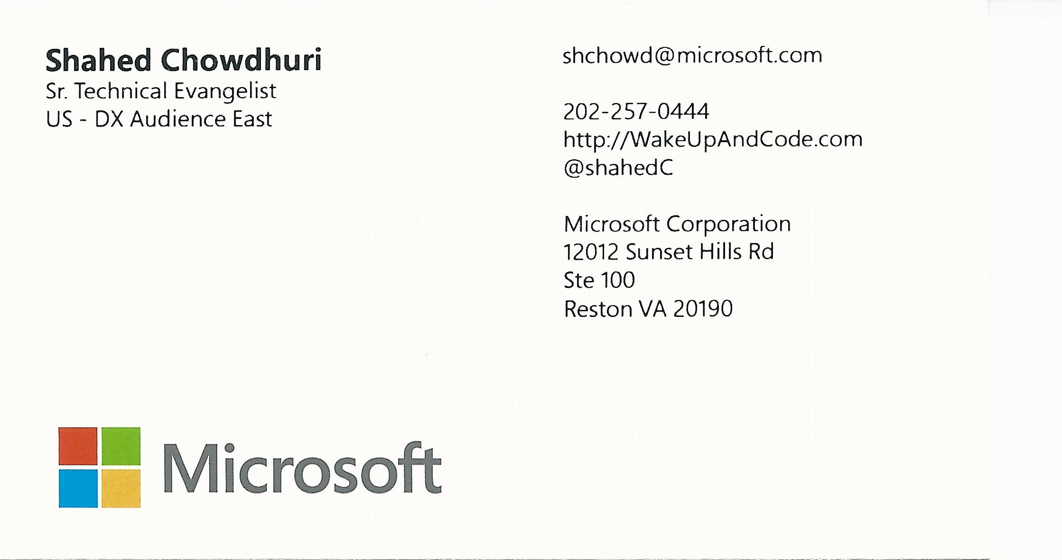
Email: shchowd@microsoft.com  Twitter: @shahedC
Notes:
Contact
Microsoft email: shchowd@microsoft.com
Personal Twitter: @shahedC
Dev Blog: WakeUpAndCode.com

