Slide 1
Universal Apps
For Windows 10
Shahed Chowdhuri
Sr. Technical Evangelist @ Microsoft
@shahedC
WakeUpAndCode.com

Slide 2
What You’ll Need
Materials for Hands-On Labs
https://github.com/Windows-Readiness/WinDevHOLs
Visual Studio 2015 (Community Edition OK):
http://aka.ms/vs2015ce
Optional: Unity 5 & Construct 2
http://unity3d.com
http://scirra.com

Slide 3
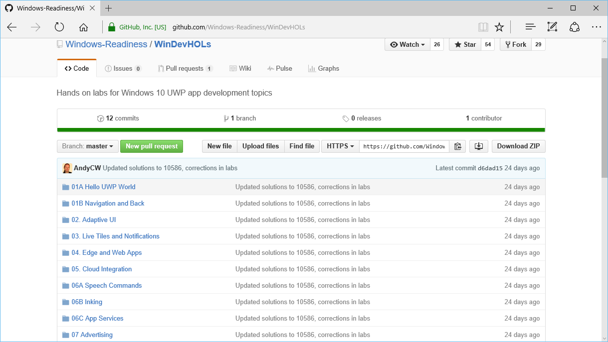
GitHub
https://github.com/Windows-Readiness/WinDevHOLs

Slide 4
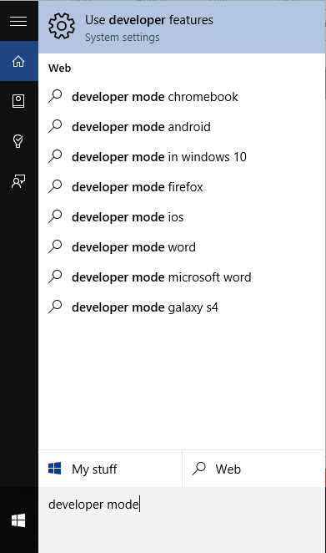
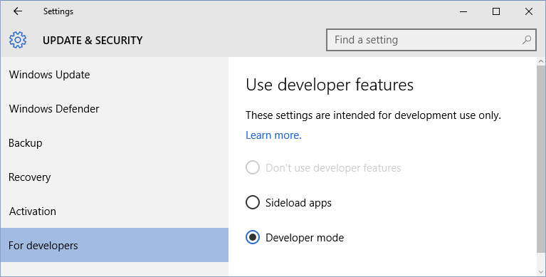
TIP: Enable Developer Mode
Search for “developer mode” or “developer features”
Enable “Developer mode” option

Slide 5
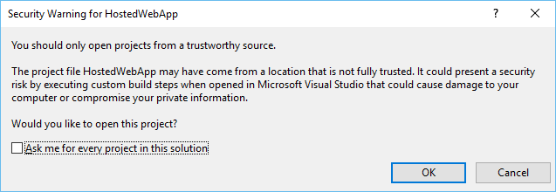
TIP: Uncheck “Ask me…” Checkbox

Slide 6
TIP: Change Platform to x86 or x64

Slide 7
Track (Do What You Want!)
1. Hello World + Navigation
2. Adaptive UI
3. Live Tiles and Notifications
4. Edge and Web Apps
5. Cloud Integration
6. Speech, Inking & App Services
7. Advertising
Notes:
Shahed Chowdhuri
Web Application Security
Overview
SQL Injection
Cross-Site Scripting (XSS)
Data Exposure
In the Real World
Next Steps
Q&A

Slide 8
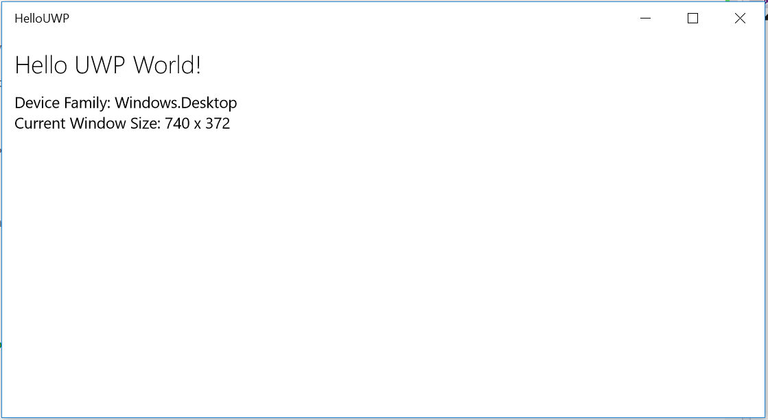
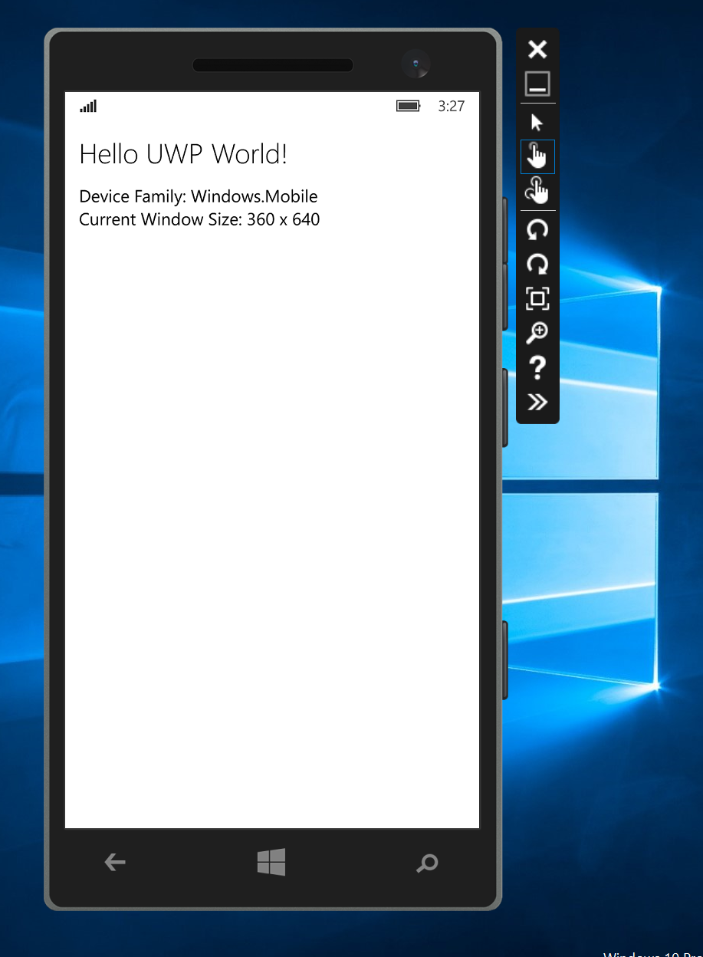
1a. Hello World

Slide 9
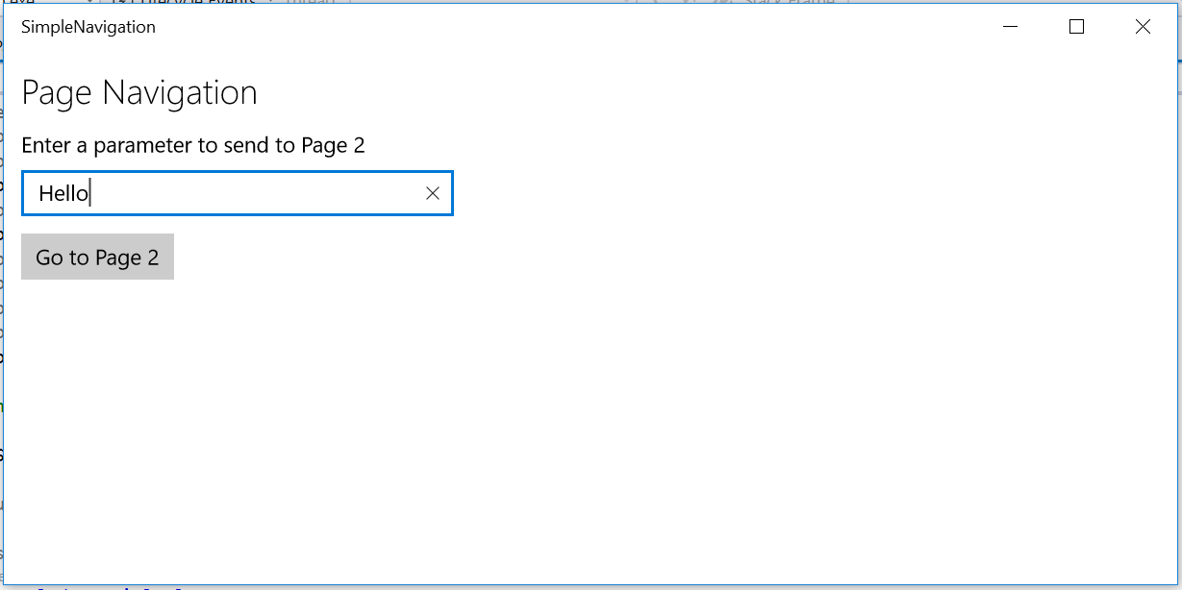
1b. Navigation

Slide 10
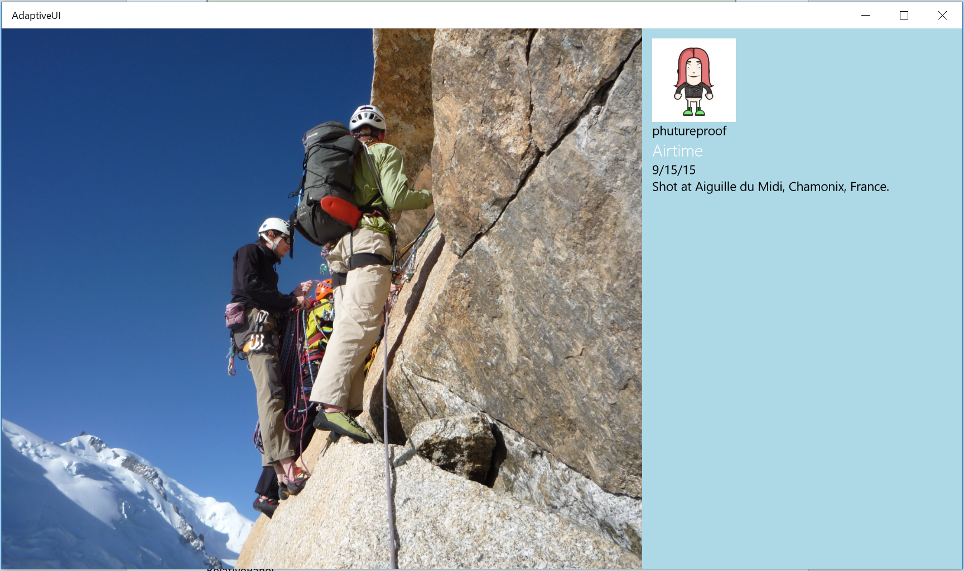
2. Adaptive UI

Slide 11
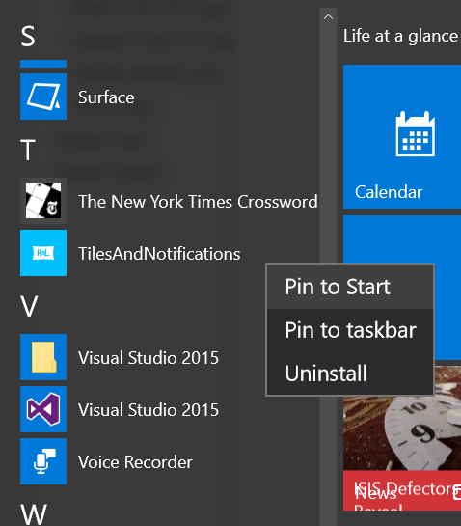
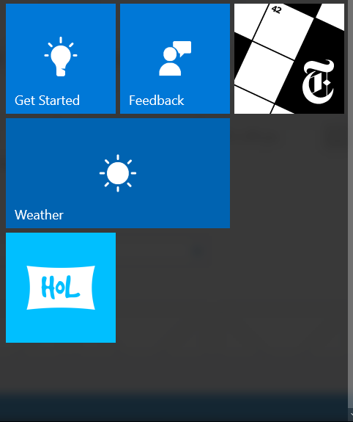
3. Live Tiles + Notifications

Slide 12
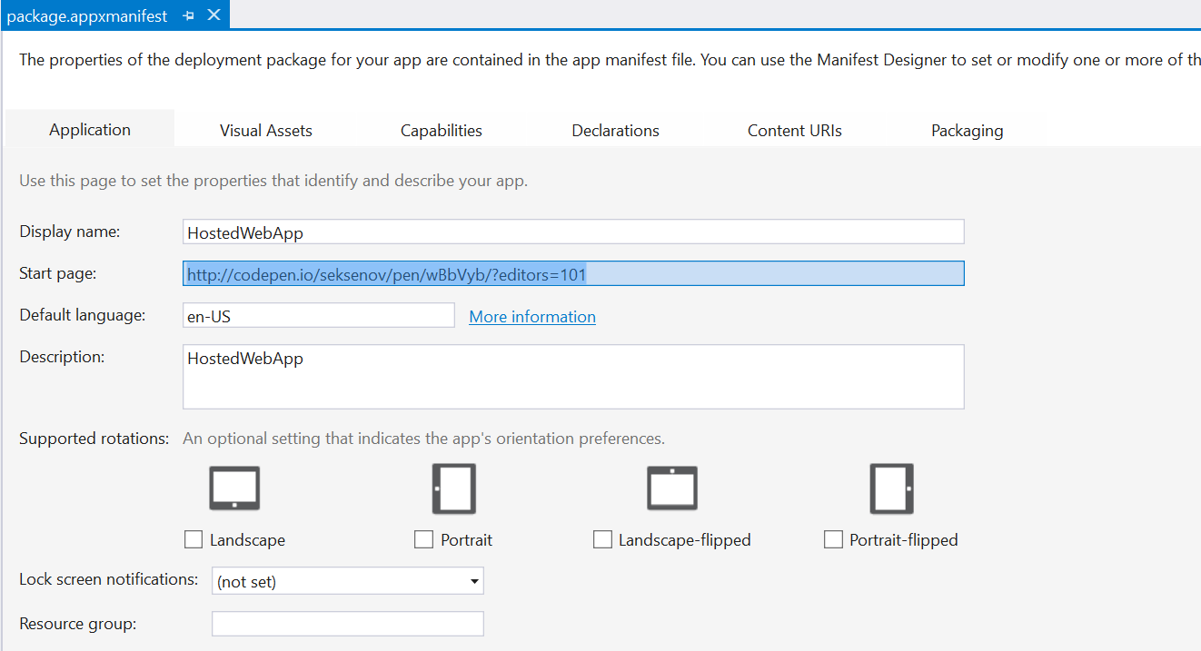
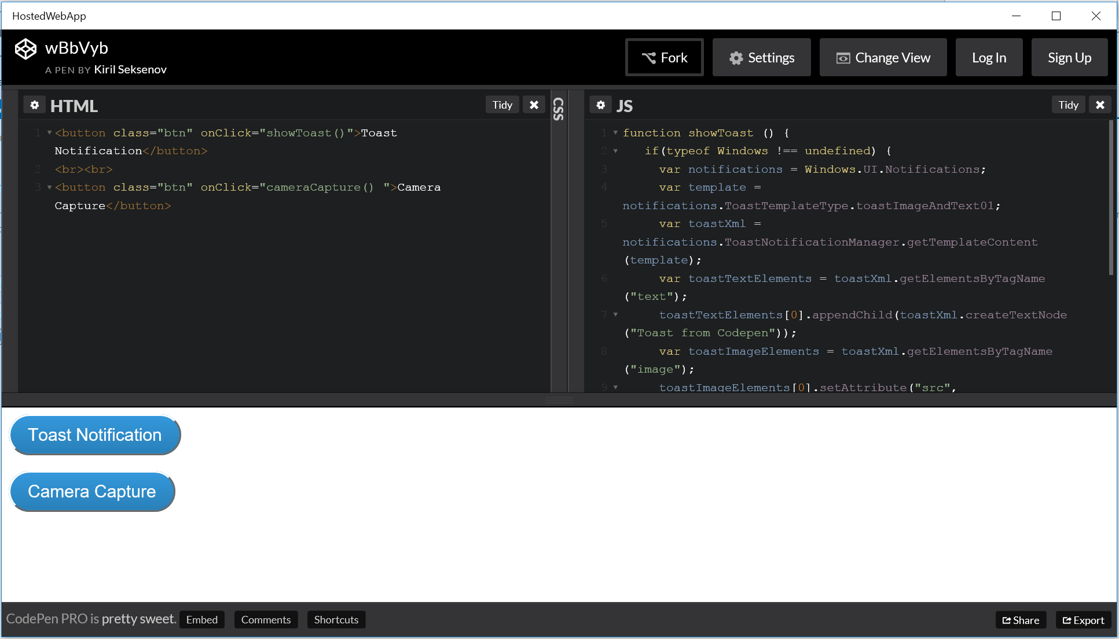
4. Edge + Web Apps

Slide 13
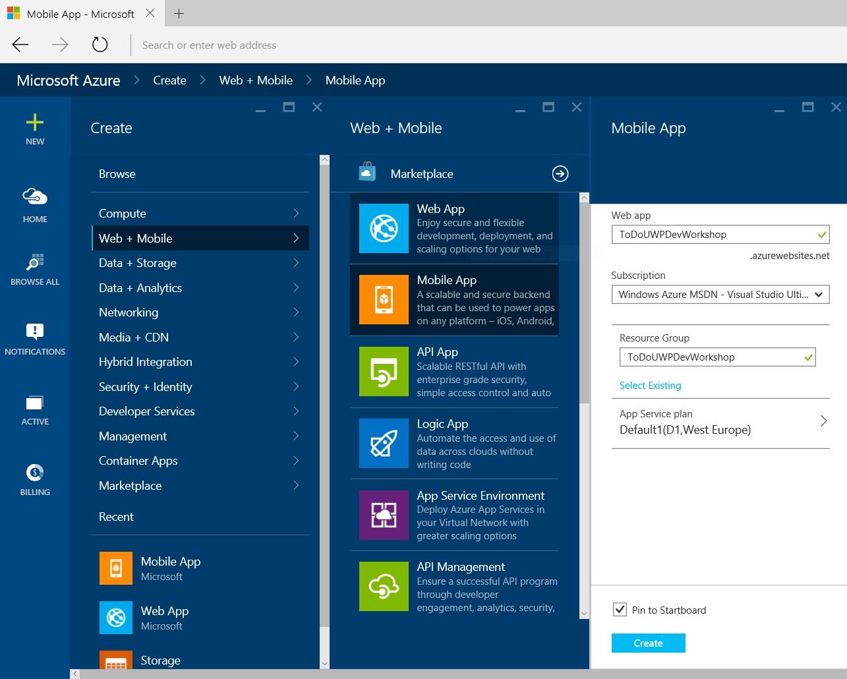
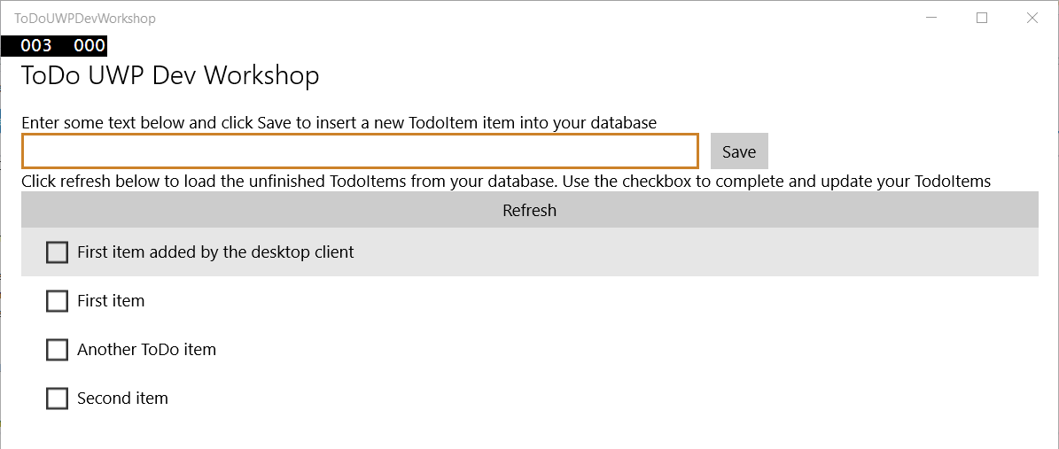
5. Cloud Integration

Slide 14
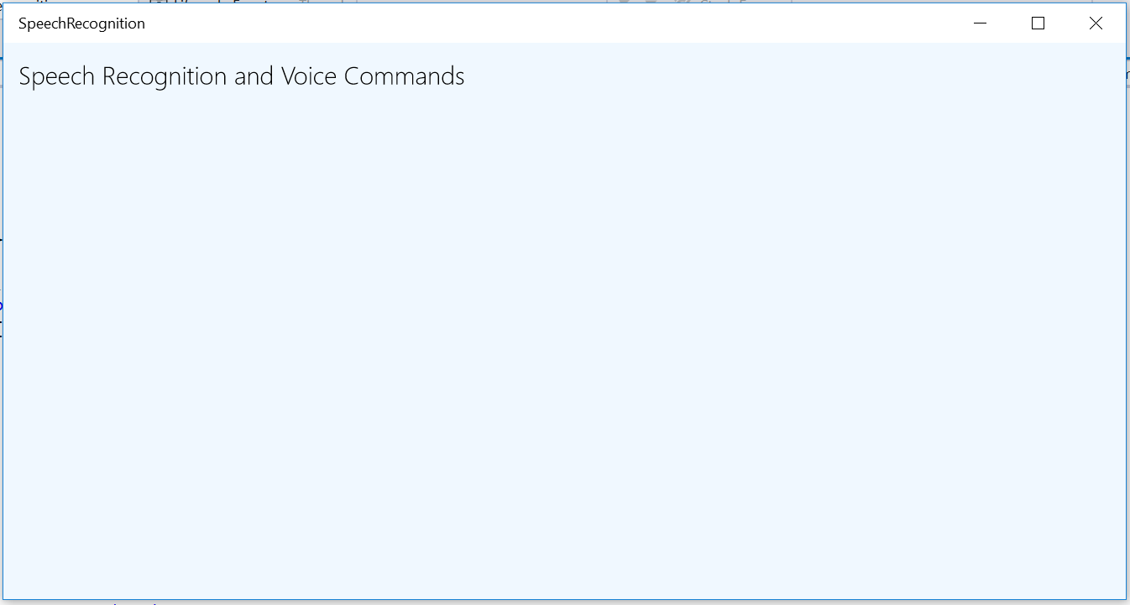
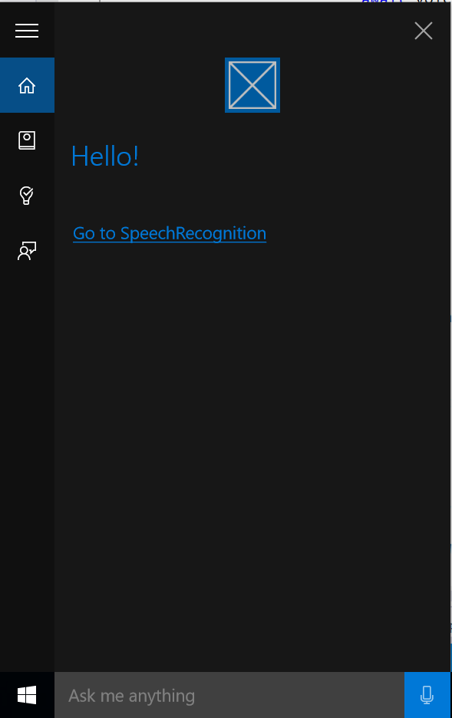
6a. Speech

Slide 15
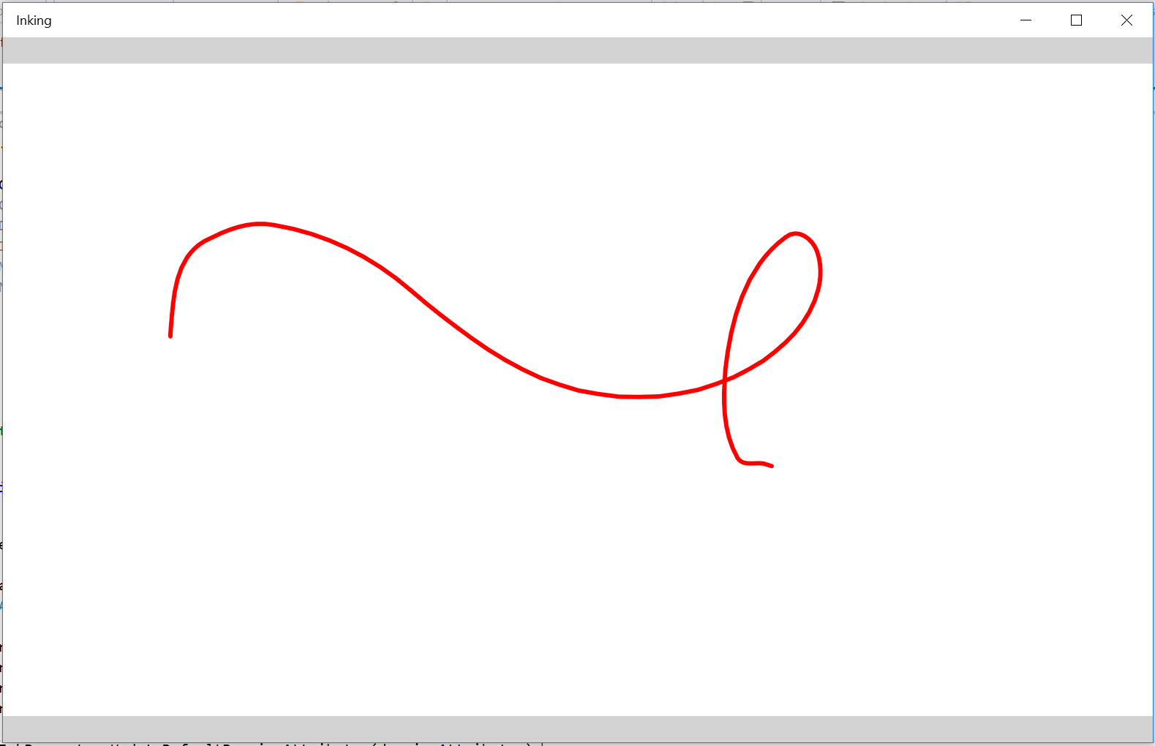
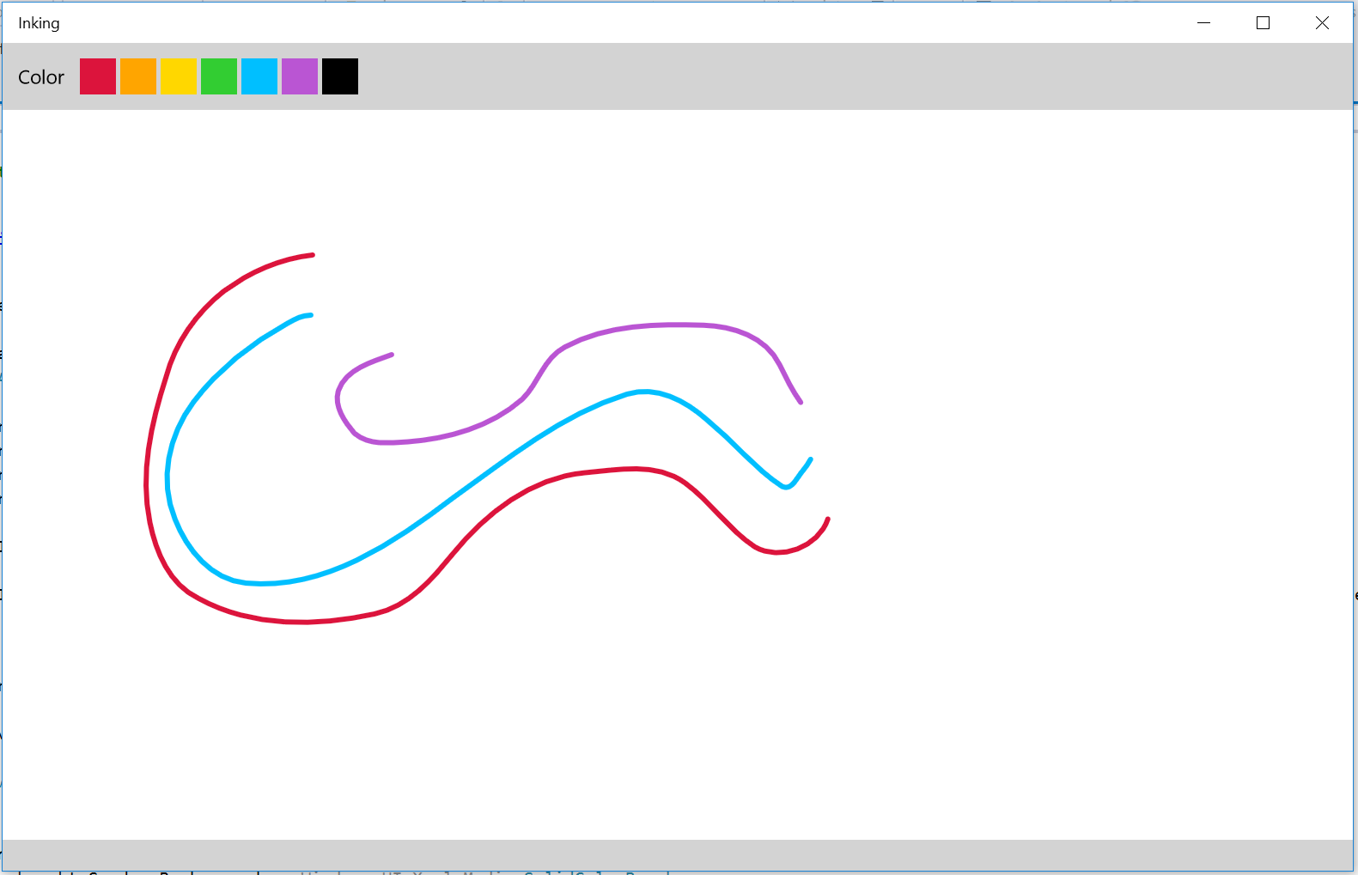
6b. Inking

Slide 16
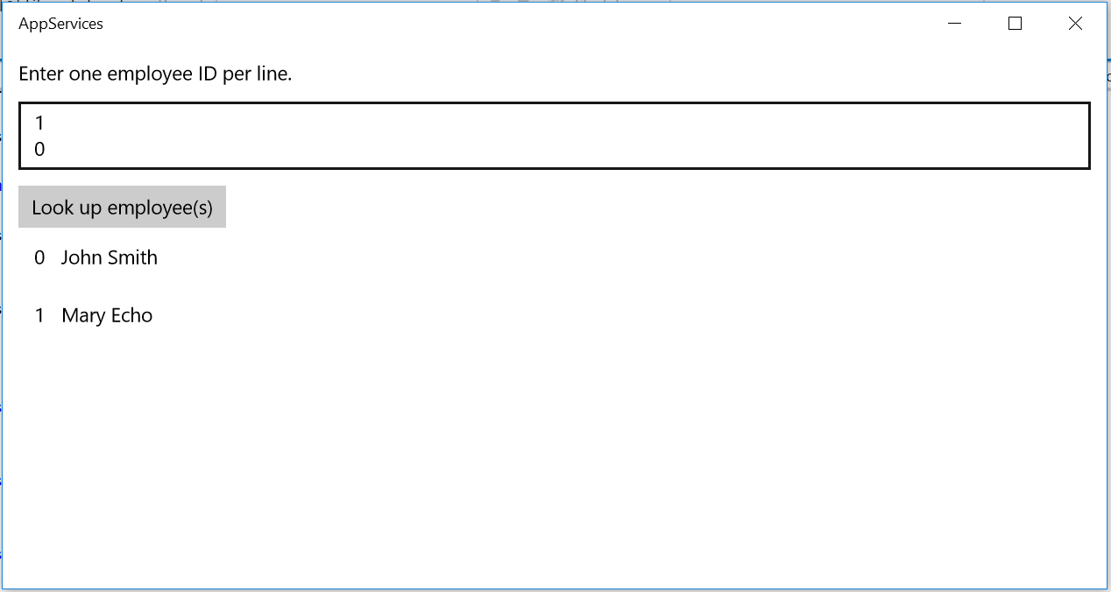
6c. App Services

Slide 17
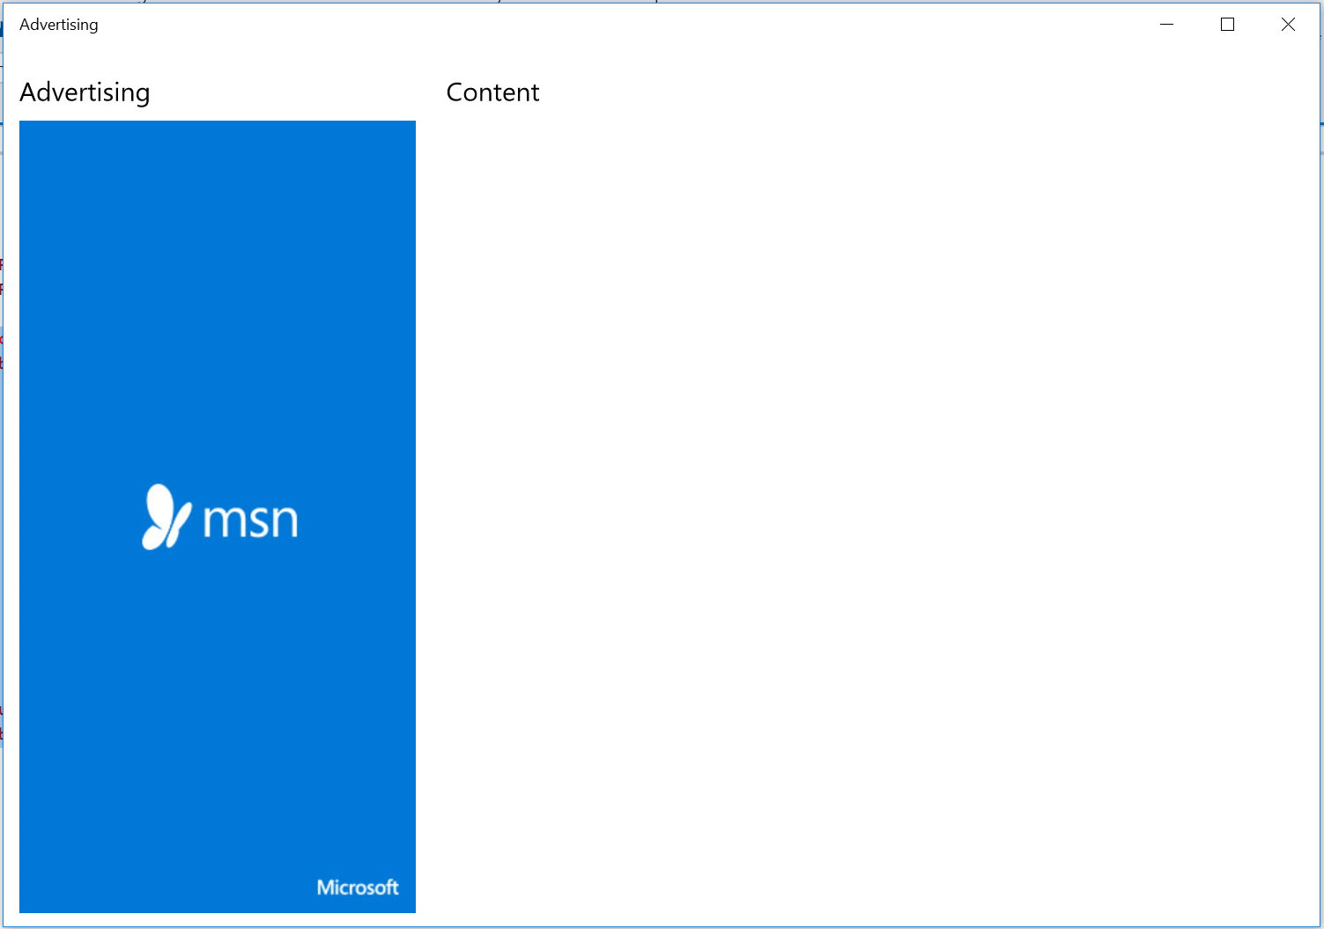
7. Advertising

Slide 18
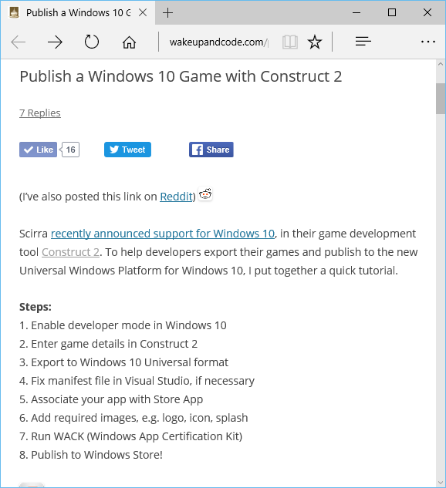
Bonus Materials: Publish to Windows Store
http://wakeupandcode.com
/publish-a-windows-10-game-with-construct-2/
http://wakeupandcode.com
/publish-a-windows-10-game-with-unity-5/
Notes:
Shahed Chowdhuri
Web Application Security
Overview
SQL Injection
Cross-Site Scripting (XSS)
Data Exposure
In the Real World
Next Steps
Q&A

Slide 19
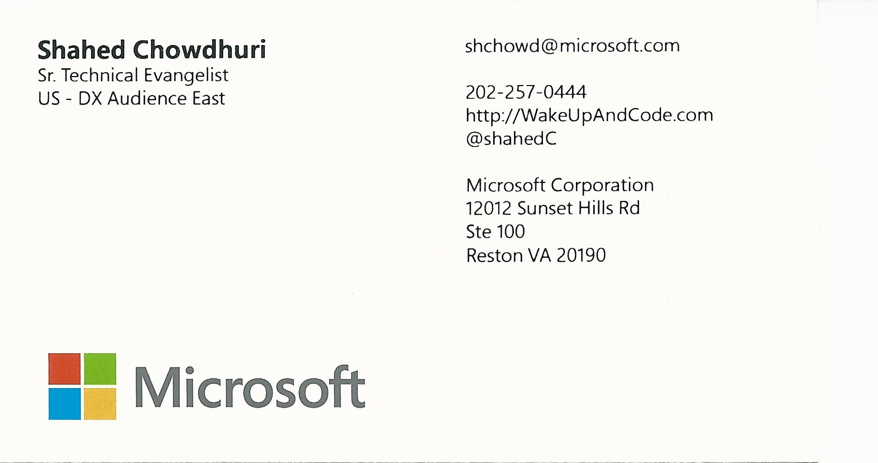
Email: shchowd@microsoft.com  Twitter: @shahedC
Notes:
Contact
Microsoft email: shchowd@microsoft.com
Personal Twitter: @shahedC
Dev Blog: WakeUpAndCode.com

