Slide 1
Publishing on Windows and Xbox
Windows 8.1  Windows 10  Xbox One  … and more!
By Shahed Chowdhuri
Sr. Technical Evangelist
WakeUpAndCode.com
@shahedC
Notes:
Title Page: Publishing on Windows and Xbox Windows  Windows Phone  … and more!
By Shahed Chowdhuri
Sr. Technical Evangelist
Blog: WakeUpAndCode.com
Twitter: @shahedC

Slide 2
Tools & Technologies
Notes:
Tools & Technologies
Visual Studio
Windows 8, Windows 10
Microsoft .NET and Visual C#
Windows Phone
HTML5/CSS/JS
Xbox One
Unity
C++ and DirectX
XAML
Construct 2

Slide 3
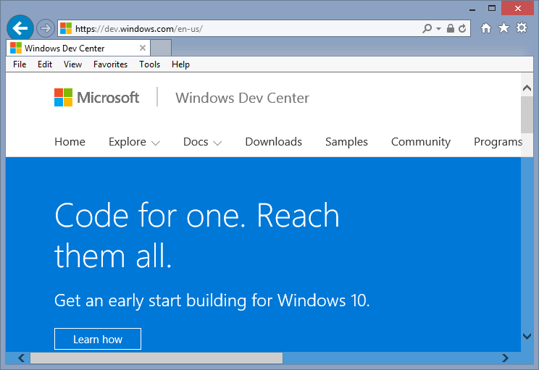
Start Here
http://dev.windows.com

Slide 4
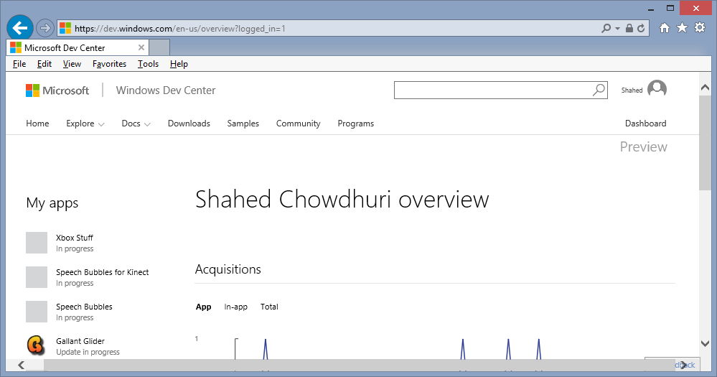
New Dashboard (Preview)
http://dev.windows.com/overview

Slide 5
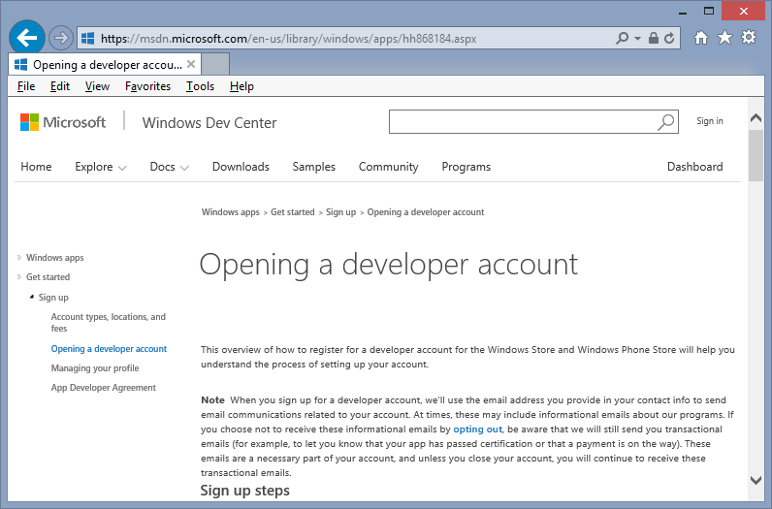
Open Developer Account
High-Level Steps
Sign Up
Choose Account Type
Submit Your Info
Instructions: https://msdn.microsoft.com/en-us/library/windows/apps/hh868184.aspx

Slide 6
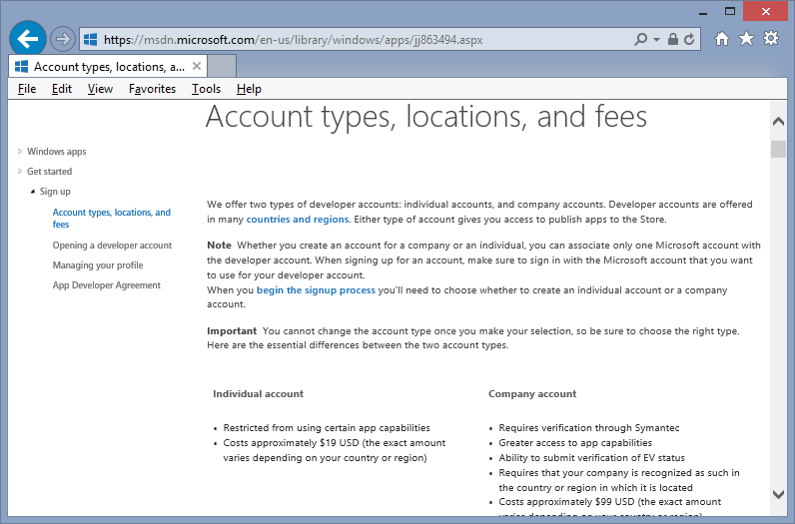
Account Types
Choose One:
Individual ($19)*
Company ($99)
* Free with BizSpark!
Details: https://msdn.microsoft.com/en-us/library/windows/apps/jj863494.aspx

Slide 7
Publishing Steps
Store Cert
Store Graphics
Package
Publish

Slide 8
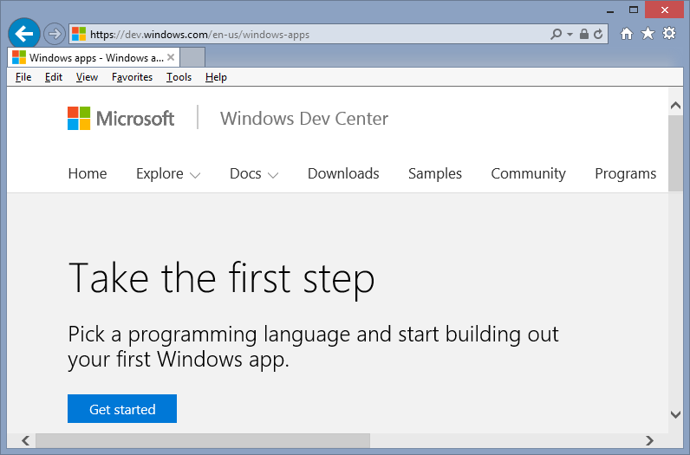
Windows App Development
https://dev.windows.com/windows-apps

Slide 9
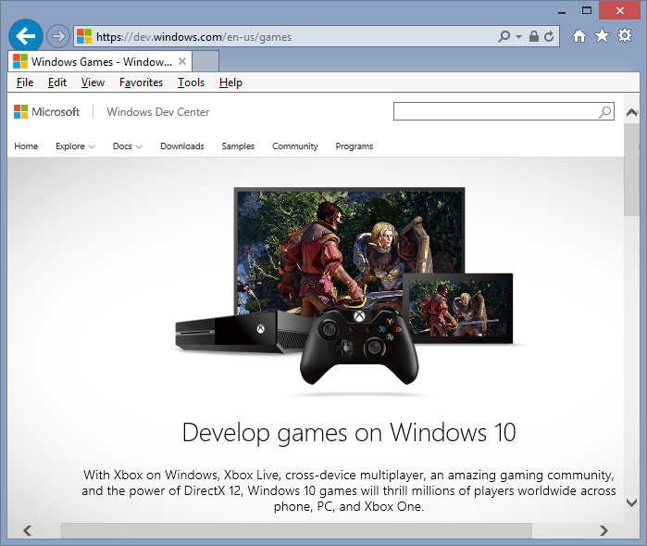
Windows Game Development
https://dev.windows.com/games
C++ and DirectX 12
HTML5 and JavaScript
C# and XAML
3rd-party tools
Universal Windows Platform
Desktops/laptops/tablets
Smartphones
Xbox One
HoloLens (coming soon!)

Slide 10
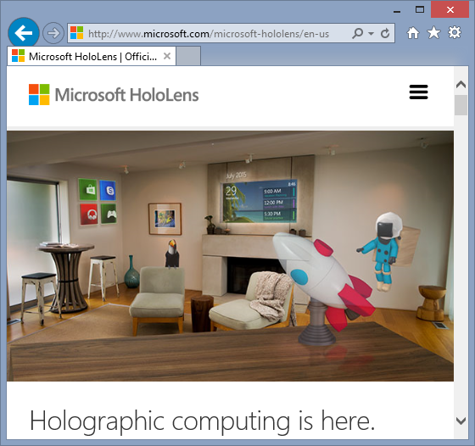
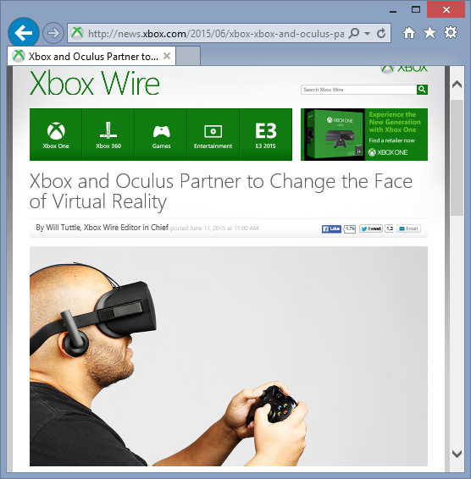
VR, AR & Mixed Reality
http://microsoft.com/microsoft-hololens
https://www.oculus.com

Slide 11
Xbox One!
Apply: http://xbox.com/id
Contact: id@xbox.com
Discuss: http://facebook.com/groups/XboxOneIndieDevs
Unofficial FAQ: http://tinyurl.com/idxboxfaq

Slide 12
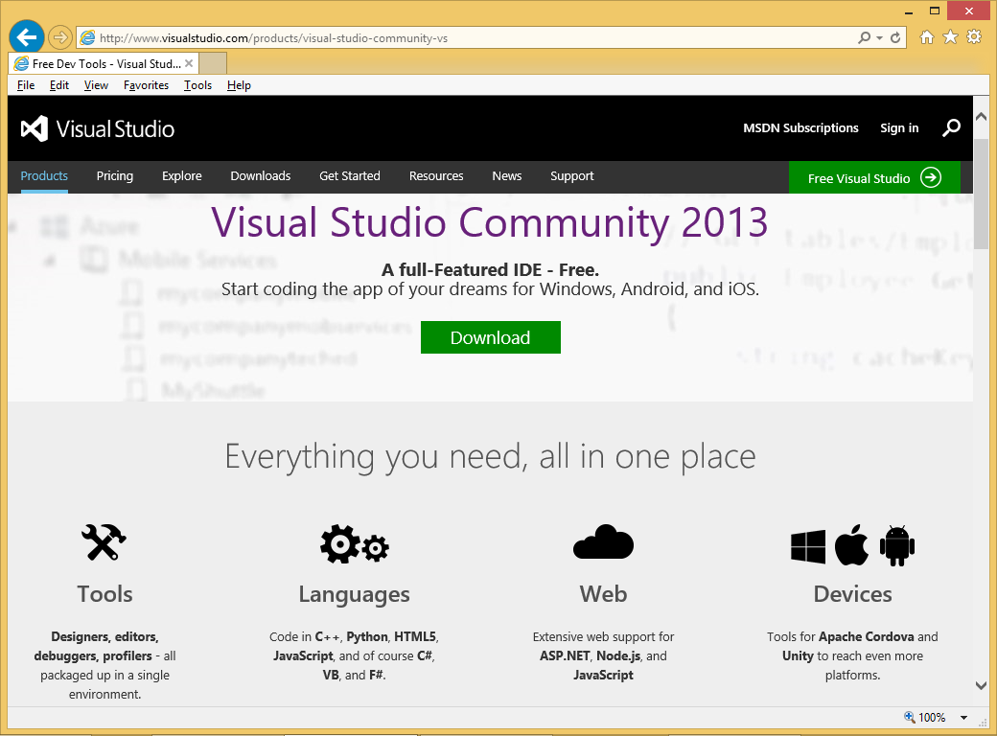
Visual Studio Community Edition
http://www.visualstudio.com/products/visual-studio-community-vs
VS 2013 CE (stable)
VS 2015 CE (RC)
Equivalent to Pro
Replaces Express
FREE!
Short URL:
http://aka.ms/vs2013ce

Slide 13
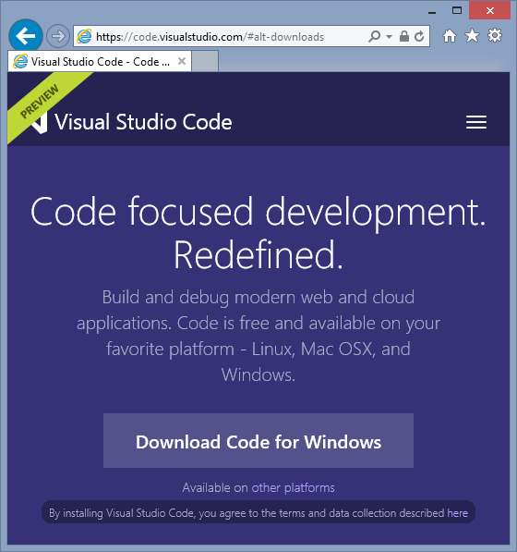
Visual Studio Code: Preview
Cross-platform
Lightweight editor
Windows, Linux, OS X
Intellisense
ASP.NET, NodeJS
Unity Development
Windows
Mac
Download: https://code.visualstudio.com/

Slide 14
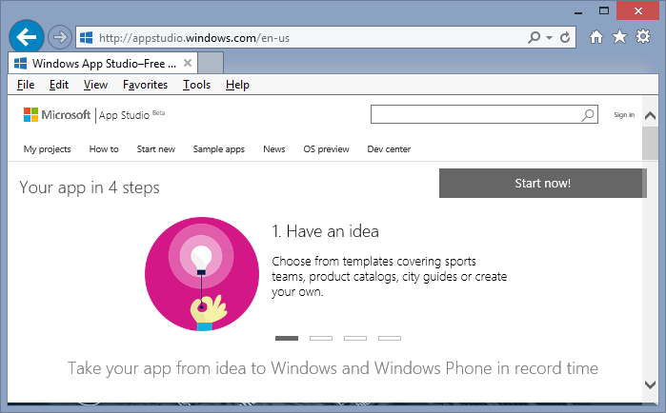
Windows App Studio
http://appstudio.windows.com
Notes:
App Studio
(website)
App Studio
Link: https://appstudio.windows.com/

Slide 15
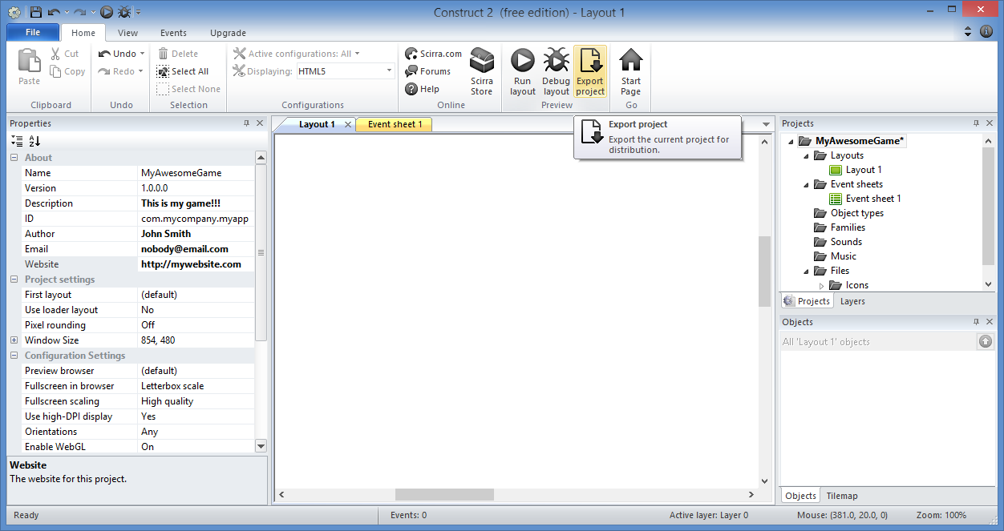
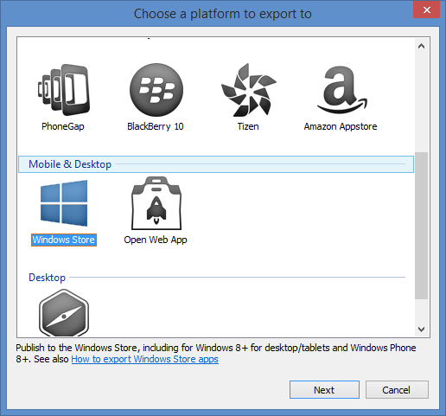
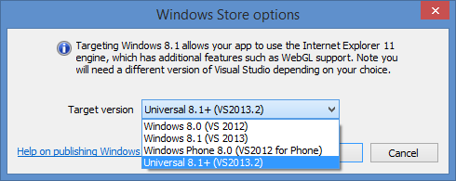
Construct 2, from Scirra
http://WakeUpAndCode.com/construct2
Notes:
Construct 2
(screenshot of Construct 2 UI for Exporting to Windows Universal format)
More information:
Index Page: http://WakeUpAndCode.com/construct2
Exporting & Publishing: http://wakeupandcode.com/construct-2-exporting-and-publishing-to-web-windows-8-and-windows-phone-8/

Slide 16
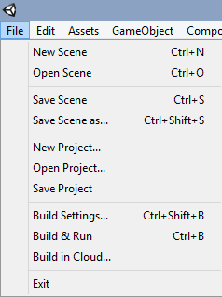
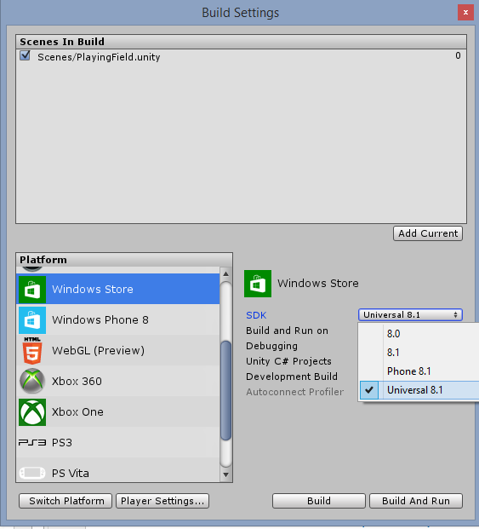
Unity
http://WakeUpAndCode.com/unity
Notes:
Unity
(screenshot of Unity for setting Build Settings to Windows Universal format)
More Information
Index Page: http://WakeUpAndCode.com/unity
Universal Apps in Unity: http://blogs.unity3d.com/2014/08/07/introducing-universal-windows-applications-in-unity/

Slide 17
Questions?
Notes:
Questions?

Slide 18
Contact
Email: shchowd@microsoft.com  Twitter: @shahedC
Notes:
Contact
Microsoft email: shchowd@microsoft.com
Personal Twitter: @shahedC
Dev Blog: WakeUpAndCode.com

