Slide 1
Deploy Your Web Site/App on Azure
… using Visual Studio, GitHub, FTP and more!
By Shahed Chowdhuri
Sr. Technical Evangelist
WakeUpAndCode.com
@shahedC
Notes:
Title Page: ASP .NET 5 (aka vNext) The Future of Web Apps
By Shahed Chowdhuri
Senior Technical Evangelist @ Microsoft
Blog: WakeUpAndCode.com
Twitter: @shahedC

Slide 2
Introduction
Notes:
Introduction

Slide 3
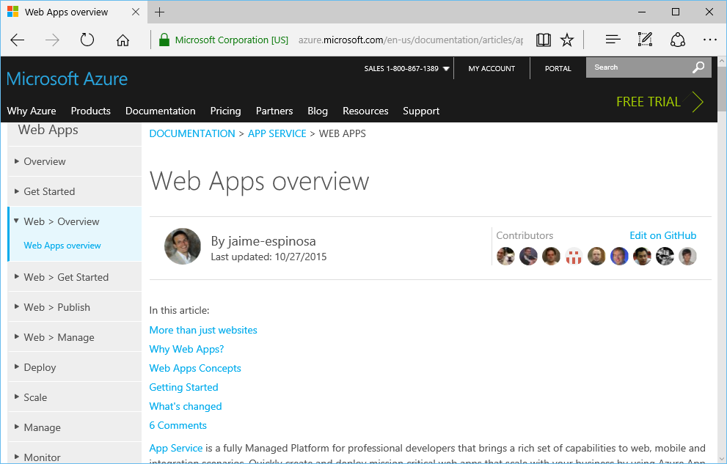
Create a Web Site/App
.NET
Java
PHP
Python
HTML/JS/CSS
etc
https://azure.microsoft.com/en-us/documentation/articles/app-service-web-overview/

Slide 4
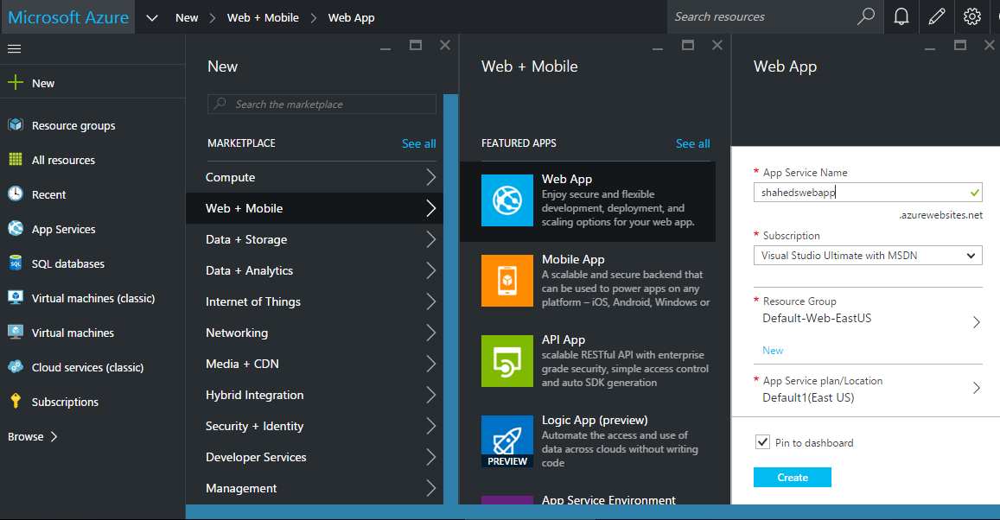
Demo: Web App

Slide 5
Visual Studio
Notes:
Introduction

Slide 6
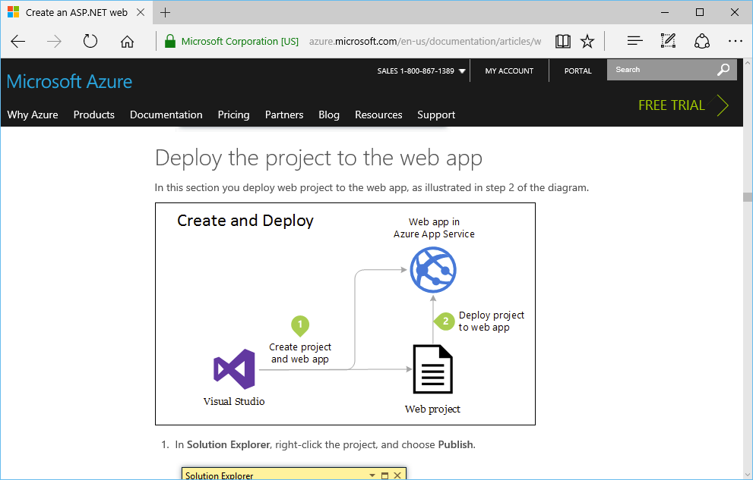
Publish from Visual Studio
https://azure.microsoft.com/en-us/documentation/articles/web-sites-dotnet-get-started
/#deploy-the-project-to-the-web-app

Slide 7
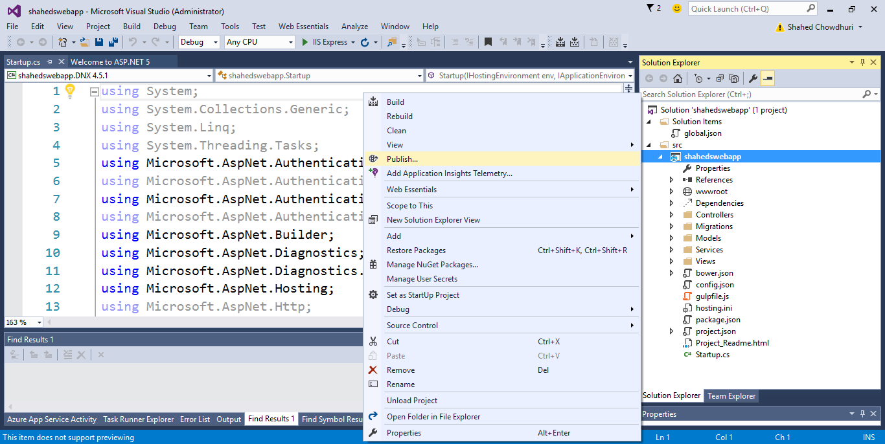
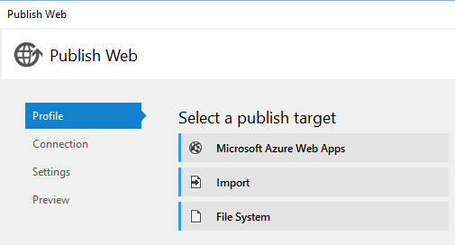
Demo: Publish from Visual Studio

Slide 8
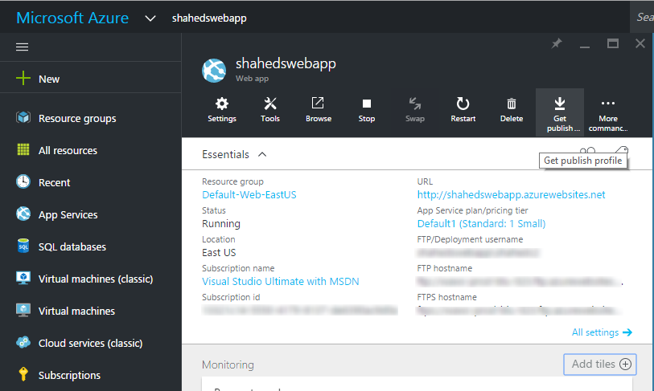
Publish Profile: Export from Azure

Slide 9
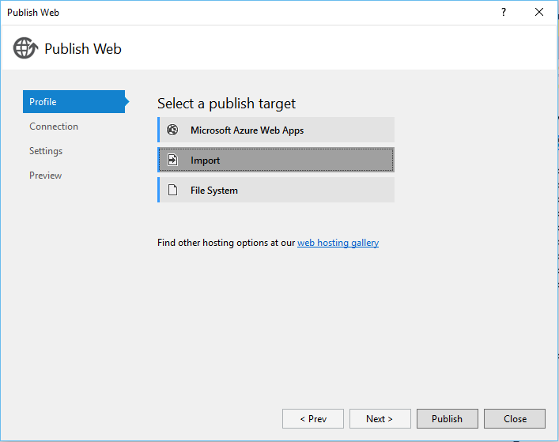
Publish Profile: Import into Visual Studio

Slide 10
Git & GitHub
Notes:
Introduction

Slide 11
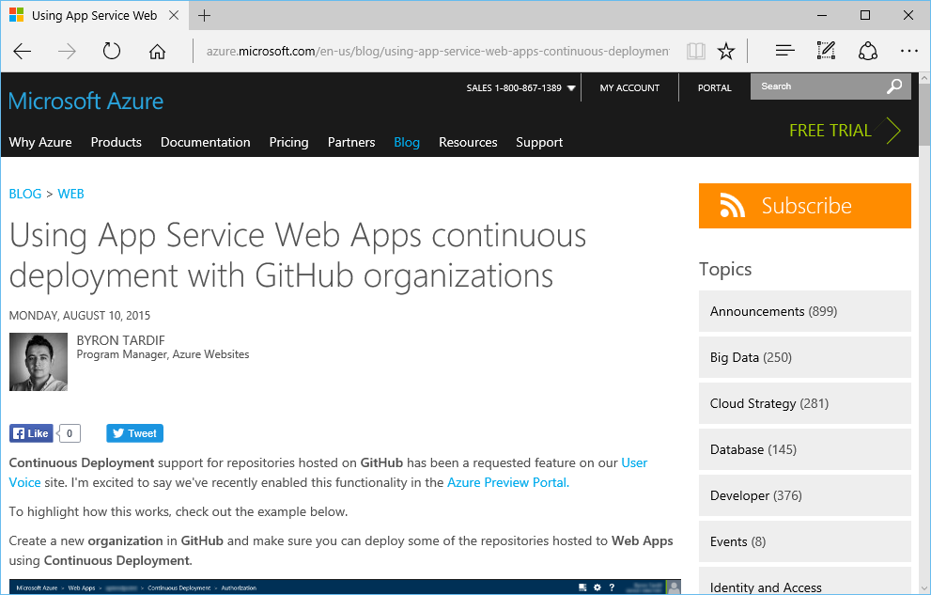
GitHub Sync
https://azure.microsoft.com/en-us/blog/using-app-service-web-apps-continuous-deployment-with-github-organizations/

Slide 12
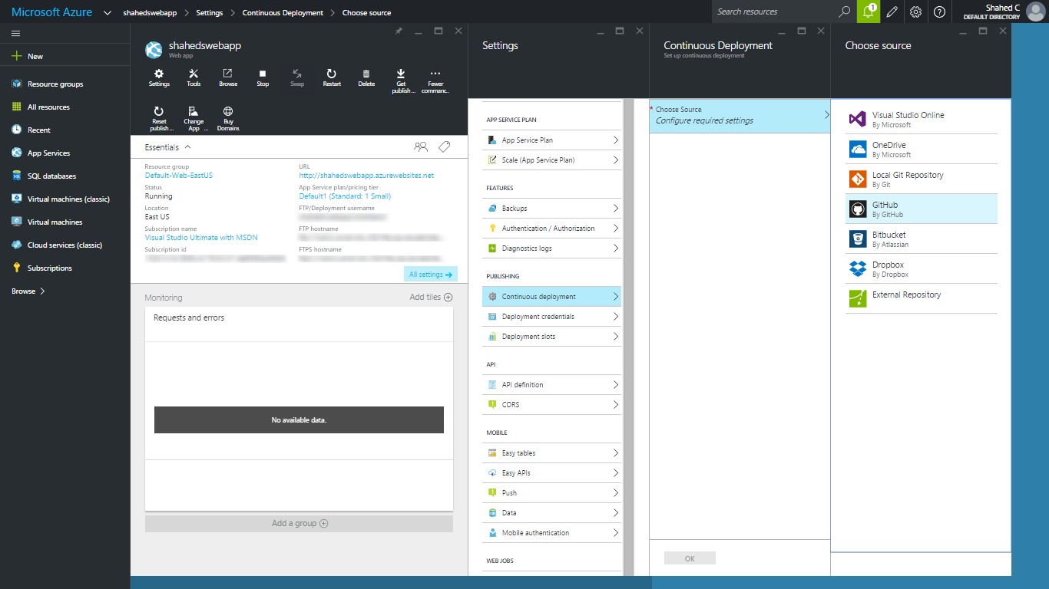
Demo: GitHub Sync

Slide 13
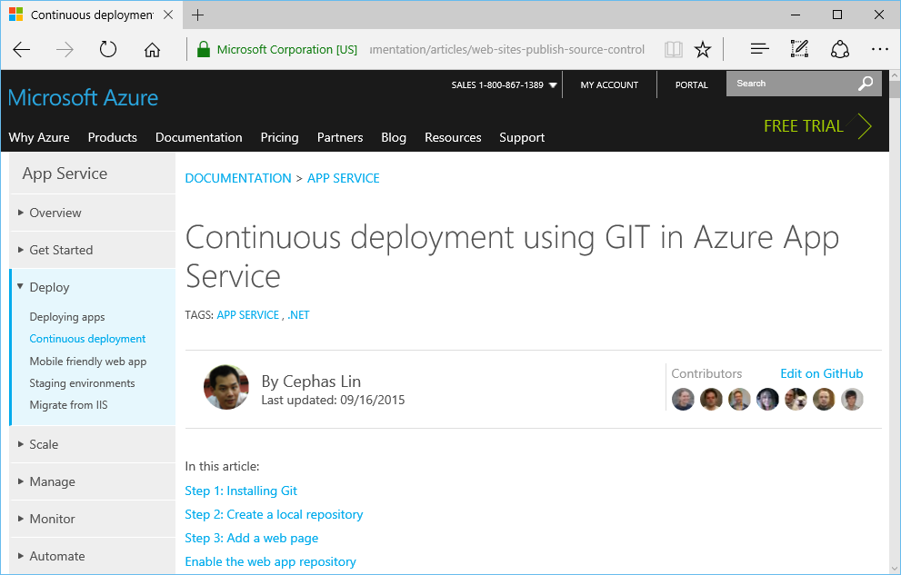
Git Push
https://azure.microsoft.com/en-us/documentation/articles/web-sites-publish-source-control/

Slide 14
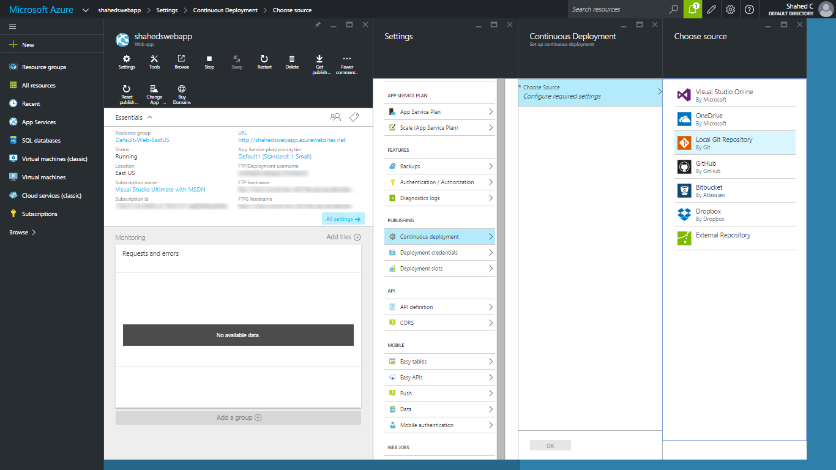
Demo: Git Push

Slide 15
FTP
Notes:
Introduction

Slide 16
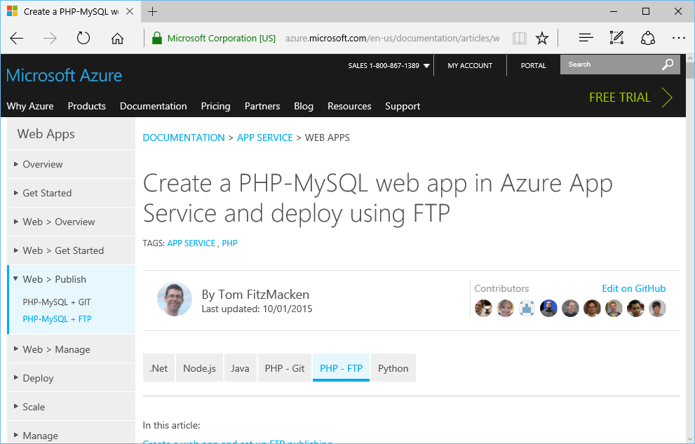
FTP
https://azure.microsoft.com/en-us/documentation/articles/web-sites-php-mysql-deploy-use-ftp/

Slide 17
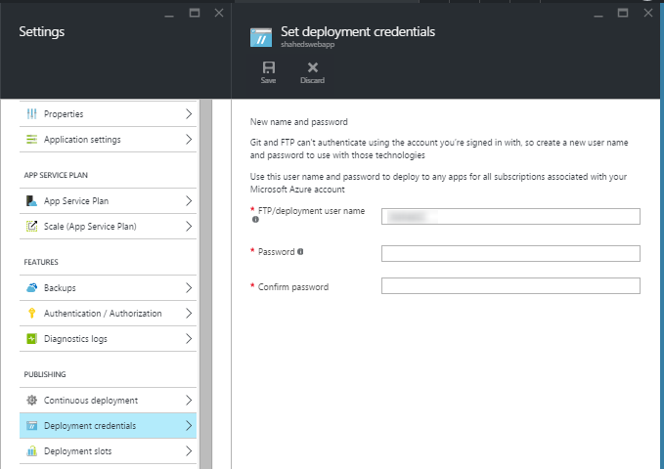
Demo: FTP

Slide 18
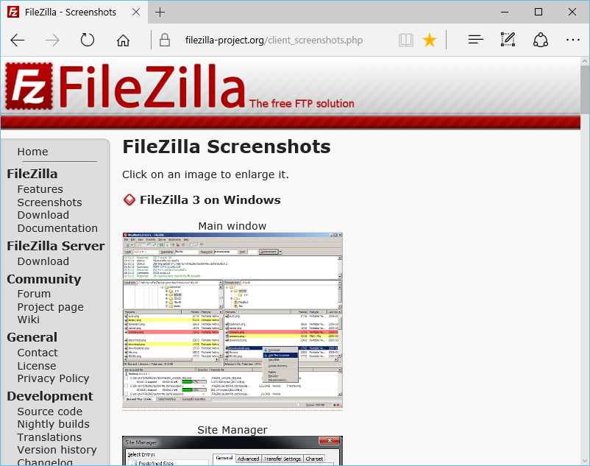
FTP Client for Windows, Mac, Linux
https://filezilla-project.org

