Slide 1
Intro to Construct 2 Game Development
Windows 8  Windows Phone 8  Web  Mobile  … and more!
By Shahed Chowdhuri
Sr. Technical Evangelist
WakeUpAndCode.com
@shahedC
Notes:
Title Page: Intro to Indie Game Development Windows  Web  Xbox  Mobile
By Shahed Chowdhuri
Technical Evangelist
Blog: WakeUpAndCode.com
Twitter: @shahedC

Slide 2
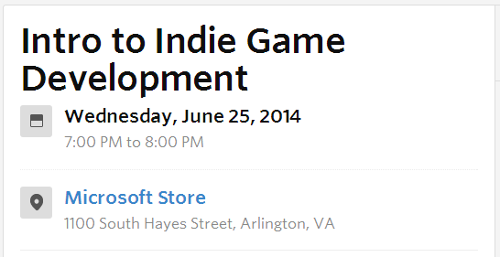
Events & Contests
URL: http://aka.ms/BAMWashDC
URL: http://aka.ms/BAMPhilly
(select Windows 8 for platform!)
BAM! Best App a Month for June 2014
URL: http://tinyurl.com/msdcmeetup
Notes:
Events & Contests
BAM! Contest: http://aka.ms/BAMWashDC
Intro to Indie Game Development: http://tinyurl.com/msdcmeetup

Slide 3
Agenda
Intro
> Construct 2 Basics
> Characters and Objects
> Bringing It All Together
Wrap-Up
Notes:
Agenda
Intro
> Construct 2 Basics
> Characters and Objects
> Bringing It All Together
Wrap-Up

Slide 4
My Background
Period | Background/Experience
1997 – present | Microsoft web/software development
2011 | XNA games on XBLIG 2D Math Panic Angry Zombie Ninja Cats
2012 | Tools for XNA developers XBLIG Sales Data Analyzer (OnekSoftLabs.com) XNA Basic Starter Kit (CodePlex)
Online: http://facebook.com/OnekSoftGames
Notes:
My Background
1997 – present: Microsoft web/software development
2011: XNA games on XBLIG
2D Math Panic
Angry Zombie Ninja Cats
2012: Tools for XNA developers
XBLIG Sales Data Analyzer (OnekSoftLabs.com)
XNA Basic Starter Kit (CodePlex)
Online: http://facebook.com/OnekSoftGames

Slide 5
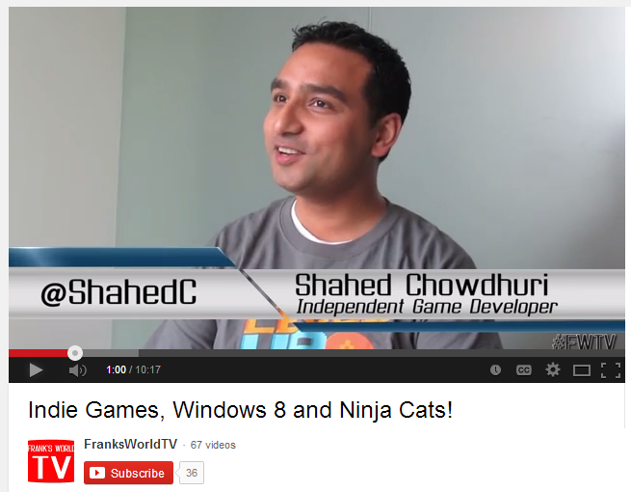
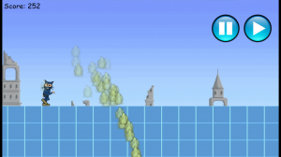
My Background (continued)
Period | Background/Experience
2013 | Ninja Cat Runner on Win8, WP8, Web (Construct2) Video Q&A with MS Tech Evangelist Frank La Vigne Founder/Admin of FB groups: Construct 2, Xbox One & Unity Indie Devs Attended ID@Seattle, Microsoft’s ID@Xbox summit
2014 | Public Speaking on Indie Game Development Joined Microsoft as a Technical Evangelist Attended ID@Chicago
Video: http://youtu.be/lRjrQPvVOpo
Notes:
My Background (continued) 2013
Ninja Cat Runner on Win8, WP8, Web (Construct2)
Video Q&A with MS Tech Evangelist Frank La Vigne
Founder/Admin of FB groups: Construct 2, Xbox One & Unity Indie Devs
Attended ID@Seattle, Microsoft’s ID@Xbox summit
2014
Public Speaking on Indie Game Development
Joined Microsoft as a Technical Evangelist
Attended ID@Chicago
Video: http://youtu.be/lRjrQPvVOpo

Slide 6
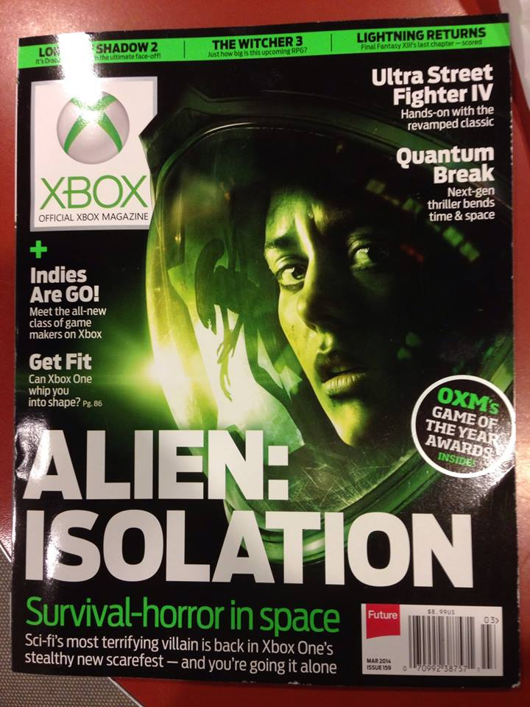
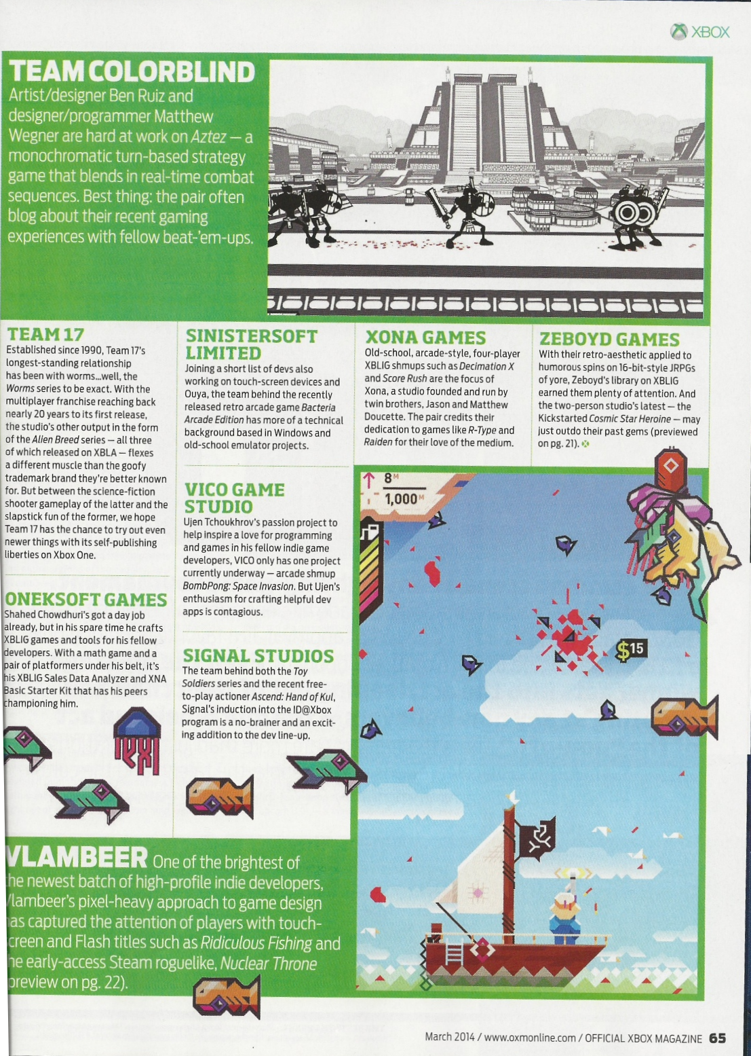
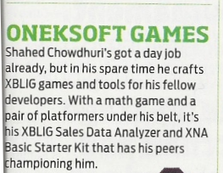
Official Xbox Magazine
`
Source: Official Xbox Magazine, March 2014, Page 65
Notes:
Official Xbox Magazine, March 2014, Page 65
"Shahed Chowdhuri's got a day job already,
but in his spare time he crafts XBLIG games and tools for his fellow developers.”
“With a math game and a pair of platformers under his belt,
it's his XBLIG Sales Data Analyzer and XNA Basic Starter Kit that has his peers championing him."

Slide 7
Tools & Technologies
Tip: Get free dev software via BizSpark!
http://aka.ms/dcmeetup201406  http://aka.ms/PhillyBizSpark
Notes:
Tools & Technologies
Visual Studio 2013
Windows 8
Windows Phone 8
Construct 2
HTML5
CSS3
JavaScript
Blender
Paint.net

Slide 8
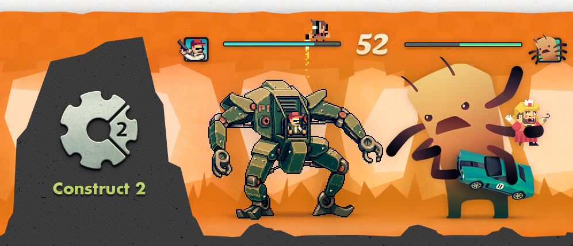
Construct 2
Source: https://www.scirra.com/construct2
Notes:
Construct 2
Source: https://www.scirra.com/construct2

Slide 9
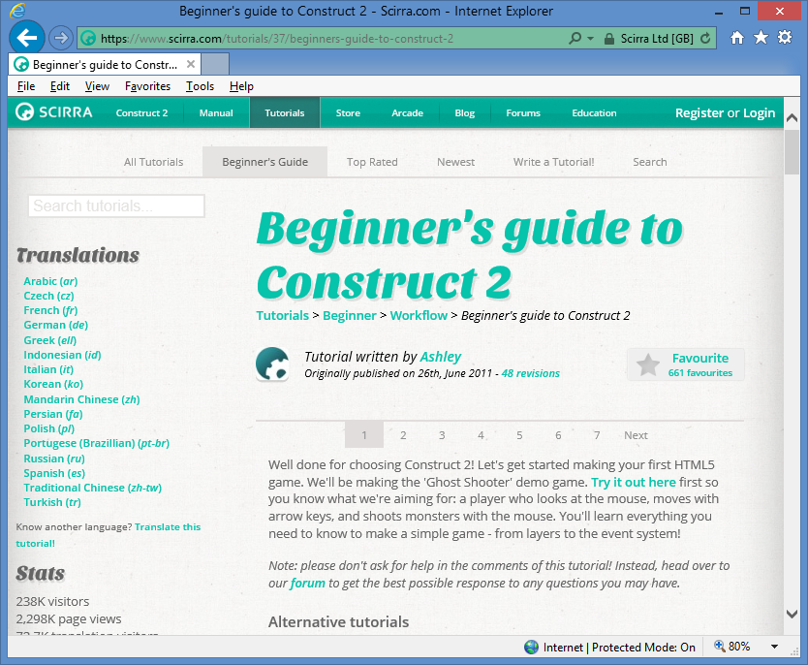
How This Presentation Was Put Together
Concepts
Step-by-Step Screenshots, Grouped into Concepts
Steps
Derived from Beginner's Guide to Construct 2 originally published by Ashley
Get pptx file and images from: http://WakeUpAndCode.com/downloads
Notes:
Construct 2
Source: https://www.scirra.com/tutorials/37/beginners-guide-to-construct-2

Slide 10
Construct 2 Concepts
Going Multiplatform
Tiled Backgrounds
Layers and Locks
Mouse and Keyboard Support
Sprites and Game Characters
Adding NPCs
Other Game Objects
Organizing Your Layout
Moving the Player
Adding Behaviors
Moving NPCs
Accepting User Input
Spawning Other Objects
Image Points
Collision Detection
Basic AI
Improved AI
Instance Variables
Affecting NPC Health
Global Variables
Adding a HUD
Displaying Text
Updating the HUD
Spawning NPCs
Destroying the Player

Slide 11
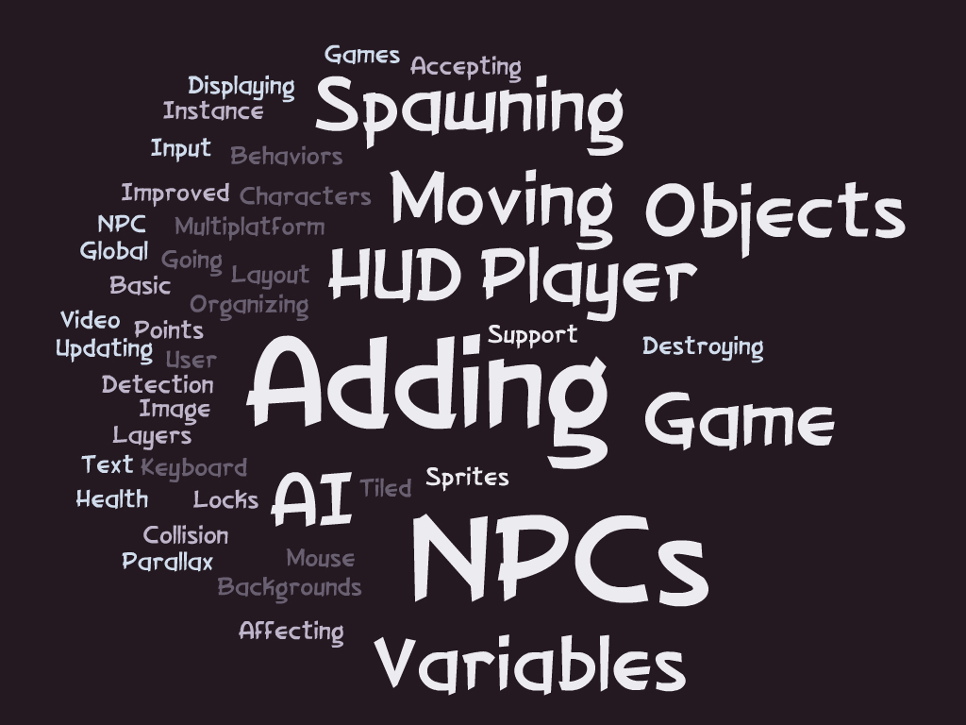

Slide 12
Construct 2 Basics

Slide 13
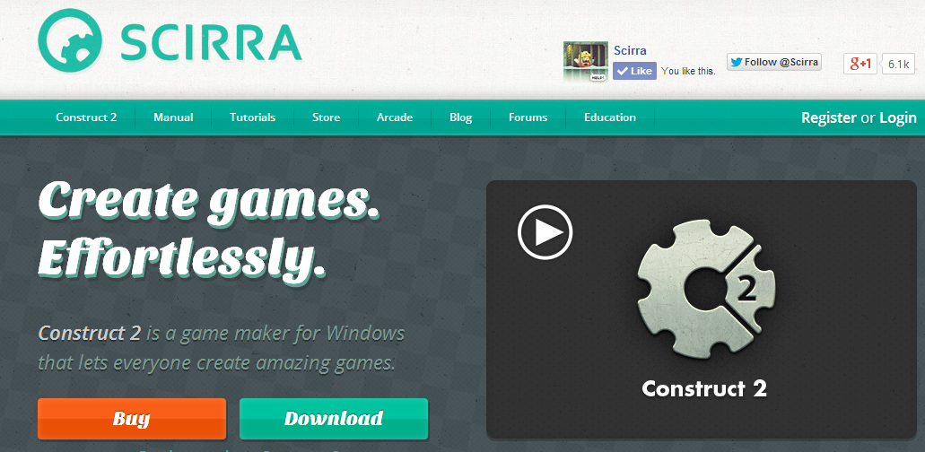
Getting Started: Step 1
Download!
https://www.scirra.com/

Slide 14
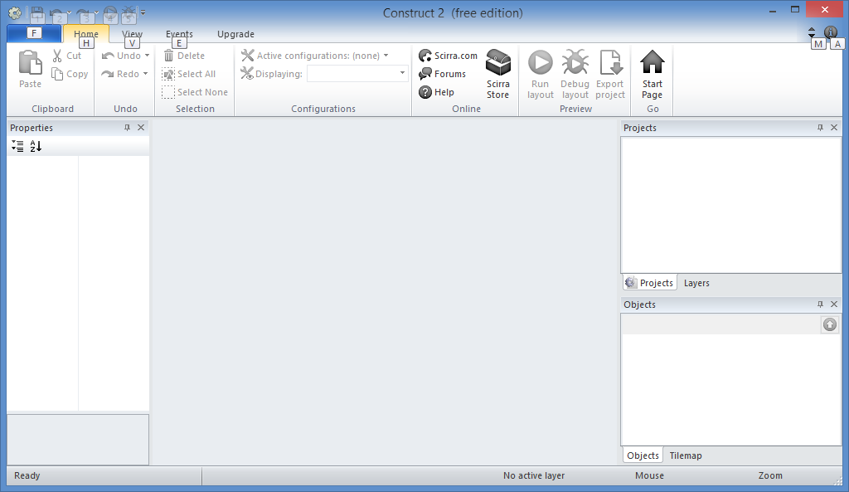
Getting Started: Step 2
Run it!

Slide 15
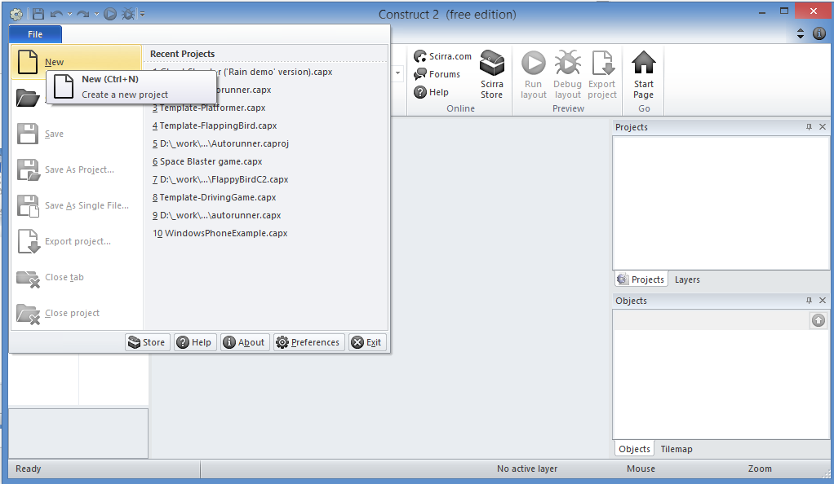
Getting Started: Step 3
Click
File → New

Slide 16
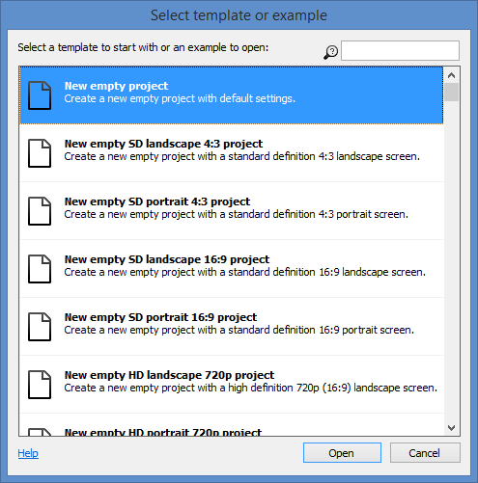
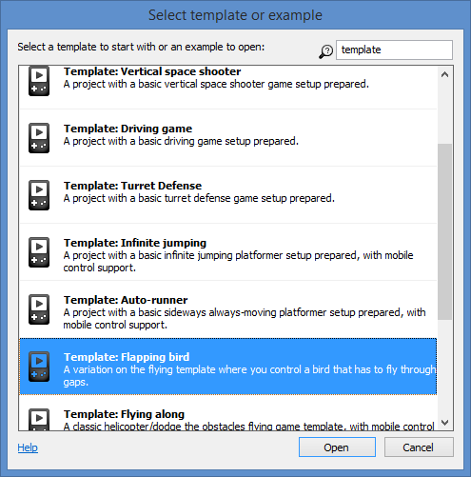
Getting Started: Step 4
Filter
Scroll
Up
Or
Down
Open!

Slide 17
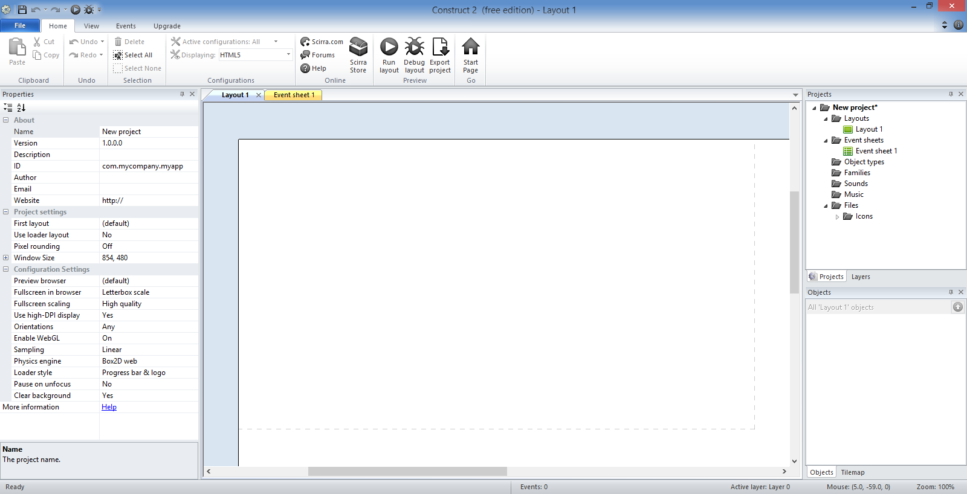
Getting Started: Step 5
Toolbar
Projects/Layers
Tabs for Layouts & Event Sheets
Properties
Layout
Objects

Slide 18
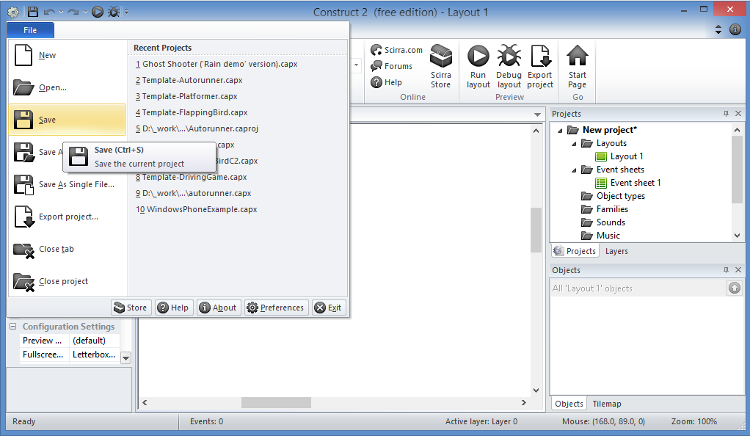
Getting Started: Step 6
Click
File → Save

Slide 19
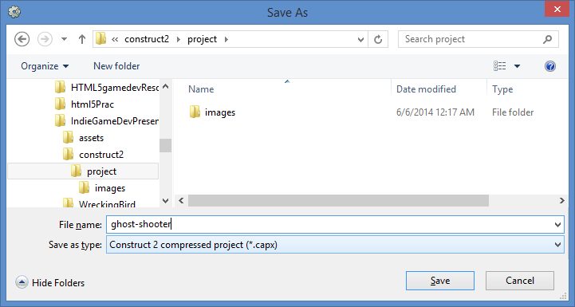
Getting Started: Step 7
Enter
File name
Save!

Slide 20
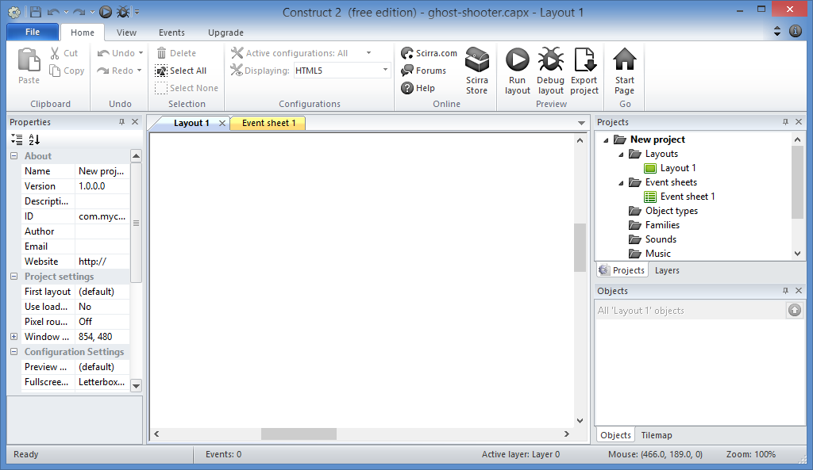
Getting Started: Done!

Slide 21
1. Going Multiplatform

Slide 22
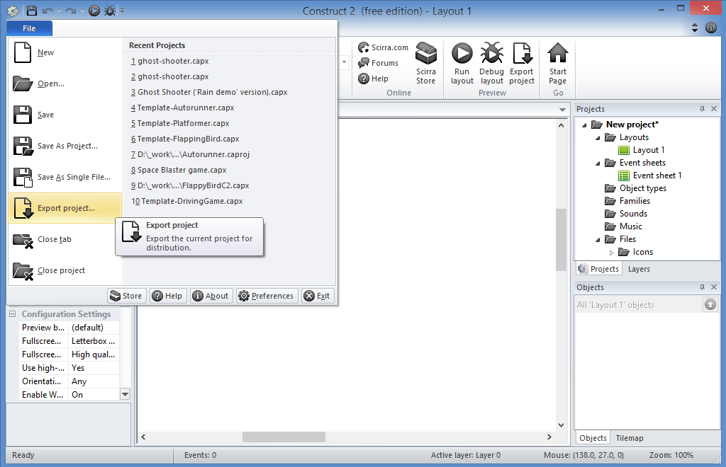
Export Project: Step 1
Click
File → Export project…

Slide 23
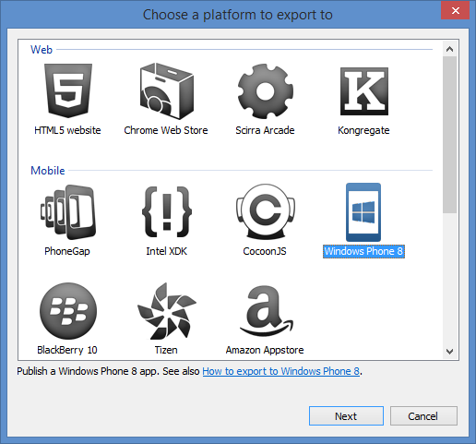
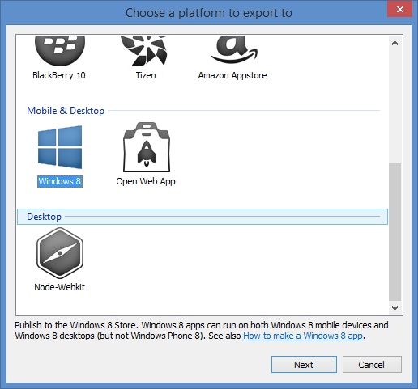
Export Project: Step 2
Choose a platform…
Notes:
Construct 2: Export
Multiplatform Support
Web (HTML5 website, etc)
Mobile (PhoneGap, WP8, etc)
Desktop (Windows 8)

Slide 24
Export Project: Step 3
Publish anywhere…
Notes:
Construct 2 publishing
HTML5 website -> web server
Scirra Arcade
WP8 or Windows 8
PhoneGap -> iOS or Android

Slide 25
2. Tiled Backgrounds

Slide 26
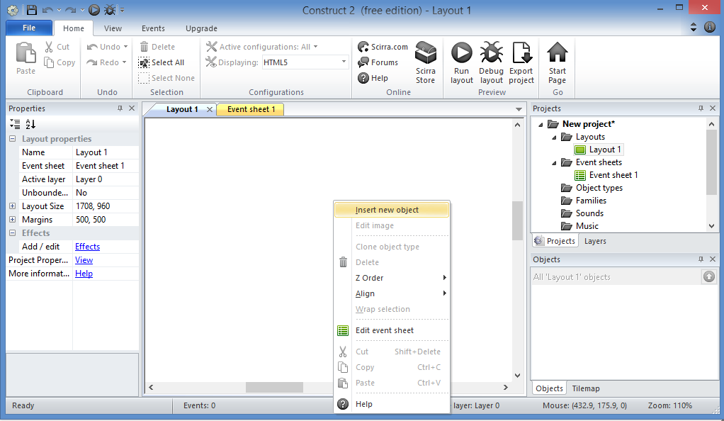
Add a Tiled Background: Step 1
Right-Click
Inside Layout

Slide 27
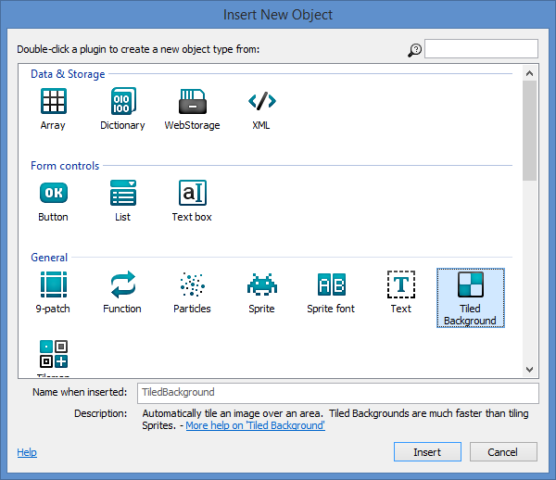
Add a Tiled Background: Step 2
Select
“Tiled Background”
then
Click Insert

Slide 28
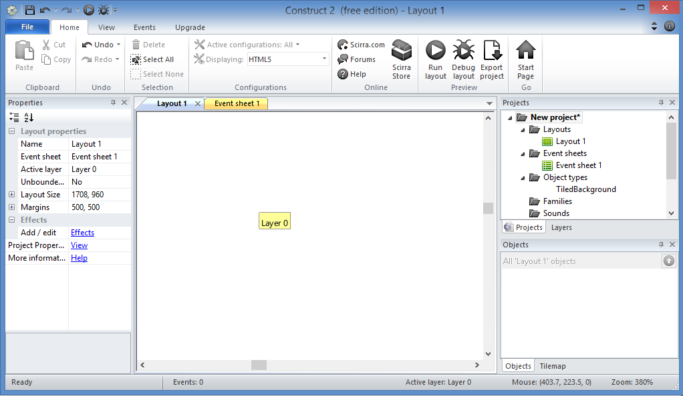
Add a Tiled Background: Step 3
Click inside
Layout

Slide 29
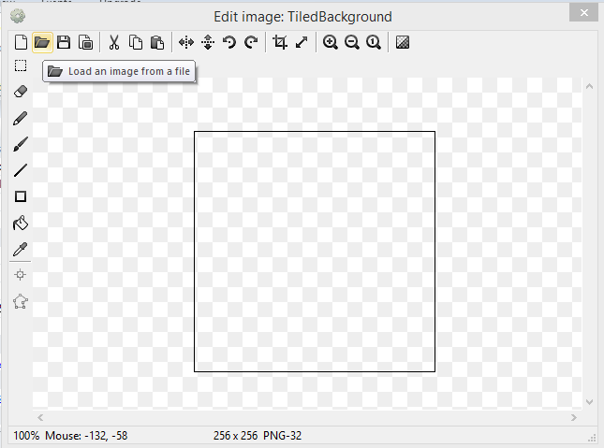
Add a Tiled Background: Step 4
Click
Open
icon
to load an image

Slide 30
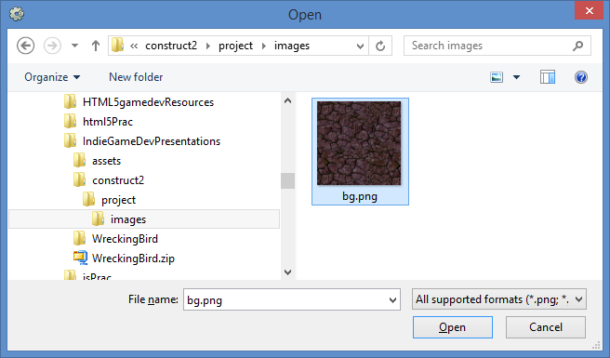
Add a Tiled Background: Step 5
Select
bg.png from the
images folder
Open!
NOTE: this may look different on your computer

Slide 31
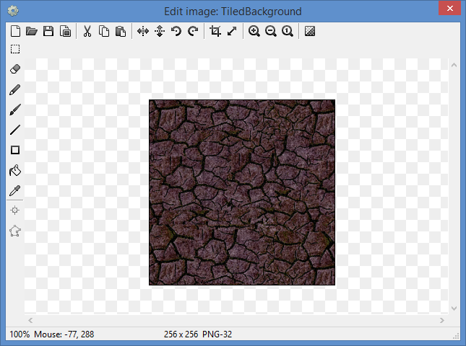
Add a Tiled Background: Step 6
Close this
popup window

Slide 32
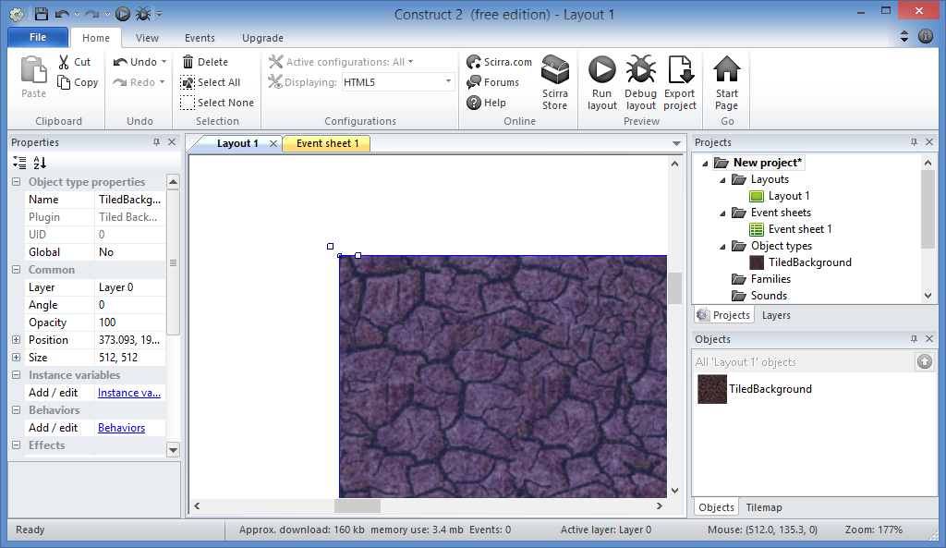
Add a Tiled Background: Step 7
Notice the extra space?

Slide 33
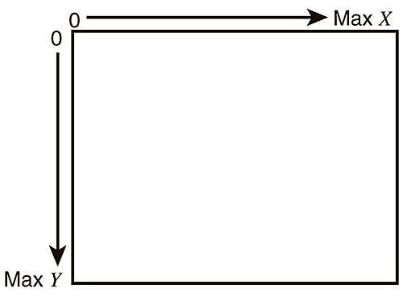
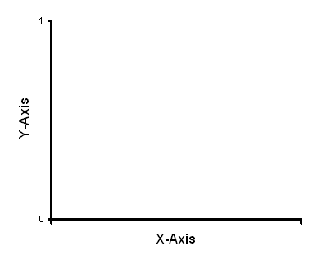
BUT FIRST… KNOW YOUR X and Y!
Graphs in Math class
Graphs in Computer Graphics

Slide 34
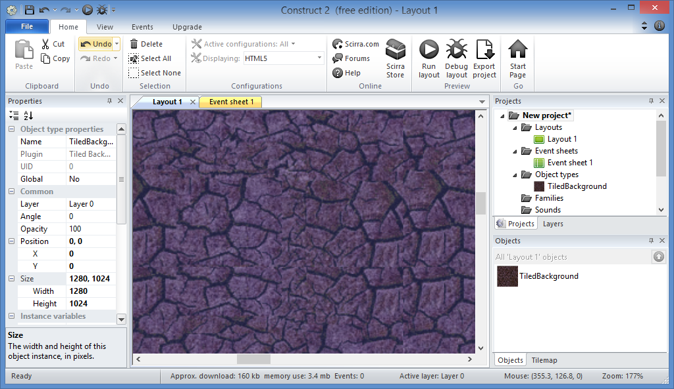
Add a Tiled Background: Step 8
Update:
Position:
X = 0
Y = 0
Size:
Width = 1280
Height = 1024

Slide 35
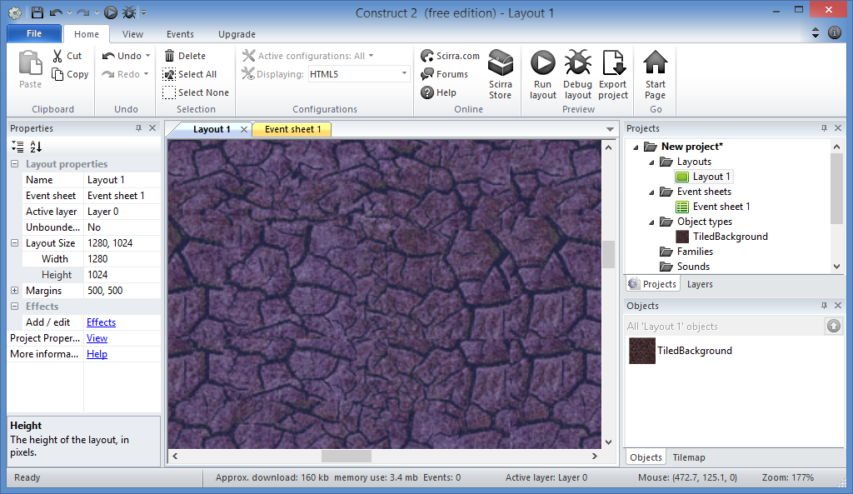
Add a Tiled Background: Step 9
Select Layout 1
Update:
Size:
Width = 1280
Height = 1024

Slide 36
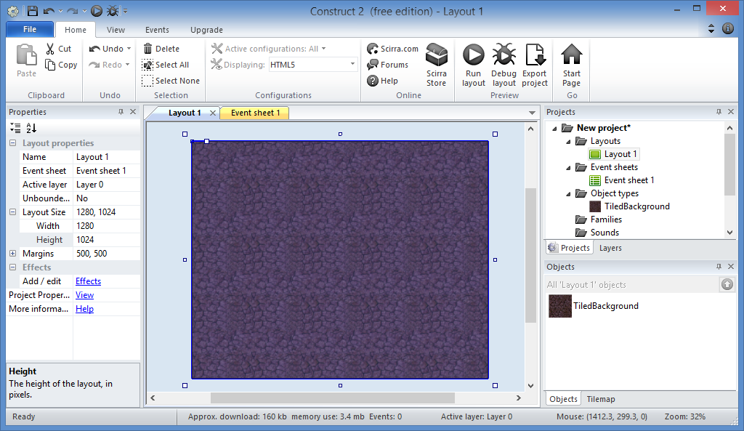
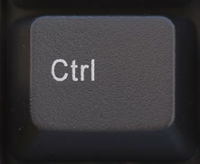
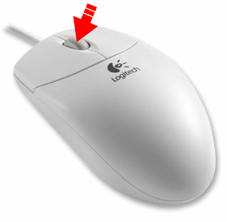
Add a Tiled Background: Step 10
Zoom Out:
Ctrl + Scroll

Slide 37
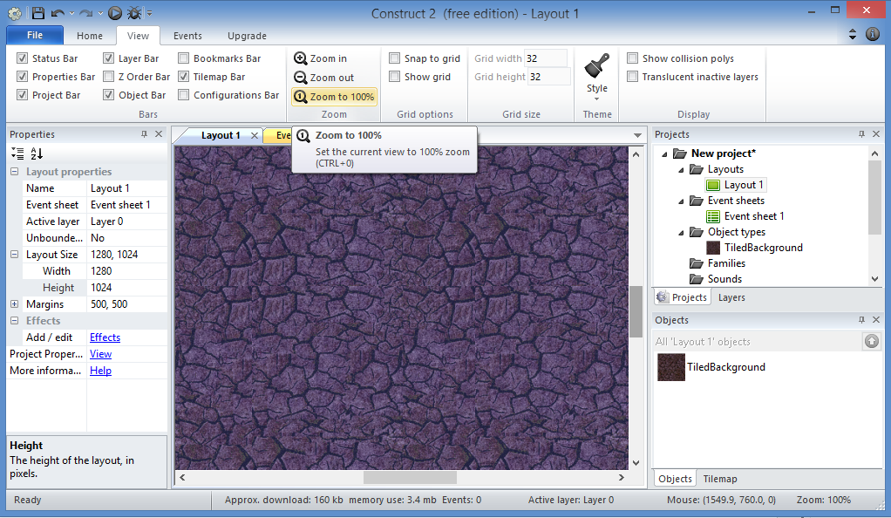
Add a Tiled Background: Step 11
Zoom To 100%:
Ctrl + 0 (zero)

Slide 38
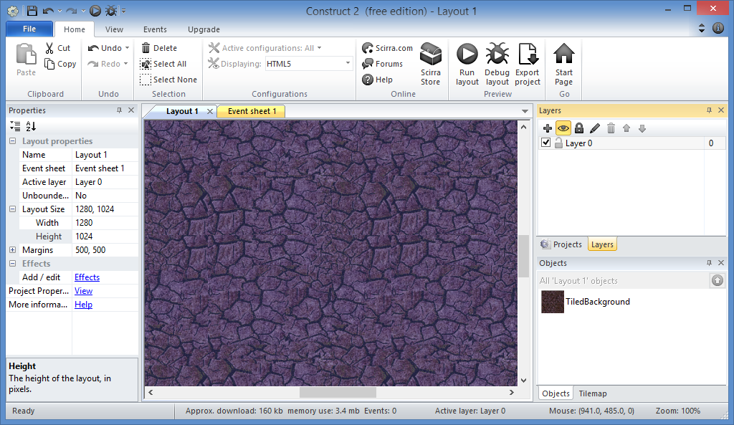
Add a Tiled Background: Done!

Slide 39
3.Layers and Locks

Slide 40
Add Layers: Step 1
Click the
Layers tab

Slide 41
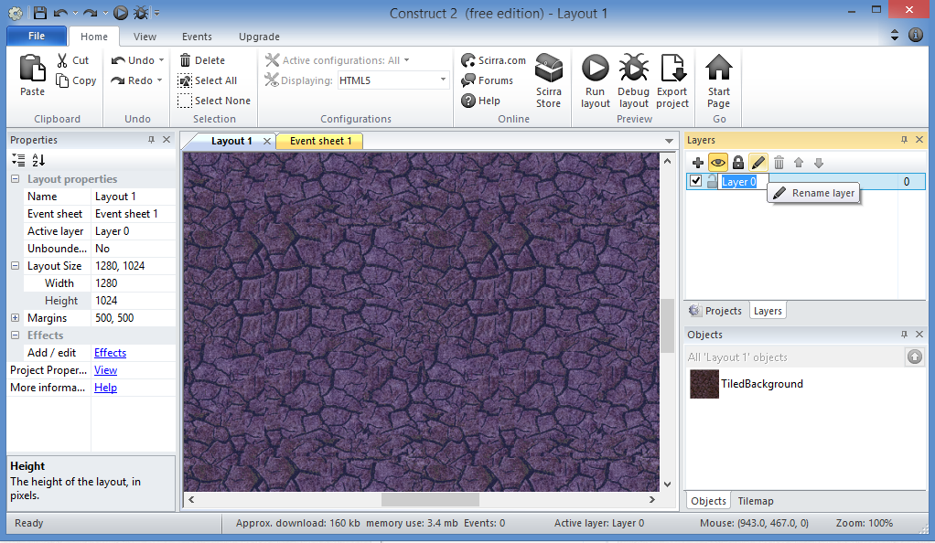
Add Layers: Step 2
Click the
Edit icon
(pencil)
to
rename
Layer 0

Slide 42
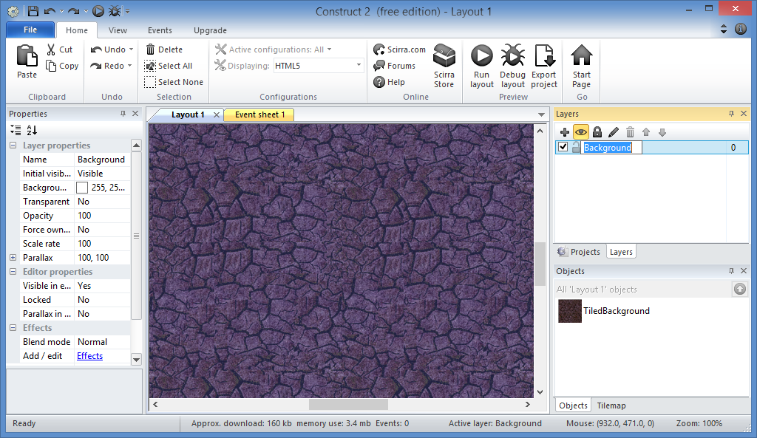
Add Layers: Step 3
Enter
“Background”

Slide 43
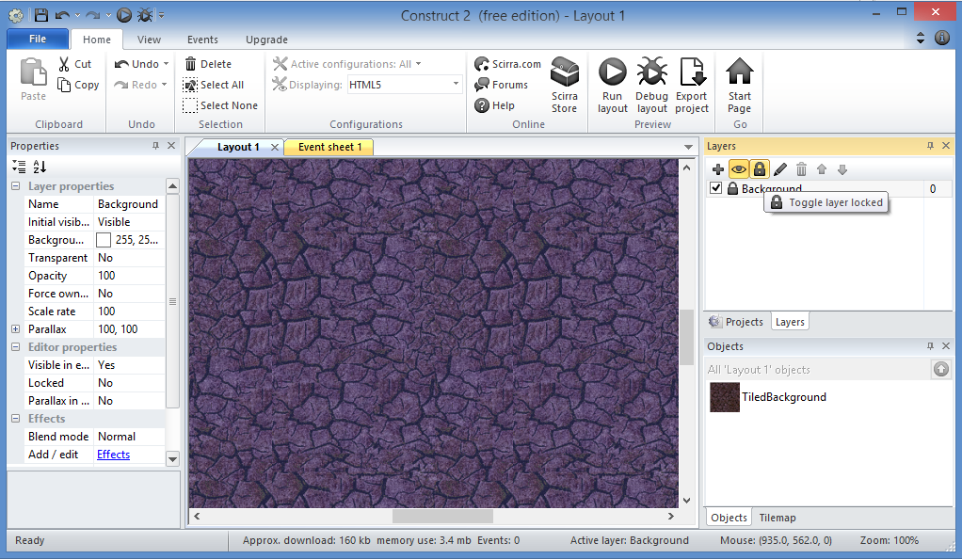
Add Layers: Step 4
Lock it!
(lock symbol)

Slide 44
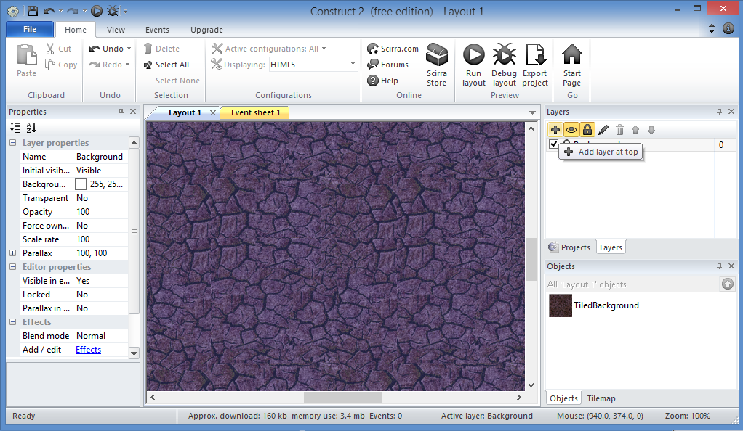
Add Layers: Step 5
Add a
new layer
(plus sign)

Slide 45
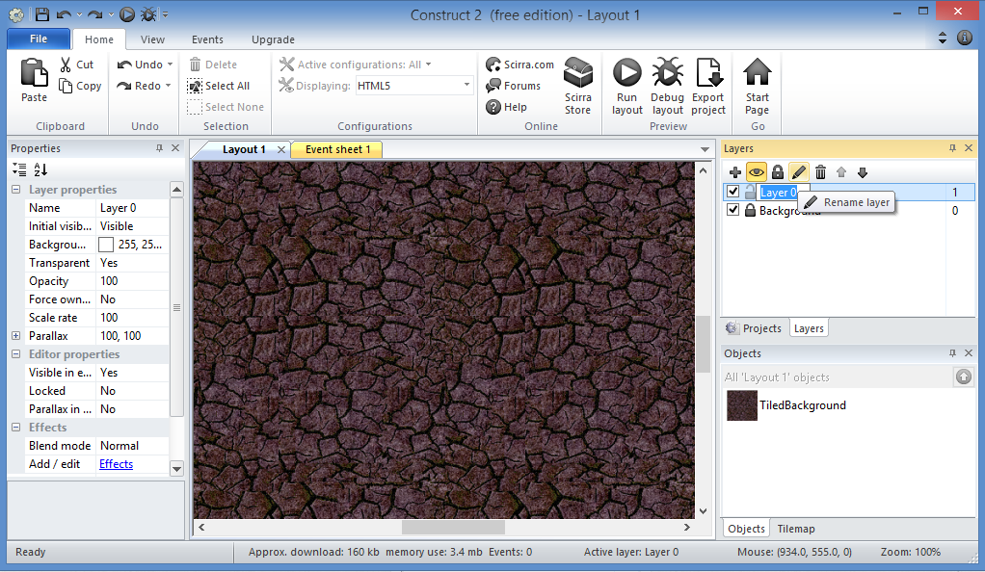
Add Layers: Step 6
Click the
Edit icon
(pencil)
to
rename
new layer

Slide 46
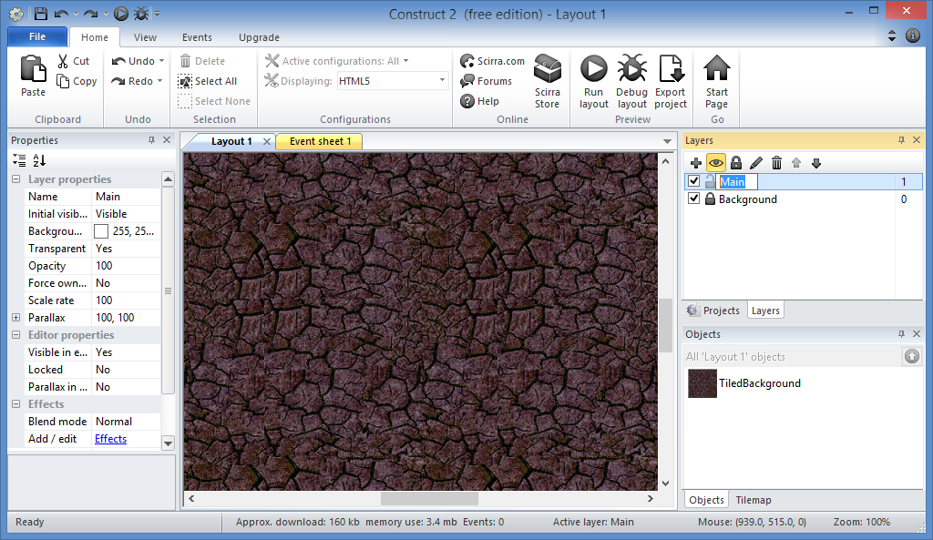
Add Layers: Step 7
Enter
“Main”

Slide 47
Add Layers: Done!

Slide 48
4. Mouse and Keyboard Support

Slide 49
Add Hidden Objects: Step 1
Make sure
Main layer
is selected

Slide 50
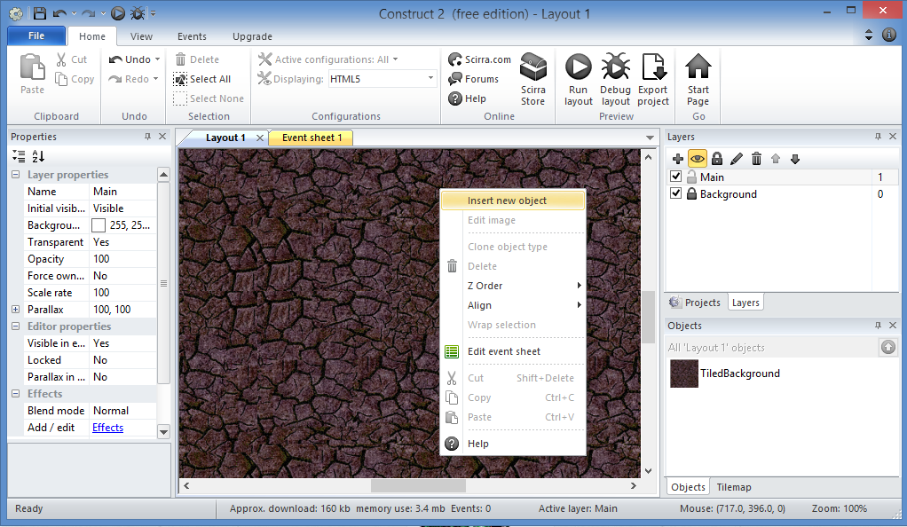
Add Hidden Objects: Step 2
Right-click to
insert new object

Slide 51
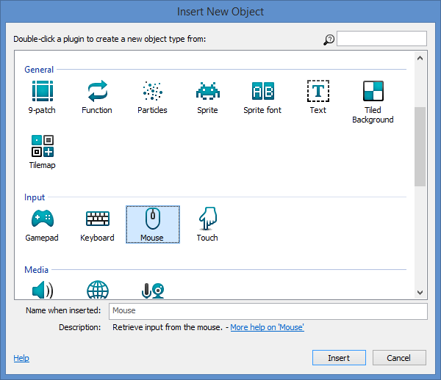
Add Hidden Objects: Step 3
Select
“Mouse”
then
Click Insert

Slide 52
Add Hidden Objects: Step 4
Right-click *again* to
insert another object

Slide 53
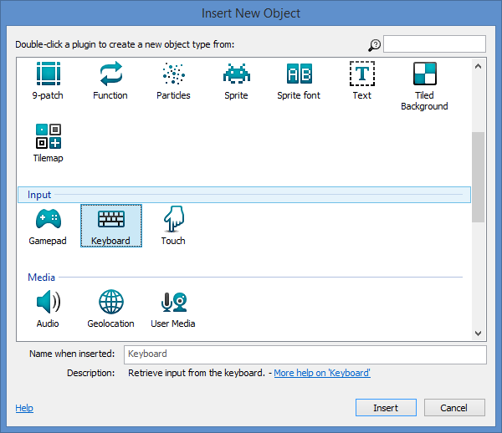
Add Hidden Objects: Step 5
Select
“Keyboard”
then
Click Insert

Slide 54
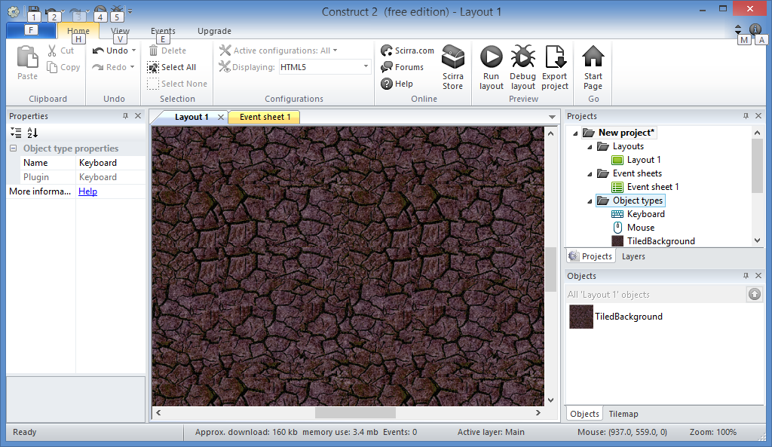
Add Hidden Objects: Done!
Notice
both
Keyboard
and
Mouse
here

Slide 55
5. Sprites and Game Characters

Slide 56
Add Player to Game: Step 1
Right-click to
insert new object

Slide 57
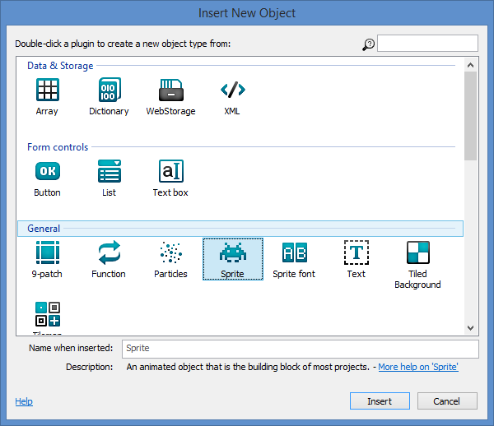
Add Player to Game: Step 2
Select
“Sprite”
then
Click Insert

Slide 58
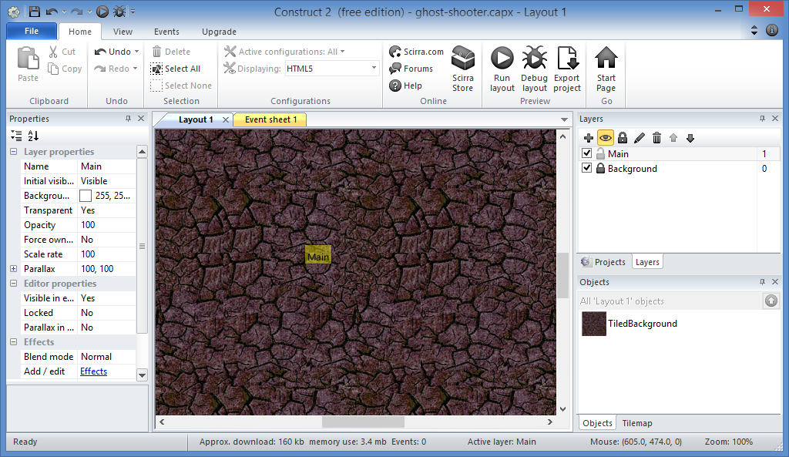
Add Player to Game: Step 3
Click inside
Layout

Slide 59
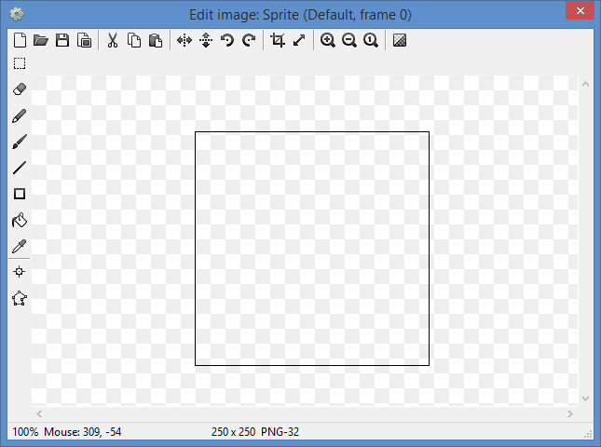
Add Player to Game: Step 4
Click
Open
icon
to load an image

Slide 60
Add Player to Game: Step 5
Select
player.png
from the
images folder
Open!
NOTE: this may look different on your computer

Slide 61
Add Player to Game: Step 6
Close this
popup window

Slide 62
Add Player to Game: Done!

Slide 63
6. Adding NPCs i.e. non-playable characters

Slide 64
Add Monster to Game: Step 1
Right-click to
insert new object

Slide 65
Add Monster to Game: Step 2
Select
“Sprite”
then
Click Insert

Slide 66
Add Monster to Game: Step 3
Click inside
Layout

Slide 67
Add Monster to Game: Step 4
Click
Open
icon
to load an image

Slide 68
Add Monster to Game: Step 5
Select
monster.png
from the
images folder
Open!
NOTE: this may look different on your computer

Slide 69
Add Monster to Game: Step 6
Close this
popup window

Slide 70
Add Monster to Game: Done!

Slide 71
7. Other Game Objects e.g. bullets and explosions

Slide 72
Add Objects to Game: Step 1
Right-click to
insert new object

Slide 73
Add Objects to Game: Step 2
Select
“Sprite”
then
Click Insert

Slide 74
Add Objects to Game: Step 3
Click inside Layout

Slide 75
Add Objects to Game: Step 4
Click
Open
icon
to load an image

Slide 76
Add Objects to Game: Step 5
Select
bullet.png
from the
images folder
Open!
NOTE: this may look different on your computer

Slide 77
Add Objects to Game: Step 6
Close this
popup window

Slide 78
Add Objects to Game: Step 7
Right-click to
insert new object

Slide 79
Add Objects to Game: Step 8
Select
“Sprite”
then
Click Insert

Slide 80
Add Objects to Game: Step 9
Click inside Layout

Slide 81
Add Objects to Game: Step 10
Click
Open
icon
to load an image

Slide 82
Add Objects to Game: Step 11
Select
explode.png
from the
images folder
Open!
NOTE: this may look different on your computer

Slide 83
Add Objects to Game: Step 12
Close this
popup window

Slide 84
Add Objects to Game: Done!

Slide 85
Bonus Step: Update Blend Mode
Change Blend Mode
to Additive

