Slide 1
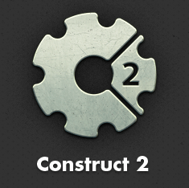
8. Organizing Your Layout

Slide 2
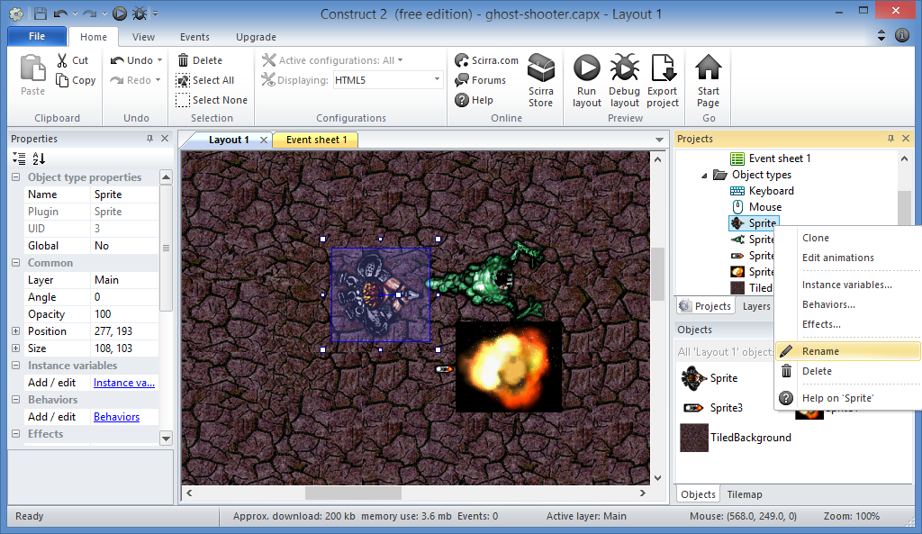
Organize Your Layout: Step 1
Right-click to
Rename
each sprite

Slide 3
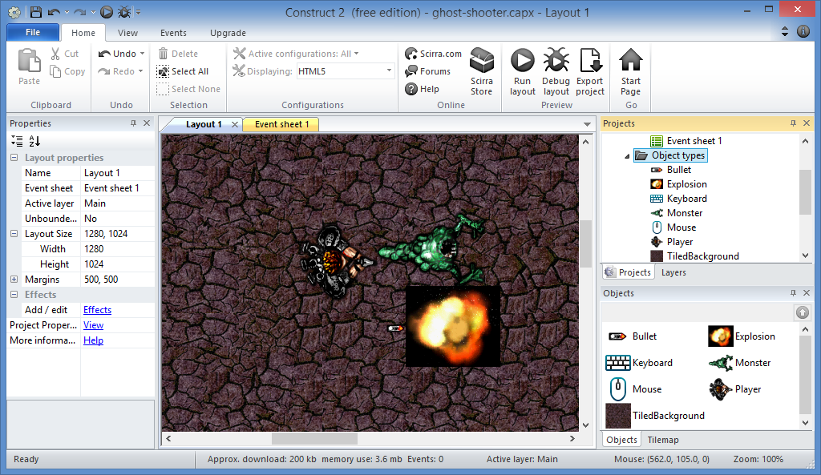
Organize Your Layout: Step 2
Name them:
Player
Monster
Bullet
Explosion

Slide 4
Bonus Step: Update Blend Mode
Change Blend Mode
to Additive

Slide 5
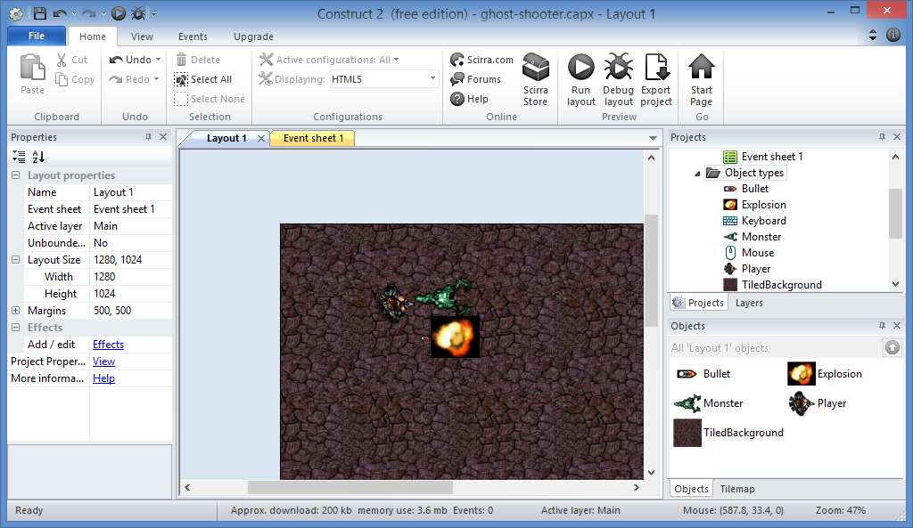
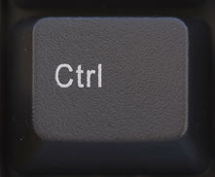
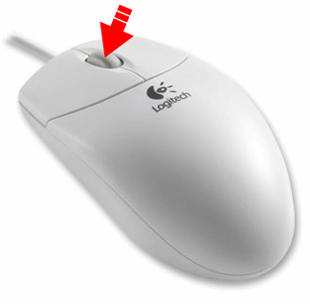
Organize Your Layout: Step 3
Zoom Out:
Ctrl + Scroll

Slide 6
Organize Your Layout: Step 4
Move the
bullet and
explosion
outside the
Layout

Slide 7
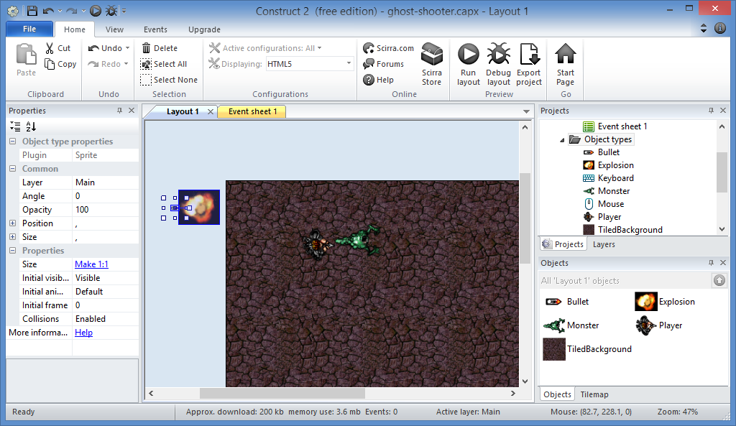
Organize Your Layout: Done! ☺

Slide 8
9. Moving the Player

Slide 9
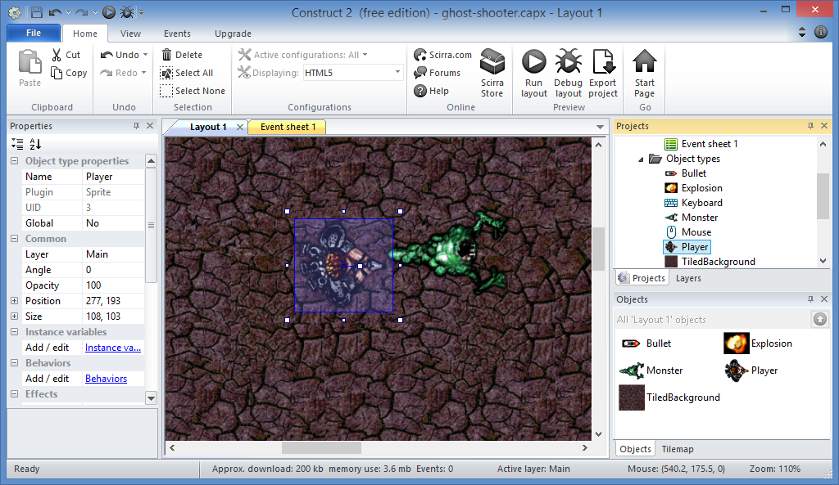
Move The Player: Step 1
Select Player

Slide 10
Move The Player: Step 2
Click

Slide 11
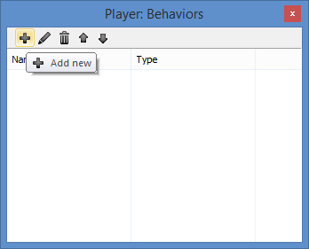
Move The Player: Step 3
Click Add New
(plus sign)

Slide 12
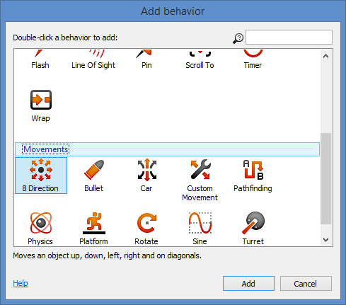
BUT FIRST… KNOW YOUR MOVEMENTS!
Scroll
Up
Or
Down

Slide 13
Move The Player: Step 4
Select
“8 Direction”
then
Click Add

Slide 14
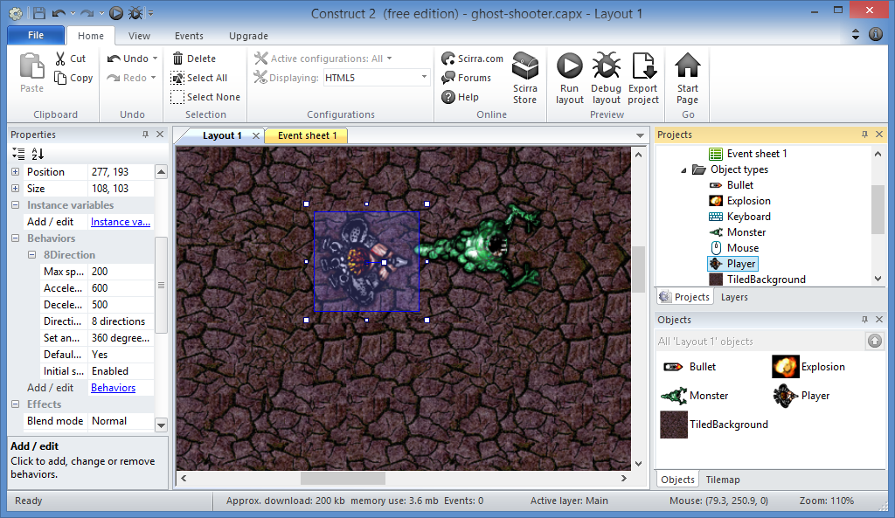
Move The Player: Step 5
Click
Again

Slide 15
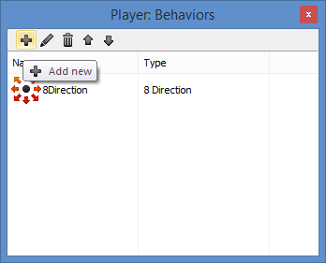
Move The Player: Step 6
Click Add New
(plus sign) again

Slide 16
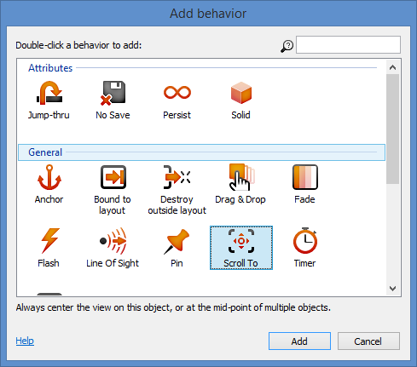
Move The Player: Step 7
Select
“Scroll To”
then
Click Add

Slide 17
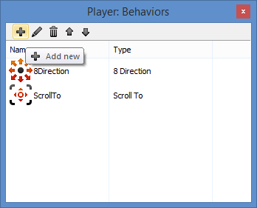
Move The Player: Step 8
Click Add New
(plus sign) again

Slide 18
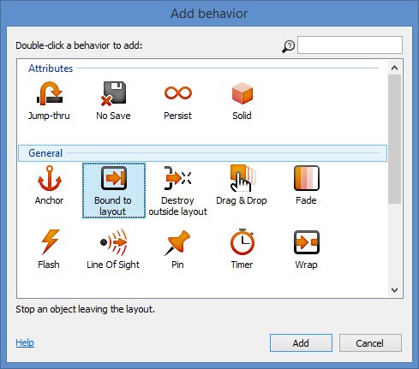
Move The Player: Step 9
Select
“Bound To
layout”
then
Click Add

Slide 19
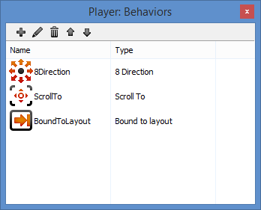
Move The Player: Step 10
Close
popup

Slide 20
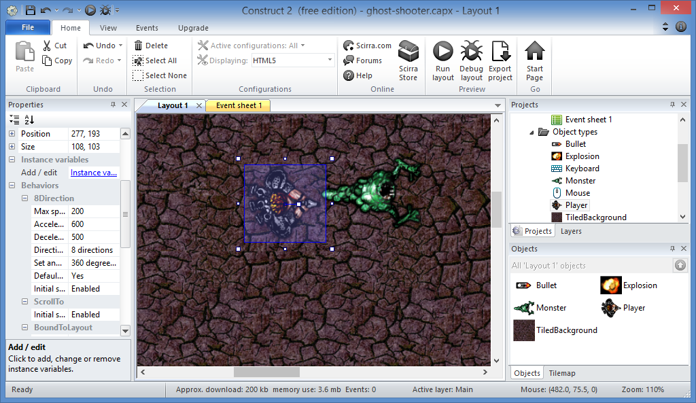
Move The Player: Done!

Slide 21
10. Adding Behaviors

Slide 22
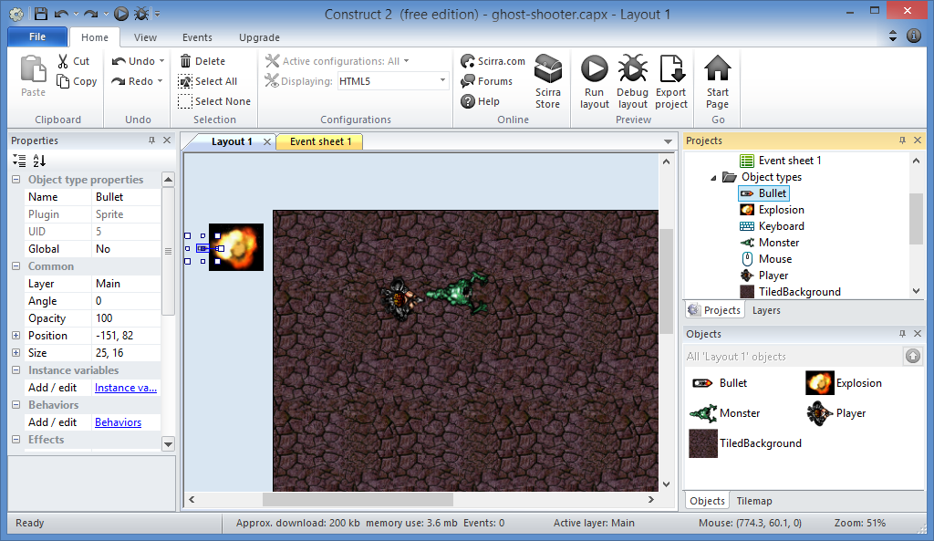
Add Behaviors: Step 1
Select Bullet

Slide 23
Add Behaviors: Step 2
Click

Slide 24
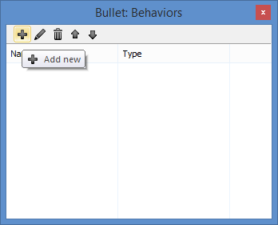
Add Behaviors: Step 3
Click Add New
(plus sign)

Slide 25
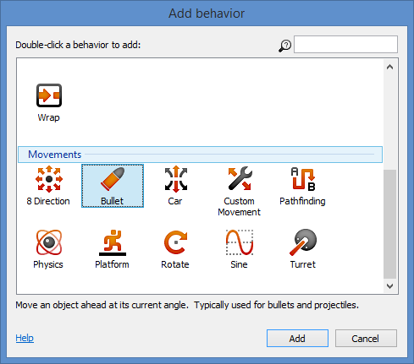
Add Behaviors: Step 4
Select
“Bullet”
then
Click Add

Slide 26
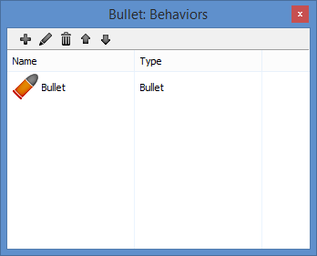
Add Behaviors: Step 5
Click Add New
(plus sign) again

Slide 27
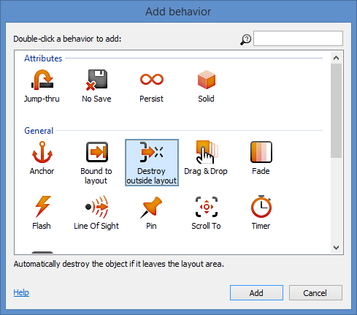
Add Behaviors: Step 6
Select
“Destroy
outside layout”
then
Click Add

Slide 28
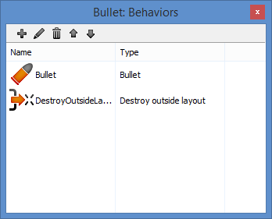
Add Behaviors: Step 7
Close
popup

Slide 29
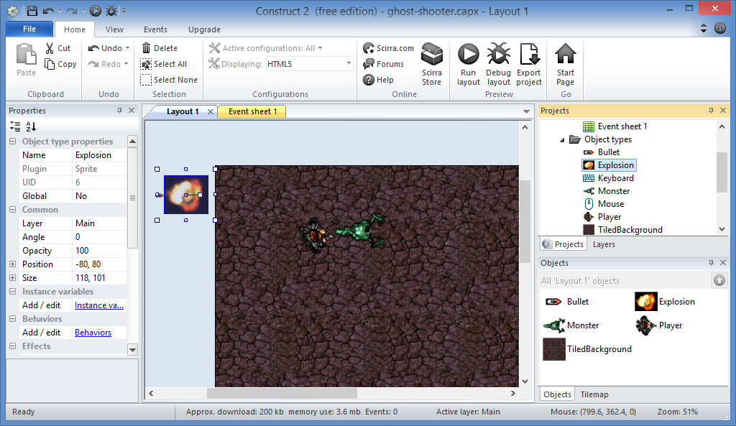
Add Behaviors: Step 8
Select
Explosion

Slide 30
Add Behaviors: Step 9
Click

Slide 31
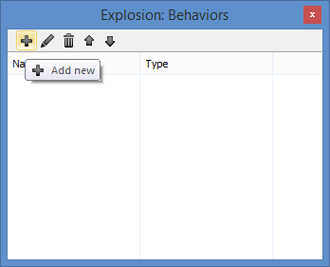
Add Behaviors: Step 10
Click Add New
(plus sign)

Slide 32
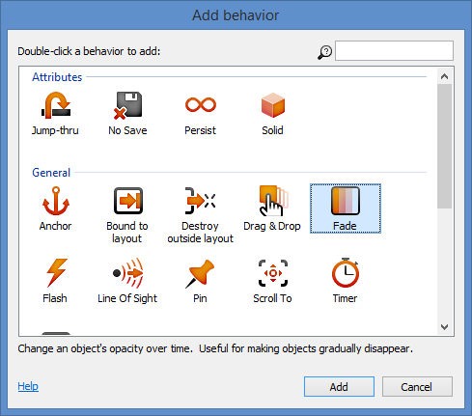
Add Behaviors: Step 11
Select
“Fade”
then
Click Add

Slide 33
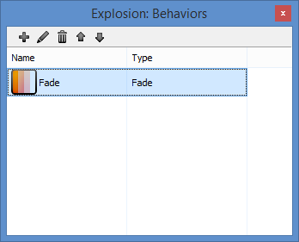
Add Behaviors: Step 12
Close
popup

Slide 34
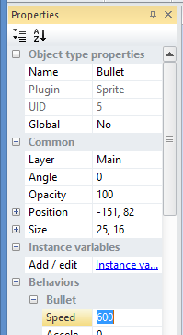
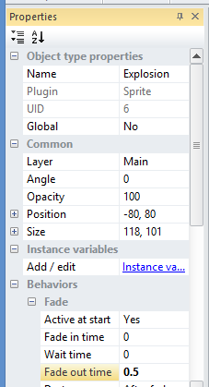
Add Behaviors: Step 13
Update Bullet
Speed = 600
Update Explosion
Fade out time = 0.5

Slide 35
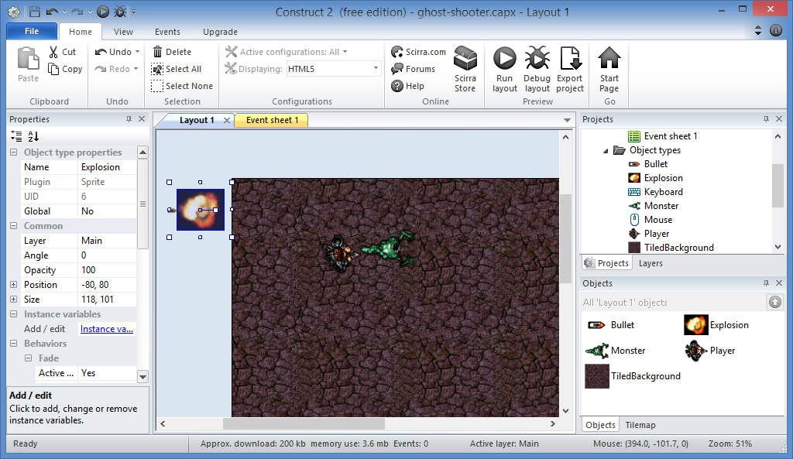
Add Behaviors: Done!

Slide 36
11. Moving NPCs i.e. non-playable characters

Slide 37
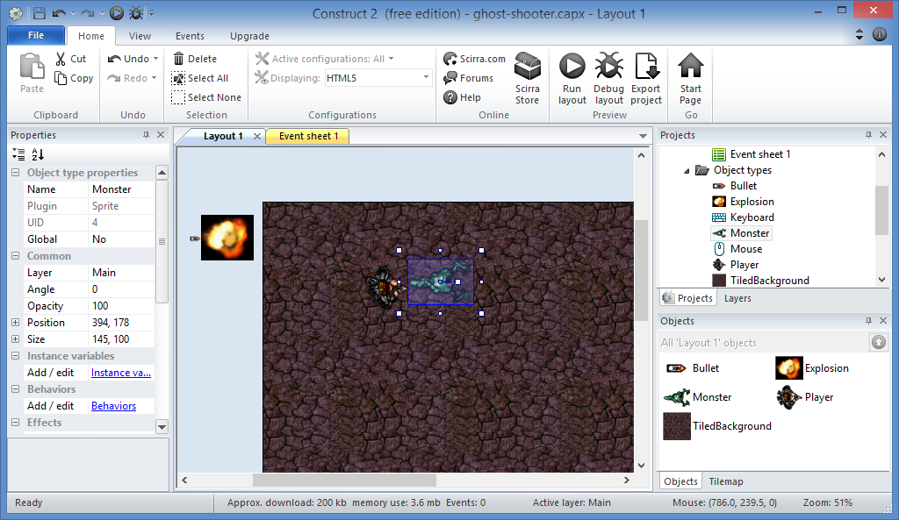
Move Monsters: Step 1
Select
Monster

Slide 38
Move Monsters: Step 2
Click

Slide 39
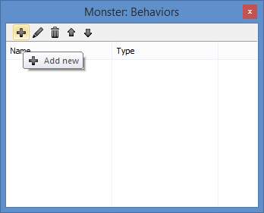
Move Monsters: Step 3
Click Add New
(plus sign)

Slide 40
Move Monsters: Step 4
Select
“Bullet”
then
Click Add

Slide 41
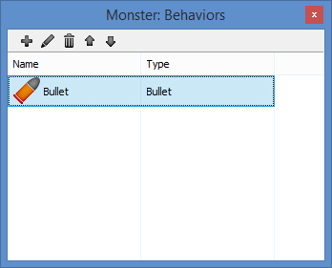
Move Monsters: Step 5
Close
popup

Slide 42
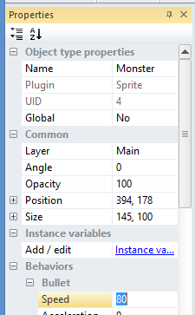
Move Monsters: Step 6
Update Monster’s
Bullet Behavior
Speed = 80

Slide 43
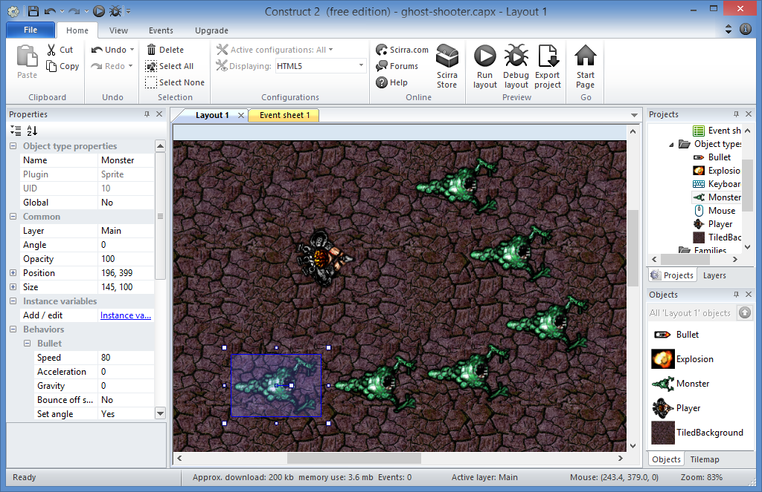
Move Monsters: Step 7
Select Monster
Ctrl-Click and Drag
to create more!

Slide 44
Move Monsters: Done!

Slide 45
12. Accepting User Input

Slide 46
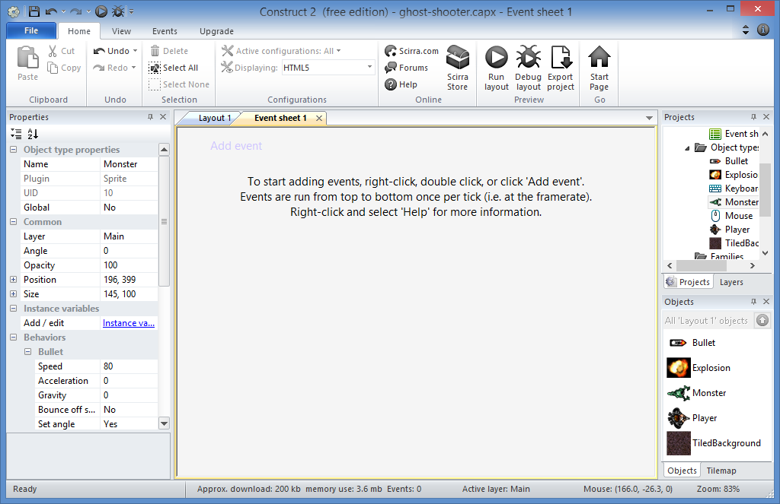
Add Mouse Event: Step 1
Add events to the
Event Sheet

Slide 47
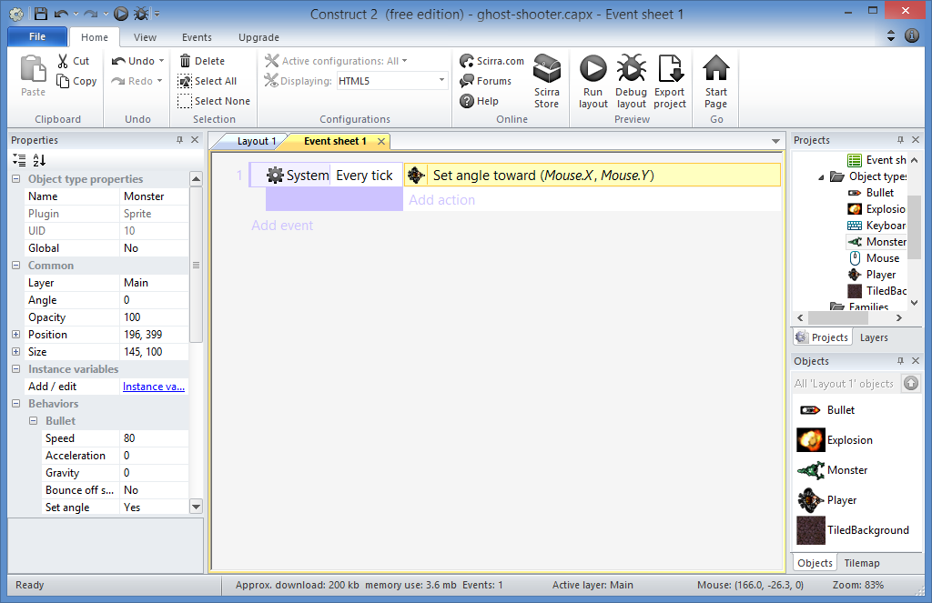
BUT FIRST… KNOW ABOUT EVENTS!
An “Event” happens
when a Condition
is True
for an Object
Event
Condition
Object

Slide 48
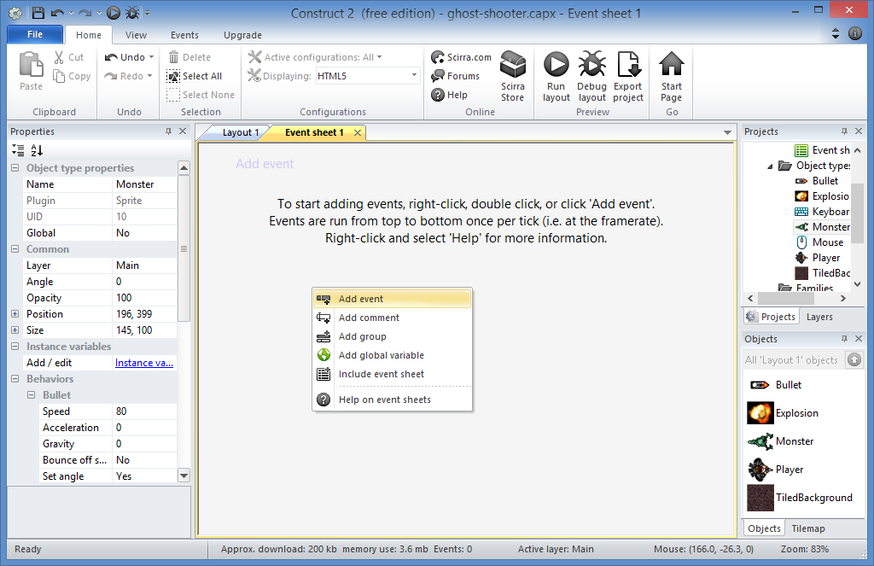
Add Mouse Event: Step 2
Right-Click, then
Add
Event

Slide 49
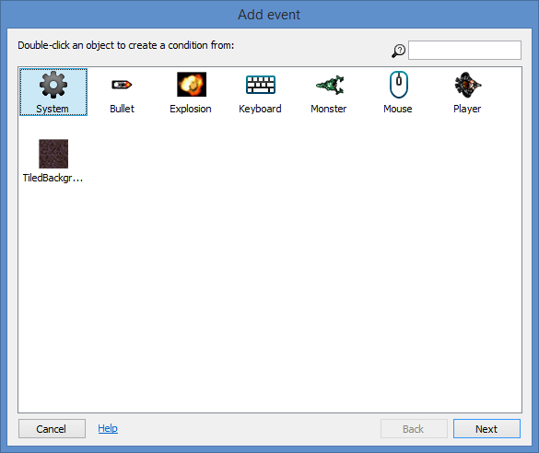
Add Mouse Event: Step 3
Select
“System”
then
Next!

Slide 50
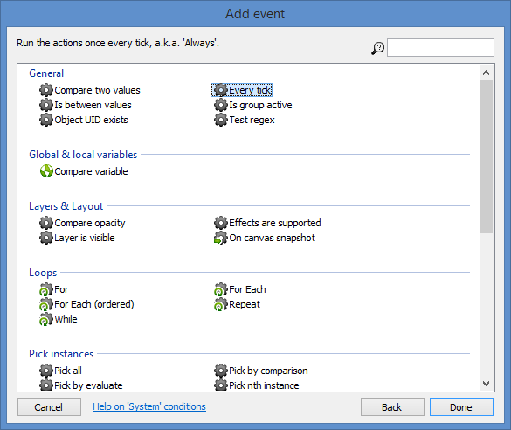
Add Mouse Event: Step 4
Select
“Every tick”
then
Done!

Slide 51
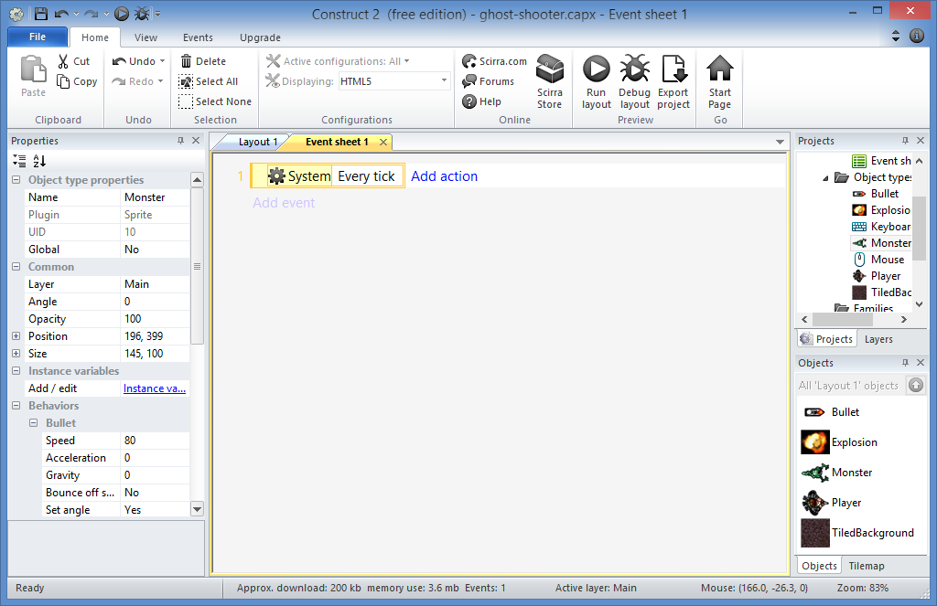
Add Mouse Event: Step 5
Click to
Add Action

Slide 52
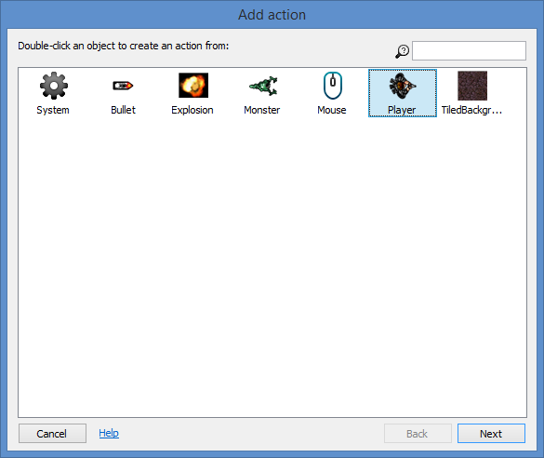
Add Mouse Event: Step 6
Select
“Player”
then
Next!

Slide 53
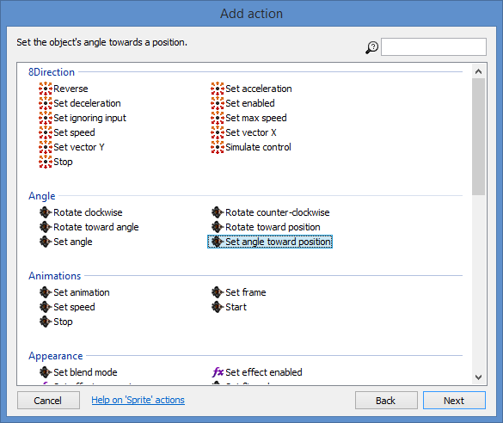
Add Mouse Event: Step 7
Select
“Set angle toward position”
then
Next!

Slide 54
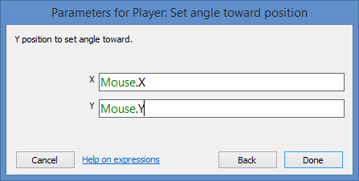
Add Mouse Event: Step 8
Enter Parameters
X = Mouse.X
Y = Mouse.Y
Done!

Slide 55
Add Mouse Event: Done!

Slide 56
13. Spawning Other Objects e.g. Bullets

Slide 57
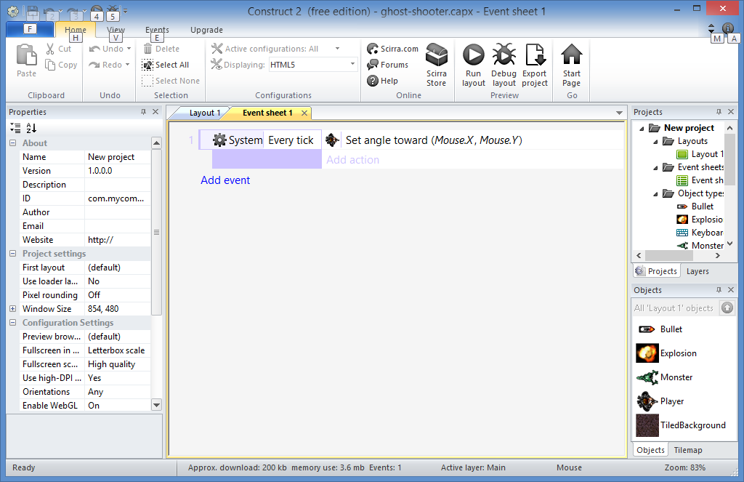
Shoot Bullets: Step 1
Click to Add Event

Slide 58
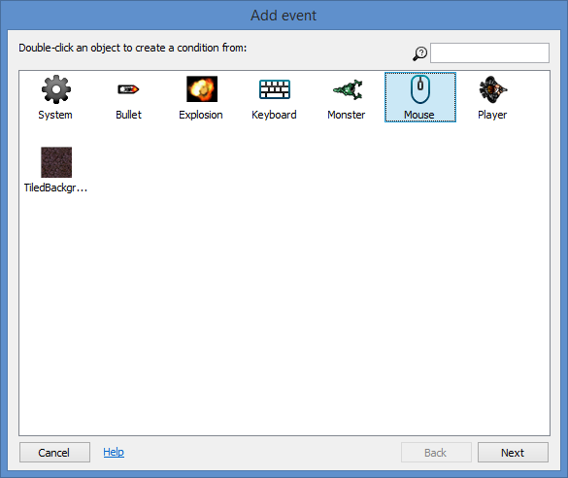
Shoot Bullets: Step 2
Select
“Mouse”
then
Next!

Slide 59
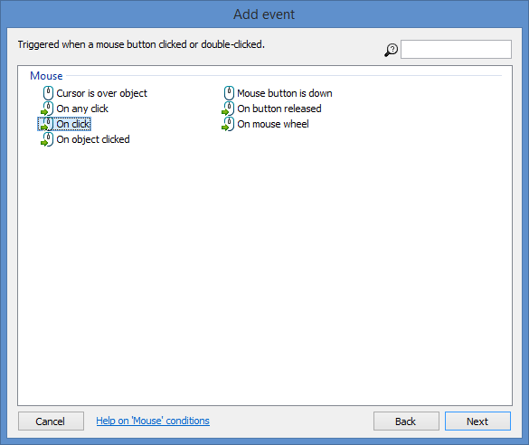
Shoot Bullets: Step 3
Select
“On click”
then
Next!

Slide 60
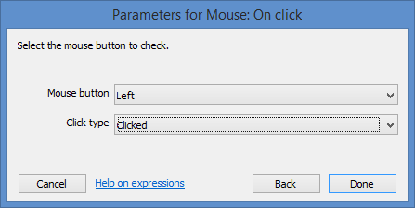
Shoot Bullets: Step 4
Done!

Slide 61
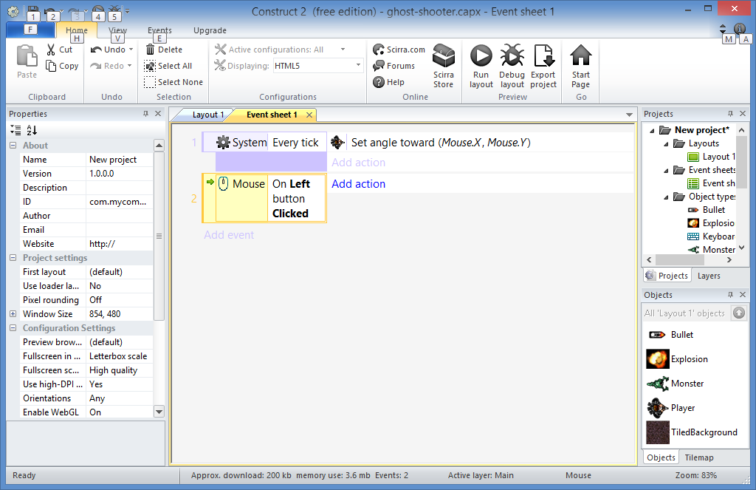
Shoot Bullets: Step 5
Click to Add Action

Slide 62
Shoot Bullets: Step 6
Select
“Player”
then
Next!

Slide 63
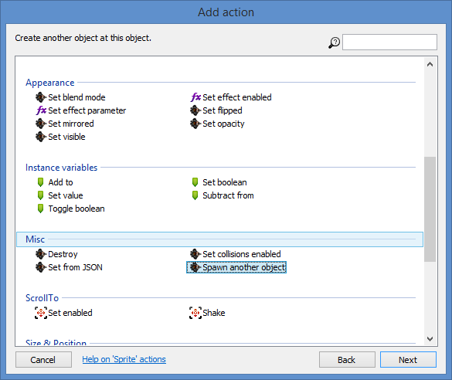
Shoot Bullets: Step 7
Select
“Spawn another object”
then
Next!

Slide 64
Shoot Bullets: Step 8
Click to Choose

Slide 65
Shoot Bullets: Step 9
Select
“Bullet”
then
OK!

Slide 66
Shoot Bullets: Step 10
Enter
Layer = 1
Image point = 0
Done!

Slide 67
Shoot Bullets: Done!

Slide 68
14. Image Points

Slide 69
Fix Bullets: Step 1
Right-Click
Player
then
Edit animations

Slide 70
Fix Bullets: Step 2
Click to
Set origin and image points

Slide 71
Fix Bullets: Step 3
Click to add

Slide 72
Fix Bullets: Step 4
Click in
front of gun
Then, close popup

Slide 73
Fix Bullets: Step 5
Right-Click
Spawn
then
Click Edit

Slide 74
Fix Bullets: Step 6
Update
Image point = 1
Done!

Slide 75
15. Collision Detection

Slide 76
Destroy Monsters: Step 1
Click to Add Event

Slide 77
Destroy Monsters: Step 2
Select
“Bullet”
then
Next!

Slide 78
Destroy Monsters: Step 3
Select
“On collision with another object”
then
Next!

Slide 79
Destroy Monsters: Step 4
Click to choose

Slide 80
Destroy Monsters: Step 5
Select
“Monster”
then
OK!

Slide 81
Destroy Monsters: Step 6
Done!

Slide 82
Destroy Monsters: Step 7
Click to Add Action

Slide 83
Destroy Monsters: Step 8
Select
“Monster”
then
Next!

Slide 84
Destroy Monsters: Step 9
Select
“Destroy”
then
Done!

Slide 85
Destroy Monsters: Step 10
Click to Add Action

Slide 86
Destroy Monsters: Step 11
Select
“Bullet”
then
Next!

Slide 87
Destroy Monsters: Step 12
Select
“Spawn another object”
then
Next!

Slide 88
Destroy Monsters: Step 13
Click to Choose

Slide 89
Destroy Monsters: Step 14
Select
“Explosion”
then
OK!

Slide 90
Destroy Monsters: Step 15
Enter
Layer = 1
Image point = 0
Done!

Slide 91
Destroy Monsters: Step 16
Click to Add Action

Slide 92
Destroy Monsters: Step 17
Select
“Bullet”
then
Next!

Slide 93
Destroy Monsters: Step 18
Select
“Destroy”
then
Done!

Slide 94
Destroy Monsters: Done!

Slide 95
16. Basic AI e.g. enemy placement

Slide 96
Randomize Monsters: Step 1
Go to your
Event Sheet

Slide 97
Randomize Monsters: Step 1
Click to Add Event

Slide 98
Randomize Monsters: Step 3
Select
“System”
then
Next!

Slide 99
Randomize Monsters: Step 4
Select
“On start
of layout”
then
Done!

Slide 100
Randomize Monsters: Step 5
Click to Add Action

Slide 101
Randomize Monsters: Step 6
Select
“Monster”
then
Next!

Slide 102
Randomize Monsters: Step 7
Select
“Set angle”
then
Next!

Slide 103
Randomize Monsters: Step 8
Enter Angle
random(360)
Done!

Slide 104
Randomize Monsters: Done!
x

Slide 105
17. Improved AI e.g. follow the player

Slide 106
Improve Monsters: Step 1
Go to your
Event Sheet

Slide 107
Improve Monsters: Step 2
Click to Add Event

Slide 108
Improve Monsters: Step 3
Select
“Monster”
then
Next!

Slide 109
Improve Monsters: Step 4
Select
“Is outside
layout”
then
Done!

Slide 110
Improve Monsters: Step 5
Click to Add Action

Slide 111
Improve Monsters: Step 6
Select
“Monster”
then
Next!

Slide 112
Improve Monsters: Step 7
Select
“Set angle
towards position”
then
Next!

Slide 113
Improve Monsters: Step 8
Enter paramters
X = Player.X
Y = Player.Y
Done!

Slide 114
Improve Monsters: Done!

Slide 115
18. Instance Variables e.g. NPC Health

Slide 116
Add Health: Step 1
Select Monster

Slide 117
Add Health: Step 2
Click

Slide 118
Add Health: Step 3
Click Add New
(plus sign)

Slide 119
Add Health: Step 4
Enter the following:
Name: health
Type: Number
Initial Value = 5
Description (optional)
OK!

Slide 120
Add Health: Done!

Slide 121
Update Health: Step 1
Right-click
Monster – Destroy
then
click
Replace action

Slide 122
Update Health: Step 2
Select
“Monster”
then
Next!

Slide 123
Update Health: Step 3
Select
“Subtract from”
then
Next!

Slide 124
Update Health: Step 4
“Monster”
“Monster”
Enter
Value = 1
Done!

Slide 125
Update Health: Done!

