Slide 1
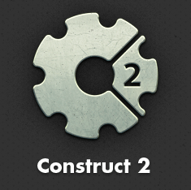
19. Affecting NPC Health i.e. destroying monsters!

Slide 2
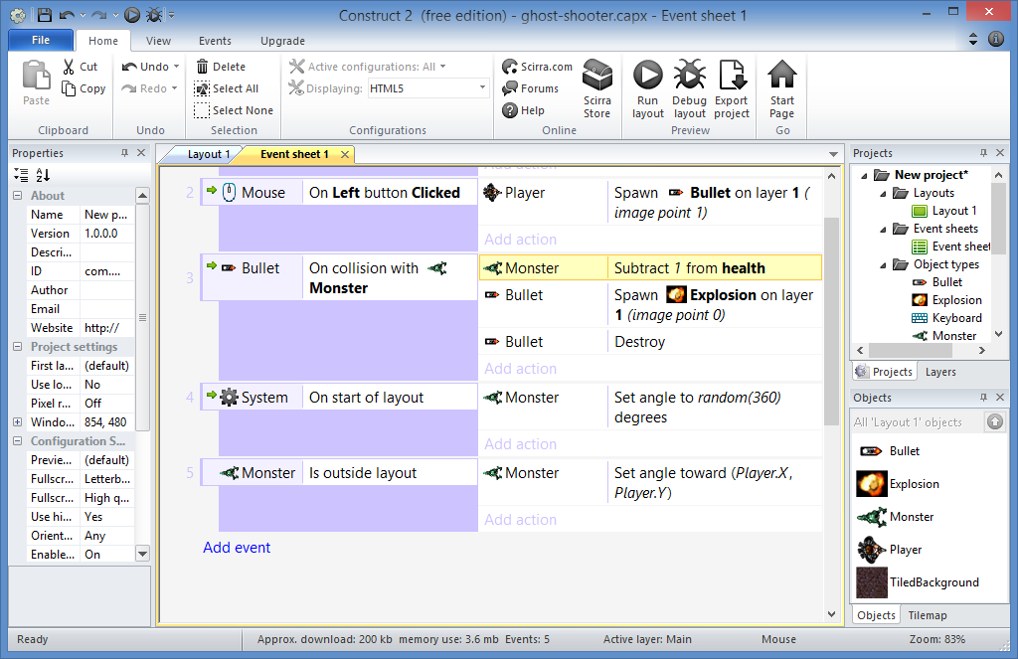
Destroy Monsters: Step 1
Go to your
Event Sheet

Slide 3
Destroy Monsters: Step 2
Click to Add Event

Slide 4
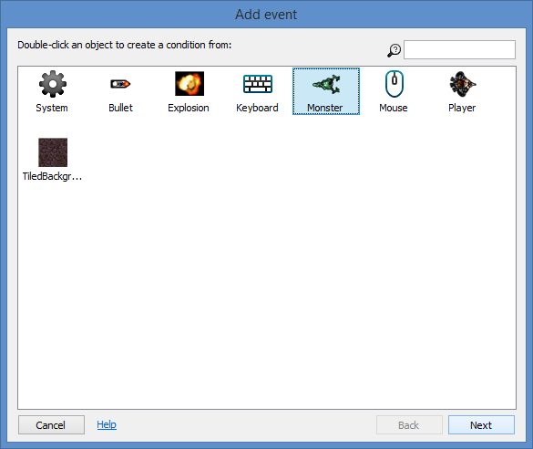
Destroy Monsters: Step 3
Select
“Monster”
then
Next!

Slide 5
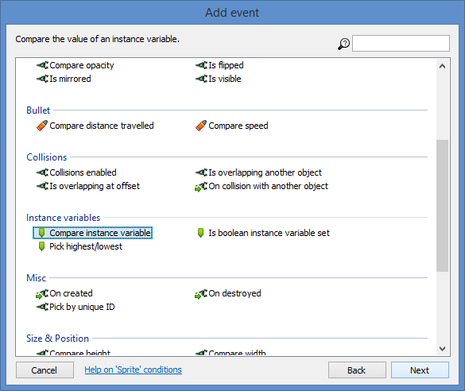
Destroy Monsters: Step 4
Select
“Compare instance variable”
then
Next!

Slide 6
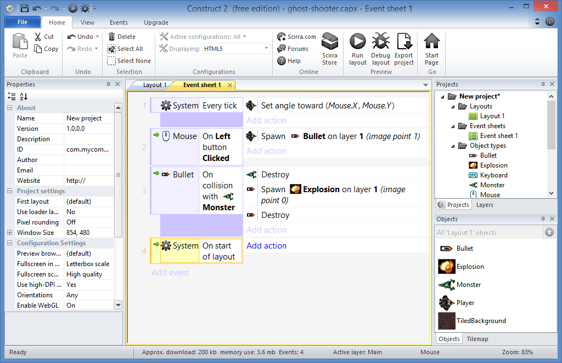
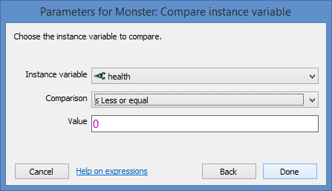
Destroy Monsters: Step 5
Enter:
Comparison: ≤ Less or equal
Value = 0
Done!

Slide 7
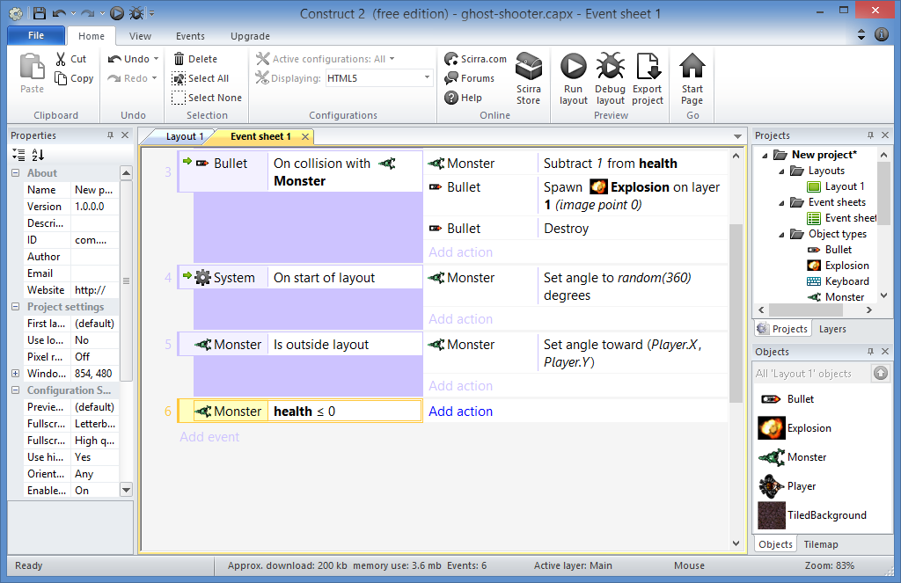
Destroy Monsters: Step 6
Click to Add Action

Slide 8
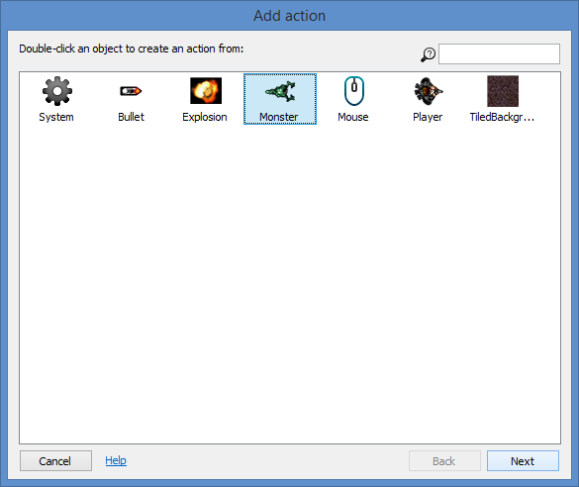
Destroy Monsters: Step 7
Select
“Monster”
then
Next!

Slide 9
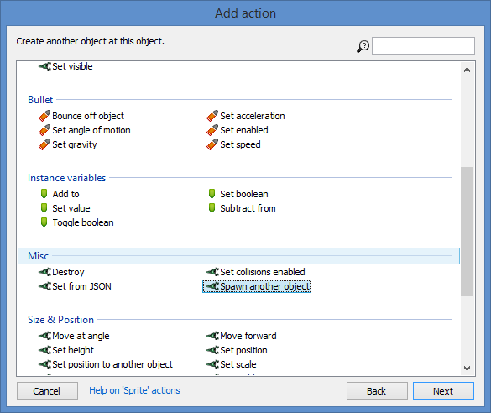
Destroy Monsters: Step 8
Select
“Spawn another object”
then
Next!

Slide 10
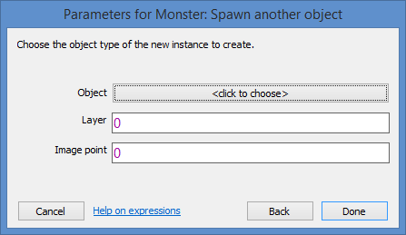
Destroy Monsters: Step 9
<click to choose>

Slide 11
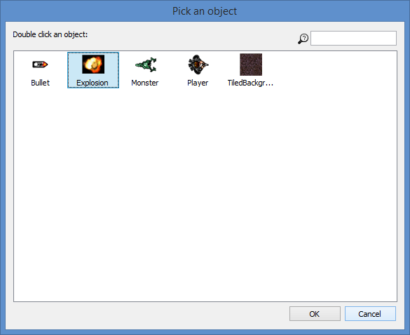
Destroy Monsters: Step 10
Select
“Explosion”
then
OK!

Slide 12
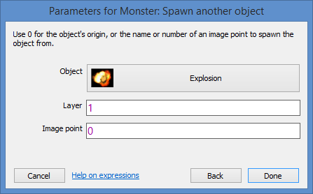
Destroy Monsters: Step 11
Enter:
Layer = 1
Image point = 0
Done!

Slide 13
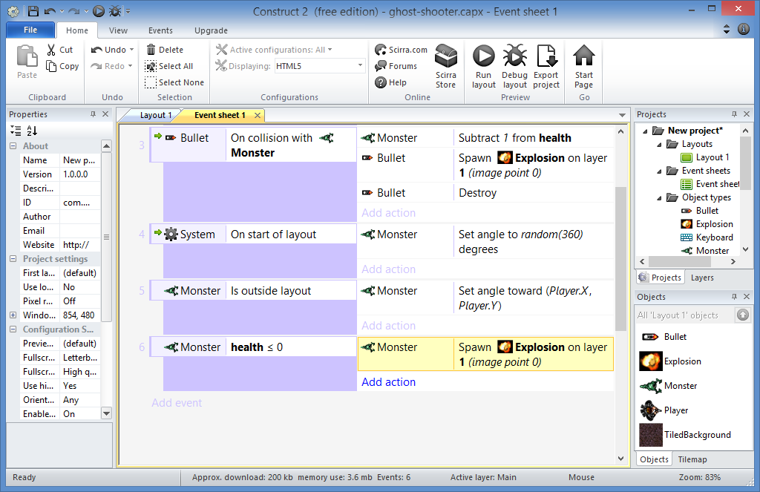
Destroy Monsters: Step 12
Click to Add Action

Slide 14
Destroy Monsters: Step 13
Select
“Monster”
then
Next!

Slide 15
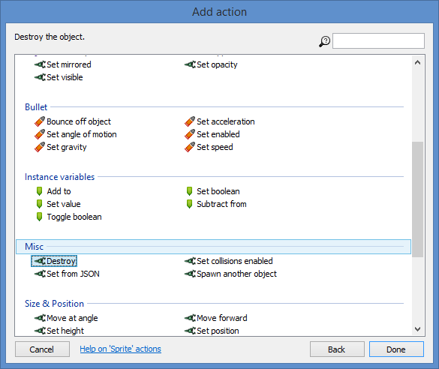
Destroy Monsters: Step 14
Select
“Destroy”
then
Done!

Slide 16
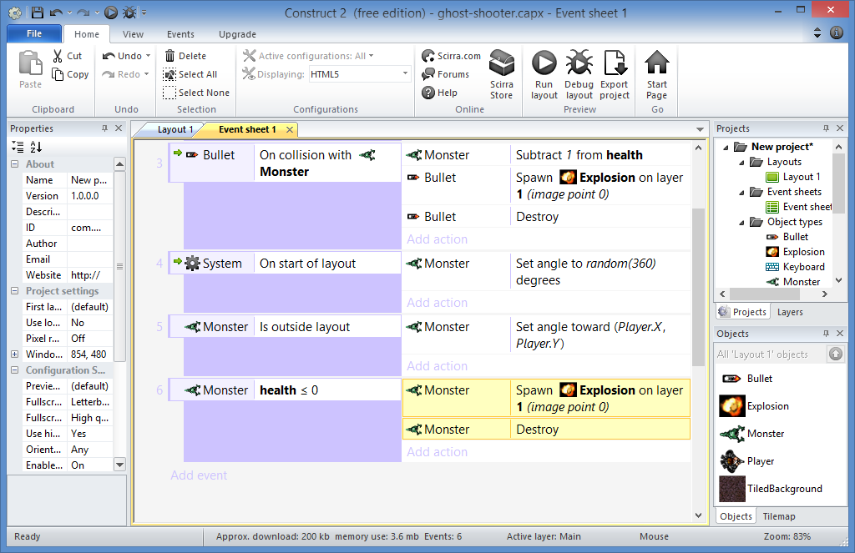
Destroy Monsters: Done!

Slide 17
20. Global Variables e.g. player score

Slide 18
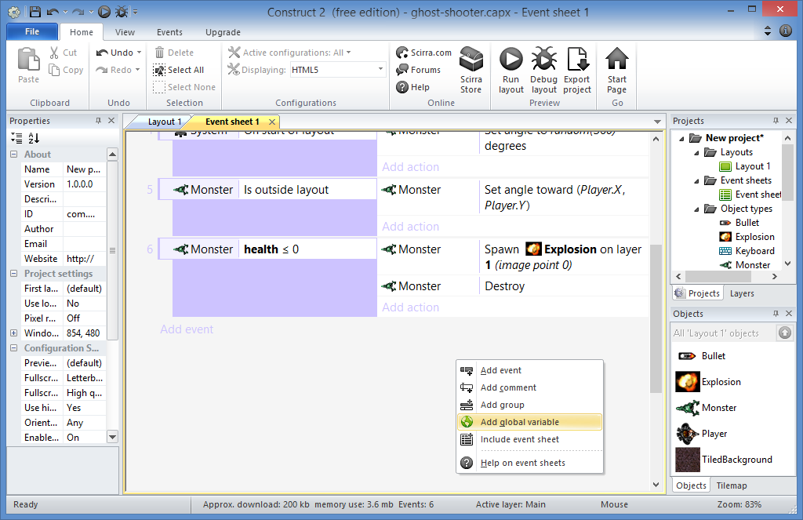
Add Score: Step 1
Right-click,
then click
Add global variable

Slide 19
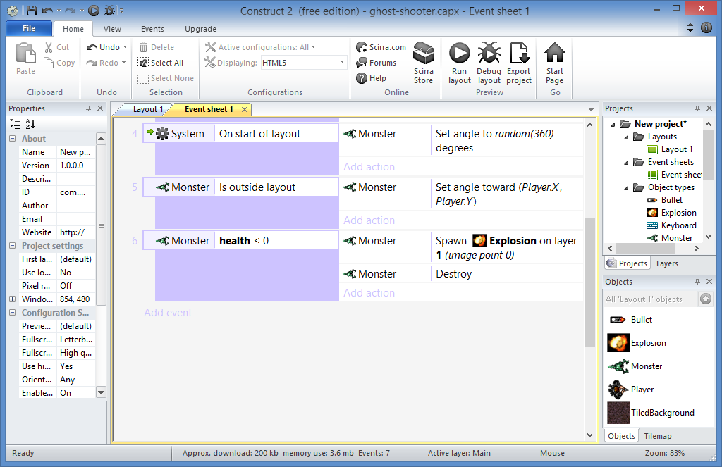
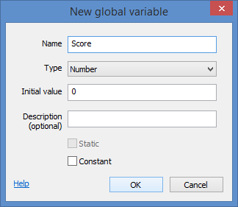
Add Score: Step 2
Enter:
Name: Score
Type: Number
Initial value: 0
Description (optional)
Constant?
OK!

Slide 20
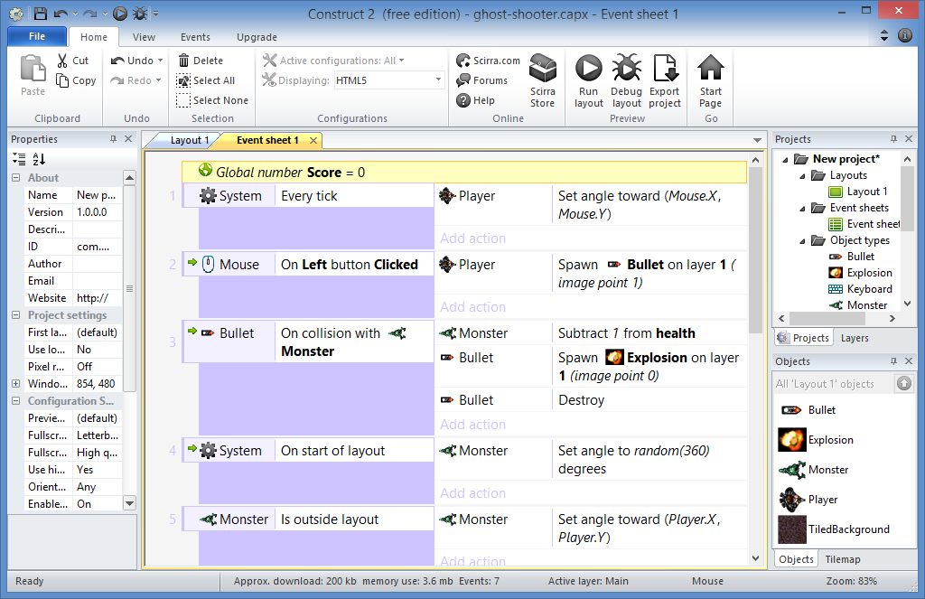
Add Score: Step 3
Scroll to the top
to see it!

Slide 21
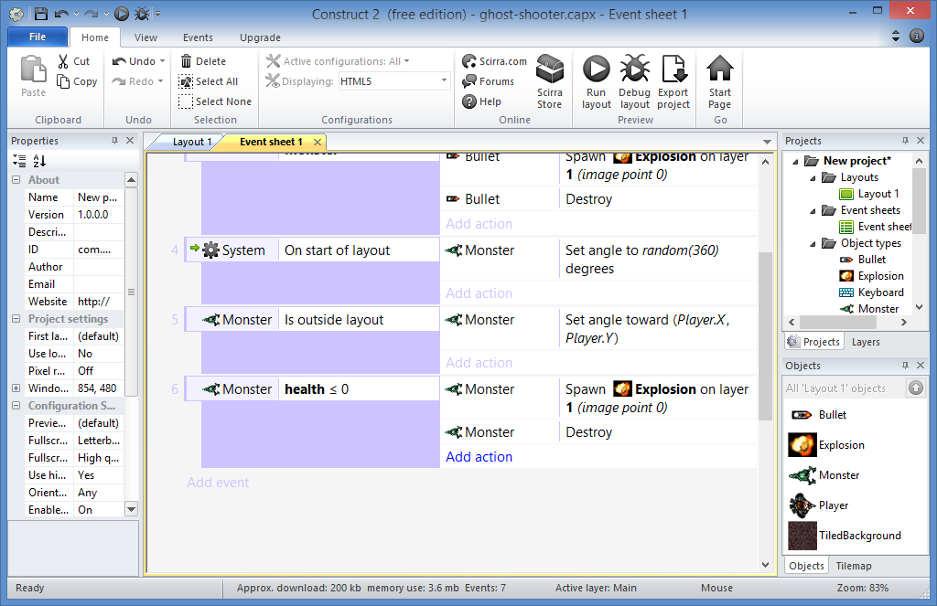
Add Score: Step 4
Scroll back
to the bottom
Click Add action

Slide 22
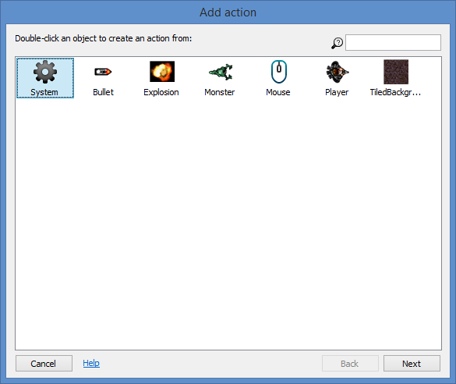
Add Score: Step 5
Select
“System”
then
Next!

Slide 23
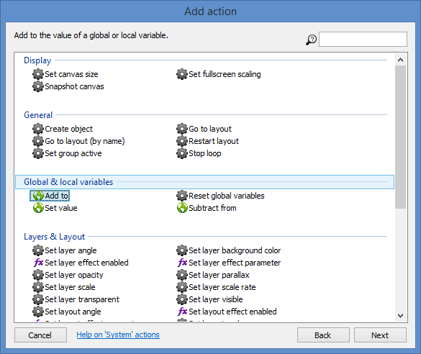
Add Score: Step 6
Select
“Add to”
then
Next!

Slide 24
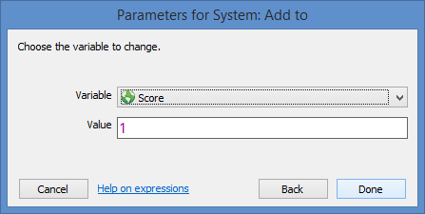
Add Score: Step 7
Enter:
Value = 1
Done!

Slide 25
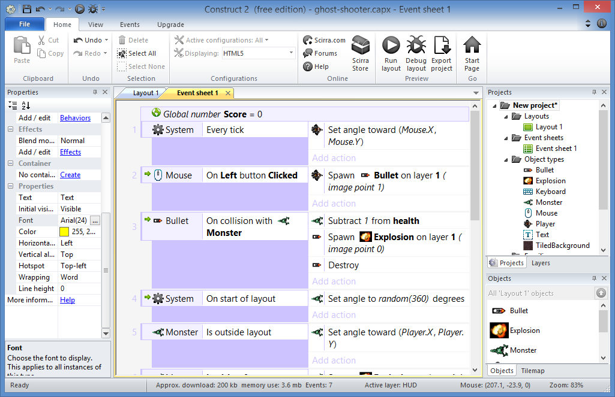
Add Score: Done!

Slide 26
21. Adding a HUD i.e. Heads-Up Display

Slide 27
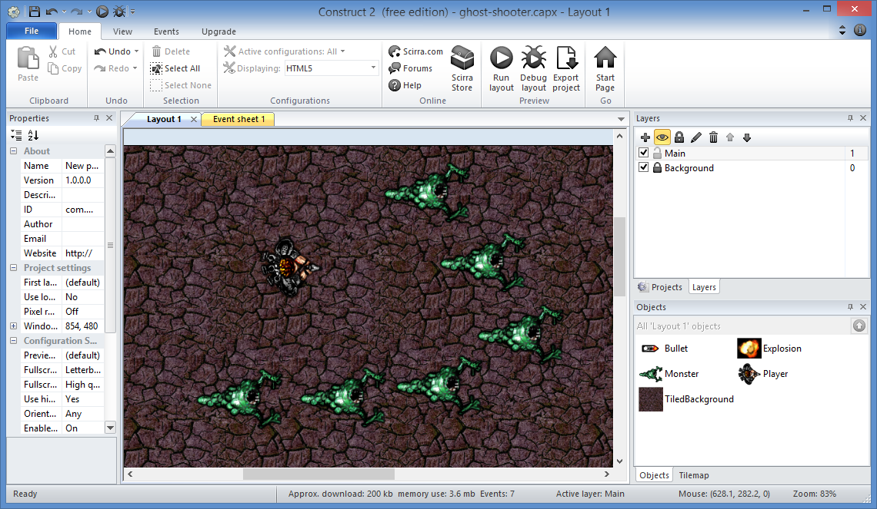
Add HUD Layer: Step 1
Click
Layers

Slide 28
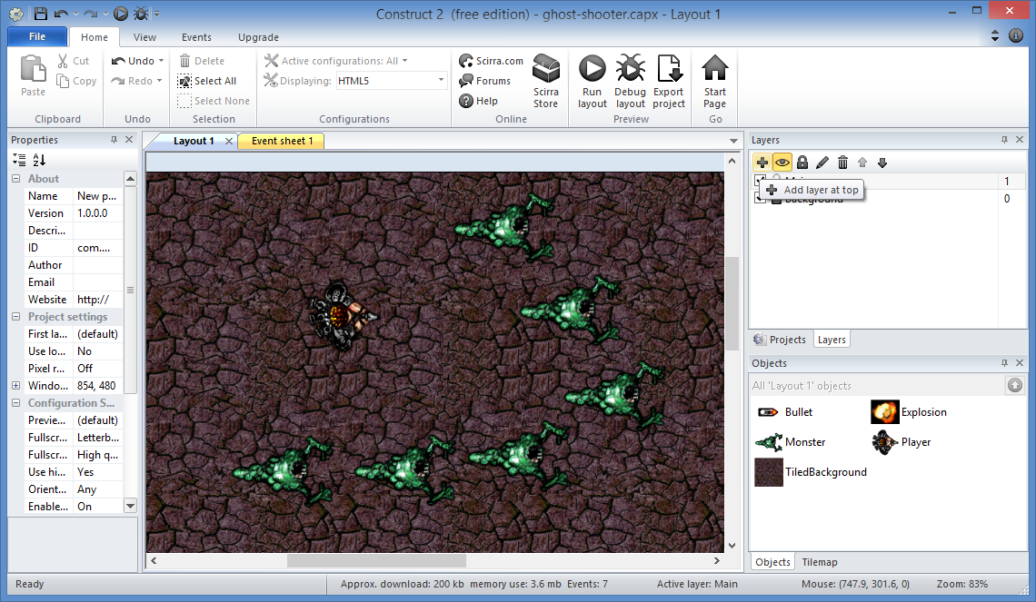
Add HUD Layer: Step 2
Add a
new layer
(plus sign)

Slide 29
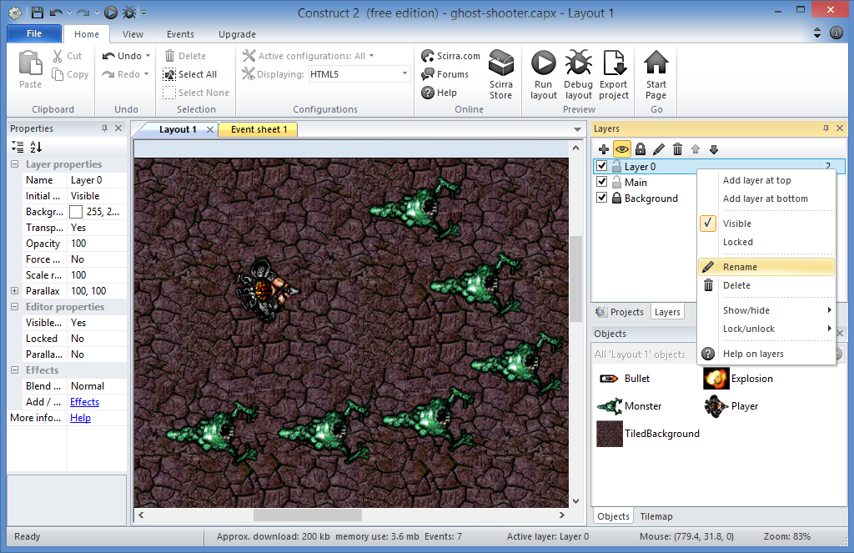
Add HUD Layer: Step 3
Right-click
then
click Rename

Slide 30
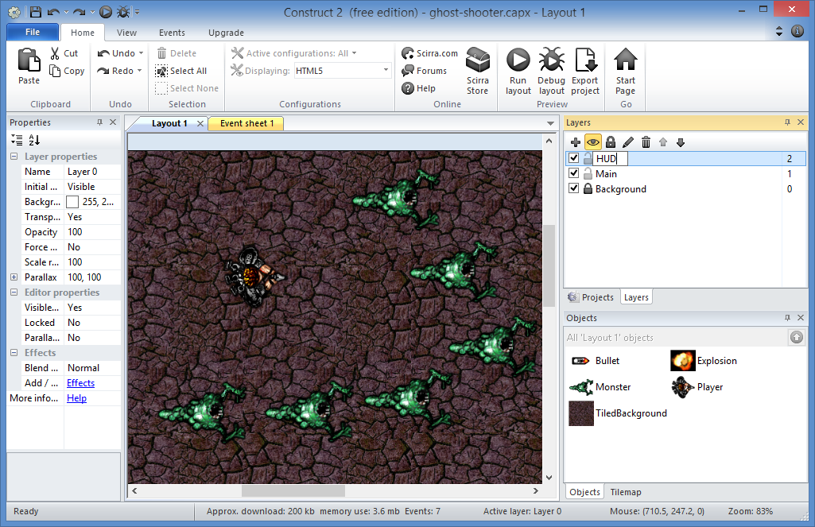
Add HUD Layer: Step 4
Change
the name
to “HUD”

Slide 31
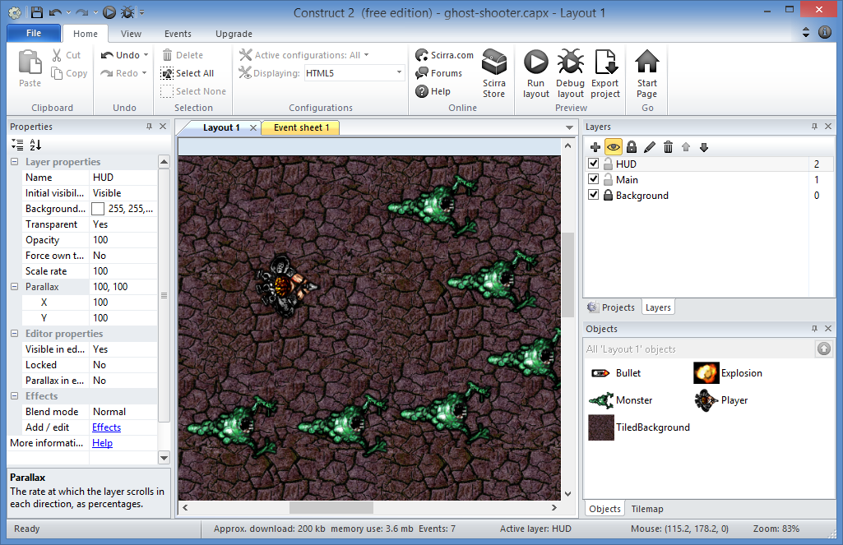
Add HUD Layer: Step 5
Let’s update
the Parallax
values…

Slide 32
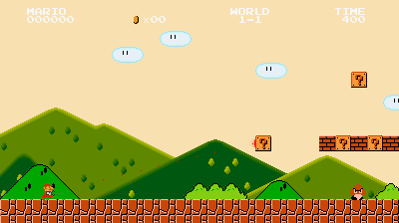
BUT FIRST… WHAT IS PARALLAX?
When the
background layers
scroll separately
http://wakeupandcode.com/c2/parallax.html
Source: Super Mario Bros, from Nintendo

Slide 33
Add HUD Layer: Step 6
Set the HUD’s
Parallax to
0, 0

Slide 34
Add HUD Layer: Done!

Slide 35
22. Displaying Text e.g. player score

Slide 36
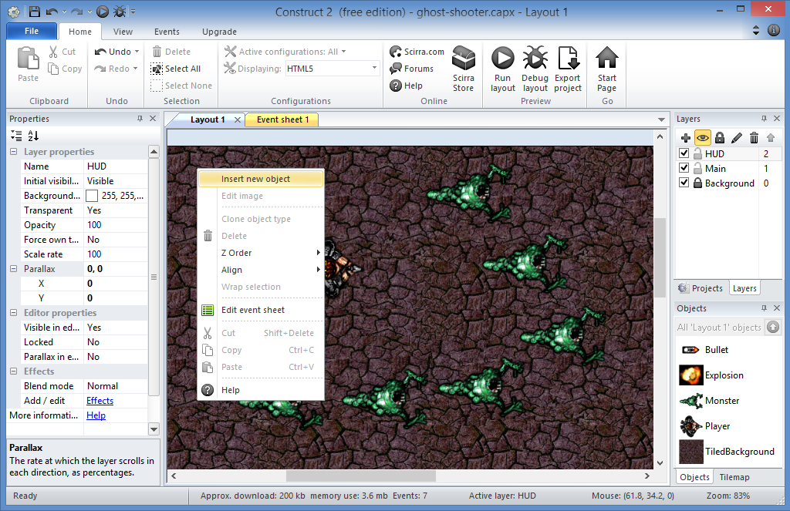
Display Text: Step 1
Right-click
top left
of Layout 1
then
Insert new object

Slide 37
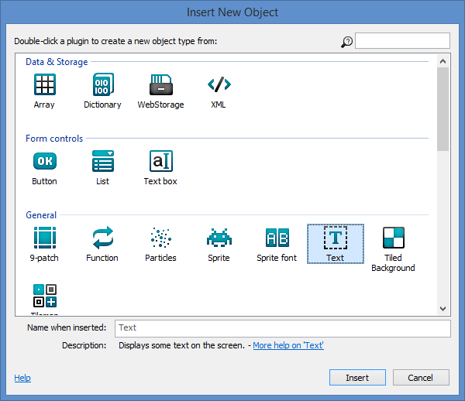
Display Text: Step 2
Select
“Text”
then
Click Insert

Slide 38
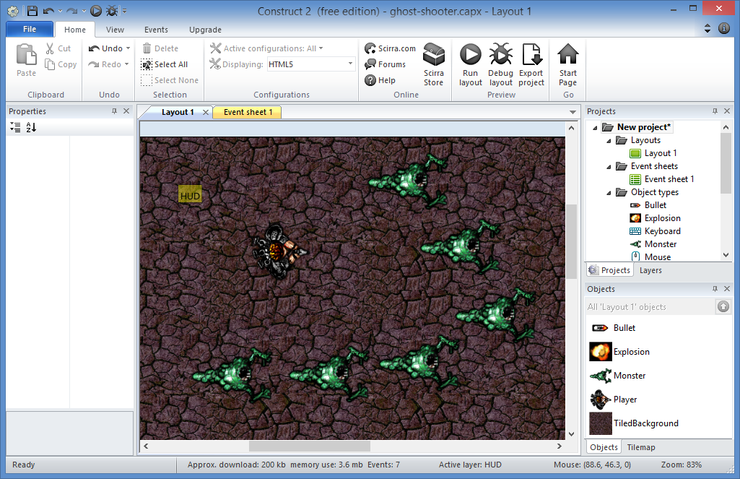
Display Text: Step 3
Click to place
Text object
(HUD layer)

Slide 39
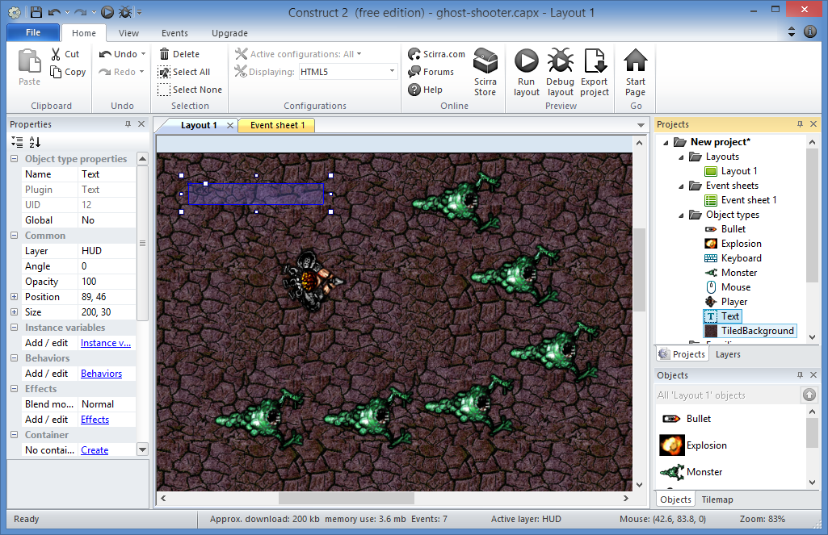
Display Text: Step 4
Notice
Text
object

Slide 40
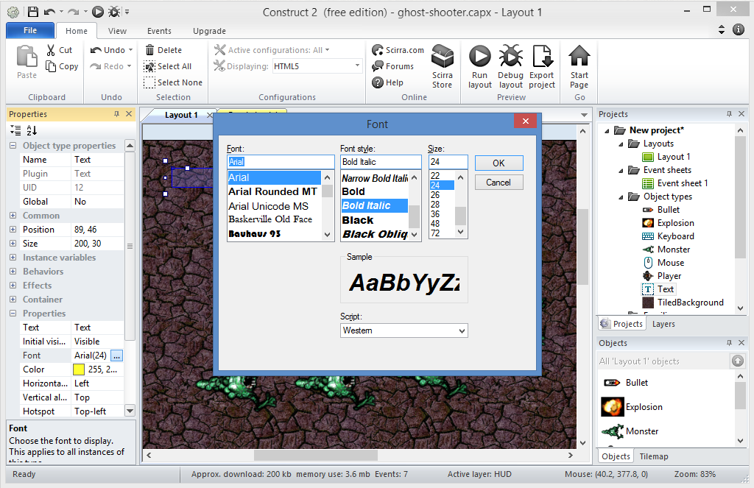
Display Text: Step 5
Change Properties
Font
Style: Bold Italic
Size: 24
Color: Yellow

Slide 41
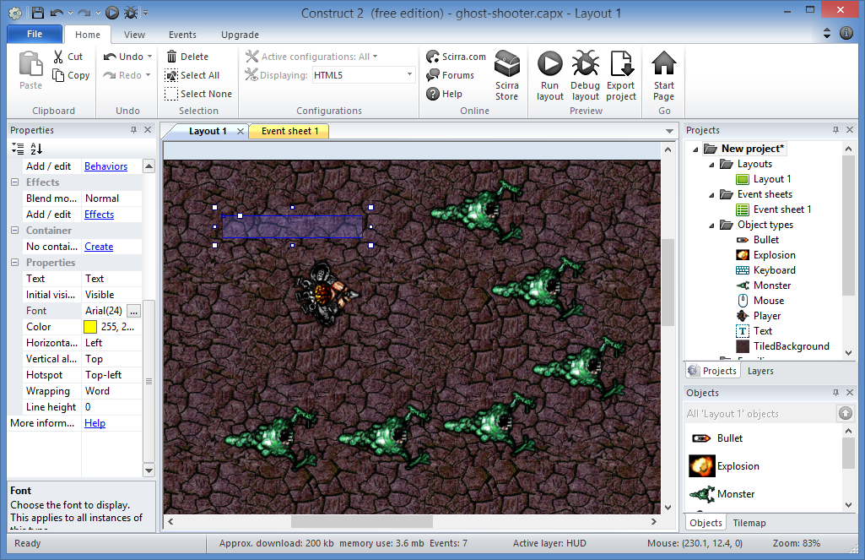
Display Text: Done!

Slide 42
23. Updating the HUD e.g. showing player score

Slide 43
BUT FIRST… HOW DO YOU COMBINE TEXT?
quote
text
space
quote
"Score: " & Score
&
(ampersand)
String
Variable

Slide 44
WHAT WILL IT LOOK LIKE IN THE GAME?
"Score: " & Score
displays
Score: 100

Slide 45
Display Score: Step 1
For System,
Every tick
Click
Add action

Slide 46
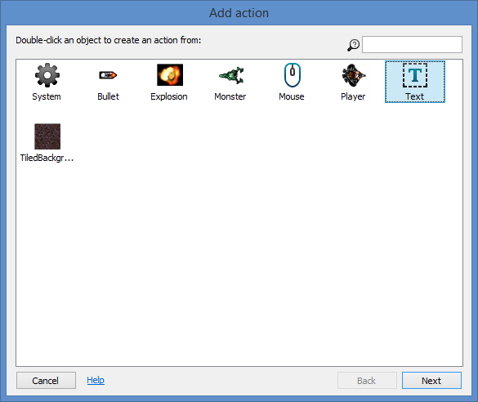
Display Score: Step 2
Select
“Text”
then
Next!

Slide 47
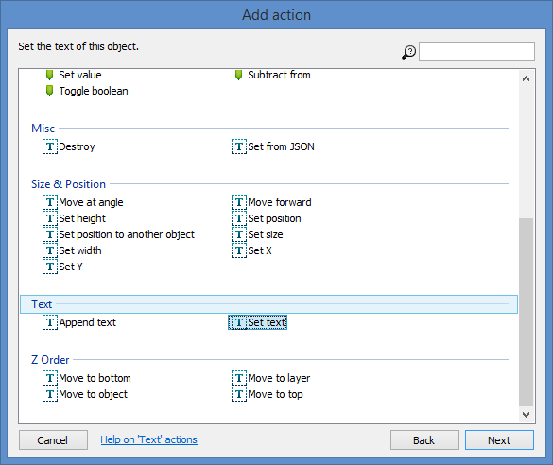
Display Score: Step 3
Select
“text”
then
Next!

Slide 48
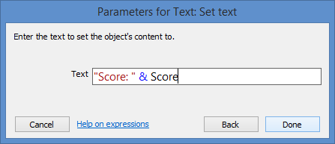
Display Score: Step 4
Enter:
“Score: “ & Score
Done!

Slide 49
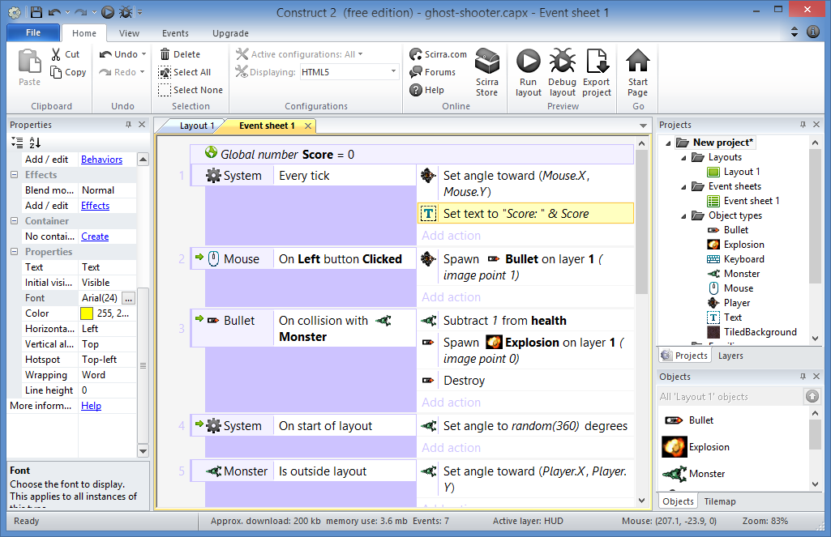
Display Score: Done!

Slide 50
24. Spawning NPCs i.e. more monsters

Slide 51
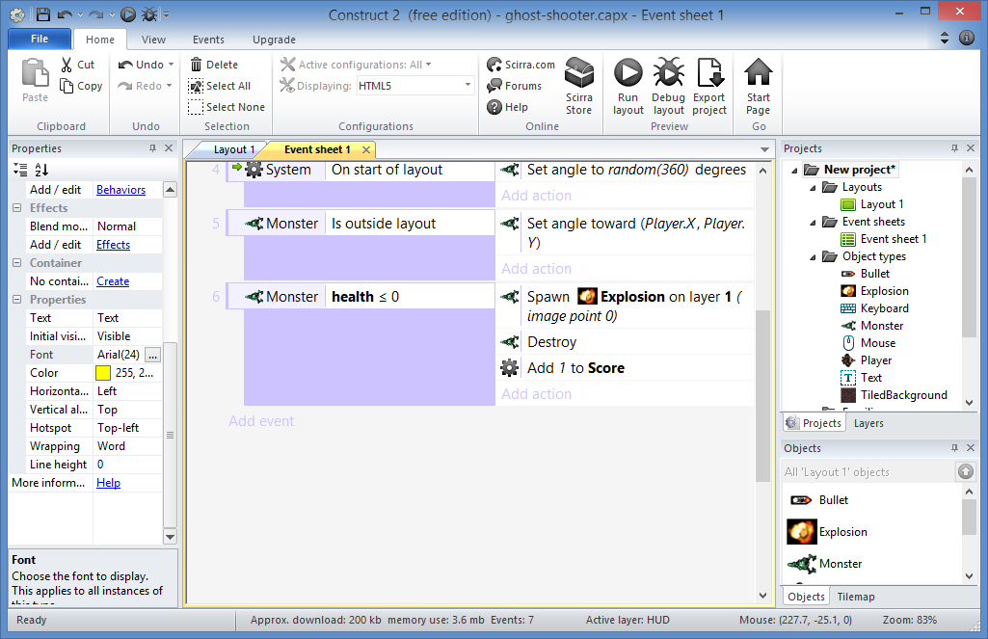
Spawn Monsters: Step 1
Click to Add Event

Slide 52
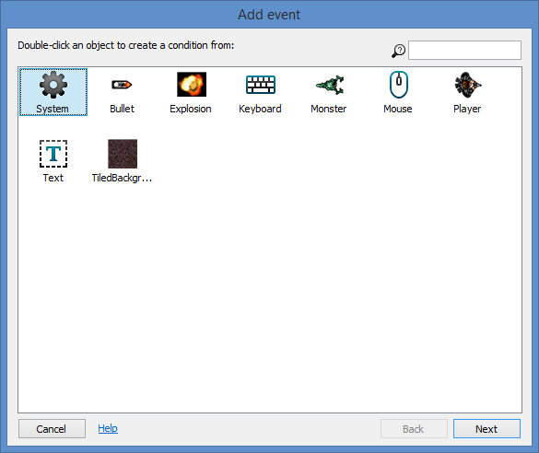
Spawn Monsters: Step 2
Select
“System”
then
Next!

Slide 53
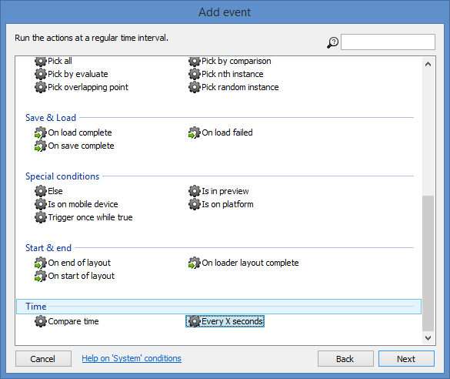
Spawn Monsters: Step 3
Select
“Every X seconds”
then
Next!

Slide 54
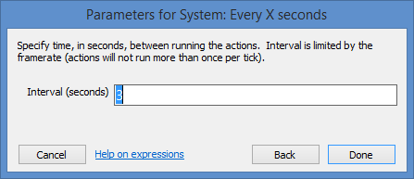
Spawn Monsters: Step 4
Enter:
Interval (seconds): 3
Done!

Slide 55
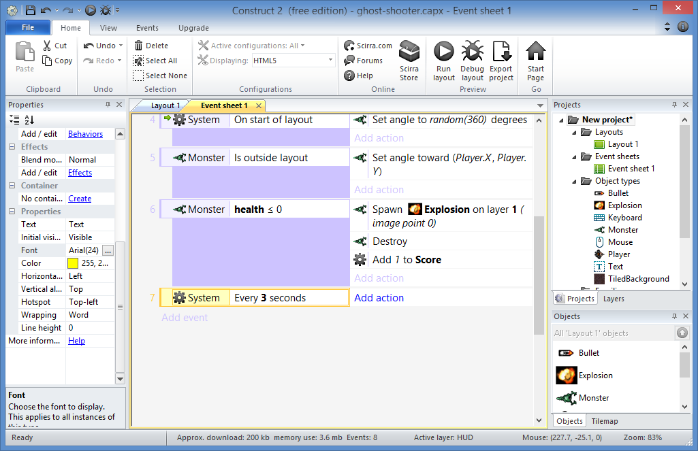
Spawn Monsters: Step 5
Click to Add Action

Slide 56
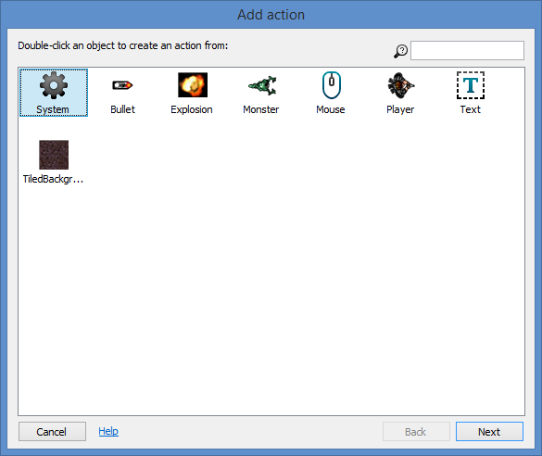
Spawn Monsters: Step 6
Select
“System”
then
Next!

Slide 57
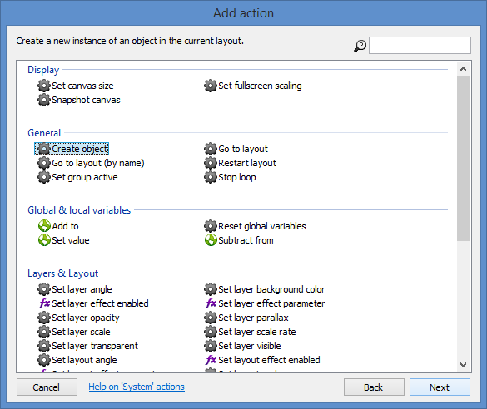
Spawn Monsters: Step 7
Select
“Create object”
then
Next!

Slide 58
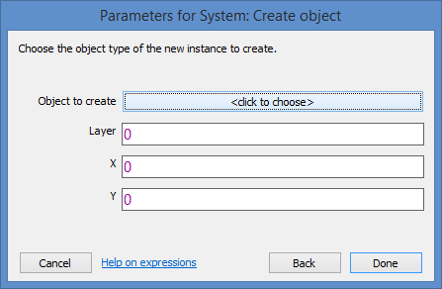
Spawn Monsters: Step 8
<click to choose>

Slide 59
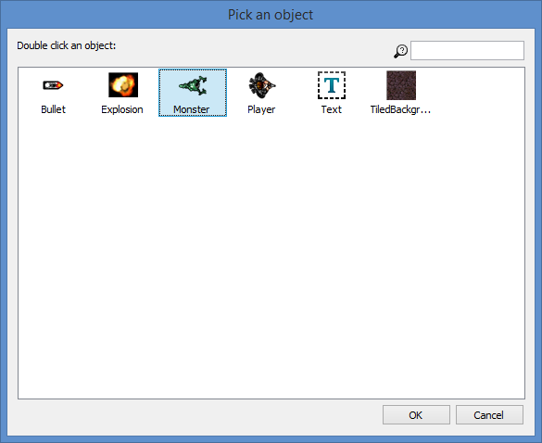
Spawn Monsters: Step 9
Select
“Monster”
then
OK!

Slide 60
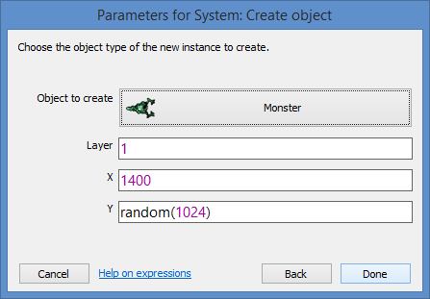
Spawn Monsters: Step 10
Enter:
Layer = 1
X = 1400
Y = random(1024)
Done!

Slide 61
Spawn Monsters: Done!

Slide 62
25. Destroying the Player ☹

Slide 63
Destroy Player: Step 1
Click to Add Event

Slide 64
Destroy Player: Step 2
Select
“Monster”
then
Next!

Slide 65
Destroy Player: Step 3
Select
“On collision with another object”
then
Next!

Slide 66
Destroy Player: Step 4
<click to choose>

Slide 67
Destroy Player: Step 5
Select
“Player”
then
OK!

Slide 68
Destroy Player: Step 6
Done!

Slide 69
Destroy Player: Step 7
Click to Add Action

Slide 70
Destroy Player: Step 8
Select
“Player”
then
Next!

Slide 71
Destroy Player: Step 9
Select
“Destroy”
then
Done!

Slide 72
Destroy Player: Done!

Slide 73
Wrap-Up

Slide 74
Construct 2 Tutorials
Online: http://www.scirra.com/tutorials
Notes:
Construct 2 Tutorials
Online: http://www.scirra.com/tutorials

Slide 75
Construct 2 Forum & FB group
Forum: https://www.scirra.com/forum/
FB: https://www.facebook.com/groups/construct2devs/
Notes:
Construct 2 Forum & FB group
Forum: https://www.scirra.com/forum/
FB: https://www.facebook.com/groups/construct2devs/

Slide 76
Contact
Email: shchowd@microsoft.com  Twitter: @shahedC
Notes:
Contact
Web: OnekSoft.com
Email: games@OnekSoft.com
Twitter: @OnekSoftGames
Microsoft email: shchowd@microsoft.com
Personal Twitter: @shahedC
R&D: OnekSoftLabs.com
Dev Blog: WakeUpAndCode.com
FB: http://facebook.com/groups/XboxOneIndieDevs

