Slide 1


C# Crash Course
For Beginners
By Shahed Chowdhuri
Sr. Technical Evangelist
WakeUpAndCode.com
@shahedC
Notes:
Title Page: C# Crash Course
For Beginners
By Shahed Chowdhuri
Senior Technical Evangelist
Blog: WakeUpAndCode.com
Twitter: @shahedC

Slide 2
Agenda
Introduction
> Variables, Operators & Loops
> Classes & Methods
> Files & Exceptions
Additional Topics
Notes:
Agenda
Introduction
> Variables, Operators & Loops
> Classes & Methods
> Files & Exceptions
Additional Topics

Slide 3



My Background
Period | Background/Experience
1997 – present | Microsoft web/software development
2011 | XNA games on XBLIG for Xbox 360 2D Math Panic Angry Zombie Ninja Cats
2012 | Tools for XNA developers XBLIG Sales Data Analyzer (OnekSoftLabs.com) XNA Basic Starter Kit (CodePlex)
Online: http://facebook.com/OnekSoftGames
Notes:
My Background
1997 – present: Microsoft web/software development
2011: XNA games on XBLIG for Xbox 360
2D Math Panic
Angry Zombie Ninja Cats
2012: Tools for XNA developers
XBLIG Sales Data Analyzer (OnekSoftLabs.com)
XNA Basic Starter Kit (CodePlex)
Online: http://facebook.com/OnekSoftGames

Slide 4
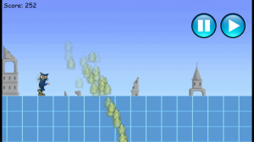
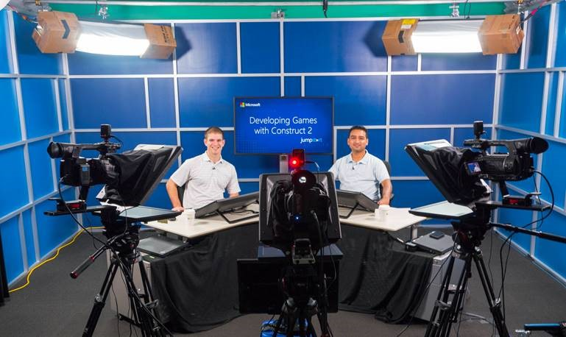
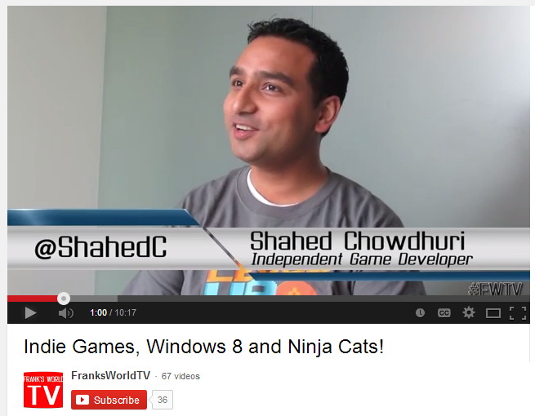
My Background (continued)
Period | Background/Experience
2013 | Ninja Cat Runner on Win8, WP8, Web (Construct 2) Video Q&A with MS Tech Evangelist Frank La Vigne Founder/Admin of FB groups: Construct2, Xbox One & Unity Indie Devs Started Public Speaking in DC area and East Coast
2014 | Public Speaking on Indie Game Development Joined Microsoft as a Sr. Technical Evangelist Gallant Glider on Win8, WP8, Web (Construct 2 → Universal App)
Video Q&A: http://youtu.be/lRjrQPvVOpo
MVA: http://aka.ms/DevGames-Const2
Notes:
My Background (continued)
2013
Ninja Cat Runner on Win8, WP8, Web (Construct 2)
Video Q&A with MS Tech Evangelist Frank La Vigne
Founder/Admin of FB groups: Construct2, Xbox One & Unity Indie Devs
Started Public Speaking in DC area and East Coast
2014
Public Speaking on Indie Game Development
Joined Microsoft as a Sr. Technical Evangelist
Gallant Glider on Win8, WP8, Web (Construct 2 → Universal App)
Video Q&A: http://youtu.be/lRjrQPvVOpo
MVA: http://aka.ms/DevGames-Const2

Slide 5
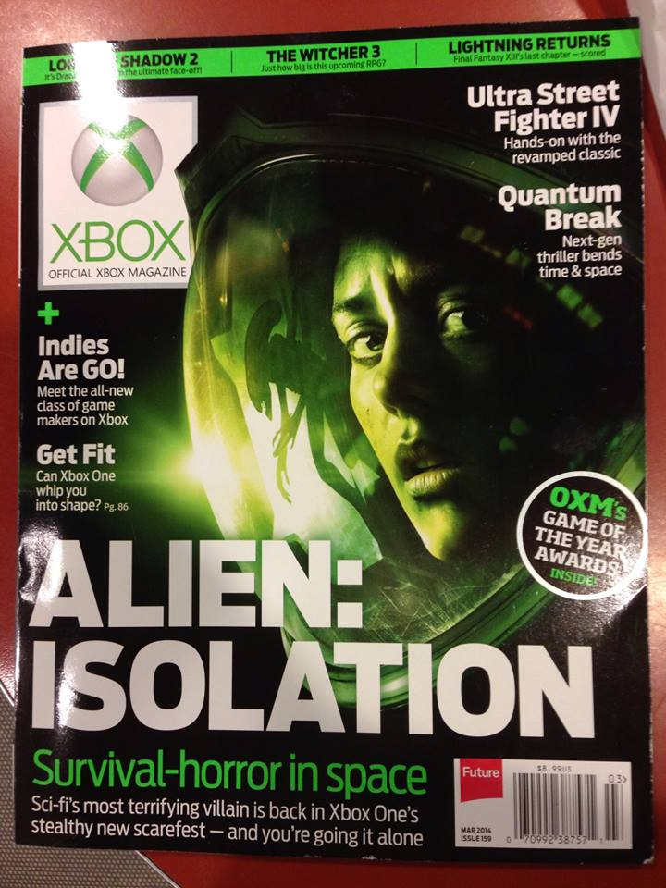
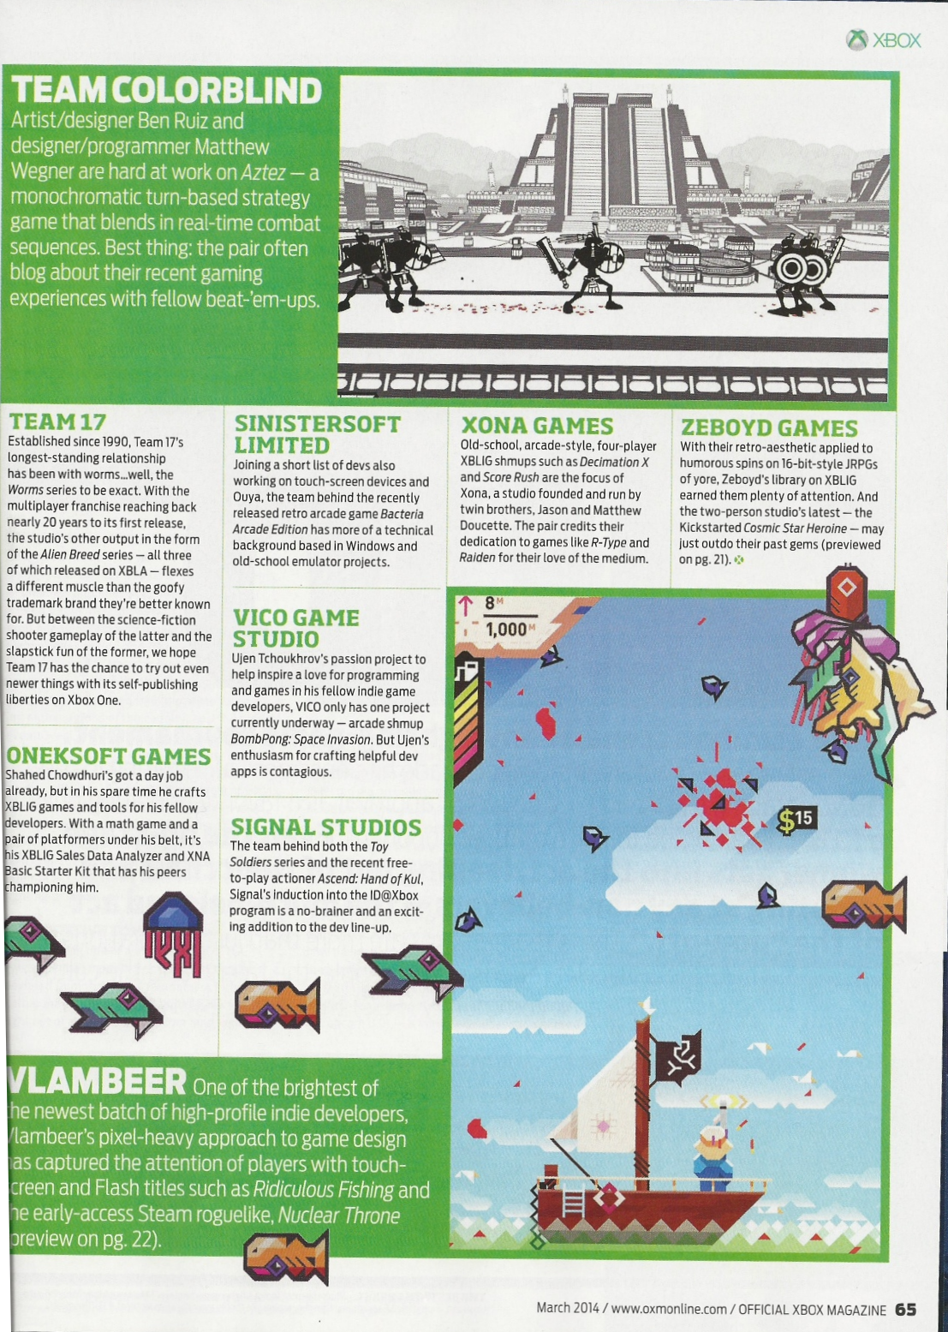

Official Xbox Magazine
`
Source: Official Xbox Magazine, March 2014, Page 65
Notes:
Official Xbox Magazine, March 2014, Page 65
"Shahed Chowdhuri's got a day job already,
but in his spare time he crafts XBLIG games and tools for his fellow developers.”
“With a math game and a pair of platformers under his belt,
it's his XBLIG Sales Data Analyzer and XNA Basic Starter Kit that has his peers championing him."

Slide 6

Introduction
Notes:
Intro to Visual Studio

Slide 7
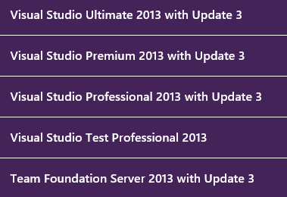



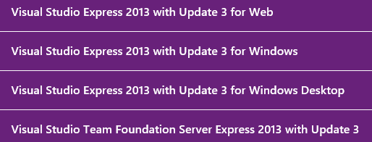
Download & Install Visual Studio
http://www.visualstudio.com/downloads
90-day Trial
Express (free)

Slide 8
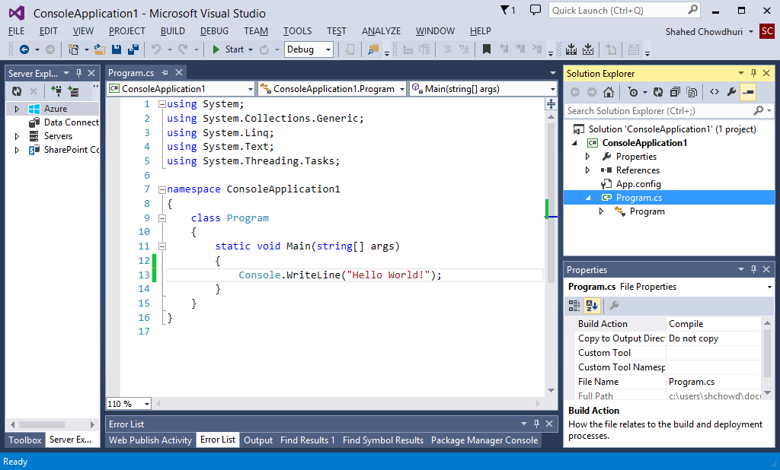
Visual Studio UI (User Interface)
Code Editor
Start (Run)
Solution
Explorer
Toolbar
References
Properties
Panel
Ouput

Slide 9
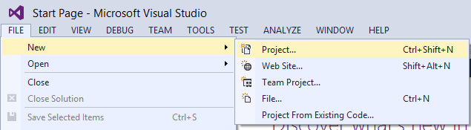
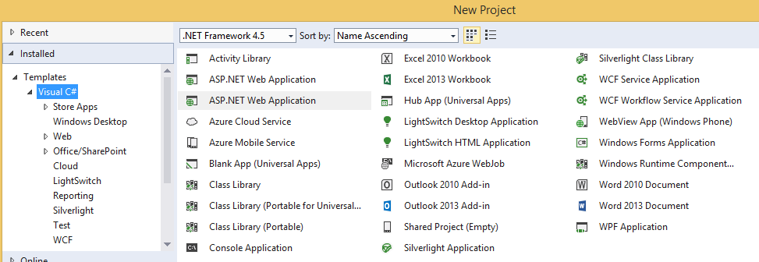
Why Learn C#?
Hint: In Visual Studio, click File → New → Project

Slide 10
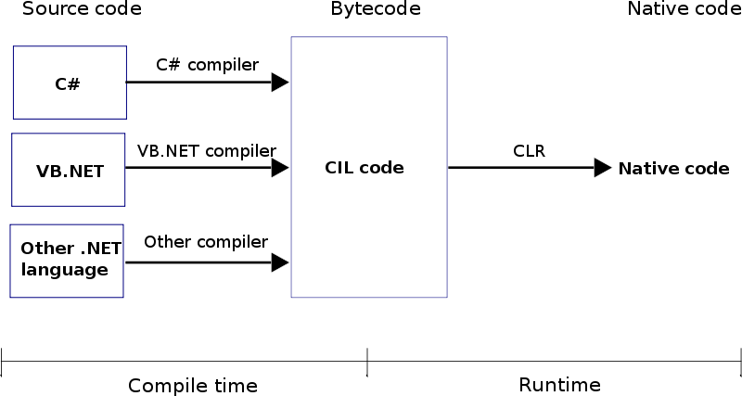
How Does It Work?
Source: http://www.dotnetspark.com/tutorialpic/clr.png

Slide 11
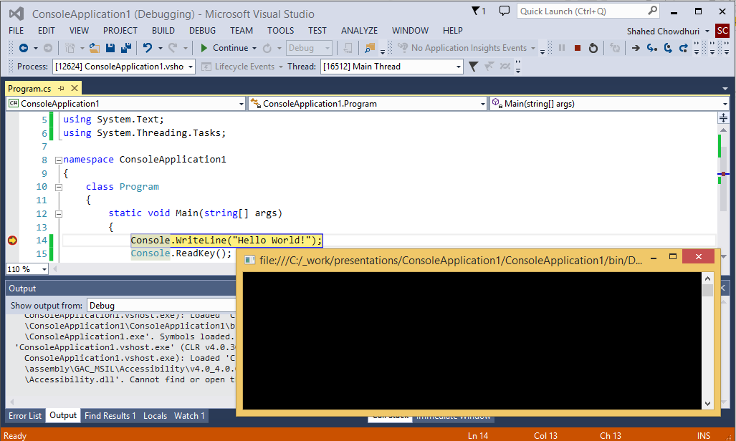
Demo (with debugging/breakpoints)
Start/Continue
Hint: Press F9 on any statement to toggle breakpoints

Slide 12
Variables, Operators & Loops
Notes:
Variables, Operators & Loops

Slide 13
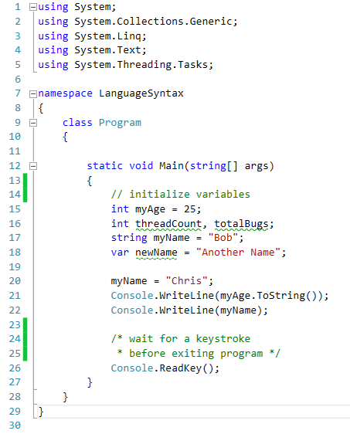
C# Language Syntax
using statements
namespace
Method ( )
class
Variables
// 1-line comment
Data Types
Integer
String
var?
Assignment
Output
/* multi-line
comments */

Slide 14
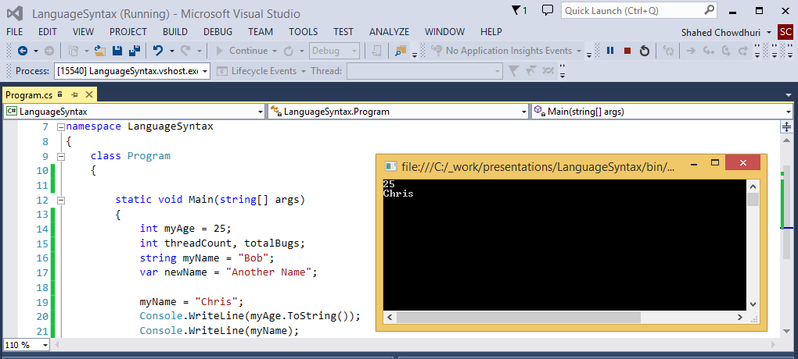
Demo (language syntax)

Slide 15
Operators (Math, Assignment)
Type | Operators
Unary Postfix Operators | ++ --
Unary Prefix Operators | ++ -- + -
Multiplicative Operators | * / % (modulus)
Additive Operators | + -
Assignment Operators | =
Precedence
higher
lower

Slide 16
Logical Operators
Type | Operators
Equality | == !=
Logical AND | &
Logical XOR | ^
Conditional AND | &&
Conditional OR | ||
Conditional Ternary Operator | ?:

Slide 17
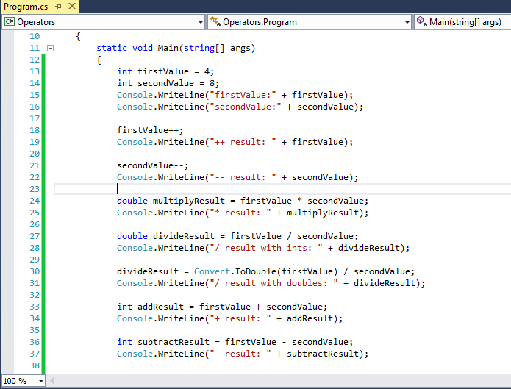
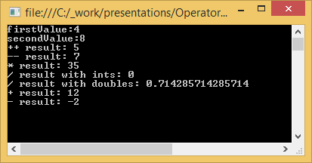
Demo (operators)

Slide 18
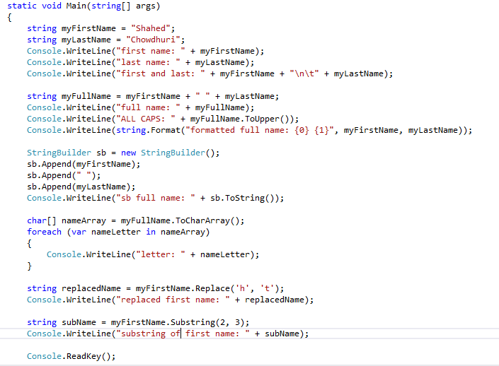
Strings
Literal
Concatenate
Special Characters
Declare
& Assign
StringBuilder
string.Format()
Char Array
String
Functions

Slide 19
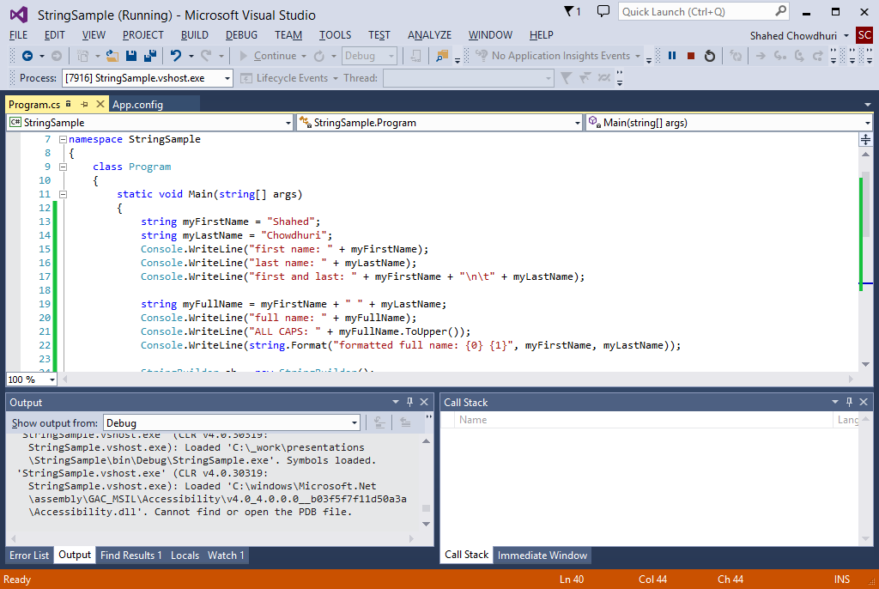
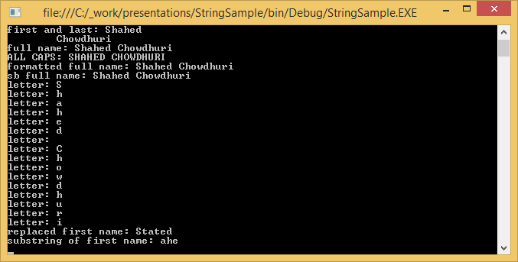
Demo (strings)

Slide 20
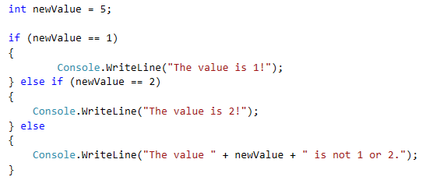
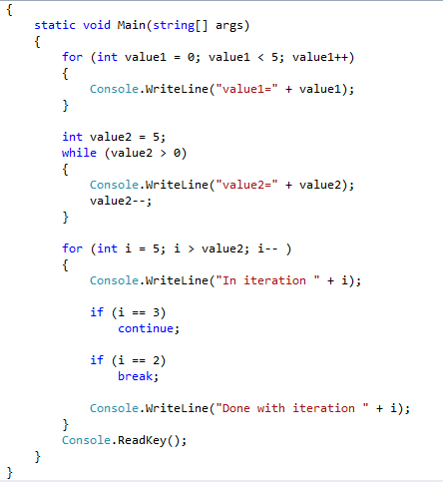
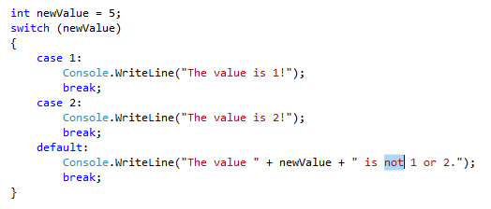
Loops, etc
if/else
blocks
for loop
switch-case statements
while loop
continue
break
default
break

Slide 21
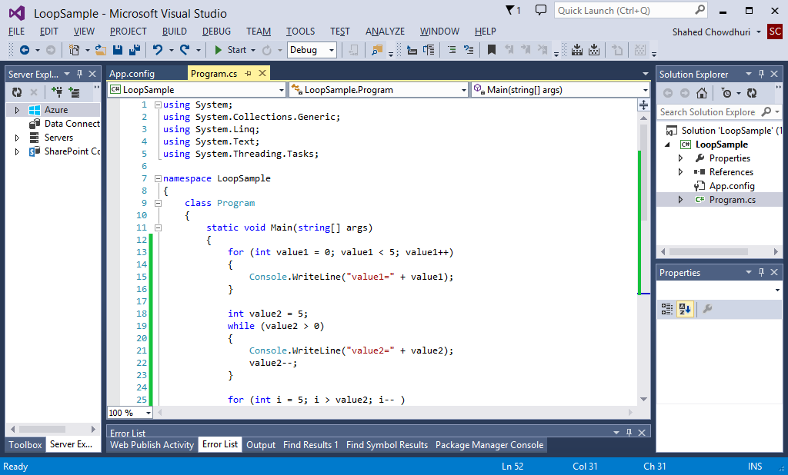
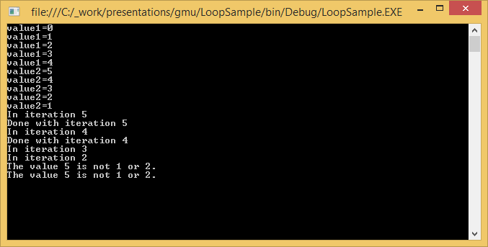
Demo (loops, etc)

Slide 22
Classes & Methods
Notes:
Arrays, Objects & Methods

Slide 23
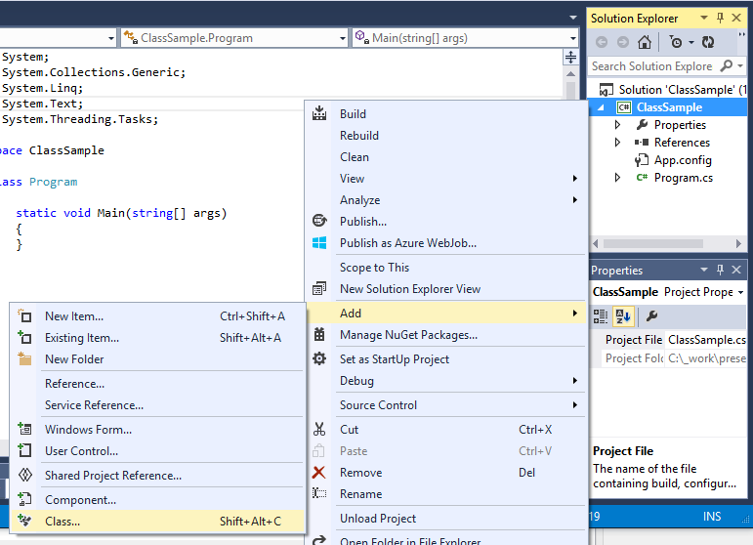
Creating a New Class
1
Right-click project
Click Add
Click Class…
3
2

Slide 24
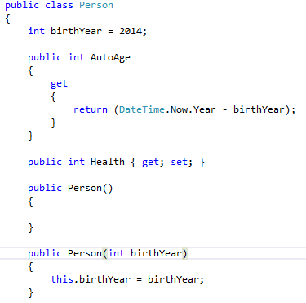
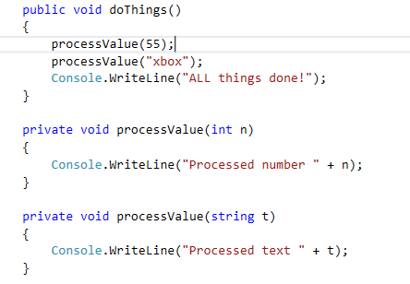
Parts of a Class
class declaration
Instance
variable
properties
public method
constructors
private
methods
(overloaded)
this keyword

Slide 25
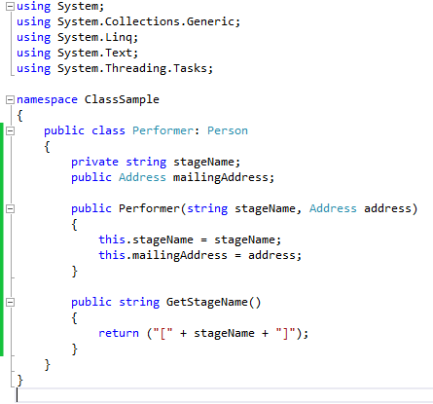
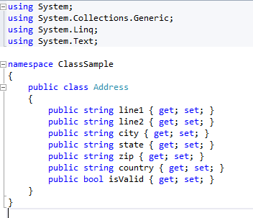
Inheritance & Complex Objects
private variable
parent class
complex
object
public
method

Slide 26
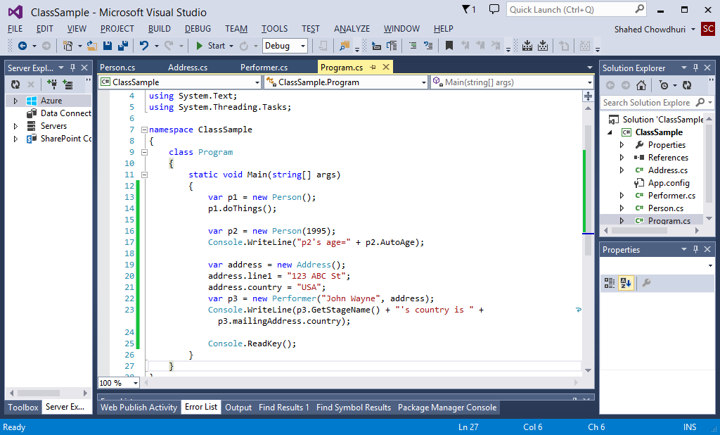
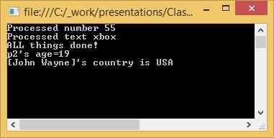
Demo (classes)

Slide 27
Files & Exceptions
Notes:
Namespaces, Files & Exceptions

Slide 28
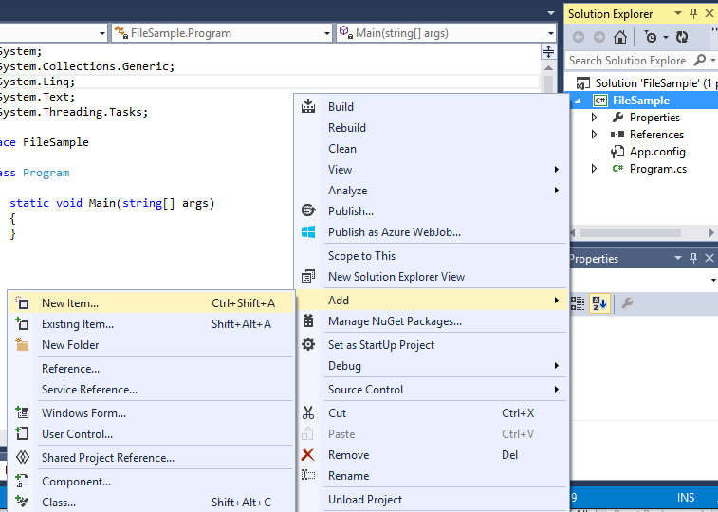
Add Text File
1
Right-click project
Click Add
Click New Item…
3
2

Slide 29
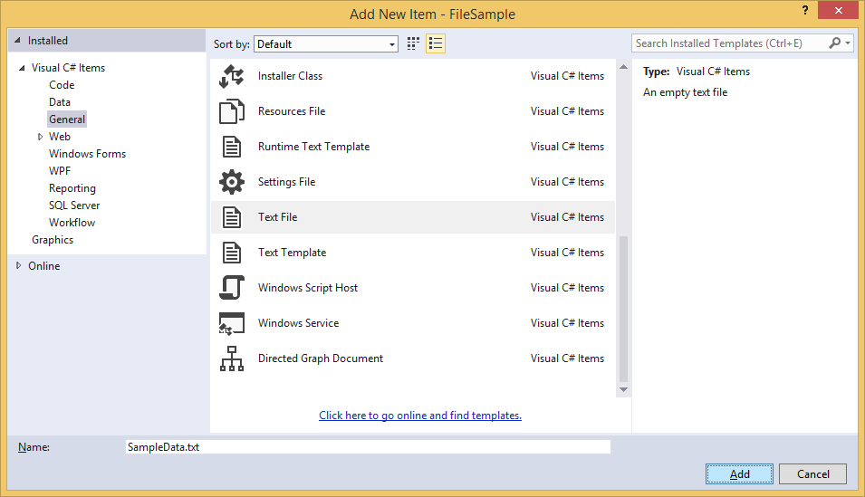
Name New Text File
1
Select “General”
Select “Text File”
Name it.
2
3

Slide 30
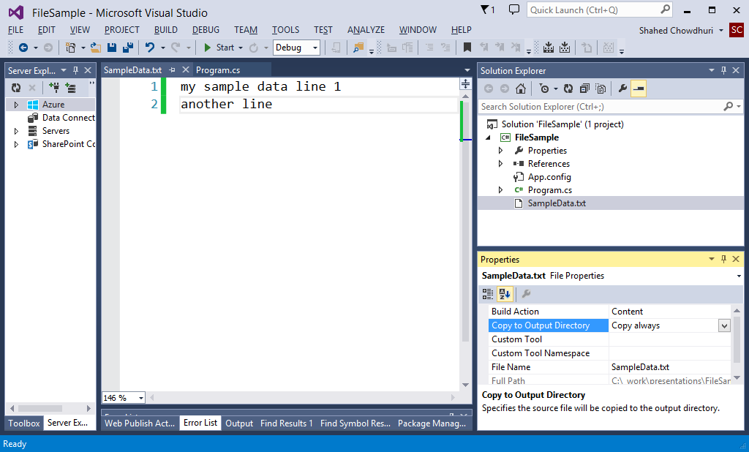
Update Text File And Properties
Set to
“Copy always”
enter sample data

Slide 31
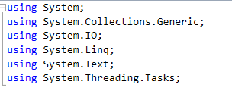
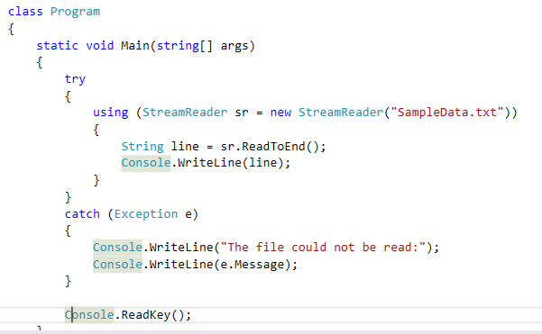
Read File, Handle Exceptions
Use System.IO namespace for
StreamReader
Handle possible
exceptions with
try-catch block

Slide 32
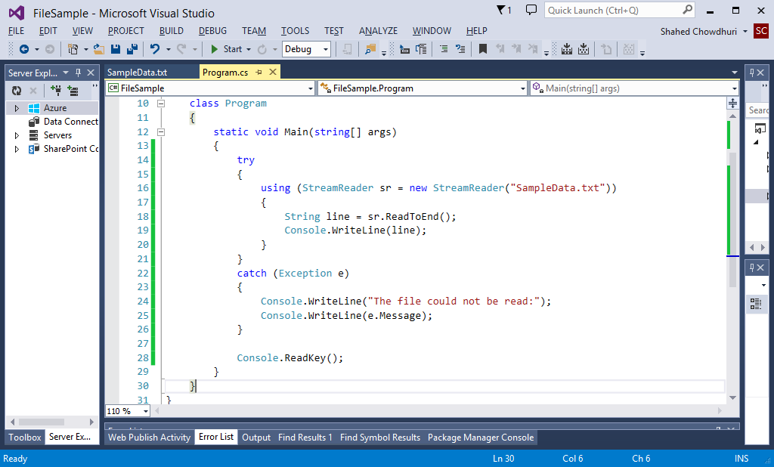
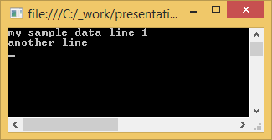
Demo (read text file)

Slide 33
Additional Topics
Notes:
Additional Topics

Slide 34
Also Learn…
Enumerators, e.g. enum keyword
Extension Methods
Generics
List, e.g. List<int>
Dictionary, e.g. Dictionary<string, string>
Linq

Slide 35

Videos on Microsoft Virtual Academy
C# Fundamentals for Absolute Beginners:
http://www.microsoftvirtualacademy.com/training-courses/c-fundamentals-for-absolute-beginners
Programming in C# Jump Start:
http://www.microsoftvirtualacademy.com/training-courses/developer-training-with-programming-in-c

Slide 36
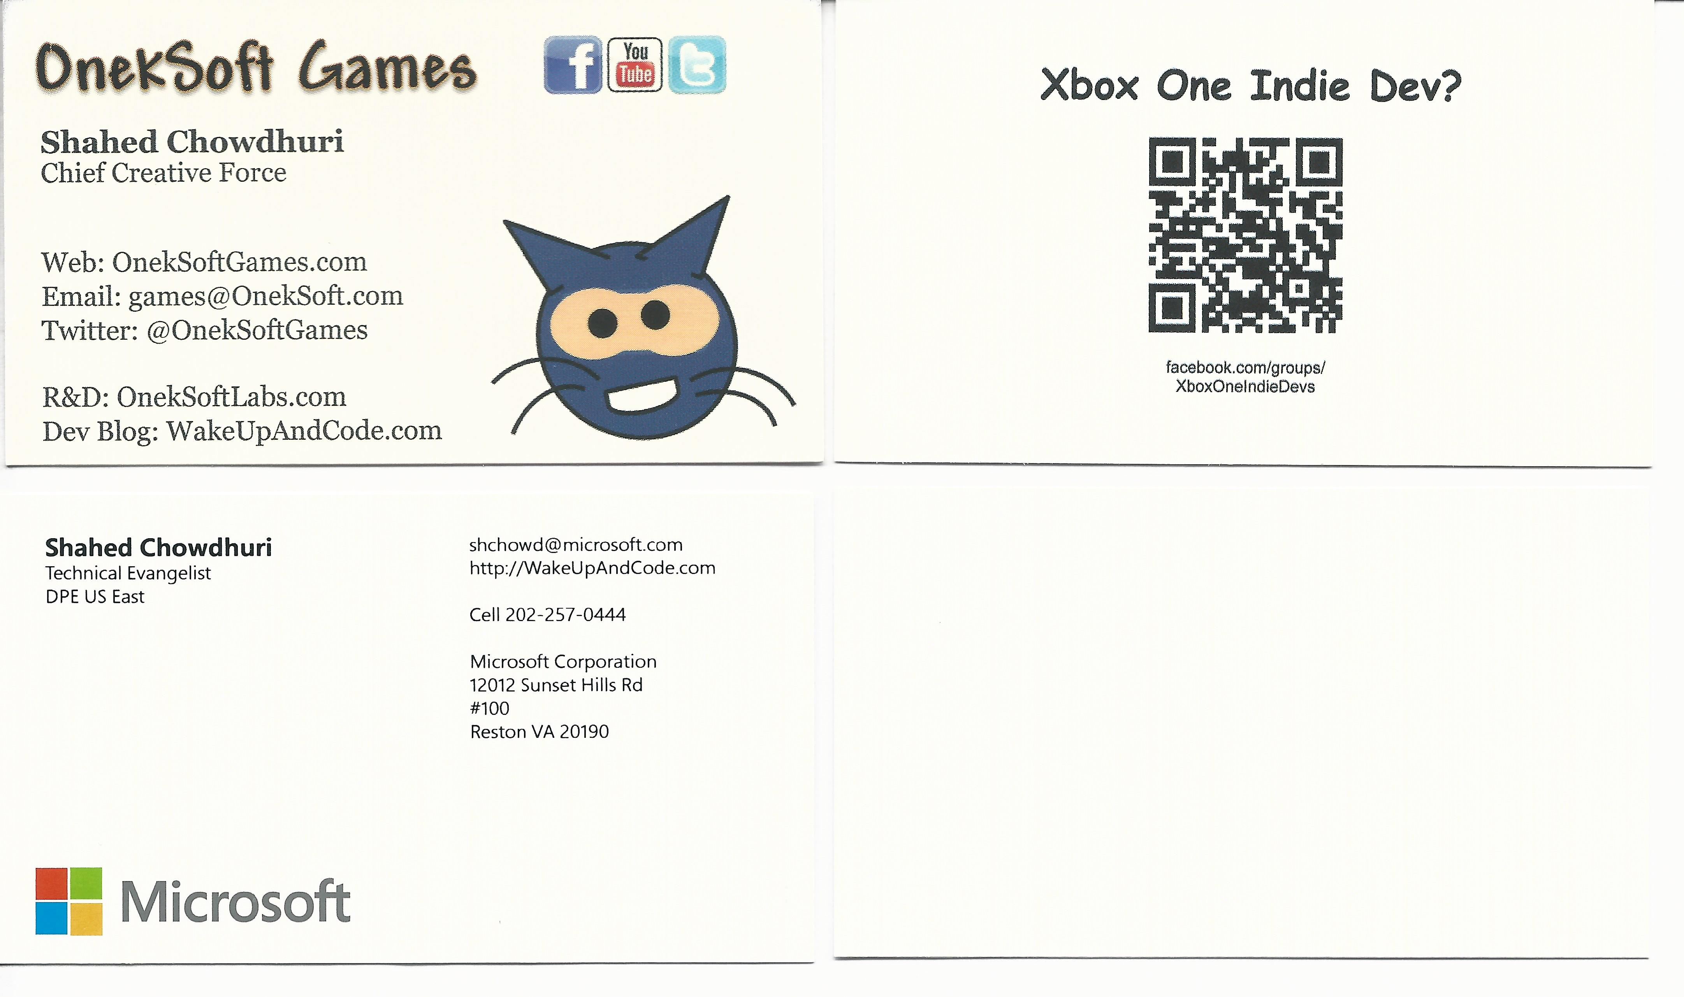
Contact
Email: shchowd@microsoft.com  Twitter: @shahedC
Notes:
Contact
Web: OnekSoft.com
Email: games@OnekSoft.com
Twitter: @OnekSoftGames
Microsoft email: shchowd@microsoft.com
Personal Twitter: @shahedC
R&D: OnekSoftLabs.com
Dev Blog: WakeUpAndCode.com

