Slide 1
Intro to Indie Game Development
Windows  Web  Xbox  Mobile
By Shahed Chowdhuri
Sr. Technical Evangelist
WakeUpAndCode.com
@shahedC
Notes:
Title Page: Intro to Indie Game Development Windows  Web  Xbox  Mobile
By Shahed Chowdhuri
Technical Evangelist
Blog: WakeUpAndCode.com
Twitter: @shahedC

Slide 2
What’s Going On
URL: http://tinyurl.com/msdcmeetup
Notes:
What’s Going On
URL: http://tinyurl.com/msdcmeetup

Slide 3
Agenda
Intro + XNA/XBLIG
> Construct 2
> C++ and DirectX
> Unity with C#
Being an Indie in the Real World
Notes:
Agenda
Intro + XNA/XBLIG
> Construct 2
> C++ and DirectX
> Unity with C#
Being an Indie in the Real World
* Learn about how you can build games for Windows, Web and Xbox platforms.
* Visual tools like Construct 2, programming with C++ and DirectX, and using your C# experience with Unity.
* Not a deep dive into each topic, but enough info for you to get started and pick a direction.

Slide 4
My Background
Period | Background/Experience
1997 – present | Microsoft web/software development
2011 | XNA games on XBLIG for Xbox 360 2D Math Panic Angry Zombie Ninja Cats
2012 | Tools for XNA developers XBLIG Sales Data Analyzer (OnekSoftLabs.com) XNA Basic Starter Kit (CodePlex)
Online: http://facebook.com/OnekSoftGames
Notes:
My Background
1997 – present: Microsoft web/software development
2011: XNA games on XBLIG for Xbox 360
2D Math Panic
Angry Zombie Ninja Cats
2012: Tools for XNA developers
XBLIG Sales Data Analyzer (OnekSoftLabs.com)
XNA Basic Starter Kit (CodePlex)
Online: http://facebook.com/OnekSoftGames

Slide 5
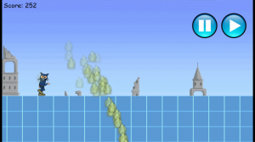
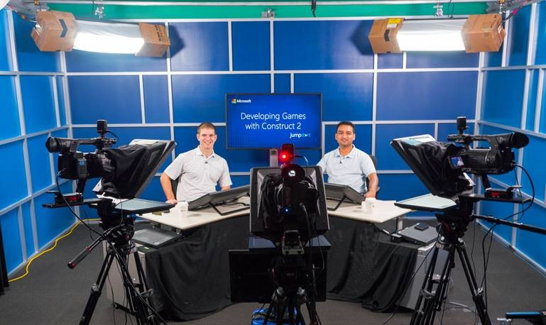
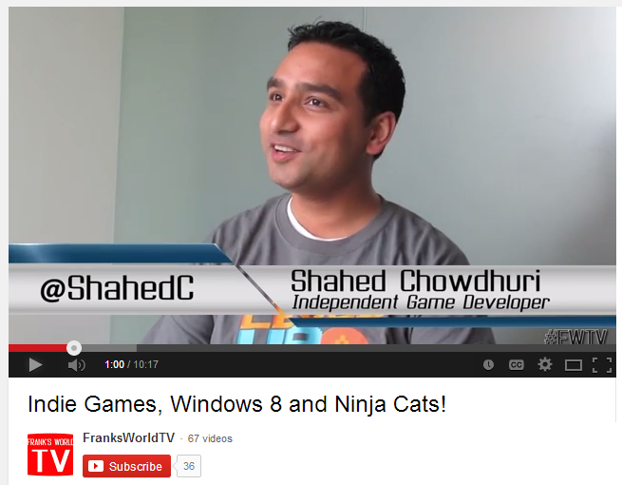
My Background (continued)
Period | Background/Experience
2013 | Ninja Cat Runner on Win8, WP8, Web (Construct 2) Video Q&A with MS Tech Evangelist Frank La Vigne Founder/Admin of FB groups: Construct2, Xbox One & Unity Indie Devs Started Public Speaking in DC area and East Coast
2014 | Public Speaking on Indie Game Development Joined Microsoft as a Sr. Technical Evangelist Gallant Glider on Win8, WP8, Web (Construct 2 → Universal App)
Video Q&A: http://youtu.be/lRjrQPvVOpo
MVA: http://aka.ms/DevGames-Const2
Notes:
My Background (continued) 2013
Ninja Cat Runner on Win8, WP8, Web (Construct 2)
Video Q&A with MS Tech Evangelist Frank La Vigne
Founder/Admin of FB groups: Construct2, Xbox One & Unity Indie Devs
Started Public Speaking in DC area and East Coast
2014
Public Speaking on Indie Game Development
Joined Microsoft as a Sr. Technical Evangelist
Gallant Glider on Win8, WP8, Web (Construct 2 → Universal App)
Video Q&A: http://youtu.be/lRjrQPvVOpo
MVA: http://aka.ms/DevGames-Const2

Slide 6
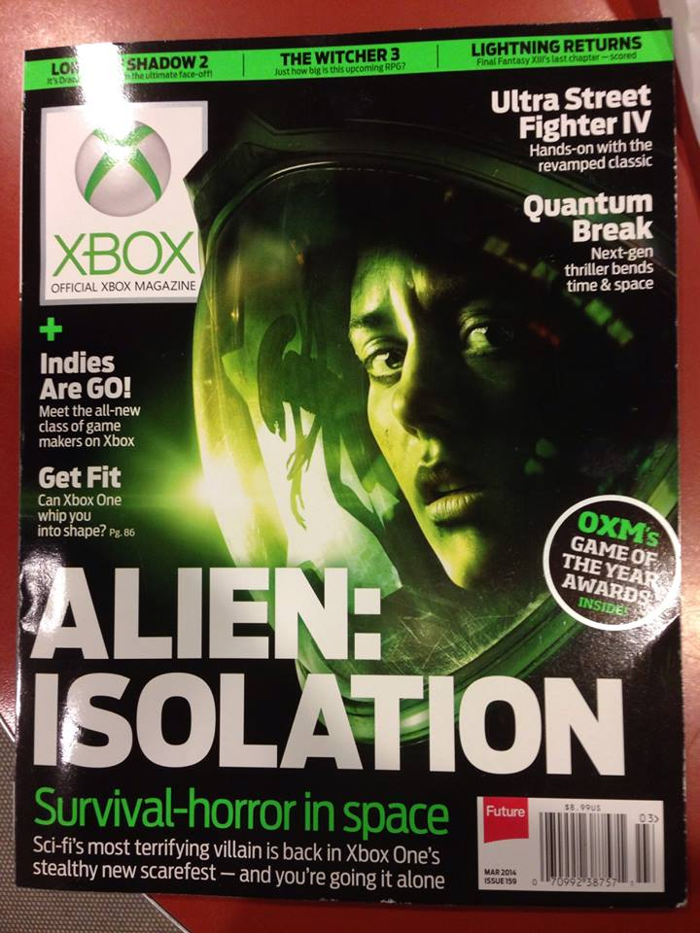
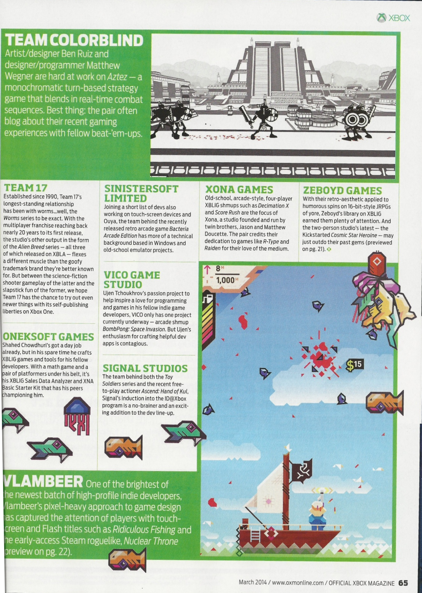
Official Xbox Magazine
`
Source: Official Xbox Magazine, March 2014, Page 65
Notes:
Official Xbox Magazine, March 2014, Page 65
"Shahed Chowdhuri's got a day job already,
but in his spare time he crafts XBLIG games and tools for his fellow developers.”
“With a math game and a pair of platformers under his belt,
it's his XBLIG Sales Data Analyzer and XNA Basic Starter Kit that has his peers championing him."

Slide 7
Tools & Technologies
+
Notes:
Tools & Technologies
Visual Studio 2013
Windows 8
Windows Phone 8
Microsoft Visual C#
Xbox One
Construct 2
C++ and DirectX 11.1+
HTML5/CSS/JS
Unity
Paint.net
Blender

Slide 8
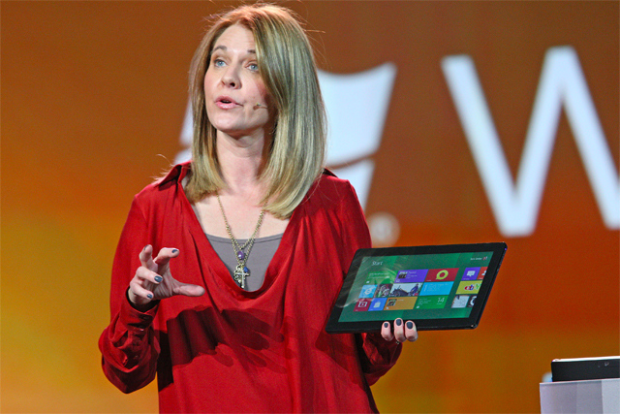
Why Windows 8?
"We surpassed 200 million licenses now on Windows 8, which is pretty stunning," she said, adding that while the platform has received a lot of traction, there is still a lot more work to do.
Tami Reller, Microsoft's executive vice president of marketing
Notes:
Why Windows 8?
Tami Reller, Microsoft's executive vice president of marketing
"We surpassed 200 million licenses now on Windows 8”

Slide 9
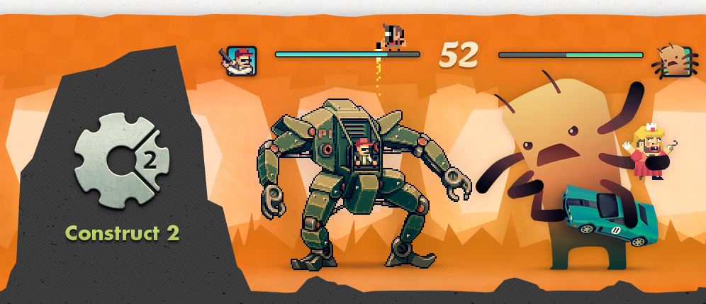
Construct 2
Source: https://www.scirra.com/Construct 2
Notes:
Construct 2
Source: https://www.scirra.com/Construct 2

Slide 10
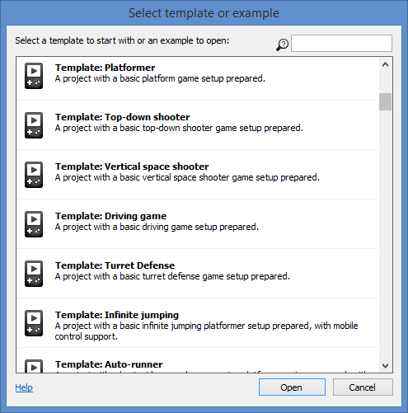
Construct 2 – Getting Started
Choose a genre or sub-genre, use a template, download complete examples
Templates
Platformer
Top-down shooter
Vertical space shooter
Driving Game
Turret Defense
Infinite jumping
Auto-runner
etc.
Notes:
Construct 2 – Getting Started
Choose a genre or sub-genre, use a template, download complete examples
Templates
Platformer
Top-down shooter
Vertical space shooter
Driving Game
Turret Defense
Infinite jumping
Auto-runner
etc.

Slide 11
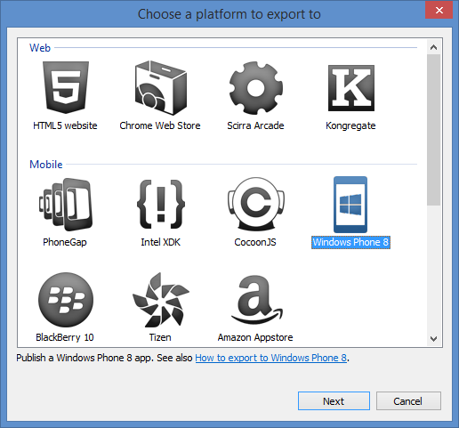
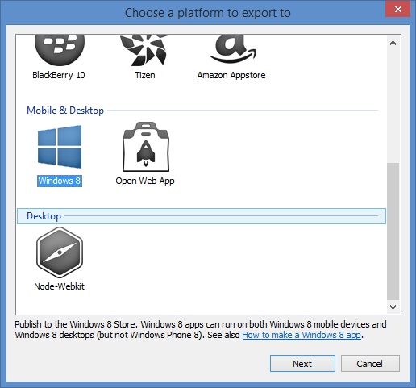
Construct 2: Export
Multiplatform Support
Notes:
Construct 2: Export
Multiplatform Support
Web (HTML5 website, etc)
Mobile (PhoneGap, WP8, etc)
Desktop (Windows 8)

Slide 12
Construct 2 publishing
Notes:
Construct 2 publishing
HTML5 website -> web server
Scirra Arcade
WP8 or Windows 8
PhoneGap -> iOS or Android

Slide 13
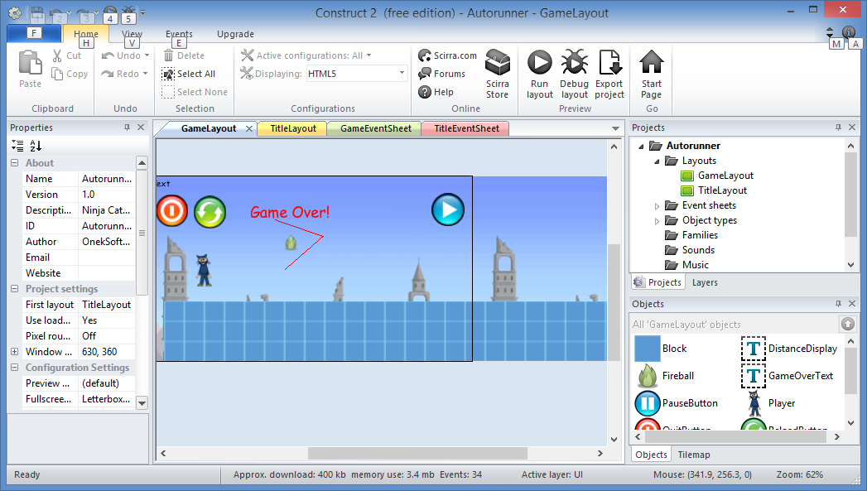
Construct 2 - demo
Properties
Layouts and Event Sheets
Online: http://OnekSoftLabs.com/ninja-cat-runner
Notes:
Construct 2 – demo
Online: http://OnekSoftLabs.com/ninja-cat-runner

Slide 14
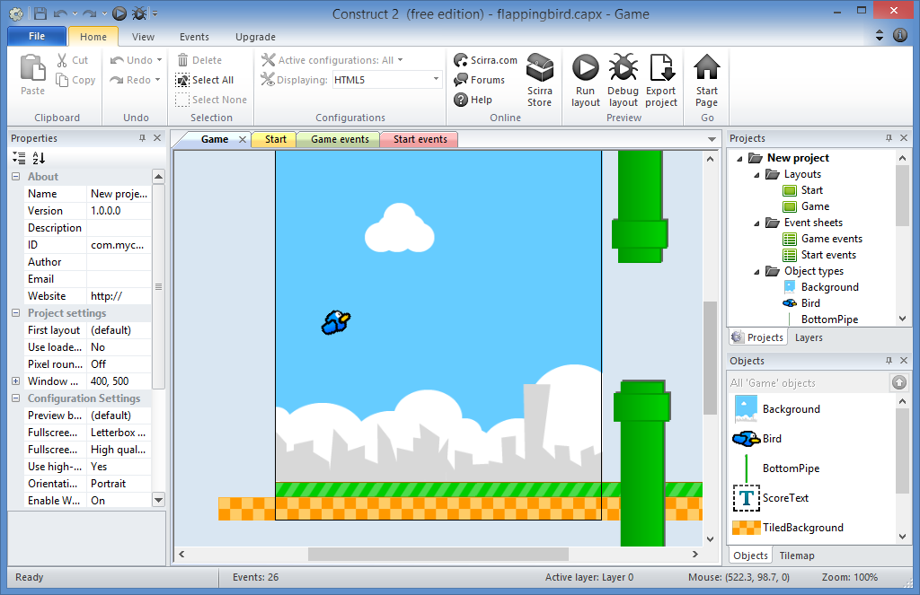
Flappy Bird clone
Tutorial:
https://www.scirra.com/tutorials/857/flappy-birds-clone-in-10-minutes
Notes:
Flappy Bird clone
Tutorial:
https://www.scirra.com/tutorials/857/flappy-birds-clone-in-10-minutes

Slide 15
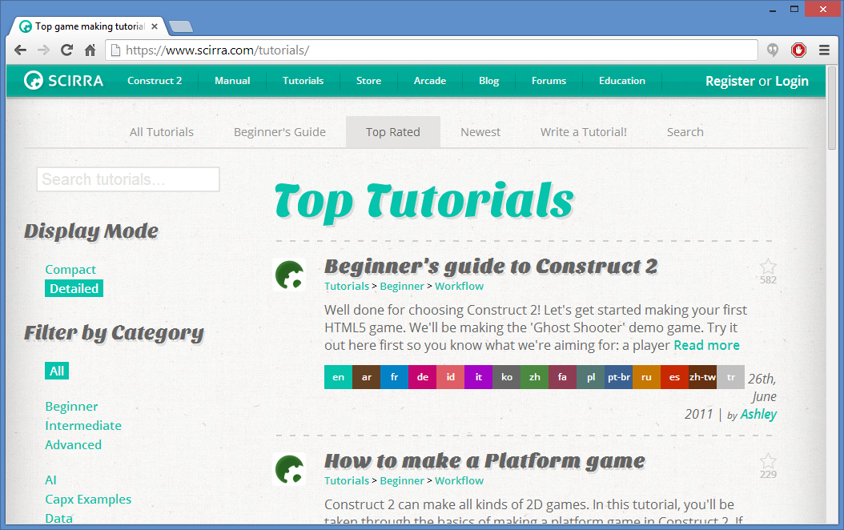
Construct 2 Tutorials
Online: http://www.scirra.com/tutorials
Notes:
Construct 2 Tutorials
Online: http://www.scirra.com/tutorials

Slide 16
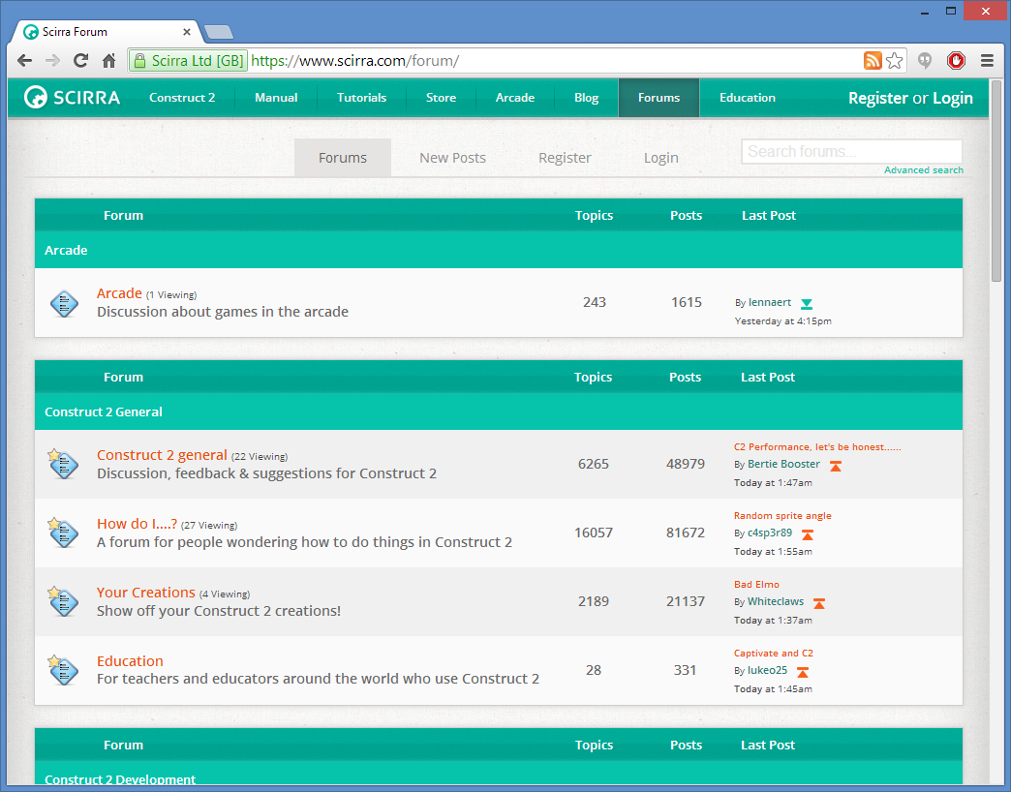
Construct 2 Forum & FB group
Forum: https://www.scirra.com/forum/
FB: https://www.facebook.com/groups/Construct 2devs/
Notes:
Construct 2 Forum & FB group
Forum: https://www.scirra.com/forum/
FB: https://www.facebook.com/groups/Construct 2devs/

Slide 17
C++, DirectX, etc
+
DirectX Tool Kit (aka DirectX TK)
DirectX Tex (texture processing library)
RandomChaos game engine
from former XNA/DirectX MVP Charles Humphrey
Target Windows 8 or Xbox One
Notes:
C++, DirectX, etc
DirectX Tool Kit (aka DirectX TK)
DirectX Tex (texture processing library)
RandomChaos game engine (from former MVP Charles Humphrey)
Target Windows 8 or Xbox One

Slide 18
Learning C++
New to C++? Read beginner books
Experienced with C++? Learn game programming
Coming from C#? Learn C++ from a C# coder’s perspective
More info: http://tinyurl.com/learn-cpp-directx
Notes:
Learning C++
New to C++? Read beginner books
Experienced with C++? Learn game programming
Coming from C#? Learn C++ from a C# coder’s perspective
More info: http://tinyurl.com/learn-cpp-directx

Slide 19
Learning DirectX
+
MSDN: http://msdn.microsoft.com/directx
Notes:
Learning DirectX
DirectX has a learning curve
Experience with OpenGL may help somewhat
C# and XNA background? You will have to unlearn some things
But there are things to make it better
MSDN: http://msdn.microsoft.com/directx

Slide 20
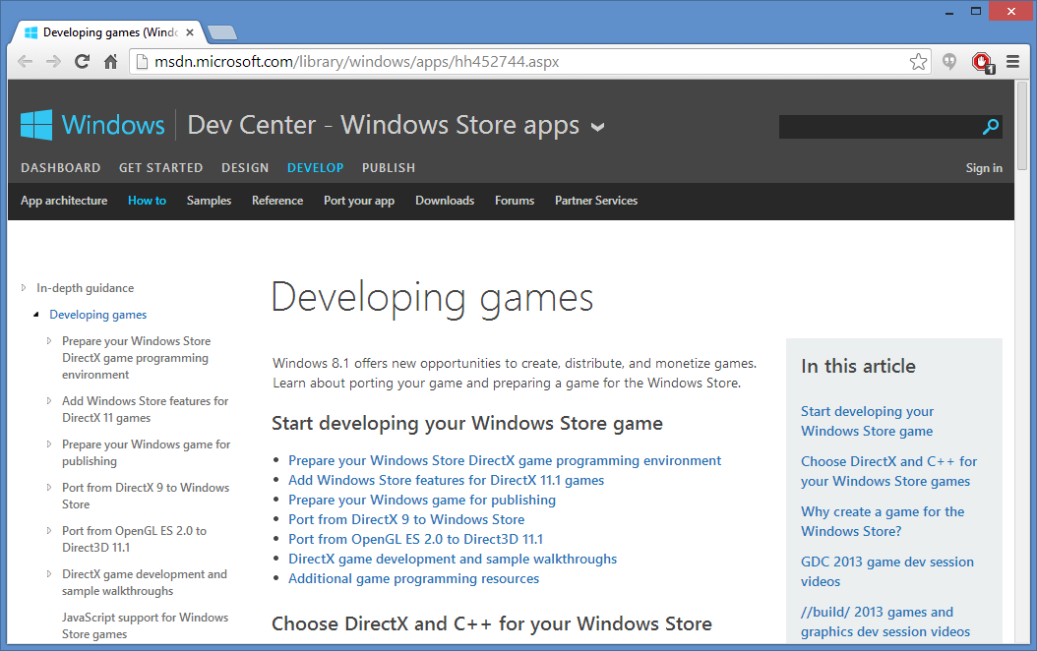
DirectX on MSDN
http://msdn.microsoft.com/library/windows/apps/hh452744.aspx
Notes:
DirectX on MSDN
http://msdn.microsoft.com/library/windows/apps/hh452744.aspx

Slide 21
DirectX TK and DirectX Tex
DirectX Tool Kit
“collection of helper classes for writing DirectX 11.x code in C++”
Features include SpriteBatch for “simple & efficient 2D sprite rendering” and SpriteFont for “bitmap based text rendering”
https://directxtk.codeplex.com/
DirectX Tex
“shared source library for reading and writing DDS [DirectDraw Surface] files, and performing various texture content processing operations”
http://directxtex.codeplex.com/
Notes:
DirectX TK and DirectX Tex
DirectX Tool Kit
“collection of helper classes for writing DirectX 11.x code in C++”
Features include SpriteBatch for “simple & efficient 2D sprite rendering” and SpriteFont for “bitmap based text rendering”
https://directxtk.codeplex.com/
DirectX Tex
“shared source library for reading and writing DDS [DirectDraw Surface] files, and performing various texture content processing operations”
http://directxtex.codeplex.com/

Slide 22
DirectX TK Sample
Source: http://code.msdn.microsoft.com/windowsapps
/DirectXTK-Simple-Sample-608bc274
Notes:
DirectX TK Sample
Source: http://code.msdn.microsoft.com/windowsapps/DirectXTK-Simple-Sample-608bc274

Slide 23
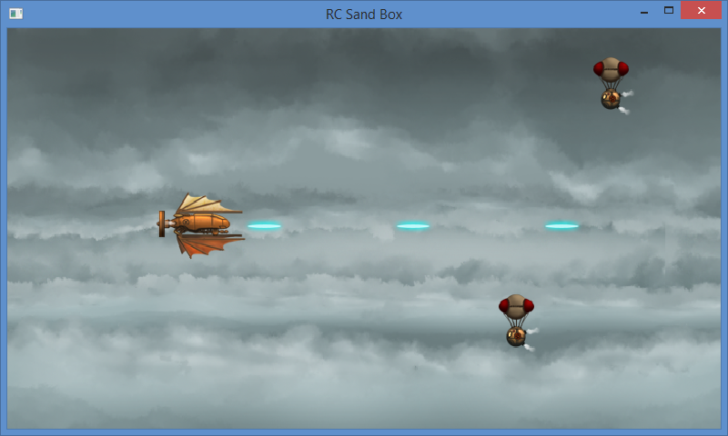
RandomChaos
Charles Humphrey’s open source C++ engine for DX11
Source: https://randomchaosdx11engine.codeplex.com/
Tutorial: http://davevoyles.azurewebsites.net/c-directx-11/
Notes:
RandomChaos
Charles Humphrey’s open source C++ engine for DX11
Source: https://randomchaosdx11engine.codeplex.com/
Tutorial: http://davevoyles.azurewebsites.net/c-directx-11/

Slide 24
Game Loop: Update-Draw
Run
Handle Input and Update
Stop
Startup
Shutdown
Loop
Draw/Render
Notes:
Game Loop: Update-Draw
Run→ [Startup] → [Update←→ Draw] → Stop → [Shutdown]

Slide 25
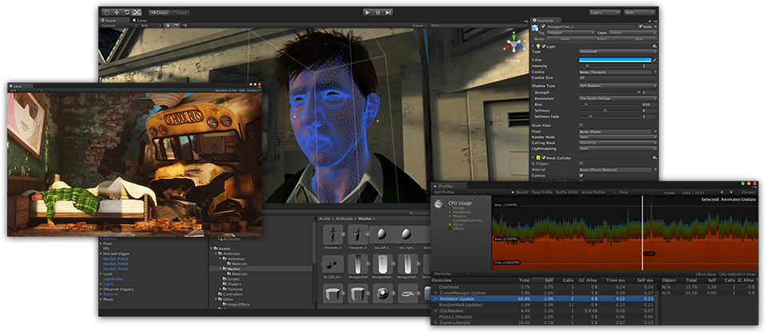
Unity
Source: http://unity3d.com/
Notes:
Unity3D
Source: http://unity3d.com/

Slide 26
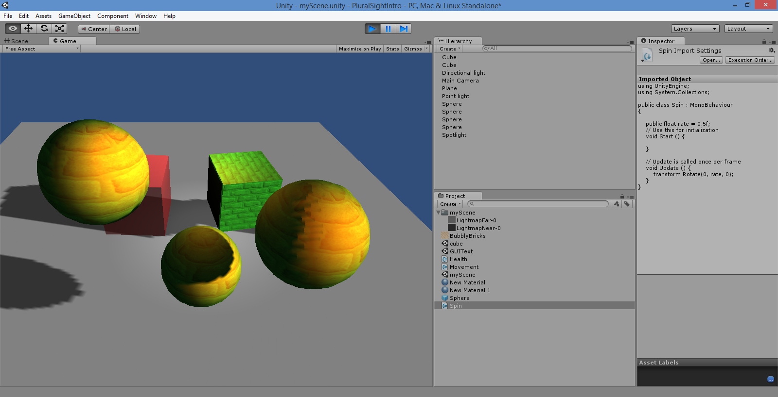
Unity UI
3D scene
C# script
Assets
More info: http://tinyurl.com/learn-unity-3d-2d
Notes:
Unity UI
Scripting: Boo, JavaScript, C#
More info: http://tinyurl.com/learn-unity-3d-2d

Slide 27
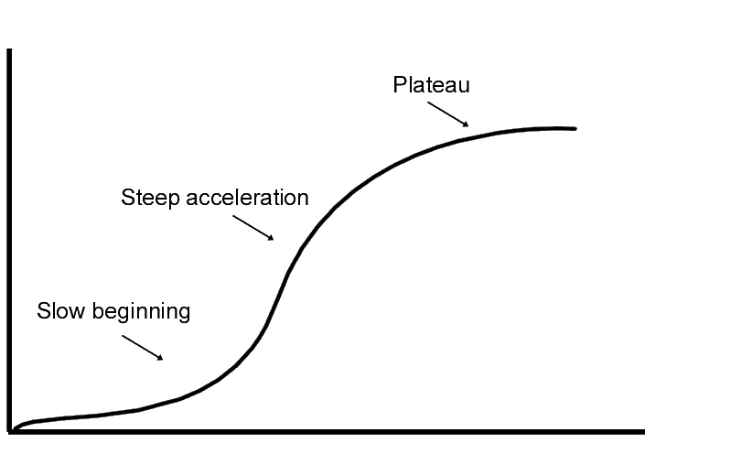
Unity: Things to Know
Learning curve
Create/Import models
Download/purchase models
Publish virtually anywhere!
Notes:
Unity: Things to Know
Learning curve for beginners
Need to create your own models
Or download/purchase pre-built models
Publish to Web, mobile, desktop, consoles

Slide 28
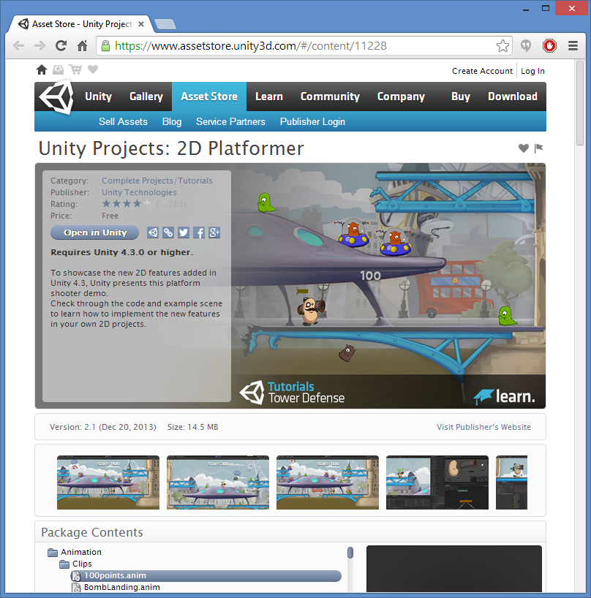
Unity 2D features
Announced for 4.3
Native 2D support
2D Platformer sample project available
Walkthrough videos available
Source: http://blogs.unity3d.com/2013/08/28/unity-native-2d-tools
Notes:
Unity 2D features
Announced for 4.3
Native 2D support
2D Platformer sample project available
Walkthrough videos available
Source: http://blogs.unity3d.com/2013/08/28/unity-native-2d-tools

Slide 29
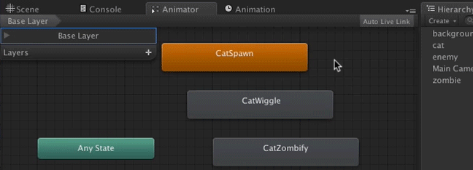
Unity 2D Tutorial
Step-by-step with screenshots
Source:
Christopher LaPollo
http://www.raywenderlich.com/u/clapollo
Notes:
Unity 2D TutorialAnnounced for 4.3
Step-by-step with screenshots
Source:
Christopher LaPollo
http://www.raywenderlich.com/u/clapollo

Slide 30
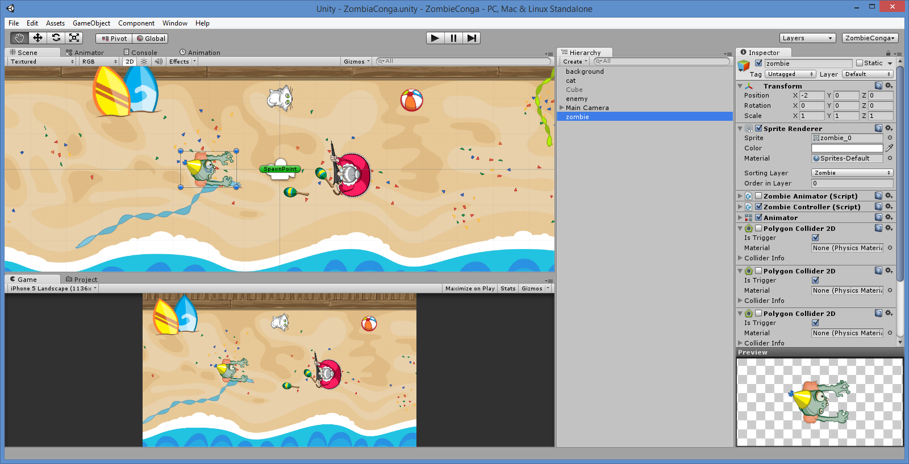
Zombie Conga demo
Notes:
Zombie Conga demo

Slide 31
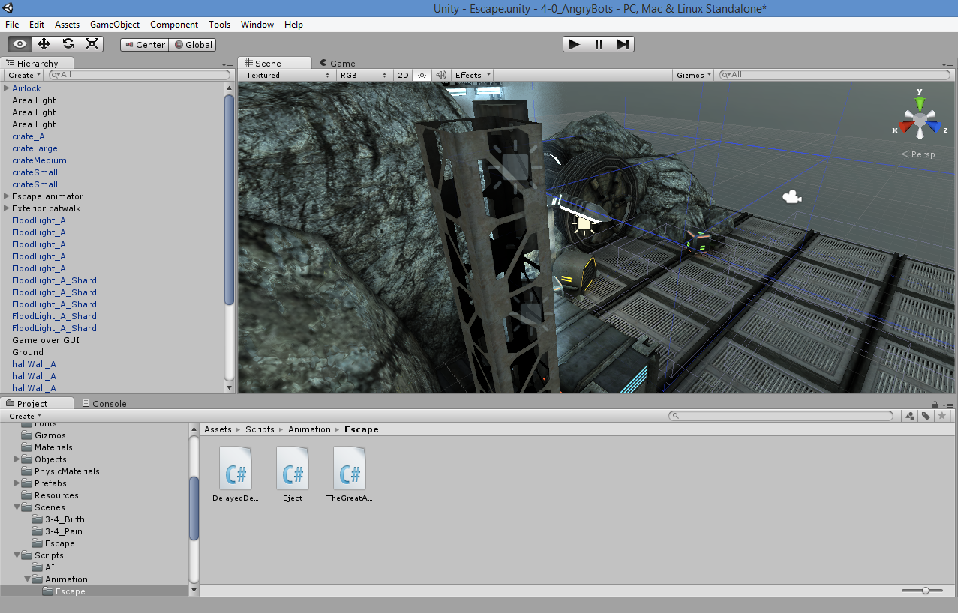
Angry Bots Sample
Unity Asset Store, https://www.assetstore.unity3d.com/
Notes:
Angry Bots Sample
Unity Asset Store, https://www.assetstore.unity3d.com/

Slide 32
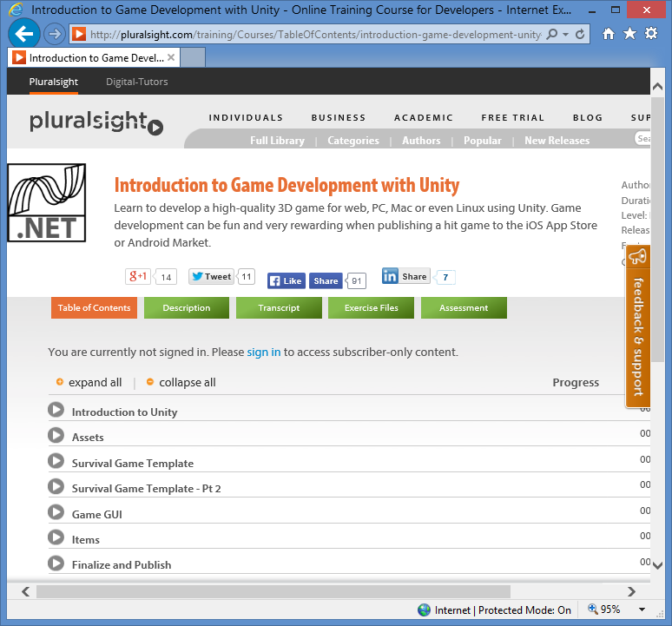
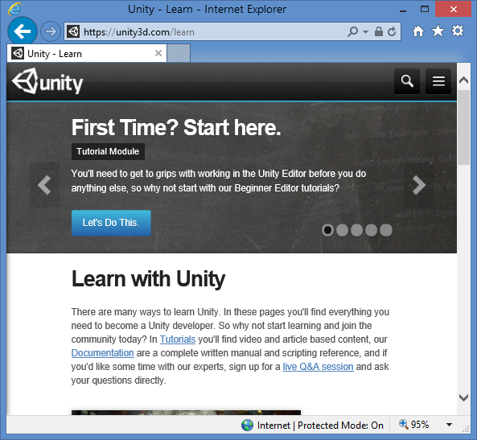
Learn Unity
Unity website: https://unity3d.com/learn
Pluralsight: http://pluralsight.com/training/Courses/TableOfContents/introduction-game-development-unity
Notes:
Learn Unity
Unity website: https://unity3d.com/learn
Pluralsight: http://pluralsight.com/training/Courses/TableOfContents/introduction-game-development-unity

Slide 33
Real-world Lessons
1. UI Design
2. Multiplatform
3. Optimization
4. Work-Life Balance
5. Feedback and Ratings
Notes:
Real-world Lessons
UI Design: predicting human behavior
Targeting multiple platforms and screen sizes
Memory allocation and code optimization
Work-life balance
User feedback + Anonymous Ratings

Slide 34
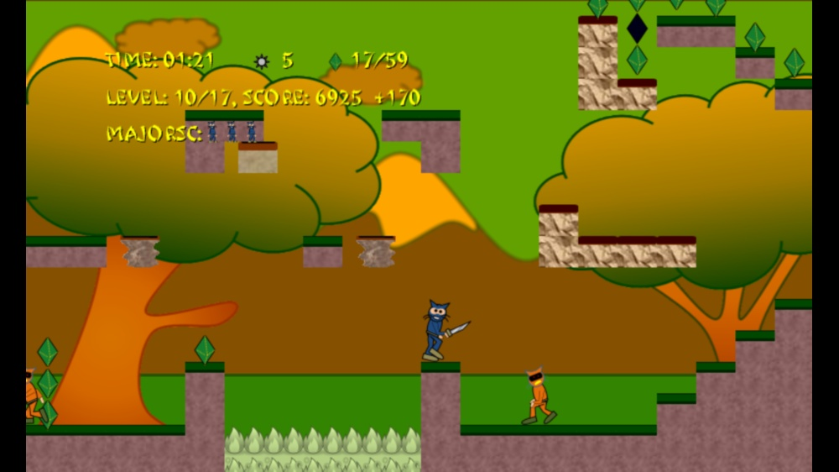
1. UI Design
Special items
HUD in “safe area”
Focus on primary user action
Notes:
1. UI Design
HUD in “safe area”
Special items
Focus on primary user action

Slide 35
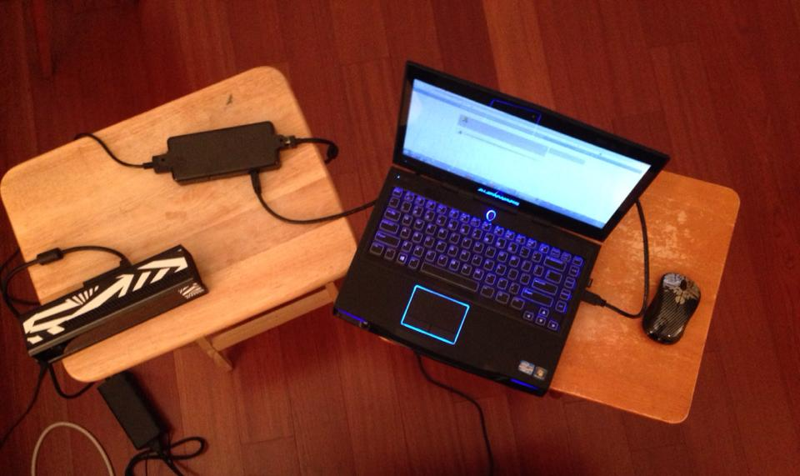
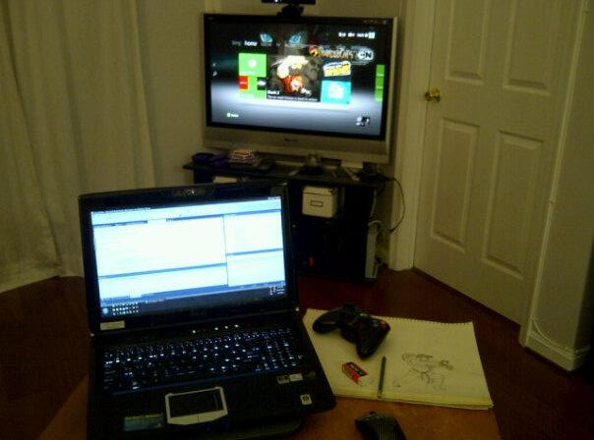
2. Target Multiple Platforms
Kinect v2 dev kit
HDTV via Xbox 360 console
Windows
Notes:
2. Target Multiple Platforms
Windows
Xbox 360
Xbox One
Kinect v2

Slide 36
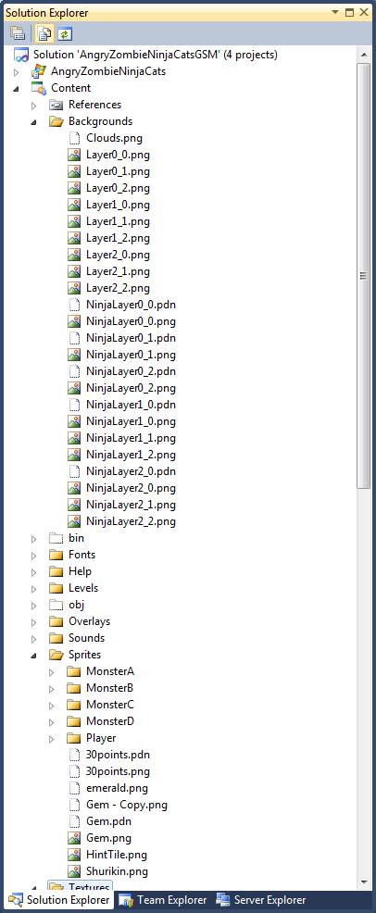
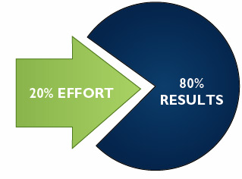
3. Optimization & Cleanup
Notes:
3. Optimization & Cleanup
80-20 rule

Slide 37
4. Work-Life Balance
Notes:
4. Work-Life Balance

Slide 38
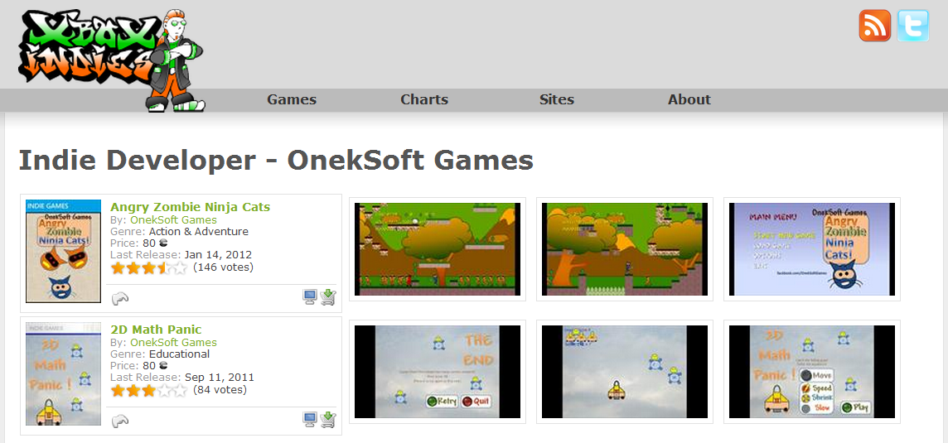
5. Feedback & Ratings
Anonymous ratings from Xbox Marketplace on XboxIndies.com
Notes:
5. Feedback & Ratings
Anonymous ratings from Xbox Marketplace on XboxIndies.com

Slide 39
* Business Intelligence
Measuring Sales and Performance
Spotting Trends
Pricing and Competition
Making Better Business Decisions
Learning From Past Success (and Mistakes)
Notes:
* Business Intelligence
Measuring Sales and Performance
Spotting Trends
Pricing and Competition
Making Better Business Decisions
Learning From Past Success (and Mistakes)

Slide 40
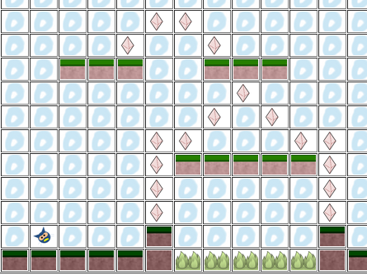
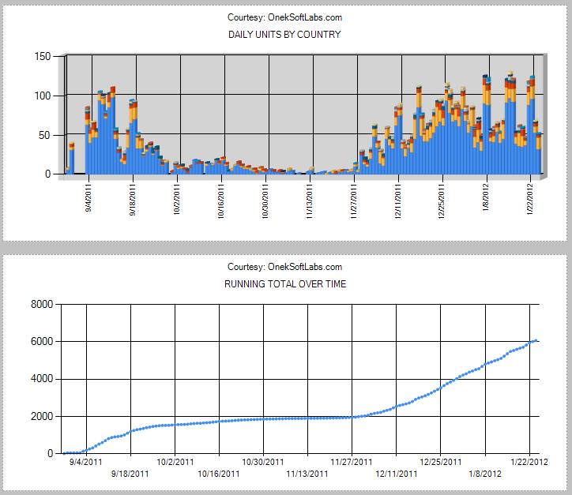
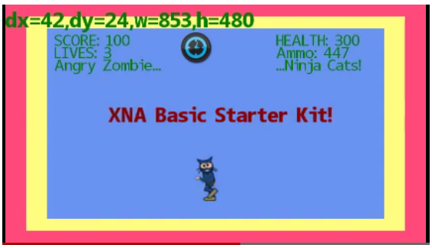
* Community
Platformer Level Editor
XBLIG Sales Data Analyzer
XNA Basic Starter Kit
Notes:
* Community
XBLIG Sales Data Analyzer
XNA Basic Starter Kit
Platformer Level Editor

Slide 41
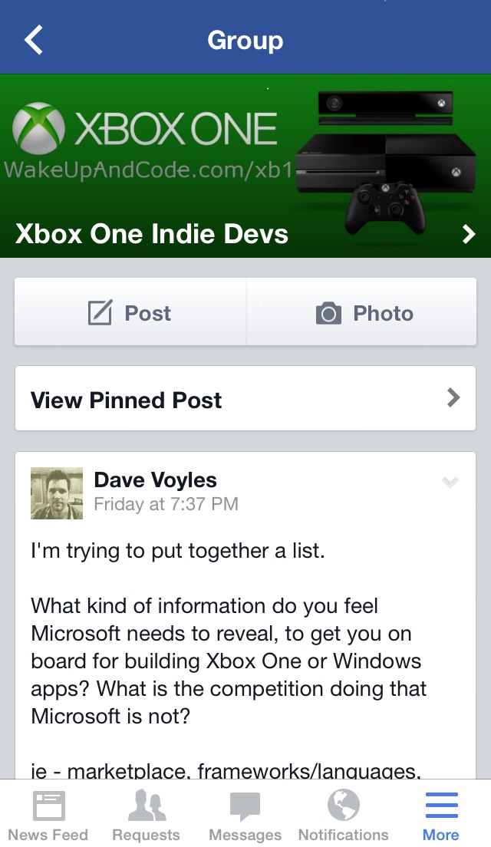
* Xbox One Community
Xbox One index page: http://WakeUpAndCode.com/xb1
Notes:
Xbox One Community
Xbox One index page: http://WakeUpAndCode.com/xb1

Slide 42
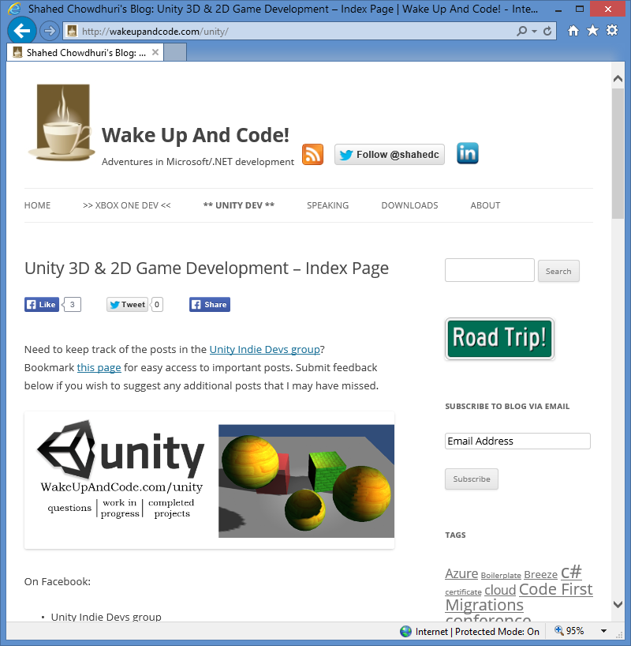
* Unity Community
Unity index page: http://WakeUpAndCode.com/unity
Notes:
Unity Community
Unity index page: http://WakeUpAndCode.com/unity

Slide 43
For more info:
Xbox One Indie Devs:
http://facebook.com/groups/XboxOneIndieDevs
http://WakeUpAndCode.com/xb1
Unity Indie Devs:
http://facebook.com/groups/UnityIndieDevs
http://WakeUpAndCode.com/unity
Construct 2 Devs:
https://www.facebook.com/groups/Construct 2devs
Notes:
For more info:
Xbox One Indie Devs:
http://facebook.com/groups/XboxOneIndieDevs
http://WakeUpAndCode.com/xb1
Unity Indie Devs:
http://facebook.com/groups/UnityIndieDevs
http://WakeUpAndCode.com/unity
Construct 2 Devs:
https://www.facebook.com/groups/Construct 2devs

Slide 44
Contact
Email: shchowd@microsoft.com  Twitter: @shahedC
Notes:
Contact
Web: OnekSoft.com
Email: games@OnekSoft.com
Twitter: @OnekSoftGames
Microsoft email: shchowd@microsoft.com
Personal Twitter: @shahedC
R&D: OnekSoftLabs.com
Dev Blog: WakeUpAndCode.com
FB: http://facebook.com/groups/XboxOneIndieDevs

