Slide 1
Mobile Apps & the Cloud
Windows  Windows Phone  Azure  … and more!
By Shahed Chowdhuri
Sr. Technical Evangelist
WakeUpAndCode.com
@shahedC
Notes:
Title Page: Mobile Apps & the Cloud Windows  Windows Phone  Azure  … and more!
By Shahed Chowdhuri
Sr. Technical Evangelist
Blog: WakeUpAndCode.com
Twitter: @shahedC

Slide 2
Agenda
Introduction
> Creating a Mobile Service
> Consuming the Service
> Publishing the Service
Q&A
Notes:
Agenda
Introduction
> Creating a Mobile Service
> Consuming the Service
> Publishing the Service
Q&A
* Learn about how you can build a mobile service in Azure and consume it with a mobile app.

Slide 3
Tools & Technologies
Notes:
Tools & Technologies
Visual Studio 2013
Windows 8
Microsoft .NET and Visual C#
Windows Phone
JavaScript
Microsoft Azure

Slide 4
Introduction
Notes:
Introduction

Slide 5
What is a Mobile Device?
Smartphones
Tablets
Laptops
Netbooks and smaller laptops
Laptop/Tablet hybrids
Notes:
What is a Mobile Device?
Smartphones
Tablets
Laptops
Netbooks and smaller laptops
Laptop/Tablet hybrids

Slide 6
What is the Cloud?
“No one understands
the Cloud!!!”
Notes:
What is the Cloud?
Screen Capture: “No one understands the Cloud!!!”

Slide 7
Cloud Services: IaaS, PaaS and SaaS
 |  | Host | Build | Consume
 | Packaged Software | IaaS: infrastructure as a service | PaaS: Platform as a service | Saas: software as a service
Applications | Self- Managed | Self- Managed | Self- Managed | Managed By Vendor
Data
Runtime |  |  | Managed By Vendor
Middleware
O/S
Virtualization |  | Managed By Vendor
Servers
Storage
Networking
Source: Bret Stateham, Windows Azure evangelist
Notes:
Cloud Services: IaaS, PaaS and SaaS

Slide 8
In Line with Microsoft’s Vision
“… mobile first, cloud first… ”
Microsoft CEO Satya Nadella
Notes:
In Line with Microsoft’s Vision
“… mobile first, cloud first… ”
Microsoft CEO Satya Nadella

Slide 9
Creating a Mobile Service
Notes:
Creating a Mobile Service

Slide 10
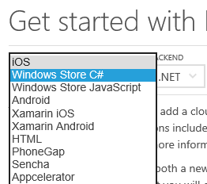
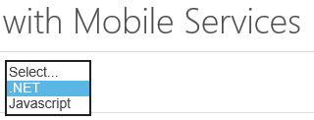
Getting Started
Link: http://azure.microsoft.com/en-us/documentation/articles/mobile-services-dotnet-backend-windows-store-dotnet-get-started/
Notes:
Getting Started
Link: http://azure.microsoft.com/en-us/documentation/articles/mobile-services-dotnet-backend-windows-store-dotnet-get-started/

Slide 11
Create a Mobile Service
Notes:
Create a Mobile Service

Slide 12
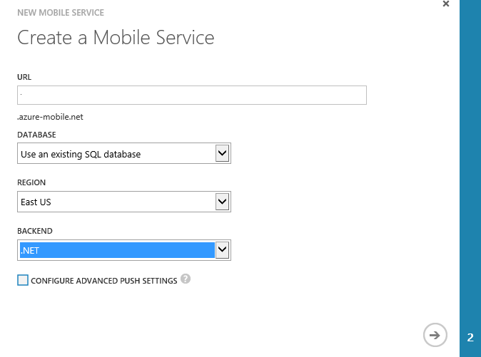
Specify Mobile Service Details
Name for the URL
(not the full URL)
Notes:
Specify Mobile Service Details

Slide 13
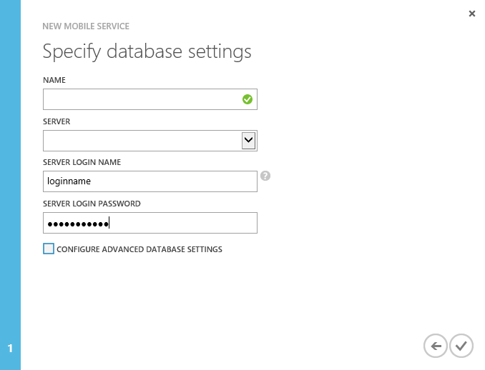
Specify Database Settings
Notes:
Specify Database Settings

Slide 14
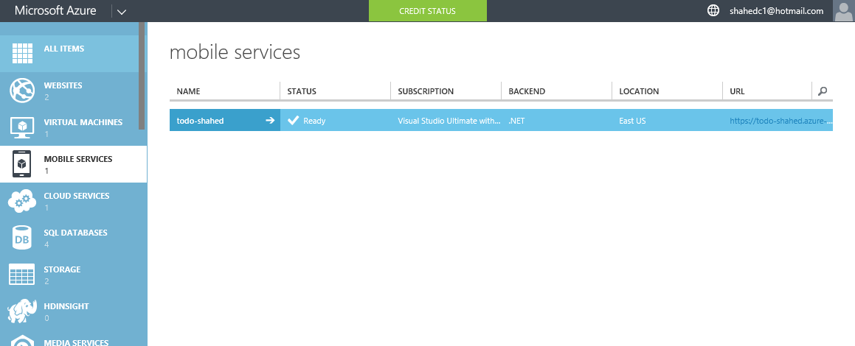
Verify Status of Mobile Service
Notes:
Verify Status of Mobile Service

Slide 15
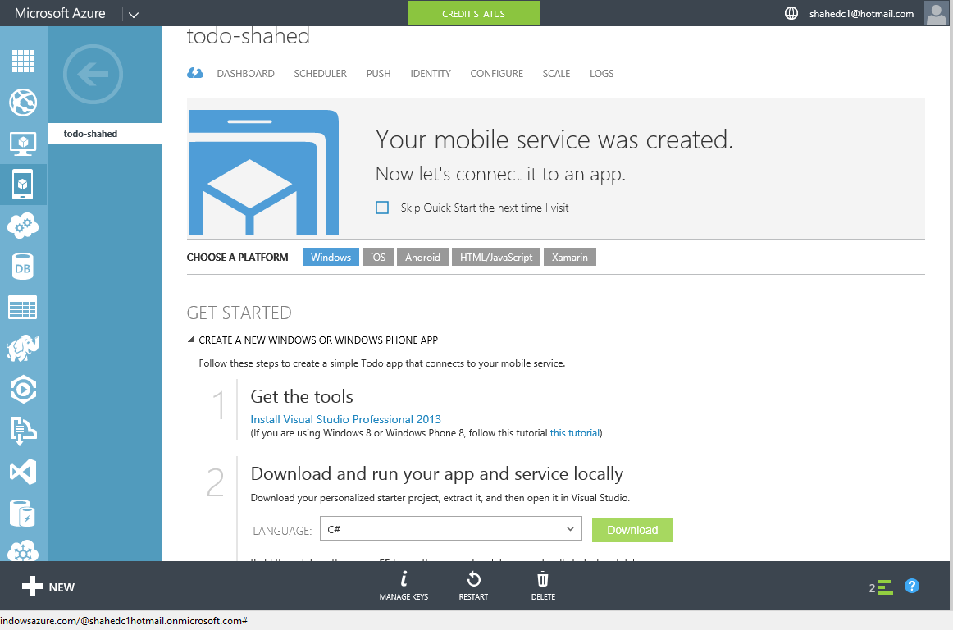
Get Tools & Download Your Solution
Notes:
Get Tools & Download Your Solution

Slide 16
Consuming the Service
Notes:
Consuming the Service

Slide 17
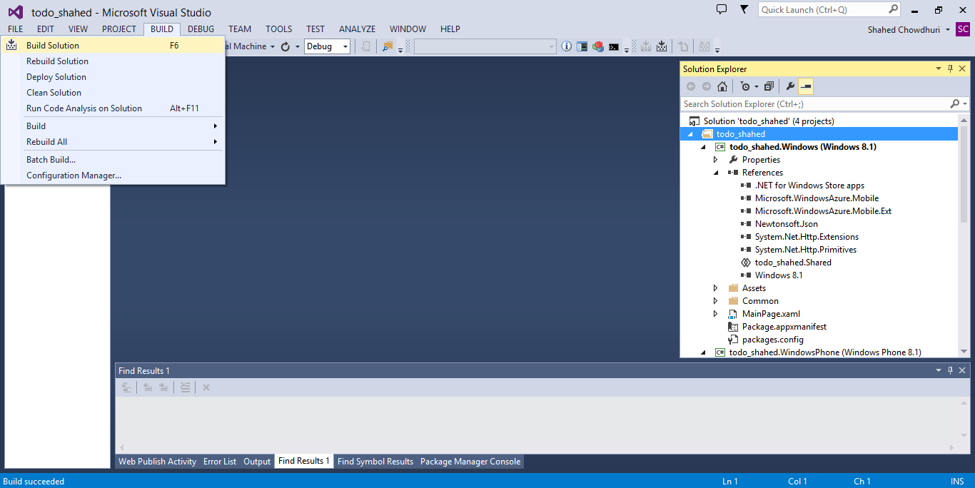
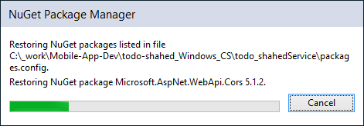
Build Your Solution (update NuGet packages)
. . .
Notes:
Build Your Solution (update NuGet packages)

Slide 18
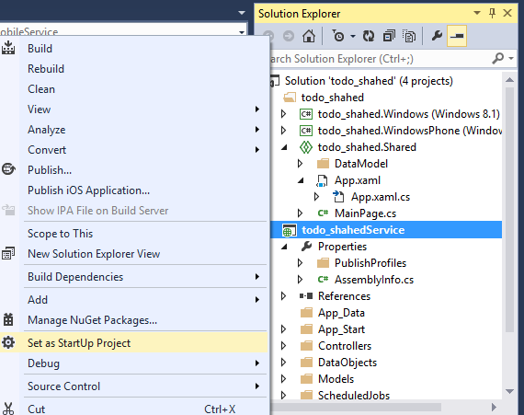
Run the Service Locally
Notes:
Run the Service Locally

Slide 19
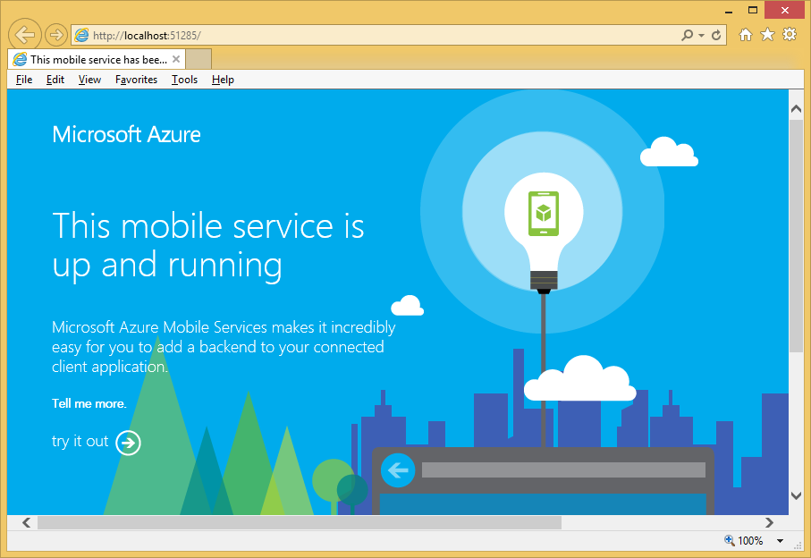
Verify the Service Locally
Notes:
Verify the Service Locally

Slide 20
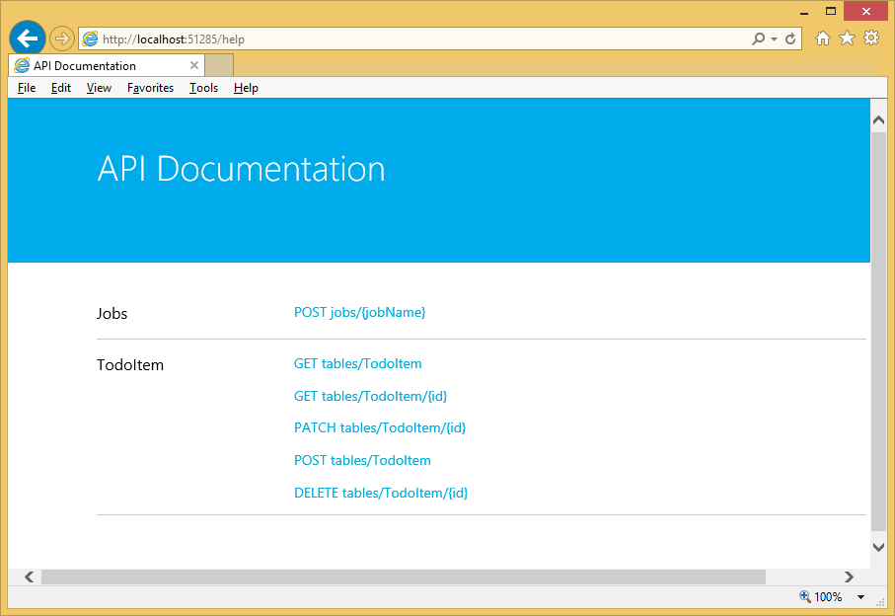
Try it out…
Notes:
Try it out…

Slide 21
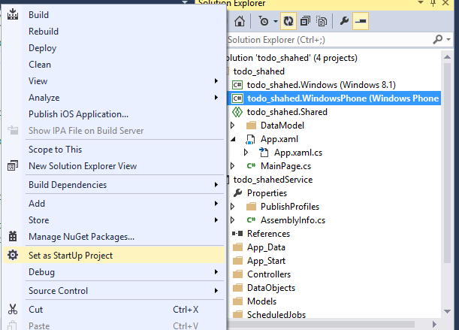
Run Windows Phone App Locally
Notes:
Run Windows Phone App Locally

Slide 22
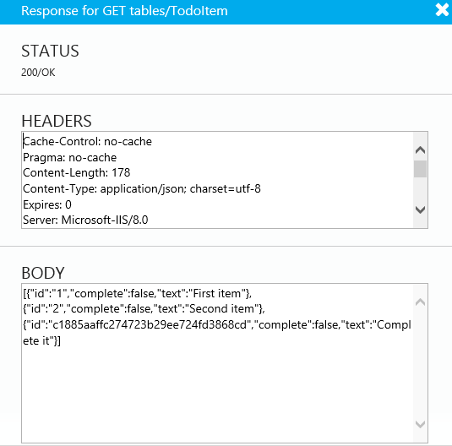
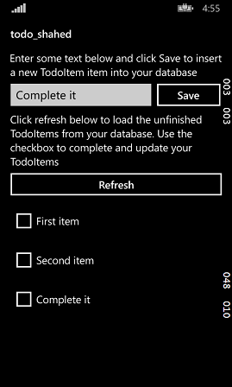
Verify Windows Phone App
Notes:
Verify Windows Phone App

Slide 23
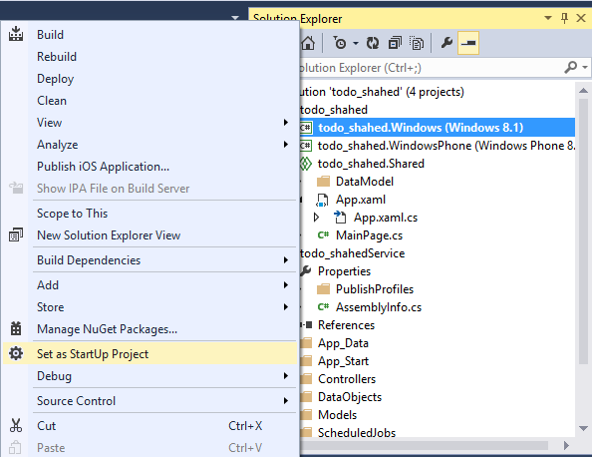
Run Windows App Locally
Notes:
Run Windows App Locally

Slide 24
Verify Windows App Locally
Notes:
Verify Windows App Locally

Slide 25
Publishing the Service
Notes:
Publishing the Service

Slide 26
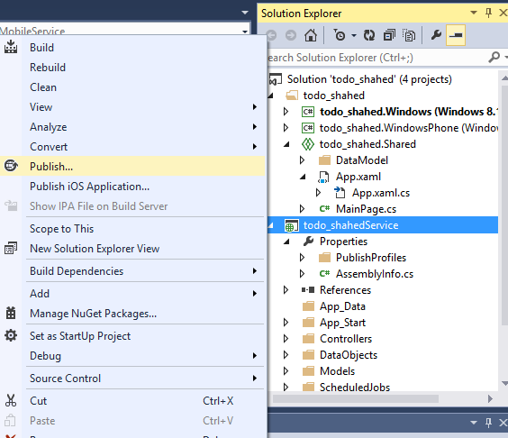
Publish Your Mobile Service
Notes:
Publish Your Mobile Service

Slide 27
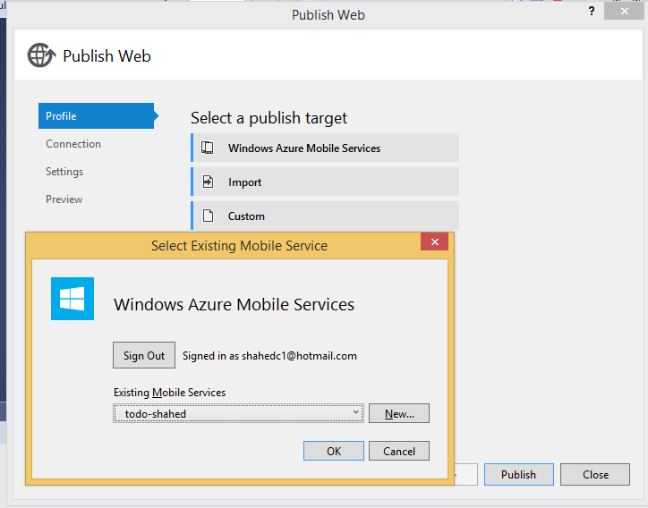
Sign In and Select Existing Service
Notes:
Sign In and Select Existing Service

Slide 28
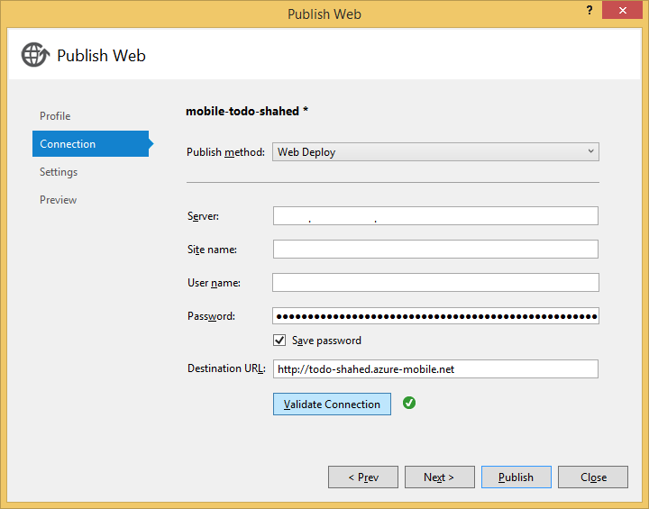
Complete the Publishing Process
Notes:
Complete the Publishing Process

Slide 29
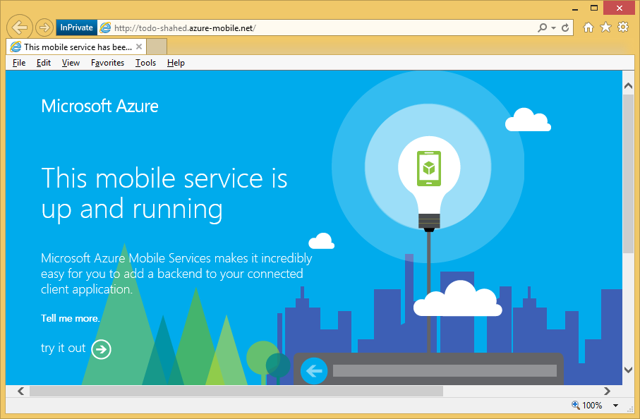
Verify the Service is Running
Troubleshoot: http://azure.microsoft.com/en-us/documentation/articles/mobile-services-dotnet-backend-how-to-troubleshoot/
Notes:
Verify the Service is Running
Troubleshoot: http://azure.microsoft.com/en-us/documentation/articles/mobile-services-dotnet-backend-how-to-troubleshoot/

Slide 30
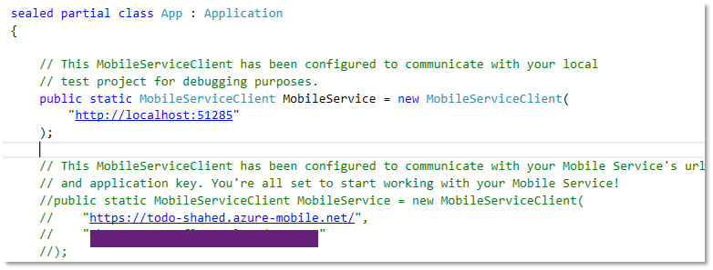
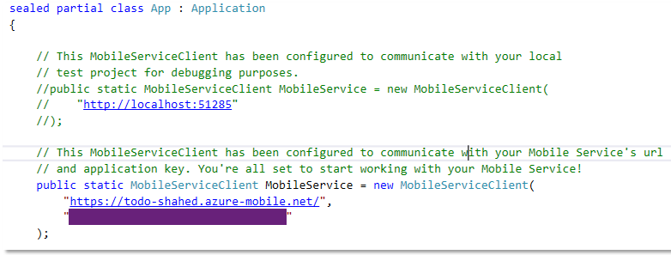
Update App.Xaml.cs (Shared project)
BEFORE:
AFTER:
Comment out local settings
Uncomment server settings, including key
Notes:
Update App.Xaml.cs (Shared project)
Comment out local settings
Uncomment server settings, including key

Slide 31
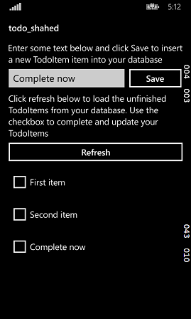
Run Windows Phone Project
Enter a value to test it
Notes:
Run Windows Phone Project

Slide 32
Run Windows project
Enter a value to test it
Notes:
Run Windows project

Slide 33
Questions?
Notes:
Questions?

Slide 34
Contact
Email: shchowd@microsoft.com  Twitter: @shahedC
Notes:
Contact
Microsoft email: shchowd@microsoft.com
Personal Twitter: @shahedC
Dev Blog: WakeUpAndCode.com

